Slide 1
FY 2017 Budget Request to Congress for DOE’s Office of Science
BESAC Meeting, February 11, 2016
Cherry A. Murray, PhD
Director, Office of Science
www.science.energy.gov

Slide 2
Office of Science FY16 - $5.35B
> 20,000 Scientists Supported
Largest Supporter of Physical Sciences in the U.S.
>30,000 Scientific Facility Users
Funding at >300 Institutions including all 17 DOE Labs
Facility Operations: 38%, $2.02B
~40% of Research to Universities
Research: 42%, $2.2B
Construction: 13.5%, $723M

Slide 3
Office of Science FY17 Request: $5.67B, +6.1%
> 20,000 Scientists Supported
Largest Supporter of Physical Sciences in the U.S.
>30,000 Scientific Facility Users
Funding at >300 Institutions including all 17 DOE Labs
Facility Operations: 36%, $2.06B
~40% of Research to Universities
Research: 42%, $2.4B
$1.8B Mission Innovation

Slide 4
Office of Science FY 2017 Budget Request to Congress
(Dollars in thousands)
 | FY 2015 Enacted Approp. | FY 2015 Current Approp. | FY 2016 Enacted Approp. | FY 2017 President's Request | FY 2017 President's Req. vs. FY 2016 Enacted Approp.
Science
Advanced Scientific Computing Research | 541,000 | 523,411 | 621,000 | 663,180 | +42,180 | +6.8%
Basic Energy Sciences | 1,733,200 | 1,682,924 | 1,849,000 | 1,936,730 | +87,730 | +4.7%
Biological and Environmental Research | 592,000 | 572,618 | 609,000 | 661,920 | +52,920 | +8.7%
Fusion Energy Sciences | 467,500 | 457,366 | 438,000 | 398,178 | -39,822 | -9.1%
High Energy Physics | 766,000 | 745,232 | 795,000 | 817,997 | +22,997 | +2.9%
Nuclear Physics | 595,500 | 580,744 | 617,100 | 635,658 | +18,558 | +3.0%
Workforce Development for Teachers and Scientists | 19,500 | 19,500 | 19,500 | 20,925 | +1,425 | +7.3%
Science Laboratories Infrastructure | 79,600 | 79,600 | 113,600 | 130,000 | +16,400 | +14.4%
Safeguards and Security | 93,000 | 93,000 | 103,000 | 103,000 | ...... | ......
Program Direction | 183,700 | 183,700 | 185,000 | 204,481 | +19,481 | +10.5%
University Grants (Mandatory) | ...... | ...... | ...... | 100,000 | +100,000 | ......
Small Business Innovation/Technology Transfer Research (SC) | ...... | 132,905 | ...... | ...... | ...... | ......
Subtotal, Science | 5,071,000 | 5,071,000 | 5,350,200 | 5,672,069 | +321,869 | +6.0%
Small Business Innovation/Technology Transfer Research (DOE) | ...... | 65,075 | ...... | ...... | ...... | ......
Rescission of Prior Year Balance | -3,262 | -3,262 | -3,200 | ...... | +3,200 | -100.0%
Total, Science | 5,067,738 | 5,132,813 | 5,347,000 | 5,672,069 | +325,069 | +6.1%

Slide 5
Priorities for FY 2017
Maintain strong support for discovery science and world-class science facilities
  Maintain a healthy balance among PI research, groups and centers, and facility operations
  Continue to use community priorities to make difficult choices and design, build, operate, and sunset world-class facilities
  Lead and steward the US accelerator science R&D capabilities
  Lead and steward the US computational R&D capabilities, in collaboration with NNSA – garner support for and execute the exascale initiative
  Support partnerships and collaborations
Be proactive in supporting science for clean energy
  Basic research needs workshops – partner with DOE technology offices and industry
  Science-based transformational energy technology in Mission Innovation
Increase relationship building with Congress
Increase relationship building with research universities
Given the importance of the DOE national labs in US R&D, institutionalize best practices in national lab management
Notes:
Research
Continue on the path to exascale computers by
initiating a research program in the area programming models and runtime systems that address the challenges of energy efficient, data intensive applications, which are characterized by asynchronous, fine grain parallelism;
funding HPC vendors to perform research efforts in critical technologies and system interconnects, with the goal of migrating these technologies into their future exascale products;
initiating system engineering efforts with high performance computer vendors that address system level challenges to ensure resulting exascale computer systems will achieve DOE goals.
expanding exascale system studies to model system performance, from hardware architecture to application workflow, with system software management. These studies are necessary to understand the properties determining ultimate operational and performance characteristics, within the projected range of exascale size and capability.
Initiate exploratory SciDAC partnership efforts to establish for future partnership programs for data intensive scientific problems.
Initiate a computer science research program to support development of scientific data management and analysis and visualization techniques, including knowledge representation.
Conduct innovative mathematics research to improve the fidelity and predictability of continuous and/or distributed complex systems that accurately capture the physics and/or subcomponent interactions across vastly different time and length scales.
Facility Operations
Operate NERSC and the LCFs at a level to achieve 90% availability.
Begin deployment of planned 20-30 petaflop upgrade at NERSC (NERSC-8); Relocate NERSC from the Oakland Scientific Facility into the new Computational Research and Theory building, located on the LBNL campus.
Begin preparations for the 75-200 petaflop upgrades at each Leadership Computing Facility, which are planned to be operational in the 2017-2018 timeframe.
Extend ESnet to further support SC facilities and large experiments in the U.S. and Europe.
Initiate a Postdoctoral Computational Scientists for Energy, Environment and National Security (CSEENS) program at ASCR facilities to ensure an adequate supply of computational science and engineering trained to meet the national workforce need.

Slide 6
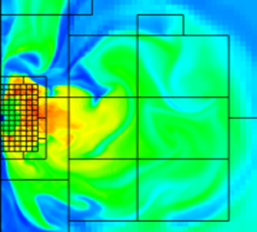
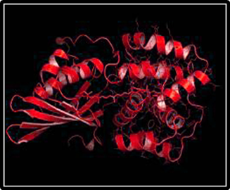
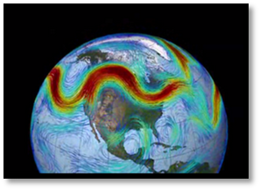
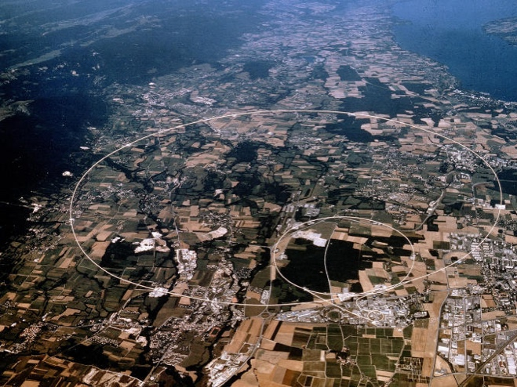
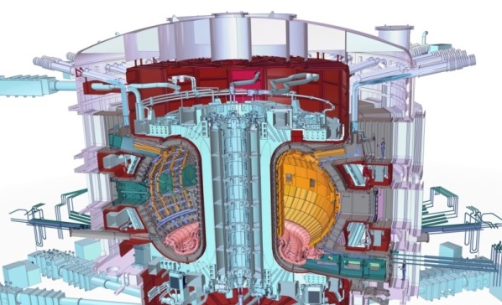


Office of Science Programs
Advanced Scientific Computing Research
FY2016 $621M
Basic Energy Sciences
FY2016 $1849M
Biological and Environmental Research
FY2016 $609M
FY2017 Request +6.8%
FY2017 Request +4.7%
FY2017 Request +8.7%
High Energy Physics
FY2016 $795M
Fusion Energy Sciences
FY2016 $438M
Nuclear Physics
FY2016 $617M
FY2017 Request +2.9%
FY2017 Request -9.1%
FY2017 Request +3.0%

Slide 7
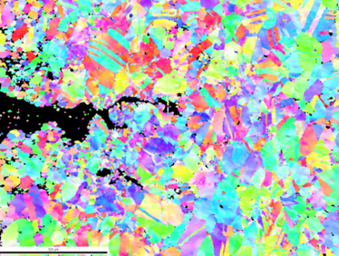
SC Investments for Mission Innovation
$100M in new funding in FY 2017
ASCR (+$10M)
  Computational Partnerships with EFRCs on solar, CO₂ reduction, catalysis, storage, subsurface, and biofuels; possibly new partnerships in wind and nuclear ($10M)
BES (+$51M)
Energy Efficiency: Catalysts, modeled after nature’s enzymes, that can operate at low-temperature and under ambient conditions; lightweight metallic materials; thermocaloric materials ($34.4M)
Materials for Clean Energy: Self-healing materials for corrosive and high radiation environments (next-gen corrosive-resistant materials based on experiments and multi-scale modeling; chemistry under harsh or extreme environments) ($16.6M)
Analysis of cracks at the nanoscale
BER (+$35M)
Biosystems design (computationally design and then bio-engineer biosystems) to introduce beneficial traits into plants and microbes for clean energy applications ($20M)
Bioenergy Research Centers: New investments to translate 10 years of BRC research to industry
($15M, $5M per BRC)
FES (+4M)
Whole-device fusion modeling and simulation using SciDAC partnerships ($4M)
Notes:
Top Image: Center for PRedictive Integrated Structural Materials Science (PRISMS). High-Angle Annular Dark Field (HAADF) TEM image of beta-prime precipitates in a Mg-Nd alloy. The bright lines are individual nano-scale precipitates that line up along the basal planes of the hcp Mg structure, which improves strength, and is predicted by their statistical mechanics simulations. They have run first-principles calculations to indicate the Mg-Rare Earth combinations that will result in optimum precipitate shape and stability to best strengthen the Mg alloy. The modeling-experimental link is not yet published but the precipitate structure work is in “Chemistry and morphology of β′ precipitates in an aged Mg-Nd-Y-Zr alloy”, E. Sitzmann and E. A. Marquis, Philosophical Magazine Letters, 2015 Vol. 95, No. 1, 7–13, http://dx.doi.org/10.1080/09500839.2014.995737
Middle Image: Corrosion follows a different path when it comes to uranium dioxide, the primary component of the rods that power nuclear reactors. Oxygen atoms (represented in red) follow a set pattern in corroding uranium dioxide, and understanding this pattern opens new doors for controlling corrosion. Scientists at the Pacific Northwest National Laboratory, University of Chicago, and the Stanford Synchrotron Radiation Lightsource found that the oxygen atoms do not diffuse randomly through the material. Rather, the oxygen atoms settle into the third, sixth, ninth, etc., layers. They space themselves within the layers and alter the structure by causing the layers of uranium atoms above and below to draw closer to the oxygen. Essentially, the oxygen atoms self-assemble into a highly structured array. Image Credit: Cortland Johnson, PNNL. Image from a PNNL press release “Oxygen: Not at All Random.”
PI: Anne Chaka (PNNL); primary author on paper Peter Eng (U. Chicago)
Bottom Image: Electron Backscatter image of a fatigue crack. The different colors are representative of grain orientations and the black region is the crack itself.

Slide 8
SC Increases Academic Research by $100M (Mandatory) in FY 2017
Investments are made in all of the SC programs, emphasizing emerging research areas, especially those recently identified by Federal Advisory Committees or other community activities. A few examples are:
ASCR: Applications software, applied mathematics, and computer science for capable exascale computing; mathematics for large-scale scientific data; neuromorphic computing architectures and information processing for extreme and self-reconfigurable computing architectures
BES: Topics described in the 2015 BESAC Report Challenges at the Frontiers of Matter and Energy: Transformative Opportunities for Discovery Science, including hierarchical architectures, non-equilibrium matter, non-ideal systems, coherence in light and matter, modeling & computation, and imaging across multiple scales.
BER: New platform microbes for biofuels and bioproducts engineering; biofuel crop modeling for incorporation into a predictive framework.
FES: Plasma/fusion research centers emphasizing the results of the 2015 community workshops, including for example low-temperature plasmas, plasma measurements, and verification & validation for magnetic fusion.
HEP: Topics described in the 2014 HEPAP Long Range Plan and also topics that span multiple SC programs, including quantum information sciences/the entanglement frontier and quantum field theory across disciplines.
NP: Topics described in the 2015 NSAC Long Range Plan, including research to accelerate discovery at FRIB, fundamental nuclear structure and nuclear astrophysics, fundamental symmetries, and super-heavy elements.

Slide 9
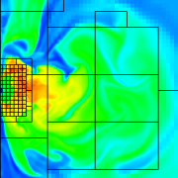
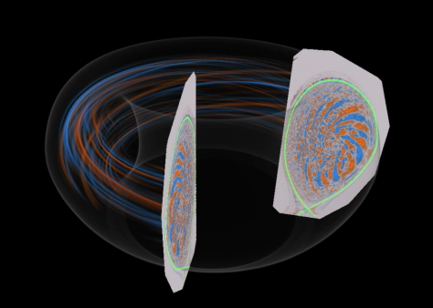
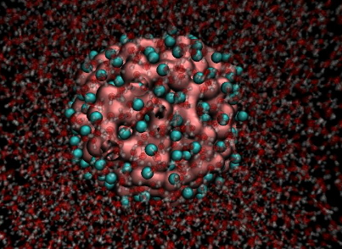
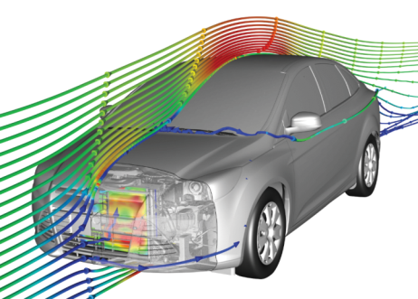
Advanced Scientific Computing Research
Computational and networking capabilities to extend the frontiers of science and technology
Exascale Computing Initiative (ECI) and Exascale Computing Project (ECP). The ECP is initiated as a joint ASCR/NNSA partnership using DOE’s formal project management processes. A new budget line is created for the ECP.
Facilities operate optimally and with >90% availability; deployment of 10-40 petaflop upgrade at NERSC and site preparations for NERSC-9; upgrade of high traffic links on Esnet; and continued preparations for 180-200 petaflop upgrades at ALCF and OLCF.
SciDAC partnerships will be recompeted in FY 2017 with new activities to include accelerating the development of clean energy technologies.
Applied Mathematics research addresses challenges of increasing complexity and Computer Science research addresses exploration of “beyond Moore’s law” architectures and supports data management, analysis, and visualization techniques.
The Computational Sciences Graduate Fellowship is funded at $10,000K.
Notes:
Research
Continue on the path to exascale computers by
initiating a research program in the area programming models and runtime systems that address the challenges of energy efficient, data intensive applications, which are characterized by asynchronous, fine grain parallelism;
funding HPC vendors to perform research efforts in critical technologies and system interconnects, with the goal of migrating these technologies into their future exascale products;
initiating system engineering efforts with high performance computer vendors that address system level challenges to ensure resulting exascale computer systems will achieve DOE goals.
expanding exascale system studies to model system performance, from hardware architecture to application workflow, with system software management. These studies are necessary to understand the properties determining ultimate operational and performance characteristics, within the projected range of exascale size and capability.
Initiate exploratory SciDAC partnership efforts to establish for future partnership programs for data intensive scientific problems.
Initiate a computer science research program to support development of scientific data management and analysis and visualization techniques, including knowledge representation.
Conduct innovative mathematics research to improve the fidelity and predictability of continuous and/or distributed complex systems that accurately capture the physics and/or subcomponent interactions across vastly different time and length scales.
Facility Operations
Operate NERSC and the LCFs at a level to achieve 90% availability.
Begin deployment of planned 20-30 petaflop upgrade at NERSC (NERSC-8); Relocate NERSC from the Oakland Scientific Facility into the new Computational Research and Theory building, located on the LBNL campus.
Begin preparations for the 75-200 petaflop upgrades at each Leadership Computing Facility, which are planned to be operational in the 2017-2018 timeframe.
Extend ESnet to further support SC facilities and large experiments in the U.S. and Europe.
Initiate a Postdoctoral Computational Scientists for Energy, Environment and National Security (CSEENS) program at ASCR facilities to ensure an adequate supply of computational science and engineering trained to meet the national workforce need.

Slide 10
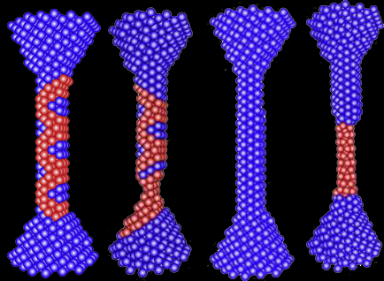
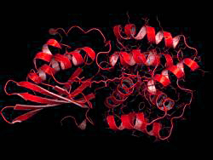
Basic Energy Sciences
Understanding, predicting, and controlling matter and energy at the electronic, atomic, and molecular levels
Increased funding for Energy Frontier Research Centers (EFRCs) will fully fund up to five new awards in the area of subsurface science, with an emphasis on advanced imaging of geophysical and geochemical signals.
A new activity in Computational Chemical Sciences will leverage U.S. leadership in computational chemistry community codes for petascale and in anticipation of exascale computing.
Core research increases to advance the Mission Innovation agenda, targeting materials and chemistry for energy efficiency and for use in extreme environments.
Both Energy Innovation Hubs continue. Joint Center for Energy Storage Research (JCESR) will be in its 5th year. Joint Center for Artificial Photosynthesis (JCAP) will be in its 3rd year of renewal.
To maintain international competitiveness in discovery science, support continues for the Linac Coherent Light Source-II (LCLS-II) construction project and the Advanced Photon Source Upgrade (APS-U) major item of equipment project.
BES user facilities operate at optimal levels.
Notes:
All funding excludes SBIR/STTR. The four highlight images are (left to right):
Tabletop laser systems generate extreme ultraviolet (EUV) probes to measure transient electronic and magnetic structures in materials. This artistically enhanced depiction shows an atom being hit by a strong rosette-shaped laser field (purple), ripping an electron (green) from the parent atom that then re-collides with the atom. The result is the emission of bright, circularly polarized light at extreme ultraviolet (EUV) wavelengths (blue) that can be used to measure the magnetic and electronic structure of materials with ultrafast resolution. Performers: Margaret Murname, JILA, U Colorado and Robert Kaindl, MF, LBNL
Simulation of stretching of a silver nanowire accurately shows the entire process from “necking” (thinner regions in the wire) to the formation of a new phase (red portion in the last image). In the center images, atomic features called “stacking faults” – the red regions in the necked portion – form. As the stretching continues, the structure evolves back to a “perfect” structure (all-blue image), but with a smaller diameter. In the final image, even further strain has caused formation of a new phase (red). Impressively, each microsecond of atom movement during the stretching of the nanometer-thick wire required only one wall-clock minute on LANL’s Roadrunner high performance computer, possible only by using accelerated dynamics methods developed at LANL. Performers: Nlas Uberuaga and Art Voter, LANL
The orange carotenoid protein (OCP) of cyanobacteria binds a single carotenoid pigment molecule that may dissipate excess light energy when it moves within the protein. Performer: Cheryl Kerfeld, MSU/LBNL
Numerical simulation of the magnetic inhomogeneity (red = magnetism, blue = superconductivity) caused by replacing 1% of the indium atoms in a superconductor (CeCoIn ) with cadmium atoms. The field of view is approximately 100 nanometers along each edge. Performer: Joe Thompson, LANL

Slide 11
BES FY 2017 Budget Request to Congress
(Dollars in thousands)

Slide 12
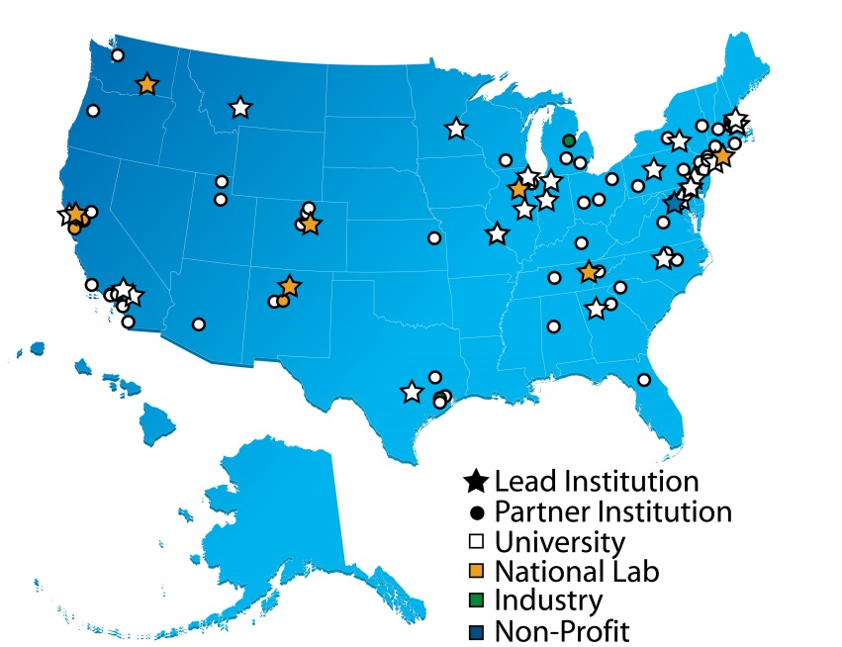
Energy Frontier Research Centers
FY 2016 = $110M; FY 2017 = $143M
Current EFRCs ($100M in FY 2015)
32 awards; $2-4M/year for 4 years
(22 renewal, 10 new centers)
Lead institutions by type: 23 universities; 8 DOE National Laboratories; 1 nonprofit organization
  Over 100 participating institutions, located in 33 states plus the District of Columbia
    FY2016 Appropriation
    In 2016, there will be a Funding Opportunity Announcement (FOA) for up to five new EFRCs that focus on research directions under-represented in the current EFRC portfolio; included will be topics identified at the 2015 Basic Research Needs for Environmental Management Workshop.
    EFRC solicitations begin a two year FOA cycle.
    FY2017 Budget Request
    FY 2017 budget request includes an increase of $33M to fully fund up to 5 new EFRCs in subsurface science relevant to the Departmental Subsurface crosscut.
    The new EFRCs will support multidisciplinary teams to address the grand challenge identified in 2015 strategic planning activities: “Advanced imaging of geophysical and geochemical signals in the subsurface.”
EFRCs 2009-14 ($100M/year+$277M ARRA)
46 EFRCs of $2-5M per year for 5 years
12
Notes:
Note on funding distribution:
Of the $100M FY15 annual budget, approximately $36.6M went to DOE Labs, with the remainder going to other institutions (primarily universities). Of the $36.6M provided to the Labs, approximately $7.4M is subsequently sent to other partner institutions via subawards, thus approximately $29.2M supports EFRC research conducted at the Labs.

Slide 13
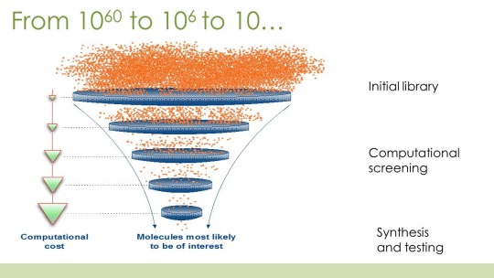
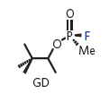
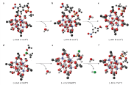
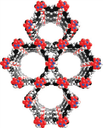
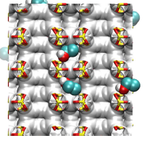
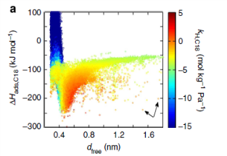

Computational Chemical Sciences
FY 2017 = $14M
  Deliverable: Open-source modular chemistry codes and software packages that are automated, account for quantum/relativistic effects, and with sufficient accuracies for d- and f- electron systems
  A new activity -- $14M is requested to support 4-5 teams of researchers to capitalize on existing investments in quantum chemistry codes and upgrade them to be compatible with the current and future generations of high performance computers.
  Assemble teams of mathematical and computational chemists to develop open-source software with new algorithms to allow simulation of chemical processes of complex systems.
  Rewrite software and algorithms to fully realize the current and future gains in efficiency offered by massively parallel computing platforms.
  Deliver codes that treat electronic and spin effects in order to avoid case-by-case retooling of the model of electronic potential that is embedded in many current computational methods.
Solar Harvesting Molecules
Gas Purification of 33000 ZIFs
Initial Library
Computational Screening
High Accuracy Validation
Accuracy
Catalytic Frameworks
Best Compound
Performance vs Structure
High-Accuracy Design of Catalysis Artificial Photosynthesis Field-Driven Chemical Rearrangements
Notes:
Assemble teams of mathematical and computational chemists to widely deploy open-source chemical simulation software with new algorithms that allow thousands of researchers to simultaneously and immediately simulate chemical processes on larger and more complex systems -- on DOE Computers.
Rewrite software and algorithms to fully realize the current and future gains in efficiency offered by massively parallel computing platforms
Deliver codes that treat all electronic and spin effects so as to permanently bypass the need for the continued case-by-case retooling of the model of electronic potential (pseudopotential approximation) that is embedded in many current computational methods.
$14M is requested to allow 4-5 teams of researchers to capitalize on existing investments in the quantum chemistry codes and upgrade them to be compatible with the current and future generations of high performance computers.

Slide 14
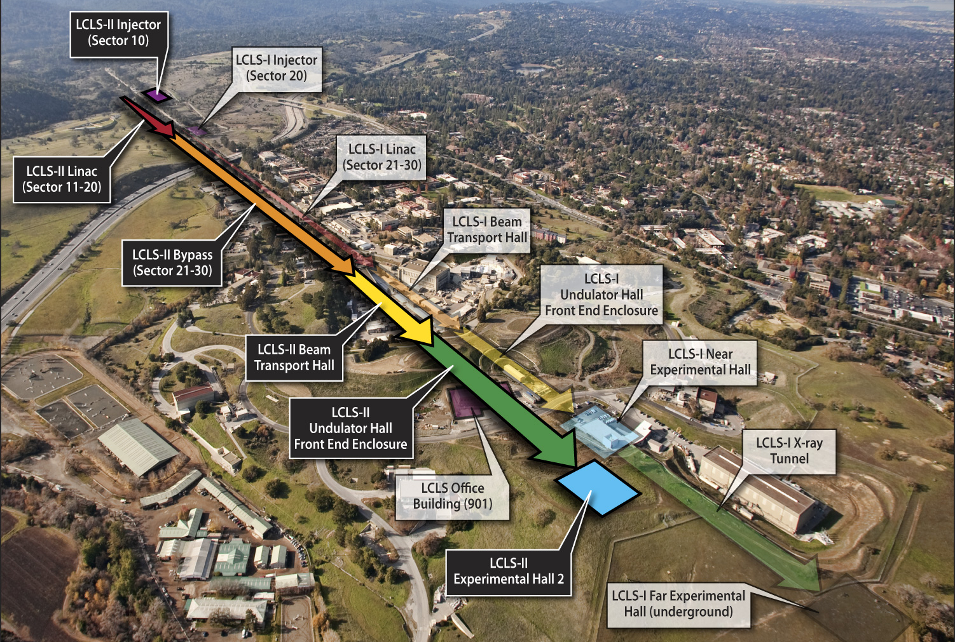
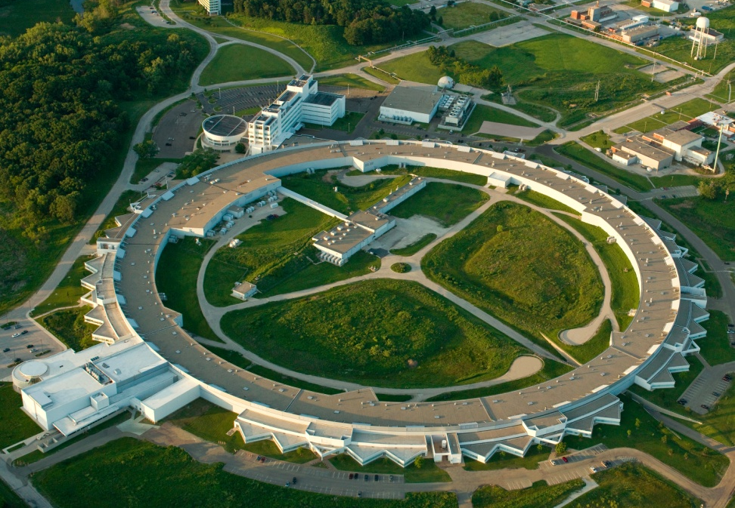
LCLS-II and APS-U Underway
Linac Coherent Light Source-II (LCLS-II)
FY 2016 = $200,300K; FY 2017 = $190,000K for R&D, design, prototyping, long lead procurement, and construction of technical systems.
LCLS-II will provide high-rep-rate, ultra-bright, transform-limited femtosecond x-ray pulses with polarization control and pulse length control to ~1 femtosecond. The hard x-ray range will be expanded to 25 keV.
Added are a 4 GeV superconducting linac; an electron injector; and two undulators to provide x-rays in the 0.2–5 keV energy range.
Advanced Photon Source Upgrade (APS-U)
FY 2016 = $20,000K; FY 2017 = $20,000K for R&D, design, and limited prototyping.
APS-U will provide a multi-bend achromat lattice to provide extreme transverse coherence and brightness.
Initial conceptual design for the new lattice completed; conducting R&D and key component prototyping in support of the new design. Key performance parameters are being defined for the project and the new storage ring.
14

Slide 15
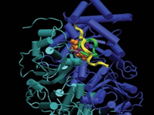
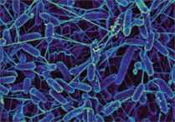

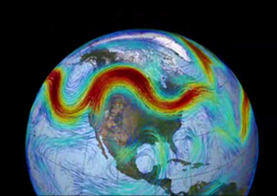
Biological and Environmental Research
Understanding complex biological, climatic, and environmental systems
Genomic sciences supports the Bioenergy Research Centers, new microbiome research, and increases efforts in biosystems design for bioenergy and renewable bioproducts.
Mesoscale-to-molecules research supports the development of enabling technology to visualize key metabolic processes in plant and microbial cells at the subcellular and mesoscale.
Climate and Earth System Modeling supports development of physical, chemical, and biological model components to simulate climate variability and change at regional and global scales.
Atmospheric System Research (ASR) addresses major uncertainties in climate change models: the role of clouds and the effects of aerosols on precipitation, and the atmospheric radiation balance.
Environmental System Science supports research to provide a robust, predictive understanding of terrestrial surface and subsurface ecosystems. Includes Next Generation Ecosystem Experiments targeting climatically sensitive terrestrial ecosystems not well represented in models.
Climate and Environmental Data Analysis and Visualization employs server side analysis to simplify analysis of large scale observations with model-generated data.
User facilities operate at optimal levels: ARM continues measurements at fixed sites, and mobile facilities deploy to the Arctic, Antarctic, and the Atlantic Ocean. JGI provides genome sequence data, synthesis, and analysis. EMSL continues novel research using the High Resolution and Mass Accuracy Capability.
Notes:
Hot cell reduction not reflected in this slide. Lisa, please fix

Slide 16
FY 2017 SC Contributions to DOE Crosscuts
 | Adv Mat | ECI | Sub-surface | EWN | Cyber- security | Total
Advanced Scientific Computing Res. | 0 | 154,000 | 0 | 0 | 0 | 154,000
Basic Energy Sciences | 17,600 | 26,000 | 41,300 | 0 | 0 | 84,900
Biological and Environmental Research | 0 | 10,000 | 0 | 24,300 | 0 | 34,300
Safeguards and Security | 0 | 0 | 0 | 0 | 27,197 | 27,197
Total, SC Contribution Crosscuts | 17,600 | 190,000 | 41,300 | 24,300 | 27,197 | 300,397
Adv Mat: Advanced Materials Crosscut
ECI: Exascale Computing Initiative Crosscut
Subsurface: Subsurface Technology and Engineering RD&D Crosscut
EWN: Energy-Water Nexus Crosscut
Cybersecurity: Cybersecurity Crosscut

Slide 17
SC Contributes to Five FY 2017 DOE Crosscuts
Advanced Materials (Adv Mat): Identified as a priority in both the 2015 QTR and the QER, activities in the Adv Mat crosscut address faster development of new materials and reductions in the cost of materials qualification in clean energy applications, from discovery through deployment. New activities emphasize DOE-wide efforts in (1) materials design and synthesis, (2) applied design, (3) process scale-up, (4) qualification, and (5) digital data and informatics.
Exascale Computing Initiative (ECI): Activities in the ECI crosscut, a partnership between SC and NNSA, address accelerating R&D to overcome key challenges in parallelism, energy efficiency, and reliability, leading to deployment of exascale systems in the mid-2020s. In addition to underpinning DOE’s missions in science and national security, the computational capabilities developed in the ECI also will support R&D in DOE’s applied energy technology areas, as described in the 2015 QTR.
Subsurface Technology and Engineering RD&D (Subsurface): Activities in the Subsurface crosscut address coordinated research in Wellbore Integrity, Stress State and Induced Seismicity, Permeability Manipulation, New Subsurface Signals, and Risk Assessment Tools. Over 80 percent of our total energy supply comes from the subsurface; the goals of this crosscut are enhanced energy security, reduced impact on climate change via CO₂ sequestration, and significantly mitigated environmental impacts from energy-related activities and operations.
Energy-Water Nexus (EWN): The EWN crosscut addresses the transition to more resilient energy and coupled energy-water systems. The EWN crosscut supports: (1) an advanced, integrated data, modeling, and analysis platform to improve understanding and inform decision-making; (2) investments in targeted technology research offering the greatest potential for impact; and (3) policy analysis and stakeholder engagement designed to build from and strengthen the two preceding areas while motivating community involvement and response.
Cybersecurity: The Department of Energy (DOE) is engaged in two categories of cyber-related activities: protecting the DOE enterprise from a range of cyber threats that can adversely impact mission capabilities and improving cybersecurity in the electric power subsector and the oil and natural gas subsector. The cybersecurity crosscut supports central coordination of the strategic and operational aspects of cybersecurity and facilitates cooperative efforts such as the Joint Cybersecurity Coordination Center (JC3) for incident response and the implementation of Department-wide Identity Control and Access Management (ICAM).

Slide 18
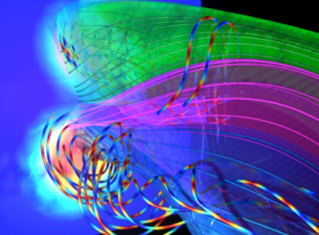
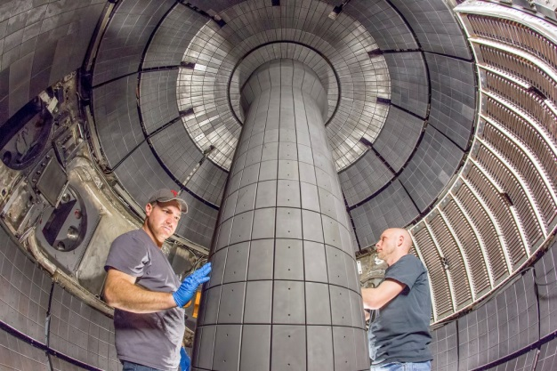
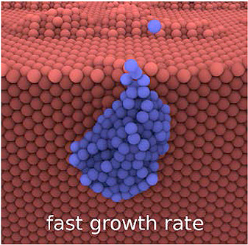
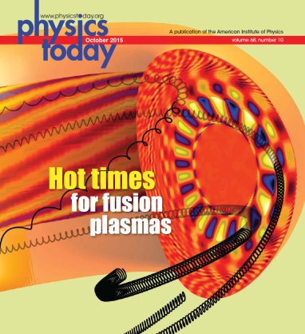
Fusion Energy Sciences
Matter at very high temperatures and densities and the scientific foundations for fusion
Research is supported for the DIII-D and NSTX-U national programs.
NSTX-U operates for 16 weeks; DIII-D operates for 14 weeks; Alcator C-Mod ceases operation as scheduled and MIT scientists collaborate full-time on domestic and international facilities.
Support continues for U.S. research involvement on international machines EAST (China), KSTAR (Korea), and W7-X (Germany).
HEDLP research is focused on the MEC instrument at LCLS.
General plasma science activities continue, including the partnership with NSF for discovery‐driven plasma science and engineering research.
U.S. contributions to ITER support US ITER Project Office; the US direct contribution; and progress on hardware contributions, including fabrication of the central solenoid magnet modules and structures and the toroidal field magnet conductor.
Magnetic reconnection driven by 3-D flux-rope interaction in the Large Plasma Device
New central solenoid magnet inside NSTX-Upgrade
Growth of helium bubbles that degrade tungsten performance
Gyrokinetic simulation of energetic ions in tokamak plasma
18

Slide 19
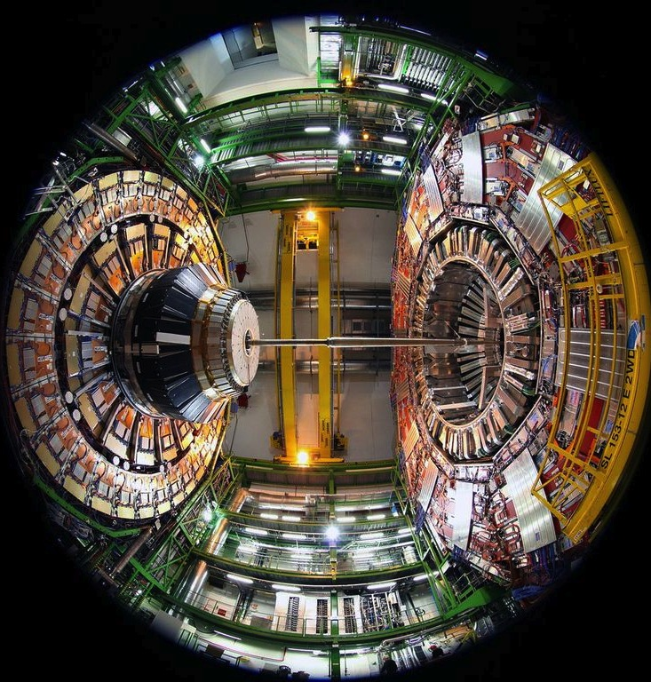
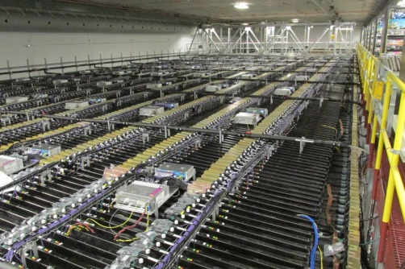
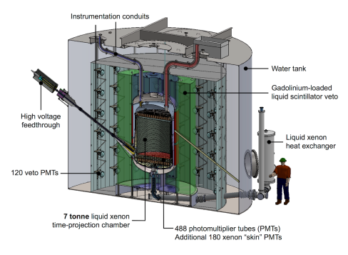
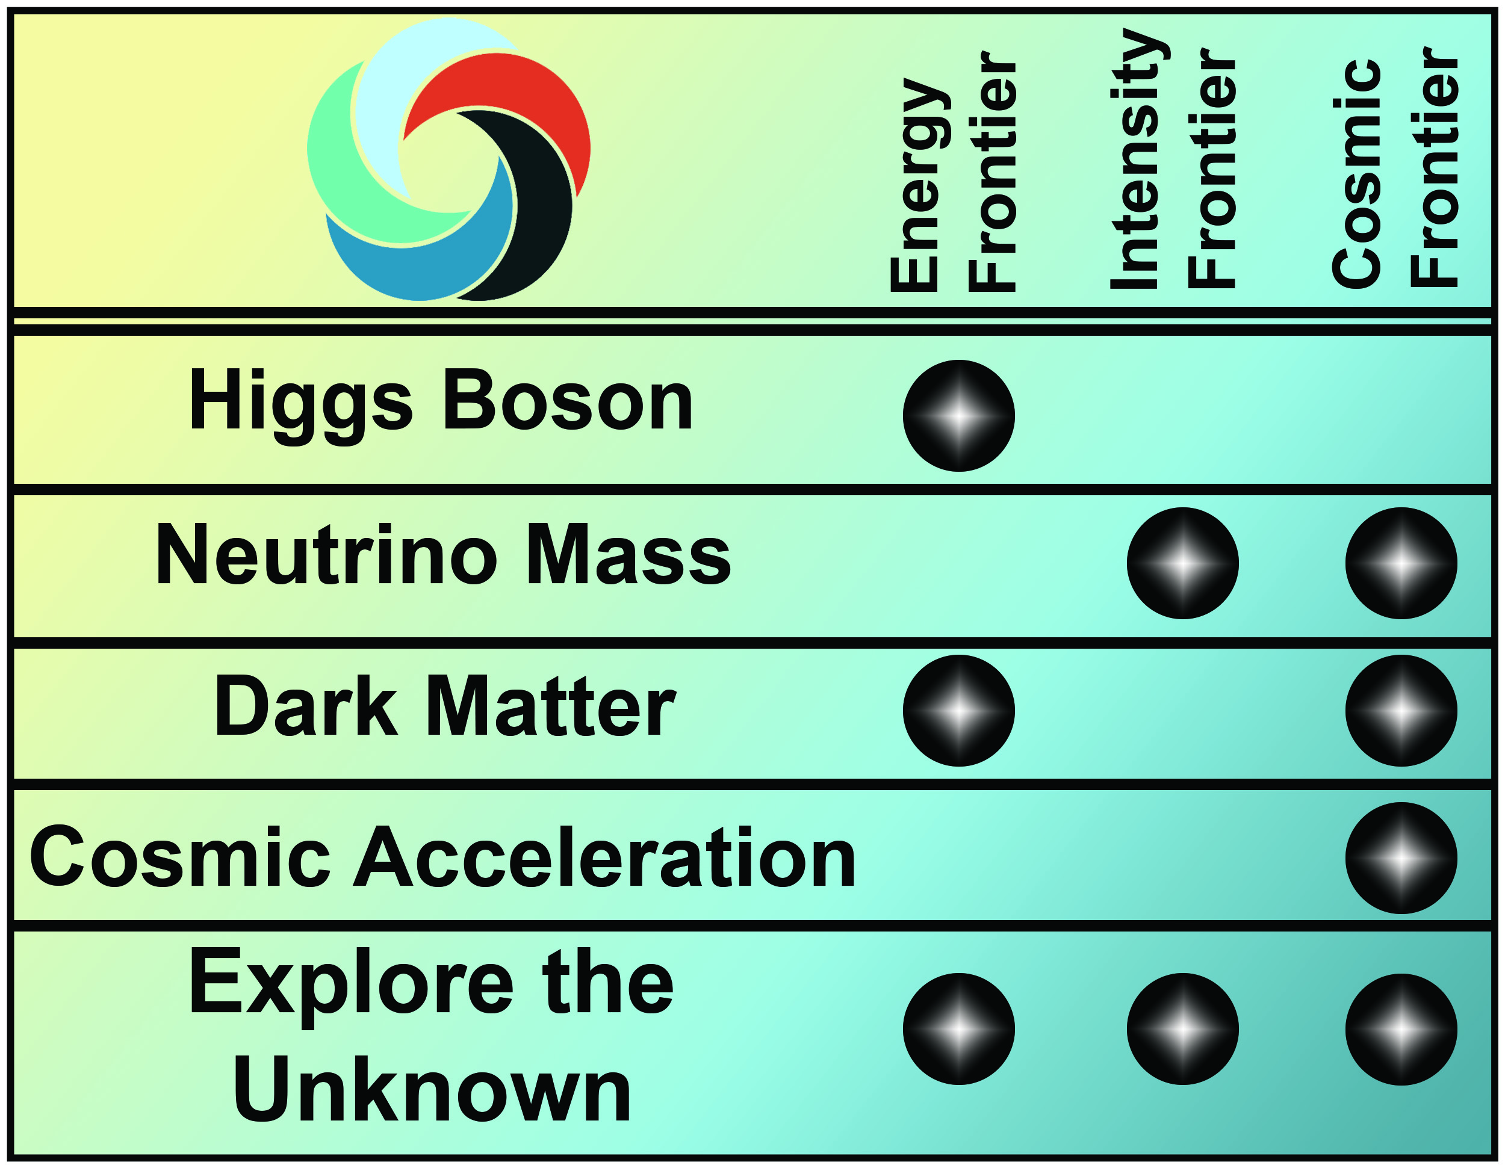

High Energy Physics
Understanding how the universe works at its most fundamental level
The FY 2017 HEP budget reflects the way the P5 plan has evolved as the U.S. and international community have adopted and responded to it
Energy Frontier: Continue active engagement in highly successful LHC program
  Initial LHC detector upgrade project funding ends in FY 2017
  Scope being determined for high luminosity(HL)- LHC, P5’s highest priority near-term project;
  CD-0 in 2016
  The U.S. will continue to play a leadership role in LHC discoveries by remaining actively engaged in LHC data analysis of world’s highest energy particle collider data, at 13 TeV
Intensity Frontier: Solidify international partnerships for U.S.-hosted LBNF/DUNE
  Rapid progress on LBNF/DUNE has attracted attention from interested international partners, and FY 2017 investments in site preparation and cavern excavation aim to solidify formal agreements
  Fermilab will continue improvements to accelerator complex while serving high-intensity neutrino beams to short-and long-baseline experiments enabling full utilization of the FNAL facilities
Cosmic Frontier: Advance our understanding of dark matter and dark energy
  Fabrication funding ramp up in FY 17 supports key P5 recommended Cosmic Frontier projects to study dark matter and dark energy: LSSTcam, DESI, SuperCDMS-SNOLab, and LZ
Energy Frontier
LHC
Intensity Frontier
NOvA
Cosmic Frontier
LZ

Slide 20
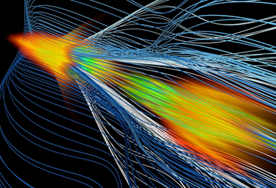
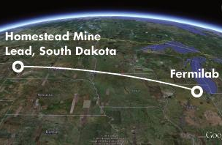
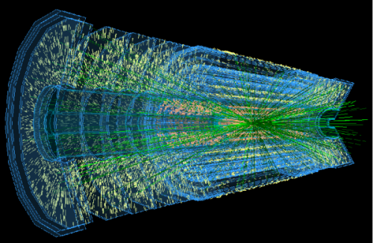
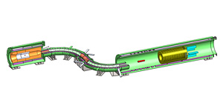
High Energy Physics
The technology and construction needed to pursue to physics
Construction & project support increases to implement the P5 strategy:
  LBNF/DUNE aims to solidify partnerships with FY 2017 investments in site preparation and excavation of caverns for the neutrino detectors and cryogenic infrastructure
  LHC ATLAS and CMS Detector Upgrade projects continue fabrication; HL-LHC upgrades begin
  Muon g-2 completes project funding profile and will begin receiving beam at Fermilab
  Dark energy: LSSTcam and DESI fabrication support increase according to planned profiles
  Dark matter: LZ will continue fabrication as SuperCDMS-SNOLab proceeds to final design
  Construction continues for the Muon to Electron Conversion Experiment (Mu2e)
  FACET-II support begins, in order to create a new facility that will enable accelerator R&D aimed at dramatically improved capability and cost-effectiveness in future high-energy colliders
Accelerator Stewardship
  AS works to make particle accelerator technology widely available to science and industry by supporting use-inspired basic research in accelerator science and technology
  FY17 Request supports research activities at laboratories, universities, and in industry for technology R&D areas such as laser, ion-beam therapy, and accelerator technology for energy and environmental applications
  FY17 Request supports Brookhaven Accelerator Test Facility (ATF) operations and the continuation of the Accelerator Stewardship Test Facility Pilot Program
FACET-II
Mu2e
LBNF
LHC Upgrades

Slide 21
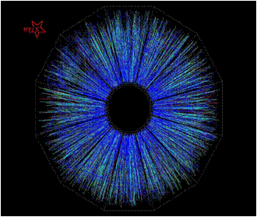
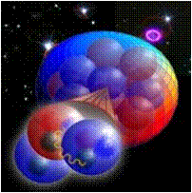
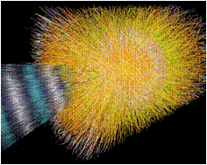
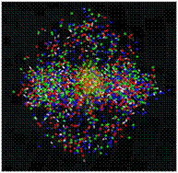
Nuclear Physics
Discovering, exploring, and understanding all forms of nuclear matter
      Funding for research increases to advance activities across the program, including R&D to develop new approaches for isotopes not currently available in sufficient quantities.
      A graduate traineeship is initiated in radiochemistry and nuclear chemistry with an emphasis in isotope production ($1M).
      Operations at RHIC increase to explore the properties of the quark gluon plasma first discovered there and to enable studies of spin physics.
The 12 GeV CEBAF Upgrade is completed in FY 2017 and the scientific program is initiated promising new discoveries and an improved understanding of quark confinement.
Construction continues on the Facility for Rare Isotope Beams. The Gamma-Ray Energy Tracking Array (GRETA) MIE is initiated to exploit the scientific potential of FRIB.
Fabrication begins for a Stable Isotope Production Facility (SIPF) to produce enriched stable isotopes, a capability not available in the U.S. for almost 20 years.

Slide 22
END

