Slide 1
The Office of Biological and Environmental Research
Briefing to BESAC
February 11, 2016
Sharlene Weatherwax, Ph.D.
Associate Director of Science
Biological and Environmental Research
(http://science.energy.gov/ber/)

Slide 2
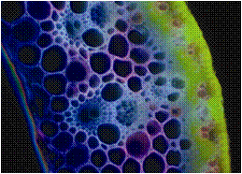
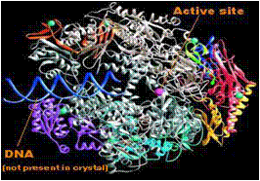
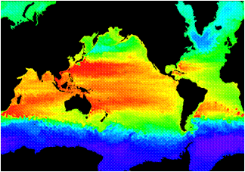
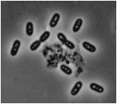
Biological and Environmental Research (BER)
Understanding complex biological, climatic, and environmental systems across vast spatial and temporal scales
The Scientific Challenges:
Understand how genomic information is translated with confidence to redesign microbes, plants or ecosystems for improved carbon storage, sustainable biofuel production, and controlled biological transformation of nutrients and contaminants in the environment.
Understand the roles of Earth’s biogeochemical systems (atmosphere, land, oceans, sea ice, subsurface) in determining climate so we can predict climate decades or centuries into the future, information needed to plan for future energy and resource needs.

Slide 3
BER - Organization
BER research and user facilities are managed within and across two Divisions.
Advanced Scientific Computing Research
Basic Energy Sciences
High Energy Physics
Fusion Energy Sciences
Nuclear Physics
Biological and Environmental Research
Sharlene Weatherwax, Associate Director
Biological Systems Science
Todd Anderson, Director
  Genomic Science
    Bioenergy Research Centers
  Mesoscale to Molecules
  Facilities & Infrastructure
    Joint Genome Institute
    Structural Biology
Climate & Environmental Sciences
Gary Geernaert, Director
  Atmospheric System Research
  Environmental System Science
  Climate & Earth System Modeling
  Facilities & Infrastructure
    Environmental Molec. Sciences Lab
    ARM Climate Research Facility

Slide 4




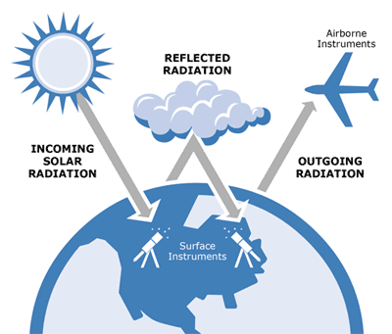
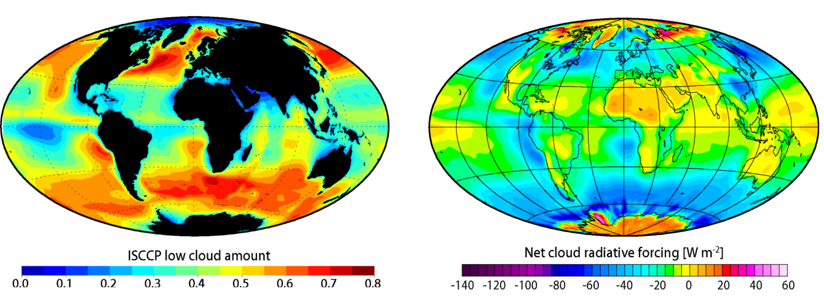

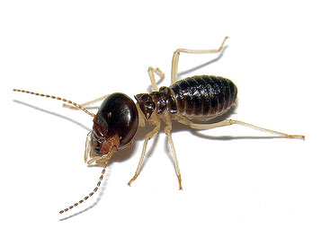
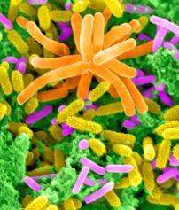
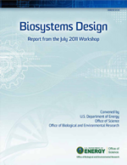
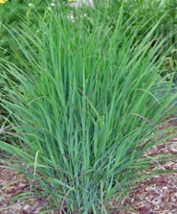
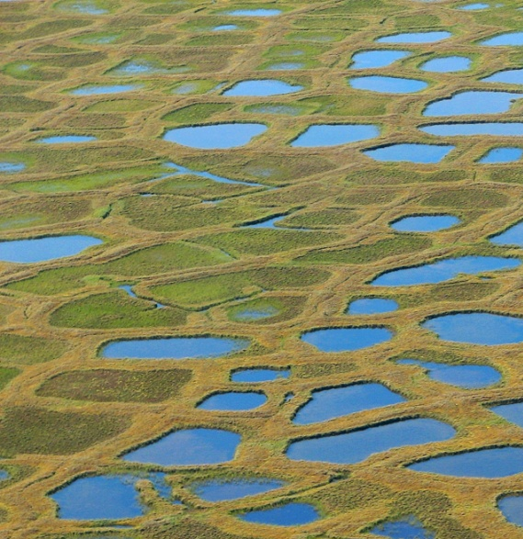
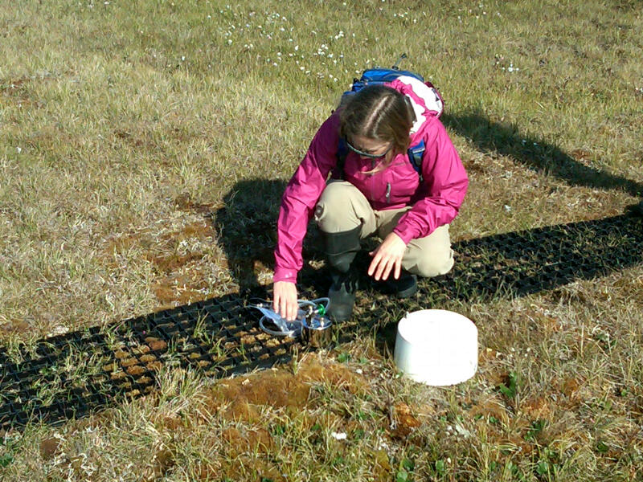
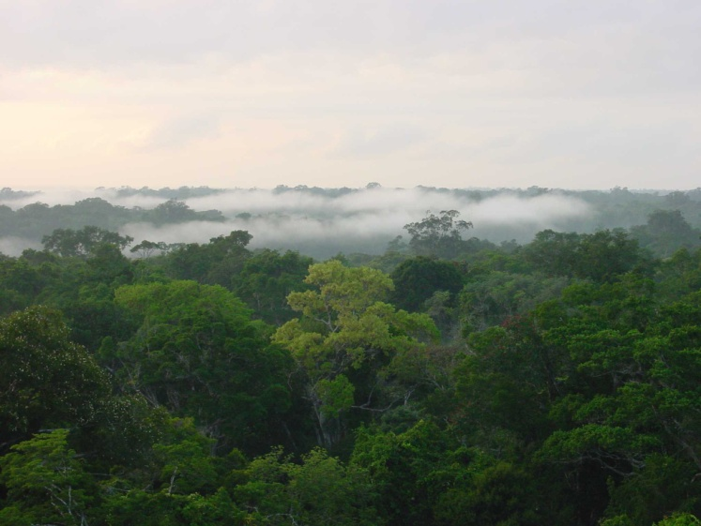
BER-at-a-Glance
Foundational Science - integrating observations and experimental
capabilities with modeling for predictive understanding
Explore frontiers of genome-enabled biology
Sustainable bioenergy resources
Function & organization of plant and microbial systems
Mechanisms of carbon storage in plant biomass and microbial communities
Biosystems design
Systems biology via data integration and analysis within a systems biology knowledgebase
Integrative bioimaging technology
Understand the effects of greenhouse gas emissions on Earth’s climate and biosphere
  World-leading capabilities in climate modeling
  Representation of clouds in climate models
  Direct/indirect effects of aerosols on climate
  Interactions of carbon cycle and climate
  Predictive understanding of terrestrial ecosystems, with a focus on sensitive systems (e.g., Arctic and tropics)

Slide 5

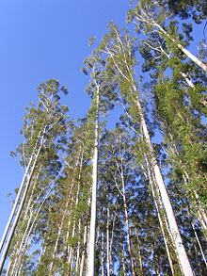
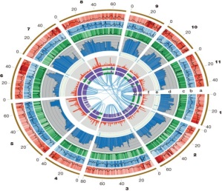
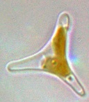
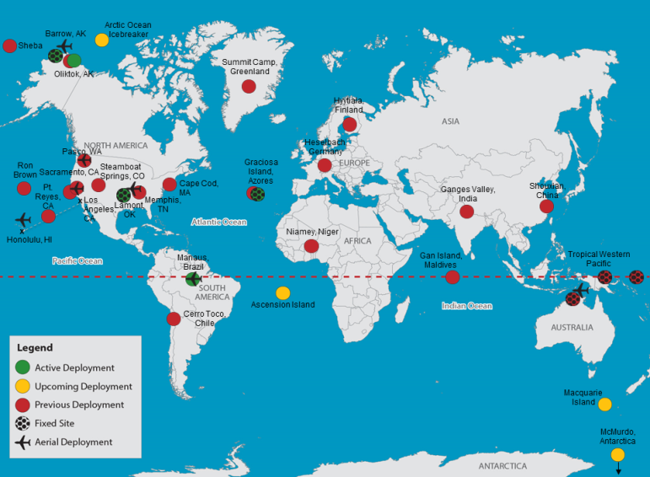
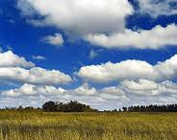

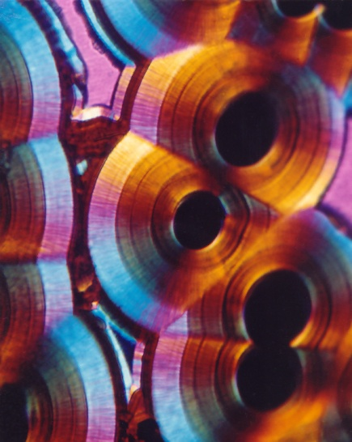
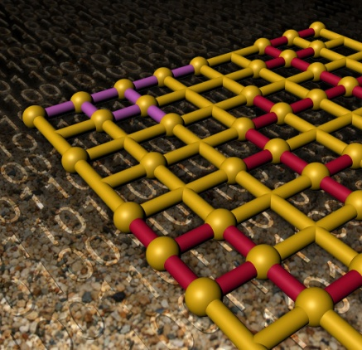
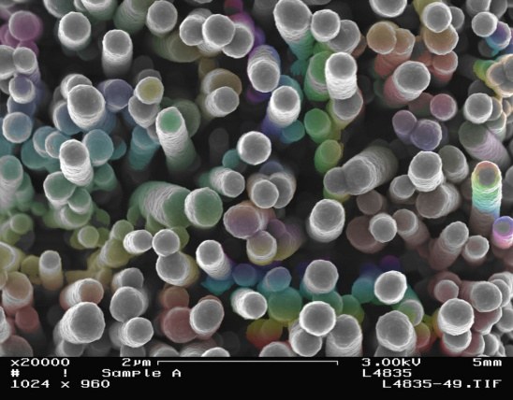
BER - Facilities
Scientific User Facilities
  Joint Genome Institute (JGI) - meeting the genome sequencing needs of the bioenergy, carbon cycle, and biogeochemical science communities
  Atmospheric Radiation Measurement (ARM) Climate Research Facility - providing continuous field measurements and data products to improve cloud and aerosol science in climate models
Nov 2015
  Environmental Molecular Sciences Laboratory (EMSL) - enables molecular-scale experimental and theoretical research on aerosol chemistry, biological systems, geochemistry/biogeochemistry, and interfacial and surface science.

Slide 6
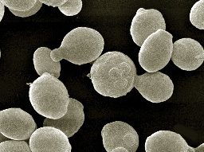
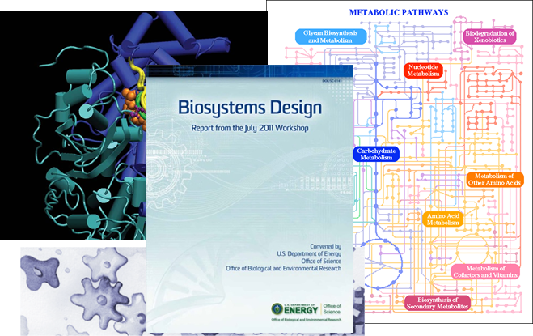
Genomic Science
Determine the genomic properties, molecular and regulatory mechanisms, and resulting functional potential of microbes, plants, and biological communities central to DOE missions.
Develop the experimental capabilities and enabling technologies needed to achieve a genome-based, dynamic system-level understanding of organism and community functions.
Develop the knowledgebase, computational infrastructure, and modeling capabilities to advance the understanding, prediction, and manipulation of complex biological systems.
Biosystems Design Tools for Plant & Microbial Systems
Research to establish biological design rules will enable the predictive design of innovative natural and hybrid systems for clean energy production.
Synthetic biology methods
Genetic toolkits
Predictive integration of components and processes
Verify & validate computer-aided design toolkits
Testbeds to prototype performance and function

Slide 7
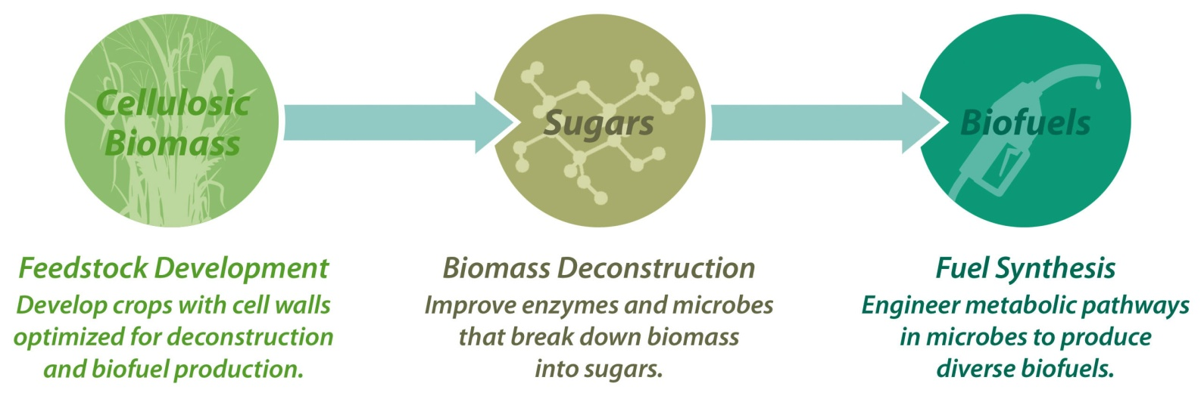
Bioenergy Research Centers—Innovation for Clean Energy
    Established in 2007; in 8th year of operation:
  795 invention disclosures and/or patent applications
  32 patents awarded
  116 licensing agreements
  2108 peer-reviewed publications
  The centers were renewed for 5 years following merit review in September 2012.
  FY 2017 is the final year in the funded renewal period.
  BioEnergy Science Center (Oak Ridge National Lab)
  Strategic focus on overcoming biomass “recalcitrance”
  Goal of “Consolidated Bioprocessing” – one-microbe or microbial community approach going from plants to fuel
  Great Lakes Bioenergy Research Center (U. of Wisconsin, Michigan State U.)
  Goal of re-engineering plants to produce more starches and oils
  Using high throughput technologies to optimize chem/bio process for biomass deconstruction
  Major research thrust on sustainability of biofuels
  Joint BioEnergy Institute (Lawrence Berkeley National Lab)
  Experimenting with new pretreatment process using room temperature ionic liquids
  Engineering E.coli and yeast to produce hydrocarbons, “green” gasoline, diesel, jet fuel
Increased funding requested in FY 2017 accelerates innovation and translation of research results to industry
A competitive FOA will be issued in FY 2016 for merit review and selection in FY 2017.

Slide 8
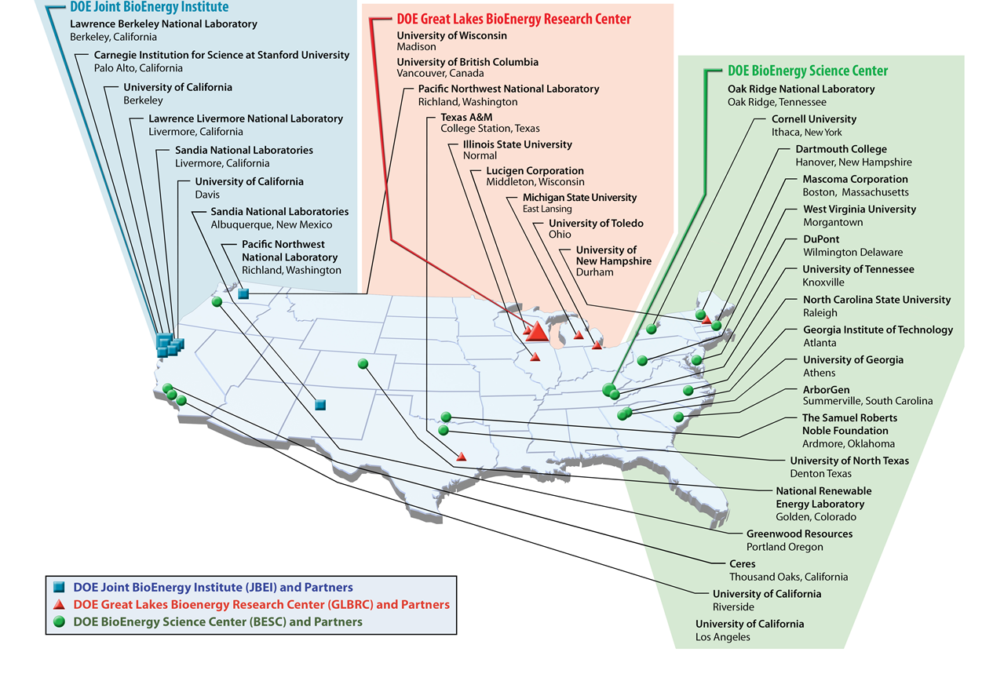
Bioenergy Research Center Partner Institutions
February 2015

Slide 9
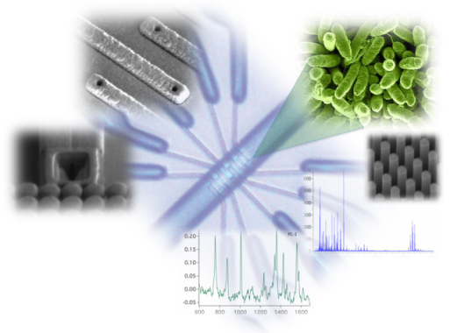
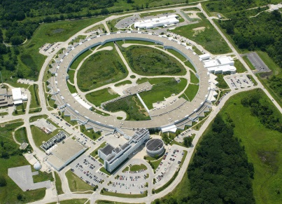

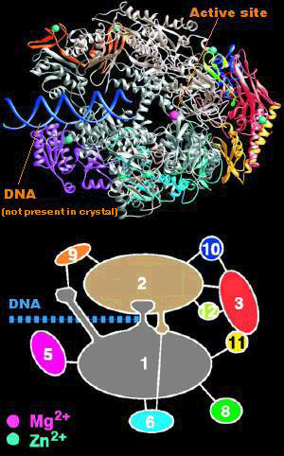
Enabling Technologies for Systems Biology
Enable access for the biology community to structural biology beamlines and instrumentation at national user facilities (DOE BES light sources and neutron facilities; the Linac Coherent Light Source). Coordinated with BES and NIH.
Develop capability to combine structural information on biomolecules with computation and/or bioinformatics to infer function and improve genome annotation or design new functions.
Develop in situ, dynamic, and nondestructive approaches to multifunctional imaging, quantitative flux measurements, and multiscale integrative analysis of biological systems.
Develop and support the DOE Systems Biology Knowledgebase (KBase), a Community Resource for Predictive Biology. This open-source and open-architecture computational environment will enable collaborative generation & sharing of systems biology data and workflows; perform large-scale analyses on a scalable computing infrastructure; model interactions between relevant organisms; propose new experiments to further refine the models.
http://www.kbase.us

Slide 10
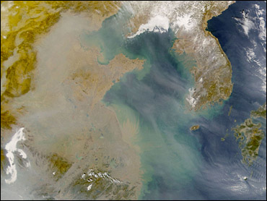
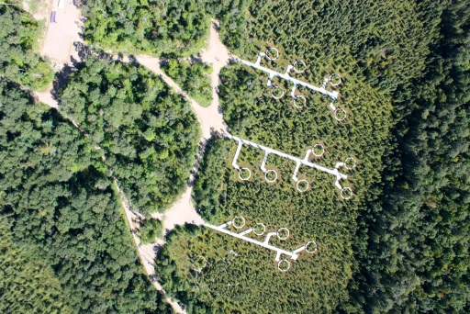
DOE’s Role in Climate Change Research
DOE has been a leader in climate science since the 1950s, beginning with atmospheric transport and the relationship between CO₂ and climate change.
Today’s research relies on unique SC user facilities, such as the Atmospheric Radiation Measurement (ARM) Climate Research Facility and the Leadership Computing Facilities, to develop predictive, systems-level understanding of climate change.
DOE coordinates with other agencies through partnerships and through the U.S. Global Change Research Program.
DOE/SC research addresses:
The three important uncertainties in the earth’s radiant energy balance—clouds, aerosols, and atmospheric greenhouse gases
The relationship between climate change and critical ecosystems
The climate-energy-water nexus through modeling, data analytics, and analysis
Complexity of the climate and earth system, that demands extreme scale computing

Slide 11
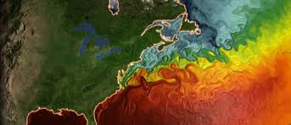
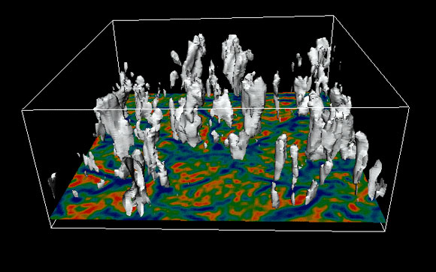








Accelerated Climate Model for Energy (ACME)
As one of the three major US climate model research centers, ACME is a DOE multi-laboratory project designed to accelerate the assimilation of advanced software, numerical methods, and advanced high resolution physics, to study extreme phenomena in a warming climate.
Unique, world-leading capabilities
Highest spatial resolution of all climate models in the world
  Resolution at 15-25 km in fully coupled mode
  Resolution below 10 km, using advanced adaptive-mesh for specific regions
Will be the first climate model compatible with next generation computer architectures, as they become available.
Science to assimilate into ACME
Carbon cycle, with dynamic ecology, biogeochemistry, and land-atmosphere fluxes
Detailed studies of the cryosphere: permafrost; ice sheets
Detailed validation of ecosystem component models, using data from DOE field projects in the Arctic and Tropics
Uncertainty quantification for full system and its components
Focus in FY 2017: Testing with Large-Eddy-Simulation, based on high resolution details obtained from the DOE Atmospheric Radiation Measurement Facility to better predict extremes
Begun in 2014, involves 7 National laboratories and the National Center for Atmospheric Research (NCAR).

Slide 12
Next-generation Ecosystem Experiments (NGEE)
NGEE—coordinated projects coupling terrestrial field experiments and process modeling to more rapidly improve the representation of terrestrial ecosystem processes in Earth system models thereby improving the quality of climate model projections.
Target regions chosen are globally important, climatically sensitive, and understudied/underrepresented in predictive models.
NGEE projects combine field and laboratory studies, observations, and multi-scale model simulation, coordinating with ARM mobile campaigns.
NGEE-Arctic (FY2012-2022): Warming of permafrost soils will release vast amounts of CO₂ and/or CH₄ to the atmosphere—a strong positive feedback to warming.
NGEE-Tropics (FY2014-2023): Rainfall stress on tropical ecosystems and release of biogenic aerosols impact cloud condensation nuclei.

Slide 13
BER Funding Modalities
Grants to Academic/Private Institutions
Response to specific targeted Funding Opportunity Announcements
All proposals are merit reviewed, most by peer review panels
Most awards are made to single investigators (or collaborative teams of investigators at multiple institutions)
Collaborations between DOE labs and universities are encouraged
Projects have a defined scope and project period
Scientific Focus Areas (SFAs) – Integrated Team Funding to DOE Labs
In 2009, research programs map to broad BER research budget categories.
SFAs must be coherent, cohesive, long-term programs that reflect coordination and collaboration among individual and teams of investigators across National Lab divisions and institutions.
Strong management plans are essential
SFAs established by competitive merit review; progress is evaluated on annual basis and triennial peer reviews (often on-site)

Slide 14
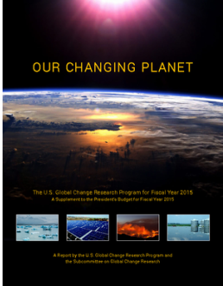
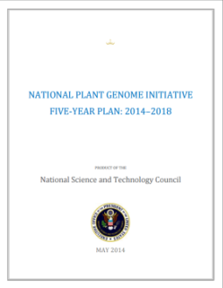

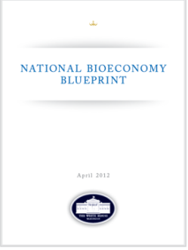
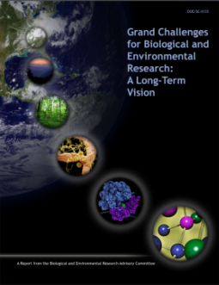
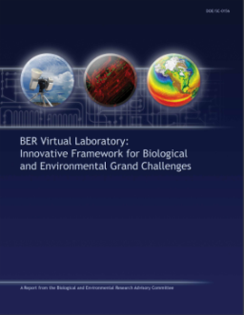
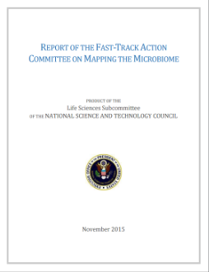


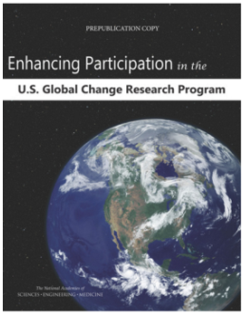
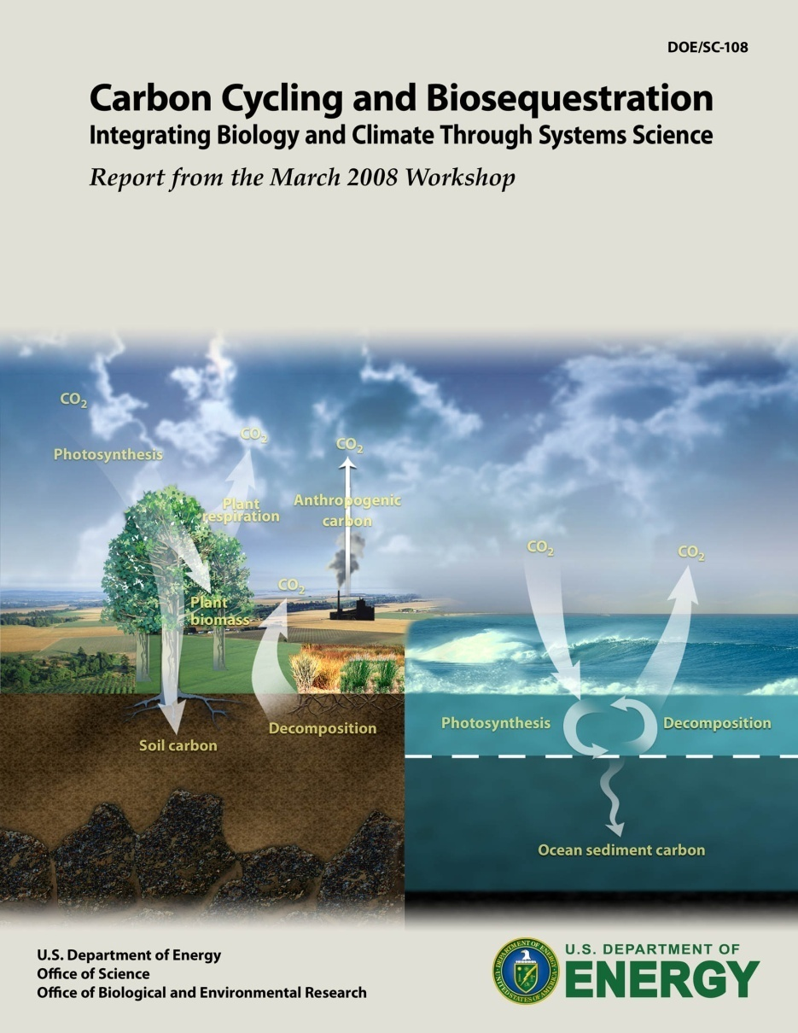
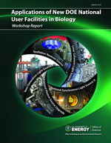
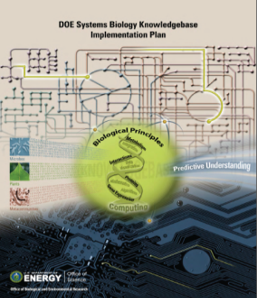

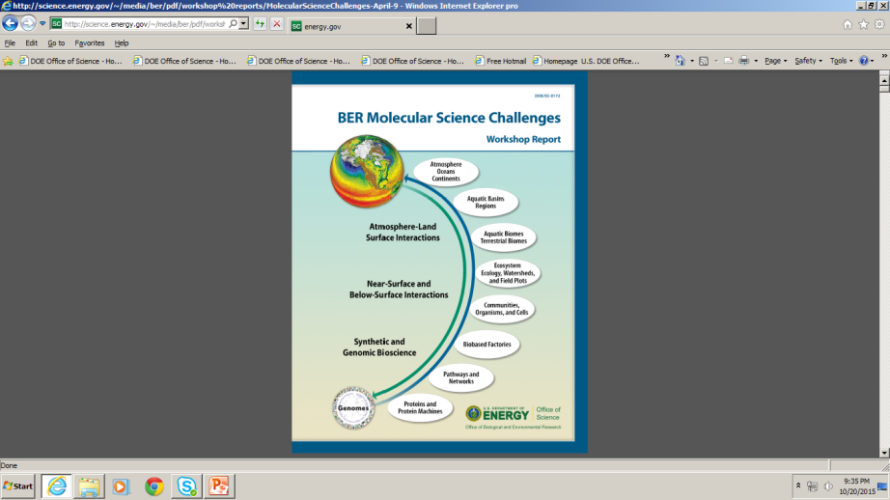
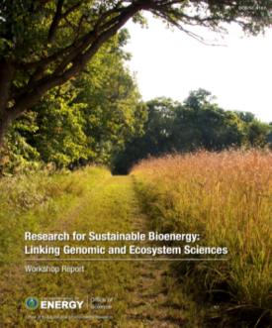
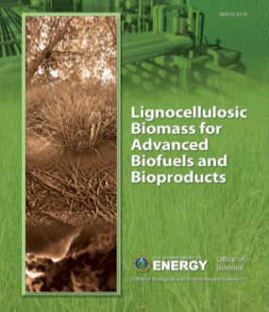
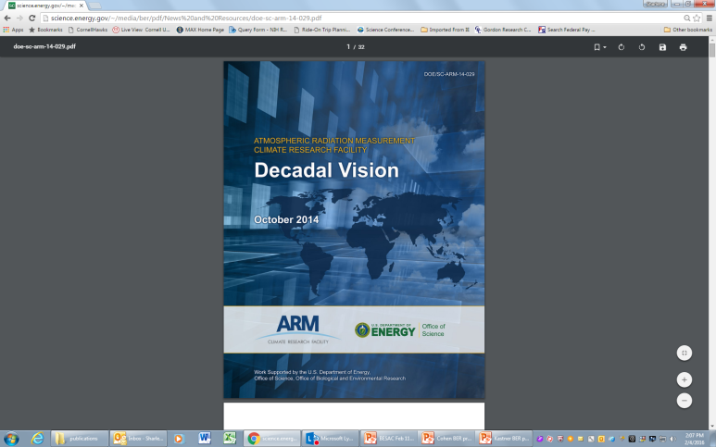
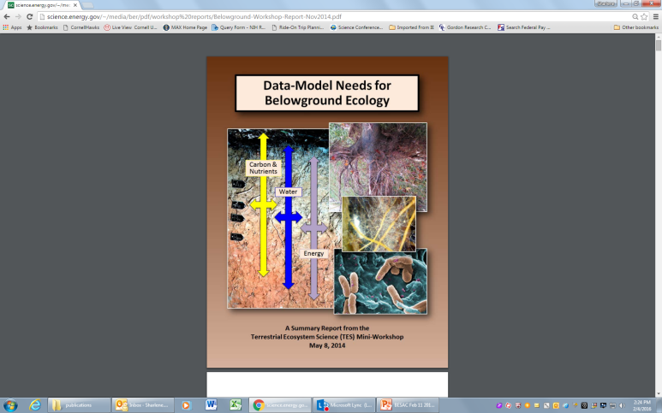
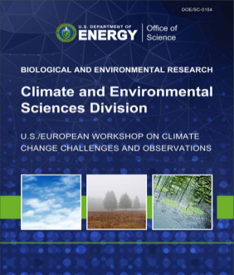
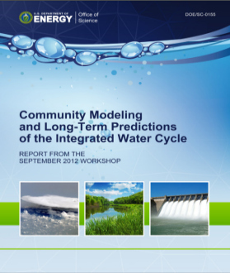
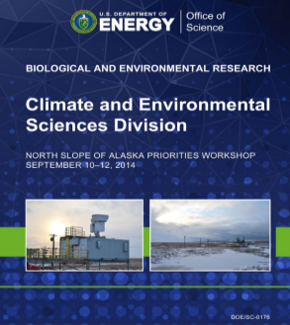



BER strategic science directions are guided by input from the research community, scientific workshops, the National Science and Technology Council, the National Academy of Sciences and BERAC.

Slide 15
Cross-fertilization, Collaboration, and Partnering Opportunities between BER and BES (and ASCR)
Continued collaboration and partnerships on instrumentation at the user facilities
Joint user facility calls for projects that leverage capabilities across the programs
Mutual participation in Principal Investigator/contractor meetings
Community workshops to identify scientific opportunities and knowledge gaps between programs
  BES Biomolecular Materials
  BES Photochemistry and Biochemistry
  BER Genomic Science (Biodesign)
  BER Mesoscale and Bioimaging
Enable data analysis and integration across BER and BES programs (Kbase – Computational Materials Science – Computational Chemistry)

Slide 16


BER Scientific User Facilities—Collaborative projects
JGI – EMSL Collaborative Science Initiative
Opportunity to combine the power of genomics and molecular characterization in one research project
Mission focus on energy, environment and basic research
  Biofuels and bioproducts
  Plant-microbe interactions in the context of climate change
  Biogeochemistry of select inorganic elements
Generate datasets unique to both user facilities
FY 2016 Pilot Program for joint EMSL and ARM Capabilities
Focus on atmospheric aerosol science that takes advantage of both the analytical instrumentation and capabilities in EMSL and the infrastructure and observational capabilities of the ARM Climate Research Facility
Analyze aerosol samples collected at ARM’s Southern Great Plains Site
Enable understanding of the molecular, physical, and/or optical properties of aerosol particles that influence and control macroscopic climate-relevant processes, such as cloud formation, radiation balance, and precipitation

Slide 17


DOE Contributions to the BRAIN Initiative
The BRAIN (Brain Research through Advancing Innovative Neurotechnologies) Initiative aims to revolutionize our understanding of the human brain
In FY 2017, the Office of Science (ASCR, BER, and BES) proposes partnering
with NIH and coordinating with the interagency BRAIN initiative
    ASCR ($3M) – HPC, data management and computational expertise
    BES ($4M) – DOE X-ray Light Sources and Nanoscale Science Research Centers to enable brain imaging and sensing, including fabricating biocompatible electronic materials and sensors
  BER ($2M) – JGI and EMSL to enable biosensor and bioprobe
  synthesis and characterization
Office of Science Scientific User Facilities will enable development of:
    Specialized, high-resolution tools for measuring key neurological processes
    Capabilities for obtaining a dynamic, real-time read-out of
    neurological measurements
    An integrated computational framework for analyzing and
    utilizing this dynamic multi-modal data
  A DOE-NIH Joint BRAIN Workshop (October 2015) has defined the preliminary scope of DOE participation. Additional SC workshops will define targeted scientific objectives.

Slide 18
BER encourages its research community to seek scientific partnerships and new collaborations to accomplish mission goals.
If you have ideas—let us know!
Thank you!
http://science.energy.gov/ber/

