Slide 1
Basic Research Needs for Innovation and Discovery of Transformative Experimental Tools
Solving Grand Challenges in Energy Sciences
Ali Belkacem
Lawrence Berkeley National Laboratory
BESAC June 9-10, 2016

Slide 2

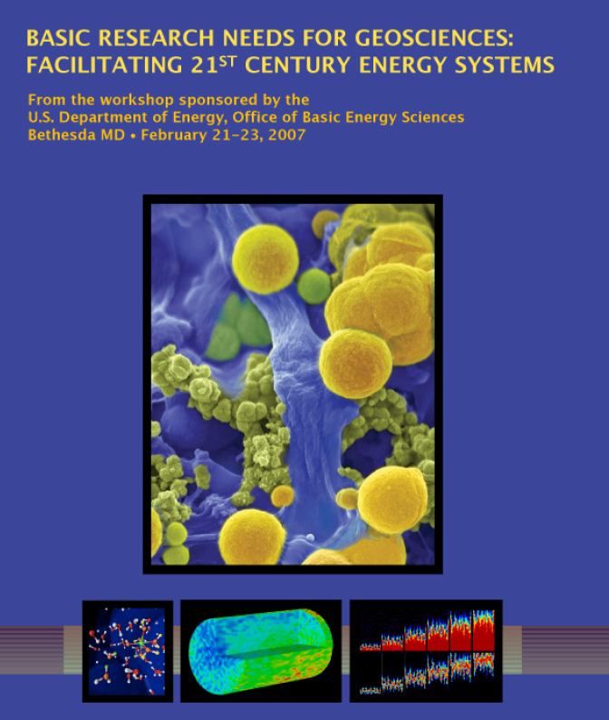
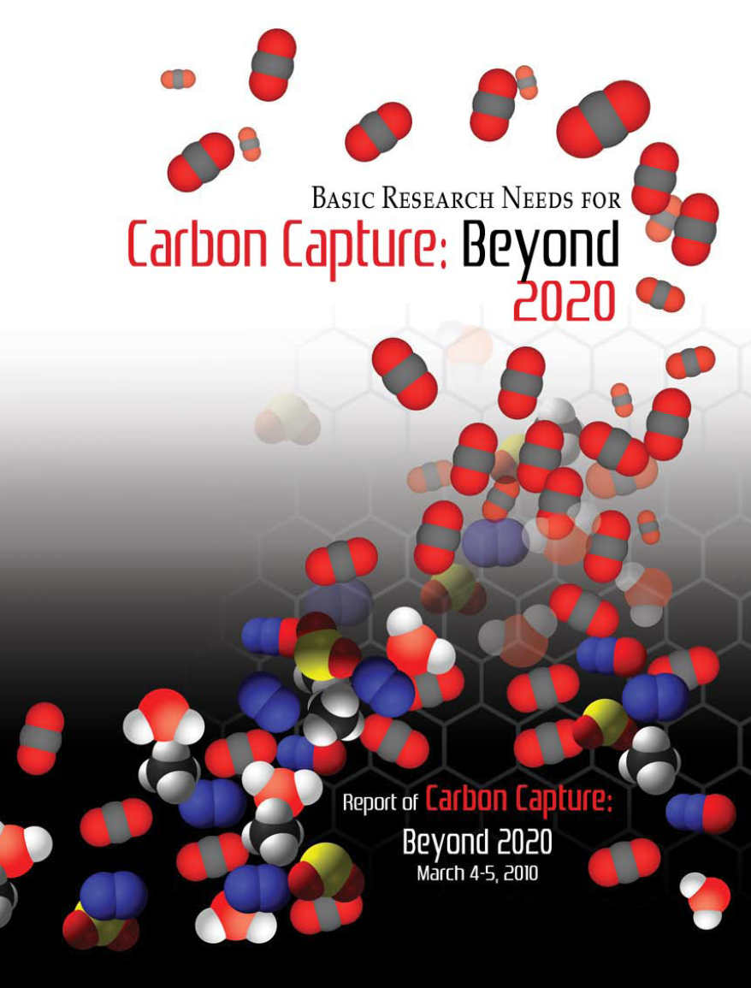
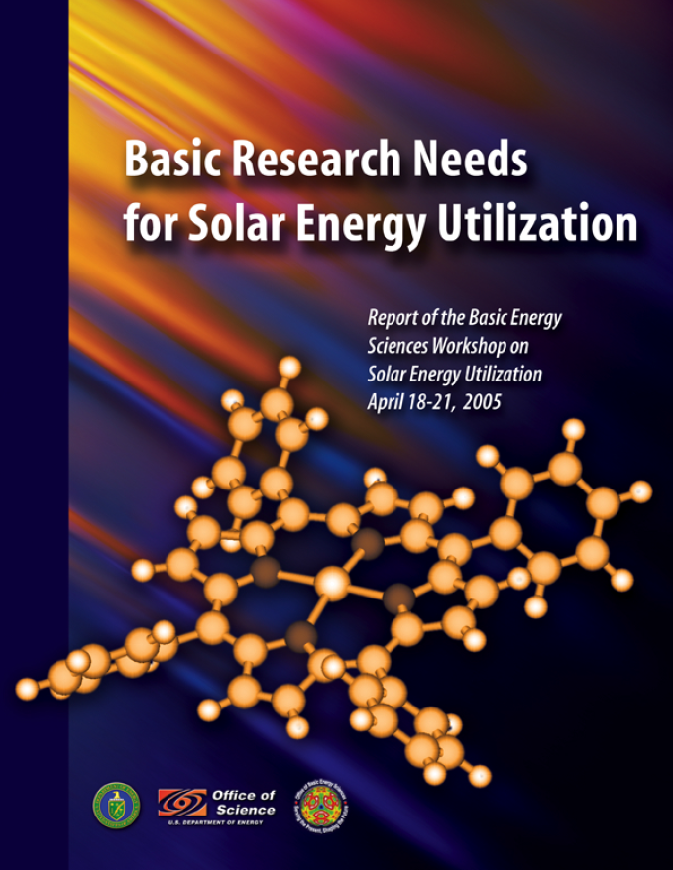
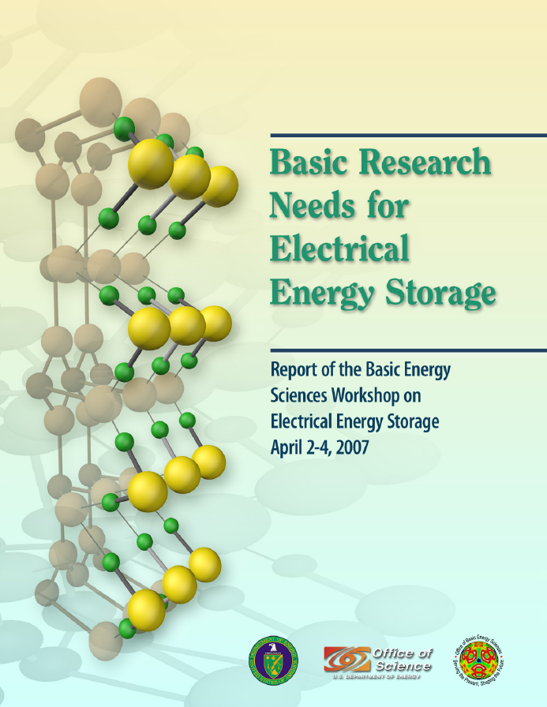
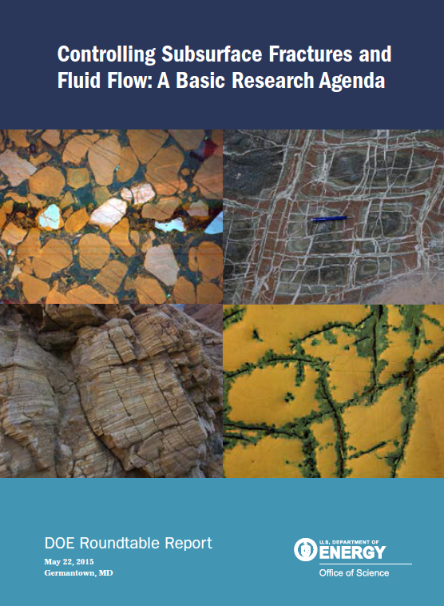
Energy technologies and Basic Energy Sciences
Energy Technologies
Fuel from Sunlight
Energy Storage
Geothermal
Functional Materials
Combustion
Systems improvement and engineering
BRN
Basic Energy Sciences
Materials and Chemical processes in gas, liquid, solid and at interfaces
Mesoscale energy systems
Beyond ideal systems, Beyond equilibrium systems
Quantum Coherence

Slide 3
Basic Research Needs for Innovation and Discovery of Transformative Experimental Tools
“Measure what can be measured, and make measurable what cannot be measured.”
― Galileo Galilei
Basic Energy Research Thrusts
Materials and Chemical processes in gas, liquid, solid and at interfaces
Mesoscale energy systems
Beyond ideal systems
Beyond equilibrium systems
Truly brilliant idea
or Paradigm Shift!
Limitations!
Enabling Tools
State-of-the-art instrumentation
State-of-the-art experimental methods
State-of-the-art Facilities
Integration of Theory and Experiment
Innovate and Discover Transformative Experimental Tools
Need

Slide 4
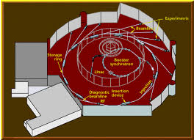
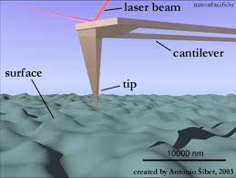
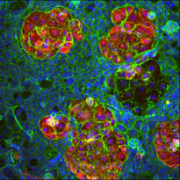
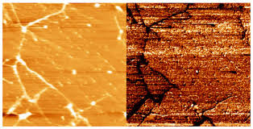
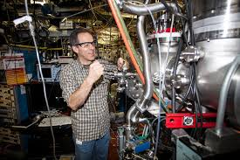
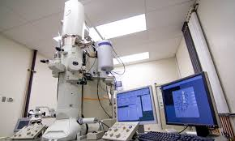
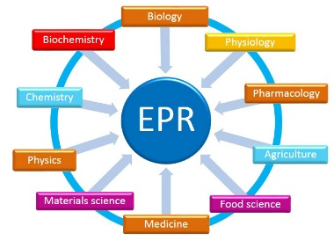
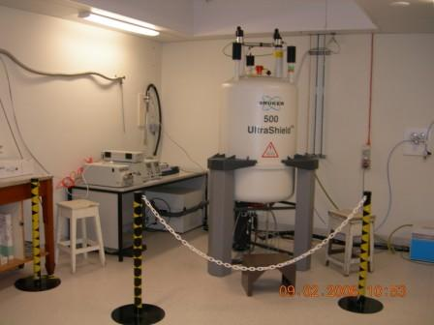
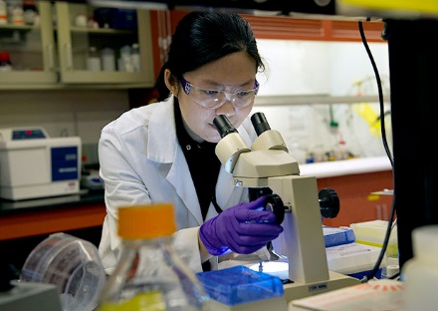
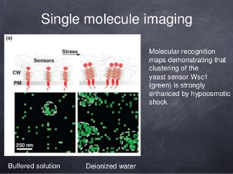
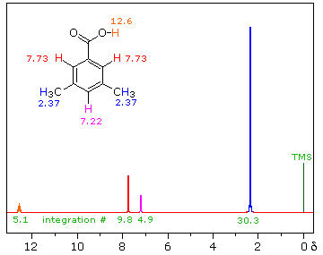
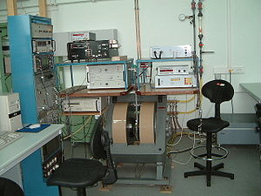
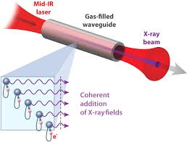
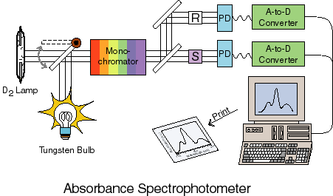
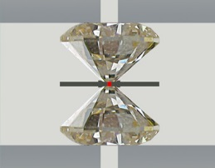
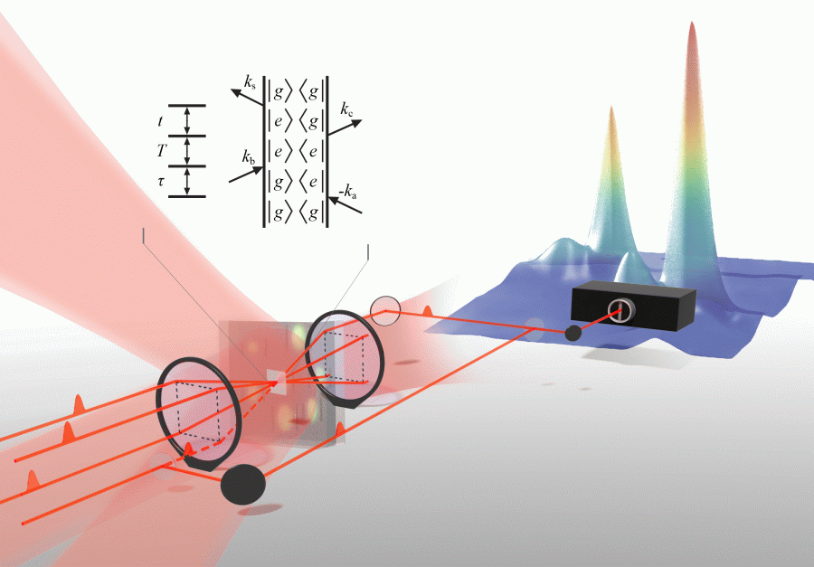
Breakthrough science is performed in different laboratory settings using vastly different tools
Electron microscopy
AFM
Synchrotron radiation
EPR
Synthesis & characterization
Single molecule
NMR
High pressure and temperature methods
UV-Vis and other laser methods
Multi-dimensional Spectroscopy
Ultrafast methods

Slide 5
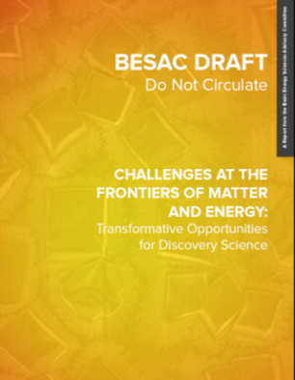

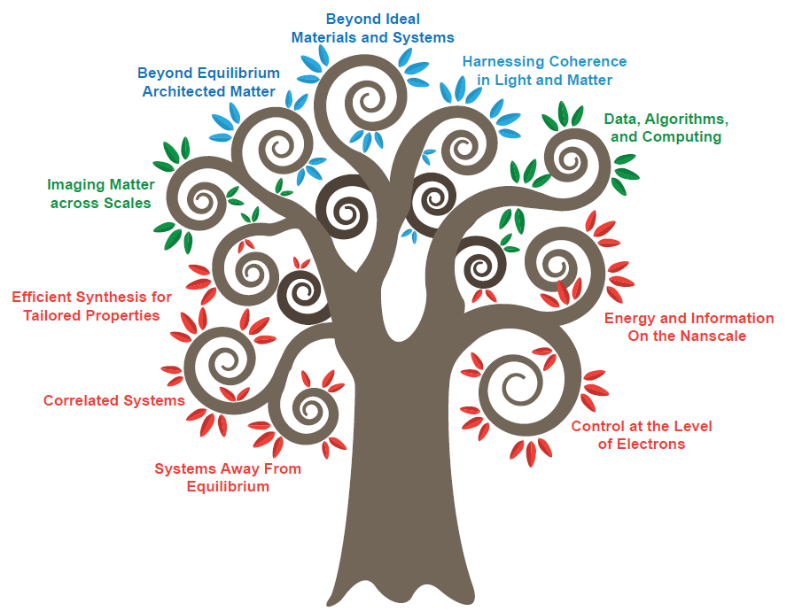
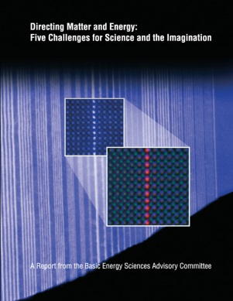
Challenges at the Frontiers of Matter and Energy:
Transformative Opportunities for Discovery Science
Instrumentation
& Tools
Human Capital
Synthesis
Beyond Ideal Materials and Systems
2015
Mastering Hierarchical Architectures
Harnessing Coherence in Light and Matter
Imaging Matter across Scales
Data, Algorithms and Computing
Efficient Synthesis for Tailored Properties
Energy and Information on the Nanoscale
2007
Correlated Systems
Control at the Level of Electrons
Systems Away from Equilibrium

Slide 6
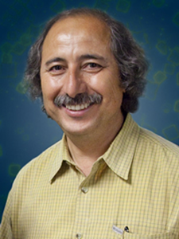


Basic Research Needs for Innovation and Discovery of Transformative Experimental Tools — June 1-3, 2016
Workshop Chair: Ali Belkacem (LBNL)
Co-chairs: Cynthia Friend (Harvard)
Yimei Zhu (BNL)
SC Technical Lead: Tom Settersten (BES)
CHARGE: Explore the frontiers of instrumentation science that provide opportunities to advance grand challenge energy research. The workshop will identify the scientific challenges and resulting priority research directions for instrumentation development. The workshop is expected to emphasize university-laboratory-scale instruments, portable instruments for dual use at the bench or at facility end-stations, and new concepts for experimental methods and the corresponding advanced data analytics and related approaches that are intrinsic to meaningful measurements.
Breakout Sessions and Panel Leads:
Chemical reactions and transformations in functional environments – Beyond model systems,
Peter Crozier (Arizona State Univ.) and Cynthia Jenks (Ames Lab)
Imaging materials far away from equilibrium,
Paul Fenter (ANL) and Wayne Hess (PNNL)
Challenges of heterogeneity across multiple length scales and multiple time scales,
Ralph Nuzzo (Univ. Illinois) and Jennifer Ogilvie (Univ. Michigan)
Transformational experimental tools through integration of instrumentation with theory and computation,
Jeff Neaton (LBNL) and Monica Olvera de la Cruz (Northwestern Univ.)
Plenary Session Speakers:
Plenary 1 – Overall vision and catalysis, Robert Schlögl, Fritz Haber Institute
Plenary 2 – Energy transformations at interfaces, Eric Stach, BNL
Plenary 3 – Nanostructured materials, Amanda Petford-Long, NWU/ANL
Plenary 4 – Integration theory-experiment, Sharon Glotzer, Univ. Michigan
Plenary 5 – Mathematics and data handling, James Sethian, UC Berkeley/LBNL
Plenary 6 – Dynamical processes, Frances Ross, IBM
Plenary 7 – Heterogeneity in materials and chemistry, Simon Bare, SLAC

Slide 7
Basic Research Needs for Innovation and Discovery of Transformative Experimental Tools
The goals of the workshop:
To identify currently out of reach scientific discoveries associated with complex energy systems
To report the status of experimental research and state-of-the-art instrumentation that currently address that challenge
To discuss the current limitations of the scientific methods
To explore opportunities and articulate priority research directions in innovation and discovery of experimental tools and methods that will enable breakthrough advances in energy sciences.

Slide 8
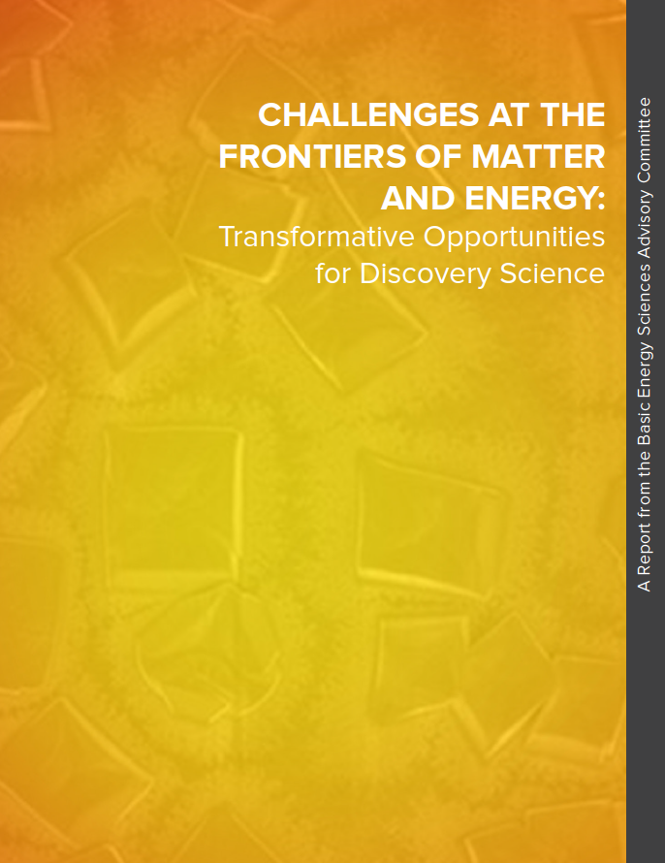
Basic Research Needs for Innovation and Discovery of Transformative Experimental Tools
Workshop Themes:
Chemical reactions and transformations in functional environments
Imaging materials far away from equilibrium
Challenges of heterogeneity across multiple length scales and multiple time scale
Transformational experimental tools through integration of instrumentation with theory and computation

Slide 9
Chemistry – Materials – Biology
Three Pillars of Energy Sciences
Research at the atomic and molecular level
Nano and meso scale systems
Materials
Processes at interfaces, in liquids or extreme environments
Biotic/Abiotic
Organic/Inorganic
Strong connections
through
Experimental Methods
Chemistry
Biology

Slide 10
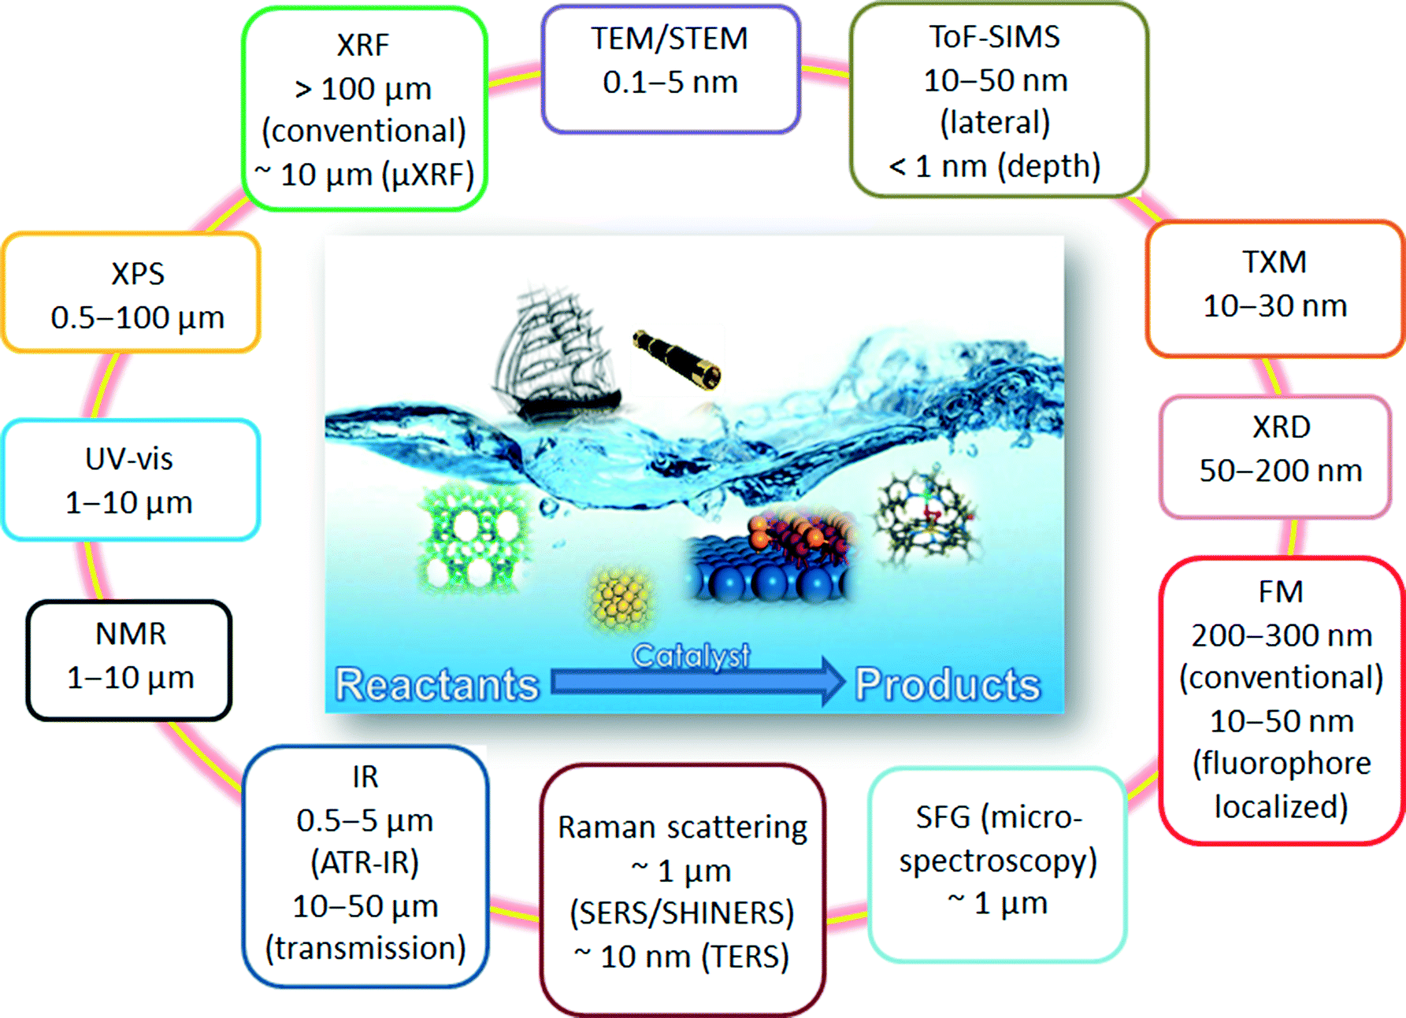
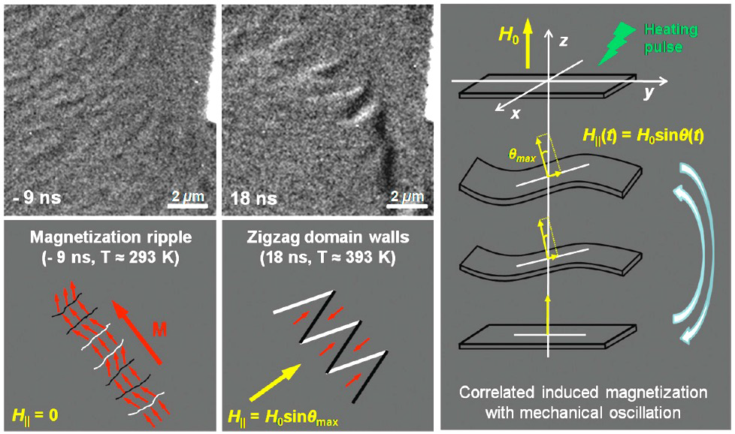
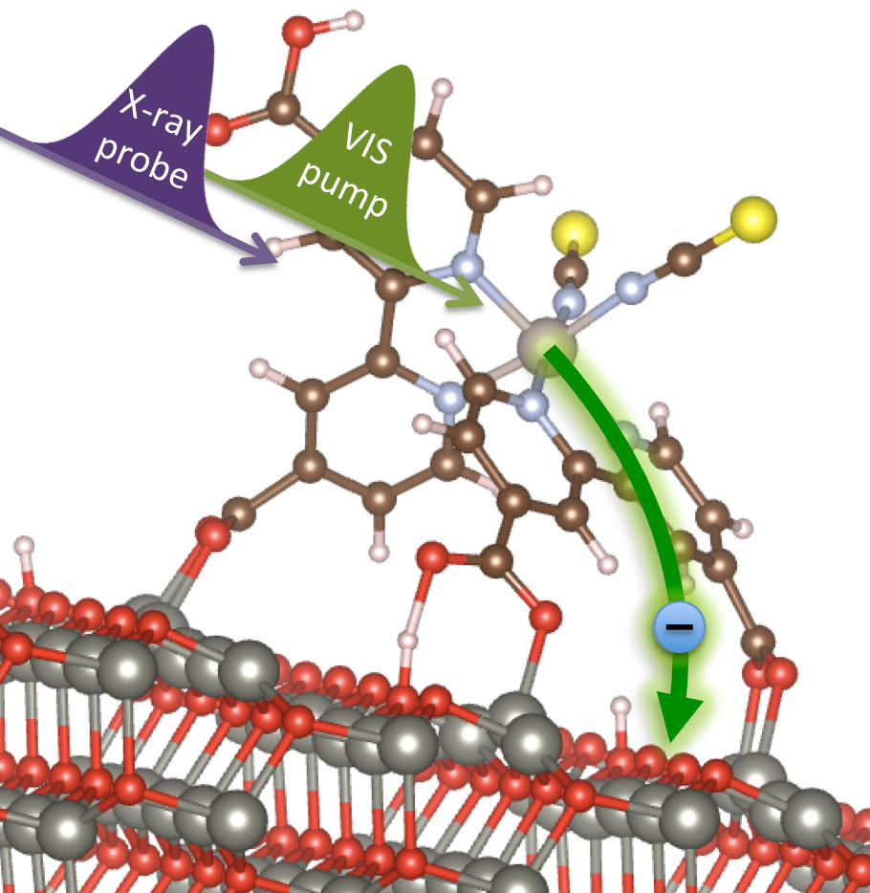
Scientific Themes and Challenges
1. Chemical reactions and transformations in functional environments
Studying energy systems under functional conditions, and observing, measuring, and quantifying parameters simultaneously pose a serious challenge. Limited progress has been made over the decades due to the limitations associated with the various instrumentation and probes.
2. Imaging materials far away from equilibrium
Processes that occur far away from equilibrium are central to most areas of energy science. Most of the progress to date in understanding these phenomena has been made through the observation of materials in “frozen” states represented by spatially or temporally averaged structures

Slide 11
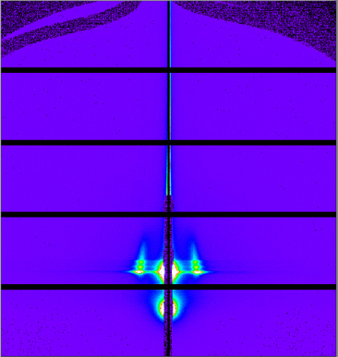
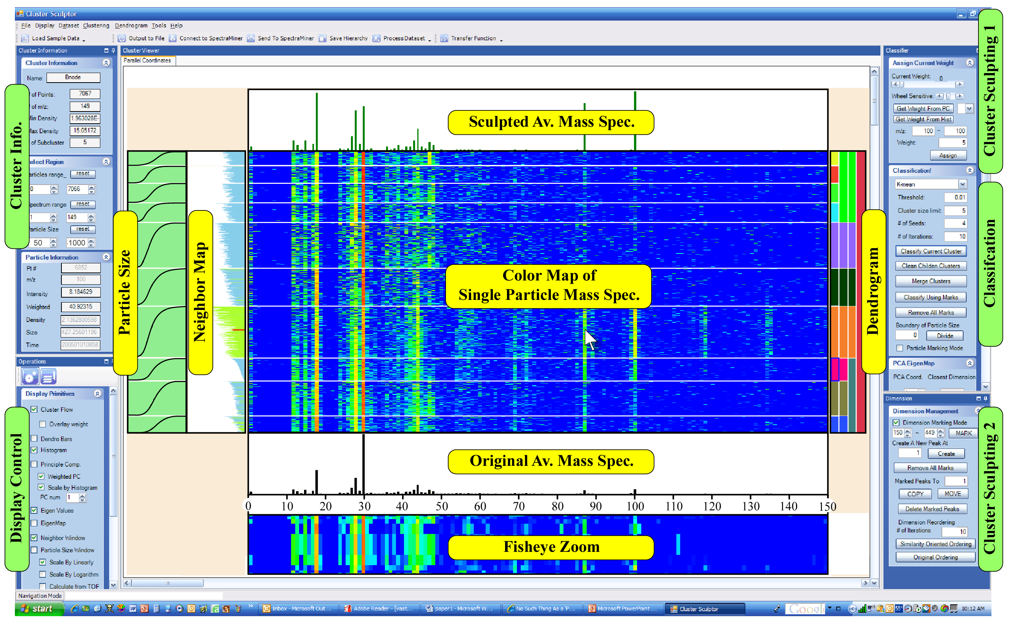
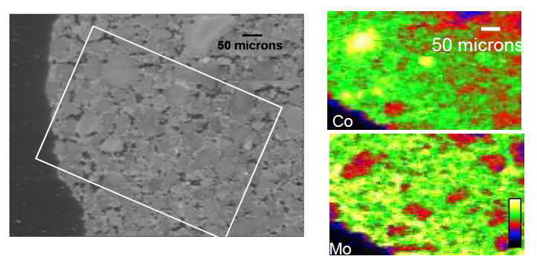
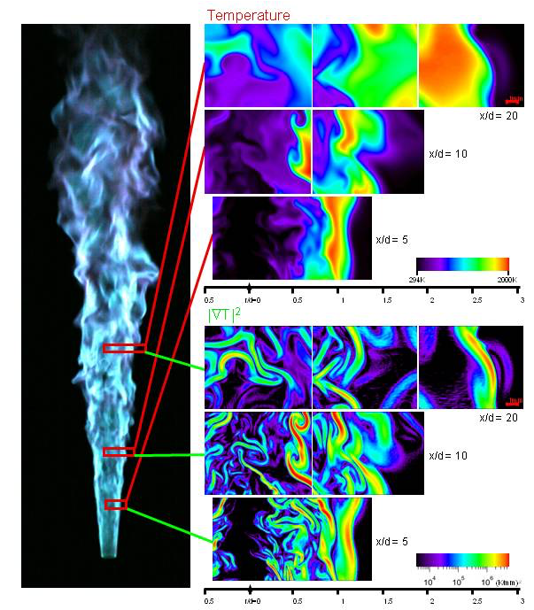
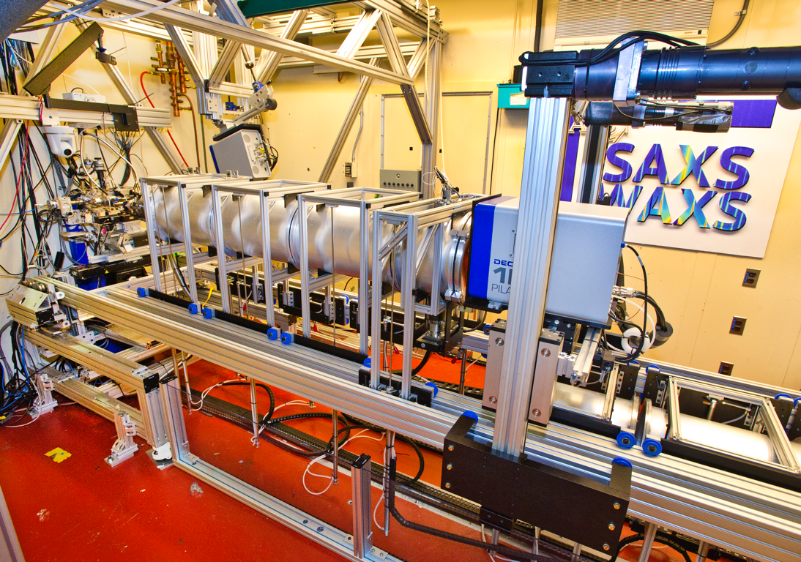
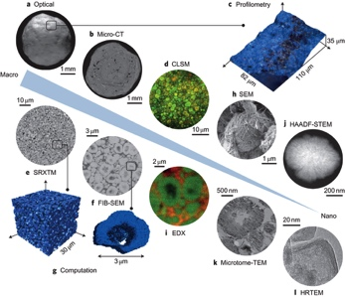
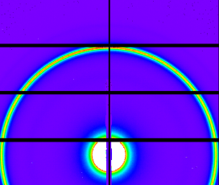
Scientific Themes and Challenges
3. Heterogeneity challenge across multiple length scales and time scales
The ability to study heterogeneous materials and chemical systems in space and time under functional conditions is one of the biggest challenges in energy sciences. A fundamental obstacle remains to bridge the multiple spatial and temporal scales that are simultaneously relevant.
4. Integration of instrumentation with theory and computation
To meet the spatiotemporal heterogeneity challenge in energy sciences there is a critical need to integrate instrumentation, innovative algorithms, theory and applied mathematics.
Mitchell et al., Nature Chemistry 4, 825 (2012)

Slide 12
Panel 1. Chemical reactions and transformations in functional environments
Designing, Creating, and Probing Local Functionality at High Resolution
Scientific challenges
Summary of research direction
Understanding and controlling transformations using high spatial and energy resolution techniques in complex functional environments
  Detect and design activity at individual reactive sites
  Elucidate and tailor local transport at defects
  Investigate and control multiphase processes at and near complex interfaces
Potential scientific impact
Time-resolved, high-resolution 3D imaging of interfaces across solids, liquids, and gases, under in situ and operando conditions
Develop more sensitive local probes, including approaches that exploit quantum technologies
Determine real active species in a complex environment
Elucidate contributions of bulk versus surface defects in charge transport processes
Differentiating properties associate with local versus collective phenomena
Novel functional catalysts and materials
Potential impact on energy technology
Thermo-, photo-, electro- catalysis
Energy conversion and storage
Combustion
Lubrication, friction, and wear
Separations
Quantum computing
Nanomanufacturing
12

Slide 13
PRD for tools to Probe Local Functionality
Imagine if we are able to invent, design and build instruments that will allow the characterization of functional complex systems while:
Matching or exceeding what we can do with model systems in terms of resolution (time, space and spectroscopy)
Accessing local information at any location of the complex heterogeneous functional system
Having the sensitivity to detect very dilute concentrations
Enabling the detection of rare events
Accessing information related to correlated responses of the various components of the functional system
Will transform basic energy research and its impact on energy technologies

Slide 14
Panel 2. Imaging materials far away from equilibrium
Scientific challenges
Summary of research direction
Understanding non-equilibrium phenomena requires going beyond the observation of spatially or temporally averaged structures towards imaging processes in their operational environments with multidimensional characterization including structural, temporal, chemical sensitivities.
Develop the capability to image chemical and materials processes, away from equilibrium, with spatial resolution from atomic to functional length scales, and temporal resolutions from ultrafast to the natural timescales.
Novel sources, optics, detectors, imaging modalities and analyses will enable new multimodal time resolved imaging capabilities.
Potential scientific impact
Potential impact on energy technology
- Understanding solar to chemical conversion and photovoltaic processes.
- Measurement and control of material response in energy devices (e.g., fuels cells, batteries and reactors).
- Development of novel methods for microstructural control of functional materials.
- Full utilization and improved efficiencies of solar and other renewable energy systems, from production to conversion and storage.
- Improved materials performance in reactive or radiation environments.
- Assembly of materials with superior properties (e.g., high strength, lightweight, corrosion resistant).
14

Slide 15
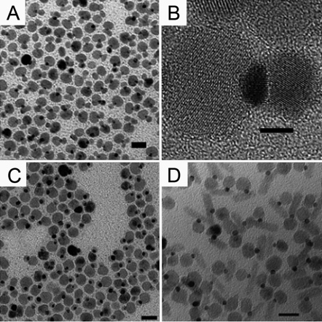
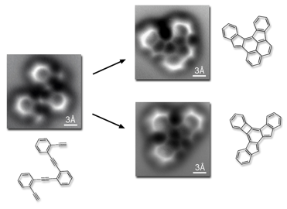
Imaging materials far away from equilibrium
PRD for tools that increase the dimensionality of characterization
What if we could advance imaging and spectroscopy across time scales and length scales while preserving high resolution and other attributes!!
Watch complex processes evolve in order to learn how to control them
Watch new phenomena emerge as length scales are crossed
Bridging length scales
Emerging Phenomena
Bridging time scales
High-resolution spectroscopy & microscopy
(time – space – energy - functionality)
WATCH CHEMISTRY
HAPPEN

Slide 16
Panel 3. Challenges of heterogeneity across multiple length scales and multiple time scales
Multimodal characterization methods that explore structural and dynamical heterogeneity in materials and chemical systems and predict important behaviors under the conditions of their use including under extreme conditions
Scientific challenges
Summary of research direction
Systems that contain disruption of perfect order
Complex speciation of phases and chemical states
Multiscale functionality and hierarchical architectures
Temporal evolution of complex interrelationships of system-level variables
Develop integrated instrumentation and computation to exploit transformative advances in imaging and spectroscopy across multiple length and time scales
Tools for simultaneous multimodal 5D (space, time and energy) characterization of disorder and interfaces
Potential scientific impact
Potential impact on energy technology
Understanding fundamental interactions between mass and energy transport and chemical transformation
Exploit and control heterogeneity for transformative/emergent functionality
Ability to track the chemical identity and electronic state of each atom across key time/length scales
Clean and efficient combustion
Increased energy density for batteries and fuel cells
Low power information technology systems
Design of catalysts and separation schemes with 100% selectivity
Energy conversion at the thermodynamic limit
Efficient waste remediation
16

Slide 17
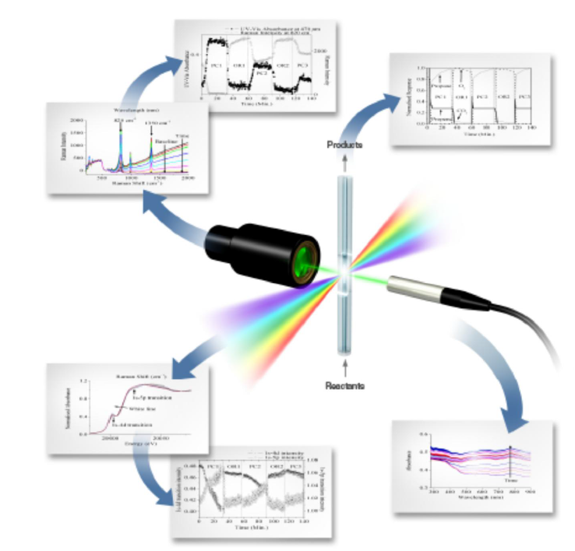
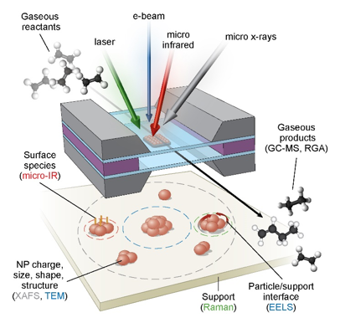
PRD for the development of multimodal characterization methods to study structural and dynamical heterogeneity
Imagine if we are able to invent, design, build and bring together instruments and capabilities that can simultaneously characterize and correlate different aspects of functional complex systems
Both at university Lab scale capabilities and large scale capabilities at user facilities
Will have a transformative impact on some areas of basic energy sciences like catalysis and materials synthesis

Slide 18
Panel 4. Co-design and development of algorithms, theory across scales, and data management with new experimental tools
Scientific challenges
Summary of research direction
Management and sharing of time-dependent, multimodal, and/or multidimensional data
Extracting information from heterogeneous datasets via real time analytics and/or modeling, and feedback to experiment
Predictive simulation of experimental observables via integration of theories, algorithms, and information spanning time and length scales
Development of applied math tools and approximate theoretical methods for extracting and assessing physical quantities from datasets (structure, order parameters, reaction coordinates, etc)
Systematic coarse graining and mapping across multiple time and length scales in the context of one or more observables using applied math, new algorithms, and data analytics
Potential scientific impact
Potential impact on energy technology
Advanced experimental tools for accelerating scientific discovery
Smart data acquisition for accelerated information extraction
Broadly accessible databases and information
Materials by design
Directed assembly of hierarchical functional materials
Structure-function relationships
There are many.
New materials for catalyst development, solar fuels, PV, and energy storage.

Slide 19
PRD for the integration of experimental tools with theory and computation
New theoretical, mathematical, and computational capabilities can enhance our ability to extract new insight from large data streams in multimodal and multidimensional experiments.
Imagine if these capabilities are fully developed in conjunction with specific experiments and integrated with instrumentation.
Need to develop an environment, research modality and other modalities (such as funding) that promote this integration at the design stage of experimental projects
Accelerate discovery in energy sciences

Slide 20
Thank You

