Slide 1
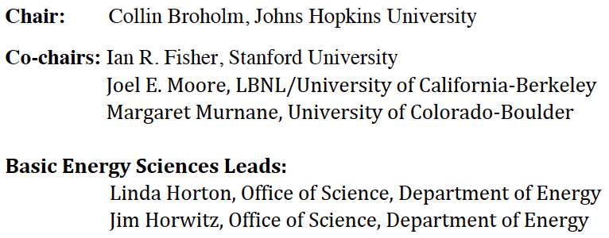
Basic Research Needs Workshop on Quantum Materials for Energy Relevant Technology

Slide 2

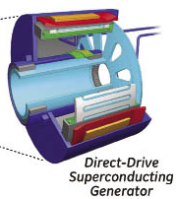
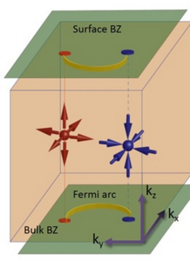
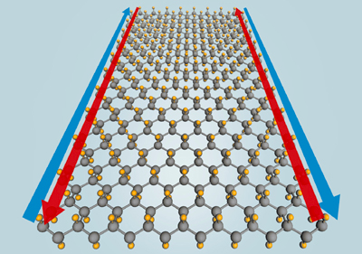
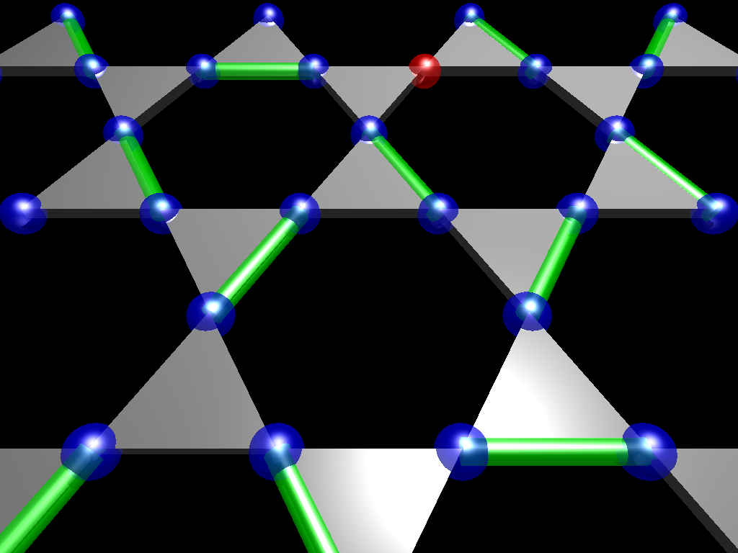
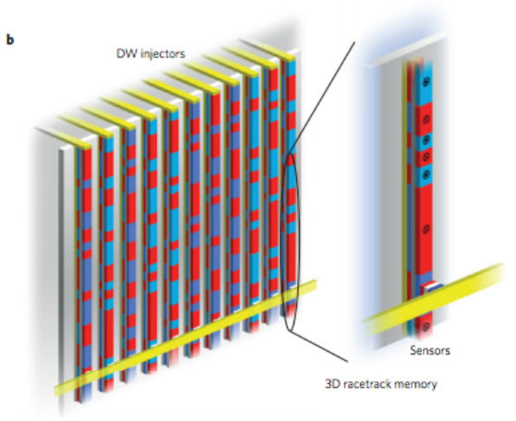
Quantum Materials
Quantum mechanics beyond the atom
  Quantization, quantum fluctuations, coherence, & tunneling at mesoscopic or macroscopic length scales
  Superconductivity, BEC, Quantum spin liquid, Topological insulators, Dirac and Weyl materials, spin-orbital liquid
Fundamental challenge
  Discover, Create, classify, understand, & control qualitatively new quantum states of matter
Energy relevant technology
  Lossless transmission, generation & transduction
  Novel material responses for energy efficiency and sensing
  Energy efficient information storage & processing
  Quantum information processing based on collective quasi-particles

Slide 3
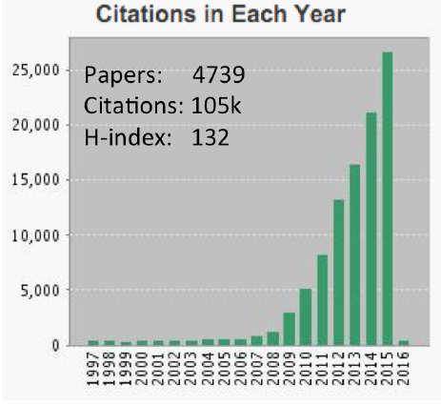
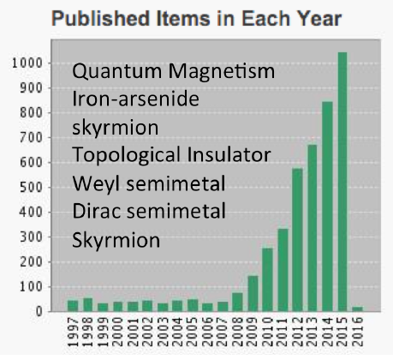
A Focus on Quantum Materials
Scientific Excitement
  Copper; then iron superconductivity
  Richness of quantum magnetism
  Surprising impacts of topology
  Topology & interactions
Public & Private funding
  Univ. & Gov. Labs. start quantum materials groups
  Network grants in North America, Asia & Europe
  Moore foundation invests $90M (EPIQS program)
DOE: Basic Research Needs Workshop

Slide 4
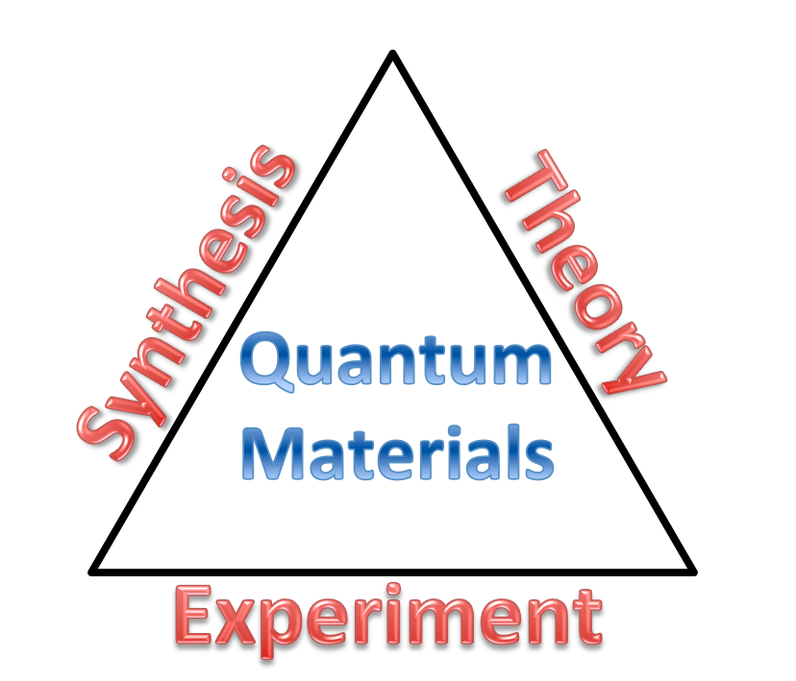
Elements of Quantum Materials Research
Materials Synthesis
  Exploratory synthesis
  single crystal growth
  Nanostructured
Experimental work
  Multifaceted characterization
  Advance the experimental methods
  Laboratory and facility scale experiments
Theory & modeling
  Interacting quantum systems (analytical field theory)
  Numerical methods for correlated electrons
  Density functional theory and extensions

Slide 5
Quantum BRN Workshop Charge:
Identify basic research needs and priority research directions for quantum materials with a focus on new, emerging areas with potential for transformative scientific advances and for impact on energy technologies.
Questions to be addressed include:
  What distinct materials phenomena can arise when ordered electronic states are suppressed by quantum fluctuations?
  What experimental and theoretical methods are needed to advance the understanding of quantum materials?
  What roles can heterogeneity and interfaces play in their function?
  What technological opportunities – particularly in the areas relevant to energy – arise from quantum materials and how can this potential be realized?
An opportunity to:
  Accelerate and coordinate progress in our understanding of quantum materials and their applications for energy relevant technology

Slide 6
Five Panels – A universe of materials
Superconductivity and charge orders in quantum materials
Magnetism in quantum materials
Transport & non-equilibrium dynamics in quantum materials
Topological quantum materials
Heterogeneous & nanostructured quantum materials
A. Moreo
J. Tranquada
M. Aronson
A. MacDonald
D. Basov
J. Freericks
E. Fradkin
A. Yacoby
N. Samarth
S. Stemmer

Slide 7
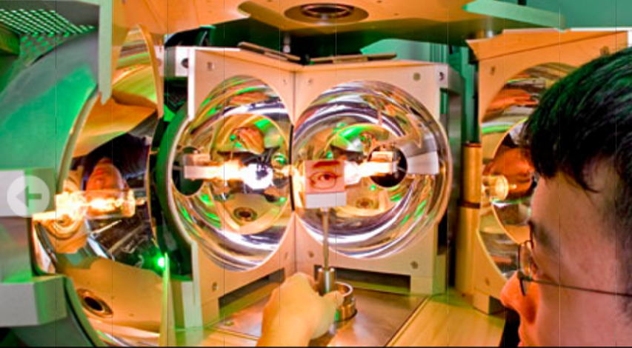
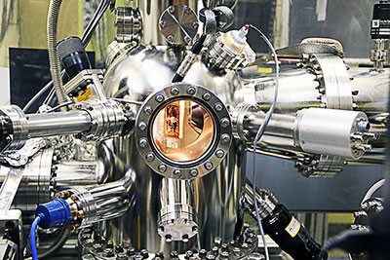


Cross-cutting panels: Tools of the trade
Synthesis [Ian R. Fisher]
  Bulk; powder, crystal
  Nano-structured, heterogeneous
Instrumentation [M. Murnane & C. Broholm]
  Spectroscopy (photons, x-rays, neutrons, electrons)
  Imaging (photon, x-ray, STM, neutron)
  Extreme conditions (B, P, T,..)
  Transport
  Thermomagnetic methods
Theory and Modeling [J. E. Moore]
  Ab-initio (LDA+U, DMFT)
  Analytical
  Exact numerical

Slide 8







Plenary Presentations
Fundamental Science
  Louis Taillefer
  Subir Sachdev
  Harold Hwang
  Alessandra Lanzara
Applications
  Eli Yablonovitch
  Peter Littlewood
  Stuart Parkin

Slide 9
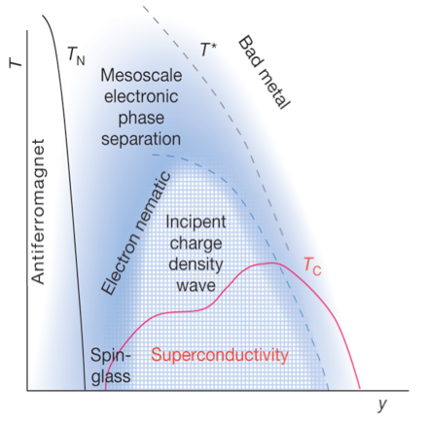
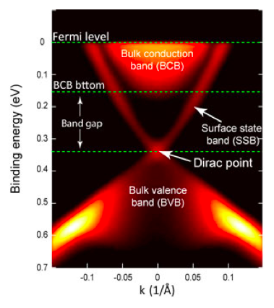
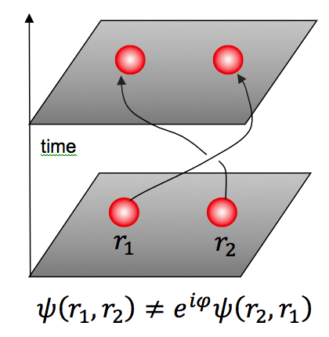
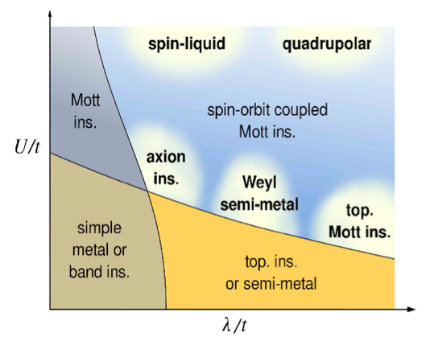
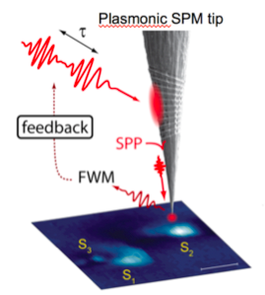
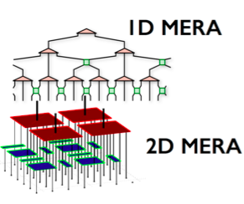
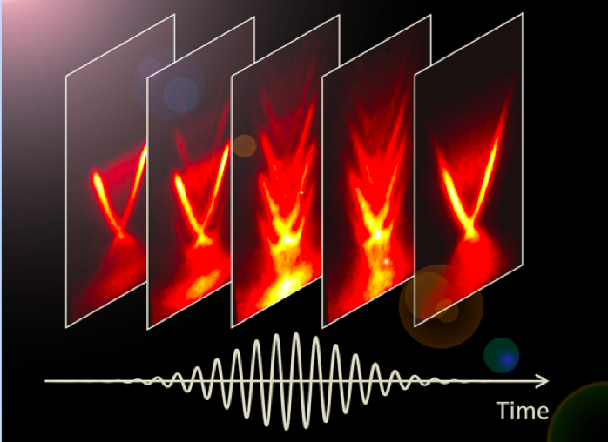
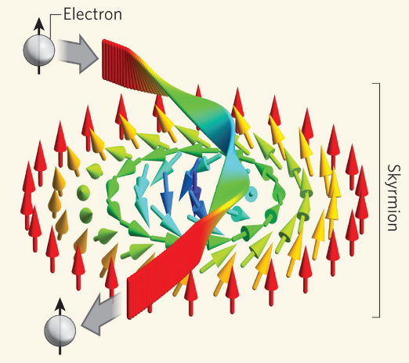
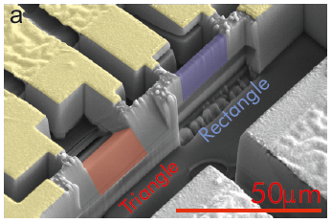
Priority Research Direction
Control & Exploit Electronic Interactions for Design of Materials with Novel Functionality
Harness topological quantum states for disruptive functionalities
Drive & manipulate quantum behavior (coherence, entanglement, & transport) for transformative technologies
Design revolutionary tools for synthesis, characterization, & modeling to accelerate discovery & technological deployment

Slide 10

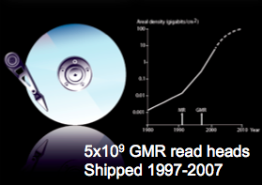
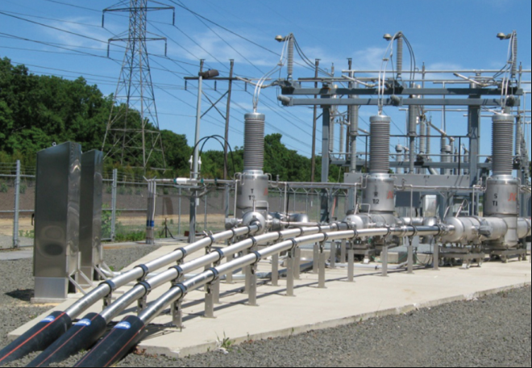
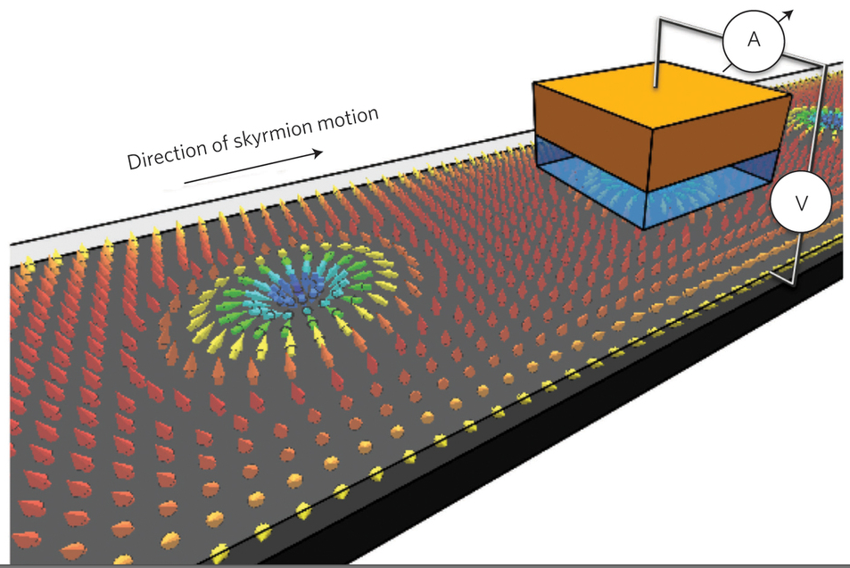
Control & Exploit Electronic Interactions for Design of Materials with Novel Functionality
Extraordinary materials properties
when we marshal interacting electrons
Adaptable and responsive materials
  Efficient optical, electric, thermal switching
  Detection/sensing
  Thermo-electrics solid state refrigeration & energy scavenging
  Neuromorphic computing
Practical Superconductivity
  Energy distribution: generation, transmission, storage
  Transportation: Levitation & Propulsion
A fabric for collective particles
  Quantum computing (non-abelian anyons)
  Fast & efficient communication (magnons, skyrmions)
High power DC link
Monchesky
Nature (2015)

Slide 11
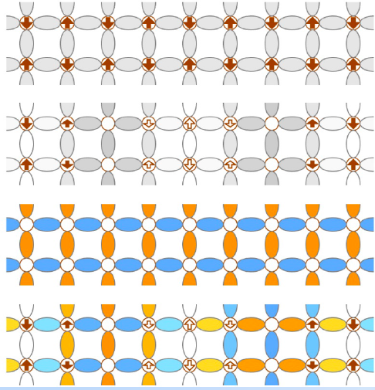
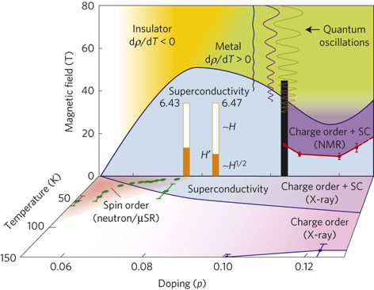
Understand & control competing, coexisting & intertwined order in metallic quantum materials
Interplay between ordered phases of conducting systems
Quantum criticality in metals
The physical origins of strange metals
The roles of disorder

Slide 12
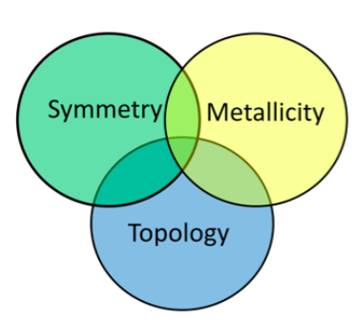
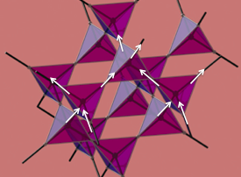
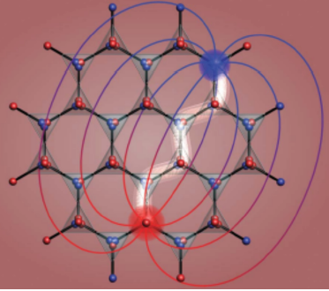
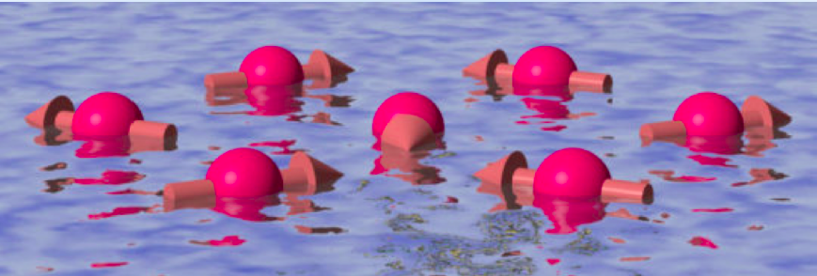
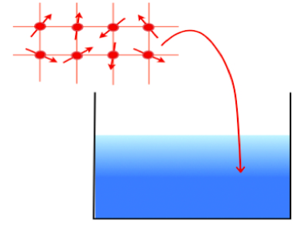
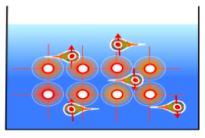
Predict, realize, & probe strongly correlated quantum magnets
Destabilization of order in quantum magnets
Taming entanglement in quantum magnets
Metallization of quantum magnets
Castelnovo, Nature 2008

Slide 13
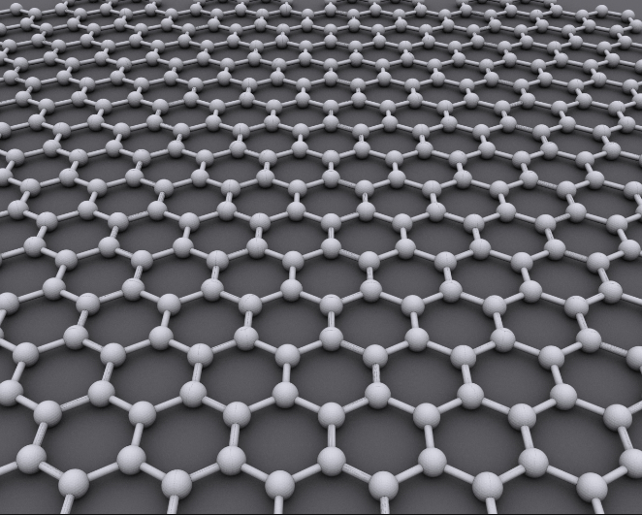
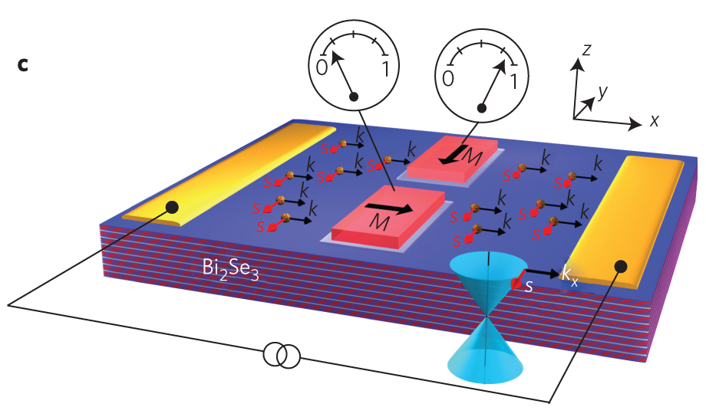
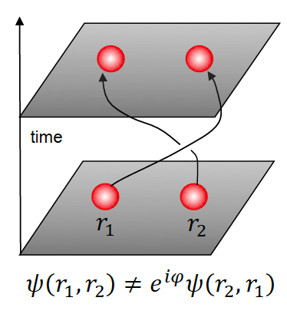
Harness Topological Quantum States for groundbreaking Functionalities
Topologically Protected Transport
  Energy efficient surface transport
  Reduced dissipation in electronics
  Neuromorphic computing
Fractional quasi-particles
  Solid state quantum computing
  Information storage
  communication

Slide 14
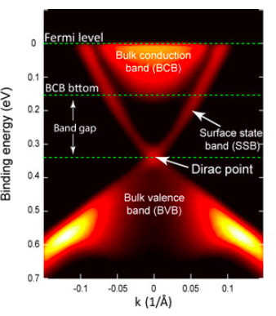
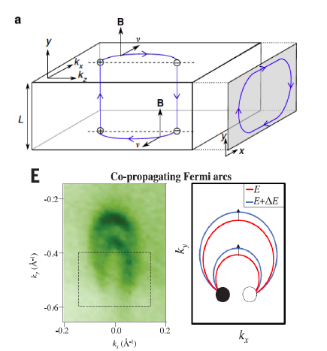
A. New Topological Quantum Materials
Non-Interacting Topological Insulators, and Dirac and Weyl semimetals
Topological Superconductors
Interacting topological insulators
Topological phases in strongly-correlated systems
Fractionalized topological phases in 3D
Topological magnetic systems
Robust topological quantum phenomena

Slide 15
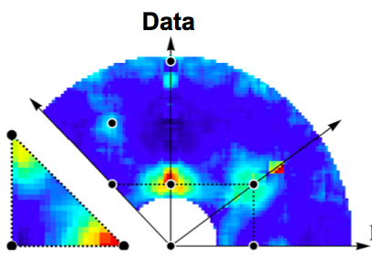
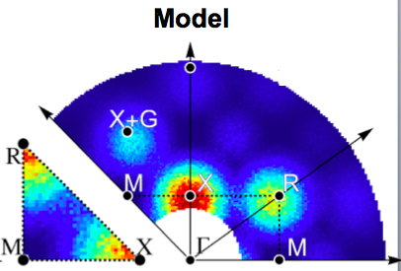
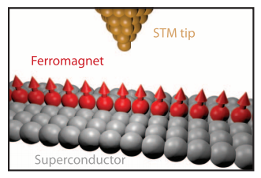
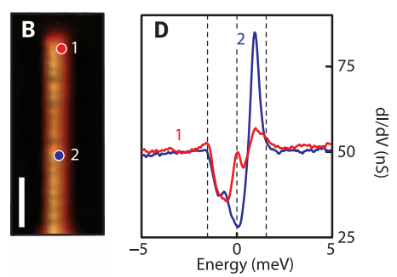
New methods to probe & manipulate topological states
Fuhrman 2015
Topologically sensitive probes
Transport in extreme magnetic fields: topological states in the quantum limit
Correlated topological materials probed by symmetry-specific probes
Fractional quantum magneto-electric effect
Engineering non-abelian statistics and Majorana fermion zero-modes
Engineering topological phases by proximity coupling
Engineering states with parafermions and other exotic excitations
Neutrons probe
correlated TI SmB₆
Yazdani (2014)

Slide 16
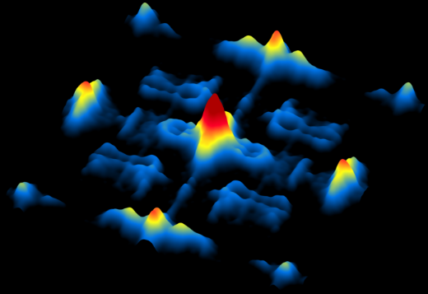
Drive & Manipulate Coherence, Entanglement, & Transport for Transformative Technologies
Nanostructured functionality
  at the interface between quantum materials
  In confined quantum materials
  In artificially layered structures
Quasi-particles transport
  Low-loss transport
  Coherent transport
Out of equilibrium
  Writing bits with photons
  Switched quantum matter

Slide 17
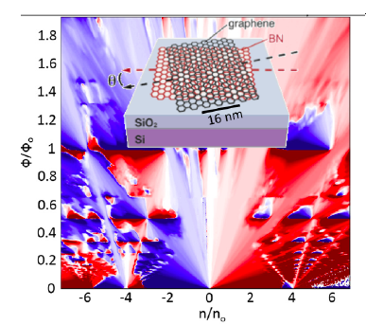
Employ nanoscale structuring to elucidate & exploit quantum coherence & entanglement
Control the character of electrons in quantum materials
Use electrostatic gating to adjust the electron density without disorder.
Use layered structures such as moiré solids for rational design of bandstructures and their filling.
Tune electronic interactions through nano structuring
Confine electrons to surfaces where it is easier to modulate anisotropic interactions.

Slide 18
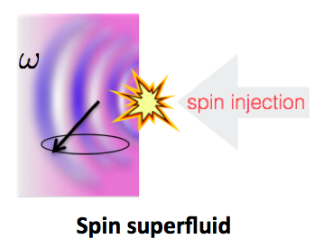
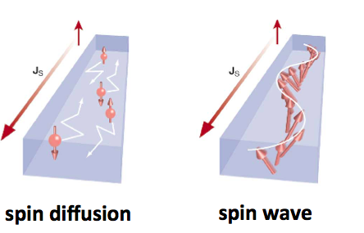
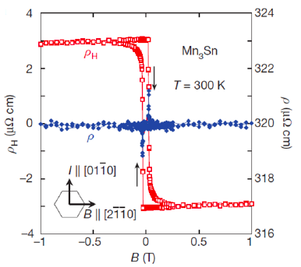
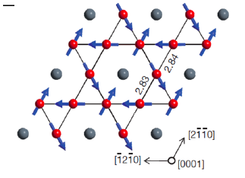
Understand transport in quantum materials & expose the technological potential
Spin-orbit torques to read and write information
Topological magnon band structures for quantum transport
Store and transport energy and information in antiferromagnets
lossless transport through magnetic condensates
Skyrmions for information storage and transport
Valley index quantum transport
Transport in moiré patterned solids
Nakatsuji et al. (2016)

Slide 19

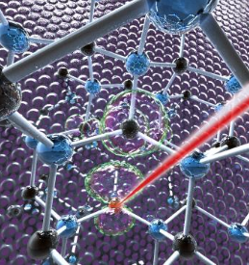
Dynamically visualize and manipulate quantum materials, harnessing coherence & entanglement
Access metastable states of matter
Explore thermalization of interacting quantum matter
Create novel states of matter driven by the strong time dependent fields of pulsed light.
Form entangled states between defects in pristine solids, which act as isolated atoms
New theoretical methods to understand and control interacting quantum materials in the time domain.
Wang (2013)
Defects in SiC:
Falk (2013)

Slide 20
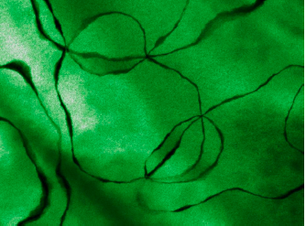
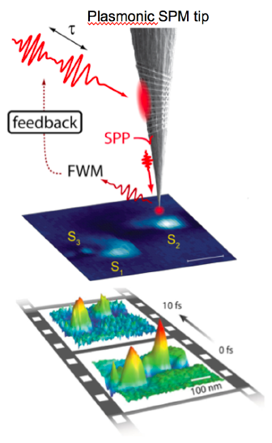
Design Revolutionary Tools for Synthesis, Characterization, & Modeling to Accelerate Discovery & Deployment
Progress in all PRDs driven by ability to make, measure, and model
Impacts on applications
  New quantum materials faster
  Diagnose operating device
  Predict behavior of heterogeneous strongly interacting quantum systems

Slide 21

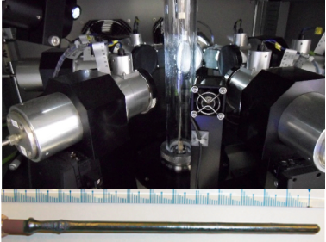
Enhanced synthesis of quantum materials; from bulk crystals to single atomic layers
Establish generalized rules of assembly for complex materials
  Towards materials by design
New methodologies and new tools
  Extend the physical regimes for synthesis
  Establish methods to tailor local structure
  Access kinetically trapped compounds
Expand the scope of exploratory synthesis
  experimentally driven exploratory synthesis
  Accelerated discovery of new materials
YBa₂Cu₃O_{7-δ}
Liang
BiFeO₃
Cheong

Slide 22



New windows into quantum materials
LCLS - XFEL
Enhanced efficiency, speed and resolution for spectroscopic probes of response functions with THz to X-ray light, neutrons & electrons
Real-time and real-space imaging to capture quantum materials in situ and in operando
Multi-dimensional spectroscopies from THz to multi-keV.
Probe solid state quantum entanglement in spin and orbital sectors
Access to new phases of matter using extreme electric and magnetic field, stress, and pressure
X-ray and neutron scattering under extreme electric and magnetic field, stress, and pressure
Big Data: Better algorithms and data sharing approaches
High Harmonic soft x-rays

Slide 23


Develop efficient theoretical methods for quantum materials beyond 1-electron paradigms
Tensor Networks (DMRG, PEPS, MERA)
Quantum Monte Carlo
Simulate lattice gauge theories
Interacting quantum matter far from equilibrium
PEPS

Slide 24
Conclusions
In the quest to shape materials to our needs we reach the atomic scale where quantum physics drives function
Basic science can unlock the potential of quantum materials for energy and information
The science is transforming our understanding of matter with broad impacts on physical sciences
As we master the quantum realm technology is transformed
Quantum Materials:
Profound scientific challenges
Transformative technological impacts

Slide 25
Priority Research Direction
Control & Exploit Electronic Interactions for Design of Materials with Novel Functionality
Harness topological quantum states for disruptive functionalities
Drive & manipulate quantum behavior (coherence, entanglement, & transport) for transformative technologies
Design revolutionary tools for synthesis, characterization, & modeling to accelerate discovery & technological deployment

