Slide 1
Chemical Sciences, Geosciences & Biosciences (CSGB)
Strategic Planning Process
BESAC Meeting
June 9, 2016
Gail McLean
Jeff Krause
Raul Miranda

Slide 2
CSGB Division Mission and Goals
“The division supports experimental, theoretical, and computational research to provide fundamental understanding of chemical transformations and energy flow in systems relevant to DOE missions. This knowledge serves as the basis for the development of new processes for the generation, storage, and use of energy and for the mitigation of the environmental impacts of energy use.”
CSGB research programs embrace the two BES strategies:
Discovery or Grand Challenge Research:
  Understand, direct, and control matter and energy flow in materials and chemical processes.
  May be conducted on model systems not immediately relevant to energy technologies.
Use-Inspired Basic Research:
  Basic research required for the development of transformative energy technologies.
  Usually conducted on systems that have a clear potential relevance to energy technologies
2

Slide 3
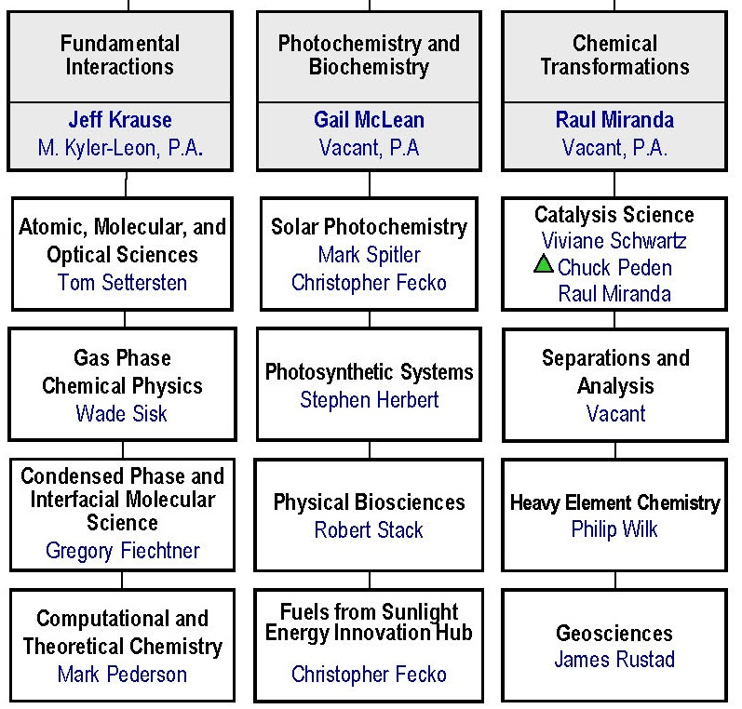
Divisional Structure
Philip Wilk
Acting
3

Slide 4
FY 2016 CSGB Core Program Funding
*Does not include the Hub or EFRCs

Slide 5
CSGB Strategic Planning Process
DIVISION
BESAC Reports
BRNs, NAS Reports
Roundtables
Council Workshops
Scientific Societies
Community Input
Strategic Discussions
Program Discussions
TEAM
PROGRAM
19

Slide 6
CSGB Council
Intent of the Council is to
  Identify emerging research needs and opportunities through focused workshops/panel studies
  Publish workshop review papers in peer-reviewed publications in archival journals
CSGB previously had two Councils: “Chemistry and Biochemistry” and “Earth Sciences.”
These two Councils were merged into a single CSGB Council in late 2015 and the Charter revised.
Council Chair: | Mark Thompson University of Southern California
Council Co-Chair: | Laura Pyrak-Nolte Purdue University

Slide 7
CSGB Council Workshops
Recent and Upcoming Workshops:
  “Optimal Coherence in Chemical and Biophysical Dynamics;” April 4-5, 2016. Initial draft completed.
  “Fracture mechanics and fracture pattern evolution in deep, hydrothermal and reactive environments;” May 9-10, 2016. Publication being drafted.
  “Nitrogen Activation;” Dates TBD. Workshop on different complementary topic to that of the Ammonia Synthesis Roundtable held February 18, 2016.
Previous Workshops:
  “What is the Efficiency of Photosynthesis?” (Chem/Bio 2009); R. E. Blankenship et al., “Comparing Photosynthetic and Photovoltaic Efficiencies and Recognizing the Potential for Improvement”, Science 2011, 332, 805-809.
  “CO₂ Fixation” (Chem/Bio 2011); “Frontiers, Opportunities, and Challenges in Biochemical and Chemical Catalysis of CO₂ Fixation”, A. M. Appel et al., Chem. Rev. 2013, 113, 6621-6658.
  “Unraveling the Interpretations of Attosecond Measurements” (Chem/Bio 2012); “What will it take to observe processes in ‘real time’?, S. R. Leone et al., Nature Photonics 2014, 8, 162-166.
“Crystallization by Particle Attachment” (Geo 2013); “Crystallization by Particle Attachment in Synthetic, Biogenic, and Geologic Environments”, J. J. De Yoreo et al., Science 2015, 349, aaa6760, doi: 10.1126/science.aaa6760.

Slide 8
Program Strategic Discussions
All core programs have presented an overview of their programs, research challenges, and the strategic research directions being considered
Program discussions for calendar year 2016 still to be scheduled.
21

Slide 9
General Strategic Discussions
2015
Jan. 30: World Scientific Leadership (via email)
Feb. 23: Budget Allocation Process
March 17: Visibility of Funded Research
April 8: Portfolio Balance
June 4: Portfolio Impact
August 11: PI Meetings
2016
April 19, May 11, May 24: Lab Review Timeline
22

Slide 10
Team Presentations

Slide 11
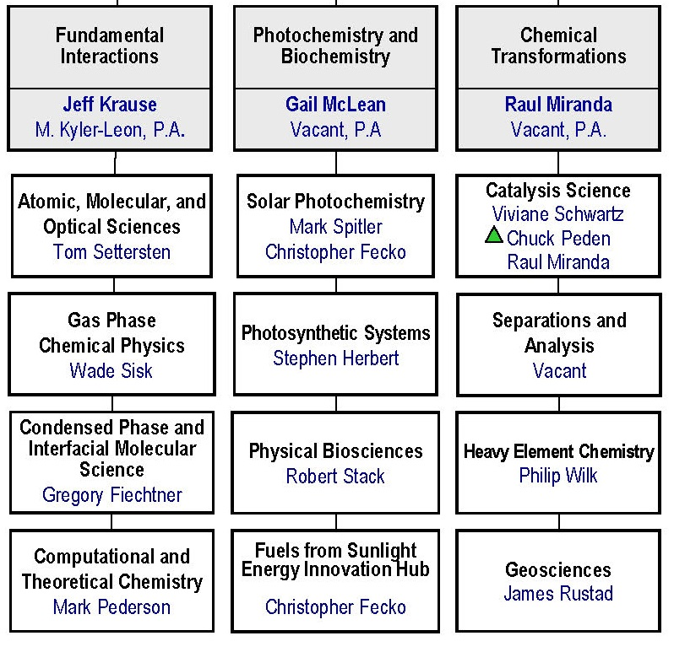
Fundamental Interactions (FI) Team

Slide 12
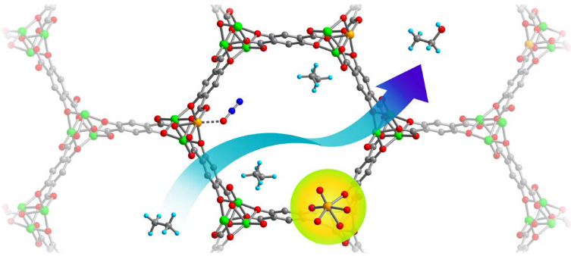
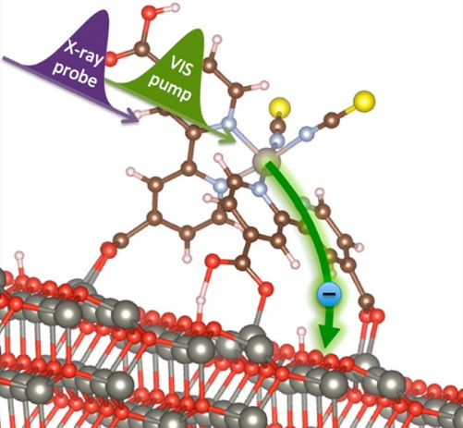
Fundamental Interactions: Programs
Understanding reactive chemistry at full quantum detail
Atomic, Molecular, and Optical Sciences
  Fundamental interactions of atoms, molecules, and nanostructures with photons and electrons to characterize, understand and control their behavior
  Gas Phase Chemical Physics
  Dynamics and rates of chemical reactions at conditions characteristic of combustion, and the chemical and physical properties of key intermediates, to enable computational models of combustion systems
  Condensed Phase and Interfacial Molecular Science
  Molecular-level understanding of chemical processes and dynamics in aqueous media and at interfaces, confronting the transition from molecular-scale chemistry to collective phenomena in complex systems
  Computational and Theoretical Chemistry
    Development and integration of theoretical and computational approaches for the accurate and efficient description of chemical processes
Upper figure: Oxidation of ethane to ethanol by N₂O in a metal–organic framework. Lower figure: X-ray photoelectron spectroscopy at the LCLS provides an atomic perspective of ultrafast interfacial charge transfer.

Slide 13
Fundamental Interactions: Mission
Emphasis on structural and dynamical studies of atoms, molecules, and nanostructures, and the description of their interactions in full quantum detail, with the aim of providing a complete understanding of reactive chemistry in the gas phase, condensed phase, and at interfaces.
BES Mission: BES supports fundamental research to understand, predict, and ultimately control matter and energy at the electronic, atomic, and molecular levels in order to provide the foundations for new energy technologies and to support DOE missions in energy, environment, and national security.
SC Mission: Delivery of scientific discoveries and major scientific tools to transform our understanding of nature and to advance the energy, economic, and national security of the United States.

Slide 14
Fundamental Interactions: Division Integration
Crosscutting, division-wide relevance; Synergy within team and across the division:
  Gas-phase chemical physics & CPIMS closely coupled (formerly one program)
  AMOS intersects strongly with chemical physics in molecular systems
  Theory/computation very strong in team and across division, joint efforts with MSE and ASCR
  Ultrafast chemical science growing theme across division, anchored in AMOS
  Interfacial chemistry in CPIMS connects with catalysis and geochemistry; condensed phase chemical physics relevant to radiation and heavy element chemistry
Relationship to use-inspired science opportunities/mission:
  AMOS tied strongly to application of current and next generation light sources, e.g., lasers, synchrotrons, X-ray FELS, LCLS and LCLS-II
  Gas-phase chemical physics has significant impact on clean & efficient combustion processes; management of Combustion Research Facility, SNL

Slide 15
AMOS: Current Investment Portfolio
Intense Field and Ultrafast X-Ray Science (60%)
  Goal: Discover, understand, and exploit fundamental phenomena associated with interactions of intense electromagnetic fields and matter on ultrashort time scales.
Correlated Dynamics (35%)
  Goal: Characterize, understand, and control strongly correlated dynamics involving electrons, atoms, and molecules.
Nanoscale Science (5%)
  Goal: Discover, understand, and exploit novel phenomena in light-matter interactions in nanoscale structures.

Slide 16
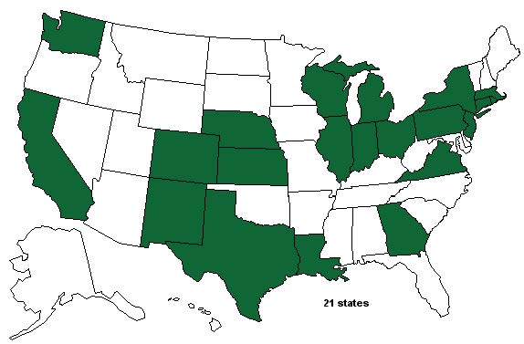
AMOS: PIs and Institutions
Lab Program
  27 PIs (6 Th / 21 Exp)
  4core programs at
  4 National Labs and
  3 DOE light sources
  2 ECRP projects
Grant Program
  61 PIs (33 Th / 28 Exp)
  38 single-investigator projects at 28 universities
  3 large-group/center projects involving 8 universities

Slide 17
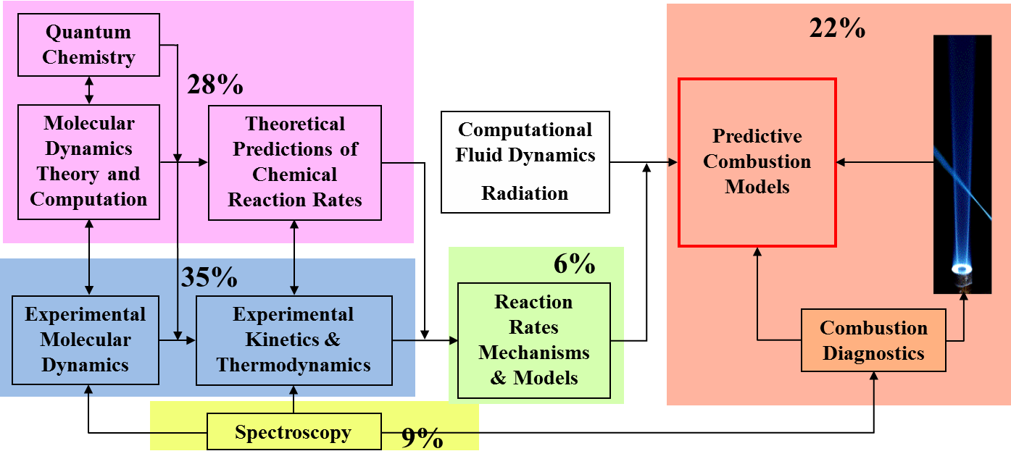
Gas Phase Chemical Physics (GPCP)
Overarching Theme:
Support of fundamental research leading to the development of fully predictive models for combustion
Topic areas of emphasis: P-Chem & Transport
Approaches used: Lasers, synchrotrons, shock tubes, molecular beams, jet-stirred reactors, HP computing,

Slide 18
GPCP Composition
86 PIs at 36 universities and 4 DOE Labs
  Universities [49 PIs (57%)] / Labs [37 PIs (43%)]
  Theory/Simulation [42 PIs (49%)] / Experiment [44 PIs (51%)]
  3 Early Career Grants: Blanquart (2011), Douberly (2012) and Dawes (2013)
  New investigators: 15 since FY11 (including 3 ECs)
  FY15: 83% Labs (39% SNL/CRF), 17% Universities

Slide 19
CPIMS: Condensed Phase and Interfacial Molecular Science
Emphasis:
Studies of reactions and dynamics at well-characterized metal and metal-oxide surfaces and clusters lead to the development of theories on the molecular origins heterogeneous chemistry.
Single molecule studies with extreme spatial and/or temporal resolution on well-characterized, model surfaces.
Understand the transition from molecular-scale chemistry to collective phenomena in complex systems, such as the effects of solvation on chemical structure and reactivity.
Studies of model condensed-phase systems target first-principles understandings of molecular reactivity and dynamical processes in solution and at interfaces.
Key Relationships:
BES research programs (for example, Solar Photochemistry), Nanoscience Centers, Synchrotron Facilities, BER EMSL User Facility.

Slide 20
Examples of CPIMS Interactions and Coordination
Co-funded project with Solar Photochemistry: femtosecond, surface electronic structure and resulting surface dynamics using chemical imaging; also radiation track modeling in solutions.
Application of physical science tools to biochemical systems, photosynthesis kinetics, PCET
Photo- and Biochemistry
Radiation Chemistry, Photocatalysis
67% Lab
33% University
Chemical
Transformations
27 Lab PIs
20 University PIs
CPIMS
Methods and approach of chemical physics/physical chemistry in solution and at interfaces.
Co-funded project with Heavy Element Chemistry: Actinide-ligand binding and the electronic structure of gaseous actinides with anion photoelectron spectroscopy.
Interfacial nanoscale chemistry, hydrogen bonding and weak interactions, proton transport
CPIMS well aligned with BES goal of “Understanding, Predicting, and Ultimately Controlling Matter and Energy Flow at the Electronic, Atomic, and Molecular Levels”

Slide 21
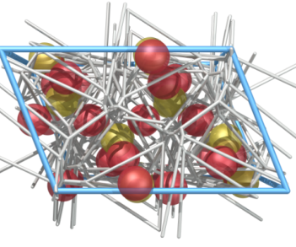
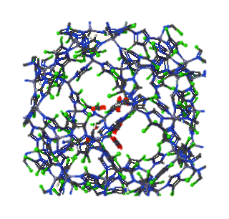
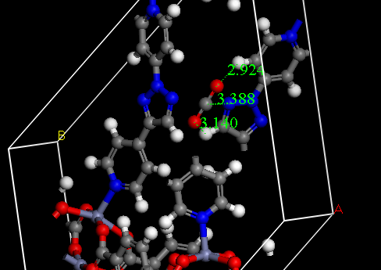




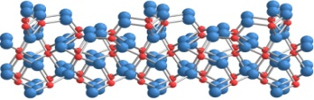
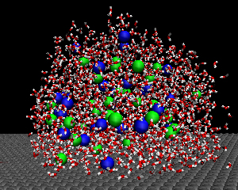
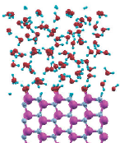
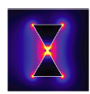
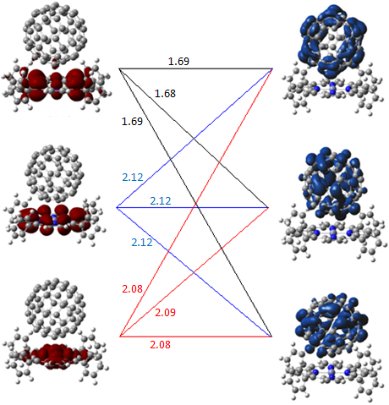
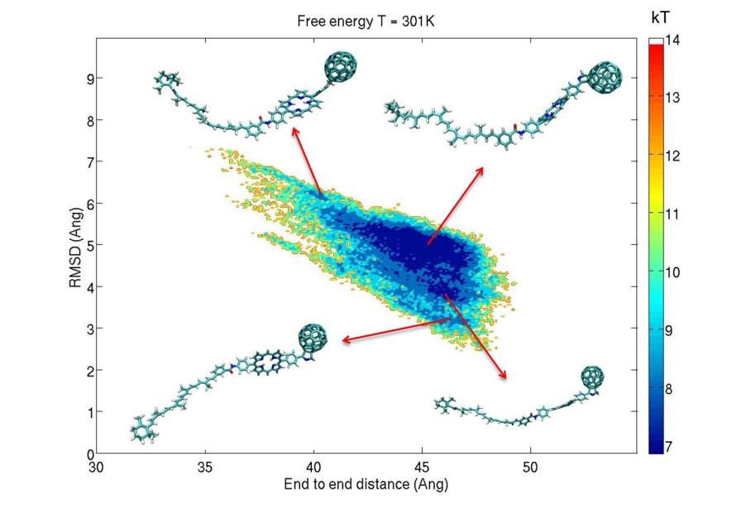
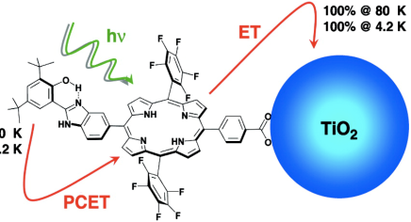
Computational & Theoretical Chemistry Evolution since 2009
  CO₂ capture & Photocatalytic reduction: 10%
METHODS:
Excited State Dynamics
Energy Transfer & Conversion
Structure-Function Screening
Weak Interactions
Spin , Vibron, Plasmon & Field Coupling
40%
  Membranes, solvents, and polarization: 25%
Nanocatalysts 15 %
Donor & Acceptors in Solvents: 20%
e⁻
Fundamental Transport Processes (20%)
  Solar to fuels: 15 %
  Light-matter interactions and interfacial charge transfer: 20 %
Combustion 10 %

Slide 22
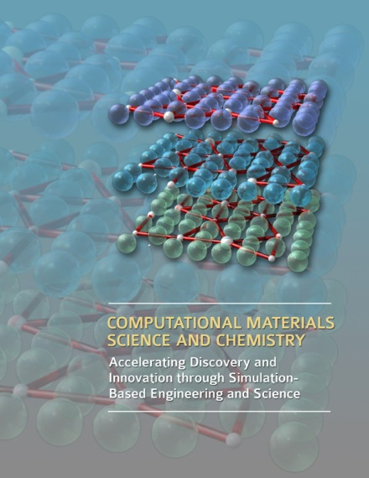
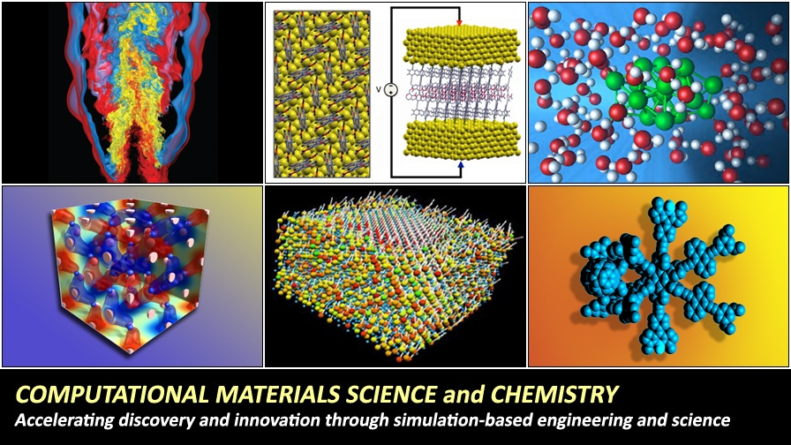
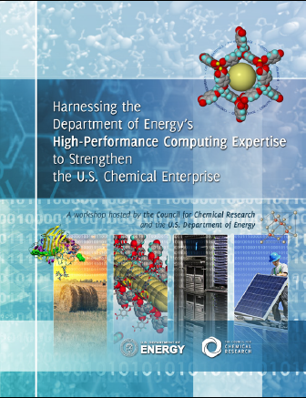
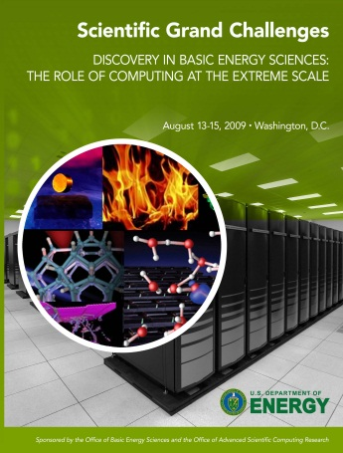
Activities of CTC
Excited States
Chemistry Council Workshop
2010-2020
2011
2011
2009-2011
50 PIs
Components of CTC Portfolio
25 % Lab
2008 New Start From SC22.1
25 % Group
2012 Predictive Theory & Modeling (from SC22)
2012 SciDAC Call (SC22/SC21)
50 % Single University
Early Career Awards (FY09-FY13)

Slide 23
Photochemistry and Biochemistry (PBC) Team

Slide 24
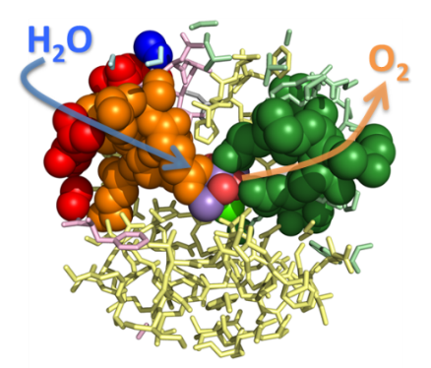
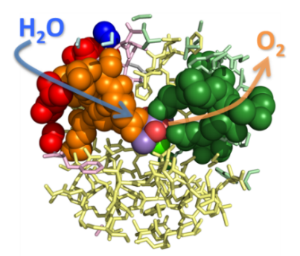
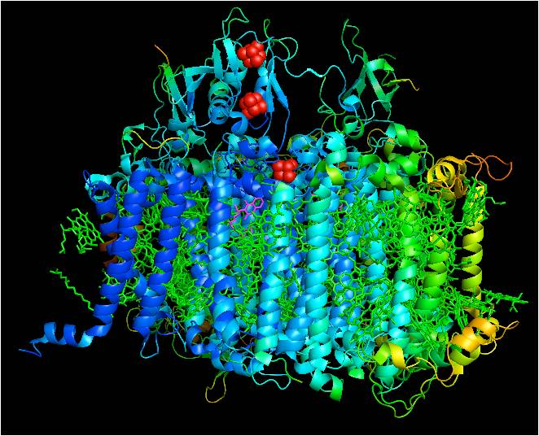
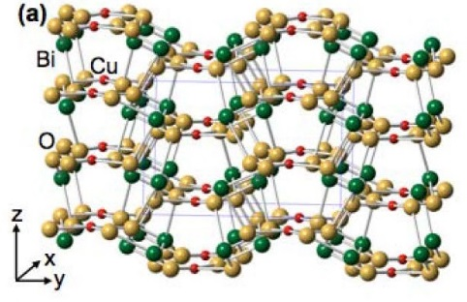
Photochemistry and Biochemistry Programs
    Energy capture, conversion, & storage
  Photosynthetic Systems (PS): Brings together biochemistry, chemistry, biology, and biophysics to uncover the fundamental science of biological capture of sunlight and its conversion to and storage as chemical energy in plants, algae, and microbes.
  Physical Biosciences (PB): Combines experimental and computational tools from physical sciences with biochemistry, chemistry and molecular biology to increase basic understanding of processes to capture, convert and store energy in living systems; placing an increasing emphasis on redox biochemistry
  Solar Photochemistry (SPC): Investigates solar photochemical energy conversions focused on the elementary steps of light absorption, electrical charge generation, charge transport and energy harvesting within a number of chemical systems
  Fuels from Sunlight Hub: Joint Center for Artificial Photosynthesis (JCAP): Advances basic scientific research and development on systems for the conversion of sunlight, water and carbon dioxide into a range of commercially useful fuels.

Slide 25
Photochemistry and Biochemistry: Mission
Fundamental studies of the molecular mechanisms involved in capture of light energy and its conversion into chemical and electrical energy through biological and chemical pathways.
BES Mission: BES supports fundamental research to understand, predict, and ultimately control matter and energy at the electronic, atomic, and molecular levels in order to provide the foundations for new energy technologies and to support DOE missions in energy, environment, and national security.
SC Mission: Delivery of scientific discoveries and major scientific tools to transform our understanding of nature and to advance the energy, economic, and national security of the United States.

Slide 26
Photochemistry and Biochemistry: Division Integration
Cross-cutting, division-wide relevance; synergy within team and across the division:
  PS and PB are closely coupled and coordinate across multiple areas
  All three programs intersect with Catalysis Science in areas such as enzymatic and bioinspired catalysis, electron transfer reactions and catalytic materials
  SPC interacts with PS in photon capture & exciton transfer; CPIMS for physical chemical aspects of radiolysis; MSE in fundamental photovoltaics research
  All three programs make increasing use of computation and theory, anchored in the Computational & Theoretical Chemistry
  Coordination among solar photochemistry efforts, JCAP and relevant EFRCs; PS and PB also coordinate with relevant EFRCs
  All program areas make use of ultrafast chemical science, anchored in AMOS
Relationship to use-inspired science opportunities/mission:
  Solar efforts in EERE Solar and Fuel Cell Technologies programs
  With EM and NE through the radiation sciences activity
  Biosciences efforts in EERE BETO and with ARPA-E to enhance the capabilities of plants and microbes for bioenergy and biochemicals

Slide 27

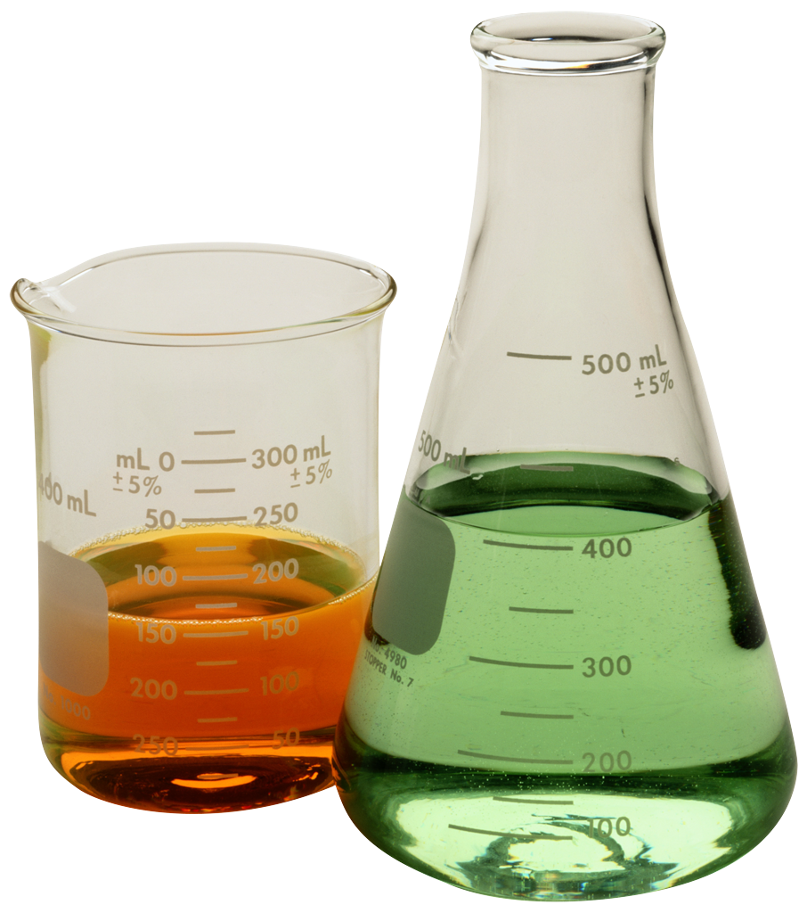
PBC Program Interactions
Scientific
λ
λ
BIOCHEMICAL
CHEMICAL
Bio & related
EFRCs
Bio & related
EFRCs
Photosynthetic Systems
Biological Energy Capture & Conversion
Solar
Photo-chemistry (including photo-catalysis)
Chemical Solar
Energy Conversion
Fuels from Sunlight Hub JCAP
&
Solar and related EFRCs
Fuels from Sunlight Hub JCAP
&
Solar and related EFRCs
Biological Energy Conversion & Storage
Physical Biosciences
Catalysis
AMOS
CTC
Catalysis
AMOS
CTC
CPIMS
Fuel, (bio)chemicals, electricity

Slide 28
Physical Biosciences (Redox Biochemistry):
What Can We Learn?
Gating and controlling electron flow
  Interfacing 1 and 2 e⁻ redox reactions (quinones, flavins)
  “Hopping” via FeS clusters (short distances), multi-heme proteins (intermediate distances), and soluble e⁻ carriers (longer distances)
  Using soluble ferredoxins to create “smart circuits” based on allowable donor/acceptor cognate pairs
“Tuning” redox potentials
  Altering ligands proximal to carriers can have significant effects on potential
  Electron bifurcation used with to deal with over-and under-potential
Simple proton relays and proton-coupled electron transport (PCET)
Performing catalytically difficult reactions in ambient conditions with earth-abundant elements, exquisite specificity, & ability to regenerate cofactors
Compartmentalization of incompatible reactions in vesicles, organelles, or other specialized structures
Provides basic knowledge for development of highly selective, efficient catalysts, enhanced biochemical pathways for biofuels & chemicals, next generation energy conversion/storage technologies.

Slide 29
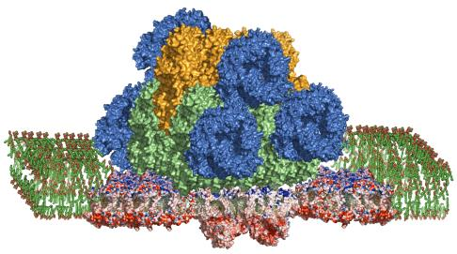
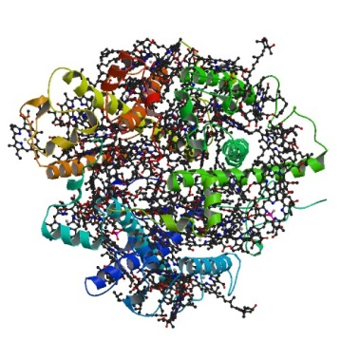
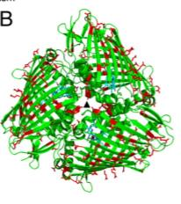
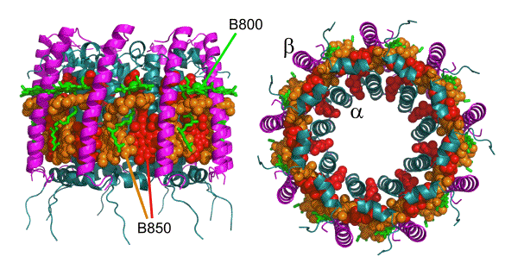
Photosynthetic Systems:
What does photosynthesis tell us and how can we use it?
Natural photosynthesis offers great diversity in molecular systems that capture and convert solar energy to chemical energy with high efficiency on vast scales using earth-abundant elements.
Utilize 350 nm to 850nm light
Oxidize water and reduce soluble e⁻ carriers with a quantum efficiency near 1
Convert sunlight to biomass at 1-4% efficiency but manufacture themselves at landscape scale
Reduce 10¹¹ metric tons of CO₂ to organic compounds annually (10x fossil fuel use).
PBS
LHCII
FMO
LH2
Research in photosynthesis provides insights for:
Development of bio-inspired (synthetic) and bio-hybrid energy systems
Improvement of biological photosynthesis for biofuel and biochemicals

Slide 30
Solar Photochemistry: Supra Photosynthesis
  Natural photosynthetic model systems have motivated efforts in Solar Photochemistry since the program’s creation in 1977.
Chemists are now capable of both building on and advancing beyond the original model photosynthetic systems:
  Emulate the proteins in photosynthesis and synthesize new variants based on Nature’s blueprint.
  Can readily make structures of solid inorganic composition not typically found in Nature – photoelectrodes and nanostructures of metals and semiconductors with an immense variety.
The photosynthetic system remains a good model but other biological reaction pathways and structures could also guide non-biological systems.
Learning to envision new systems and extrapolate back to the basic research problems to enable their assembly and operation and vice versa.
Fundamental knowledge for development of semiconductor photovoltaic cells and solar photochemical and photoelectrochemical conversion processes for production of fuels, chemicals, and electricity with minimal environmental impact and with closed renewable energy cycles.

Slide 31
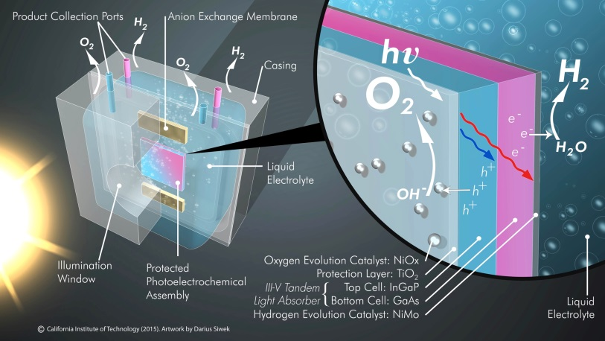
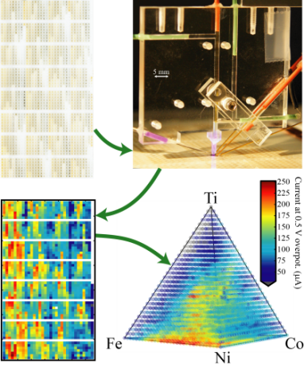
Fuels from Sunlight Hub
Joint Center for Artificial Photosynthesis (JCAP)
Overview:
Mission: Produce the scientific foundation for an efficient and scalable technology that converts carbon dioxide, water, and sunlight into transportation fuels.
Launched in Sept. 2010 and renewed in 2015
Led by Caltech with LBNL as primary partner; additional partners are SLAC, UC San Diego and UC Irvine
Phase 1: Development of prototypes capable of efficiently producing hydrogen via photocatalytic water splitting
Phase 2: Focus on CO₂ reduction discovery science, funded at $15M per year pending appropriations
Illustration of integrated solar-driven prototype with protected photoelectrochemical assembly coupled with oxygen and hydrogen evolution reaction catalysts
Research Accomplishments:
  Developed a stable integrated solar-driven prototype system capable of splitting water to produce hydrogen at >10% efficiency
  Discovered how to protect light-absorbing semiconductors (e.g. Si, GaAs) from corrosion in basic aqueous solutions while still maintaining excellent electrical charge conduction
Developed novel high throughput capabilities to prepare and screen light absorbers and electrocatalysts; characterized activity of various materials with throughput of >10,000 prioritized samples/day
Discovered new earth-abundant catalysts for splitting water
Established benchmarking capabilities to compare large quantities of catalysts and light absorbers

Slide 32
Chemical Transformations (CT) Team
Chemical Transformations
Raul Miranda
Vacant, P.A.
Catalysis Science
Viviane Schwartz
Charles Peden, IPA
Vacant
130 active projects
$42M
50% national lab
Separations and
Analysis
Philip Wilk, Acting PM
40 active projects
$12M
45% national lab
Heavy Element
Chemistry
Philip Wilk
30 active projects
$11M
75% national lab
Geosciences
James Rustad
80 active projects
$20M
50% national lab

Slide 33
Chemical Transformations: Programs
Understanding and controlling the stabilization, transport, and chemical conversion of matter
Catalysis Science
  Mechanisms of clean and efficient synthesis and conversion of fuels and chemicals; synthesis of organic, inorganic, nano and hybrid complex catalysts; surface chemistry, electrochemistry, and bio-inspired processes
  Separations and Analysis
    Chemical separations relevant to energy processes; purification of critical materials; selected analytical methods
  Heavy Element Chemistry
  Spectroscopy, bonding, reactivity and separations of actinides and fission products
  Geosciences
  Geochemistry and selected areas of geophysics, including subsurface imaging, mineral-fluid interactions and flow/transport phenomena
Cross-cutting: theory and simulation, synthesis, imaging and characterization

Slide 34
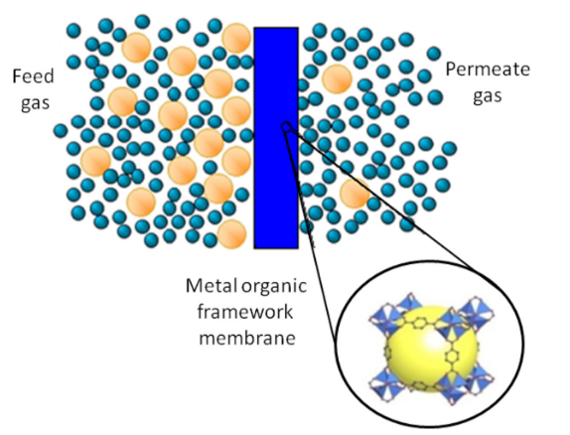
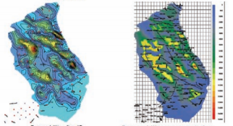
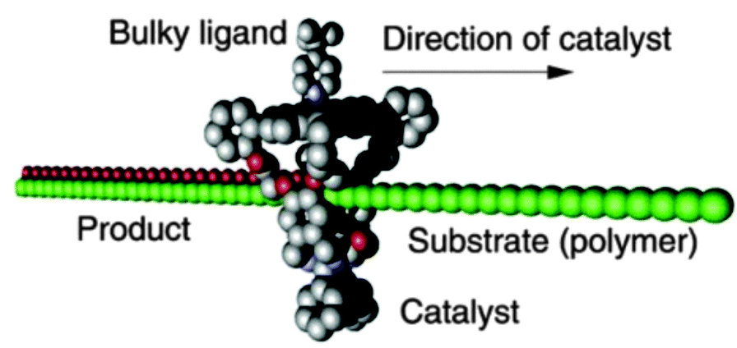
Chemical Transformations: Mission
Understand at the atomic level the synthesis, conversion, stabilization and transport of chemical systems at multiple scales, in their artificial or earth environments, with the ultimate goal to transform chemical and geochemical technologies.
BES Mission: BES supports fundamental research to understand, predict, and ultimately control matter and energy at the electronic, atomic, and molecular levels in order to provide the foundations for new energy technologies and to support DOE missions in energy, environment, and national security.
SC Mission: Delivery of scientific discoveries and major scientific tools to transform our understanding of nature and to advance the energy, economic, and national security of the United States.

Slide 35
Chemical Transformations: Division Integration
Crosscutting, division-wide relevance; synergy within team and across the division:
  Catalysis Science, Separations and Analysis, Geosciences and Heavy Element Chemistry share similar goals in synthetic chemistry, nanoscience, operando characterization with multi-modal techniques at lab-scale or at synchrotron and neutron facilities.
  Catalysis Science and Heavy Element Chemistry co-review and have exchanged principal investigators in the area of organometallic chemistry.
  All of the programs share reviewers with specific expertise in theoretical reaction mechanisms, microkinetics, and transport phenomena in multiphase environments.
  Geosciences and Heavy Element Chemistry share goals in chemistry aspects that have applications to environmental management.
  Heavy Element Chemistry and Separations and Analysis have related goals related to the stabilization of f-element compounds. They have exchanged principal investigators on occasion.
  Geosciences and Catalysis share similar interests in inorganic nucleation, crystallization, liquid-solid interfacial chemistry and fluid transport.

Slide 36
Chemical Transformations: BES Integration
Chemical Sciences, Geosciences,
and Biosciences Division
Materials Sciences and Engineering Division
Condensed Phase and Interfacial Molecular Science
Materials Chemistry
Biomolecular Materials
Computational and Theoretical Chemistry
Chemical TransformationsTeam
Synthesis and
Processing Science
Solar Photochemistry
Theoretical Condensed
Matter Physics
Physical Biosciences
Team: Scattering and
Instrumentation Sciences
Fuels from Sunlight Energy Innovation Hub
Scientific User Facilities Division
Batteries and Energy
Storage Hub
EFRCs
X-ray and Neutron Scattering Facilities
EFRCs
NSRCs
Beyond BES: SC offices, EERE, FE, NNSA, ARPA-e, etc.

Slide 37
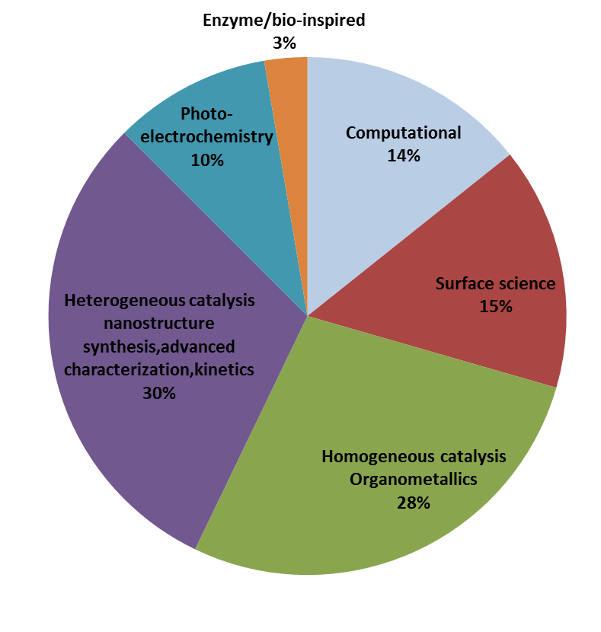
Catalysis Science Program
Catalytic reaction mechanisms and kinetics
Synthesis of catalytic sites, molecular ligands, metal clusters, and reaction environments designed to tune catalytic activity and selectivity
Structure-reactivity relationships of inorganic, organic, or hybrid catalytic materials in solution or supported on solids
Dynamics of catalyst structure relevant to catalyst stability
Experimental determination of potential energy landscapes for catalytic reactions
Novel spectroscopic techniques and structural probes for in situ characterization of catalytic processes
Theory, modeling, and simulation specific to catalytic pathways

Slide 38
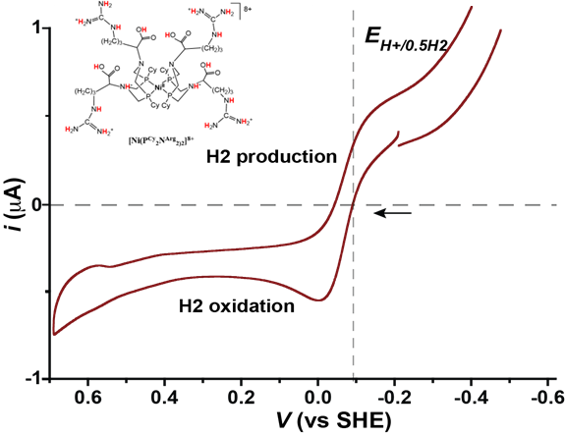
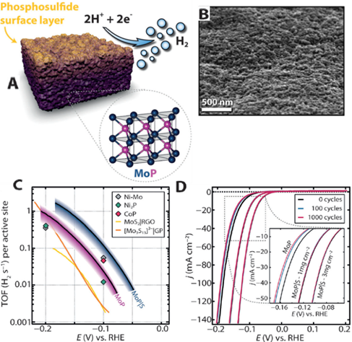
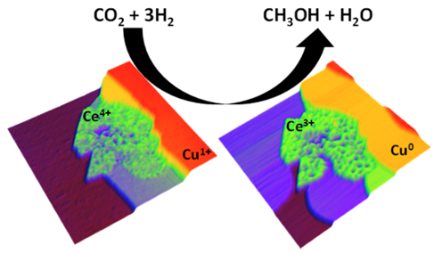
Catalysis Science Evolving Opportunities
(This is not a comprehensive list)
-- Extend the basic science of catalysis to:
Alternative energy sources
Alternative feedstocks
Non-precious group metals
Alternatives to rare earth elements
-- Develop novel systems-scale approaches to improve atom- and energy- efficiency and cleanliness of chemical conversions
-- Develop fundamental understanding of interacting dynamic systems to minimize the number of reaction steps.

Slide 39
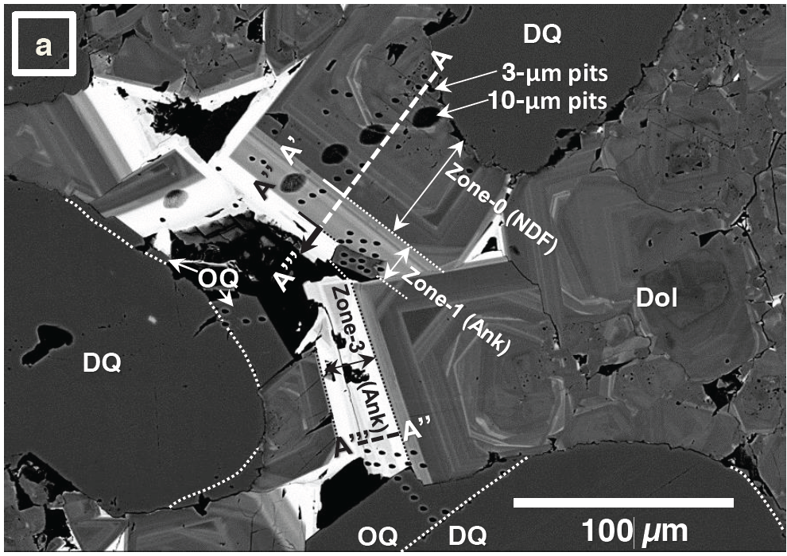
Geosciences Program
Natural Systems –
processes and rates
Analytical Geochemistry ($3 M)
Geophysics ($5 M)
Nonlinear elasticity
Fluid/Fracture Coupling
Attenuation and scattering
Synchrotron science
Mass Spec/Stable Isotope geochemistry
Neutrons
Theoretical & Experimental
Geochemistry
($7 M)
Flow and Transport ($5 M)
Figure courtesy of
John Valley, U Wisc.
Fracture/Porosity evolution
Reactive transport
Chemical mechanical feedbacks
Natural Paradigms –
for technological needs
Interfacial processes
Computational modeling
Nanogeosciences

Slide 40
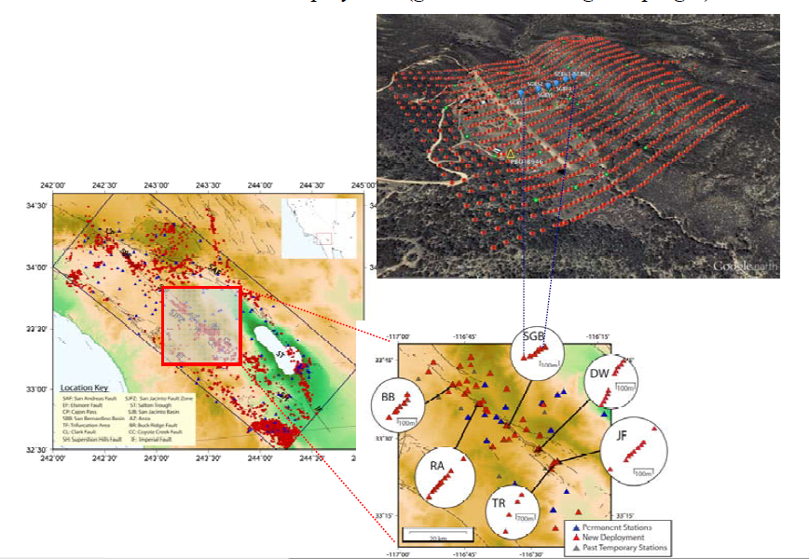
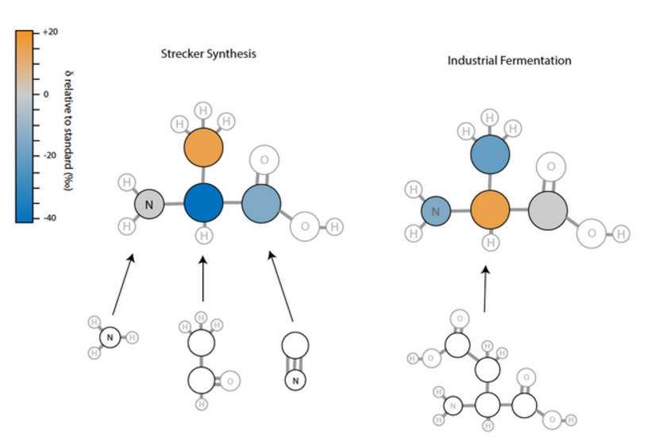
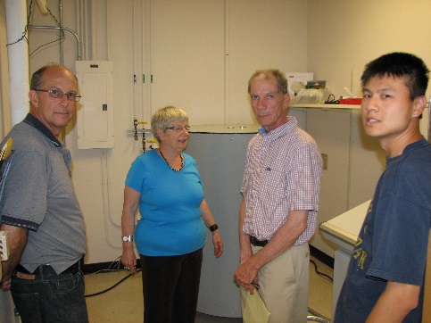
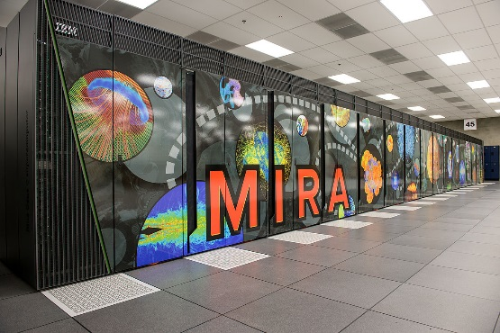
Geosciences Evolving Opportunities
Molecular “Isotomics”: high-throughput position-specific analysis of stable isotope ratios in molecules (and minerals)
Multiscale Imaging of time-dependence of Failure, Fracture and Healing in the Shallow Crust
Large N seismic arrays
Geodetics, Mathematical
Geophysics
Beyond total combustion to a new level of analytical sensitivity, coupled with modern theory
Isotopic distributions in alanine
Figure courtesy of John Eiler, Caltech
Phase Equilibria in Low-Temperature Earth Materials:
Experiment, First Principles, Databases
Connecting experiment, first principles calculations and high-throughput ‘on the fly’ database technologies aimed at the special challenges of equilibria in complex low-temperature phases

Slide 41
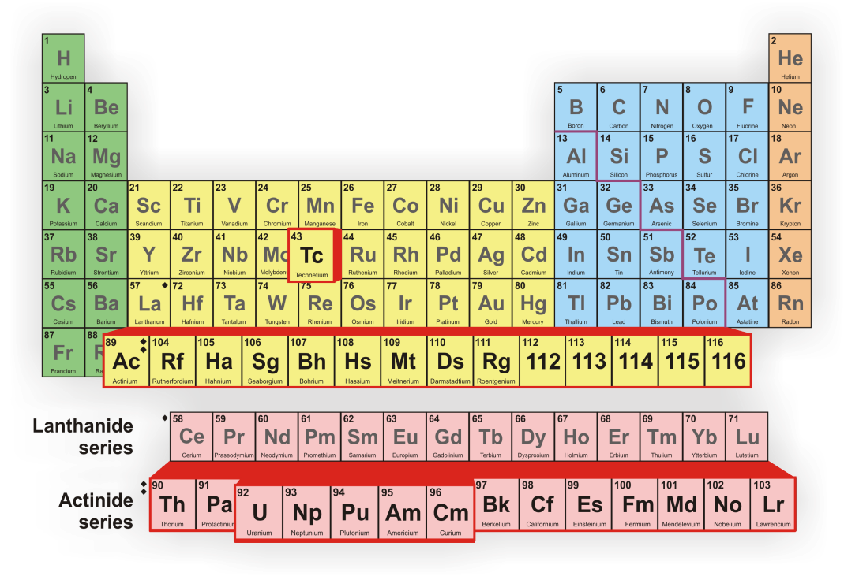
Heavy Element Program
Directly supports DOE missions in energy, environment, and national security
Bonding, Reactivity, and Spectroscopy (60%)
  Underlying goal to understand and quantify the chemical bonding due to 5f electrons and explore the extremes of the periodic table
Synthesis and Separation (40%)
  Actinide interfacial chemistry and synthesis of actinide ligands that function in extreme environments such as reprocessing facilities and waste repositories, as well as the natural environment and nuclear forensic laboratories
Program can be uniquely described by the elements it works with!
Actinides
  U, Np, Pu, Am, Cm
  Pa, Bk, Cf
    macroscopic (milligram)
  Es, Fm, Md, No, Lr
    tracer (microgram to ng)
Transactinides
  atom-at-a-time
    picoscale chem.

Slide 42
Heavy Element Chemistry Evolving Opportunities
National laboratories are a national resource
  Unique capability for experimentation on these challenging materials
  Due to regulations for working with radioactive materials, starting or restarting projects is difficult; therefore long-term stewardship is demanded
HEC is responsive to evolving research frontiers
  Frontiers are at the extreme reaches of the periodic table (superheavy)
  Relatively new elements offer a rich and unexplored chemistry
  Research on chemical bonding and spectroscopy continues to increase at DOE user facilities.
HEC underpins the work at the applied nuclear programs
  Isotope program in Nuclear Physics
  NEUP in Nuclear Energy
  Defense programs: NA-22 (NNSA), DNDO (DHS), DTRA (DoD)
Nh: Nihonium
Mc: Moscovium
Ts: Tennessine
Og: Oganesson
Elements added in
January 2016
Names proposed on
June 8, 2016
113
Nh
115
Mc
117
Ts
118
Og
Row 7 now complete!

Slide 43
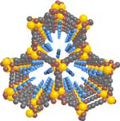
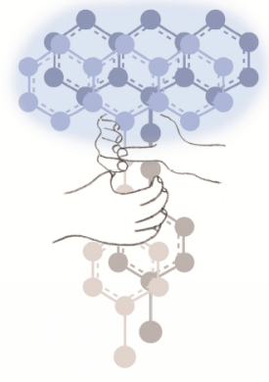

Separations and Analysis Program
Separations science (60%)
  Interfaces and solvation
  Coordination chemistry, ligand design, synthesis
  Nanopores/membranes
  MOFs, ZIFs, COFs, nanomaterials
Separations supports DOE missions:
  Separations of heavy elements for detection, nuclear energy, environmental clean-up
  Energy intensive separations in industry
  Carbon capture
Analysis science (40%)
  Mass spectroscopy
  Ambient P chemical imaging
  Chromatography and plasma
Analysis impacts various DOE technologies

Slide 44
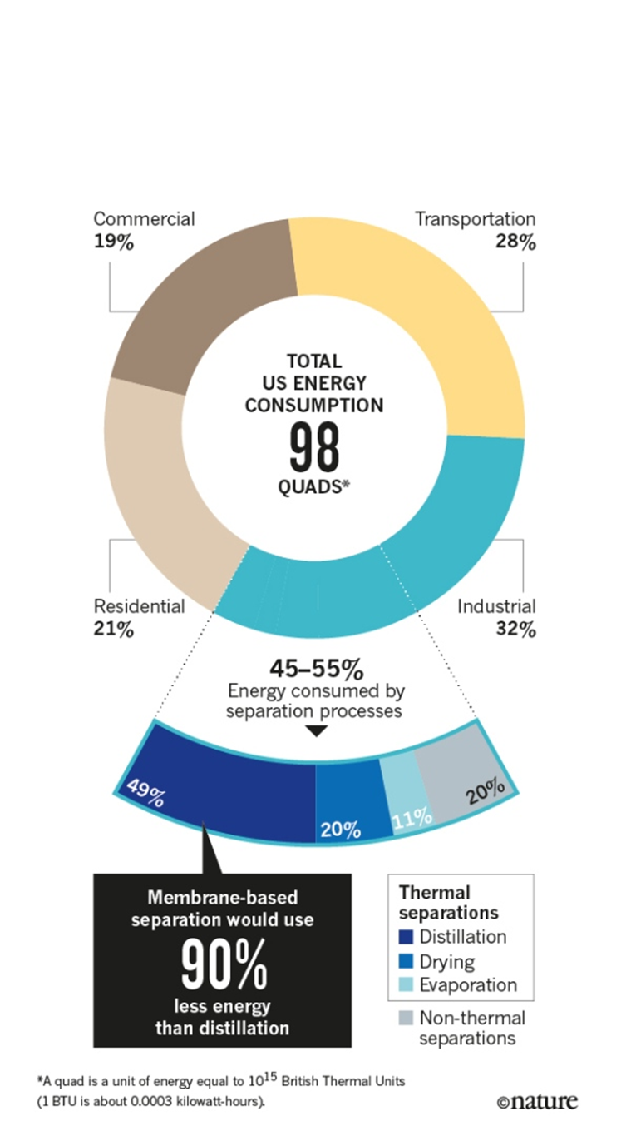
Separations and Analysis Program Evolving Opportunities
(This is not a comprehensive list)
Understand and control interfacial phenomena in extreme environments
Chemical imaging of inaccessible environments over extremes of time and space
Understand and develop ultra-selective separation media for complex mixtures
“Chemical separations account for about half of US industrial energy use and use 10-15% of the nation’s total energy consumption.” (D. Sholl et el.,
Nature, 28 April 2016, 532, 435)
Impacts the efficiency aspects of Mission Innovation

Slide 45
Next Steps: Divisional Strategic Discussions
Program Discussions (recurring)
  CRA assessments, program scope
  Portfolio balance and impact
Lab review documents best practices
Selection statement best practices
Communication of science results
  Improvements since first discussion but still a work in progress
…
35

Slide 46
Program Directions: On-Going Strategic Questions
Strategic planning is an ongoing iterative process within programs, teams, and the division as a whole and considers questions such as:
Where are the knowledge gaps?
What are the most pressing scientific needs and key scientific challenges?
Where can programmatic investment make a real difference?
Where do we have and want leadership?
What integrates best with other BES programs?
In light of constrained budgets, how do we focus programs for the most energy relevant impact?

Slide 47
Summary
Ultimate Goals remain:
Support an impactful portfolio that produces highly visible world-class science that is aligned with DOE’s mission.
Continue to develop synergism among the core research activities that takes advantage of the diverse disciplines in the Division.
Continuing the Process of
Using BESAC reports as guidance in portfolio development
Soliciting community input (Councils, Roundtables, Scientific Societies, PI meetings, etc.)
Annual program discussions
Strategic discussions of division activities and processes
Hiring strategically for tomorrow’s portfolio
Increasing PM conference attendance

