Slide 1
JCESR: Next Generation Energy Storage
George Crabtree
Director, JCESR
Argonne National Laboratory
University of Illinois at Chicago
Outline
JCESR Vision, Mission and Legacies
Science and Prototypes Status and Outlook
Multivalent
Lithium-Sulfur
Macromolecular Organic Flow
Basic Energy Sciences Advisory Committee
June 10, 2016
Bethesda, MD

Slide 2


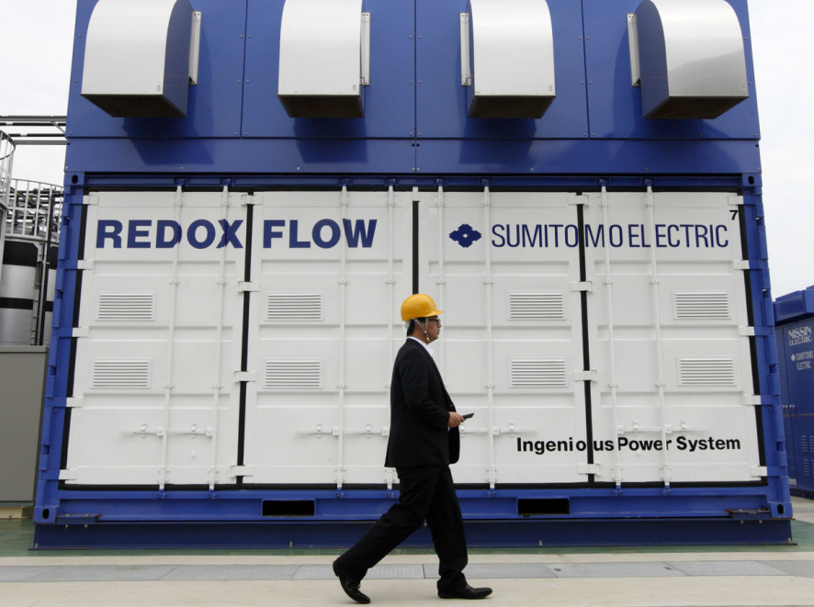
Today
Lithium-ion batteries enable
the personal electronics revolution
Forever changed the way we interact
with people and information
~ 2% of US energy
Personal electronics
Tomorrow
$20K electric cars
Displace gasoline cars
Replace foreign oil with domestic electricity
Reduce energy use and carbon emissions
28% of US energy
Transportation
Grid-scale electricity storage
Widespread deployment of wind and solar
Enhance reliability, flexibility, resilience
Uncouple instantaneous generation
from instantaneous demand
39% of US energy
Electricity grid

Slide 3
JCESR: Beyond Lithium-ion Batteries for Cars and the Grid
Vision
Transform transportation and the electricity grid
with high performance, low cost energy storage
Mission
Deliver electrical energy storage with five times the energy density and one-fifth the cost of today’s commercial batteries within five years
Legacies
A library of the fundamental science of the materials and phenomena of energy storage at atomic and molecular levels
Two prototypes, one for transportation and one for the electricity grid, that, when scaled up to manufacturing, have the potential to meet JCESR’s transformative goals
A new paradigm for battery R&D that integrates discovery science, battery design, research prototyping and manufacturing collaboration in a single highly interactive organization
$100/kWh
400 Wh/kg 400 Wh/L
800 W/kg 800 W/L
1000 cycles
80% DoD C/5
15 yr calendar life
EUCAR
Transportation
$100/kWh
95% round-trip efficiency at C/5 rate
7000 cycles C/5
20 yr calendar life
Safety equivalent to a natural gas turbine
GRID

Slide 4

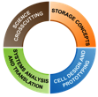
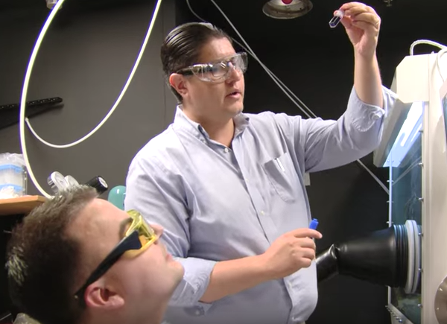



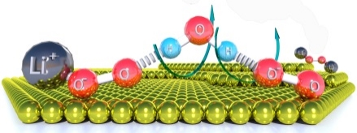
JCESR Creates a New Paradigm for Battery R&D
MATERIALS
PROJECT
Sprints
https://www.youtube.com/watch?v=wEzsKJwYjDQ
Multivalent Intercalation
CROSSCUTTING SCIENCE
Systems
Analysis and Translation
Cell Design
and Prototyping
Commercial Deployment
Chemical Transformation
Non-Aqueous Redox Flow
Discovery Science
Battery Design
Research Prototyping
Manufacturing Collaboration
++
ELECTROCHEMICAL DISCOVERY LAB
TECHNO-ECONOMIC MODELING
“Building battery systems on the computer”
A single highly interactive organization
Focus exclusively on beyond lithium ion

Slide 5

JCESR Team
20 Institutional Partners, 180-200 Researchers

Slide 6
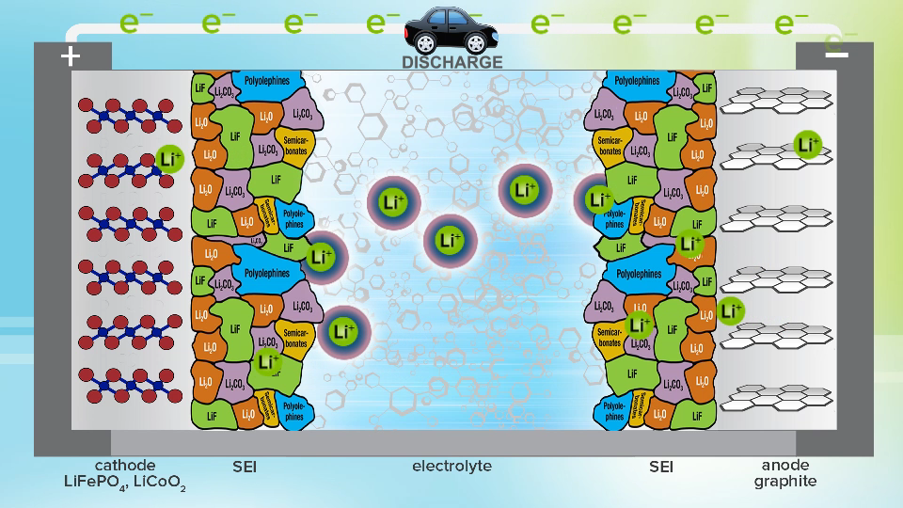



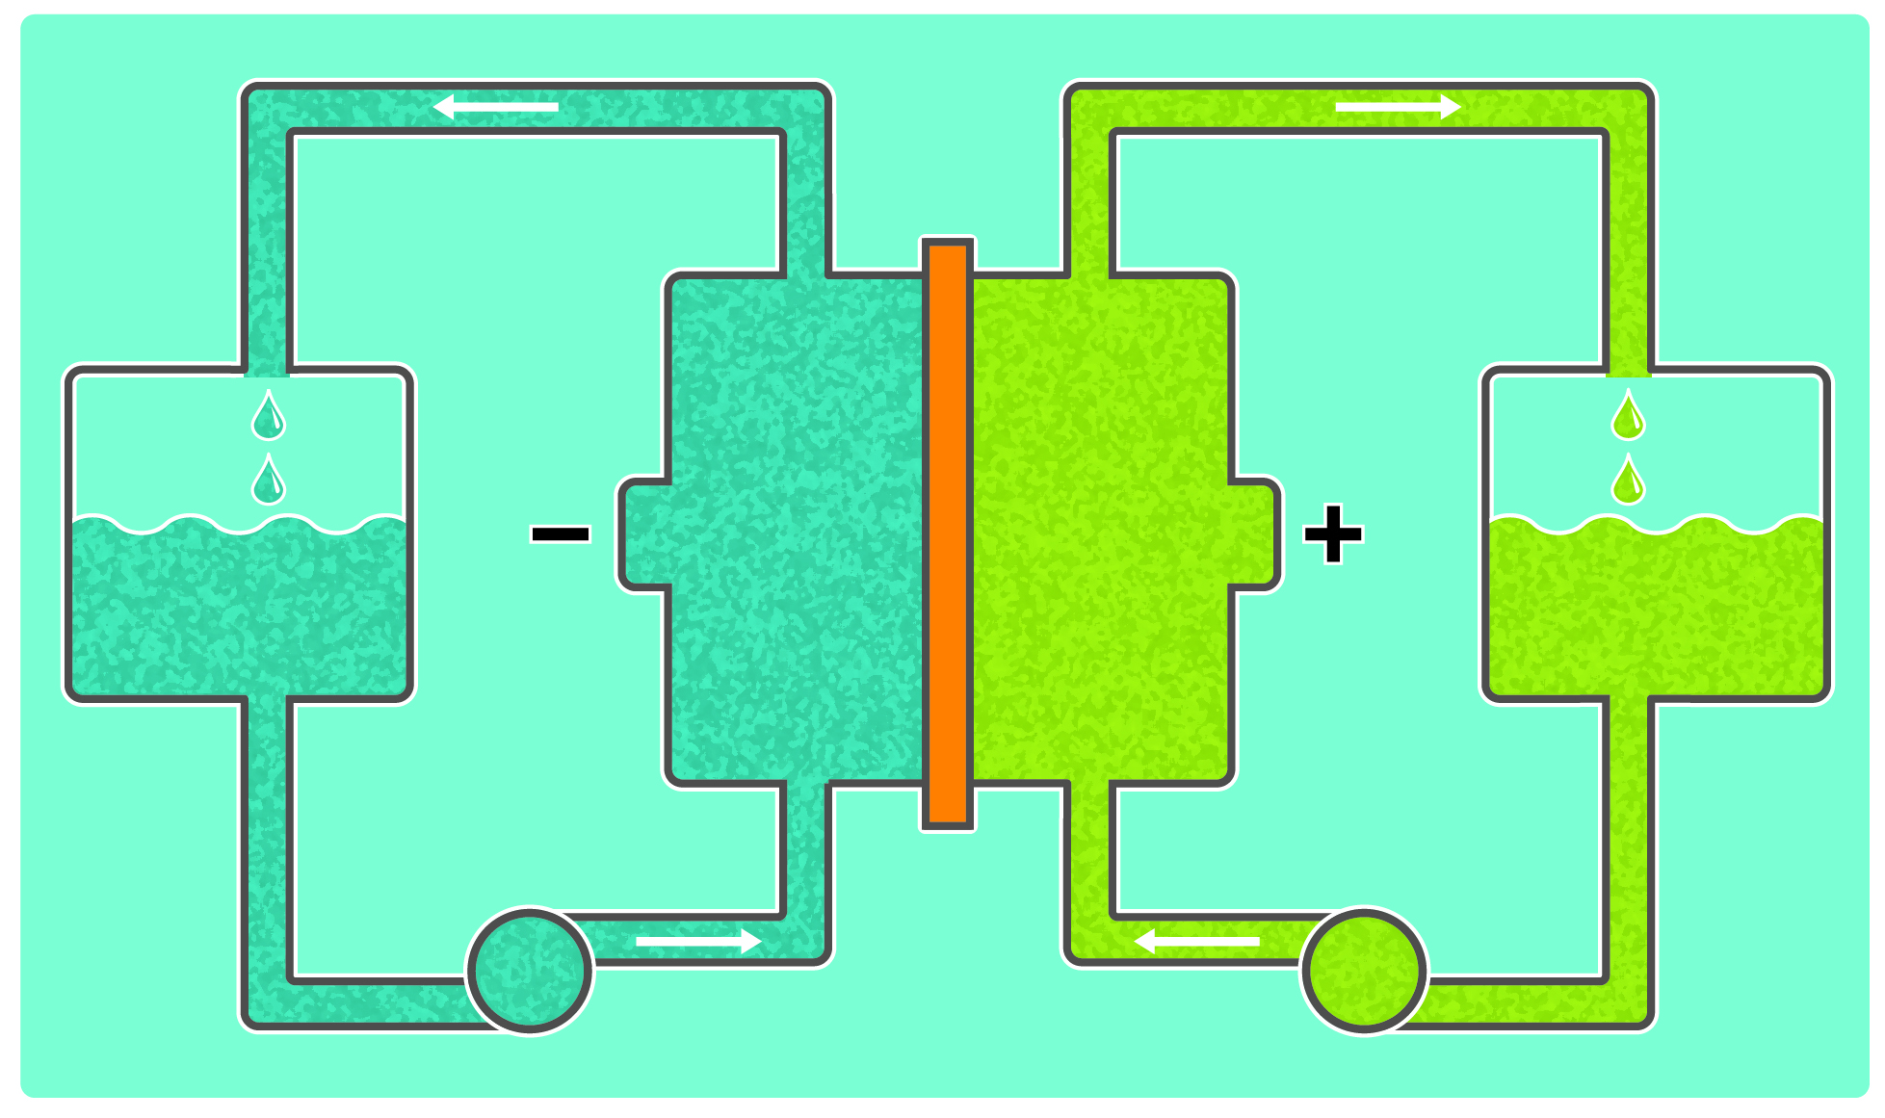
JCESR’s Beyond Lithium-ion Concepts
e
Li metal anode
Li⁺
Sulfur
cathode
Lithium-ion “Rocking Chair”
Chemical Transformation
Li⁺ cycles between anode and cathode, storing and releasing energy
Replace intercalation with high energy chemical reaction: Li-S, Li-O, Na-S, . . .
Mg⁺⁺
Multivalent Intercalation
Non-aqueous Redox Flow
Replace monovalent Li+ with
di- or tri-valent ions: Mg⁺⁺, Ca⁺⁺, Al⁺⁺⁺, . . .
Double or triple capacity
Replace solid electrodes with liquid solutions or suspensions:
lower cost, higher capacity, greater flexibility

Slide 7


Four Prototype Targets
TE modeling
Organic
Redox Flow
Science-Driven Outcomes
Genome
Air-Breathing Aqueous Sulfur
Li-S Flow
Proof-of-concept Prototypes
Grid
Materials
Components
Integration
Transportation
Multivalent
Mg++, . . .
Synthesis
Li-Sulfur Stationary
Li-O
Science-Driven Outcomes
EDL
Final Prototype Targets Selected Jan 2016

Slide 8
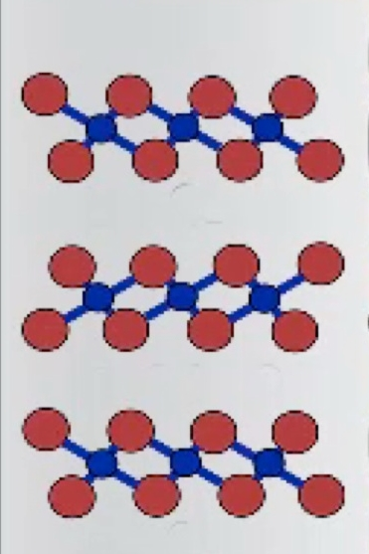
e
Multivalent Intercalation
Concept
Replace Li+ with Mg++, Ca++, Zn++
Advantage: double the energy per ion transfer
Mg++
Ca++
Zn++
++
MV metal
anode
Organic electrolyte
Intercalation cathode
Challenges
Many cathodes operate at low voltage → low energy density
Divalent ions move slowly in cathode → slow charge, discharge
Electrolytes decompose at desirable cathode voltages
Anode surface degradation on plating and stripping
One working example: Mg++ in Chevrel phase Mo₆S₈,
Aurbach et al (2000), Levi et al (2006)
Why is progress so slow?
Too many candidates, too few winners
Inadequate fundamental understanding for rational design

Slide 9
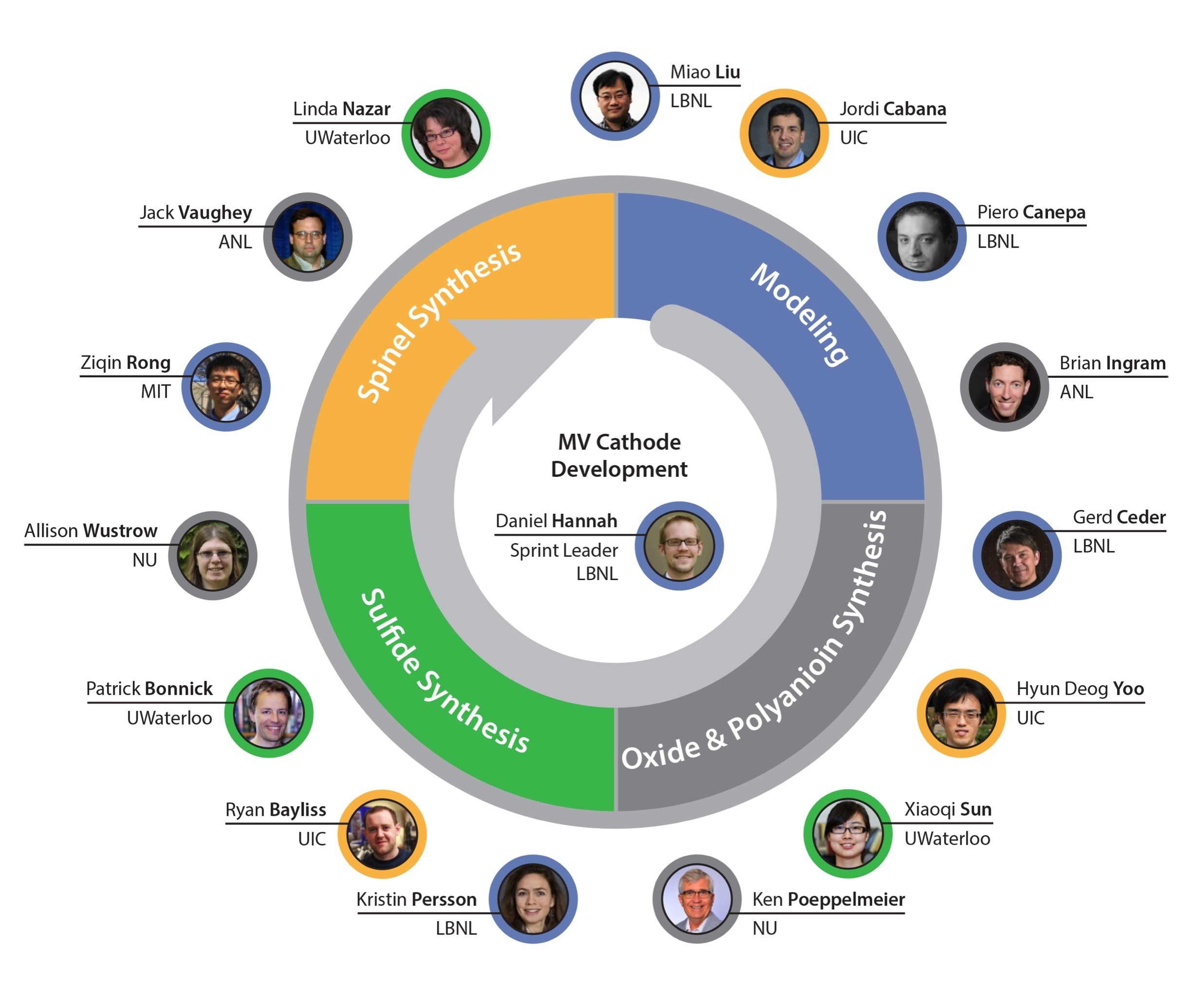
Cathode Design Team

Slide 10
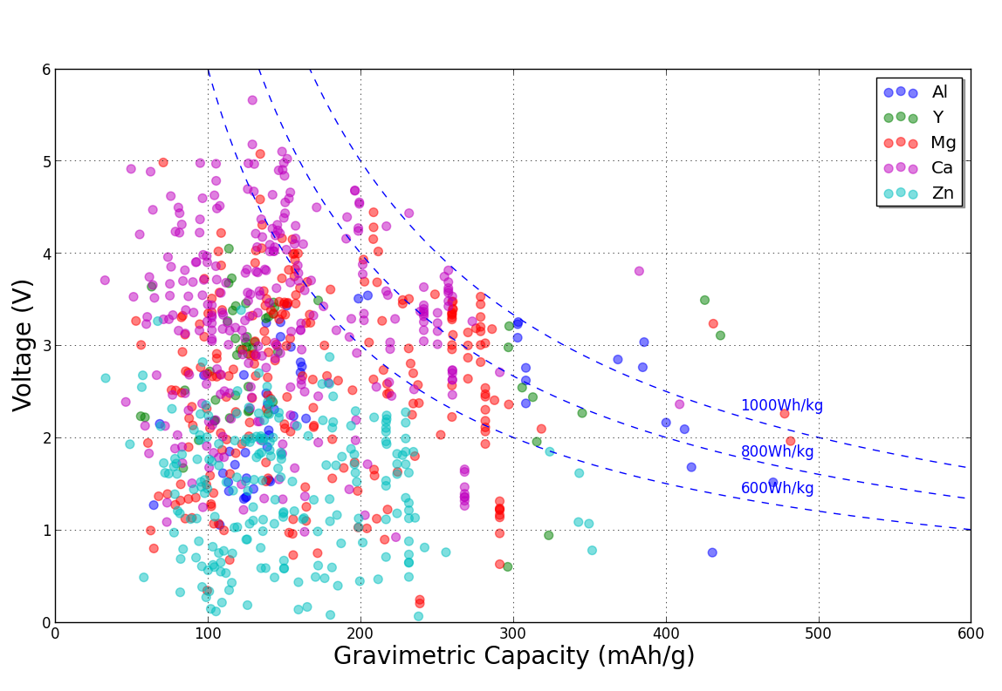
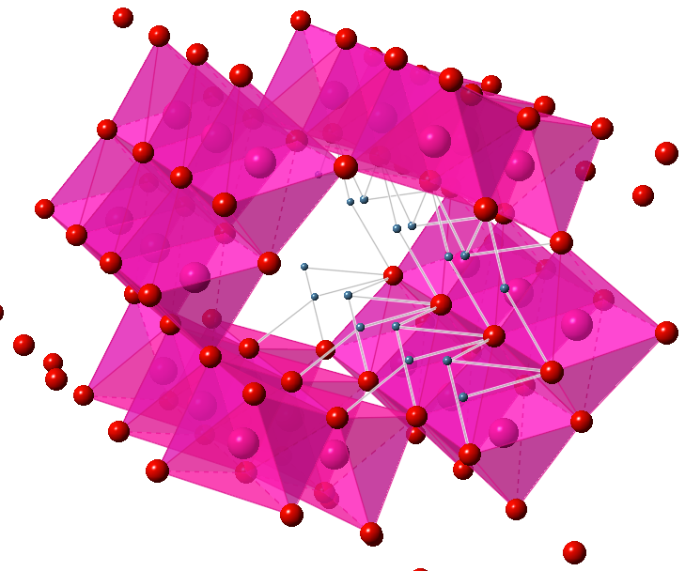
New Multi-Valent Cathodes using Materials Project
Mg good, Ca superior
Al, Y rare
Zn voltage low

Slide 11
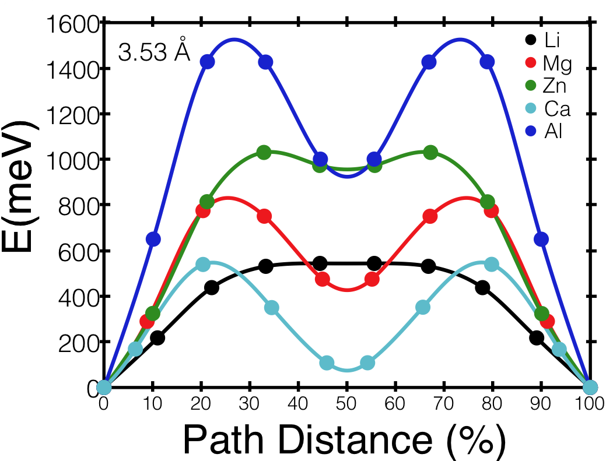
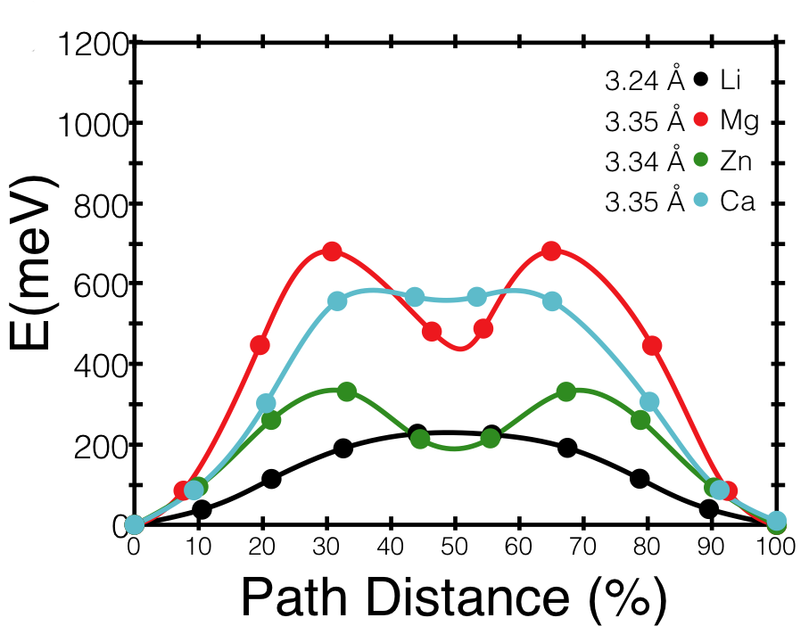
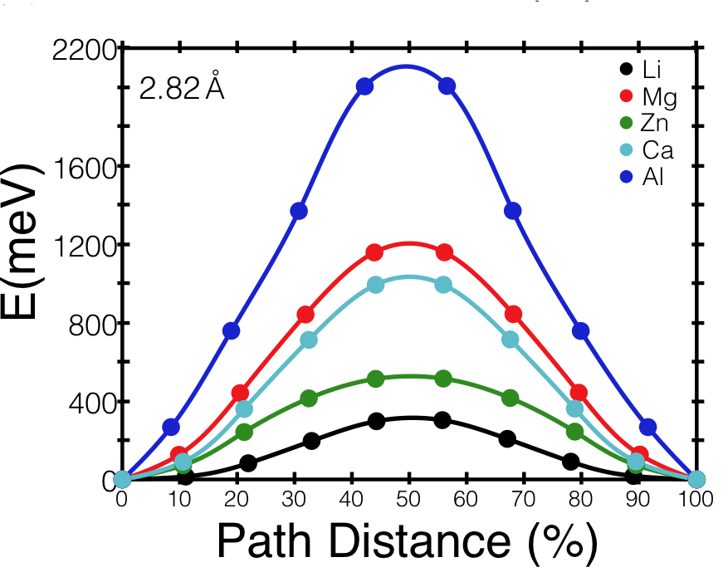
The Mobility Challenge: A Pattern Emerges
M_{1/8}Mn₂O₄ (spinel)
M_{1/8}FePO₄ (olivine)
oct
Li, Ca, Mg borderline
tet
Li, Zn
tet
tet
oct
oct
M_{1/8}CoO₂ (layered)
Design: best mobility is found for materials where the percolating ion is not too comfortable in its original site as compared to the sites along the percolation path
tet
Li, Zn
Materials Design Rules for Multivalent Ion Mobility in Intercalation Structures
Z. Rong, R. Malik, P. Canepa, G. Sai Gautam, M. Liu, A. Jain, K. Persson, and G. Ceder, Chemistry of Materials 2015 27 (17), 6016-6021
oct
oct

Slide 12
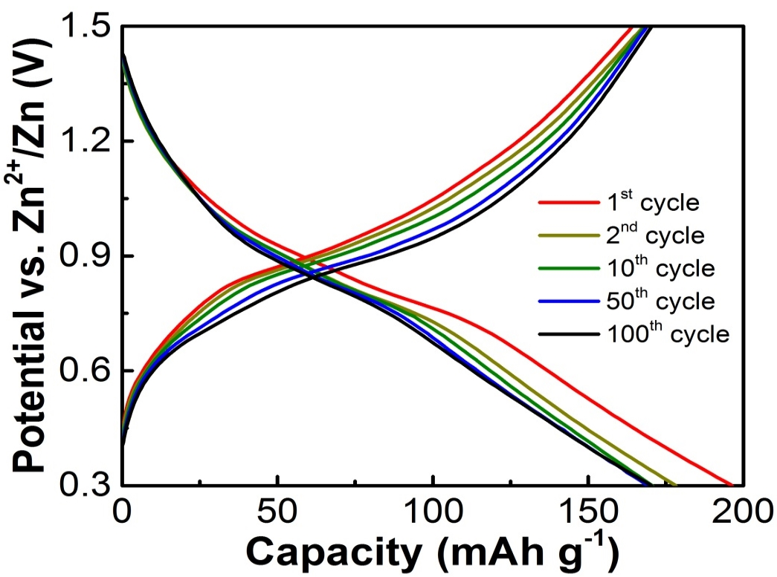
Stable Full Cell Cycling: TiS₂ spinel and BL-V₂O₅
First stable full-cell cycling of Mg in two dense crystal lattices beyond Mo₆S₈
(Aurbach 2000, Levi 2006)
Excellent performance for Mg in a sulfide spinel and validating design rules
A High Capacity Thiospinel Cathode for Mg Batteries, X. Sun, P. Bonnick, V. Duffort, Z. Rong M. Liu, K. Persson, G. Ceder, and L. F. Nazar, submitted
Excellent rate and cycle performance for Zn in a bi-layered V₂O₅ and validating design rules
A High Power Rechargeable Non-aqueous Multivalent Zn/V₂O₅ Battery P. Senguttuvan, S.-D. Han, S. Kim, A. L. Lipson, S. Tepavcevic, T. T. Fister, I. D. Bloom, A. K. Burrell, C. S. Johnson submitted.

Slide 13
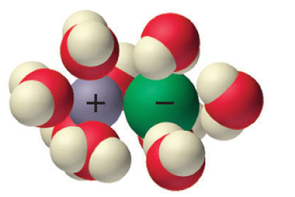
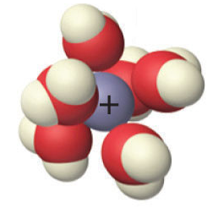
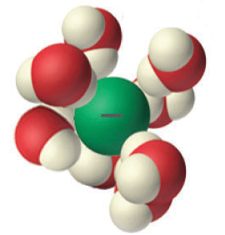
Electrolytes: Fundamental Understanding of Ion Pairing Enables Rational Design of Stability and Stripping / Plating
Ion paired
anion and cation
Concentrated solution
Strong electrostatic attraction
Divalent Mg++, Ca ++, Zn++
Separately solvated
anion and cation
Dilute solution
Weak electrostatic attraction
Monovalent Li+

Slide 14
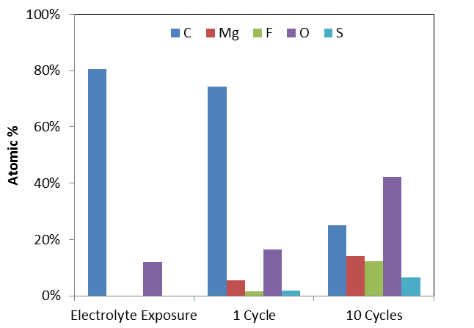
Ion-pairing Shifts the Electrochemical Stability Window . . .
Exp: 4 V
TFSI
Ion-paired Mg²⁺ reduces
Exp: 2 V
BH₄
Ion-paired anion reduces
Free anion reduces
. . . reduces TFSI- anion, Mg absorbs the electron and triggers TFSI- decomposition
Ion-paired anions reduce more easily than well-solvated anions
Qu and Persson, submitted
decreasing organic
increasing F, S, O
Hahn and Zavadil, in preparation
The Coupling between Stability and Ion Pair Formation in Magnesium Electrolytes from First-Principles Quantum Mechanics and Classical Molecular Dynamics, N. N. Rajput, X. Qu, N.Sa, A. K. Burrell, and K. A. Persson, JACS 2015 137 (9), 3411-3420

Slide 15
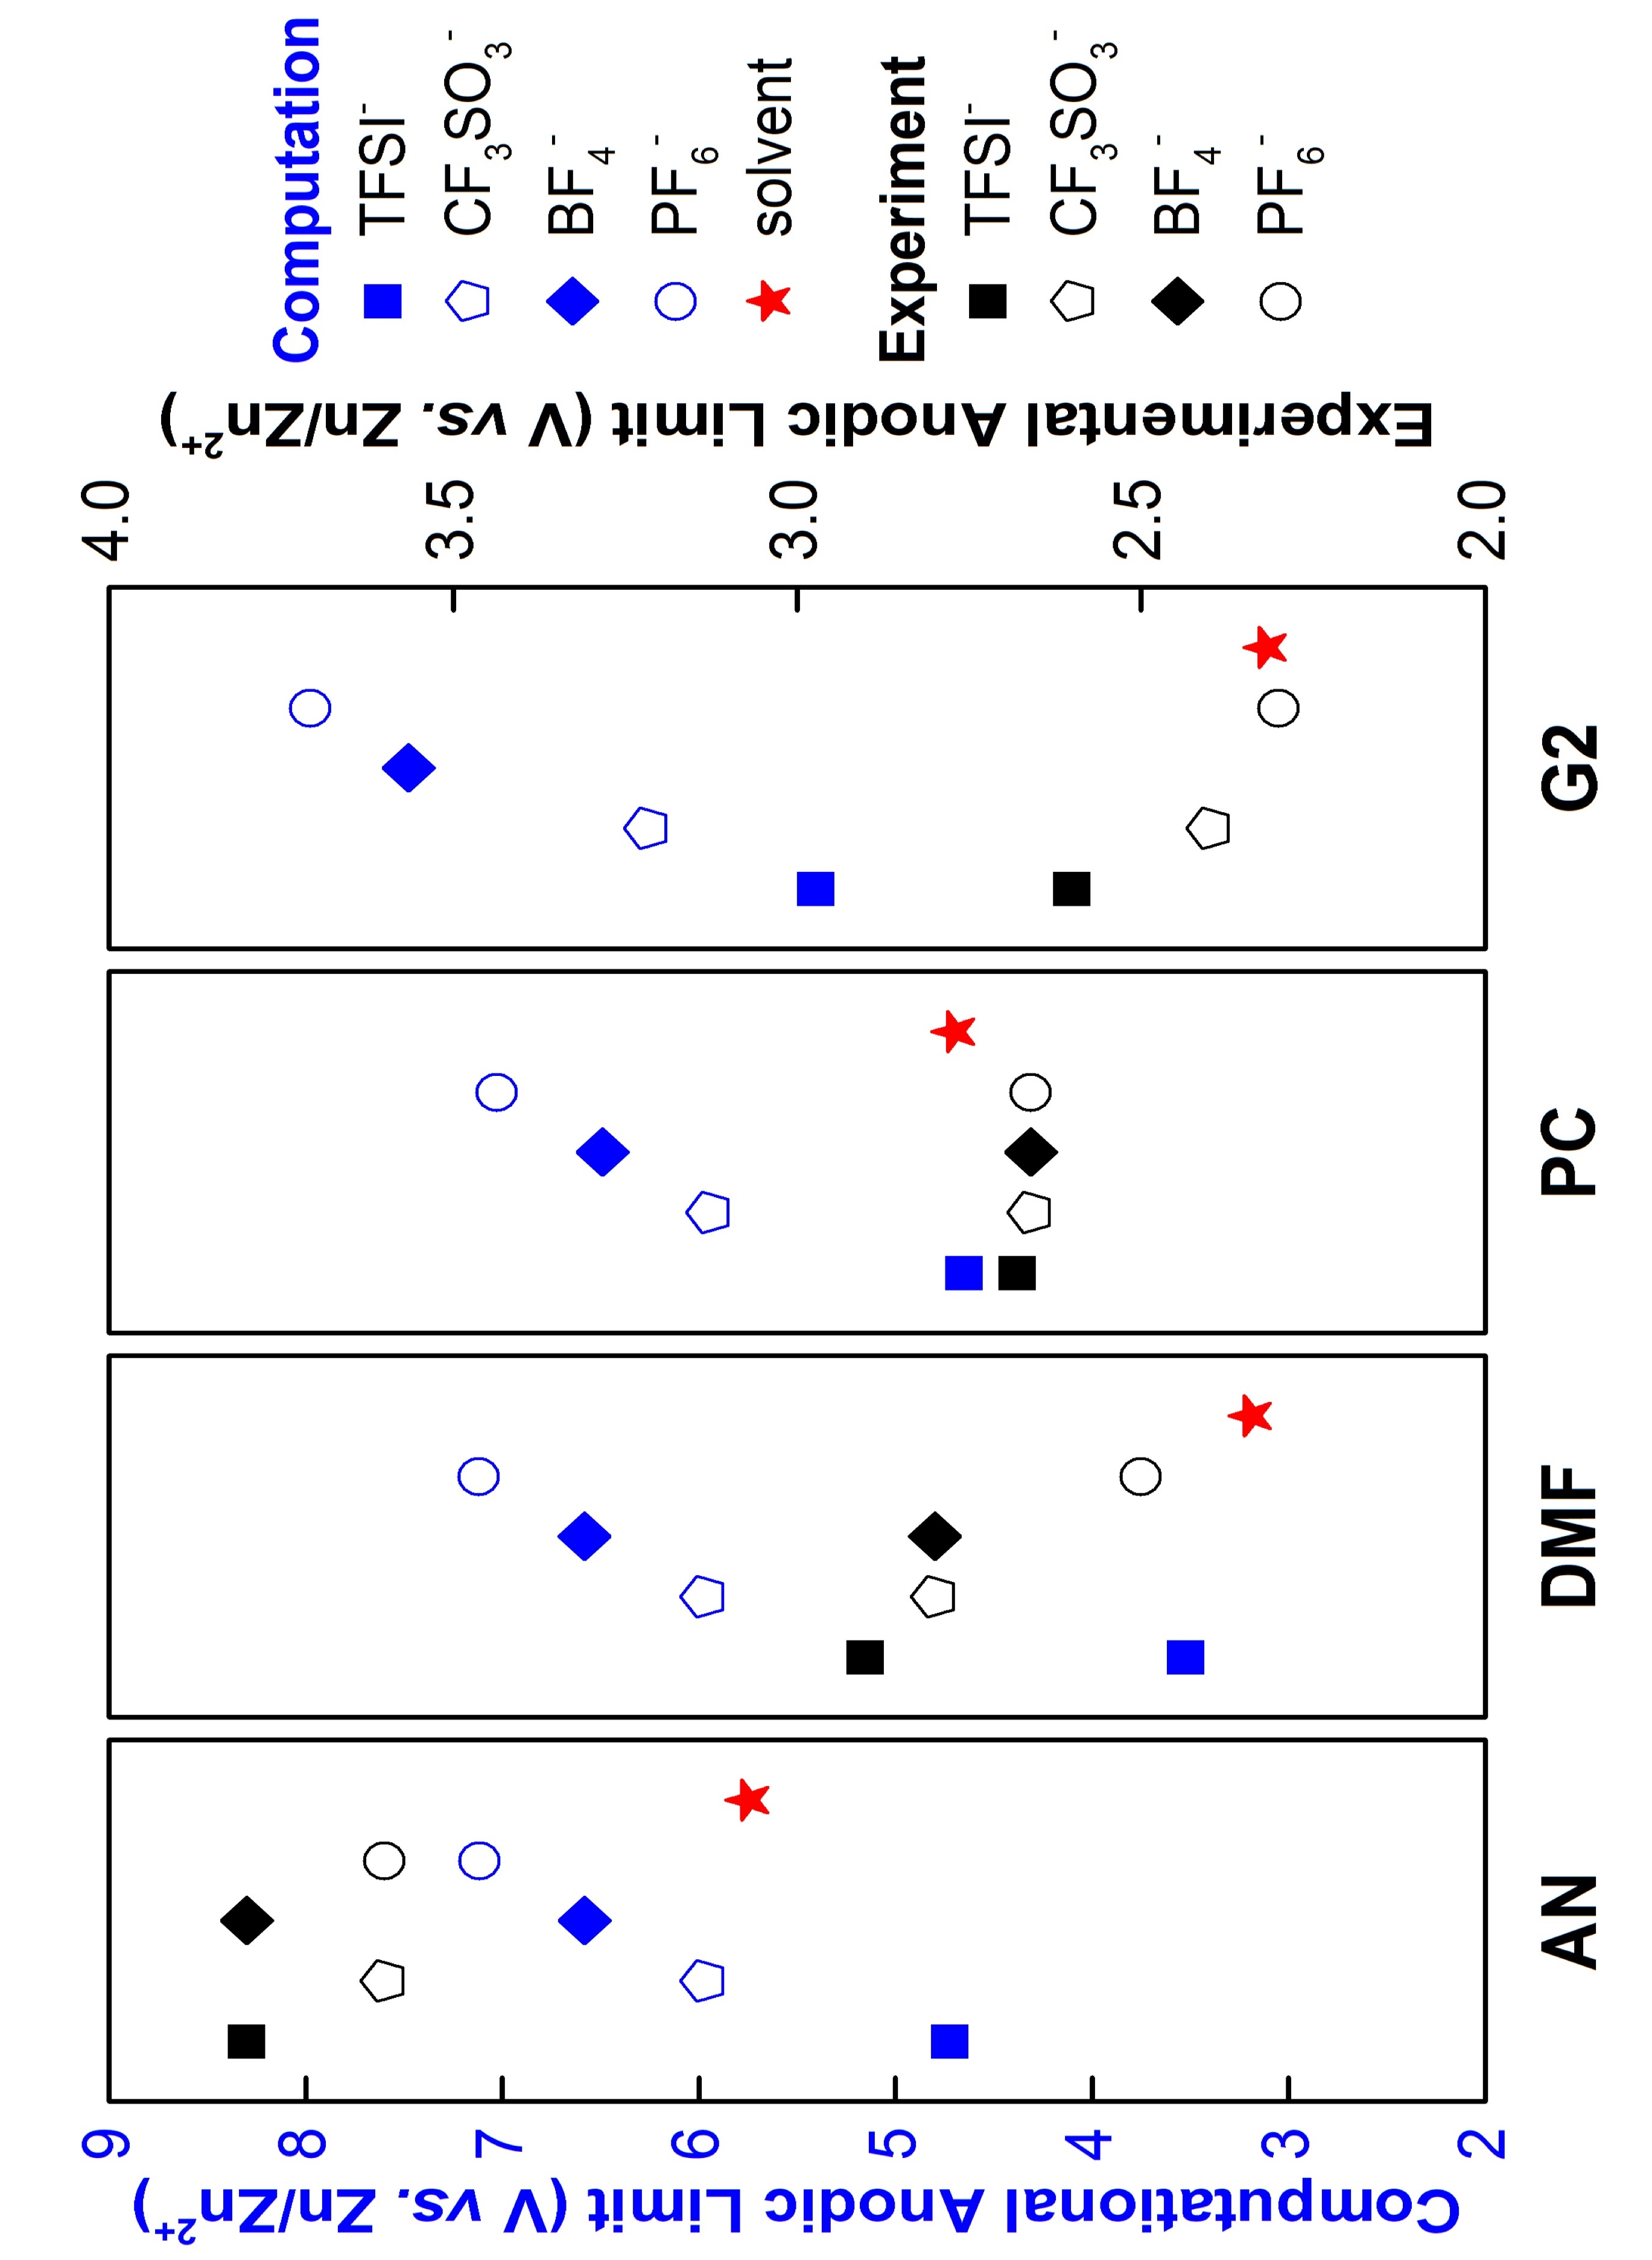
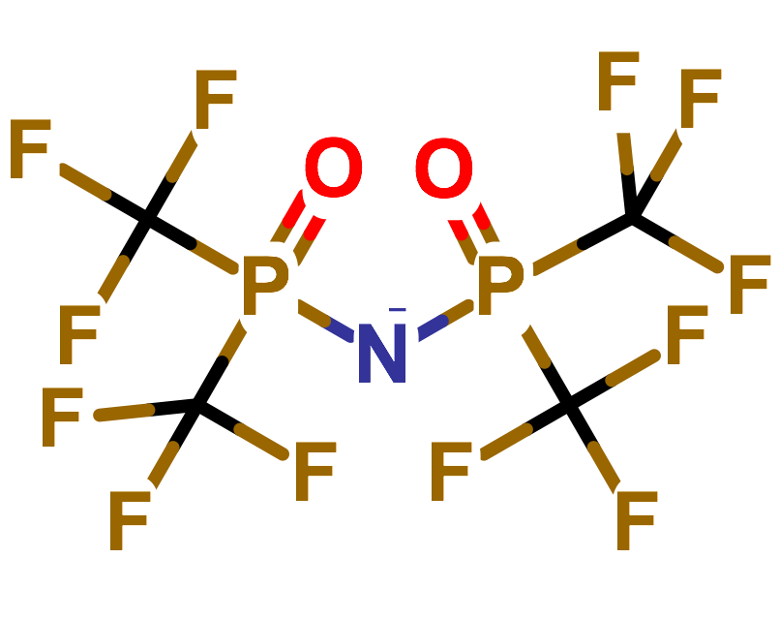
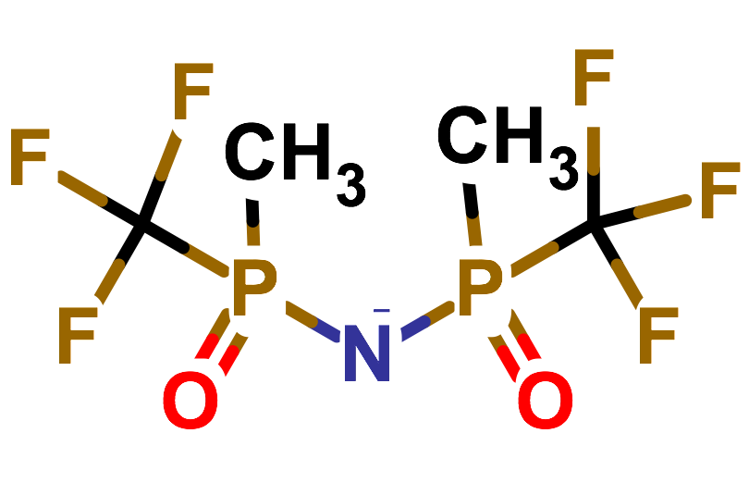
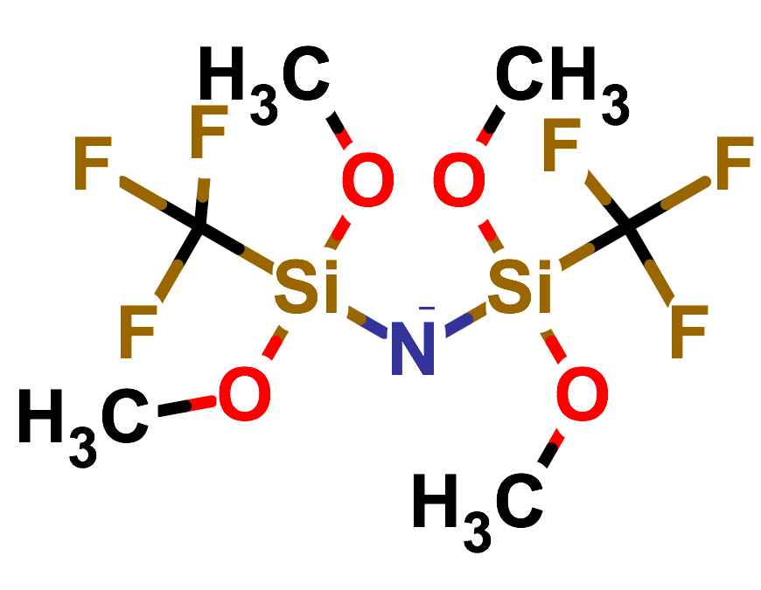
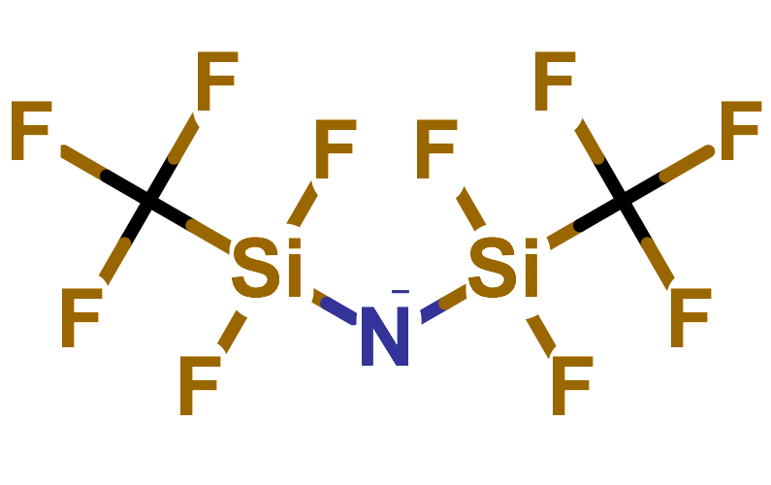
Understanding Decomposition Pathway
Enables Rational Design
Ion-pairing induces decomposition of TFSI- anion
reduces anodic stability
partially reduces Mg++ to Mg+
alters stripping / plating behavior at anode
BH₄- anion is stable under ion-pairing
→ Rational design route to control anodic stability
TFSI⁻ derivatives maintaining high anodic stability while substituting the C-S bond
Electrochemical Stability
6 stable + 6 marginally stable
Chemical Decomposition
5 stable
Hydrolysis
3 stable
4 promising anions; one under synthesis and testing at Sandia
X. Qu, K. Matthews, …E. Maginn, K. Persson, in preparation
DTPA
MDPA
DMSA
DFSA
experiment
Compare with Zn electrolytes
Strong ion-pairing with excellent plating/stripping
Solvent, not anion, sets anodic stability limits of most Zn electrolytes (except Acetonitrile)
Rational design → achieve this for Mg
modeling*
Rajput and Han et al., ACS Interfaces 2016
Computational and experimental anodic limits of Zn electrolytes

Slide 16

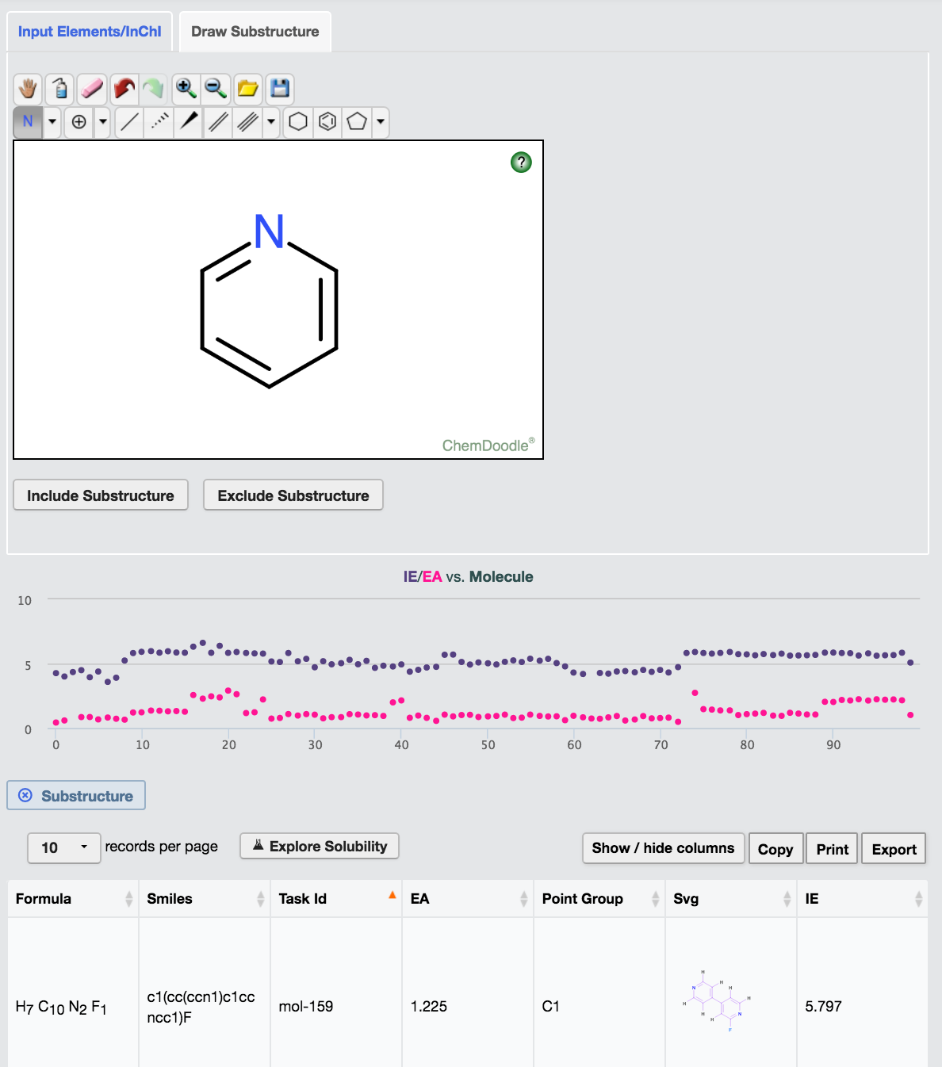
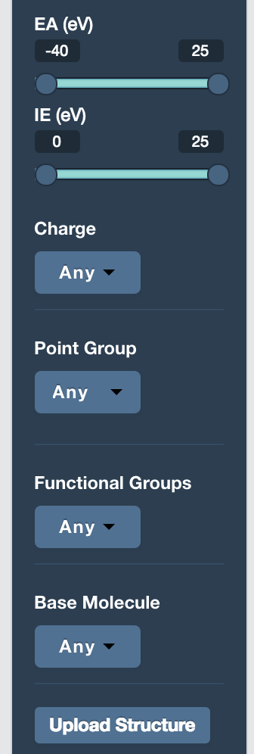
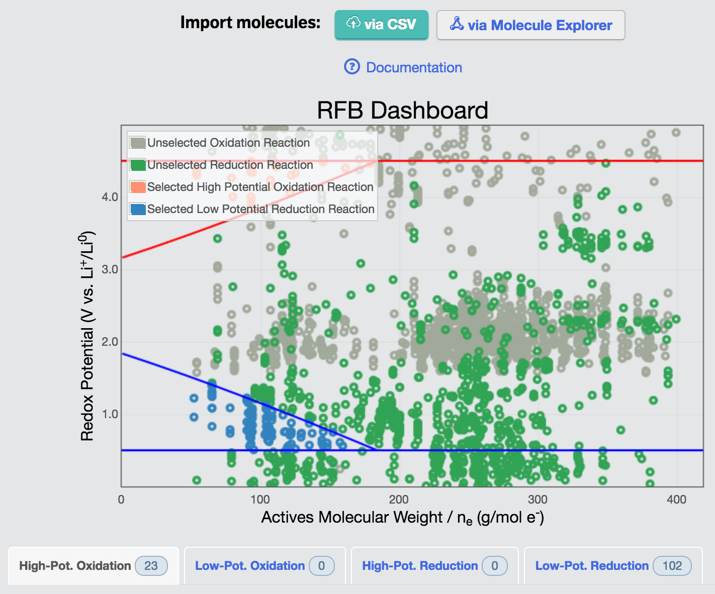
Public release of JCESR MV data and app
14,615 New structures
15,789 VASP runs
10,119 calculations
2+ Million CPU hours
5255 New Compounds
1467 MV Cathodes
+
Battery App
to analyze properties
Materials
Project
May 11, 2016
Public release of JCESR Molecule Data and Apps
Molecules Explorer
> 21,000 organic molecules
Multi-faceted search by
  Drawn substructure
  Selected base molecule
  or functional groups
  Redox potentials
Redox flow battery dashboard
  Explore solubility and price targets
  Aqueous and non-aqueous
Redox Flow Battery Dashboard

Slide 17
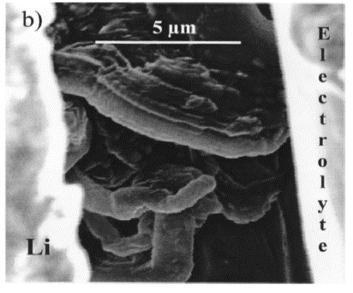
Lithium-Sulfur Challenges
e
Li₂S₆
Li₂S₄
S_{x}
2-
Li₂S₈
?
Li₂S
Li metal anode
Li⁺
Sulfur
cathode
S
Li₂S_{x}
Li₂S
Li dendrite
Plating
anode
electrolyte
cathode
  S₈ _{(s)} + 16 Li ↔ 8 Li₂S _{(s)}
  U = 2.2 V vs Li
Li dendrite growth
• cycling roughens Li surface
• dendrites form and grow
• break off to deplete Li
• grow across electrolyte to
short cathode
Li-electrolyte side reaction
Depletes Li and electrolyte
Limits cycles
Conventional fix: large excess of Li and electrolyte
Polysulfides: Li₂S_{x}
• soluble in electrolyte
• migrate to anode
• react with Li → precipitate
• depletes Li and S
• limits cycle life
JCESR
membrane in contact with Li anode surface
Maintain coherent interface as Li strips and plates through membrane
JCESR
Protective membrane
• blocks electrolyte
• allows Li conduction
JCESR
• “lean” electrolyte
• sparing solvation
• solvates Li and anion, but
not polysulfides
Functionalized graphene oxide membrane

Slide 18
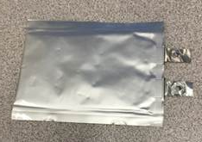
JCESR Prototypes Constructed and Tested Push State-of-the-Art
JCESR today: 1 Ah Li/S cell (6 layers)
  270% excess Li
  1.7 mL_{Electrolyte}/g_{Sulfur} lean electrolyte
  > 4.5 mAh/cm² areal charge density in cathode
JCESR targets
  < 100% excess Li
  1 mL_{Electrolyte}/g_{Sulfur}
  > 8 mAh/cm²
1 M LiTFSI, 0.2 M LiNO₃
DOL:DME (v/v)
Chen et al., in prep (2016)
JCESR target
JCESR target
JCESR today
Industry SOA
Research
JCESR today
Eroglu et al., J. Electrochem. Soc., 162(6) A982 (2015)

Slide 19
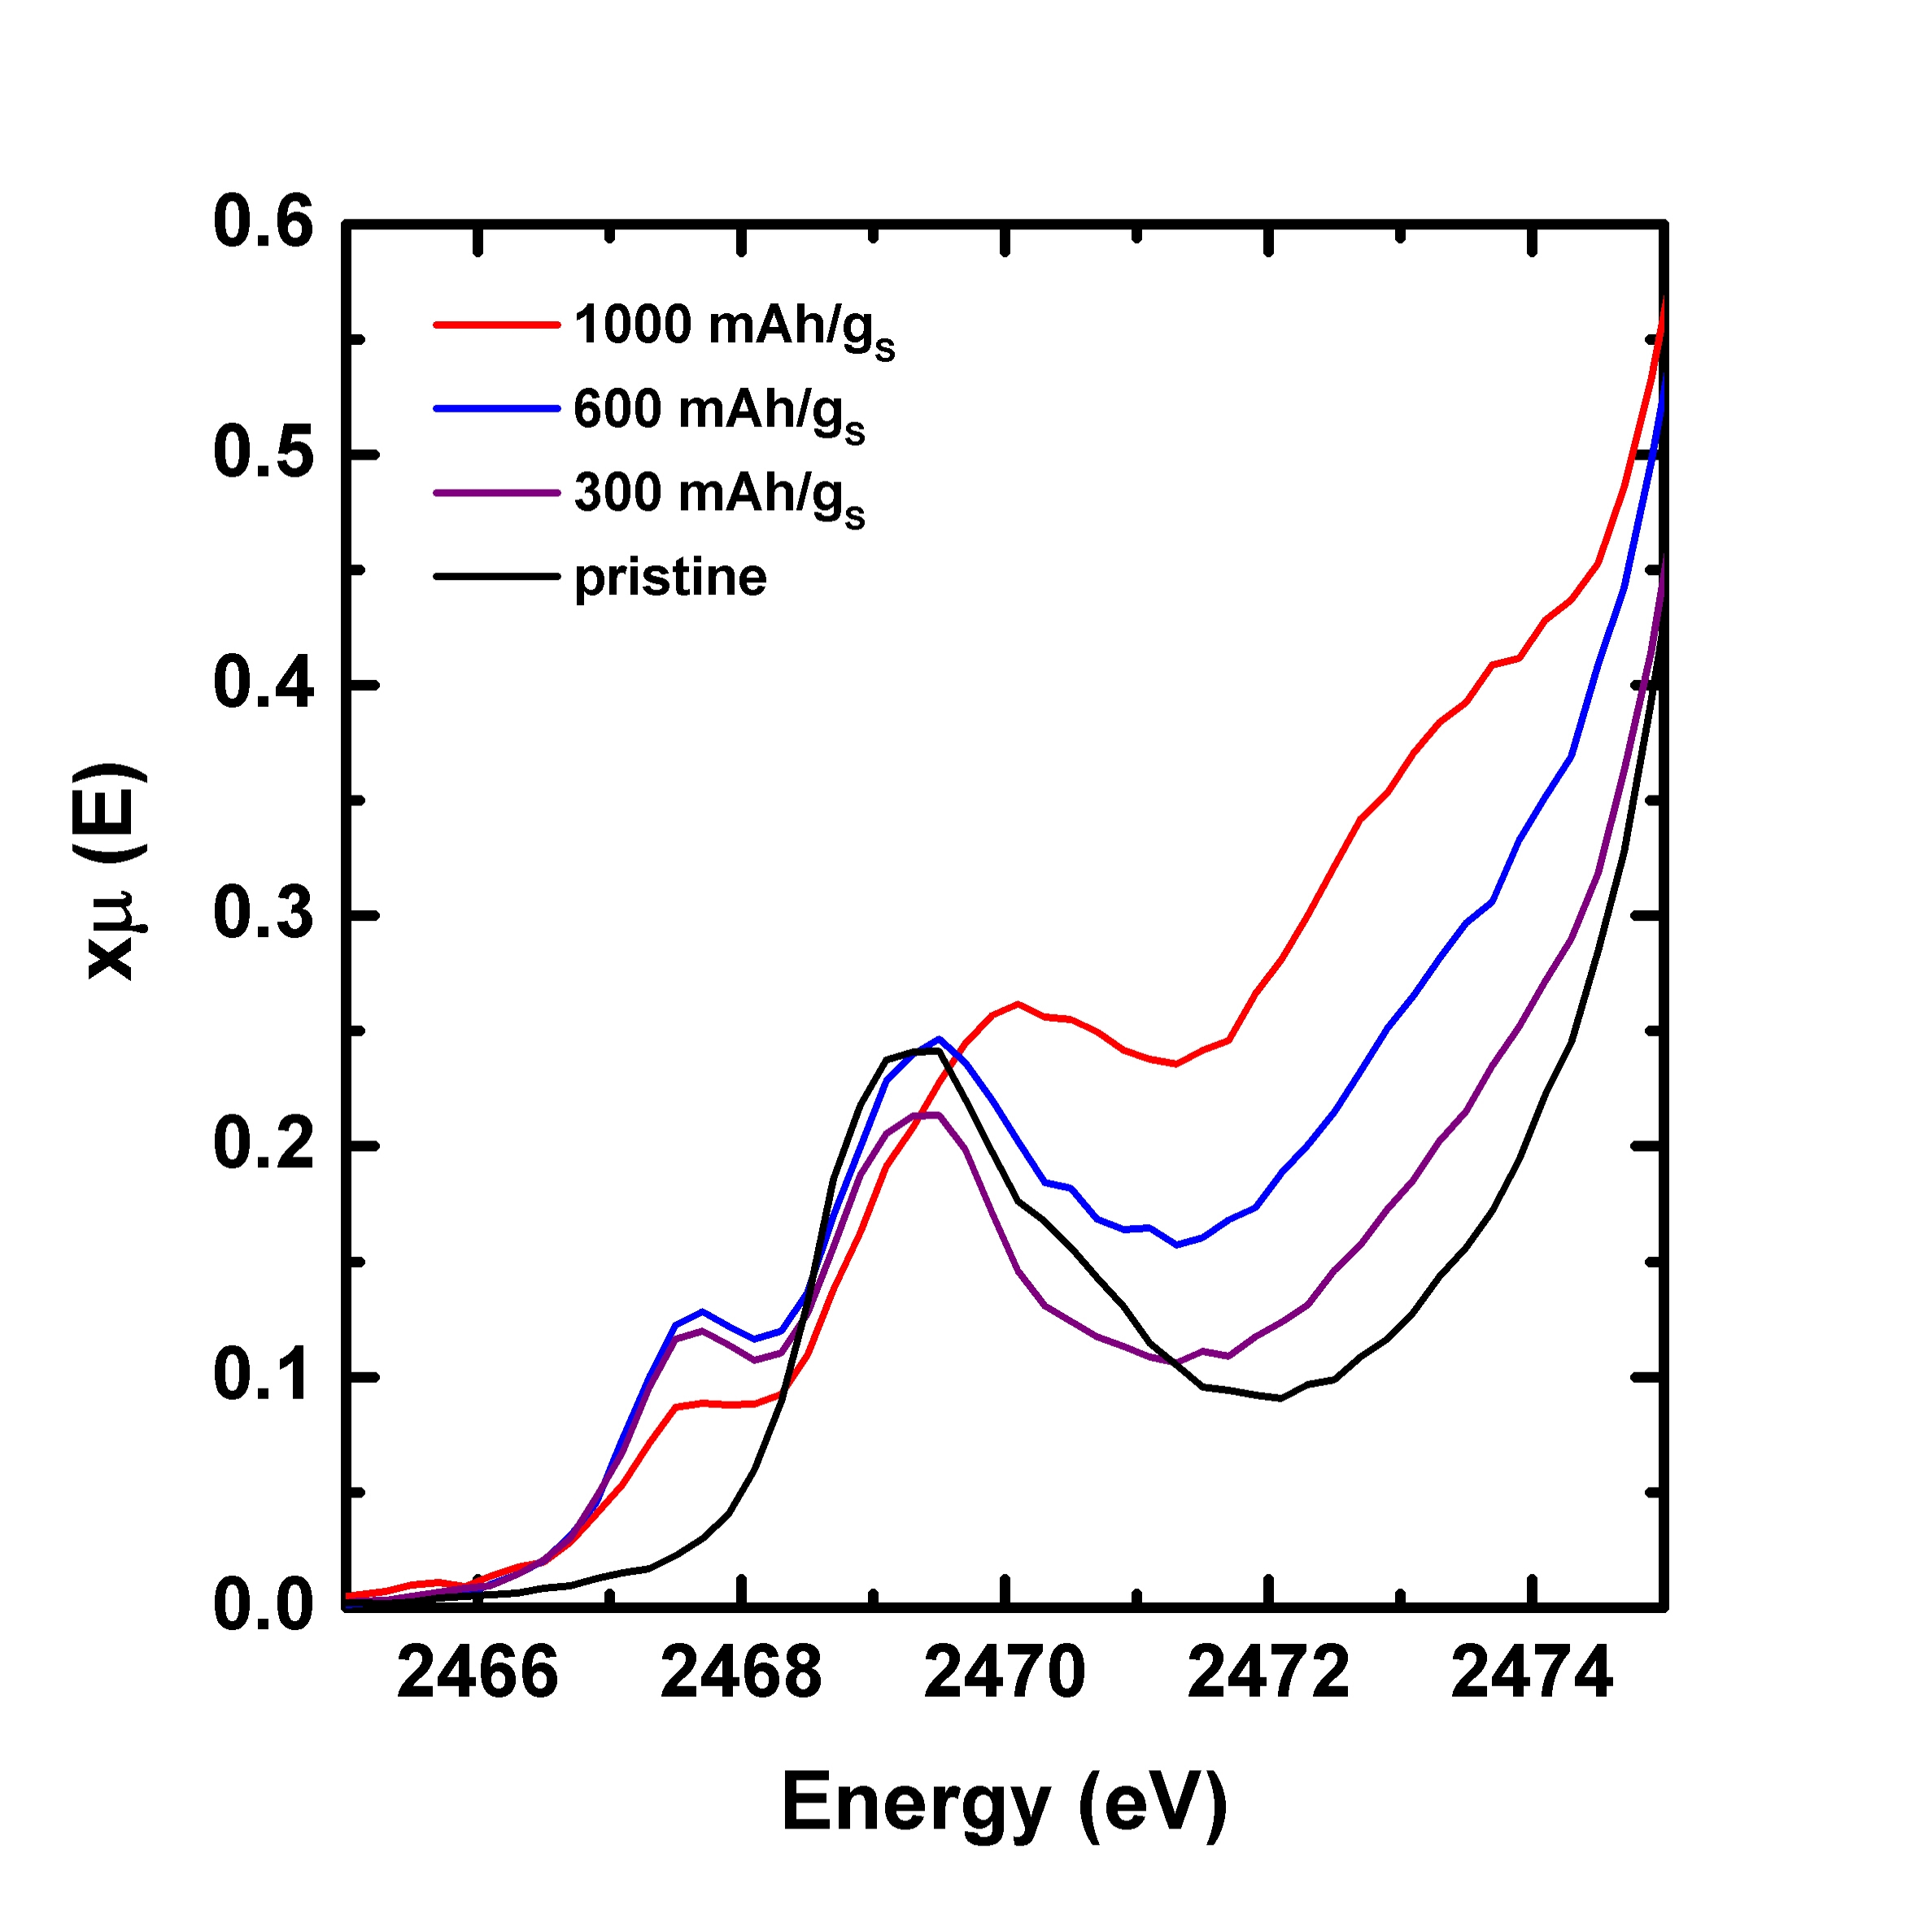
Lean Electrolyte / Sparing Solvation
ACN₂-LiTFSI:HFE electrolyte directs Li-S discharge reaction along different pathway from DOL-DME
Sparingly solvating
Unexplored Space
JCESR Opportunity
Operando X-ray Absorption
1-3%
Solid State
10%
S
1-3%
10%
Li₂S/S₂²⁻
Li₂S_{x}
other
10%
Li₂S_{x}
S
Li₂S
Fraction of Sulfur Species
Li₂S/S₂²⁻
10%
Li₂S
Everyone else
DOL-DME
85%
Discharge time
70%
Li₂S₆ has small solubility ACN₂-LiTFSI:HFE
1000x smaller than conventional DOL:DME-LiTFSI
Relatively low solubility for S₈
Note: Rough estimation based on literatures published from 2014-2016
15 person Sprint underway to determine mechanism of ACN₂-LiTFSI:HFE solvation
Promising new route to JCESR targets

Slide 20
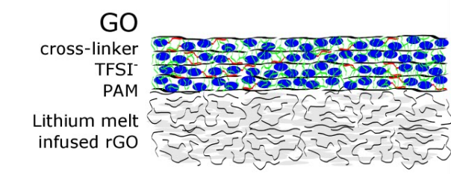
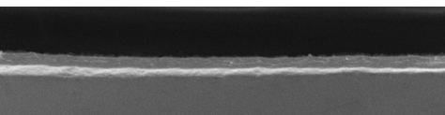
Graphene Oxide Protective Membranes
Why GO Membranes?
laminar assembly
chemically functional
compliant, flexible
high shear modulus
Strategies
Cross-link to block solvent
Impregnate with fast ion conductor for Li+ transport
Li-graded interface to insure coherent contact
Li⁺
L ≈ 50 μm
d ≈ 0.7 nm
Li metal
Prior to cycling Li
200 nm thick functionalized GO
melt diffused Li in porous GO
After cycling 0.5 μm at 1 mA/cm²
200 nm thick fGO
melt infused Li in porous GO creates coherent interface
cycled Li layer
melt diffused Li
Coherent interface maintained after cycling
Next 18 months
Integrate functionalized GO membranes with sparingly solvating ACN₂-LiTFSI:HFE electrolytes
  These two innovations, with PEO multifunctional cathodes already under way, are capable of meeting JCESR’s Li-S goals
                1 mL_{Electrolyte}/g_{Sufur} lean electrolyte
                < 100% excess Li
                8 mAh/cm² areal capacity

Slide 21
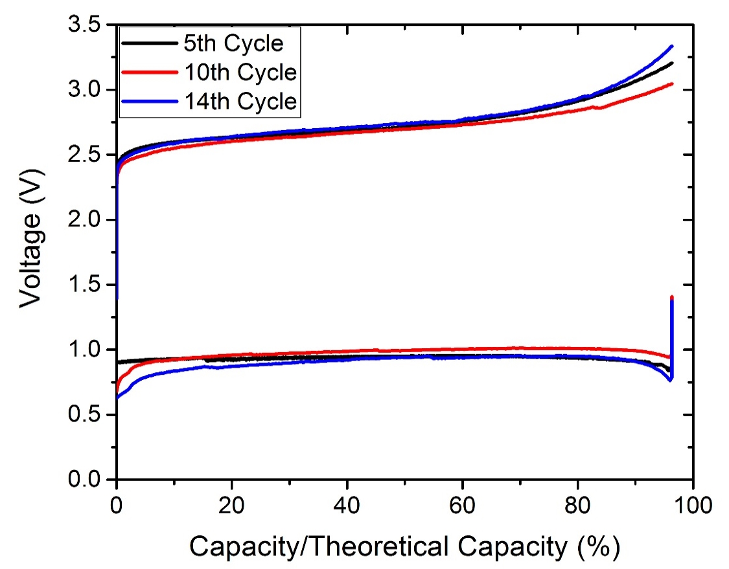
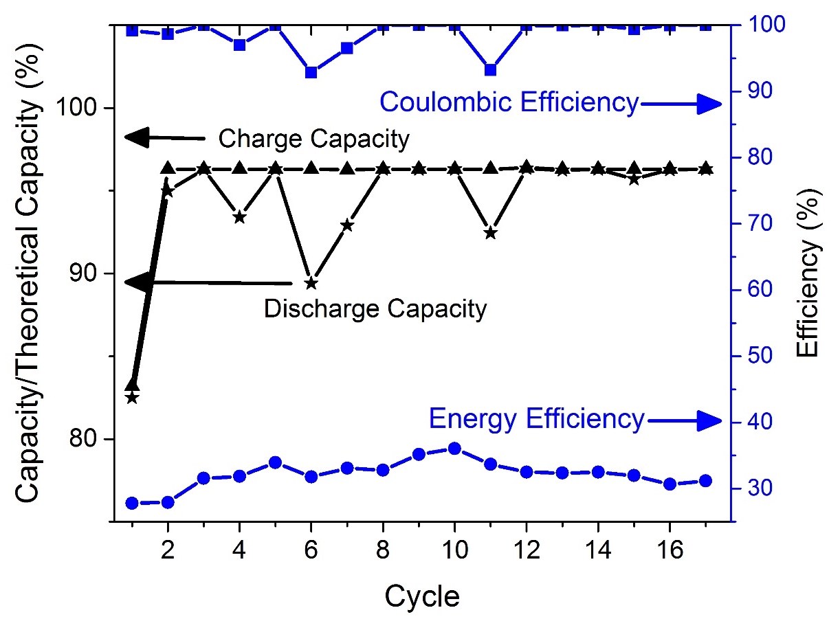
Air-Breathing Aqueous Sulfur Flow Battery
• Ultralow $/Ah cost of sulfur
• High solubility in water → 4X the energy density of
V-redox solutions
JCESR work on nonAq S laid groundwork
Aqueous anolyte (Na₂S₈-Na₂S)
Acidic catholyte (Na₂SO₄+ H₂SO₄))
$0.50/kg
Materials cost
Aqueous anolyte (Li₂S₈-Li₂S)
Alkaline catholyte (Li₂SO₄, LiOH-H₂O)
~ 4M cubic meters of sulfur from oil sands Fort McMurray, Alberta
$0.05/kg
Materials cost
Can <$1/kWh chemical cost enable seasonal electrochemical energy storage?
Capture summer solar energy, use in winter
Full cell reaction
2Na₂S + O₂↑+ 2H₂SO₄ ⇄ 2S + 2Na₂SO₄ + 2H₂O
Catholyte Deep Cycling
8M sulfur (16M e⁻)

Slide 22



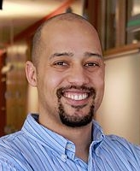
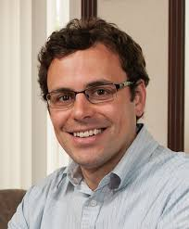
Air-Breathing Aqueous Sulfur Flow Directions
Stable, low-cost
membranes
    Ceramic membrane to separate pH
    Polymer membranes for alkaline/alkaline cells
OER/ORR voltage hysteresis at cathode
    Catalyst selection
    Simultaneous gas and fluid flow
Aqueous polysulfide solubility and speciation
    From 8M S today to >20M S
Prototyping
TE Modeling

Slide 23
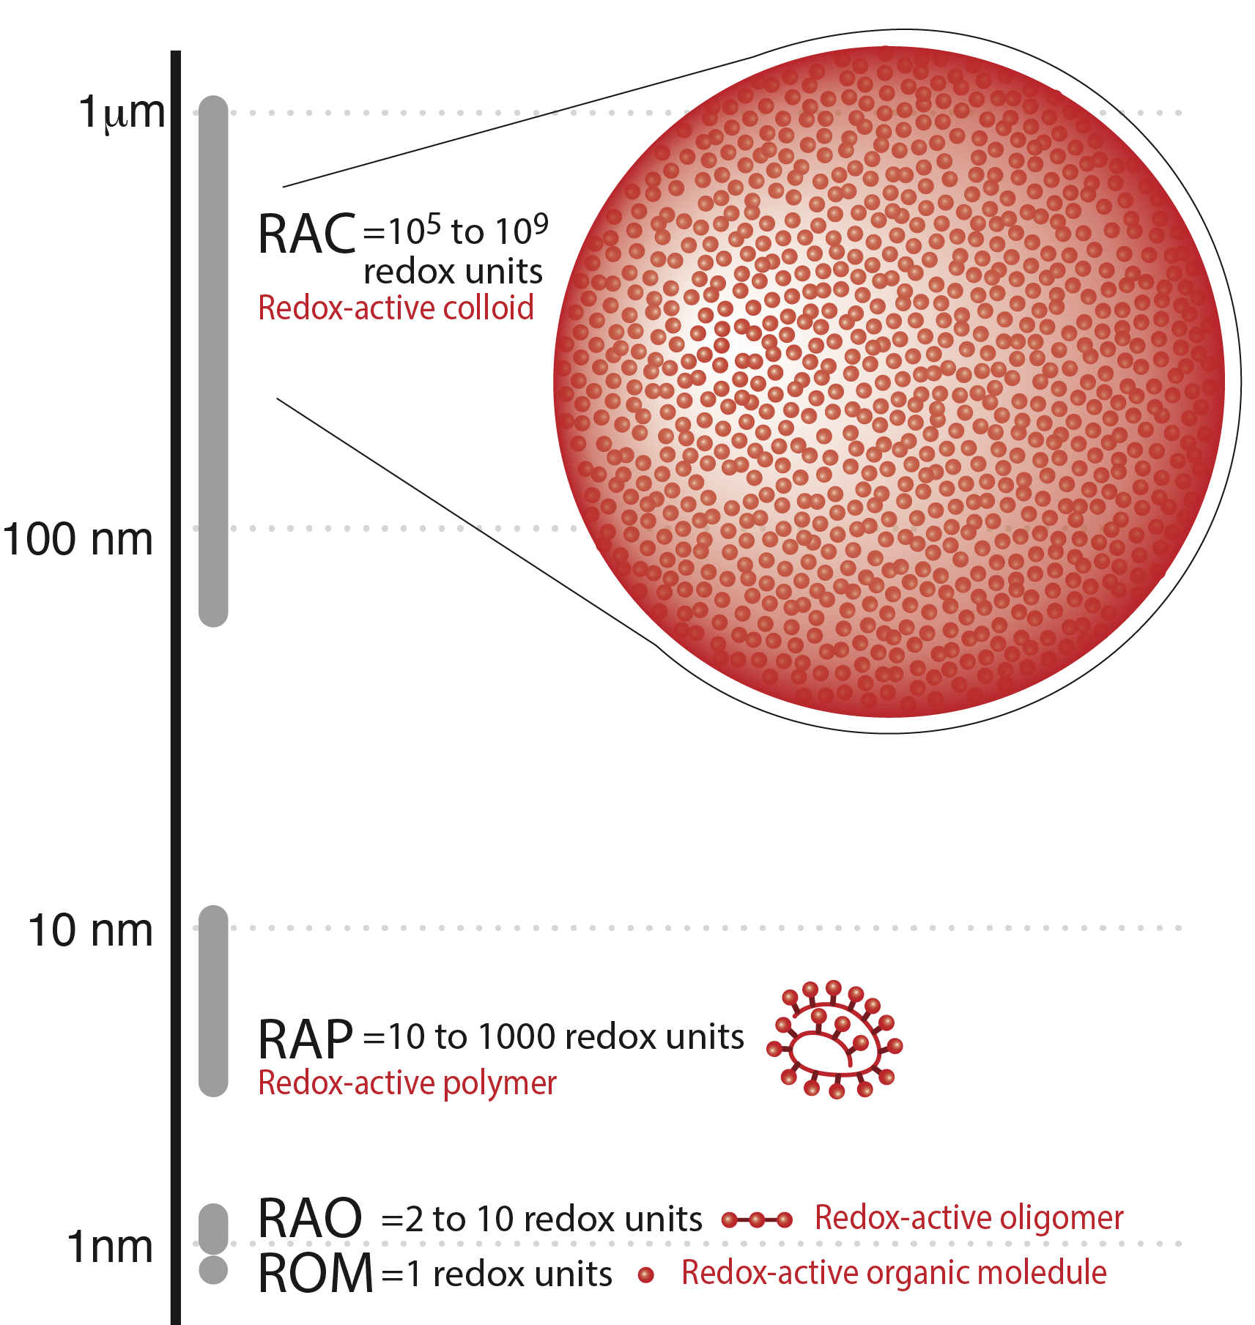

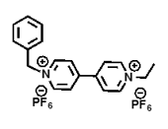

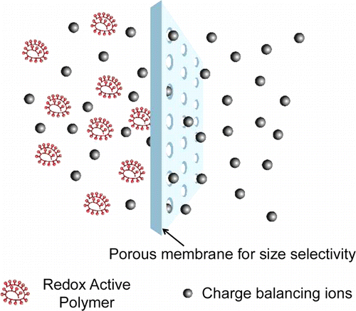
In 2014, JCESR Introduced the Concept of Macromolecular-based Redox Electrolytes . . .
RAC
10⁵-10⁹ redox units
Colloid
Electrode Particle Size
RAP
10 -1000 redox unit
Polymer
RAO
2 -10
redox units
Oligomer
. . . and the field gains momentum as others follow our lead . . .
Synthesis and characterization of TEMPO- and viologen-polymers for water-based redox-flow batteries, Polym. Chem., 6, 7801-7811 (2015)
Poly(TEMPO)/Zinc Hybrid-Flow Battery: A Novel, Green, High Voltage, and Safe Energy Storage System, Adv. Mater. 28, 2238–2243 (2016)
Poly(boron-dipyrromethene)—A Redox-Active Polymer Class for Polymer Redox-Flow Batteries, Chem. Mater., Article ASAP Publication Date (Web): May 6, 2016
RAM
1 redox unit
Molecule
Advantages
Inexpensive
Recyclable
Design for
• Solubility
• Stability
• Activity
• Size selectivity

Slide 24
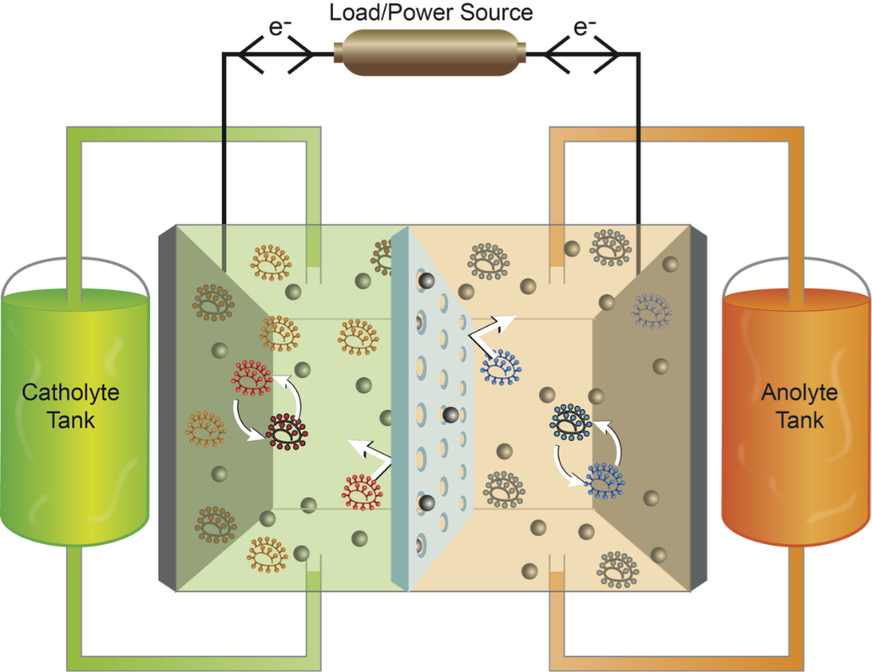
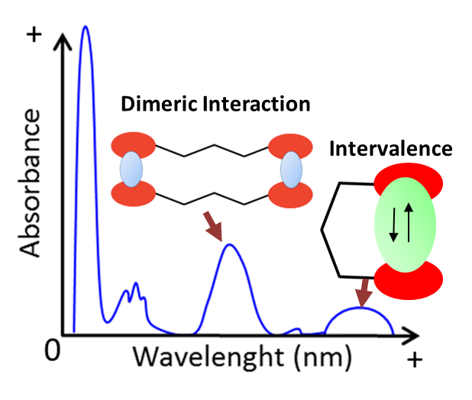
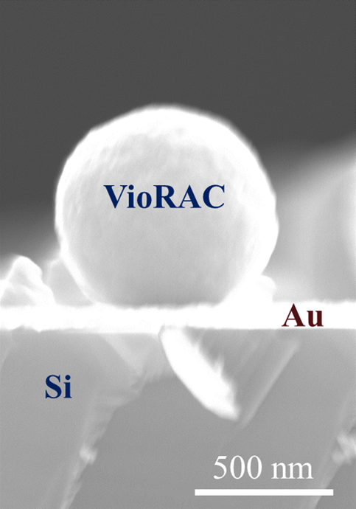
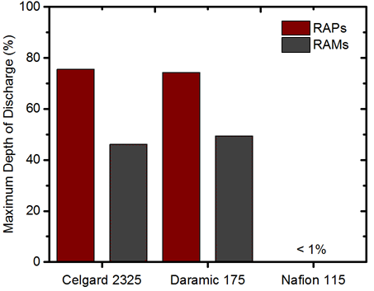
Addressing a New Materials Challenge: Multiple Fronts
Electrode Structure
Electronic Interactions
Burgess, M; Assary, R.; Moore, J.S. Rodríguez-López, J. et. al. In preparation.
Montoto, E. C.; Nagarjuna, G.; Lewis, J.; Moore, J.S.; Rodriguez-Lopez, J.; et. al., Science (In Review)
Burgess, M.; Moore, J.S.; Rodríguez-López, J. et. al. J. Electrochem. Soc. 2016, 163, H3006-H3013.
Solvent
And
Electrolyte
Dynamics
Flow Battery
Performance
Gavvalapalli, N.; Hui, J.; Moore, J.S.;
Rodriguez-Lopez, J. et. al. J. Am. Chem. Soc. 2014, 136, 16309.
Montoto, E. C.; Brushett, F.; Moore, J.S.; Rodríguez-López, J. In preparation.
Burgess, M.; Moore, J.S. Rodríguez-López, J. et. al. Analyst 2016, In Press.

Slide 25
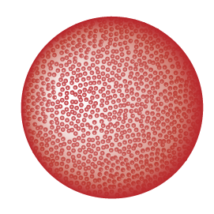
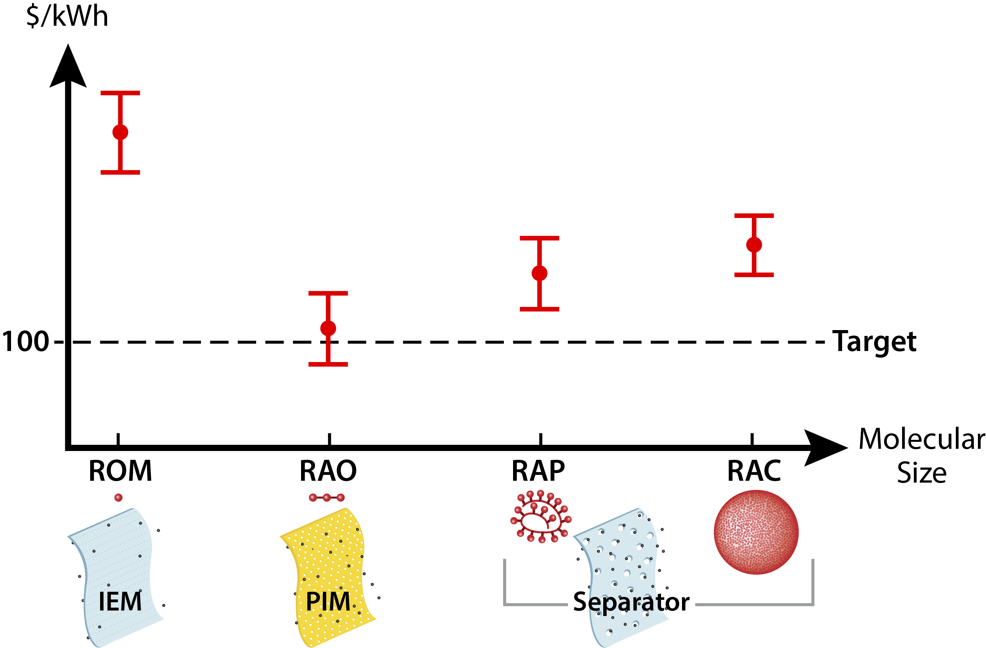
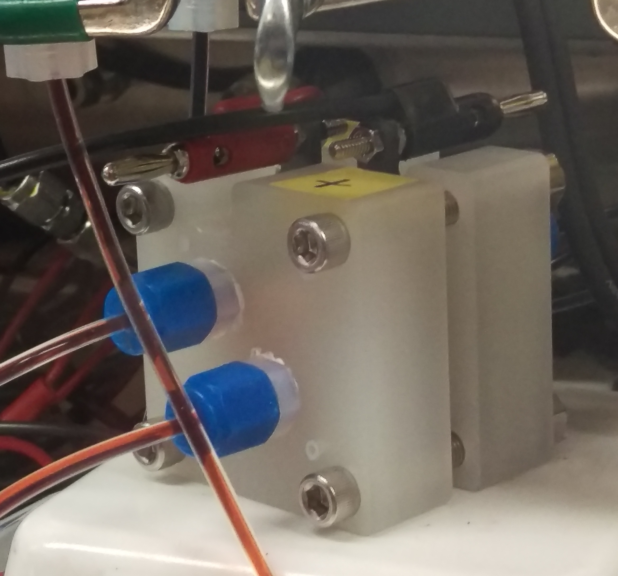
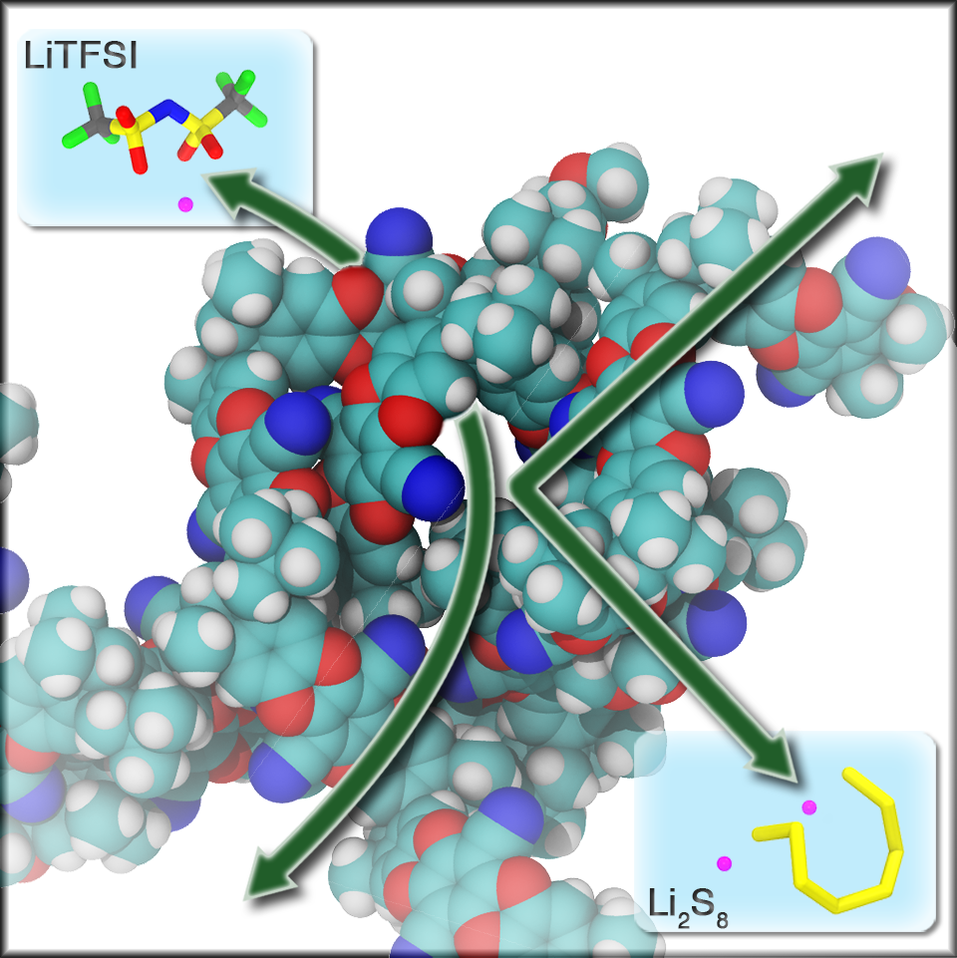
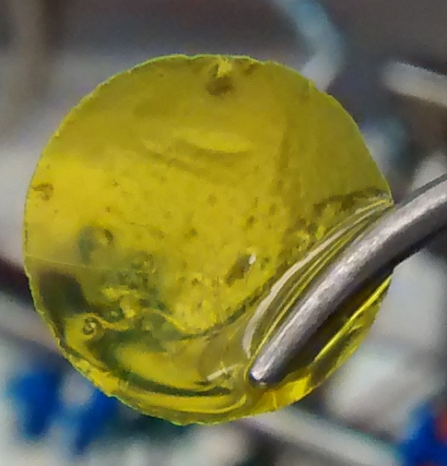
JCESR’s Macromolecular Organic Flow Cell Directions
Full cells of all four types routinely cycled
based on TE modeling
Celgard
Inexpensive
off the shelf
Target for next 18 months
Primary: RAO-PIM for cost target
Secondary: RAP-Celgard for
cost -performance comparison
Polymer Intrinsic Microporous (PIM) membranes developed in JCESR for Li-S polysulfide selectivity
Tunable pore size ~ 1 nm
Li et al., Nano Letters, 15, 5724 (2015)

Slide 26
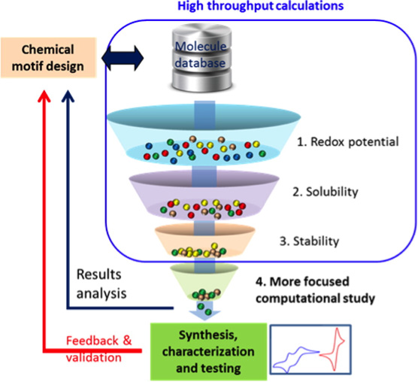
JCESR has opened new avenues for energy storage
e
Opened the “Electrolyte genome” website to the whole scientific community
Discovered breakthrough sulfur-based storage concept that promises low cost
Li metal anode
Li⁺
Sulfur
cathode
Chemical Transformation
Mg⁺⁺
Rational Design of Cathodes and Electrolytes
New Mg Cathodes with Stable, Full-cell Cycling
Enabled a completely new class of redox flow molecules based on macromolecules
Multivalent Intercalation
Non-aqueous Redox Flow

Slide 27
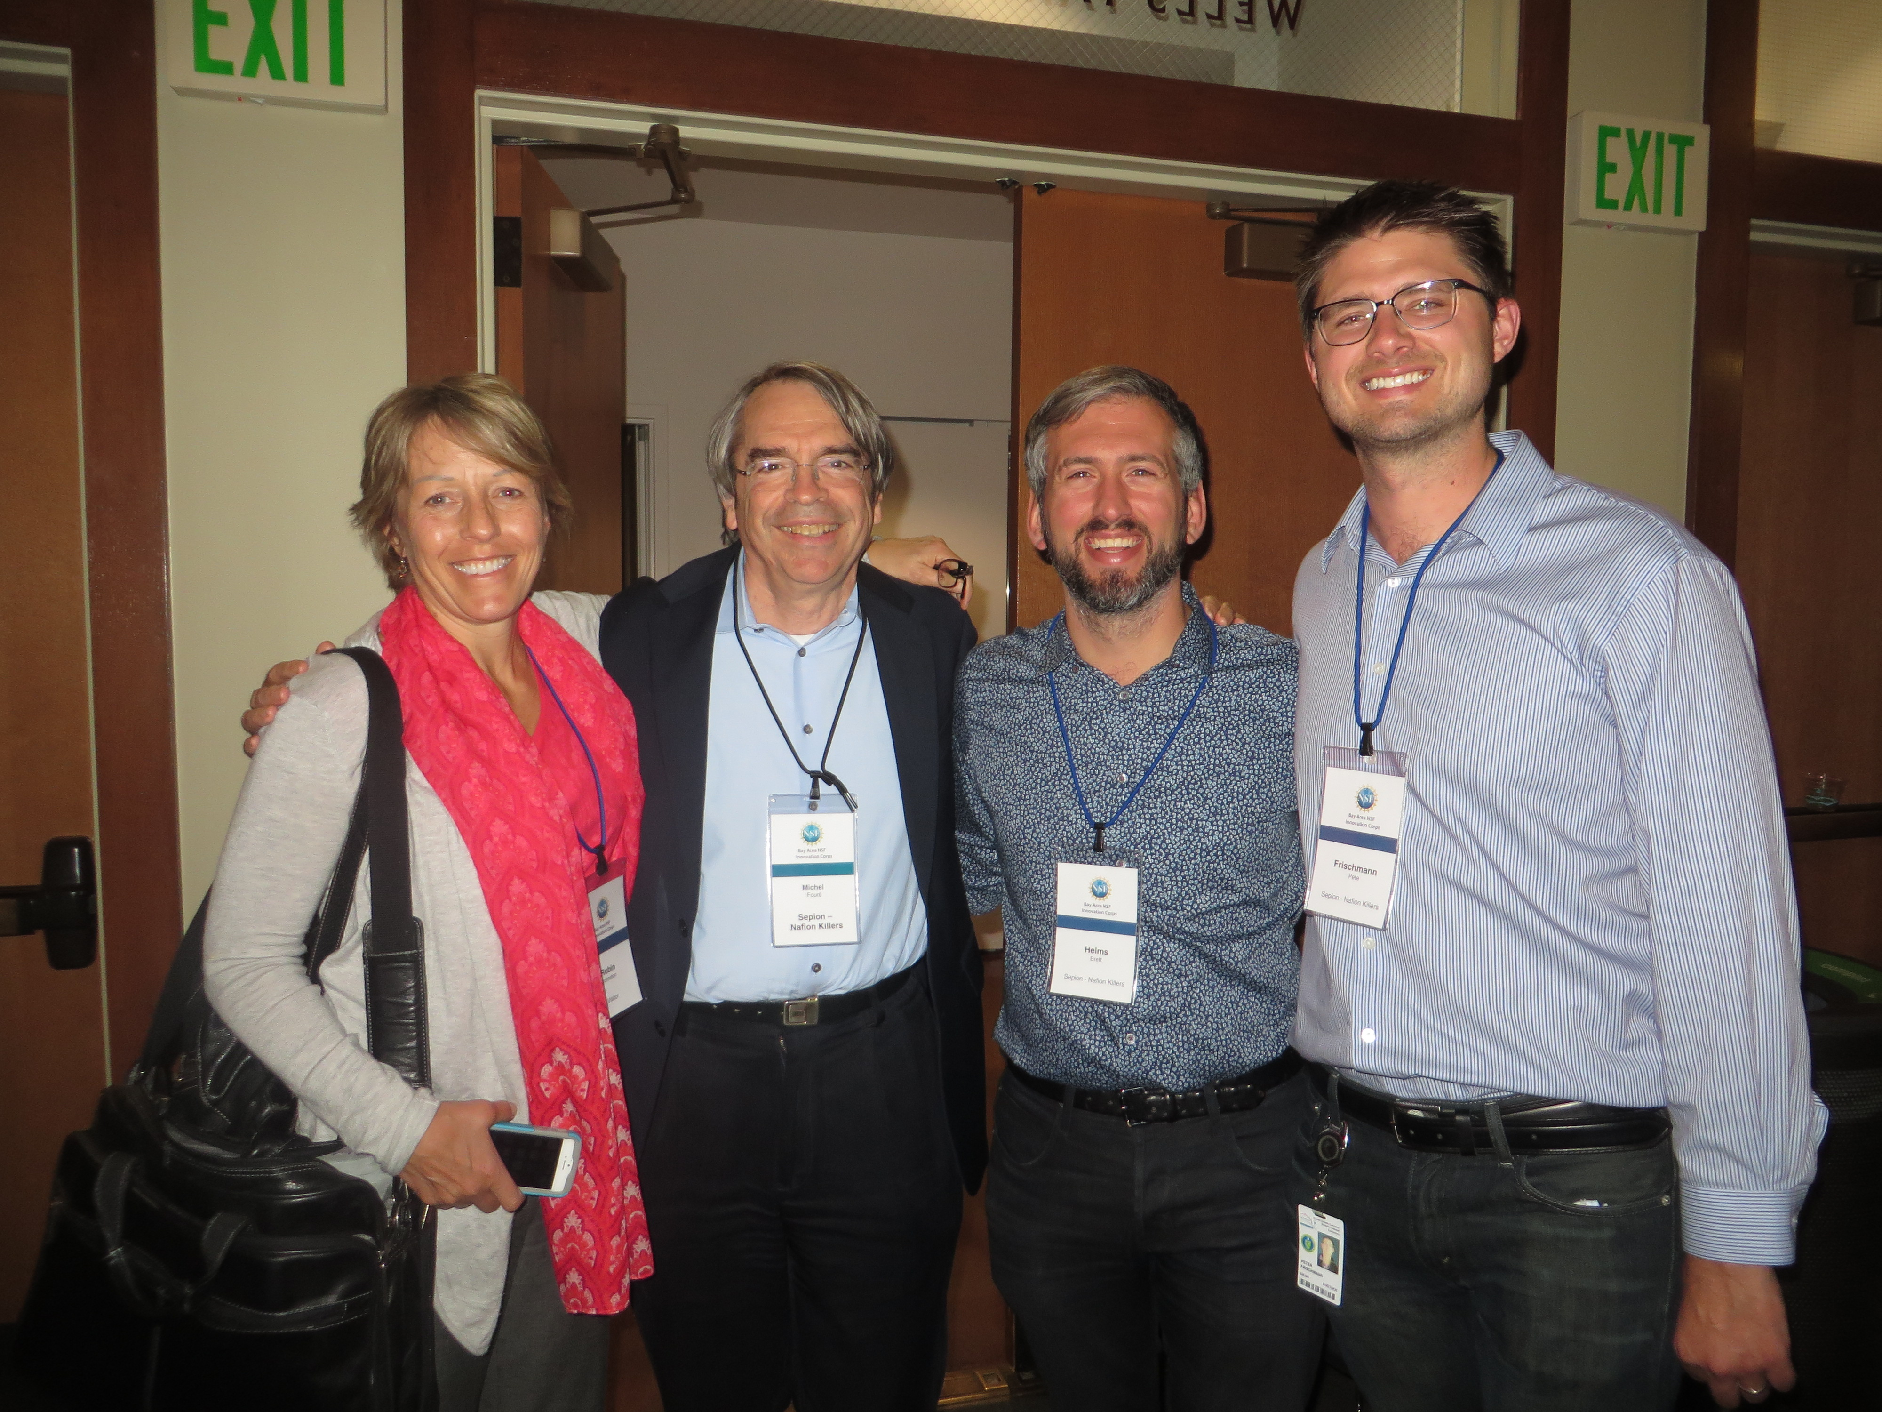
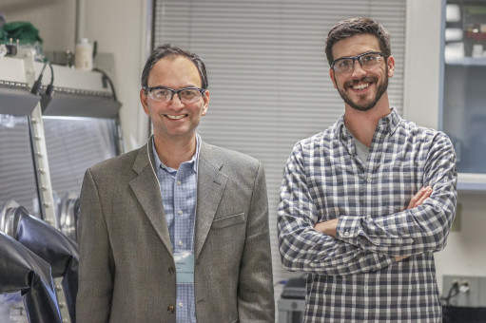
JCESR Intellectual Property
Sepion
44 invention disclosures
26 patent applications
First license to Blue Current
Other licenses under negotiation
Two startup companies by JCESR members
Blue Current
Robin Johnston, Michel Fouré, Brett Helms and Peter Frischmann
Lightweight energy storage
for the electrification of flight
Li et al, Nano Lett. 15, 5724 (2015)
Best All-around Team
Bay Area I-Corps competition
Nitash Balsara, Alex Teran and Joe DeSimone (UNC)
Inorganic-polymer hybrids for Li anode batteries
Villaluenga et al, PNAS 113, 52, (2015)
Engage the private sector
Train next generation entrepreneurs
Build JCESR relationships

Slide 28


Further Reading
JCESR Website
Interactive, visual, engaging
www.jcesr.org
Why Energy Storage May Be the Most Important Technology in the World Right Now
Forbes Apr 1, 2016
Why We Need
A Revolution in Energy Storage
PBS Jan 5, 2016
Frontiers of Energy
Nature Energy Jan 11, 2016
Ten experts, including JCESR’s George Crabtree, share their vision of coming energy challenges
Lithium Batteries: To the Limits of Lithium
Nature Oct 28, 2015
Perspective: The Energy Storage Revolution
Nature Oct 28, 2015
How next-generation storage can change the car and the grid

Slide 29
Supplementary Slides

Slide 30




Community and Congressional Outreach
Regional Events Since July 2015
Mississippi State University Aug 2015
Pacific Northwest Seattle Sep 2015
Bay Area Battery Summit Nov 3 2015
UT Arlington Feb 2016
Congressional Battery Energy Storage Caucus Reps Takano(D-CA) and Collins (R-NY)
Senate Science, Energy and Natural Resources Committee
June 8, 2016
Energy Summit
Phoenix ECS Oct 2015
Keynote: Under Sec’y Lynn Orr
Overviews by JCESR, JCAP and EFRCs
ACS Symposium on QTR
San Diego Mar 13, 2016
Briefing CA delegation
Mar 15, 2016
National Lab Day on the Hill
Apr 20, 2016
  At launch: 45 Affiliates
  Now: 97 Affiliates in 25 States
Annual Affiliates Days
Argonne Mar 2014
UC-Chicago Innovation Exchange May 2015
Chicago area – Fall 2016
Affiliates Newsletter Oct 2015
http://www.jcesr.org/partnerships/affiliates/
With Rep Jerry McNerney (D-CA)
https://twitter.com/RepMcNerney/status/710873658282090496
Berkeley Energy Summit
Nov 3, 2015

Slide 31
JCESR Publications
Cumulative Publications
Peer reviewed journals exclusive of proceedings
Papers by Journal Impact Factor
Q1
Q2
Q3
Q4
Q1
Q2
Q3
Q4
Q1
Q2
Q3
Q4
Q1
Q2
0-5
5-10
10-15
15-20
>20
Y1
Y2
Y3
Journal Impact Factor
Y4
to date
Quarterly Publications
Peer reviewed journals exclusive of proceedings
Citations/Year
Top Ten Papers
764 citations
19 Highly Cited Papers
top 1% for field
1 Hot Paper
top 0.1% for field
ISI Web of Science
May 5, 2016
Q1
Q2
Q3
Q4
Q1
Q2
Q3
Q4
Q1
Q2
Q3
Q4
Q1
Q2
2013
2014
2015
2016
to date
Y1
Y2
Y3
Y4
to date

Slide 32

Institutional Collaboration within JCESR
38% of JCESR papers collaborate across JCESR institutions
Fruchterman-Reingold force-directed graph: springs between nodes
  Attractive force: number of collaborative papers
  Artificial repulsive force to keep nodes from collapsing
  Nodes near the center are most collaborative
Matt Shapiro
Political Science
Illinois Institute of Technology

Slide 33

Institutional Collaboration with the Broader Community
Collaboration with 58 non-JCESR institutions
Engaging the community
Tapping valuable resources
Matt Shapiro
Political Science
Illinois Institute of Technology

Slide 34

Personal Collaboration within JCESR
Nodes near the center are more collaborative
Matt Shapiro
Political Science
Illinois Institute of Technology

Slide 35

Personal Collaboration with the Broader Community
> 300 Non-JCESR collaborators
Building relationships
Tapping intellectual resources
Matt Shapiro
Political Science
Illinois Institute of Technology

