Slide 1
Basic Energy Sciences Update
BES Advisory Committee Meeting
June 9, 2016
Harriet Kung
Director, Basic Energy Sciences
Office of Science, U.S. Department of Energy

Slide 2
Outline
Staffing Update
Program Highlights
  Energy Frontier Research Centers
  Catalysis Research Highlights
  NSLS-II Update
FY 2017 Budget Request & Appropriation Status
Follow-up to BESAC Transformative Opportunities Report

Slide 3
Office of Basic Energy Sciences
BES Operations
Kerry Hochberger, Program Support Specialist
Robin Hayes, Program Manager
Natalia Melcer, Program Manager
Katie Runkles, Program Analyst / BESAC*
Andy Schwartz, Senior Technical Advisor for EFRCs*
BES Budget and Planning
Vacant, Financial Management
Donetta Herbert, Financial Management
Thomas Russell, Senior Technical Advisor
Harriet Kung, Director
Wanda Smith, Administrative Specialist
* Basic Energy Sciences Advisory Committee
* Energy Frontier Research Centers
Materials Sciences and
Engineering Division
Scientific User Facilities Division
Chemical Sciences, Geosciences,
and Biosciences Division
Linda Horton, Director
Teresa Crockett, Program Analyst
Vacant, Secretary
James Murphy, Director
Vacant, Program Support Specialist
Rocio Meneses, Program Assistant
Gail McLean, Acting Director
Diane Marceau, Program Analyst
Vacant, Program Assistant
Joshua Haines, Science Assistant
Materials Discovery, Design, and Synthesis
Arvind Kini
Vacant, P.A.
Condensed Matter and Materials Physics
Jim Horwitz
Marsophia Agnant, P.A.
Scattering and Instrumentation
Sciences
Helen Kerch
Vacant, P.A.
Fundamental Interactions
Jeff Krause
M. Kyler-Leon, P.A.
Photochemistry and
Biochemistry
Gail McLean
Vacant, P.A
Chemical Transformations
Raul Miranda
Vacant, P.A.
Operations
Construction
Materials Chemistry
Craig Henderson
Michael Sennett
Kelly Perry
Experimental Condensed Matter Physics
Michael Pechan
X-ray Scattering
Lane Wilson
X-ray and Neutron Scattering Facilities
Peter Lee
Jim Rhyne
Linac Coherent Light Source-II
Phil Kraushaar
Atomic, Molecular, and Optical Sciences
Tom Settersten
Solar Photochemistry
Mark Spitler
Christopher Fecko
Catalysis Science
Viviane Schwartz
Chuck Peden
Vacant
Biomolecular Materials
Mike Markowitz
Theoretical Condensed Matter Physics
Jim Davenport
Matthias Graf
Neutron Scattering
Thiyaga P. Thiyagarajan
NSRCs **
George Maracas
Tof Carim
Facilities Upgrades and
MIE*** Projects
Phil Kraushaar
Ed Stevens
Gas Phase
Chemical Physics
Wade Sisk
Photosynthetic Systems
Stephen Herbert
Separations and Analysis
Philip Wilk
Vacant
Synthesis and Processing Science
Bonnie Gersten
Physical Behavior
of Materials
Refik Kortan
Kelly Perry
Electron and Scanning Probe Microscopies
Jane Zhu
Kelly Perry
Accelerator and Detector Research
Eliane Lessner
*** Major Items of Equipment
Condensed Phase and Interfacial Molecular Science
Gregory Fiechtner
Physical Biosciences
Robert Stack
Heavy Element Chemistry
Philip Wilk
Batteries and Energy Storage Hub;
Technology Coordination Craig Henderson
John Vetrano
Mechanical Behavior
and Radiation Effects
John Vetrano
Experimental Program to
Stimulate Competitive Research (DOE EPSCoR)
Tim Fitzsimmons
Facilities Coordination; Metrics; Assessment
Van Nguyen
Computational and Theoretical Chemistry
Mark Pederson
Fuels from Sunlight
Energy Innovation Hub
Christopher Fecko
Geosciences
James Rustad
L E G E N D
** Nanoscale Science Research Centers
On detail to OSTP
Detailee from DOE Laboratory
IPA from BMI/PNNL
P.A. Program Assistant
New
Vacancy
June 2016
Posted 01 June 2016

Slide 4
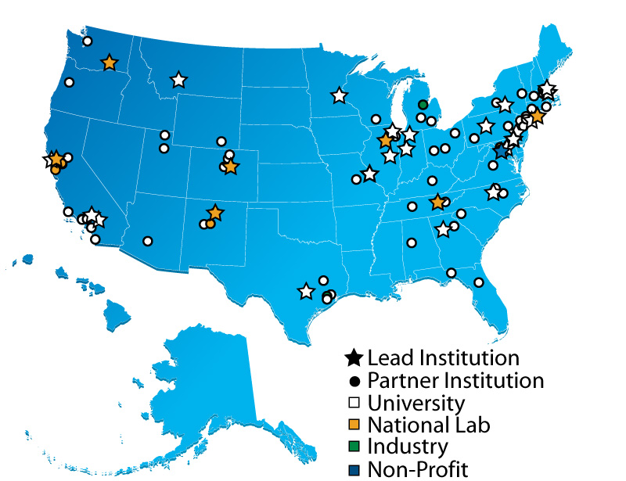
Energy Frontier Research Centers
Current Status
  Over 100 participating institutions, located in
  33 states plus the District of Columbia
Advisors from:
12 countries
29 states
Website: http://science.energy.gov/bes/efrc/
Data updated on 6/6/2016
4

Slide 5
Energy Frontier Research Centers
Accomplishments
*Based on 2014 DOE Technology Transfer Report
5

Slide 6

















































































Companies that Benefit from EFRC Research

Slide 7

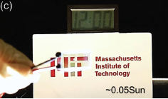


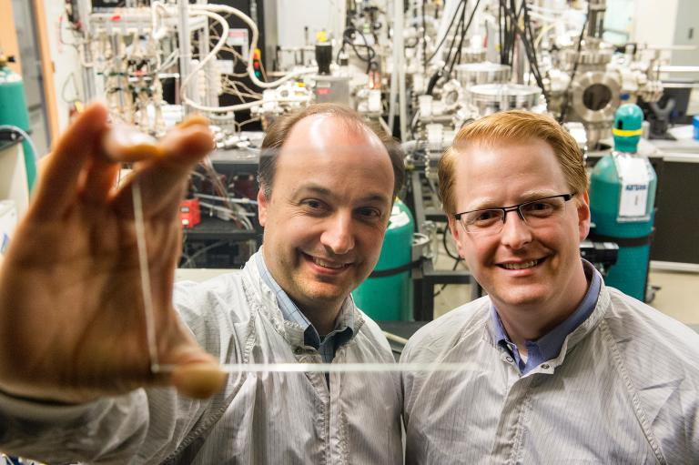
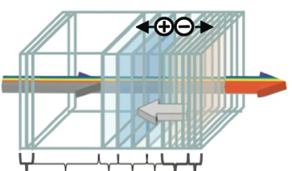


EFRC Impact: World’s First Truly Transparent Solar Technology
Basic Science
Applied R&D
Manufacturing/
Commercialization
Transparent solar cells first demonstrated at MIT as part of the Center for Excitonics EFRC
Improve efficiency and transparency
of solar cells
Mission: To eliminate the battery lifetime limitations of mobile devices and power smart glasses for buildings
A thin film that covers the display area of electronic products - including wearables, tablets, internet-of-things devices, and digital signage - generates electricity to power these devices.
Ubiquitous Energy was established in 2011 as a spin-out of Vladmir Bulovic’s EFRC work on solar energy harvesting
Organic films generate electricity at low cost from ambient light.
A window coating
to offset building energy consumption.
Cells are transparent by selectively transmitting visible light, while harvesting invisible ultraviolet and near-infrared light into electricity.
Vladimir Bulovic, Miles Barrr,
and Richard Lunt (not shown),
co-founders of Ubiquitous Energy
Ubiquitous Energy has a pilot facility in CA, raised over $8M to date, and won numerous awards including the 2015 Display Week Innovation Award
Center for Excitonics EFRC
Follow-on funding by NSF SBIR/ STTR
Photograph by Justin Knight

Slide 8
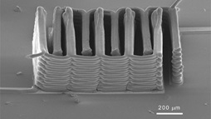




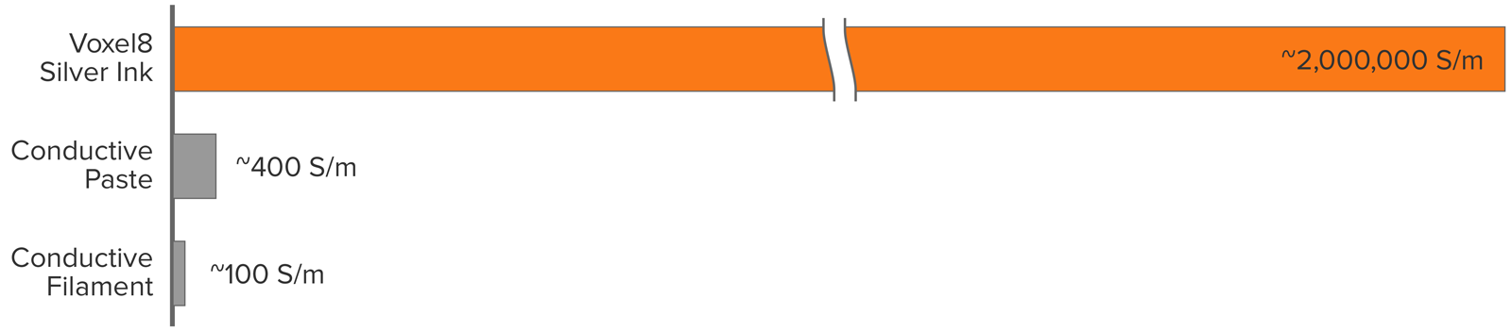

EFRC Impact: World’s First 3D Electronics Printer
BES Science
Commercialization
Designed inks critical to 3D printing of customized electronics
Start-up company formed to commercialize Jennifer Lewis’ work on conductive inks and 3D printed batteries
3D printed Liithium-ion microbattery created with new electro-chemically active inks
This VC-backed venture has raised $14.5M since its inception in Fall 2014, and has grown to more than 25 full-time employees.
Laser-assisted direct writing with conductive ink creates unsupported 3D shapes
As printed ink at room temperature is 5000x more conductive than conductive pastes and filaments currently used in additive manufacturing.
Voxel8 will be shipping its first commercial product, a desktop 3D electronics printer in May 2016.
One of the 9 best ideas at CES 2015 – FAST Company
One of the 50 smartest companies – MIT Technology Review
Light-Material Interactions in Energy Conversion EFRC
Research supported by the DOE LMI EFRC and
DOE BES Core program
Images courtesy of Voxel8 and Jennifer Lewis

Slide 9
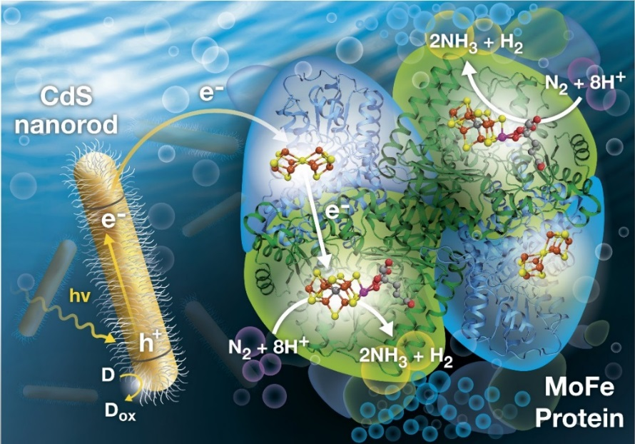





EFRC/Core Research:
Light-Driven N₂ Reduction by a CdS:MoFe Protein Biohybrid
Scientific Achievement
Achieved light-driven reduction of nitrogen (N₂) to ammonia (NH₃) by coupling nitrogenase enzyme to light-harvesting nanorods.
Significance and Impact
The chemical process for making NH₃ uses
2-4% of the world’s energy supply. These results, using light energy to drive electrons into the catalytic center of the enzyme, can guide development of novel electrocatalysts for N₂ reduction and NH₃ synthesis.
Light-driven N₂ reduction catalyzed by CdS:nitrogenase molybdenum iron protein complex
Brown et al., Science, 2016 352: 448; doi: 10.1126/science.aaf2091
Research Details
In biology, an adenosine 5’-triphosphate (ATP)-dependent electron transfer mechanism drives reduction of N₂ to NH₃ by the enzyme nitrogenase; however, this requires significant amounts
of ATP.
Electrons were effectively delivered from photoactivated cadmium-sulfide (CdS) nanorods to nitrogenase to achieve N₂ reduction; all energy came from light with electrons coming from a sacrificial donor.
Relatively high rates of N₂ reduction were achieved: approximately 70% of the normal enzyme rate. This research shows photochemical (light) energy substitute for ATP in a biological system.

Slide 10

2016 EFRC Mid-Term Reviews
  2014 Funding Opportunity Announcement stated that “… funding for the final two years is contingent upon satisfactory completion of an extensive progress review …”
  Written review documents and one-day reverse site visit for each EFRC
  12 Peer review panels (January – March 2016)
    68 reviewers
    Each panel reviewed 2-3 centers; each reviewer provided independent reviews
  Guidance letters sent to EFRCs in early May
    19 Action Items; Responses required
    22 Recommendations
    Some funding
    adjustments
Characteristics of a Successful EFRC
A compelling mission
that everyone understands and embraces
Active management
to evaluate progress and redirect resources in response to promising new opportunities
High-risk research
that would not be attempted by individual investigators
Synergy
among researchers working toward collectively developed objectives.
Accelerated success and failure
enabling adjustments and key decisions that lead to the most impactful science
Training the next generation of scientists
in collaborative research, including students, postdocs and other early-career scientists.

Slide 11
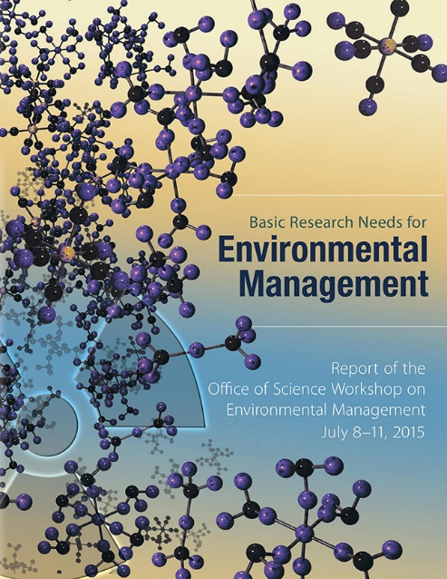
2016 EFRC FOA on Environmental Management Research
To support multi-disciplinary basic research teams in two topical areas of relevance to the DOE environmental management mission:
  Novel and innovative methods for characterization, transformation, and separation of nuclear waste
  New materials for long-term storage of nuclear waste, including waste forms
Applications must:
  Address relevant Priority Research Directions identified in the Basic Research Needs for Environmental Management report
  Address BESAC “grand challenges” and embody “transformative opportunities”
Funding level per Award: $2M to $4M per year for 4 years (3-5 awards) for a total of $10M
Award announcements expected by July
http://science.energy.gov/~/media/bes/pdf/reports/2016/BRNEM_rpt.pdf

Slide 12
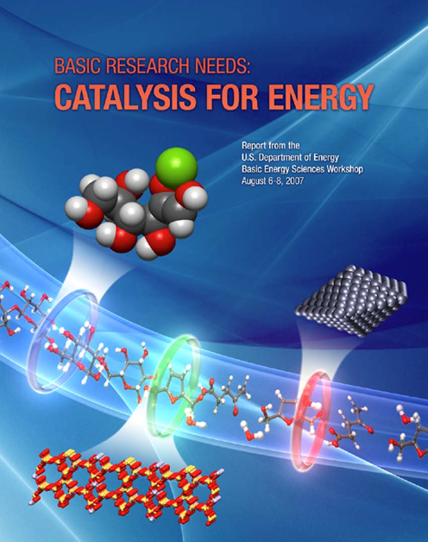
Catalysis for Energy Production and Utilization
Catalytic Solutions for Alternative Energy
Hydrogen fuels
Electrocatalysts for fuel cells
Biomass to liquid fuels
Solar energy to fuels
Grand Challenges in Catalysis – Basic Research Needs (2007)
  Catalysts for the conversion of heavy fossil energy feedstocks
  Catalysts for the conversion of biologically derived feedstocks
  Catalysts for the photo- and electro-driven conversion of carbon dioxide and water

Slide 13
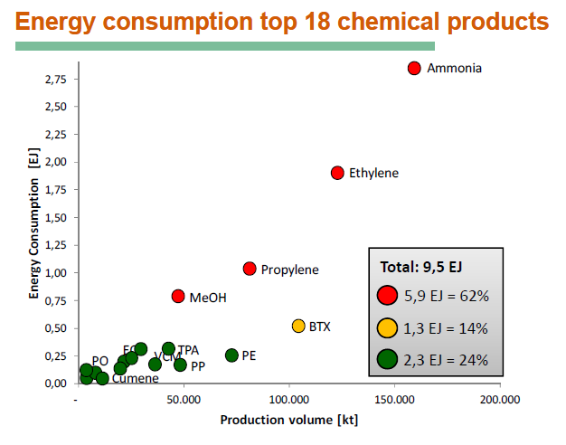
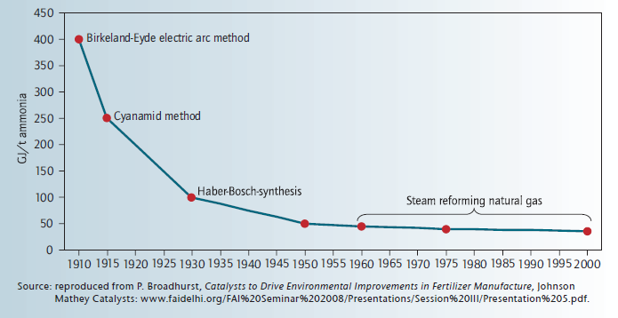
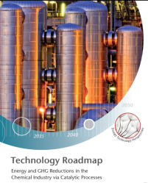
Catalysis:
A growing role in chemical manufacturing
Efficiency gains by catalysis enabled large-scale NH₃ & H₂ production
Ammonia
Catalytic Haber-Bosch and Steam-Reforming Processes Invented and Improved
Ethylene
Propylene
MeOH
  Fossil fuels provide a significant amount of production energy chemical products
  90% of chemical manufacturing and nearly all petroleum refining processes employ catalysts. The top 18 chemical products consume 9.5 EJ and are projected to reach 13 EJ by 2050.
  Catalysts for fuels, chemicals and pharmaceuticals are >$16B/year business worldwide. Ethylene and Propylene derived directly from fossil fuels.

Slide 14
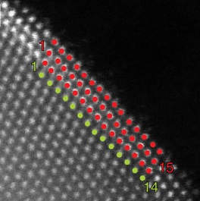
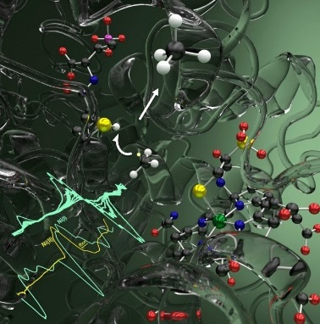
Catalysis Research Highlights:
Insights into Catalytic Mechanisms
  Unique Surface Structures Enhance Oxygen Reduction Synthesis and characterization of novel palladium-platinum core-shell catalysts revealed enhanced oxygen reduction activity. This result suggests shape-controlled synthesis can maximize reaction activity and use of core-shell structures can minimize the amount of expensive platinum while enhancing activity.
  X. Wang et al., GA Tech, ASU, U. Wisc, & ORNL, Nature Communications 6, 7594 (2015)
  Synthetic Enzyme Strategy for Transition Metal Catalysis
  A catalytic pathway for carbon-carbon bond formation was created through a development of a bio-inspired catalyst. The synthetic metal-organic assembly promoted carbon-carbon bond formation at transition metal centers and could enable new cross coupling technology.
  D.M. Kaphan et al., LBNL & UC-Berkeley, Science 350, 1235 (2015)
  Nature Uses a Radical Way to Make - or Activate – Methane
  The enzyme methyl-coenzyme M reductase (MCR) catalyzes the final step of methane synthesis and may catalyze the first step of methane oxidation. A combined biochemical and computational approach determined a key MCR reaction intermediate and could enable new catalyst design.
  T. Wongnate et al., U.Mich. & PNNL, Science 352, 953 (2016)
14

Slide 15
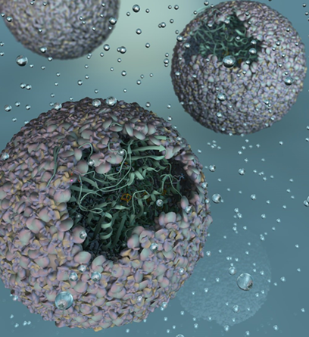
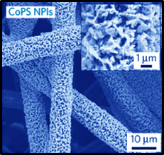
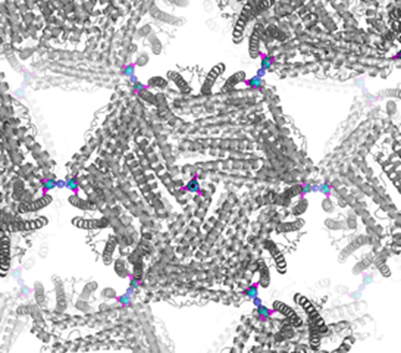
Catalysts Research Highlights:
Novel Synthesis Routes
  Nano-sized Bioreactors Increase Catalytic Activity
  Directed assembly of a hydrogen-producing enzyme within a virus protein shell created a highly active and stable catalytic material. These nanoreactors represent a new class of bio-inspired materials that are easily and sustainably made at room temperature. The encapsulated enzyme is nearly 150-fold more catalytically active than the puriﬁed, free enzyme for converting water to hydrogen.
  T. Douglas, Indiana University, Nature Chemistry 8, 179 (2015)
  Synthesis Confirms Predicted Improvement in Catalyst Performance
  Nanoplates of a pyrite-type cobalt phosphor-sulfide (CoPS) catalyst were synthesized by chemical substitution. The synthesis strategy was based on theoretical predictions that replacing the sulfur in CoS₂ with the more electron-donating phosphorus would improve its catalytic properties. Films achieved a 4.7% solar-to-hydrogen efficiency for water splitting.
  S. Jin, University of Wisconsin, Nature Materials 14, 1245 (2015)
  New Class of Porous Media Made of Proteins, Metal, and Organics
  The cage-like protein ferritin was engineered to have metal hubs on its surface with organic molecules bridging the hubs, controllably creating a new class of porous, crystalline material with potential applications ranging from catalysis to separations.
  F. A. Tezcan, University of California, San Diego, J. Am. Chem. Soc.137, 11598 (2015)
15

Slide 16
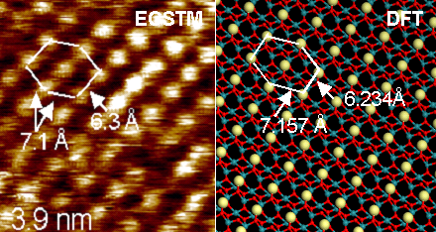
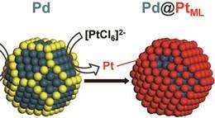
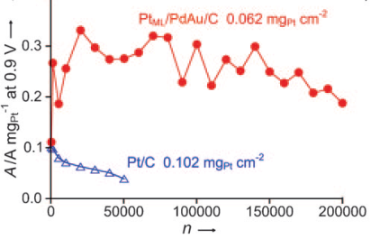

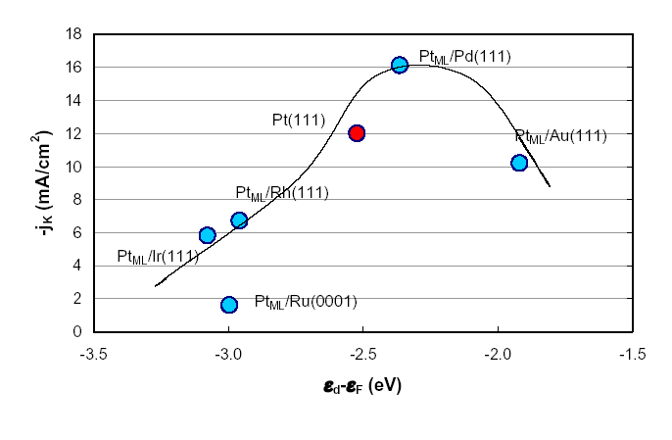


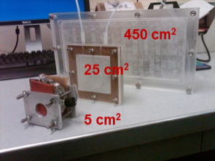

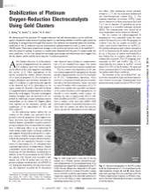

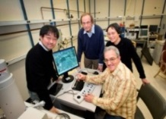

Advanced Fuel Cell Electrocatalysts
BES
Basic Science
EERE Fuel Cell Office
Applied Research
Industrial Collaboration
Toward Deployment
Principles and methods for monolayer electrocatalysis.
Core-shell electrocatalysts developed for high activity and durability with ultralow Pt mass.
Performance and durability in subsystem membrane electrode assemblies, licensing, manufacture methods
Developed syntheses for nanoscale core-shell catalysts with monolayer control.
Excellent fuel cell durability 200K cycles with Toyota
In-situ electrochemical studies of structure and catalytic activity of single atomic layers
Licensed to NECC, manufacturing
scale-up.
Discover and develop high activity monolayer platinum catalysts.
Enhanced Pt-mass weighted activity 10x. Scale-up synthesis led to membrane electrode assemblies with good performance.
Excellent electrolyzer performance, >10x reduced Pt mass with Proton OnSite.
Metal alloys to improve durability
High performance, low Pt electrocatalysts ready for applications in fuel cell vehicles and hydrogen generation.
Core-shell electrocatalysts >100 publications 2001-14
>8000 citations
R&D 100
Award

Slide 17

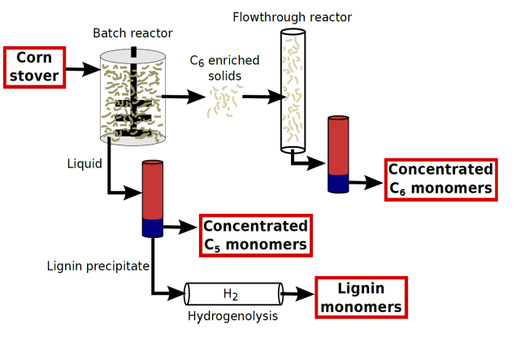

Efficient Lignocellulosic Biomass Conversion in γ-Valerolactone
Basic Science
Applied R&D
Manufacturing/
Commercialization
Use of γ-valerolactone (GVL) as a solvent increases rates and selectivities for acid-catalyzed biomass conversion processes compared to water by decreasing the solvation of protons.
Lignocellulosic biomass is fractionated into concentrated solutions of C₆ sugars, C₅ sugars, and solid lignin in GVL solvent.
TriVersa ProcessTM
Science 343, 277 (2014)
Diverse
High
Biomass
Loading
Angew. Chem. 126, 12066 (2014)
Simultaneous
Deconstruction and Refinement
Biomass
High Yielding
>95% C₅
> 90% C₆
> 95% L
Product Purity
Furfural >98%
Cellulose >96%
Lignin >98%
Pure
Revenue Hat Trick
$
Three Product Co-Production =
Cost Disruption
The process separates ligno-cellulosic biomass into its three main components, cellulose, hemicellulose, and lignin. All three fractions can then be upgraded separately into high value products without diminishing the value of any of the fractions.
No Enzymes or Microbes
RH^{+†}
ΔG_{act}(org)
f*ΔG(H⁺)_{solv}
Glucan Biorenewables, LLC is scaling up the technology to produce furfural from C₅ sugars, high purity cellulose and glucose from C₆ sugars, and lignin monomers from lignin using GVL as solvent
HB, R
Gibbs Free Energy
ΔG_{act}(H₂O)
ΔG(H⁺)_{solv}
H⁺, R
Reaction Coordinate
17

Slide 18
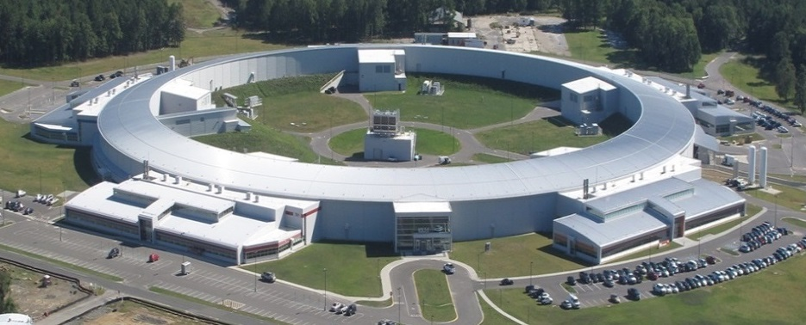
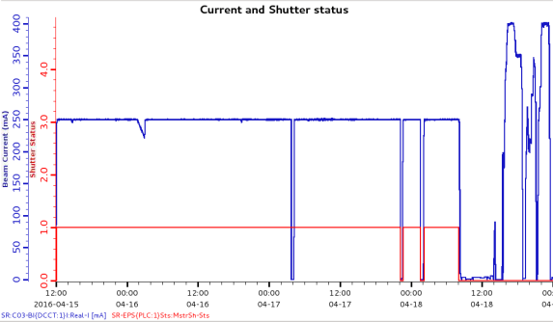
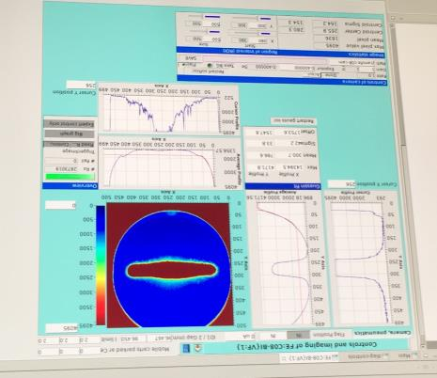
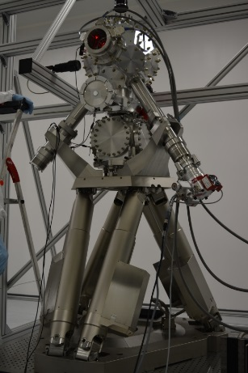
National Synchrotron Light Source-II
First light achieved on October 23, 2014; CD-4 approved on March 19, 2015
All project beamline insertion devices commissioned and front-ends are conditioned and certified for 250 mA operations; 5 of 7 project beamlines are in GU program
Successfully stored 400 mA in the storage ring on April 18, 2016
Routine Top-off operation at 250 mA started during 2016-1 run-cycle and will continue in the 2016-2 run-cycle
400 mA
250 mA
First light at Inner Shell Spectroscopy (ISS) beamline, one of the NEXT MIE project beamlines, was delivered on April 5th, 2016 and the light to the experimental end-station on April 13th, 2016
Experimental Chamber installed
18

Slide 19
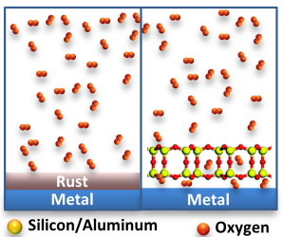
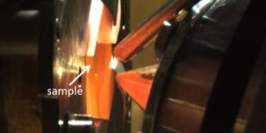


Ultrathin Nanoporous Coatings Prevent Metals from Rusting
Scientific Achievement
  The oxidation of a ruthenium surface was studied as a function different ultra-thin coatings comprised of inexpensive materials (silicon and aluminum). A collaboration among researchers from the CFN, NSLS-II, and U. of Minnesota found that ultrathin (~0.5 nm), nanoporous, and crystalline coatings comprised these materials (aluminosilicates that act as model two-dimensional molecular barriers), prevent the surface from oxidation at conditions under which the ruthenium metal would normally oxidize.
Significance
Provide critical insights on (i) chemical reactions within confined nanospaces, and (ii) industrially relevant reactions, such as the conversion of methanol into gasoline.
1st publication from CSX-2 beamline, commissioned in 2015 and will begin general user operations in the summer of 2016
CFN Capability
CFN’s Ambient Pressure Photoelectron Spectroscopy endstation at the CSX-2 beamline of NSLS-II was used to follow the chemical state of the ruthenium surface at oxidizing and reducing conditions, namely at elevated pressures of oxygen and hydrogen at elevated temperatures.
Top: Schematic of the rusting of a metal with and without the nanoporous coating. Bottom: A heated sample at the AP-PES endstation.
J.-Q. Zhong, et al., J. Phys. Chem. C (2016)

Slide 20
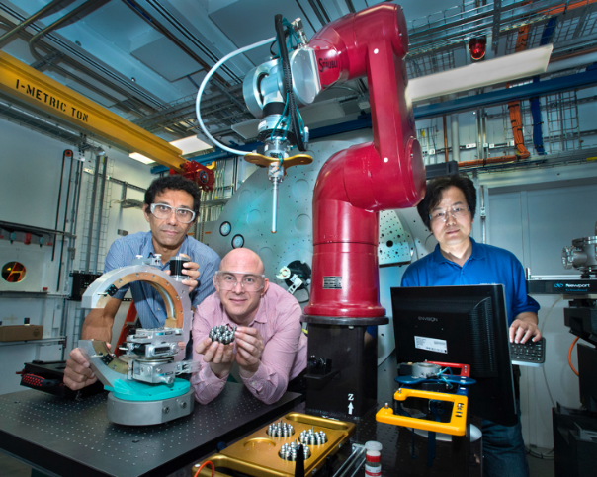
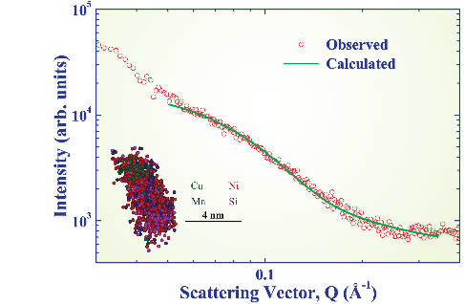
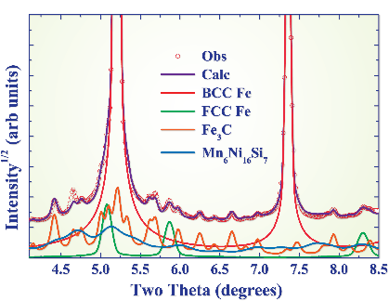


Understanding Radiation Induced Embrittlement of Steel
(a)
Scientific Achievement
Using complementary techniques to identify, for the first time, the crystal structure of the Mn–Ni–Si nanoprecipitates that cause embrittlement and degradation of steel in nuclear reactor pressure vessels
Significance and Impact
Improved predictions of material performance for the life extension of nuclear reactors. Maintaining the existing fleet of commercial reactors is essential to meeting carbon reduction goals.
(b)
(c)
Research Details
  Nanoprecipitates form due to radiation damage in reactor vessel steels. The process is a complex function of metallurgical variables (microstructure, alloying elements) and irradiation conditions (flux, fluence, temperature)
  Robot at a NSLS-II synchrotron beamline was used to collect X-ray data on hundreds of irradiated (radioactive) steels
  Data are used to inform thermodynamic modeling of nanoprecipitate formation and stability
(a) Robot installed at NSLS-II (b) small-angle and (c) wide-angle X-ray scattering profiles from an irradiated RPV sample. The inset of (b) shows the shape of a precipitate from atom probe tomography. The phase components are overlaid in (c) for reference
D.J. Sprouster et al., Scripta Mat. 113, 18 2016
Work was performed at Brookhaven National Laboratory

Slide 21
FY 2017 BES Budget Request
Research programs (w/SBIR/STTR)
  Energy Frontier Research Centers (Δ = +$33.8M)
  Computational Chemical Sciences (new, $14M)
  Core Research* with increase for Mission Innovation and other new opportunities, including quantum materials, synthesis science, and subsurface science (Δ = +$52M)
  Energy Innovation Hubs & Computational Materials Sciences
FY 2017 Request:
$1,936.7M
(+$87.7M from FY 2016)
SUF Research 26.9
SBIR/STTR, LTSM & GPP
73.7
Construction
MIE
210
NSRCs 122.3
EFRCs, Hubs, CM&CS
207.3
Neutron Sources
261.1
Facilities
Ops 872.5
CSGB
Research
256.8
Light Sources
489.1
MSE
Research
289.5
  Scientific user facilities (w/SBIR/STTR)
    All full operating facilities at optimal operations (Δ = +$7.5M)
    Accelerator and Detector Research (Δ = +$4.8M)
Construction and instrumentation
  Advanced Photon Source Upgrade
  Linac Coherent Light Source-II (Δ = -$10.3M)
*Includes EPSCoR

Slide 22
FY 2017 SC Marks: HEWD vs. SEWD
HEWD Mark
$ in K | FY 16 Approp. | FY 17 Request | FY 17 HEWD | FY 17 HEWD vs. FY 16 |  | FY 17 HEWD vs. FY 17 Req.
SC Total | 5,347,000 | 5,572,069* | 5,400,000 | +49,800 | +0.9% | -172,069 | -3.0%
ASCR | 621,000 | 663,180 | 621,000 | — | — | -42,180 | -6.4%
BES | 1,849,000 | 1,936,730 | 1,859,972 | +10,972 | +0.6% | -76,758 | -4.0%
BER | 609,000 | 661,920 | 595,000 | -14,000 | -2.3% | -66,920 | -10.1%
FES | 438,000 | 398,178 | 450,000 | +12,000 | +2.7% | +51,822 | +13.0%
HEP | 795,000 | 817,997 | 823,009 | +28,009 | +3.5% | +5,012 | +0.6%
NP | 617,100 | 635,658 | 620,000 | +2,900 | +0.5% | -15,658 | -2.5%
SEWD Mark
$ in K | FY 16 Approp. | FY 17 Request | FY 17 SEWD | FY 17 SEWD vs. FY 16 |  | FY 17 SEWD vs. FY 17 Req.
SC Total | 5,347,000 | 5,572,069* | 5,400,000 | +49,800 | +0.9% | -172,069 | -3.0%
ASCR | 621,000 | 663,180 | 656,180 | +35,180 | +5.7% | -7,000 | -1.1%
BES | 1,849,000 | 1,936,730 | 1,912,630 | +63,630 | +3.4% | -24,100 | -1.2%
BER | 609,000 | 661,920 | 637,000 | +28,000 | +4.6% | -24,920 | -3.8%
FES | 438,000 | 398,178 | 280,110 | -157,890 | -36.0% | -118,068 | -29.7%
HEP | 795,000 | 817,997 | 832,997 | +37,997 | +4.8% | +15,000 | +1.8%
NP | 617,100 | 635,658 | 635,658 | +18,558 | +3.0% | — | —
*The number excludes the $100M mandatory spending.
22

Slide 23
FY 2017 BES HEWD Mark
The Committee recommends $1,859,972,000 for Basic Energy Sciences, $10,972,000 above fiscal year 2016 and $76,758,000 below the budget request.
Research
  Within available funds, the recommendation includes $97,800,000 for Energy Frontier Research Centers; $10,000,000 for the Experimental Program to Stimulate Competitive Research (EPSCoR); $12,000,000 for Computational Materials Sciences; and the requested level of $24,088,000 for the fifth year of the Batteries and Energy Storage Innovation Hub.
  The Committee encourages the Department to support ongoing research in polymers and optoelectronics.
  Within available funds, the recommendation includes the requested level of $15,000,000 for the second year of the second five-year term of the Fuels from Sunlight Innovation Hub.
Scientific User Facilities
  The recommendation includes $978,529,000, of which $35,000,000 is for the Advanced Photon Source upgrade (APS-U). The recommendation includes the requested levels for facilities operations of the nation’s synchrotron radiation light sources, high flux neutron sources, and nanoscale science research centers.
Construction
  The Committee recommends $190,000,000 for Basic Energy Sciences construction (LCLS-II), the same as the request.
23

Slide 24
FY 2017 BES SEWD Mark
The Committee recommends $1,912,630,000 for Basic Energy Sciences, $63,630,000 above fiscal year 2016 and $24,100,000 below the budget request.
The Committee recommends $26,000,000 for exascale systems, the same as the crosscut request for fiscal year 2017 (Computational Materials and Chemical Sciences). The Committee recommends $24,088,000 for the Batteries and Energy Storage Hub, the Joint Center for Energy Storage Research [JCESR]. The Committee recommends $15,000,000 for the Fuels from Sunlight Hub, the Joint Center for Artificial Photosynthesis [JCAP]. The Committee recommends $20,000,000 for the Experimental Program to Stimulate Competitive Research [EPSCoR].
Within the funds provided, $3,000,000 is to continue to work on a new generation of nanostructured catalysts that can be used to synthesize fertilizer and ammonia without any secondary greenhouse gases.
The Committee further encourages the Secretary to undertake additional efforts to perform energy research activities related to enhanced efficiency in energy conversion and utilization, including emergent polymer technologies, with a focus on infrared optoelectronic devices to ensure continued competitiveness in a global marketplace.
The Committee recommends funding for optimal operations $489,059,000 for the five BES light sources. The Committee recommends $265,000,000 for high-flux neutron sources, which will allow for both Spallation Neutron Source [SNS] and High Flux Isotope Reactor [HFIR] to proceed with the most critical deferred repairs, replace outdated instruments, and make essential machine improvements. Further, the Committee recommends optimal funding for the Nanoscale Science Research Centers, and supports the development of capabilities with co-located facilities.
The Committee is aware the Department did not provide adequate funding within Major Items of Equipment for the Advanced Photon Source Upgrade (APS-U), which received approval for CD–1 in January 2016, and is ready to move ahead with design and procurement. The Committee rejects this approach, and provides $50,000,000 for construction, as previously recommended by the Department.
The Committee recommends $190,000,000 to support the continuation of the construction effort for LCLS–II.
24

Slide 25
FY 2017 BES Marks: HEWD vs. SEWD
HEWD Mark
SEWD Mark
 | FY 2016 Approp. | FY 2017 Request | FY 2017 House | FY 17 House vs. FY 16 Approp. |  | FY 17 House vs. FY 17 Request
BES Total | 1,849,000 | 1,936,730 | 1,859,972 | +10,972 | +0.6% | -76,758 | -4.0%
MSE & CSGB | 681,851 | 783,201 | 691,443 | +9,592 | +1.4% | -91,758 | -11.7%
SUF | 966,849 | 963,529 | 978,529 | +11,680 | +1.2% | +15,000 | +1.6%
Construction | 200,300 | 190,000 | 190,000 | -10,300 | -5.1% | — | —
 | FY 2016 Approp. | FY 2017 Request | FY 2017 Senate | FY 17 Senate vs. FY 16 Approp. |  | FY 17 Senate vs. FY 17 Request
BES Total | 1,849,000 | 1,936,730 | 1,912,630 | +63,630 | +3.4% | -24,100 | -1.2%
MSE & CSGB | 681,851 | 783,201 | 727,206 | +45,355 | +6.7% | -55,995 | -7.1%
SUF | 966,849 | 963,529 | 995,424 | +28,575 | +3.0% | +31,895 | +3.3%
Construction | 200,300 | 190,000 | 190,000 | -10,300 | -5.1% | — | —
  EFRCs are reduced to $97.8M, preventing a planned solicitation in FY 2017 on advanced imaging of geophysical and geochemical signals.
  Overall funding for research does not support a new activity in computational chemical sciences ($14M in the request).
  The requested core research increase is significantly reduced in the House mark.
  The LCLS-II construction project is funded at $190M, the same as the request.
  APS-U is funded at $35M, $15M above the request.
  Facilities operations are funded at the requested level.
  $10M for DOE EPSCoR, $1.5M above the request.
  $120M for EFRCs, $23M below the request. BES could proceed with a planned solicitation for new EFRCs on advanced imaging of geophysical and geochemical signals.
  $3M for ammonia synthesis will continue.
  $14M is provided for computational chemical sciences, same as the request.
  The requested core research increase is significantly reduced in the Senate mark.
  The LCLS-II construction project is funded at $190M, the same as the request.
  APS-U is funded at $50M, $30M above the request.
  Facilities operations are fully funded at (and in the neutron case above) the requested level.
  $20M for DOE EPSCoR, $11.5M above the request.
25

Slide 26
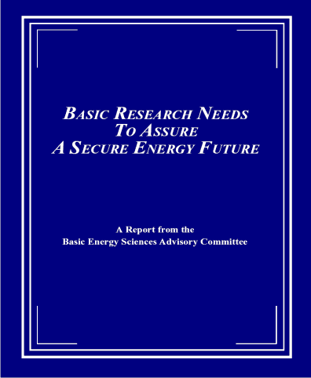
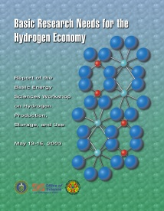



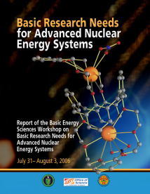
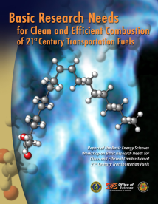
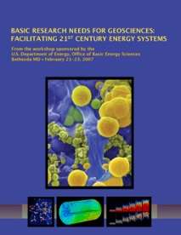

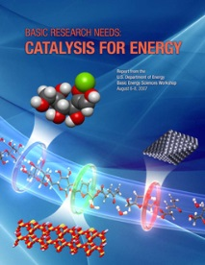
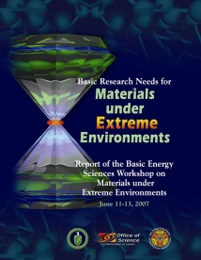
“Basic Research Needs …” Workshops
16 reports; 14 years; >2,000 participants from academia, industry, and DOE labs
BRN to Assure a Secure Energy Future (BESAC)
  BRN for Hydrogen Economy (2003)
  BRN for Solar Energy Utilization (2005)
  BRN for Superconductivity (2006)
  BRN for Solid State Lighting (2006)
  BRN for Advanced Nuclear Energy Systems (2006)
  BRN for Geosciences (2007)
  BRN for Clean and Efficient Combustion (2007)
  BRN for Electrical Energy Storage (2007)
  BRN for Catalysis for Energy Applications (2007)
  BRN for Materials under Extreme Environments (2007)
  BRN for Carbon Capture (2010)
  New Science for Sustainable Energy Future (2008)
  Computational Materials Science and Chemistry (2010)
  Science for Energy Technology (2010)
  Controlling Subsurface Fractures and Fluid Flow (2015)
  BRN for Environmental Management (2016)
2002
http://science.energy.gov/bes/community-resources/reports/

Slide 27
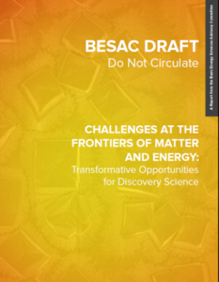

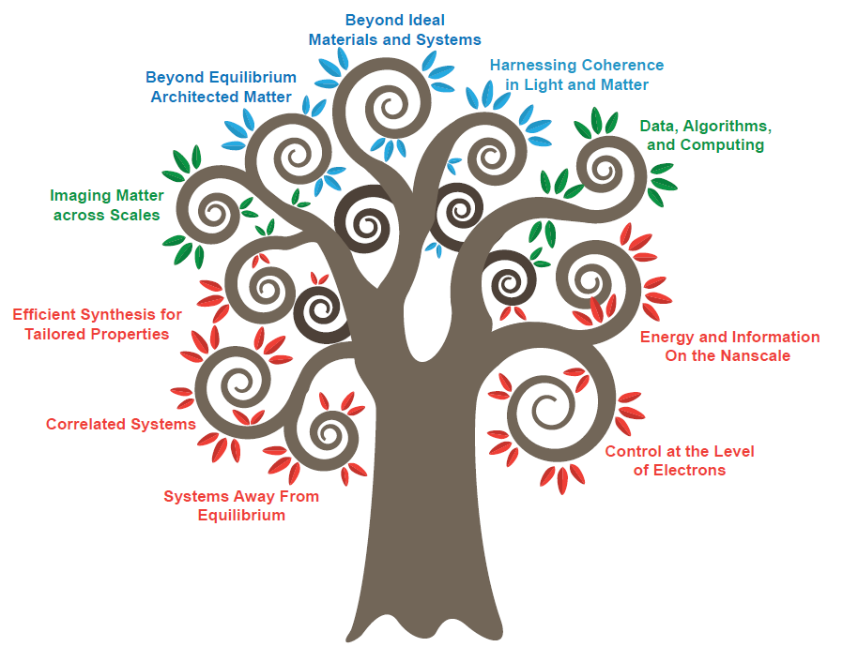
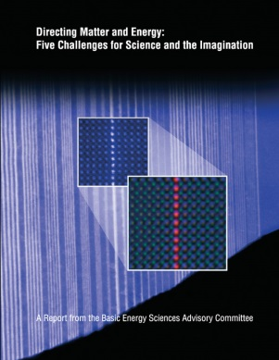
Challenges at the Frontiers of Matter and Energy:
Transformative Opportunities for Discovery Science
Instrumentation
& Tools
Human Capital
Synthesis
Beyond Ideal Materials and Systems
2015
Mastering Hierarchical Architectures
Harnessing Coherence in Light and Matter
Imaging Matter across Scales
Data, Algorithms and Computing
Efficient Synthesis for Tailored Properties
Energy and Information on the Nanoscale
2007
Correlated Systems
Control at the Level of Electrons
Systems Away from Equilibrium

Slide 28
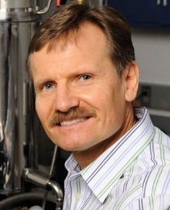
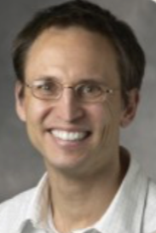

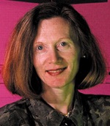
Basic Research Needs for Quantum Materials for Energy Relevant Technology
February 8-10, 2016
Workshop Chair: Collin Broholm (JHU)
Associate Chairs: Ian Fisher (SLAC/Stanford)
Joel Moore (UC-Berkeley/LBNL)
Margaret Murnane (UC-Boulder)
SC Technical Leads: Linda Horton and Jim Horwitz (BES)
CHARGE: Identify basic research needs and priority research directions for quantum materials with a focus on new, emerging areas with potential for transformative scientific advances and for impact on energy technologies. The phenomena of quantum materials are examined in the broad categories of:
(1) superconductivity and charge-related order, (2) magnetism and spin, (3) transport and non-equilibrium dynamics, (4) electronic topology, (5) nano-structure or heterogeneity.
Breakout Sessions and Chairs:
Superconductivity and charge order: Adriana Moreo (U Tennessee) and John Tranquada (BNL)
Magnetism and spin: Meigan Aronson (Texas A&M) and Allan MacDonald (U Texas Austin)
Transport and non-equilibrium dynamics: Dimitri Basov (UCSD) and Jim Freericks (Georgetown)
Topological quantum materials: Eduardo Fradkin (U of Illinois) and Amir Yacoby (Harvard)
Heterogeneous and nano-structured quantum materials: Nitin Samarth (PSU) and Susanne Stemmer (UCSB)
Plenary Session Speakers:
  Eli Yablonovitch, University of California-Berkeley
  Louis Taillefer, University of Sherbrooke (Quebec)
  Harold Hwang, SLAC National Accelerator Laboratory and Stanford University
  Alessandra Lanzara, Lawrence Berkeley National Laboratory and University of California-Berkeley
  Subir Sachdev, Harvard University
  Peter Littlewood, Argonne National Laboratory
  Stuart Parkin, IBM/Max Planck Institute
28

Slide 29

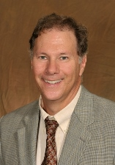
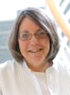
Basic Research Needs for Synthesis Science for Energy Relevant Technology
May 2-4, 2016
Workshop Chair: James De Yoreo (PNNL)
Co-chairs: David Mandrus (UT-K/ORNL)
Lynda Soderholm (ANL)
SC Technical Leads: Linda Horton, Arvind Kini, Raul Miranda (BES)
CHARGE: Identify basic research needs and priority research directions in synthesis science with a focus on new, emerging areas with the potential to leapfrog current capabilities and impact future energy technologies. The workshop will identify the scientific opportunities and new frontiers associated with both existing and novel synthetic processes that will enable predictive synthesis of energy relevant matter via assembly of atoms, molecules, clusters, nanoparticles, and other constituents. This research is essential to realizing the research opportunities identified in the recent BES Advisory Committee report on Challenges at the Frontiers of Matter and Energy: Transformative Opportunities for Discovery Science. This report concluded that further progress towards the transformative opportunities will require specific, targeted investments in synthesis science, specifically the ability to make the materials and architectures that are envisioned.
Breakout Sessions and Panel Leads:
Mechanisms of synthesis under kinetic and thermodynamic controls, Tori Forbes (U Iowa) and Mercouri Kanatzidis (NWU)
Establishing the design rules for supramolecular and hybrid assemblies, Ulrich Wiesner (Cornell) and Ting Xu (UC-Berkeley)
Interface-defined matter, Sarah Tolbert (UCLA) and Michael Zaworotko (U Limerick)
Crystalline matter: Challenges in discovery and directed synthesis, Julia Chan (UT-Dallas) and John Mitchell (ANL)
Emerging approaches to synthesis at all length scales, Jonah Erlebacher (Johns Hopkins) and Julia Laskin (PNNL)
Cross-cutting – In situ characterization, Simon Billinge (Columbia)
Cross-cutting – Theory and simulation, Giulia Galli (U Chicago)
Plenary Session Speakers:
Plenary 1 – Overall vision, George Whitesides, Harvard
Plenary 2 – Crystalline matter, Paul Canfield, Ames Lab
Plenary 3 – Interface-defined matter, Tobin Marks, NWU
Plenary 4 – Theory and simulation, Kristin Persson, LBNL
Plenary 5 – Emerging approaches, Angela Belcher, MIT
Plenary 6 – Synthesis science/Energy technologies, Tony Cheetham, Cambridge

Slide 30
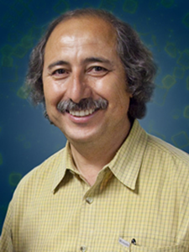


Basic Research Needs for Innovation and Discovery of Transformative Experimental Tools — June 1-3, 2016
Workshop Chair: Ali Belkacem (LBNL)
Co-chairs: Cynthia Friend (Harvard)
Yimei Zhu (BNL)
SC Technical Lead: Tom Settersten (BES)
CHARGE: Explore the frontiers of instrumentation science that provide opportunities to advance grand challenge energy research. The workshop will identify the scientific challenges and resulting priority research directions for instrumentation development. The workshop is expected to emphasize university-laboratory-scale instruments, portable instruments for dual use at the bench or at facility end-stations, and new concepts for experimental methods and the corresponding advanced data analytics and related approaches that are intrinsic to meaningful measurements.
Breakout Sessions and Panel Leads:
Chemical reactions and transformations in functional environments – Beyond model systems,
Peter Crozier (Arizona State Univ.) and Cynthia Jenks (Ames Lab)
Imaging materials far away from equilibrium,
Paul Fenter (ANL) and Wayne Hess (PNNL)
Challenges of heterogeneity across multiple length scales and multiple time scales,
Ralph Nuzzo (Univ. Illinois) and Jennifer Ogilvie (Univ. Michigan)
Transformational experimental tools through integration of instrumentation with theory and computation,
Jeff Neaton (LBNL) and Monica Olvera de la Cruz (Northwestern Univ.)
Plenary Session Speakers:
Plenary 1 – Overall vision and catalysis, Robert Schlögl, Fritz Haber Institute
Plenary 2 – Energy transformations at interfaces, Eric Stach, BNL
Plenary 3 – Nanostructured materials, Amanda Petford-Long, NWU/ANL
Plenary 4 – Integration theory-experiment, Sharon Glotzer, Univ. Michigan
Plenary 5 – Mathematics and data handling, James Sethian, UC Berkeley/LBNL
Plenary 6 – Dynamical processes, Frances Ross, IBM
Plenary 7 – Heterogeneity in materials and chemistry, Simon Bare, SLAC

