Slide 1
Office of Science Update
BESAC Meeting
June 8, 2016
Cherry A. Murray
Director, Office of Science
cherry.murray@science.energy.gov

Slide 2
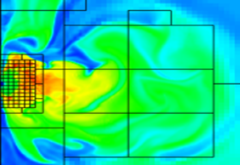

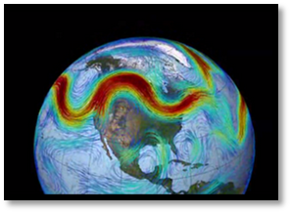

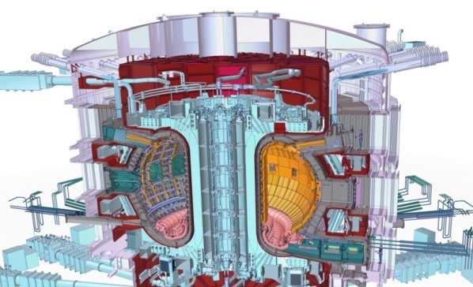


Office of Science Programs
Advanced Scientific Computing Research
FY2016 $621M
Basic Energy Sciences
FY2016 $1849M
Biological and Environmental Research
FY2016 $609M
High Energy Physics
FY2016 $795M
Fusion Energy Sciences
FY2016 $438M
Nuclear Physics
FY2016 $617M

Slide 3
Federal Budget Cycle
Midterm
We are here
Midterm
Presidential
2014
2015
2016
2017
J
F
M
A
M
J
J
A
S
O
N
D
J
F
M
A
M
J
J
A
S
O
N
D
J
F
M
A
M
J
J
A
S
O
N
D
J
F
M
A
M
J
J
A
S
O
N
D
2016 Omnibus Appropriations Act
Internal SC discussions
Internal DOE discussions
Submission to OMB
OMB Passback
Submission to Congress
House and Senate Marks
House and Senate Conf.
Budget testimony
Appropriation
Execution
2016 Budget
Internal SC discussions
Internal DOE discussions
Budget testimony
Submission to OMB
OMB Passback
Submission to Congress
House and Senate Conf.
House and Senate Marks
Appropriation
Execution
2017 Budget
Internal SC discussions
Internal DOE discussions
Budget testimony
Submission to Congress
House and Senate Marks
House and Senate Conf.
Submission to OMB
Appropriation
Execution
2018 Budget

Slide 4
Office of Science FY16 - $5.35B
> 20,000 Scientists Supported
Largest Supporter of Physical Sciences in the U.S.*
>35,000 Scientific Facility Users**
Funding at >300 Institutions including all 17 DOE Labs
Facility Operations: 38%, $2.02B
~40% of Research to Universities
Research: 42%, $2.2B
Construction: 13.5%, $723M
* 43% of all physical sciences, 30% of computer science and math
** from all 50 states and DC

Slide 5
Office of Science FY17 Request: $5.67B, +6.1%
> 20,000 Scientists Supported
Largest Supporter of Physical Sciences in the U.S.
>35,000 Scientific Facility Users
Funding at >300 Institutions including all 17 DOE Labs
Facility Operations: 36%, $2.06B
~40% of Research to Universities
Research: 42%, $2.4B
$1.8B Mission Innovation
Without $100M mandatory, $5.57B, +4%

Slide 6
FY17 HEWD and SEWD Appropriations Marks, 4-14-16
Science - +3% for both marks compared to FY16 enacted but some differences of opinion

Slide 7
FY 2017 Appropriations Action for Science Detail
FY17 HEWD and SEWD marks
2.9% increase over FY2016 enacted, 1% decrease from FY17 disc. request
Detailed differences of opinion, esp. for FES, BER

Slide 8
FY 2017 Appropriations Action
Basic Energy Sciences
House Mark: Reduces funding for new Energy Frontier Research Centers (EFRC’s); does not support new Computational Chemical Sciences component of the Exascale crosscut; and, limits proposed Mission Innovation investments in light weight materials, corrosion, quantum materials, chemistry under extreme environments and catalysis; planned research in thermocaloric materials will not proceed; planned geosciences research in support of the Subsurface crosscut will proceed. Strong support is provided for the Advanced Photon Source Upgrade project.
Senate Mark: Provides a modest increase for EFRC’s; reduces Mission Innovation by almost eight percent allowing limited enhancements to research in lightweight materials, corrosion, quantum materials and catalysis, planned research in thermocaloric materials and chemistry under harsh/extreme environments will not proceed; planned geosciences research in support of the Subsurface crosscut will proceed. Strong support is provided for the Advanced Photon Source Upgrade project.

Slide 9
FY2017 Issues and Priorities
BALANCE - Research funding vs scientific user facilities construction vs operation
  BESAC study of 5 proposed user facility upgrades
BALANCE - Discovery research vs science for clean energy and departmental crosscuts
Exascale Computing Project! National Strategic Computing Initiative
International partnerships in Big Science
  ITER
  LHC CMS, ATLAS upgrades at the same time as LBNF/DUNE

Slide 10

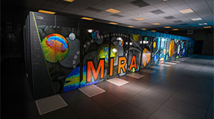

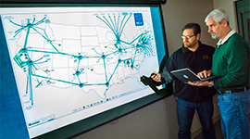

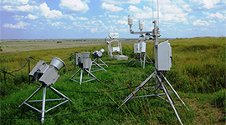

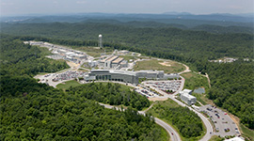
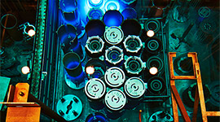
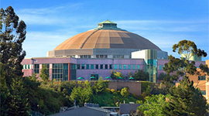
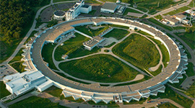
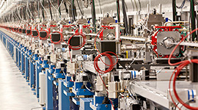
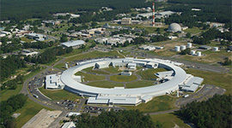
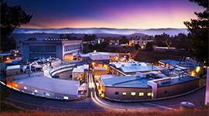
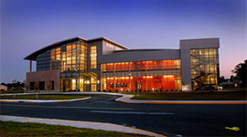
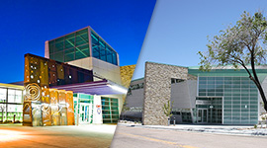
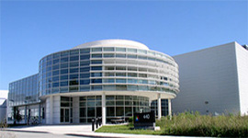
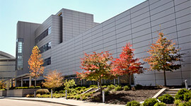
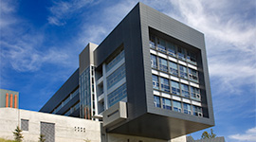
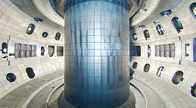
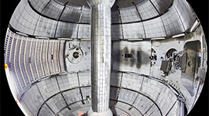
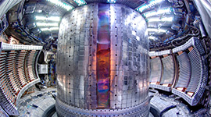
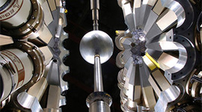
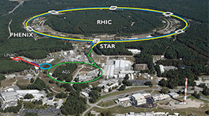
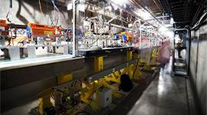
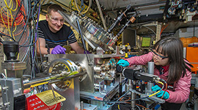
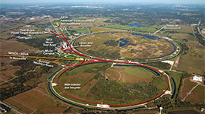
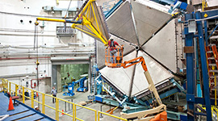

FY 2016
28 user facilities
OLCF
ALCF
NERSC
ESnet
EMSL
ARM
JGI
SNS
HFIR
ALS
APS
LCLS
NSLS-II
SSRL
CFN
CINT
CNM
CNMS
TMF
DIII-D
NSTX-U
C-Mod
ATLAS
RHIC
FACET
ATF
Fermilab AC
CEBAF

Slide 11
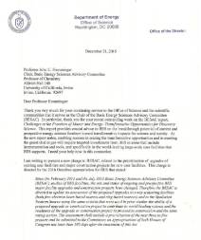
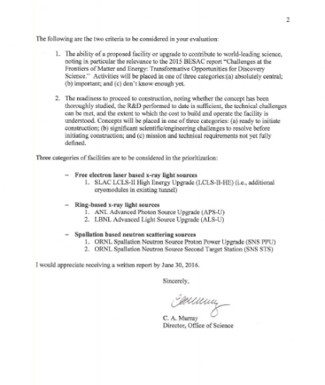
BESAC New Charge on Prioritization of Facility Upgrades
From: Dr. Cherry A. Murray (Director, Office of Science)
I am writing to present a new charge to BESAC, related to the prioritization of upgrades of existing user facilities and major construction projects for new user facilities.
The following are the two criteria to be considered in your evaluation:
The ability of a proposed facility or upgrade to contribute to world-leading science, noting in particular the relevance to the 2015 BESAC report “Challenges at the Frontiers of Matter and Energy: Transformative Opportunities for Discovery Science.” Activities will be placed in one of three categories:(a) absolutely central; (b) important; and (c) don’t know enough yet.
2. The readiness to proceed to construction, noting whether the concept has been thoroughly studied, the R&D performed to date is sufficient, the technical challenges can be met, and the extent to which the cost to build and operate the facility is understood. Concepts will be placed in one of three categories: (a) ready to initiate construction; (b) significant scientific/engineering challenges to resolve before initiating construction; and (c) mission and technical requirements not yet fully defined.

Slide 12
Office of Science User Facility Statistics FY14
Other includes many institutions, such as: non-DOE labs, federal agencies, research hospitals, K-12 students, and international institutions

Slide 13
SC Investments in Research, Facilities, and Construction

Slide 14
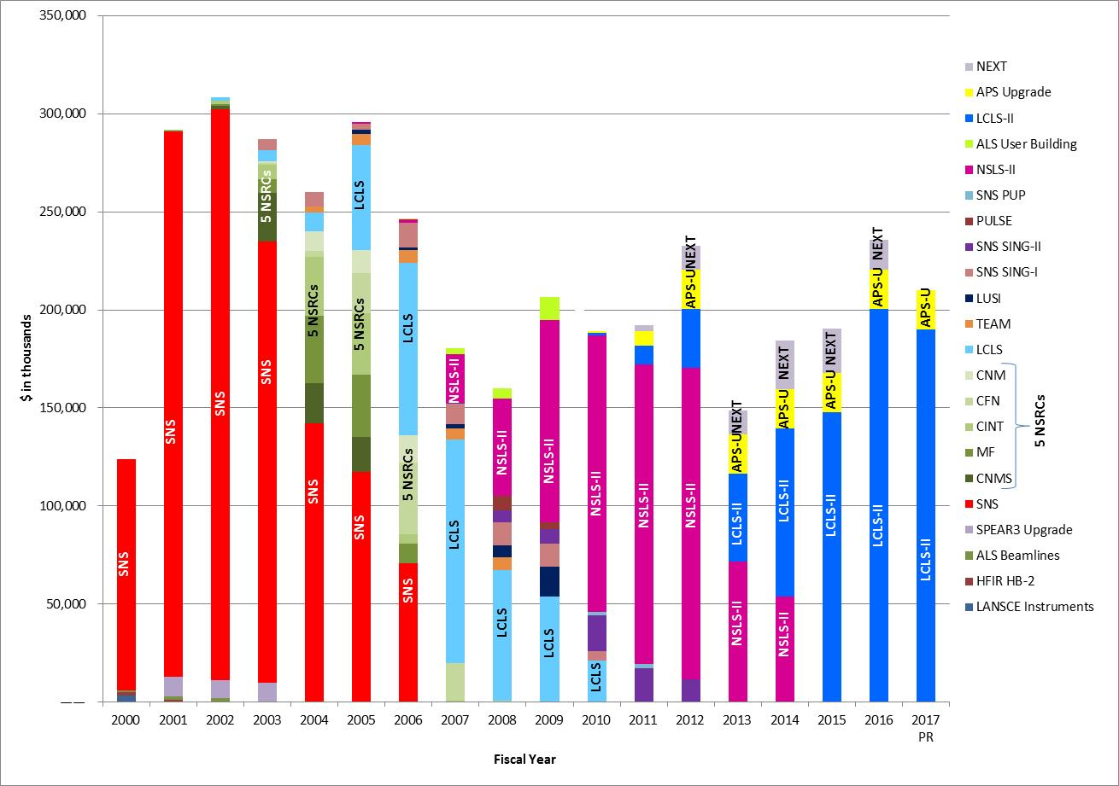
BES Construction/MIE Funding Profile 2000 – 2017

Slide 15
FY2017 Issues and Priorities
BALANCE - Research funding vs scientific user facilities construction vs operation
  BESAC study of 5 proposed user facility upgrades
BALANCE - Discovery research vs science for clean energy and departmental crosscuts
Exascale Computing Project! National Strategic Computing Initiative
International partnerships in Big Science
  ITER
  LHC CMS, ATLAS upgrades at the same time as LBNF/DUNE

Slide 16
DOE Mission Innovation R&D, FY 16 and 17 proposed
Fy17 $4.8B scored as Mission Innovation
by OMB, 70% of applied energy, 32% of science
70%
30%
32%

Slide 17
FY2017 Issues and Priorities
BALANCE - Research funding vs scientific user facilities construction vs operation
  BESAC study of 5 proposed user facility upgrades
BALANCE - Discovery research vs science for clean energy and departmental crosscuts
Exascale Computing Project! National Strategic Computing Initiative
International partnerships in Big Science
  ITER
  LHC CMS, ATLAS upgrades at the same time as LBNF/DUNE

Slide 18
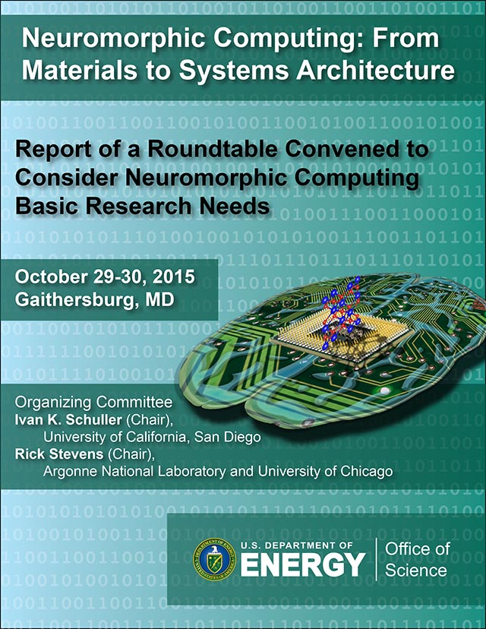
http://science.energy.gov/~/media/ascr/ascac/pdf/reports/Exascale_subcommittee_report.pdf
http://science.energy.gov/~/media/ascr/ascac/pdf/meetings/20140210/Top10reportFEB14.pdf
http://science.energy.gov/bes/community-resources/reports/abstracts/#NCFMtSA

Slide 19
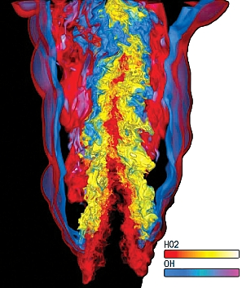
DOE’s Exascale Computing Initiative:
Next Generation of Scientific Innovation
Departmental Crosscut – In partnership with NNSA
“All-in” approach: hardware, software, applications, large data, underpinning applied math and computer science
Supports DOE’s missions in national security and science:
  Stockpile stewardship – support annual assessment cycle
  Discovery science – next-generation materials; chemical sciences
  Mission-focused basic science in energy – next-generation climate software
  Use current Leadership Computing approach for users
The next generation of advancements will require Extreme Scale Computing
  100-1,000X capabilities of today’s computers with a similar physical size and power footprint
  Significant challenges are power consumption, high parallelism, reliability
Extreme Scale Computing, cannot be achieved by a “business-as-usual,” evolutionary approach
  Initiate partnerships with U.S. computer vendors to perform the required engineering, research and development for system architectures for capable exascale computing
  Exascale systems will be based on marketable technology – Not a “one off” system
  Productive system – Usable by scientists and engineers
Exascale Project

Slide 20

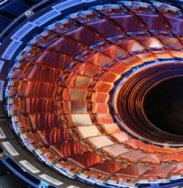
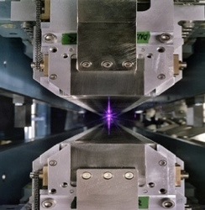
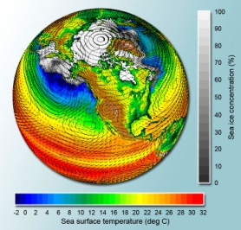
Extreme-Scale Science Data Explosion
Genomics
Data Volume increases to 10 PB in FY21
Driven by exponential technology advances
Data sources
  Scientific Instruments
  Scientific Computing Facilities
  Simulation Results
  Observational data
Big Data and Big Compute
  Analyzing Big Data requires processing (e.g., search, transform, analyze, …)
  Extreme scale computing will enable timely and more complex processing of increasingly large Big Data sets
High Energy Physics (Large Hadron Collider)
15 PB of data/year
Light Sources
Approximately
300 TB/day
Climate
Data expected to be hundreds of 100 EB
20

Slide 21
FY2017 Issues and Priorities
BALANCE - Research funding vs scientific user facilities construction vs operation
  BESAC study of 5 proposed user facility upgrades
BALANCE - Discovery research vs science for clean energy and departmental crosscuts
Exascale Computing Project! National Strategic Computing Initiative
International partnerships in Big Science
  ITER
  LHC CMS, ATLAS upgrades at the same time as LBNF/DUNE

Slide 22
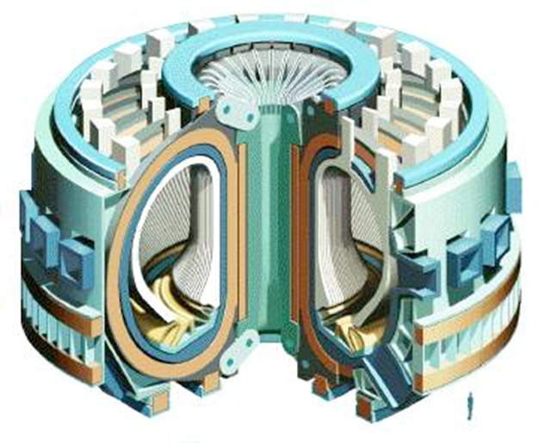
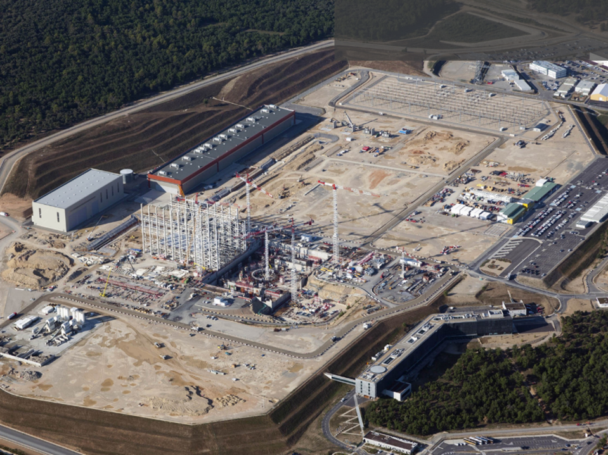
ITER Congressional Report
“…not later than May 2, 2016, the Secretary of Energy shall submit to the Committees on Appropriations of both Houses of Congress a report recommending either that the United States remain a partner in the ITER project after October 2017 or terminate participation, which shall include, as applicable, an estimate of either the full cost, by fiscal year, of all future Federal funding requirements for construction, operation, and maintenance of ITER or the cost of termination.”

Slide 23

ITER Congressional Report
The U.S. should remain an ITER partner through the end of calendar year 2017 (through FY18) and focus on efforts related to first plasma.
In late calendar year 2017, the U.S. will reevaluate participation based on assessment of the performance of the ITER project management against the project schedule and milestones listed in the report.
Under DG Bigot, there have substantial improvements to the ITER project performance and the project culture in the ITER organization.
Significant technical, management, and funding risks that remain.
DOE will baseline the U.S. ITER Project (the in-kind contribution to the IO) to FP in FY 2017.
DOE will request a National Academies study on how to best advance the fusion energy sciences in the U.S., with scenarios if the U.S. is in or out of ITER.

Slide 24
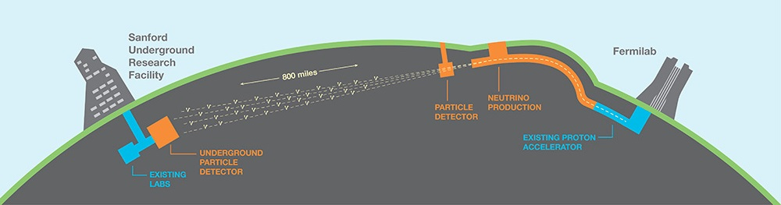
Long Baseline Neutrino Facility
P5 recommended LBNF as the centerpiece of a U.S.-hosted world-leading neutrino program
  P5 recognized LBNF as the highest-priority large project in its timeframe
The world’s most intense neutrino beam will be produced at Fermilab and directed 800 miles through the earth to Lead, South Dakota
  Fermilab will lead this effort with a few international partners, most notably CERN
A very large (40 kiloton) liquid argon neutrino detector will be placed in the Homestake Mine in Lead, SD
  An international collaboration has been established for the Deep Underground Neutrino Experiment (DUNE)
  The U.S. will contribute to the detector as part of the LBNF project

Slide 25
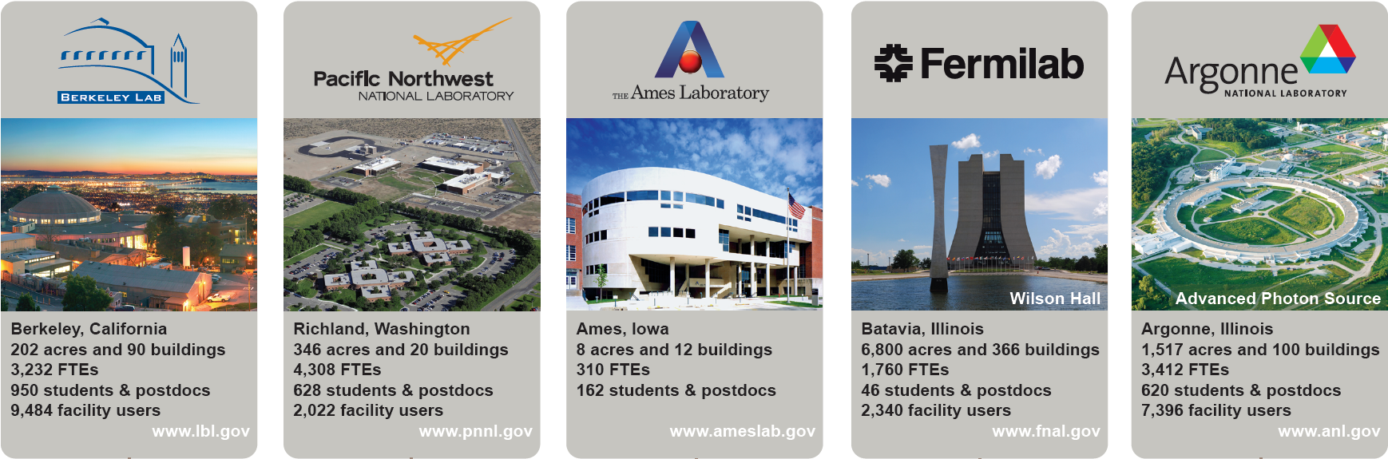
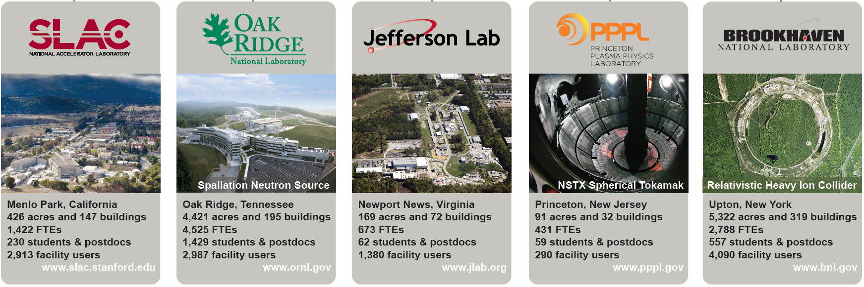
Office of Science Laboratories Total FY15 $5.5B, SC funding $3.4B

Slide 26
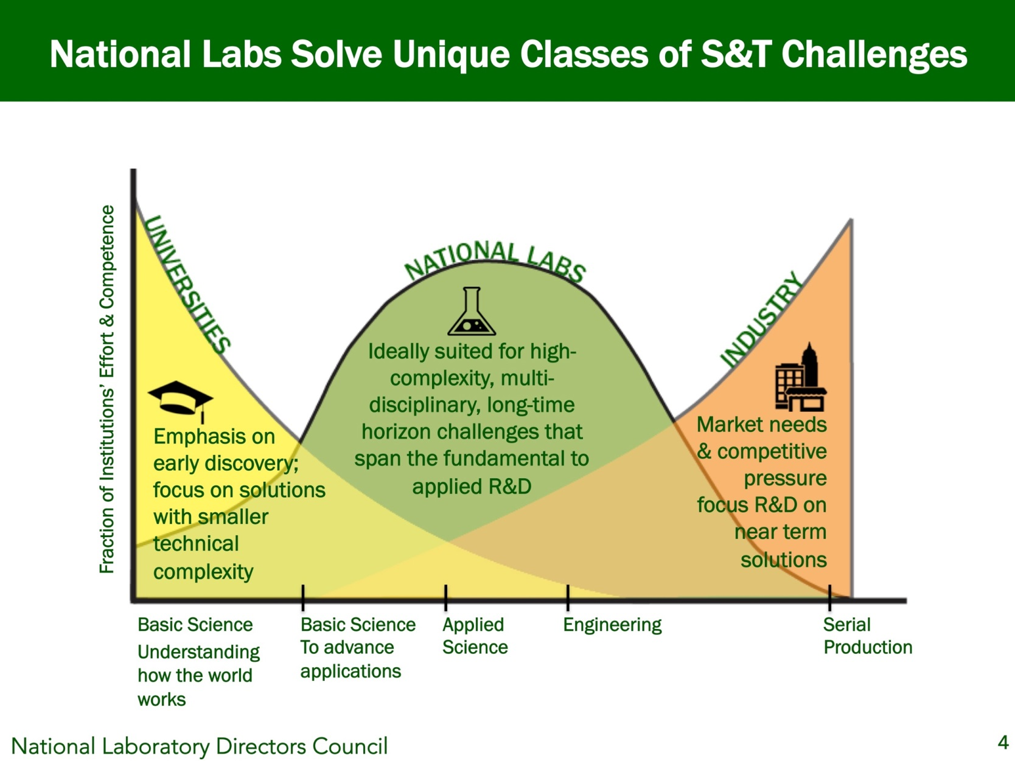
National Labs Address Multidisciplinary S&T Challenges
Most of the national labs have broader scope than Office of Science
Office of Science funding

Slide 27
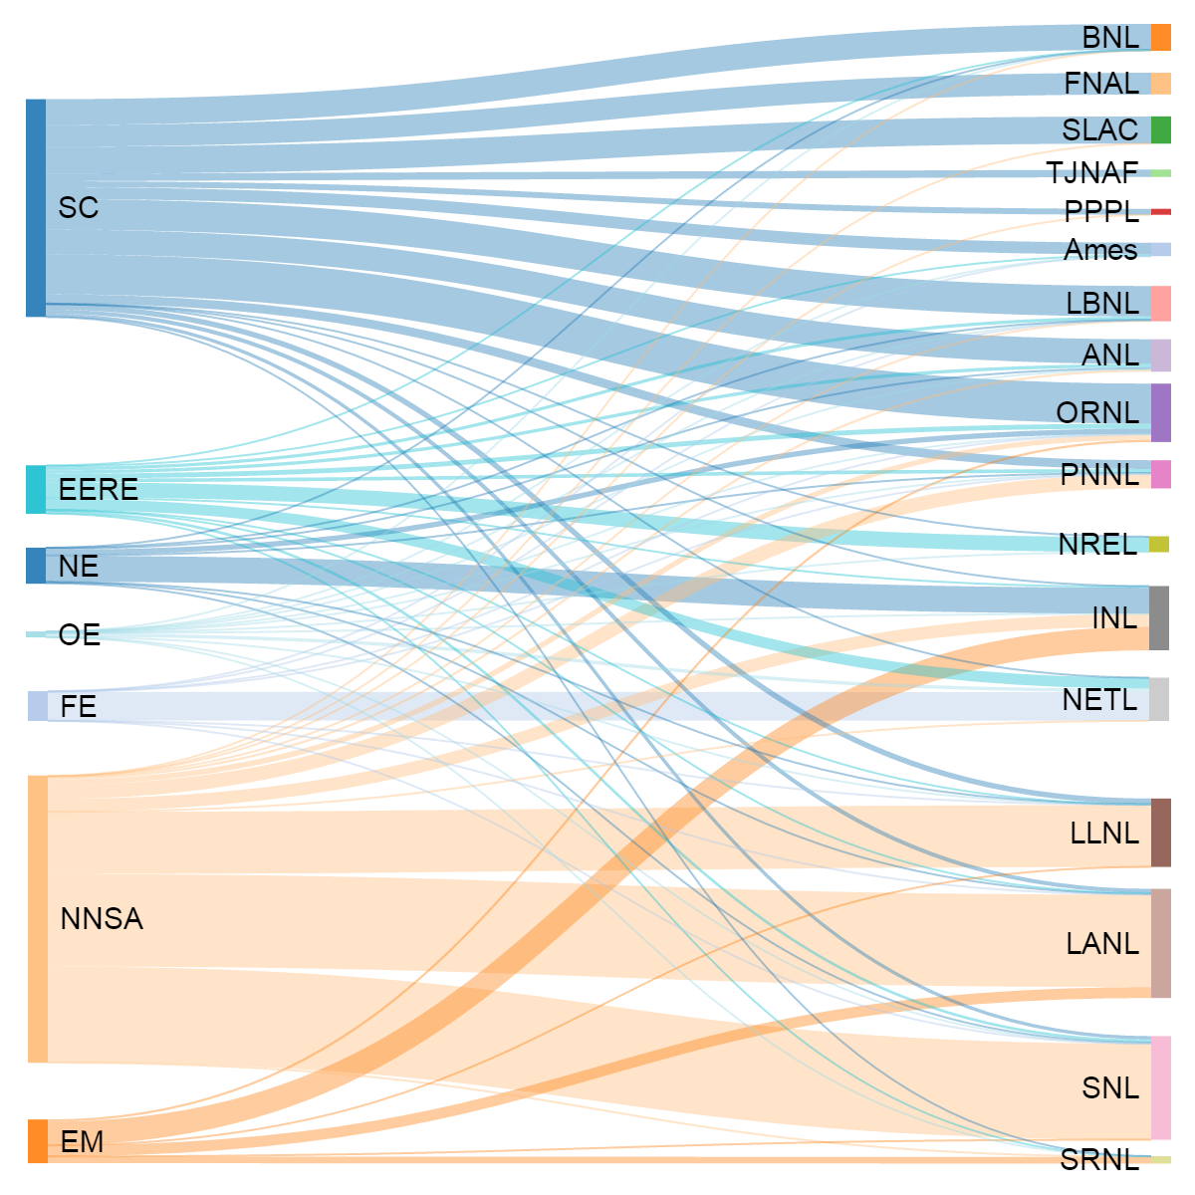
Flow of Funds between DOE Programs to Labs, 2015

Slide 28
National Lab Management
Streamlined Contracts and partnership in FFRDCs ( response to CRENEL, etc. )
  “Evolutionary Working Group” – will be incorporated at FNAL
  “Revolutionary Working Group” – in concurrence process at HQ
Science and Energy Programs integrated Lab strategy reviews

