Slide 1
NSLS-II Operations Update
J.P. Hill, Director, NSLS-II
BESAC February 23rd 2017

Slide 2
Outline
The power of high brightness
  High-Tc superconductivity
Accelerator Performance
  Outstanding reliability
  Increasing current
User Program
  Growing rapidly, driven by beamline construction
  Emphasis on new users.
  Data and computing
Early Science
  High spatial resolution
  High coherence
Next steps
  Developing designs for next 6 beamlines
Summary

Slide 3
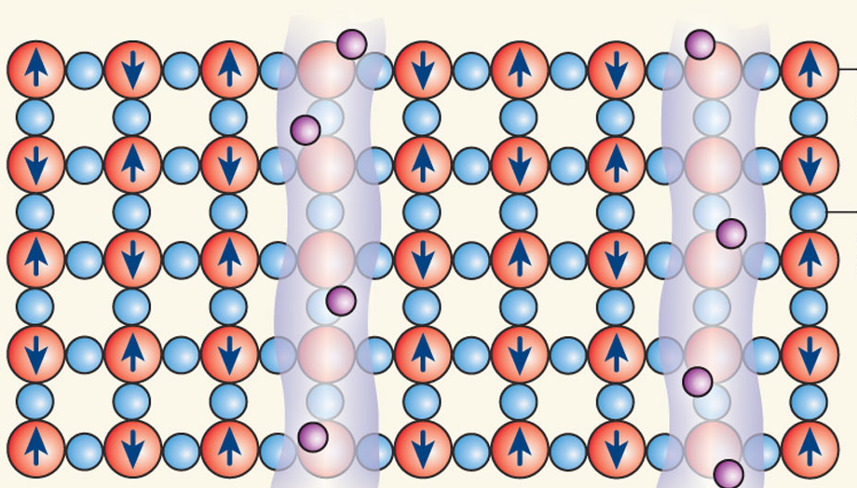
Direct Observation of Charge Stripes Locked to the Lattice of La_{2−x}Ba_{x}CuO₄
High coherent flux facilitated the first ever speckle and XPCS measurement of charge stripes in a cuprate
High coherent flux facilitated the first ever speckle and XPCS measurement of charge stripes in a cuprate
Discovered at BNL, Tranquada et al. (1995)
X.M. Chen, et al. PRL (2016)
CSX and CMPMSD

Slide 4
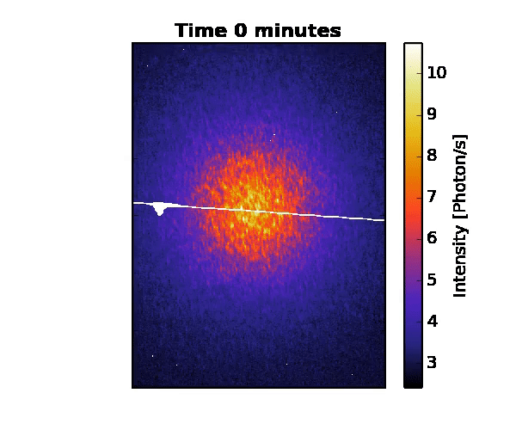
Direct Observation of Charge Stripes Locked to the Lattice of La_{2−x}Ba_{x}CuO₄
High coherent flux facilitated the first ever speckle and XPCS measurement of charge stripes in a cuprate
Stripe correlations are found to be static from 15 to 45 K
Demonstrates that pairing mechanism is not fluctuating CDW
X.M. Chen, et al. PRL (2016)
CSX and CMPMSD
X.M. Chen, et al. PRL (2016)

Slide 5
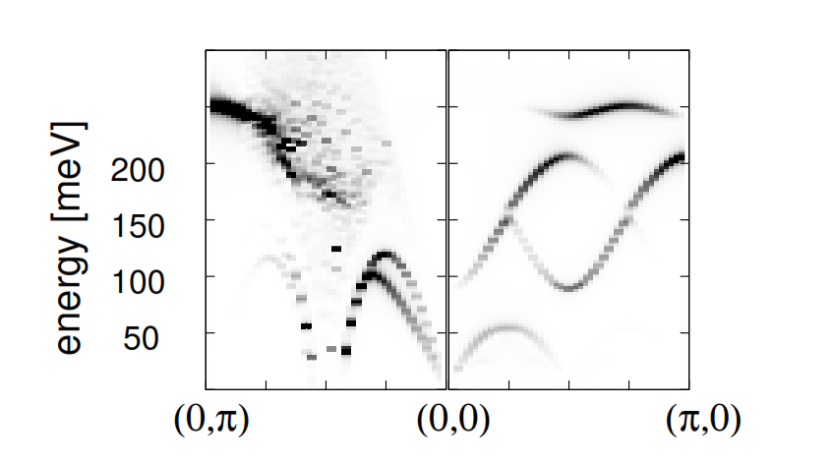
Soft Inelastic X-ray (SIX) Beamline
How are the spin excitations renormalized by these charge stripes?
Theoretical prediction (Seibold et al., (2012))
Neutrons have insufficient intensity to test this. Can only be done at NSLS-II
ΔE=14 meV
First light February 20th 2017

Slide 6
Accelerator
Performance

Slide 7
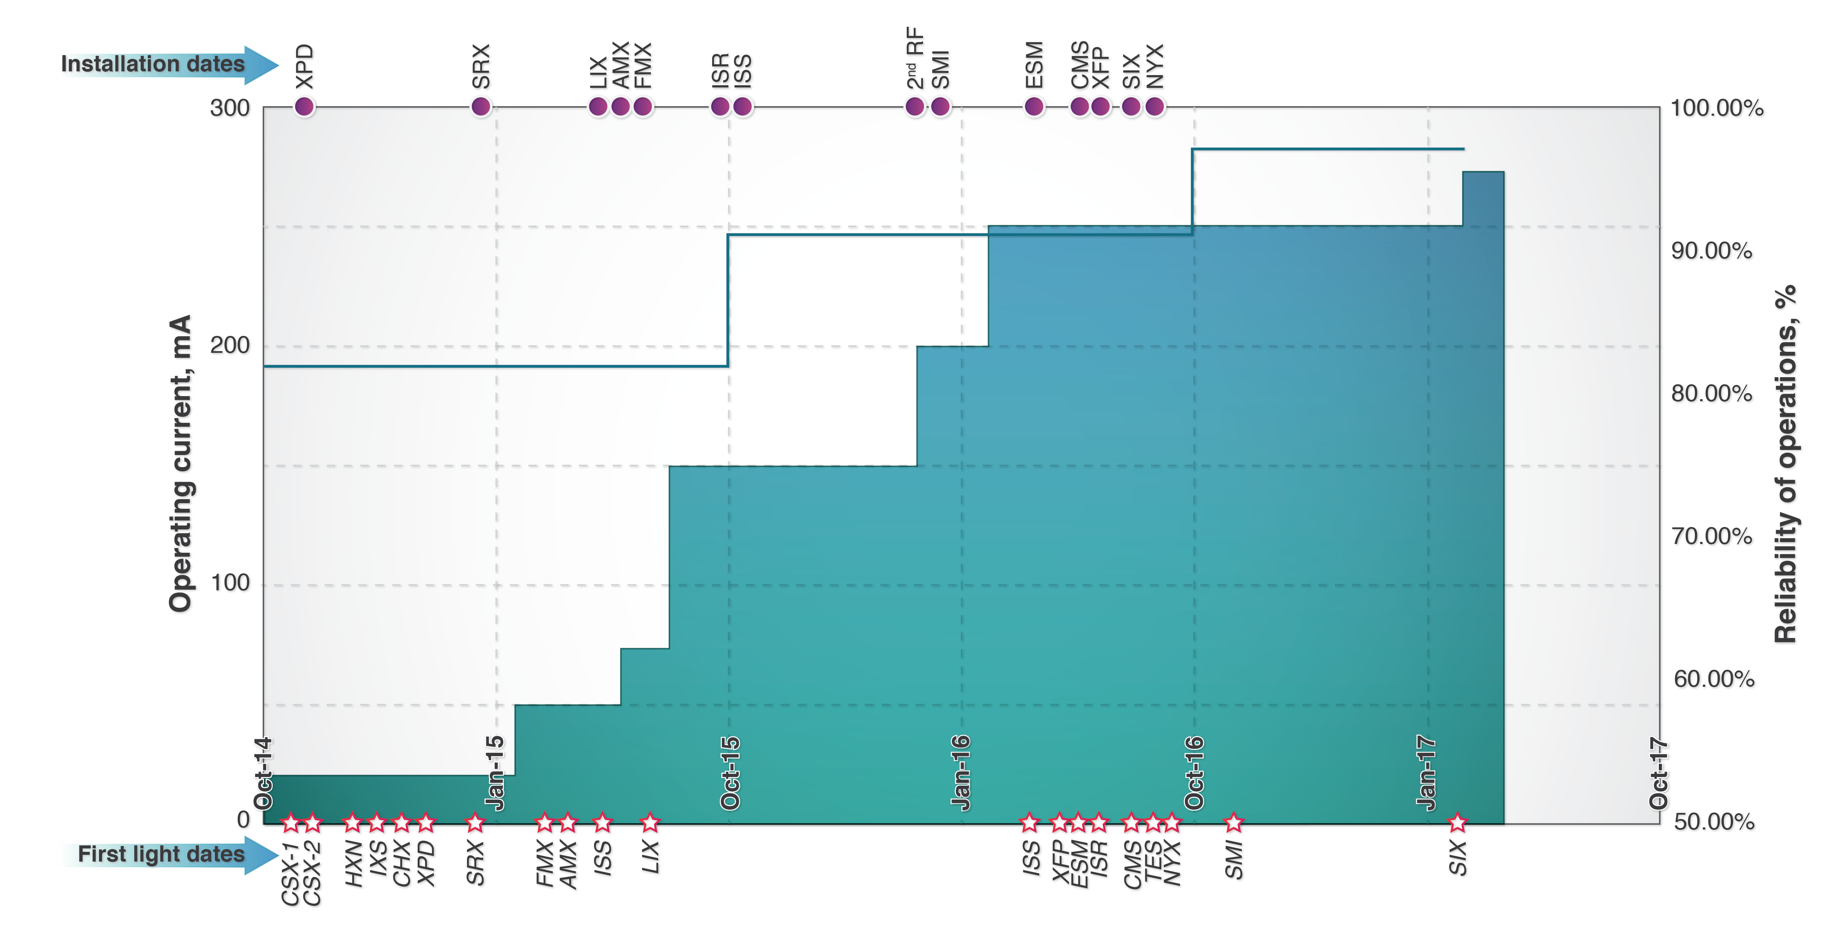
Accelerator Performance
FY17 Goals: Reliability > 95%, Operating current 300 mA.

Slide 8
User program

Slide 9
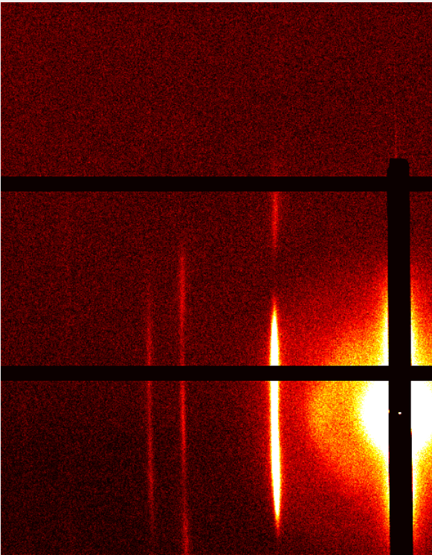
Beamlines Operations Update
General User Operations
CSX-1, CSX-2, XPD, HXN, SRX,
IXS, CHX, LiX, AMX, FMX,
Science Commissioning
ISS, XFP, TES, CMS
Technical Commissioning
ESM, ISR, SMI, NYX, SIX
Completion in FY17
BMM, SST-1, SST-2, QAS, XFM
Completion in FY18
PDF, FXI, FIS, MET
CMS
19 beamlines in operations or commissioning
GISAXS pattern from 2D ordered monolayer of nanoparticles self-assembled at a liquid-air interface [I. Herman group, Columbia U.]

Slide 10
Beam Time Proposals
340
311
220
217
144
117
BTR: Beam Time Request (against existing proposal)
GU = General User
SC = Science Commissioning
BAGs = Block Allocation Groups
2016-1: Jan-Apr 2016
2016-2: May-Aug 2016
2016-3: Sept-Dec 2016
2017-1: Jan-Apr 2017
2017-2: May-Aug 2017

Slide 11
NSLS-II Facility Users by FY
(as of February 13, 2017)
600
FY15
FY16
500
477
FY16 (as of 2/13/16)
FY17 (as of 2/13/17)
400
Users
334
300
Productivity:
51 papers from NSLS-II beamlines
6 high-impact
200
110
100
148
0
FY 15
FY 16
FY 17

Slide 12
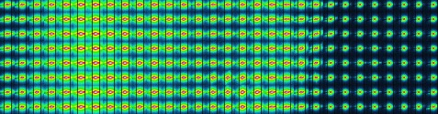
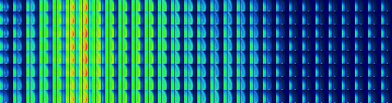
Partnerships with other facilities
Center for Functional Nanomaterials (BNL)
Partnership on 4 beamlines:
CSX-2 – Ambient pressure PES
ESM – LEEM/PEEM
CMS – SAXS/WAXS
SMI – GISAXS
Neutrons @ORNL (HFIR and SNS)
Combined SAXS and SANS program.
Users can write a single proposal
for SAXS and SANS time at the two facilities
Microbeam SAXS/WAXS imaging at LiX
SAXS
WAXS
SAXS/WAXS imaging of plant tissues (Makowski, Northeastern U; Liu, BNL; Bomble, NREL)

Slide 13
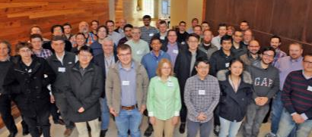
Data Acquisition, Management and Analysis
Of central importance to a successful facility
BlueSky: open source python-based code for DAQ. Initial user reviews are very positive
Test implementations installed at SNS and APS
Developing workflows for data analysis including optimized existing code, e.g. from CAMERA (LBL) and “tomopy” (APS)
Hack-a-thons: BES SUF code developers
congregate for a week to write code together around a given issue. Extremely successful in increasing collaboration across facilities and in reducing duplication of effort
BNL setting up central data and computing facility to enable near-real time and remote data analysis (CSI) with NYS investment ($15 M)
Bluesky
Ophyd
EPICS
Databases
Notes:
SHARP from CAMERA for HXN increased the speed of ptycho analysis
Xi-CAM
GISAXS code

Slide 14
Science Highlights

Slide 15
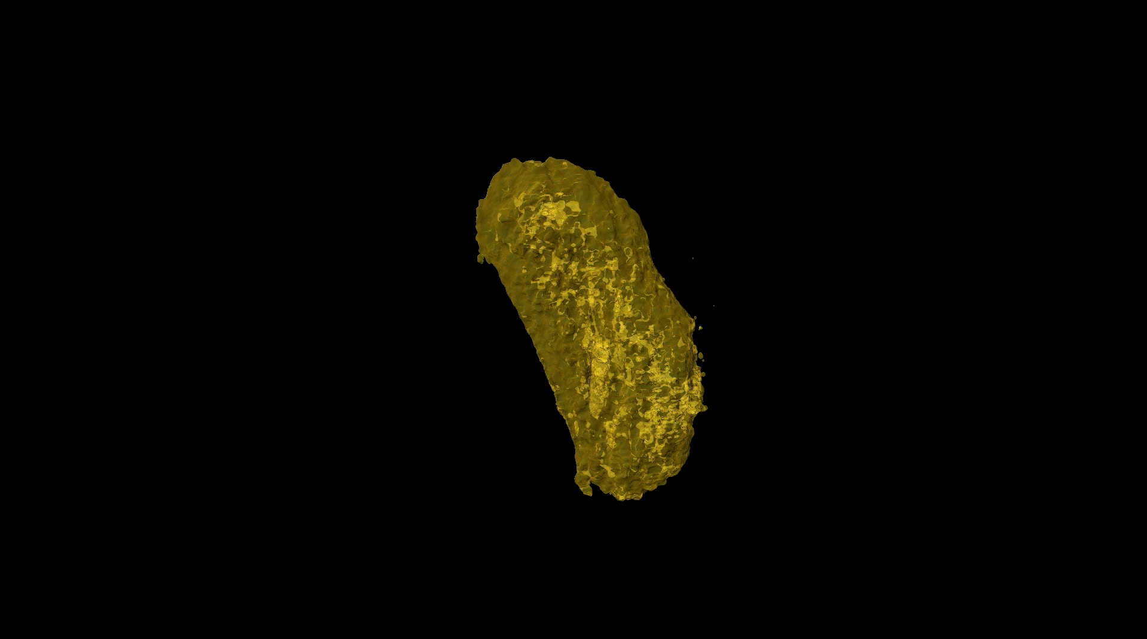

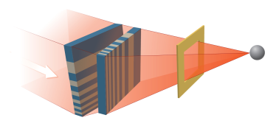


Hard X-ray Nanoprobe
Award Winning MLL design
Er Distribution
Smallest spot in working x-ray microscope in the world (13 nm x 13 nm)!
500 nm
E. Nazaretski, Y. S. Chu, et al.
2017
Highest resolution 3D XRF image ever taken. Showing Er tag on surface of E-coli
20 nm voxel, 0.1 sec/pixel dwell
K. Allen (Boston Univ), B. Imperiali (MIT), L. Miller (BNL), whole HXN Team

Slide 16
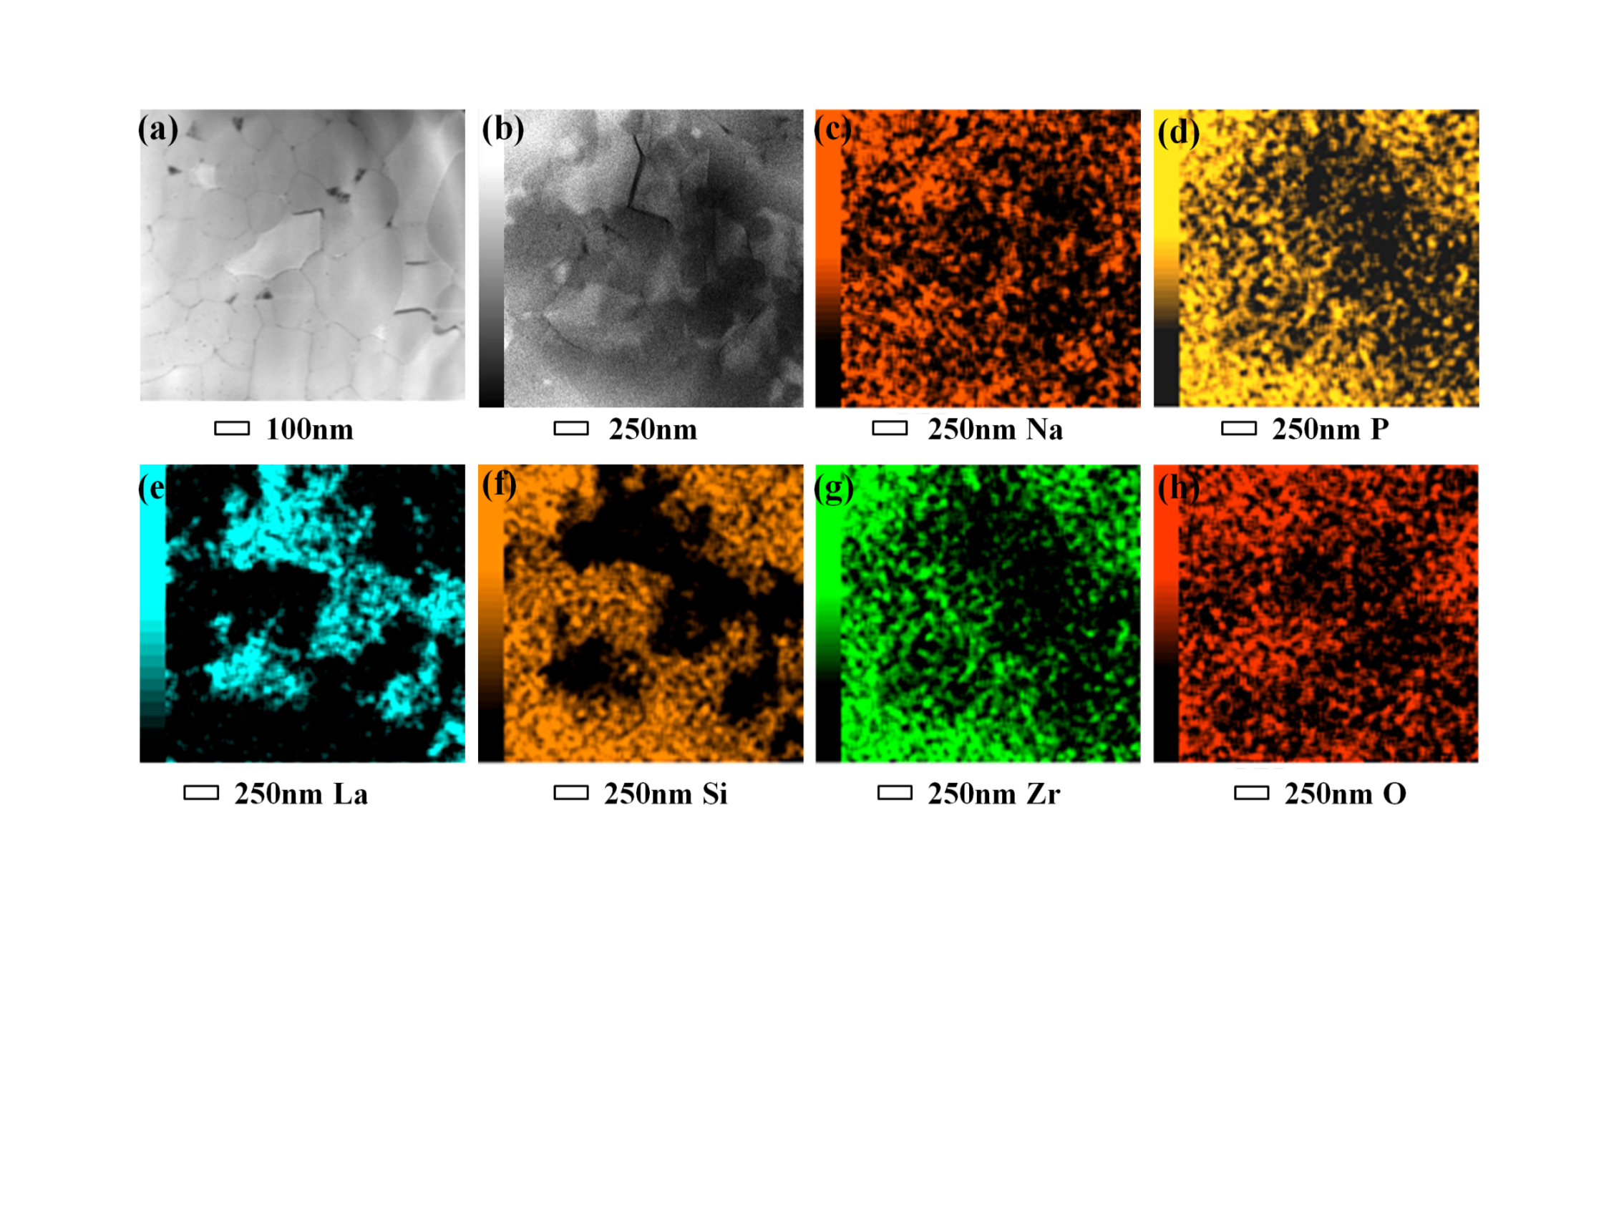

HXN: Imaging Grain Boundaries in Battery Materials
HXN investigated formation of secondary phase Na₃La(PO₄)₂ in a Na_{3+x}Zr_{2-x}La_{x}Si₂PO₁₂ a solid electrolyte with the highest conductivity
Formation of secondary phase is important to improve the bulk conductivity by facilitating ion transport along the grain boundary.
Nano-XRF gives a higher elemental detection sensitivity than STEM EDX.
35nm/pixel, 0.1s/pixel
10 nm/pixel, 0.3s/pixel
STEM-EDX from
same material
Zhang et al. Adv. Energy Mater. (2016).
Notes:
Measured at 12 keV with 150 mA Storage ring current.
Low res image: 35 nm/pixel, 0.1s/pixel, 200 x 200 pixels, total imaging time = 75 mins.
High res image: 10 nm/pixel 0.3s/pixel, 100 x 100 pixels, total imaging time = 55 mins.
Zr image is poorer because we are detecting Zr L-edge (2.044 keV). The XRF photons are self absorbed. Elements with higher emission energies can be detected much better.
This work was conducted in collaboration with Xiao-Qing Yang Group at Chemistry/BNL.

Slide 17
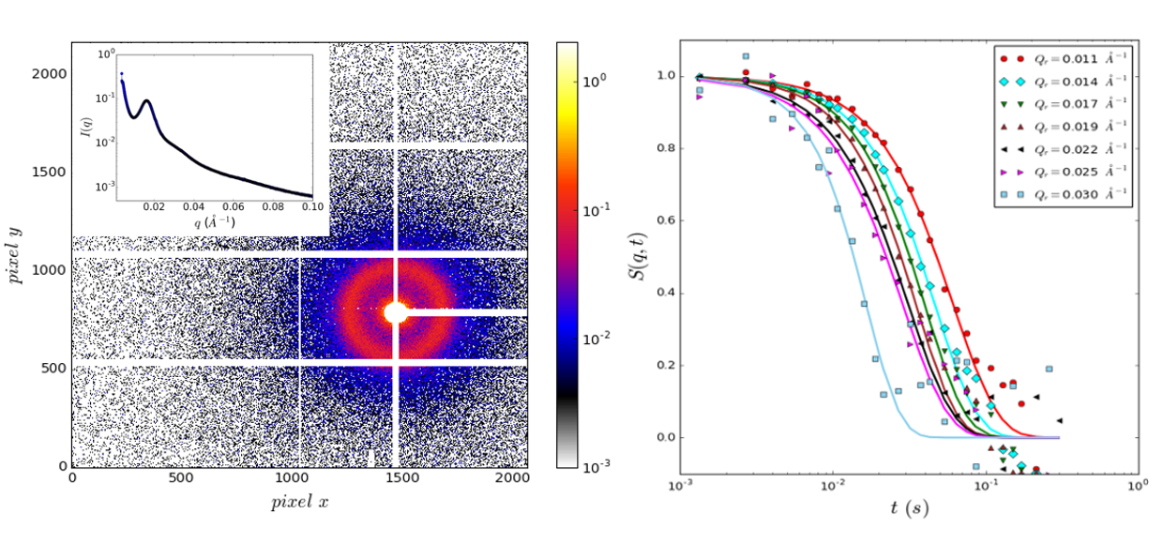
Revealing Dynamics of Polymer Gels
Coherent x-ray scattering studies of dynamics in transient networks of associative polymers which are used in applications such as artificial skin and self-healing gels
Challenging expt: low signal as samples are real and not dressed w/ nanoparticles
Unprecedented coherent flux at CHX produced high quality dynamical information on smaller length scales (q~0.03 Å⁻¹) and shorter time scales (~10 ms) than ever possible before with similar polymer samples
Olsen and Dursch (MIT) with CHX group, unpublished
Notes:
The MIT group led by Prof. B. Olsen (PI) and Dr. T. Dursch (Lead Experimenter) studies transient networks of associative polymers which are used in applications such as artificial skin and self-healing gels. To complement previous results using forced Rayleigh scattering and numerical simulation with information about the molecular and meso-scale associative network dynamics, they have performed X-ray Photon Correlation Spectroscopy (XPCS) experiments at the CHX beamline. The XPCS data is recorded by a 750Hz Eiger 4M area detector. The scattered intensity is shown in the left panel with the circular averaged I(q) in the inset. Even near the structure factor peak, at the maximum of I(q) the sample scatters in average a mere ~0.1 photons/pixel/frame (1 frame = 1.33 ms!). In addition, with the unprecedented 10¹¹ photon/s available at the CHX beamline, the maximum time the samples can be exposed to the beam was measured to be 400 ms. To mitigate the beam damage effects and obtain good statistics from such low scattering samples, the MIT-CHX team has employed a data acquisition strategy in which short bursts of 300 frames (=400 ms) are recorded at different locations on the sample. The intensity autocorelation functions associated with speckle fluctuations are calculated from each of these bursts independently and subsequently averaged. The right panel shows the dynamics structure factor S(q,t) obtained from the data with the publicly available CHX analysis pipelines.
XPCS data acquired on Eiger 4M with short bursts of 300 frames at 1.3 ms/frame in 400 ms for fast dynamics

Slide 18
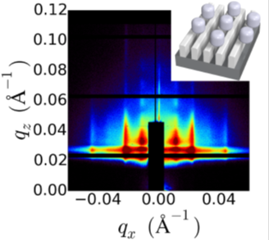
Self-assembly of 3D block copolymer morphologies
  CFN researchers developed a novel method for creating complex multilayered structures via block copolymer self-assembly wherein each polymer
  layer acts as both a structural component and as a template for directing the order of subsequent layers.
  This opens the door to a wide variety of nanomaterial structures which are difficult or impossible to achieve via conventional
  self-assembly or even lithography, thus potentially advancing nanotechnology used for medicine, energy generation, and other applications
  The structures were characterized by scanning electron microscopy (SEM ) at the CFN and by Grazing Incidence Small Angle X-ray Scattering (GISAXS) at NSLS-II
A. Rahman et al. Nature Comm. (2016)
Notes:
Notes: Self-assembly is a powerful paradigm in material design, where molecules spontaneously form ordered phases exhibiting well-defined nanoscale periodicity and shapes. However, the inherent energy-minimization aspect of self-assembly yields a very limited set of morphologies, such as lamellae or hexagonally packed cylinders. The CFN researchers proposed a novel self-assembly paradigm and showed that self-assembled materials – here block copolymer thin films – can be ‘directed’ to form a diverse set of previously unreported three dimensional layered morphologies. In this iterative process each polymer layer acts as a structural component of the final morphology and as a template for directing the order of subsequent layers. The structures achieved by this novel method were investigated by scanning electron microscopy (SEM) at the CFN and by grazing-incidence small angle scattering (GISAXS) at NSLS-II Beamline 11-ID. The attached image shows a representative GI-SAXS pattern from a two-layer structure in which the lamellar spacing of the first layer templates the spacing of cylinders in the second layer. The strong scattering peaks, including higher-orders, are indicative of well-defined nanostructures over wide areas.

Slide 19
Future: NEXT Steps

Slide 20
Next steps
Priority is to
Operate existing beamlines. Grow user program
Maintain reliable accelerator operations. Reach design performance
Develop new beamlines:
  FY15 – User community-driven proposal process
  FY16 – Selection of 6 beamlines. Task force developed approximate cost and schedule
  FY17 – Advance designs to appropriate level to seek additional funding. Push development of highest priority beamline, dependent on operating budgets

Slide 21
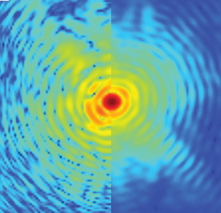
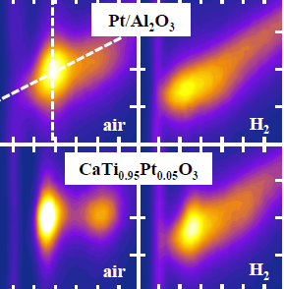
New Beamlines
Hard x-ray imaging
World-leading lensless imaging down to 5nm
2) Soft x-ray imaging-1
Chemical and electronic structure down to 5 nm resolution
3) Soft x-ray imaging-2
State-of-the-art transmission x-ray microscope
4) Chemical reactions
Time-resolved snapshots of chemical reactions in-operando
5) Polymer processing and liquids
Liquid interfaces and thin film processing studied in-situ
6) Infra-red spectroscopic imaging
Nano-IR spectroscopy on heterogeneous solid state systems
These beamlines will provide world-leading capabilities that will significantly enhance NSLS-II. We are working with BES and others to seek additional funds to develop and operate them.

Slide 22
Summary
Accelerator is performing very well. We will continue to increase the current, consistent with maintaining reliability
Beamline construction has been very rapid. 19 beamlines currently taking light. 9 more on the way
User program is growing rapidly, strong demand for beamtime
Early science is exciting! Publications following
Next steps
  Continue strong focus on user program growth
  Continue to push accelerator performance
  Work with BES and others to develop funding for additional beamlines

Slide 23
Back up slides

Slide 24
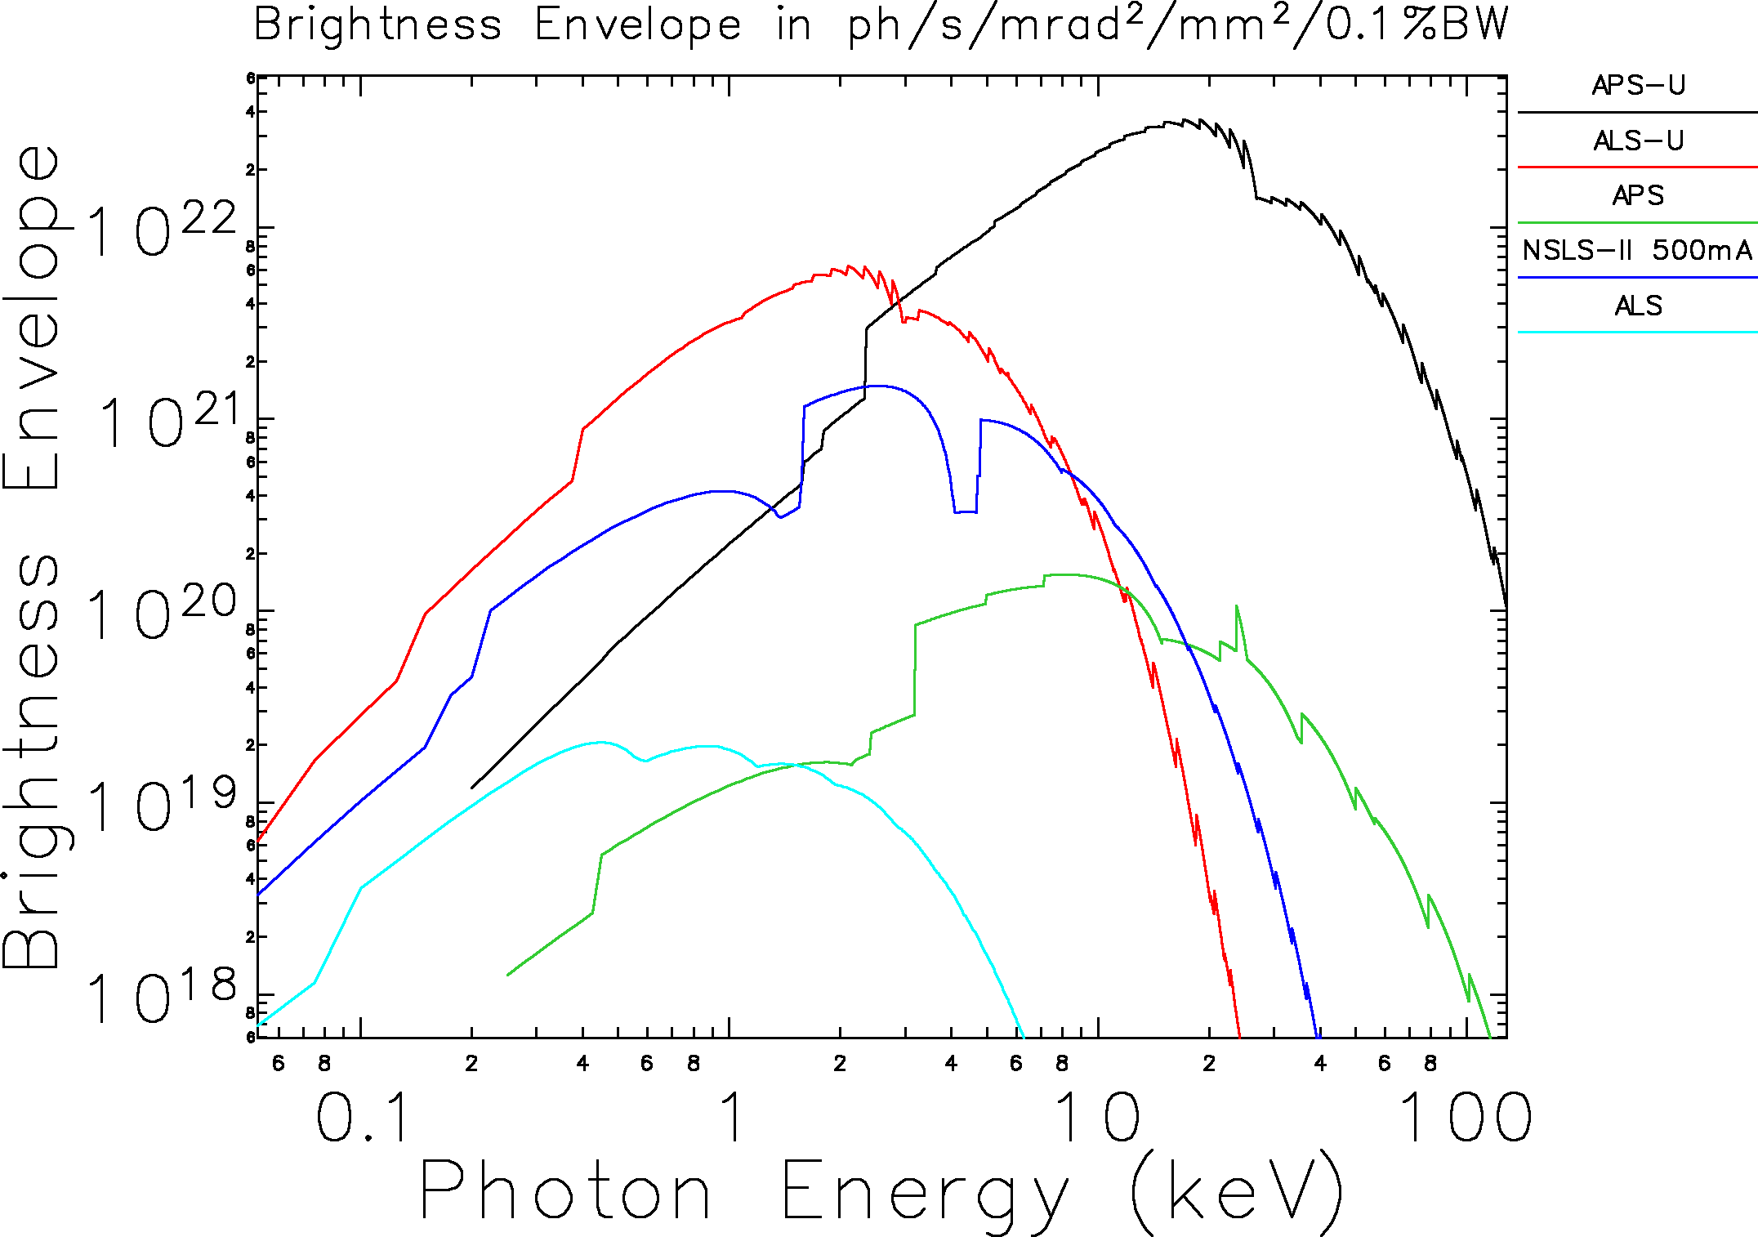
National context for NSLS-II
APS-U
ALS-U
NSLS-II 500 mA
APS
ALS

Slide 25
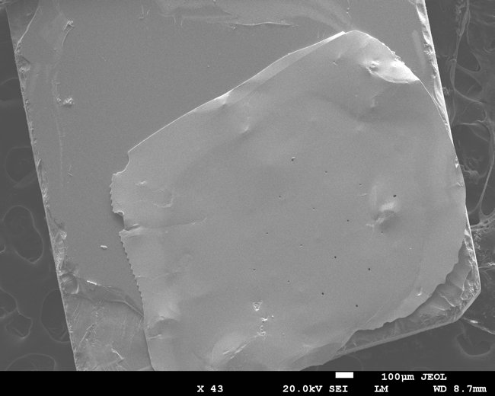
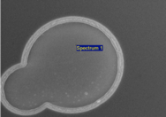

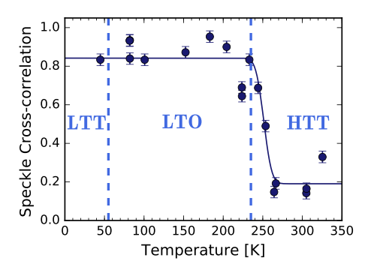
  What is the origin of stripe pinning?
Ultra thin gold foil was placed on sample with pinholes made using FIB at the CFN.
Same domain pattern is observed after cycling above the LTT transition and returning to 20K
But if the LTO transition is passed then a new domain pattern is observed.
Suggests that there are correlations in the LTO phase which define the domain structure, even though there is no long range stripe order.

Slide 26
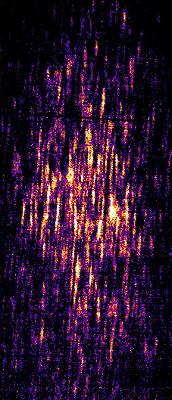
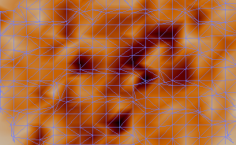
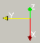
BCDI reconstructed image of LBCO stripes
(0.24,0,1.5)
3 μm
6.3 x 5.7 micron support (shrinkwrap) overlaid
CSX beamline, Dec 2016

Slide 27
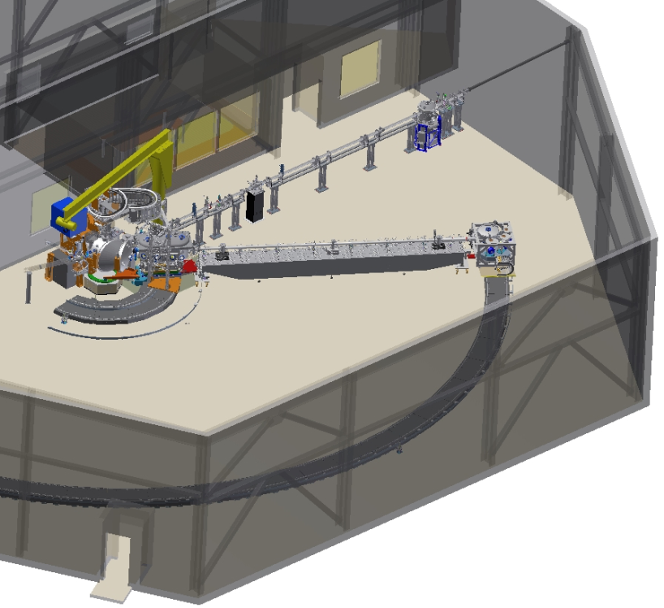
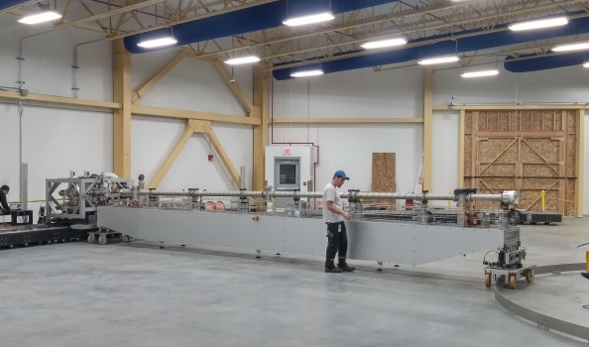
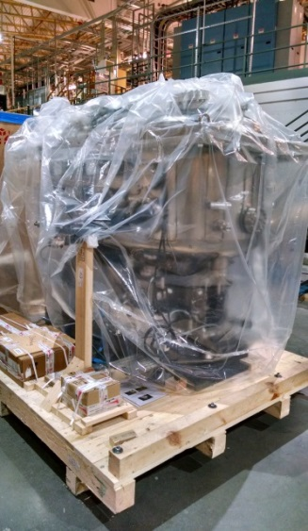
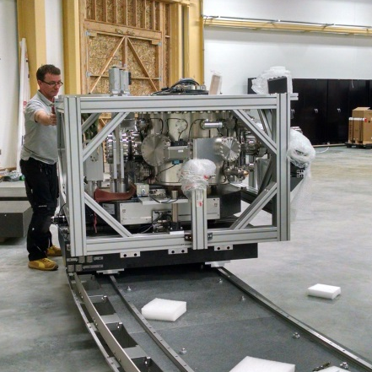
SIX construction progress
Beam direction
Detector chamber
Spectrometer Arm
First light projected: February 2017
Detector Chamber installed on 15m-radius track

Slide 28
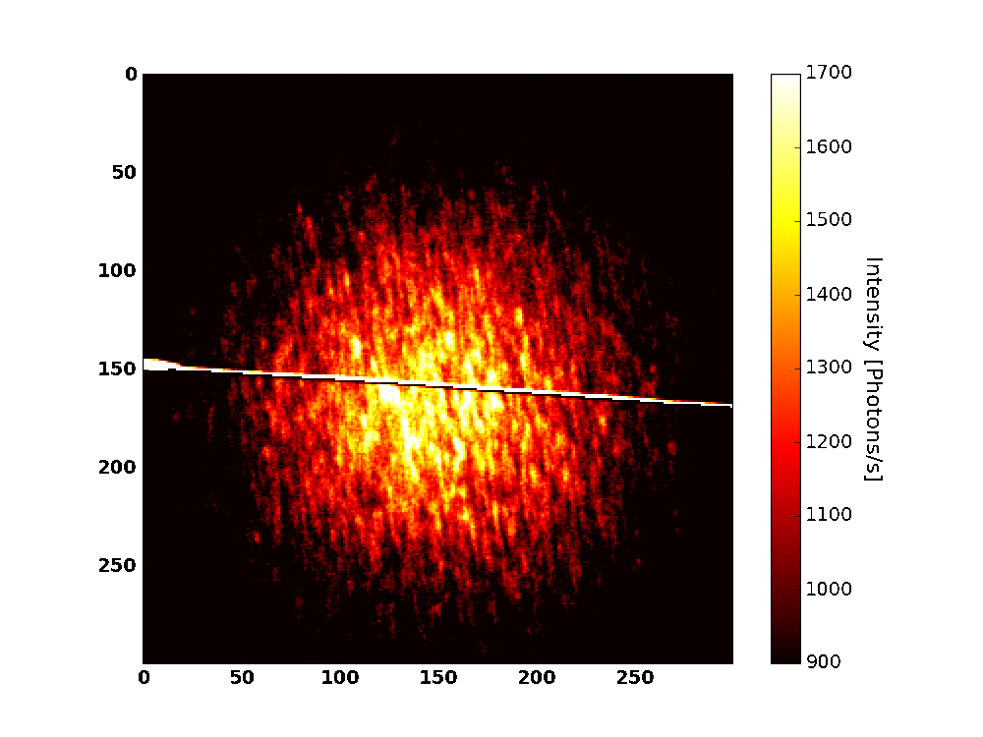
Direct Observation of Charge Stripes Locked to the Lattice of La_{2−x}Ba_{x}CuO₄
Sample translation (10 μm)
High coherent flux facilitated the first ever speckle and XPCS measurement of charge stripes in a cuprate
Stripe correlations are found to be static from 15 to 45 K
Demonstrates that pairing mechanism is not fluctuating CDW
X.M. Chen, et al. PRL (2016)
CSX and CMPMSD

Slide 29
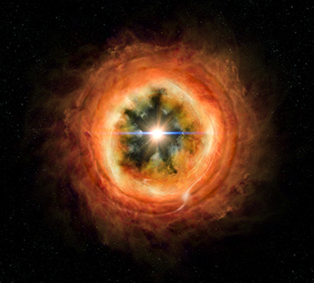
Transition User Program
Supporting former NSLS users at other facilities while
capabilities are being ramped up at NSLS-II.
Working with APS, ALS and SSRL we have had programs in
EXAFS, MX, TXM, ED-XRD and IR spectroscopy
We have supported 353 unique users to date (FY14-17)
Producing 52 papers to date
Recent highlight: Lifetime of solar nebula
Measurements on the NSLS TXM instrument at the APS isolated micron-sized ferromagnetic grains of angrite in meteorites. Studying their magnetism revealed that they formed in near-zero magnetic field and therefore that the solar nebula had dispersed 3.8 million years after the solar system formed
Wang et al., Science (2017)
Notes:
Used txm to find magnetization carrying iron minerals in meteorites. XANES determined their mineral structure

Slide 30
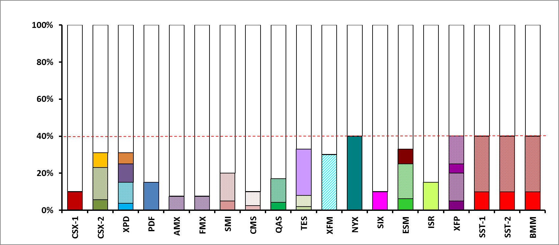
Partner Users at NSLS-II (Run 18-1)
Percentages of beamtime in Run 18-1 allocated to partner users at 19 beamlines (with different solid colors indicating different approved PUPs)
Hashed fill indicates portion of the PU time used for GU proposals reviewed through NSLS-II system
Total Partner Investment >$85M
Notes:
Same groups have same colors even if PUA is separate; hashed indicates proposals will go through GU system (although PU has opportunity to rank out-of-order for proposals they want to fill their PU time – justification required retroactively each cycle).

Slide 31
Publications Based on Data at
NSLS-II Beamlines
Total number of publications based on data from NSLS-II beamlines: 51
6 DOE “high-impact” journal papers
30% of these publications are in premier journals with impact factor > 6
as of Feb 12, 2017

Slide 32
NSLS-II Beamline Buildout
First light date
first

Slide 33
Beamline Value Engineering Process
Launched process to understand costs of beamline construction and operation
Working with other DOE light sources through a series of workshops
Utilize the process to reduce costs for the next beamlines at NSLS-II and transfer experience to APS-U, ALS-U

Slide 34
Imaging Strain and Stacking Faults (SF)
In_{1-x}Ga_{x}As nanowires (x=0.14)
Catalyst-free, site-selective
growth by MBE on Si(111)
(2,0,-2,0): sensitive to SF
(2,-1,-1,2) insensitive to SF
Stacking
faults
Slowly
varying
strain
field
Scanned region of interest ROI 1
ROI 1
100 nm
100 nm
(0001)
Growth
direction
Imaging experiment reveals variation in stacking fault density along growth direction.
Strain found to be largely uniform over ~100nm scale.
~ 8 nm resolution based on signal.
Sampling resolution of 3.6nm/pixel.
2 min/image using fly-scan.
ROI 2
500 nm
ROI 2
Hruszkewycz, Holt, Stephenson – ANL
Hill, Lauhon – Northwestern U.
Huang, Yan, Chu, Nazaretski – NSLS-II
Treu, Morkötter, Koblmueller – TU Munich
100 nm

Slide 35
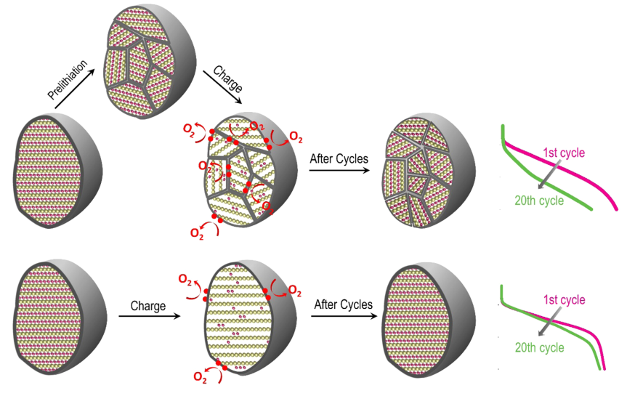




Microstructural Defects and Voltage Fade in Li and Mn-Rich Cathodes
  Li and Mn-rich cathodes have a high energy density, but suffer from serious voltage fade
  Combining x-ray tools, including Pair distribution function (PDF) analysis done at NSLS-II, XPD with STEM revealed that nanosized micro-structural defects, especially grain boundaries created by prelithiation, accelerates transition metal reduction and the layered-to-spinel phase transition. This greatly accelerates the voltage fade in lithium ion batteries.
  These findings suggest solutions to the voltage fade issue, facilitating the application of these cathode materials for energy storage applicationsa
Illustration of prelithiation-induced smaller crystallite size and its eﬀect on voltage fade in Li₂Ru_{0.5}Mn_{0.5}O₃.
E.Y. Hu et al., Nano Lett. (2016).
Notes:
Li- and Mn-rich (LMR) cathode materials have been considered as promising candidates for energy storage applications due to high energy density. However, these materials suffer from a serious problem of voltage fade. Oxygen loss and the layer to spinel phase transition are two major contributors of such voltage fade. In this paper, using a combination of x-ray diffraction (XRD), pair distribution function (PDF), x-ray absorption (XAS) techniques and aberration-corrected scanning transmission electron microscopy (STEM), we studied the effects of micro structural defects, especially the grain boundaries on the oxygen loss and layered-to-spinel phase transition through prelithiation of a model compound Li2Ru0.5Mn0.5O3. It is found that the nano-sized micro structural defects, especially the large amount of grain boundaries created by the prelithiation can greatly accelerate the oxygen loss and voltage fade. Defects (such as nano-sized grain boundaries) and oxygen release form a positive feedback loop, promote each other during cycling, and accelerate the two major voltage fade contributors: the transition metal reduction and layered-to-spinel phase transition. These results clearly demonstrate the important relationships among the oxygen loss, microstructural defects and voltage fade. The importance of maintaining good crystallinity and protecting the surface of LMR material are also suggested. [DOI: 10.1021/acs.nanolett.6b01609]
Work was funded by Energy Efficiency and Renewable Energy, Office of Vehicle Technologies and DOE-BES under Contract No. DE-SC0012704. Use of SSRL at SLAC was is supported by DOE-BES under Contract no. DEAC02-76SF00515. Use of the APS at ANL was supported by DOE-BES under contract no. DE-AC02-06CH11357.

Slide 36
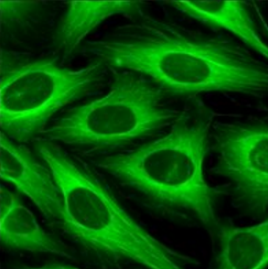
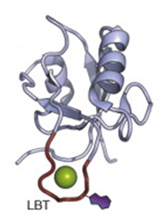
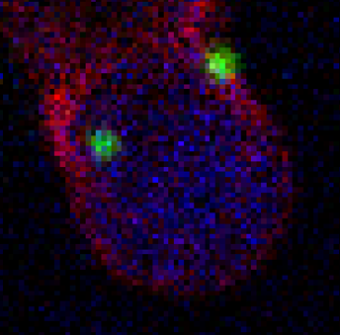
HXN: Highest Resolution X-ray Fluorescence Tomography
K. Allen (Boston Univ), B. Imperiali (MIT), L. Miller (BNL), whole HXN Team
GFP fusion tags are a ubiquitous for visualizing individual proteins in cells with light microscopy. But due to the wavelengths of visible light, the spatial resolution is limited to hundreds of nm.
Er Distribution
0.5 um
We are developing lanthanide-based fusion tags to perform the same task with X-ray fluorescence microscopy at <20 nm spatial resolution in 3D.
Eu
Zn
Au
20 nm voxel, 0.1 sec/pixel dwell
Er ion (green) complexed to an LBT loop (red) in OMP-A (outer membrane protein A)
2D image shows Eu localized on the cell membrane surface. Au (100 nm) was added as a fiducial marker for tomo reconstruction.
Notes:
-GFP tags are also quite large, limiting the locations they can be expressed in cells.
-LBTs are only ~20 amino acids long, making them easier to express anywhere, and not disturb the target protein’s function.
-advantage over EM is the ability to do 3D without sectioning or FIBing the cells.
-we can embed cells in salt crystals to help retain their 3D structure and image without cryoprotection

Slide 37
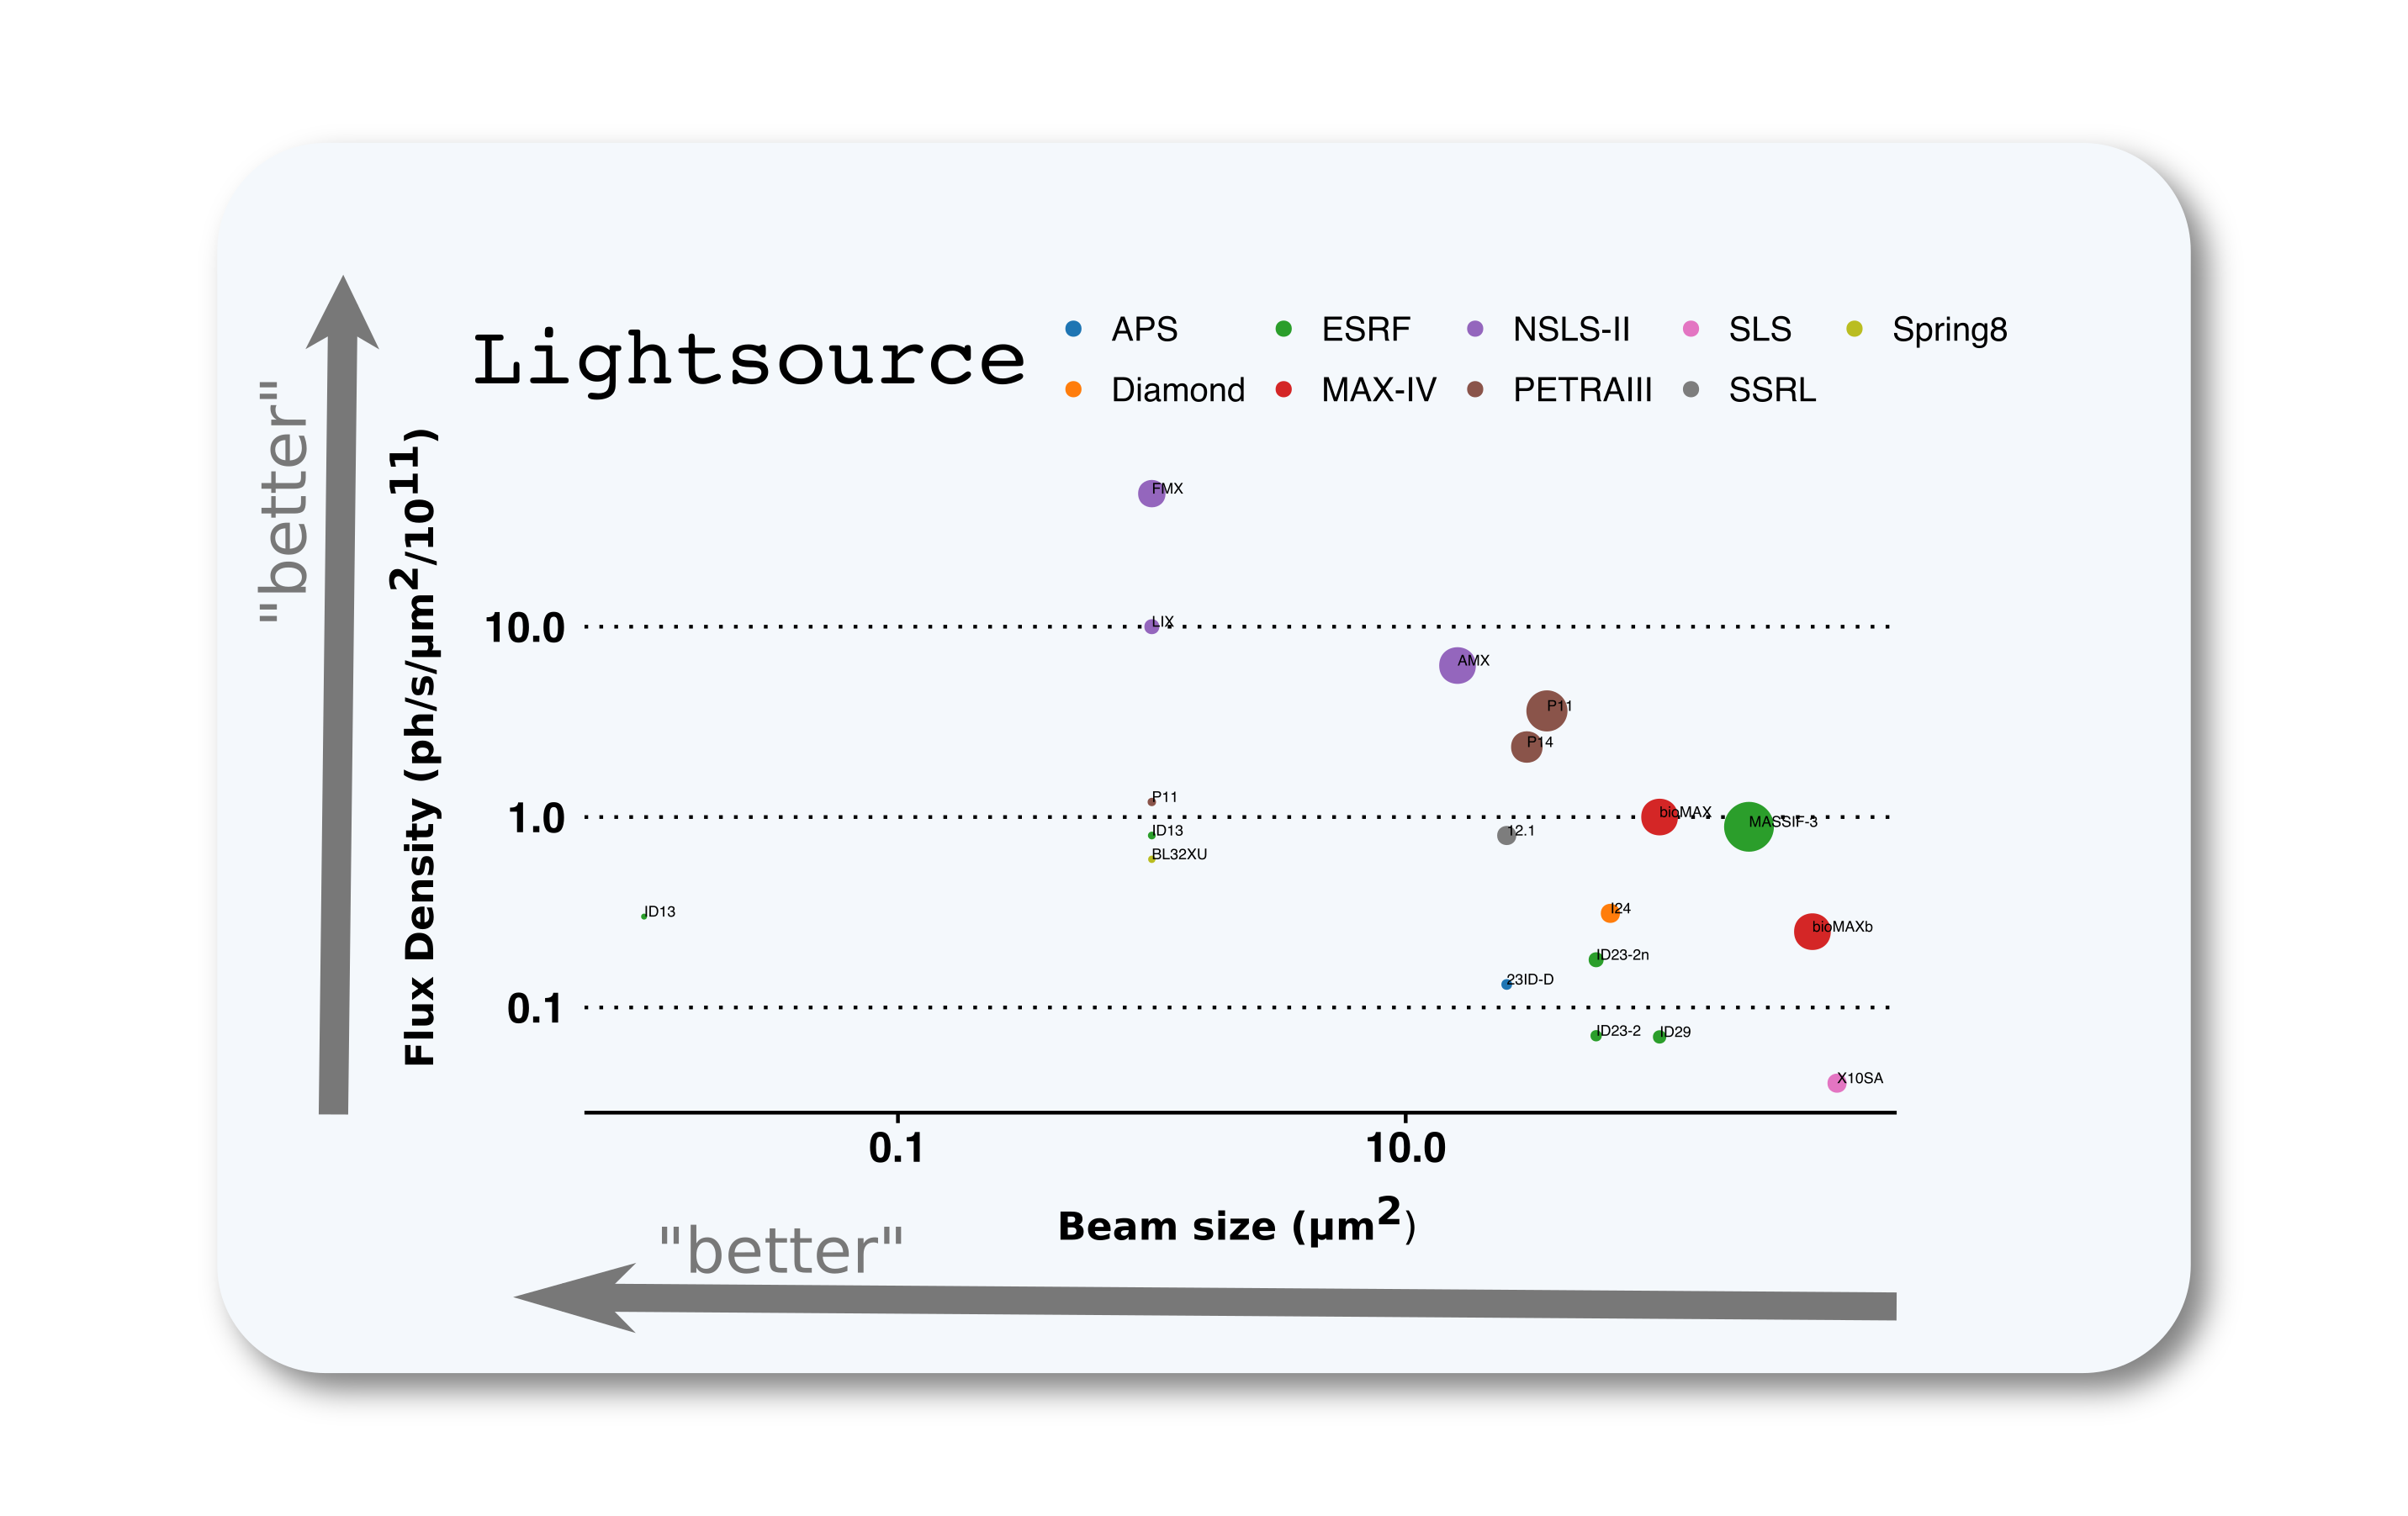
NSLS-II: Brightest MX beamlines
NSLS-II
this will mean we can innovate to study dynamics

Slide 38
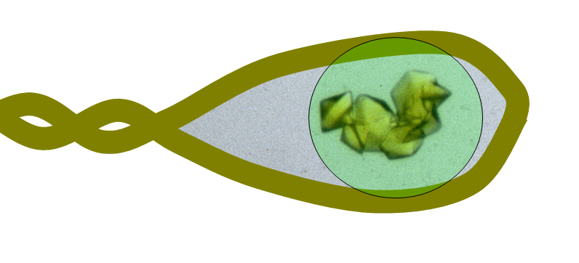
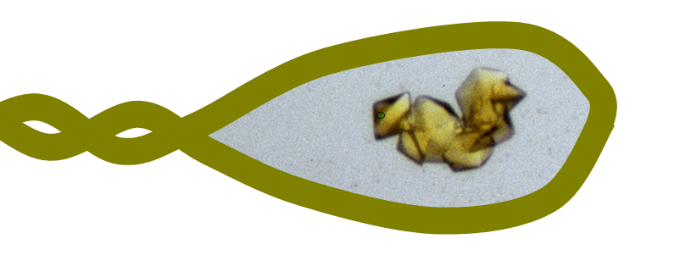
The old brightness problem

Slide 39
The new brightness problem

Slide 40
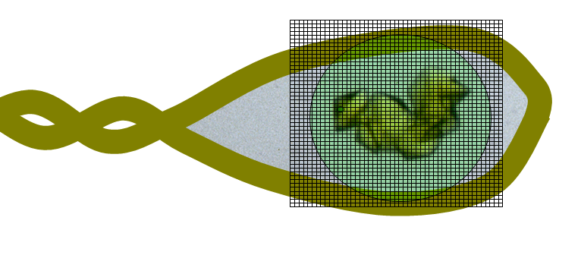
NSLS-II can change the way structural biology is done
~ 5ms before radiation damage destroys sample = 4 frames

Slide 41
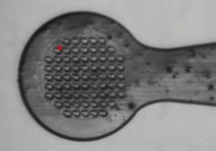
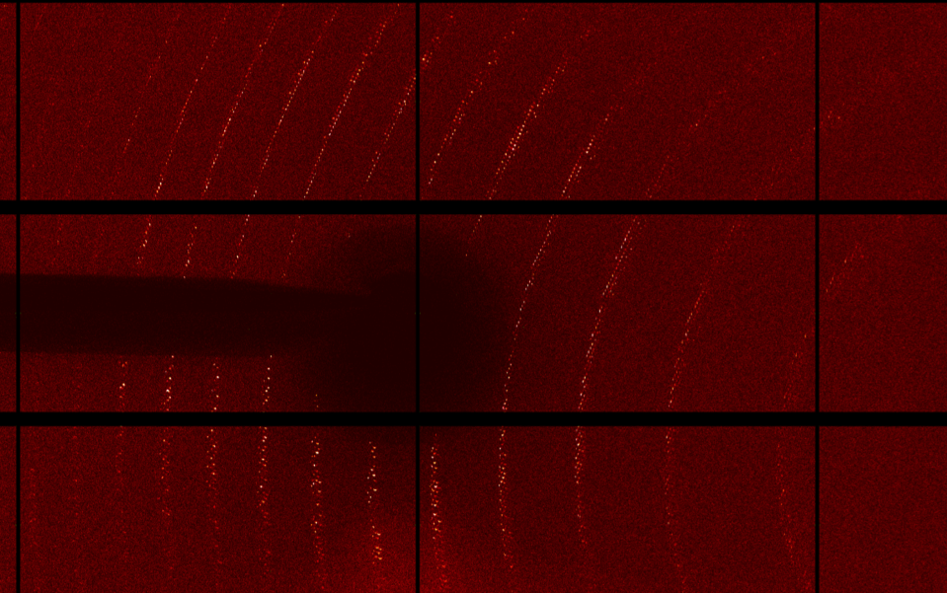
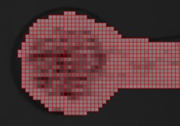
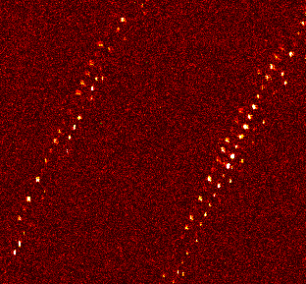
FMX Scientific Commissioning
Developing raster data collection
Serial microcrystallography of 1-5 µm size Thaumatin crystals
“real samples” now being studied.
Maben, Stern (U Massachusetts Medical School)
  Endoplasmic-reticulum associated aminopeptidase 1
  Very large unit cell 585 × 545 × 125 Å³
  Full separation of 2 large axes

Slide 42
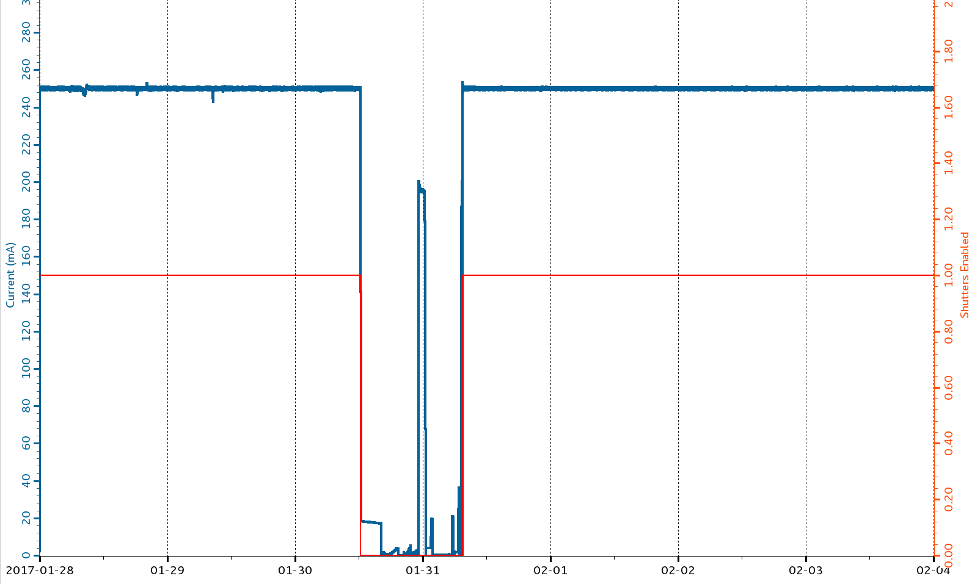
NSLS-II Accelerator Update
Accelerator is performing well, delivering 275 mA top-off in routine operations
FY17-to-date reliability performance = 96.4%
Operations plan in 2017 is to reach 300 mA top-off with > 95% reliability:
  2/16/17: 250 mA → 275 mA
  4/17: 275 mA → 300 mA
Operations
Studies
Operations
6+ days

