Slide 1
CSGB Strategic Planning Update
& COV Planning
Briefing to BESAC
February 24, 2017
Bruce Garrett, CSGB Division Director
Basic Energy Sciences
Office of Science, U.S. Department of Energy

Slide 2
Strategic Planning for
BES Chemical Sciences, Geosciences, and Biosciences Division

Slide 3
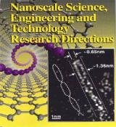
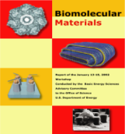
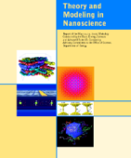
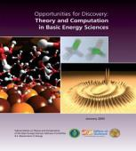



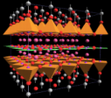

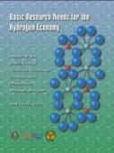



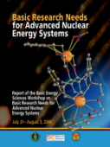

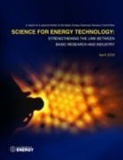
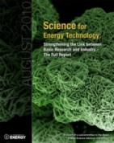
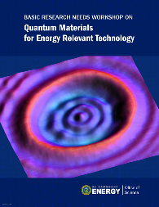
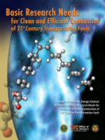
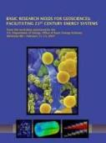

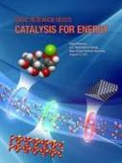
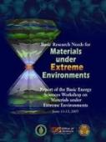
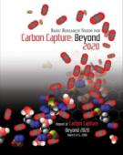
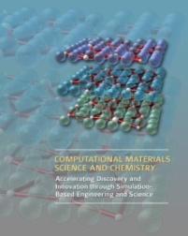
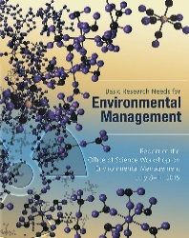
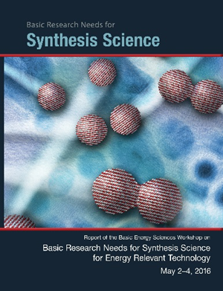


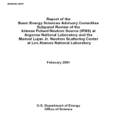
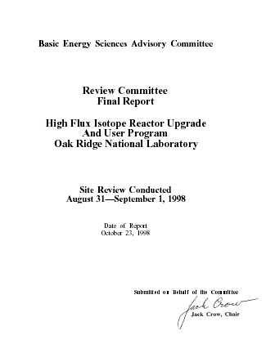

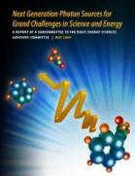
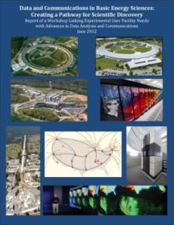
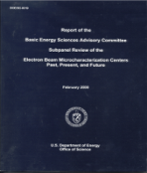
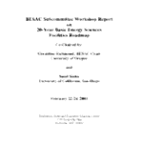




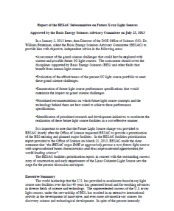
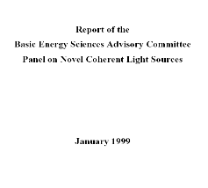
BES strategic planning activities provide the foundation for the CSGB strategy
Science for Discovery
Complex
Systems
Science for National Needs
National Scientific User Facilities, the 21st century tools of science
BESAC Future Light Sources
2013
BESAC Report on Facility Upgrades
2016
http://science.energy.gov/bes/news-and-resources/reports/
Notes:
3

Slide 4
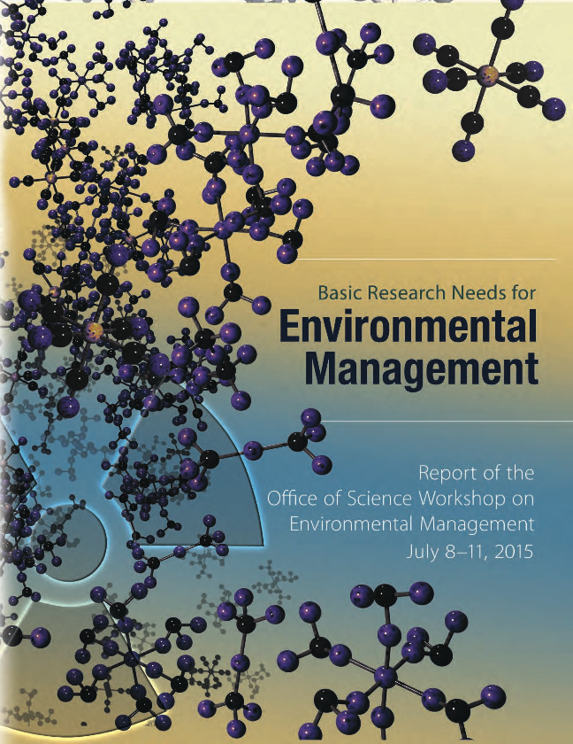

BES/CSGB strategic plan driven by mission/vision/goals
Mission: BES/CSGB research focus is on gaining understanding leading to control of chemical transformations and energy flow, which provides foundations for new technologies to generate, store, and use energy and to mitigate its environmental impacts
Vision: Recognition of BES/CSGB for impact of scientific programs that are at the forefront of chemical sciences, geosciences and biosciences and advance DOE missions
Goals:
  Balance and synergy of discovery and use-inspired
  fundamental research
    Advance ability to understand, predict, and ultimately
    control matter and energy
    Surmount scientific barriers to implementing technologies
  Innovative management of science portfolios
    Provide focus on key and evolving scientific challenges
    Maintain balance and health of university and lab programs;
    demonstrate the value and distinction of both

Slide 5
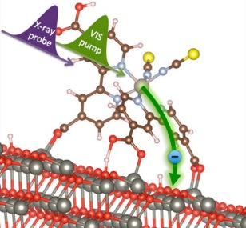
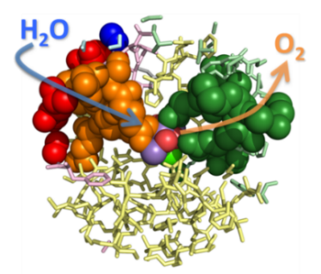
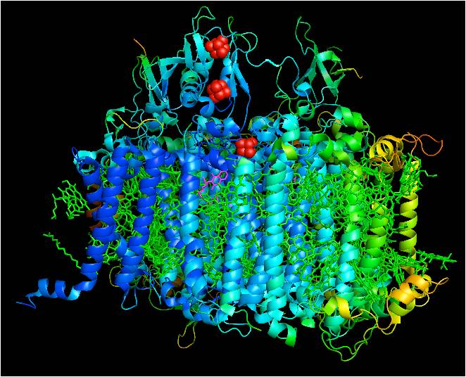
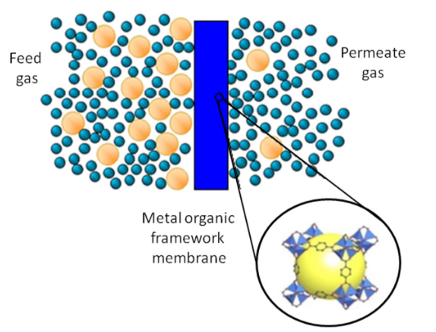
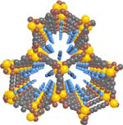
CSGB Research Portfolio – current status
Fundamental Interactions:
  Discover the factors controlling chemical reactivity and dynamics in the gas phase, condensed phases and at interfaces, based upon a quantum description of the interactions among photons, electrons, atoms, molecules and nanostructures
Photochemistry and Biochemistry:
  Elucidate the molecular mechanisms of the capture of light energy and its conversion into chemical and electrical energy through biological and chemical pathways
Chemical Transformations:
  Understand and control synthesis, conversion, stabilization and transport processes in chemical systems, from atomic to geologic scales

Slide 6
CSGB Research Portfolio – current status
Fundamental Interactions:
  Discover the factors controlling chemical reactivity and dynamics in the gas phase, condensed phases and at interfaces, based upon a quantum description of the interactions among electrons, atoms, molecules and nanostructures
Photochemistry and Biochemistry:
  Elucidate the molecular mechanisms of the capture of light energy and its conversion into chemical and electrical energy through biological and chemical pathways
Chemical Transformations:
  Understand and control synthesis, conversion, stabilization and transport processes in chemical systems, from atomic to geologic scales
Division-wide themes
energy ←→ chemical conversions
molecular to meso-scale science
ultrafast science
complex interfaces
artificial and natural systems
chemical imaging
chemical synthesis
theory, modeling & computation

Slide 7


Photochemistry and Biochemistry Team:
Integrating vision across programs
Program Interactions
Scientific Interactions
λ
λ
BIOCHEMICAL
CHEMICAL
Bio related
EFRCs
Photo-synthetic Systems
Solar
Photo-chemistry
Fuels from Sunlight Hub (JCAP)
&
Solar related EFRCs
Physical Biosciences
Catalysis
AMOS
CTC
Catalysis
AMOS
CTC
CPIMS
Fuel, (bio)chemicals, electricity

Slide 8
Photochemistry and Biochemistry Team:
Integrating vision across programs
Scientific Interactions
λ
λ
BIOCHEMICAL
CHEMICAL
Bio related
EFRCs
Biological Energy Capture & Conversion
Chemical
Solar
Energy
Capture & Conversion
Fuels from Sunlight Hub (JCAP)
&
Solar related EFRCs
Biological Energy Conversion & Storage
Catalysis
Ultrafast sci.
Theory/comp.
Catalysis
Ultrafast sci.
Theory/comp.
Interfacial proc.
Fuel, (bio)chemicals, electricity

Slide 9
Division-wide strategic planning process to move forward
Assess
Start assessment at level of core research areas (CRAs)
Assess current programs, opportunities, and capabilities
Analyze/integrate CRA assessments → teams → division
Identify strategic research directions; set objectives
Create action plan (steps to achieve objectives) and act on it
  Consider budget, organization, operations, communications, etc.
We are here
Analyze/Plan
Execute

Slide 10
Assessments of program elements (CRAs)
Inventory assessment: what’s in the portfolio and why?
  What is the overarching goal? Why is it important? What areas are being addressed? Why are they the right research areas? What is the distribution across lab and university programs, PI demographics, etc.?
Opportunity assessment: what new opportunities have emerged?
  What are the most pressing scientific needs and key scientific challenges? What are the highest priorities for focusing the portfolio on areas with high potential impact?
Capability assessment: what is needed to succeed?
  What current research areas and capabilities can help move the portfolio into new directions? What’s missing, i.e., what new research areas and capabilities are required?

Slide 11
Example of Recent Strategic Planning
Assessment of Condensed Phase and
Interfacial Molecular Science (CPIMS)

Slide 12
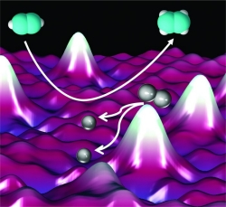

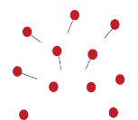
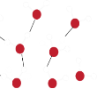


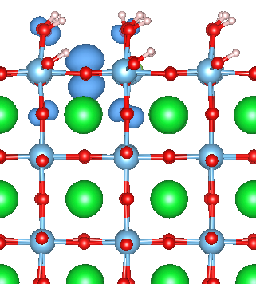
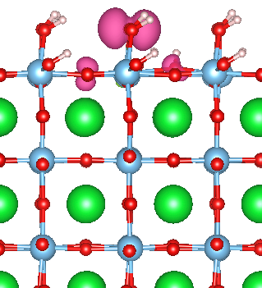
CPIMS goal aligned with team and division focus
Overarching CPIMS goal: understand and ultimately control chemical processes and dynamics in liquids and at interfaces at a molecular level, and confront the transition from molecular-scale chemistry to collective phenomena in complex systems
→ Discover the factors controlling chemical reactivity and dynamics in the gas phase, condensed phases and at interfaces, … (Fundamental Interactions)
→ Gain fundamental understanding of chemical transformations and energy flow, … (CSGB)
1.3 ps
∼4 ps
h⁺

Slide 13
CPIMS is evolving to address new science challenges
Current emphasis:
  Discovering the molecular-origins of heterogeneous chemistry processes for well-characterized metal and metal-oxide surfaces
  Understanding reactivity and dynamical processes in solutions (e.g., aqueous systems) and at their interfaces using model systems
  Advancing knowledge of the transition from molecular-scale chemistry to collective phenomena in complex systems
Reducing emphasis:
  Understanding reactions and dynamics for gas-phase clusters
  Exploring the dynamics of single molecules with extreme spatial and/or temporal resolution on model systems
Increasing emphasis of future work:
  Building on model system studies to understand increasingly more complex interfacial and solution systems (e.g. novel and mixed solvents)
  Extending molecular-level insight in model systems across a range of scales to understand origins of macroscopic processes

Slide 14

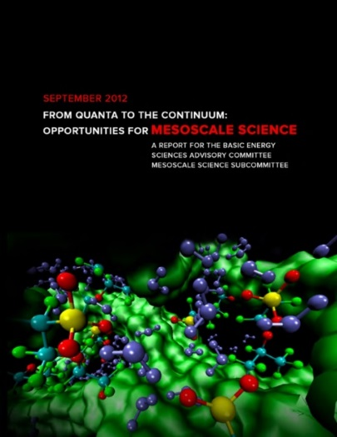

CPIMS is positioned to address mesoscale chemistry challenges
Established |  | Emerging
Aqueous Systems |  | Mixed and Novel Solvents
Clusters, Ideal Interfaces, UHV Surface Science | → | Complex (Heterogeneous and Dynamic) Interfaces
Model Single-Molecule Systems |  | Molecular Imaging of Multiscale Systems
“Understanding how remarkable properties of matter emerge from complex correlations of the atomic or electronic constituents …”
“Beyond ideal materials & systems: understanding the critical role of heterogeneity, interfaces and disorder …”
Bridging from molecular details
to ensemble outcomes
(2007)
(2012)
(2015)

Slide 15
Questions/comments?

Slide 16
Planning for Committee of Visitors Review of the BES Chemical Sciences,
Geosciences, and Biosciences Division

Slide 17
Committee of Visitor Charge (Standard)
1. For both the DOE laboratory projects and the university projects, assess the efficacy and quality of the processes used to:
  (a) solicit, review, recommend, and document proposal actions, and
  (b) monitor active projects and programs.
2. Within the boundaries defined by DOE missions and available funding, comment on how the award process has affected:
  (a) the breadth and depth of portfolio elements, and
  (b) the national and international standing of the portfolio elements.

Slide 18
COV reviews play a significant role in BES & SC
Initiated in 2002 with review of the chemical sciences portion of the CSGB division
Now a standard BES practice, and embraced by all SC offices
COV recommendations have an impact
Previous COV reports and BES responses available at: http://science.energy.gov/bes/about/bes-cov/

Slide 19
COV recommendations led to a significant outcome
The Portfolio Analysis and Management System (PAMS) is enabling the “rigorous collection of data on all aspects of proposal solicitation, review, funding recommendation, proposed action and all metrics associated with progress …” (2008)
  Recommendations for portfolio management tool in all COVs through 2014; BES concurred and SC responded with development of PAMS
  PAMS significantly changed how BES conducts its management of proposals and projects
  PAMS continues to add capabilities:
    Progress towards full implementation “to allow data analysis related to the reviewing process and demographics of BES programs” (2014)
    The COV will use PAMS for the first time in the upcoming meeting

Slide 20
COV recommendations changing BES/CSGB practices
Continued “use of preliminary statements of potential research projects” (2014)
Initiated “strategic planning session at the division level to evaluate current directions and identify new opportunities and synergies strategic planning” (2014)
Continuing updates to BES web sites, as part of SC effort, to “provide web sites that are more accessible and encouraging” (2011)
Evolving laboratory review formats (on-site, mail, virtual meetings) to allow “increase in the funding for Program Officers to travel to national and international conferences” (2014)

Slide 21
2017 COV will review actions for FY14-FY16
The COV will review actions on:
  New and renewal proposals to CSGB programs from universities through the SC Financial Assistance Program (“annual solicitation”)
  New and renewal proposals to CSGB programs from DOE labs
  Proposals for new solicitations:
    FY14 FOA for Scientific Discovery through Ultrafast Materials and Chemical Sciences
    FY16 FOA on Sustainable Ammonia Synthesis
The COV will not review actions from other opportunities such as:
  Energy Innovation Hubs, Energy Frontier Research Centers, SC Early Career Awards, SC Graduate Fellowship Program, EPSCoR, SBIR/STTR

Slide 22
FY 2017 Committee of Visitors
Chair: Bruce Kay, Pacific Northwest National Laboratory
Location: Rockville Hilton Hotel
Dates: March 28 – 30, 2017
COV statistics
  18 COV panelists organized into 3 panels
  12 from academia, 4 from DOE labs, 2 from other Federal Agencies (NSF and AFOSR)
  9 female, 9 male
  12 funded by CSGB
  3 served on prior COVs (Kay, McCoy, Berman)
  1 BESAC member (Kay)

Slide 23
Panel Structure and Membership
Panel 1: Fundamental Interactions, Anne McCoy, University of Washington
Michael Berman AFOSR
Gary Douberly University of Georgia
Kelly Gaffney SLAC
Evelyn Goldfield NSF
Amber Krummel Colorado State University
Panel 2: Photochemistry and Biochemistry, Robert Blankenship, Washington University David Britt University of California, Davis
Marilyn Gunner City College University of New York
Jennifer Ogilvie University of Michigan
Cyndi Zoski New Mexico State University
Panel 3: Chemical Transformations, Michael Hochella, Virginia Tech
Donna Chen University of South Carolina
Pete McGrail PNNL
Laura Pyrak-Nolte Purdue University
Lynda Soderholm ANL
Peter Stair Northwestern University

Slide 24
PAMS will be used by the COV
COV members will have read-only access to proposals that had actions (awarded, declined, or withdrawn) in fiscal years 2014, 2015, and 2016
Material provided:
  Reference Materials
    Description of programs
    Lists of awarded, declined, and withdrawn proposals
  Solicitation Folders
    Letters of intent/preproposals
  Proposal Folders
    Proposals
    Reviews
    Declination memos
  Award Folders
    Budgets
    Selection statements

Slide 25
Elements of agenda
Day 1
  Plenary session: welcome, BESAC charge, BES and CSGB overviews, introduction to review process and PAMS COV module
  Panel breakout sessions: brief portfolios overviews from CSGB team leads; first read of selected packages by COV; Program Managers on call
  Executive session: preliminary report drafting and first assessment of key elements and gaps
Day 2
  Executive session: completion and discussion of first read reports
  Panel breakout sessions: portfolio overviews available if requested, second read by COV; Program Managers on call
  Executive session: merge first and second read input; draft and discuss panel reports
Day 3
  Executive session: finalize draft panel reports
  Closeout plenary session: presentation of major findings and recommendations

Slide 26
Questions/comments?

