Slide 1

Quantum Information Science: From a NIST Perspective
DR. CARL J. WILLIAMS
Acting Director
Physical Measurement Laboratory (PML)
National Institute of Standards and Technology
13 July 2017
carl.williams@nist.gov

Slide 2
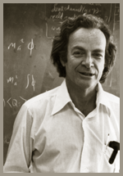
A First Hint of Quantum Information?
“When we get to the very, very small world---say circuits of seven atoms---we have a lot of new things that would happen that represent completely new opportunities for design. Atoms on a small scale behave like nothing on a large scale, for they satisfy the laws of quantum mechanics. So, as we go down and fiddle around with the atoms down there, we are working with different laws, and we can expect to do different things. We can manufacture in different ways. We can use, not just circuits, but some system involving the quantized energy levels, or the interactions of quantized spins, etc.” -- Richard P. Feynman, “Plenty of Room at the Bottom”, December 1959

Slide 3
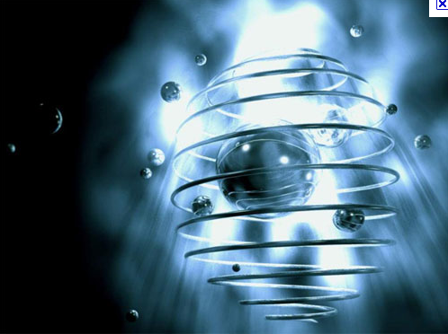
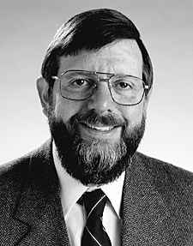
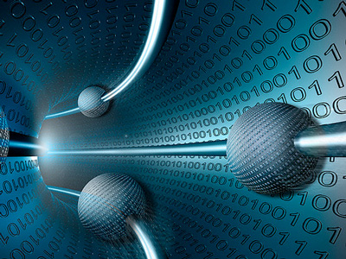
Quantum Mechanics & Information Science
Two of the most important and revolutionary developments of the 20th century, both for science and technology:
QIS is a convergence of these two 20th Century’s revolutions
Quantum Mechanics changed the way we think about the physical world.
“Quantum information is a
radical departure in
information technology,
more fundamentally
different from current
technology than the
digital computer is from
the abacus.” -- W. D. Phillips, 1997 Nobel Prize in Physics
Information Science changed the way we think about processing and communicating information

Slide 4
Quantum Information Science in a Nutshell
Quantum information science (QIS) exploits unique quantum properties such as coherence, superposition, entanglement, and squeezing to acquire, transmit, and process information in ways that greatly exceed existing capabilities.
QIS is a field of scientific inquiry in its own right, with applications in:
sensing and metrology: precision navigation, timekeeping, …
communication: secure data transmission and storage, random number generation, …
simulation: complex materials, molecular dynamics, QCD, …
computing: cryptanalysis, quantum chemistry, optimization, quantum field theory, …
and robust intellectual connections to numerous areas of basic research.
We focus here on QIS because it is much broader than just quantum computing!

Slide 5
QIS and the US Government
QIS is of active interest to USG
  Subject of numerous reports and focused meetings of various agencies
  Coordinated across the agencies
  Public report released in July 2016 → (also see: https://obamawhitehouse.archives.gov/blog/2016/07/26/realizing-potential-quantum-information-science-and-advancing-high-performance)
White House OSTP hosted a Forum on QIS on October 18, 2016 (see: https://obamawhitehouse.archives.gov/blog/2016/10/18/identifying-strategic-options-advancing-quantum-information)
https://www.whitehouse.gov/sites/whitehouse.gov/files/images/Quantum_Info_Sci_Report_2016_07_22%20final.pdf

Slide 6
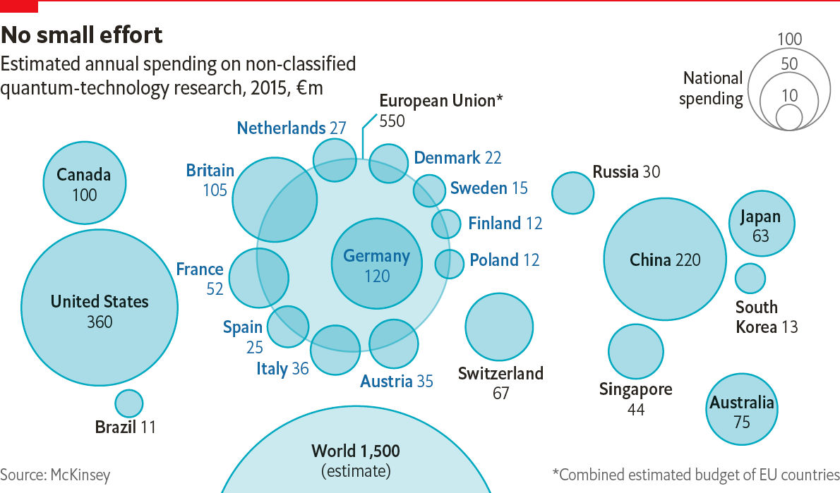
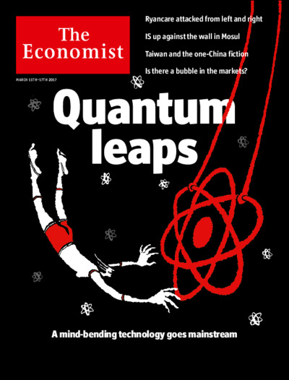
Nations and Companies are Investing
March 11, 2017

Slide 7
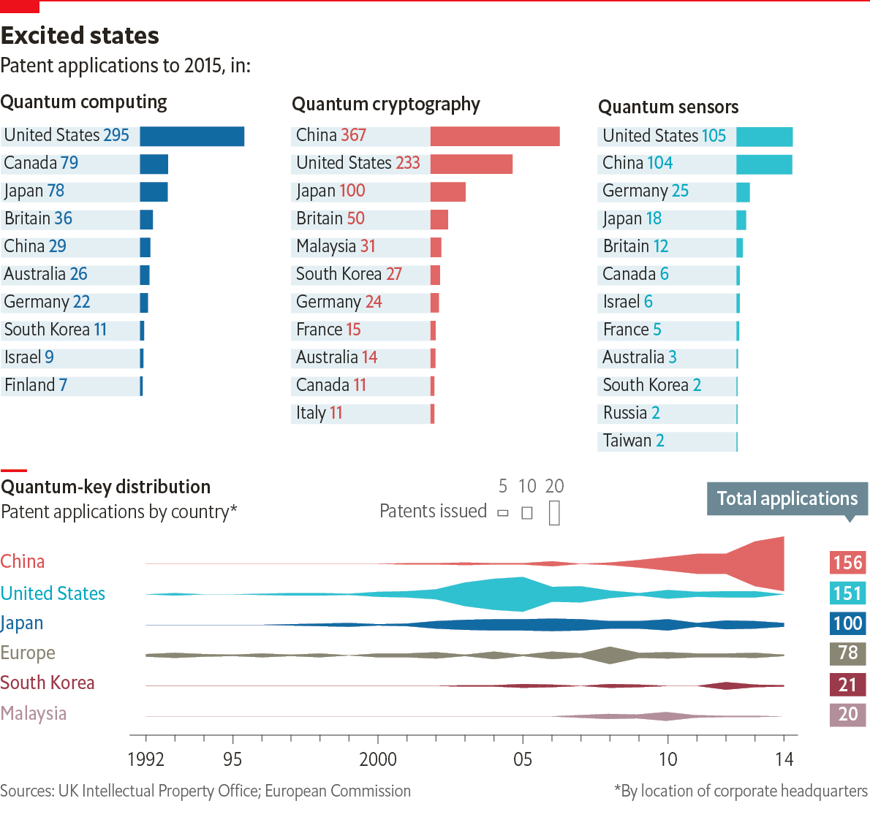
World-wide Patents
March 11, 2017
Extracted from the Economist

Slide 8
U.S. Patents

Slide 9
QIS and DOE/OS/BES
According to the BES website: “Basic Energy Sciences (BES) supports fundamental research to understand, predict, and ultimately control matter and energy at the electronic, atomic, and molecular levels in order to provide the foundations for new energy technologies and to support DOE missions in energy, environment, and national security.”
The future of understanding, predicting, and controlling matter and energy at these levels is not just based on quantum mechanics but on QIS! Feynman foresaw the answer more than 50 years ago!
Moreover, one of the largest application of a QIS will be the efficient solution (emulation, simulation, and/or computation) of one quantum problem by another quantum system!

Slide 10
Applications of QIS Relevant to DOE/OS
For BES:
  Material characterization
  New quantum materials for computing or energy collection and harvesting
  Understanding of fundamental interactions relevant to AMO
  Computational Theoretical Chemistry – whether exact or new density functionals
  Condensed Matter Physics including theoretical CMP
  Fundamental research to predict and control matter and energy
For the broader OS:
  Computation
  Search for Dark Matter
  Gravity wave detectors
  Sensor and detectors for HEP

Slide 11
Possible Applications of Q. Computers
Solution of basics physics problems including:
  Lattice Quantum Electro/Chromo-Dynamics (QED/QCD)
  Simulations of Condensed Matter Hamiltonians – High Tc Superconductivity
Optimization of commercially important problems:
  Electronic Circuit layout
  Airline Schedules (efficiency here – even at a fraction of a penny per mile can drive out competitors)
Accelerated search of large databases (numerous possibilities)
Simulation of important physical systems:
  Biological applications: e.g. protein folding & pharmaceutical binding
  Potential design of new commercial materials with unimagined properties
Other undreamt of applications – remember:
  In 1960 nobody believed the laser would be used for eye surgery, welding, …
  In 1950 nobody guessed the transistor would lead to the information revolution, little own the integrated circuit and personal PC!!!

Slide 12
Why Now
Intellectual Frontier where scientific and technical opportunities have implications for:
  National Security: cryptanalysis, secure communications, inertial navigation
  Economic Competiveness: new sensors and imaging tools, improved metrology
  Frontiers of Science: discovery of new materials, insights into cosmology
QIS is at a Tipping Point – U.S. and international companies are investing:
  Major IT industries: for e.g. Google, Microsoft, IBM, Intel
  Technology companies:
  Small and/or New companies:
  Venture capital is appearing and investing
  Niche products are appearing – considered to be harbinger of a nascent field (chip-scale atomic clocks, quantum gravimeters, quantum-secure networks, …)
Foreign competition is growing rapidly:
  Some foreign investment levels are approaching those in the U.S.
  Foreign governments are implementing focused QIS initiatives
    China, UK, Germany, Canada, Japan, Australia, Netherlands, EU, …
  Lucrative research opportunities abroad are attracting top-tier U.S. researcher’s

Slide 13
Some NIST Quantum Definitions
Quantum Technology:
  Materials/systems that provide individual sensitivity to quanta – whether light, spins, charge, …
  Enabling technologies – e.g. stable chip scale lasers, chip-scale frequency combs, …
  Enabling technology that creates high-efficiency detection and transport of quanta – e.g. UV fiber for UV lasers, materials with less charge trapping or fewer stray electron spins, ion traps with lower decoherence, etc. – basically how to beat down noise and decoherence
Quantum Metrology:
  The exploitation of quantum technology to improve measurement science to make better detectors, sources, magnetic or electric field sensors, improved QHR devices, improved SETs,
  Includes clocks, magnetometers, self-correcting interferometers
  Transduction of signals – including both classical and quantum
  Squeezing to allow measurement beyond the Standard Quantum Limit (SQL) – this together with transduction allows amplification and parametric amplification of signals beyond the SQL
Quantum Based Measurement:
  The exploitation of quantum technology, quantum metrology, superposition, entanglement, or squeezing to improve a physical measurement

Slide 14
Why NIST was Positioned in QIS
Extensive background in
  Coherent manipulation of atoms and ions for clocks (power of a single qubit)
  Superconducting electronics for Josephson Voltage Systems
  Only National Measurement Institute (NMI) to ever close the electrical metrology triangle (V=IR or Ohm’s Law) at a few parts part in 10⁷ – Single electron transistors (SETs)
    Achieved more than 20 years ago and abandoned 15 year ago because it was too hard and not competitive with direct approaches (for a recent review see H. Scherer et al., Meas. Sci. Technol. 23, 124010 (2012))
    In the next few years several other NMIs may duplicate and improve – on this 20 year old result
    NIST is reinvesting in SETs in Si that should not have the charge offset noise problem in the Al SETs used 20 years ago
A long history of manipulating quanta and quantum objects

Slide 15
Why NIST Cares about QIS
Allows better measurements
Improved clocks
Clocks so good they sense their environment → search for gravity waves, dark matter
If I have technology that can integrate two legs of the electrical metrology triangle on chip then I have the ultimate self-calibrating electrical instrument
Standards are increasingly quantum in nature – QHR, JVS, clocks, magnetometers, …
Quantum transduction provides technology to directly convert classical rf or microwaves to optical signal
Control and manipulation of JJs may lead to high-speed arbitrary waveform generators (100 GHz)
Technology may enable operation in extreme environments
Technology allows measurements beyond the shot noise or standard quantum limit

Slide 16
History of QI at NIST
1992 Wineland suggests spin squeezing for improved sensitivity of clocks
1993 Competence project initiated to support idea
1994 First Workshop focused on QI held at NIST, Gaithersburg (August 94)
1995 Cirac and Zoller propose gate based on ion traps
1995 Wineland and Monroe implement concept
2000 NIST QI Program established
2000 First NIST QI Competence (like LDRD)
2001 DARPA supports Q. Communication effort
2003 NIST QI Program broadened
2005 First NIST Initiative for QI is funded
2006 Joint Quantum Institute established (FY07 Initiative)
2012 Wineland wins Nobel Prize for research in support of Q
2104 Joint Center for Quantum Information in Computer Science (QuICS) is established

Slide 17
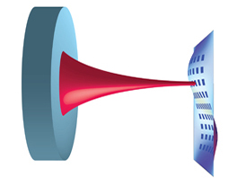
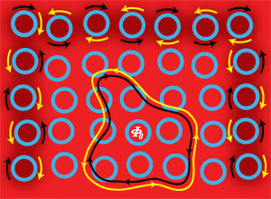
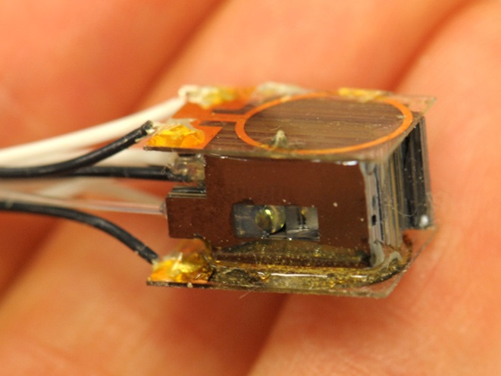
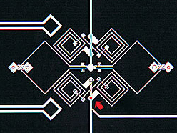
Quantum Information Science at NIST
Quantum
Transduction
We must realize efficient transfer of information between quanta of different types. Shown here: an optical cavity coupled to a vibrating, mechanical membrane.
Complex
Quantum Systems
We must develop tools for understanding, controlling, and measuring complex quantum systems. Shown here: a photonic chip with ring resonators provides topologically robust transport of photons.
Small
Quantum Systems
Small quantum systems will be improved sensors and better standards. Shown here: a chip-scale atomic magnetometer.
Quantum Materials and
Solid State Qubits
Solid state realizations of qubits are promising for mass production, though additional research is required. Shown here: a Josephson junction qubit.

Slide 18
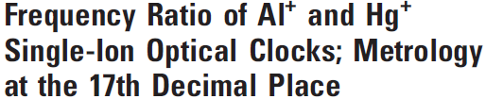
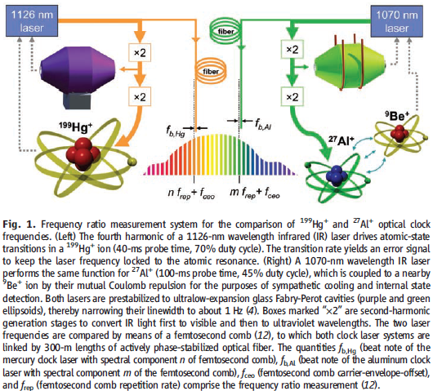
Quantum Information Prospects
Quantum Logic Clock
Quantum Transduction
Single photon sources and detectors – many apps.
Low noise, high-speed, amplifiers and parametric amplifiers beyond the SQL
Random Number Beacons
Quantum Based Measurements – electrical, optical, …
Improved Sensors
Quantum Communication & Computing
Science 319, 1808, 2008

Slide 19
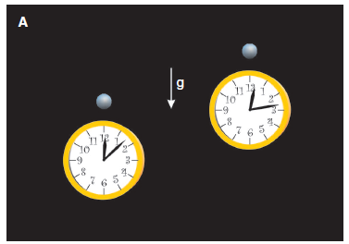
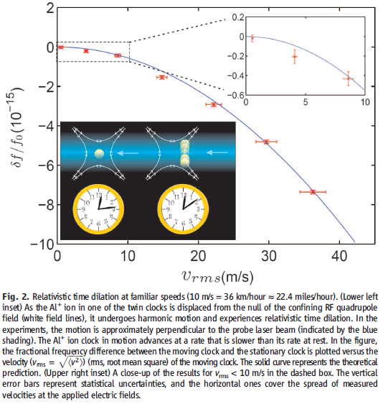
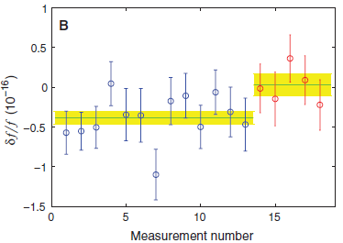


Quantum Logic Clock & Metrology
Science 329, 11630, 2010

Slide 20
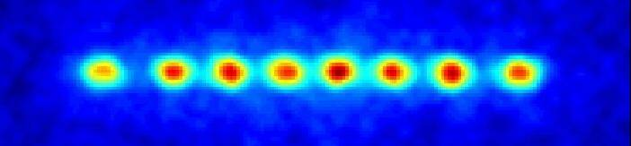
Harness Entanglement to Reduce Quantum Noise
Operate Al⁺ clock with N = 5 ions in fully entangled state: Reduced quantum noise
Differential excitation overcomes atom/laser desynchronization
→ 1x10⁻¹⁸ measurement precision in 1 hour! (1000x improvement)
High risk: differential excitation and entanglement have
never been implemented in state-of-the-art clocks!

Slide 21
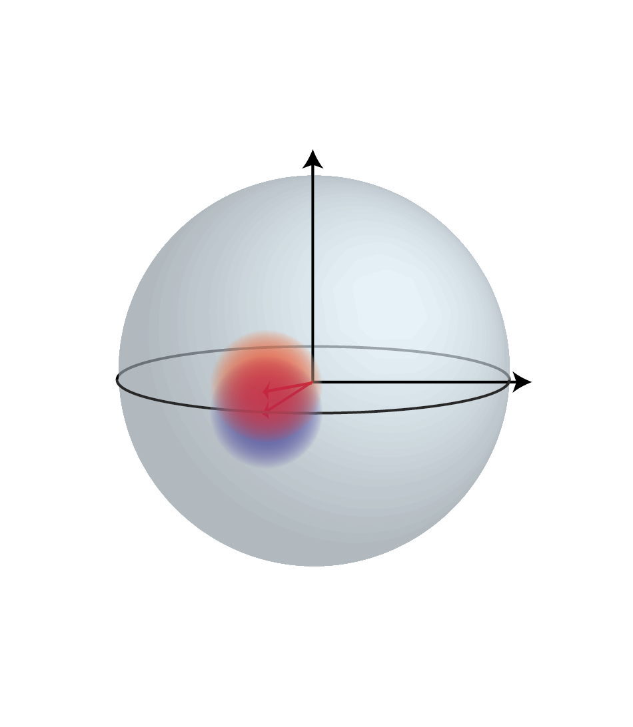
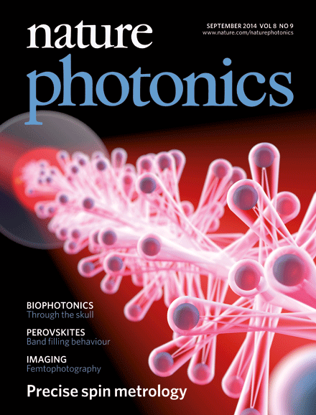
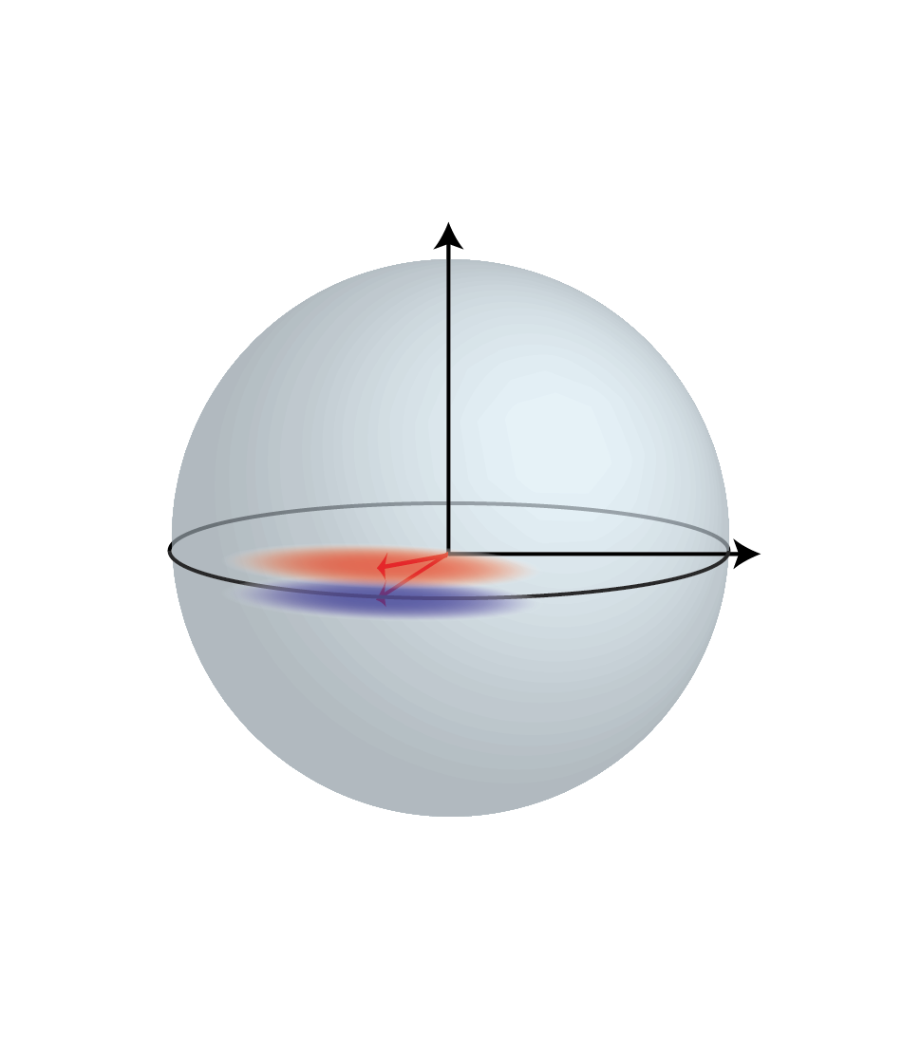
Entanglement-Enhanced Quantum Measurements
Cavity-based measurements forge entanglement or quantum links between a million atoms.
Quantum noise smears out the orientation of quantum sensors, limiting the precision of the information that can be extracted.
The entanglement squeezes the quantum noise, enhancing the precision of the information that can be extracted by a factor of 10.
Technique directly applicable to improving state-of-the art optical lattice clocks and inertial sensors.
J. G. Bohnet; et al., Nature Photonics 8, 731-736 (2014)

Slide 22
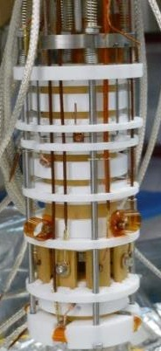
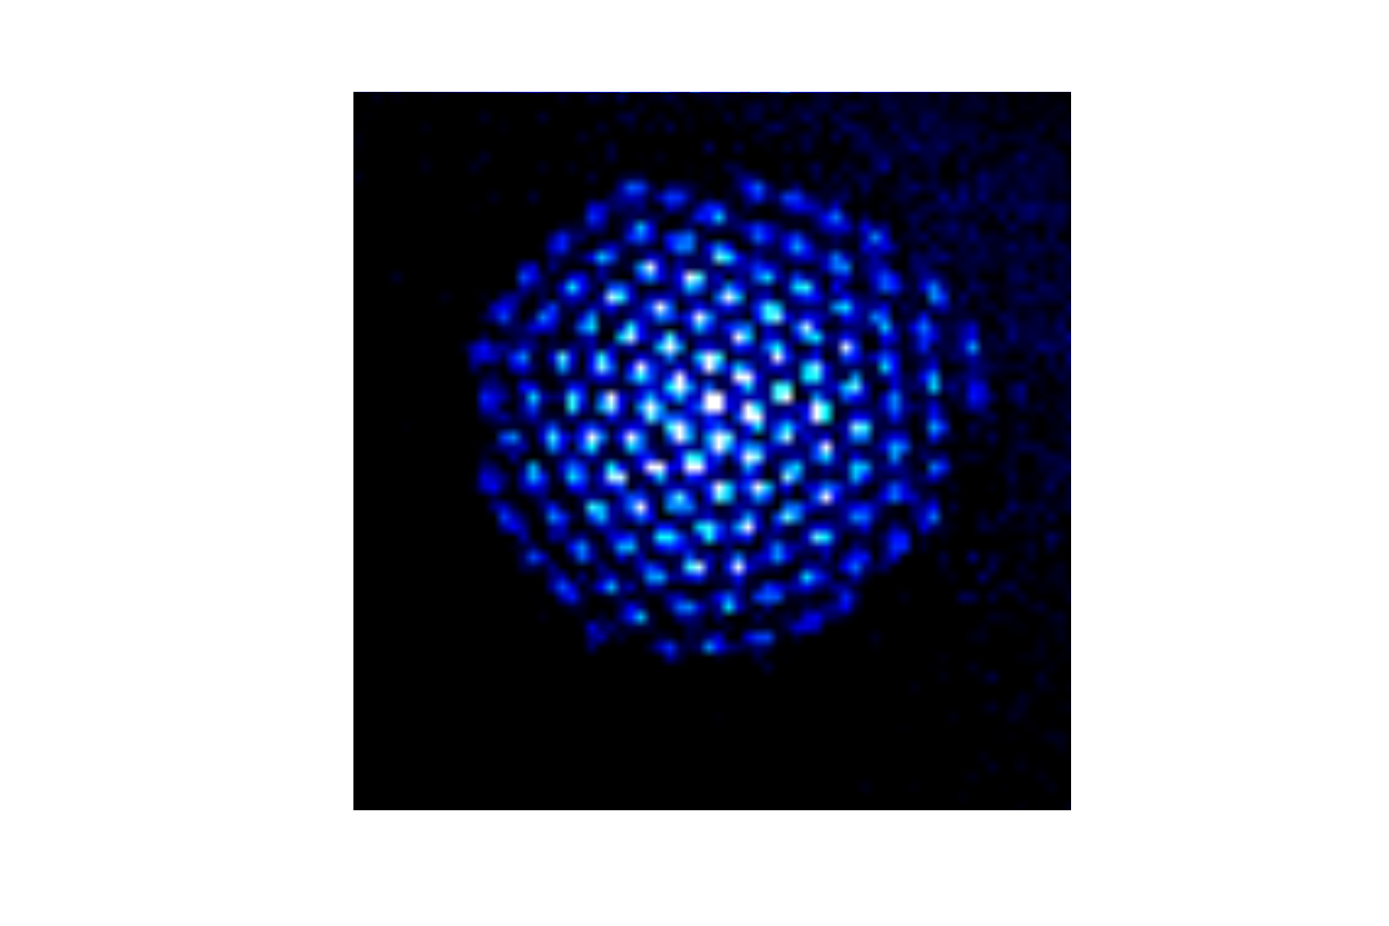
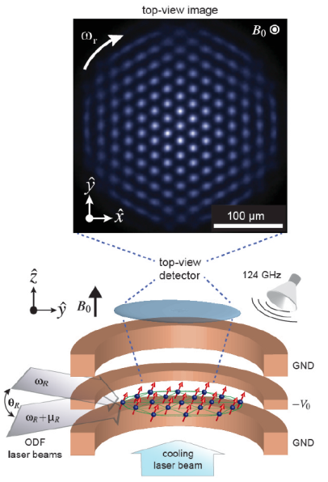
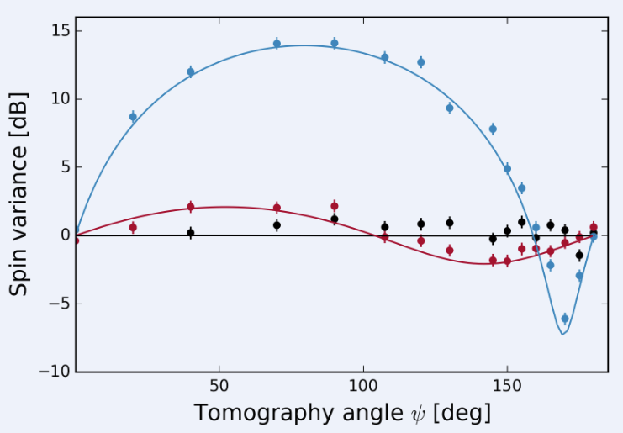
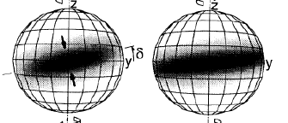
Simulating Spin-Spin Interactions
2-d arrays of hundreds of ions formed and controlled in a Penning trap; provides platform for simulation of quantum magnetism with a number of spins that is intractable on a conventional computer
Synthesized transverse Ising model on 100s of spins
Benchmarked quantum dynamics and entanglement
Implement protocol for out-of-time-order correlation measurement → quantifies spread of quantum information
New trap: increases spin-spin coupling by 50
J. Britton et al., Nature 484, 489 (2012)
G. Bohnet et al., Science 352, 1297 (2016)
Gaerttner et al., arXiv:1608.08938

Slide 23

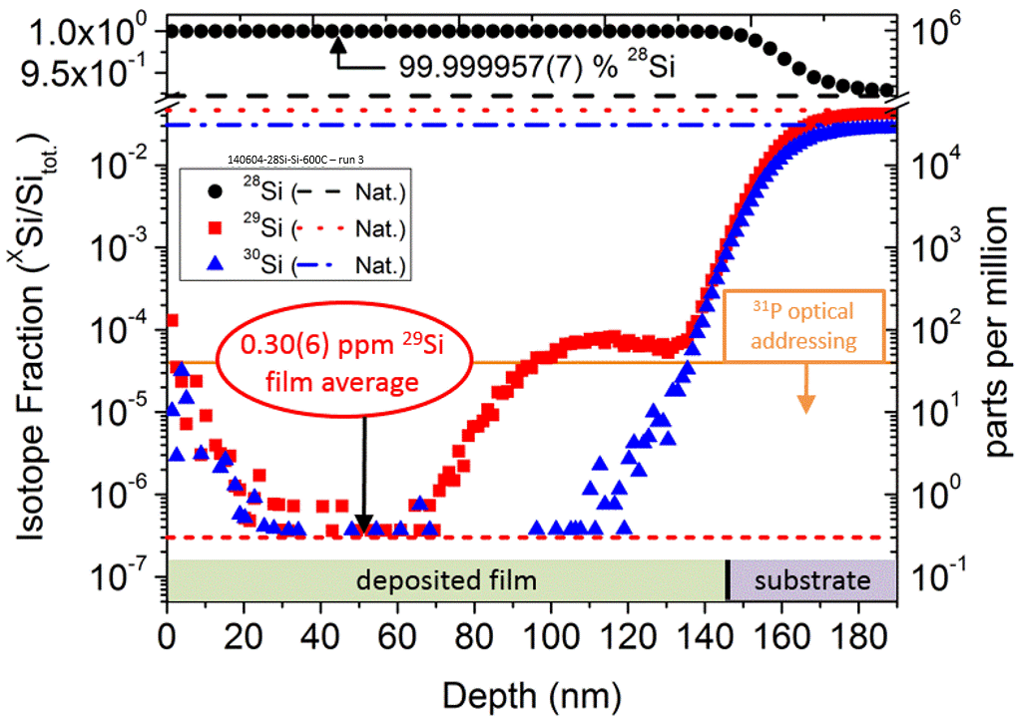
Enriched ²⁸Si for quantum devices
 | BBC News - Purer-than-pure silicon solves problem for quantum tech Physicists make the purest silicon ever seen, solving a supply problem for research into quantum computers.
<1 ²⁹Si in this picture
Enriched silicon has been shown to dramatically extend coherence (T2) times and also reduce optical linewidths. We are producing the most highly enriched silicon known, allowing the technical limits of these benefits to be tested while providing an enabling source for ongoing Si QIS qubit efforts based on these benefits.
K. J. Dwyer, et al., J. Phys. D: Appl. Phys. 47, 345105 (2014)

Slide 24
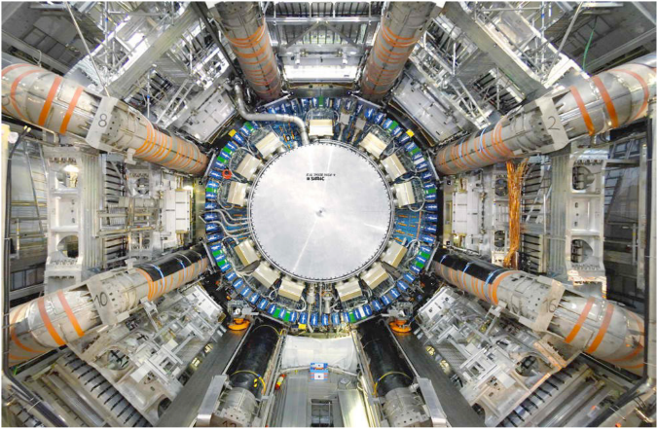
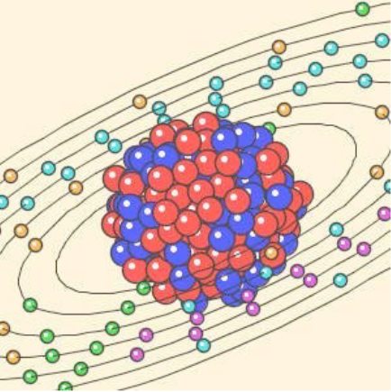
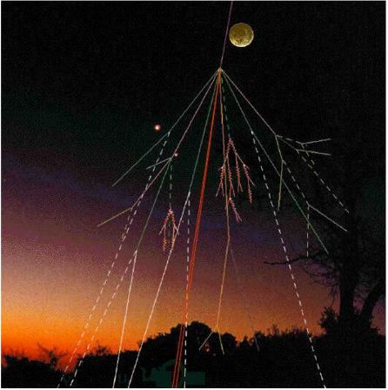
Simulating Quantum Field Theory
Quantum field theory describes relativistic quantum systems:
Classical supercomputers cannot compute dynamics of strongly coupled quantum field theories.
Can quantum computers succeed where classical computers fail?
particle physics
nuclear physics
cosmic rays

Slide 25
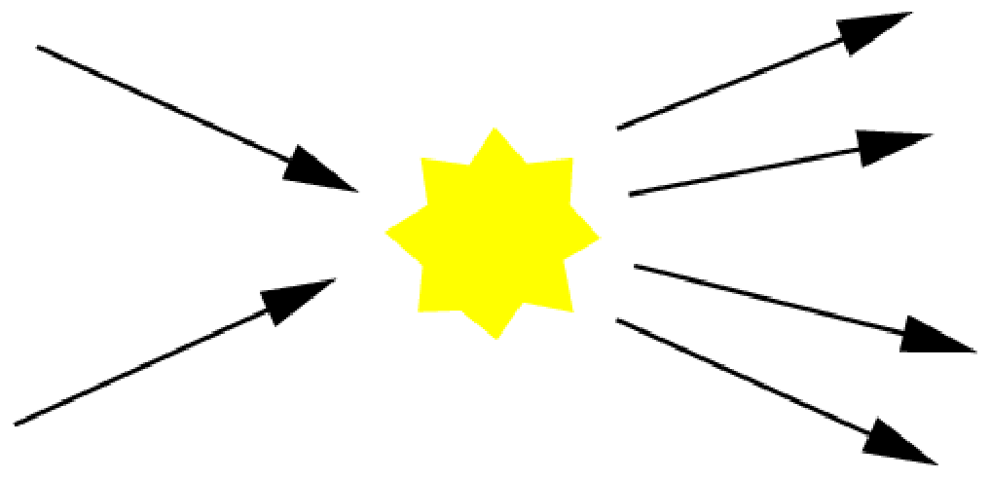
Simulating Quantum Field Theory
Problem: Simulate particle scattering
Given: list of incoming particles and their momenta
Goal: sample from probability distribution over outgoing
particles that would be observed in an experiment
Results: quantum computers can do this efficiently (polynomial time)
whereas classical computers in many cases cannot
[Jordan, Lee, Preskill, Science 336:1130 (2012)]
[Jordan, Lee, Preskill, arXiv:1404.7115 (2014)]

Slide 26
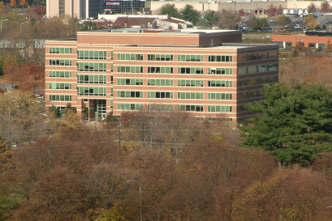
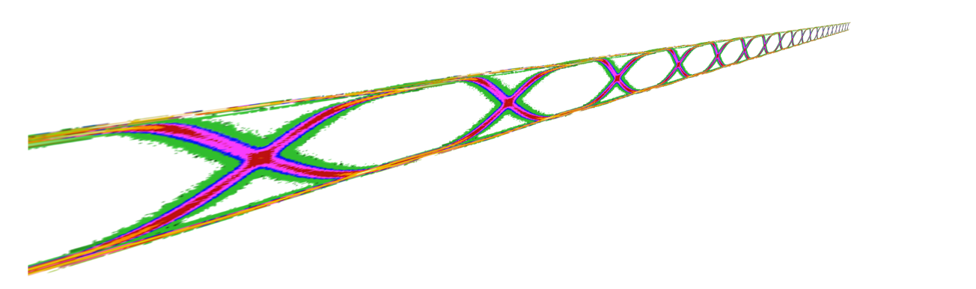



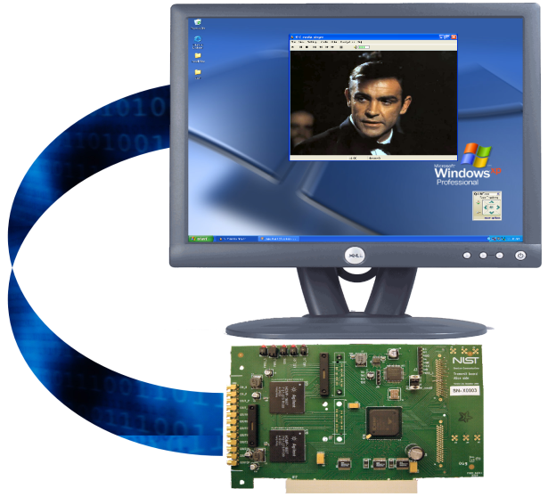

Quantum Communications Effort
Transmission of “single photons” using clock-synchronization enables up to 6 GHz rate – both free space and in fiber
Key processing uses multi-threaded Forward Error Correction algorithm
Demonstration of continuous one-time-pad encryption with quantum key at a data rate > 4 MB/s; ~ x100 greater than previous demonstrations
Enables broadband applications of quantum encryption
How do you pull a single photon in the near infrared or the green out of space in broad daylight?
What is the physical limitation?
Josh Bienfang (PML) and Xiao Tang (ITL)

Slide 27
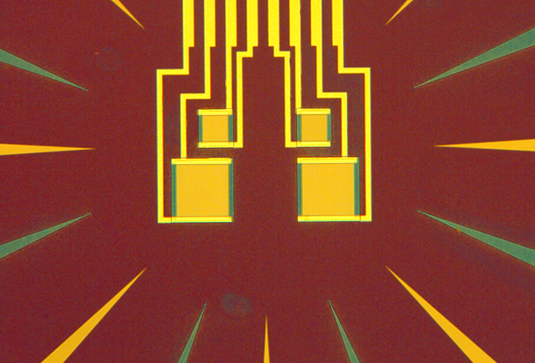
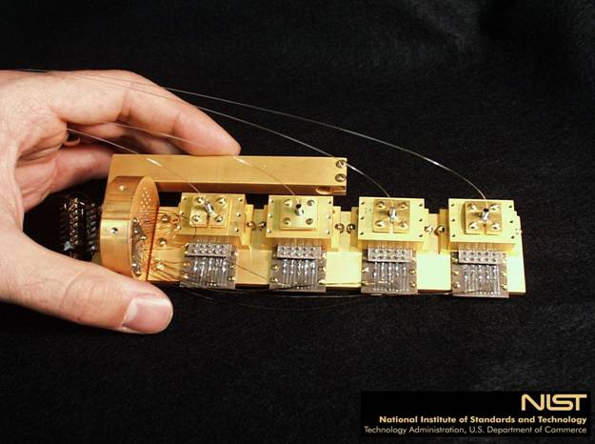
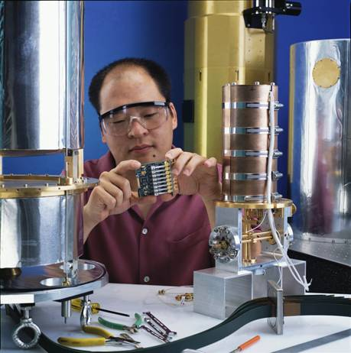
Superconducting Photon Detectors
Demonstrated Transition Edge Sensor with QE > 99 % – Optics Express 16, 1808, (2008); SPIE (2010)
Developing improved materials for detectors
High-speed single photon superconducting detectors with QE > 93% – Nature Photonics 7, 210, (2013)
TES Detector
Sae Woo Nam
Used to set a QKD distance record of 200 km!

Slide 28
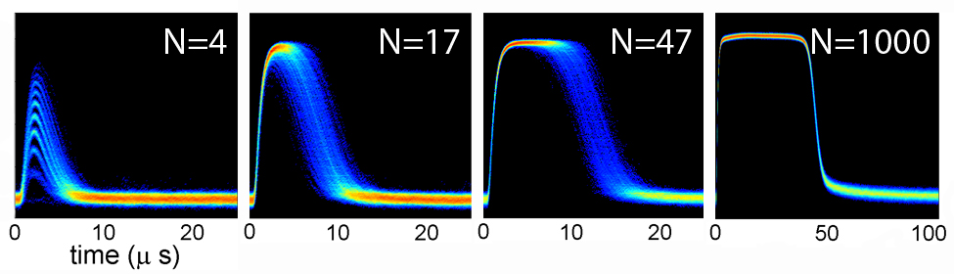
Determining Photon Number in a Weak Pulse
Transition edge sensor (TES) is capable of counting the number of as many as 1,000 photons in a single pulse of light with an accuracy limited mainly by the quantum noise of the laser source.
This series of data read-outs shows how the TES relaxation time increases with photon number. For N=4 photons, the TES returns from the elevated-resistance state to the edge of the transition region in less than 10 μs. At N=47 photons, it takes around 15 μs. And when the count is 1000, the relaxation time is approximately 50 μs.

Slide 29
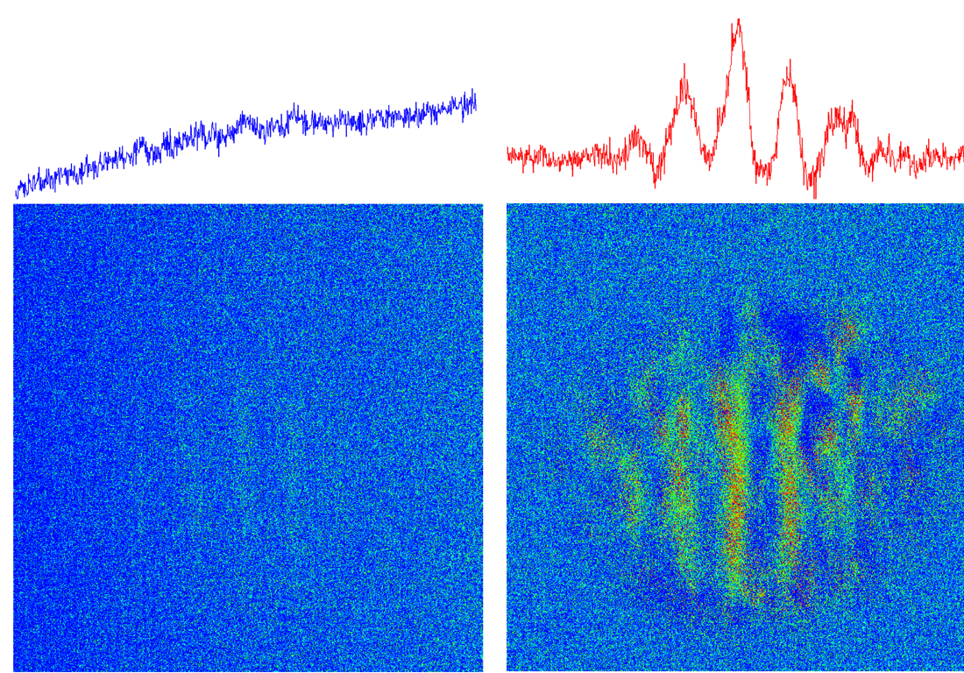
Phase Sensitive Amplifier
Signal must be in the proper quadrature; monochromatic and low-resolution for now, but preserves SNR at maximum gain
Noiseless amplification for defense and medical imaging applications
U. Vogel, et al.; New J. Phys. 16, 013011 (2014); N. V. Corzo, et al.; Phys. Rev. Lett. 109, 043602 (2012)
Same color scale (false color), both with their respective backgrounds subtracted (single shot of each)
Input (unamplified) image
PSA amplified image

Slide 30
NIST Perspective on Future Quantum Technologies
Ability to manipulate and detect quanta provides new tools for both classical and quantum measurables
Emerging technologies and nanofabrication are enabling disruptive change
Embedded standards (NIST-on-a-chip) will change everything from infrastructure monitoring to drilling and mining
Control of quantum objects will enable high speed (300 GHz) arbitrary waveform synthesis and detection beyond the standard quantum (shot-noise) limit

Slide 31
Quantum Information Science Summary
QIS is a field of scientific inquiry in its own right, with applications in:
sensing and metrology: precision navigation, timekeeping, …
communication: secure data transmission and storage, random number generation, …
simulation: complex materials, molecular dynamics, QCD, …
computing: cryptanalysis, quantum chemistry, optimization, quantum field theory, …
and robust intellectual connections to numerous areas of basic research.
Quantum communication is available today – not necessarily valuable today
Quantum sensing and metrology is in the lab and being commercialized
Quantum simulation is an exciting research field and within the next few years will simulate a classically incalculable problem
Quantum computing, especially generalized QC, is years off but companies are investing

Slide 32
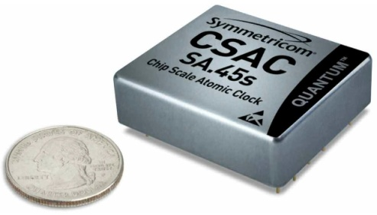
Why is Quantum Information Useful?
We are witnessing the second quantum revolution where technology
Will use the weird properties of quantum mechanics
Will exploit how nature works at the quantum level
“. .. and if you want to make a simulation of Nature, you’d better make it quantum mechanical, and by golly it’s a wonderful problem, because it doesn’t look so easy.” -- Richard P. Feynman, “Simulating Physics with Computers”, May 1981
In the 20th Century only atomic clocks
used the strange aspects of QM (GPS)
Now chip scale atomic clocks are available
Related technologies include exquisitely sensitive
magnetometers, accelerometers, gravimeters
NV centers may be lead to unimaginable magnetic imaging systems
A quantum computer, if it existed, could break all present-day public key encryption systems
Quantum encryption can defeat any computational attack
Quantum Logic Clocks, Magnetometers, Gyroscopes
Quantum Simulations, Drug Design, other problems
Notes:
³²

Slide 33
Thank you!
Any questions? carl.williams@nist.gov

