Slide 1
X-ray free-electron lasers development
Claudio Pellegrini
UCLA Department of Physics and Astronomy
SLAC National Accelerator Laboratory

Slide 2
Outline
Introduction to X-ray Lasers and X-ray free-electron lasers (FELs)
The physics and present status of X-ray FELs
The science being done at LCLS
Future developments

Slide 3
Why X-ray lasers?
A laser generating high intensity, coherent X-ray pulses at Ångstrom wavelength and femtosecond pulse duration -the characteristics time and space scale for atomic and molecular phenomena- allows imaging of periodic and non periodic systems, non crystalline states, studies of dynamical processes in systems far from equilibrium, nonlinear science, opening a new window on atomic and molecular phenomena of interest to biology, chemistry, material sciences and physics.

Slide 4
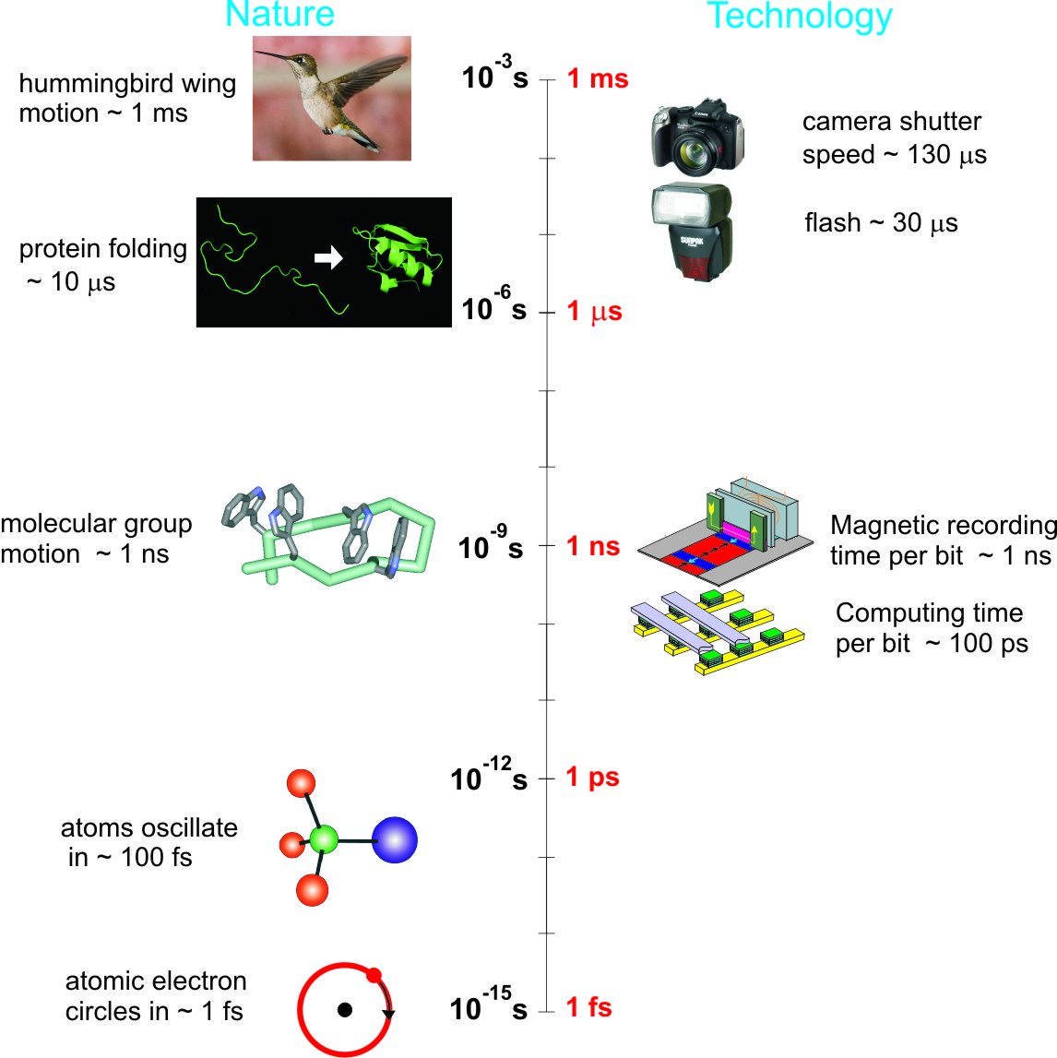
Time scales: smaller systems, shorter times.
Atomic scale, 1Å, time fs X-ray FEL
macro
molecules
molecular
groups
the technology gap
Courtesy J. Stohr
atoms
“electrons”
& “spins”
optical laser pulse

Slide 5
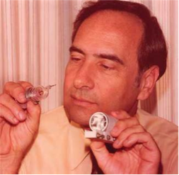
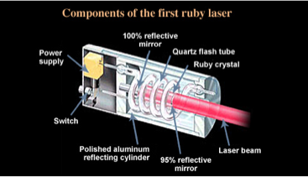
Early work on X-ray lasers
1960: A breakthrough, first laser light
Ted Maiman (25 years
after first Ruby laser)
The interest in X-ray lasers started in the 70’s, following the first infrared laser in 1960. In the atom-based, population inversion, laser approach, reaching the X-ray wavelength is extremely difficult, because of the very short lifetime of excited atom-core inner quantum energy levels. George Chapline and Lowell Wood of Lawrence Livermore National Laboratory estimated the radiative lifetime of an X-ray laser transition would be about 1 fs times the square of the wavelength in angstroms.(Chapline G. and L. Wood,1975, Physics Today 40, 8).
The short lifetime and large energy needed to excite inner atomic levels, 1 to 10 KeV compared to about 1 eV for visible lasers, lead to a very intense pumping power requirement to attain population inversion, too large for practical purposes. Building low loss optical cavities for X-ray laser oscillators is also difficult.
6/24/2017
C. Pellegrini, Passion for Physics

Slide 6
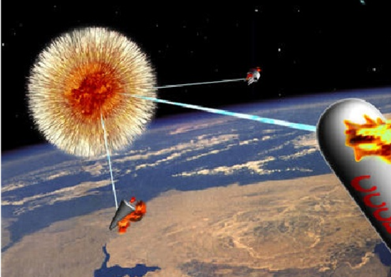
Early work on X-ray lasers
But not to be discouraged: Scientists at LLNL proposed to use a nuclear weapon to drive an X-ray laser. They tried the concept in the Dauphin experiment, apparently with success, in 1980.(Hecht J., 2008, The History of the X-ray Laser, Optics and Photonics News, 19 (2008)).
During the Cold War X-ray lasers were supposed to be used to destroy incoming missiles. Joseph Nilsen, “Legacy of the X-ray Laser Program,” Lawrence Livermore National Laboratory Report, also Energy and Tech. Rev. Nov. 1994
High peak power, short pulse, visible light lasers made possible another approach: pumping cylindrical plasmas, in some cases confining the plasma with magnetic fields. These experiments led to X-ray lasing around 18 nm with gain of about 100 in1985 (Matthews D.L. et al., 1985, Physics Review Letters 54, 110, Suckewer S. et al., 1985, Physics Review Letters 55, 1753.) From that time lasing has been demonstrated, with limited peak power and tunability, at several wavelengths in the soft X-ray region. A review of the most recent developments with this approach is given in*Suckewer S. and P. Jaeglé, 2009, Laser Physics Letters 1, 411 (2009)

Slide 7
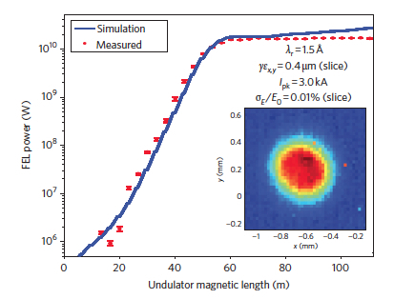

An alternative solution
The way out of this difficult situation is given by self amplified spontaneous emission free-electron laser (SASE FEL), generating X-rays from high brightness relativistic electron beams.
A proposal in 1992 (C. Pellegrini, 1992 Proc. of the Workshop on 4th generation light sources, SSRL/SLAC Rep. 92/02) to build an X-ray FEL using 1 km of the SLAC linac, producing a 15GeV high brightness beam, lead to the design and construction of LCLS at SLAC. In 2009 LCLS successfully started to work (P. Emma et al., 2010 Nat. Phot. 4, 641) with characteristics similar or better than originally proposed.
A history of this development is found in C. Pellegrini, X-ray free-electron lasers: from dreams to reality, Physica Scripta T169, 014004 (2016).
LCLS saturates: 1.5 Å, 4/2009, 1-3 mJ.
60 cm long undulator used for the first 16 μm SASE FEL at UCLA . Varfolomeev, A.A. et al., 1992 Nucl. Instr. and Meth. A 318, 813.
6/24/2017
C. Pellegrini, Passion for Physics

Slide 8
The alternative solution
Population inversion doesn’t work for an X-ray laser. How does the X-ray FEL work?
Use undulator radiation from relativistic electrons.
Generate an electron beam with electrons squeezed in micro-bunches λ/10 long and separated by λ, a kind of 1-D relativistic crystal. Intensity proportional to electron number N_{e}^{1+α}, α=1 for a perfect crystal, 0<α≤1 for non perfect case.
How do we do it? We do not have an electron gun capable of generating such a beam, and it would be hard to imagine one at 1A wavelength.
Solution: use a collective instability* to do it for us.
*Bonifacio R., Pellegrini C., Narducci L., COLLECTIVE INSTABILITIES AND HIGH-GAIN REGIME IN A FREE ELECTRON LASER, 1984 Optics Comm. 50, 373.

Slide 9
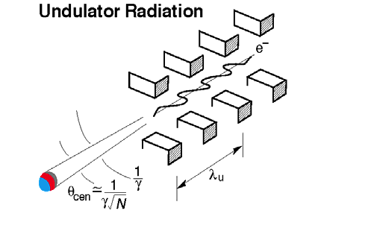
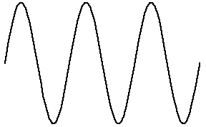
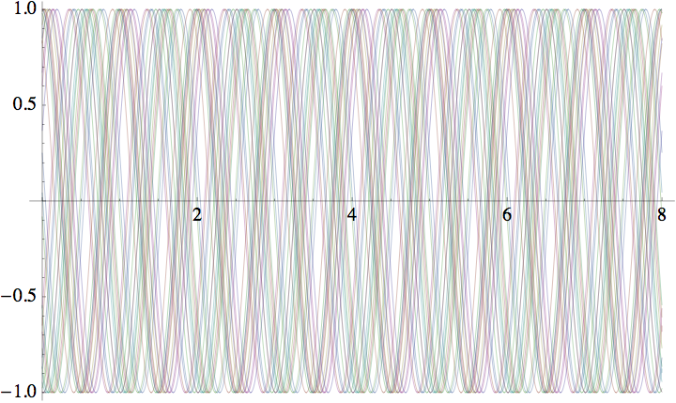
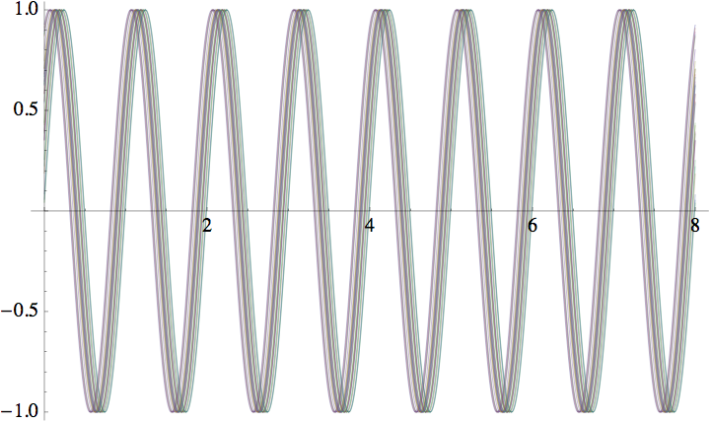
Radiation from one and many, N_{e}, electrons.
A picture of the emitted wave trains
Number of coherent photons/electron
Disordered state: single electron wave trains superimpose with random phases: noise. Intensity ~ N_{e}
The FEL instability takes us from the disordered to an ordered state
Ordered state: wave trains superimpose in phase. Intensity ~ N_{e}²
The order parameter is the “Bunching factor”
is the relative phase of the wave and electron oscillation. B=1 is perfect order.

Slide 10
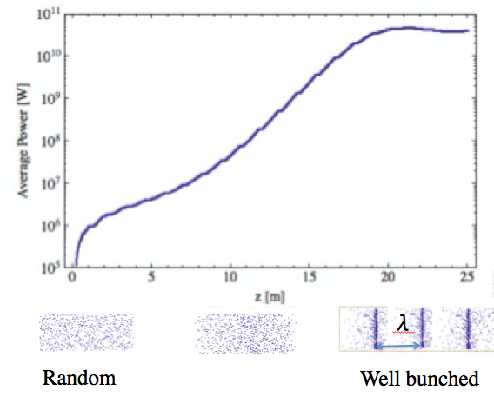
The FEL parameter
The instability is characterized by a single universal FEL parameter
Exponential gain length
Saturation power
For the instability to develop, the electron beam must satisfy three conditions on its space phase density:
Transverse phase space matching
Cold beam
Gain> diffraction losses
Initial beam state
Final beam state
LCLS Example: E_{ph}=10keV, E=15 GeV, ρ=10⁻³. We obtain ~10³ coherent photons/e. (Compare to ~10⁻² for spontaneous radiation). P_{FEL}~45 GW.

Slide 11
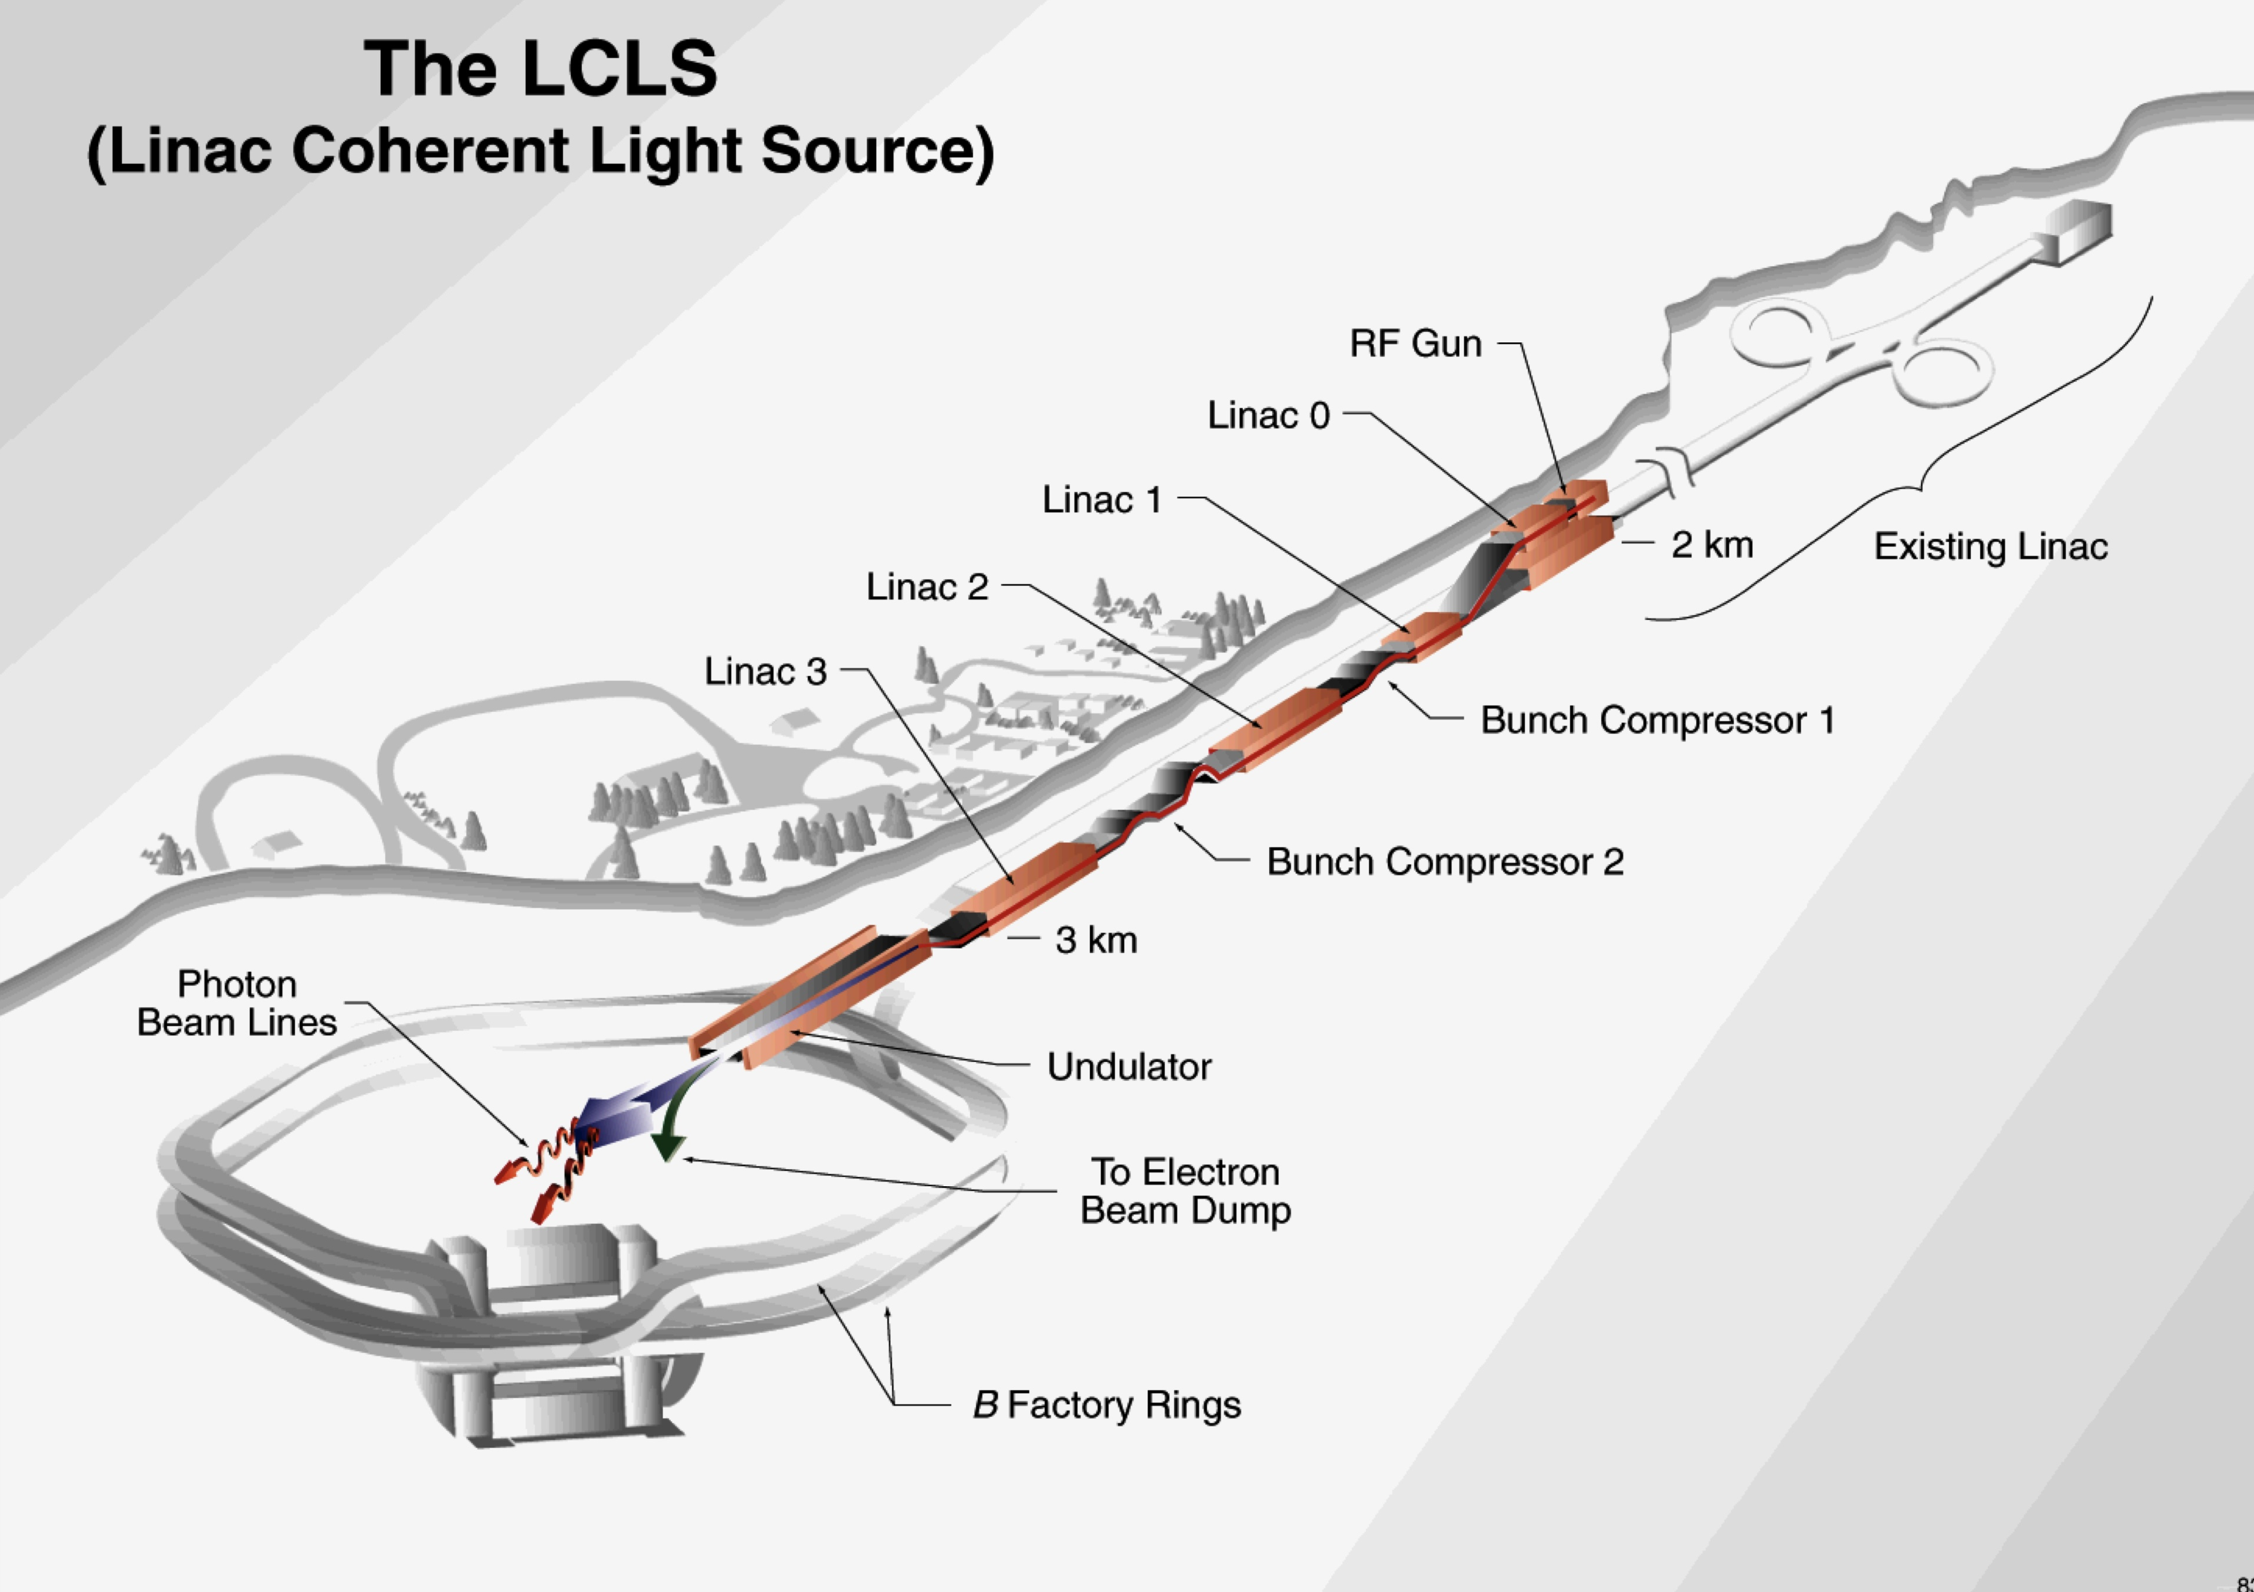
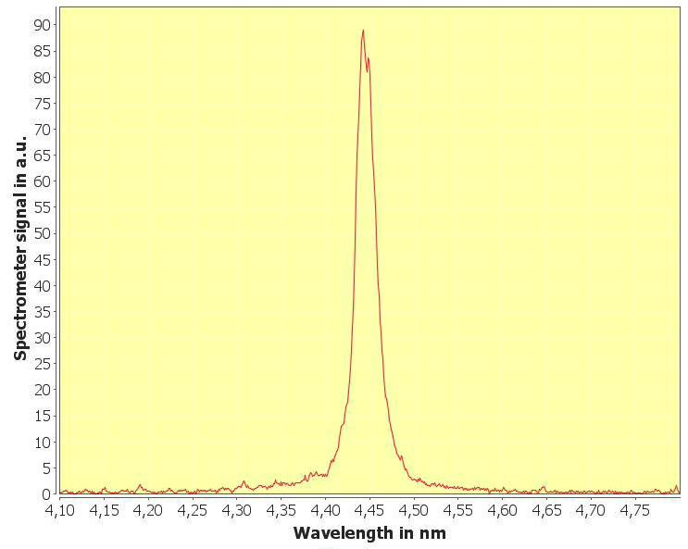
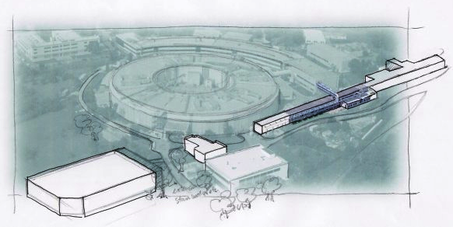

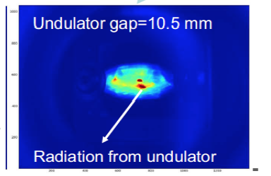
X-ray Free-electron Lasers today
LCLS, 1.5 Å, 4/2009, 1-3 mJ
Flash: 4.45 nm, 0.3 mJ, 6/2010
Fermi@Elettra,
43nm,12/2010
SACLA 0.8 Å, 6/2011
Recently added hard X-ray FELs: Korean X-FEL (lased at 0.1 nm, 3/16,2017); European XFEL (lased at 0.15 nm, 6/23/2017)
UV FEL Dalian, 50-150 nm, January 2017

Slide 12
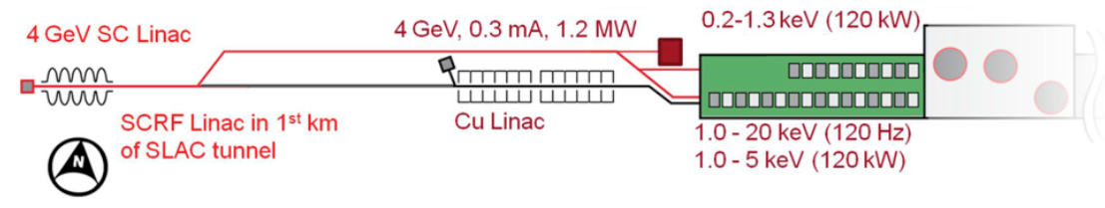

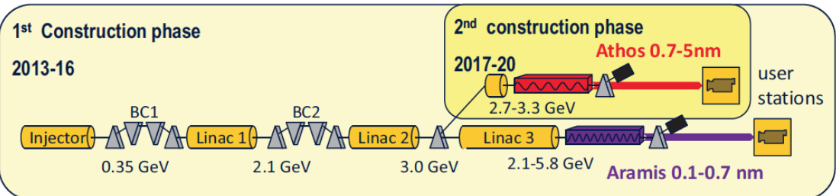
Coming up: Swiss X-FEL, Shanghai, LCLS-II
LCLS-II
Shanghai SXFEL, S+C band, 1.6 GeV, 2-10 nm
Swiss FEL0.1-5nm, 100 Hz, First lasing at 0.9 GeV, 4 nm, May 2017 .

Slide 13
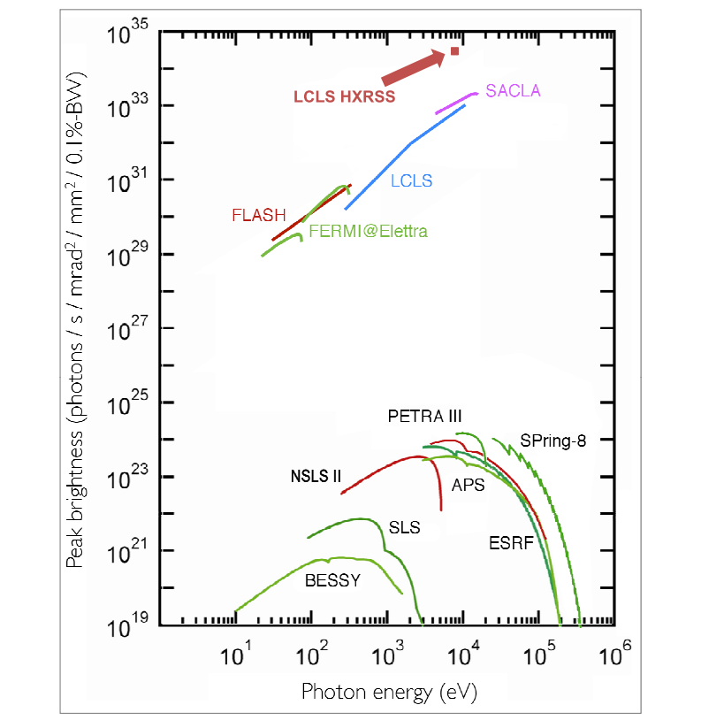
Comparison of X-ray sources
X-ray sources brightness (number of photons in the X-ray beam six dimensional phase space). In practical units it is the number of photons/sec/mm²mrad²/0.1% bandwidth. . Notice the jump by a factor 10⁹ with LCLS in 2009.
6/24/2017
C. Pellegrini, Passion for Physics

Slide 14
Main XFELs characteristics
Photon energy range: 10-0.1nm
Peak power: 1-50 GW
Line width: 10⁻³-10⁻⁴
Pulse length: few-100 fs
Repetition rate: 10²-10⁶ Hz
Flexibility: high, the x-ray pulse can be tailored to the experiment
Two colors with delay variable from few to 100 fs, or ns
6/24/2017
C. Pellegrini, Passion for Physics

Slide 15
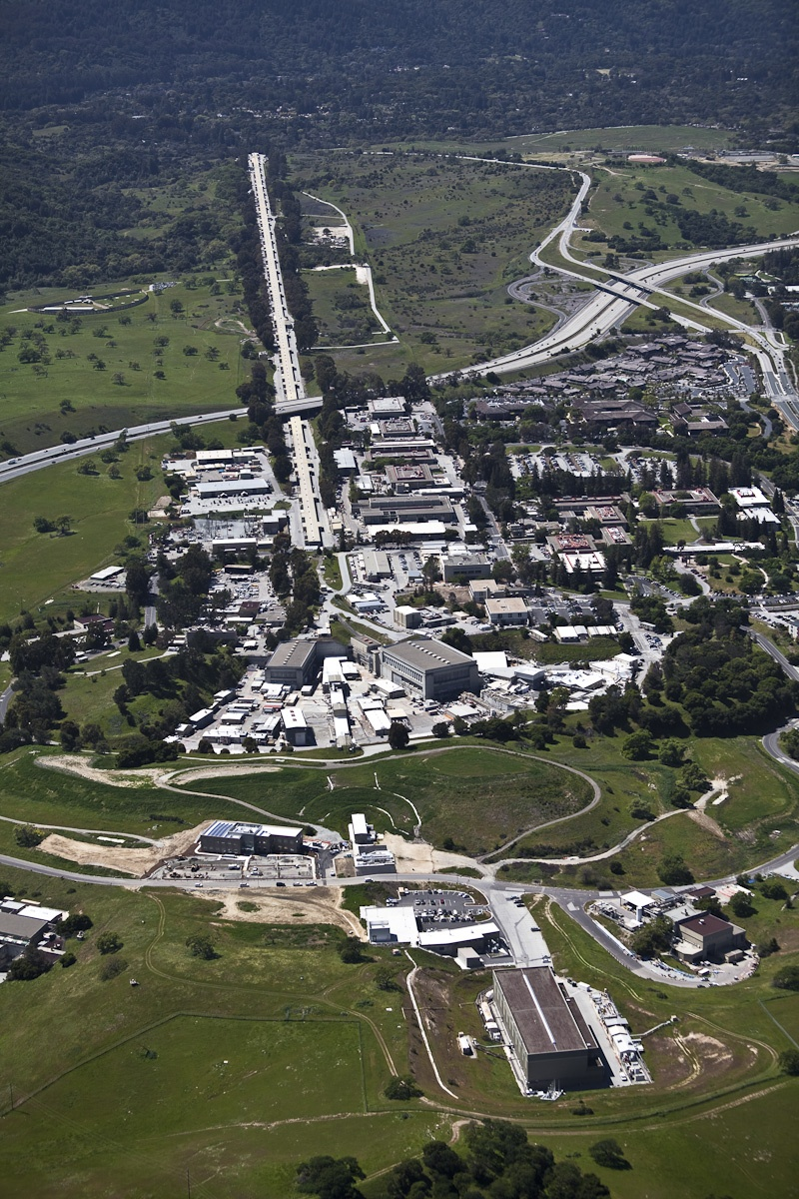
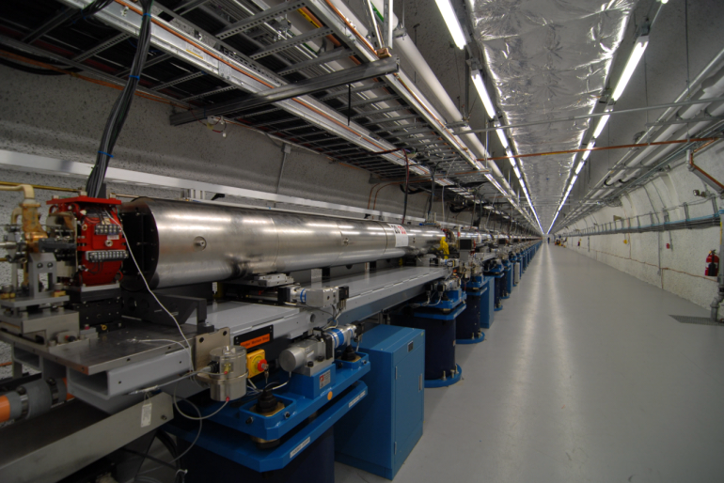
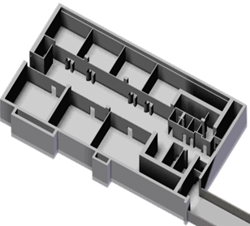
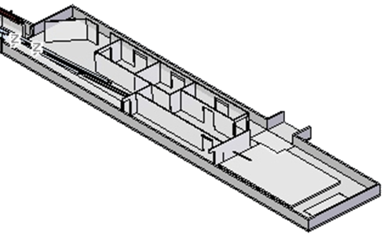
LCLS: the world’s first x-ray free electron laser
AMO: Atomic, Molecular & Optical Science
CXI: Coherent X-ray Imaging
MEC: Matter in Extreme Conditions
SXR: Soft X-ray Materials Science
XCS: X-ray Correlation Spectroscopy
XPP: X-ray Pump Probe
Injector
electron beam
1km linac 14GeV
AMO
SXR
XPP
Undulator hall
More instruments will be added with LCLS II, starting about 2018.
Near-hall: 3 stations
x-ray beam
XCS
CXI
MEC
6/24/2017
Far-hall: 3 stations
C. Pellegrini, Passion for Physics

Slide 16
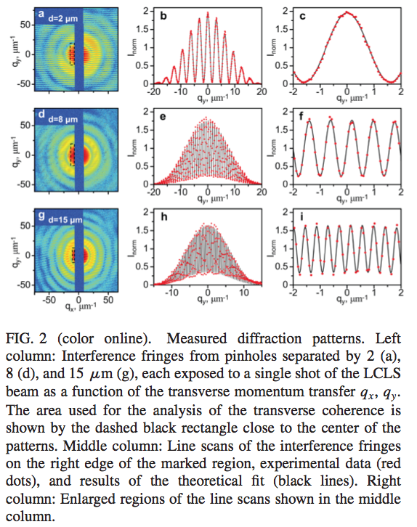
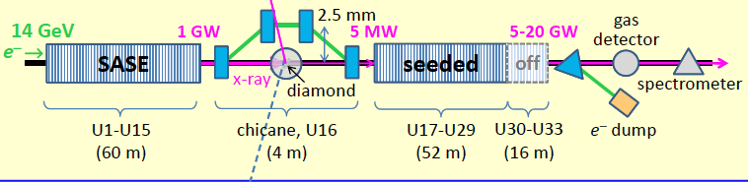
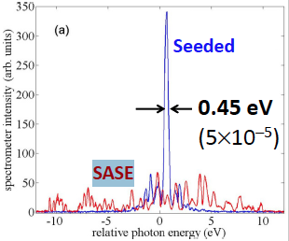
Coherence properties of X-ray FEL
Transverse coherence: good.
Coherence properties of individual femtosecond pulses of an X-ray FEL, I. A. Vartanyants et al., 2011, Phys. Rev. Lett. 107, 144801.
Improving LCLS temporal coherence: Self-seeded spectra
In a SASE FEL the spectrum is wide and fluctuates. Bonifacio, Pellegrini et al., Phys. Rev. Lett. 1994, 73,70. Self-seeding is a way to improve the spectrum and reduce the line-width using the transmission around the stop band of a Bragg reflection in a diamond crystal, Geloni, G., V. Kocharyan and E. Saldin, 2011, J. of Mod. Opt. 58, 16.
The concept as been demonstrated at LCLS , J. Amann, et al. Nature Photonics, DOI: 10.1038/NPHOTON 2012.180

Slide 17
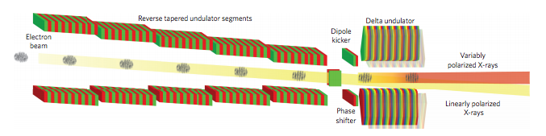
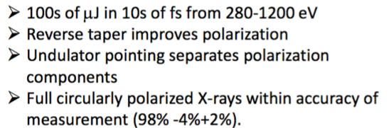
99% circular polarization with DELTA undulator
The beam is microbunched in a planar undulator with decreasing gap to suppress linearly polarized radiation. A dipole kicker redirects the beam into the
repointed Delta undulator. The Delta undulator produces arbitrarily polarized X-rays. A phase shifter controls the phase between the linearly polarized light at the entrance of the Delta and the microbunches in the electron beam.
Result: over 99% circular polarization.
A. A. Lutman et al., Polarization control in an X-ray free-electron laser, Natire Photonics, 10, 468 (2016).

Slide 18
Manipulating the gain medium
For an X-ray FEL the gain medium is the electron bunch. Gain can be enhanced or switched off for the full bunch or part of it (a slice) in several ways:
By making it oscillate around the undulator axis;
By increasing the slice emittance or the energy spread;
By creating a slice with a large peak current.

Slide 19
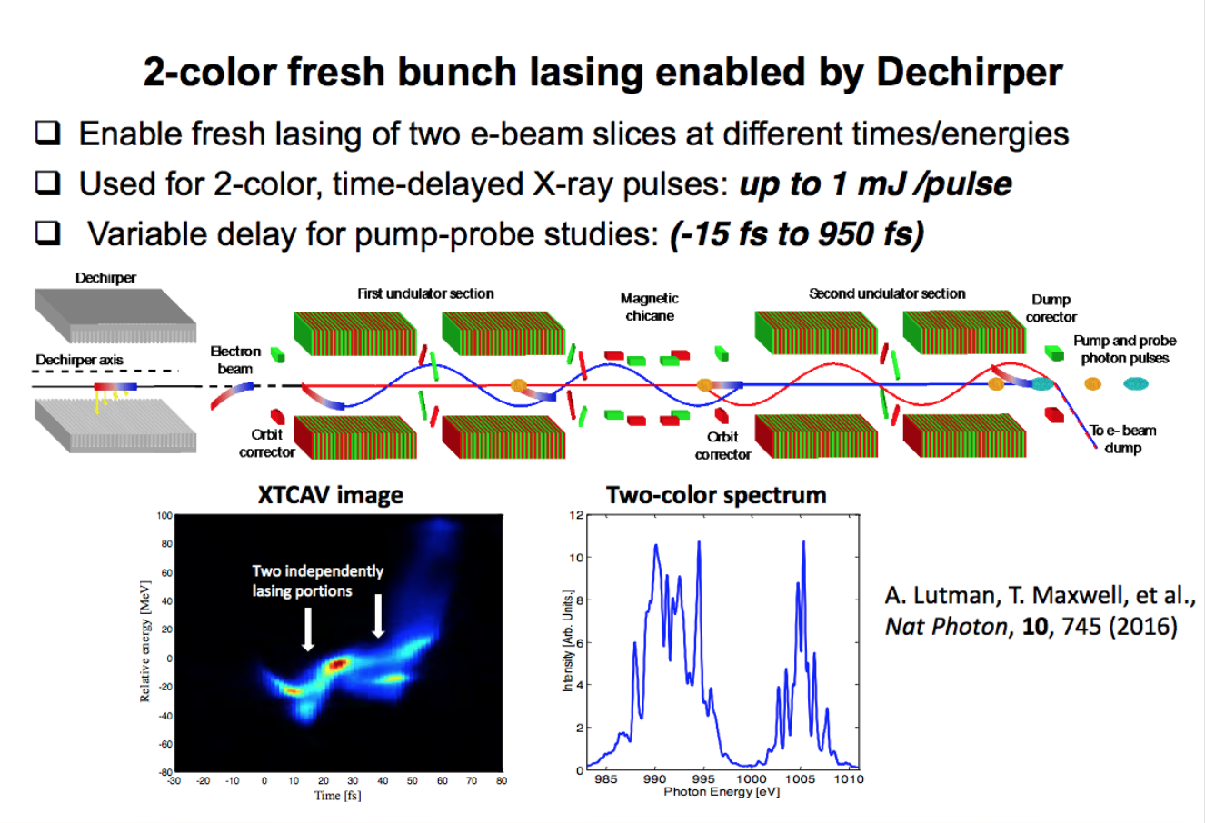
Manipulating the gain medium (the electron bunch)

Slide 20
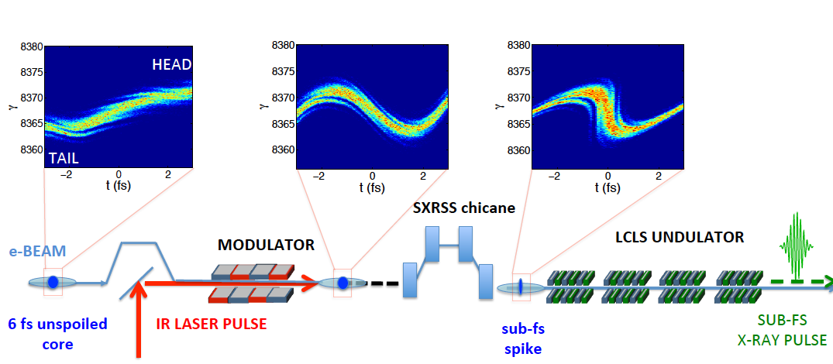
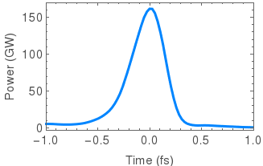
Attosecond pulses: XLEAP
Enhanced SASE
Use intense IR pulse in a wiggler to compress a fraction of the electron beam.
(A. Zholents, 2005)
Courtesy A. Marinelli
ΔT = ~0.5 fs FWHM, E_{pulse} ~ 20 to 50 uJ
-10 x shorter than fastest pulse measured at LCLS.
- 4 times shorter than typical cooperation length.
Coherent bandwidth ~ 5 eV
4 times larger than achieved before at SXR.

Slide 21
Attosecond Pump/Probe with Two-Color XLEAP
Variable delay
Attosecond Pulse
Attosecond Pulse
< 1 fs
Use different e- beam spikes in two halves of the undulator.
Delay LOCKED by the laser modulation:
Two sub-fs pulses with sub-fs jitter!
XLEAP in combination with:
-time-dependent wake
(A. Lutman et al.)
ΔT= ΔT_{CHICANE}+ Nλ_{LASER}+ Slippage
-
Courtesy A. Marinelli
-
-

Slide 22
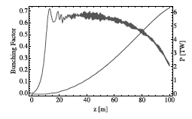
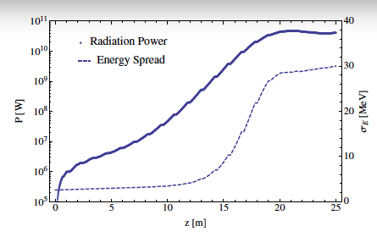
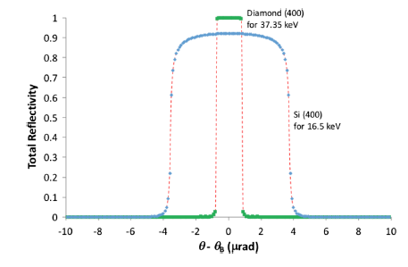
Toward High Power: The Double Bunch XFEL*
y
y
y
Chicane
t
t
t
t
~ 1ns
Seed generating FEL
High efficiency tapered amplifier
Monochromator
and X-ray delay
The DBFEL increases 100 times the efficiency of energy transfer, and the peak power. Operating LCLS with two bunches has already been demonstrated.**
*C. Emma, Y. Feng, D. Nguyen, A. Ratti, and C. Pellegrini, Phys. Rev. Acc. and Beams 20, 030701 (2017).
**Characterization of the LCLS “nanosecond two-bunch” mode for X-ray Speckle Visibility Spectroscopy experiments, Y. Suna et al., SPIE 10237, 102370N-1-10 (2017).

Slide 23
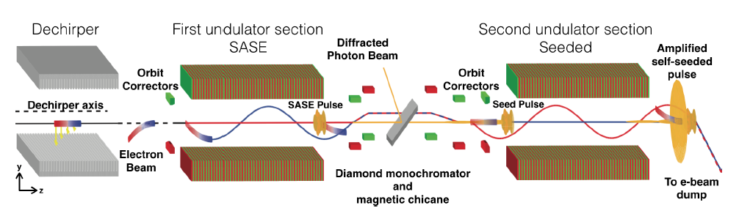
Experimental demonstration of double slice self seeding*
E_{photon} =5.5 keV, 2.2 Å
Schematic of the enhanced (fresh bunch) self seeding, ESS, experiment at LCLS. The bunch tail generates the seed signal in the first part of the undulator, where the head is oscillating and not lasing. After the monochromator the tail oscillates, the head moves on axis and amplifies the seed signal. The oscillation is generated by an off-axis dechirper and kickers.
Gain length change with
oscillation kick:
*C. Emma, A. Lutman, M. W. Guetg, J. Krzywinski, A. Marinelli, J. Wu, and C. Pellegrini, Appl. Phys. Lett. 110, 154101 (2017).

Slide 24
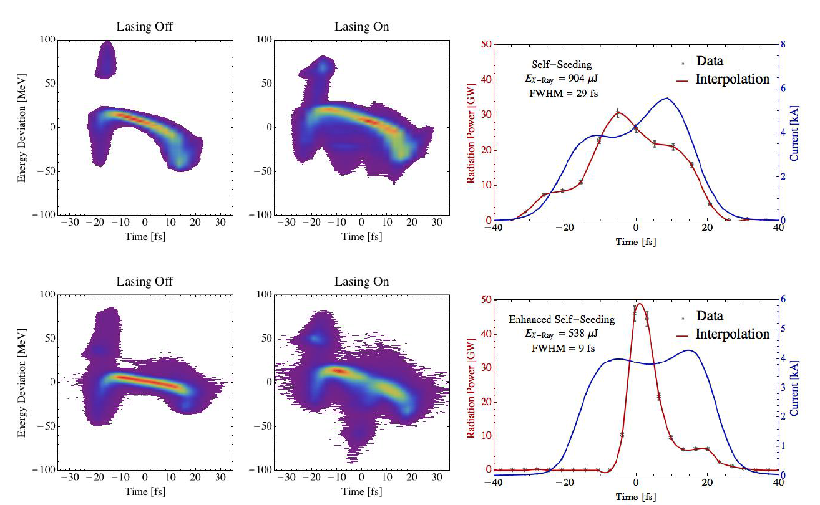
Experimental results
Measurements with X-band transverse cavity.
Top: Self seeded case; Single shot longitudinal phase space with, left, and without, middle, lasing; X-ray pulse energy 904 μJ, seeded pulse duration 29 fs, most of the electron beam contributing to lasing.
Bottom: Same plots in the ESS scheme. Lasing electrons in SASE section are on the tail (t = 20 fs); seeded electrons in the core (t = 0) have large energy loss ∼ 90 MeV. Peak X-ray power 50 GW, FWHM pulse duration 9 fs. Error bars calculated using the combined rms intensity error of two independent detector readings.
SASE lasing slice
Seeded core
ESS (fresh slice self seeding) generates 3 times shorter pulses with higher peak power.

Slide 25
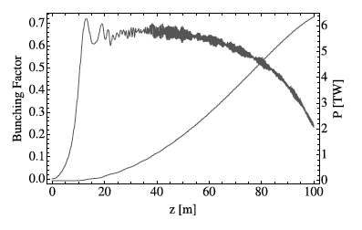
Strong field LCLS-II
With LCLS-II copper linac, an Advanced Undulator and the double bunch system we can reach 6TW peak power in 100 m at photon energy of 10 keV *.
Power density and peak electric field:
W=3x10²³ W/cm², E=10¹⁵ V/m at 10 nm spot size
*C. Emma, Y. Feng, D. Nguyen, A. Ratti, and C. Pellegrini, Phys. Rev. Acc. and Beams 20, 030701 (2017).

Slide 26
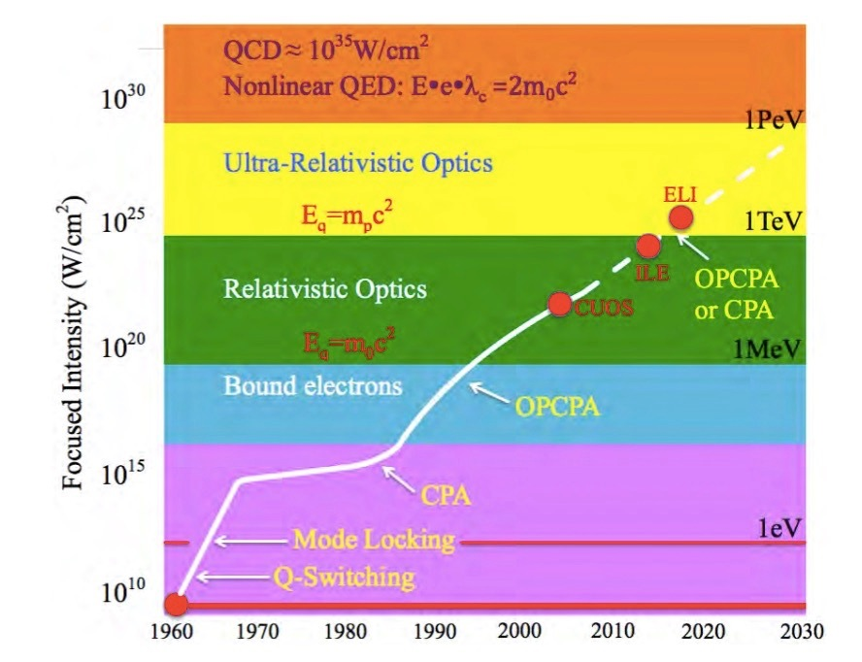
LCLS-II power density for 1 TW and 10 nm spot size
LCLS-II e-γ ≈10³³ W/cm²
LCLS-II ≈3×10²³ W/cm²
SLAC
E144
New strong-field and collective phenomena only accessible above QED critical intensity/field
Current and future light sources far from this limit.
Only possible by combining high energy particles with laser (relativistic boost)
  4g² intensity
  2γ field
Ponderomotive Energy [λ²/1µm²]
LCLS,
SACLA
XFEL
Modified from https://eli-laser.eu/media/1019/eli-whitebook.pdf
July 1st, 2017
C. Pellegrini, Varenna 2017

Slide 27
Conclusion: X-ray FELs today and tomorrow
XFEL characteristics: | Today | Tomorrow
Wavelength, nm | 10-0.1 | 10-0.01
Transverse coherence | good | good
Line width | 10⁻³-10⁻⁴ | 10⁻²-10⁻⁶
Peak Intensity, mJ | 2-4 | 2-100
Pulse duration, fs | 100-4 | 100-0.3
Peak Power, TW | 0.02-0.05 | 1-10-100?
Peak intensity and power can be increased by a factor 10 to 100 using tapered undulators and multi-bunch techniques.

Slide 28
… and the day after tomorrow
Advanced undulator
1-2 cm period
Gain length 10-40 cm
Plasma wakefield accelerator
Energy 2-12 GeV
I_{peak}>10kA
Normalized emittance < 10⁻⁷m
Energy spread < 10⁻³
X-rays photon energy 0.5-100 keV
Peak power 0.01-10 T
Pulse duration 0.1-100fs
< 30 m

Slide 29
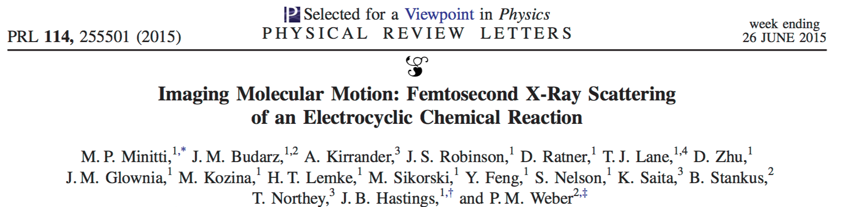
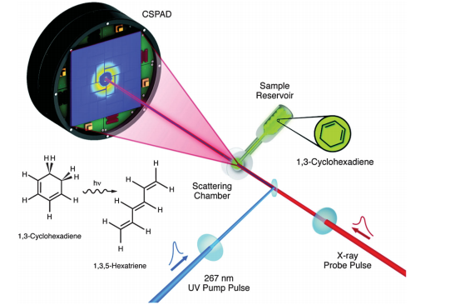
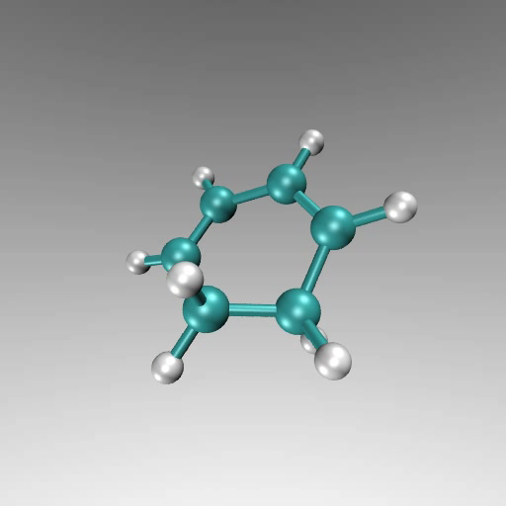
… .. By mapping nuclear motions using femtosecond x-ray pulses, we have created real-space representations of the evolving dynamics during a well-known chemical reaction and show a series of time- sorted structural snapshots produced by ultrafast time-resolved hard x-ray scattering.
Our analysis shows that, upon absorption of the optical photon, the chemical reaction of 1,3-cyclohexadiene to 1,3,5-hexatriene starts with a rapid expansion of the carbon bonds of the cyclohexadiene ring. ..
8.3 keV, 30 fs, 10¹² photons/pulse, 3 torr
Within one or two oscillations of the carbon skeleton, the C1–C6 chemical bond breaks as the terminal carbon atoms move perpendicular to the molecular plane along the reaction
coordinate. It is already at this point that the terminal hydrogen atoms of the nascent hexatriene molecule align to conform to the Woodward-Hoffman rules. Consequently, the stereochemical fate of the chemical reaction is sealed as early as 30 fs after the optical excitation.
Reaction movie in 30 fs.

Slide 30
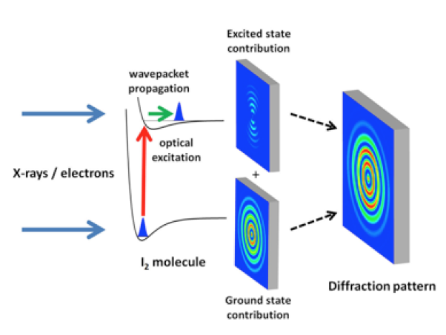
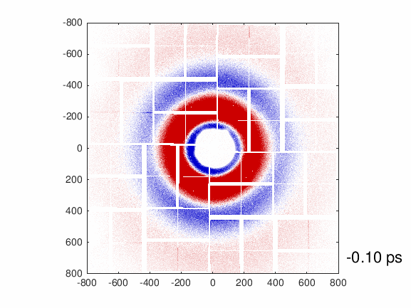
Molecular movies 2
Self-Referenced Coherent Diffraction X-Ray Movie of Ångstrom-and Femtosecond-Scale Atomic Motion, J. M. Glownia et al., 2016 Phys. Rev. Lett. 117, 153003.
Physics View point , M.J.J. Vrakking 2016 Physics 9, 112
‘‘Molecular movie’’ showing the vibration of an iodine molecule triggered by the excitation to a low-lying electronic state. Diffraction patterns are measured using an ultra short x-ray pulse with variable delay from LCLS X-FEL. The vibrational motion is extracted by unfolding the holographic interference between x rays scattered from ground-state molecules and x rays scattered from vibrationally excited molecules.
9.0 keV, 2 mJ, 120 Hz, 40 fs, horizontal
polarization, 30 μm beam diameter.
Raw data as a function of pump-probe delay. The average scattering image over all time delays is subtracted to show more easily the interference features.
6/24/2017
C. Pellegrini, Passion for Physics

Slide 31
Molecular movies
X-ray spatial coherence is required for this experiment.
The experiment image, in real time, the changes of the distance between the two atoms in a vibrating iodine molecule. The x-ray scattering signal is the mixing of two contributions. The ﬁrst comes from the fraction of molecules in the gas sample excited by the visible pump laser (typically 1–10%). These molecules are displaying a vibrational wave-packet motion and produce a weak x-ray scattering pattern that, by itself, is not measurable. However, this signal becomes measurable through its interference with the stronger x-ray scattering pattern from the ground-state molecules. By subtracting a ground-state-only scattering pattern (measured when the x-ray probe precedes the visible pump), the authors isolate the ground-state and excited-state interference contribution to the signals. The internuclear distance is obtained from the interference pattern formed by the ground-state and excited-state signals.
The analysis does not rely on molecular modeling and shows oscillations in the internuclear distance of the vibrational wave packet with a period of a few hundred femtosecond and a space/time resolution of 0.3A/30fs.
6/24/2017
C. Pellegrini, Passion for Physics

Slide 32
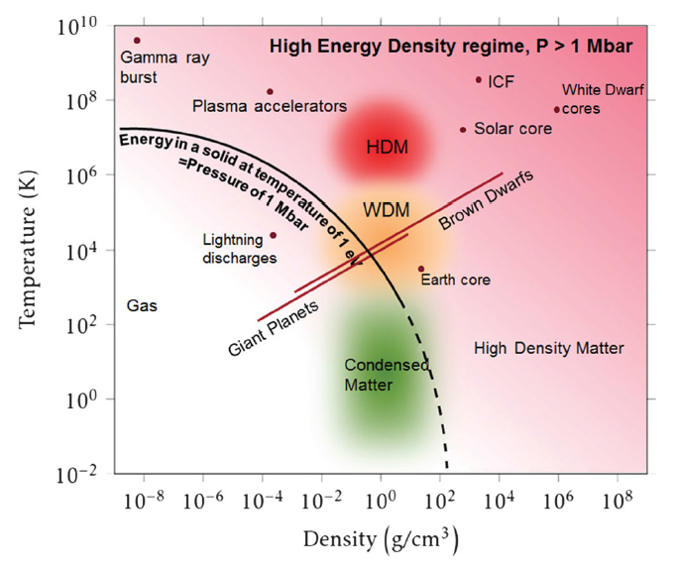
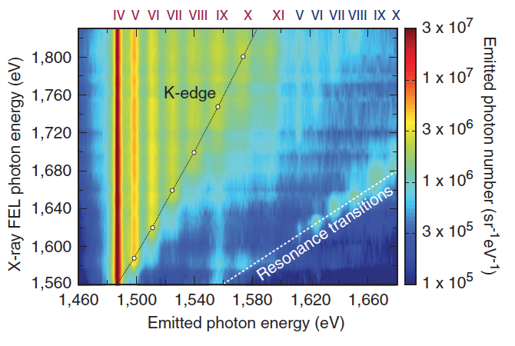
Warm dense matter, hot dense matter
Map of high-energy density (HED) regime above 1 Mbar.
HED science includes study of warm dense matter (WDM), hot dense matter (HDM), interior of planets, astrophysics, relativistic laser plasmas, inertial confinement fusion.
Many experiments with LCLS to irradiate a solid density sample and measure subsequent K-shell emission of dense aluminum plasmas, revealing saturation of the absorption induced by the ionization in the x-ray regime (Rackstraw et al., 2015) and much larger lowering of the ionization potential (Cho et al., 2012; Ciricosta et al., 2012; Vinko et al., 2012, 2015; Vinko, Ciricosta, and Wark, 2014) than predicted by commonly used plasma models (Stewart and Pyatt, 1966).
Vinko, S. M., et al., 2012, Nature 482, 59; and 2015, Nat. Commun. 6, 6397.
Spectrally resolved Al Kα emission as a function of x-ray FEL excitation photon energy from 1460 to 1680 eV. Emission lines from Al charge states from 4. to 10. are marked
in Roman numerals: red for states with a single K-shell hole and blue for states with a double K-shell hole.
Chung, Ciricosta, Falcone, Heimann, Lee, Nagler, Vinko, Wark received the 2015 APS Dawson Prize for creating high density plasma, measure ionization potential depression with X-ray FEL and new theories to explain discrepancies with old models.
6/24/2017
C. Pellegrini, Passion for Physics

Slide 33

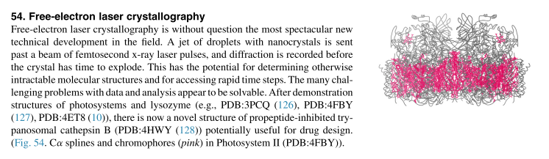
X-ray FELs impact on structural biology
Henry Chapman received the 2015 Leibniz Prize for this work
C. Pellegrini, Passion for Physics

Slide 34
Natively Inhibited Trypanosoma brucei Cathepsin B Structure Determined by Using an X-ray Laser, L. Redecke et al. Science 339, 227 (2013)
The Trypanosoma brucei cysteine protease cathepsin B (TbCatB), which is involved in host protein degradation, is a promising target to develop new treatments against sleeping sickness, a fatal disease caused by this protozoan parasite. …
By combining two recent innovations, in vivo crystallization and serial femtosecond
crystallography, we obtained the room-temperature 2.1 angstrom resolution structure of the fully glycosylated precursor complex of TbCatB. The structure reveals the mechanism of native TbCatB inhibition and demonstrates that new biomolecular information can be obtained by the “diffraction-before-destruction” approach of x-ray free-electron lasers from hundreds of thousands of individual microcrystals.
Times resolution: few femtosecond, few x 10⁻¹⁵ s.
In these measurements the time and space resolution are the atomic space and time scales.
6/24/2017
C. Pellegrini, Passion for Physics

Slide 35
Toward Single Particle Imaging
Three-Dimensional Reconstruction of the Giant Mimivirus Particle with an X-Ray FEL. T. Ekberg et al., PRL 114, 098102, 2015
X-ray FELs such as LCLS can provide a path to single-particle imaging (SPI) by collecting 2D coherent diffractive imaging patterns from individual noncrystalline particles and assembling a three-dimensional pattern from multiple copies of sufficiently identical particles. The promise of single-particle imaging is tantalizing, with all the challenges related to crystal growth and crystallography in general removed. Studying single molecules free of the crystal contacts and interactions that may distort their structure at room temperature would be revolutionary. The extremely weak signal, especially at high resolution, expected from single biological molecules makes imaging them in this way very challenging.
(Top) 24 of the 198 diffraction patterns collected by a sequence of single viruses injected into the XFEL beams. Each pattern comes from a virus with random orientation with respect to the x-ray beam. (Bottom, left) Through a mathematical algorithm, the orientation of each single-virus diffraction pattern was recovered and the 198 patterns were combined into a complete three-dimensional pattern. (Bottom, right) 3D electron density of the mimivirus recovered from such diffraction pattern. The achieved spatial resolution is 125 nanometers.
6/24/2017
C. Pellegrini, Passion for Physics

Slide 36
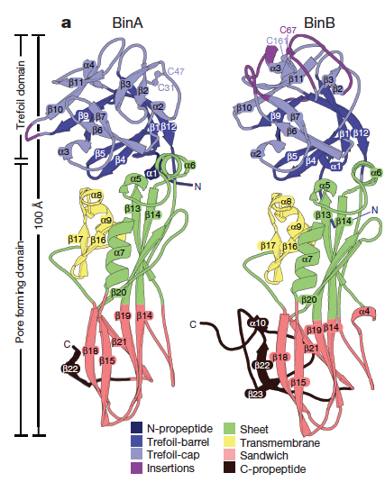
De novo phasing with X-ray laser reveals mosquito larvicide BinAB structure, J.P. Colletier et al, Nature 2016, 539, 43
A collaboration between UCLA, UCR, LBNL, Univ. of Grenoble, Stanford and SLAC.
Countries around the globe have begun killing mosquito larvae using a natural toxin derived from bacteria. In this experiment X-rays from LCLS are used to determine the atomic structure of this larvicide, lethal to mosquitoes transmitting malaria and West Nile virus. These results reveal how the toxin functions, knowledge that will inform future efforts to genetically engineer it, to also kill mosquitoes carrying Zika virus and dengue fever.
6/24/2017
C. Pellegrini, Passion for Physics

Slide 37
BinA and BinB are structurally similar to each other, each composed
of trefoil and pore-forming domains. The most noticeable differences
correspond to insertions in surface loops on the trefoil domains (purple).
Naturally occurring protein crystals from Bacillus thuringiensis subsp. israelensis (Bti) and L. sphaericus are one of the most environmentally safe and efficient means of controlling mosquitos. The specificity and efficiency of the L. sphaericus binary toxin, BinAB, presumably arise from its structural complexity, which allows it to navigate through a series of barriers en route and recognize only its intended target.
The experiment elucidates the structure of BinAB crystals, revealing features that endow BinA and BinB with their functions. The authors suggest a mechanism by which alkalinity and proteolytic activation trigger a series of structural rearrangements that navigate BinAB past barriers to reach its target while maintaining the resilient 1:1 association throughout the life cycle.
6/24/2017
C. Pellegrini, Passion for Physics

Slide 38
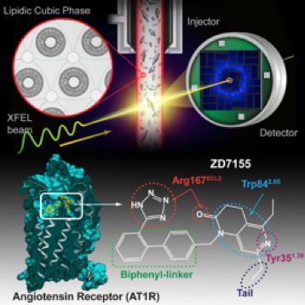
Structure of Angiotension receptor
Angiotensin II type 1 receptor (AT1R) is a G protein-coupled receptor that serves as a primary regulator for blood pressure maintenance. Although several anti-hypertensive drugs have been developed as AT1R blockers (ARBs), the structural basis for AT1R ligand-binding and regulation has remained elusive, mostly due to the difficulties of growing high-quality crystals for structure determination using synchrotron radiation. Using serial femtosecond crystallography at an X-ray free-electron laser, we successfully determined the room-temperature crystal structure of the human AT1R in complex with its selective antagonist ZD7155 at 2.9-Å resolution. The AT1R-ZD7155 complex structure revealed key structural features of AT1R and critical interactions for ZD7155 binding. Docking simulations of the clinically used ARBs into the AT1R structure further elucidated both the common and distinct binding modes for these anti-hypertensive drugs. The results provide fundamental insights into AT1R structure-function relationship and structure-based drug design.
Zhang H et al. 2015 Structure of the Angiotensin receptor revealed by serial femtosecond crystallography, Cell 161 833
6/24/2017
C. Pellegrini, Passion for Physics

Slide 39
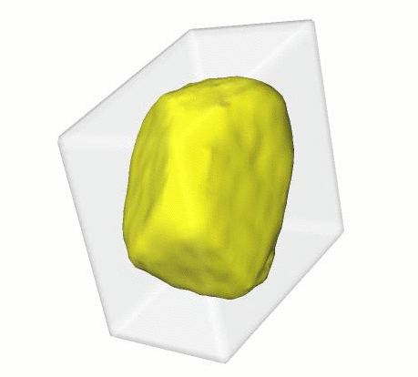
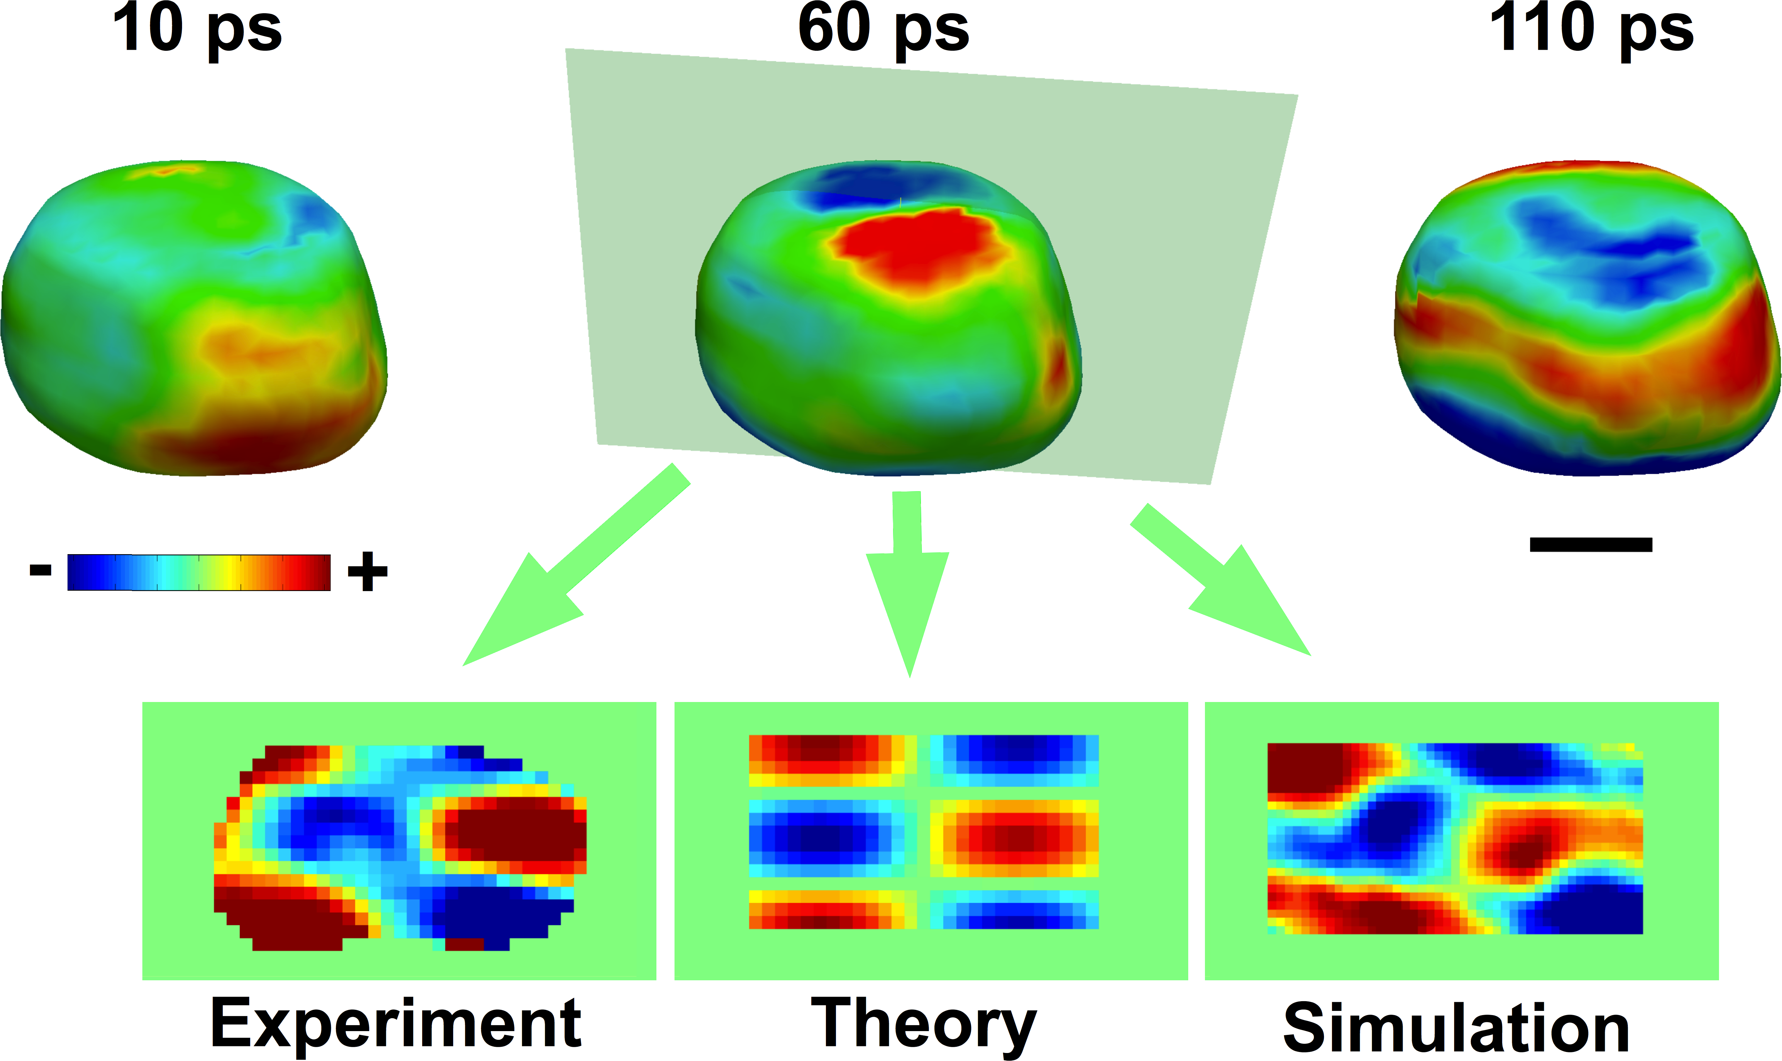
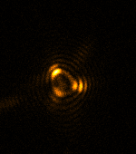
Exploring Vibration Modes in Gold Nanocrystals
Ultrafast Three-Dimensional Imaging of Lattice Dynamics in Individual Gold Nanocrystals, J. N. Clark et al., Science, 341, 6141 (2013)
Key insights into the behavior of materials can be gained by observing their structure as they undergo lattice distortion.
Acoustic vibrations in gold nanocrystals (300-400 nm) triggered with infrared light pulses
  High-resolution real-space images of the deformation field inside the nanocrystal were obtained via the Bragg coherent diffraction imaging technique at various time delays
  Technique can extend to nanoscale objects of importance to catalysis and energy storage
6/24/2017
C. Pellegrini, Passion for Physics

