Slide 1


BES and the National Laboratories
Advancing DOE Missions for 40 Years
Dr. Steven Ashby
Director, Pacific Northwest National Laboratory
Chair, National Laboratory Directors’ Council
PNNL-SA-127533

Slide 2
1977
The Founding of BES
Created to link federally funded fundamental research
to energy technologies

Slide 3
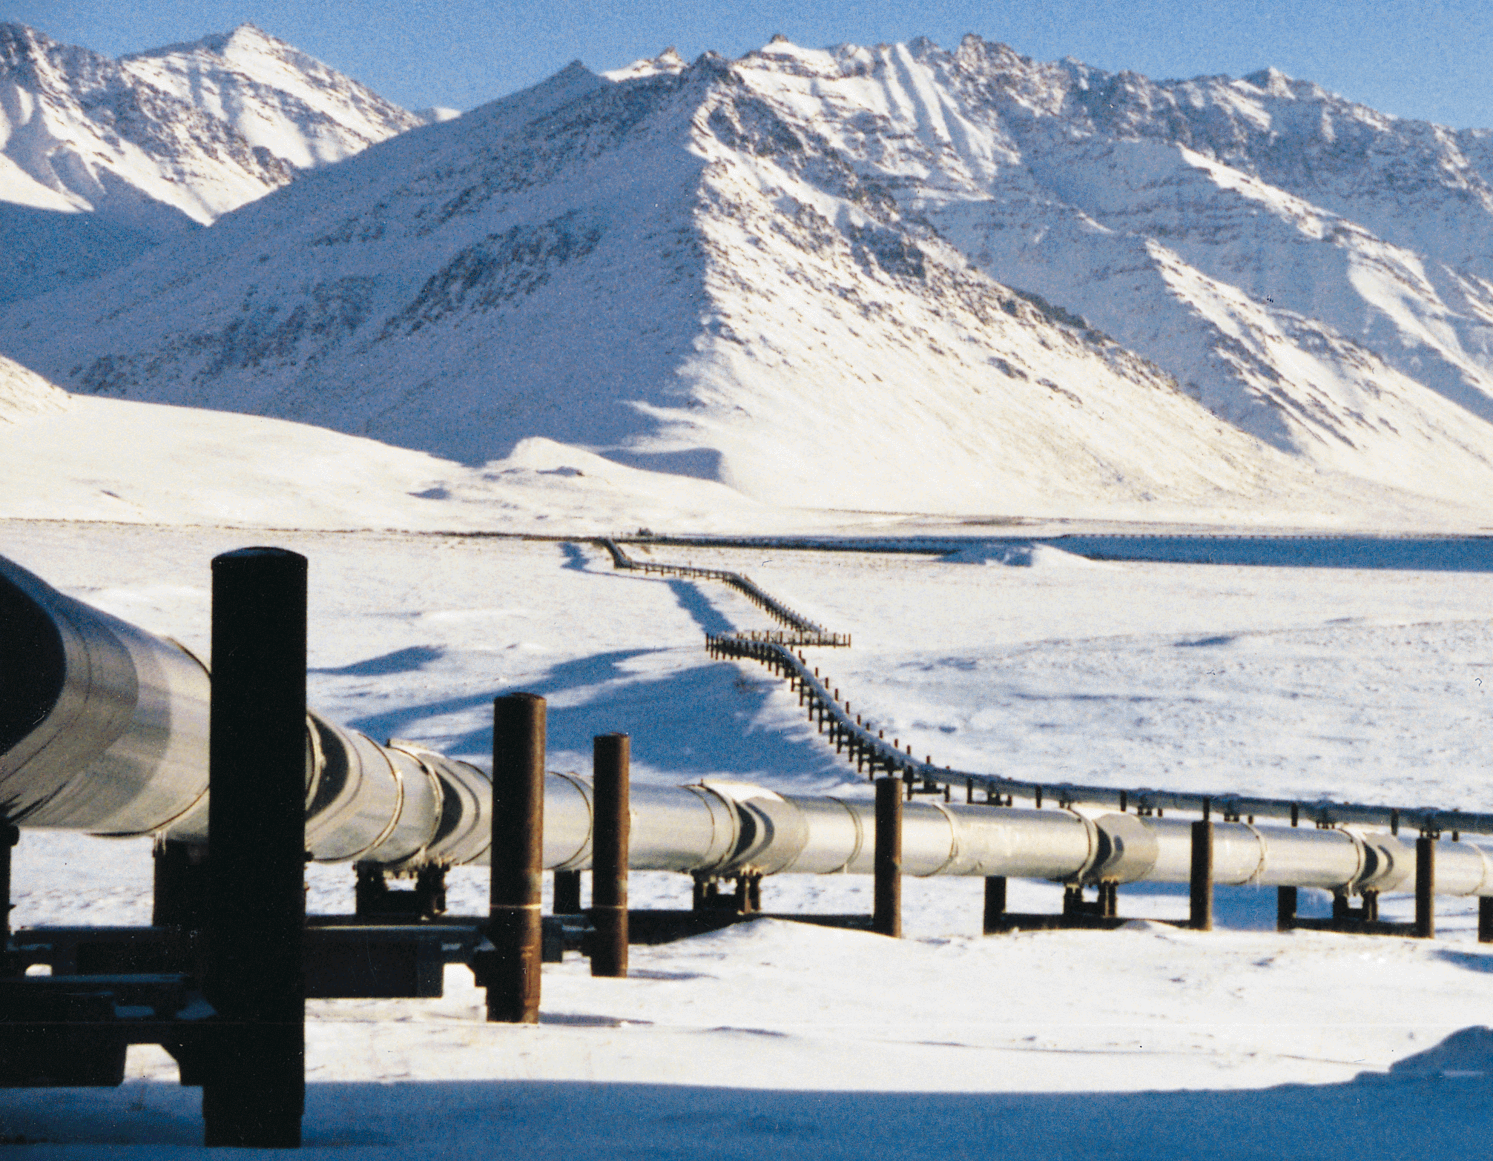
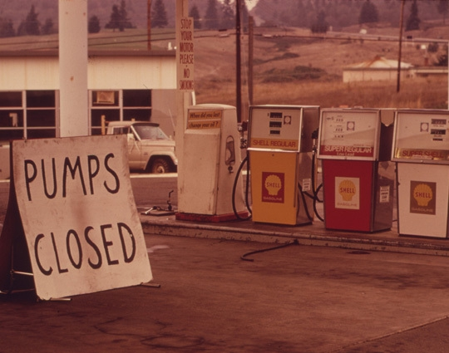

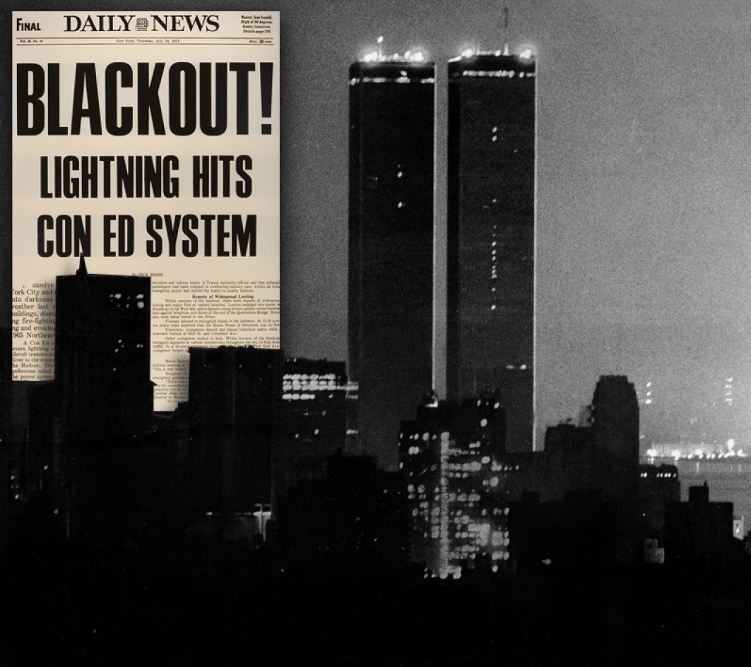
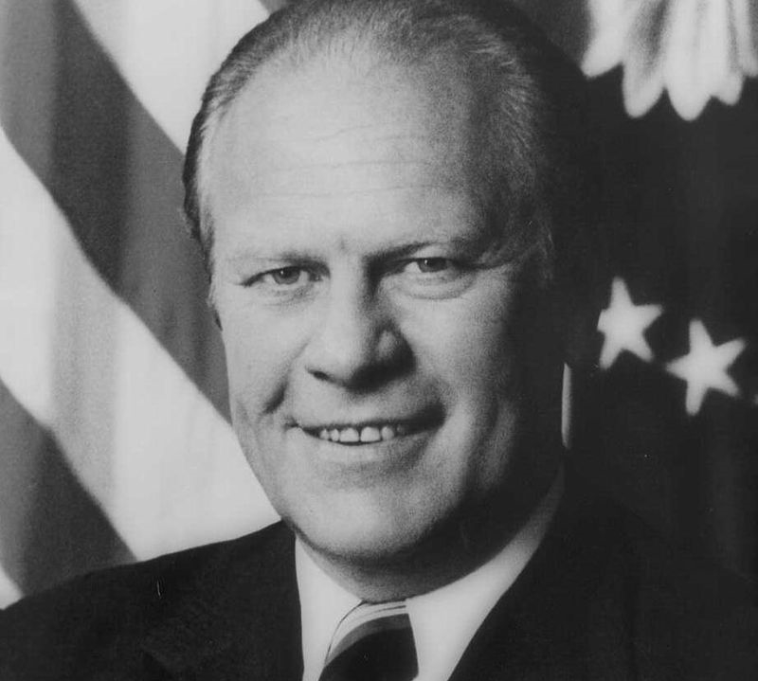
Our World
in 1977

Slide 4

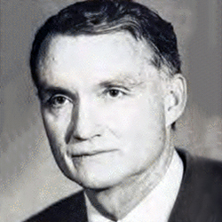
2017 BES Structure
1977 BES Structure
Foundational Goals
$1.87B
$156M
Explore fundamental phenomena
Create scientific knowledge
Provide unique user facilities necessary for conducting basic research
Harriet Kung
2017 Budget
James S. Kane
1977 Budget
Materials Sciences and Engineering Division
Scientific User Facilities Division
Chemical Sciences, Geosciences, and Biosciences Division
Materials Sciences
Molecular, Mathematical, and Geosciences
Nuclear Sciences

Slide 5
BES by the Numbers
(FY 2016)
150
Academic, nonprofit, and industrial institutions
15,000
Users
25
Research areas
17
DOE National Laboratories
5,400
Investigators
1,000
Research projects
47
States + Washington, D.C.
1,700
Students
3,500
Peer-reviewed publications

Slide 6
BASIC ENERGY SCIENCES
Nobel Prizes
Nine since 1986
1986
in Chemistry
For the dynamics of chemical elementary processes including a new type of experiment that revealed the evolution of a chemical reaction, step by step.
1987
in Chemistry
For the development and use of molecules with structure-specific interactions of high selectivity, including the incorporation of guest molecules into hollow host molecules.
1994
in Physics
For pioneering neutron scattering techniques, now widely used around the world to understand materials structure, chemistry, and properties.
1995
in Chemistry
For pioneering contributions to understand the formation and decomposition of ozone in the atmosphere, including the “hole” in the ozone layer at the poles.
1996
in Chemistry
For discovery of a novel form of carbon consisting of 60 carbon atoms with a soccer ball-like structure, the first of a vast new class of carbon-structures with novel properties.
1997
in Chemistry
For revealing how enzymes synthesize adenosine triphosphate (ATP), the molecule that stores energy to power cellular processes.
2003
in Physics
For advances in the theory of superconductors, materials that can conduct electricity with no energy losses, thus opening new avenues to energy technologies.
2005
in Chemistry
For devising new methods of organic synthesis, now used in the chemical, food processing, and biotechnology industries.
2009
in Chemistry
For mapping (with BES synchrotron light sources) the structure and inner workings of the ribosome, the cell’s machinery for churning out proteins from the genetic code.

Slide 7
2016 Budget
Core research
12 national scientific user facilities
36 EFRCs

Slide 8
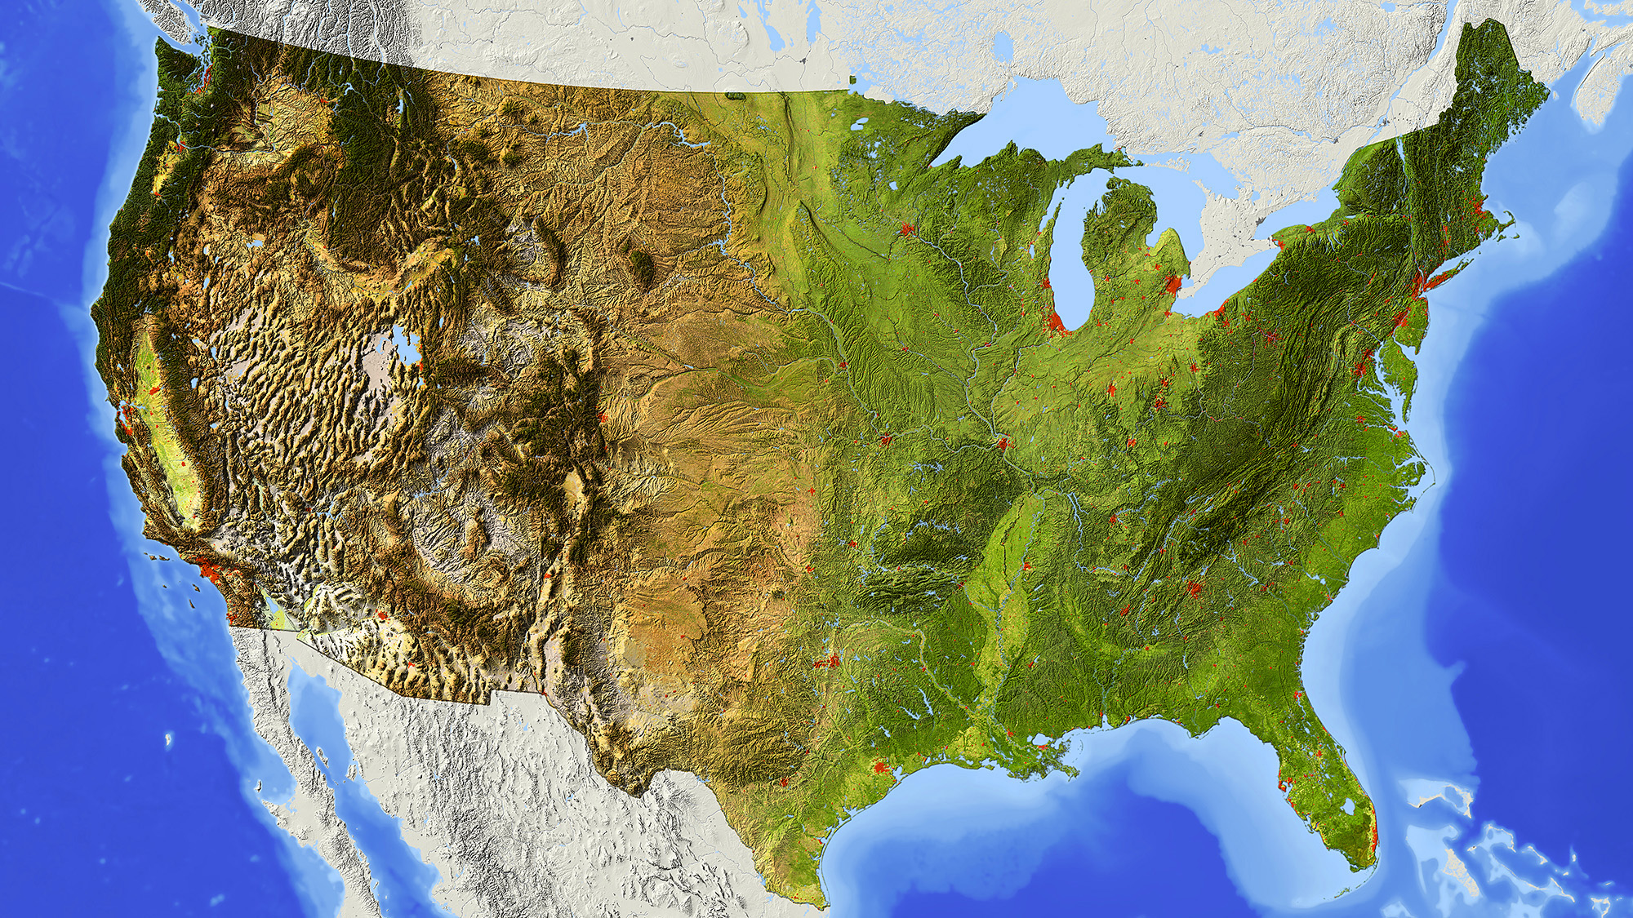

Slide 9
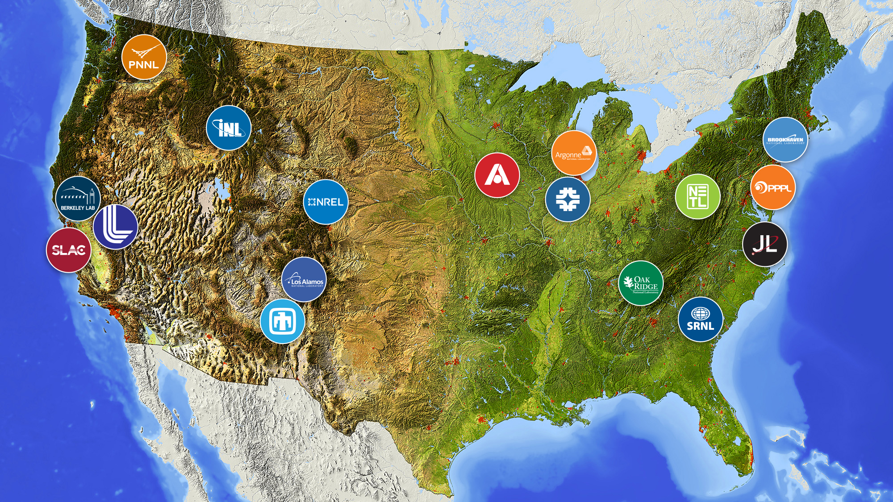

Slide 10
The National Laboratory System
Working together to address national needs
and advance DOE missions

Slide 11




$14B
Annual Funding
57,000
Research & Support Staff
11,000
Peer-reviewed Publications
(Annually)
5,860
Active Licenses
(Cumulative)

Slide 12
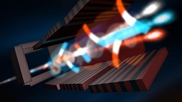
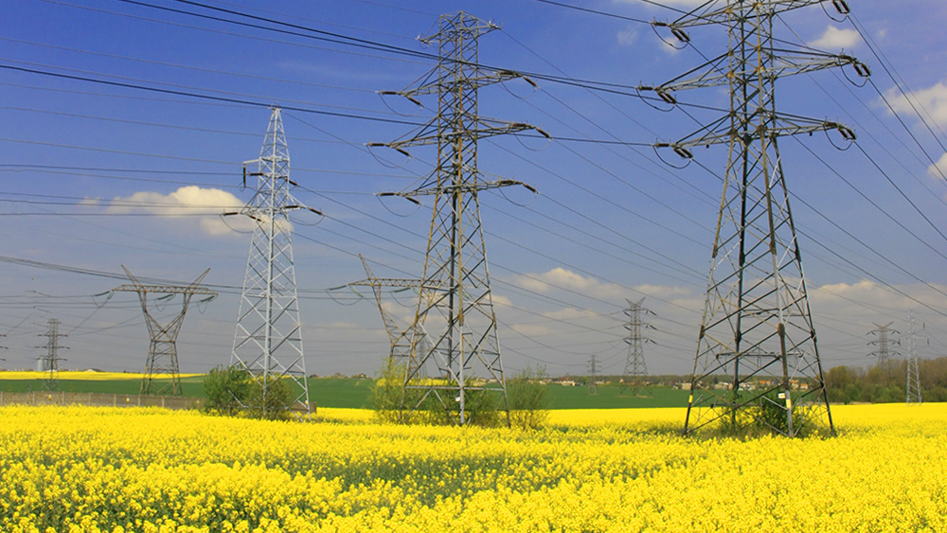
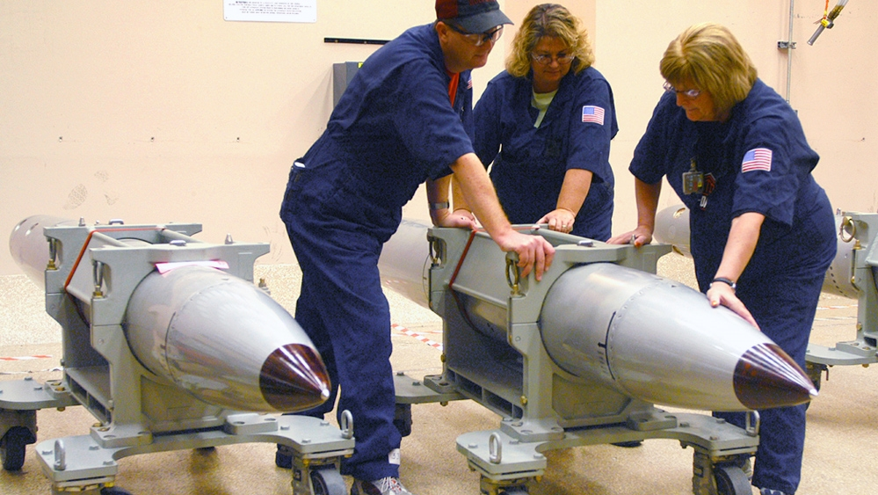
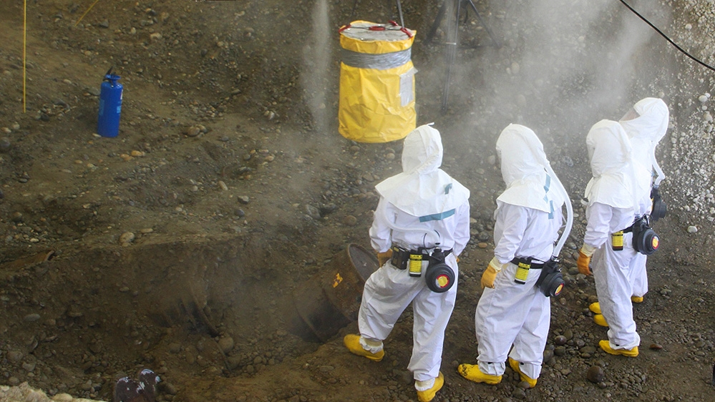
Advancing DOE
MISSIONS
Scientific Discovery
Energy Independence
National Security
Environmental Management

Slide 13
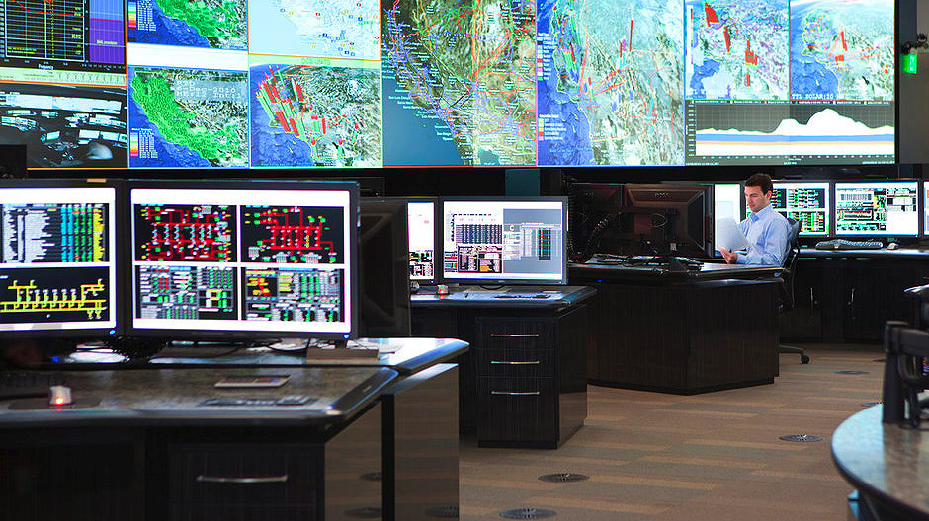
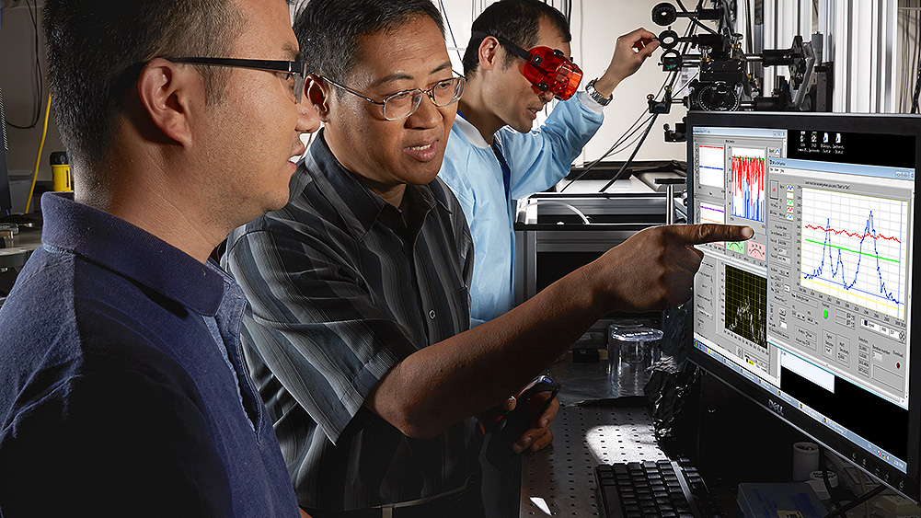

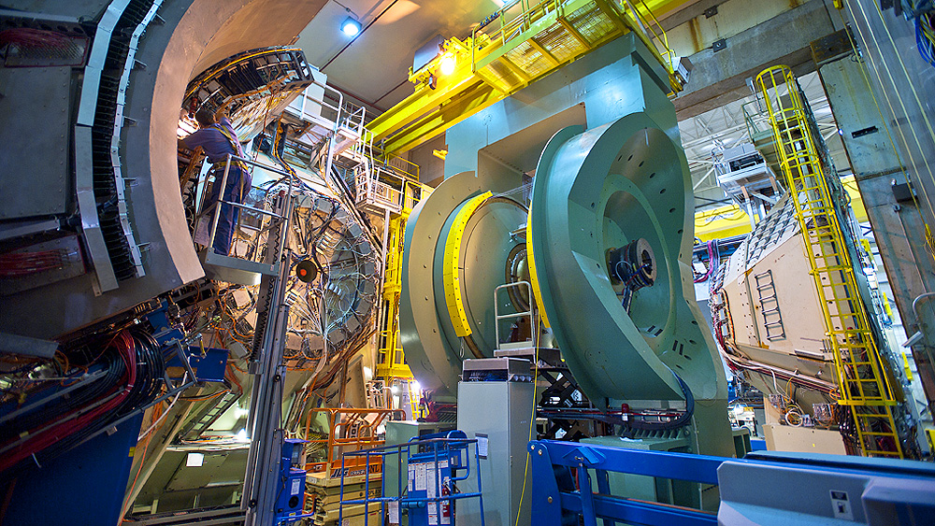
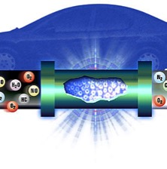
Congested grid
Delivering
IMPACT
Address National Needs
Steward S&T Capabilities
Enhance Economic Competitiveness
Operate Unique Facilities and Instrumentation

Slide 14

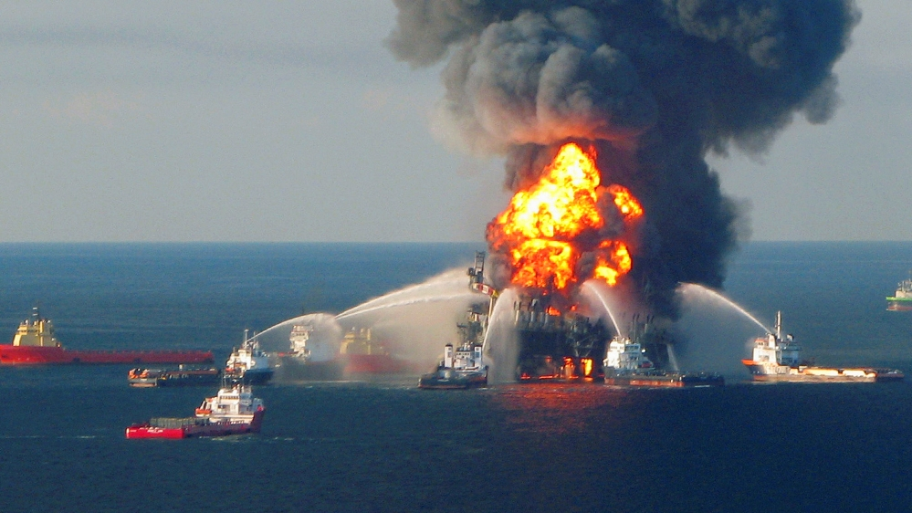
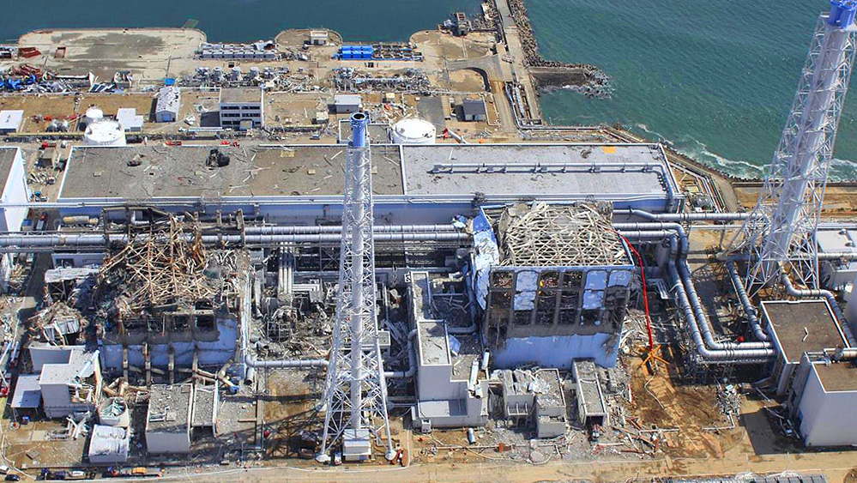
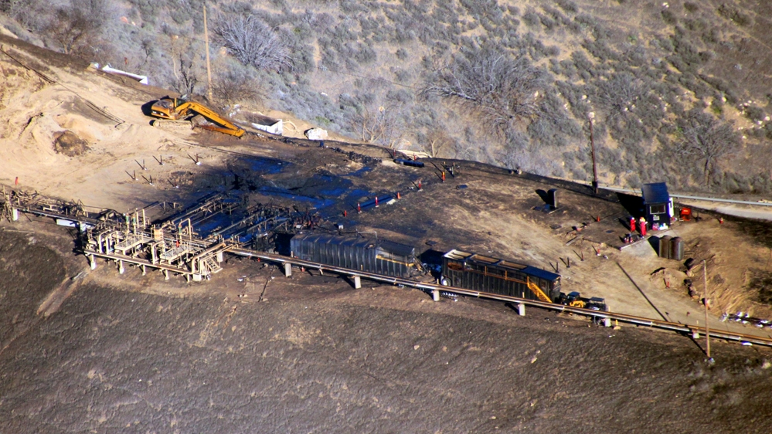
Responding to
CRISES
9/11 Terrorist Attacks
Deep Water Horizon Oil Spill
Fukushima Daiichi Nuclear Disaster
Aliso Canyon Gas Leak

Slide 15
The National Labs and BES
Partnering to advance scientific discovery

Slide 16
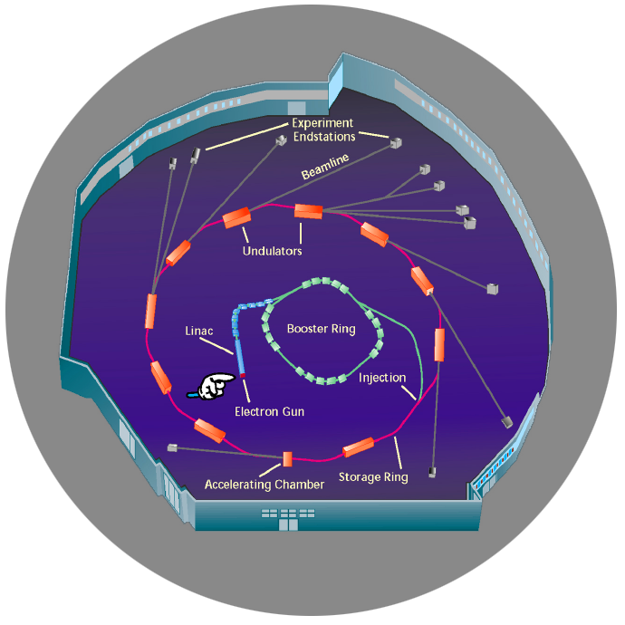
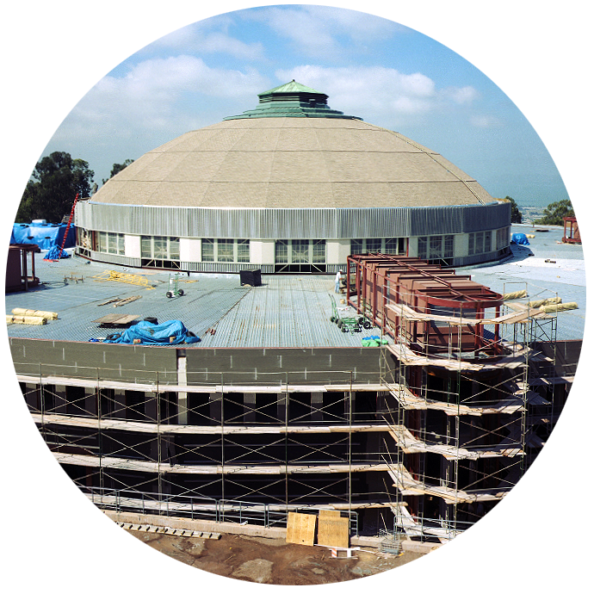
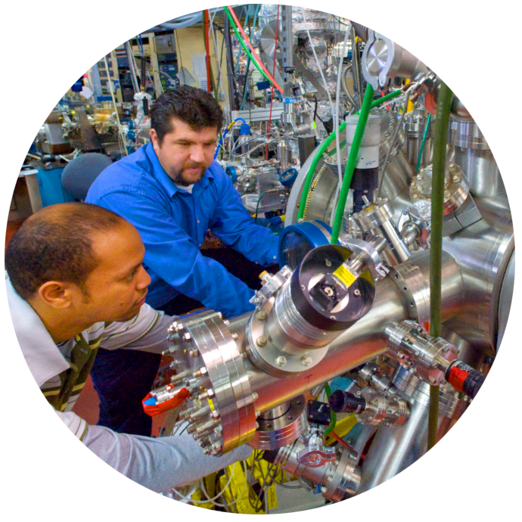

The National Labs play a critical role in designing, constructing, and operating BES user facilities
Design
Build
Operate

Slide 17
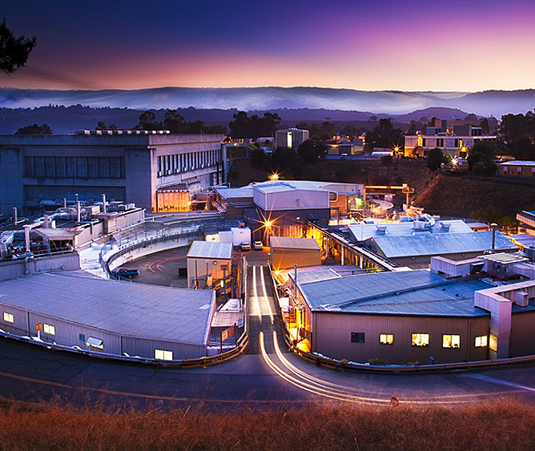
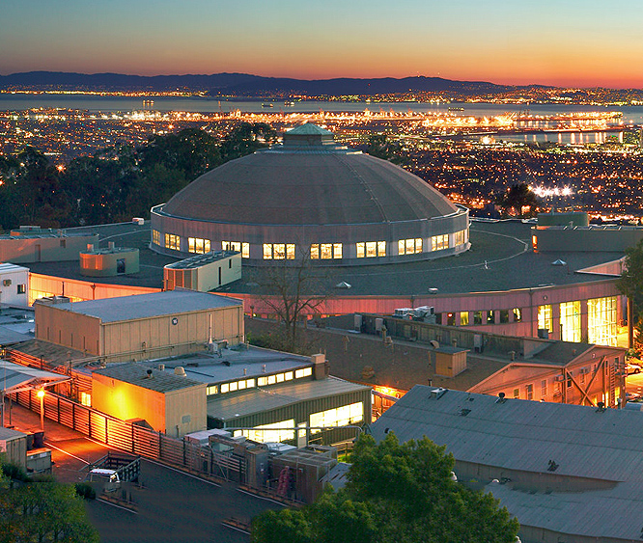
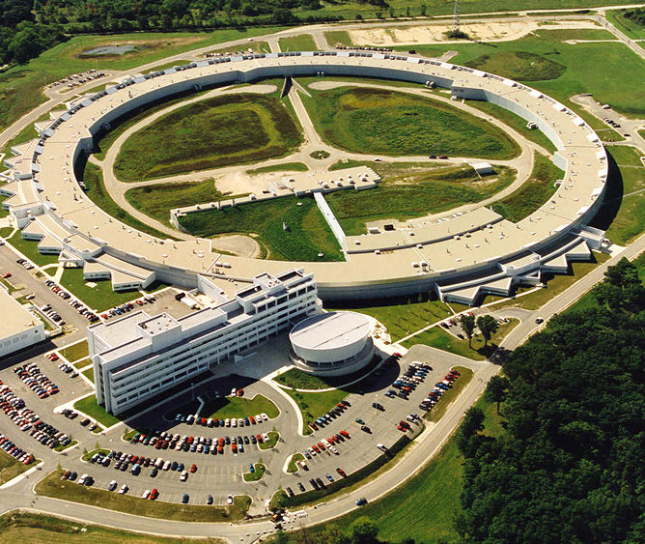
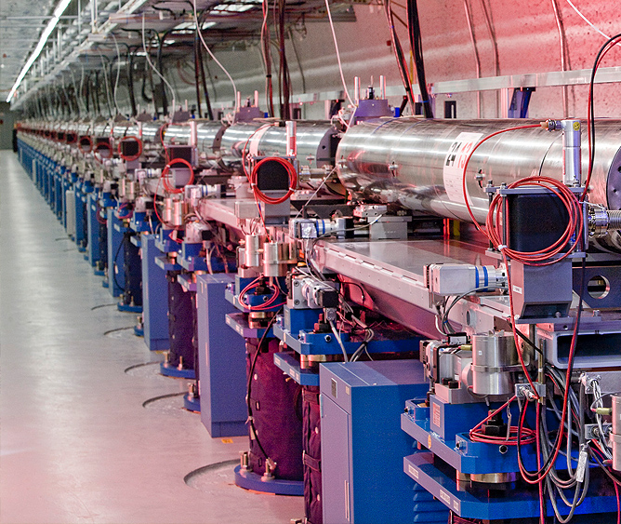
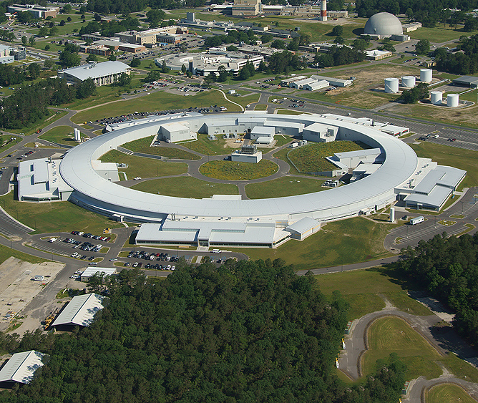
X-Ray
Light
Sources
1974
1993
Stanford Synchrotron Radiation Light Source
SLAC
Advanced Light Source
LBNL
1996
2010
2010
Advanced Photon Source
ANL
LINAC Coherent Light Source
SLAC
National Synchrotron Light Source II
BNL

Slide 18
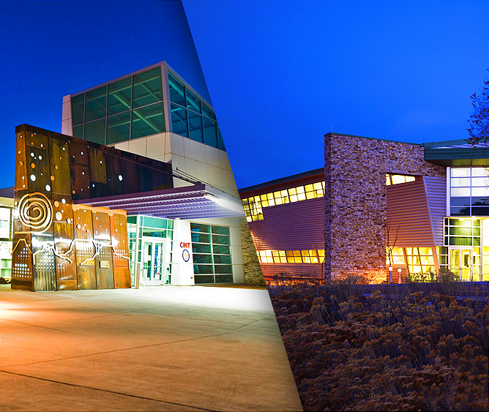
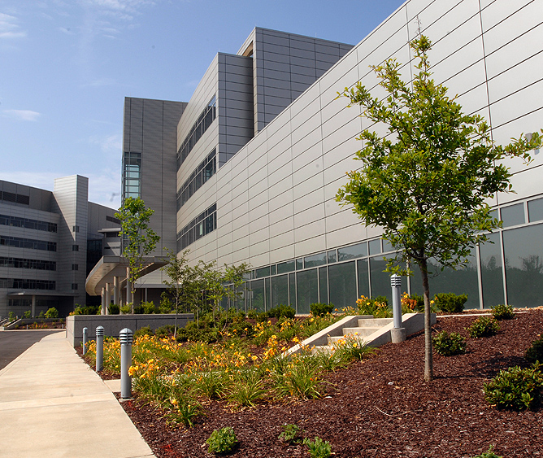
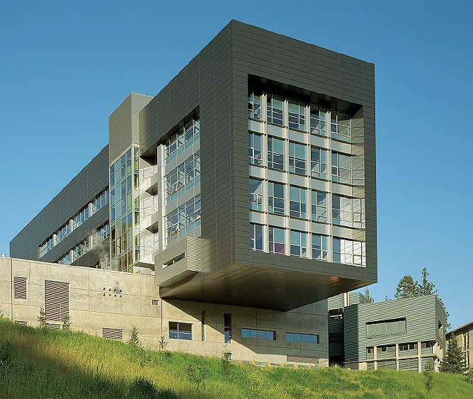
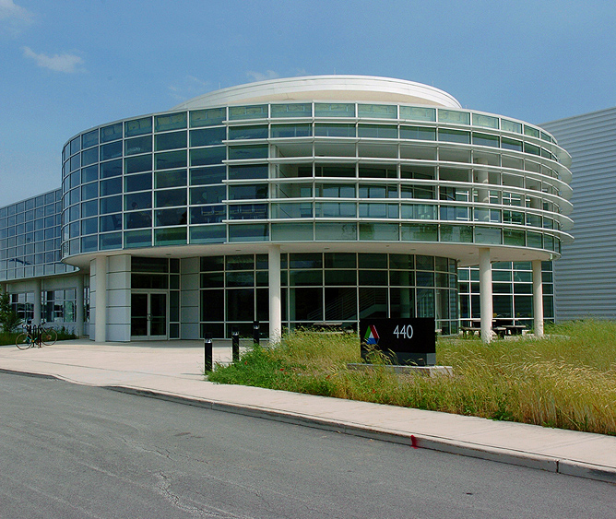
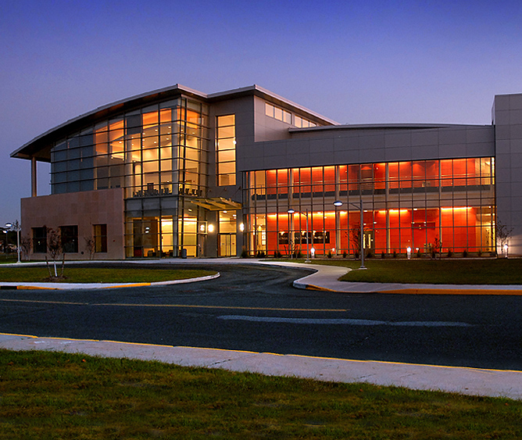
Nanoscale
Science
Research
Centers
2006
2006
Center for Integrated Nanotechnologies
SNL/LANL
Center for Nanophase Materials
ORNL
2006
2007
2008
The Molecular Foundry
LBNL
Center for Nanoscale Materials
ANL
Center for Functional Nanomaterials
BNL

Slide 19
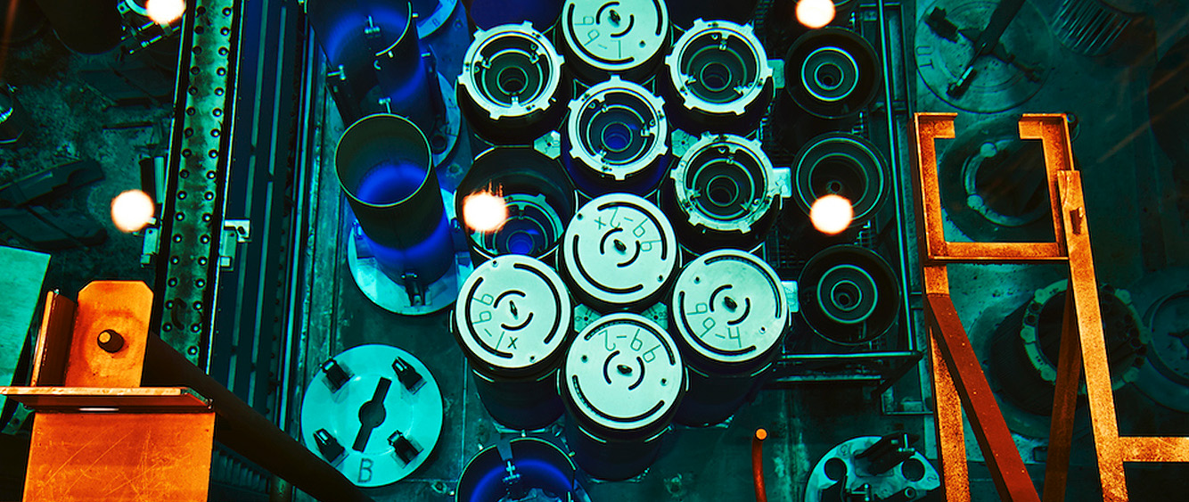
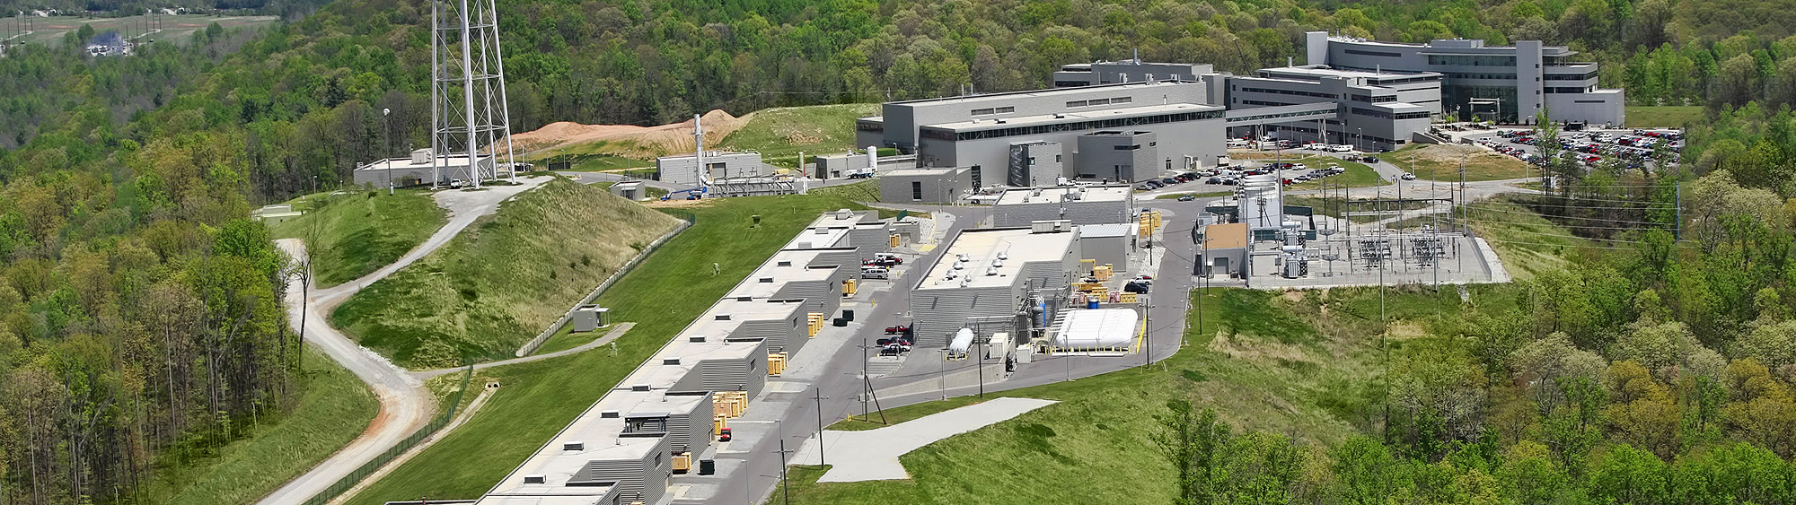
Neutron
Scattering
1966
High Flux Isotope Reactor
ORNL
2006
Spallation Neutron Source
ORNL

Slide 20
EFRC Highlights
Energy Storage Material
M. Thackeray, ANL
Energy & Environmental Science, 2011
Center for Electrochemical Energy Science: Scientists developed new electrode materials for energy storage--carbon particles and nanotubes.
Synthetic Ni Electrocatalyst
R. Bullock, PNNL
Science, 2011
Center for Molecular Electrocatalysis: Scientists created a catalyst that is 10x faster than nature in hydrogen production.
Suppressing Rad. Damage
Y. Zhang, ORNL
Nature Communications, 2015
Energy Dissipation to Defect Evolution: Chemically complex or high entropy alloys could lead to materials with suppressed damage accumulation under irradiation.

Slide 21
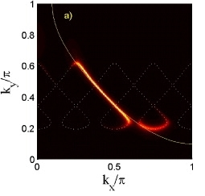
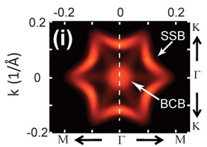
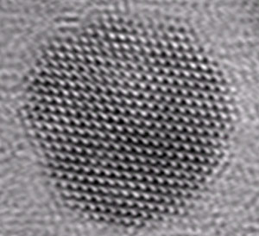
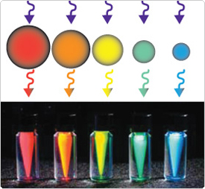
Materials Science and Engineering
Stripes in Superconductors
J. Tranquada, BNL
1995 highly cited paper in Nature
Scientists discovered striped phases in semiconductors; this discovery necessitated developing new principles that describe charge transport in materials able to conduct electricity without resistance.
Quantum Dots
A.P. Alivisatos, LBNL
1996 highly cited paper in Science
Quantum dots exhibit strong size-dependent optical electric properties. The ability to join the dots into complex assemblies creates many opportunities for scientific discovery in electron behavior plus opportunities in solar cells, tracking devices and more.
3-D Topological Insulators
Z.X. Shen, SLAC
2009 highly cited paper in Science
By investigating the surface state of Bi₂Te₃, scientists demonstrate that the surface state consists of a single nondegenerate Dirac cone. The discovery may provide new routes to generating novel materials, possibly finding uses in next-generation computing.

Slide 22
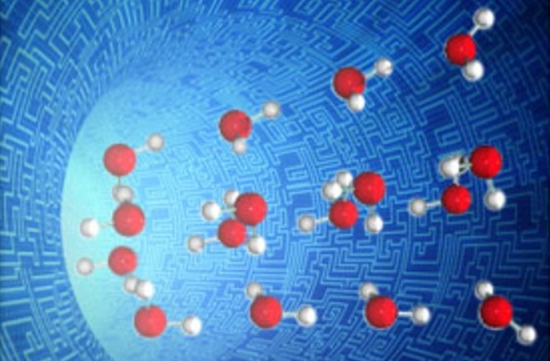
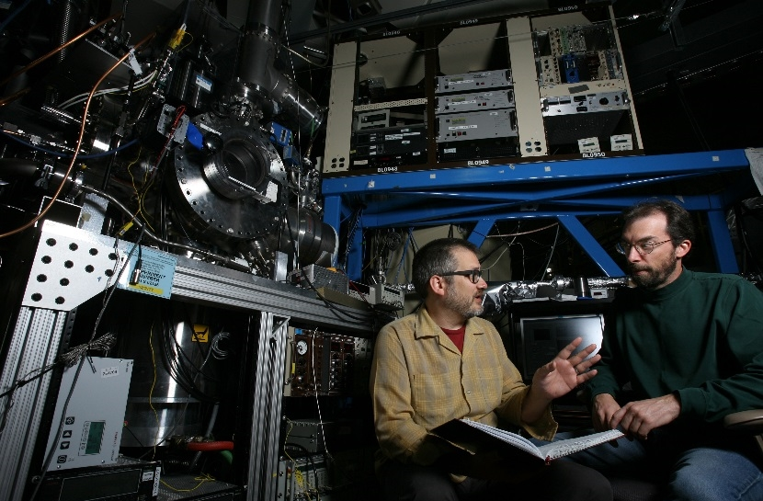
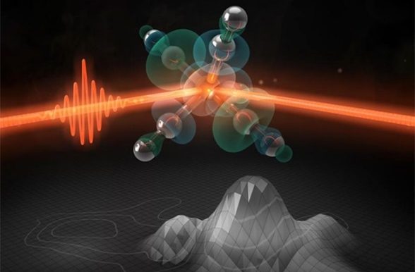
Chemical and Biosciences
Morphology of Water
B. Kay, PNNL
1999 highly cited paper in Science
The morphology of water can be controlled by the angular distribution of condensing molecules, giving us insight into rare forms of water.
Combustion Kinetics
O. Welz, SNL
2012 “breakthrough paper” in Science
CRF measurements of gas-phase reaction intermediates using photoionization mass spectrometry provide direct knowledge of poorly understood kinetics.
Formation of a Catalyst
P. Wernet, SLAC
2015 highly cited paper in Nature
Light rearranges the outermost electrons of Fe(CO)₅ and turns it into an active catalyst. Light could be used to enhance active sites.

Slide 23
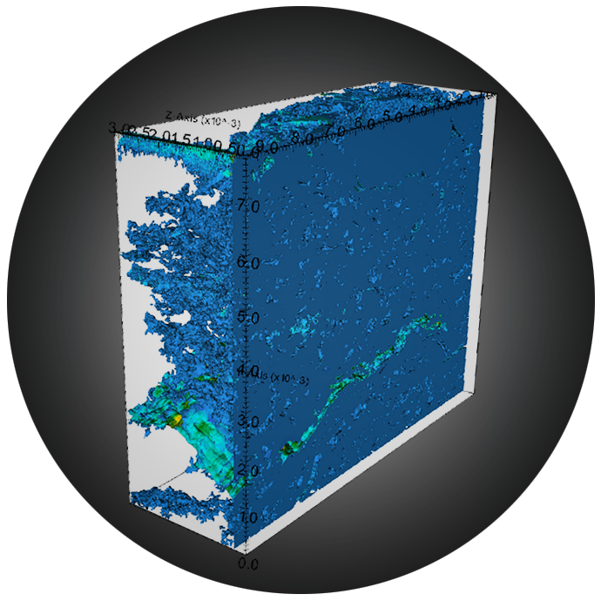
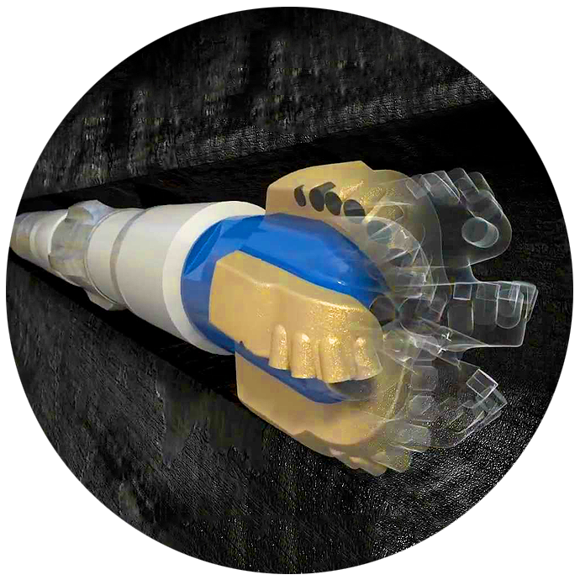
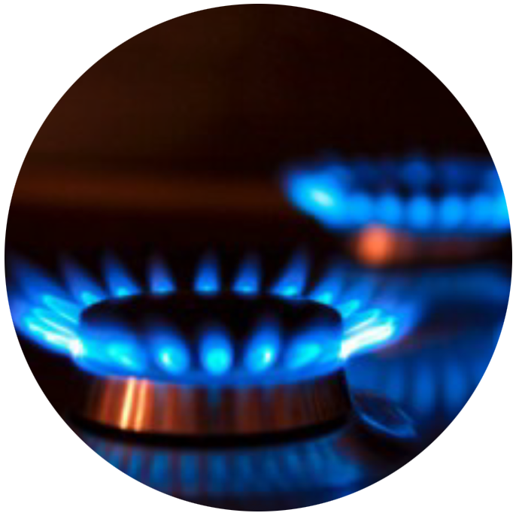
Geosciences: Discovery to societal impact
Subsurface
Characterization
Horizontal
Drilling
Natural
Gas

Slide 24
Envisioning the Future
Engaging the community in a time-tested strategic planning process

Slide 25
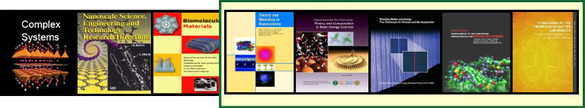
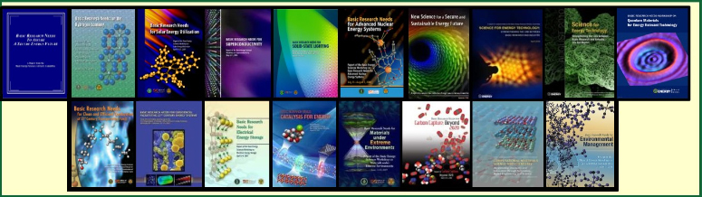
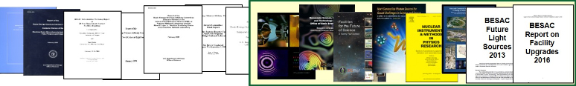
The BES Planning Process
Science for Discovery
Science for National Needs
The BES User Facilities

Slide 26
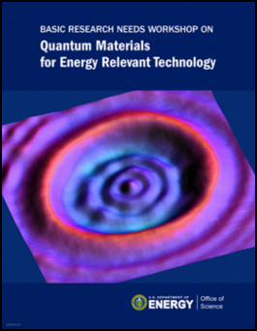
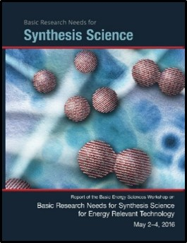
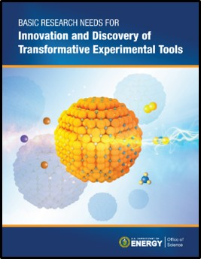
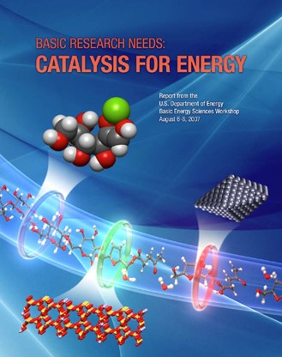

Basic Research Needs Workshops
Quantum materials for energy-relevant technology
Synthesis science for energy-relevant technology
Innovation/discovery of transformative experimental tools
Next-generation electrical energy storage*
Catalysis science to transform energy technologies*
Energy-water issues: new approaches to ensure robust and secure energy and water systems
Basic research needs for future nuclear energy*
*REFRESH

Slide 27

BES and Computing
BES will use exascale simulation to make
scientific discoveries in
Quantum materials and chemistry
Catalysis and combustion
Photosynthesis and light harvesting
BES will leverage its strengths to enable
beyond-CMOS computing technologies

Slide 28






Creating our Energy Future

Slide 29



