Slide 1
DOE Office of Science
Update and FY 2018 Budget Request to Congress
Presented to the
Basic Energy Sciences Advisory Committee
by
Steve Binkley
Deputy Director for Programs
Steve.Binkley@science.doe.gov
July 13, 2017

Slide 2
Outline
  Message from DOE leadership
  Appointee status
  Office of Science personnel changes
  FY 2018 budget

Slide 3
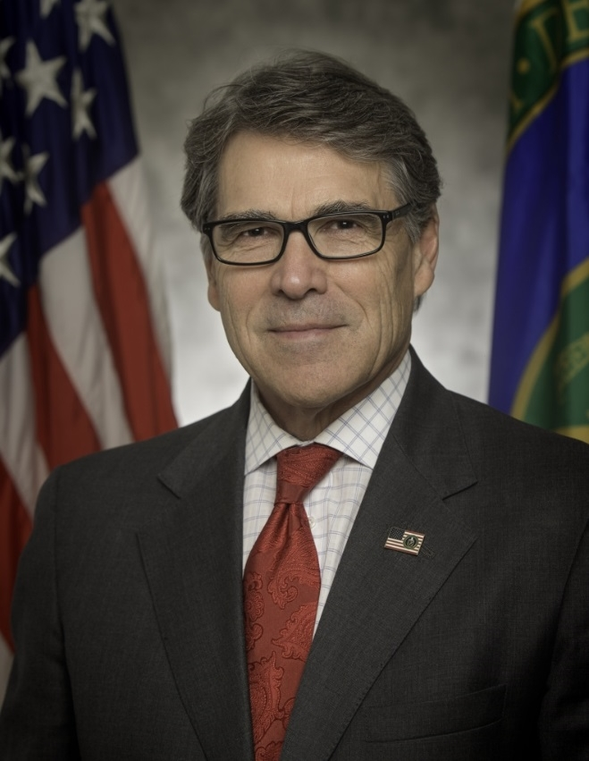
Message from Secretary Perry
The FY18 budget request attempts to refocus and refine our mission on several critical fronts that directly affect the safety and security of the American public.
The $28 billion FY 2018 budget advances the DOE mission in key areas through significant investments to:
  Modernize the country’s nuclear weapons arsenal
  Achieve exascale computing
  Advance the Nation’s nuclear waste management program
  Protect our national electric grid from cyberattacks
  Shift the Department’s focus to early-stage research and development at our national laboratories to more efficiently and cost effectively advance American dominance in scientific and energy research

Slide 4
Message from the DOE Office of Science
The President establishes the priorities for the Budget Request
Historically, budgets have gone up and down
  Our job is to deliver the best science we can with the resources we are given by the President and Congress
There will be some challenges for FY 2018, and it’s not easy to say at this early stage exactly how the budget will impact our programs — we’ll be working out the details over the coming weeks and months
We need to remain clear about our priorities:
  Deliver the best science we can with the resources we have when Congress votes and the President finally signs an FY 2018 budget
Our commitment to you: we will do our best to keep you informed as we learn more

Slide 5

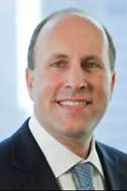
Appointee Status
  Deputy Secretary of Energy Nominee Dan Brouillette
  Nomination announced April 3, 2017
  Senate Hearing May 25, 2017
  Pending Senate Confirmation
  Under Secretary for Science Nominee Paul Dabbar
  Nomination announced July 12, 2017
  Senate Hearing TBD

Slide 6
Under Secretary for Science Nominee Paul Dabbar
Paul Dabbar is Managing Director in the Global Mergers & Acquisitions Group, and Head of Energy Mergers & Acquisitions at J.P.Morgan, the investment banking division of JPMorgan Chase & Co. He has also led a number of M&A transactions for JPMorgan Chase. He has been financial advisor on over $300 billion in M&A transactions, including corporate mergers, subsidiary sales and purchases, government privatizations, joint ventures, corporate restructurings, private equity transactions, and unsolicited corporate transactions for companies in the energy sector, including nuclear, as well as in the industrials and financial institutions sectors.
Mr. Dabbar is a member of the Board of the U.S. Department of Energy Environmental Management Advisory Board, and is chairman of his U.S. Naval Academy class fundraising board.
Prior to J.P.Morgan, Mr. Dabbar was a nuclear submarine officer, serving on board the U.S.S. Pintado (SSN-672) out of Mare Island, CA, and Pearl Harbor, HI, where he completed deployments to places including the North Pole and South America. He also worked at the Johns Hopkins Applied Physics Laboratory conducting U.S. Department of Defense research.
Mr. Dabbar has a B.S. with merit in marine engineering from the U.S. Naval Academy (Class of ‘89) and a M.B.A. from Columbia University. He also completed the U.S. Naval nuclear program’s Engineer’s School.
https://energy.gov/em/contributors/paul-m-dabbar

Slide 7
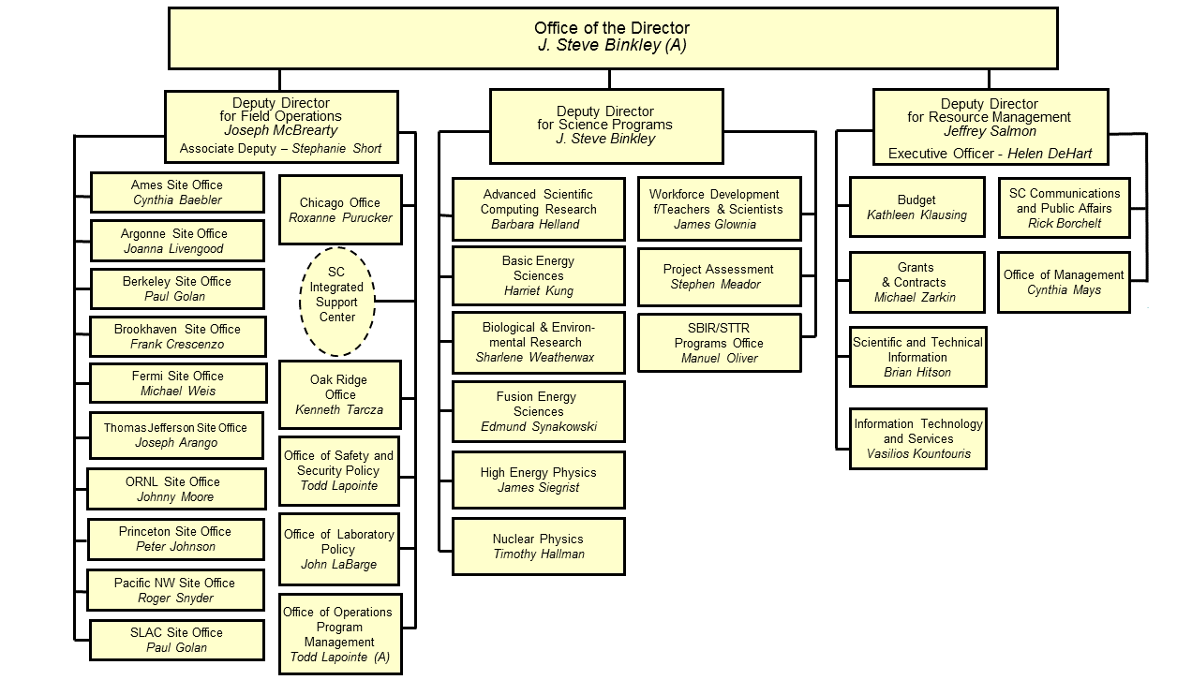
DOE Office of Science Organization

Slide 8
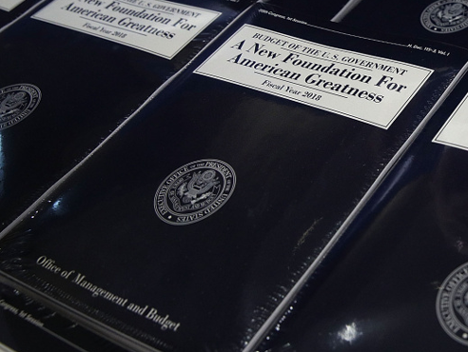
FY 2018 President’s Budget Request

Slide 9
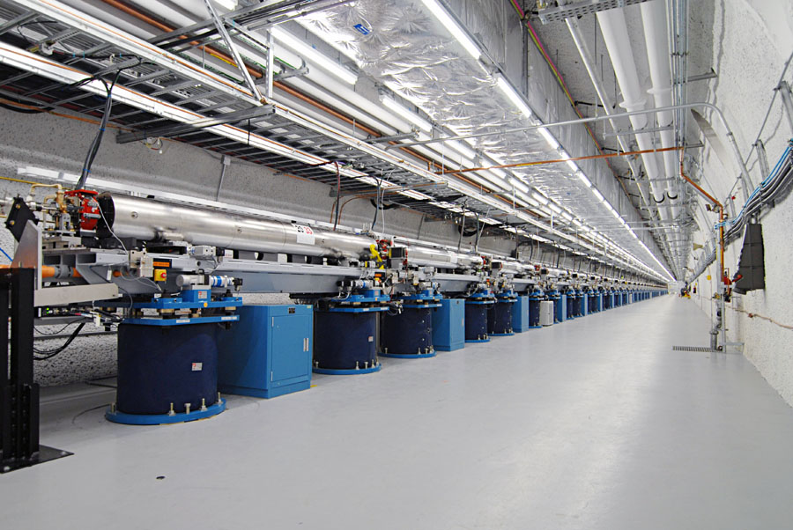
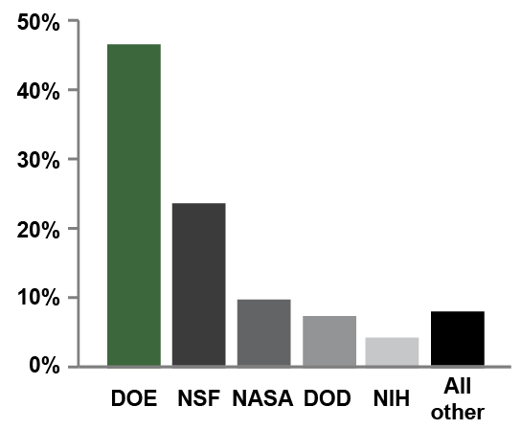
Office of Science
By the numbers
  SC delivers scientific discoveries and tools to transform our understanding of nature and advance the energy, economic, and national security of the U.S.
  Research
  Provides about half of the U.S. Federal support for basic research in the physical sciences;
  Supports about 19,000 Ph.D. scientists, graduate students, engineers, and support staff at over 300 institutions and 10 DOE national laboratories;
  Maintains U.S. and world leadership in high-performance computing and computational sciences;
  Continues to be the major U.S. supporter of physics, chemistry, materials sciences, and biology for discovery and for energy sciences.
Scientific User Facilities
  SC maintains the world’s largest collection of scientific user facilities (aka research infrastructure) operated by a single organization in the world, used by more than 27,000 researchers each year.
Support for basic research in the physical sciences by agency.
Source: NSF Science and Engineering Indicators 2012
Shown is a portion of SLAC's two-mile-long linear accelerator (or linac), which provides the electron beam for the new Linac Coherent Light Source (LCLS) – the world’s first hard x-ray, free-electron laser. For nearly 50 years, SLAC's linac had produced high-energy electrons for physics experiments. Now researchers use the very intense X-ray pulses (more than a billion times brighter than the most powerful existing sources) much like a high-speed camera to take stop-motion pictures of atoms and molecules in motion, examining fundamental processes on femtosecond timescales.

Slide 10
Priorities for FY 2018
Focus on cutting edge, early stage research and development; achieve 40% funding for research
  The Office of Science (SC) is the largest Federal supporter of basic research in the physical sciences in the United States. SC supports research at the frontiers of science—discovering nature’s mysteries, from the study of subatomic particles, atoms, and molecules that are the building blocks of the materials of our everyday world, to the DNA, proteins, and cells that are the building blocks of entire biological systems.
  SC also supports science for energy—advancing a clean energy agenda through fundamental research on energy production, conversion, storage, transmission, and use, and through advancing our understanding of the earth.
Continue operations of the national laboratories
  SC oversees the operation of ten DOE national laboratories. SC conducts a formal laboratory strategic planning process annually with its labs to understand future directions, immediate and long-range challenges, and resource needs. SC also conducts an annual evaluation of the scientific, technological, managerial, and operational performance of the management and operating contractors of its laboratories. In addition, SC funds mission-ready infrastructure and investments that foster safe and environmentally responsible operations at the labs.
  Increase funding for Exascale Computing
Maintain all on-going projects and start two new construction projects
  2 New Construction Projects:
    Advanced Photon Source Upgrade (APS-U) at Argonne National Laboratory (ANL) in Basic Energy Sciences and
    Energy Sciences Capability at Pacific Northwest National Laboratory (PNNL) in Science Laboratories Infrastructure.

Slide 11
Office of Science FY 2018 President’s Request
(Dollars in thousands)

Slide 12
Office of Science FY 2018 House Mark
(Dollars in thousands)
 | FY 2016 Enacted Approp. | FY 2016 Current Approp. | FY 2017 Enacted Approp. | FY 2018 President's Request | FY 2018 House Mark
Science
Advanced Scientific Computing Research | 621,000 | 599,782 | 647,000 | 722,010 | 694,200
Basic Energy Sciences | 1,849,000 | 1,794,412 | 1,871,500 | 1,554,500 | 1,871,500
Biological and Environmental Research | 609,000 | 588,145 | 612,000 | 348,950 | 582,000
Fusion Energy Sciences | 438,000 | 427,267 | 380,000 | 309,940 | 395,000
High Energy Physics | 795,000 | 774,153 | 825,000 | 672,700 | 825,000
Nuclear Physics | 617,100 | 600,954 | 622,000 | 502,700 | 619,200
Workforce Development for Teachers and Scientists | 19,500 | 19,500 | 19,500 | 14,000 | 19,500
Science Laboratories Infrastructure | 113,600 | 113,600 | 130,000 | 76,200 | 105,600
Safeguards and Security | 103,000 | 103,000 | 103,000 | 103,000 | 103,000
Program Direction | 185,000 | 185,000 | 182,000 | 168,516 | 177,000
University Grants (Mandatory) | …… | …… | …… | …… | ……
Small Business Innovation Research/Technology Transfer (SBIR/STTR) (SC portion) | …… | 144,387 | …… | …… | ……
Subtotal, Office of Science | 5,350,200 | 5,350,200 | 5,392,000 | 4,472,516 | 5,392,000
SBIR/STTR (DOE transfer) | …… | 72,438 | …… | …… | ……
Rescission of prior year balances | -3,200 | -3,200 | -1,028 | …… | ……
Total, Office of Science | 5,347,000 | 5,419,438 | 5,390,972 | 4,472,516 | 5,392,000
Recap:

Slide 13
In Conclusion …
In the immediate future:
  Keep producing great science!
  Communicate your concerns with us
In the coming weeks and months:
  Congress is deliberating its appropriations decisions and the final appropriation will become known shortly
  We must be ready to execute when the new fiscal year starts on October 1, 2017

Slide 14
Questions?

Slide 15
Backup Slides

Slide 16
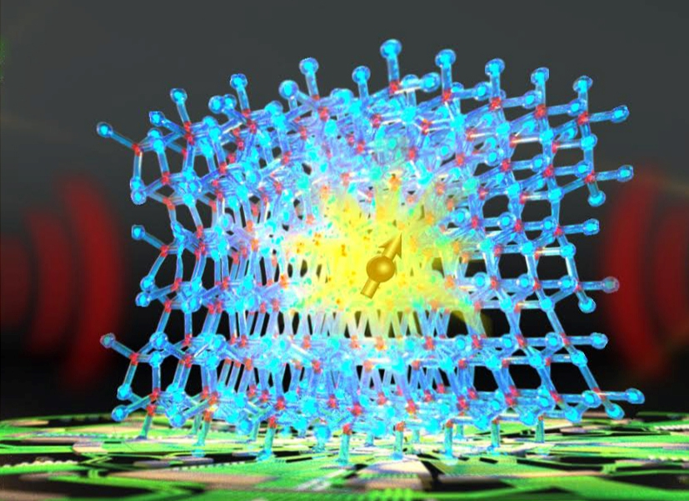
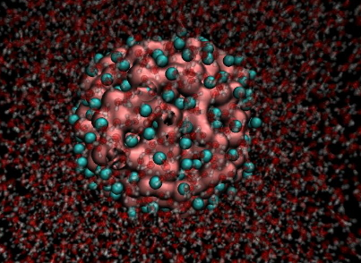
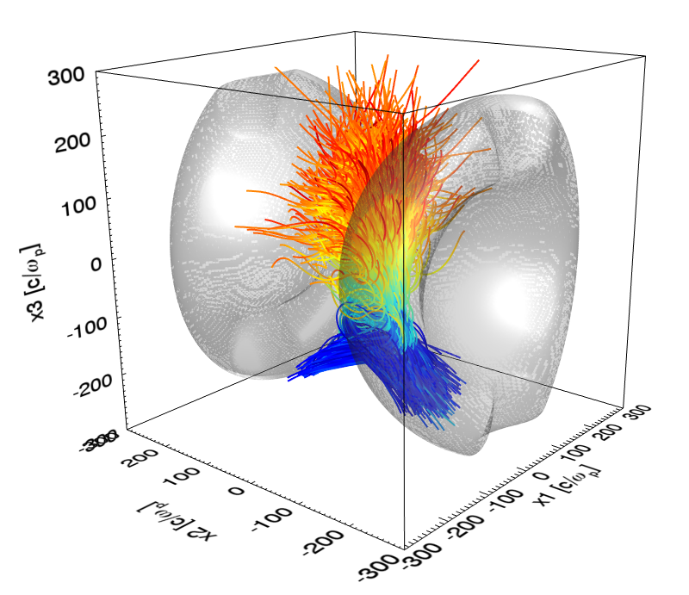
Advanced Scientific Computing Research
Computational and networking capabilities to extend the frontiers of science and technology
Exascale Computing Initiative (ECI) and Exascale Computing Project (ECP). The ECP is initiated as a joint ASCR/NNSA partnership using DOE’s formal project management processes. A new budget line was created for the SC-ECP in FY 2017.
Facilities operate optimally and with >90% availability; deployment of 200 petaflop upgrade at OLCF and site preparations for exascale machines and NERSC-9 and upgrade of ESnet.
SciDAC partnerships were recompeted in FY 2017 with new institutes and partnerships that span basic science priorities.
Applied Mathematics research addresses challenges of increasing complexity and Computer Science research and Research and Evaluation Partnerships explores technologies “beyond Moore’s law” including testbeds.
The Computational Sciences Graduate Fellowship is funded at $10 million.

Slide 17
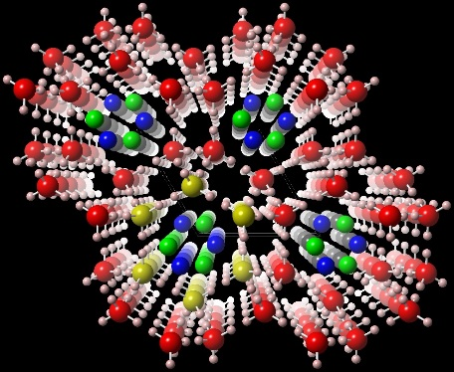
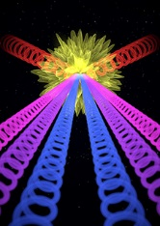
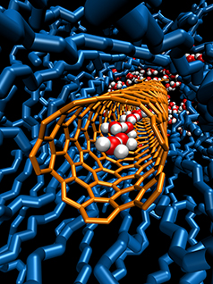
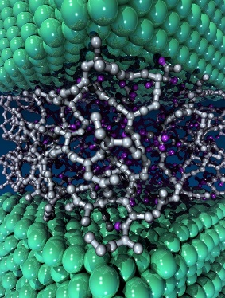
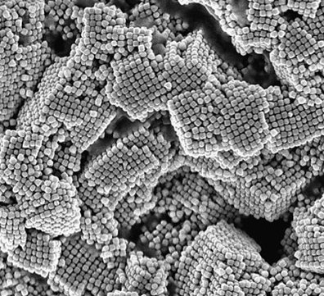
Basic Energy Sciences
Understanding, predicting, and controlling matter and energy at the electronic, atomic, and molecular levels
The BES FY 2018 Request of $1,554.5 million is a decrease of $294.5 million or 16% from the FY 2016 Enacted level.
The overall research funding in FY 2018 is reduced by 18% from FY 2016, requiring a significant shift in priorities with targeted reductions of activities that extend to later-stage fundamental research. Both the core research and the EFRC program will emphasize emerging high priorities in quantum materials and chemistry, catalysis science, synthesis, and instrumentation science.
No funding is requested for the two BES-supported Energy Innovation Hubs, Batteries and Energy Storage and Fuels from Sunlight, or for the DOE Experimental Program to Stimulate Competitive Research.
All BES user facilities will operate at significantly below optimal levels. Selected light source beamlines and neutron flight paths will be shut down. The Stanford Synchrotron Radiation Lightsource will operate up to the first quarter and then transition to a warm standby status. No funding is requested for two Nanoscale Science Research Centers: the Center for Functional Nanomaterials or the Center for Integrated Nanotechnologies.
No funding is requested for Long Term Surveillance and Maintenance or for the disposition of unused equipment for the Lujan Neutron Scattering Center.
To maintain international competitiveness of our facilities, BES will continue to support the Linac Coherent Light Source-II (LCLS-II) and Advanced Photon Source Upgrade (APS-U) projects. APS-U will transition from a major item of equipment to a line item construction project.

Slide 18
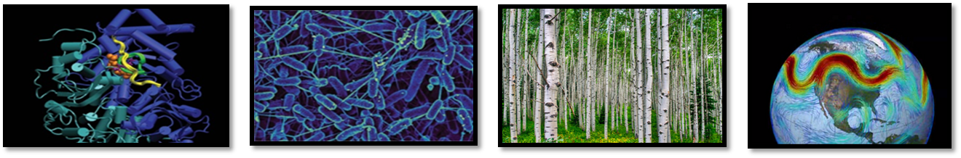
Biological and Environmental Research
Understanding complex biological and environmental systems
Genomic sciences supports recompeted Bioenergy Research Centers at reduced levels, microbiome research, and efforts in biosystems design for bioenergy and renewable bioproducts.
Mesoscale-to-molecules research supports the development of enabling technology to visualize key metabolic processes in plant and microbial cells at the subcellular and mesoscale, including new efforts in cryo-EM.
Atmospheric System Research supports research to advance the understanding of cloud-aerosol-precipitation interactions to improve dynamic earth system models.
Environmental and Earth System Modeling supports development of physical, chemical, and biological model components physical, chemical, and biological model components, as well as fully coupled Earth system models to simulate climate variability at regional and global scales.
Environmental System Science supports research to provide a robust, predictive understanding of terrestrial surface and subsurface ecosystems. Supports the Next Generation Ecosystem Experiment in the Arctic, targeting a terrestrial ecosystem not well represented in earth system models.
User facilities operate at reduced levels: ARM continues measurements at two fixed sites: North Slope, Alaska and Southern Great Plains, Oklahoma; one mobile facility deploys to the Southern Ocean. JGI provides genome sequence data, synthesis, and analysis. EMSL focuses on molecular scale analysis for biological and environmental samples.

Slide 19
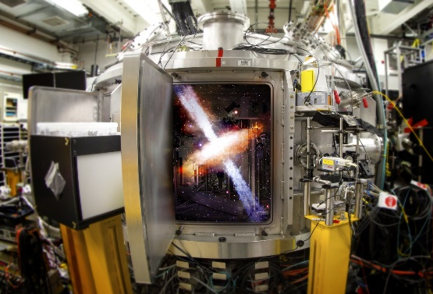
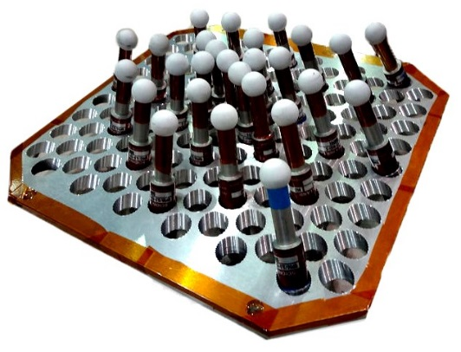
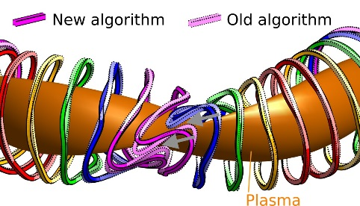
Fusion Energy Sciences
Matter at very high temperatures and densities and the scientific foundations for fusion
DIII-D will operate for 18 weeks and focus on high priority research
NSTX-U is down for repair. Scientists will analyze previous data, support recovery, and perform collaborative research on other tokamaks
Support increases for Scientific Discovery through Advanced Computing activities
Support is maintained for U.S. research involvement on international machines EAST (China), KSTAR (Korea), and W7-X (Germany)
Materials and Fusion Nuclear Science research will focus on high priority research
HEDLP research is will focus on the MEC instrument at LCLS
General Plasma Science activities will continue, including the partnership with NSF
The Request supports the U.S. Contributions to ITER Project
Performing astrophysics experiments in the lab (MEC / SLAC)
New γ-ray camera in DIII-D to detect ultra high energy electrons
Atomistic modeling of H-He synergies in tungsten
Advanced simulations lead to optimized stellarator coils

Slide 20
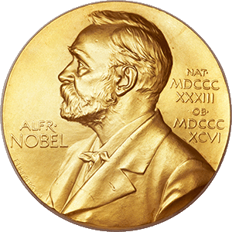
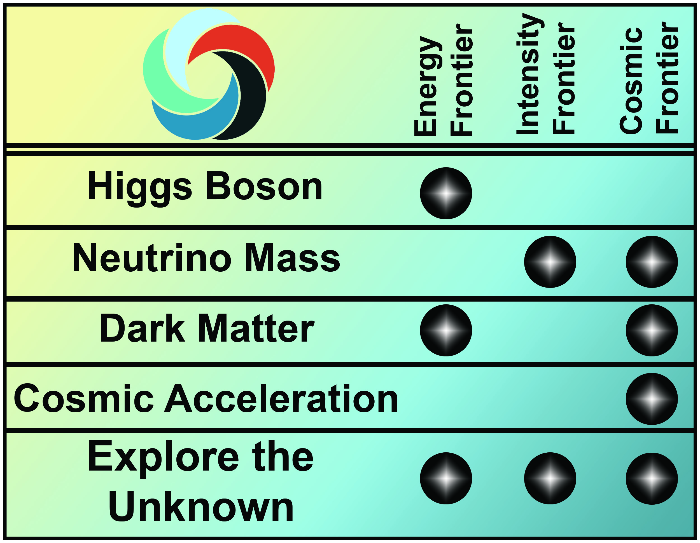

High Energy Physics
Understanding how the universe works at its most fundamental level
The HEP mission is to understand how our universe works at its most fundamental level:
  Discover the most elementary constituents of matter and energy
  Probe the interactions between them
  Explore the basic nature of space and time
In May 2014 the Particle Physics Project Prioritization Panel (P5) released a report presenting an actionable long-term strategy for U.S. particle physics that enables discovery and maintains the U.S. position as a global leader in particle physics.
  The P5 report identified five intertwined science drivers, compelling lines of inquiry that show great promise for discovery:
    Use the Higgs boson as a new tool for discovery
    Pursue the physics associated with neutrino mass
    Identify the new physics of dark matter
    Understand cosmic acceleration: dark energy
    and inflation
    Explore the unknown: new particles,
    interactions, and physical principles
Science drivers identify the scientific motivation while the Energy, Intensity, and Cosmic Research Frontiers provide a useful categorization of experimental techniques

Slide 21
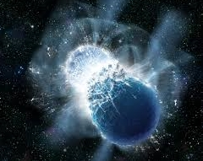
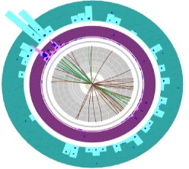
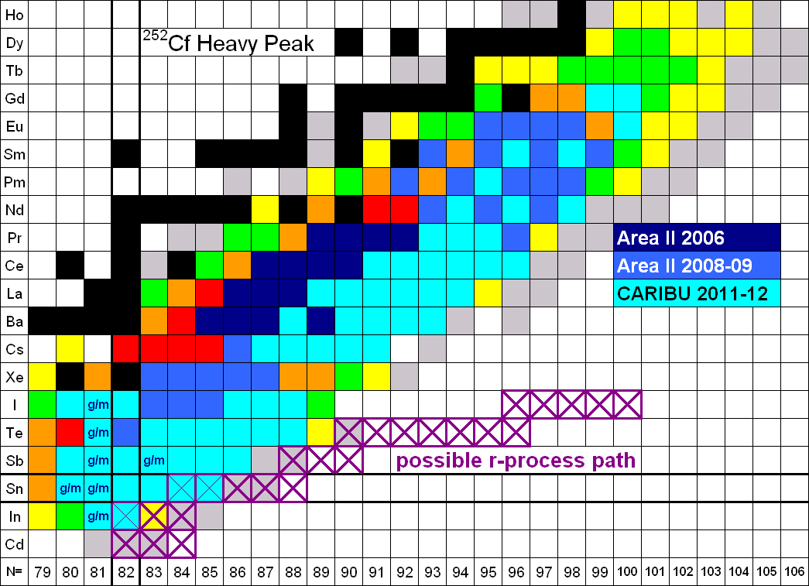
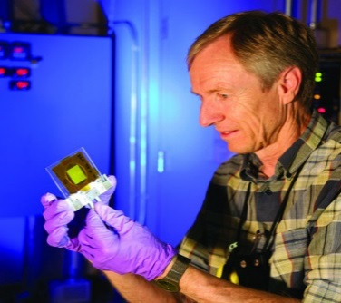
Nuclear Physics
Discovering, exploring, and understanding all forms of nuclear matter
      Decreased funding for research focuses resources on the most critical areas of nuclear science research
      Operations at RHIC will be supported for ten weeks in FY 2018. Beam time in FY 2018 will be combined with planned operation in FY 2019 to explore the properties of the quark gluon plasma first discovered there and to enable studies of spin physics
The 12 GeV CEBAF Upgrade, completed in FY 2017, will begin its scientific program with a ten week run, promising new discoveries and an improved understanding of quark confinement.
Operations at ATLAS are supported, continuing to provide high-quality beams of all the stable elements up to uranium as well as selected beams of short-lived nuclei.
Construction will continue on the Facility for Rare Isotope Beams following a rebaseline of the project reflecting reduced construction funding in FY 2018. Funding for the Gamma-Ray Energy Tracking Array (GRETA) MIE is continued to exploit the scientific potential of FRIB.
Fabrication continues on the Stable Isotope Production Facility (SIPF) to produce enriched stable isotopes, a capability not available in the U.S. for almost 20 years.

Slide 22
FY 2018 Construction Projects
 | (dollars in millions)
 | FY 2016 Current w/ SBIR/STTR | FY 2017 Enacted | FY 2018 President's Request
Ongoing Projects:
BES - 13-SC-10 Linac Coherent Light Source II (LCLS-II), SLAC | 200.3 | 190.0 | 182.1
FES - 14-SC-60 U.S. Contributions to International Thermonuclear Experimental Research (ITER) | 115.0 | 50.0 | 63.0
HEP - 11-SC-40 Long Baseline Neutrino Facility/Deep Underground Neutrino Experiment (LBNF/DUNE) | 26.0 | 50.0 | 54.9
HEP - 11-SC-41 Muon to Electron Conversion Experiment (Mu2e) | 40.1 | 43.5 | 44.4
NP - 14-SC-50 Facility for Rare Isotope Beams (FRIB), Michigan State University | 100.0 | 100.0 | 80.0
SLI - 15-SC-76 Materials Design Laboratory at ANL | 23.9 | 19.6 | 24.5
SLI - 15-SC-78 Integrative Genomics Building at LBNL | 20.0 | 19.6 | 24.8
SLI - 17-SC-71 Integrated Engineering Research Center at FNAL | … | 2.5 | 1.5
SLI - 17-SC-73 Core Facility Revitalization at BNL | … | 1.8 | 1.5
Total, Ongoing Projects | 525.3 | 477.0 | 476.7
New Starts in FY 2018:
BES - 18-SC-10 Advanced Proton Source (APS) Upgrade, ANL* | … | … | 20.0
SLI - 18-SC-71 Energy Sciences Capability, PNNL | … | … | 1.0
Total, New Starts in FY 2018 | … | … | 21.0
Total, Construction | 525.3 | 477.0 | 497.7
*converts from MIE to Line-Item Construction

Slide 23
FY 2018 MIE Projects
 | (dollars in millions)
 | FY 2016 Current w/ SBIR/STTR | FY 2017 Enacted | FY 2018 President's Request
Ongoing Projects:
BES - Advanced Photon Source Upgrade (APS-U), ANL* | 20.0 | 42.5 | …
HEP - Large Synoptic Survey Telescope camera (LSSTcam) | 40.8 | 45.0 | 9.8
HEP - Dark Energy Spectroscopic Instrument (DESI) | 9.8 | 12.0 | 1.9
HEP - Facility for Advanced Accelerator Experimental Tests (FACET-II) | … | 0.5 | 2.0
HEP - Large Underground Xenon (LUX) - ZonEd Proportional scintillation in Liquid Noble gases (ZEPLIN) experiment (LZ) | 10.5 | 12.5 | 14.1
HEP - Super Cryogenic Dark Matter Search at Sudbury Neutrino Observatory Laboratory (SuperCDMS-SNOLab) | 2.4 | 3.4 | 2.0
NP - Gamma-Ray Energy Tracking Array (GRETA) | … | 0.7 | 0.2
NP - Stable Isotope Production Facility (SIPF) | … | 2.5 | 1.5
Total, Ongoing Projects | 83.5 | 119.1 | 31.5
New Starts in FY 2018:
HEP - High Luminosity Large Hadron Collider Accelerator Upgrade Project (HL-LHC AUP) | … | … | 27.0
Total, MIEs | 83.5 | 119.1 | 58.5
*converts from MIE to Line-Item Construction

