Slide 1
Chemical Sciences, Geosciences, and Biosciences Division:
Strategic Planning Process & Progress
Briefing to BESAC
March 23, 2018
Bruce Garrett
CSGB Division Director

Slide 2
Strategic planning activities address major recommendations from Committee of Visitors for CSGB Division
2014 COV recommends “that BES execute a strategic planning session at the division level to evaluate current directions and identify new opportunities and synergies. This type of strategic planning will facilitate communication and collaboration among the programs …”
2017 The COV “commends CSGB’s initial implementation of strategic planning and encourages broadening the scope to identify synergies and new research opportunities among various CSGB teams and with other BES divisions.

Slide 3
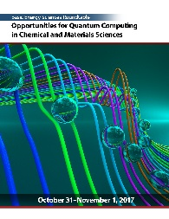
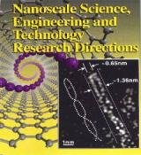
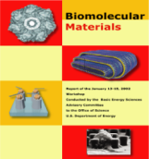
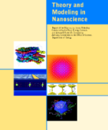
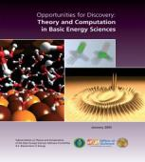
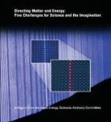
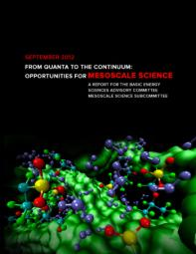

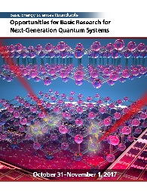
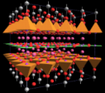
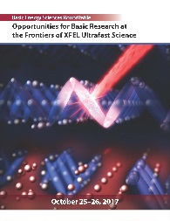

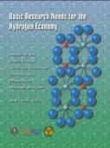



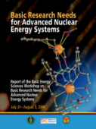
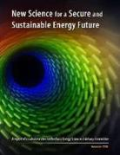
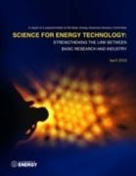
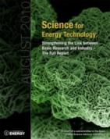
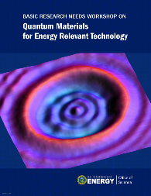
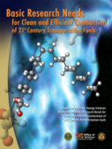
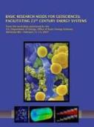
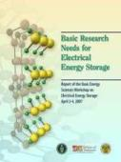
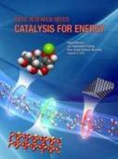
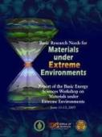
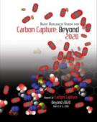
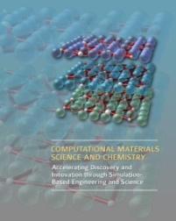
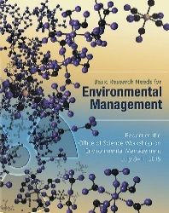
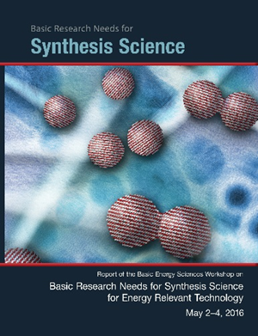
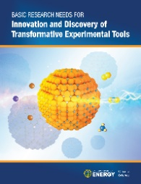
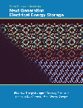


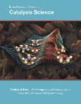

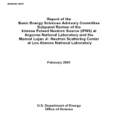
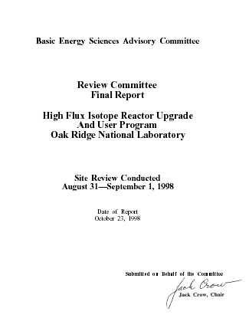
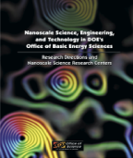
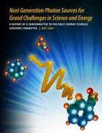
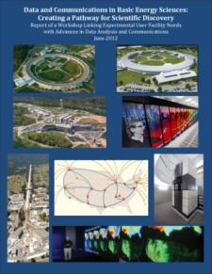
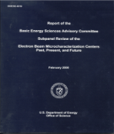
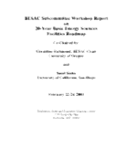


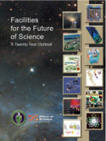

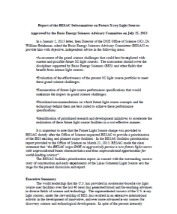
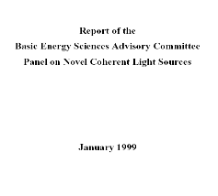

BES strategic planning activities provide the foundation for the CSGB strategy
Science for Discovery
Complex
Systems
Science for National Needs
National Scientific User Facilities, the 21st century tools of science
BESAC Future Light Sources
2013
BESAC Report on Facility Upgrades
2016
https://science.energy.gov/bes/community-resources/reports/
Notes:
3

Slide 4

BES/CSGB strategic planning driven by mission/vision/goals
Mission: BES/CSGB research focus is on gaining understanding leading to control of chemical transformations and energy flow, which provides foundations for new technologies to generate, store, and use energy and to mitigate its environmental impact
Vision: Recognition of BES/CSGB for impact of scientific programs that are at the forefront of chemical sciences, geosciences and biosciences and advance DOE missions
Goals:
  Balance and synergy of discovery and use-inspired
  fundamental research
    Advance ability to understand, predict, and ultimately
    control matter and energy
    Surmount scientific barriers to advancing technologies
  Innovative management of science portfolios
    Provide focus on key and evolving scientific challenges
    Maintain balance and health of university and lab programs;
    demonstrate the value and distinction of both

Slide 5
Strategic planning is essential to maintain health of the division’s research portfolio
Community input is critical to division strategic planning
BESAC reports
BRN workshops
Roundtables
National Academy studies
(Separations Science)
Chemical Science Roundtable workshops
(Data Science: Opportunities for Chemistry)
CSGB Council workshops
(Coherence in Chem/Bio, Nature 543, 647, 2017)
Program Discussions
(PI meetings)
Scientific Meetings
(ACS Fed Funders)
Interagency Interactions
(e.g., EERE, FE, etc.)
Strategic planning process engages multiple levels
Division:
Plan/Execute
Teams:
Analyze/Integrate
Programs
Assess: programs, opportunities, and capabilities

Slide 6






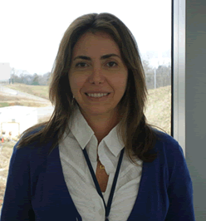









Chemical Sciences, Geosciences and
Biosciences Division
Bruce Garrett, Division Director
Fundamental Interactions
Team
Photochemistry and Biochemistry Team
Chemical Transformations Team
Team Lead – Jeff Krause
Team Lead – Gail McLean
Team Lead – Raul Miranda
Atomic, Molecular, and Optical Sciences
Photosynthetic Systems
Catalysis Science
Tom Settersten
Stephen Herbert
Viviane Schwartz
Chris Bradley
Gas Phase Chemical Physics
Physical Biosciences
Separation Science
PM vacancy
Wade Sisk
Robert Stack
Chuck Peden
Condensed Phase and Interfacial Molecular Science
Solar
Photo-
chemistry
PM vacancy
Heavy
Element Chemistry
Philip Wilk
Gregory Fiechtner
Computational and Theoretical Chemistry
Fuels from Sunlight Energy Innovation Hub
Geosciences
Chris Fecko
Mark Pederson
James Rustad

Slide 7


Photochemistry and Biochemistry Team:
Integrating vision across programs
Program Interactions
Scientific Interactions
λ
λ
BIOCHEMICAL
CHEMICAL
Bio related
EFRCs
Photo-synthetic Systems
Solar
Photo-chemistry
Fuels from Sunlight Hub (JCAP)
&
Solar related EFRCs
Physical Biosciences
Catalysis
AMOS
CTC
Catalysis
AMOS
CTC
CPIMS
Fuel, (bio)chemicals, electricity

Slide 8
Photochemistry and Biochemistry Team:
Integrating vision across programs
Scientific Interactions
λ
λ
BIOCHEMICAL
CHEMICAL
Bio related
EFRCs
Biological Energy Capture & Conversion
Chemical
Solar
Energy
Capture & Conversion
Fuels from Sunlight Hub (JCAP)
&
Solar related EFRCs
Biological Energy Conversion & Storage
Catalysis
Ultrafast sci.
Theory/comp.
Catalysis
Ultrafast sci.
Theory/comp.
Interfacial proc.
Fuel, (bio)chemicals, electricity

Slide 9
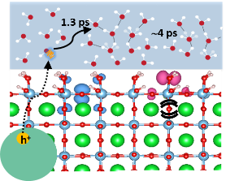
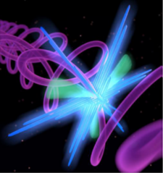
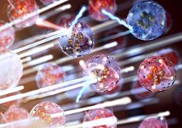
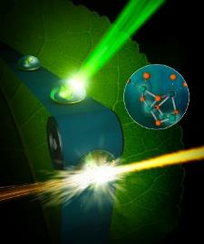
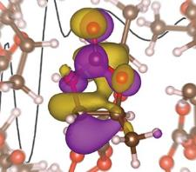
Our strategic focus is on 5 synergistic research areas at the intersection of CSGB programs
Ultrafast chemistry:
Probe dynamics of electrons, understand energy flow, elucidate structural dynamics
Chemistry at complex interfaces:
Uncover emergent chemical phenomena at dynamic interfaces with structural and functional heterogeneity
Charge transport and reactivity:
Elucidate contributions of charge dynamics to energy flow and its coupling to reactions
Reaction pathways in diverse environments:
Discover the influence of nonequilibrium, heterogeneous, nanoscale environments on complex reaction mechanisms
Chemistry in aqueous environments:
Address unique properties of water in extreme environments and its role in chemical phenomena
Elucidating charge transfer and reaction at oxide-water interface
Manipulating x-rays with visible light
Understanding intense
x-ray–electron interactions
Elucidating
water-splitting by Photosystem II
Modeling interactions of ions in solution

Slide 10
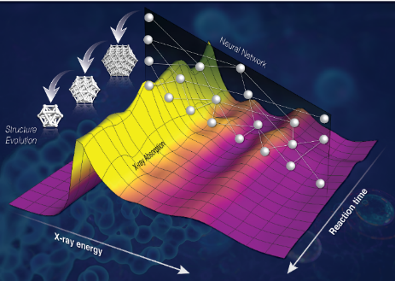
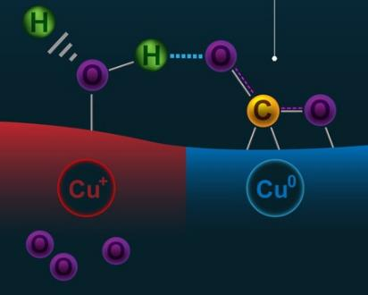
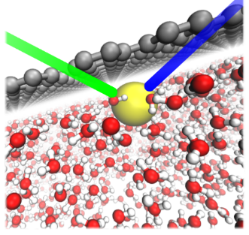
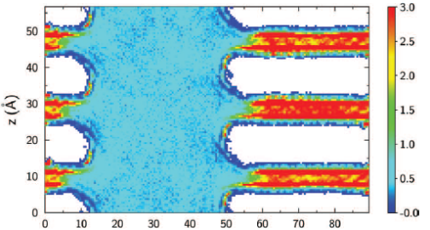
Chemistry at Complex Interfaces
Catalysis: Solving the structure
of nanoparticles during reaction
JCAP: Revealing subsurface oxide is critical for CO₂ activation on Cu
Solar Photo: Understanding surface recombination dynamics
Separations: Simulating ion gating to dynamically control gas separation
Geosci: Understanding ion exclusion in small pores of clay minerals
CPIMS: Unraveling mechanism of ion adsorption to aqueous interfaces

Slide 11
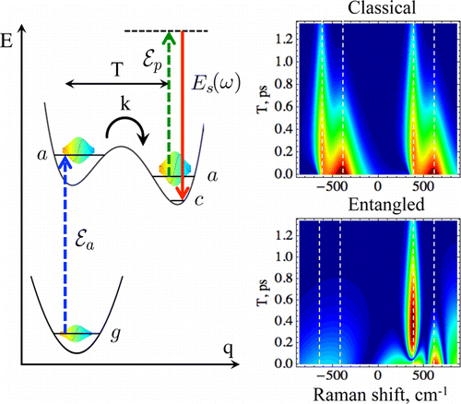
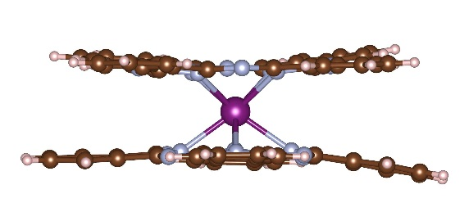

Quantum Information Science
Understand, control & exploit novel quantum behaviors
Opportunities for chemical sciences to advance QIS
  Design and create tunable qubits
  Develop probes such as nonlinear, ultrafast x-ray spectroscopies of quantum phenomena
  Contribute understanding of fundamental principles of quantum phenomena, ultimately leading to ‘quantum control’
Opportunities to exploit QIS for chemical sciences:
  Quantum sensing of chemical processes (e.g., coherence in photosynthesis)
  Quantum computing (“Chemistry is quantum computing’s killer app” C&E News (Oct 30, 2017)
Ab initio design of molecular magnets – Tb(phthalocyanine)₂ (Barnes, Mayhall, Park, Economou)
JACS 134, 12430, 2012
(Kobr, Gardner, Smeigh, Dyar,
Karlen, Carmieli, Wasielewski)
JPC Lett, 5, 2843, 2014
(Dorfman, Schlawin, Mukamel)

Slide 12


Opportunities in Data Science for Knowledge Discovery
Recognition of data science needs
  CSR workshop identified the need to move beyond prediction to develop understanding that can constrain data models
  Catalysis BRN identify coupled data science, theory and experiment as a priority research direction: “caution is warranted when data science methods are applied without sufficient regard for the underlying scientific basis”
Emergence of powerful data analytic tools
J. Phys. Chem. A 121, 8799, 2017
(Changala, Nguyen, Baraban, Ellison, Stanton, Bross, Ruscic)
PNAS 49, 17492, 2014
Dashti, Schwander, Langlois, Fung, Li, Hosseinizadeh, Liao, Pallesen, Sharma, Stupina, Simon, Dinman, Frank, Ourmazd)
PNAS 2017
(Yan, Yu, Suram, Zhou, Shinde, Newhouse, Chen, Li, K. Persson, Gregoire, Neaton)

Slide 13
Comments/Questions?

Slide 14
Backup

Slide 15






Ultrafast Chemistry
AMOS: Revealing ultrafast photo-chemistry with x-ray spectroscopy
GPCP: Tracking an electrocyclic reaction with ultrafast x-ray spectroscopy
AMOS: Probing molecular motion with relativistic electrons
Photosyn: Taking snapshots of water splitting in photo-synthesis using an x-ray free-electron laser
Catalysis: Elucidating intermediate hydrogenation reaction steps by ultrafast laser temperature jump
CPIMS: Resolving strongly mixed intra- and intermolecular character of water vibrations

Slide 16





Charge Transport and Reactivity
CPIMS: Quantifying effect of structural and energetic disorder on charge transport
AMOS: Providing an atomic-scale perspective of ultrafast charge transfer at interfaces
EFRC: Revealing mechanism of energy conservation by electron bifurcation
HEC: Investigating electron transfer in a plutonium material
Geosci: Understanding electron transfer pathways through an iron oxide nanoparticle
Solar Photo: Elucidating proton-coupled electron transfer in a linked chromophore-base-phenol complex

Slide 17

Reactive Pathways in Diverse Environments
Catalysis: Addressing surface reaction network complexity using computational and data science tools
GPCP: Exploring mechanisms for PAH formation in extreme environments
Phys Bio: Understanding plant metabolic pathways for fatty acid synthesis
Catalysis: Developing a strategy to allow a wide variety of tandem reactions that involve incompatible catalytic transformations

Slide 18






Chemistry in Aqueous Environments
CPIMS: Stabilization mechanism of multi-charged metal cations in water
HEC: Chelating and stabilizing tetravalent Berkelium in aqueous solution
CPIMS: Understanding how local electric fields affect water structure
Catalysis: Enhancing the catalytic activity of hydronium ions via constraints
Geosci: Determining pressure dependence of polyborate species in aqueous solution
Phys Bio & Photosyn: Understanding protein-enclosed aqueous environments for CO₂ reduction and other chemistries

