Slide 1
Committee of Visitors (COV) Review of the BES Chemical Sciences, Geosciences, and Biosciences (CSGB) Division
Update for BESAC
March 18, 2011
Eric A. Rohlfing; Director, CSGB Division

Slide 2
History of COVs in SC/BES
The very first COV in SC was the review of the chemical sciences portion of the CSGB division in 2002.
This will be the fourth review for CSGB and the tenth COV review in BES.
All previous COV reports and BES responses can be found at: http://www.science.doe.gov/bes/archives/COVs.html
COVs are now a standard part of BES practice. COV recommendations are taken very seriously by BES and have resulted in substantive changes.
The previous COV of CSGB in 2008 resulted in a single recommendation:
“The COV recommends, in the strongest terms, the rigorous collection of data on all
aspects of proposal solicitation, review, funding recommendation, proposed action and all
metrics associated with progress that can assist in the evaluation of the impact of funded work.”
The response to this recommendation, and similar recommendations for improved information management made by other COVs, has been the development of a new system for SC: Portfolio Analysis and Management System (PAMS).

Slide 3
COV Charge (Standard)
1. For both the DOE laboratory projects and the university projects, assess the efficacy and quality of the processes used to:
  (a) solicit, review, recommend, and document proposal actions and
  (b) monitor active projects and programs.
2. Within the boundaries defined by DOE missions and available funding, comment on how the award process has affected:
  (a) the breadth and depth of portfolio elements, and
  (b) the national and international standing of the portfolio elements.
In addition to the above elements, the panel is asked to provide input for the evaluation of Basic Energy Sciences progress toward the Government Performance and Results Act (GPRA) long-term goals.

Slide 4
GPRA Long-Term Goals for BES
Demonstrate progress in designing, modeling, fabricating, characterizing, analyzing, assembling, and using a variety of new materials and structures, including metals, alloys, ceramics, polymers, biomaterials and more – particularly at the nanoscale – for energy-related applications.
Demonstrate progress in understanding, modeling, and controlling chemical reactivity and energy transfer processes in the gas phase, in solutions, at interfaces, and on surfaces for energy-related applications, employing lessons from inorganic, organic, self-assembling, and biological systems.
Develop new concepts and improve existing methods for major energy research needs identified in the 2003 Basic Energy Sciences Advisory Committee workshop report, Basic Research Needs to Assure a Secure Energy Future.
Demonstrate progress in conceiving, designing, fabricating, and using new instruments to characterize and ultimately control materials.
COV rates each element of the division as Excellent, Good, Fair, Poor, or Not Applicable.

Slide 5
COV Coverage: FY 2008-2010
Covered
  Core research programs, including:
  Base program awards to universities and DOE labs
  Single-Investigator and Small-Group Research (SISGR) program in FY 2009 (companion to EFRCs)
  Renewals of awards made in earlier BES solicitations: Hydrogen Fuel Initiative (HFI), Solar Energy Utilization (SEU), Nanoscale science (NSET), Chemical Imaging (CI)
Not covered
  Energy Frontier Research Centers (FY 2009)
  SC Early Career Awards (FY 2009-2010)
  SC Graduate Fellowship Program (FY 2010)
  BES Equipment Supplement Program (FY 2010)
  Fuels from Sunlight Energy Innovation Hub (FY 2010)

Slide 6
COV Details
Bruce Gates, UC Davis (BESAC, COV 2008), chair.
April 5-8, 2011 at DOE Germantown.
39 COV panelists organized into 7 panels to review the core programs within the division. This represents an increase of one panel relative to previous COVs.
Panelist statistics:
  Academia: 24 Funded by BES: 18
  DOE Lab: 6 Not funded: 21
  Industry: 4
  Other Fed agency/lab: 4 Male: 21
  Other: 1 Female: 18
  6 served on 2008 CSGB COV.
  4 are on BESAC (Gates, Bare, Berrah, Kirby)

Slide 7
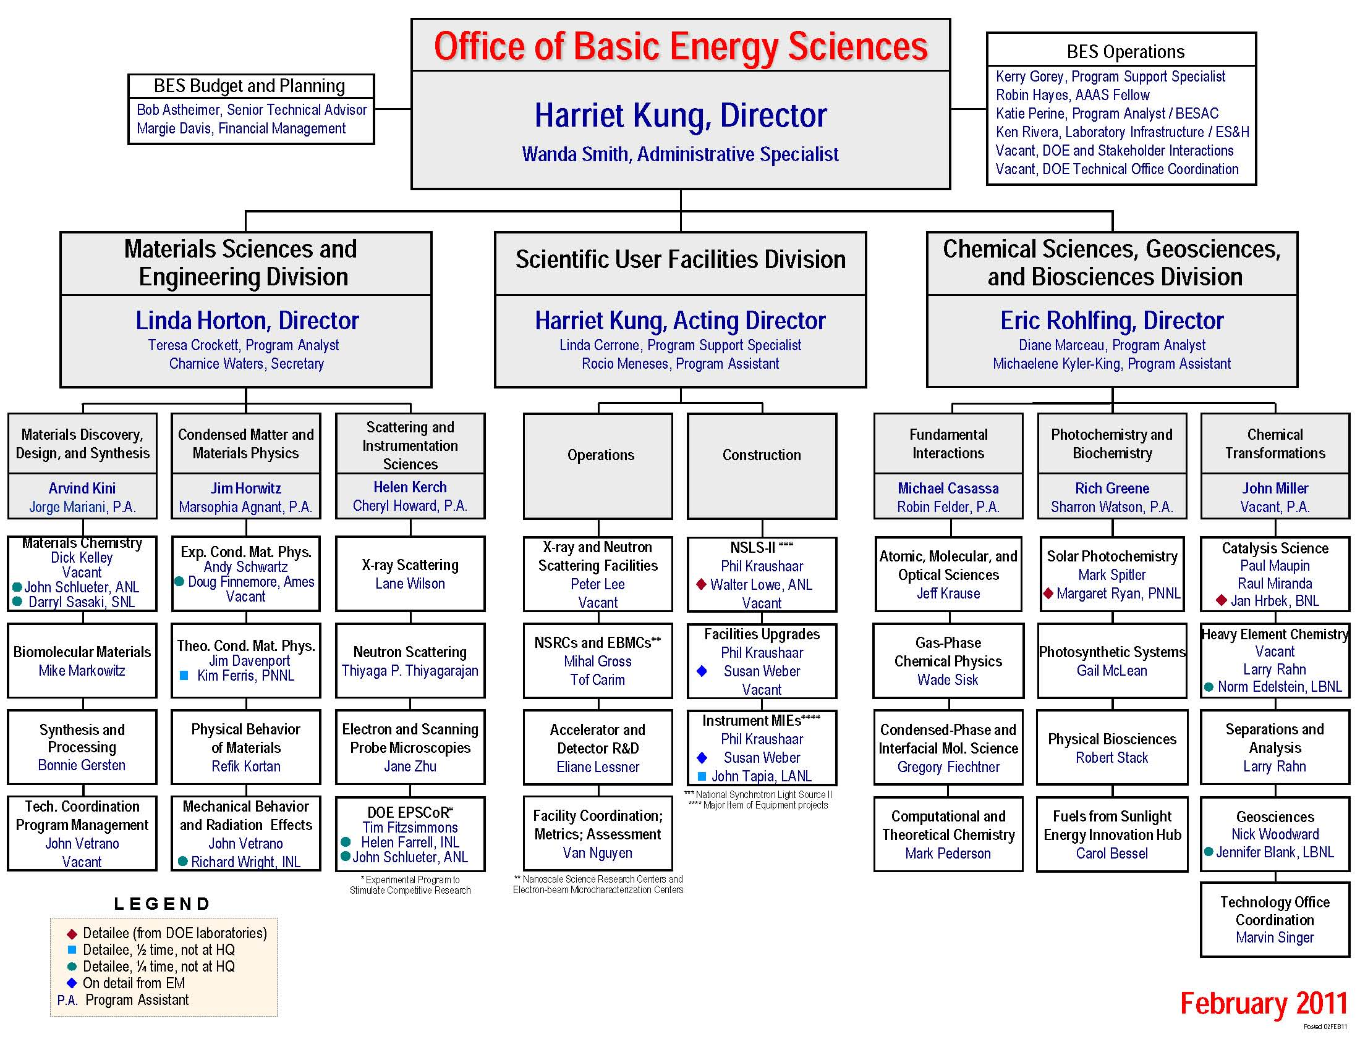
COV Panel Structure
P
Panel 3:
Solar Photochemistry
Panel 1:
AMO Sciences
Panel 5:
Catalysis Science
Panel 6:
HEC/Sep. & Analysis
Panel 2:
Chemical Physics
Panel 7:
Geosciences
Panel 4:
Biosciences

Slide 8
Panel Structure and Membership
Panel 1: AMO Sciences
Tom Gallagher, University of Virginia (Lead, COV 2008)
Kate Kirby, American Physical Society (BESAC)
Nora Berrah, Western Michigan University (BESAC)
Ron Phaneuf, University of Nevada, Reno
Nick Bigelow, University of Rochester
Panel 2: Chemical Physics
Veronica Vaida, University of Colorado (Lead)
Arthur Suits, Wayne State University (COV 2008)
Anne McCoy, Ohio State University
Hope Michelsen, Sandia National Laboratories
Ian Harrison, University of Virginia
Panel 3: Solar Photochemistry
Ben Schwartz, UCLA (Lead)
Dave Carlson, BP Solar
Victor Batista, Yale University
Jeanne Pemberton, University of Arizona
Lin Chen, Argonne National Laboratory
Matthew Platz, NSF/Ohio State University

Slide 9
Panel Structure and Membership
Panel 4: Biosciences
Kay Simmons, USDA (Lead, COV 2008)
John Shanklin, Brookhaven National Laboratory (COV 2008)
Carrie Harwood, University of Washington
Cristina Ubach, Monsanto
Julie-Maupin Furlow, University of Florida
Panel 5: Catalysis Science
Mark Barteau, University of Delaware (Lead)
Simon Bare, UOP (BESAC, COV 2008)
Susannah Scott, UCSB
Nora Radu, DuPont
Anne Chaka, NIST
Tom Baker, University of Ottawa
Panel 6: Heavy Element Chemistry/Separations & Analysis
Rod Ewing, University of Michigan (Lead)
Laetitia Delmau, Oak Ridge National Laboratory
Lloyd Smith, University of Wisconsin
Gordon Jarvinen, Los Alamos National Laboratory
Laura Gagliardi, University of Minnesota
Panel 7: Geosciences
John Valley, University of Wisconsin (Lead)
Neil Sturchio, Univ. of Illinois, Chicago
Patricia Maurice, Univ. of Notre Dame
Kevin Rosso, Pacific Northwest Nat. Lab
Katherine McCall, Univ. of Nevada, Reno

Slide 10
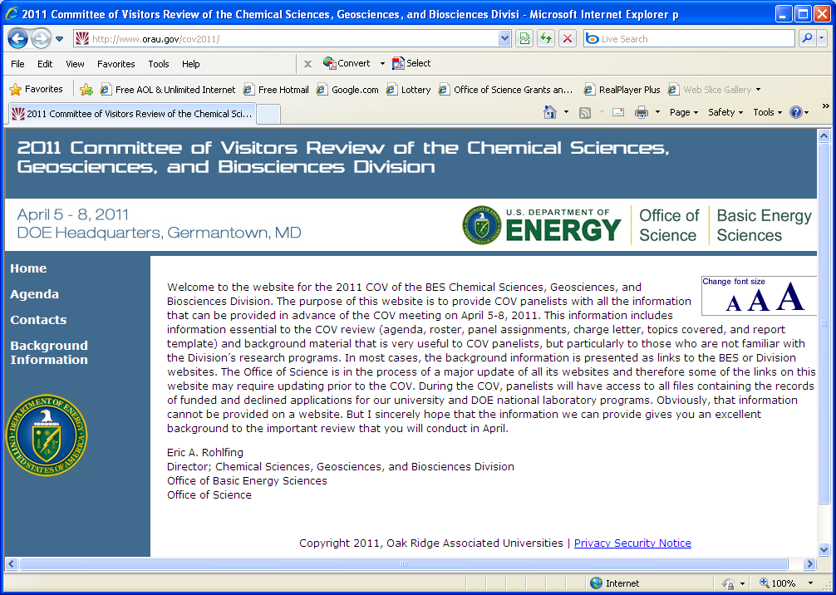
COV Preparations
Chair visited the division on Dec. 14, 2010.
  Met with division director, team leads, program managers.
  Helped inform chair of division’s programs and set agenda for COV.
Conference calls – chair, panel leads, division director, and team leads.
  After initial COV recruitment to explain roles and responsibilities of panel leads.
  Prior to COV (March 22) to go over agenda, discuss process, and address concerns.
COV Website:
  Provides read ahead materials for COV panelists

Slide 11
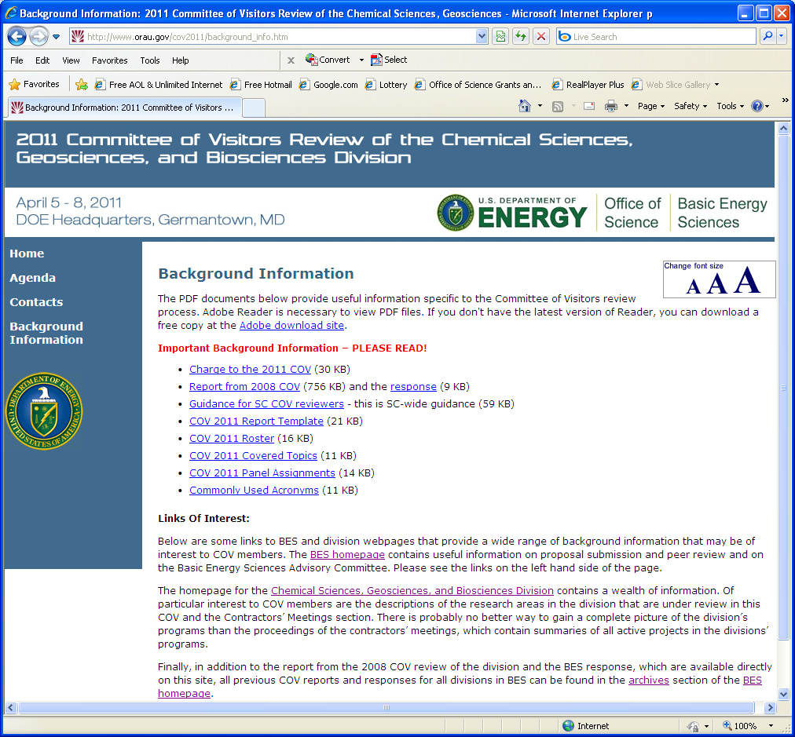
COV Website – Background Information

Slide 12
COV Agenda
Wednesday, April 6, 2011
Time | Activity | Committee Members | Division Staff | Location
8:30 AM | Welcome and Charge to the Committee | All | John Hemminger, Chair Basic Energy Sciences Advisory Committee | A-410
8:40 AM | Overview of Basic Energy Sciences | All | Harriet Kung, Director Office of Basic Energy Sciences | A-410
9:00 AM | Overview of the Chemical Sciences, Geosciences, and Biosciences Division | All | Eric Rohlfing, Director Chemical Sciences, Geosciences, and Biosciences Division | A-410
9:30 AM | Update on the SC Portfolio Analysis and Management System (PAMS) | All | Linda Blevins, Office of Science | A-410
9:50 AM | Review Procedures | All | Rich Greene, Team Lead, Photo- and Biochemistry | A-410
10:15 AM | Instructions and schedule | All | Bruce Gates, Chair Committee of Visitors | A-410
10:30 AM | Break and disperse to panel rooms
10:45 AM | First Read Panels 1-7 | First-Read Panel Members | CSGB Team Lead and Program Manager(s) | Panel Rooms
12:30 PM | Lunch | All | All | A-410
 | Resume First Read Panels | Panels |  | Panel Rooms
4:00 PM | Preliminary Report Drafting – Key Elements and Gaps | Panels |  | Panel Rooms
5:00 PM | Meeting between Panel Leads and Chair | Panel Leads and Chair |  | A-410
5:30 PM | Meeting with Chair and BES Senior Management | Chair | Harriet Kung, Eric Rohlfing | A-410

Slide 13
Team Structure in CSGB
Molecular mechanisms of light capture and its conversion to chemical and electrical energy via chemical and biochemical pathways
Application of physical science tools to biochemical systems
Photo- and Biochemistry
Biomimetic catalytic systems
Structural and dynamical studies of atoms, molecules, and nanostructures; description of their interactions with external stimuli (photons, electrons) at full quantum detail
Fundamental
Interactions
Chemical
Transformations
Characterization, control, and optimization of chemical transformations, from catalysis to geochemistry
Interfacial nanoscale chemistry
Division-wide themes: chemical imaging; ultrafast chemical sciences; nanoscale science; interfacial science; theory, modeling, & simulation (including computation); synthesis

Slide 14
COV Agenda, cont’d.
Thursday, April 7, 2011
Time | Activity | Committee Members | Division Staff | Location
8:30 AM | Fundamental Interactions Team Session | Panels 1 & 2 | Team Lead and Program Managers | E-401
8:30 AM | Photo- and Biochemistry Team Session | Panels 3 & 4 | Team Lead and Program Managers | G-426
8:30 AM | Chemical Transformations Team Session | Panels 5,6, & 7 | Team Lead and Program Managers | E-301
9:15 AM | Complete First Read Panel Reports | Panels |  | Panel Rooms
11:15 AM | COV Executive Session Reports from Panel Leads on First Read | All |  | A-410
12:30 PM | Lunch | All |  | A-410
1:30 PM | Second Read Panels 1-7 | Second-Read Panel Members | Team Lead and Program Manager(s) | Panel Rooms
4:00 PM | Merge First and Second Read Input Finalize Draft Panel Reports | First Read Panels |  | Panel Rooms
Friday, April 8, 2011
Time | Activity | Committee Members | Division Staff | Location
8:30 AM | COV Executive Session | All |  | A-410
9:15 AM | Closeout Session with COV and BES Senior Management | All | Harriet Kung, Eric Rohlfing | A-410
10:00 AM | Closeout Session with COV and BES Staff | All | All | A-410
10:45 AM | COV Chair meets with Panel Leads | COV Chair Panel Leads |  | A-410

