Slide 1
Update from the Office of Science
Basic Energy Sciences Advisory committee
August 5, 2010
Dr. W. F. Brinkman
Director, Office of Science
U.S. Department of Energy
www.science.doe.gov

Slide 2
The Administration’s S&T Priorities for the FY 2011 Budget
“When we fail to invest in research, we fail to invest in the future. Yet, since the peak of the space race in the 1960s, our national commitment to research and development has steadily fallen as a share of our national income. That’s why I set a goal of putting a full 3 percent of our Gross Domestic Product, our national income, into research and development, surpassing the commitment we made when President Kennedy challenged this nation to send a man to the moon.”
President Barack Obama
September 21, 2009
http://www.whitehouse.gov/the_press_office/Remarks-by-the-President-on-Innovation-and-Sustainable-Growth-at-Hudson-Valley-Community-College/

Slide 3

Secretary
Steven Chu
Deputy Secretary
Daniel B. Poneman
Energy R&D Organizations
Under Secretary
for Energy
Kristina Johnson
Under Secretary
for Science
Steven E. Koonin
Office of Science
William Brinkman
Patricia Dehmer
Energy Efficiency & Renewable Energy
Cathy Zoi
Advanced Research Projects Agency – Energy
Arun Majumdar
Basic Energy Sciences
Harriet Kung
High Energy Physics
Dennis Kovar
Fossil Energy
James Markowski
Advanced Scientific Computing Research
Michael Strayer
Nuclear Physics
Tim Hallman
Nuclear Energy
Pete Miller
Biological & Environmental Research
Anna Palmisano
Fusion Energy Sciences
Ed Synakowski
Electricity Delivery
and Energy Reliability
Pat Hoffman (A)
Workforce Development for Teachers & Scientists
Bill Valdez
3
Notes:
3

Slide 4
Status of FY 2011 Budget Request and Appropriations

Slide 5
Office of Science – House Mark
(dollars in Thousands)
 | FY 2010 Approp. | FY 2011 Request | House | House vs. FY 2010 Approp. |  | House vs. Request
SC, Total | 4,903,710 | 5,121,437 | 4,900,000 | -3,710 | -0.1% | -221,437 | -4.3%
No details are available, no vote on bill scheduled
Includes $18,350 in Earmarks.
Approximately the same as FY 2010.
Ensures the United States’ continued global leadership of basic science research and develops the fundamental knowledge necessary for the next generation of energy innovations.
Investments in HEP pushes the edges of scientific knowledge and fosters our nation’s world-leading scientists.
Research in BES, FES, ASCR, NP, and BER build the foundation of knowledge that will enable us to transform our energy sector to be more secure and sustainable.

Slide 6
Office of Science – Senate Mark
(dollars in Thousands)
 | FY 2010 Approp. | FY 2011 Request | Senate | Senate vs. FY 2010 Approp. |  | Senate vs. Request
SC, Total | 4,903,710 | 5,121,437 | 5,012,000 | +108,290 | +2.2% | -109,437 | -2.1%
Includes $40.8M in Earmarks, $11M for Artificial Retina, $15.4M for Nuclear Medicine research, $100M to support EFRCs, $16M for Fuels from Sunlight Energy Innovation Hub, $22M for a new Batteries and Energy Storage Energy Innovation Hub, $35M for EPSCoR, and $5M for Graduate Fellowship.
NP is down $8M from request but has the nuclear medicine added
Funding increase in FY 2011 will support initiatives to advance scientific understanding for new energy technologies.
Concerned about LHC’s planned shutdown; the Federal commitment to nuclear medicine research; cost increases and schedule delays related to the ITER project; and finding that the United States risks losing leadership and competitiveness in material science.

Slide 7
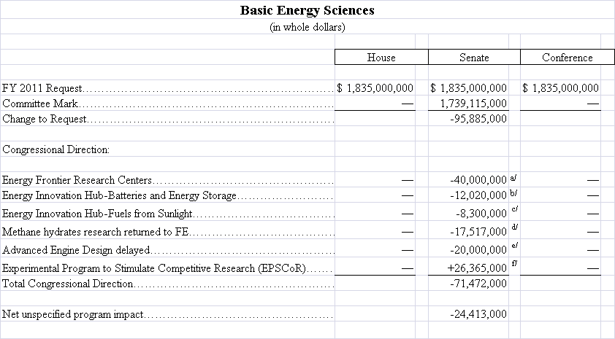
FY 2001 Senate Markup Details for BES
BESAC August 5, 2010

Slide 8
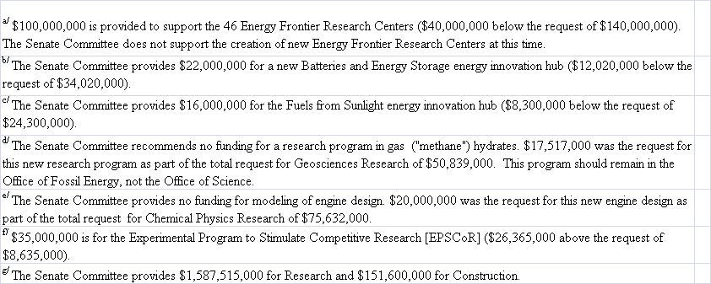
FY 2001 Markup Details for BES
BESAC August 5, 2010

Slide 9
DOE Office of Science Graduate Fellowships
The FY 2011 request doubles the number of graduate fellowships in basic science
$10 million will be available in FY 2011 to fund about 170 additional fellowships
Purpose: To educate and train a skilled scientific and technical workforce in order to stay at the forefront of science and innovation and to meet our energy and environmental challenges
Eligibility:
    Candidates must be U.S. citizens and a senior undergraduate or first or second year graduate student to apply
  Candidates must be pursuing advanced degrees in areas of physics, chemistry, mathematics, biology, computational sciences, areas of climate and environmental sciences important to the Office of Science and DOE mission
Award Size:
  The three-year fellowship award, totaling $50,500 annually, provides support towards tuition, a stipend for living expenses, and support for expenses such as travel to conferences and to DOE user facilities.
FY 2010 Results:
    160 awards will be made this Spring with FY 2010 and American Recovery and Reinvestment Act funds.
  FY 2011 Application Process:
    Funding Opportunity Announcement issued in Fall 2010
    Awards made in March 2011

Slide 10
Office of Science Early Career Research Program
Investment in FY 2011 will bring 60 new scientists into the program
$16 million will be available in FY 2011 to fund about 60 additional Early Career Research Program awards at universities and DOE national laboratories.
Purpose: To support individual research programs of outstanding scientists early in their careers and to stimulate research careers in the disciplines supported by the Office of Science
Eligibility: Within 10 years of receiving a Ph.D., either untenured academic assistant professors on the tenure track or full-time DOE national lab employees
Award Size:
    University grants $150,000 per year for 5 years to cover summer salary and expenses
    National lab awards $500,000 per year for five years to cover full salary and expenses
FY 2010 Results:
    69 awards funded via the American Recovery and Reinvestment Act
    1,750 proposals peer reviewed to select the awardees
    47 university grants and 22 DOE national laboratory awards
    Awardees are from 44 separate institutions in 20 states
  FY 2011 Application Process:
    Funding Opportunity Announcement issued in Spring 2010
    Awards made in the Second Quarter of 2011
http://www.science.doe.gov/SC-2/early_career.htm

Slide 11
Prospects for Solar Fuels Production
What We Can Do Today
Two Limits
Ultimate Goal
solar microcatalytic energy conversion
$12/kg H₂ @ $3/pW PV
(BRN on SEU 2005)
PV cell
High capital costs
Low capital costs
balance of system
current
liquid
electrolyzer
fuel storage
gas
We do not know how to produce solar fuels in a cost effective manner.
Chemists do not yet know how to photoproduce O₂, H₂, reduce CO₂, or oxidize H₂O on the scale we need.
gas
fuel storage
fuel storage
H₂ compression
compression
Notes:
Given that we now have an active FOA out on the Fuels from Sunlight topic, we have decided not to follow the other module example by giving specific research highlight examples. This is to avoid the “perception” of endorsing any specific groups’ efforts. Therefore, the solar fuels slides are essentially laying the case for why we would need a Hub and ending with a Hub FOA slide. Please let me know if you would like us to do something different for this module.

Slide 12
Award of the “Fuel From Sunlight” Hub
Winning team led by Cal Tech and LBNL
Other institutions involved:
  SLAC National Accelerator Laboratory
  Stanford University
  UC Berkeley
  UC Santa Barbara
  UC Irvine
  UC San Diego
Professor Nate Lewis leader
Looking for a factor of 10 over nature
Strong push to integrate processes to form a complete system

Slide 13
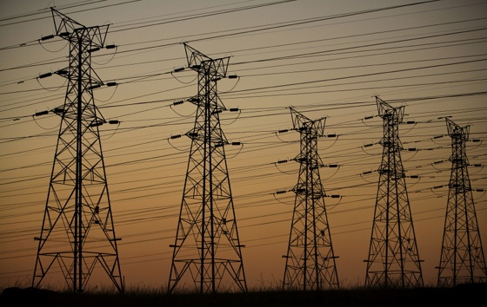

FY 2011 Energy Innovation Hub for Batteries and Energy Storage
Addressing science gaps for both grid and mobile energy storage applications
The Administration’s Energy Plan has two goals that require improvements in the science and technology of energy storage:
Solar and wind providing over 25% of electricity consumed in the U.S. by 2025
1 million all-electric/plug-in hybrid vehicles on the road by 2015
Grid stability and distributed power require innovative energy storage devices
  Grid integration of intermittent energy sources such as wind and solar
  Storage of large amounts of power
  Delivery of significant power rapidly
Enabling widespread utilization of hybrid vehicles requires:
  Substantially higher energy and power densities
  Lower costs
  Faster recharge times
Notes:
Electrical Energy Storage
The projected doubling of world energy consumption within the next 50 years, coupled with the growing demand for low- or even zero-emission sources of energy, has brought increasing awareness of the need for efficient, clean, and renewable energy sources. Energy based on electricity generated from renewable sources, such as solar or wind, offers enormous potential for meeting future energy demands. However, practical use of large scale solar- or wind-based electrical generation requires electrical energy storage (EES) systems to level their cyclic nature. In addition, greatly improved EES systems are needed to replace today’s hybrid electric vehicles with plug-in hybrids or all-electric vehicles.
Fundamental performance limitations of energy storage systems are rooted in the constituent materials making up an EES device, and novel approaches are needed to develop multifunctional EES materials that offer new self-healing, self-regulating, failure-tolerant, impurity-sequestering, and sustainable characteristics. The discovery of novel nanoscale materials with architectures tailored for specific performance offer particularly exciting possibilities for the development of revolutionary three-dimensional architectures that simultaneously optimize ion and electron transport and capacity. New capabilities are also needed to “observe” the dynamic composition and structure at an electrode surface, in real time, during charge transport and transfer processes. New in situ photon- and particle-based microscopic, spectroscopic and scattering techniques with time resolution down to the femtosecond range and spatial resolution spanning the atomic and mesoscopic scales are needed to meet this challenge. Research to formulate a predictive knowledge of structural and functional relationships based upon multiscale integrating theory-based methods at different time and length scales can effectively complement experimental efforts to provide insight into mechanisms, predict trends and identify new materials. With such underpinning knowledge, wholly new concepts in rational materials design can result in EES systems capable of storing higher energy densities with long cycle lifetimes.

Slide 14
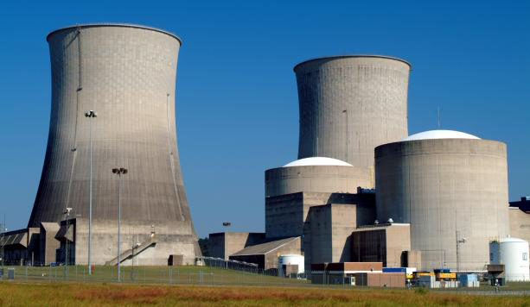
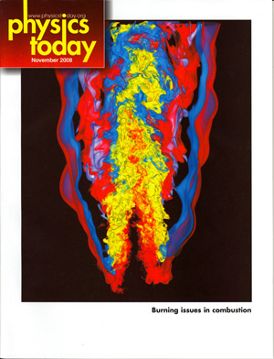
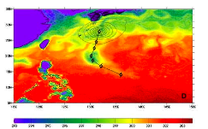
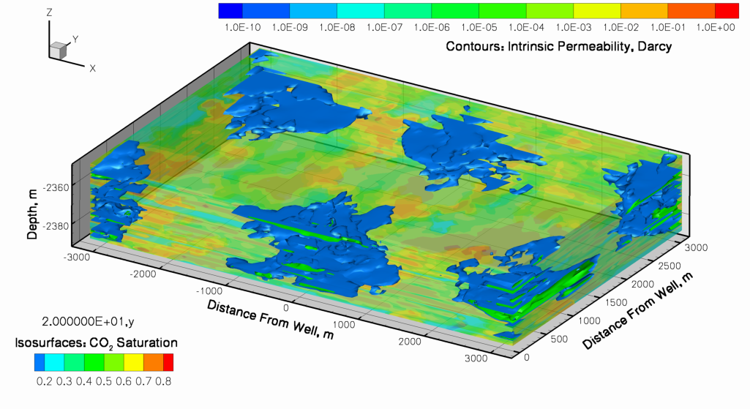
Exascale Initiative
The Goal: “Provide the United States with the next generation of extreme scale computing capability to solve problems of National importance in Energy, the Environment, National Security, and Science”
Why do Exascale?
  Environment
  Energy
  National Security
  Science and Innovation
  American Competitiveness
Geologic sequestration
Massive Earth System Model ensembles
(e.g. decadal forecasts, extreme weather )

Slide 15
Exascale Initiative Major Components
Platform R&D
2 Vendor Tracks
Critical Technologies
(everyone benefits)
Software and Environments
Co-design
Platforms
Memory
Nonvolatile storage
Optics
Power
Integration
Risk Mitigation
Operating environment
Systems Software
System reliability
Programming model
Performance models
Simulators
Applications integration with vendors
Early prototypes to ensure component integration and usefulness
Risk mitigation for vendors – Non recoverable engineering cost
Physics Models
Applied Math
Exascale Initiative

Slide 16
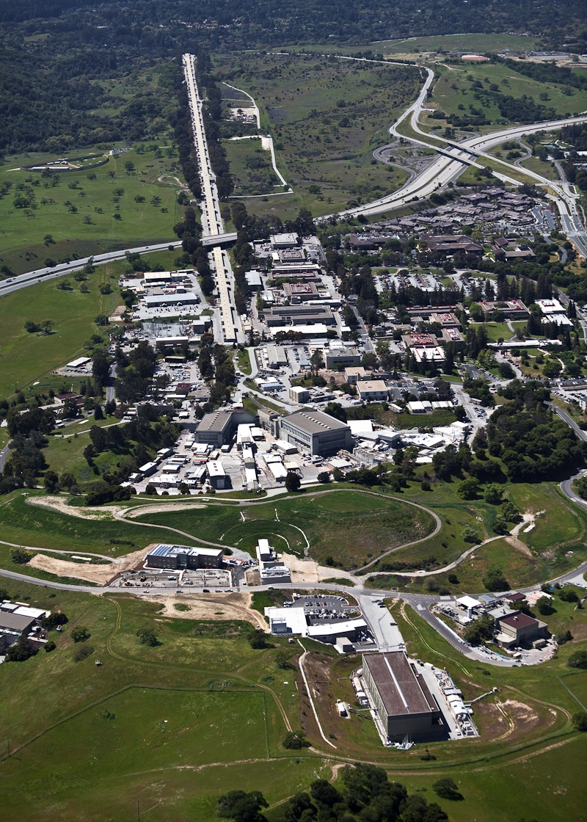
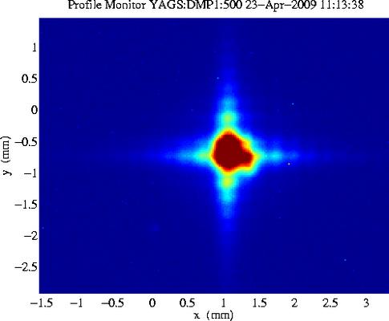
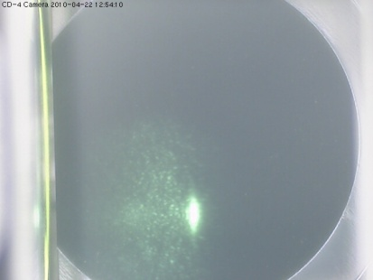
Linac Coherent Light Source or “LCLS” at SLAC
The World’s First X-ray Laser
LCLS uses 1/3 of linac
First X-rays:
~ 1 PM PDT
4/15/2009
electron beam
undulator hall
x-ray production
Detection of
X-ray at Far Hall ~ 1 PM PDT 4/22/2010
near hall
3 experiments
x-ray beam
far hall
3 experiments
Notes:
The LCLS constitutes a revolutionary advance in photon science. It combines the atomic resolution capability of x-rays with the ultrafast capability of conventional lasers. This capability became possible by employing frontier concepts in accelerator physics. High quality electron beams generated in a specially designed gun are accelerated to relativisitic speeds and then compressed to a small volume. When these ultra-small bunches of charge are sent through long precisely engineered magnetic structures called undulators, all electrons in the tiny bunch radiate complete in tune and the generated x-rays are more than a billion times brighter than those produced by the most powerful existing sources. The ultrafast x-ray pulses are used much like flashes from a high-speed strobe light, enabling scientists to take stop-motion pictures of atoms and molecules in motion, shedding light on the fundamental processes of chemistry, technology, and life itself. The first three months of LCLS user assisted commissioning have already shown that the LCLS pulses are intense enough and bright enough to capture images of atomic and electronic events with a “shutter speed” of less than 10 femtoseconds. Molecular movies, revealing the inner workings of the atomic world are now within our reach.
The purpose of the Linac Coherent Light Source (LCLS) Project is to provide laser-like radiation in the x-ray region of the spectrum that is 10 billion times greater in peak brightness than any existing coherent x-ray light source. The LCLS Project will provide the first demonstration of an x-ray Free Electron Laser (XFEL) in the 1.5 - 15 Ångstrom range and will apply these extraordinary, high-brightness x-rays to scientific problems.
Technical Objective: 13 GeV electron energy, 0.2 nano coulomb electron charge, Minimum of 10⁶ photons/(mm² *0.1%BW) X-ray flux density at the Front End Enclosure, ~100,000 ft² conventional facility, 1 instrument installed ready for commissioning.

Slide 17
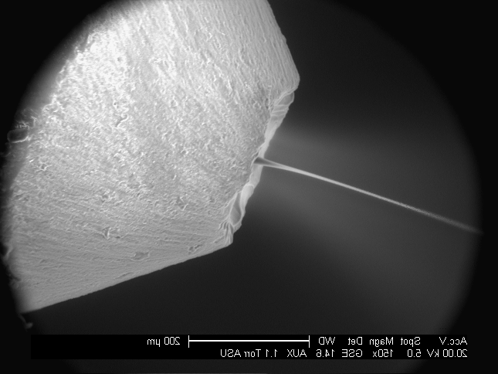
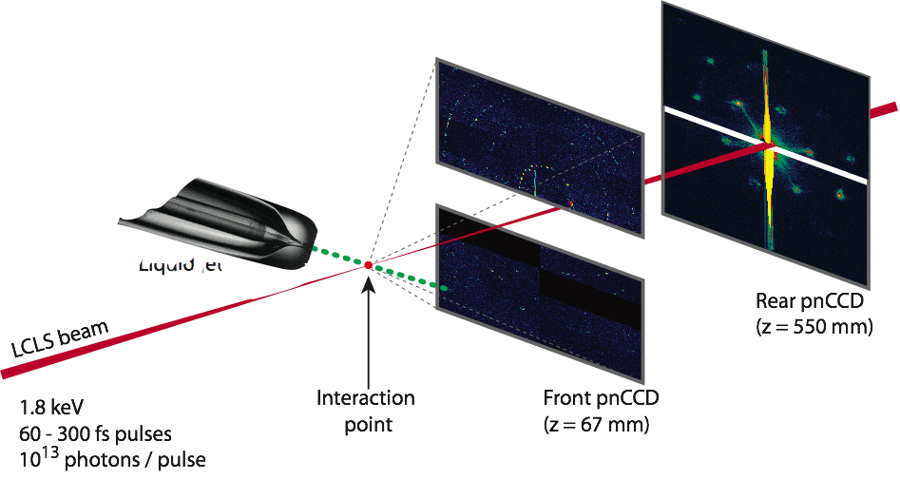
Early Studies at LCLS: Nanocrystals in Water Microjet
John Spence et al. ASU
Spokesperson: Henry Chapman et al.
collaboration of
Center for Free Electron Laser Science DESY
Arizona State University, Max Planck CFEL ASG, SLAC, LLNL, CBST, Uppsala University
Liquid jet
8 cm
Liquid jet
back
detector
at 55cm
x-rays: 7 μm
liquid jet: 4 μm
front
detector
at 7cm

Slide 18
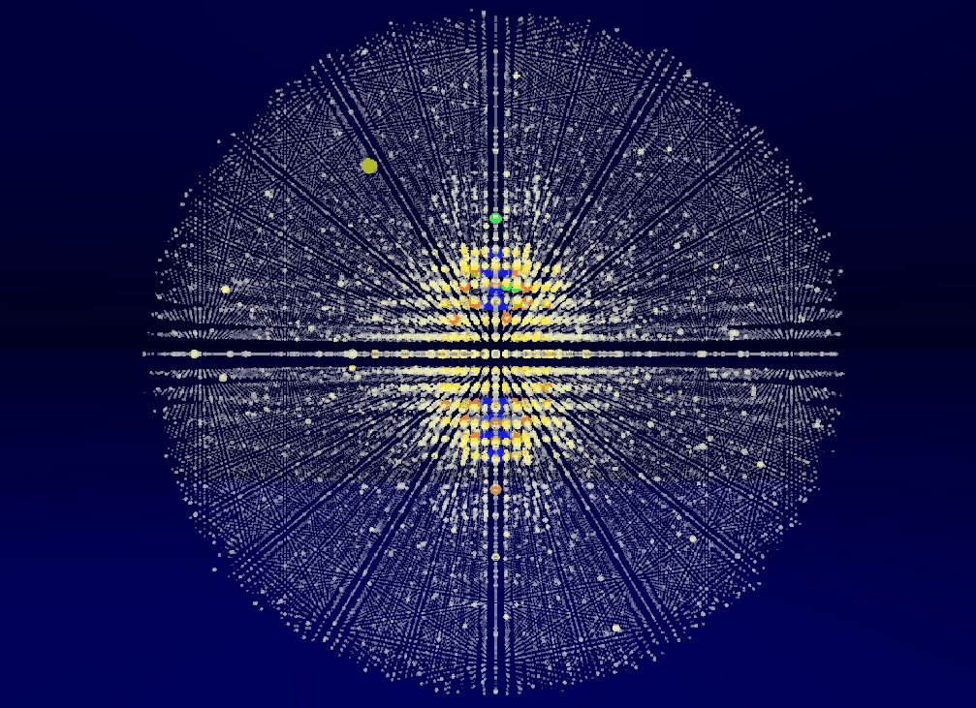
Notes:
Gateway to the Future

Slide 19
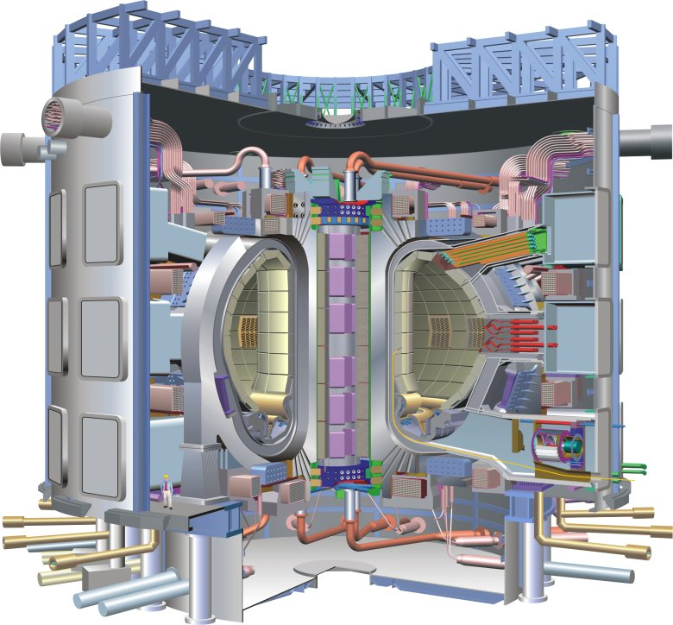
ITER
ITER (Latin for “the way”) is a first of a kind major international research collaboration on fusion energy.
U.S. is a 9.09% partner.
ITER Goals
  Designed to produce 500 MW
  of fusion power (Q > 10)
  for at least 300-500 seconds
  Burning plasma dynamics and control
    - U.S. emphasizes the value of ITER, its flexibility, and its diagnostics as a scientific instrument: develop a predictive capability of the burning plasma state
  Will optimize physics and integrate many of key technologies needed for future
  fusion power plants
The Agreement on the Establishment of the ITER International Fusion Energy Organization for the Joint Implementation of the ITER Project, entered into force in October 2007 for a period of 35 years.
ITER Tokamak – Cross Sectional View

Slide 20
ITER Background
The ITER Organization (IO), located at Cadarache, France, has been established as an independent international legal entity comprised of personnel (~400) from all of the Members.
Like all non-host Members, the U.S. share for ITER’s construction is 1/11th (9.09%) of the total value estimate.
  roughly 80% will be in-kind components manufactured largely by U.S. industry and beyond that, the United States has agreed to fund 13% of the cost for operation, deactivation, and decommissioning.
  At Critical Decision 1 (January 2008), the Total Project Cost (TPC) range for the U.S. share of the Construction Phase was estimated to be $1.45-2.2 B

Slide 21
ITER Status
Over the past year a scope, schedule and cost analysis has been completed.
The EU and Japan agreed that if the EU gained approval for the additional funding they required to allow them to commit to the overall ITER project cost and schedule, the Japanese would agree to a change in the DG position. SC led effort in brokering this agreement and in helping the EU find ways to accelerate their schedule
Dr. Osama Motojima (Japan) is the new DG. He led highly successful LHD stellarator construction (superconducting) and research institution in Japan.
EU funding outlook now positive even amidst overall EU financial chaos. Their delegation is optimistic that EU is poised to commit € 6.6 B.
    Represents a €600M decrease over the previous estimated costs.
    Cost management imperative for all parties. US ITER Project Office (ORNL) undergone Lehman Reviews of project operations (February and July; favorable).
Acceptance of ITER cost, schedule, and baseline, and leadership change occurred in late July Extraordinary Council meeting.

Slide 22
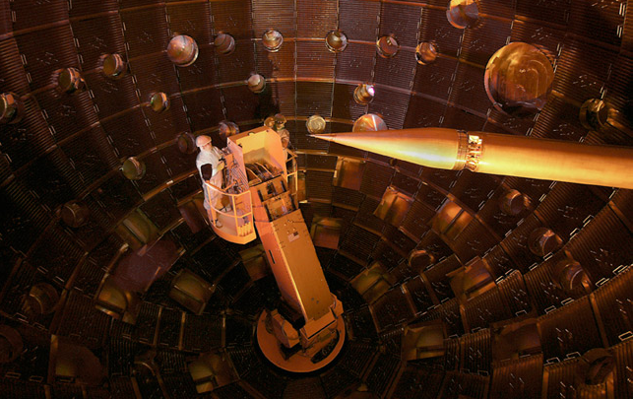
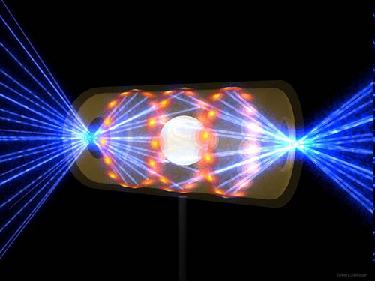
Inertial Fusion Energy: Nearing Ignition
The newly completed National Ignition Facility – the world’s most powerful laser system – recently began full operations
NIF is on track to achieve the first laboratory demonstration of “ignition” or net energy gain
Notes:
Edit down and broader context; add NIF ignition

Slide 23
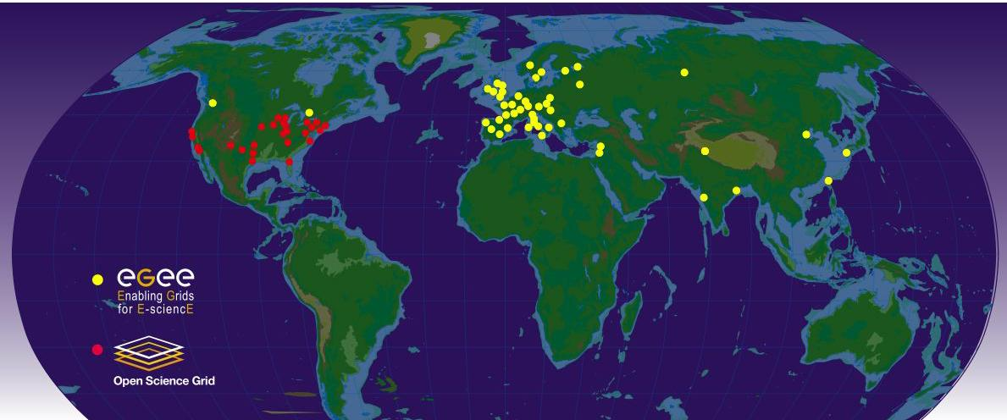
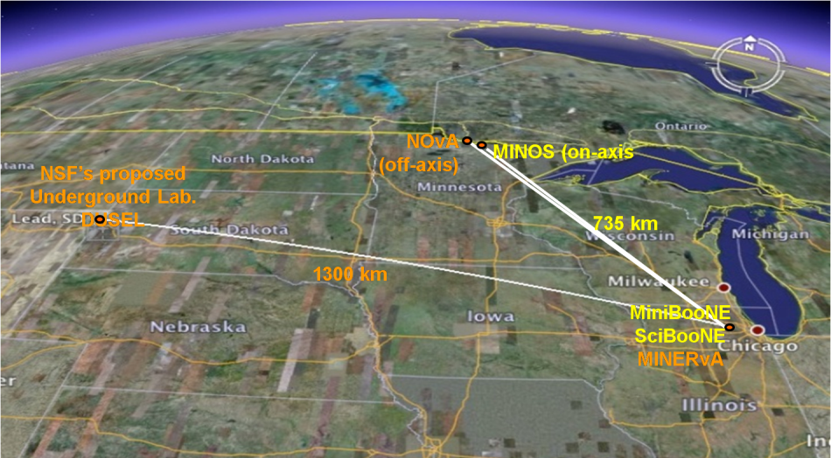
The U.S. High Energy Physics Program
The U.S. is uniquely positioned for a world-leading program in neutrino physics
The U.S. is a critical and strategic partner in global scientific collaborations that push the boundaries of High Energy Physics. The U.S. has developed components for the Large Hadron Collider at CERN and hosts centers for data analysis.
Network sites of the Open Science Grid and Enabling Grids for E-sciencE used for transmitting experimental data from the LHC to scientists worldwide.
At home, HEP builds on its investments in tools and facilities to capture the unique opportunities of neutrino science. These opportunities are fundamental to the science of particle physics.
At the heart of the DOE HEP program is the NuMI beamline at Fermilab, the world’s most intense neutrino source, which serves MINERvA and MINOS and will support NOvA and the proposed LBNE (+$12,000K, HEP, initiated in FY 2011).
The NuMI beamline provides the world’s most intense neutrino beam for the MINOS experiment and proposed NOvA and LBNE experiments
Notes:
Global Map Image sources http://www.interactions.org/cms/?pid=2100&image_no=CE0227
Shows data center sites for LHC
“Google Map” showing trajectory of current and proposed neutrino beamlines from Fermilab, serving MINOS, NOVA, and LBNE

Slide 24
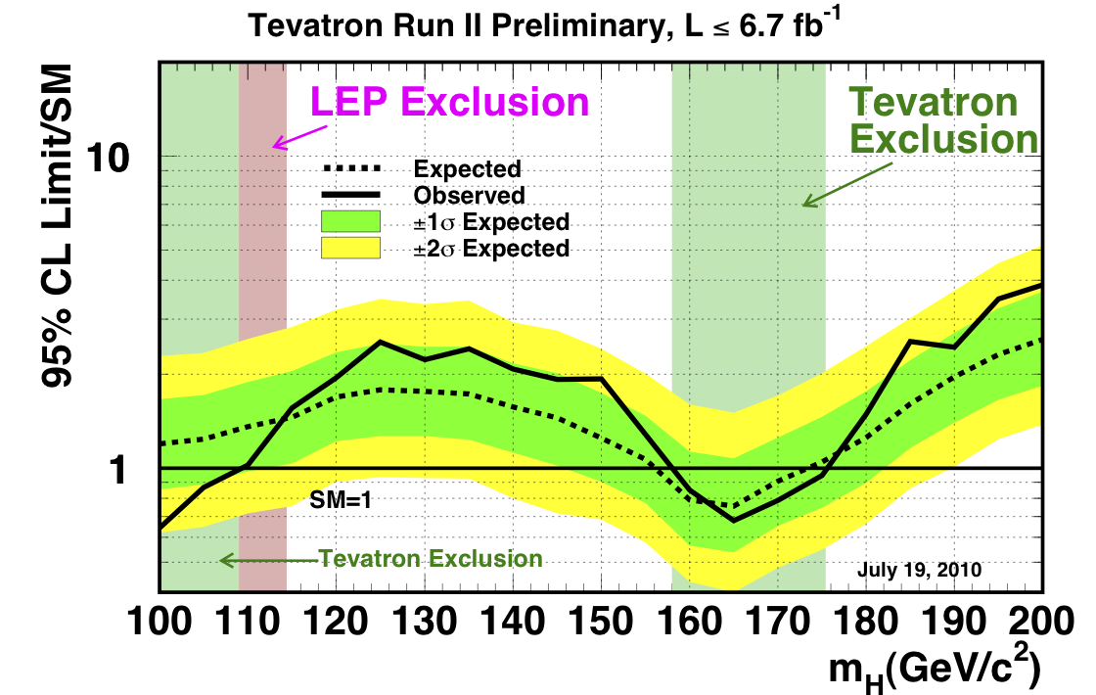
Progress Toward the Higgs Particle*
*D. Wright, LLNL, private communication
BESAC August 5, 2010

Slide 25
Accelerator Technology – Is it good enough?
Long term waste storage needs dominated by actinides
Fast Spectrum Reactors can burn actinides but require chemical processing
Accelerator Driven Systems would allow the reduction of the actinides and burning of the spent fuel without chemical processing
Question is can accelerators be built with ~50MW of power in the beam and can associated targets be constructed

Slide 26
SBIR
Continuous need for enhancing small businesses
DOE-wide SBIR program is managed by SC
It is not a small program ~$150M/yr
Steps are being taken to strengthen program
Moved up to report to Deputy SC Director
Enhancing office to make it more effective
Strengthening involvement of DOE executive management

