Slide 1
FY 2011 Budget Request to Congress for DOE’s Office of Science
Presented to the
Basic Energy Sciences Advisory Committee
March 2, 2010
Dr. W. F. Brinkman
Director, Office of Science
U.S. Department of Energy
www.science.doe.gov

Slide 2
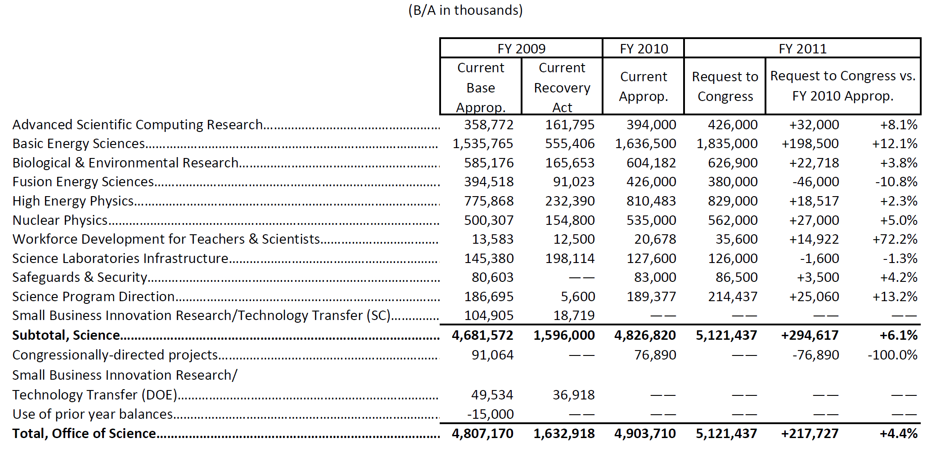
Office of Science (SC) FY 2011 Budget Request to Congress

Slide 3
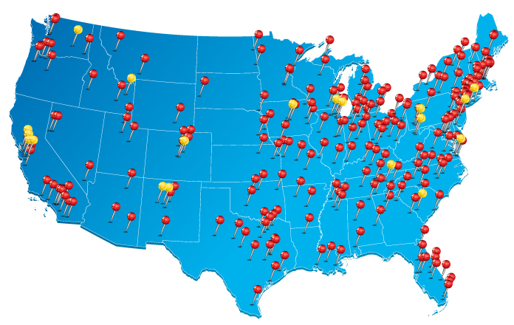
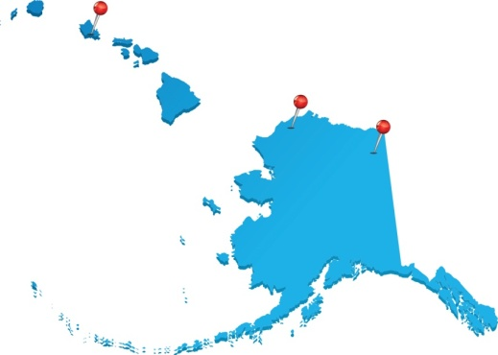
SC Supports Research at More than 300 Institutions Across the U.S.
Universities
DOE laboratories
The Office of Science supports:
27,000 Ph.D.s, graduate students, undergraduates, engineers, and technicians
26,000 users of open-access facilities
300 leading academic institutions
17 DOE laboratories

Slide 4
SC Supports World-Leading, Open Access Scientific User Facilities
User numbers continue to increase with more than 26,000 users expected in FY 2011
Breakdown of the expected users in FY 2011 by facility.
Alcator
DIII-D
NSTX
SSRL
ARM
JGI
EMSL
FES
ALS
 | Numbers of Users at SC Facilities
 | FY 2009 | FY 2010 (Est) | FY 2011 (Est)
ASCR | 3,696 | 3,850 | 4,025
BES | 11,509 | 12,780 | 13,560
BER | 2,716 | 2,690 | 2,690
FES | 542 | 575 | 580
HEP | 2,960 | 2,600 | 2,100
NP | 3,170 | 3,260 | 3,300
Total | 24,593 | 25,755 | 26,255
Bio & Enviro
Facilities
ATLAS
HRIBF
TJNAF
Nuclear physics
facilities
APS
RHIC
Light Sources
B-Factory
High energy physics facilities
Tevatron
ALCF
Computing
Facilities
Neutron Sources
NSLS
OLCF
Nano
Centers
LCLS
HFIR
NERSC
Lujan
SNS
NSRCs

Slide 5
Office of Science FY 2011 Investment Highlights
The FY 2011 budget advances discovery science and invests in science for national needs in energy, climate, and the environment; national scientific user facilities; and education and workforce development.
Discovery science addressing national priorities
  Energy Innovation Hub for Batteries and Energy Storage (+$34,020K, BES)
  Enhanced activities in climate science and modeling (Regional and Global Climate Modeling, +$6,495K; Earth System Modeling, +$9,015K; Atmospheric System Research, +$1,944K; ARM Climate Research Facility, +$3,961K; BER)
  Individual investigator, small group, and Energy Frontier Research Centers (EFRCs) in areas complementing the initial suite of 46 EFRCs awarded in FY 2009 (+$66,246K, BES)
  Leadership Computing Facilities operations and preparation for next generation of computer acquisitions for S&T modeling and simulation ($34,832K, ASCR)
  Multiscale modeling of combustion and advanced engine systems (+$20,000K, BES)
Scientific user facilities—21st century tools of science, technology, and engineering
  Facility construction is fully funded; projects are meeting baselines
  28 scientific user facilities will serve more than 26,000 users
  Several new projects and Major Items of Equipment are initiated (e.g., the Long Baseline Neutrino Experiment, +$12,000K, HEP)
Education and workforce development
  Expansions of the SC Graduate Fellowship Program (+$10,000K, 170 new awards, WDTS) and the SC Early Career Research Program (+$16,000K, 60 new awards, funded in all of the SC research programs)

Slide 6
The Status of the DOE Energy Innovation Hubs
Three new Hubs are launched in FY 2010 with SC leading the Fuels from Sunlight Hub
Modeled after the Office of Science Bioenergy Research Centers, the Energy Innovation Hubs focus on critical energy technology challenges by building creative, highly-integrated research teams that can accomplish more, faster, than researchers working separately.
FY 2010 Hubs tackle three important energy challenges:
Production of fuels directly from sunlight (SC)
Energy-efficient building systems design (EERE)
Modeling and simulation of advanced nuclear reactors (NE)
The Fuels from Sunlight Hub will accelerate the development of a sustainable commercial process for the conversion of sunlight directly into energy-rich chemical fuels, likely mimicking photosynthesis, the method used by plants to convert sunlight, carbon dioxide, and water into sugar. In FY 2011, BES has budgeted $24,300K for the 2nd year of the Fuels from Sunlight Hub. The FOA was released on 12/22/2009, and proposals are due on 3/29/2010.
To access the Fuels from Sunlight FOA (reference number DE-FOA-0000214) go to: https://www.fedconnect.net/FedConnect/PublicPages/PublicSearch/Public_Opportunities.aspx
and search for “Fuels from Sunlight” in the search box (note that the search flag should be set to “Title” or “Title/Description”).

Slide 7
FY 2011 Energy Innovation Hub for Batteries and Energy Storage
Addressing science gaps for both grid and mobile energy storage applications
A new FY 2011 SC/BES Hub for Batteries and Energy Storage ($34,020K) will address the critical research issues and will include:
  Design of advanced materials architectures: design of low-cost materials that are self-healing, self-regulating, failure tolerant, and impurity tolerant
  Control of charge transfer and transport: control of electron transfer through designer molecules; electrolytes with strong ionic solvation, yet weak ion-ion interactions, high fluidity, and controlled reactivity
  Development of probes of the chemistry and physics of energy storage: tools to probe interfaces and bulk phases with atomic spatial resolution and femtosecond time resolution
  Development of multi-scale computational models: computational tools to probe physical and chemical processes in storage devices from the molecular scale to system scale

Slide 8
Comparison of Core Research, EFRCs, Hubs, and ARPA-E
Key attributes distinguish among the various funding modalities
 | Investigators and their institutions | Diversity of Disciplines Per Award | Period of Award and Management | Annual Average Award Amount | Core Motivation, Research Focus
Core BES Program | Single or small-groups of researchers led by Universities or National Laboratories | Few | 3 –year renewable awards | ~$300k | Fundamental research to understand the underlying science of materials and chemistry issues related to electrical energy storage. Current projects focus on electrode and electrolyte phenomena.
Energy Frontier Research Centers | Self-assembled group of ~6-12 investigators. Led by Universities, National Laboratories and Industry. | Several | Five years with 5-year renewal possible. Managed by DOE SC-BES. | ~$3M | Fundamental research on electrical energy storage with a link to new energy technologies or technology roadblocks. The investigators are addressing subject matter from among a large set of scientific grand challenges and electrical energy storage-related topics based on the “Directing matter and Energy: Five Challenges for Science and the Imagination”, and “Basic Research Needs in Electrical Energy Storage” reports, respectively.
Batteries and Energy Storage Energy Innovation Hub | Large set of investigators spanning multiple science and engineering disciplines and possibly including other non-science areas such as energy policy, economics, and market analysis. May be led by Labs or universities, nonprofit organizations or private firms. | Many | Five years with 5-year renewal possible; the "bar" is significantly higher for further renewals. Managed by DOE SC with broad DOE participation. A Board of Advisors consisting of senior leadership will coordinate across DOE. | ~$25 million per year for R&D | Integrate from fundamental research through potential commercialization of electrical energy storage relevant to transportation and the electric grid. The breadth and emphasis of activities will be influenced by the nature of the selected Hub proposal. Some may place a greater emphasis on basic and applied research, while others may focus more on technology development. This Hub will be managed by SC with input from OE and EERE
ARPA-E | Single investigator, small group, or small teams. | Few | 1-3 years Managed by ARPA-E, which reports to the Secretary of Energy | $1 -7M | High risk translational research driven by the potential for significant commercial impact in the near-term. Current solicitation open on Batteries for Electrical Energy Storage in Transportation which is focused on ultra-high energy density, low-cost battery technologies

Slide 9
Climate Science for a Sustainable Energy Future
Enhanced activities in climate research to improve our predictive capability
The demands on climate change modeling to inform policy and investment decisions are increasing. The current state of climate models is insufficient to predict with detail and accuracy the impact of energy policy on the climate.
FY 2011 funding increases in BER ($21,415K) support the development of a predictive capability that will rapidly incorporate new science into state-of-the-art climate models and that will improve uncertainty quantification.
New and enhanced activities will emphasize:
Research and atmospheric data collection for improving representation of the feedbacks produced by the indirect effect of aerosols
Enhanced uncertainty quantification for climate model simulations and predictions
Conversion of observational data sets into specialized, multi-variable data sets for Earth System Model testing and improvement.
Model development testbeds in which model components can be rapidly prototyped and evaluated using integrated observational datasets; development of numerical methods to enable climate models to use future computer architectures
Atmospheric System Research and operation of new ARM Climate Research Facility instruments to provide data for improving representation of clouds and aerosols in climate models

Slide 10
The Status of the SC/BES Energy Frontier Research Centers
46 EFRCs were launched in late FY 2009 using FY 2009 Appropriations and Recovery Act Funds
46 centers awarded, representing 103 participating institutions in 36 states plus D.C
Energy Frontier Research Center Locations ( Leads; Participants)
Industry/Nonprofit
Energy Storage
1
2
Energy
Efficiency
6
12
DOE Labs
6
20
Energy
Supply
31
Universities
14
Crosscutting
Sciences
By Topical Category
By Lead Institution
10

Slide 11
New BES Research Investments Address Critical Needs
An FY 2011 BES call will cover a broad range of research awards including new EFRCs
About $66 million will be competed in the BES Program to support single investigators, small groups, and additional Energy Frontier Research Centers in the following areas:
1. Discovery and development of new materials
The FY 2011 solicitation will emphasize new synthesis capabilities, including bio-inspired approaches, for science-driven materials discovery and synthesis. Research will include crystalline materials, which have broad technology applications and enable the exploration of novel states of matter.
2. Research for energy applications
The FY 2011 solicitation will emphasize fundamental science related to:
  Carbon capture, including the rational design of novel materials and separation processes for post-combustion CO₂ capture in existing power plants and catalysis and separation research for novel carbon capture schemes to aid the design of future power plants.
  Advanced nuclear energy systems including radiation resistant materials in fission and fusion applications and separation science and heavy element chemistry for fuel cycles.
Awards will be competitively solicited via Funding Opportunity Announcements following the FY 2011 appropriation.

Slide 12
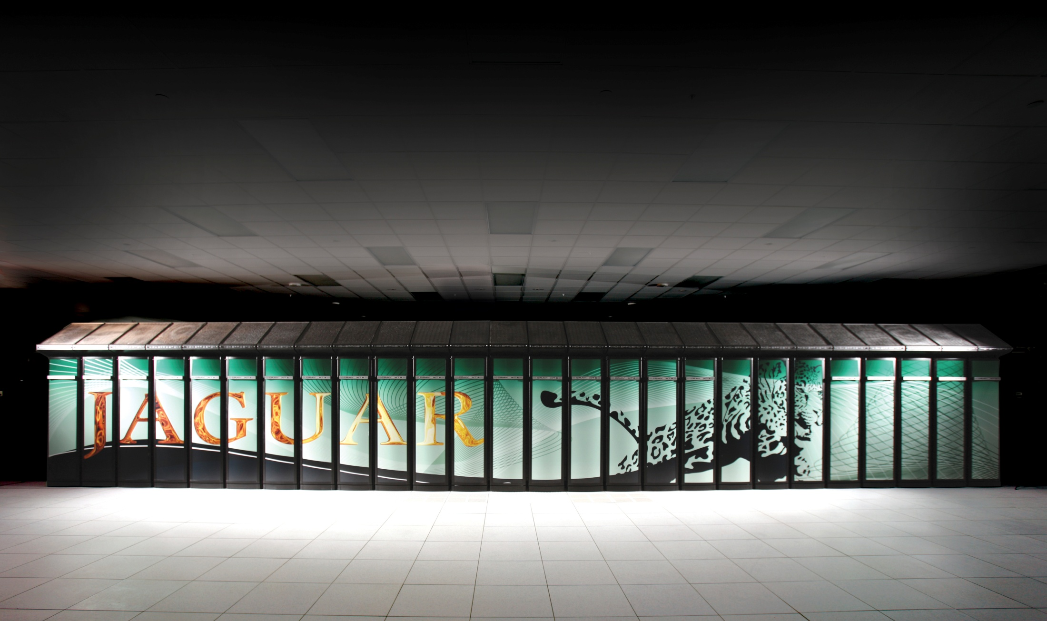
Leadership Computing Facilities
The Office of Science leads the World in supercomputing capabilities
“Supercomputer modeling and simulation are changing the face of science and sharpening America’s competitive edge.”
Secretary Steven Chu
The Cray XT5 Supercomputer at Oak Ridge National Lab
can perform over 2.3 quadrillion operations per second.
It ranks #1 of the fastest computers world wide by Top500.org
Notes:
Chu quote is from Jaguar press release: http://www.energy.gov/news2009/8290.htm
16 Nov 2009

Slide 13
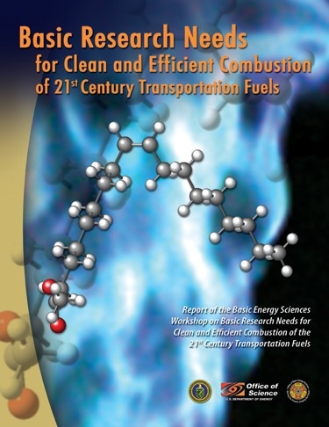
Multi-scale Simulation of Internal Combustion Engines
A new initiative to develop the science base for computational design of advanced engines
Predictive simulation of combustion in an
evolving fuel environment is essential for
developing more efficient and cleaner engines.
The scientific community has provided a roadmap via:
  BES workshop: Basic Research Needs for Clean and
  Efficient Combustion, October 2006
  ASCR/BES workshop: Discovery in Basic Energy Sciences:
  The Role of Computing at the Extreme Scale, August 2009
  SC ongoing collaboration with EERE’s Vehicle
  Technology Program
The new BES activity (+$20,000K) will provide:
  Models that span vast scale ranges: coupling of combustion chemistry with turbulent flow requiring simulation over 9 orders of magnitude in space and time.
  Improved understanding of fundamental physical and chemical properties: multi-phase fluid dynamics, thermodynamic properties, heat transfer, and chemical reactivity.
  Engine simulation: science-based predictive simulation and modeling design

Slide 14
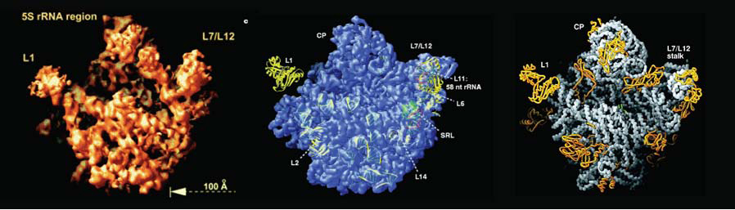
The 2009 Nobel Prize Work Used all Four BES Light Sources
PIs were supported by DOE/SC and NIH National Center for Research Resources
Ribosome translates the genetic instructions encoded by DNA into chains of amino acids that make up proteins. The ribosome is composed of two subunits: 30S, which reads the code; and 50S, which links up the amino acids.
The structures of 30S and 50S have been crucial to understanding everything from how the ribosome achieves its amazing precision to how different antibiotics bind to the ribosome.
  Ramakrishnan and Steitz used x-ray crystallography at the NSLS to gather structures of these two ribosome subunits: Ramakrishnan on 30S and Steitz on 50S.
  Steitz, Ramakrishnan, and Yonath also performed studies at the APS. Most work was performed at the DOE beamline; Steitz and Yonath also used two other beamlines – GMCA-CAT and BIOCARS.
  Steitz also performed work at the ALS.
  Yonath also did early work at SSRL related to developing the cryo-cooling of ribosome particles.
The 50S subunit structure at 9Å resolution (left, 1998), 5Å resolution (middle, 1999), and 2.4Å resolution (right, 2000) (From Ban et al., 1998; 1999; 2000).
Notes:
14

Slide 15
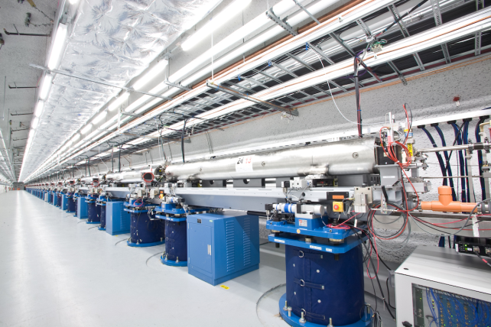
Linac Coherent Light Source (LCLS) at SLAC
Already producing new science today, the LCLS is the world’s first x-ray free electron laser
LCLS is SC’s newest x-ray light source user facility, providing an unprecedented combination of high spatial and temporal resolution for the investigation of atomic-scale structure and processes.
On target for an on time, within budget completion in FY 2010
  Time between first start up and first light was, remarkably, under two hours!
Meeting or exceeding design specifications to enable new science
  Peak brightness 10 orders of magnitude greater than existing x-ray sources
  X-ray pulses as short as 2 millionths of a nanosecond (2 femtoseconds)
Overwhelming demand for access
  More than 850 researchers have applied for time on LCLS during the early access experimental runs, prior to CD-4

Slide 16
Bioenergy Research Centers
The BRCs have pioneered new approaches to accelerate biofuels research
$75 million will support the fourth year of operations of the three BRCs
Joint BioEnergy Institute (JBEI)—research on model crops (Arabidopsis and rice) that can be transferred to bioenergy crops; lignin modification; synthetic biology approaches to fuels
Advanced biomass pretreatment using room temperature ionic liquids to remove lignin from plant cell walls improved biomass breakdown 5x.
New cellulase enzyme more stable and active in ionic liquids at elevated temperatures and low pH.
Great Lakes Bioenergy Research Center (GLBRC)—research on model plants and potential bioenergy plants; microbial biorefineries; sustainability of biofuel production
Improved screening of hydrolytic enzymes using gene expression approach coupled with enzyme screening and computational approaches – 100x more efficient than conventional methods
BioEnergy Science Center (BESC)—research to overcome “recalcitrance” (resistance of plant fiber, or lignocellulose, to break down into sugars); gene discovery for recalcitrance; consolidated bioprocessing
New high throughput screening of chemical, structural, and genetic features of biomass – >100x faster than conventional methods.
New imaging technologies to view cell wall at multiple scales to analyze recalcitrance

Slide 17
The Genomic Revolution
Advances in DNA sequencing and analysis have revolutionized the study of biology
Sequencing the 3 billion base-pair human genome took 13 years and multiple national and international partners. Today the DOE Joint Genome Institute sequences over a trillion base pairs annually.
DNA sequencing and analysis capabilities and the availability of genome data in the 1990s led to functional genomics, proteomics, metabolomics, systems biology, and synthetic biology.
Genomic sequence information has dramatically increased our understanding of the biological processes of microbes and plants—knowledge that is being used to develop solutions for clean energy production, sequestration of atmospheric CO₂, and remediation of contaminated environments.
Recent accomplishments:
  Sequencing the 1.1 billion base-pair soybean genome—The largest plant project sequenced at JGI and the largest plant sequenced by the whole genome shotgun strategy, the soybean sequence will accelerate crop improvements for energy production and environmentally sustainable food and feed production for agriculture.
  DOE JGI publishes the Genomic Encyclopedia of Bacteria and Archaea—The initial 56 microbial genomes sequenced resulted in the discovery of tens of thousands of genes that provide insights into natural environmental processes and advance biotechnology.
  Viable microbes in toxic subsurface environments—Genetic techniques demonstrate that micoorganisms of the Anaeromyxobacter family, known to enzymatically reduce uranium to a less mobile form, can be detected in the most heavily contaminated environments and likely play a role in reducing the mobility of uranium in groundwater.

Slide 18
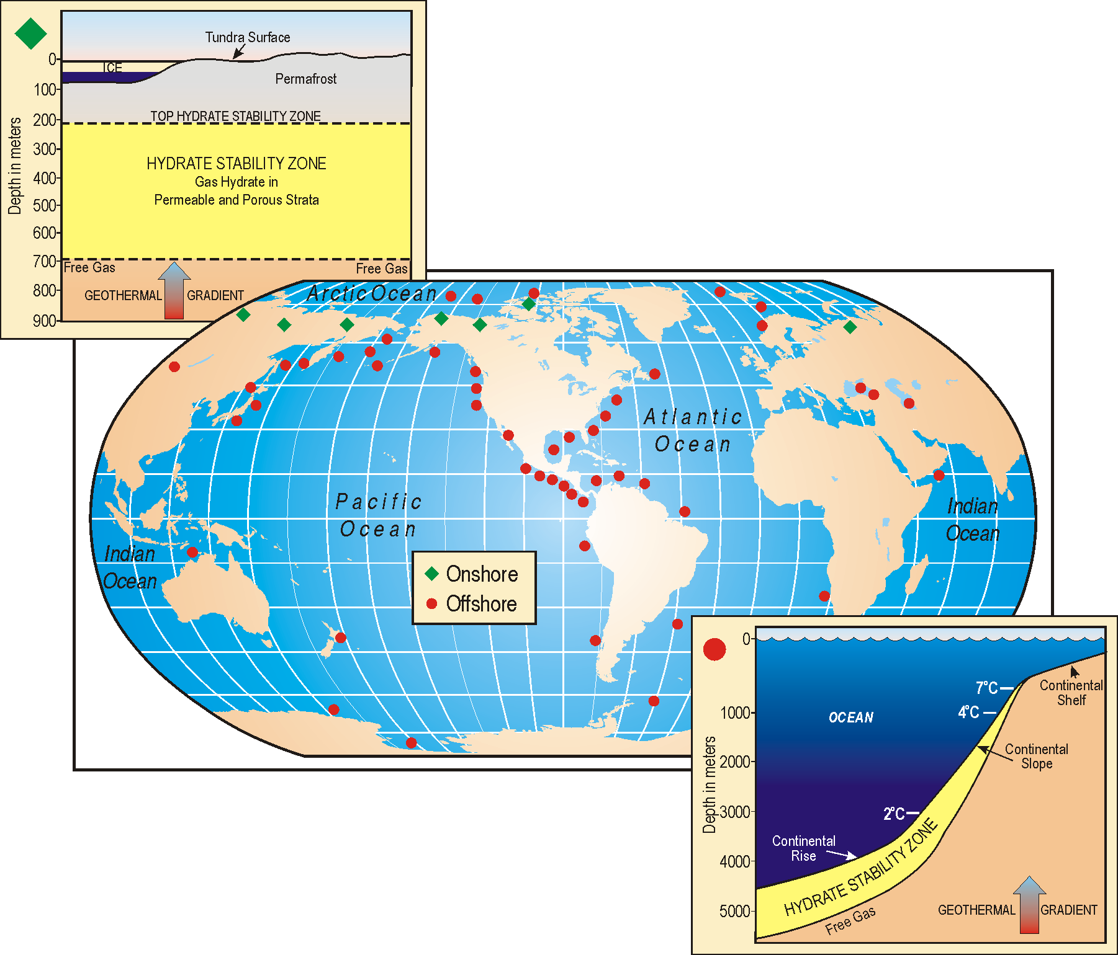
Geosciences Research for Gas Hydrates
Developing the science base for understanding the potential of gas hydrates as a resource
BES research will investigate fundamental scientific questions about methane hydrates: their formation and occurrence; their stability in natural or engineered systems; their role in geological/ ecological systems; and their role in the carbon cycle (+$17,517K).
The program will also study hydrates via controlled in situ depressurization and physical, thermal, and chemical stimulation in the Arctic and the Gulf of Mexico. This research will be supported by theory and multi-scale modeling and simulation in areas such as the intermolecular forces that govern the structure and properties of gas hydrates.
Free Gas
Free Gas
GEOTHERMAL GRADIENT
Methane hydrates are naturally occurring combinations of methane and water that form at low temperatures and high pressure.

Slide 19
High Energy Density Laboratory Plasmas
Expanded research efforts in HEDLP will reveal new understanding of matter in extreme conditions
The emerging science of high energy density laboratory plasma (HEDLP) — the study of ionized matter at extremely high density and temperature — is enabling deeper understanding of extreme phenomena in a range of disciplines including fusion energy science, condensed matter physics, materials science, fluid dynamics, nuclear science, and astrophysics.
The increase in the FES High Energy Density Laboratory Plasma program (+$6,489K) will enable new research awards under the HEDLP joint program between FES and NNSA, which began in FY 2009.
This research will leverage world-class FES and NNSA facilities to provide:
  information in assessing the viability of inertial fusion energy as a future energy source;
  first-of-kind laboratory studies of astrophysical phenomena that include testing of models used to infer the age of the universe; and
  opportunities for junior researchers to ensure continued excellence in scientific disciplines closely aligned with fusion energy science and stockpile stewardship.

Slide 20
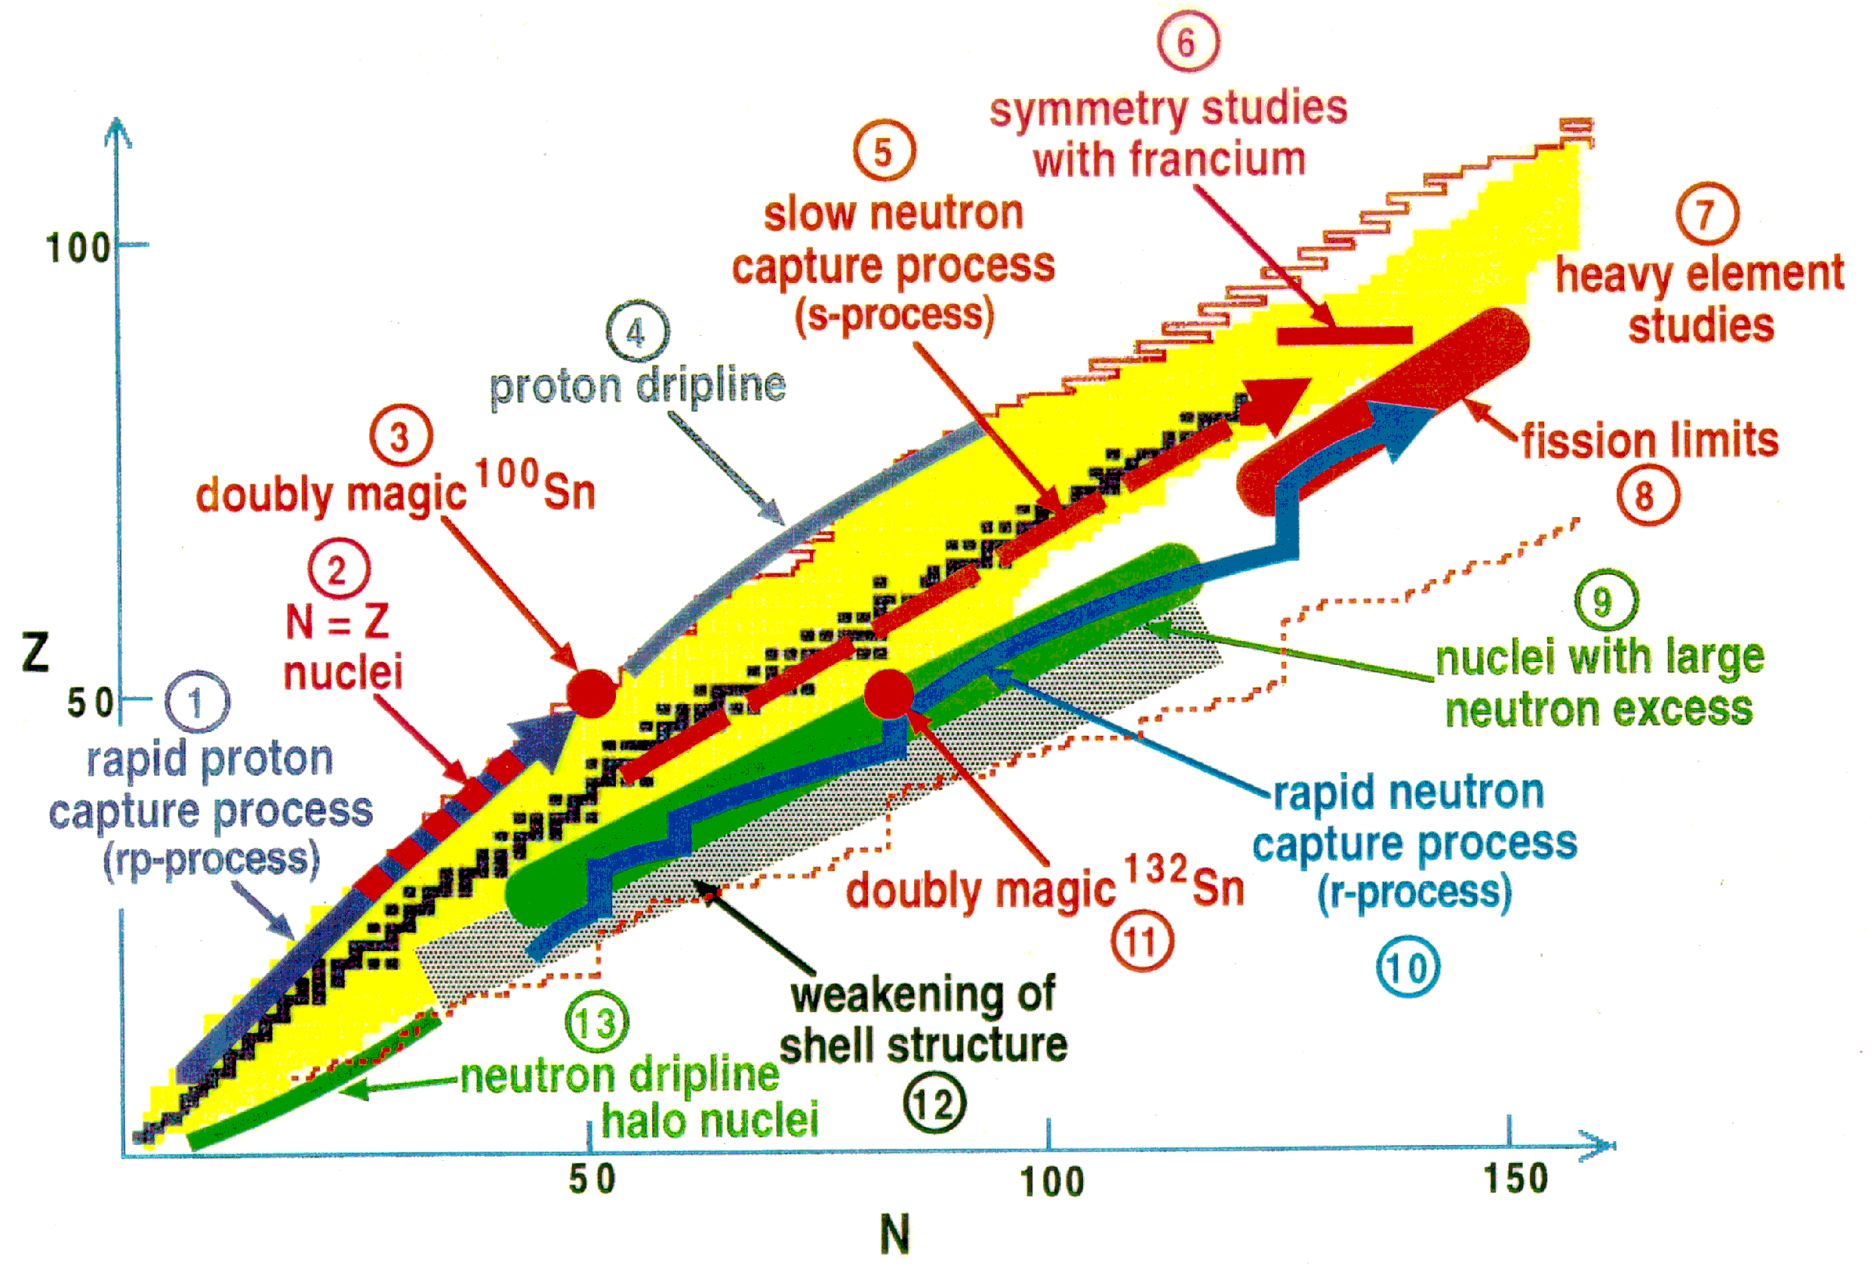
The DOE Nuclear Physics Program
Charting new directions at the frontiers of nuclear science
The U.S. is a leader in studying the compelling questions of nuclear science, advancing our knowledge of the world, and leading to applications in energy research, medicine, national security, and isotopes for a wide variety of purposes.
The Relativistic Heavy Ion Collider (RHIC) is the only machine in the world colliding heavy ions at near light speed.
The Continuous Electron Beam Accelerator Facility (CEBAF) is the world’s most powerful probe for studying the nucleus of the atom.
Investments in Radioactive Ion Beam experiments and capabilities (such as the Facility for Rare Isotope Beams—FRIB), probe the properties of rare nuclear isotopes to better understand the origin of the elements and fundamental symmetries of nature
Office of Science FY 2011 Budget
20

Slide 21
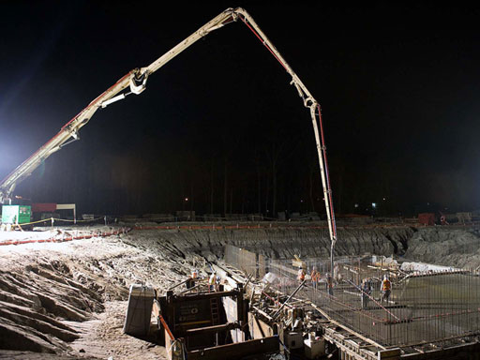
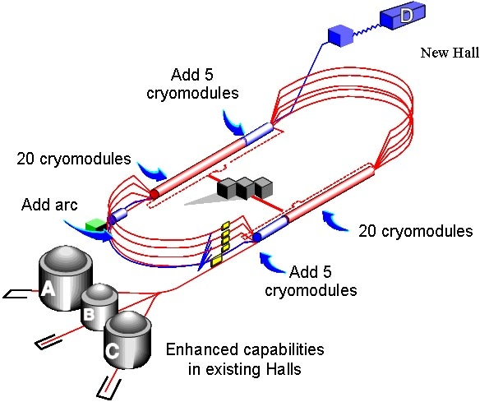
The DOE Nuclear Physics Program
New science follows the completion of the 12 GeV Upgrade at TJNAF
With the completion of the 12 GeV Upgrade, researchers will address:
The search for exotic mesons—a quark and an anti-quark held together by gluons, but unlike conventional mesons, the gluons are excited
Physics beyond the Standard Model via high precision studies of parity violation
The spin and flavor dependence of valence parton distributions—the heart of the proton, where its quantum numbers are determined
The structure of atomic nuclei, exploring how the valence quark structure is modified in a dense nuclear medium
Nuclear tomography to discover and explore the three-dimensional structure of the nucleon
Pouring the foundation for the Hall D complex.
Office of Science FY 2011 Budget
21

Slide 22
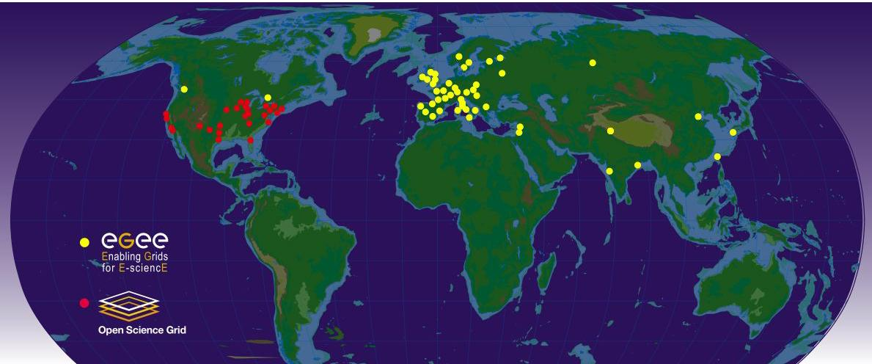
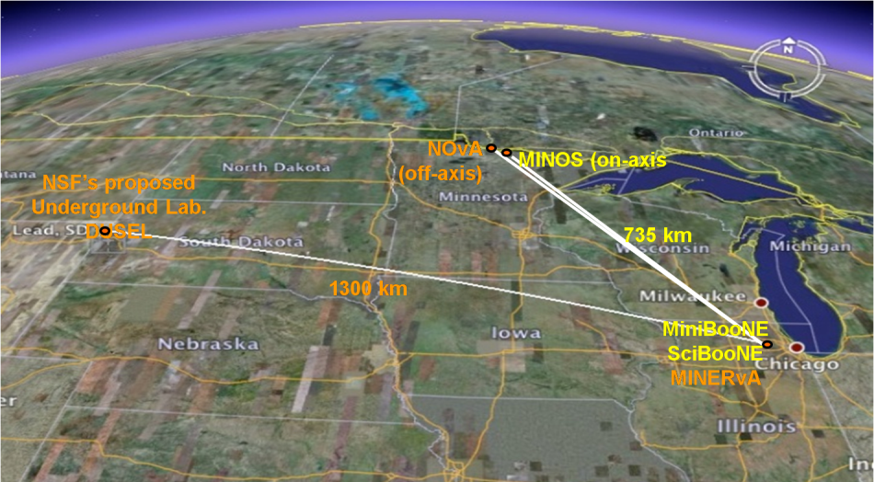
The U.S. High Energy Physics Program
The U.S. is uniquely positioned for a world-leading program in neutrino physics
The U.S. is a critical and strategic partner in global scientific collaborations that push the boundaries of High Energy Physics. The U.S. has developed components for the Large Hadron Collider at CERN and hosts centers for data analysis.
Network sites of the Open Science Grid and Enabling Grids for E-sciencE used for transmitting experimental data from the LHC to scientists worldwide.
At home, HEP builds on its investments in tools and facilities to capture the unique opportunities of neutrino science. These opportunities are fundamental to the science of particle physics.
At the heart of the DOE HEP program is the NuMI beamline at Fermilab, the world’s most intense neutrino source, which serves MINERvA and MINOS and will support NOvA and the proposed LBNE (+$12,000K, HEP, initiated in FY 2011).
The NuMI beamline provides the world’s most intense neutrino beam for the MINOS experiment and proposed NOvA and LBNE experiments
Notes:
Global Map Image sources http://www.interactions.org/cms/?pid=2100&image_no=CE0227
Shows data center sites for LHC
“Google Map” showing trajectory of current and proposed neutrino beamlines from Fermilab, serving MINOS, NOVA, and LBNE

Slide 23
Office of Science Early Career Research Program
Investment in FY 2011 will bring 62 new scientists into the program
$16 million will be available in FY 2011 to fund about 60 additional Early Career Research Program awards at universities and DOE national laboratories.
Purpose: To support individual research programs of outstanding scientists early in their careers and to stimulate research careers in the disciplines supported by the Office of Science
Eligibility: Within 10 years of receiving a Ph.D., either untenured academic assistant professors on the tenure track or full-time DOE national lab employees
Award Size:
    University grants $150,000 per year for 5 years to cover summer salary and expenses
    National lab awards $500,000 per year for five years to cover full salary and expenses
FY 2010 Results:
    69 awards funded via the American Recovery and Reinvestment Act
    1,750 proposals peer reviewed to select the awardees
    47 university grants and 22 DOE national laboratory awards
    Awardees are from 44 separate institutions in 20 states
  FY 2011 Application Process:
    Funding Opportunity Announcement issued in Spring 2010
    Awards made in the Second Quarter of 2011
http://www.science.doe.gov/SC-2/early_career.htm

Slide 24
DOE Office of Science Graduate Fellowships
The FY 2011 request doubles the number of graduate fellowships in basic science
$10 million will be available in FY 2011 to fund about 170 additional fellowships
Purpose: To educate and train a skilled scientific and technical workforce in order to stay at the forefront of science and innovation and to meet our energy and environmental challenges
Eligibility:
    Candidates must be U.S. citizens and a senior undergraduate or first or second year graduate student to apply
  Candidates must be pursuing advanced degrees in areas of physics, chemistry, mathematics, biology, computational sciences, areas of climate and environmental sciences important to the Office of Science and DOE mission
Award Size:
  The three-year fellowship award, totaling $50,500 annually, provides support towards tuition, a stipend for living expenses, and support for expenses such as travel to conferences and to DOE user facilities.
FY 2010 Results:
    160 awards will be made this Spring with FY 2010 and American Recovery and Reinvestment Act funds
  FY 2011 Application Process:
    Funding Opportunity Announcement issued in Fall 2010
    Awards made in March 2011

