Slide 1

Basic Energy Sciences Update
BES Advisory Committee Meeting
March 2, 2010
Harriet Kung
Director, Basic Energy Sciences
Office of Science

Slide 2
Outline
FY 2011 Budget Request
  Batteries and Energy Storage Hub
  New Materials Synthesis
  Multi-scale Combustion Modeling
  Ultrafast Science
Staffing Update
Strategic Planning: BESAC Science for Energy Technology Subcommittee

Slide 3
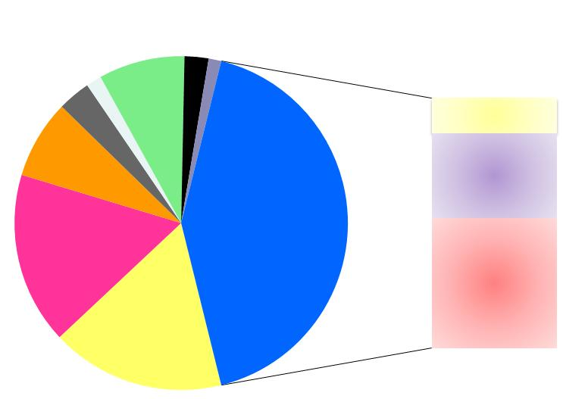
FY 2011 BES Budget Request
Research programs
  Energy Innovation Hubs
  Energy Frontier Research Centers
  Core research increases for grand challenge science, use-inspired science, accelerator & detector research
  Topical areas include: basic research in ultrafast science, materials synthesis, carbon capture, radiation resistant materials, separation sciences, advanced combustion modeling for engine design, geophysics and geochemistry on CO₂/minerals & rocks interactions, and gas hydrates
Scientific user facilities operations
  Synchrotron light sources
  Neutron scattering facilities
  Nanoscale Science Research Centers
FY 2011 Request:
$ 1,835M
SBIR & GPP
40.2
SUF Research
27.3
MIE 22.4
Hub 58.3
153.1
Construction
& OPC
NSRC 109.5
EFRC
140
Neutron Sources
262.7
Facilities
Ops
777.3
CSGB
Research
306
Light Sources
403.6
MSE
Research
309.4
Construction and instrumentation
  National Synchrotron Light Source-II
  Spallation Neutron Source instruments
  SNS Power Upgrade

Slide 4
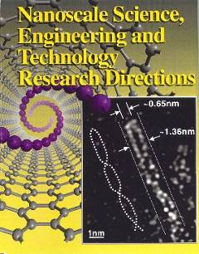
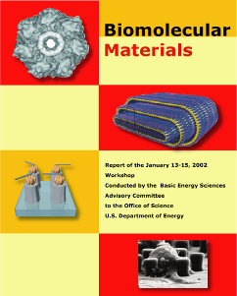
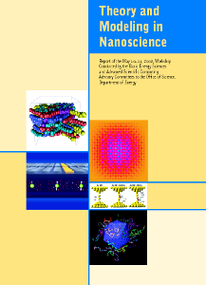
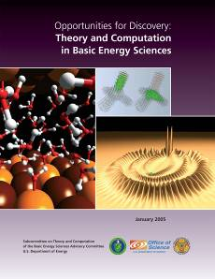
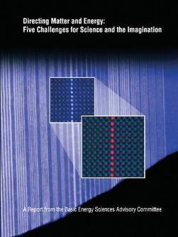
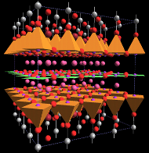
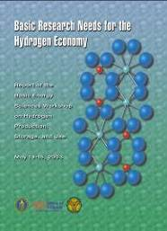

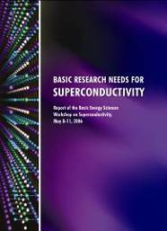

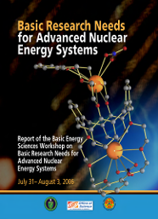


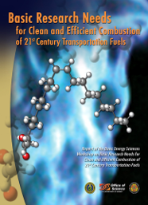
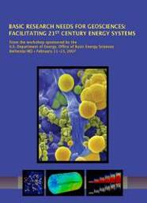

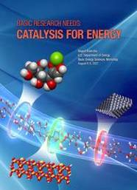
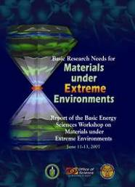
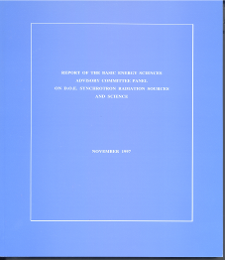
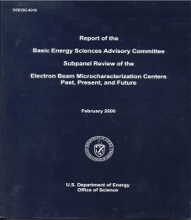
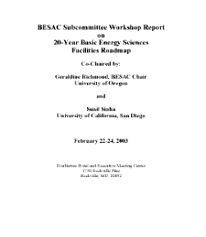
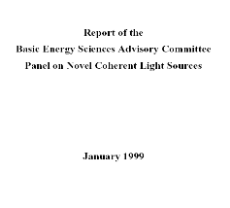
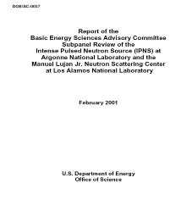
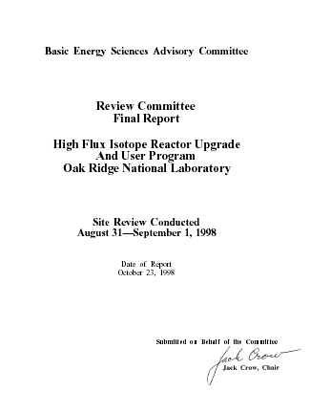
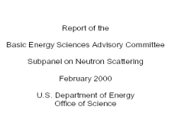
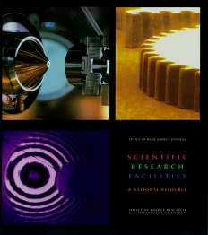
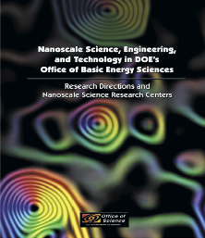
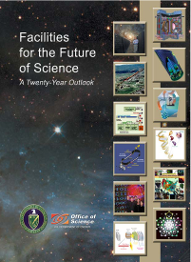

FY 2011 Budget Informed by BESAC & BES Strategic Planning Activities
Science for Discovery
Complex
Systems
Science for National Needs
National Scientific User Facilities, the 21st century tools of science
http://www.sc.doe.gov/bes/reports/list.html
4

Slide 5
FY 2011 Budget Highlights
  ~$66,000K will be available to support single investigators, small group research awards, and Energy Frontier Research Centers in the following areas:
    Discovery and development of new materials with emphasis on new synthesis capabilities, including bio-inspired approaches
    Fundamental sciences for energy technologies, including carbon capture, and advanced nuclear energy systems
  Energy Innovation Hubs are initiated in the area of Batteries and Energy Storage (+$34,020K) and continued in the area of Fuels from Sunlight (+$24,300K). Hubs create large, highly integrated teams spanning basic to engineering development to accelerate solutions to priority energy technology challenges.
  An increase in Chemical Physics enables initiation of a significant effort in the area of multiscale modeling for advanced engine design (+$20,000K) .
  An increase in Geosciences Research enables new research on methane hydrates (+$17,517K) and various geophysical and geochemical investigations (+$10,000K).
  Increases for ultrafast science research in Neutron and X-ray Scattering (+$2,500K) and Atomic, Molecular, and Optical Sciences (+$2,500K) enables development of ultrafast x-ray and optical probes of matter and dynamic phenomena.
  Accelerator and Detector Research (+$2,469K) is expanded to include free-electron laser, diagnostics, detectors, and accelerator modeling.
  BES light sources facilities receive funds for critical instrumentation and device upgrades at the Advanced Photon Source ($3,000 K), the Advanced Light Source ($2,000 K), and LCLS ($1,000K).
  The Spallation Neutron Source Power Upgrade Project (PUP) (+$3,000K) efforts accelerate per its established project schedule.

Slide 6
Energy Innovation Hub:
Batteries and Energy Storage

Slide 7
Energy Innovation Hub for Batteries and Energy Storage
Addressing science gaps for both grid and mobile energy storage applications
A new FY 2011 SC/BES Hub for Batteries and Energy Storage ($34,020K) will address the critical research issues and will include:
  Design of advanced materials architectures: design of low-cost materials that are self-healing, self-regulating, failure tolerant, and impurity tolerant
  Control of charge transfer and transport: control of electron transfer through designer molecules; electrolytes with strong ionic solvation, yet weak ion-ion interactions, high fluidity, and controlled reactivity
  Development of probes of the chemistry and physics of energy storage: tools to probe interfaces and bulk phases with atomic spatial resolution and femtosecond time resolution
  Development of multi-scale computational models: computational tools to probe physical and chemical processes in storage devices from the molecular scale to system scale

Slide 8
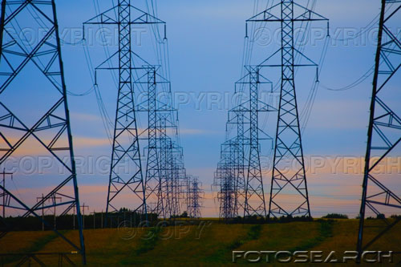



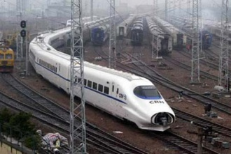


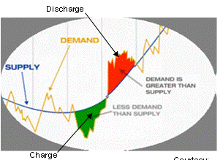
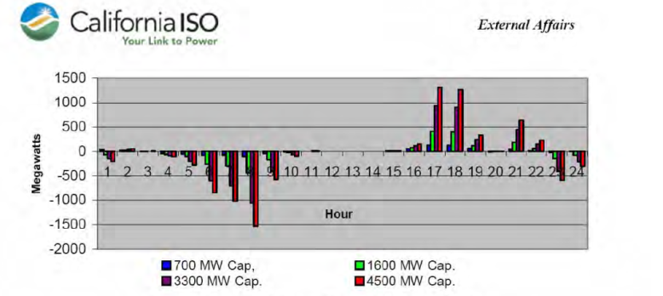
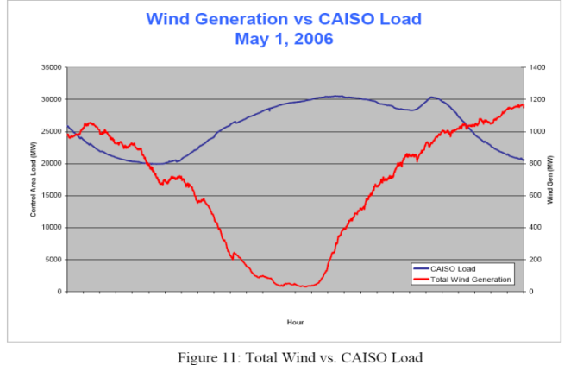
Energy Storage: Scales of Power & Time
10000
Hybrid Electric
Vehicles
Military
1000
Utility
Utility
Different power requirements and time regimes will require different storage solutions
Current (A)
100
Ships
Consumer Products
10
Traction
Aerospace
1
10
100
1k
10k
100k
Voltage (V)
Seconds to Minutes
Minutes - one Hour
Several Hours - one Day
Regulation
Ramping
Peak shaving, load leveling

Slide 9
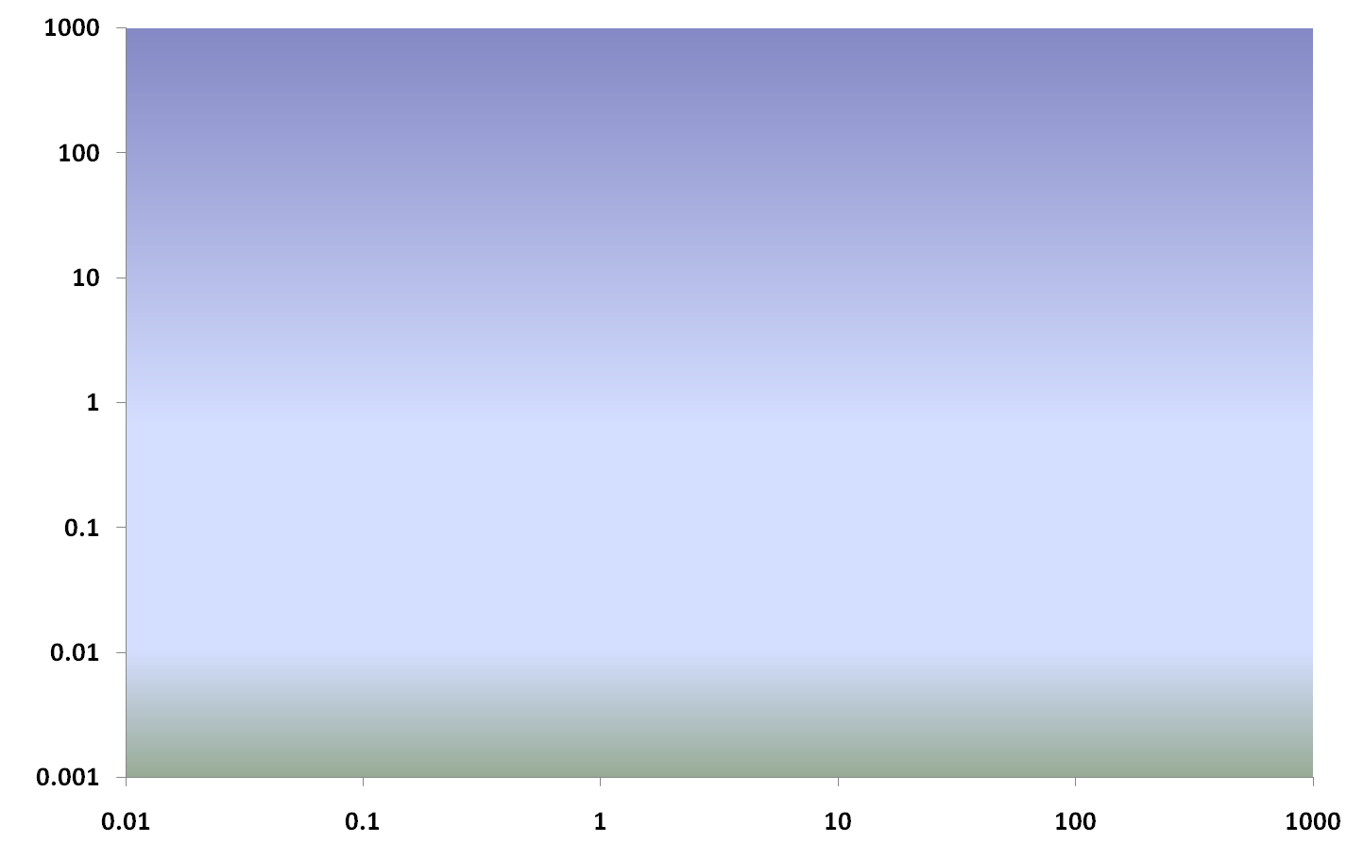
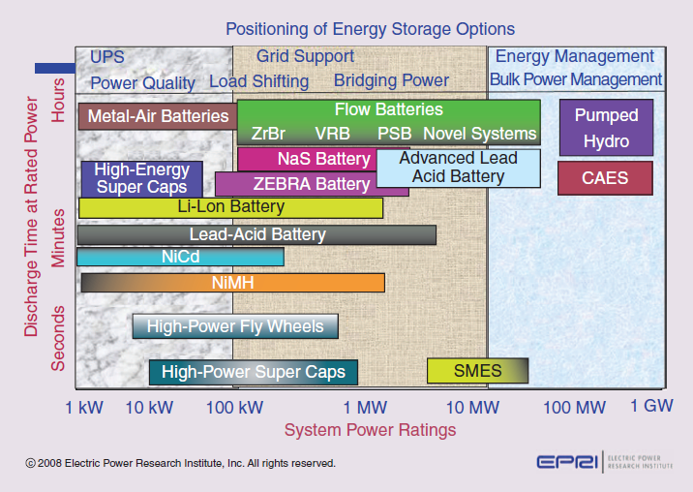
Batteries and Energy Storage: Grid and Transportation
Myriad of technologies required for grid and transportation energy storage
Existing technologies
  limited use lifetimes
  far from theoretical densities
  cost
  often environmentally hazardous
  require higher power and charge/discharge rates
  weight
  Overall, 2X – 10X improvements needed
Opportunity: Revolutionize technologies for energy storage
EV
Storage Time (minutes)
Grid Services, Stabilization, Energy Management
PHEV
HEV
Storage Power Requirements (MW)
Consumer Transportation Grid Management

Slide 10
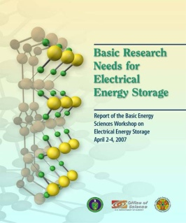
Batteries and Energy Storage: Critical Issues in Research
A Unified Research Framework for Transportation and Stationary End-use
How can we approach theoretical energy densities?
- Need to know how to design and control energy transfer
- Need to develop novel multi-electron systems
Need to understand fluid behavior in nanopores
Increased Energy Density
How do we increase the safe storage capacity and achieve the optimum charge/discharge rate?
- Need to improve ionic and electrical conductivity
- Need to design simple, stable nanostructures
Need to understand energy transport
Higher Power
Can we maximize the reversibility?
- Need to understand interfaces and phase stability
- Need to understand system dynamics
Need to design new materials and structures
Longer Lifetimes

Slide 11
Unique Characteristics of Batteries and Energy Storage Hub
Central Motivation: Addressing grand science questions that fundamentally limit the cost and performance of a broad range of electrical energy storage applications
  Different energy storage technologies have similar underlying science issues but diverse technology issues and requirements
  Reap the most advanced scientific discoveries to transcend existing technology constructs (Li-ion) or nascent concepts (metal-air)
  Requires a broad-based approach at the fundamental and applied research levels
Funding & Scope: Hub-sized effort ensures that the technology and production needs would be linked to the fundamental science resulting in rapid and meaningful communication across the spectrum
  Addresses the need to strengthen the links from basic science all the way to industrial development
  Integrating consideration of materials selection, architecture design, manufacturability with systems analysis
  Will lay the groundwork for commercialization and demonstration projects
Sustained Support
  Allows fundamental knowledge and novel concepts to be thoroughly vetted before down selections for applied research and development
  Greater potential for both improvements in current technologies and rapid development of transformational science into game-changing technologies

Slide 12
DOE Batteries and Energy Storage Program Features
 | Investigators and their institutions | Diversity of Disciplines Per Award | Period of Award and Management | Annual Average Award Amount | Core Motivation, Research Focus
Core BES Program | Single or small-groups of researchers led by Universities or National Laboratories | Few | 3 –year renewable awards | ~$300k | Fundamental research to understand the underlying science of materials and chemistry issues related to electrical energy storage. Current projects focus on electrode and electrolyte phenomena.
Energy Frontier Research Centers | Self-assembled group of ~6-12 investigators. Led by Universities, National Laboratories and Industry. | Several | Five years with 5-year renewal possible. Managed by DOE SC-BES. | ~$3M | Fundamental research on electrical energy storage with a link to new energy technologies or technology roadblocks. The investigators are addressing subject matter from among a large set of scientific grand challenges and electrical energy storage-related topics based on the “Directing matter and Energy: Five Challenges for Science and the Imagination”, and “Basic Research Needs in Electrical Energy Storage” reports, respectively.
Batteries and Energy Storage Energy Innovation Hub | Large set of investigators spanning multiple science and engineering disciplines and possibly including other non-science areas such as energy policy, economics, and market analysis. May be led by Labs or universities, nonprofit organizations or private firms. | Many | Five years with 5-year renewal possible; the "bar" is significantly higher for further renewals. Managed by DOE SC with broad DOE participation. A Board of Advisors consisting of senior leadership will coordinate across DOE. | ~$25 million per year for R&D | Integrate from fundamental research through potential commercialization of electrical energy storage relevant to transportation and the electric grid. To enable revolutionary electrical energy storage concepts and applications by addressing key questions that fundamentally limit their cost and performance. The Hub will lay the foundation for commercialization. This Hub will be managed by SC with input from OE, EERE, and ARPA-E
ARPA-E | Single investigator, small group, or small teams. | Few | 1-3 years Managed by ARPA-E, which reports to the Secretary of Energy | $1 -7M | High risk translational research driven by the potential for significant commercial impact in the near-term. Current solicitation open on Batteries for Electrical Energy Storage in Transportation which is focused on ultra-high energy density, low-cost battery technologies.
EERE and OE Research | Range of research teams, frequently involving industrial partners | Few | Varies, typically 1-3 years | Ranging from small teams ($300K+) to technology demonstrations (can be >$1M) | Developmental research and technology demonstration projects. EERE primarily focuses on mobile applications, OE on stationary and grid applications.

Slide 13
Innovation Pipeline: Hubs vs. EFRCs& ARPA-E
Modified chart from Kosinski, BESAC presentation, 10July, 2009, http://www.sc.doe.gov/bes/besac/Meetings.html
Government-Dominated Funding
Industry- Dominated Funding
High Risk,
High Payoff
Office
of Science
(e.g., EFRCs)
ARPA-E
Breakthrough; Opportunistic; Focused
Handoff
Energy Innovation Hubs
Big problem; Sustained Support of Integrated Research
Applied Offices
Innovative
Program
Loans
Low Risk,
Evolutionary
Commercial-ready
Program
Basic Applied Deployed

Slide 14
New BES Research Investments Address Critical Needs
An FY 2011 BES call will cover a broad range of research awards including new EFRCs
About $66 million will be competed in the BES Program to support single investigators, small groups, and additional Energy Frontier Research Centers in the following areas:
1. Discovery and development of new materials
The FY 2011 solicitation will emphasize new synthesis capabilities, including bio-inspired approaches, for science-driven materials discovery and synthesis. Research will include crystalline materials, which have broad technology applications and enable the exploration of novel states of matter.
2. Research for energy applications
The FY 2011 solicitation will emphasize fundamental science related to:
  Carbon capture, including the rational design of novel materials and separation processes for post-combustion CO₂ capture in existing power plants and catalysis and separation research for novel carbon capture schemes to aid the design of future power plants.
  Advanced nuclear energy systems including radiation resistant materials in fission and fusion applications and separation science and heavy element chemistry for fuel cycles.
Awards will be competitively solicited via Funding Opportunity Announcements following the FY 2011 appropriation.

Slide 15
    Discovery and Development of New Materials

Slide 16
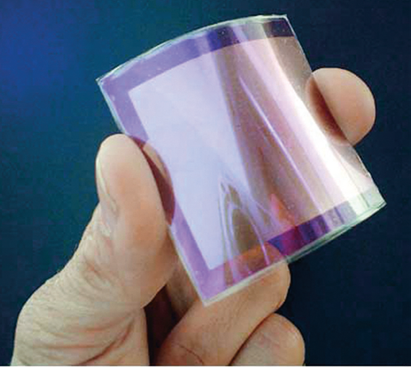

New Materials Discovery – Enabler of Technology Innovations
Numerous recent Nobel prizes- quantum Hall effect and fractional quantum Hall effect (Physics 1985, 1998), buckyballs (Chemistry 1996), and conducting polymers (Chemistry 2000) – were made possible by new materials.
The material discoveries have also enabled generations of technology breakthroughs, from integrated circuits, lasers, optoelectronic communications, to solid-state lighting. Virtually, further advances in these technologies have been limited by the performance of materials.
Understanding and controlling the hierarchical assembly of fundamental building blocks (atoms, molecules, clusters, and colloids etc.) in ways to synthesize materials with “designer” properties defines a grand challenge for materials research, i.e. shifting the paradigm of materials discovery from serendipity to rational design.
Flexible, plastic solar cell
Negative Index Materials

Slide 17
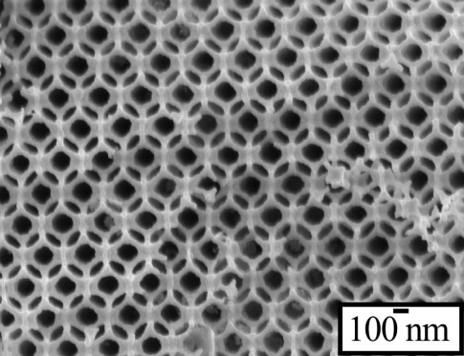
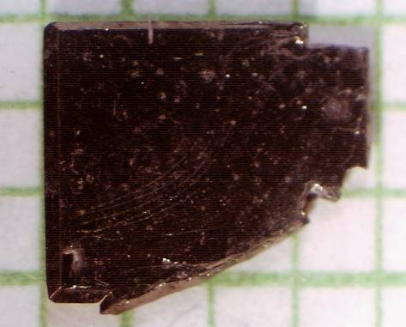
Discovery and Development of New Materials
To expand scientific frontiers and drive technology innovation
Develop new synthesis capabilities and a strong foundation for science-driven materials discovery
Build U.S. leadership in materials synthesis and discovery enterprise to drive technology innovation
The new BES activity will provide:
Research on crystalline materials, including bioinspired approaches, which have
broad technology applications and enable the exploration of novel states of matter.
Establish new synthesis capabilities for materials discovery and synthesis
Crystalline materials by “reverse design”– expanding the use of theoretical tools in materials design
Atom-by-atom design – manipulation of effective dimensionality and connectivity which manifest in novel behavior and properties
Exploiting biological strategies and approaches to materials synthesis and assembly
1mm

Slide 18

Directing Matter and Energy: 2007 BESAC Report
Five Grand Challenges
  How do we control materials properties at the level of electrons?
  How do we design and perfect atom- and energy-efficient synthesis of revolutionary new forms of matter with tailored properties?
  How do remarkable properties of matter emerge from complex correlations of the atomic and electronic constituents and how can we control these properties?
  How can we master energy and information on the nanoscale to create new technologies with capabilities rivaling those of living systems?
  How do we characterize and control matter--especially very far away--from equilibrium?
Creation of New Materials ─ An Essential Component of Science Grand Challenges
18

Slide 19
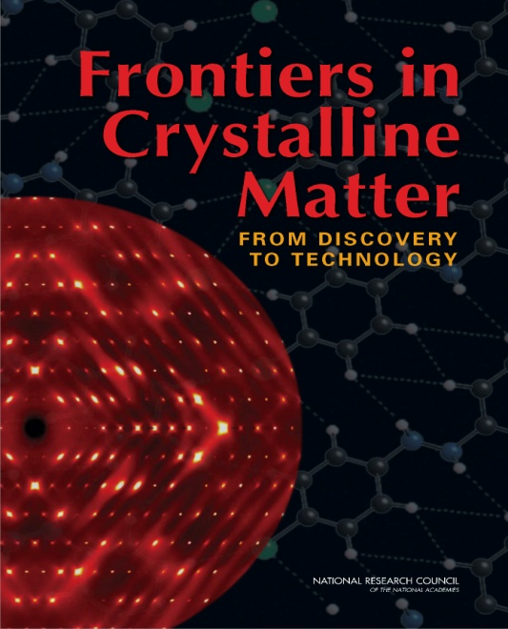
Crystalline Matter: 2009 NRC Report
Three Grand Challenges
  Novel Properties from Next Generation Crystalline Materials
    Manipulation of effective dimensionality and connectivity of crystal substructures to manifest in novel behavior and properties
  Crystalline Materials for Energy Production and Conversion
    Band gap engineering for solar energy conversion, solid state lighting, new superconductors for electricity delivery, catalysts for fuels, new crystalline materials for energy conversion and storage
  Crystalline Materials by Design
    Advances in experimental and theoretical tools will make possible the ability to design materials for specific technological purposes

Slide 20

Inspired by Biology: 2008 NRC Report
Biology can be a source and inspiration to new materials synthesis under mild conditions and novel assembly strategies
  Dynamically adaptive and far-from-equilibrium materials
  Self-repairing materials
  Effective and unique strategies for interfacing biological and non-biological materials for emergent behavior
  Synthetic enzymes
  Material architectures for efficiently integrating light-harvesting, photo-redox, and catalytic functions
  Materials that take inspiration from biological gates, pores, channels, and motors
20

Slide 21
Synthesis Science and Discovery: Implementation
EFRCs –
  Larger centers to broadly address materials discovery and crystals growth
  Provide infrastructure for cutting-edge materials discovery and development
    larger-scale facilities, specialized staff, specialized infrastructure for safely performing processes involving toxic chemicals
    capabilities based upon multidisciplinary teams
  “Thematic” focus to tackle the most significant synthesis challenges related to energy research
Single PIs/Small Groups –
  Unique education and training needed for new materials synthesis and discovery
  High risk, niche research areas
Together, EFRCs and individual PI activities will result in a network for materials discovery across the Nation
  Strong foundation for a culture of science-driven synthesis
  Will provide the scientific and technological impact to return leadership of this crucial field to the U.S.

Slide 22
The Science Base for Multi-Scale Simulation of Internal Combustion Engines

Slide 23
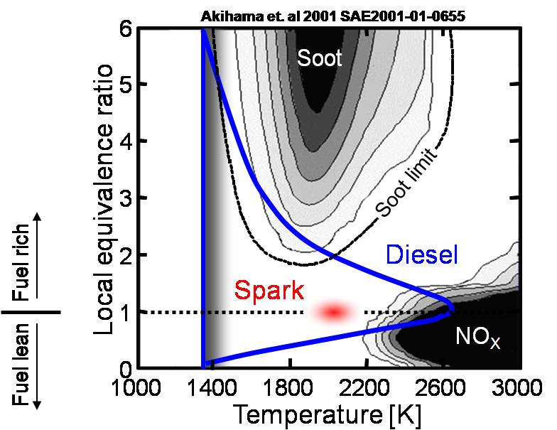


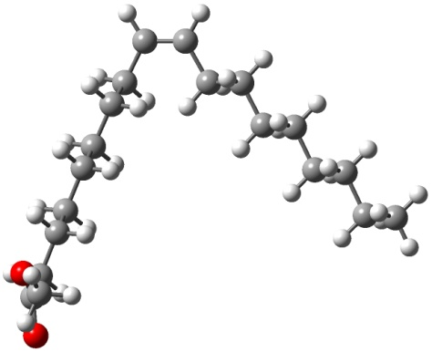

Transportation Combustion Challenge:
How to get “clean” and “efficient”?
Transportation accounts for 60% of oil consumption
Combustion engine viable for decades to come, but efficiency & cleanliness difficult to achieve together
Fuel streams are rapidly evolving
  Heavy hydrocarbons: oil sands, oil shale, coal
  New renewable fuel sources: ethanol, biodiesel
New engine technologies
  Direct Injection (DI)
  Homogeneous Charge Compression Ignition (HCCI)
  Low-temperature combustion
Hybrid vehicle technologies
23

Slide 24
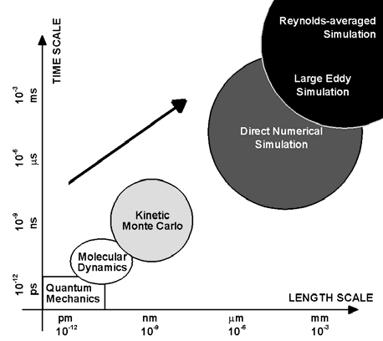
Multi-scale Simulation of Internal Combustion Engines
A new initiative to develop the science base for computational design of advanced engines
Predictive simulation of combustion in an evolving fuel environment is essential for
developing more efficient and cleaner engines.
The scientific community has provided a roadmap via:
  BES workshop: Basic Research Needs for Clean and
  Efficient Combustion of 21st Century Transportation Fuels, October 2006
  BES-ASCR workshop: Discovery in Basic Energy Sciences:
  The Role of Computing at the Extreme Scale, August 2009
  BESAC report: Opportunities for Discovery: Theory and
  Computation in Basic Energy Sciences, January 2005
  SC ongoing collaboration with EERE’s Vehicle Technology Program
The new BES activity (+$20,000K) will accelerate the scientific
foundation for predictive simulation and modeling design by:
  Developing models that span vast scale ranges: coupling of combustion chemistry with turbulent flow requiring simulation over 9 orders of magnitude in space and time.
  Improving understanding of fundamental physical and chemical properties: multi-phase fluid dynamics, thermodynamic properties, heat transfer, and chemical reactivity.
Elements of combustion simulation versus time and length scales

Slide 25
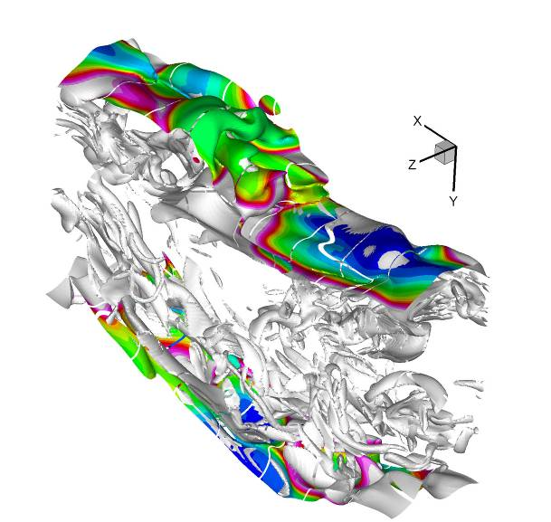
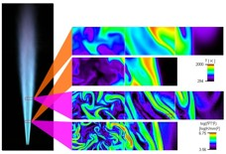
Establishing the science base for multi-scale simulation of advanced engines
Computational chemistry and benchmark combustion simulations (in collaboration with ASCR).
  Numerical investigations of canonical flame behavior
  Automated discovery of chemical reaction mechanisms and kinetics
Experimental validation, verification, and discovery.
  Cinematic imaging of canonical flames
  Mulitplex investigation of chemical reactions
To set the stage for subsequent development of new, science-based engineering tools for advanced engine design (in collaboration with EERE Vehicle Technologies Program).
Top: Direct numerical simulation of a CO/H2 slot flame
Bottom: Imaging of a model flame jet flame
25

Slide 26
Ultrafast Science

Slide 27
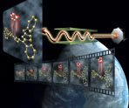
Ultrafast Science
An increase in funding to initiate promising new activities in grand challenge science
Research to expand our understanding of chemistry and materials sciences by allowing stroboscopic investigations of the earliest stages of dynamic phenomena.
Research directions informed by:
  BESAC report: Directing Matter and Energy: Five challenges for
  Science and the Imagination, December 2007
  NRC report: Controlling the Quantum World: The Science of
  Atoms, Molecules, and Photons, July 2006
  BES-DMSE Council Workshop on Ultrafast Materials Sciences ,
  October 2007
  The expanded BES activity (+$5,000K) will provide support for:
  Ultrafast Materials Research at the intersection of ultrafast, optical and measurement science, condensed matter physics/chemistry and nanoscience to observe, control and understand dynamic emergent behavior in materials.
  Atomic, Molecular and Optical Science: applications of new x-ray and optical probes of matter using LCLS; Theoretical and computational methods for interpretation of ultrafast measurements; Use of optical fields to control and manipulate quantum systems for.
LCLS: A femto second camera for molecular processes

Slide 28
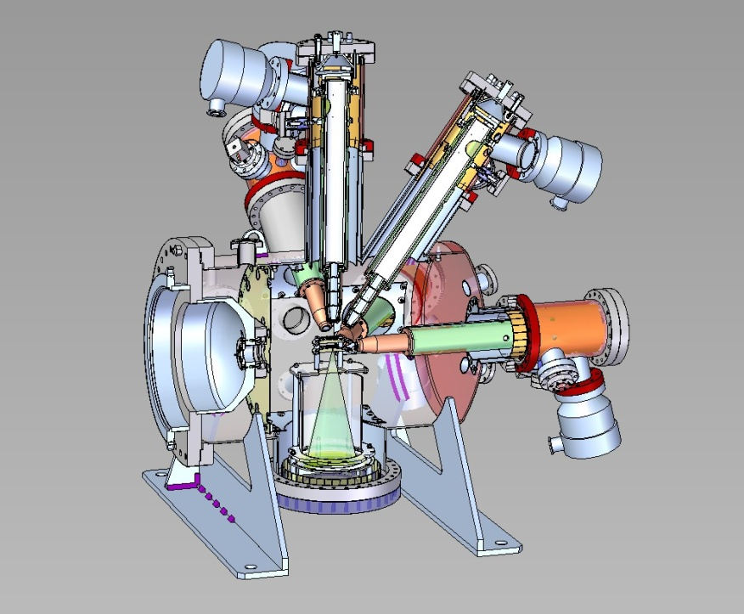
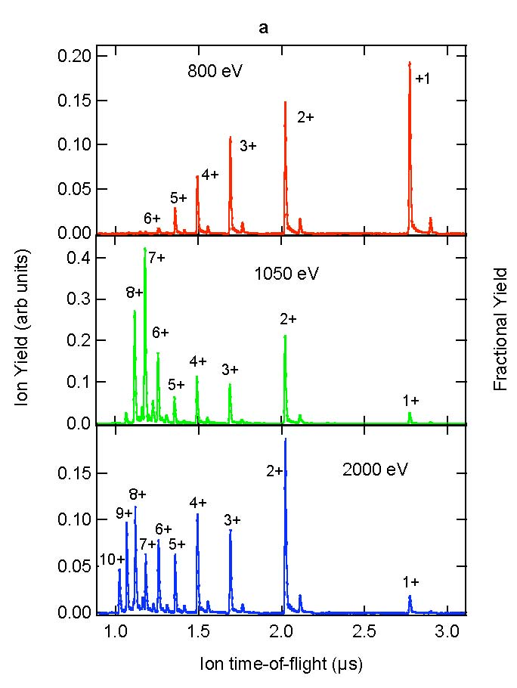
LCLS: First Experiments
First experiments October 1 on the Atomic, Molecular and Optical Science end station (above)
First data, September 2009: Neon stripped bare from the inside-out via inner shell photoionization (schematic left)
28

Slide 29
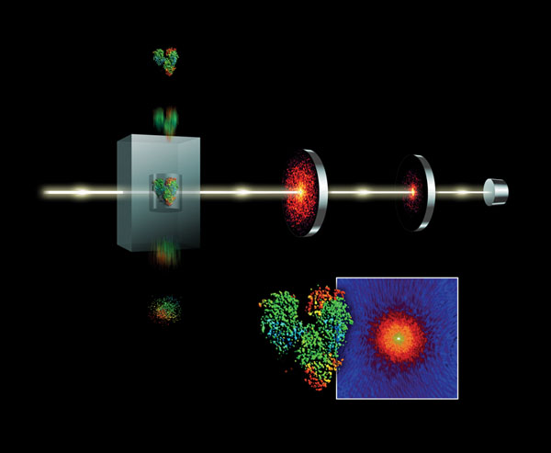
Single Particle Imaging at the LCLS
The advent of ultrafast, ultra
intense x-rays promises to
revolutionize research in structural biology, warm dense matter, femtochemistry and nanoscale dynamics
Recent experiments have captured the first diffraction images of small crystals. A critical need is the development of theoretical methods to invert the diffraction patterns to determine structural, and ultimately, dynamical data.
Using LCLS pulses to probe the ultrasmall and capture the ultrafast
29

Slide 30
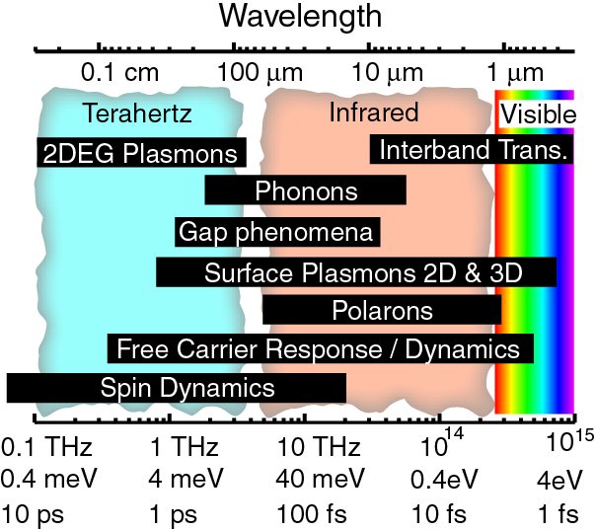
Ultrafast Optics for Material Sciences
~10-100 fs pulses are short enough to resolve processes at the fundamental timescales of electronic and nuclear motion allowing for the discrimination of different dynamics.
Time
electron-electron (fs) electron-phonon (ps) spin-lattice (many ps)
Understanding the interplay between atomic and electronic structure
Beyond single-electron band structure model: correlated systems (charge, spin, orbit, lattice)
Beyond simple adiabatic potential energy surfaces
Competing order parameters
Understanding the nature of quasiparticles
Formation dynamics, scattering processes, relaxation channels and dynamics
Creating new states of matter
Photoinduced phase transitions—fast switching, probing dynamics where the order parameter has been perturbed, creating nonthermally accessible phases.
Source: D. Basov
30

Slide 31
Staffing Update

Slide 32
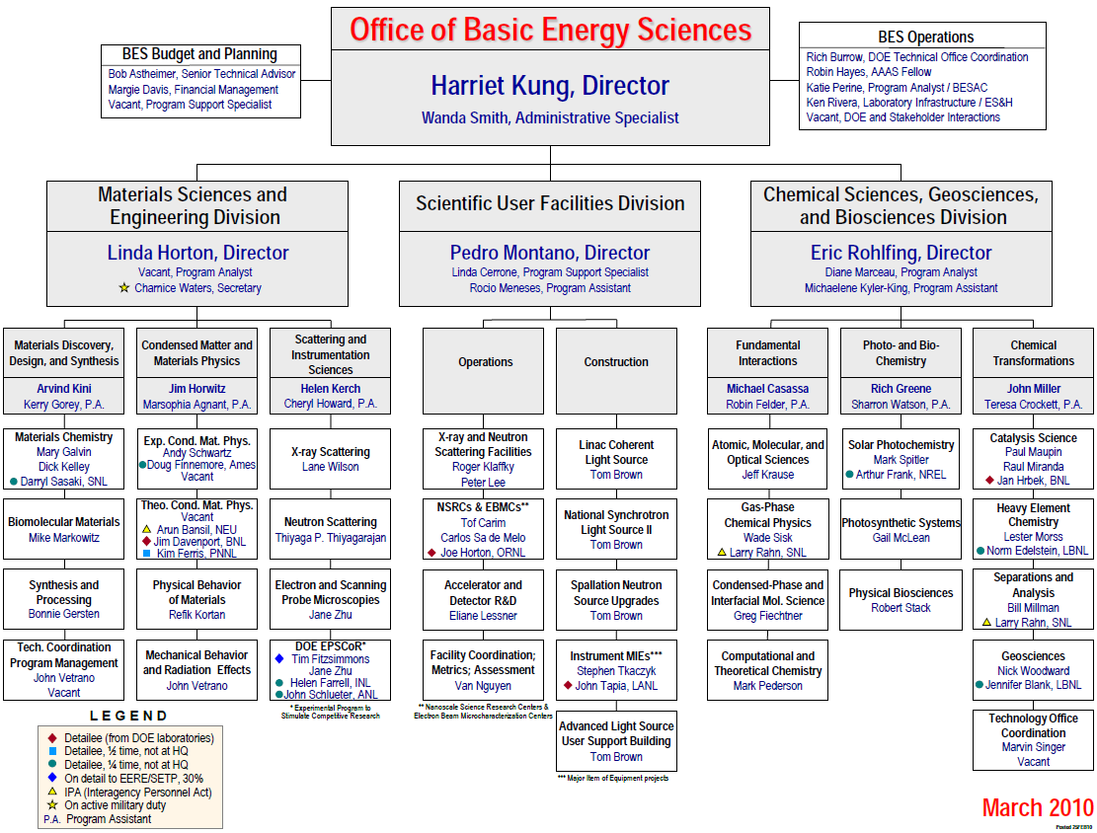
New
Vacancy

Slide 33
BESAC Science for Energy Technology Subcommittee Report

Slide 34
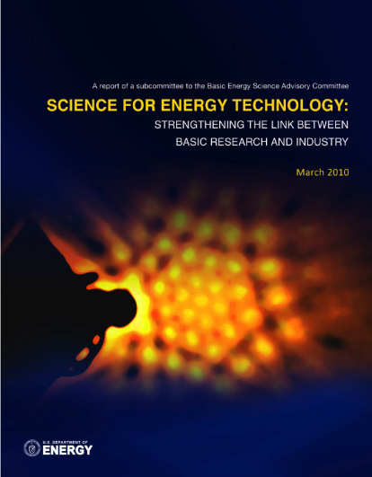
BESAC & BES Strategic Planning Activities
Science for Discovery
Complex
Systems
Science for National Needs
National Scientific User Facilities, the 21st century tools of science
http://www.sc.doe.gov/bes/reports/list.html
34

Slide 35

BESAC Science for Energy Technology Report (Draft)
"The opportunities are large, and the potential impacts on clean energy technologies and on economic and jobs growth are high. Seizing the opportunity requires maintaining BES’s commitment to basic fundamental science, and also finding new mechanisms for BES-funded and industrial scientists to work together in addressing the key scientific challenges of clean energy development. These collaborations will produce greater understanding and control of sustainable energy conversion at the nanoscale, and faster translation of this knowledge to industry where it can bring emerging clean energy technologies to competitive viability and transformative impact on our economy."

Slide 37
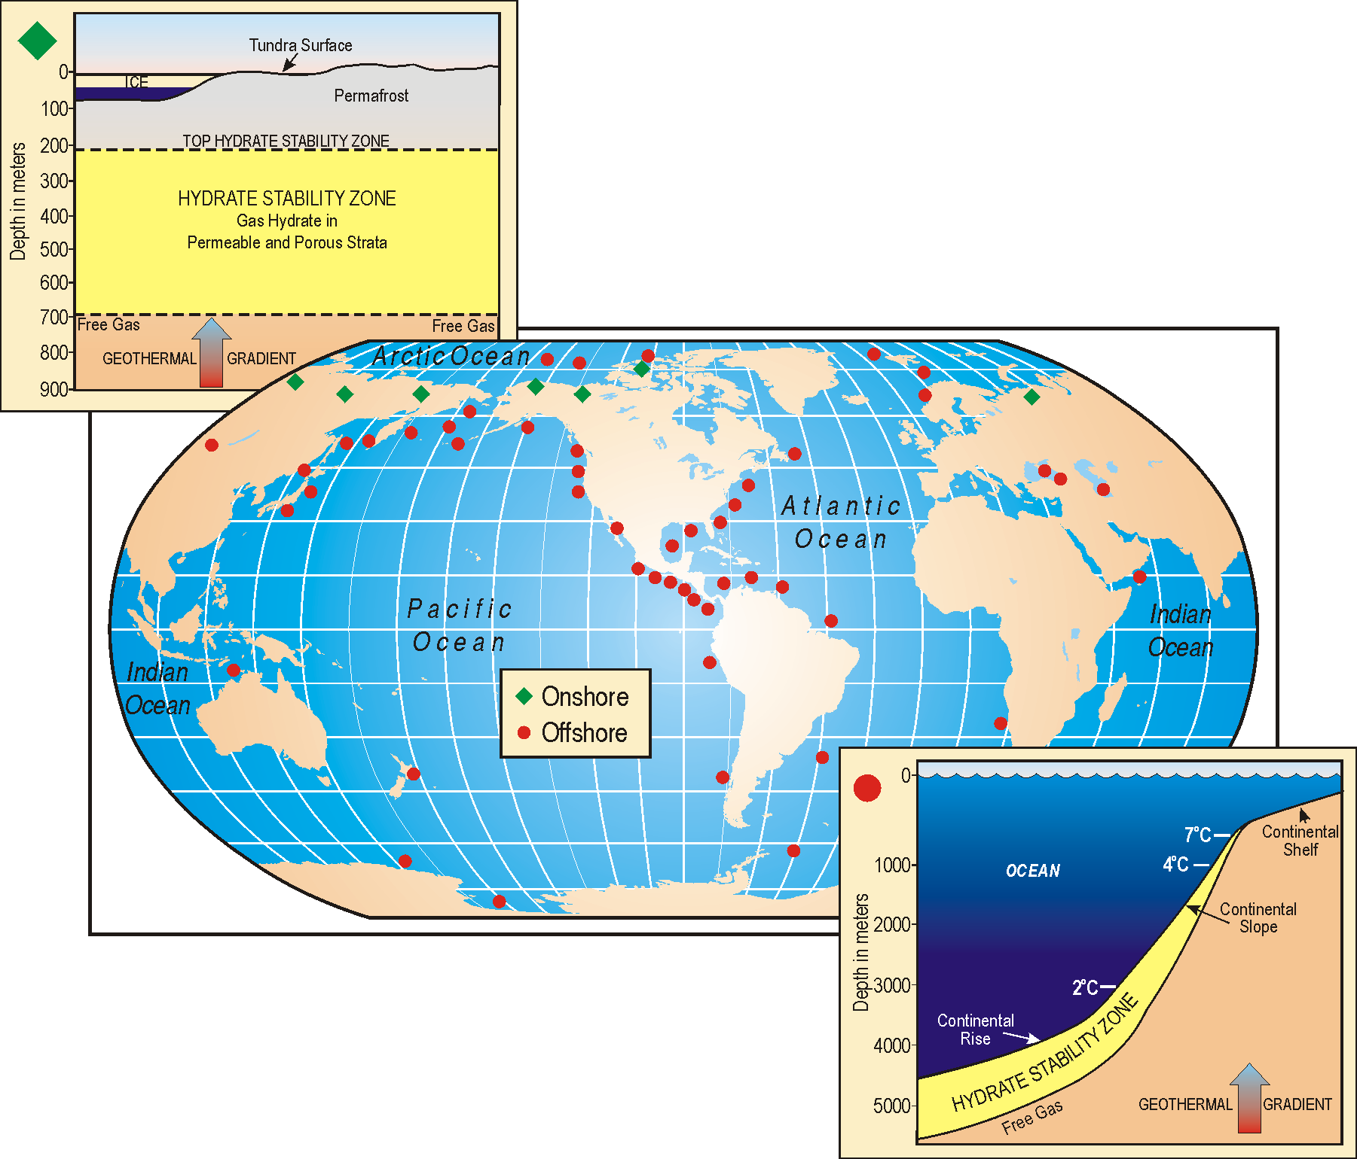
Geosciences Research for Gas Hydrates
Developing the science base for understanding the potential of gas hydrates as a resource
BES research will investigate fundamental scientific questions about methane hydrates: their formation and occurrence; their stability in natural or engineered systems; their role in geological/ ecological systems; and their role in the carbon cycle (+$17,517K).
The program will also study hydrates via controlled in situ depressurization and physical, thermal, and chemical stimulation in the Arctic and the Gulf of Mexico. This research will be supported by theory and multi-scale modeling and simulation in areas such as the intermolecular forces that govern the structure and properties of gas hydrates.
Free Gas
Free Gas
GEOTHERMAL GRADIENT

Slide 38
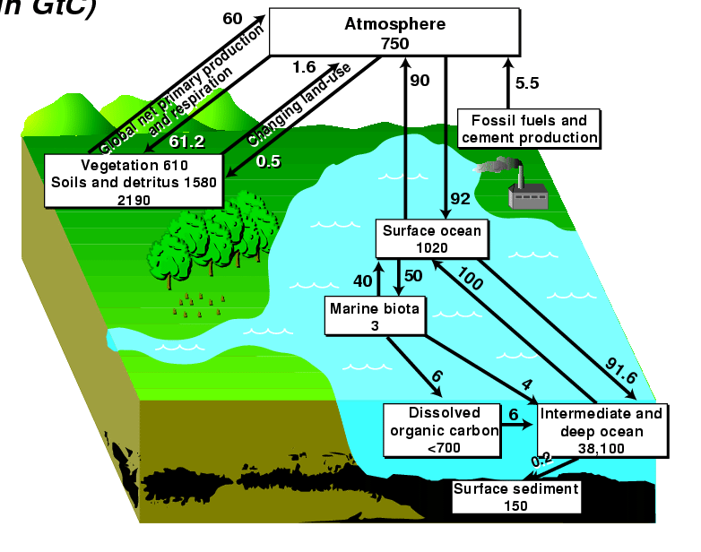

Geosciences for understanding and tracking the effects of greenhouse gas mitigation strategies
The Global Climate/Greenhouse Gas cycle includes both natural exchanges of gases, particulates, and water among the earth, the atmosphere and the oceans, and anthropogenic exchanges from industrial, commercial and other human activities. The challenge is to develop a deeper understanding of the natural exchanges of gases and particulates, which can control whether and how anthropogenic activities affect global climate and how those effects might be modified.
The scientific community led by BES supported investigators is poised to expand efforts in this area based on recent workshops:
  BES workshop: Basic Research Needs for Geosciences: Facilitating 21st Century Energy Systems, February 2007
  ASCR workshop: Computational Subsurface Sciences Workshop, January 9-12, 2007
The BES Geosciences activity (+$10,000K) will focus on enhanced field, experimental and theoretical investigations of CO₂ – rock/mineral interactions and other related topics.
  The research will produce new tools and techniques enhancing long-standing BES capabilities in optical and physico-chemical diagnostics related to geosciences.
  This research will develop newer, higher resolution, more broadly applicable approaches to verify the effectiveness of CO₂ sequestration and other potential geological greenhouse gas mitigation measures.
  Emphasis will be placed on geochemical and geophysical studies and computational analysis of complex subsurface fluids, particles and solids, the dynamics of fluid flow, associated rock deformation, and modeling integrating multiple data types for prediction of subsurface processes and properties.
Insufficient understanding exists about background earth - atmosphere CO₂ or other GHG interactions.
Multi-scale geological processes need to be investigated and modeled to verify effective greenhouse gas management solutions

Slide 39

Multi-scale Simulation of Internal Combustion Engines
A new initiative to develop the science base for computational design of advanced engines
Predictive simulation of combustion in an
evolving fuel environment is essential for
developing more efficient and cleaner engines.
The scientific community has provided a roadmap via:
  BES workshop: Basic Research Needs for Clean and
  Efficient Combustion, October 2006
  ASCR/BES workshop: Discovery in Basic Energy Sciences:
  The Role of Computing at the Extreme Scale, August 2009
  SC ongoing collaboration with EERE’s Vehicle
  Technology Program
The new BES activity (+$20,000K) will provide:
  Models that span vast scale ranges: coupling of combustion chemistry with turbulent flow requiring simulation over 9 orders of magnitude in space and time.
  Improved understanding of fundamental physical and chemical properties: multi-phase fluid dynamics, thermodynamic properties, heat transfer, and chemical reactivity.
  Engine simulation: science-based predictive simulation and modeling design

