Slide 1
Fusion Energy Sciences Program
Update to FESAC
Following release of the FY’12 Congressional Budget Request
March 7, 2011
Edmund J. Synakowski
Associate Director, Office of Science
for Fusion Energy Sciences
Office of Science, U.S. DOE

Slide 2
Welcome… and thank you
Welcome to new FESAC members, and thanks to those continuing to serve
There are clear directions in which we need to move. The priorities are informed by FESAC advice.
These directions, described at the last FESAC meeting and other national forums, drive internal budget discussions, choices, and paths forward

Slide 3
In this overview…
This Administration, science, and fusion
Priorities, opportunities, and the FY’12 Budget proposal
FES work approaches and engagement with the community

Slide 4
For 2012, the Administration proposes to make sacrifices in many areas of science and energy
From Secretary Chu, regarding sacrifice:
“In the Office of Energy Efficiency and Renewable Energy, the Department is reducing funding for the hydrogen technology program by more than 41 percent, or almost $70 million, in order to focus on technologies deployable at large scale in the near term.
“In January, the Department decided to end operation of the Tevatron at Fermi National Laboratory rather than extend it through FY 2014, which will save taxpayers a projected $35 million for FY 2012.
“The Department is reducing the budget for the Office of Fossil Energy by 45 percent, or $418 million. This includes zeroing out the Fuels Program, the Fuel Cells Program, the Oil and Gas Research and Development Program, and the Unconventional Fossil Technology Program.
“Additionally, current law provides a number of credits and deductions that are targeted towards certain oil, gas and coal activities. In accordance with the President's agreement at the G-20 Summit in Pittsburgh to phase out subsidies for fossil fuels so that the country can transition to a 21st century energy economy, the Administration proposes to repeal a number of tax preferences available for fossil fuels. Repeal of these preferences will save the taxpayer approximately $3.6 billion in FY 2012. The ten-year estimate (FY2012 to FY2021) is $46.2 billion.
“The FY 2012 budget request closes the Holifield Radioactive Ion Beam Facility at the Oak Ridge National Laboratory, which will save $10.3 million.”
The FES funding request increase, as compared to the ‘11 request, with an increase in ITER project funding compared to ‘11, is notable and important. We need to support this.
Notes:
Provides $380M, a reduction of $46M
Reduces ITER funding to $80M
Supports most program areas at the FY 2010 level
Provides increases for:
HEDLP (+6.5M)
Fusion Simulation Program (+$2M)
NSTX MIE Upgrade (+1.1M)
DIII-D and Alcator C-Mod Facility Operations
(+2.3M DIII-D and +1.0M C-Mod)
Materials (+$.5M)

Slide 5
The Administration is committed to targeted science investments with near-term payoffs
In the Office of Science, the Department requests $5.4 billion, a 9.1 percent or $452 million increase over the FY 2010 current appropriation levels, and a 4.6% increase over the FY 2011 request, to advance U.S. leadership in basic and applied science and to support targeted investments in basic research relevant to new clean energy technologies
The focus is on investments that have the promise of paying off in the marketplace in the near term. BES’s Energy Hubs are an example of this. It is as measured with these priorities that this fusion research program is being developed and executed.
Fusion’s request of $399.7M represents a 6% decrease compared to the FY 2010 appropriation and a 5.1% increase over the FY 2011 request.
Science overall does comparatively well in this budget while other endeavors are challenged. By this standard fusion will be the envy of most federal enterprises.
Notes:
Provides $380M, a reduction of $46M
Reduces ITER funding to $80M
Supports most program areas at the FY 2010 level
Provides increases for:
HEDLP (+6.5M)
Fusion Simulation Program (+$2M)
NSTX MIE Upgrade (+1.1M)
DIII-D and Alcator C-Mod Facility Operations
(+2.3M DIII-D and +1.0M C-Mod)
Materials (+$.5M)

Slide 6
In this overview…
This Administration, science, and fusion
Priorities, opportunities, and the FY’12 Budget proposal
FES work approaches and engagement with the community

Slide 7
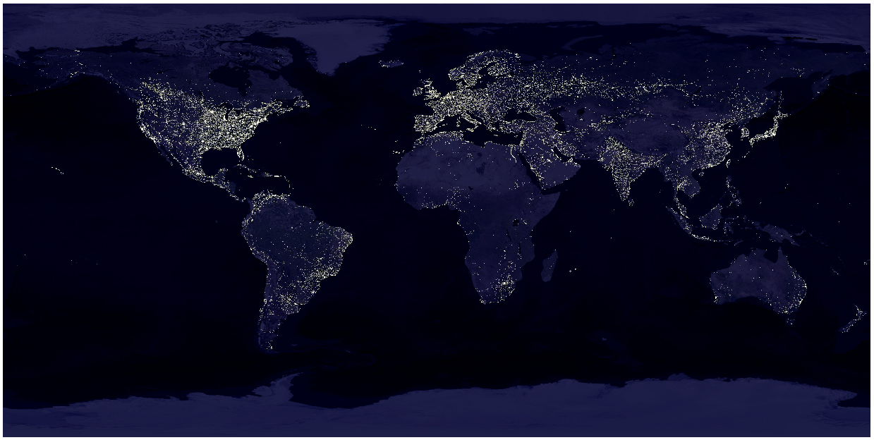
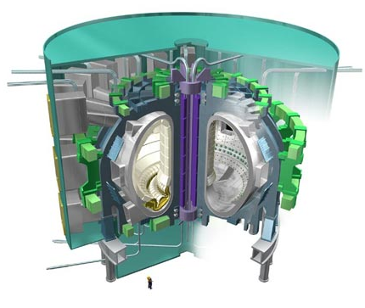
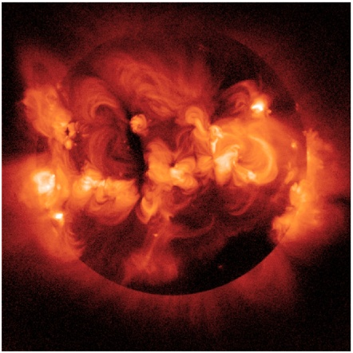
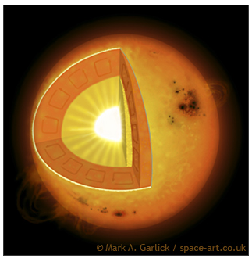
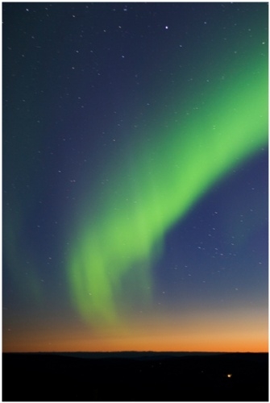
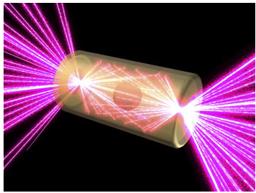
The science that undergirds fusion energy is far-reaching and is poised for a transformation
The science pursued by FES may form the basis for powering the planet through fusion energy: bringing a star to earth.
This science enables a deeper understanding of our universe and has a wide range of practical applications.
Our long term interests in major projects and energy are well served by nurturing of discovery and innovation

Slide 8
The U.S. is a world leader in establishing the scientific basis for fusion energy and understanding the plasma universe
Understanding for fusion on earth and of the plasma universe
Mission
The mission of the Fusion Energy Sciences (FES) program is to expand the fundamental understanding of matter at very high temperatures and densities and to develop the scientific foundations needed to develop a fusion energy source. This is accomplished by the study of the plasma state and its interactions with its surroundings.
Priorities
Advance the fundamental science of magnetically confined plasmas
Pursue scientific opportunities and grand challenges in high energy density plasma science
Support the development of the scientific understanding required to design and deploy fusion materials
Increase the fundamental understanding of plasma science beyond burning plasmas
Burning plasma science
Plasma dynamics and control science
Plasma-materials science and technology
Discovery science

Slide 9
The U.S. is a world leader in establishing the scientific basis for fusion energy and understanding the plasma universe
Understanding for fusion on earth and of the plasma universe
Mission
The mission of the Fusion Energy Sciences (FES) program is to expand the fundamental understanding of matter at very high temperatures and densities and to develop the scientific foundations needed to develop a fusion energy source. This is accomplished by the study of the plasma state and its interactions with its surroundings.
Priorities
Advance the fundamental science of magnetically confined plasmas
Pursue scientific opportunities and grand challenges in high energy density plasma science
Support the development of the scientific understanding required to design and deploy fusion materials
Increase the fundamental understanding of plasma science beyond burning plasmas
Burning plasma science
Drives the need for major facility operations, V&V, step forward in international research, and investment in validated simulation
Plasma dynamics and control science
Plasma-materials science and technology
Discovery science

Slide 10
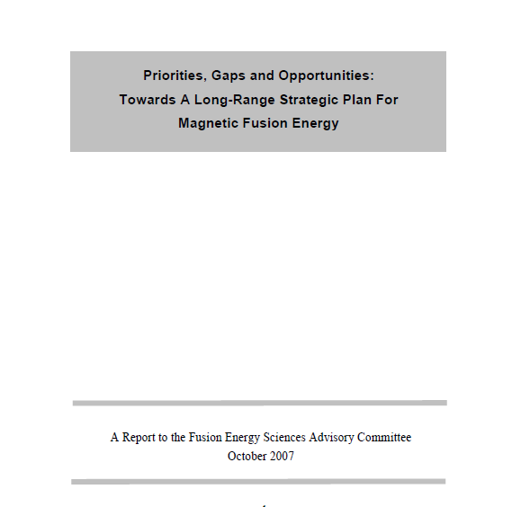
The U.S. is a world leader in establishing the scientific basis for fusion energy and understanding the plasma universe
Understanding for fusion on earth and of the plasma universe
Mission
The mission of the Fusion Energy Sciences (FES) program is to expand the fundamental understanding of matter at very high temperatures and densities and to develop the scientific foundations needed to develop a fusion energy source. This is accomplished by the study of the plasma state and its interactions with its surroundings.
Priorities
Advance the fundamental science of magnetically confined plasmas
Pursue scientific opportunities and grand challenges in high energy density plasma science
Support the development of the scientific understanding required to design and deploy fusion materials
Increase the fundamental understanding of plasma science beyond burning plasmas
Burning plasma science
Plasma dynamics and control science
Plasma-materials science and technology
Urgent international need. U.S. leadership opportunity
Discovery science
The subject of the on-going Fusion Nuclear Science
Pathways Assessment, which you will hear about

Slide 11
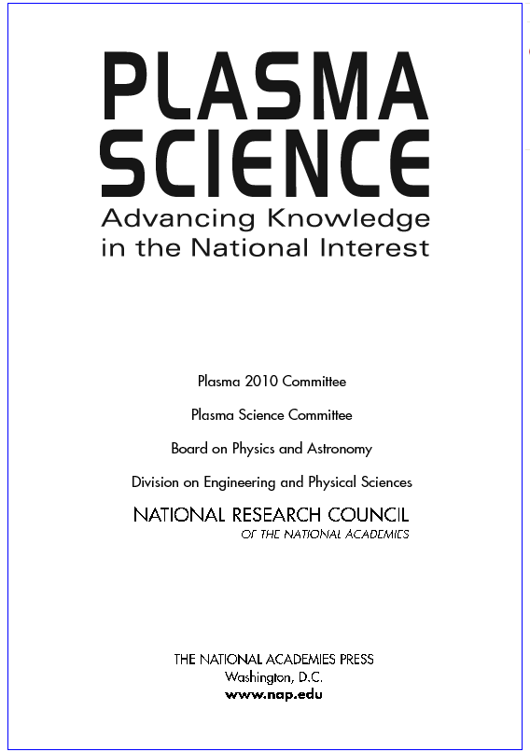
The U.S. is a world leader in establishing the scientific basis for fusion energy and understanding the plasma universe
Understanding for fusion on earth and of the plasma universe
Mission
The mission of the Fusion Energy Sciences (FES) program is to expand the fundamental understanding of matter at very high temperatures and densities and to develop the scientific foundations needed to develop a fusion energy source. This is accomplished by the study of the plasma state and its interactions with its surroundings.
Priorities
Advance the fundamental science of magnetically confined plasmas
Pursue scientific opportunities and grand challenges in high energy density plasma science
Support the development of the scientific understanding required to design and deploy fusion materials
Increase the fundamental understanding of plasma science beyond burning plasmas
Burning plasma science
Plasma dynamics and control science
Plasma-materials science and technology
Discovery science
Common to all elements of FES, and captures our need to reach beyond the challenges of particular targets

Slide 12
FES priorities govern the choices we’ve made
Burning plasma science, the ITER project and our future research program ➔ This past year was marked by an outstanding effort by SC leadership in addressing critical issues. Our ITER future drives the demand for continued or growing major facility operations, 3D physics, careful consideration for how we proceed with validated simulation, and growth of international research. The ITER project and related physics requires continued strong community support
Plasma dynamics and control science ➔ Major facility operations and upgrades need to be sustained or grown. International research needs to be developed and strengthened. FNSF-scenario-relevant and burning plasma research needs to be focused and strengthened.
Materials science/fusion nuclear science ➔ Materials science investment required in experiment as well as computation. Also places emphasis on major facility operations, international research, and provides an opportunity for university engagement.
The Plasma 2010 call for a federal home for plasma science ➔ need to grow Discovery Science to provide opportunity for non-BP-related experiments to compete, especially where we have opportunities for leverage
Budgetary constraints and implications for how we govern our science ➔ careful consideration of the Fusion Simulation Program is in order after completion of planning activity in FY’11
HEDLP science to inform IFE and for discovery, maximizing leverage with other agencies and laboratories, priority for near-term results, and capturing our ARRA investments ➔ FES will reconfigure some of our HEDLP research portfolio, through solicitation, review, and assessment by this office
Notes:
Provides $380M, a reduction of $46M
Reduces ITER funding to $80M
Supports most program areas at the FY 2010 level
Provides increases for:
HEDLP (+6.5M)
Fusion Simulation Program (+$2M)
NSTX MIE Upgrade (+1.1M)
DIII-D and Alcator C-Mod Facility Operations
(+2.3M DIII-D and +1.0M C-Mod)
Materials (+$.5M)

Slide 13

FY 2012 FES Congressional Request ($399.7M)
Facility Operations: $195,882K
ITER at $105M
13 Weeks of post- upgrade DIII-D operations
17 run weeks of Alcator C-Mod
10 Weeks of NSTX operations prior to major upgrade shutdown
NSTX MIE Upgrade
General Plant Projects/ Infrastructure
Research: $177,816K
DIII-D, C-Mod, NSTX
International Collaborations
High Energy Density Laboratory Plasmas
Outreach & Education
Innovative Confinement Concepts (ICCs) - Experimental Plasma Research
Diagnostics
Madison Symmetric Torus (MST)
Theory and Modeling
SciDAC
General Plasma Science
SBIR/STTR
Enabling R&D: $26,002K
Plasma Technology
Advanced Design Studies
Materials Research
*Smaller Scale MFE includes ICCs and MST
**Other includes SBIR/STTR, Outreach, Education & Diagnostics

Slide 14
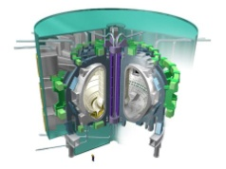
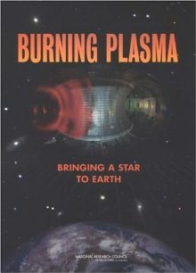
ITER is the keystone for establishing the scientific and technological feasibility of magnetic fusion energy
Understanding for fusion on earth and of the plasma universe
Facilities Operations: U.S. ITER Project MIE
ITER will advance every element of science and technology required to establish the basis for fusion: burning plasma science, plasma control science, technology, and discovery
FY’12 request | FY’10 enacted | FY’11 request | FY’12 – FY’10
$105M | $135M | $80M | -$30M
Note increase from FY’11 request. Request reflects the accelerated pace of ITER construction as of mid-2010. Emphasis will be given to industrial involvement in completing design work in preparation for subsequent large-scale fabrication activities.
Designs will be completed with industry input for the majority of U.S. hardware needed for first plasma, including the largest U.S. hardware subsystems: Central Solenoid Magnets and
Tokamak Cooling Water.
Long-lead items for magnet materials and Ion/Electron Cyclotron heating systems will be initiated and R&D will continue to support finalization of design efforts for diagnostics and other systems. Purchase of hardware for the U.S share of the Steady State Electrical system will also be initiated. Toroidal field magnet conductor production will be largely completed.
Burning plasma science
Plasma dynamics and control science
Plasma-materials science and technology
Discovery science

Slide 15
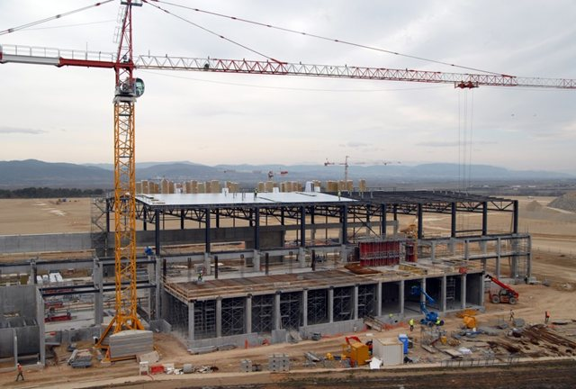
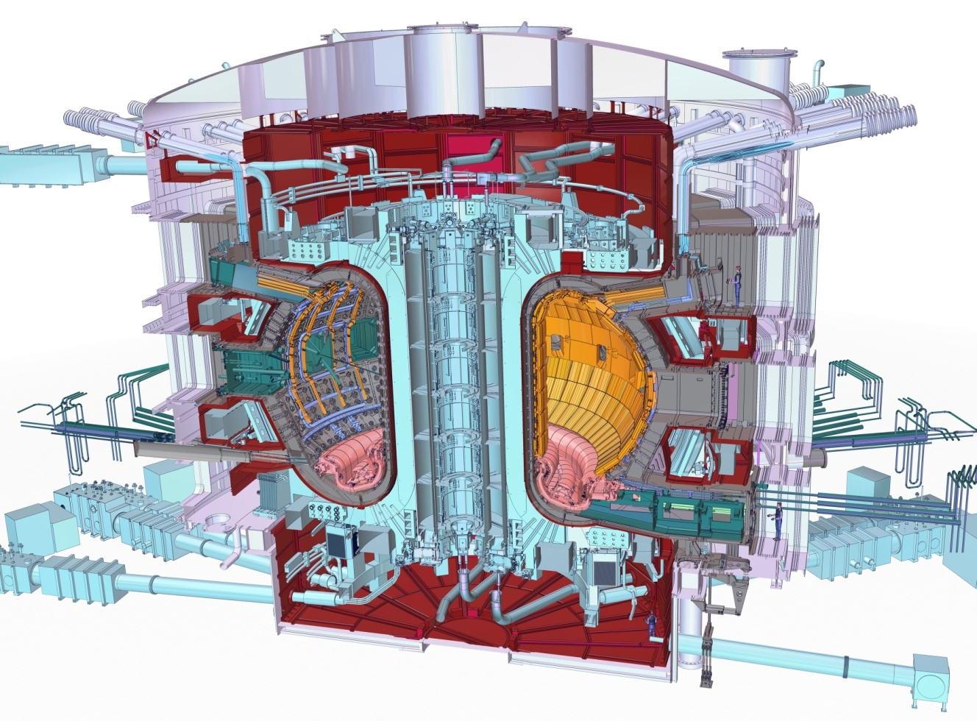
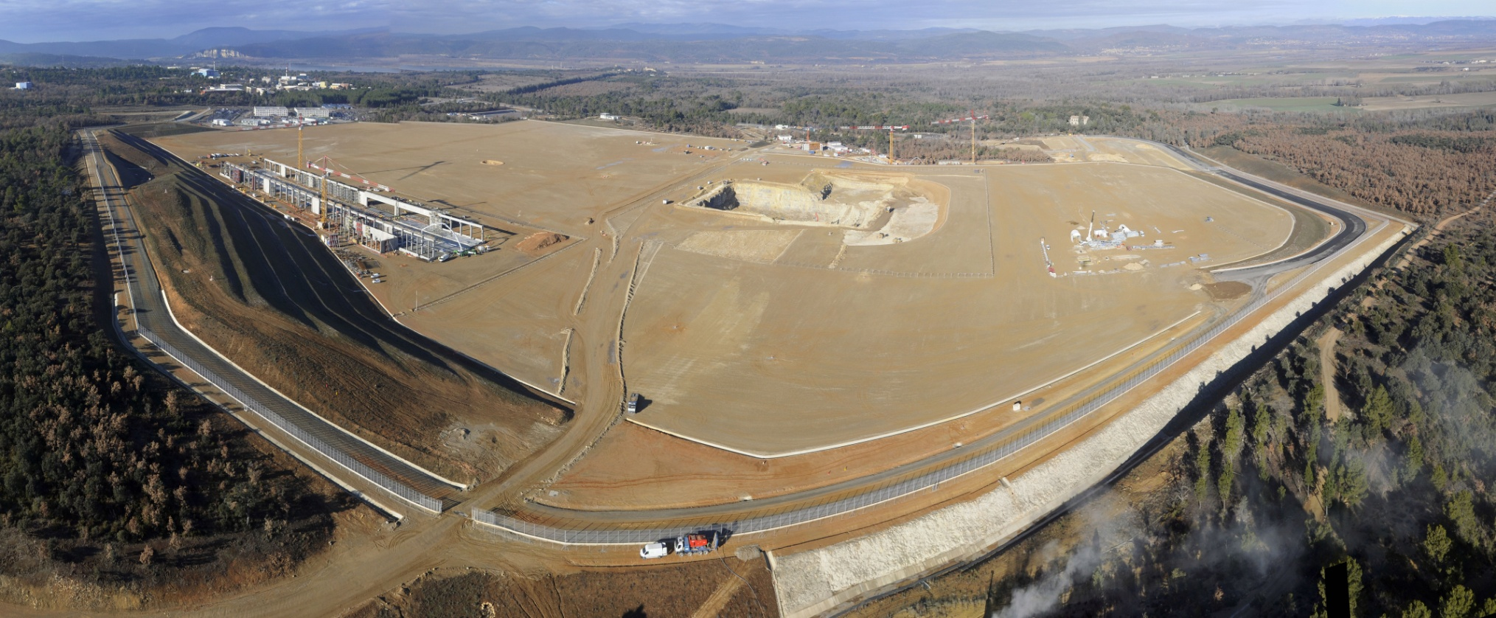

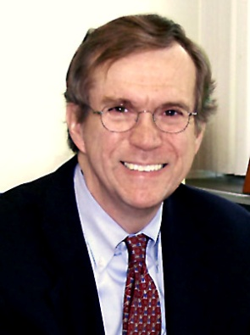
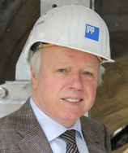
There has been important progress in constructing ITER
This past year, the U.S. led a series of initiatives to put in place a world-leading management team essential for the construction phase of ITER, and to establish a credible schedule and cost basis.
Poloidal winding building construction
Site construction is underway
The ITER Device
New project leadership
Rich Hawryluk (U.S., from PPPL); new DDG for Administration
Rem Haange (Netherlands), new DDG for ITER Construction
Director General Motojima
Notes:
Provides $380M, a reduction of $46M
Reduces ITER funding to $80M
Supports most program areas at the FY 2010 level
Provides increases for:
HEDLP (+6.5M)
Fusion Simulation Program (+$2M)
NSTX MIE Upgrade (+1.1M)
DIII-D and Alcator C-Mod Facility Operations
(+2.3M DIII-D and +1.0M C-Mod)
Materials (+$.5M)

Slide 16
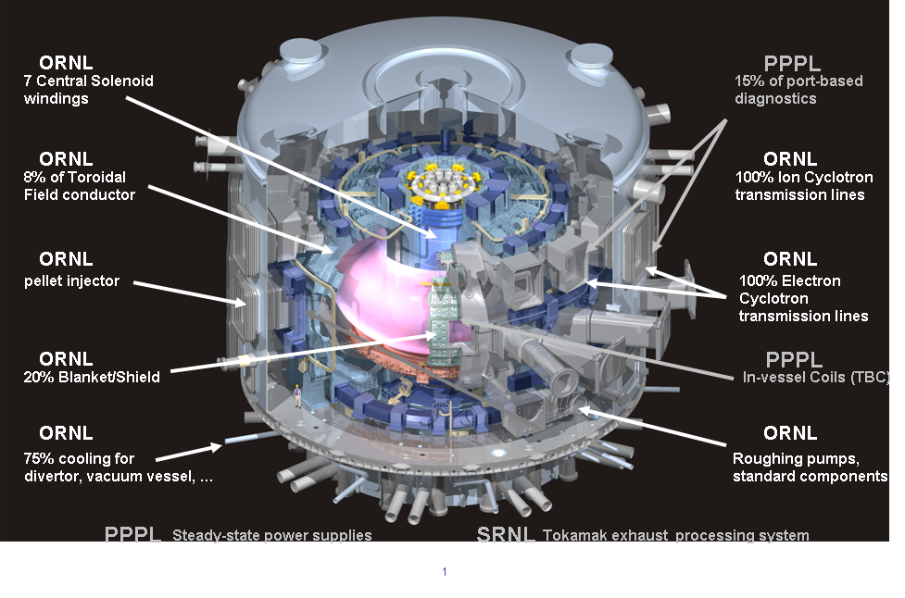
U.S. ITER In-kind Hardware Contributions
Procurement Arrangement Signed
Awarded contract for ~40tons of Nb₃Sn Strand
Procurement Arrangement Signed
Procurement Arrangement Signed
Procurement Arrangement & BOASigned
Notes:
16

Slide 17
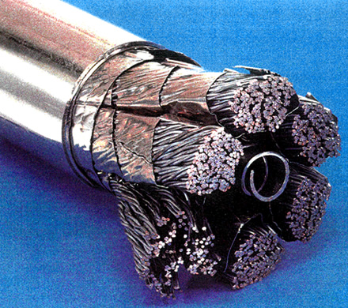
The U.S. ITER Project has already been of benefit to U.S. industry
Over the life of the project, 80-90% of the funds allocated for hardware construction will be awarded competitively to U.S. industry
The ITER Agreement calls for a roughly 80-20 split between in-kind contributions and contributions to the IO. As such, a large percentage of U.S. ITER funding will be used to fulfill our in-kind contribution commitments, primarily through contracts with U.S. industry. The value of industrial contracts will be roughly as follows:
  Cumulative through Sept 2011 = ~$155 M
  In FY12 - ~$85M
  FY13 and beyond will be ~$1300M
The US ITER Project Office (USIPO) has been working with industry through industrial design and engineering contracts and to develop cost estimates for the U.S. scope of work on ITER. The USIPO will be ramping up procurements over the next couple of years.
It works both ways - The EU has let a contract to Luvata Industries for its superconducting strand ($58M; Connecticut)
South Korea has let a contract to CICFET for superconductor integration ($6.5M; Florida)
Notes:
Provides $380M, a reduction of $46M
Reduces ITER funding to $80M
Supports most program areas at the FY 2010 level
Provides increases for:
HEDLP (+6.5M)
Fusion Simulation Program (+$2M)
NSTX MIE Upgrade (+1.1M)
DIII-D and Alcator C-Mod Facility Operations
(+2.3M DIII-D and +1.0M C-Mod)
Materials (+$.5M)

Slide 18
The major facilities are critical elements of the U.S. research program and contribute to every major research element, most notably plasma control science
Our research approach needs to sharpen to settle hard questions of ITER scenarios, FNSF choices, and materials science
University-scale programs need to join forces where suitable in settling critical questions
Understanding for fusion on earth and of the plasma universe
Facilities Operations and Science Budgets: DIII-D, NSTX, and Alcator C-Mod
Facility | FY’12 request | FY’10 enacted | FY’12 – FY’10
DIII-D Research, Operations | $28.9M $39.7M | $27.2M $37.8M | +$1.7M, +1.9M
Alcator C-Mod Research + Operations | $10.5M, $18.0M | $9.0M, $17.4M | +$1.4M, +6M
NSTX Research + Operations | $17.5M, $17.6M | $16.9M, $21.3M | +$0.7M, -$3.8M
NSTX Upgrade MIE | $14.6M | $8.9M | +$5.7M
Burning plasma science
leading strength, but need to complement major facility capabilities with international
DIII-D and C-Mod R+O increases will provide for 13 run weeks on DIII-D and 17 run weeks on C-Mod, enabling full utilization of upgrades and ARRA investments. NSTX will operate for 10 weeks prior to a full shutdown to construct the NSTX Upgrade
NSTX upgrade, to be completed in FY’15, will double the magnetic fields and plasma current carrying capability, enabling NSTX to retain world leadership in this geometry and putting it on the critical path to assess the vaibility of the Spherical Tokamak concept as a future Fusion Nuclear Science Facility.
Plasma dynamics and control science
Plasma-materials science and technology
high quality science in U.S., but we can deepen and focus this effort on our major facilities
Discovery science

Slide 19
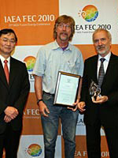
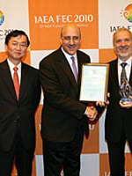
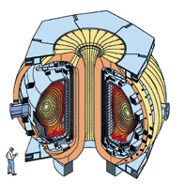
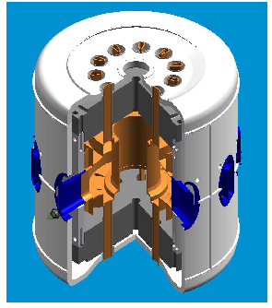
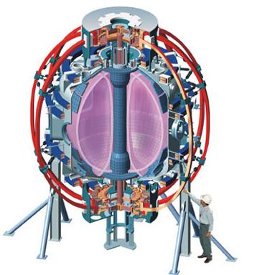
Research on the major U.S. facilities is highly impactful – it is noted in DOE leadership, and by our international partners
John Rice (MIT, 2010 recipient, and Steve Sabbagh, (Columbia University, 2009 recipient for research carried out on NSTX and DIII-D) were awarded their prizes in 2010 at the IAEA meeting in Daejon, South Korea. They join previous winners Todd Evans (General Atomics, San Diego; 2008) and Tim Luce (General Atomics, 2006).
John Rice
Steve Sabbagh
Four of the first five recipients of the Nuclear Fusion Prize are U.S. researchers. The prize is awarded annually to the researcher who authored the most impactful publication in the field of fusion energy research worldwide. Two are from universities and all awards are for research conducted on our major facilities
Each year, a shortlist of ten papers is nominated for the Nuclear Fusion prize. These are papers of the highest scientific standard, published in the journal volume from two years previous to the award year. Nominations are based on citation record and recommendation by the Board of Editors. The Board then votes by secret ballot to determine which of these papers has made the largest scientific impact. DD

Slide 20
International Research grows in the proposed FY’12 budget
Leading-edge technologies are overseas. We’ve been offered programmatic seats and can help make these programs advance the overall fusion cause.
How we respond with labs and universities to these opportunities in the next decade will be a major factor determining our future place on the world stage
Such efforts will define our work approach on ITER, and will justify a vigorous U.S. fusion community active on the international scientific frontier
Understanding for fusion on earth and of the plasma universe
Science: International Research Budget
Area | FY’12 request | FY’10 enacted | FY’12 – FY’10
International Research | $7.4M | $5.0M | +$2.4M
Reasons for change: The next generation of research magnetic fusion research facilities is being built overseas. Superconducting tokamaks (based on U.S. designs) are now operating in China (EAST, Hefei) and South Korea (K-STAR). All major new facilities have offered the U.S. a leadership seat at the program governance table.
The research model is for U.S. teams, formed by national labs, private industry, and universities, to participate on-site and with remote data centers
Developing these approaches is a leading challenge for FES and will lead to a research team model to be implemented on ITER
Burning plasma science
Major opportunities and needs
Plasma dynamics and control science
Plasma-materials science and technology
Discovery science

Slide 21
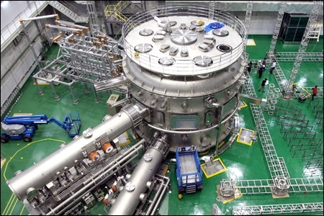
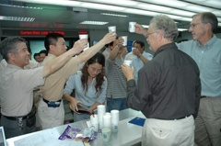
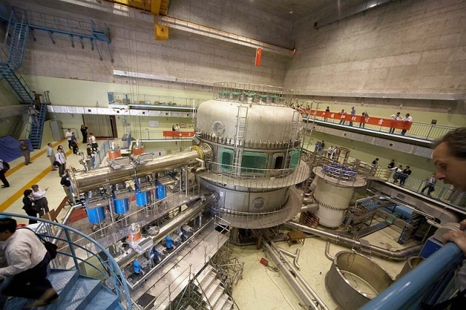
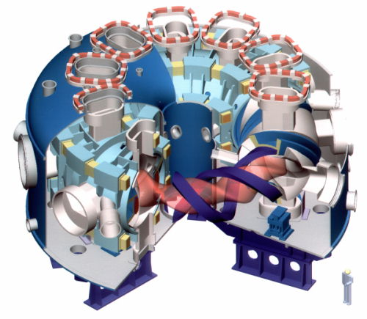
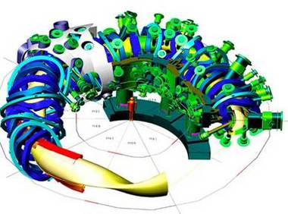
Emergent opportunities for plasma control research, with superconducting magnetic technology, reside overseas
K-STAR
Daejon, S. Korea
Goal: 300 s pulse 2 MA
EAST
Hefei, China
Goal: 1000 s 1 MA
The DIII-D control system has been implemented on K-STAR and EAST devices
W7-X stellarator (Germany – mid-decade)
LHD stellarator
(Japan – > 100,000 plasmas!)

Slide 22
Materials and Enabling Technologies research grows in the proposed FY’12 budget
Increasing this priority reinforces the conclusions of the Gaps, Priorities, and Opportunities Report
FES has keen interest in the output of the Fusion Nuclear Science Pathways Assessment, with particular attention on information relevant to
near-term solicitations
Enabling Research and Development
Understanding for fusion on earth and of the plasma universe
Area | FY’12 request | FY’10 enacted | FY’12 – FY’10
Materials Research | $ 7.7M | $6.5M | +$1.2M
Plasma Technology | $15.8M | $13.9M | -$1.9M
Advanced Design Studies | $4.4M | $3.4M | +$1M
Explanation for changes:
Materials research: the increase will support both modeling and experimental research on nanocomposited high strength structural materials such as oxide-dispersion strengthened steels; tungsten, the leading candidate for a plasma facing material; and other fusion chamber materials.
Plasma technologies: The decrease reflects a one-time Congressional increase and investments from reserves in ‘10. The change will slow the planned upgrades to a plasma material testing facility located at Sandia National Laboratories
Advanced Design Studies: The increase will result in a higher level of effort in the advanced concepts studies that are examining possible pre-conceptual designs for a new facility in
the U.S.
Burning plasma science
Major opportunities and needs
Plasma dynamics and control science
Plasma-materials science and technology
Discovery science

Slide 23
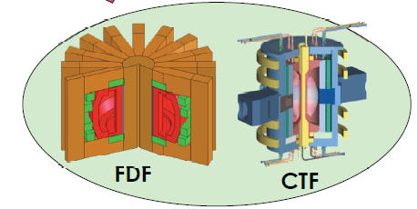
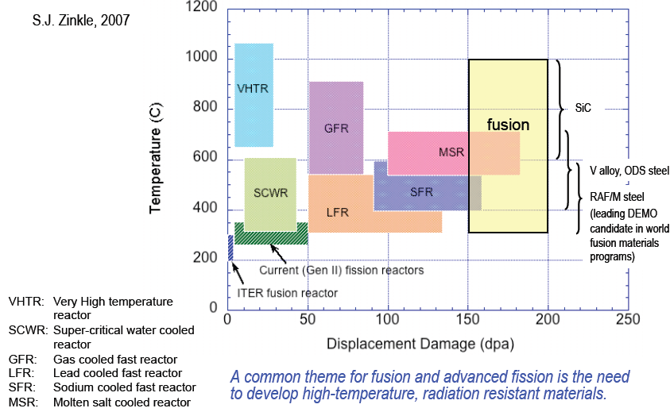
A Fusion Pathways Assessment is ongoing that will identify research needs at a level that enables new solicitations
This year-long study is enabled by a detailed assessment of Gaps, Priorities, and Opportunities in the world program (FESAC subpanel; “Greenwald Report”)
This was taken further by the ReNeW process in magnetic fusion that was completed in 2009. This activity aims to take the ReNeW process a level deeper, to a level of detail that will enable well-informed solicitations.
Chuck Kessel will report on this later in the meeting
Establish the basis for a significant move into materials science, both nuclear and non-nuclear.
  Lever common interests in MFE, IFE, NE, SC, NNSA
  Complementarity of DIII-D, C-Mod, and NSTX-Upgrade will inform the decision on a Fusion Nuclear Science Facility later in this decade.
  Launch a prerequisite computational materials and beam line programs. Strong university role
Candidate geometries for a fusion nuclear materials science facility. Down-select late this decade

Slide 24
Theory and validated simulation are critical for fusion’s future success
How we use validated simulation as instruments of scientific discovery is a great question for science overall.
How we execute our simulation efforts in terms of both experimental validation and program governance, including the relation between universities and labs, is critical.
Understanding for fusion on earth and of the plasma universe
Science Subprogram: Theory, modelling, and advanced simulation
Area | FY’12 request | FY’10 enacted | FY’12 – FY’10
Theory and Modelling | $24.4M | $25.1MM | -$0.8M
SciDAC | $8.3M | $7.2M | +$1.1M
Fusion Simulation Program Planning | $0M | $4M | -$4M
Burning plasma science
Explanation for changes:
Theory and Modeling: Higher level enacted in 2010 is due to a one-time addition from reserves to address specific needs
SciDAC: The increase in funding will support a new computational materials project that will address the interactions of different materials that will be located in and around the fusion chamber with the plasma.
Fusion Simulation Program: The decrease in funding reflects the decision by FES to first evaluate the results of the two-year planning phase of the FSP, which will be completed before proceeding with the initiation of the full program.
New SciDAC solicitation
Plasma dynamics and control science
Plasma-materials science and technology
Discovery science

Slide 25
On the pause in the FSP
The FSP planning activity will be completed this fiscal year.
Concern: budget pressures, esp. with ITER growth, may make it difficult to execute the FSP at the funding levels previously envisioned
Concern: the FSP management models being discussed potentially set a precedent for how the Office of Science and FES steward plasma and fusion simulation. This needs to be assessed before stepping out smartly on the FSP
➔ This is the optimal time to pause and take advantage of completion of the planning prior to execution of the FSP itself. Considerations now include the respective roles of the FES office and FSP organization in selecting the research team and managing the work, and the funding level requirement for making qualitative advances in validated simulation.

Slide 26
FES performed a strategic redirection of the ICC Program in FY’10
This class of experiment is a key component of experimental validation work, can be a close partner in answering questions important to ITER, and should play a critical role in assessing issues central to developing a future FNSF.
Understanding for fusion on earth and of the plasma universe
Science Subprogram: Experimental Plasma Research
FY’12 request | FY’10 enacted | FY’11 request | FY’12 – FY’10
$11M | $17.5MM | $16.8M | -$6.5M
Explanation for change:
Recall the portfolio was reduced in number with the redirection.
The proposed budget reduction will enable most of elements in this portfolio to continue at a funding level similar to FY’10. Some will be encouraged to compete in the arena of General Plasma Science
Burning plasma science
Emphasis on V&V, in partnership with larger experiments where possible. Also, materials research at this scale could be of high value
Science Subprogram: Madison Symmetric Torus
FY’12 request | FY’10 enacted | FY’11 request | FY’12 – FY’10
$6M | $7M | $6.9M | -$1.0M
Plasma dynamics and control science
Plasma-materials science and technology
Explanation for change:
Funding pressures drive this choice. Exploiting its capabilities for fusion science, including model validation, is of high value
Discovery science

Slide 27
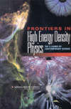
High Energy Density Laboratory Plasma Physics will be adjusted to emphasize near-term science results relevant to IFE and discovery
National Academies Report
Understanding for fusion on earth and of the plasma universe
Science Subprogram: HEDLP
FY’12 request | FY’10 enacted | FY’11 request | FY’12 – FY’10
$24.7M | $24.5M | $31.0M | -$0.2M
NIF
Explanation for change:
In FY 2012, FES and NNSA plan to hold a joint solicitation. Emphasis will be on
basic science
potential for near-term output
access to extreme states of matter
leverage with other agencies or multiple institutions
leverage of existing investments
building research opportunities around recent ARRA investments
Burning plasma science
This research can also be framed as questions in plasma dynamics, control, and discovery
Plasma dynamics and control science
Plasma-materials science and technology
Partnership with NNSA is highly valued in advancing this element of plasma science
Discovery science

Slide 28
General Plasma Science is increased in the FY’12 FES proposal to help capture the call made by the National Academies
Understanding for fusion on earth and of the plasma universe
Science Subprogram: General Plasma Science
FY’12 request | FY’10 enacted | FY’12 – FY’10
$16.8M | $14.5M | +$2.3M
Explanation for change:
The increase will allow for preparation for new proposals in discovery science that lever cross-agency and international partnership. Also, this proposed budget will provide full funding of a Plasma Science Center which was started with Recovery Act funding.
Burning plasma science
This area’s leading emphasis is exploration and curiosity-driven research
Plasma dynamics and control science
Plasma-materials science and technology
Leverage with other agencies and programs can be of high value here
Discovery science

Slide 29
High
Density
High
Energy
Laser-Driven, Heavy-Ion, Magneto-Inertial
Shocks and
Extreme Fields
Enhanced-Performance
Materials
Equation of State and Transport
HEDLP/IFE
Angular Momentum Transport
Planets--Stars--Black Holes
3D Magnetic Reconnection
HEDLP and
General Plasma
Science
Warm Dense
Matter
Lab Astro
Low Temperature
Plasma Science
Non-equilibrium and Chemically Active
Low
Energy
Predictive Control of Plasma Kinetics
Low
Density

Slide 30
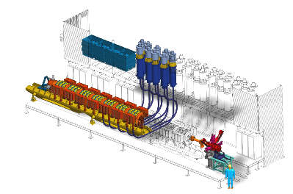
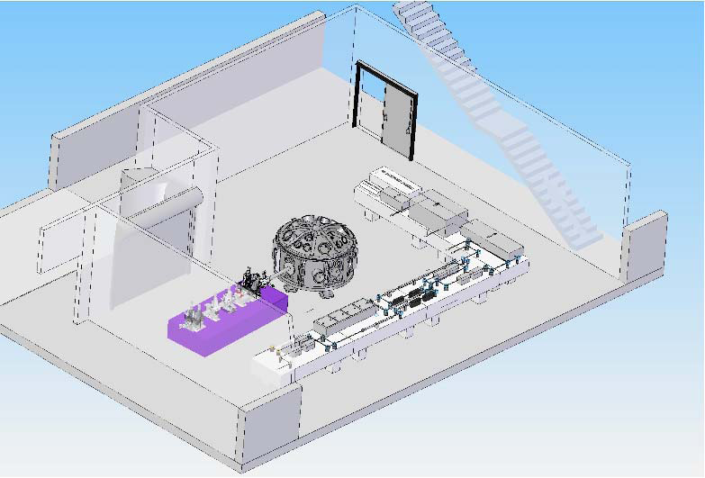
ARRA is enabling significant investment in HEDLP for FES
NDCX-II: heavy ion accelerator for warm dense matter and heavy ion fusion science research. $11M
  Lever NNSA accelerator components to upgrade from 300 keV system to 2 – 3 MeV
LCLS: the Matter under Extreme Conditions (MEC) End Station: $20M.
  First-of-kind creation and fs measurements of warm and hot dense matter.

Slide 31
The depth and breadth of university engagement in FES-sponsored activities is striking
About 490 students participate in FES-sponsored research across our portfolio – major devices, ICC’s, technology, HEDLP, General Plasma Science, Theory, SciDAC, Diagnostics...
The challenges include:
  Creating opportunities for students to be engaged in areas most relevant to fusion and plasma science’s future
  Finding models that university leadership finds attractive for student and faculty participation in the world’s leading experiments
  Ensuring strong university/lab partnership and appropriate stewardship of national endeavors that have impacts on students’ research life and prospects
We need to develop a path for universities, considering our destinations:
  ITER will be a vital center of U.S. research life
  The U.S. will assert leadership through engagement in materials science
  The U.S. will lead in experimental validation of massively parallel simulation
  FES needs to be a steward for discovery in the plasma and fusion sciences, strengthened through cross-agency partnership.
These challenges were discussed at the APS UFA meeting and I met with students at the invitation of the Committee for the Concerns of Junior Scientists on this topic. We welcome further discussions.

Slide 32
On IFE…
Any new initiative will depend on the output of the NAS study, ignition on NIF, and available budget authority

Slide 33
The National Academies study on IFE and IFE technology is of high interest to FES
I addressed the NAS panel and offered some perspectives on what would be useful for FES to learn from their assessment
Like other speakers, I was asked my opinion regarding the appropriate home for IFE.
My view is that caution should be exercised in creating a governance structure that reinforces a divide between MFE and IFE – the race is too long, the stakes too high, and the common interests too great to do so at this time. From the technical perspective, there is much commonality between the two (e.g. materials and computation) to warrant common governance. However, the role of classification and NNSA’s responsibility for facilities probably implies that energy science and technology development will entail some dual responsibility.
General point of view: the prospect of NIF ignition should be viewed as a victory and opportunity for fusion as a general enterprise

Slide 34
Another comment I made to the NAS: the multiscale character of IFE plasma physics challenges demand validated predictive capability take a step up
Personal impression: the relationship between codes and measurement in IFE vs. MFE is quite different. Different nature of the physics problems? Differences in measurement accessibility? Culture? I suspect all three play a role
Taking a qualitative step up in validated predictive capability is part of a redirection being executed for MFE.
  Motivation: add credibility, reduce technical risks for development
  NNSA’s success in integrated, multiscale simulation in ICF serves as a model on which to draw for MFE.
IFE’s challenges seem to rival MFE’s in their multiscale character and complexity.
For NAS: What standards or metrics should a validated predictive capability achieve in order to serve as a credible tool that can substantially reduce development risks? What can be the role of the entire range of available facilities in developing this capability?

Slide 35
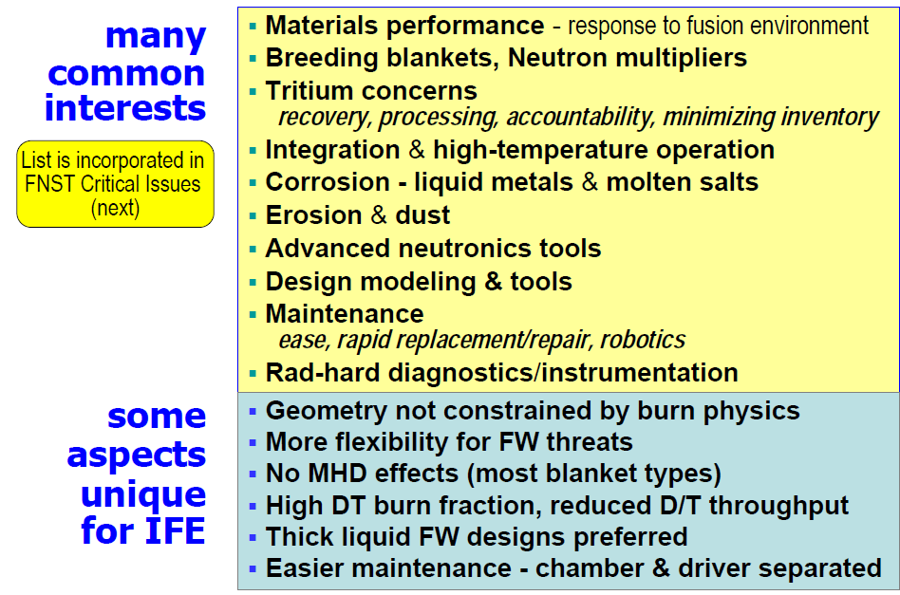
Also expressed to the NAS: IFE and MFE share many issues and interests related to materials

Slide 36
A comment I made to the NAS: their views on the benefit to IFE of a vigorous materials science program will be of value
FES view: this is an opportunity/necessity for both IFE and MFE. Materials science questions are key to credibility
Let the IFE and MFE competition ebb for a minute, and consider a “black box” that produces copious 14 MeV neutrons for materials and component testing. There would be myriad customers for such a facility, regardless of whether the source of neutrons is a toroidally confined or an HED plasma: IFE, MFE, NNSA…
For NAS: Your assessment of the state of materials science for fusion and the standards that must be met will be of high value. Commentary on the potential role of computational searches for advanced materials will be welcome. Your assessment of the potential of leverage with advanced fission research will also be of value

Slide 37
Also expressed to the NAS: establishing fusion’s credibility is the overarching task
Credibility: Both IFE and MFE need a qualitative sharpening of science and technology metrics for success so as to become credible, viable options for energy development. Both can benefit from like needs and approaches.
Science ⬄ technology: A future IFE program needs to be deeply scientific as well as technologically aggressive. Technological development (e.g. in drivers or advanced ignition scenarios, for example) will require a strong scientific basis to create attractive innovation pathways.
Critical elements that require progress are linked and are found in plasma science, control science and technology, and materials science.

Slide 38
In this overview…
This Administration, science, and fusion
Priorities, opportunities, and the FY’12 Budget proposal
FES work approaches and engagement with the community

Slide 39
There have been big changes in FES in the last year
Retirements and other departures:
    Mike Crisp, Rostom Dagazian, TV George, Jeff Hoy, Darlene Markevich, Erol Oktay, Chris Saba, Sharon Stevens
But we have been working hard to increase staffing to where we need it to be.
    Research Division position was posted, closed, and is moving through DOE processes. No comment at this time. A new Facility, Operations, and Projects Division Director posting is on hold with the hiring freeze
    New hires: Ed Stevens (Project Manager from NASA); Ann Satsangi (General Plasma Science); Sean Finnegan (GPS and HEDLP); Materials scientist (hopefully can be announced soon); Pam Miller (Program analyst and budget formulation). Also, when I came here in June of ‘09, I was sworn in with Nirmol Podder, and Mark Koepke joined as an IPA shortly thereafter.
These are new players in your management team. We will be reaching out to the community for strong candidates when hiring is allowed again. We will also likely be seeking additional IPA/Detailee engagement for specific FES tasks.
IPAs and detailees may be of high value to FES down the road. Please urge your colleagues to consider this if a call is made

Slide 40
The new FES organizational structure reflects what we need to do as a community
Operating principles:
    Two Divisions: (1) Research
      (2): Facilities, Operations, and Projects
In the Research Division
    Now, program managers will constitute Teams that will interface with the community to establish goals, metrics, and to monitor progress where targeted goals are appropriate.
    The Teams we develop will reflect our science and the goals we need to pursue over the next several years
In the Facilities, Operations, and Projects Division
    Develop consistent approach in major facility operations and project management
One aim of the new proposed organization is to better reflect the work we need to do, and support the work and functions required of a national program
Another is to create a flexible template for working that promotes cross-fertilization of ideas and expertise within the office

Slide 41
Fusion Energy Sciences
Strategy and Budget Advisory Group
Associate Director, Office of Science
Edmund Synakowski
Senior Policy Advisor
Tom Vanek
Division Directors
Team leads
Program Analyst
Pamela Miller
Chief of Staff
Gene Nardella
Pamela Miller
Budget Formulation
Administrative Specialist
Shahida Afzal
International Agreement Administration
Debra Frame
Research Division
Facilities, Operations and Projects Division
Development
Curt Bolton: Sci Ed & Outreach
Sam Barish, HBCU
Barry Sullivan, SBIR
Mark Koepke (Acting)
Program Analyst and Procurements
John Sauter
Vacancy, Director
Administrative Specialist
Marty Carlin
Administrative Specialist
Yvette Walker
Administrative Specialist
Sandy Newton
Theory and Simulation
MFE Experimental Research Coordination
Fusion Materials and Technology
Discovery Science and Joint Programs
U.S. ITER Project
U.S. Domestic Research Construction Projects
Simulation
John Mandrekas, lead:
SciDAC, FSP, Theory
Sam Barish: Validation Platforms; stellarator
Sean Finnegan:
Theory and modeling; HEDLP
Steve Eckstrand: (NSTX)
John Glowienka: U.S. ITER Project Manager, U.S.. Contact Person
Tom Vanek: Senior Policy Advisor, ITER (& International Collaboration Agreements
Vacancy, U.S. ITER Project Advisor
Ed Stevens: U.S. ITER project (& NDCX-II, MECI; Enabling Technologies)
ITER and AT Optimization
Materials Science and Enabling Technologies
HEDLP and IFE science
Mark Foster: Lead, DIII-D
Steve Eckstrand: NSTX
Vacancies: Alcator C-Mod and Int’l; Research
Sam Barish: Validation Platforms
Mark Koepke: Lead, , Joint NNSA HEDLP program
Sean Finnegan: HEDLP (& Theory and modeling)
Ann Satsangi: HEDLP (& General Plasma Science)
Ed Stevens :
NDCX-II, MECI,
(& Enabling Technologies; U.S. ITER Project
Gene Nardella: Lead
Fusion Materials and Enabling Technologies
Vacant, Materials Science
Ed Stevens: Enabling Technologies (& NDCX-II, MECI; U.S. ITER Project)
Al Opdenaker: Enabling Technologies, (& Fusion Systems Studies)
Barry Sullivan:, NSTX-U; ES&H (& SBIR/STTR, Enabling Technologies)
Theory and Exp’t/Theory Coordination
FNSF Science Basis
Steve Eckstrand: lead, NSTX, ST’s
Samuel Barish: val. platforms
Mark Foster: DIII-D
Vacancies: Alcator C-Mod and Int’l; Research
Gene Nardella: Technology
Al Opdenaker:Fusion Pathways
General Plasma Science
John Mandrekas: Lead
Mark Foster:, exp’l lead, DIII-D
Curt Bolton: Theory, Atomic Processes (& Science Ed.)
Sean Finnegan: Theory, HEDLP
Steve Eckstrand:; NSTX
Samuel Barish: validation platforms, stellarators
Francis Thio: Diagnostics; Plasma Science Centers
Vacancies: Alcator C-Mod and Int’l; Research
Mark Koepke: Lead, FES/NSF Joint Program, General Plasma Science
Ann Satsangi: General Plasma Science (&HEDLP)
Nirmol Podder: General Plasma Science, Low Temperature Plasmas, MST
Francis Thio: Plasma Science Centers, Diagnostics
U.S. Facility Operations
Barry Sullivan: Enabling Technologies (& NSTX-upgrade, ES&H, SBIR/STTR)
Steve Eckstrand: lead, NSTX
Mark Foster: DIII-D
Vacancy: Alcator C-Mod
3D topologies
Samuel Barish: Lead,
stellarators (&
validation platforms)
Steve Eckstrand, NSTX
Mark Foster, DIII-D
Vacancy, Int’ Research

Slide 42
Thank you

