Slide 1
FES Office Hours: Open FOA Topical Areas
April 3rd, 2024
By
Fusion Energy Sciences RD Program Managers

Slide 2
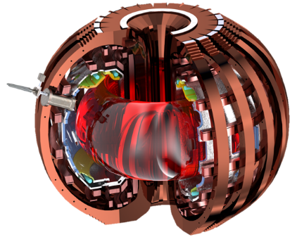

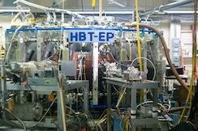
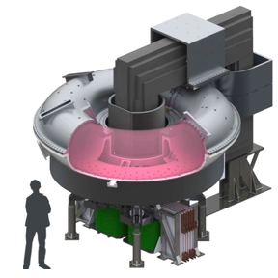
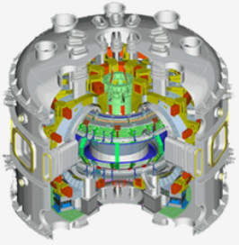
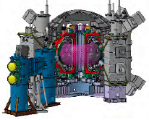



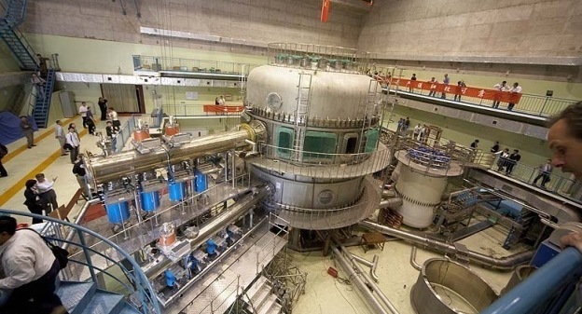

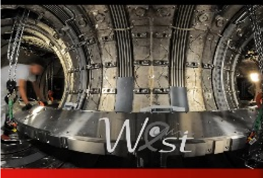
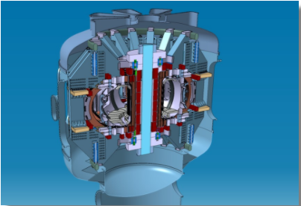
Advanced and Long Pulse Tokamak
Advanced Tokamak (AT) and Long Pulse Tokamak (LPT) areas address gaps in the physics basis for the conventional tokamak approach to magnetic confinement fusion (here conventional refers to aspect ratio R/a >2)
Primary focus is on controlling, sustaining, and predicting burning plasma state
AT: AT is an integrated fusion energy system that achieves a stationary plasma state by maximizing plasma performance within stability limits by a comprehensive optimization of plasma parameters; AT area supports a broad range of activities focused on closing gaps in the scientific and technical basis for the tokamak approach to fusion energy
SC User Facility: DIII-D National Fusion Facility in San Diego, CA at Gen. Atomics
Premier user facility for DOE Office of Science, advancing fusion/plasma sciences and associated technologies, esp. for integration with other fusion systems
Trains US fusion workforce to exploit large fusion facilities/programs
Capable of extremely high plasma performance at short pulse (~10s)
University devices: HBT-EP (Columbia) and MST (U. Wisc. Madison)
LPT: supports interdisciplinary teams from multiple U.S. institutions for collaborative research on international facilities with capabilities not available in the U.S.; a key focus is on the extension of plasma scenarios to long plasma durations 1000s seconds
High priority R&D areas include: plasma-material interactions, control of plasma transients, and long pulse, steady-state operation
US researchers make key contributions to multi-lateral, international research activities including engagement with the International Tokamak Physics Activity (ITPA) and International Energy Agency Technology Collaboration Programme
HBT-EP
DIII-D
MST
KSTAR
JT60-SA
EAST
WEST
COMPASS-U

Slide 3
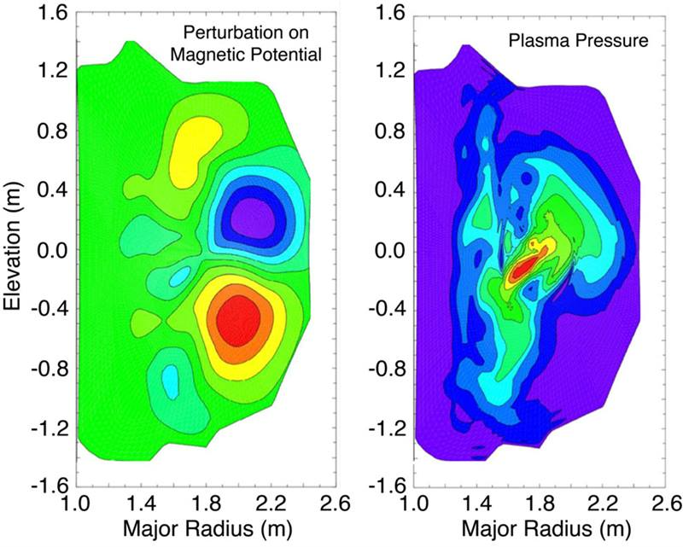
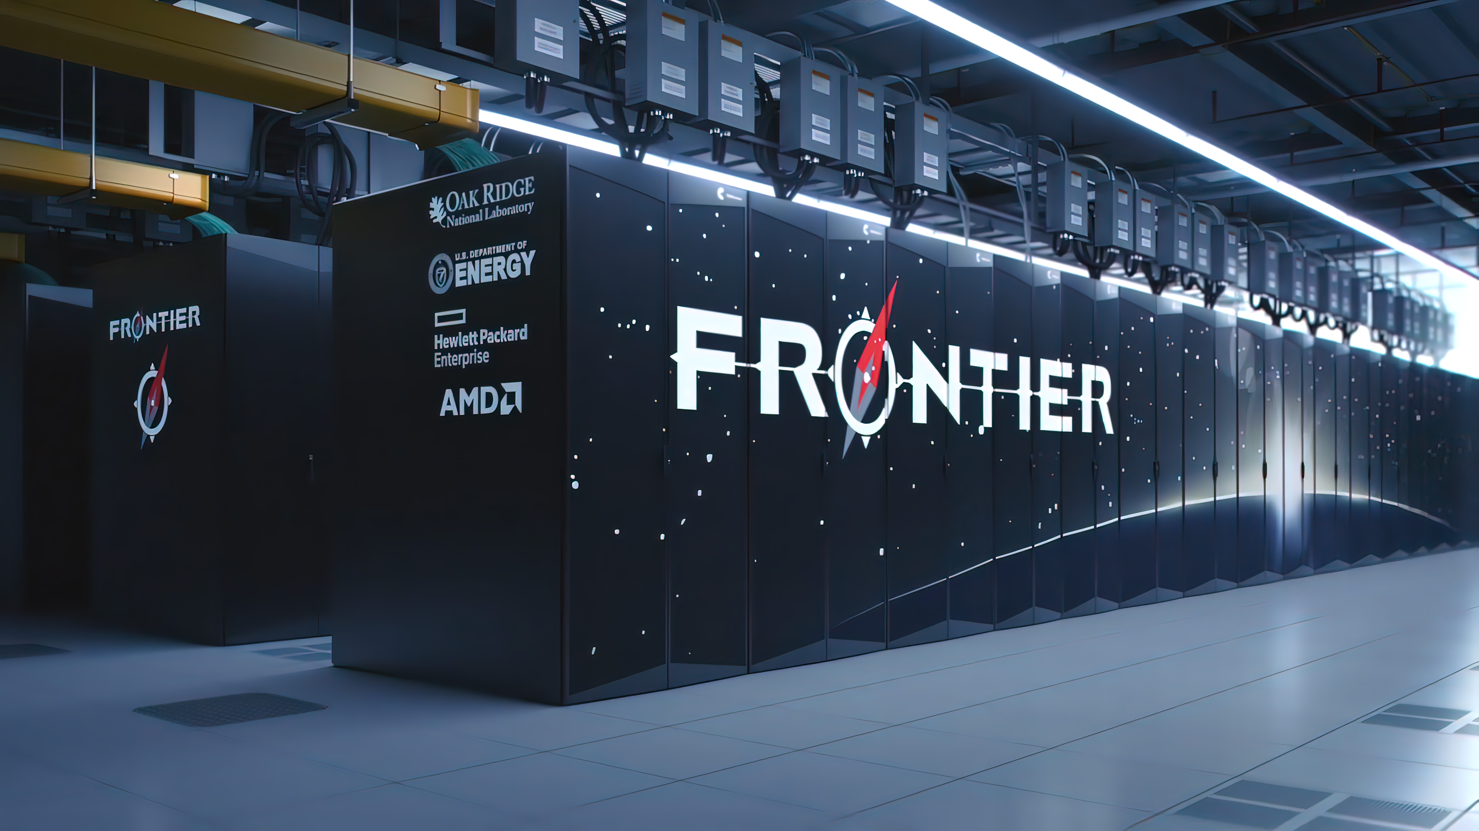
Theory & Simulation and AI/ML
The Theory and Simulation program area focuses on advancing the scientific understanding of the fundamental physical processes governing the behavior of magnetically confined plasmas. Specific areas of interest include:
Macroscopic stability of fusion plasmas.
Multiscale, collisional and turbulent physical mechanisms.
Interaction of externally launched radiofrequency waves designed to heat the plasma and drive current, with the background plasma and surrounding structures.
Nonlinear interaction between background plasma, various instabilities, and energetic particle populations.
The effect of processes at the plasma boundary on the plasma performance and on the interaction of the hot plasma boundary with the material walls.
Methodology can vary from analytic calculations to exascale simulations.
The AI/ML program area supports the development of fusion data resources and platforms through interdisciplinary collaborations with computer scientists. Areas of interest include applications across the entire FES research portfolio.

Slide 4
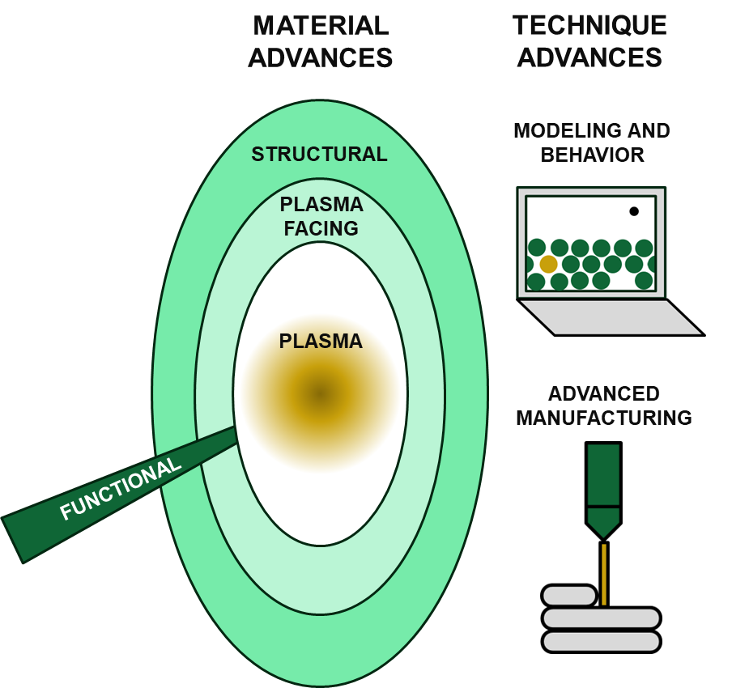
Fusion Materials
Fusion materials must be able to withstand extreme condition such as high temperatures, high mechanical stresses, and radiation exposure. Below are the areas of research covered by the Fusion Materials research program:
Plasma Facing Materials
Innermost wall components can interact with fusion plasma
Can experience: high heat, radiation, erosion, sputtering, migration…
Structural Materials
Overall construction of all component structures
Can experience: structural loads, radiation, heat, cold…
Functional Materials
Materials that impact functionality of components beyond structure
Require: specialized properties that can withstand fusion conditions
Materials Modeling and Behavior
Modeling advances critical to understanding material behavior
Simulating response allows for design and optimization
Advanced and Additive Manufacturing
Novel manufacturing can enhance properties and/or functionality
Enables otherwise impossible/impractical components and materials

Slide 5
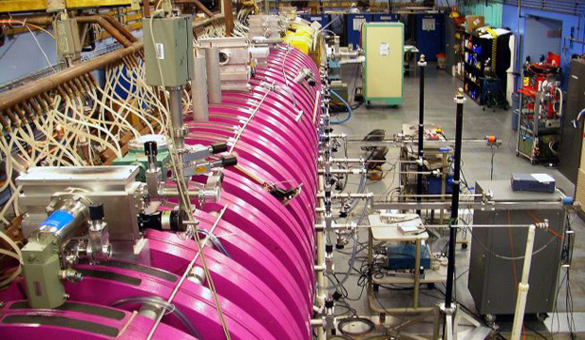
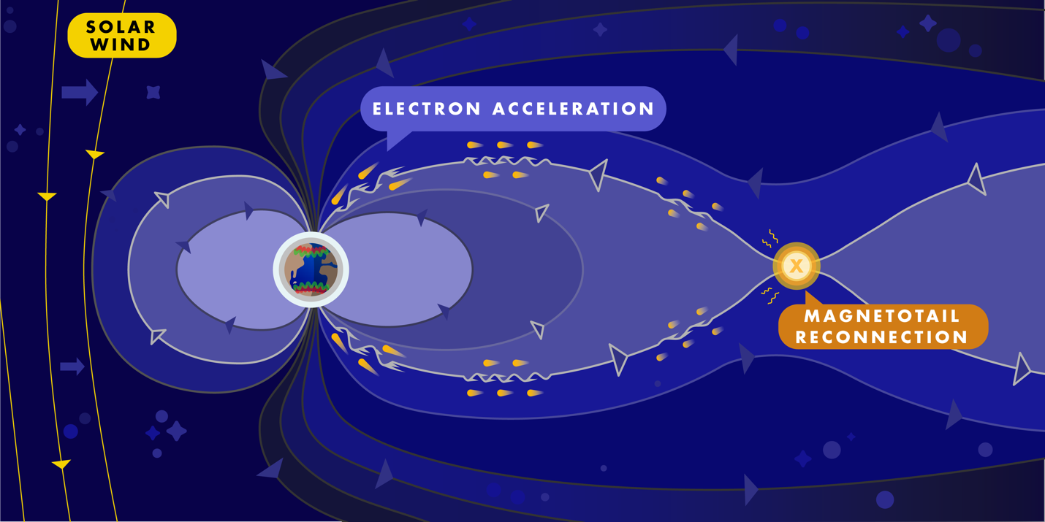

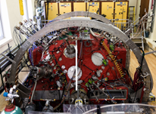
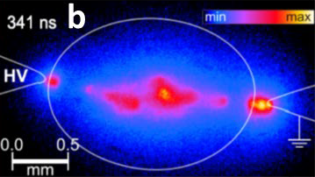
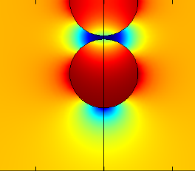
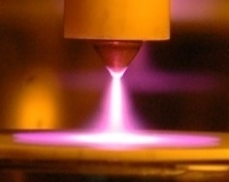
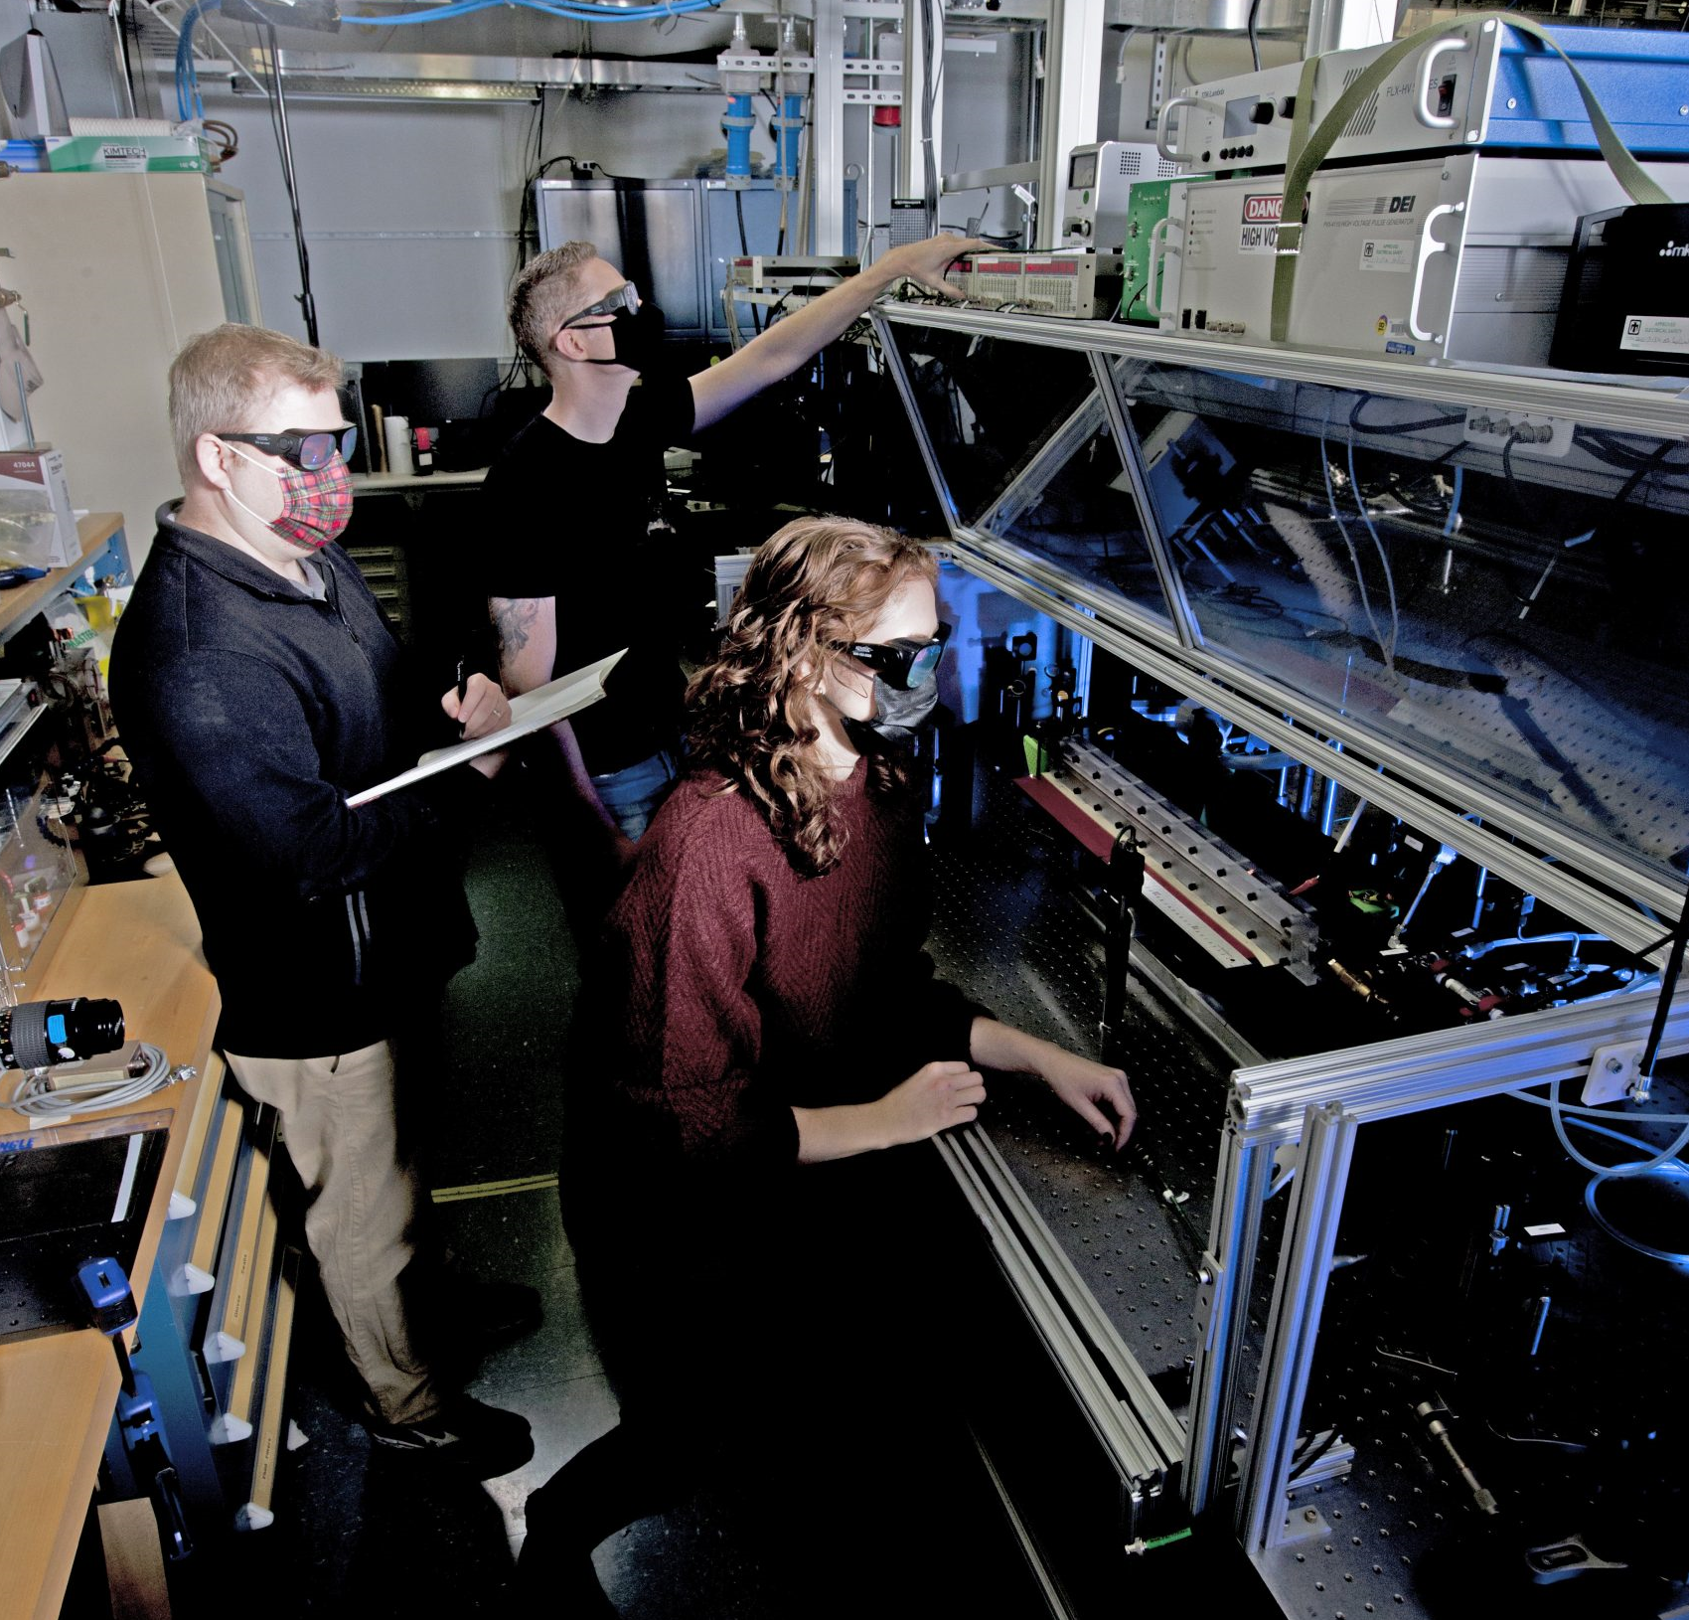
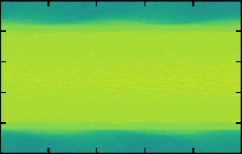
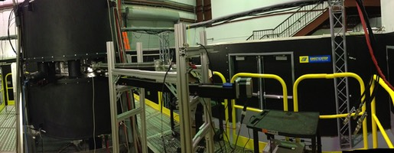
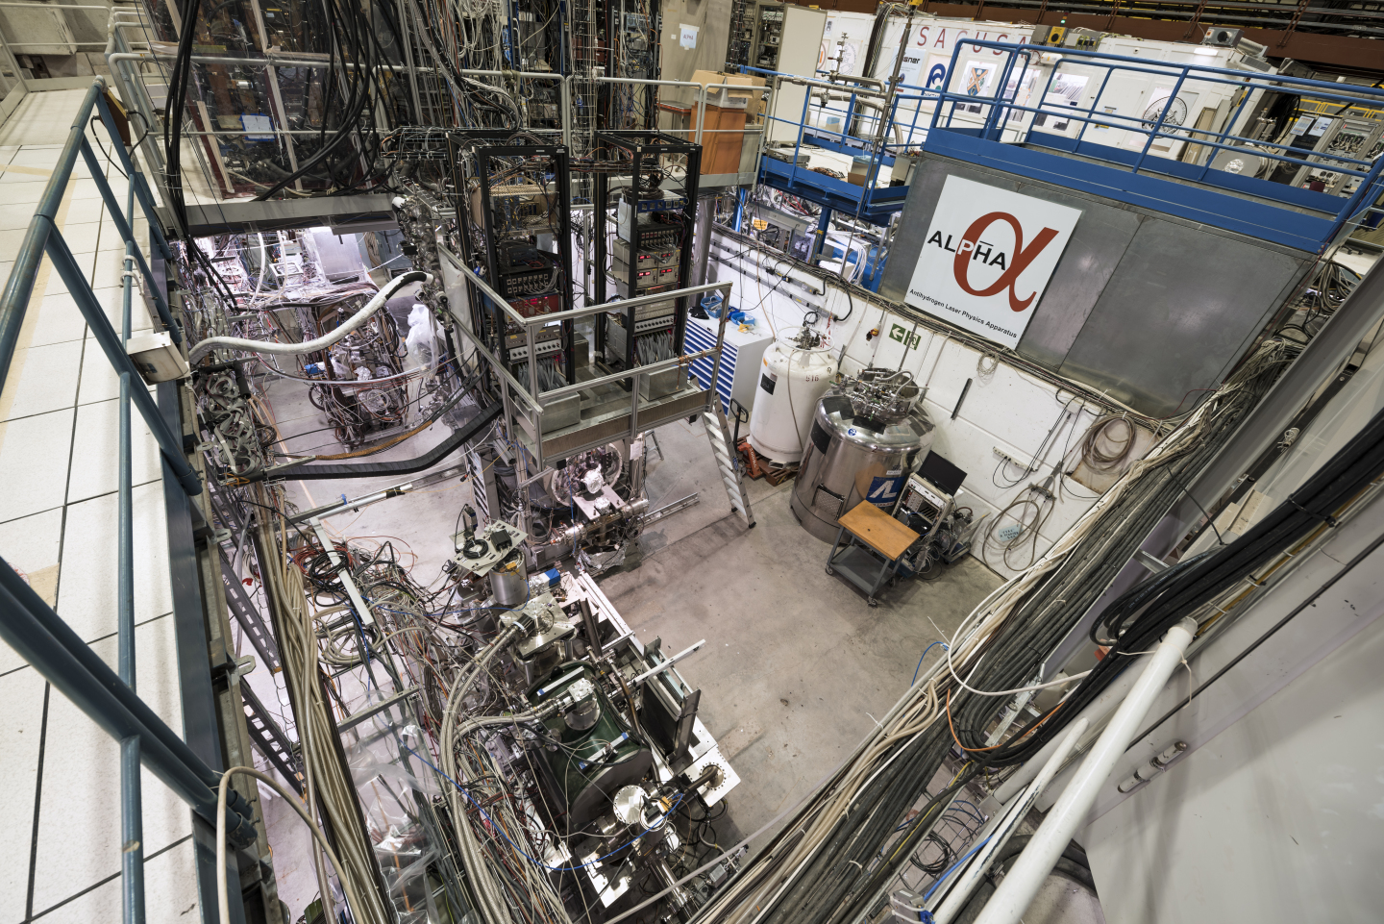
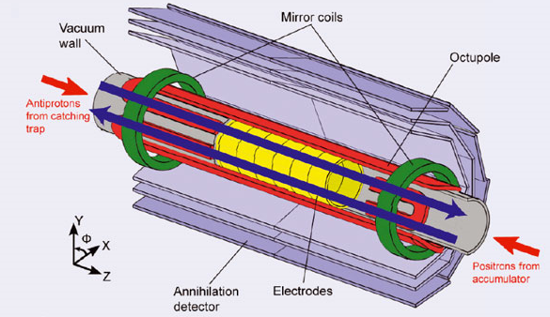
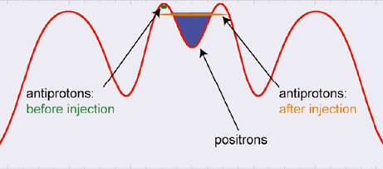
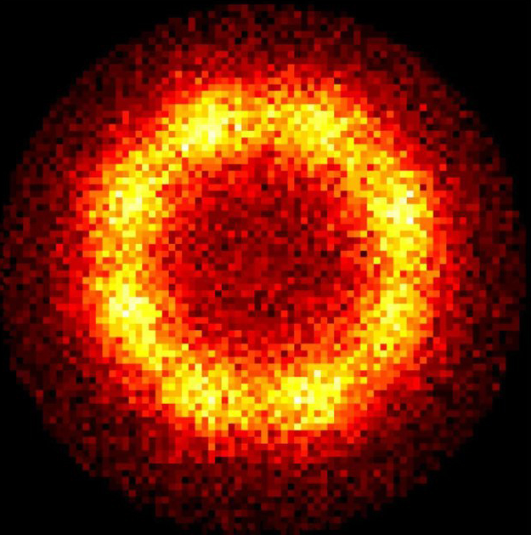
General Plasma Science Program
BaPSF/
UCLA
BRB/
UW
Core Research Areas:
Basic Plasma - laboratory, space, and astrophysical plasma
Dusty and Non-neutral Plasma - behaviors and strong coupling
Low Temperature Plasma - processes and plasma chemistry
Research Supported by GPS Program
GPS Program utilizes small to mid-scale experimental research facilities and a wide range of theoretical tools
Basic plasma science seeks to develop accurate theoretical descriptions of the complex emergent behavior of the plasma state, to push it into new regimes that expand our concept of what constitutes a plasma, and to design experiments and diagnostics to explore these states and to validate theoretical models
Plasma astrophysics translates fundamental discoveries to a better understanding of space and the cosmos
Low temperature plasma science translates discoveries into new technologies that improve our way of life by creating a richer, healthier, and more sustainable future
PCRF/
PPPL
PRF/
SNL
DIII-D/
Frontier Sci. Campaign
MPRL/
Auburn U
ALPHA/
CERN

Slide 6

Innovation Network for Fusion Energy (INFUSE)
INFUSE helps connect private fusion companies to unique lab and university resources. Since INFUSE launched (FY 2019) FES has invested $19.3M to date in 90 awards, helping 26 private fusion companies gain access to the capabilities of ten DOE laboratories and eight U.S. universities.
This topic seeks to advance our scientific understanding of fusion-related phenomena by fostering collaborations involving the expertise and unique resources available at DOE national laboratories and U.S. universities.
Universities should only apply to this topic after they have applied to the INFUSE Request for Assistance and been directed to do so.
Partnership awards made under the INFUSE program follow a unique application process, for which more information is available at the INFUSE webpage: https://infuse.ornl.gov/
Subprogram Contact: • Colleen Nehl, Colleen.Nehl@science.doe.gov Website: https://science.osti.gov/fes/Research

Slide 7
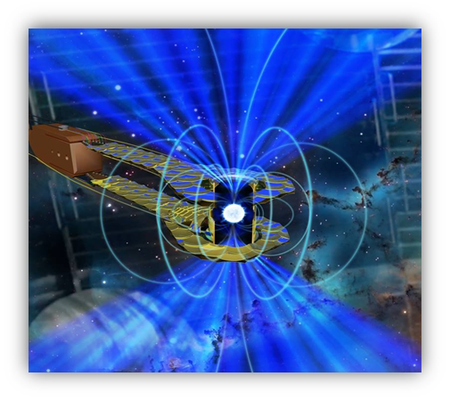
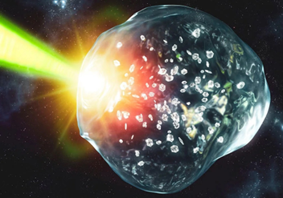
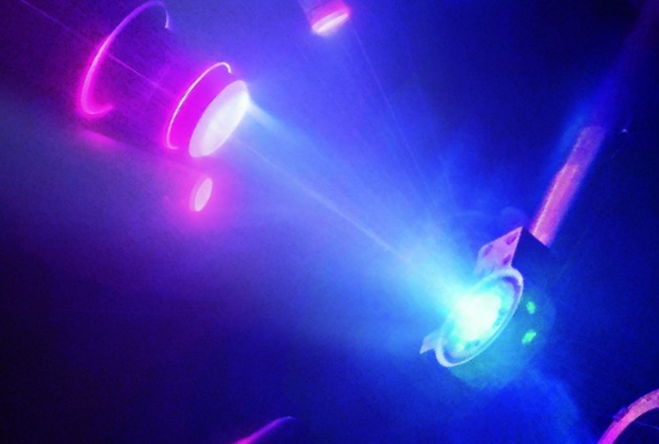
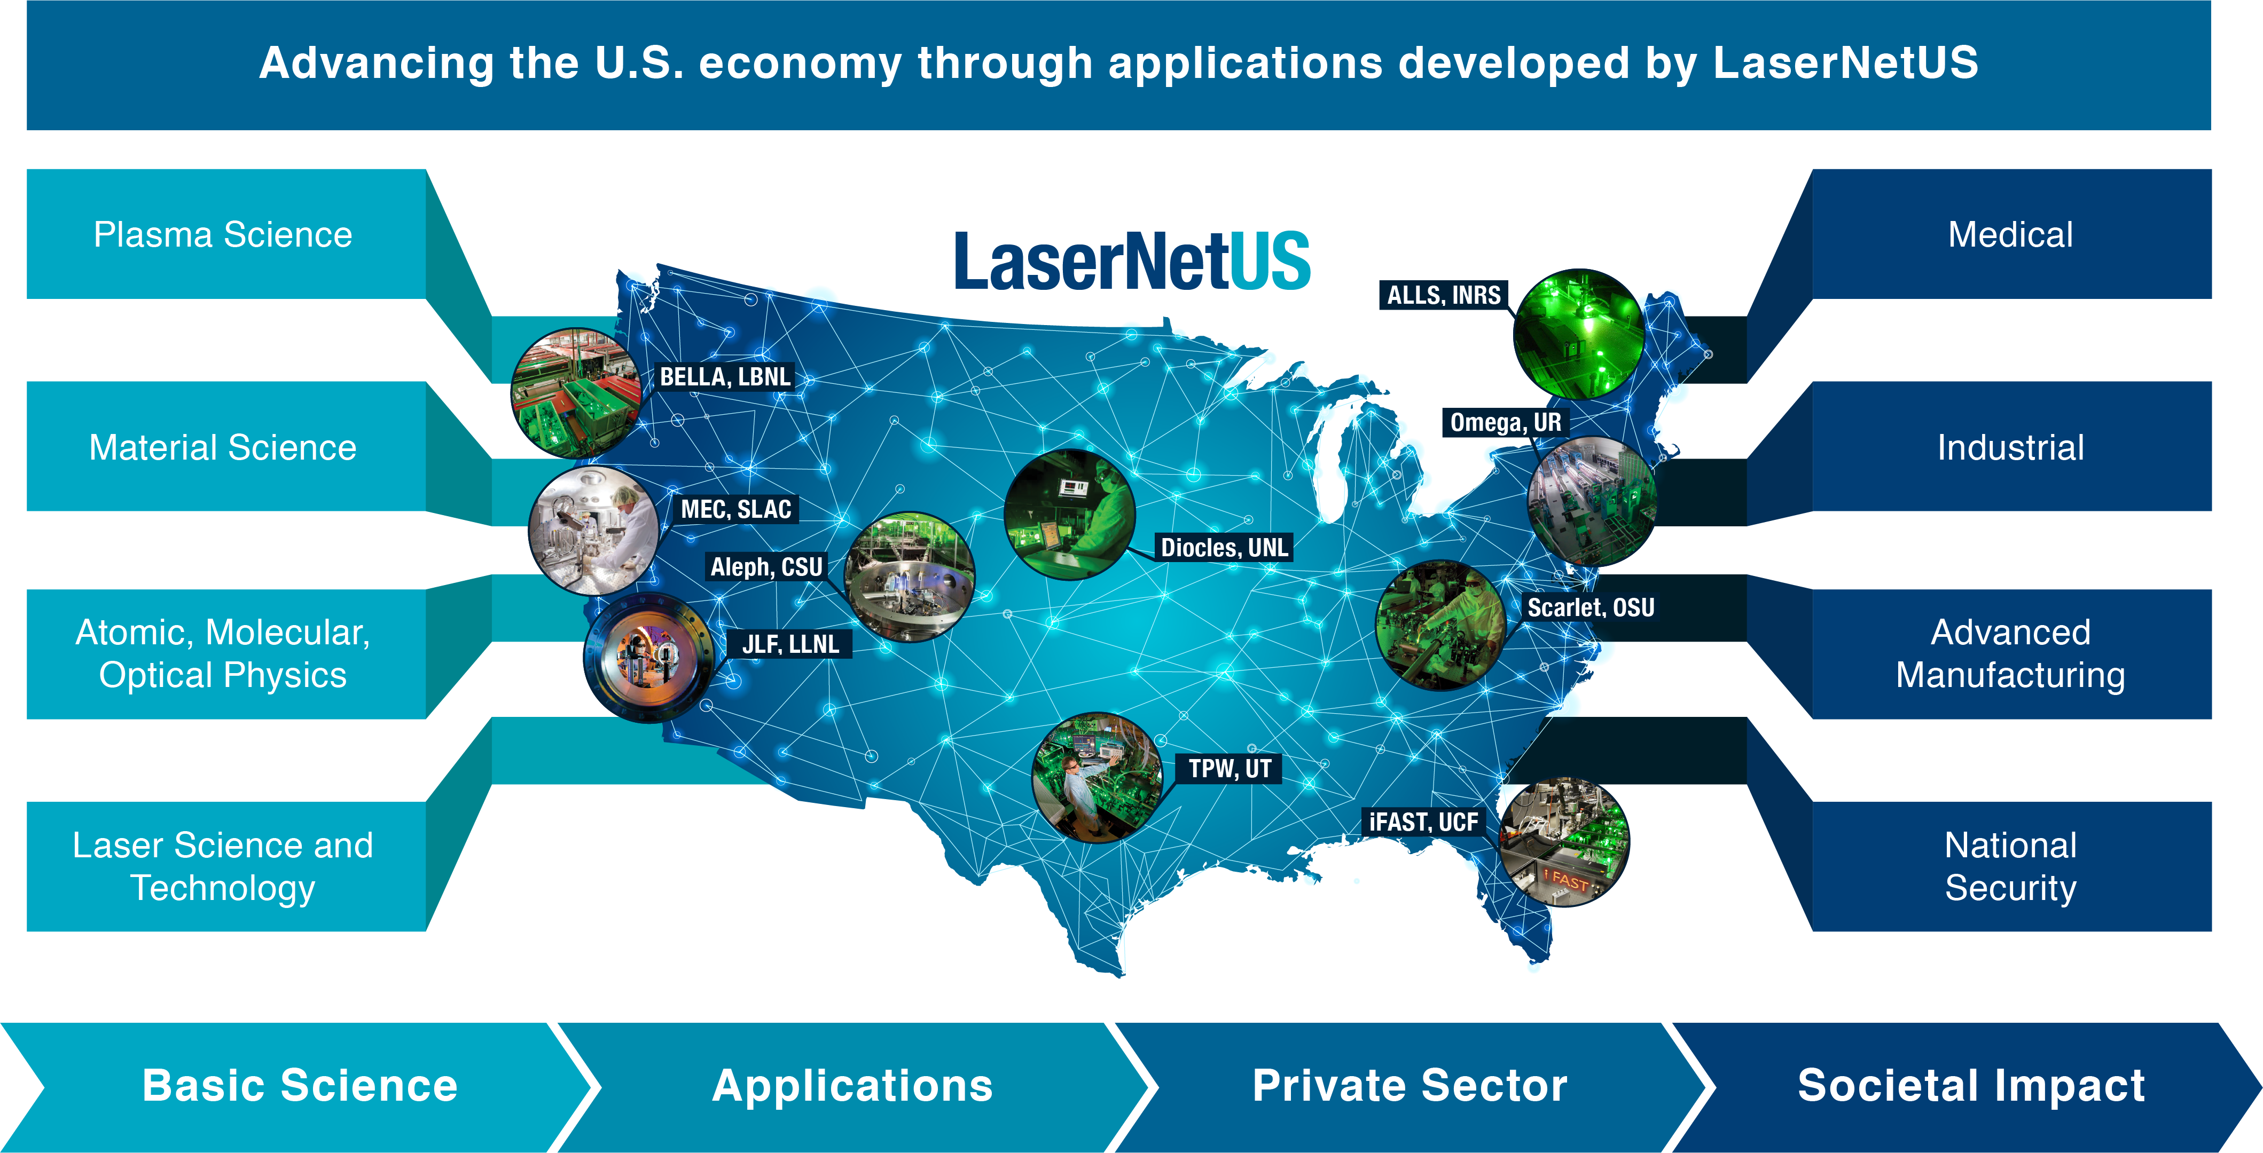
High Energy Density Laboratory Plasmas(HEDLP)
HEDLP is directed at understanding how matter behaves under extreme conditions of temperature, density, and pressure.
HEDLP spans various disciplines, including laboratory astrophysics, planetary science, laser-plasma interactions, magneto hydrodynamics (MHD), and plasma atomic physics.
What is the nature of the Earth’s iron core? How did Jupiter form? What is the reason for the unusual magnetic fields of the ice giants? How do we generate Ultra-bright VUV and X-ray sources beyond existing light sources? How do we understand and control the hydrodynamic instabilities that can limit the pressures and densities achievable in the laboratory? how does matter respond to super-intense radiation?
HEDLP supports LaserNetUS: A network of midscale laser facilities that provide access to users free of charge through a peer review process.
IFE proposals are encouraged under this topic but will be a separate topic in the future

Slide 8
Measurement Innovation
This program element supports the development of innovative diagnostics to make detailed measurements of the behavior of plasmas.
The fusion program is entering a new era where it will be able to explore strongly burning plasmas.
The Measurement Innovation program will therefore be looking for applications for new diagnostics that will be able to measure the properties of burning plasmas and be able to perform in the harsh radiation environment anticipated in burning plasmas.

Slide 9
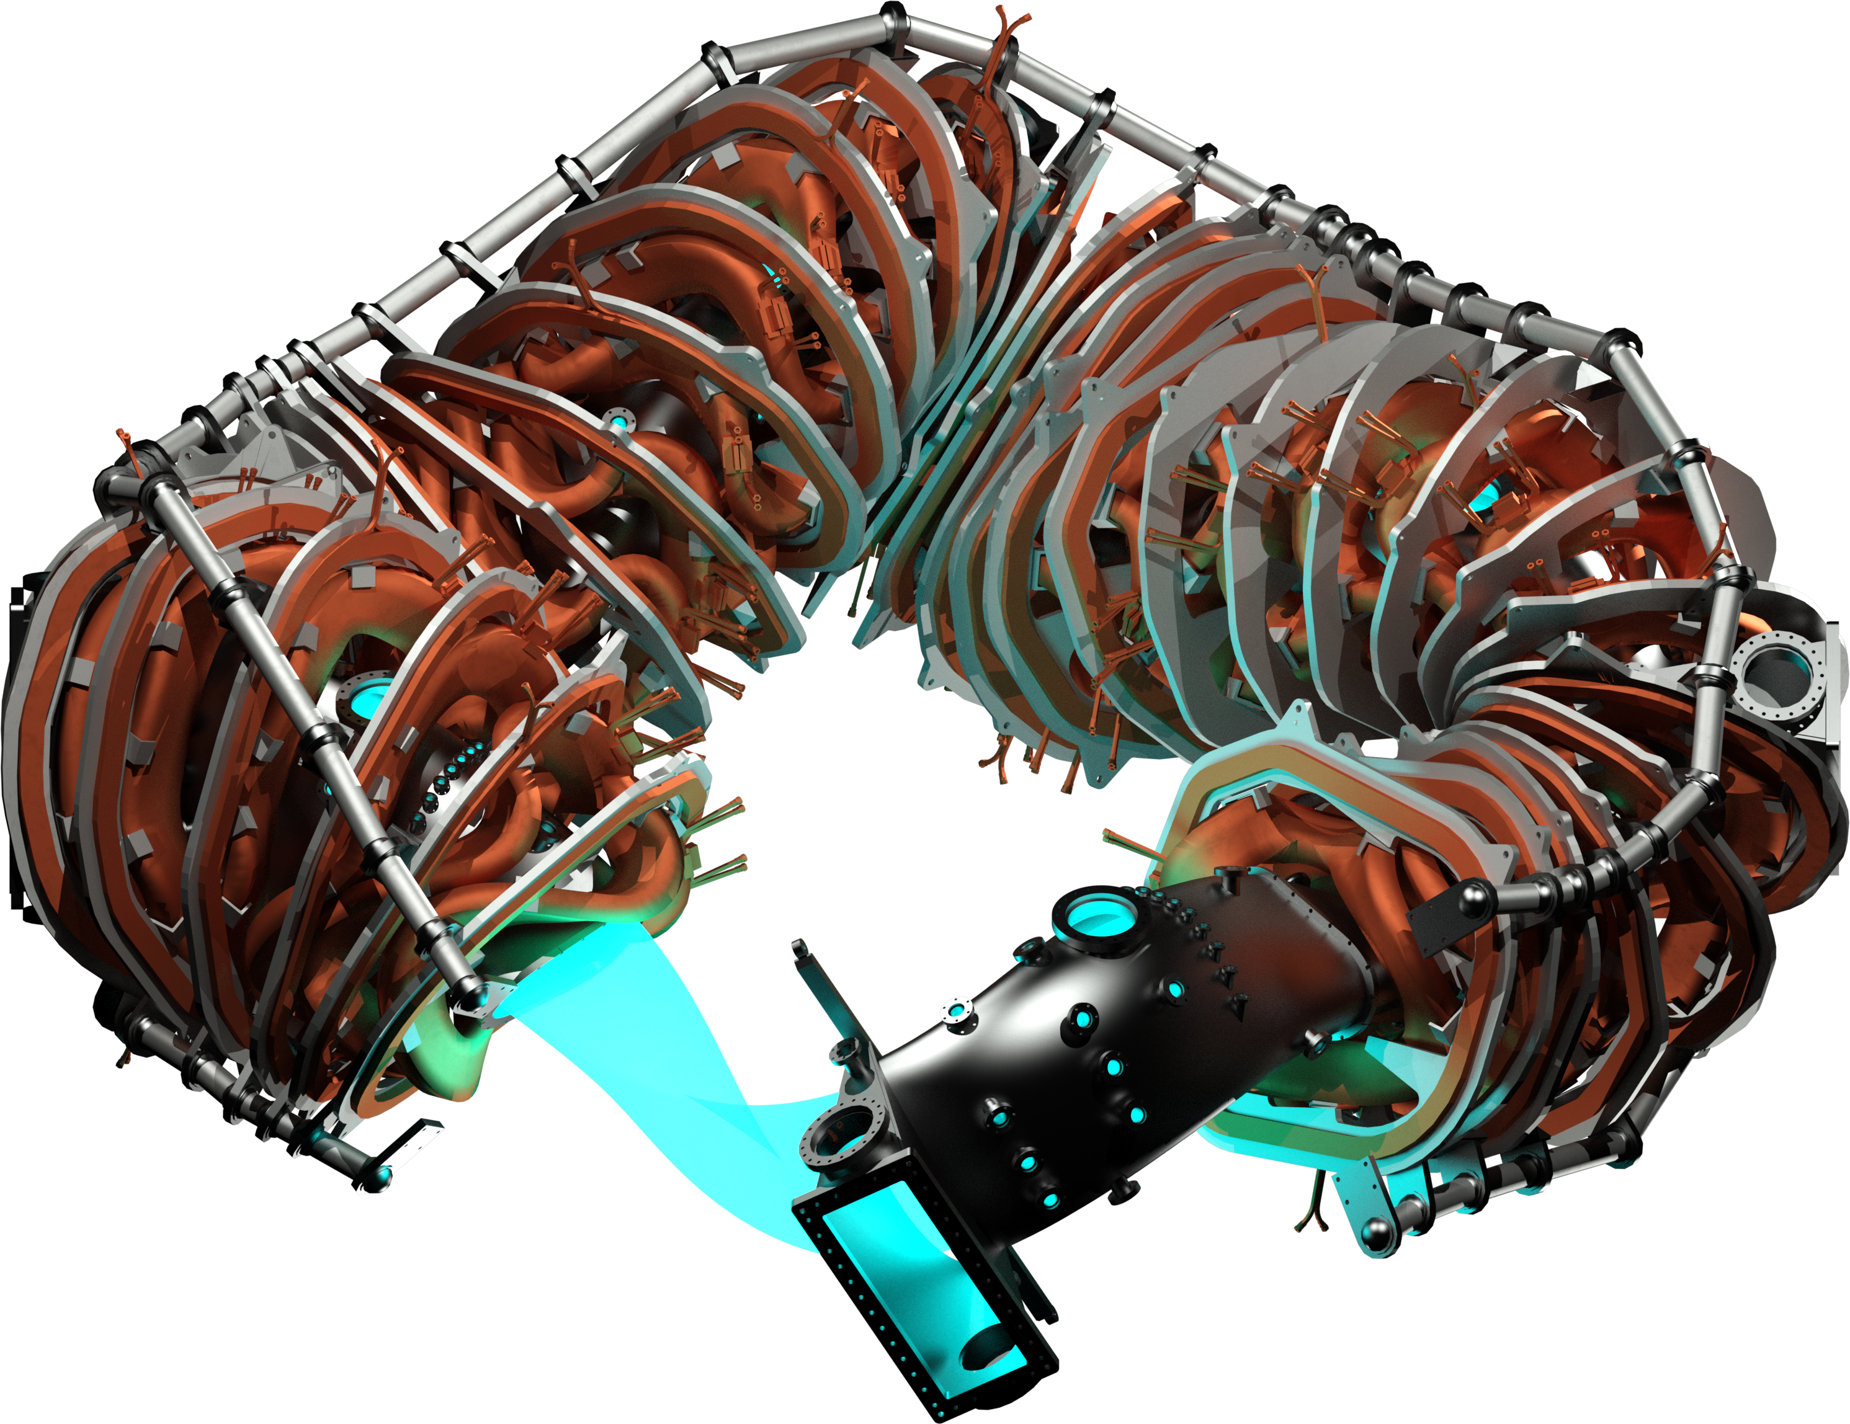
Long Pulse- Stellarator
This program area supports research on stellarators, which offer the promise of steady-state confinement regimes without transient events driven by net plasma current.
The three dimensional (3D) shaping of the plasma in a stellarator provides for a broader range in design flexibility than is achievable in a 2D system.
This program element supports research conducted on U.S. stellarators that are focused on optimization of confinement through quasi-symmetric shaping of the toroidal magnetic field, and research by U.S. teams conducted on international facilities

Slide 10
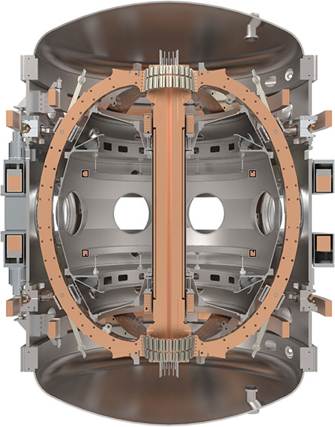
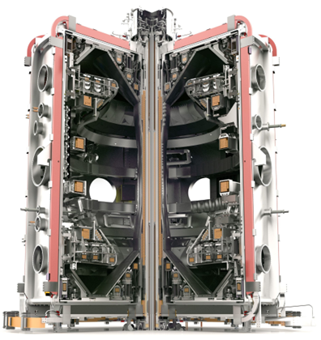
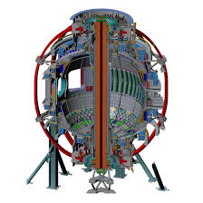
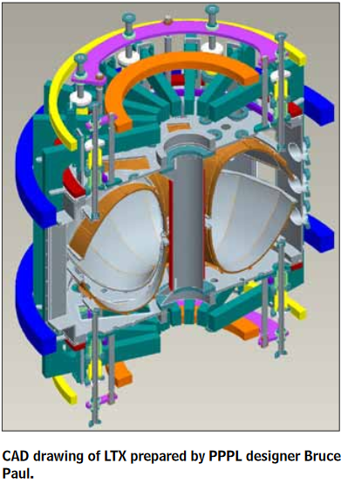
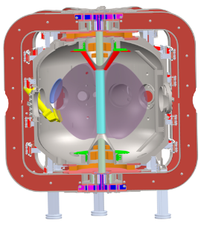
Spherical Tokamak
MAST-U
The Spherical Tokamak Research program seeks to utilize spherical tokamak research facilities with low aspect ratios to develop the physics knowledge needed to advance the FES energy mission. An improved understanding of the spherical tokamak magnetic confinement configuration is needed to establish the physics basis for next-step spherical tokamak facilities, broaden the scientific understanding of plasma confinement for burning plasmas.
Operation at higher magnetic field, reduced collisionality, and with controllable fully-non-inductive current-drive are necessary next steps for assessing the spherical tokamak as a potentially cost-effective path to fusion energy.
The program includes major domestic (i.e., National Spherical Torus Experiment-Upgrade [NSTX-U]) and international facilities, as well as small scale facilities conducting high-risk high-reward research.
Spherical tokamaks provide access to unique plasma turbulence, energetic particle instabilities, and edge plasma regimes.
Applications to this area must focus on experimental research and/or model validation pertaining to spherical tokamak plasmas. Applications addressing high impact studies involving low recycling walls, or non-inductive plasma startup are also encouraged.
ST40
NSTX-U
LTX-β
SMART
Pegasus-III

Slide 11
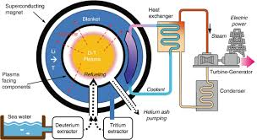
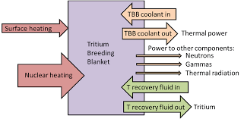
Fusion Nuclear Science and Enabling R&D
Fusion Nuclear Science: Interlinked with a burning plasma and materials that can withstand fusion reactor conditions are all the key systems required to capture the power, breed fuel, and ensure the safe operation of a fusion plant. This program area supports research in the following areas:
Blanket: Breeding tritium within the fusion plant is crucial for achieving a self-sustaining fusion reaction. Areas of interest are tritium control, functional materials, structural materials, and blanket enabling technologies.
Fuel Cycle: Extraction and exhaust processing is crucial for maintaining the self-sustaining fusion reaction. Areas of interest are fueling and exhaust processing, isotope processing, rebalancing and storage, and confinement processing and tritium accountancy.
Advanced first wall and divertor engineering components: Liquid metal plasma facing components included in the first wall and/or the divertor.
Remote Handling: Fusion involves hazardous environments, so remote handling systems are required for maintenance, repairs, and component replacement.
Safety Analysis: Safety assessments, helping to understand how the fusion plant behaves under various operational and accident scenarios.
Fusion Nuclear Analysis: Incorporates neutronics for fusion devices including the development of methodologies, radiation transport simulations, nuclear heating to components, activation of in-vessel components, radiation damage to materials, and neutron and γ-ray fluxes and biological dose rates throughout the facility.
Activation and Waste: Neutrons can cause activation and radiation damage in fusion materials. Studying these effects helps design materials that can withstand the fusion environment and predicting the radioactive waste generated during operation.
Integration and Impact Evaluation: Fusion will be integrated into the larger energy grid and society. This involves assessing the broader impacts of fusion design choices on economic, safety, environmental, and social factors.
Enabling R&D: The realization of fusion energy and the advancement of plasma science requires advances in supporting technologies to achieve higher levels of performance and flexibility to explore new plasma regimes. The purpose of the Enabling Research and Development (R&D) program element is to develop these supporting technologies for deployment on existing and next generation fusion research facilities.
Applications to this area must focus on experimental research and/or model validation pertaining to supporting technologies required to achieve higher levels of performance and flexibility to explore new plasma regimes.

