Slide 1
Roles & Responsibilities
Glen Crawford
Director, Research and Technology R&D Division
Office of High Energy Physics
Office of Science, U.S. Department of Energy

Slide 2
Roles & Responsibilities
DOE and HEP Missions
The U.S. HEP Program and Significant Outcomes
DOE HEP Roles & Responsibilities
Universities
National Laboratories
Worked Examples

Slide 3
Mission of the Department of Energy
The mission of the Energy Department is to ensure America’s security and prosperity by addressing its energy, environmental and nuclear challenges through transformative science and technology solutions.
Catalyze the timely, material, and efficient transformation of the nation’s energy system and secure U.S. leadership in clean energy technologies.
Maintain a vibrant U.S. effort in science and engineering as a cornerstone of our economic prosperity with clear leadership in strategic areas.
Enhance nuclear security through defense, nonproliferation, and environmental efforts.
Establish an operational and adaptable framework that combines the best wisdom of all Department stakeholders to maximize mission success.

Slide 4
Mission of the Office of High Energy Physics
The mission of the High Energy Physics (HEP) program is to understand how our universe works at its most fundamental level.
We do this by discovering the most elementary constituents of matter and energy, exploring the basic nature of space and time itself, and probing the interactions between them.
These fundamental ideas are at the heart of physics and hence all of the physical sciences.
To enable these discoveries, HEP supports theoretical and experimental research in both elementary particle physics and fundamental accelerator science and technology.
HEP underpins and advances the DOE missions and objectives through this research, and by the development of key technologies and trained manpower needed to work at the cutting edge of science.

Slide 5
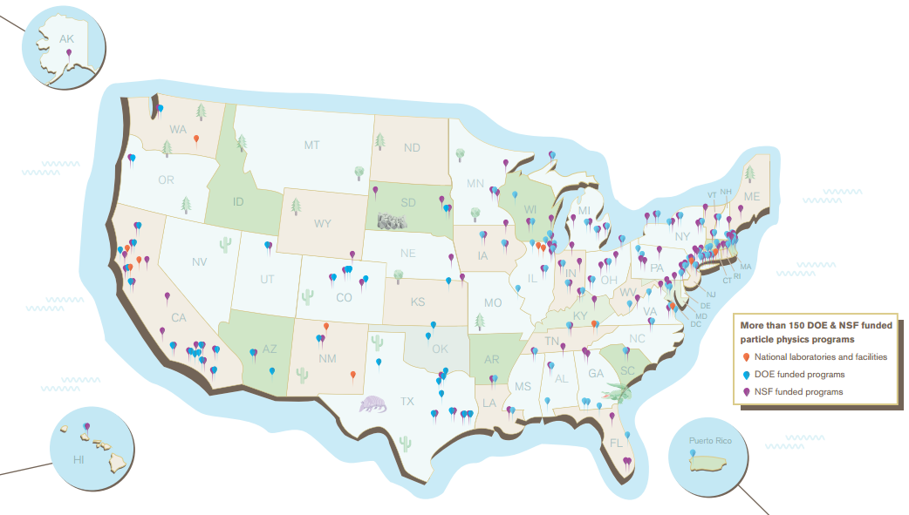
The U.S. HEP Program
U.S. particle physics research involves over 150 universities and laboratories in 43 states (plus Washington DC and Puerto Rico)

Slide 6
HEP Workforce Overview
In 2013, the entire DOE supported HEP workforce (Universities & Laboratories) consisted of ~4,300 FTEs
~2,350 engaged in Research across the Energy, Intensity, and Cosmic Frontiers, Theoretical and Computational Physics, and Advanced Technology R&D
Remaining ~1,950 FTEs provide administrative support and support for facility operations
Major activities at 5 national laboratories, involving ~2,600 FTEs:
Argonne National Laboratory (ANL)
Brookhaven National Laboratory (BNL)
Fermi National Accelerator Laboratory (FNAL)
Lawrence Berkeley National Laboratory (LBNL)
SLAC National Accelerator Laboratory (SLAC)
A few small, specialized research efforts at other SC and NNSA labs
University research program consists of ~250 active grants to >100 institutions, involving ~1,700 FTEs

Slide 7
Laboratory Support
Laboratory research is mission driven and funded through Field Work Proposals
Program guidance to the Laboratories is provided by HEP with input from a variety of sources, including:
The Laboratories themselves
Local strengths and resources
Advisory committees
Institutional reviews
HEP holds comparative reviews of the Research programs of the labs every 3 years.
Research job classifications at Laboratories are similar to those at Universities
Major exception is Senior Research Scientists in place of PIs
Rounding in percentages may cause total to be less than 100%

Slide 8
University Support
University research is supported by a competitive, proposal-driven process
Grants issued after comparative review of proposals submitted to Funding Opportunity Announcements
Research job classifications at universities, supported by HEP funding, include the following positions:
Principle Investigator (PI)
Tenured or tenure-track permanent Ph.D. staff
Research scientist
Permanent, non-tenured staff
Postdoctoral fellow
Term employees with Ph.D.
Graduate students
Administrative staff
Engineers
Computer professionals
Rounding in percentages may cause total to be less than 100%

Slide 9
Significant Outcomes
Expected outcomes from the DOE HEP program include but are not limited to:
Operation of facilities that enable cutting-edge science
Acquisition, management and curation of science data
Production of science results documented in research publications
Training of students and postdoctoral researchers
Development of new concepts and technology for advancing scientific frontiers and serving a broader community
Science leadership to enable significant advances in specific science areas
Partnerships as needed to leverage additional science and expertise
To achieve these outcomes the agency and stakeholders in the HEP community have different roles

Slide 10
DOE Roles and Responsibilities
Certain functions are considered “inherently governmental” and reserved for Federal staff, including:
Determination of Federal program priorities for budget requests
Determination of budget policy, guidance, and strategy
Approving, awarding and administering government prime contracts
Including determining what supplies or services are to be acquired with government funds
Moreover, since Federal staff are normally hired following civil service laws, there is a strong precept that contractors must not act as Federal staff and vice versa, e.g.:
Government employees do not directly supervise contractors
Federal staff are generally not involved in contractor personnel decisions
For all intents and purposes, DOE labs are prime contractors and lab employees are contractor employees.
Some specific worked examples follow

Slide 11
DOE Lab Roles and Responsibilities
Facility Operations and Construction
Performance judged against specified metrics (e.g. pb⁻¹ ; EVMS)
Includes maintenance, upgrades, planning for new facilities
User support
HEP Research and Technology R&D
Nurture and support HEP research collaborations to enable discovery science
Participation in all phases – from design, construction, operations & analysis
Particular emphasis on:
Management, design, construction and operation of HEP experiments
Integration of cross-cutting activities, e.g.: computation, simulation and theoretical research, in support of HEP program
Exploiting lab infrastructure and resources to develop next-generation particle accelerator and detector technologies for the advancement of HEP and science more broadly

Slide 12
University Roles and Responsibilities (DOE Perspective)
HEP Research and Technology R&D
Contribute significantly to HEP research collaborations to enable discovery science
Participation in all phases – from design, construction, operations & analysis
Particular emphasis on:
Advanced training of students and postdocs
Data analysis and comparison with theoretical models
Vision and theoretical framework for understanding the Standard Model and beyond
Novel and innovative concepts and approaches
Design of future HEP experiments

Slide 13
Example 1: DOE Budget Formulation Process
As noted above, this is an inherently governmental function
But strongly informed by community via HEPAP/P5
DOE/HEP proceeds using a few basic guidelines:
General science priorities follow HEPAP/P5 recommendations
Project-like activities on planned profiles
Some flexibility for projects not yet baselined depending on technical readiness and external factors
Need detailed input from project management and partners
Facility operations based on operations plan
Need detailed input from lab/facility management
Core research (lab/university) at level-of-effort
Generally guided by HEPAP/P5 and program needs
If funds remain, they can be used for new initiatives
Could be specific HEPAP/P5 items or call for proposals

Slide 14
Example 2: DOE Projects
Successful delivery of construction projects and facilities for science is a central part of the DOE science mission
In particular, Office of Science practice (critical decision [CD] process and Lehman reviews) considered gold-standard in DOE
“Failure is not an option”
SC has earned the authority to manage projects flexibly. This authority is only protected by unblemished project execution and is recognized as essential to SC success. This explains why so much attention is paid to project execution.
Therefore, we have close Federal oversight and coordination with contractor project managers. Experienced personnel required.
Extent of oversight tailored to total project cost
Larger projects automatically get higher visibility in DOE due to layered approval levels
Complex dance between different project and budget requirements and timelines
DOE Budget Requests require appropriate CD’s are passed before requesting/spending money
Project execution not well suited to university grant funding mechanisms
For all these reasons, DOE Labs have a critical role in project management and construction
Universities also play important roles, but must understand and adapt to requirements of DOE project system

Slide 15
Example 3: DOE Budget Execution Process
Another inherently governmental function
Start from the general plan laid out in budget formulation, modified by the actual appropriation
Details of the execution strategy informed by proposals from labs and universities, and CD process for projects.
Write financial plans (labs) and grants (universities, others) based on review of proposals and appropriated budget
DOE/HEP proceeds using a few basic guidelines:
Detailed funding allocations should optimize the overall program
Make lab and university research reviews as similar and as transparent as possible
However, there are some differences due to the inherent differences between competitively-selected financial assistance awards (grants) and modifications to the lab maintenance and operations contracts; as well as differences in their primary roles and responsibilities
Except in special cases, HEP labs and universities do not compete directly for funding under a single funding opportunity announcement due to their different roles
Instead, labs and universities are directly competed against their peers
Facility operations and maintenance of infrastructure are generally considered separately due to the different nature of that work

Slide 16
Backup

