Slide 1
High Energy Physics
Program Status
Jim Siegrist
Associate Director
Office of High Energy Physics
Office of Science, U.S. Department of Energy

Slide 2
Outline
Overview
Program Status and Accomplishments
HEP Budget and Issues
HEP Funding Opportunities
Office News

Slide 3
Take-Away Messages
HEP is global
  P5 strategic plan explicitly recognizes this fact, as does DOE implementation
  Highest priority major projects are LHC upgrades (near-term) and LBNF (mid-term)
    LBNF will be the first truly international experiment hosted by the U.S., with management modeled after the successful LHC scheme
We share the community’s enthusiastic response to the P5 strategic plan
  We are moving forward with implementation in targeted areas
  But given the current fiscal environment, full implementation of the plan will take some time
2015 will be an important year
  First results from LHC Run 2, NOνA
  Further development of short- and long-baseline neutrino program
  International agreements start coming into view

Slide 4
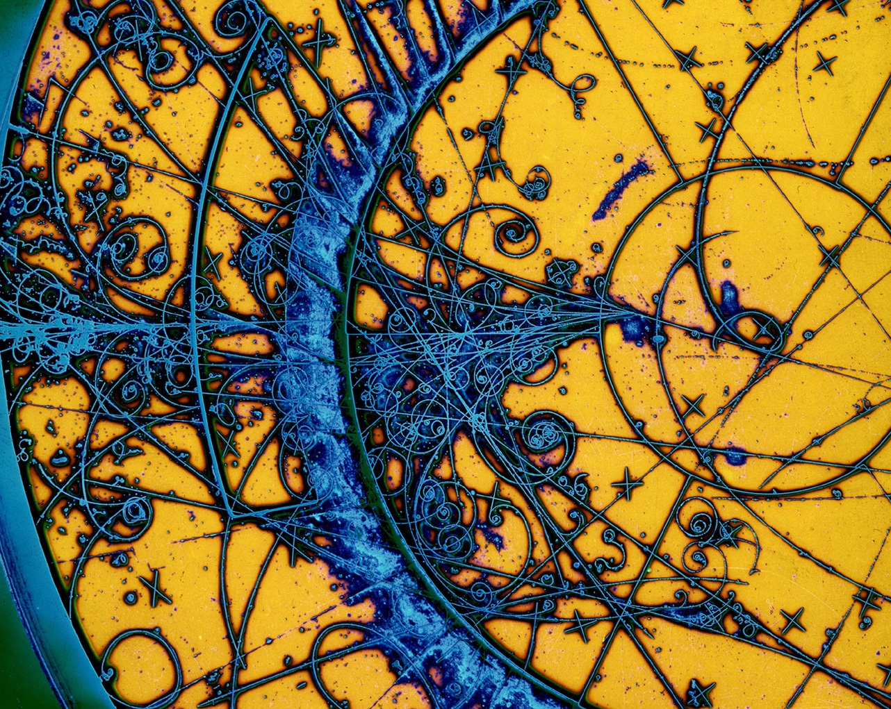
HEP Program Status

Slide 5
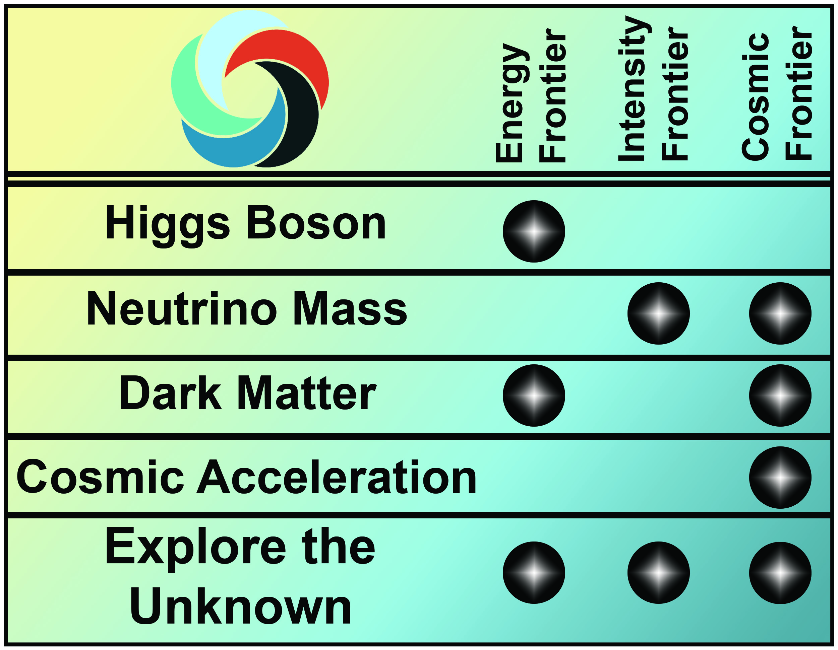

Science Drivers and Research Frontiers
Science drivers identify the scientific motivation while the Research Frontiers provide a useful categorization of experimental techniques

Slide 6
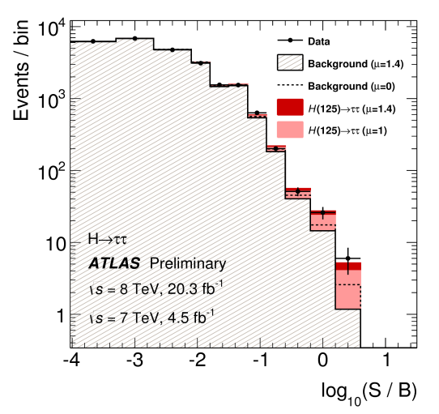
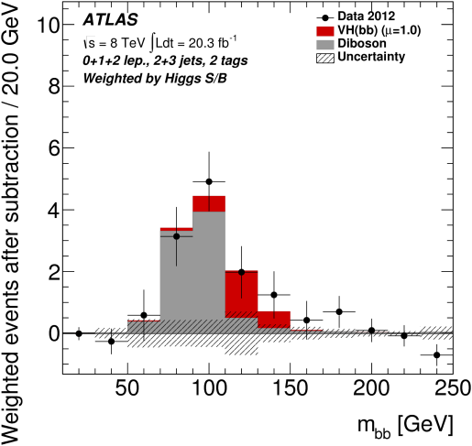
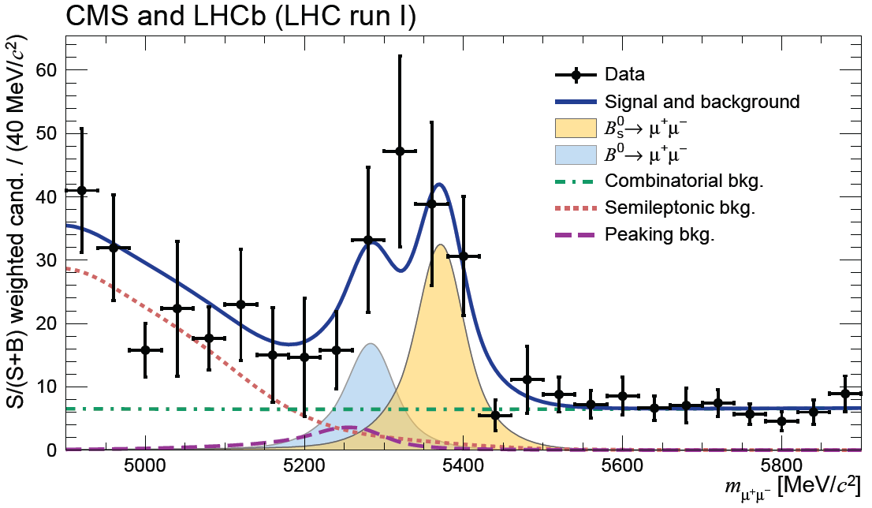
Energy Frontier Highlight:
Over 360 LHC Run 1 papers submitted for publication by each of ATLAS & CMS!
Recent ATLAS results on the decays of Higgs to fermions:
  October 2014 H→ττ result:
  observed 4.5σ significance excess
  [3.5σ expected for SM Higgs]
  September 2014 VH, H→bb result:
  observed 1.4σ significance excess
  [2.6σ expected for SM Higgs]
Joint CMS-LHCb paper submitted to Nature provides:
  First observation of the B⁰_{s}→μ⁺μ⁻ decay, at 6σ significance, and best measurement of its branching fraction to date
  Evidence for B⁰→μ⁺μ⁻ decay at 3σ significance
  Measurements statistically compatible with SM predictions
    Imposes stringent constraints on several theories beyond the SM
VH, H → bb
H → ττ
arXiV: 1409.6212
ATLAS-CONF-2014-061
Weighted events after subtraction / 20.0 GeV
Submitted to Nature on Nov. 17, 2014

Slide 7
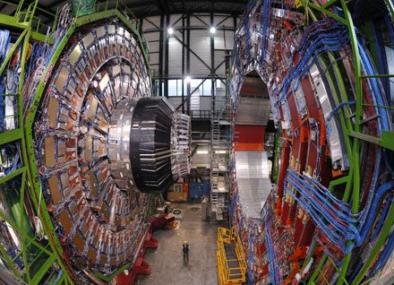
Energy Frontier Status
Current program
LHC will resume operations in Spring 2015 at collision energies of 13+ TeV
  Higher energy will increase the reach into search for new physics in high-impact topics
    SUSY, dark matter, extra dimensions, …
The U.S. will continue to play a leadership role in LHC discoveries and is actively executing the initial upgrades (Phase-I) to the LHC detectors
  Phase-I U.S. CMS/ATLAS upgrades received CD-2/3 approval on November 12, 2014
Planned program
Considering high-luminosity LHC upgrade around 2023 to extend discovery reach
  Increase luminosity by 10 times LHC design value
  to explore new physics at TeV energies
  DOE/HEP actively working with US-CMS/ATLAS to
  begin mounting HL-LHC Detector Upgrade Project
The new CERN-DOE-NSF Cooperation Agreement
undergoing final review by all parties
Very modest investments in R&D for future
options:
  Lepton colliders
  Very high energy hadron colliders

Slide 8

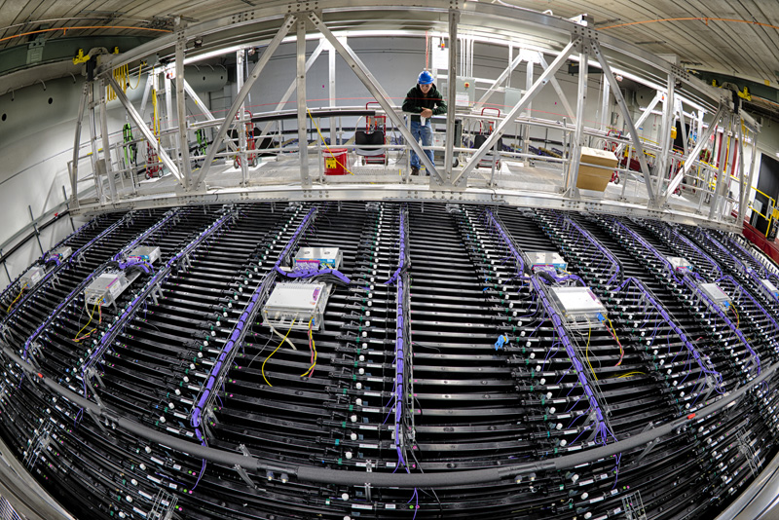
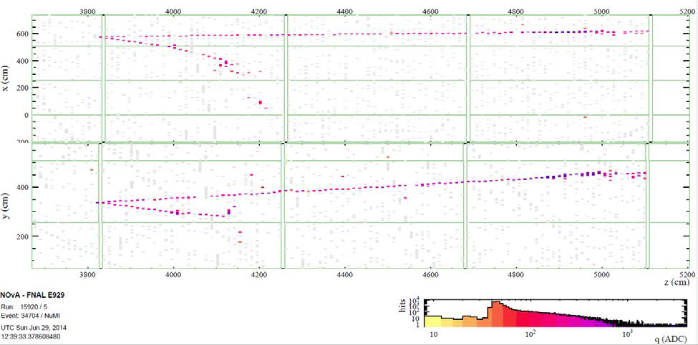
Intensity Frontier Highlight:
NOvA Experiment Taking Data
NOvA now taking data using the world’s most powerful neutrino beam and the world’s longest baseline
  NuMI beam sent 500 mi from Fermilab to Ash River, MN
  Project completed on time and under budget in September 2014
  Now beginning planned six-year run
Zoom-in on NuMI beam window charged-current ν_{μ} candidate event

Slide 9
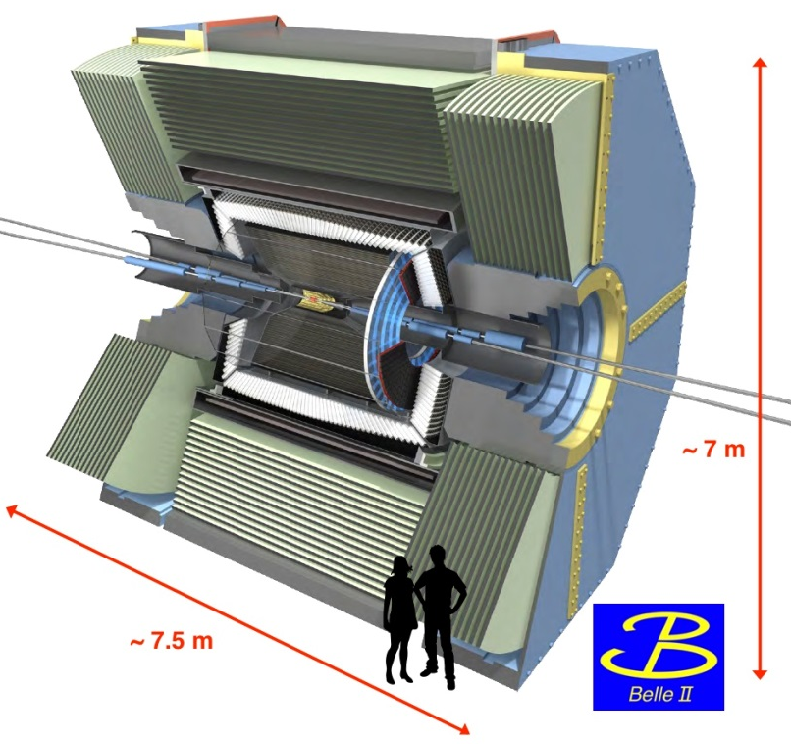
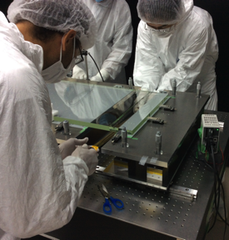
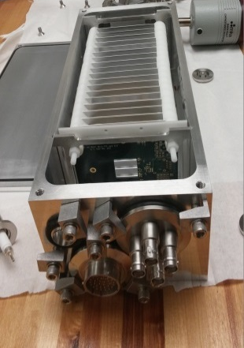
Intensity Frontier Highlight:
Belle II Experiment Construction Progress
KEKB upgrade will deliver 100x luminosity of PEP-II
Belle II Collaboration: 600 members, 99 institutions, 23 countries
  More U.S. institutions on Belle II than any other country, including Japan
Key U.S. contributions:
  Belle II Detector Systems
  Distributed Computing
  Technical & Reconstruction Software
  PNNL serving as U.S. project lead
Progress since Belle II project CD-3 reached in April 2014:
1st sector of K_{L}/muon detector system installed and integrated into DAQ
1st of 16 modules for Imaging Time-Of-Propagation (iTOP) system for Barrel particle identification assembled
Detector system to evaluate backgrounds during accelerator commissioning phase
  Micro-TPCs developed to provide fast neutron directionality using recoil track
Micro-TPC for fast neutron directionality
Aligning and gluing iTOP optics

Slide 10
Intensity Frontier Status
Exploring the unknown through precision measurements
Precisely measure charged leptons properties and search for rare particle interactions
  Program based on muon beams at Fermilab:
    Muon g-2: Cryogenic test of the superconducting magnet system will be completed before baselining
    Mu2e: Follow-up review in February to determine if project is ready for CD-2/3b in Q2 of FY 2015
Precision studies of K mesons, c/b quarks and τ leptons to search for new states of matter
  Small program being carried out at foreign labs:
    Belle II, K0TO
Identify the physics of dark matter
Intense particle beam based searches for dark matter
  APEX, Heavy Photon Search

Slide 11
Intensity Frontier Status (continued)
Pursuing the physics associated with neutrino mass
Current program aims to determine neutrino mass hierarchy & measure neutrino properties
  Experiments at Fermilab, China, Japan and underground:
    Daya Bay, MicroBooNE, MINERvA, MINOS+, NOvA, Super-K, T2K
Planned program seeks to determine if there are sterile neutrinos and if neutrinos violate CP
  Neutrino program planning underway:
    Fermilab short-baseline neutrino (SBN) Working Group established; Fermi PAC will consider proposal(s)
    BNL will host a workshop in February 2015 focused on intermediate term SBN program
    Progress is being made on internationalizing the Long Baseline Neutrino Experiment (see later talk…)
  See Fermilab talk on Tuesday for more details on Fermilab SBN program and LBNE status

Slide 12
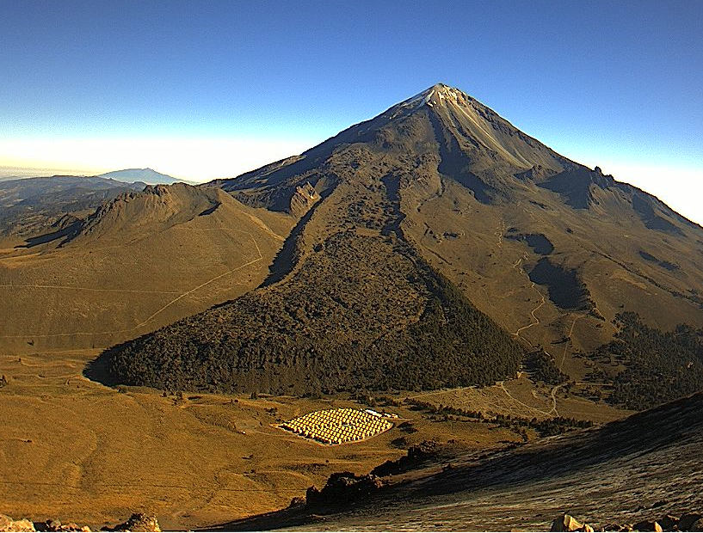
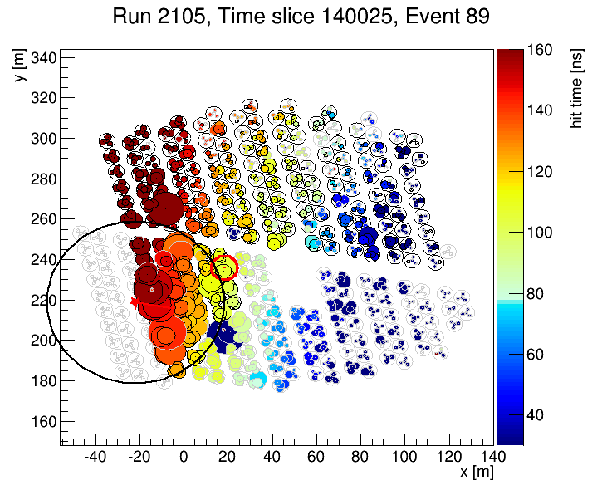
Cosmic Frontier Highlight:
HAWC-250 Array Taking Data
High-Altitude Water Cherenkov Observatory (HAWC) in Sierra Negra, Mexico, is now taking data
  Joint project between DOE, NSF and CONACYT (Mexico)
  Will perform high-sensitivity synoptic survey of the sky at wavelengths between 100 GeV and 100 TeV
  Instantaneous aperture covers >15% of the sky and will be exposed to 2/3 of the sky each day
Currently running with 250 tanks in place
  Entire HAWC-300 array will be completed by February 2015
  Filling at 4-5 tanks per week

Slide 13
Cosmic Frontier Status
Dark Energy
Operating:
  BOSS (spectroscopic) ends FY14, DES (imaging) started FY13, SN surveys
Fabrication:
  Large Synoptic Survey Telescope (LSST, Stage IV imaging)
    LSST-camera CD-3a approved June 2014, CD-2 review in November 2014, CD-2 approval planned for January 2015
Planning:
  Dark Energy Spectroscopic Instrument (DESI, Stage IV spectroscopic)
    CD-1 review Sept. 2014; Planning for fabrication start FY16
Dark Matter (direct detection)
Operating:
  1st generation (DM-G1) experiments:
    ADMX, LUX, CDMS-Soudan, DarkSide, COUPP
Planning:
  DOE and NSF announced in July 2014 selection of DM-G2 experiments to move forward to fabrication phase: ADMX-G2, LZ, SuperCDMS-SNOLab
    LZ & SuperCDMS-SNOLab MIE projects are planning for fabrication start in FY16

Slide 14
Cosmic Frontier Status (continued)
Cosmic-ray, Gamma-ray
Operating:
  Fermi/GLAST, VERITAS, Auger, AMS
    DOE operations efforts completed by FY16 for VERITAS and Auger
Fabrication:
  HAWC gamma-ray observatory began taking data in late November 2014
Cosmic Microwave Background (CMB)
Operating:
  South Pole Telescope polarization (SPTpol)
Fabrication:
  SPT-3G had successful review of DOE roles/responsibilities in September 2014
Planning:
  Community planning for a CMB Stage IV experiment

Slide 15

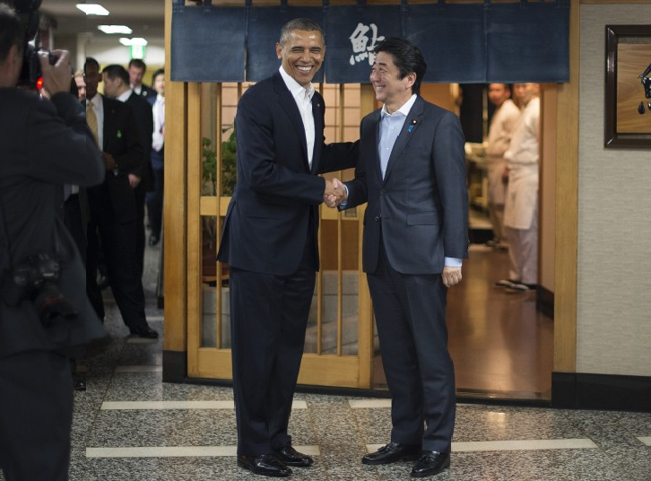
International Agreements
See International Status talk later today…

Slide 16
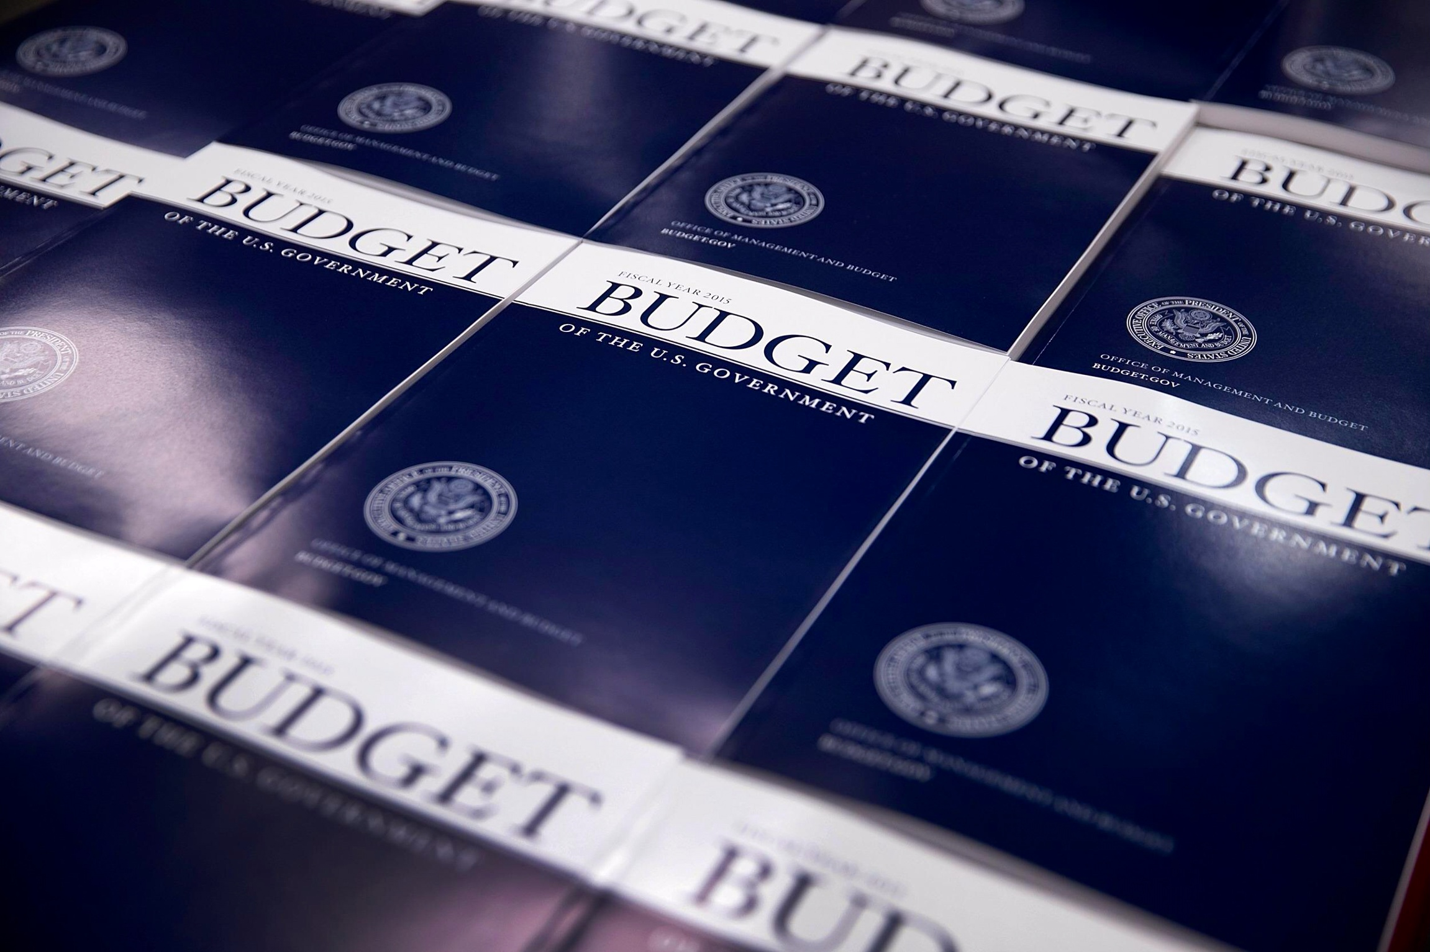
HEP Budget AND ISSUES

Slide 17
FY 2015 High Energy Physics Budget
HEP Funding Category ($ in K) | FY 2013 Current | FY 2014 Current | FY 2015 Request | Explanation of Changes (FY15 vs. FY14)
Energy Frontier | 149,446 | 154,687 | 153,639 | Reduction for Tevatron completion offset by LHC upgrade activities
Intensity Frontier | 274,412 | 275,043 | 251,245 | Reductions for NOvA project completion, Belle II offset by increase for beam line ops & refurbishment at FNAL
Cosmic Frontier | 80,063 | 99,080 | 101,245 | Ramp-up of LSSTcam
Theoretical and Comp. | 66,398 | 62,870 | 58,850 | Reduced to offset investments in future facilities
Advanced Technology R&D | 142,291 | 122,291 | 114,242 | Reduced to offset project increase, shift towards directed R&D
Accelerator Stewardship | 3,132 | 9,931 | 19,184 | Support new R&D efforts, open accelerator test facilities to industry
Construction | 11,781 | 51,000 | 25,000 | Mu2e on profile; LBNE reduced in FY15 req. (req. made during P5 report development)
SBIR/STTR | 0 | 21,619 | 20,595
Total | 727,523 | 796,521 | 744,000
DOE Office of Science (SC): | 4,681,195 | 5,066,372 | 5,111,155
FY 2015 is currently in a 72-day Continuing Resolution (CR) until Dec. 11, 2014
  Total HEP funding level based on FY 2015 President’s Request ($744M)

Slide 18
Table of FY15 Request vs. Senate & House
Funding in $K | FY 2014 Current | FY 2015 Request | FY 2015 House Mark | FY 2015 Senate Mark
Energy Frontier | 151,926 | 153,639 | 157,888 | 156,069
Intensity Frontier | 251,032 | 251,245 | 266,691 | 244,939
Cosmic Frontier | 101,371 | 101,245 | 103,056 | 106,641
Theoretical and Computational | 64,298 | 58,850 | 60,670 | 60,416
Advanced Technology R&D | 147,124 | 114,242 | 125,605 | 119,638
Accelerator Stewardship | 8,169 | 19,184 | 3,000 | 19,184
Construction | 51,000 | 25,000 | 37,000 | 47,000
SBIR/STTR | 0 | 20,595 | 21,090 | 20,595
Total | 774,920 | 744,000 | 775,000 | 774,482
House & Senate marks are similar in total funding, above Pres. Request
  House includes MIEs for US-ATLAS/CMS Phase-1 upgrades and DM-G2
Accelerator Stewardship very different between House & Senate marks

Slide 19
Implementing the P5 Plan
DOE HEP has updated the staff in the House and Senate about how the P5 report strategy affects our plans for FY15
Current Continuing Resolution (CR) ends December 11 (this week)
Plans for implementing our program depend on the final appropriation:
  A CR at the FY15 Request level creates complications, but should enable us to implement Scenario A of the P5 report strategy
  A full appropriation or CR at the House/Senate markup level would allow us to begin implementation of Scenario B of the P5 report strategy

Slide 20
Implementing the P5 Plan (continued)
We are working through project profiles with the laboratories to ensure the P5 priorities are respected and there is no damage to the program under the possible funding scenarios
  Projects that are baselined or nearly baselined will be fully funded
    This includes the LHC Phase I upgrades, Mu2e, and LSST
  High-priority near-term efforts like DM-G2 experiments will get enough funding to keep them going through the CR
    We will try to enhance their funding after an appropriation is passed
Laboratories have been asked to defer costs in anticipation of shortfalls
University research may also be impacted
  CR at current level (FY15 Request) would lead to 3-5% reductions in university grant support
  Will try to restore this to “flat cash” in the case of an appropriation near Congressional marks

Slide 21

HEP Funding Opportunities

Slide 22
Funding Opportunity Announcement Status
Scientific Discovery through Advanced Computing (SciDAC) FOA is open (High Energy Physics joint with ASCR) – will close Jan 7, 2015
  http://science.energy.gov/~/media/grants/pdf/foas/2015/SC_FOA_0001210.pdf
The HEP research FY2015 Funding Opportunity Announcement (FOA) is closed and we are performing the comparative review
  Review process underway and PIs will start to be informed of funding decisions in January
The Accelerator Stewardship FOA is now closed
  Reviews completed, consulting with partners in SC and other agencies
  Final decisions will not be made until after FY15 appropriation
Early Career Research Program FOA is now closed
  Proposals were due by November 20, and we are now preparing for review
DOE Office of Science Graduate Student Research (SCGSR) Program is now closed
  Review process near completion and award notifications planned to be sent out in December

Slide 23

Office News and Miscellany

Slide 24
HEP Program Status Updates
New Assignments
  Abid Patwa is managing U.S. LHC Operations
Comings and Goings
  William Kilgore (Detailee) is now helping in Theoretical Physics
  Eric Linder (Cosmic IPA) will begin in January 2015
  New Contractors and IPA (Intensity) identified, starting soon
  David Boehnlein (Energy Frontier IPA), Peter Kim (Detector R&D Detailee), and Larry Price (Computing Detailee) finish their terms in early 2015
  Working on new Fed staff position TBA
  Additional help welcome to aid with P5 implementation!
    Interested parties should contact HEP management

Slide 25
HEP S&T Connections Thrust
Aim of thrust is to strengthen connections with other SC Programs and the broader national Science & Technology enterprise
  Advance our mission by probing new windows to discovery by synergistic collaborations
  Accelerate science productivity by drawing on unique expertise and strengths within partnering disciplines
Near-term plans include:
  Exploit designer materials capabilities for HEP science and technology
  Discover research techniques using expertise from partnering programs
  Explore condensed matter & atomic systems that advance HEP science and verify models
  Pursue Quantum Information Systems as a window to the Universe
  Broaden the user communities for HEP facilities through new applications outside HEP

Slide 26

Current Connections Activities
HEP Connections with Basic Energy Sciences (BES) have begun, following discussions between BES and HEP at Office of Science
Talk Today by Mike Norman On Materials by Design
  Connections Question is: Can the HEP
  Community use this transformative
  technique for specialized detector
  or other materials?
Other Activities Initiated Include:
  ASCR-HEP Study Group
  BES-HEP Roundtable
Program Manager for HEP Connections:
  Lali Chatterjee lali.chatterjee@science.doe.gov
BES-HEP
ASCR-HEP

Slide 27
Take-Away Messages
HEP is global
  P5 strategic plan explicitly recognizes this fact, as does DOE implementation
  Highest priority major projects are LHC upgrades (near-term) and LBNF (mid-term)
    LBNF will be the first truly international experiment hosted by the U.S., with management modeled after the successful LHC scheme
We share the community’s enthusiastic response to the P5 strategic plan
  We are moving forward with implementation in targeted areas
  But given the current fiscal environment, full implementation of the plan will take some time
2015 will be an important year
  First results from LHC Run 2, NOνA
  Further development of short- and long-baseline neutrino program
  International agreements start coming into view

Slide 28
Backup

Slide 29
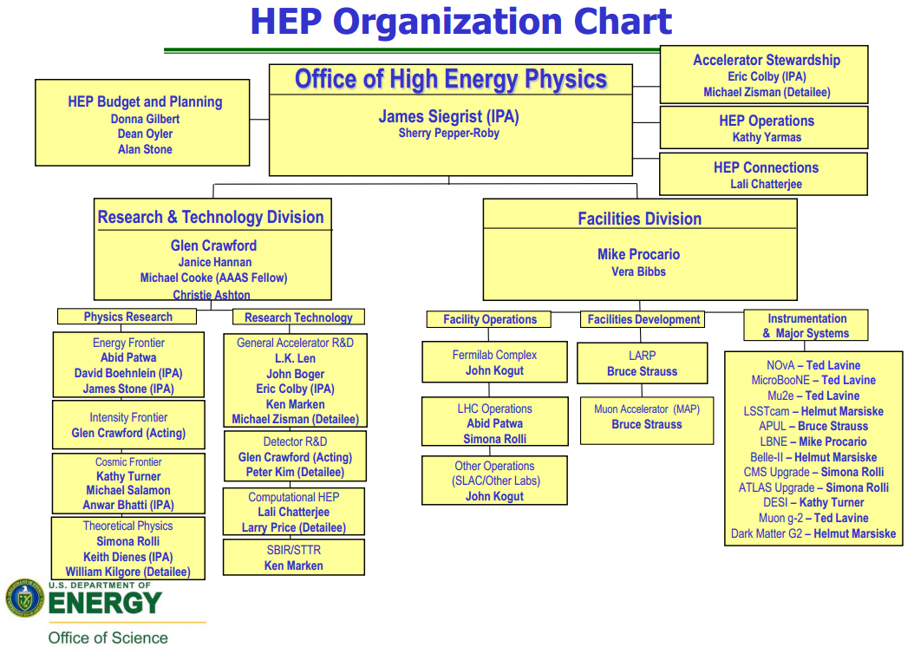
DOE Office of High Energy Physics Organization Chart

Slide 30
Accelerator Stewardship
Authorized for the first time in FY 2014 as a redirection of funds
  An initial Stewardship program was identified in discussions with SC/BES and SC/NP composed of 10 existing university grants, the BNL-ATF program, and the Facilities Pilot Program
Program elements for FY 2015 awaiting appropriations
  First Accelerator Stewardship call for proposals for FY 2015
    Three applied R&D topic areas recommended by the Accelerator Task Force, and developed by subsequent workshops
      Particle Beam Therapy Improvements
      Ultrafast Laser R&D
      Energy Efficiency Improvements for SC Accelerators
    A basic R&D category for long-term generic accelerator R&D
    Merit review process underway now
    Awards subject to available funding
  Accelerator Test Facility Pilot Program for FY 2015
    Will gauge demand and nature of “outside” uses of SC accelerator R&D infrastructure
    Defining agreement signed this summer. Will implement in FY 2015, subject to available funding

Slide 31
Office of Science (SC) Digital Data Management Statement
Data management involves all stages of the digital data life cycle including capture, analysis, sharing, and preservation. The focus of the SC Digital Data Management is the sharing and preservation of digital research data.
  Funding Opportunity Announcements (FOAs) issued after October 1, 2014, will require a Data Management Plan (DMP) and compliance with the SC Statement
  Requirements for DMPs and guidelines are available at:
  http://science.energy.gov/funding-opportunities/digital-data-management/
Additional HEP-specific guidance on DMPs is available
  http://science.energy.gov/hep/funding-opportunities/digital-data-management/
  HEP will be working with the DOE National Laboratories to make available accessory information about individual experiments and projects led by respective laboratories
  For more information please contact Dr. Lali Chatterjee and/or your Program Manager

Slide 32
HEP Science & Technology Connections Thrust
P5 noted the importance of our Benefits and Connections to Society
HEP has initiated discussions internally with some of the other SC Programs to start building stronger connections
  Explore new experimental systems and techniques
  Exploit transformative capabilities available in adjacent scientific disciplines
  With aims to advance HEP science drivers, test our models and contribute to our S&T environment
Thanks to those who submitted Nominations for an HEP Connections Committee
  We are not forming this HEP specific committee at this time
  We will keep your nominees in mind as planning progresses with potential partner communities
For more information contact Lali Chatterjee: lali.chatterjee@science.doe.gov

Slide 33
HEP Forum for Computational Excellence (FCE)
HEP-FCE is a pilot project to strengthen scientific computing within our field as part of DOE HEP’s response to P5 Recommendations on Computing
  Explore next-generation hardware and data-science software and foster more cross-laboratory and university-laboratory collaboration
  Current website: http://press3.mcs.anl.gov/hepfce/
FCE Roles
  Computing planning input
  R&D portfolio focused on cross-cutting tasks
  Computational support for smaller experiments
  Cross-cutting knowledge/capability base
  Training/Workshop activities
  Data archiving/curation/management contact point
  Strategic connectivity for DOE HEP program
  Build HEP-FCE community hub
FCE Organization
  Directors: S. Habib (ANL) and R. Roser (FNAL)
  Advisory Panel Members: D. Asner (PNNL), P. Avery (Florida), A. Boehnlein (SLAC), C. Tull (LBNL), T. Wenaus (BNL), + Additional University Members.
Currently, three FCE working groups are looking at cross-cutting HEP computing needs

