Slide 1
General Accelerator R&D Roadmaps:
Advanced Accelerator Concepts
Radio Frequency
G.C. Blazey
Northern Illinois University
HEPAP - June 5, 2017

Slide 2
Context: P5
P5 Stated: “The future of particle physics depends critically on transformational accelerator R&D to enable new capabilities and to advance existing technologies at lower cost.”
P5 Recommended:
  “Align the present R&D program with the P5 priorities and long-term vision, with an appropriate balance
    among general R&D, directed R&D, and accelerator test facilities
    and among short-, medium-, and long-term efforts”
  “Focus on outcomes and capabilities that will dramatically improve cost effectiveness of mid-term and far-term accelerators.”
P5 Suggested: a HEPAP subpanel on accelerator R&D to provide detailed guidance on implementation of accelerator R&D aligned with P5 priorities.

Slide 3
Context: ARD Subpanel
Following P5’s advice, DOE convened the HEPAP Accelerator R&D Subpanel.
ARD Subpanel Executive Summary: ”The Subpanel examined the accelerator R&D that is required to prepare for the future-generation accelerators envisioned by P5.”
Recommendation 10. Convene the university and laboratory proponents of advanced acceleration concepts to develop R&D roadmaps with a series of milestones and common down-selection criteria.
The HEP Committee of Visitors has recommended that this process be applied to other components of GARD.
Today, as “facilitator” will review roadmaps for GARD-AAC and GARD-RF.

Slide 4
AAC Workshop: Process
Convened February 2-3, 2016 by DOE at this venue.
Preceded by focused preparatory workshops.
Proceedings very detailed and intense :
  Presentation of individual roadmaps for PWFA, LWFA, DWFA.
  Talks on synergies between the roadmaps and with global efforts.
  Talks on potential early applications, diagnostic needs, simulation needs, and beam issues and challenges related to a collider.
  Discussion of individual roadmaps with emphasis on the next 5-10 years and common challenges.
Assumptions:
  The primary long-term goal is a multi-TeV e+e- collider with a timescale set by a TDR in 2035-2040 timeframe.
  As an intermediate goal, a TDR for a potential early application such as an XFEL or gamma-ray source.
Workshop report at https://science.energy.gov/~/media/hep/pdf/accelerator-rd-stewardship/Advanced_Accelerator_Development_Strategy_Report.pdf

Slide 5
AAC Workshop: Participants
Attendees:
  Expert proponents of LWFA, PWFA, DWFA
  Invited accelerator science experts from universities and laboratories
Invited participants:
  Thomas Antonsen (Maryland) Chungguang Jing (ANL/Euclid)
  Ilan Ben-Zvi (BNL, Stony Brook) Chan Joshi (UCLA)
  Jerry Blazey (NIU) Wim Leemans (LBNL)
  Yunhei Cai (SLAC) Michael Litos (SLAC)
  Weiren Chou (FNAL) Sergei Nagaitsev (FNAL)
  Michael Downer (Texas-Austin) James Rosenzweig (UCLA)
  Wei Gai (ANL) Andrei Seryi (John Adams Inst.)
  Carl Schroeder (LBNL) Bill Weng (BNL)
  Mark Hogan (SLAC)
Other participants:
  L.K. Len (DOE) J. Siegrist (DOE)
  G. Crawford (DOE) J. Boger (DOE)
  E. Colby (DOE) K. Marken (DOE)
  A. Lankford (HEPAP) V. Lukin (NSF)

Slide 6
AAC Roadmap Common Challenges
The workshop collaboratively identified a set of unifying, common challenges for the next decade:
Staging: Higher energy* staging of electron acceleration, with independent drive beams, equal energy, and 90% beam capture.
Emittance: Understanding mechanisms for emittance growth and developing methods for achieving emittances compatible with colliders.
Higher energy electron acceleration stage: Completion of a single electron acceleration stage at higher energy.
Positron acceleration: Demonstration and understanding of positron acceleration.
Collider parameter set: Continuous, joint development of a comprehensive and realistic operational parameter set for a multi-TeV collider, to guide operating specifications for AAC.
* ”Higher Energy” means multi-GeV for LWFA & PWFA and multiple 100-MeV for DWFA

Slide 7
Preliminary Roadmap for Laser Plasma Accelerators
2015 | 2020 | 2025 | 2030 | 2035 | 2040
Continuing Invention & Discovery Phase
Modeling and simulations with hi-fidelity, high speed codes
10 GeV module
Positrons
5 GeV+5 GeV staging
Phase space shaping, efficiency, diagnostics, tolerances
Final focus, cooling, …
Accelerators
Prototype Phase
GeV linac – kHz rep rate
50-100 GeV linac(s) – O(1-10kHz)
First applications (radiation sources)
Design of concepts for colliders
Collider conceptual
design report (CDR)
Collider tech. design report (TDR)
3 kW class
Collider
Lasers
30 kW class
300 kW class

Slide 8
LWFA: Next Decade
10 GeV e-beam single stage
5 GeV + 5 GeV staging.
Positron Beams
FEL Applications
Plasma target / energy recovery
Diagnostics
Simulations

Slide 9
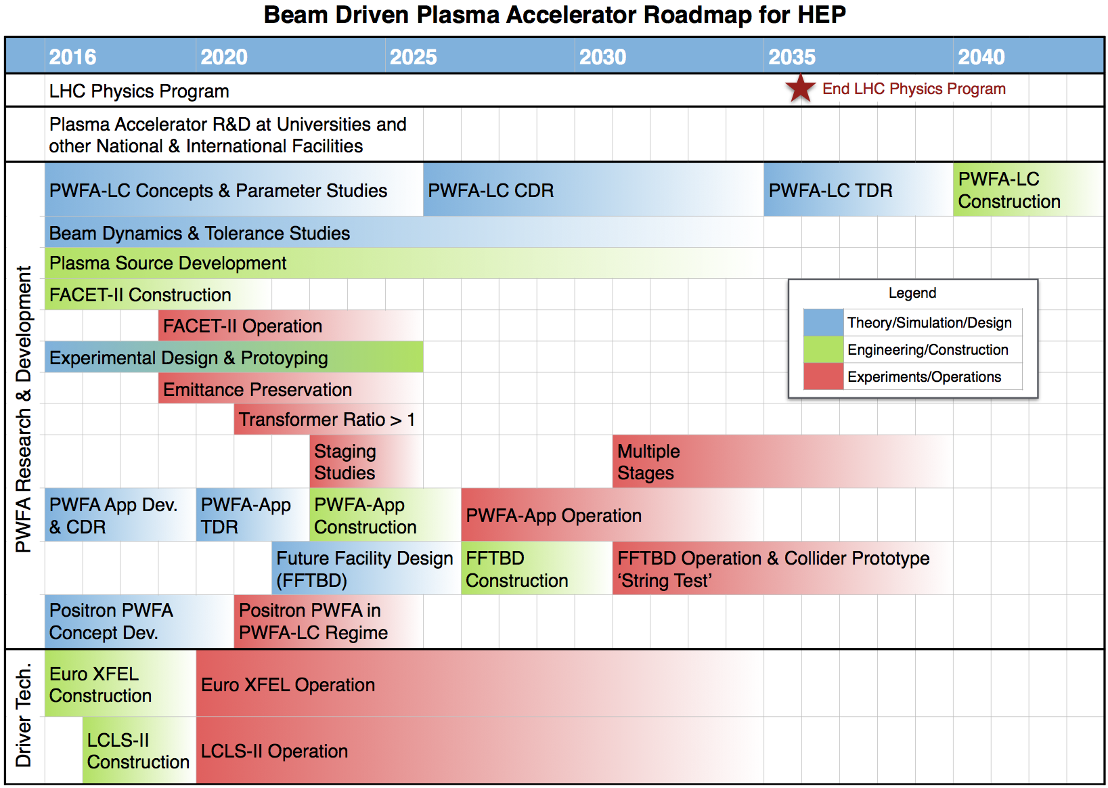
Particle Wakefield Acceleration (PWFA):
Roadmap Overview
Emittance preservation
Positron acceleration

Slide 10
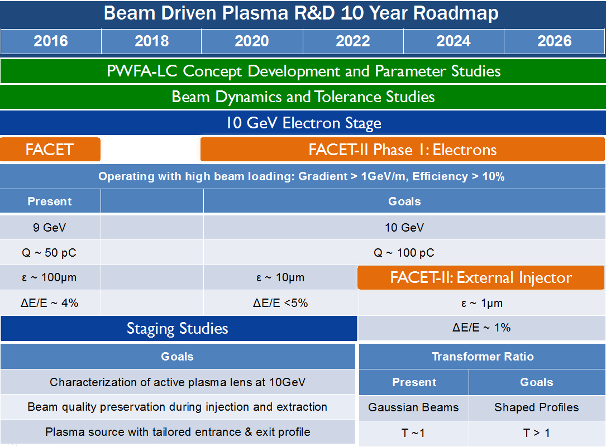
PWFA: Next Decade
Throughout the 10-years:
  LC concept development
  Beam dynamics & tolerance studies
  Early applications development
Program is shaped by availability of facilities.
  FACET-II Phase 1 – electrons
  FACET-II Phase 2 – positrons
  FACET-II w/ external injector
10 GeV Electron Stage
  FACETII will enable next step in gradient and beam quality
  FACETII external injector will enable further progress (ε and ΔE)
Staging Studies with independent witness beam injector

Slide 11
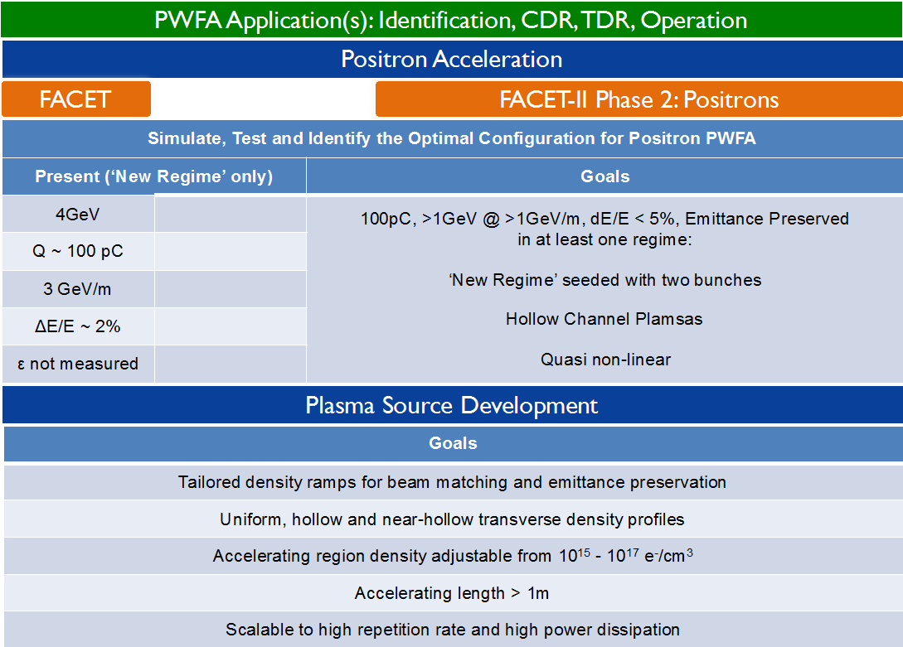
PWFA: Next Decade
Positrons: FACETII Phase 2 will enable the next step in positron acceleration
Plasma source development.

Slide 12
Dielectric Wakefield Acceleration (DWFA): Roadmap Overview
R&D primarily on dielectric two-beam acceleration:
  Several critical technology elements can draw upon CLIC or ILC designs:
    Polarized electron and positron sources
    Beam delivery system and appropriate main-beam parameters at IP
  The other critical technology elements are focus of current R&D:
    Main (witness) beam acceleration
    Drive beam power source
    Staging of multiple accelerations structures to higher energy
Goals:
  300 MV/m gradient
  Low-cost dielectric structures
  Simple drive-beam based power source
  Main bunch shaping for high efficiency
  High-efficiency klystrons
  Multi-fold cost reduction compared to current LC technology

Slide 13
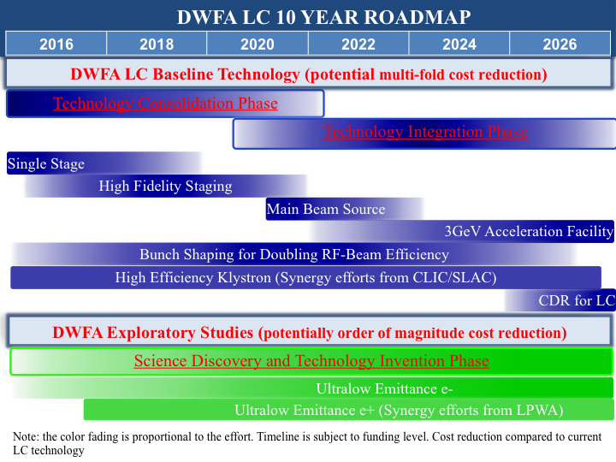
DWFA: Next Decade
2016-21 – Technology Consolidation Phase
  Single stage
    GW level RF power from drive beam
    300 MV/m in single stage
  High Fidelity Staging
    With beam kicker, RF delay lines, two TBA modules per stage
2021-26 – Technology Integration Phase
  Main Beam Source
    X-band
  3-GeV Acceleration Facility
    High-fidelity, integrated test facility
    High-gradient
    Staging
    LC quality beam
Ongoing:
  Bunch Shaping
    Increase RF-beam efficiency
  High Efficiency Klystron
    Synergistic with CLIC (and SLAC)

Slide 14
AAC Synergies
Many similarities and parallels in LWFA & PWFA roadmap, considerable physics and required R&D are independent of the driver.
  Staging of 1-10 GeV modules
  Mitigation of emittance growth due to collisions and ion motion
  High-efficiency acceleration
  Positron acceleration
  Hollow plasma channels for positrons
  Mitigation of transverse beam instabilities
Similar timescales for progress
Use of BELLA, FACET-II, ATF, and AWA as appropriate to each study will foster progress.
    E.g.: positrons studies at FACET-II; staging and tolerances at BELLA; first studies of plasma lenses at ATF, moving to BELLA & FACET-II for higher energies; AWA for staging and bunch shaping.
Synergies of DWFA with CLIC

Slide 15
RF Workshop: Process
Convened February 8-9, 2017 in Gaithersburg, MD.
Preceded by focused preparatory workshops and SLAC and FNAL.
Proceedings (also detailed, intense discussions):
  Presentation of preparatory workshops & preliminary roadmaps for both SRF and NCRF.
  Detailed talks on the status of modeling, international efforts, potential NCRF/SRF synergies beyond HEP, laboratory needs, university roles, user needs, and test facilities at SLAC and FNAL.
  Discussion of cross-cuts
  Review and integration of the two roadmaps
Overarching themes:
  Dramatically improve performance and cost by an order of magnitude or more.
  Decadal time scale for the roadmap informs improved performance and cost of accelerators now under consideration.
Currently discussing a mature draft which forms the basis of this talk.

Slide 16
RF Workshop: Participants
Attendees:
  Experts on SRF, NCRF, RF sources, and auxiliary RF systems
  Invited accelerator science experts from universities and laboratories
Invited participants:
  Sami Tantawi (SLAC) Emilio Nani (SLAC)
  Seregy Belomestnykh (FNAL) Anna Grassellino (FNAL)
  Cho Ng (SLAC) Mathias Liepe (Cornell)
  Jerry Blazey (NIU) Alex Gurevich (Old Dominion )
  Erk Jensen (CERN) Robert Rimmer (Jefferson)
  Richard Temkin (MIT) James Rosenzweig (UCLA)
  Weiren Chou (FNAL) Sergei Nagaitsev (FNAL)
  Bruce Carlsten (LANL) Lia Merminga (SLAC)
  Wim Leemans (LBNL)
Other participants:
  L.K. Len (DOE) J. Siegrist (DOE)
  G. Crawford (DOE) J. Boger (DOE)
  E. Colby (DOE) A. Lankford (HEPAP)
  V. Lukin (NSF)
  (Apologies to anyone missed!)

Slide 17
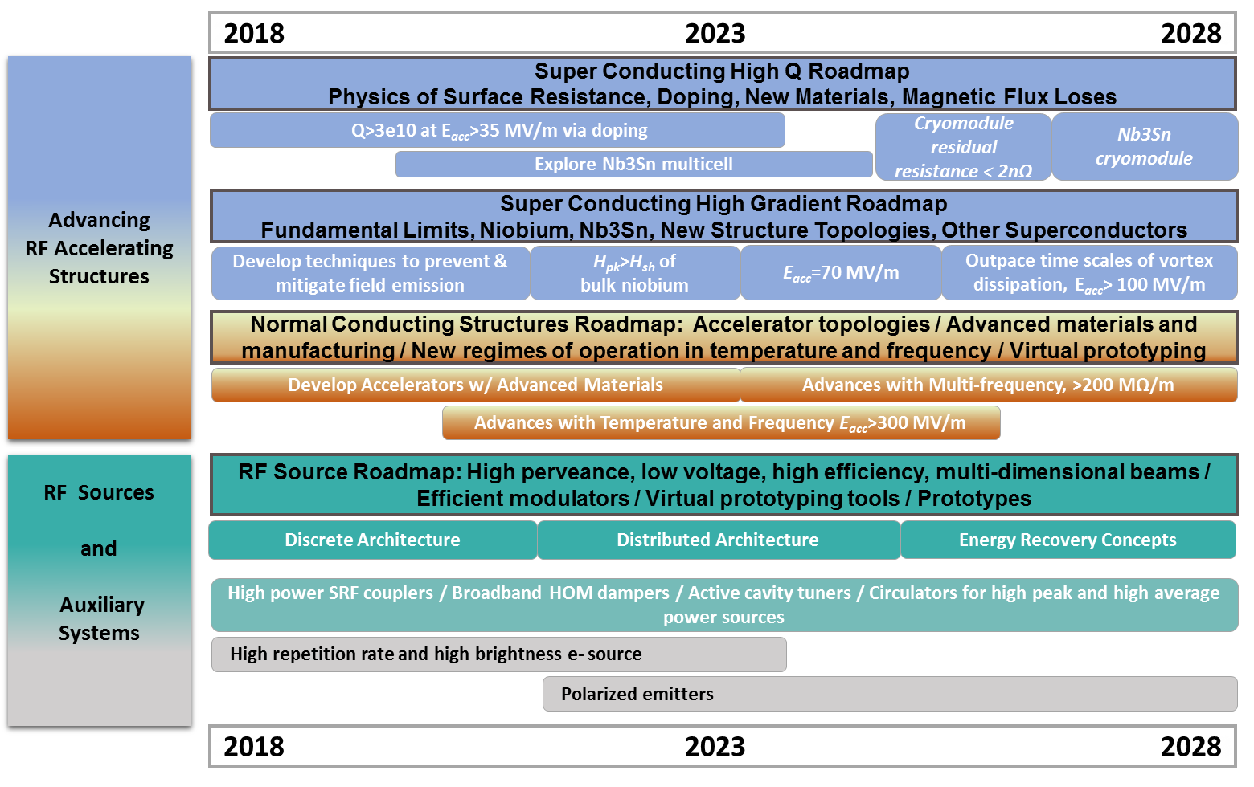
Integrated Roadmap
Decadal integrated roadmap
Two main components
  RF structures
  RF sources & auxiliary systems
Themes or cross-cuts for cryogenic or warm RF structure R&D:
  Understanding basic physics and processes
  Exploring new shapes, materials, and operating regimes.

Slide 18
SRF: High Q
Investigate the physics of RF surface resistance
Explore doping
Examine new materials
Physics of magnetic flux losses

Slide 19
SRF: High Gradient
Fundamental limits
Niobium surface treatment and doping
New materials

Slide 20
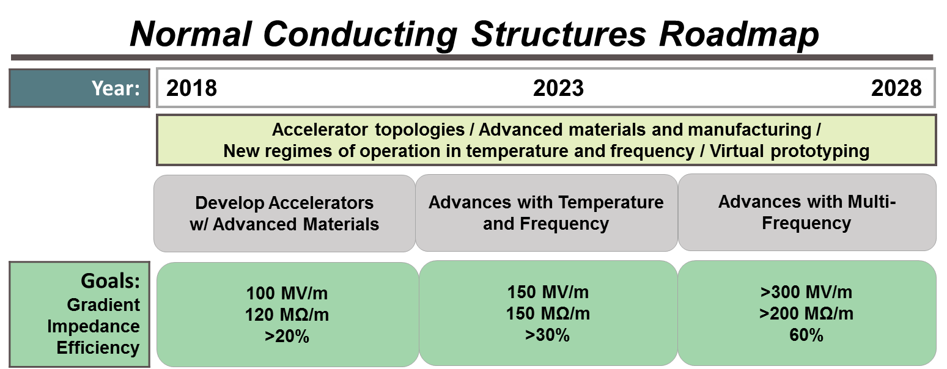
NCRF: New Structures
Advanced topologies, materials and manufacturing.
New temperature and frequency operating regimes.

Slide 21
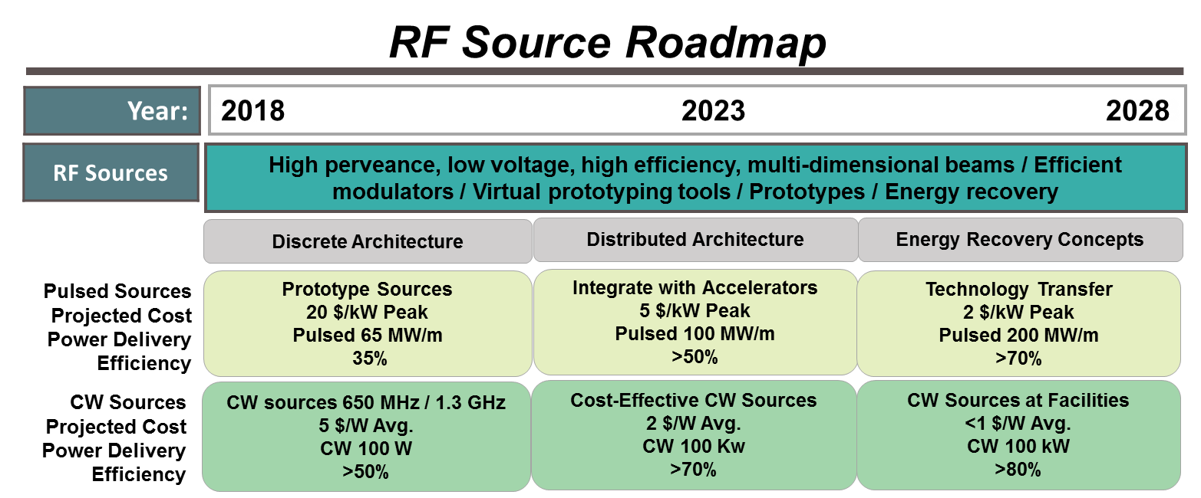
RF Sources
Explore discrete architectures (multi beam klystron) , distributed architectures (radial klystron), and energy recovery concepts to reach high perveance while operating at lower voltage and higher efficiency.

Slide 22
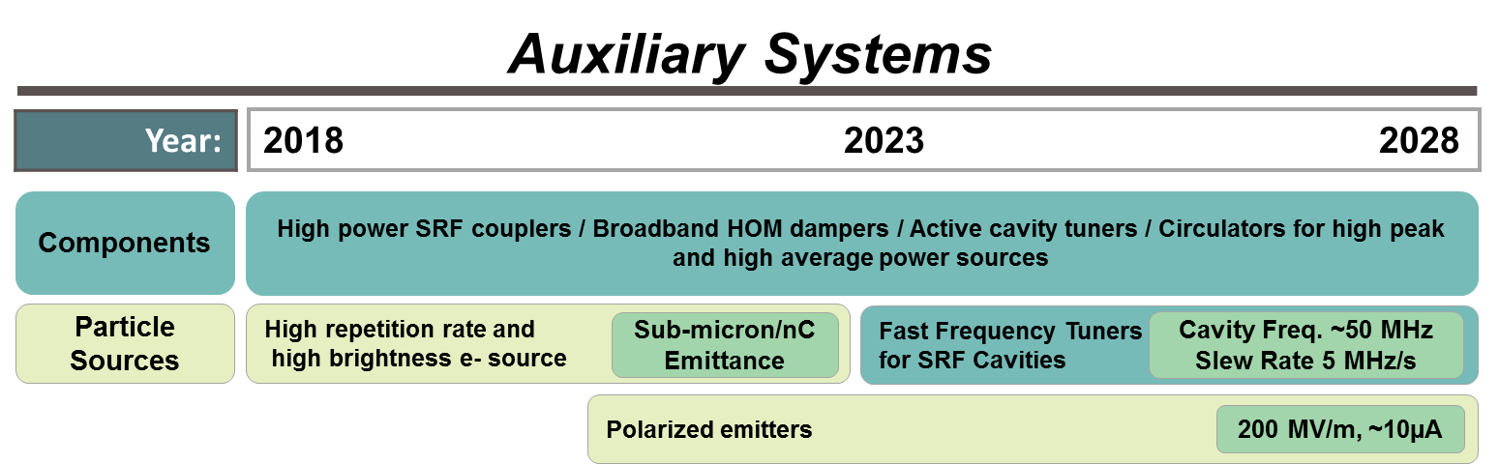
RF: Auxiliary Systems
Electron sources
Higher Order Mode damping
Power couplers
Fast frequency tuners for SRF cavities
Rapidly tunable NCRF cavities.

Slide 23
RF Synergies
SRF/NCRF synergies
  Surface physics of the cavity
  Novel fabrication methods
Office of Science synergies
  Nuclear physics (ATLAS, RHIC, FRIB)
  Spallation sources (SNS, ESS)
  Light sources (LCLS-II, NSLS-II, XFEL…)
Federal Sponsors & Industry
  Interrogation
  Medicine
  Reinvigorating commercial RF sector

Slide 24
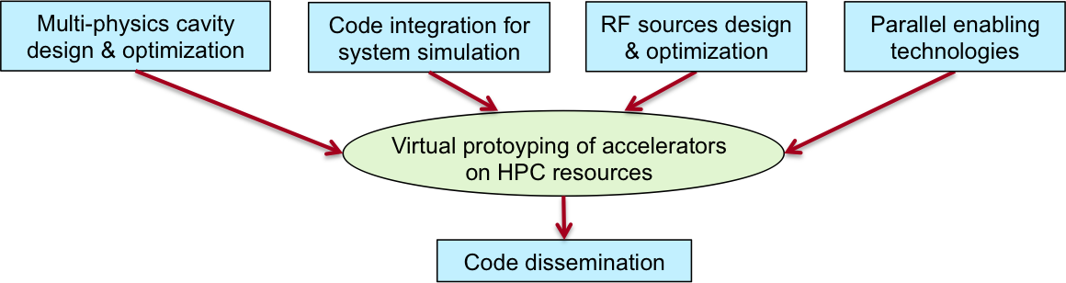
As seen by AAC and RF: GARD Computational Needs
A strong modeling program is a critical component of R&D progress.
Requirements:
  Development of personnel and of computational teams
  Development of new multi-scale models and algorithms
  Exploitation of new processor architectures
Addressing these requirement is itself a challenge.

Slide 25
Closing Comments
The Advanced Accelerator Concepts and Radio Frequency communities invested significant time and effort to develop integrated, comprehensive, and detailed roadmaps.
Roadmaps responsive to
  P5 request for alignment of R&D with priorities and improved cost and operation.
  ARD request for detailed milestones and goals.
AAC roadmap identifies and addresses five common challenges for LWFA, PWFA, DWFA: a higher energy stage, emittance control, acceleration stages, positron acceleration, maintenance of a collider parameter set.
RF roadmap addresses performance and cost goals through a focus on SRF and NCRF accelerating structures and RF and auxiliary systems.
(For details consult your local accelerator experts)

Slide 26
ARD GARD-AAC Recommendations
Recommendation 7. Vigorously pursue particle-driven plasma wakefield acceleration of positrons at FACET in the time remaining for the operation of the facility. Be-tween the closing of FACET and the operation of a follow-on facility, preserve the momentum of particle-driven wakefield acceleration research using other facilities.
Recommendation 8. Continue to support laser-driven plasma wakefield acceleration experiments on BELLA at the current level.
Recommendation 9. Reduce funding for direct laser acceleration research activities.
Recommendation 10. Convene the university and laboratory proponents of advanced acceleration concepts to develop R&D roadmaps with a series of milestones and common down-selection criteria

Slide 27
ARD GARD-RF Recommendations
Recommendation 4. Direct appropriate investment in superconducting RF R&D in order to inform the selection of the acceleration technology for the multi-MW proton beam at Fermilab.
Recommendation 6. Increase funding for development of superconducting RF (SRF) technology with the goal to significantly reduce the cost of a ~1 TeV energy upgrade of the ILC. Strive to achieve 80 MV/m accelerating gradients with new SRF materials on the 10-year timescale.
Recommendation 11. Continue research on high-efficiency power sources and high-gradient normal conducting RF structures.
Recommendation 12. Make NLCTA available for RF structure tests using its RF power and beam sources.
Recommendation 13. Focus normal conducting RF R&D on developing a multistage prototype based on high-gradient normal conducting RF structures and high-efficiency RF power sources to demonstrate the effectiveness of the technology for a multi-TeV e+e- collider.

Slide 28
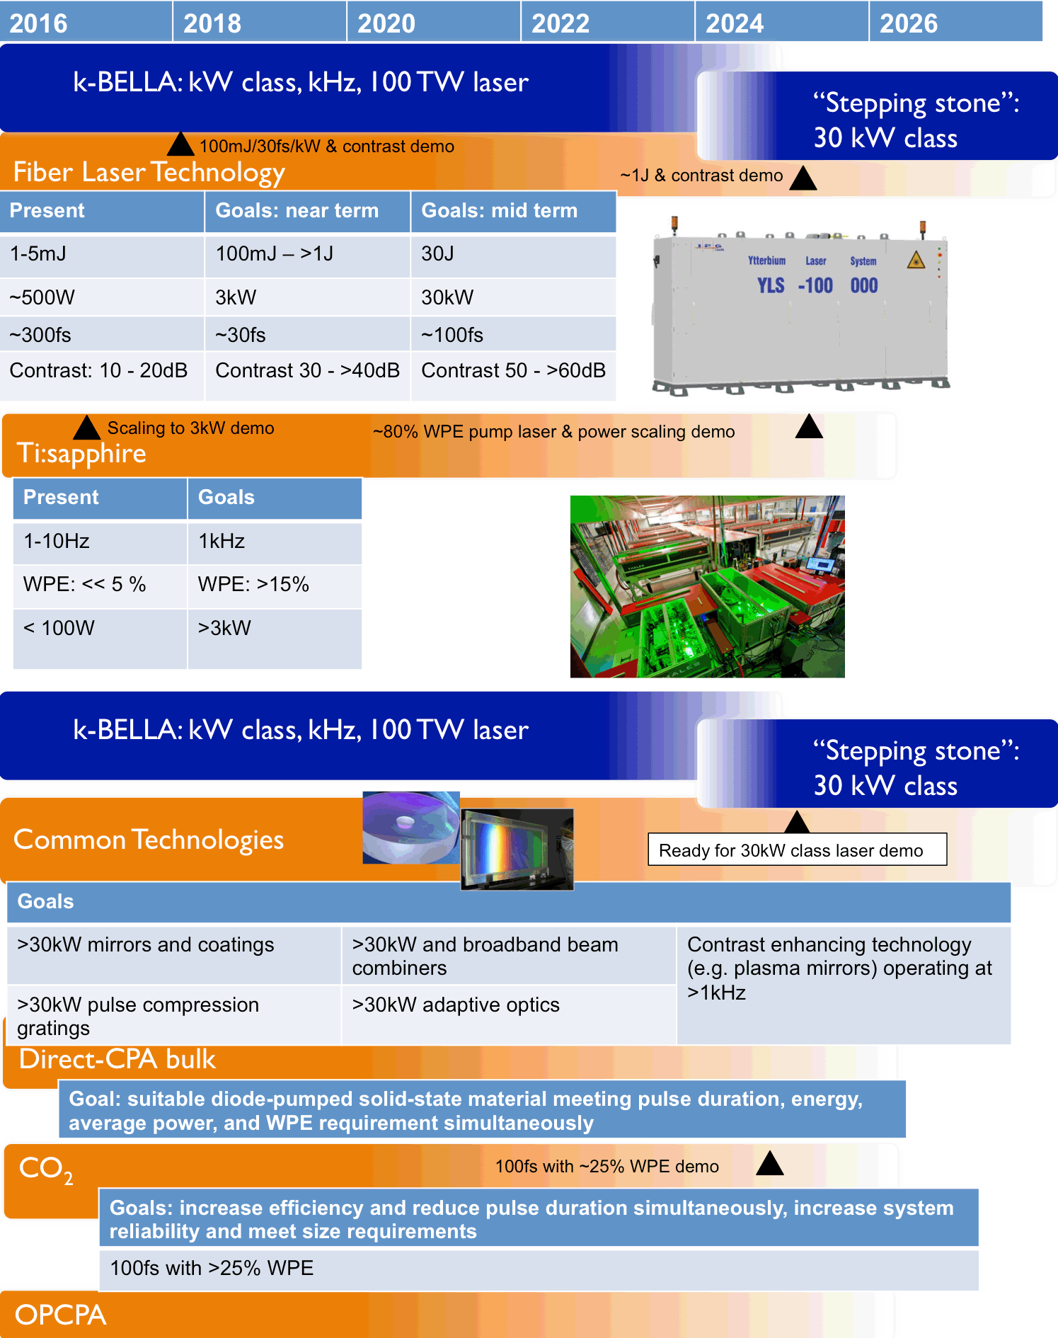
LWFA: Decadal Laser Roadmap
Laser R&D cannot be overlooked, technological progress essential
30kW, kHz class laser represents an appropriate next step.

Slide 29
LWFA Update
Modeling and simulations: novel algorithms resulting in higher speed modeling codes, EXASCALE project funded for developing tools to carry out start-to-end modeling of a 1 TeV laser plasma based colliders
10 GeV module: experimental demonstration of dynamic shaping of plasma channels in capillary discharges with laser heater pulse to provide guiding of high intensity laser pulses at lower plasma densities than previously achieved. Designed, built and operated 20 cm long monolithic capillary discharges, another key step towards higher energies. Experiments underway at BELLA towards 10 GeV with these significant new developments and preliminary results are very promising.
Staging: two independently powered modules at 100 MeV per stage were demonstrated) and a design for staging at 5 GeV+5GeV was completed. FWP submitted to DOE for second beamline on BELLA to enable experiment.
Phase space shaping, efficiency, diagnostics, tolerances: demonstrated a reliable, tunable injector based on gas jet with knife blade first emittance measurement of two different injection techniques
Design of concepts for colliders: studied impact of ion motion in plasmas for ultra-intense electron beams; analyzed beam-breakup (BBU) instability and found new method for stabilization BBU was seen as a potential roadblock but a viable solution has emerged.
Applications: two new lasers (100 TW class) and beamlines under construction towards a laser plasma accelerator driven XUV free electron laser and a tunable gamma ray source
High average power demonstrator (k-BELLA): organized workshop with national and international experts and solid approach(es) have been identified for the near future 3 kW system as well as for future 10's to 100's of kW average power collider class lasers with high wallplug efficiency.

Slide 30
PWFA Update
FACET successfully finished its final run in April 2016 & published several key new results:
  Investigated head-erosion mechanism mitigation to enhance energy extraction from drive bunch
  Demonstrated a Positron Beam-Driven Hollow Channel Plasma Wakefield Accelerator
  Mapped the longitudinal field structure within non-linear plasma wake to inform emittance preservation studies
  Demonstrated record performance (gradient, energy gain, efficiency) for dielectric wakefield accelerators
Data analysis and high-impact publications in preparation or out for review on:
  Laser-triggered injection in electron-beam driven plasma wakefield accelerators - important for studying emittance preservation and developing first off-ramp applications
  Acceleration of a trailing positron bunch in a plasma wakefield accelerator - first measurements of positron acceleration spanning non-linear to quasi-linear regimes to identify optimum regime for positron PWFA and LWFA
Planning for FACET-II as a community resource with 3rd annual science workshop in October 2017

Slide 31
DWFA Update
Single stage
  11.7 GHz Metallic structure
    (Gradient continues to increase over last year)
    300 MW RF (drive beam power generation
    150 MV/m (main beam acceleration)
  26 GHz Dielectric structure
    (TBA demonstrated for first time in 26GHz dielectric)
    300 MW RF (drive beam power generation
    150 MV/m (main beam acceleration)
High Fidelity Staging
  Fast kicker:
    design completed,
    in fabrication,
  RF delay lines:
    under construction,
  Two TBA modules for both stages
  Structures:
    in-hand
  Staging Beamline:
    under design
AWA User Facility Program
    Adding many user’s: (e.g. UCLA PWFA, US-Japan FNAL/NIU, etc.)

Slide 32
DWFA: Applications

Slide 33
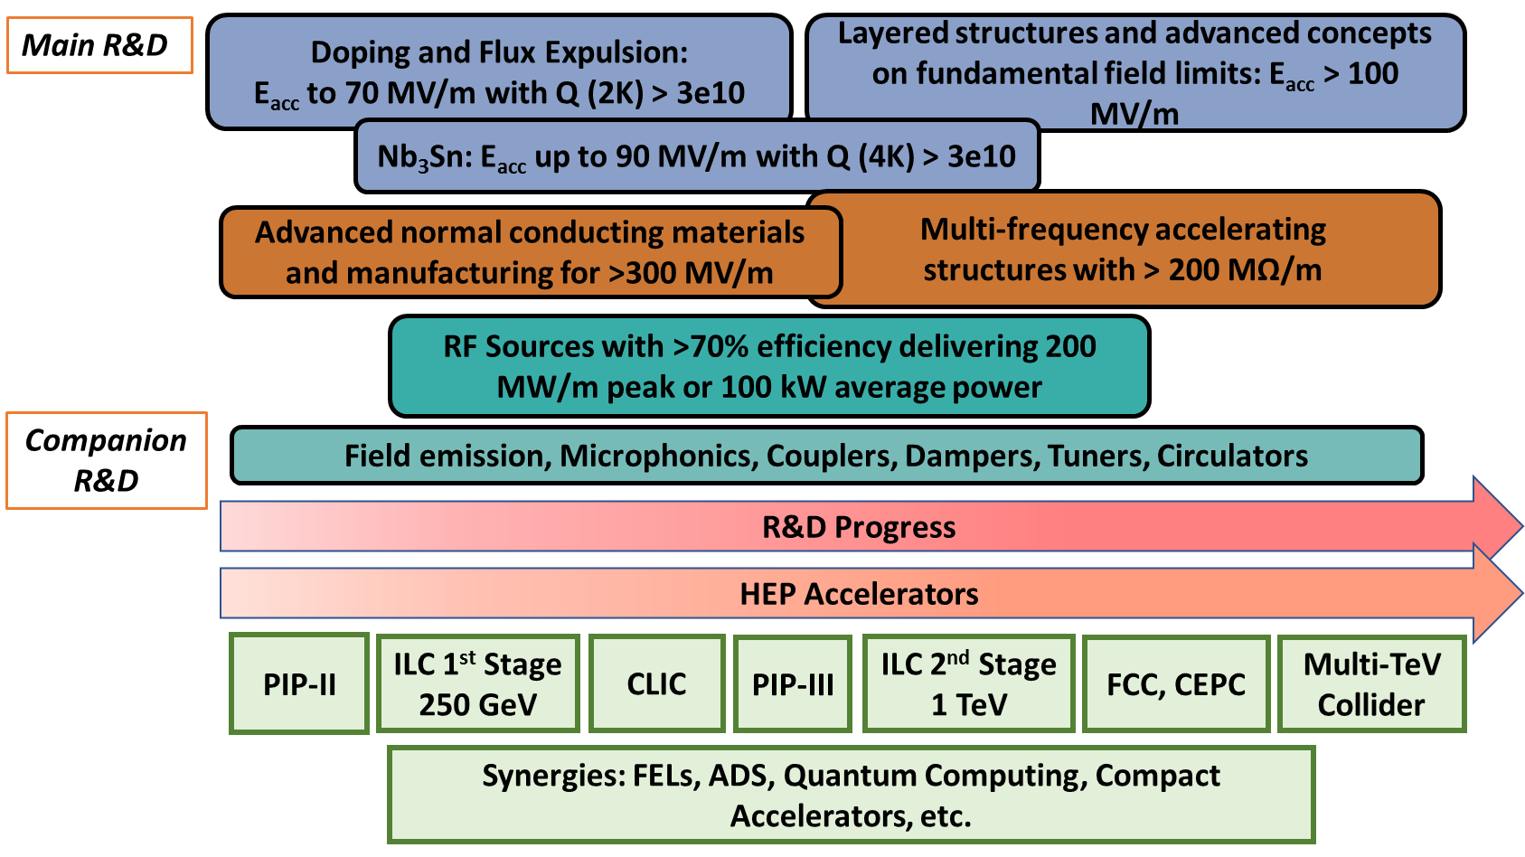
Alignment with Future Accelerators

Slide 34
SRF Common Roadmap Elements
New Materials, Films, and Multilayers:
Development of Nb₃Sn as Practical SRF Material
Field Emission Mitigation
Microphonics and Lorentz Force Detuning Compensation
Novel SRF Cavity Shapes

Slide 35
High Q/Gradient Start of the Art
N-doped
Anti-Q-slope emerges from the BCS surface resistance decreasing with field
Anti-Q-slope
Standard treatment
~ factor of 3 higher Q at mid field
Increase in Q factor of two, increase in gradient ~20%
(only single-cell cavities to date)

Slide 36
Progress on NCRF Gradients

Slide 37
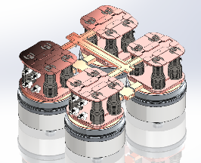
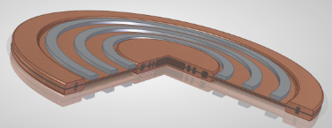
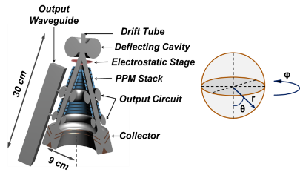
Advance RF Source Concepts/Low Cost & Low Voltage
Discrete Architecture:
  Modular-Array Multi-Beam Klystron
    Redefining the landscape of multi-beam architectures.
      Simplified, low part count, klystrinos
      Phase locked Floquet power extraction network
Distributed Architecture:
  Radial Klystron
    Exploiting a novel geometry to mitigate space charge effects.
      Low space charge radially propagating beam
  Deflected Beam Amplifier
    Multi-stage power extraction that enables high efficiency X-band operation.
      Complete beam-wave synchronism with multi-stage output structure.
Multi-beam klystron
Radial klystron
Deflected beam amplifier

Slide 38
Year | Milestone
1 - 2 | Time domain thermal and mechanical solvers for cavity design; Integration of RF and beam dynamics codes for emittance calculation; Solver components for 2D modeling of RF sources; Nonlinear eigensolvers for damping calculation; GUI for multi-physics cavity design.
3 - 4 | Capability for EM mode damping calculation for all boundary conditions; Integration of RF and radiation codes as a coupled system; 2D large-signal code for RF source design; Parallel RF shape optimization tool; GUI including RF shape optimization tool
5 – 6 | Coupled time domain thermal and mechanical solver for cavity design; System-level integrated RF and beam dynamics simulation; Tool for analysis of spurious oscillations in RF sources; Nonlinear eigensolvers for dispersive lossy materials; GUI for code integration
7 – 8 | Capability for microphonics simulation in cryomodule systems; System-level integrated RF and radiation calculation; 3D large-signal code for RF source design; Parallel multi-physics shape optimization tool; Dissemination of RF source codes
9 - 10 | Multi-physics shape optimization of large accelerator systems; End-to-end integrated simulation; Optimization procedures for RF source codes; Performance enhancement of parallel codes on emerging supercomputing platforms; GUI for multi-physics shape optimization tool
Table 1. Milestones for RF modeling and simulation R&D thrusts.

