Slide 1


The DOE Project Leadership Institute
Briefing for the High Energy Physics Advisory Panel
June 6, 2017
Benjamin L. Brown, Ph.D.
ESnet Program Manager and Senior Science and Technology Advisor
DOE Office of Science

Slide 2
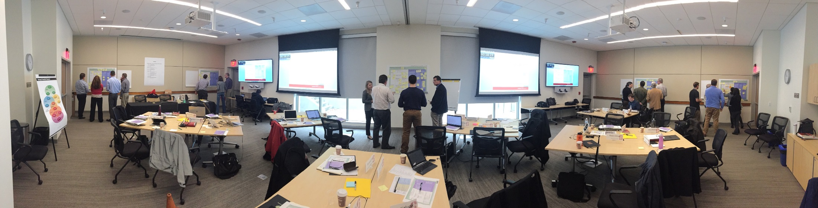

Developing a Diverse Network of Talented DOE Project Professionals

Slide 3
DOE Project Leadership Institute (PLI)
What
A new program created to connect and develop project leaders across the DOE complex; results in a formal certificate
When
Annual cycle
Year-long commitment by participants
Each year a new cohort
Who
Contractor project professionals
Federal Project Directors
Federal Program Managers
Where
Not a physical place – the PLI is for all of DOE

Slide 4
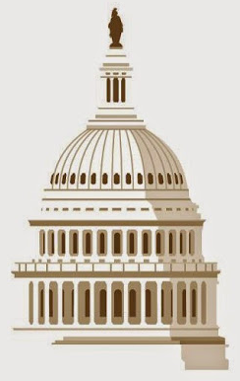
Why do we need a PLI program?
DOE project management performance depends on:
Collective learning and shared commitment
Workforce development
Knowledge management
Projects are consistently among our highest risk activities
“Program Management Improvement Accountability Act” P.L. 114-264, signed into law Dec. 14, 2016
Notes:
From the GAO High-Risk report: “The Department of Energy (DOE), the largest civilian contracting agency in the federal government, relies primarily on contractors to carry out its diverse missions and operate its laboratories and other facilities. Approximately 90 percent of DOE’s budget is spent on contracts and large capital asset projects. We designated DOE’s contract management—which includes both contract administration and project management—as a high-risk area in 1990 because DOE’s record of inadequate management and oversight of contractors has left the department vulnerable to fraud, waste, abuse, and mismanagement. In January 2009, to recognize progress made by DOE’s Office of Science, we narrowed the focus of its high-risk designation to two DOE program elements—the Office of Environmental Management (EM) and the National Nuclear Security Administration (NNSA). Together, these two programs accounted for almost 63 percent of DOE’s fiscal year 2015 discretionary funding of more than $26 billion. In February 2013, we further narrowed the focus of the high-risk designation to EM and NNSA’s major contracts and projects, those with an estimated cost of $750 million or more, to acknowledge progress made in managing projects with an estimated cost of less than $750 million. Our 2013 assessment found that DOE satisfied 3 of the 5 criteria needed for removal from the High Risk List. This year, we did not observe similar progress in DOE’s management of major projects. EM and NNSA struggled to stay within cost and schedule estimates for most of their major projects.”

Slide 5
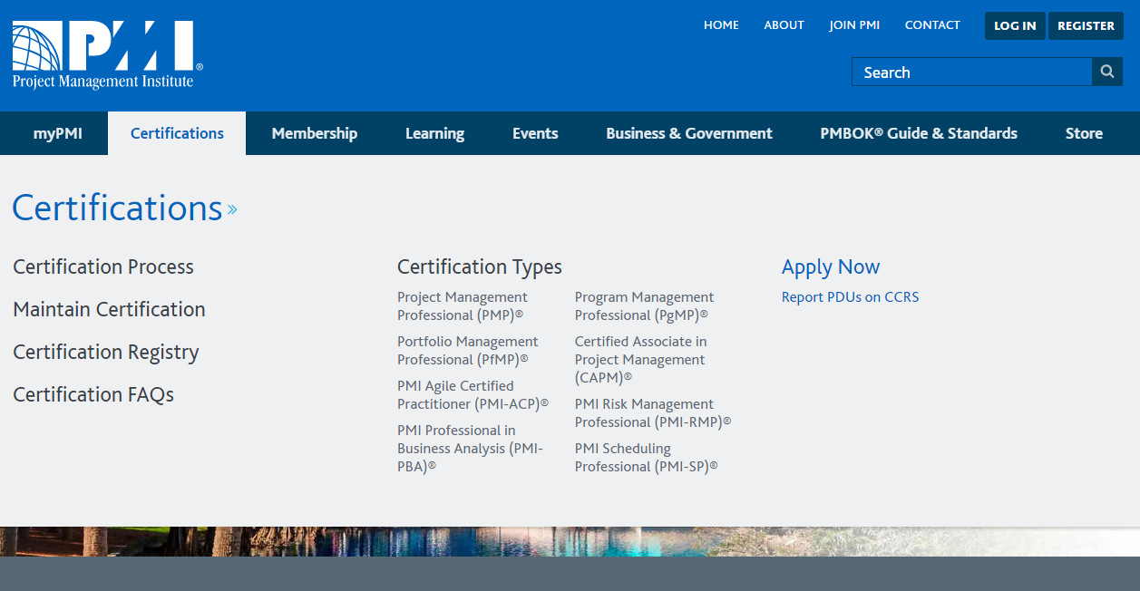
Project Management is a vibrant professional discipline

Slide 6
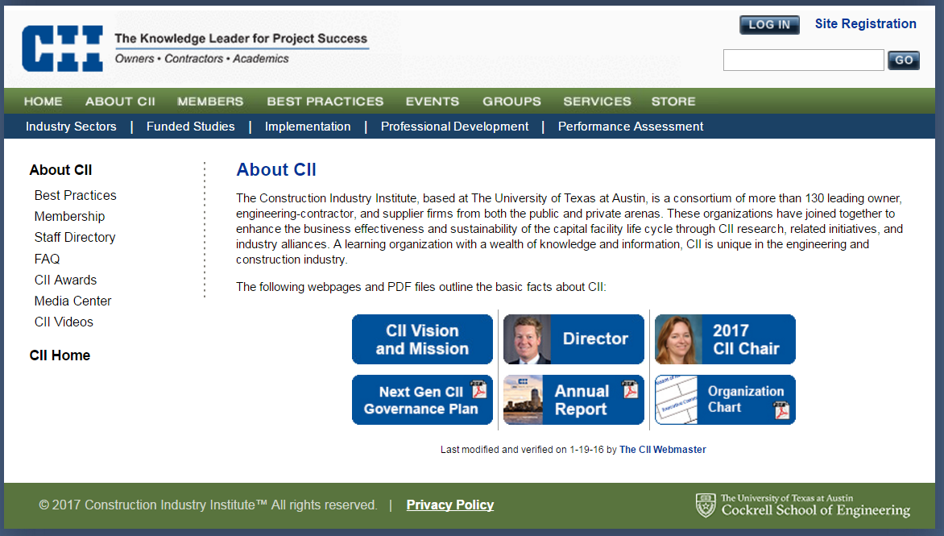
Project Management is a vibrant professional discipline

Slide 7
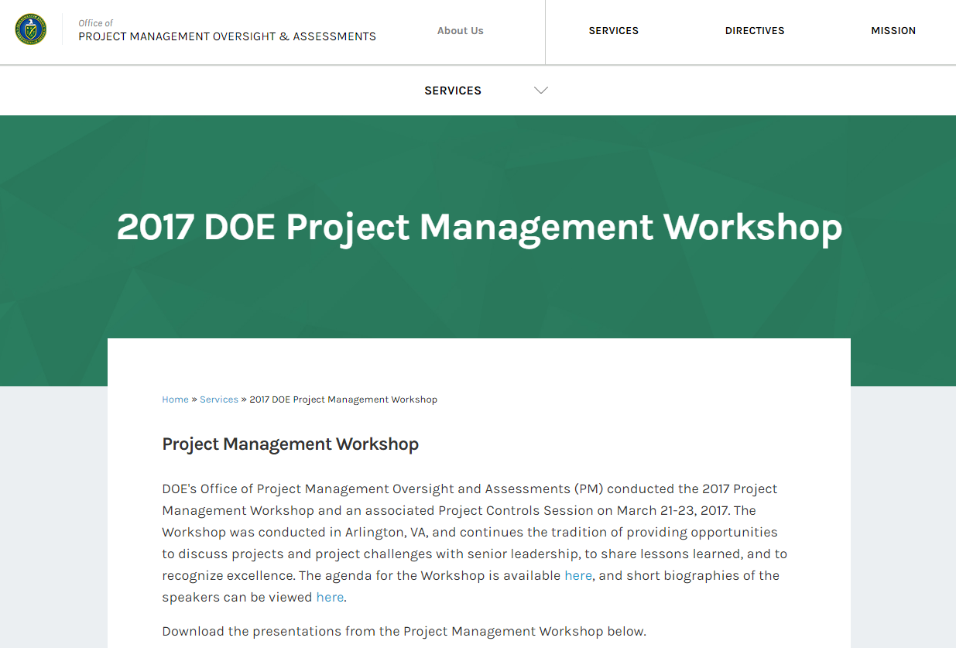
The DOE Project Management Community

Slide 8
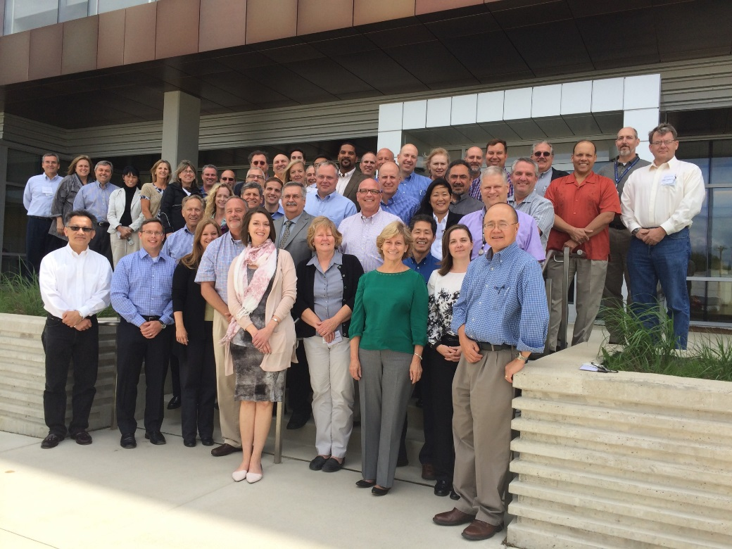
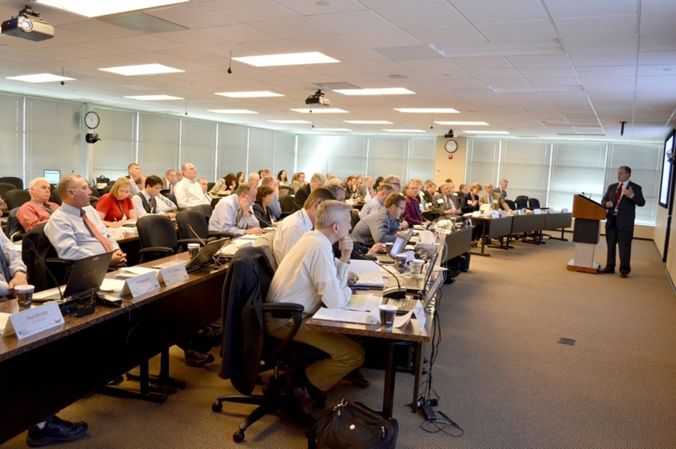
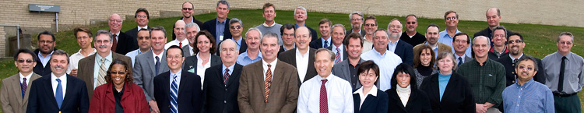
The SC Project Management Community
2014 Office of Science Project Management Workshop
July 15-17, 2014

Slide 9
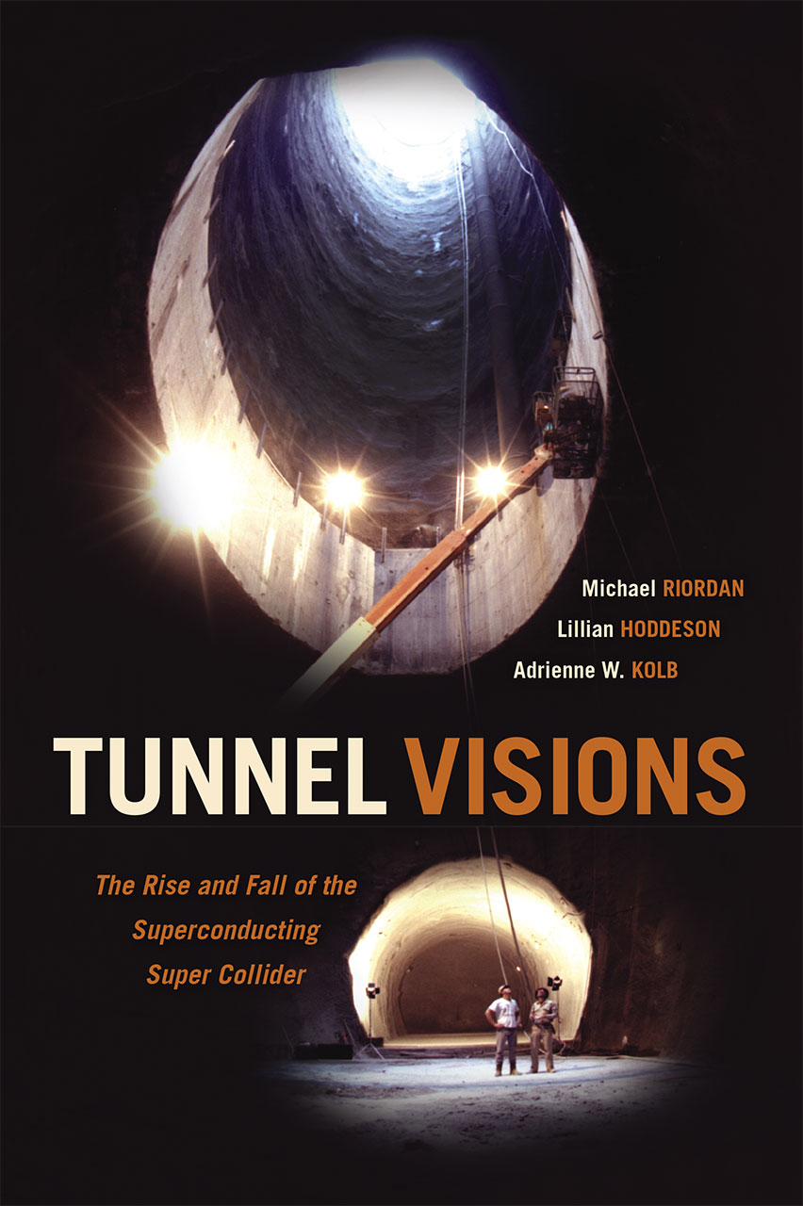
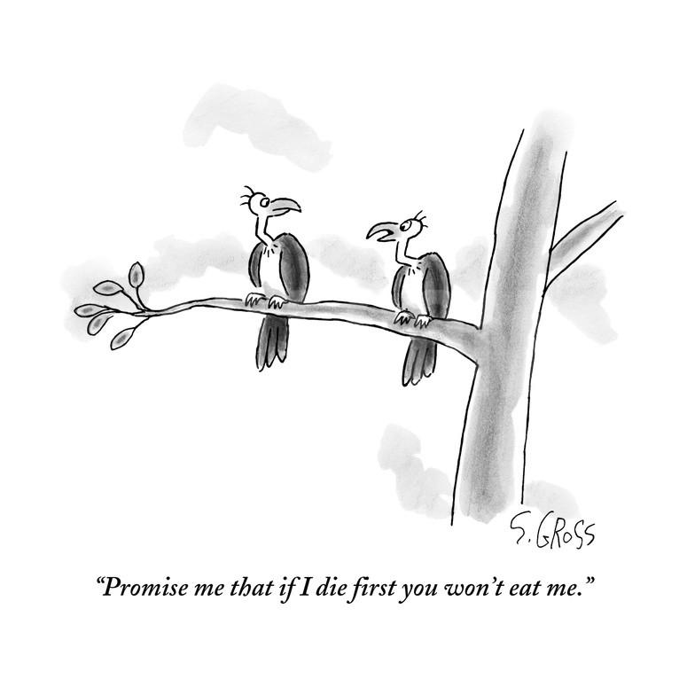
We have a shared history
Copyright Sam Gross/Conde Nast publishing

Slide 10
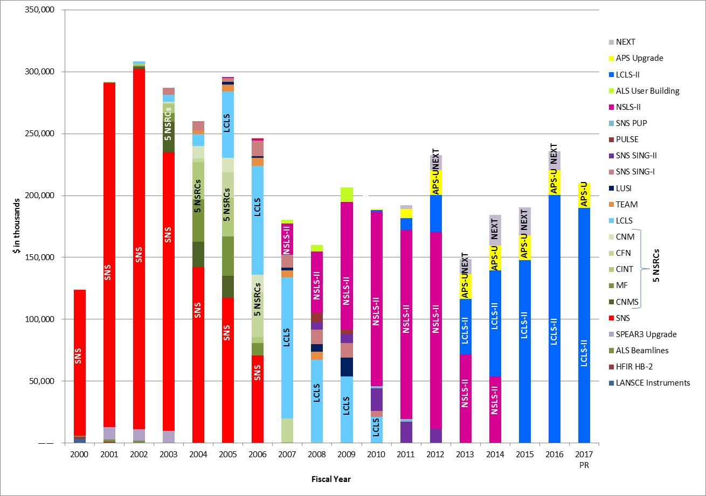
We have a shared fate
Since 2002, SC has completed 77 projects that had a Total Project Cost over $5M, totaling ~$6B. Cumulative cost growth has been held to ~2%.
Dr. Harriet
Kung
graphic
Notes:
The message on this slide is that project performance is interrelated across the complex – within a lab, within a sponsor program, within an agency sub-unit, and within DOE. This “waterfall chart” from SC/BES shows how out-year budgeting for multiple projects depends critically on project performance.

Slide 11
Why do we need a PLI program?
DOE project management performance depends on:
Collective learning and shared commitment
Workforce development
Knowledge management
Notes:
From the GAO High-Risk report: “The Department of Energy (DOE), the largest civilian contracting agency in the federal government, relies primarily on contractors to carry out its diverse missions and operate its laboratories and other facilities. Approximately 90 percent of DOE’s budget is spent on contracts and large capital asset projects. We designated DOE’s contract management—which includes both contract administration and project management—as a high-risk area in 1990 because DOE’s record of inadequate management and oversight of contractors has left the department vulnerable to fraud, waste, abuse, and mismanagement. In January 2009, to recognize progress made by DOE’s Office of Science, we narrowed the focus of its high-risk designation to two DOE program elements—the Office of Environmental Management (EM) and the National Nuclear Security Administration (NNSA). Together, these two programs accounted for almost 63 percent of DOE’s fiscal year 2015 discretionary funding of more than $26 billion. In February 2013, we further narrowed the focus of the high-risk designation to EM and NNSA’s major contracts and projects, those with an estimated cost of $750 million or more, to acknowledge progress made in managing projects with an estimated cost of less than $750 million. Our 2013 assessment found that DOE satisfied 3 of the 5 criteria needed for removal from the High Risk List. This year, we did not observe similar progress in DOE’s management of major projects. EM and NNSA struggled to stay within cost and schedule estimates for most of their major projects.”

Slide 12
PLI Origins
On December 1, 2014, Secretary of Energy Ernest Moniz signed a memorandum, Improving the Department’s Management of Projects, which introduced several new initiatives, including:
“The Department will establish a project leadership institute to create and sustain a culture of project delivery excellence.”
Steve Meador, Director of the SC Office of Project Assessment, volunteered to develop the program concept.

Slide 13
The PLI is differentiated from other programs
DOE Project Management Career Development Program (PMCDP) https://powerpedia.energy.gov/wiki/Project_Management_Career_Development_Program
Project Management Institute (PMI) Project Management Professional (PMP) certificate
http://www.pmi.org/certifications/types/project-management-pmp
Federal Executive Institute Leadership for a Democratic Society

Slide 14
PLI program development unfolded over two years
SC proposed a pilot program.
The program concept was reviewed and endorsed by then Secretary of Energy Moniz and other senior DOE leaders.
SC approved and funded the pilot program.
SC led program planning and launch.
Jan – Aug 2015
Aug 2015
Oct 2015 – Dec 2016
2017
Inaugural
Cohort

Slide 15
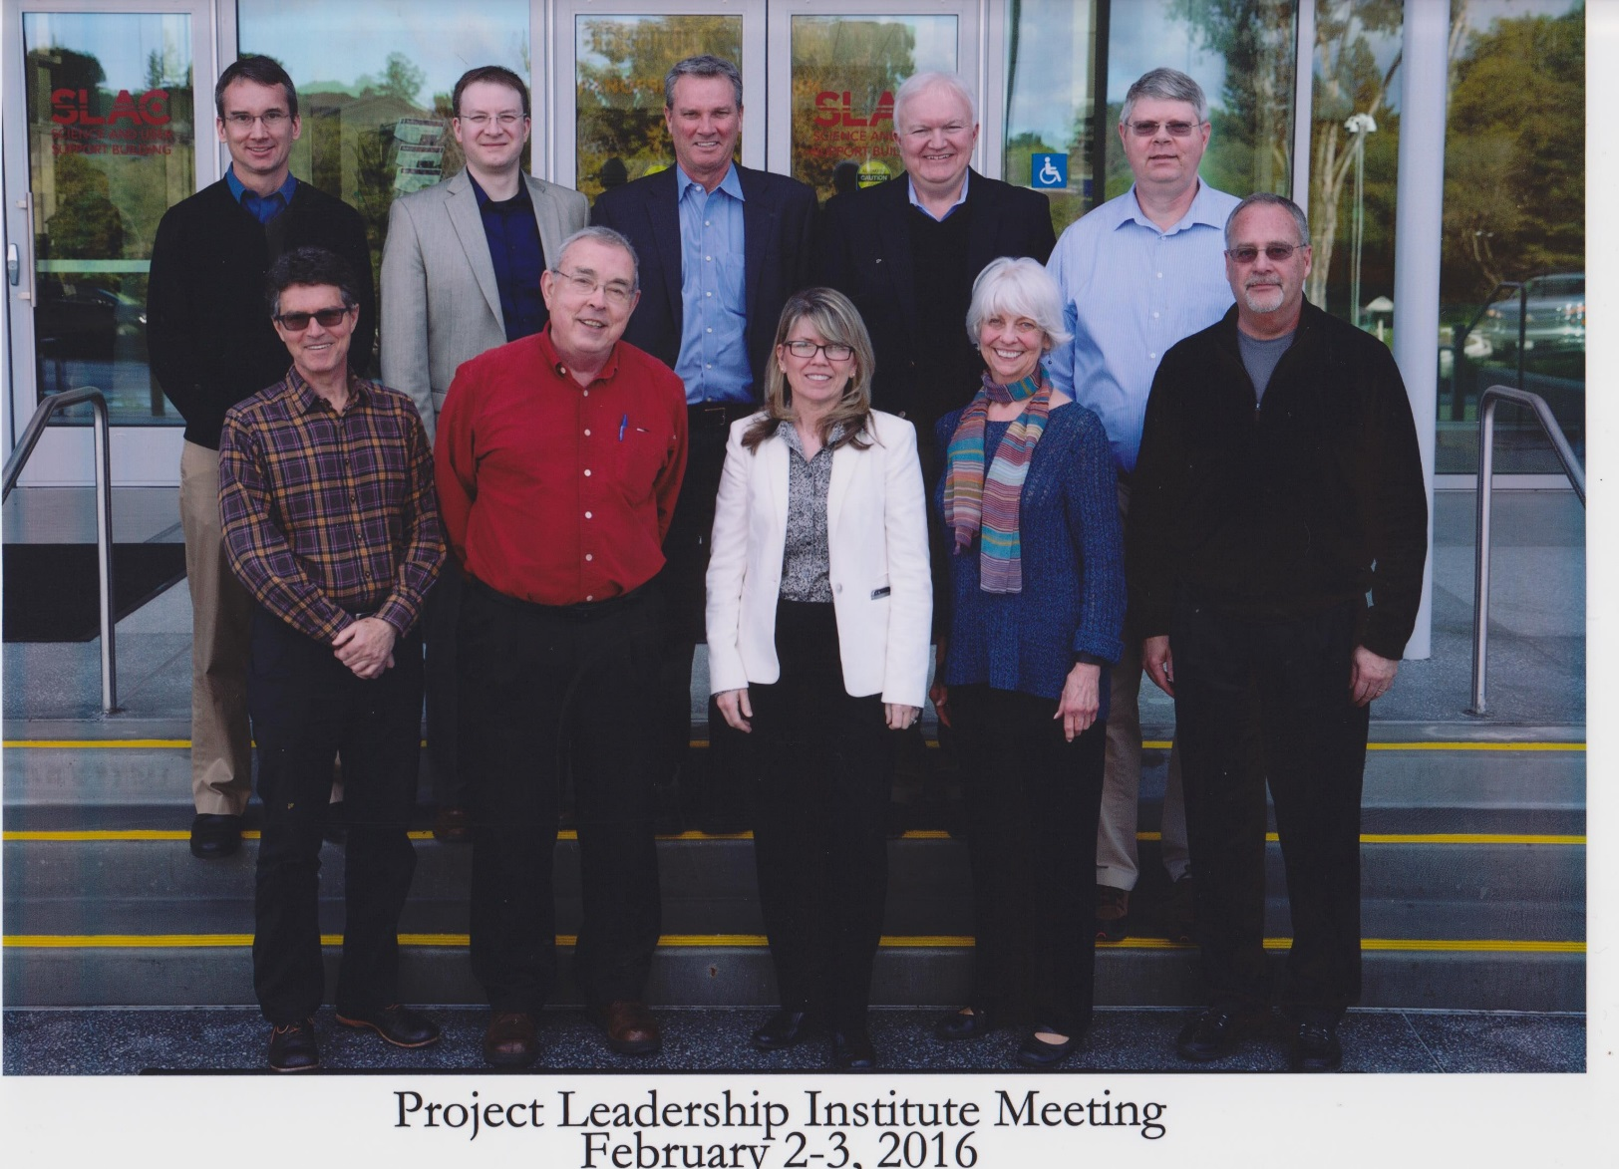
PLI Planning Team
In-person meetings
November 2015 (FNAL)
February 2016 (SLAC)
April 2016 (ASU)
June 2016 (Tysons, VA)
August 2016 (CU-Boulder)
September 2016 (SLAC)
November 2016 (SLAC)
Top (L to R)
Keith Molenaar, CU-Boulder
Ben Brown, SC
Mark Reichanadter, SLAC
Edd Gibson, ASU
Buddy Bland, ORNL
Bottom (L to R)
Jim Krupnick, LBNL (ret.)
Les Price, ORNL (ret.)
Dianne Hatton, BNL
Ann Baker, GMU (ret.)
Steve Meador, SC
Not pictured
Thomas Glasmacher, MSU

Slide 16
PLI program planning progressed through milestones
Detailed program design
Governance formalism
Key design attributes
Learning objectives
Mission and vision
Objective
Create a prestigious, transformational professional development experience that is simultaneously both a leadership development and project delivery course of study and practice, tailored to the DOE context.

Slide 17
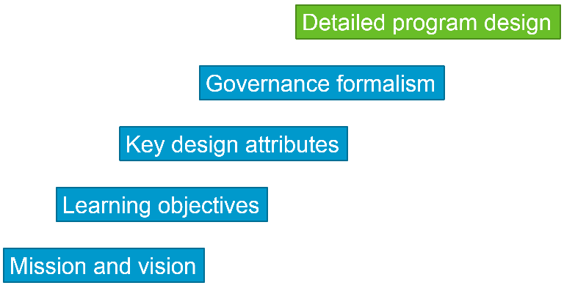
Mission
The mission of the U.S. Department of Energy (DOE) Project Leadership Institute (PLI) program is to cultivate a diverse network of successful DOE project delivery practitioners—those capable of delivering major high-risk projects.
The PLI program participants will contribute to building a culture of project management excellence across DOE.

Slide 18
Learning Objectives
Strategic Thinking/Analysis
S1: Demonstrating personal, group, lab, and organization awareness and savvy to effectively anticipate opportunities and problems early
S2: Anticipating and managing project risks through rigorous analytical methods
S3: Negotiating equitable partnering arrangements and contracts
S4: Analyzing project data, information, indicators and trends
Organization and General Management Skills
O1: Exercising resiliency in challenging management scenarios
O2: Demonstrating personal organization and time management, including delegating authority appropriately
O3: Developing and implementing effective change management process
O4: Recommending and critiquing front-end planning procedures
Team Building
T1: Building high quality teams that demonstrate consideration for varied skills, strengths, experience, and potential
T2: Setting and managing clear team expectations
T3: Modeling what it means to be an authentic leader
T4: Demonstrating awareness of cultural differences to anticipate the most effective ways to include diverse stakeholders and maximize their quality contributions.
T5: Understanding potential skill development using effective mentoring programs
Communications
C1: Using strong and effective communication skills including consultation with stakeholders, building trusting relationships, giving effective feedback, asking for help, especially regarding major decisions, listening with empathy, negotiating credibly for long-term viability
C2: Demonstrating the use of inquiry to access diverse perspectives, especially in early stages and in critical decision-points of project work
C3: Creating clear and concise project goals in consultation with primary stakeholders
C4: Creating and facilitating lab partnership agreements
C5: Capturing, disseminating and applying lessons learned

Slide 19
Learning Objectives Summary
Core Leadership Competencies
Strategic Thinking/Analysis
Team Building
Communications
Organization and General Management Skills
Foster Innovation
Maintain Strategic Focus
Deal with Ambiguity
Instill Trust
Develop Self Awareness
Attract and Retain Talent
Manage Conflict
Balance Stakeholders
Negotiate Successfully
Executive Presence
Manage Risk
Delegate Effectively

Slide 20
Key Design Attributes
An intensive year-long program
The program emphasizes in-person week-long sessions and a year-long capstone project.
Cohort-based
Each calendar year a new cohort (25-30) of participants from across the DOE complex will participate as a group, accreting the PLI network.
Experiential learning
The program is simultaneously both a leadership development and project delivery course of study and practice, tailored to the DOE context.
Self-assessment
The program requires each participant to critically self-evaluate his/her own strengths and weaknesses in a leadership development context.
Knowledge sharing
The program will promote the development of informational resources that aid DOE project practitioners.

Slide 21

Governance Formalism
A DOE-wide program, with SC supporting a PLI Office at SLAC National Accelerator Laboratory
Federal program management and oversight; program manager function is within the Office of the Deputy Director for Science Programs
Participants
  Pay tuition and travel
  Receive support from home institution
PLI Director (SLAC)
  Executes the PLI program activities
  Manages the PLI Office
Advisory Board, reporting to the Director:
  Advises the Director, including participant selection
  Composed of project management and organizational learning experts
  Ideally, representative of the DOE complex
Governance inspired by
U.S. Particle Accelerator School
DOE pays for the PLI Office
Tuition pays for the instructional program

Slide 22
Nomination and Selection Process
Eligibility:
PLI nominees shall have demonstrated their expertise as technical, business systems, or project leaders, with significant experience in private or public sector organizations with responsibility for project or organization performance and resources.
Nomination:
Nomination from employing institution is required. The Nominating Institution must prepare a letter of recommendation for the nominee from the Laboratory Director (or equivalent) and Chief Project Officer, if one exists.
Application:
The nomination package must include the letter of recommendation, a resume, and a Goals Statement.
Selection:
The Advisory Board reviews applications and recommends selections to the PLI Director.

Slide 23


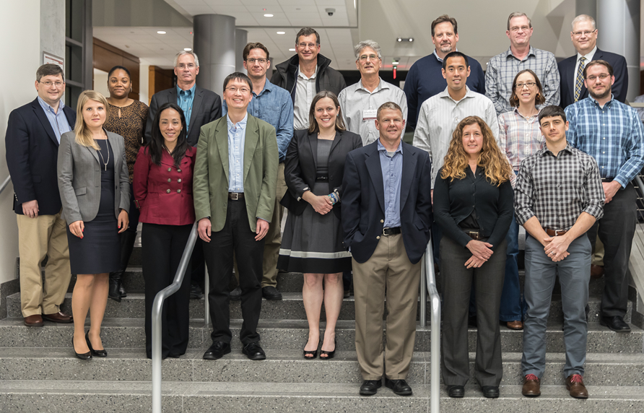









2017 Cohort: 22 participants representing 13 organizations
Argonne Site Office
Fermi Site Office

Slide 24
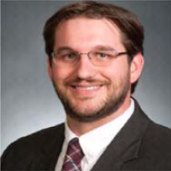



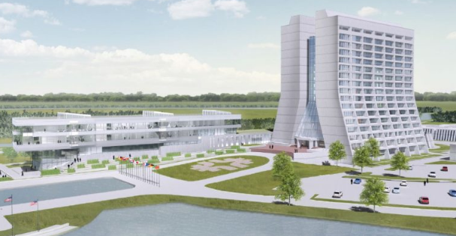
The HEP project community is well-represented in the first cohort
Adam Bihary
Fermi Site Office
Deputy Federal Project Director for LBNF/DUNE
Federal Project Director for PIP-II
Marc Kaducak
Fermilab
Head, Office of Project Support Services
Jolie Macier
Fermilab
DUNE-US Project Manager
Kate Sienkiewicz
Fermilab
IERC Project Manager

Slide 25
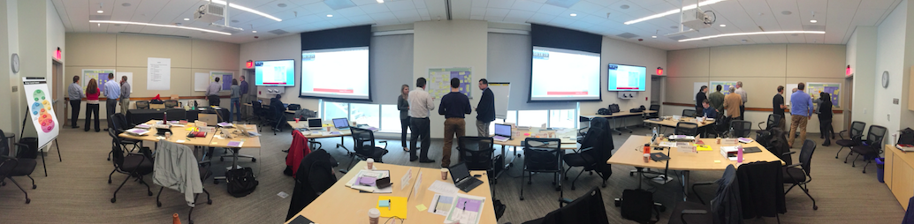
2017 Program Year
Events:
  Jan. 9-12, 2017 SLAC Preparing to Lead DOE Projects
  Mar. 20-23, 2017 LLNL Becoming a Highly Effective Leader
  Apr. - Jun., 2017 online Leadership for Strategic Execution
  May 15-18, 2017 CU-Boulder Positioning the Project for Success
  Sep. 11-14, 2017 ANL Delivering High-Risk Complex Projects
  Nov. 13-16, 2017 Washington DC Navigating to the Finish

Slide 26

Program Content
Five in-person themed events + one online course + year-long capstone project
8.0 days tailored DOE
6.0 days Stanford
Leadership coaching
Capstone project
+
Recruit experienced
DOE leaders
Event #1 (in person)
Stanford APM course, “Converting Strategy into Action” [2.0 days] + tailored DOE content [1.0 day]
Kickoff, self-assessment, project pre-planning, executing project strategy, cultural perspectives
Event #2 (in person)
Stanford APM course, “Leading Effective Teams” [2.0 days] + tailored DOE content [1.0 day]
Effective project leadership; stakeholder relationships; leading project teams; self-assessment/360 feedback
Event #3 (online)
Stanford APM online course: “Leadership for Strategic Execution”
Event #4 (in person)
Tailored DOE course [2.5 days]
Risk and contingency management; decision theory, analysis, geometric thinking; front-end planning; presentation skills
Event #5 (in person)
Stanford APM course, “Executing Complex Programs” [2.0 days] + tailored DOE content [1.0 day]
Construction/vendor management; interfacing with vendor/construction firms; project delivery methods
Event #6 (in person)
Tailored DOE course [2.5 days]
Conclusion: negotiations; change management; stakeholder relationships; crisis management; self-reflection; report-out capstone projects; PLI critique; celebration

Slide 27
Capstone Project
Designed to provide a team-oriented and integrative experience to culminate the course of study
Capstone Objectives:
A course-long experience that builds relationships
  Small group teams; each team seeks a mentor
Reinforces learning experience and objectives
Leads to an artifact that will benefit DOE or future PLI cohorts
Exercises the participant’s writing and presentation skills
The 2017 capstone project assignment is to write a case study of the Superconducting Super Collider project.
Notes:
The term is derived from the final decorative masonry ‘cap-stone’ used to complete a building or monument. In the case of the PLI, this will be an external assignment completed during the course of a year, that mirrors course materials, and reinforces learning objectives.

Slide 28
2018 Cohort
The nomination/selection process for the 2018 cohort will kick off in July 2017.
SC federal employees need to be nominated by cognizant Deputy Director. Self-nomination is not permitted. Federal employees attend at no cost, but these slots are limited in number.
Lab employees need to be nominated by their laboratory director. Self-nomination is not permitted.
Please help us spread the word!

Slide 29
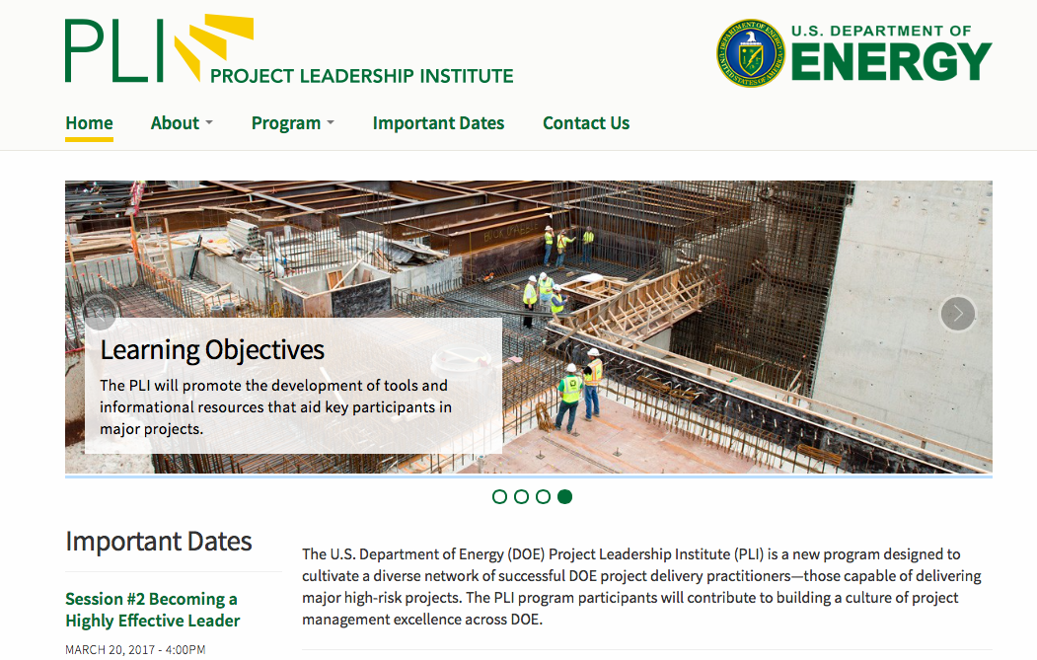

DOE Project Leadership Institute Contacts
Website: https://pli-slac.stanford.edu
Jeff Sims, PLI Director: jsims@slac.stanford.edu
Ben Brown, PLI Program Manager: ben.brown@science.doe.gov
Jeff Sims
PLI Director

Slide 31
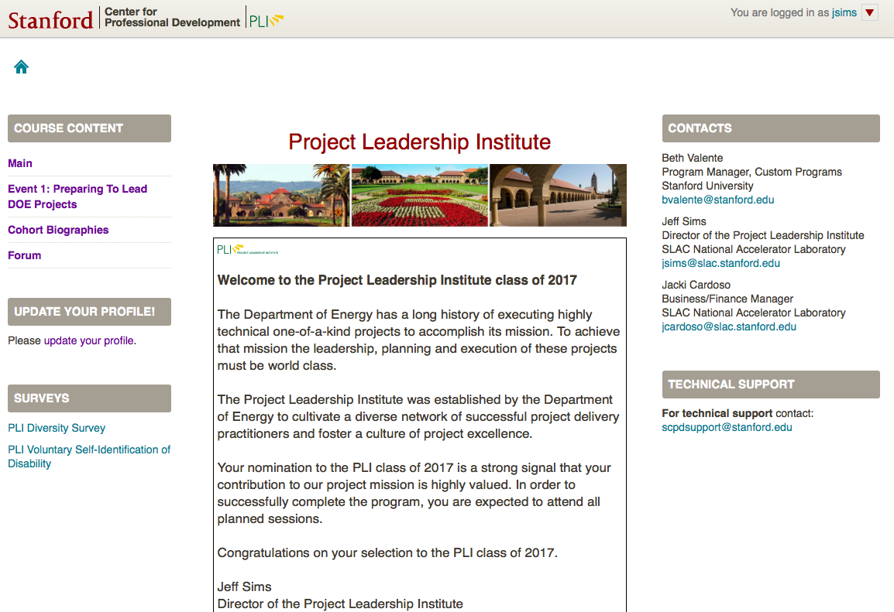
PLI Portal

Slide 32
Theme for Event 1: Preparing to Lead DOE Projects
Defining project leadership – both generally and in the DOE context
Presentations at Event 1, January 2017
    Perspectives on DOE project management practices
    Lessons learned from DOE projects past
    Characteristics of successful megaprojects
    Stakeholder management
    Facilitating multi-lab partnerships
    Converting strategy into action
    Project pre-planning
    Executing project strategy
    Cultural perspectives

Slide 33
Theme for Event 2: Becoming a Highly Effective Leader
Understanding the crucial role of team building, developing constructive relationships, growing one’s self-awareness, and enhancing conflict resolution and communication skills.
Presentations at Event 2, March 2017
    Building engagement and collaboration in DOE projects
    Interpreting and using your 360 emotional intelligence feedback
    Teamwork and learning from experience in DOE projects
    Being the leader
    Emotional intelligence for team leadership
    Conflict and conflict management
    Observing team dynamics
    Teaming across boundaries
Notes:
Explain how the program was developed by merging an existing proven Stanford academic PM program with coupled with DOE project experience

Slide 34
Theme for Event 4: Positioning the Project for Success
Leading teams through risk and uncertainty; risk and contingency management; decision theory, analysis, geometric thinking; front-end planning process; presentation and written communication skills.
Presentations at Event 4, May 2017
    Interpreting StrengthsFinder results
    Unconscious bias
    Risk identification and risk management
    Promoting a safety culture
    Front-end planning
    Acquisition planning
    Transition from planning to execution – lessons from the SNS project
    Presentation skills
Notes:
Explain how the program was developed by merging an existing proven Stanford academic PM program with coupled with DOE project experience

Slide 35
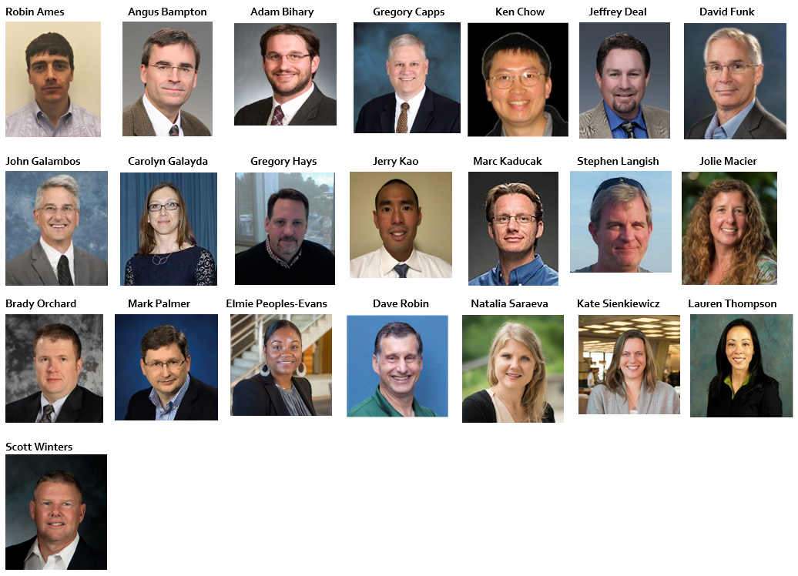
The 2017 PLI Cohort

