Slide 1
HEP and the Federal Budget Process
June 6, 2017
HEPAP Meeting
Glen Crawford
Director, Research and Technology R&D
Office of High Energy Physics
U.S. Department of Energy, Office of Science

Slide 2

HEP Civics: The Federal Budget Process
This talk will “follow the money” in an aim to illuminate the DOE/HEP role in the Federal budget process
  Three phases of the budget process
  DOE/HEP role in each phase
  Lab/university/community roles in overall program
Along the way, highlight how the P5 report is having a
significant impact in all phases of this process
Aim is to give a useful overview, but it is not possible to capture the full details or history of each item discussed!

Slide 3

U.S. Budget Process

Slide 4
Three Phases of Budget Process
Formulation: Executive branch prepares the President's Budget Request
  White House Office of Management and Budget (OMB) controls this process, providing guidance to Executive branch agencies
Congressional: Enacts laws that control spending and receipts
  Congress considers the President's Budget proposals, passes a budget resolution, and enacts the regular appropriations acts and other laws that control spending and receipts
Execution: Executive branch agencies carry out program
  OMB apportions funds to Executive Branch agencies, which obligate and disperse funding to carry out their programs, projects, and activities
Formulation
Congressional
Execution
FY 20XX Budget | DOE Internal Planning with OMB and OSTP Guidance |  |  |  |  |  |  |  |  |  |  |  | OMB Review |  |  |  | Budget Release | Congressional Budget and Appropriations |  |  |  |  |  |  | Spend the Fiscal Year Budget
 | Oct | Nov | Dec | Jan | Feb | Mar | Apr | May | Jun | Jul | Aug | Sep | Oct | Nov | Dec | Jan | Feb | Mar | Apr | May | Jun | Jul | Aug | Sep | Oct | Nov | Dec | Jan | Feb | Mar | Apr | May | Jun | Jul | Aug | Sep
 | CY(XX–3) |  |  | Calendar Year (20XX–2) |  |  |  |  |  |  |  |  |  |  |  | Calendar Year (20XX–1) |  |  |  |  |  |  |  |  |  |  |  | Calendar Year 20XX
4

Slide 5
The U.S. Federal Budget Cycle
Typically, three budgets are being worked on at any given time
  Executing current Fiscal Year (FY; October 1 – September 30)
  White House Office of Management and Budget (OMB) review and Congressional Appropriation for coming FY
  Agency internal planning for the second FY from now
FY 2016 Budget | Spend the Fiscal Year Budget
FY 2017 Budget | OMB Review |  |  |  | Budget Release | Congressional Budget and Appropriations |  |  |  |  |  |  | Spend the Fiscal Year Budget
FY 2018 Budget | DOE Internal Planning with OMB and OSTP Guidance |  |  |  |  |  |  |  |  |  |  |  | OMB Review |  |  |  | Budget Release | Congressional Budget and Appropriations |  |  |  |  |  |  | Spend the Fiscal Year Budget
 | Oct | Nov | Dec | Jan | Feb | Mar | Apr | May | Jun | Jul | Aug | Sep | Oct | Nov | Dec | Jan | Feb | Mar | Apr | May | Jun | Jul | Aug | Sep | Oct | Nov | Dec | Jan | Feb | Mar | Apr | May | Jun | Jul | Aug | Sep
 | CY 2015 |  |  | Calendar Year 2016 |  |  |  |  |  |  |  |  |  |  |  | Calendar Year 2017 |  |  |  |  |  |  |  |  |  |  |  | Calendar Year 2018
You are here

Slide 6
The U.S. Federal Budget Cycle
This year’s cycle is not “typical”
  Congress used Continuing Resolutions (CRs) until passing an appropriation on May 5
  White House released the “skinny budget” on March 13, guiding the budget formulation
  FY 2018 President’s Budget Request released on May 23
  DOE planning for FY2019 not yet begun
CR
FY 2017 Budget | OMB Review |  |  |  | Budget Release | Congressional Budget and Appropriations |  |  |  |  |  |  | Spend the Fiscal Year Budget
FY 2018 Budget | DOE Internal Planning with OMB and OSTP Guidance |  |  |  |  |  |  |  |  |  |  |  | OMB Review |  |  |  | Budget Release | Congressional Budget and Appropriations |  |  |  |  |  |  | Spend the Fiscal Year Budget
 | Oct | Nov | Dec | Jan | Feb | Mar | Apr | May | Jun | Jul | Aug | Sep | Oct | Nov | Dec | Jan | Feb | Mar | Apr | May | Jun | Jul | Aug | Sep | Oct | Nov | Dec | Jan | Feb | Mar | Apr | May | Jun | Jul | Aug | Sep
 | CY 2015 |  |  | Calendar Year 2016 |  |  |  |  |  |  |  |  |  |  |  | Calendar Year 2017 |  |  |  |  |  |  |  |  |  |  |  | Calendar Year 2018
DOE
Skinny
Budget
You are here

Slide 7
Formulation
FY 20XX Budget | DOE Internal Planning with OMB and OSTP Guidance |  |  |  |  |  |  |  |  |  |  |  | OMB Review |  |  |  | Budget Release | Congressional Budget and Appropriations |  |  |  |  |  |  | Spend the Fiscal Year Budget
 | Oct | Nov | Dec | Jan | Feb | Mar | Apr | May | Jun | Jul | Aug | Sep | Oct | Nov | Dec | Jan | Feb | Mar | Apr | May | Jun | Jul | Aug | Sep | Oct | Nov | Dec | Jan | Feb | Mar | Apr | May | Jun | Jul | Aug | Sep
 | CY(XX–3) |  |  | Calendar Year (20XX–2) |  |  |  |  |  |  |  |  |  |  |  | Calendar Year (20XX–1) |  |  |  |  |  |  |  |  |  |  |  | Calendar Year 20XX

Slide 8








Overview of Budget Formulation Process
OMB provides policy guidance for Executive branch agency budget requests
  Absent more specific guidance, agencies start with outyear estimates from previous budget
OMB works with agencies
  Identify major issues, develop plans for fall review, plan analysis of issues that will require decisions
OMB provides detailed instructions for submitting budget material
Agencies submit budgets to OMB
OMB reviews budget proposals
  Considers Presidential priorities, program performance, budget constraints
OMB provides recommended budget proposal to President and provides passback to agencies
December: Agencies may appeal to OMB and the President
January: Agencies prepare and OMB reviews final congressional budget justification materials
February: President transmits budget to Congress
Spring
Spring & Summer
June
Sept.
Fall
Late Nov.
Dec.
Jan.
…

Slide 9
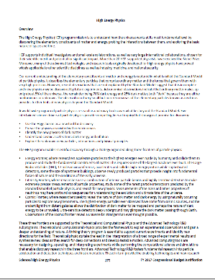
Creating the DOE HEP Budget Request
White House
White House Priorities
OMB Directives
Top-down and bottom-up influences to the DOE HEP budget
Advisory Panels (HEPAP, AAAC)
Community-driven Strategic Plans (P5)
Review Committee & Workshop Reports
Project Performance
DOE/SC Management
DOE/HEP Program
Particle Physics Community
Department of Energy

Slide 10


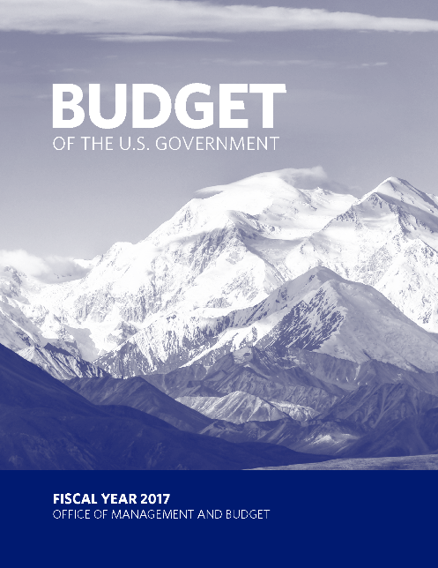
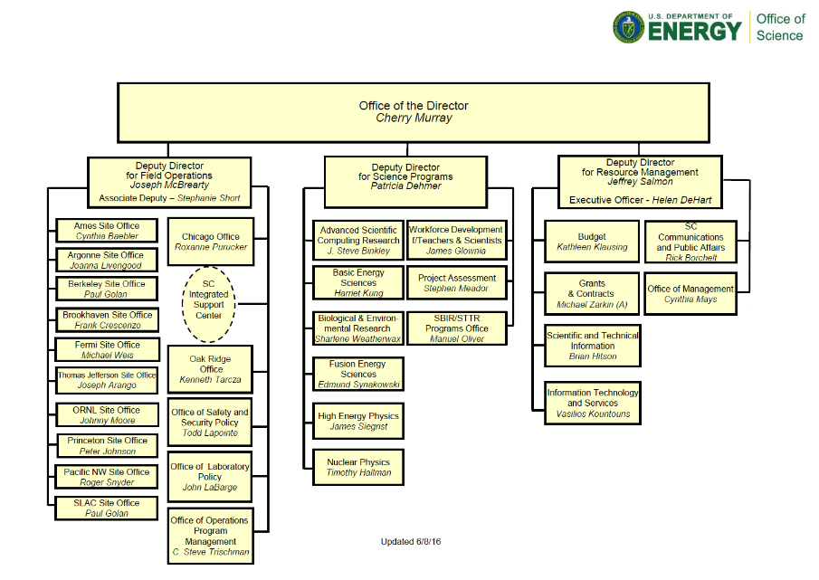

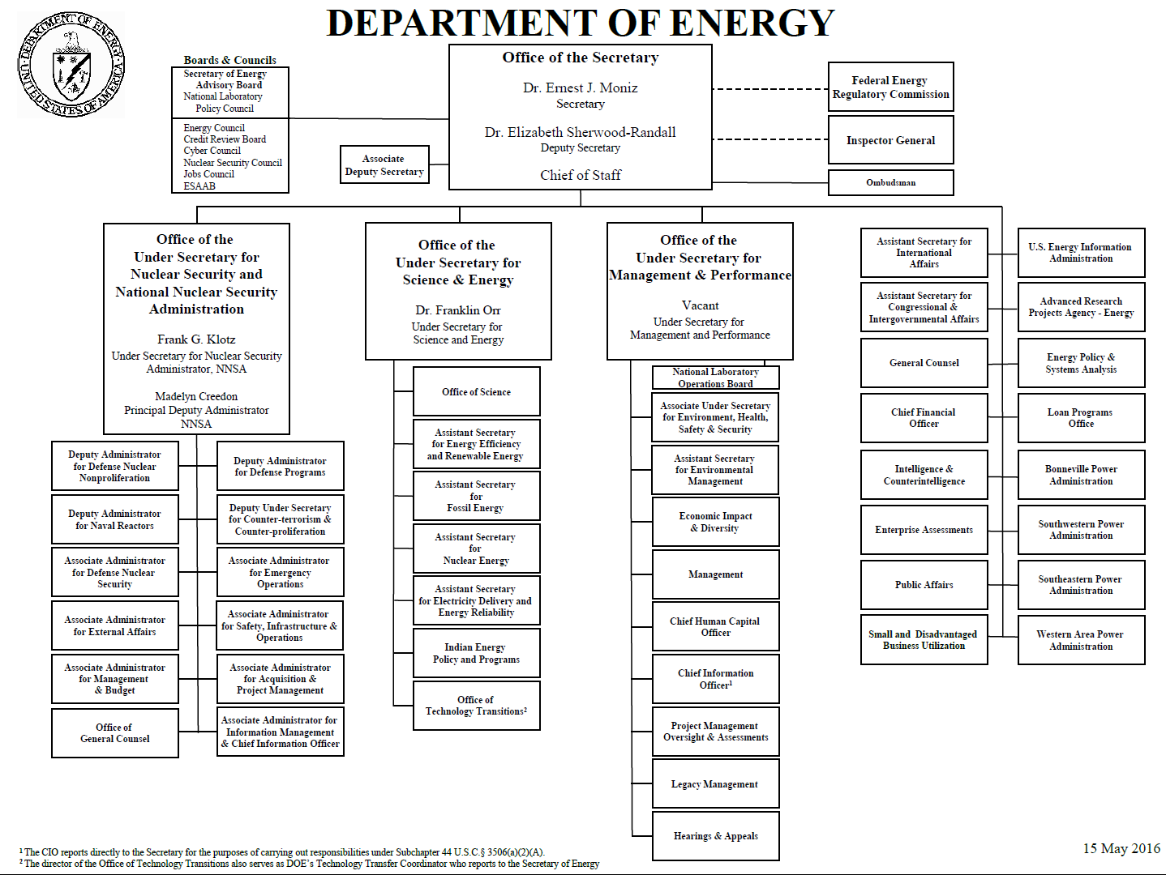


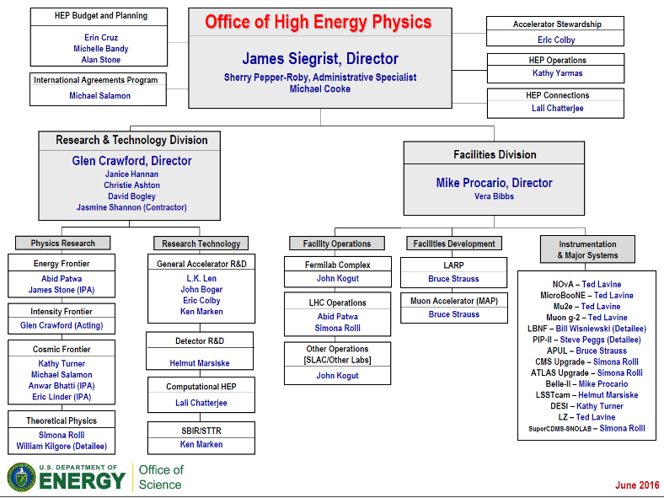
Path to the President’s Budget Request

Slide 11
Congressional
FY 20XX Budget | DOE Internal Planning with OMB and OSTP Guidance |  |  |  |  |  |  |  |  |  |  |  | OMB Review |  |  |  | Budget Release | Congressional Budget and Appropriations |  |  |  |  |  |  | Spend the Fiscal Year Budget
 | Oct | Nov | Dec | Jan | Feb | Mar | Apr | May | Jun | Jul | Aug | Sep | Oct | Nov | Dec | Jan | Feb | Mar | Apr | May | Jun | Jul | Aug | Sep | Oct | Nov | Dec | Jan | Feb | Mar | Apr | May | Jun | Jul | Aug | Sep
 | CY(XX–3) |  |  | Calendar Year (20XX–2) |  |  |  |  |  |  |  |  |  |  |  | Calendar Year (20XX–1) |  |  |  |  |  |  |  |  |  |  |  | Calendar Year 20XX

Slide 12

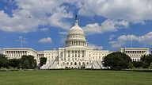
U.S. Budget and Appropriations Process
On or Before: | Action to be completed:
1st Mon. in Feb. | President submits his budget
<6 weeks after PBR submitted | Committees submit views and estimates to Budget Committees
April 15 | Congress completes action on the concurrent resolution on the budget
May 15 | Annual appropriation bills may be considered in House
June 10 | House Appropriations Committee reports last annual appropriation bill
June 15 | Congress completes reconciliation
June 30 | House completes action on bills
October 1 | Fiscal year begins
President requests, but Congress “holds the purse”
Congressional activity in this phase is a complex process!
Congressional Budget Act establishes timetable for the budget process

Slide 13
Congressional Budget Process
Budget Resolution
  Overall appropriation committee sets each subcommittee’s allocation of spending authority for the next fiscal year and aggregate spending and revenue levels for 5 years
Authorization legislation
  May create or continue agencies, programs, or activities as well as authorize and recommend funding levels for the subsequent enactment of appropriations
Appropriation bills (must originate in House)
  12 bills define discretionary spending and provide the funding for authorized agencies, programs, or activities
  Energy and Water Development Subcommittee has jurisdiction over DOE
President Submits Budget Request
1st Monday in February
House & Senate Markup Appropriations Bills
May
House & Senate Reconcile Appropriations Bills
June
House & Senate Pass Budget Resolutions
April
House & Senate Vote on Appropriations Bills
June
President Signs Appropriations Bills

Slide 14
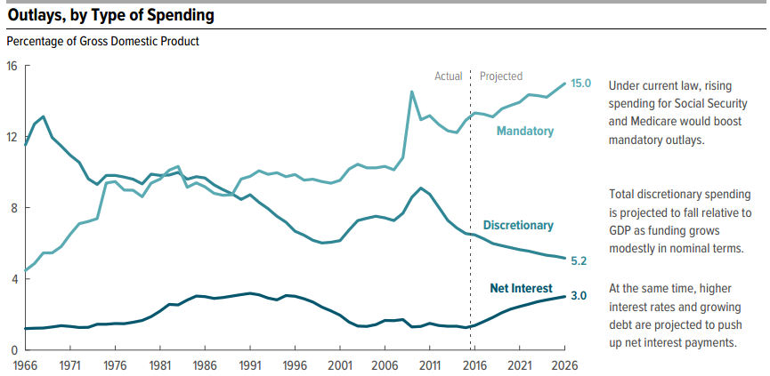
Congressional Budget Office Outlook

Slide 15
Appropriations Subcommittees
Agriculture, Rural Development, Food and Drug Administration, and Related Agencies
Commerce, Justice, Science, and Related Agencies
  National Aeronautics and Space Administration
  National Science Foundation
Defense
Energy and Water Development
  Department of Energy
Financial Services and General Government
Homeland Security
Interior, Environment, and Related Agencies
  Specific portions of Department of Health and Human Services
Labor, Health and Human Services, Education, and Related Agencies
  Department of Health and Human Services (with above exceptions)
Legislative Branch
Military Construction, Veterans Affairs, and Related Agencies
State, Foreign Operations, and Related Programs
Transportation, Housing and Urban Development, and Related Agencies

Slide 16
HEP Role in Congressional Process
The budget narrative provides the justification for the level
of support in the President’s Budget Request
  Narrative provides overview of the HEP program, highlights from the past year, discussion of each subprogram’s program and plans
  Tables with detailed breakdown of funding for past year vs. current year vs. budget request
  Explanation of changes for each line of budget table
Agencies usually invited to brief Congress on their budget request
  Opportunity to reinforce overall strategy and highlight key elements of the request
    Recall that Congress must individually approve each DOE project >$10M
  Informational request for additional detail
  Respond to requests regarding impact of alternative funding decisions

Slide 17
Department of Energy Research and Innovation Act
Passed House under unanimous consent (voice vote) on January 24, 2017
SEC. 305. HIGH-ENERGY PHYSICS.
  (a) Sense Of Congress.—It is the sense of Congress that—
    (1) the Director should incorporate the findings and recommendations of the report of the Particle Physics Project Prioritization Panel entitled “Building for Discovery: Strategic Plan for U.S. Particle Physics in the Global Context” into the planning process of the Department; and
    (2) the nations that lead in particle physics by hosting international teams dedicated to a common scientific goal attract the world’s best talent and inspire future generations of physicists and technologists.
  (b) International Collaboration.—The Director, as practicable and in coordination with other appropriate Federal agencies as necessary, shall ensure the access of United States researchers to the most advanced accelerator facilities and research capabilities in the world, including the Large Hadron Collider.
  (c) Neutrino Research.—The Director shall carry out research activities on rare decay processes and the nature of the neutrino, which may include collaborations with the National Science Foundation or international collaborations.
  (d) Dark Energy And Dark Matter Research.—The Director shall carry out research activities on the nature of dark energy and dark matter, which may include collaborations with the National Aeronautics and Space Administration or the National Science Foundation; or international collaborations.

Slide 18

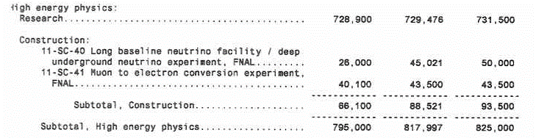
Report Language Matters!
Congress will usually specify top-line budget for a program and sometimes direct specific project or subprogram budget levels.
  It is up to program management to make it work “within available funds”.
Example: HEP received $825M in the FY 2017 Congressional Appropriation, about $7M above the FY 2017 President’s Budget Request
  Congressional direction increased funding for specific MIEs/projects by $9.9M
  The difference ($9.9M-7M = $2.9M) has to come out of the rest of the program.

Slide 19
Breaking the Cycle: Continuing Resolution
If the U.S. Congress and the President have not passed all appropriations bills by September 30, a Continuing Resolution (CR) may be passed to avoid a U.S. Government shutdown
  Must pass some level of appropriations to have legal authority to spend money!
  CRs typically extend level of funding from the previous year for a set amount of time with no significant programmatic changes (a.k.a. “no new starts”)
Therefore, a CR may impede the start of new projects
  Projects with total cost >$10M must be approved by Congress in an appropriations bill before funding can begin
  It is possible, though not typical, for CRs to include “anomalies” that would allow new starts
A CR may also impact the ramp-up of new projects
  DOE is committed to the successful execution of projects that have reached
  CD-2 and aims to provide the baseline funding profile
  Projects that have not reached CD-2 are most likely to be impacted under a CR
A CR may also impact future-year planning through such effects…

Slide 20
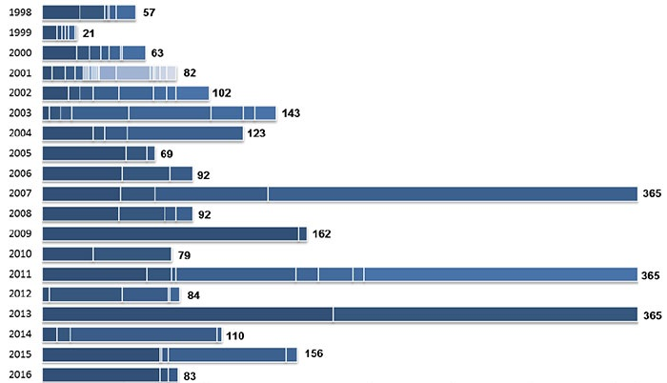
Duration of CRs: FY 1998 – FY 2017
Original Chart (FY 1998 – FY 2016) from Congressional Research Service Report R42647, "Continuing Resolutions, Overview of Components and Recent Practices," 2016.
Fiscal Year
2017
210 days through April 28, 2017
Continuing Resolution Duration (days)

Slide 21
Execution
FY 20XX Budget | DOE Internal Planning with OMB and OSTP Guidance |  |  |  |  |  |  |  |  |  |  |  | OMB Review |  |  |  | Budget Release | Congressional Budget and Appropriations |  |  |  |  |  |  | Spend the Fiscal Year Budget
 | Oct | Nov | Dec | Jan | Feb | Mar | Apr | May | Jun | Jul | Aug | Sep | Oct | Nov | Dec | Jan | Feb | Mar | Apr | May | Jun | Jul | Aug | Sep | Oct | Nov | Dec | Jan | Feb | Mar | Apr | May | Jun | Jul | Aug | Sep
 | CY(XX–3) |  |  | Calendar Year (20XX–2) |  |  |  |  |  |  |  |  |  |  |  | Calendar Year (20XX–1) |  |  |  |  |  |  |  |  |  |  |  | Calendar Year 20XX

Slide 22
Budget Execution
Start from the general plan laid out in budget formulation, modified by the actual appropriation, taking into account:
  Strategic plan for program
  Available funding vehicles
  Stewardship of DOE National Laboratories
  Support for projects
  Coordination with partners
Note that it typically takes some time to translate Congressional Appropriation into detailed agency-level budgets:
  Appropriations bills are long and detailed
  If in a CR, have to resolve current spending level versus final Appropriation
  Often there are “rescissions” and/or recovery of prior year balances
  Occasionally there are internal contradictions or errors
  Agency CFOs have to resolve all this and get agreement with OMB before issuing current FY “allotments” of budget authority

Slide 23
Funding Vehicles
DOE National Laboratories
  Most are Government Owned/Contractor Operated (GOCO) Federally Funded Research and Development Centers (FFRDCs) and operate under Management and Operating (M&O) contracts
  Laboratory research is mission driven and funded through Field Work Proposals (FWPs)
    Comparative reviews of the Lab Research programs held every 3-4 years
  Laboratories propose yearly financial plans based on DOE guidance
    Mechanisms exist to tune funding each month
Universities
  Submit grant proposals in response to a Funding Opportunity Announcements (FOAs)
    Independent peer review informs the selection of awards
  Award is ~fixed once made, with typical funding cycle of 3 years
    Funding adjustments (downward) are possible if circumstances change
    Changes are also possible through submission of supplementary proposals

Slide 24
Typical FOAs & New Initiatives
In recent years, there is one “continual” FOA (DOE/SC Open Solicitation) and these annual FOAs:
  Research Opportunities in HEP (a.k.a. Comparative Review FOA)
  Early Career
  Accelerator Stewardship
FOAs that launch new initiatives are informed through:
  Strategic plans
  Whitepapers
  Roundtables
  Workshops or working groups

Slide 25



Coordination with Partners
Many HEP efforts are collaborative and mechanisms exist to make sure that this process goes smoothly and obligations are met
  Contributions between partners are typically in-kind
The White House Office of Science and Technology Policy (OSTP) ensures that the scientific and technical work of the Executive Branch is properly coordinated
  With oversight from OSTP, DOE/HEP coordinates closely with partner agencies, including NASA and NSF, through:
    Memoranda of Understanding (MOU)
    Joint Oversight Groups (JOGs)
    Advisory panels
The U.S. State Department can authorize DOE to establish the framework necessary to work with international partners through:
  Science and Technology Agreements (S&TA): nation-to-nation agreements that acts as legal umbrellas for subsidiary agreements
  Implementing Arrangements (IAs): agency-to-agency agreements for cooperation in broad areas of S&T
  Project Annexes (PAs): Annexes to IAs are agreements that cover project- or subfield-specific cooperative activities

Slide 26
FOOTNOTES
FY 20XX Budget | DOE Internal Planning with OMB and OSTP Guidance |  |  |  |  |  |  |  |  |  |  |  | OMB Review |  |  |  | Budget Release | Congressional Budget and Appropriations |  |  |  |  |  |  | Spend the Fiscal Year Budget
 | Oct | Nov | Dec | Jan | Feb | Mar | Apr | May | Jun | Jul | Aug | Sep | Oct | Nov | Dec | Jan | Feb | Mar | Apr | May | Jun | Jul | Aug | Sep | Oct | Nov | Dec | Jan | Feb | Mar | Apr | May | Jun | Jul | Aug | Sep
 | CY(XX–3) |  |  | Calendar Year (20XX–2) |  |  |  |  |  |  |  |  |  |  |  | Calendar Year (20XX–1) |  |  |  |  |  |  |  |  |  |  |  | Calendar Year 20XX

Slide 27
DOE Roles and Responsibilities
Certain functions are considered “inherently governmental” and reserved for Federal staff, including:
  Determination of Federal program priorities for budget requests
  Determination of budget policy, guidance, and strategy
  Approving, awarding and administering government prime contracts
    Including determining what supplies or services are to be acquired with government funds
Moreover, since Federal staff are normally hired following civil service laws, there is a strong precept that contractors must not act as Federal staff and vice versa, e.g.:
  Government employees do not directly supervise contractors
  Federal staff are generally not involved in contractor personnel decisions
For all intents and purposes, DOE labs are prime contractors and lab employees are contractor employees

Slide 28
Federal Employee Restrictions
Lobbying (http://energy.gov/management/lobbying)
  Generally prohibited from contacting or encouraging others to contact a state or federal legislator or executive branch official in an attempt to influence the enactment or modification of legislation or other specified activities
Partisan Political Activity (https://osc.gov/Pages/HatchAct.aspx)
  In general, executive branch federal employees may not:
    Use official authority or influence to interfere with an election
    Solicit or discourage political activity of anyone with business before their agency
    Solicit or receive political contributions (may be done in certain limited situations by federal labor or other employee organizations)
    Be candidates for public office in partisan elections
    Engage in political activity while: on duty, in a government office, wearing an official uniform, or using a government vehicle
    Wear partisan political buttons on duty
  Certain employees (incl. Senior Executive Service) are further restricted!
(And more…)

Slide 29
DOE Lab Roles and Responsibilities
Facility Operations and Construction
  Performance judged against specified metrics (e.g. pb⁻¹ ; EVMS)
  Includes maintenance, upgrades, planning for new facilities
  User support
HEP Research and Technology R&D
  Nurture and support HEP research collaborations to enable discovery science
  Participation in all phases – from design, construction, operations & analysis
  Particular emphasis on:
    Management, design, construction and operation of HEP experiments
    Integration of cross-cutting activities, e.g.: computation, simulation and theoretical research, in support of HEP program
    Exploiting lab infrastructure and resources to develop next-generation particle accelerator and detector technologies for the advancement of HEP and science more broadly

Slide 30
University Roles and Responsibilities (DOE Perspective)
HEP Research and Technology R&D
  Contribute significantly to HEP research collaborations to enable discovery science
  Participation in all phases – from design, construction, operations & analysis
  Particular emphasis on:
    Advanced training of students and postdocs
    Data analysis and comparison with theoretical models
    Vision and theoretical framework for understanding the Standard Model and beyond
    Novel and innovative concepts and approaches
    Design of future HEP experiments

Slide 31
HEPAP Roles
Include language from HEPAP Charter here

Slide 32
Summary: Implementing the P5 Vision
The annual Federal budget process is long and complex
  Excursions from “standard order” are possible
  The community-driven P5 strategy plays an important role
  in all phases of the process.
The process is continuous, but the response time to stimulus can be long
  In May 2014 (at time of P5 Report), the FY 2015 budget was already in Congress and the FY 2016 budget was being formulated.
  Arguable the effects (success!) of the P5 plan were not fully seen until FY 2017 and are still in process
  Conversely, it will take some time for impacts of eventual FY 2018+ budgets to play out in execution of the P5 plan
Community continues to play an important role in this process
  A long-term view is necessary to provide feedback in a context that is most helpful
  HEPAP has a key role as federal advisory committee

Slide 33

Backup

Slide 34




Mission of the Department of Energy
The mission of the Energy Department is to ensure America’s security and prosperity by addressing its energy, environmental and nuclear challenges through transformative science and technology solutions.
  Catalyze the timely, material, and efficient transformation of the nation’s energy system and secure U.S. leadership in clean energy technologies.
  Maintain a vibrant U.S. effort in science and engineering as a cornerstone of our economic prosperity with clear leadership in strategic areas.
  Enhance nuclear security through defense, nonproliferation, and environmental efforts.
  Establish an operational and adaptable framework that combines the best wisdom of all Department stakeholders to maximize mission success.

Slide 35



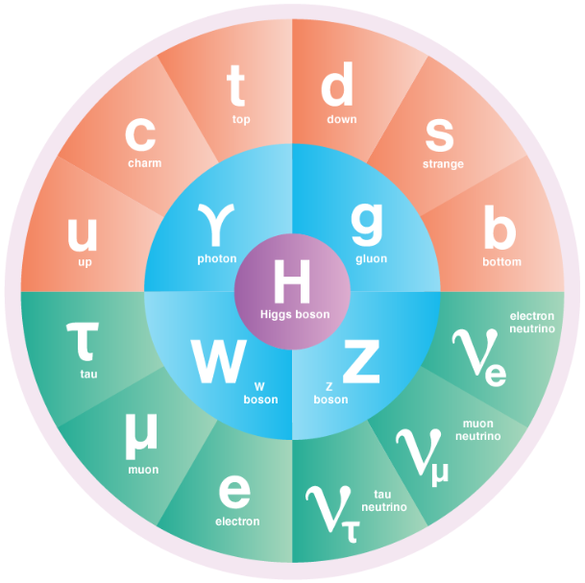
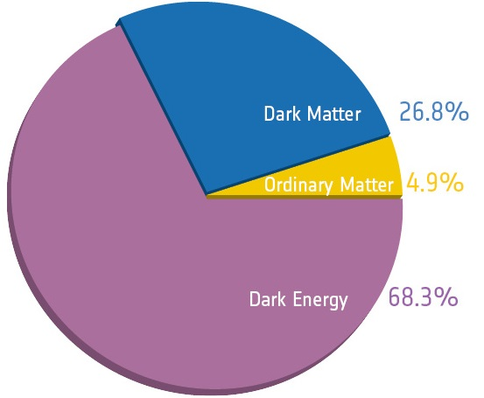
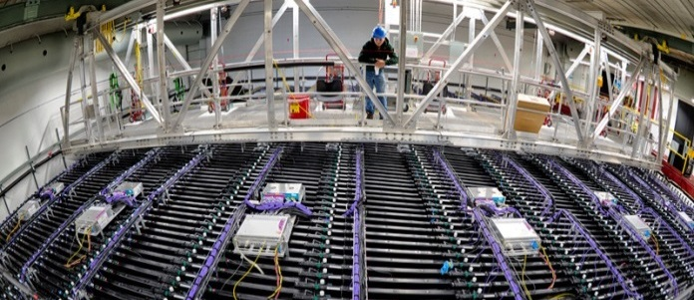
The High Energy Physics Program Mission
…is to understand how the universe works at its most
fundamental level:
  Discover the elementary constituents of matter and energy
  Probe the interactions between them
  Explore the basic nature of space and time
The Office of High Energy Physics fulfills its mission by:
  Building projects that enable discovery science
  Operating facilities that provide the capability to
  perform discovery science
  Supporting a balanced research program that
  produces discovery science

Slide 36
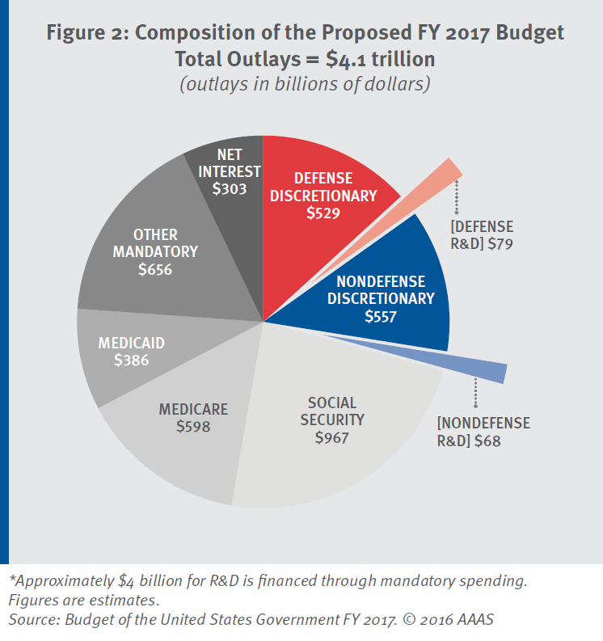
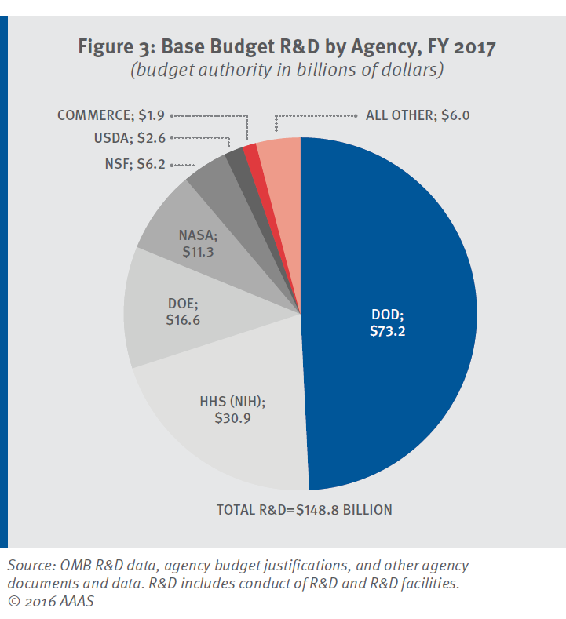
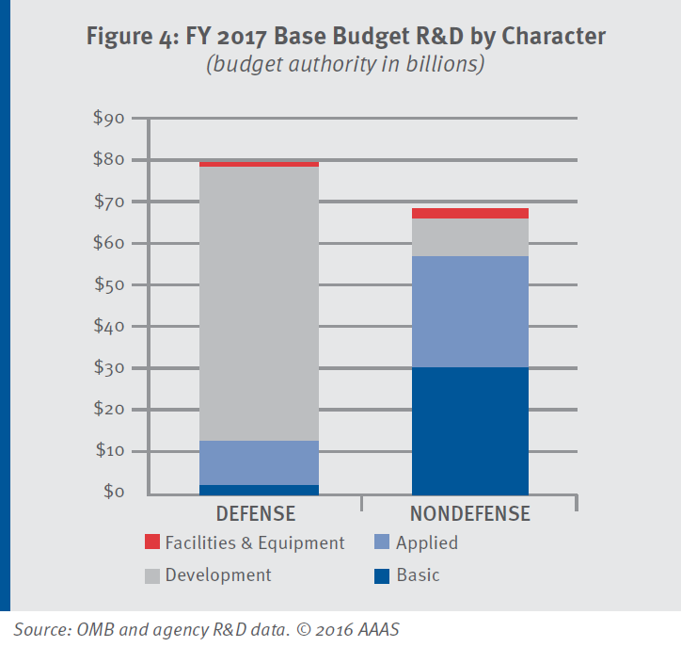
The FY 2017 President’s Budget Request

Slide 37
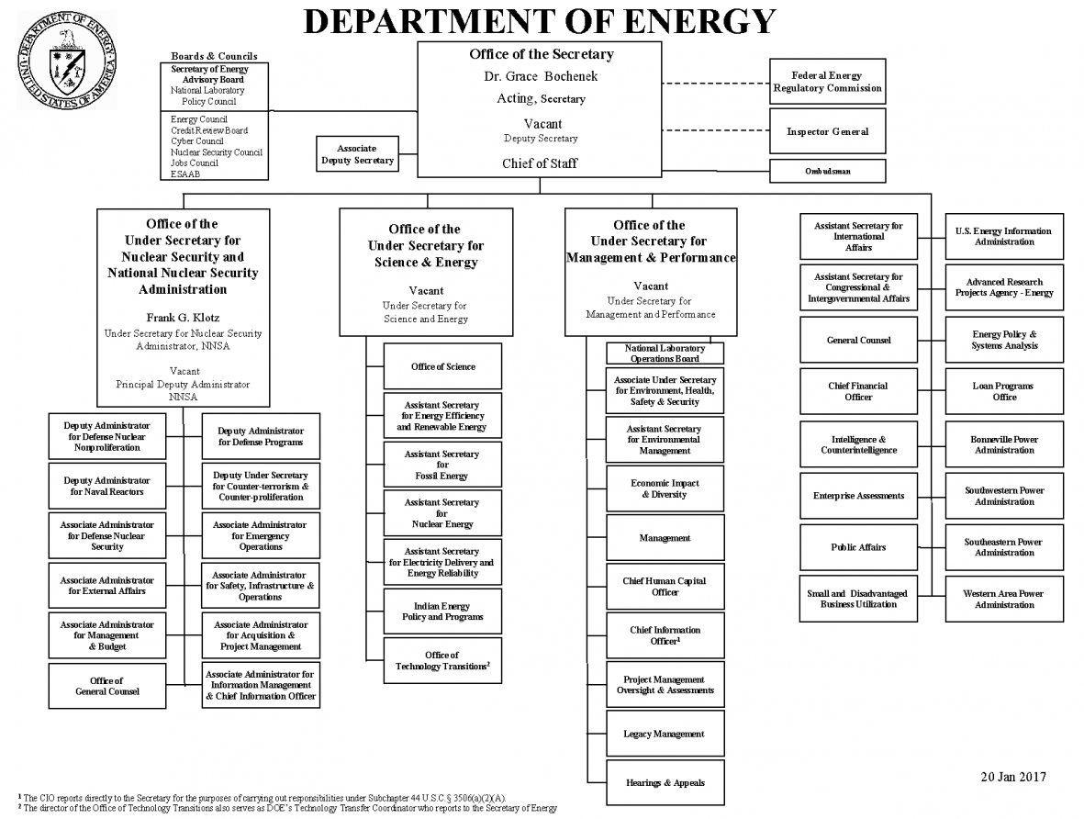
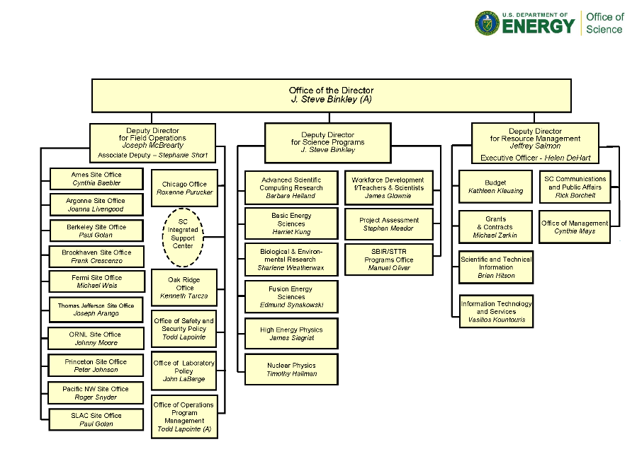
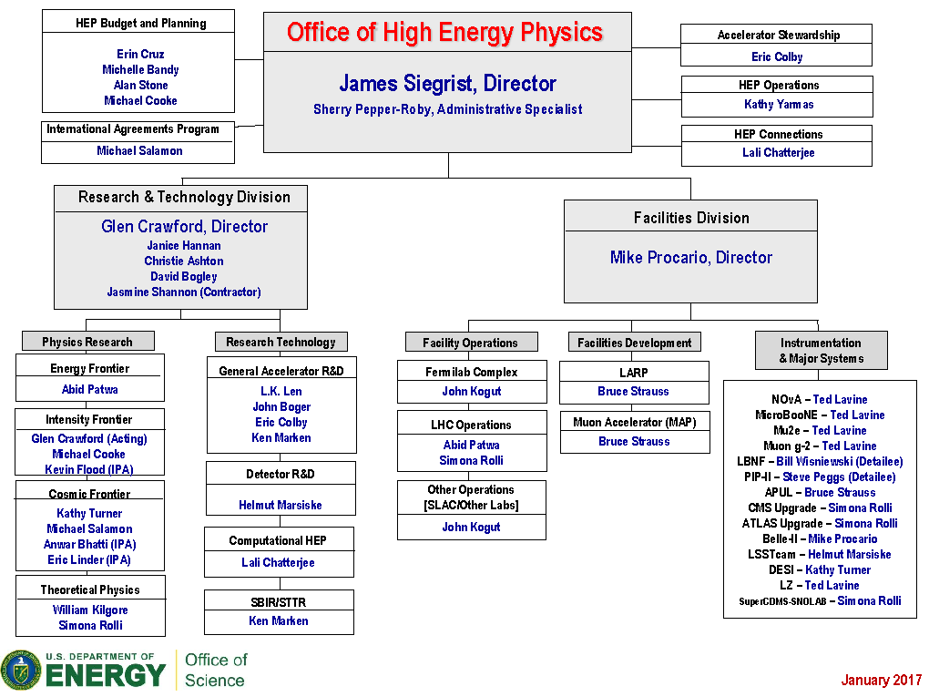
DOE Organization Chart

Slide 38
Appropriators Noticed the P5 Report
FY 2014 House Energy and Water Development Appropriations Report:
  “the Committee supports the Office of Science’s challenge to the High Energy Physics community to identify an LBNE construction approach that avoids large out-year funding spikes or to identify viable alternatives with similar scientific benefits at significantly lower cost.”
FY 2015 House Energy and Water Development Appropriations Report:
  “The Committee notes that the high energy physics research community is currently engaged in developing a ten-year plan for U.S. particle physics, which will include a ten-year report by the Particle Physics Project Prioritization Panel under various budget scenarios. The Committee applauds the Department for this undertaking . . .”
FY 2016 House Energy and Water Development Appropriations Report:
  “The Committee strongly supports the Department’s efforts to advance the recommendations of the Particle Physics Prioritization Panel and urges the Department to maintain a careful balance among competing priorities and among small, medium, and large scale projects.”
FY 2017 House ($823M) and Senate ($833M) marks above President’s Request ($818M)

Slide 39
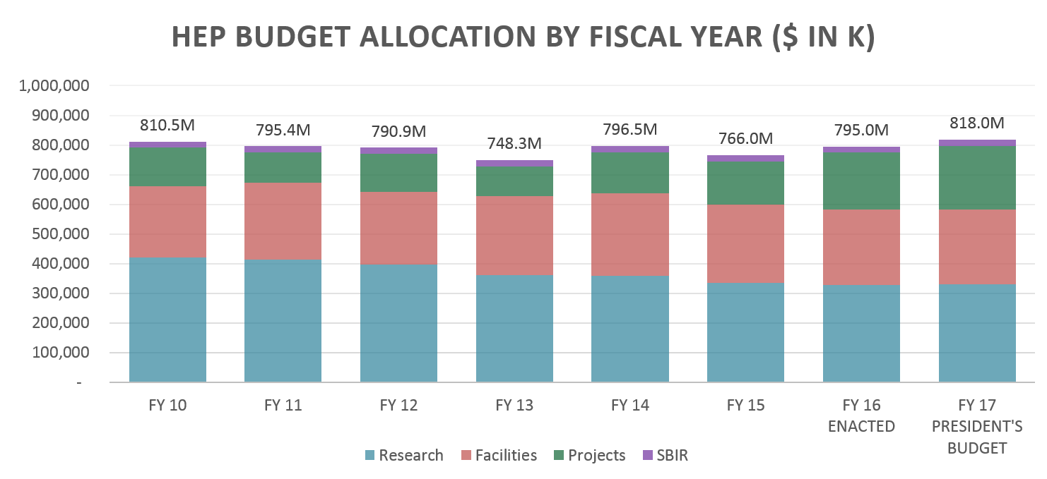
Overall HEP Budget Trend
Enabling science results is typically a process that spans many years
For a given experiment:
  R&D (Research) → Project → Operations → Research
All funding shown in “then-year” U.S. dollars

Slide 40
DOE Project Management
Construction projects and fabrication of large pieces of experimental equipment costing over $10M are managed through a series of “Critical Decision” milestones
The CD process ensures successful project execution and scientific return on agency investments, but funding must still be appropriated
  Linked to – but independent of – the budget process!
Project Definition
Project Execution
Project Closeout
Operating
Funds
Total Project Cost (TPC)
Operating
Funds
Initiation
(pre-project R&D)
(R&D continues…)
CD-0
Approve
Mission
Need
CD-1
Approve
Alternative
Selection
and Cost Range
CD-2
Approve
Performance
Baseline
CD-3
Approve
Start of
Construction
CD-4
Approve
Start of
Operations
(or Project Completion)
DOE 413.3B:
Critical
Decisions
Definitive
cost, scope, and
schedule
baselines have
been developed
Project has
demonstrated
technical
readiness for
implementation
Identifies there
is a need that can
only be met thru
material needs
Ensures the
selected alternative
and approach is the
optimum solution
Project is completed
and ready for
turnover to
program operations

Slide 41


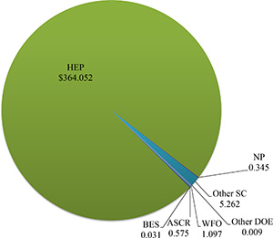
Stewardship of DOE National Laboratories
Together, the 17 DOE laboratories comprise a preeminent federal research system, providing the Nation with strategic scientific and technological capabilities. The laboratories:
  Execute long-term government scientific and technological missions, often with complex security, safety, project management, or other operational challenges;
  Develop unique, often multidisciplinary, scientific capabilities beyond the scope of academic and industrial institutions, to benefit the Nation’s researchers and national strategic priorities; and
  Develop and sustain critical scientific and technical capabilities to which the government requires assured access.
Stewardship of Fermilab is an important part of the HEP mission
Fermilab Annual Funding
by Source

Slide 42
Project Support
Successful delivery of construction projects and facilities for science is a central part of the DOE science mission
  In particular, Office of Science practice (critical decision [CD] process and Lehman reviews) considered gold-standard in DOE
    “Failure is not an option”
  SC has earned the authority to manage projects flexibly
    This authority is only protected by unblemished project execution and is recognized as essential to SC success
DOE is committed to the successful execution of projects that have reached CD-2 and aims to provide the baseline funding profile
  Approval of CD-2 establishes the Performance Baseline against which the project success or failure will be measured
  CD-2 also allows project to request construction/fabrication funds
In a difficult budget situation, projects that have not yet reached CD-2 are much more likely to have their profiles adjusted

Slide 43
Laboratory Support
Laboratory research is mission driven and funded through Field Work Proposals
  Program guidance to the Laboratories is provided by HEP with input from a variety of sources, including:
    The Laboratories themselves
      Local strengths and resources
    Advisory committees
    Institutional reviews
  HEP holds comparative reviews of the Research programs of the labs every 3 years.
Research job classifications at Laboratories are similar to those at Universities
  Major exception is Senior Research Scientists in place of PIs
Rounding in percentages may
cause total to be less than 100%

Slide 44
University Support
University research is supported by a competitive, proposal-driven process
  Grants issued after comparative review of proposals submitted to Funding Opportunity Announcements
Research job classifications at universities, supported by HEP funding, include the following positions:
  Principle Investigator (PI)
    Tenured or tenure-track permanent Ph.D. staff
  Research scientist
    Permanent, non-tenured staff
  Postdoctoral fellow
    Term employees with Ph.D.
  Graduate students
  Administrative staff
  Engineers
  Computer professionals
Rounding in percentages may
cause total to be less than 100%

Slide 45
Laboratory International Agreements
In 2012, under Secretary Chu, major changes were made in how DOE operates with respect to international Lab-to-Lab interactions, including:
  Memoranda Of Understanding (MOU)
  International Cooperative Research and Development Agreements (i-CRADA)
  Strategic Partnership Projects (SPP)
A November 17, 2014, delegation order by Secretary Moniz provides further guidance:
  Previously, the labs negotiated MOUs with foreign labs in an independent manner, with limited coordination and no HQ clearances required
  Now, lab-to-lab MOUs cannot be used for R&D collaborations and scientific exchanges, and such activities need to be cleared through the DOE Site Office and DOE HQ before being signed
Implications for HEP:
  Any R&D collaboration involving DOE laboratories (outside info sharing and workshops) need legally binding agency-to-agency agreements negotiated at the DOE level
  Better coordination between the labs, DOE, and State Department and greater U.S. Government visibility for HEP international activities

