Slide 1
The U.S. Magnet Development Program
Soren Prestemon
Director
US Magnet Development Program
Lawrence Berkeley National Laboratory

Slide 2
Outline
Context for high field accelerator magnet R&D
Motivation
P5 and the Accelerator R&D Subpanel recommendations
The US Magnet Development Program
How we are structured
Technical status of each area
Progress and current status
Corresponding roadmap within the MDP plan
Summary

Slide 3
Advanced superconducting accelerator magnet technology is critical for a future collider
A large Hadron collider entails...
A high intensity proton source,
Fast-cycling magnets for the injection chain,
New magnets - probably high-field
A new tunnel
Exception: HE-LHC could reach Ecm=33TeV with 20T dipoles…
Barletta
Dominant cost drivers for an pp collider: Magnets and tunnel
Cost/performance is the critical metric

Slide 4
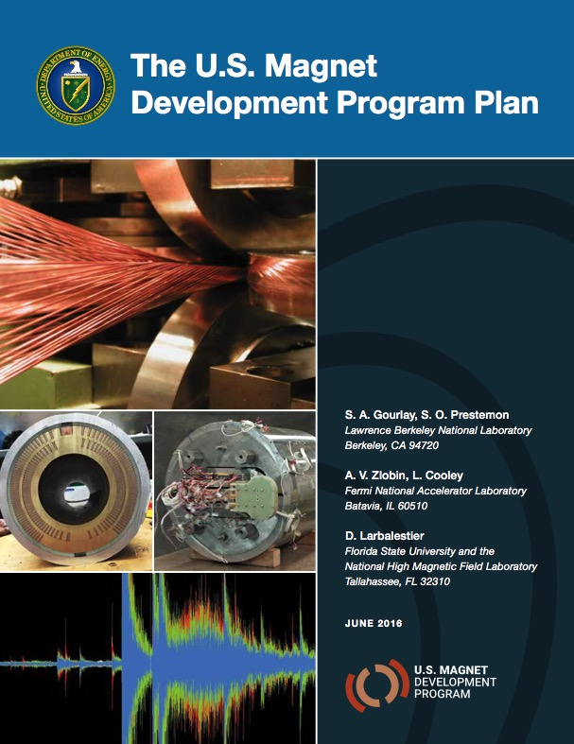
The US HEP Superconducting Magnet Programs are now integrated into the US Magnet Development Program
HEPAP Accelerator R&D Subpanel recommendations

Slide 5
The management structure of the MDP is clearly defined and the program is fully functioning
Technical Advisory Committee
Andrew Lankford, UC Irvine – Chair
Davide Tommasini, CERN
Akira Yamamoto, KEK
Joe Minervini, MIT
Giorgio Apollinari, FNAL (LARP/Hi-Lumi)
Mark Palmer, BNL
MDP Management Group
S. Prestemon, LBNL
G. Velev, FNAL (Deputy)
L. Cooley, FNAL
S. Gourlay, LBNL
D. Larbalestier, FSU
A. Zlobin, FNAL

Slide 6
Initial technical roles of participants matched with strengths and interests
FSU
Conductor R&D
Leverage Bi-2212 and REBCO R&D Program
Shared infrastructure – overpressure furnace for sub-scale coils
FNAL
Primary focus and responsibility for Cos-Theta
LBNL
Primary responsibility for CCT
Lead mechanical support structure effort between labs
Primary responsibility for HTS component
Significant leverage with other programs, e.g.
- FES (on high temperature superconductors)
- SBIR program
- Early Career Research Program
- University programs (e.g. Ohio State, Tufts, U. of Houston, MIT, Florida State/NHMFL)
Close connection with LARP/HL-LHC AUP

Slide 7
Technical areas have leads who are responsible for coordination and planning
Magnets | Lead
Cosine-theta 4-layer | Sasha Zlobin
Canted Cosine theta | Diego Arbelaez
Bi2212 dipoles | Tengming Shen
REBCO dipoles | Xiaorong Wang
Nb₃Sn
HTS
Cond Proc and R&D | Lance Cooley
Conductor R&D
Technology area | LBNL lead | FNAL lead
Modeling & Simulation | Diego Arbelaez | Vadim Kashikhin
Training and diagnostics | Maxim Martchevsky | Stoyan Stoynev
Instrumentation and quench protection | Emmanuele Ravaioli | Thomas Strauss
Material studies – superconductor and structural materials properties | Ian Pong | Steve Krave
Technology development

Slide 8
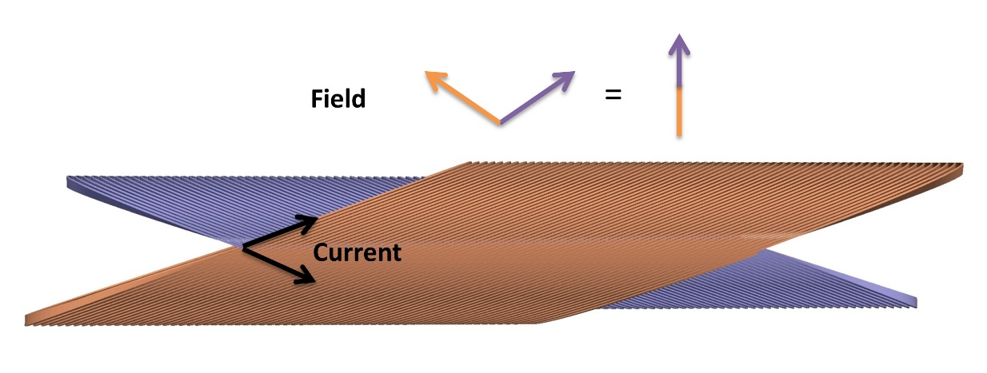
We have initiated a two-prong approach to high field dipoles to explore the limits of Nb₃Sn
A reference design based on a 4-layer cosine-theta magnet utilizing high-performance Nb₃Sn
A path to explore innovative designs
Starting with the canted cosine-theta (CCT), a different paradigm that integrates mechanical structure internally

Slide 9
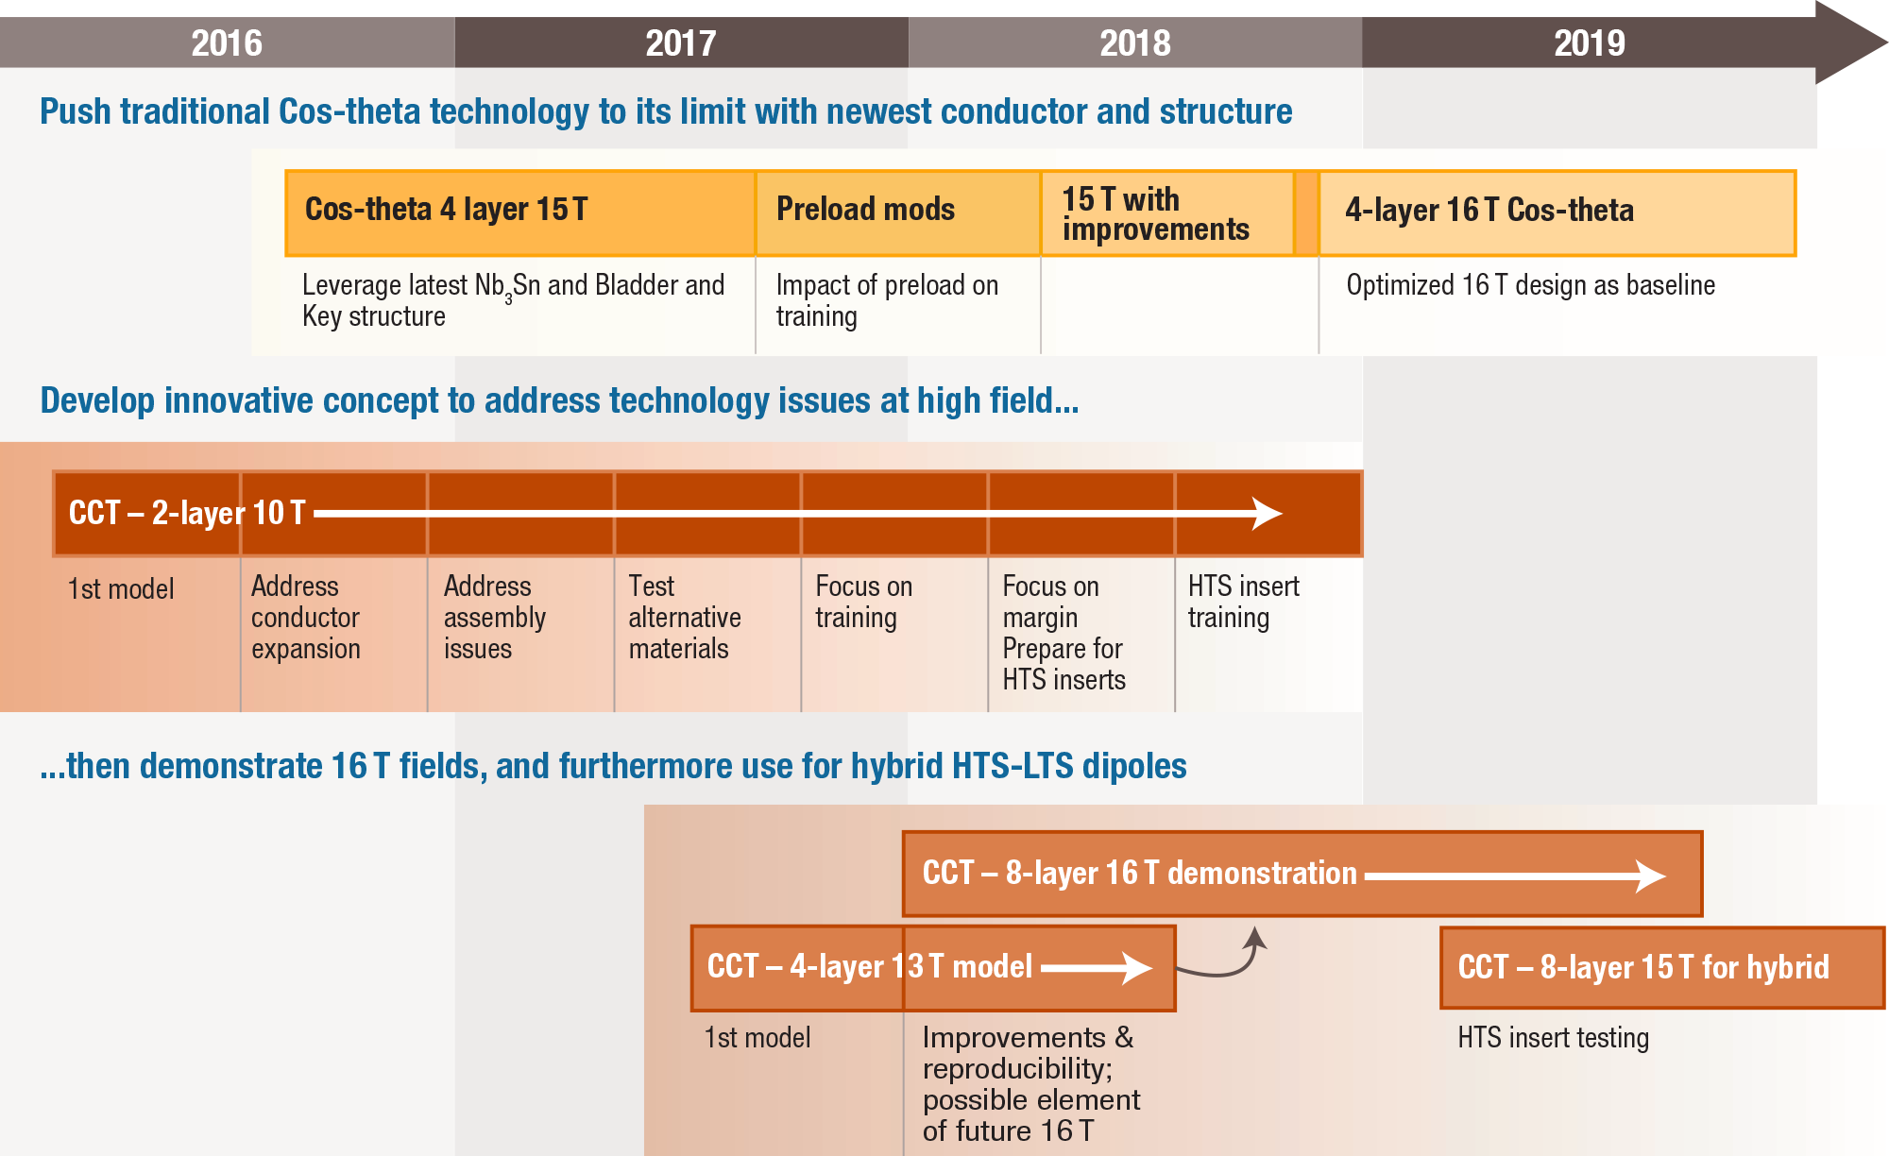
Overview of the Nb₃Sn Milestone Plan, Highlighting the Cos(θ) Reference Magnet Development and the Innovation Route with CCT

Slide 10
The Cosine-theta 4-layer magnet is proceeding well at FNAL, with first coil prepared for VPI
Lead: Sasha Zlobin
Novel coil layout addressing midplane stresses and field quality
Outer coil winding
Preparations for VPI
Coil parts provided by CERN
Traces by LBNL

Slide 11
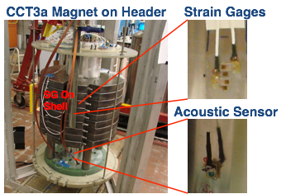
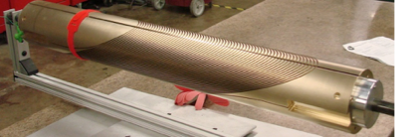
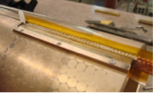

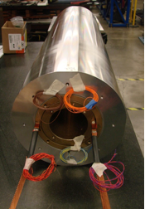
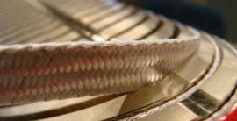
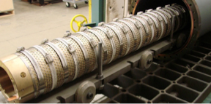
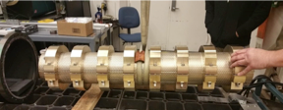
The CCT program is proceeding to systematically address technical issues
Lead: Diego Arbelaez
Progress on the Canted Cosine Theta:
Tested CCT2 (NbTi) and CCT3 (Nb3Sn)
Testing of CCT4 in June 2017
Magnet testing with a breadth of diagnostics
Mandrel fabrication developed at LBNL, now done by industry
Pace of effort scaled with funding
Cosine-theta at FNAL has higher priority
Fabrication of Nb3Sn/NbTi joints
Assembly into an Al shell
Coil winding: <1 day/layer
VPI using simple, scalable tooling
Reaction: simple, scalable tooling
Reaction of second layer; could be done together with other layers

Slide 12

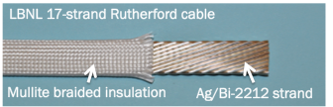
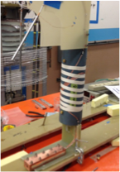
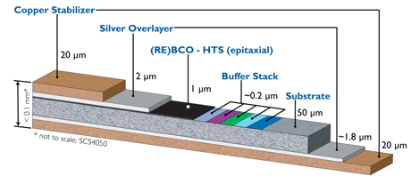
Two candidate HTS conductors are pursued to explore and push the limits of HTS for high-field dipole applications
Bi-2212
Rutherford cables and sub-scale magnets in racetrack and CCT configuration
REBCO
Cable characterization and dipole magnet development
CORC®, from Advanced Conductor Technologies, Inc.

Slide 13
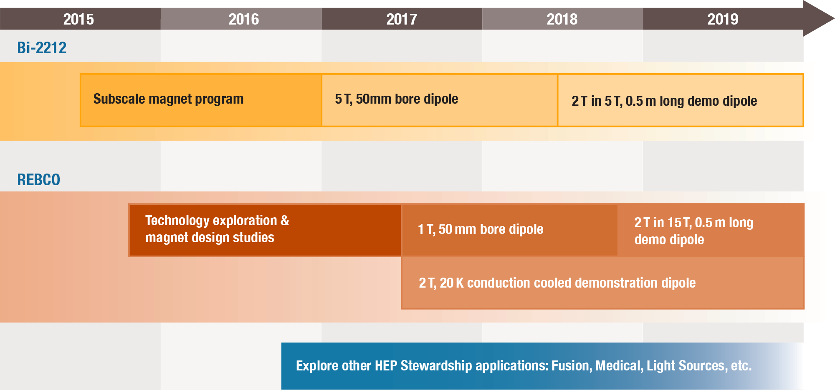
Overview of the HTS Milestone Plan, Highlighting the Bi-2212 Magnet Development and the REBCO Magnet Development

Slide 14
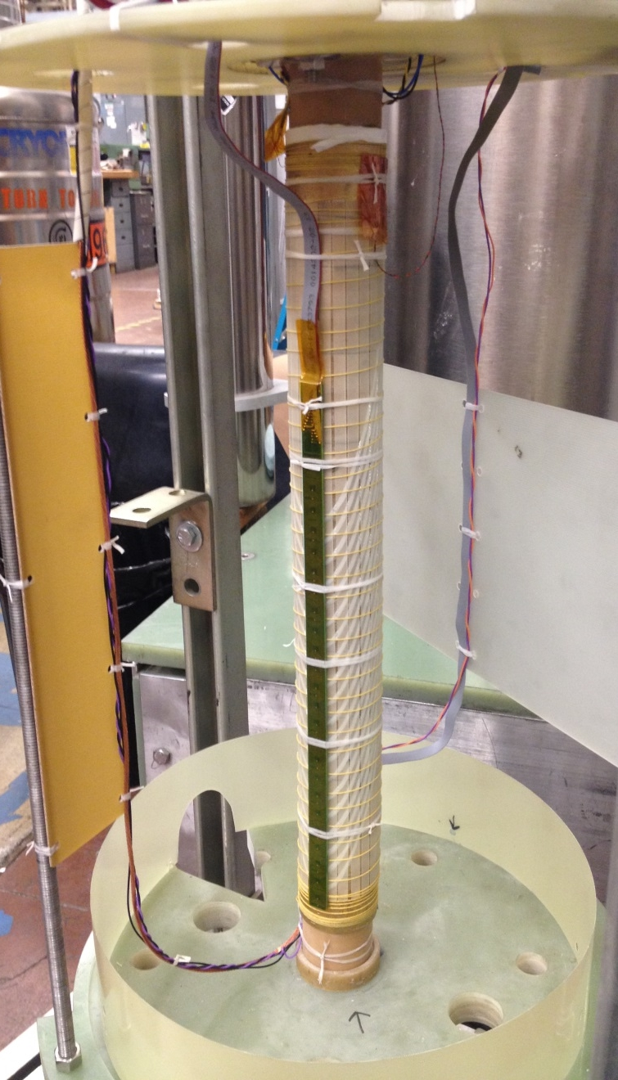
Significant progress on the Bi2212 HTS magnet front:
Leveraging overpressure boost in magnet configurations
Lead: Tengming Shen
LBNL Bi2212 magnets:
Dramatic improvements in conductor properties in last couple of years
Racetrack & CCT coils fabricated and pushed to their electrical, mechanical, and quench limits

Slide 15
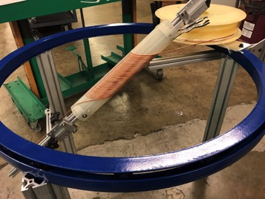
REBCO program developing quickly: conductor and cable characterization, magnet design and prototyping underway
Lead: Xiaorong Wang
Courtesy
Danko Van Der Laan,
Advanced Conductor Technologies, Inc.
C0b wound with wire #2
1000 A @ 77 K and
12400 A @ 4.2K,
Peak Je = 1198 A/mm²
Tooling developed for winding of 40-turn prtototype

Slide 16
Backbone of the Program: Magnet Science and Development of Underpinning Technologies
Areas of focus:
Training studies
Modeling
Diagnostics, quench detection, protection
Develop infrastructure, e.g. insert testing
New materials – insulation, impregnation and structural
Design comparison and cost analysis to guide program
Improvements/advances from this part of the program are then integrated into the Nb₃Sn and HTS magnets

Slide 17
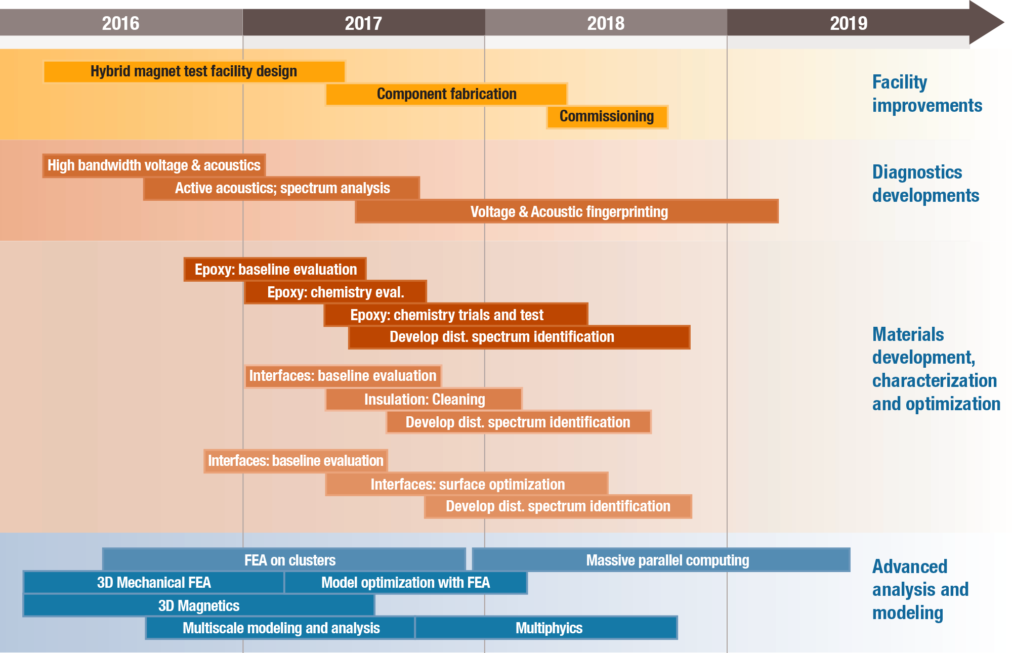
Overview of the Technology Development Milestone Plan, which Feeds the Nb₃Sn and HTS Magnet Program Elements

Slide 18
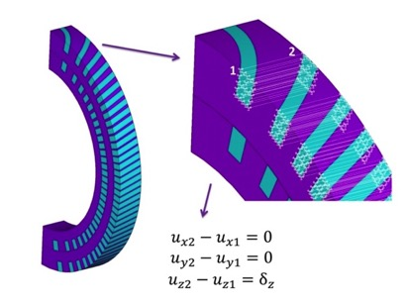
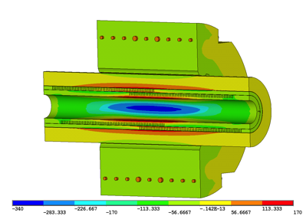
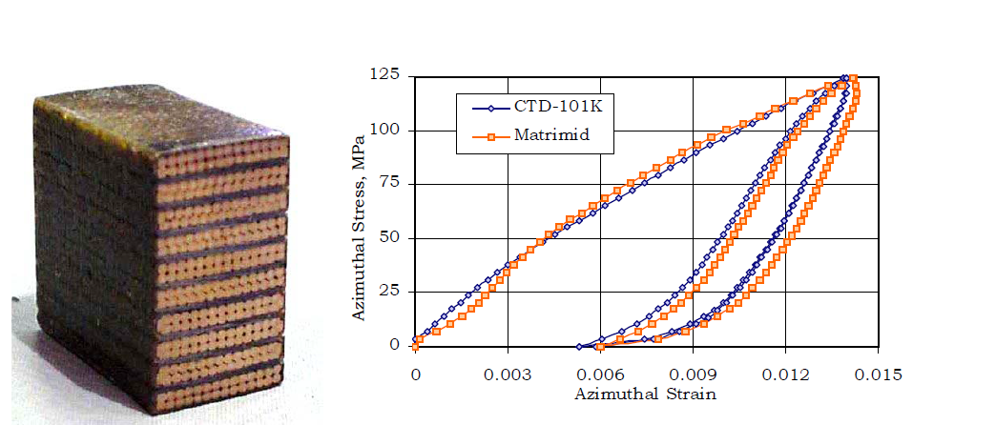
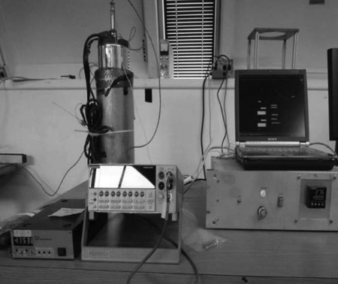
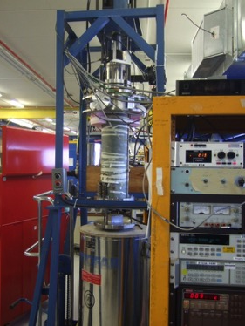
Numerous technology advances are essential to address the high field magnet challenge
Lucas Brouwer
Full 3D simulations – utilizing the computing cluster Lawrencium at LBNL
Periodic Model
Full Model
Ten-stack measurements provide critical materials properties
Leads: Ian Pong & Steve Krave
FNAL PPD and “low temperature loader”

Slide 19
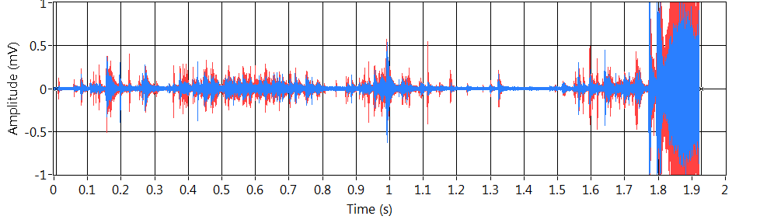

Advanced diagnostics are providing new and critical insight into the mechanisms of training and magnet performance
Leads: Maxim Marchevsky & Stoyan Stoynev
Warm-bore quench antennas
Acoustic emissions as detectors
Acoustic emissions for localization
“Axial-Field Magnetic Quench Antenna for the Superconducting Accelerator Magnets”, M. Marchevsky, A. R. Hafalia, D. Cheng, S. Prestemon, G. Sabbi, H. Bajas, G. Chlachidze, IEEE Trans. Appl. Supercond. 25, 9500605 (2015), DOI: 10.1109/TASC.2014.2374536

Slide 20
Superconducting Materials Procurement and R&D is Critical for Program Success
Lead: Lance Cooley
Push performance limits of Nb₃Sn and HTS conductors
based on magnet needs
Understand –
Uniformity and reliability
Scalability and future cost
Quantity | Target
Diameter | 0.7 to 1.2 mm; (hold @ 1.3)
Unit length | 95% yield at 150 m
Jc(16 T, 4.2K) | 1300 A/mm2 (best effort) 1240 in cable
Jc std. dev. | < 100 A/mm2
RRR | >100; >50 at cable edge or in strand rolled to 15% reduction
Cu:NC | 0.9 to 1.1 (e.g. 150/169)
DSE | <60 μm
HT duration | <240 hours
Initial specifications for Nb₃Sn conductor
Intend to procure Bi2212 wire soon utilizing existing Bi powder from SBIR programs

Slide 21
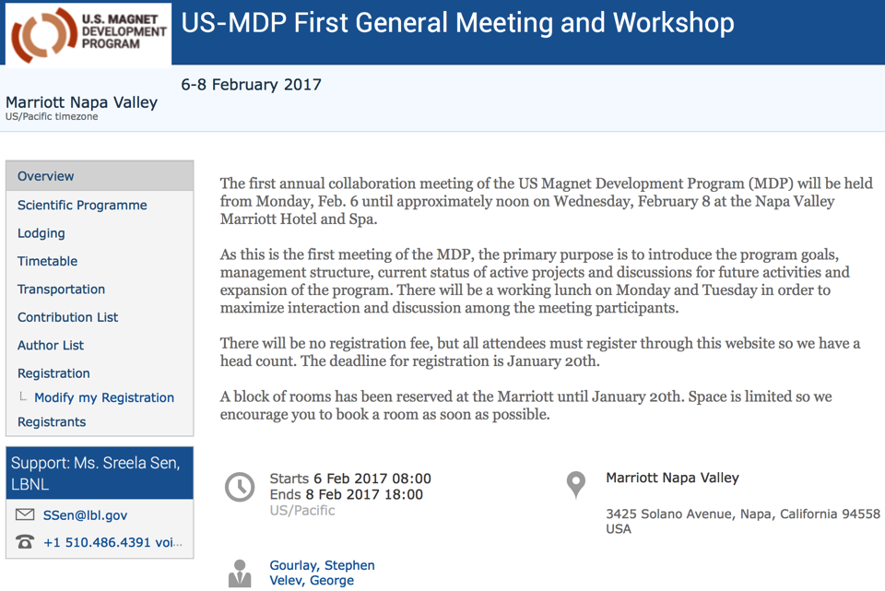
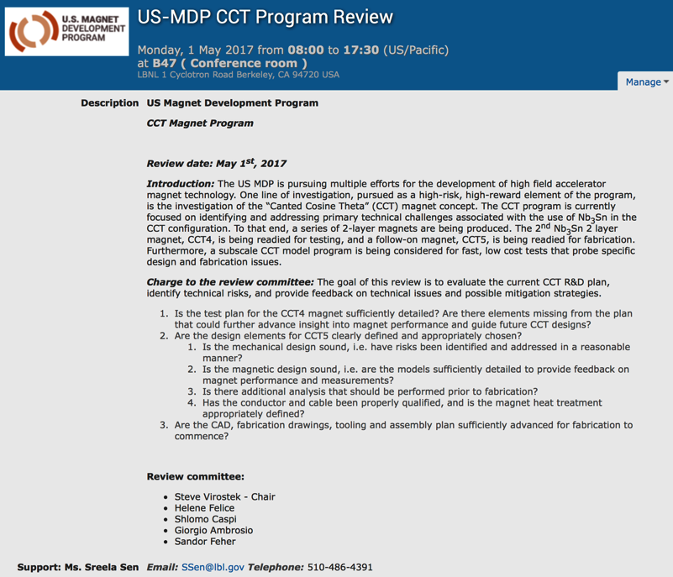
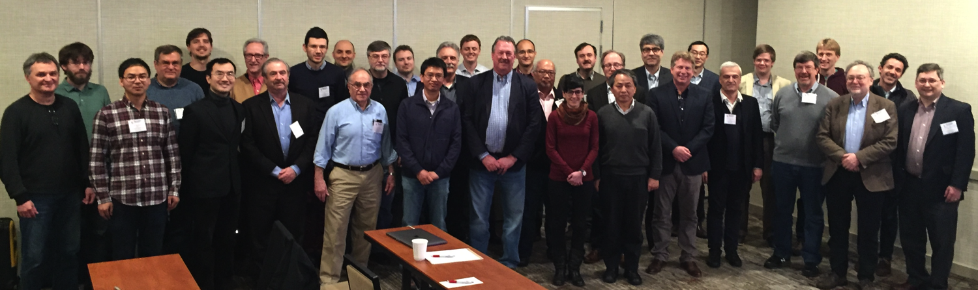
The MDP is being managed and reviewed for program coherence and technical strength

Slide 22
We have an active program focused on advancing high-field LTS and HTS accelerator magnet technology for future pp colliders
We have…
an MDP Plan that lays out our goals and a roadmap for achieving them, fully aligned with the P5 report and the HEPAP Accelerator R&D Subpanel report
established an excellent Technical Advisory Committee to provide guidance on our program
identified individuals who will lead and coordinate efforts within the program
organized our first yearly workshop to work through the program, identify technical issues, and provide input for budgets moving forward
Our focus now is delivering on our near term goals –
making the Cosine-theta 4-layer magnet a success – potential new record field
progressing through technical issues with the CCT to see if potential can be achieved
making real dipoles from HTS and integrating them with LTS
procuring sufficient conductors for the program, and identifying opportunities for conductor R&D

Slide 23
Backup slides

Slide 24
Cost-effective high-field superconducting magnets are essential for a future collider
R&D

Slide 25
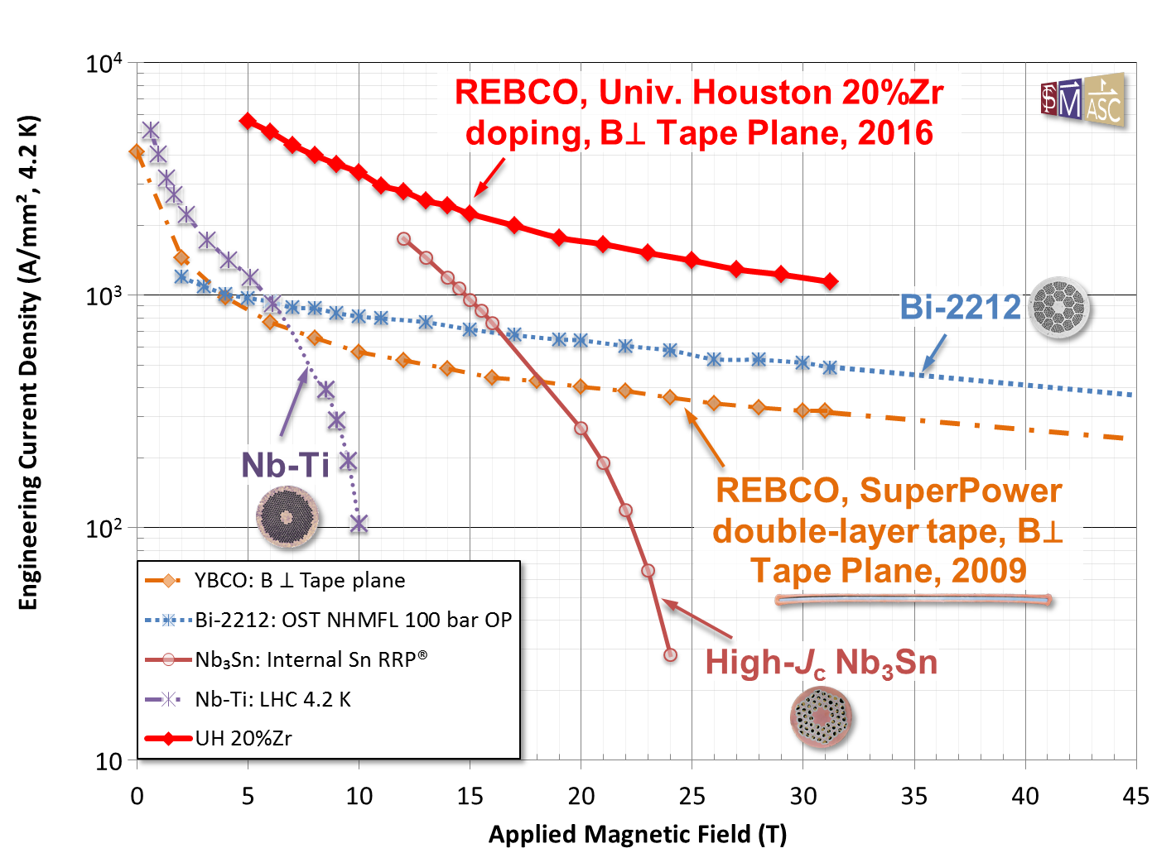
Exciting advances in HTS properties, but cost remains a major hurdle
P. Lee, ASC/FSU
V. Selvamanickam, U. Houston

Slide 26
The Program is guided by Driving Questions… related to performance
What is the nature of accelerator magnet training? Can we reduce or eliminate it?
What are the drivers and required operation margin for Nb₃Sn and HTS accelerator magnets?
What are the mechanical limits and possible stress management approaches for Nb₃Sn and 20 T LTS/HTS magnets?
What are the limitations on means to safely protect Nb₃Sn and HTS magnets?

Slide 27
The Program is guided by Driving Questions…related to cost
Can we provide accelerator quality Nb₃Sn magnets in the range of 16 T?
Is operation at 16 T economically justified? What is the optimal operational field for Nb₃Sn dipoles?
What is the optimal operating temperature for Nb₃Sn and HTS magnets?
Can we build practical and affordable accelerator magnets with HTS conductor(s)?
Are there innovative approaches to magnet design that address the key cost drivers for Nb₃Sn and HTS magnets that will shift the cost optimum to higher fields?

Slide 28
The Program is guided by Driving Questions… related to conductor development
What are the near and long-term goals for Nb₃Sn and HTS conductor development? What performance parameters in Nb₃Sn and HTS conductors are most critical for high field accelerator magnets?

