Slide 1
DOE HEP Portfolio Review
High Energy Physics Advisory Panel Meeting November 2017
Glen Crawford Director of Research and Technology Division Office of High Energy Physics Office of Science, U.S. Department of Energy

Slide 2
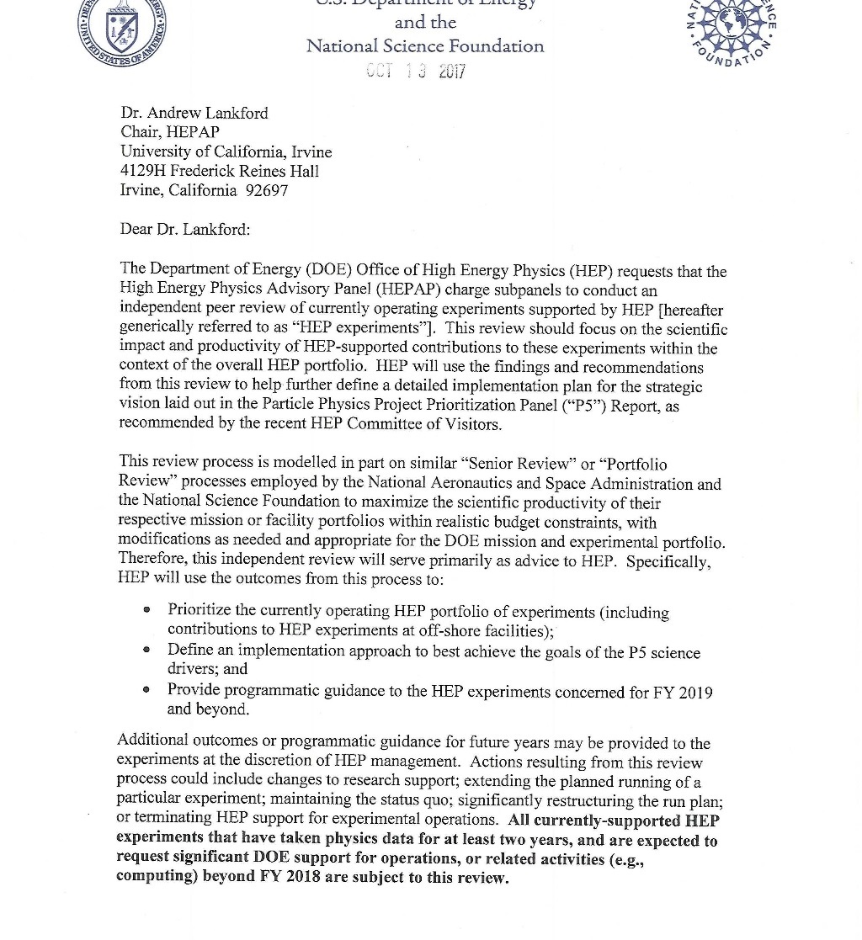
HEP Portfolio Review
DOE and NSF issued charge to HEPAP Oct 13
Copy of the Charge is available on the HEPAP website
Requests two subpanels to review currently operating experiments
Like all HEPAP charges, the charge letter is joint-agency, but reviews will only consider DOE- supported experiments

Slide 3
DOE HEP Portfolio Review
In this talk we cover general Frequently Asked Questions:
What is it?
Why are we doing this?
Why are we doing this *now*?
How are we doing this?
Why are we doing it *this way*?
What evaluation criteria will be used?
How will the results be used?
What is the timeline?
Etc.
Specific FAQ is available on the HEPAP website with the subpanel charge and supporting documents

Slide 4
DOE HEP Portfolio Review – What is it?
Independent peer review of currently operating experiments supported by DOE/HEP
Will focus on scientific impact and productivity of HEP-supported contributions
All currently-supported HEP experiments that have taken physics data for at least two years, and are expected to request significant DOE support for operations, or related activities (e.g., computing) beyond FY 2018 are subject to this review
Experiments that have not yet taken physics data (e.g. Muon g-2, Belle II) are exempt
Experiments completing DOE-supported operations in FY2018 with modest future support (e.g. EXO-200, BES-III) are exempt
This encompasses 13 experiments on Intensity or Cosmic Frontiers plus the two large LHC experiments ATLAS and CMS

Slide 5
DOE HEP Portfolio Review – Why?
During development of the FY2018 President’s Request it was realized that if the budget was enacted as requested, it would require significant reductions to current HEP operating experiments and associated research, in order to preserve P5 projects at a much lower budget level than P5 envisioned.
Note that the then-current portfolio of operating HEP experiments was not directly addressed in the 2014 P5 report, but they did anticipate this issue:
“Increasing the project fraction will necessarily entail judicious reductions in the fractions of the budget invested in the research program and operations”
Specific scenarios were not spelled out in the FY2018 Request, but it was clear that major changes would require HEPAP input on science priorities
The House and Senate Marks for FY 2018 are much more favorable but will still require some fine-tuning of the current DOE HEP experiment portfolio to meet budget bottom-line.

Slide 6
DOE HEP Portfolio Review – Why Now?
If FY18 Appropriation ~ FY18 Request: actions will need to be taken immediately.
If FY18 Appropriation ~ House, Senate Mark: actions will need to be taken or initiated by the end of FY18
Also, there was an explicit recommendation of 2016 HEP COV:
Work closely with the Laboratories and with Project Management and Program Management teams to develop a comprehensive strategic plan, consistent with P5 guidance, that anticipates the needs for future operating funds
Although this recommendation was primarily targeted at the future P5-recommended portfolio, we are taking the opportunity to develop a process that can evaluate ongoing HEP experiments in the broader P5 context
Currently operating HEP experiments have not had their science impact or performance evaluated in a consistent or comparative fashion

Slide 7
DOE HEP Portfolio Review – How?
We have requested a comparative, peer review process that will evaluate the science impact and productivity of currently operating HEP experiments for the near future:
Specific period covered by review is FY2019-22
Experiments to be reviewed are: AMS, ATLAS, CMS, Daya Bay, DES, eBOSS, Fermi/GLAST, HAWC, K0TO, MicroBooNE, Minerva, NA61/SHINE, NOvA, SuperK, T2K
LHC experiments get “special” treatment (more on this later)
Other experiments all evaluated together in one subpanel – obviously a broad range of science, scale, maturity
Subpanel reports will go to HEPAP for final review, amendment (if needed) and approval

Slide 8
DOE HEP Portfolio Review – Why like this?
Modelled on similar “Senior Review” or “Portfolio Review” processes at NASA and NSF Astronomy
Differences in detail, but these agencies also have to manage ongoing, diverse portfolios of science missions/experiments within budget constraints
Decided early on that we needed some reasonable thresholds for what was subject to review:
Don’t review experiments that have not yet taken significant physics data
Don’t review experiments that are essentially completed or close to completion
Don’t review experiments that are requesting very modest resources for the near future
Operations of many experiments has separate dedicated reviews, do not need to rehash those exercises. Assume operations per se are efficient and effective.
Proposal requirements and evaluation criteria should be the same across experiments
However, the scale and priority difference of the LHC experiments requires some customization of process (see following slides)

Slide 9
DOE HEP Portfolio Review – Why like this (more)?
Overarching goal is to maintain and optimally execute the P5 plan
For non-LHC experiments, a primary consideration should be “how well are these experiments advancing the P5 plan”?
This is one of three review criteria spelled out in the Charge
The LHC program (including HL-LHC) was the highest-priority near-term project in the P5 plan and we do not intend to abandon the US commitment to LHC
We take pains to point this out in the Charge
Note that the LHC subpanel is not asked for Recommendations, only Findings
We do not need to review further the impact of LHC on the P5 drivers, so that evaluation criteria is dropped for LHC experiments

Slide 10
DOE HEP Portfolio Review Subpanels
Review includes two subpanels, each with specific review criteria to consider
Main subpanel will assess the scientific merits and impact of DOE-supported contributions to the following operating experiments (in alphabetical order):
AMS, Daya Bay, DES, eBOSS, Fermi/GLAST, HAWC, KOTO, MicroBooNE, Minerva, NA61/SHINE, NOvA, SuperK, T2K
LHC Detectors subpanel will assess the scientific merits and impact of DOE-supported contributions to the multipurpose LHC detectors ATLAS and CMS
ATLAS and CMS have been successfully operating since 2008
High-Luminosity LHC detector upgrades are in the advanced planning stages
DOE intends to support LHC operations and research through the HL-LHC era
U.S. contributions to LHC detector operations are regularly reviewed by the DOE and the NSF in a separate process
This subpanel will focus primarily on the efficiency and impact of DOE-supported contributions to ATLAS and CMS research efforts

Slide 11
DOE HEP Portfolio Review Process
Each experiment that is invited to the HEP Portfolio Review will submit a proposal outlining its primary science goals for the next four years and describing how its research program will benefit the HEP science drivers described in the P5 Report
Performance factors to be assessed will include:
Science merit and productivity (including training and mentoring of junior researchers)
Present and anticipated future impact on the P5 science drivers
Efficiency and impact of DOE-supported contributions to the research efforts
Operations budgets and schedule information will be requested from proposers but will not be an explicit review criteria
DOE will provide additional information about DOE responsibilities and budget scenarios to the review panels
Proposers have been asked to provide detailed resource needs (FTEs) but not budget profiles

Slide 12
Review Proposals and Evaluation
Detailed instructions have been provided to proponents on requirements for proposals and how they will be evaluated
See following slides. Full text available on HEPAP website
There is also a monitored email box for Q&A
Main Subpanel – Discuss the experiment’s potential for advancing P5 science drivers during the FY 2019 to FY 2022 timeframe
LHC Subpanel – LHC experiments are not being evaluated on the P5 criterion listed in the charge to HEPAP: Present and anticipated future impact on the P5 science drivers
However, many of the instructions refer to the P5 drivers, and proposers may include expected P5 science impacts as part of their proposal narrative; Reviewers may consider this information as part of their assessment of the other review criteria
Proposals are due to the DOE Office of High Energy Physics no later than 5pm ET January 2, 2018

Slide 13
Instructions for Proposers
The proposal should address the following topics, which are closely related to, but not exactly the same as, the evaluation criteria:
Overall scientific merit, including that of the experiment itself, and its unique capabilities and relevance to the P5 science drivers as part of the overall HEP portfolio;
Promise of future science impact and productivity during this timeframe, including key science results expected, based on nominal experimental operations and demonstrated detector performance and capabilities;
Impact of past scientific results as evidenced by refereed publications, citations, etc.; and how these results relate to the projected precision of expected future science results;
Accessibility, usability, and utility of the data, both for the experiment itself and as a member of the broader HEP community, including working groups that combine and analyze data from multiple experiments; and quality and completeness of the data management plan including archiving and distribution;
Productivity and vitality of the science team, including continuity and expertise in the operation, calibration, and validation of instrumental data; scientific research productivity; and mentoring and training of younger scientists.

Slide 14
Proposal Guidance
Proposals shall contain the following sections:
Science Goals and Science Implementation Plan (up to 25 pages)
Brief summary of key science accomplishments to-date
Top science or technology goals (up to 5) for the next 4 years
Detailed description of the resources and capabilities needed
Summary of other important science results expected in the next 4 years
Technical Information (up to 5 pages)
Brief discussion of current overall technical status of the experiment
Experiment run plan for FY2019 – FY 2022
Description of any upgrades for the next 4 years, including relevant technology R&D
List specific U.S. responsibilities for experiment operations or upgrades
Data Management Plan (following standard DOE/SC requirements)
Appendices
Total DOE-supported FTEs for (i) Operations, (ii) Physics Analysis, and (iii) Upgrades
Effort Spreadsheets that support the detailed implementation described in 1©
Acronym List
Bibliography

Slide 15
HEP Portfolio Review Evaluation Criteria I
Science Merit and Productivity (including training and mentoring of junior researchers)
What is the scientific scope and impact of the top research and technology goals?
How might the results of the proposed work impact the direction, progress, and thinking in relevant scientific fields of research?
What is the likelihood of achieving valuable results?
How does the merit of the proposed research, both in terms of scientific and/or technical merit and originality, compare with other efforts within the same research area for the overall HEP field?
How productive has the experiment been in terms of science or technology results?
How effective has the experiment been in terms of training and mentoring students and junior researchers?
Will the proposed research plan deliver significant productivity in terms of science/technology results and student training?

Slide 16
HEP Portfolio Review Evaluation Criteria II
Present and Anticipated Future Impact on the P5 Science Drivers [Main Subpanel only]
How have recent results from this experiment contributed to one or more of the P5 science drivers?
How do the proposed research/R&D goals of this experiment contribute to the P5 science drivers ?
How significant are the current or anticipated science and technology results of this experiment in the context of the P5 plan?
What are the unique contributions of this experiment to advancing the P5 science drivers?
What are the key competitive advantages of this experiment relative to other experiments with similar research goals?
Does the scope of the full proposed program provide important additional benefits to implementing the P5 plan beyond the top research and technology goals?
How likely is the proposed research to impact the future direction of the overall HEP program?

Slide 17
HEP Portfolio Review Evaluation Criteria III
Efficiency and Impact of DOE-supported contributions to the physics analysis efforts
Are the proposed staffing levels well-matched to the proposed work, for each of the top science and technology goals?
Is the balance of effort by job type (e.g., faculty/staff, postdocs, graduate students) appropriate and well-matched to the proposed work, for each of the top science and technology goals?
Does the proposed work take advantage of unique or leading facilities, personnel and capabilities at DOE-supported institutions?
Are DOE-supported groups efficiently deployed to maximize their impact on the physics analysis effort?
Do the DOE-supported groups have appropriate leadership roles in the physics analysis effort?
Do the DOE-supported groups have critical impacts on the top science and technology goals?

Slide 18
Portfolio Review Process Outcomes
HEP will use outcomes to:
Prioritize the currently operating HEP portfolio of experiments (including contributions to HEP experiments at off-shore facilities)
Define an implementation approach to best achieve the goals of the P5 science drivers
Provide programmatic guidance to the HEP experiments concerned for FY 2019 and beyond
Additional outcomes or programmatic guidance for future years may be provided to the experiments
Actions resulting from this review process could include:
Changes to research support
Extending the planned running of a particular experiment
Maintaining the status quo
Significantly restructuring the run plan
Terminating HEP support for experimental operations

Slide 19
Communicating Outcomes
After HEPAP makes its recommendations, DOE/HEP will contact each of the experiments and communicate guidance resulting from the HEP Portfolio Review.
This direction may include new budget guidelines and other specific instructions resulting from the Portfolio Review process, possibly including notices of intent to terminate DOE involvement.
DOE/HEP will also post the HEPAP subpanel reports and its response to the HEPAP website.
Each of the experiments will submit back to DOE/HEP their plan for complying with the new guidance and instructions.
HEP management will ensure that key officials in institutions or agencies that are partners in operating experiments are apprised of DOE’s decisions resulting from the HEP Portfolio Review.

Slide 20
Portfolio Review DRAFT Timeline
Item | Due Date
Charge Issued | Oct 13 2017
Call for Proposals Issued | Nov 7 2017
Proposals Due | Jan 2 2018
Panels Meet | Jan/Feb 2018
Report Writing | Mar 2018
Report delivered to HEPAP | Apr 2018

Slide 21
Concluding Remarks
Given the current budget outlook, we think it is imperative to take a close and critical look at currently operating HEP experiments and how effectively they are advancing the P5 plan
Portfolio Review is the process we have created to implement this
Overarching goal is to maintain and optimally execute the P5 plan
There is a very diverse set of experiments under review
Will require diverse and broad-minded panelists
We have crafted the evaluation criteria and proposal guidelines as uniform as possible to enable meaningful comparisons
We anticipate that this review process will allow DOE the ability to periodically rebalance its HEP experimental portfolio, and adapt as needed to different budget scenarios.
We feel the participation of HEPAP is critical in this important process and very much appreciate your assistance.

