Slide 1
Fermilab Brief Overview
Tim I. Meyer
HEPAP
30 November 2017

Slide 2
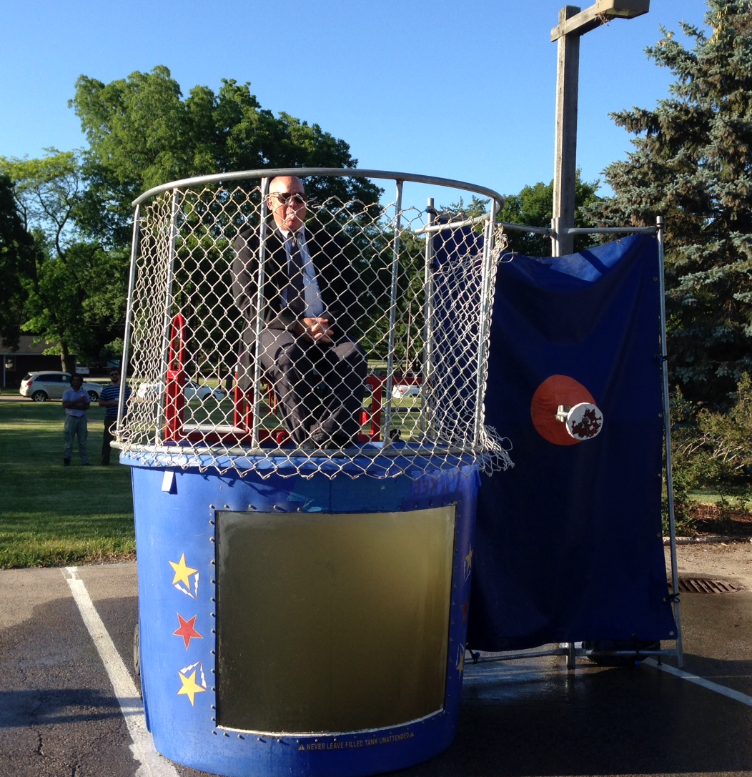
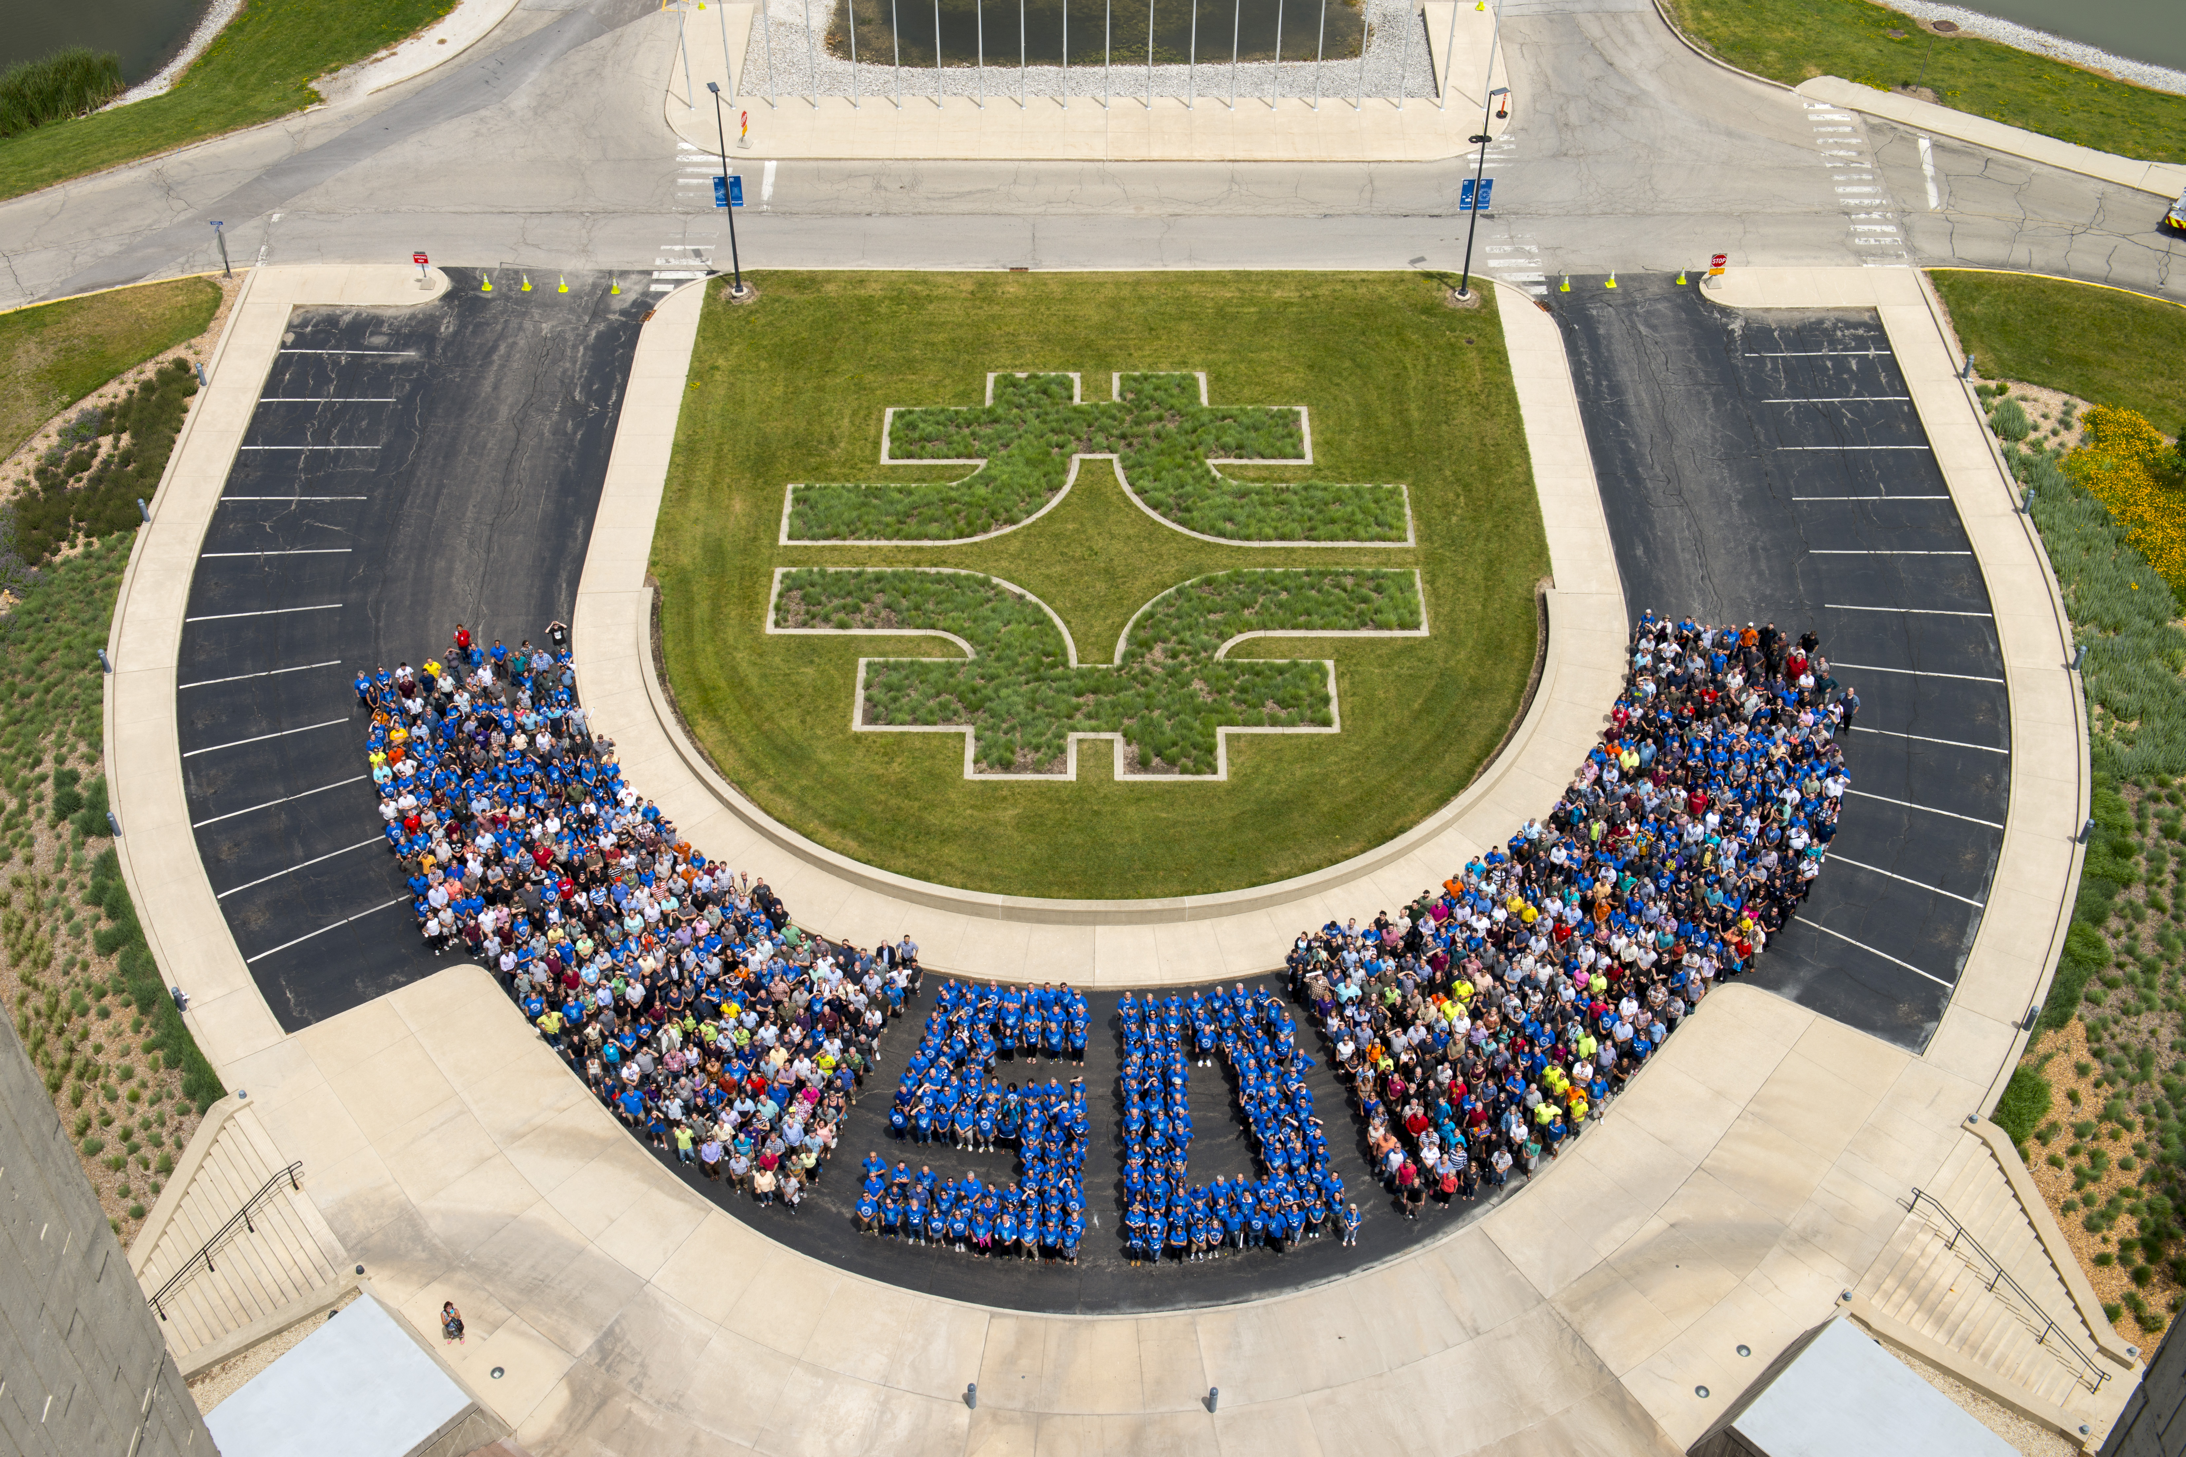
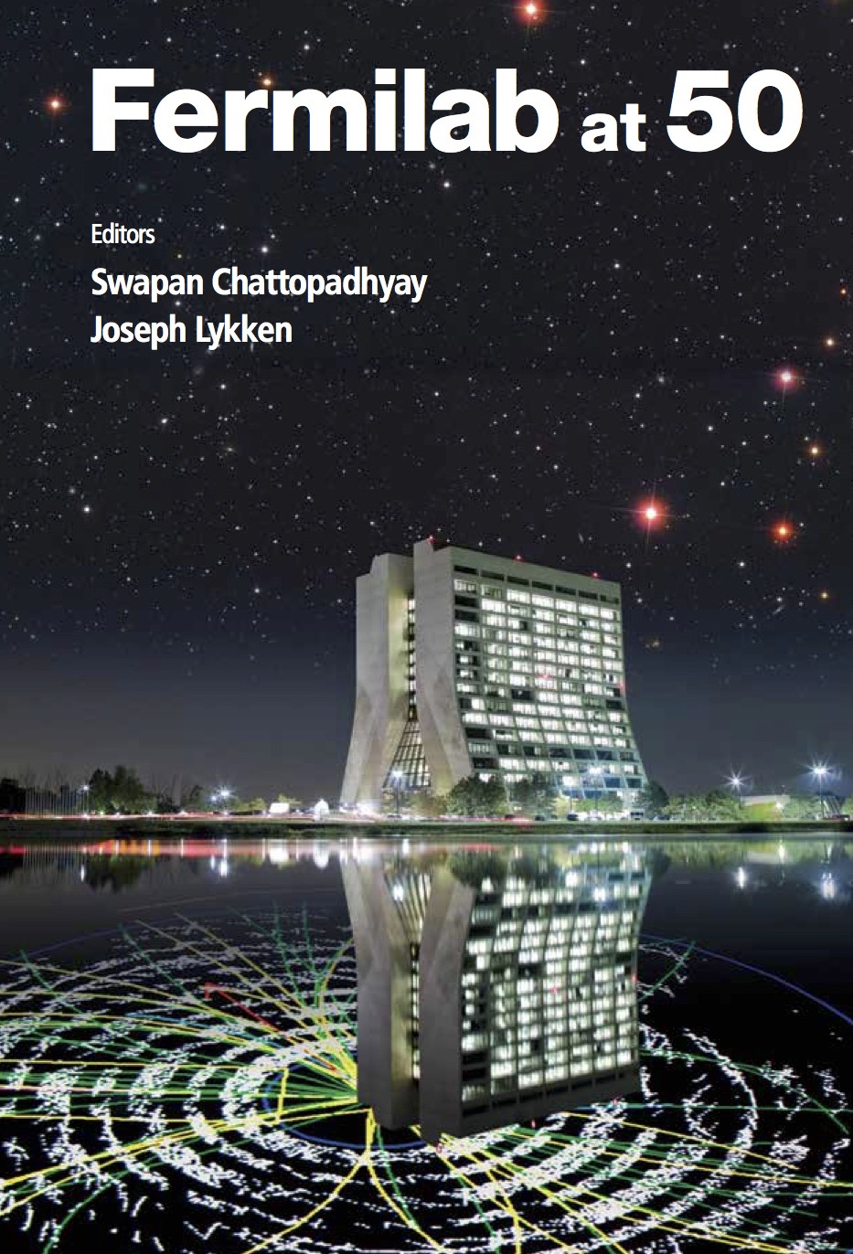
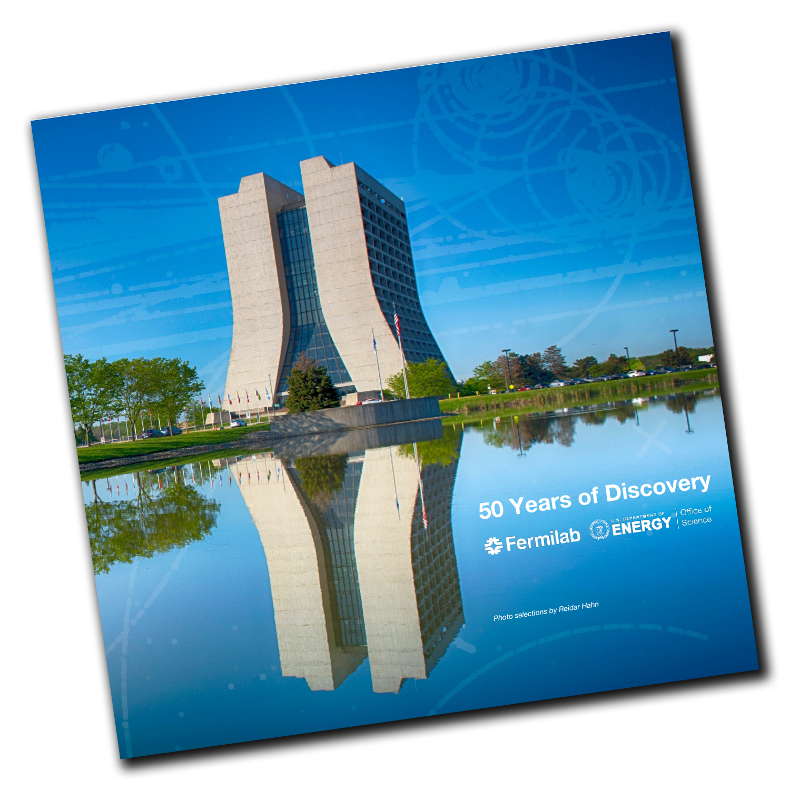
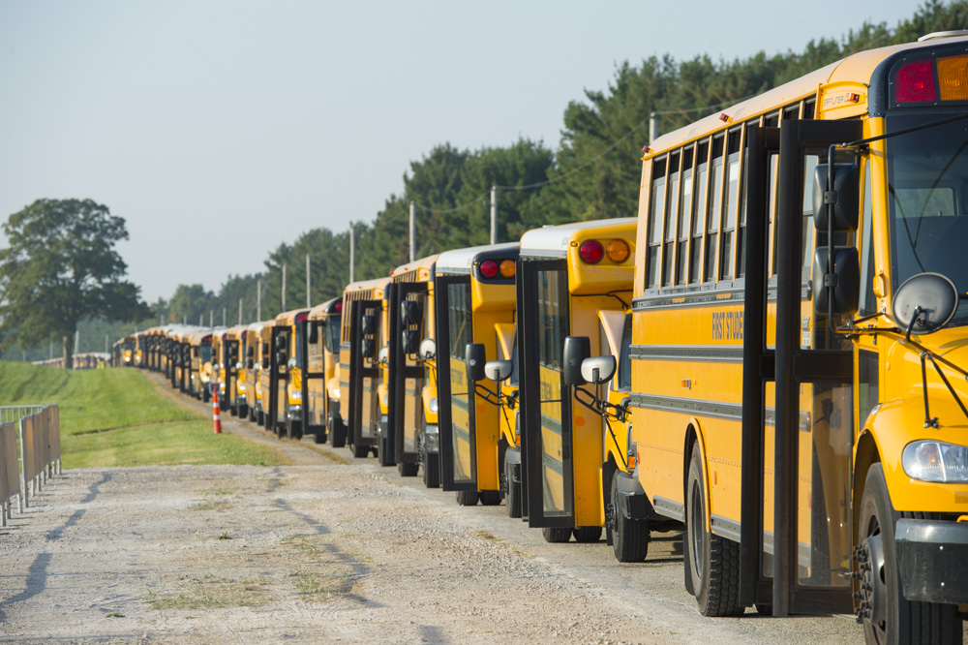
50 Years (1967 – 2017)

Slide 3
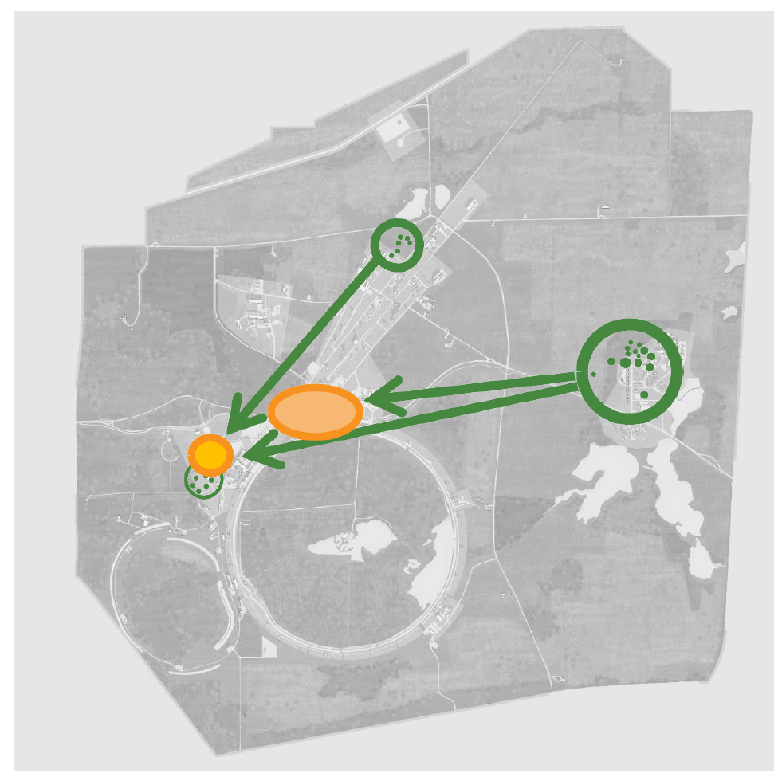
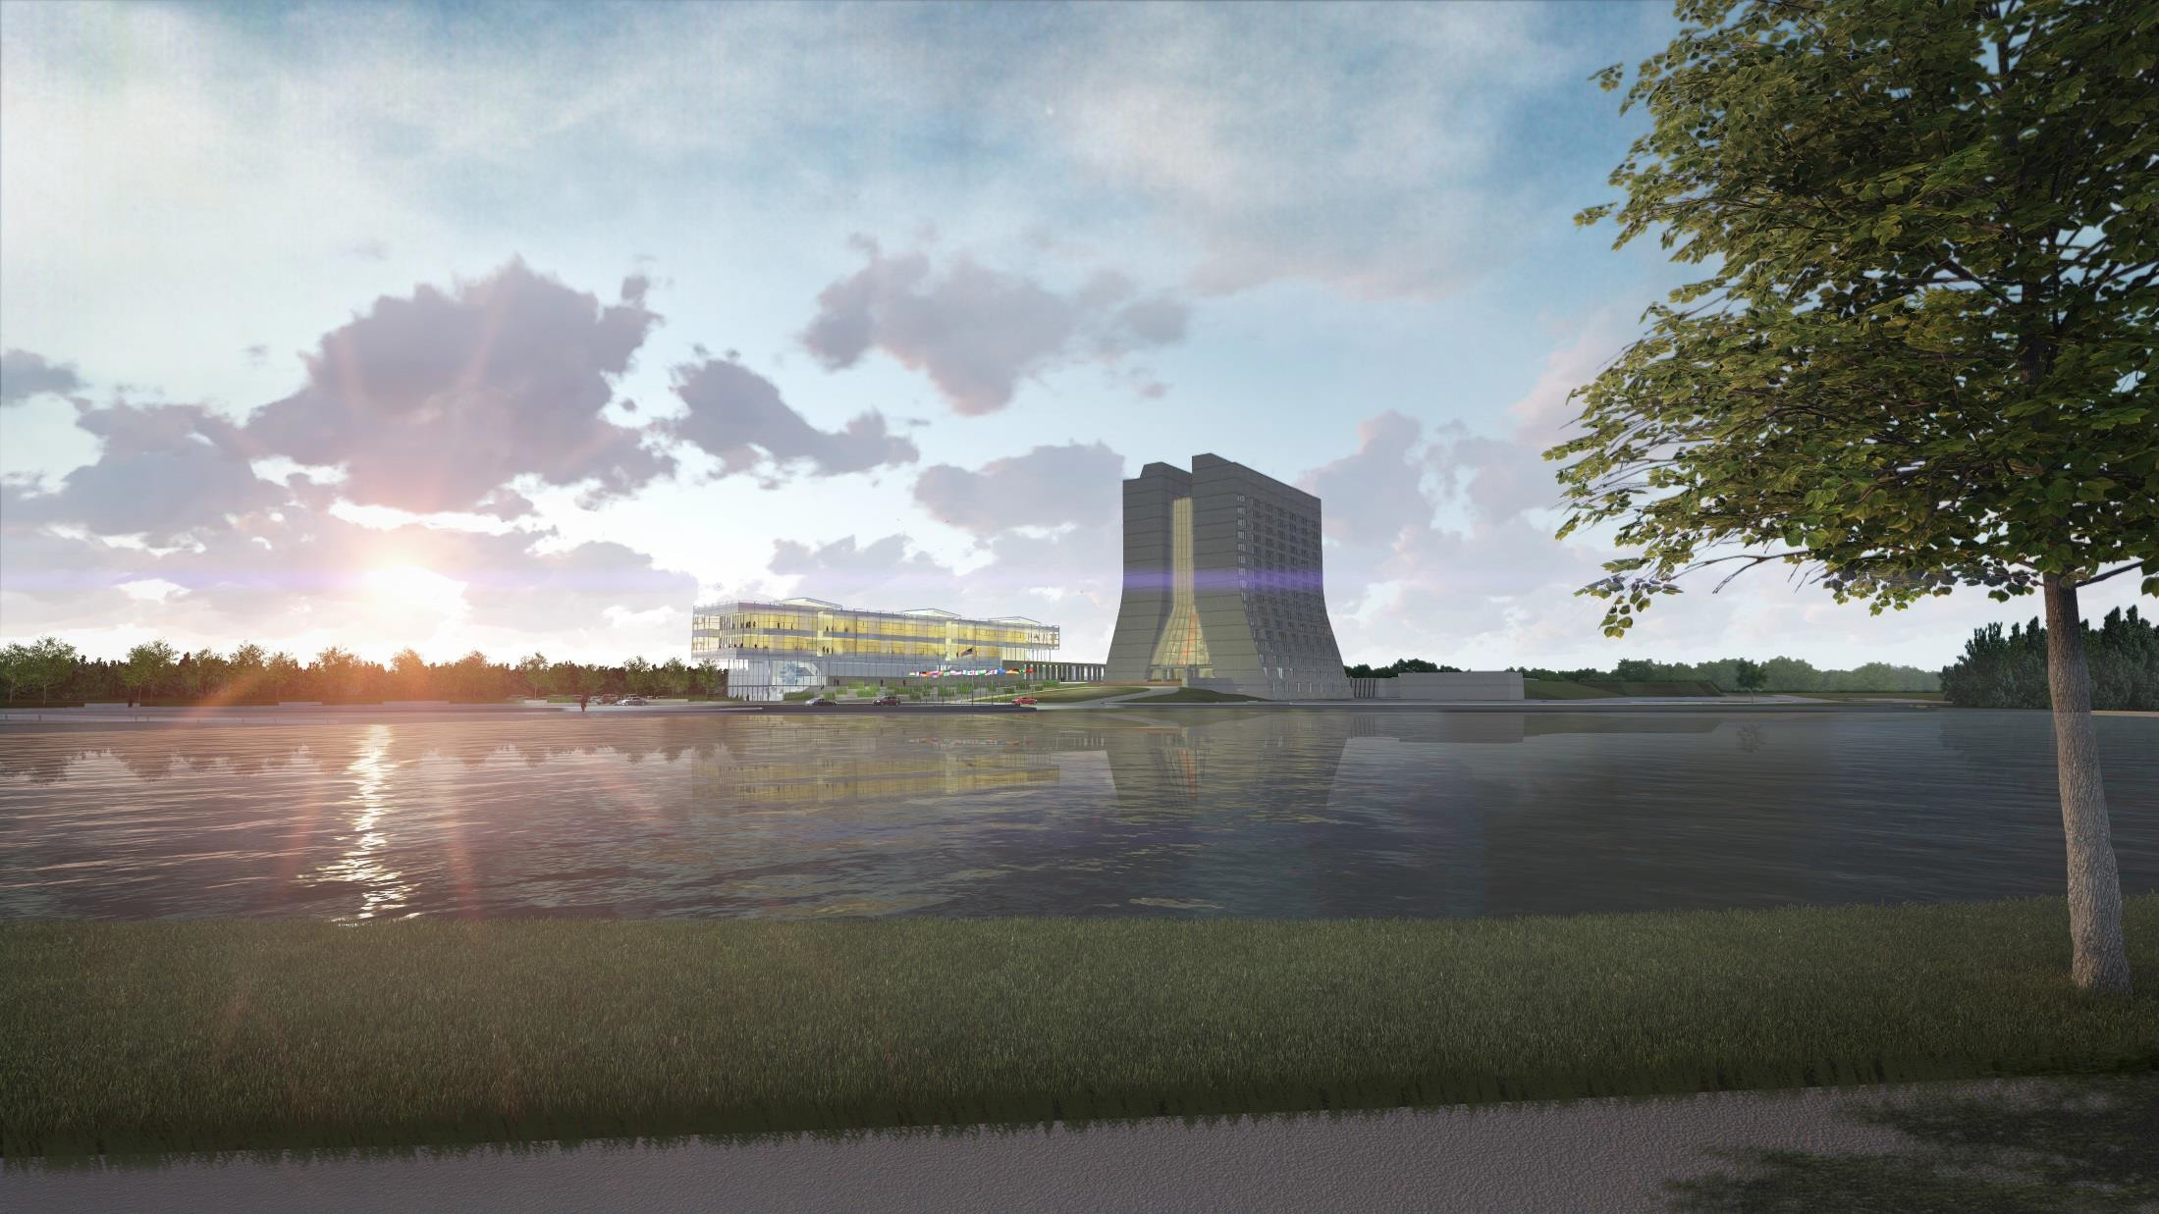
Next?
Before…
During…
After…
In response to forward thinking by SC, Fermilab has developed a Campus Master Plan that best positions the 6,800-acre campus to support our future science program
Theme of the present investment strategy is:
  “Consolidate, Centralize, Modernize” so that our community can “Eat, Sleep, and Work (safely) to Drive Discovery”
DOE-SLI funds for new Integrated Engineering Rsrch Ctr

Slide 4

Community plan for U.S. particle physics: P5
P5 was an NSF/DOE prioritization panel using input from a year-long U.S. community exercise with global coordination
Difficult choices were made; emphasis on the best opportunities for discoveries in fundamental science
Fermilab is successfully executing the P5 plan for HEP as laid out in the May 2014 P5 report. Two (interconnected) highest priorities:
  Fermilab hosts the world community at LBNF/DUNE for neutrino science
  Fermilab continues strong partnership with CERN on LHC

Slide 5


P5 science drivers
Higgs boson
Neutrinos
Dark matter, dark energy
➔ What the above have in common:
  Fundamental roles in the universe
  Intertwined
  Very difficult to study -> little is known about them
Exploring the unknown

Slide 6

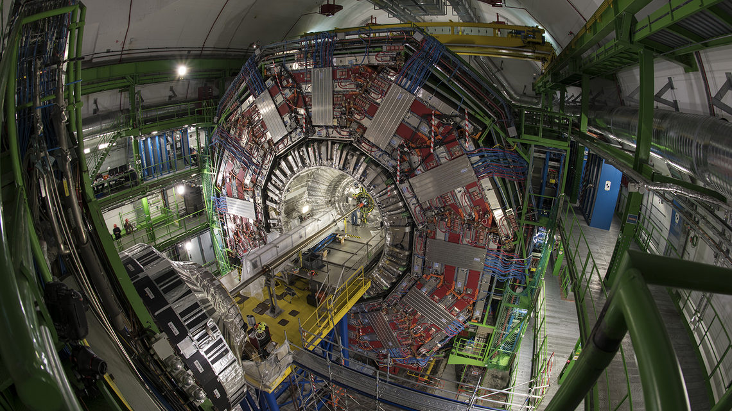
Higgs boson @ Fermilab
Higgs boson
  Discovered at CERN in 2012 by ATLAS and CMS collaborations
  Fermilab is U.S. host lab for CMS
  U.S. is by far the leading national contingent in CMS
  CMS spokesperson is Joel Butler of Fermilab
Fermilab’s unique expertise and facilities are essential for major upgrades to:
  The CMS detector
  CMS computing
  The LHC accelerator

Slide 7
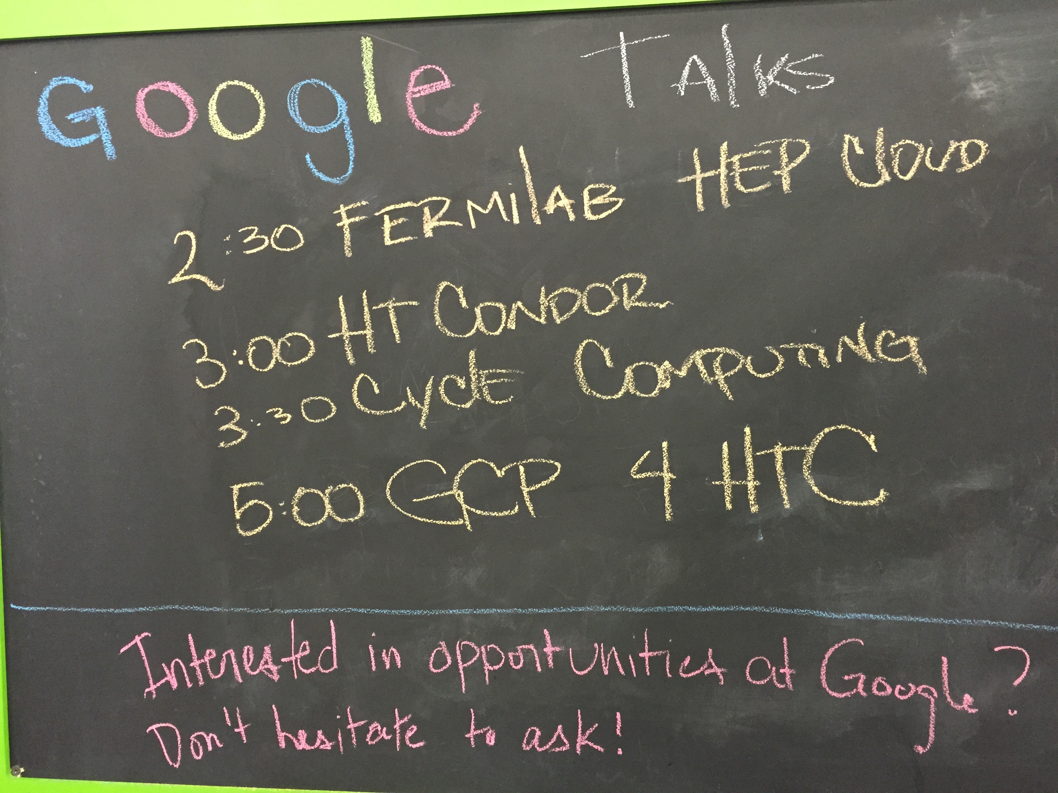
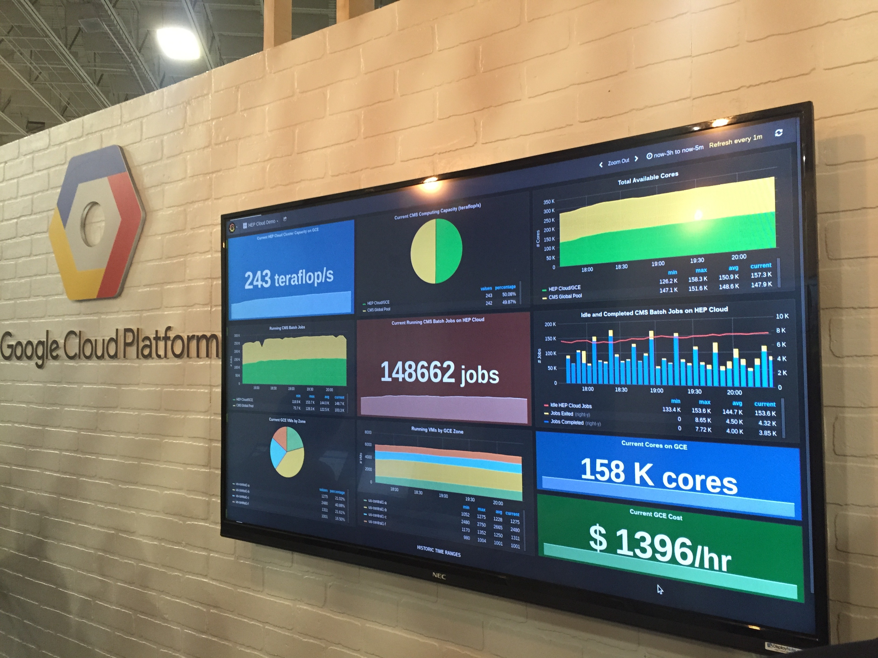
Higgs boson @ Fermilab @ Google
Need to grow our Big Data distributed computing capacity by a factor of 100 for LHC
Fermilab is creating a new system called HEPCloud, in collaboration with Google and Amazon

Slide 8

LHC AUP-CD-1 Baseline
MQXFAP1
Prototype CM
LARP
MQXFA02
AUP
MQXFA03
Both Magnet MQXFA03 and MQXFA04
are fully conforming with AUP FRS.
They are assembled in “Pre-Series CM”
Pre-series CM/
Potential Prod. CM#1
MQXFA04
CD-3b (and CD-2) - February ‘19
MQXFA05
Prod. CM#2
MQXFA06
By maintaining same assembly rate,
the opportunity offered by MQXFA03
can be capitalized in accelerating deliveries
to CERN. Usage of MQXFA03 increases schedule
float by ~2mo
MQXFA07
MQXFA08
…...
.....
MQXFA17
MQXFA18
Prod. CM#8
....

Slide 9
Fermilab Objectives achieved in 2017 in the Cosmic Frontier
Extract Cosmological constraints on Dark Energy
Complete the SPT-3G camera
Develop leadership in axion dark matter research and associated technologies (became lead lab for ADMX and LDRD awarded for future axion search technology)
Support G1 dark matter operations and improve on world-leading results
Support Dark Energy and G2 Dark Matter projects (DESI, Super CDMS, LZ)

Slide 10

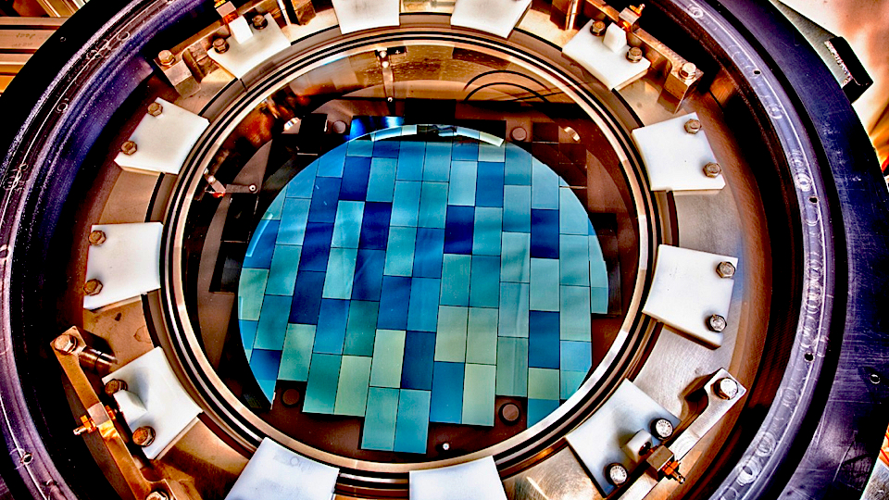
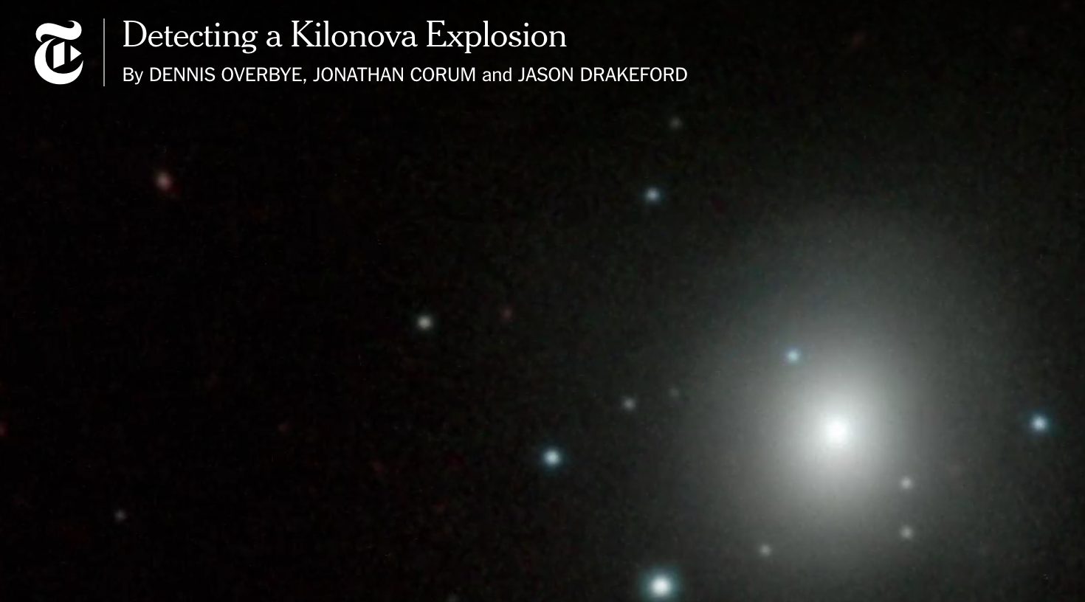
Dark Energy Survey
This year first ever observation of a “kilonova” explosion from a merger of two neutron stars, also detected by LIGO with gravity waves
More to come from imaging of 300 million galaxies

Slide 11
Cosmic Frontier: Building for the Future
Build framework for combining and cross correlating Optical and CMB data: first with SPT+ DES to build foundation for LSST and CMB-S4
Advance R&D for future optical and CMB surveys and technology for future dark matter experiments

Slide 12
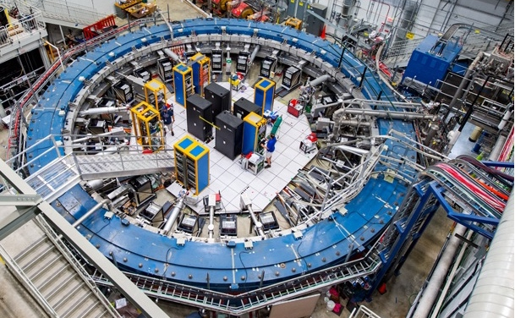
Muon g-2 commissioning…physics data hopefully January

Slide 13
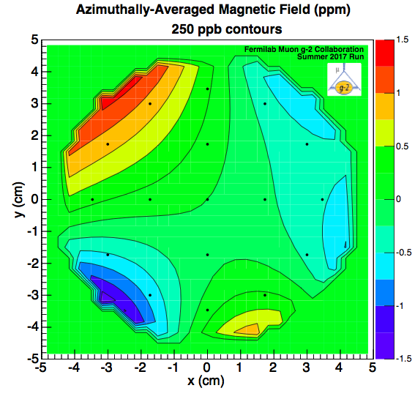
Data from 5-week FY17 engineering run
First FNAL g-2 wiggle plot
All subsystems commissioned
FY18 Challenge → Ramping up to physics production rates
  Beam transmission and injection efficiency x10
0.25 ppm
contours ~3x more uniform than BNL
45 mm
a_{μ} stat error 126 ppm in FY17 …ultimate goal 140 ppb!

Slide 14
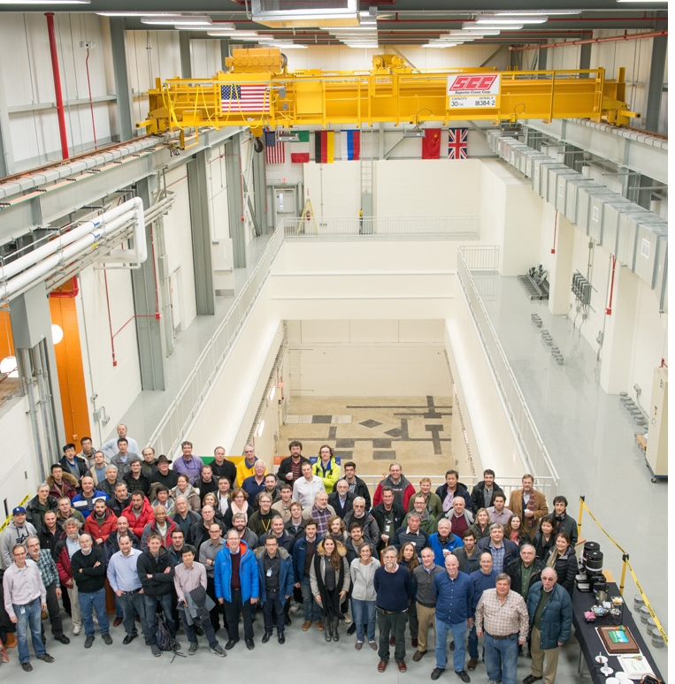
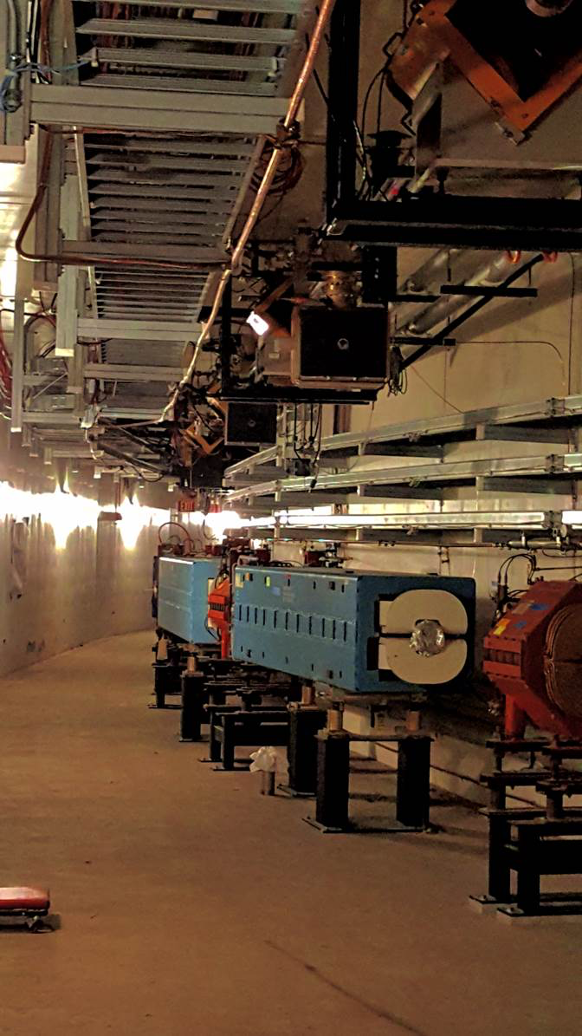
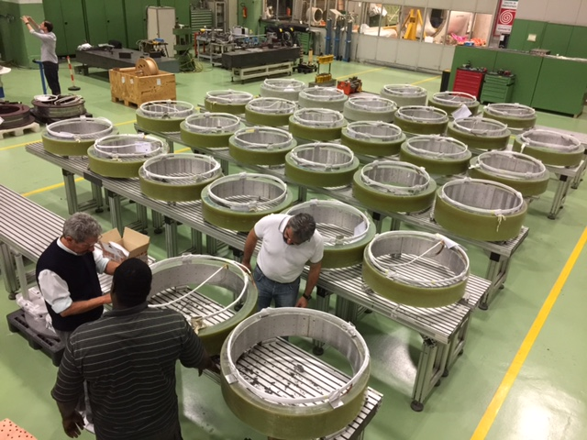
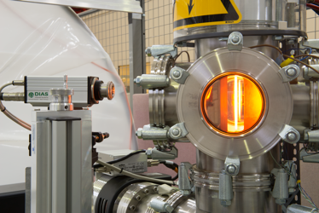
Mu2e – Good Progress on all Fronts
(For more info:
http://mu2e.fnal.gov)
Current status:
Full CD-3 approval in July 2016
  Project is 60% complete
All major procurements placed
New detector hall completed and transitioned to operations
  Installing infrastructure
Beamline magnets in position
Construction underway for all three solenoids (PS, TS, DS)
Detector preproduction prototypes constructed & tested
Mu2e Experimental Hall
Left bend magnets in Mu2e beamline
31/52 TS coils fabricated
Prototype Production Target

Slide 15
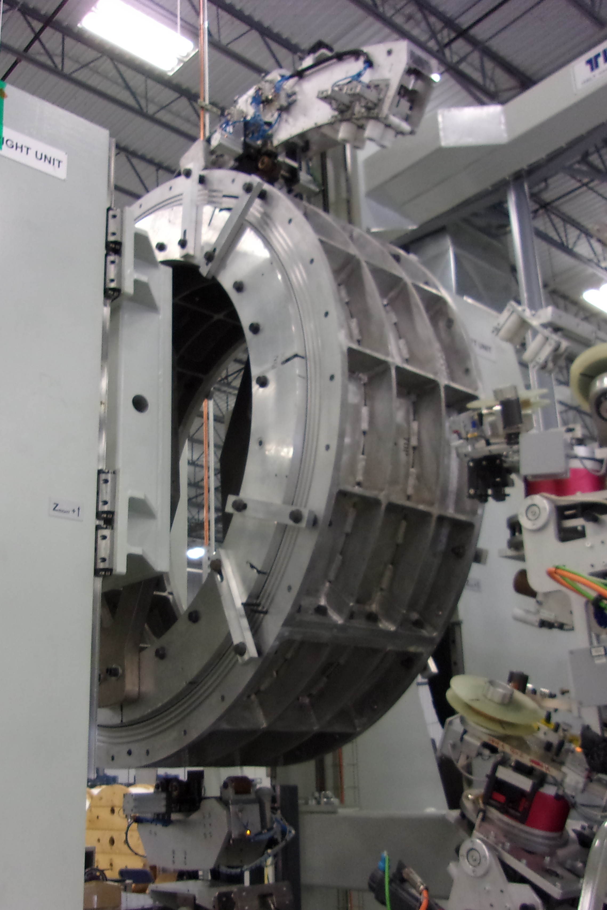
Production & Detector
Solenoid Status
Completed model coil winding
Model Coil w/
VPI Mold Outer Staves

Slide 16
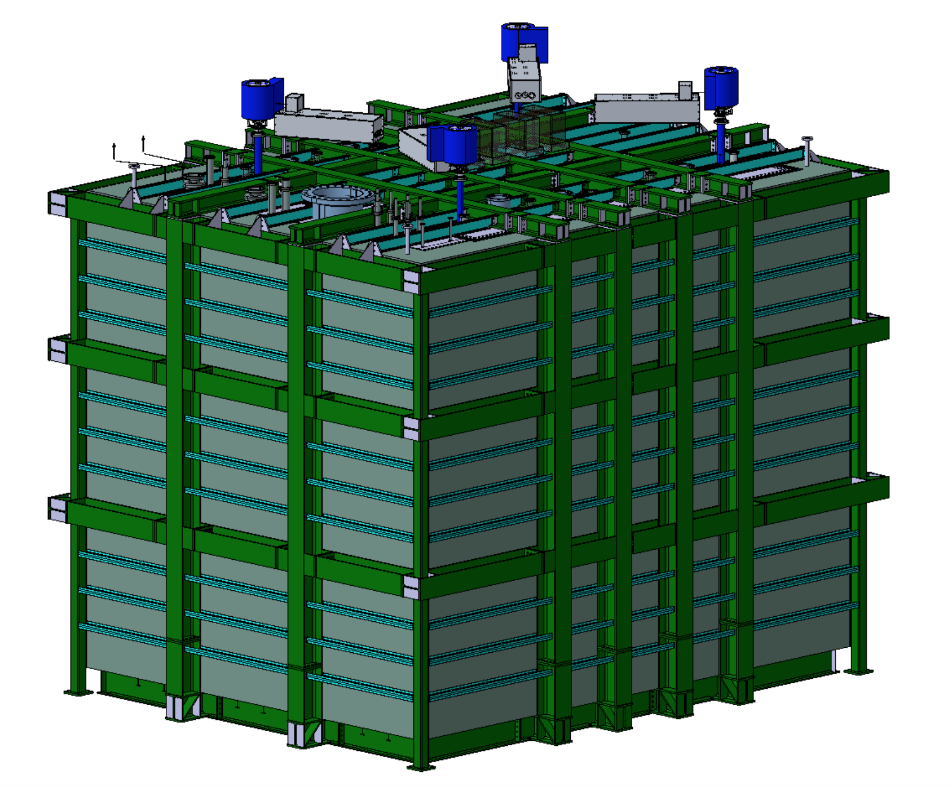
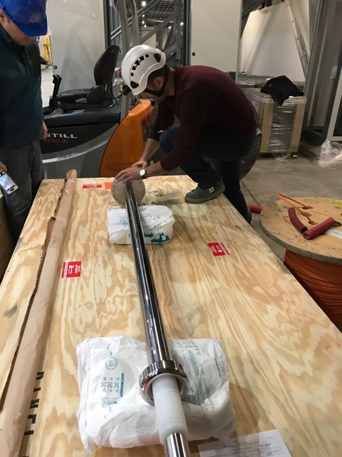
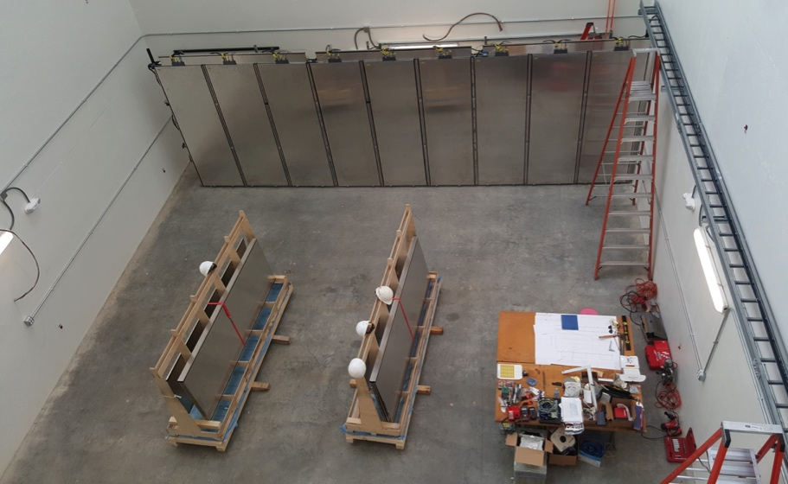
Short Baseline Near Detector (SBND)
Near detector building completed in early 2017
TPC components in fabrication:
  About to start anode plane wire winding (UK & US)
  Cathode plane nearly complete
  1st HV feedthrough delivered to Yale
TPC cold electronics prototyping near end:
  Same cold front-end ASIC as protoDUNE
  Plan to use commercial off the shelf ADC in LAr
  Very promising ADC lifetime study in LN2 near completion – decision January 2018
Cosmic ray tagger panels >50% complete
  Testing in the SBN ND building: see BNB ν interactions!
Cryostat and cryogenics starting final design
Upcoming milestones:
  Start TPC assembly at FNAL mid-2018
  Start cryostat assembly in late 2018
  Installation in 2019
SBND Cryostat
HV Feedthrough at Yale
Cosmic ray tagger testing in SBND Building

Slide 17
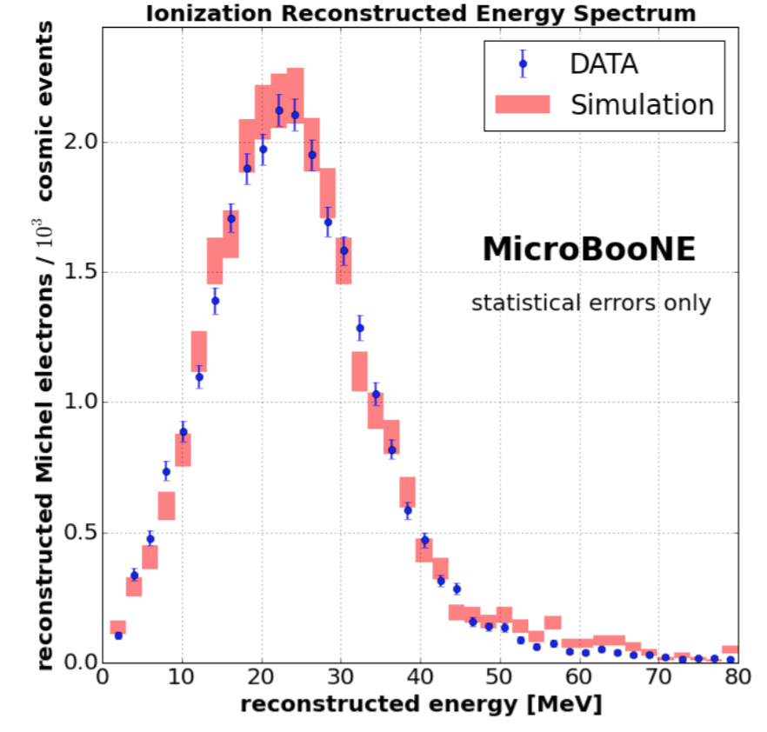
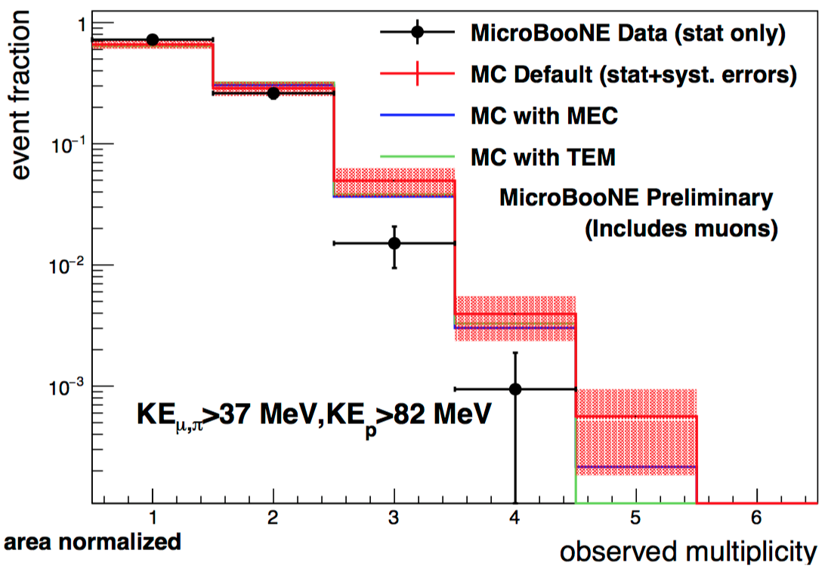
MicroBooNE
Michel electrons:
Detector & beamline are running well
MicroBooNE has developed many new techniques using data & is providing crucial input for SBN and DUNE
7 papers so far this year - more coming
)
19 public notes
ν_{μ} charged current interactions:

Slide 18
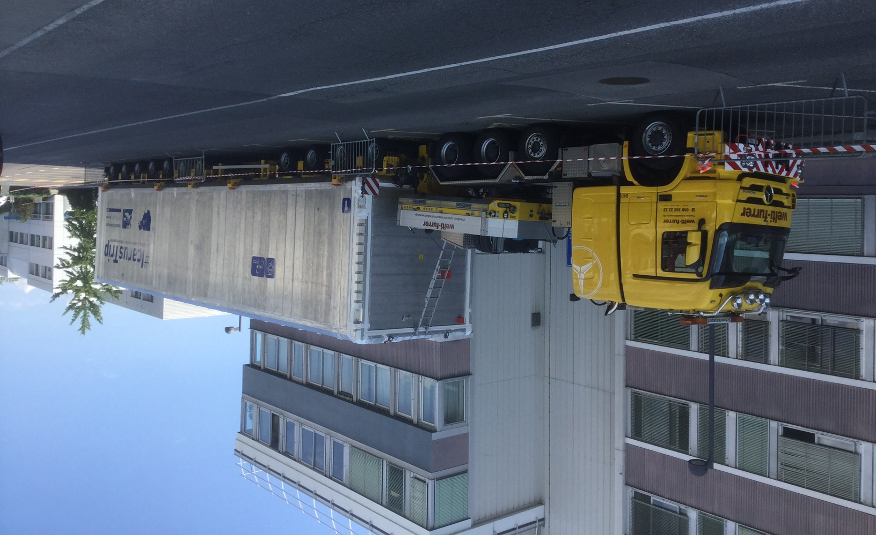
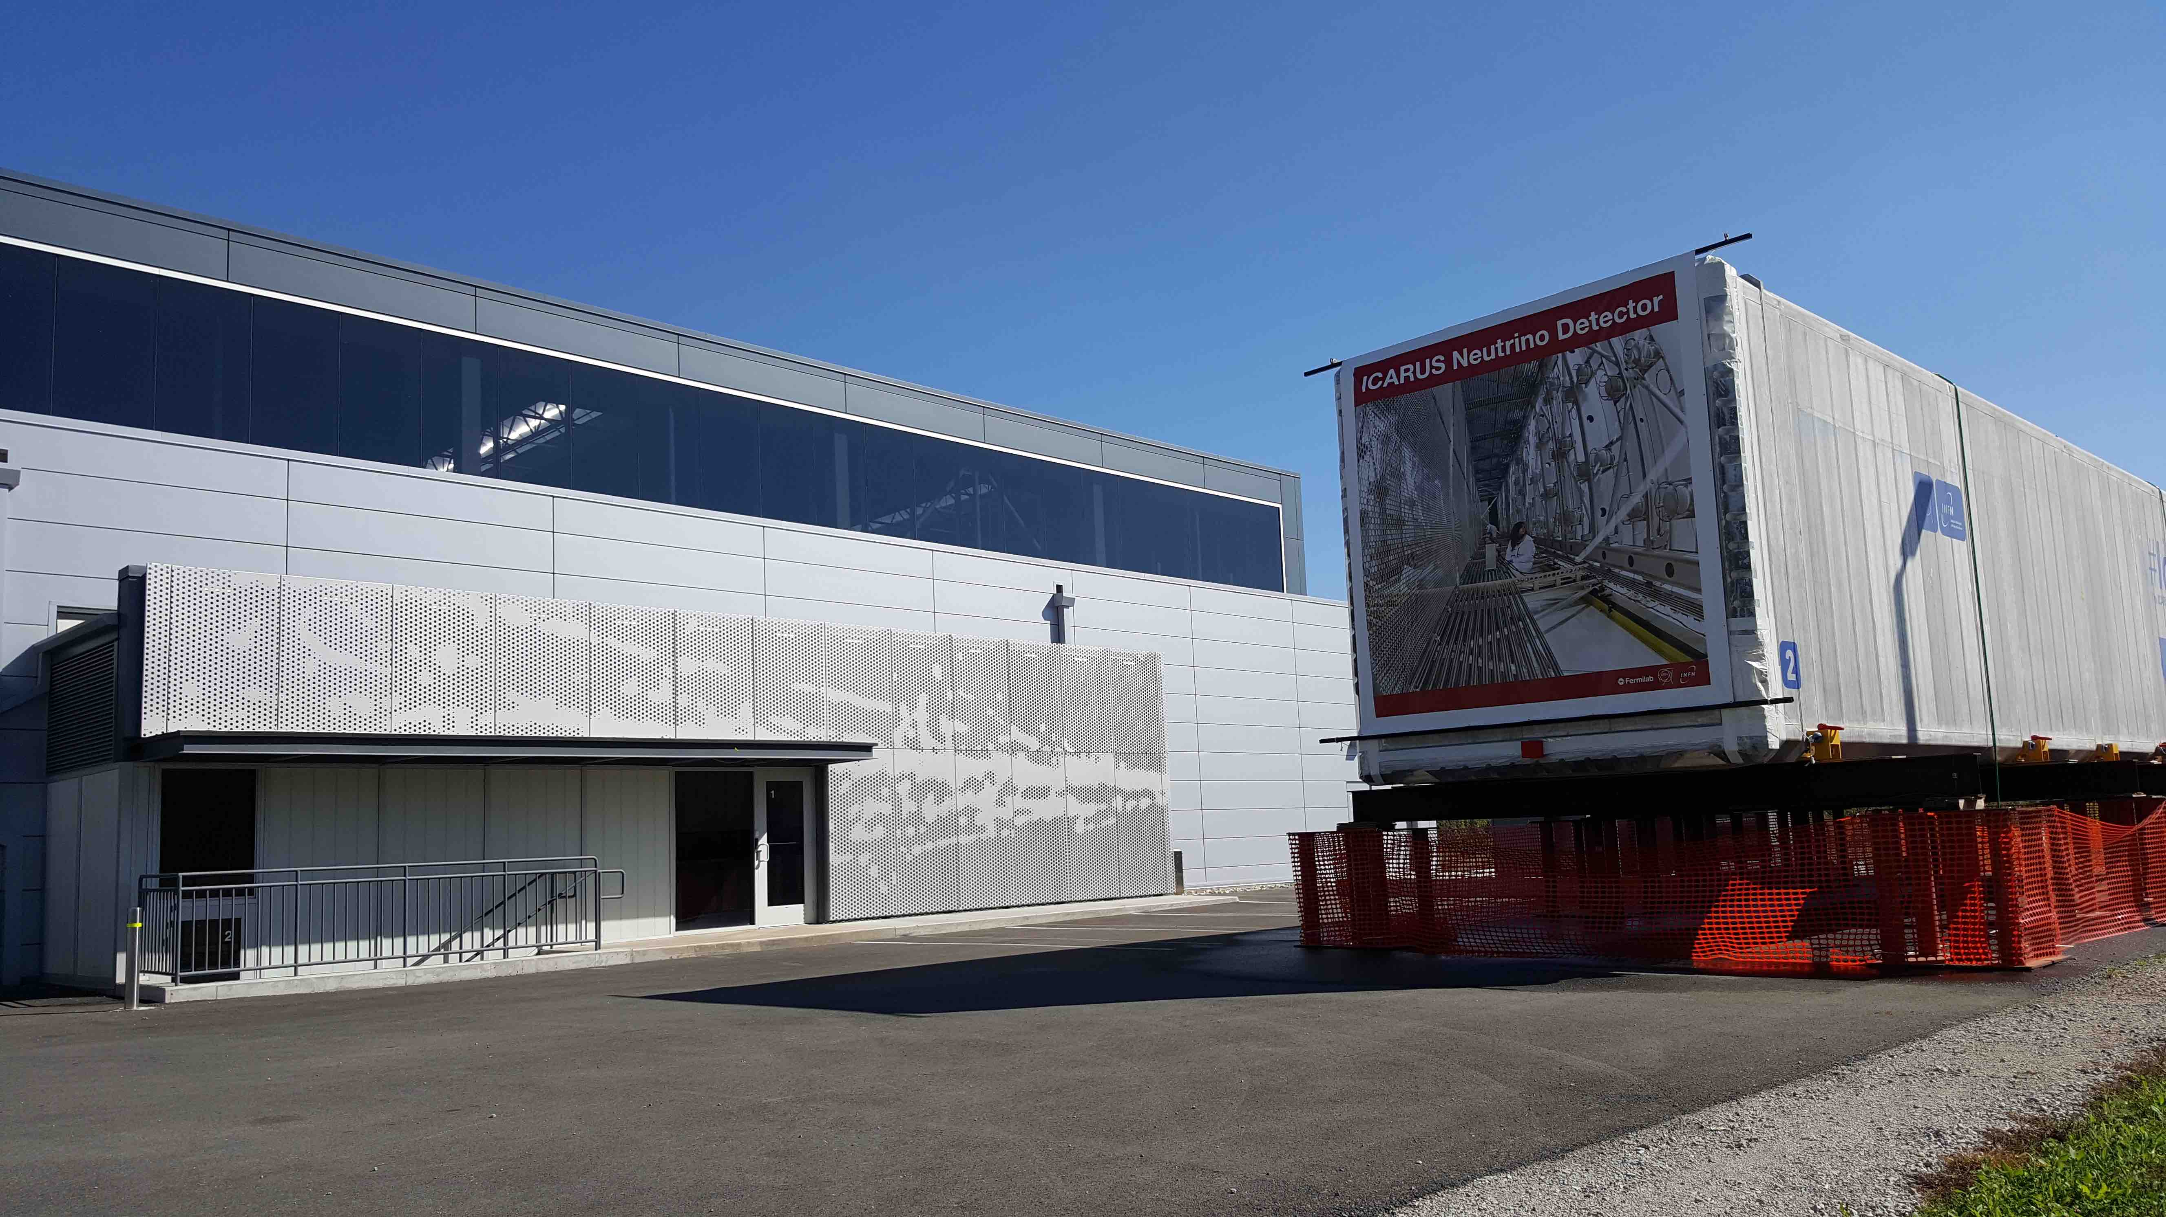
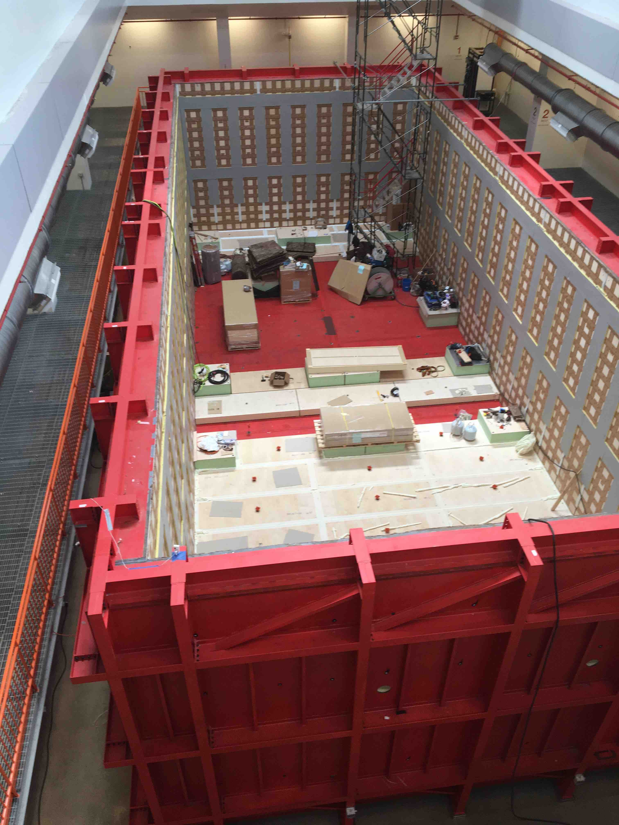
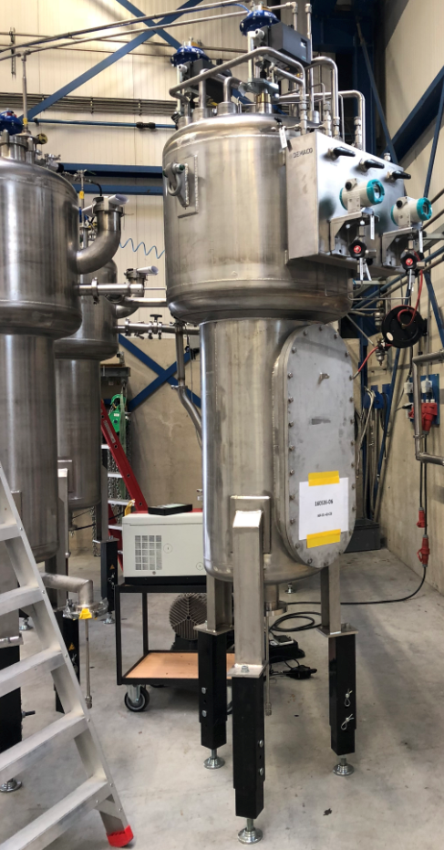
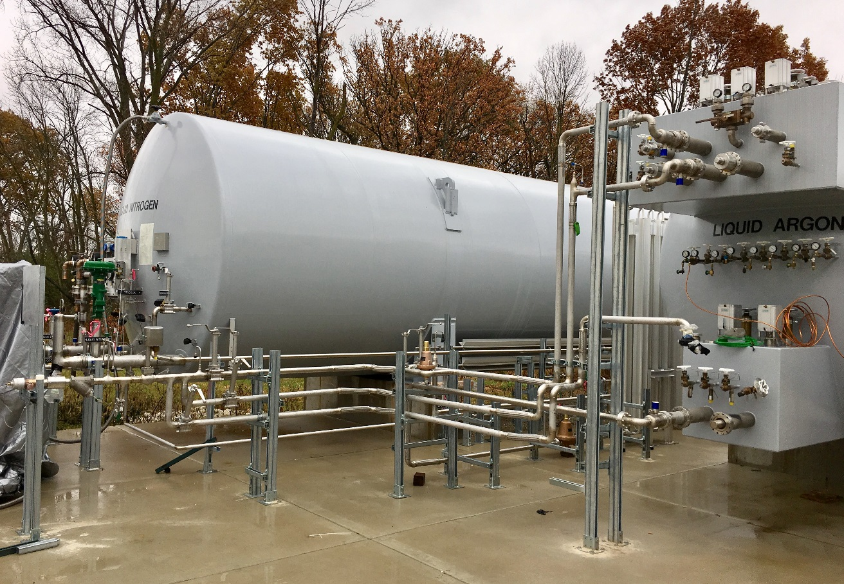
SBN: ICARUS at Fermilab
Far detector building completed in early 2017
ICARUS detector vessels successfully delivered to Fermilab in July.
  No damage to TPC or PMTs
“Warm” outer vessel installation completed
Cryogenics fabrication near completion in Europe (CERN deliverables) and US
Readout electronics fabrication in progress
Next steps for installation:
  Installation of LN2 cold shields (Feb 2018)
  Final preparation of vessels
  Rig vessels into the building (Mar 2018)
Complete installation and transition to commissioning in late CY 2018
SBN joint analysis group progressing on common tool framework
Vessel Ready to Leave CERN June 12
Vessel 2 parked west of SBN FD Building
Outer Warm Vessel
Cryogenic components @ Vendor in Holland
Piping to Dewars

Slide 19
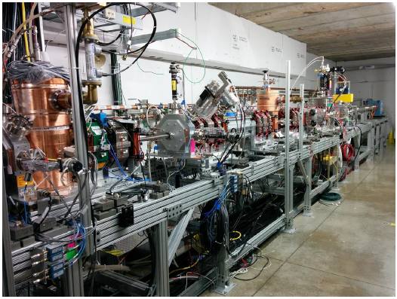
PIP-II: The accelerator driving LBNF/DUNE
Modern, 800-MeV superconducting linac
  Replace current, 47-year-old, linac
Responsive to the P5 plan
  Sustained U.S. leadership in accelerator-based neutrino physics
Goals:
  1.2 MW beams at startup of
  LBNF/DUNE
  Platform for eventual
  2+ MW
Status
  CD-0 November 2015
  CD-1 DOE Rvw Dec 12-14

Slide 20
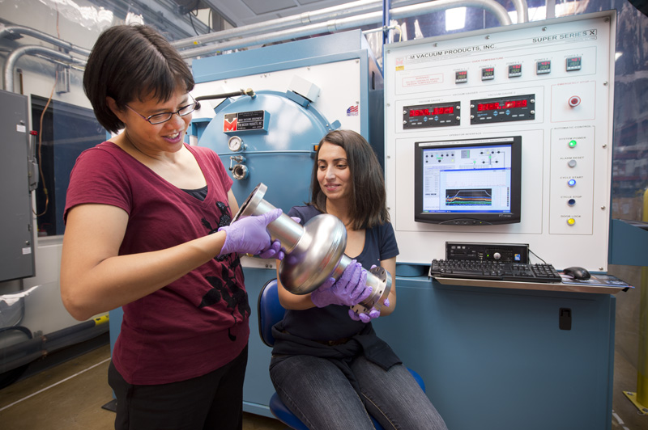
PIP-II: Driving Accelerator Technologies
Superconducting radio-frequency (SRF) technologies are the enabling technology of high-power accelerators
  SNS (ORNL)
  LCLS-II (SLAC, under construction)
Fermilab: world leader, based on investment over last decade
  Development of
  “high G/high Q₀” techniques
  Providing ~50% of LCLS-II
  acceleration modules
PIP-II will inherit the LCLS-II
workforce and infrastructure

Slide 21
PIP-II: International Partners
India/DAE
  Long-standing R&D collaboration with four DAE laboratories
    BARC, IUAC, RRCAT, VECC
  Engaged in nearly all major systems
  In-kind contributions authorized in formal agreements
Italy/INFN
  Draft agreement for construction stage under discussion
UK/STFC
  Oct 2017 announcement of significant contribution to LBNF/DUNE/PIP-II
  Construction phase deliverables under review by UK gov’t
France/CEA, IN2P3
  Technical discussions underway; agency discussions initiated

Slide 22
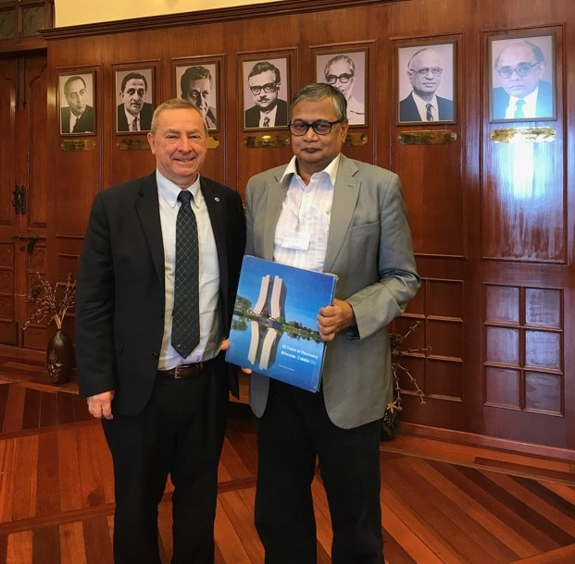
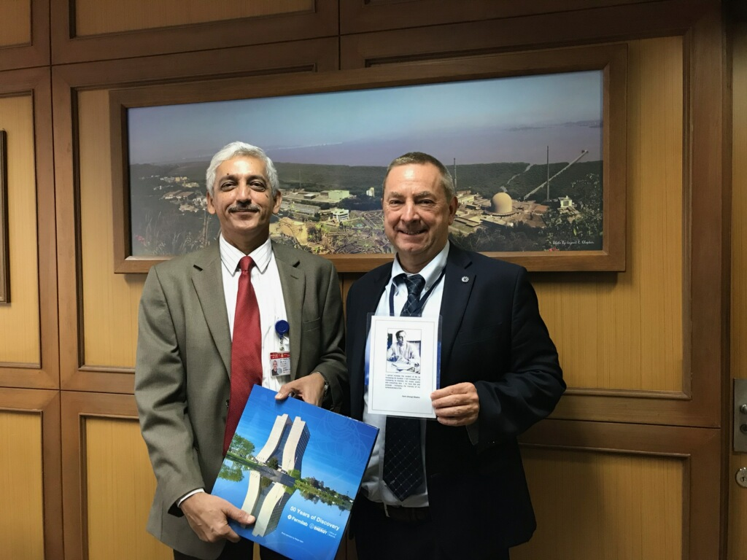
India : Dept Atomic Energy, Chairman Sekhar Basu,
& Bhabha Atomic Research Center, Director Vyas
Annex-I : Agreement for PIP-II, Accelerator projects
Annex-II: discussion ongoing– Neutrino program (anticipating signing the agreement in early 2018)

Slide 23
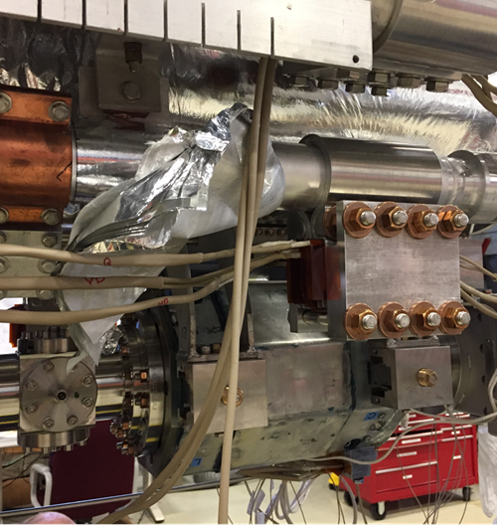
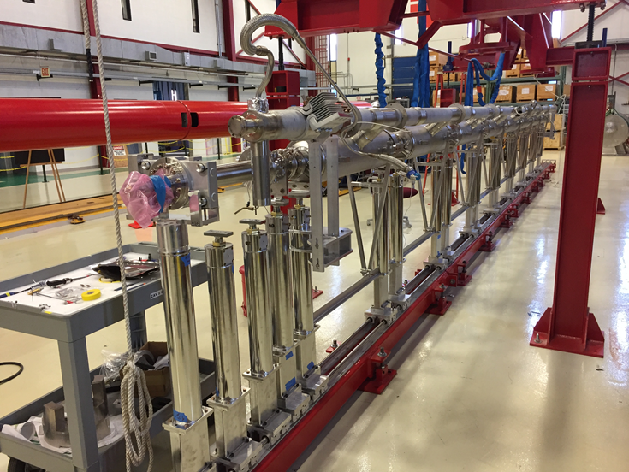
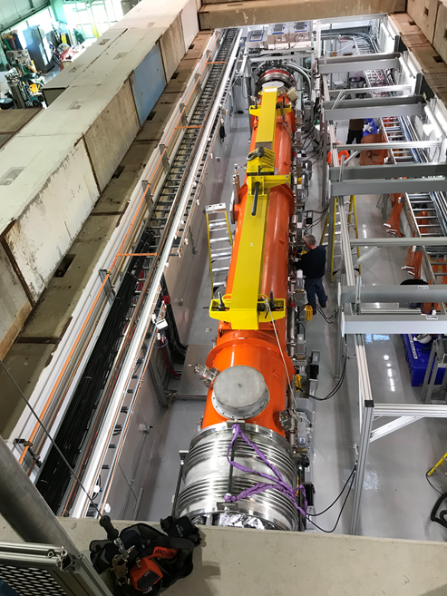
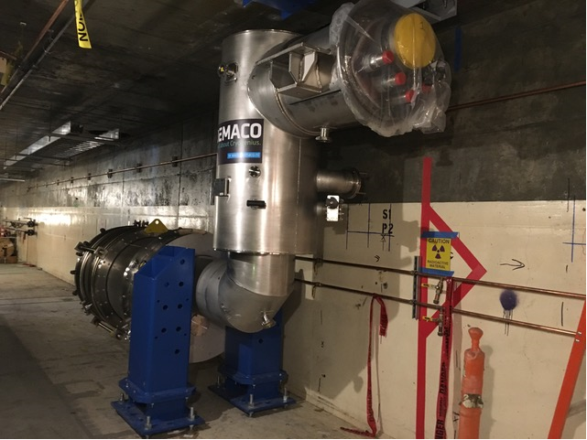
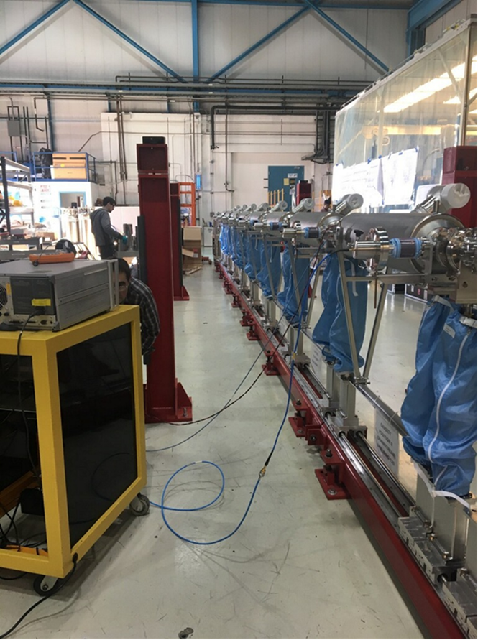
LCLS-II CM Assembly Status
All cavities for CM10 are
CM08 assembly – SC magnet
CM03 disassembly
FC-1 in SLAC tunnel
CM09 at WS2
CM05 at CMTS1

Slide 24
NOvA Updates
Accelerator and detectors performing well
  FY17 record year with 5.2E20 protons-on-target
  (POT) delivered
  To-date collected 9E20 POT neutrino mode,
  3.8E20 POT antineutrino mode
Published results on ν_{μ} disappearance,
ν_{e} appearance, and long-baseline sterile
neutrinos search with 6E20 POT
Upcoming results
  Full 9E20 POT in neutrino mode this winter.
  First antineutrino results with 7-8E20 POT
  planned for Neutrino2018
    ~2σ mass hierarchy sensitivity.
Held 3 meetings to-date with T2K in pursuit of future joint fits
PRL 118, 151802 (2017)
Hint of non-maximal 2-3 mixing
Constrains allowed combination of mass hierarchy and CP-violating phase
PRL 118, 231801 (2017)

Slide 25
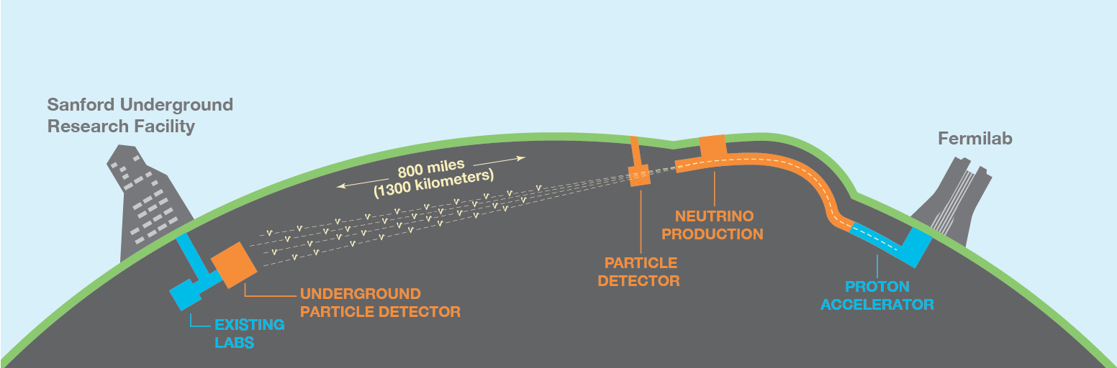
Long-Baseline Neutrino Facility / Deep Underground Neutrino Experiment (LBNF/DUNE)
LBNF/DUNE is the world’s flagship neutrino project and an international experiment that could change our understanding of the universe.
The project will send particles from the world’s most powerful neutrino beam, located at Fermilab in Illinois, to the world’s most precise neutrino detectors, located a mile underground at Sanford Lab in South Dakota.
The LBNF/DUNE project will be the first internationally conceived, constructed, and operated mega-science project hosted by the Department of Energy in the U.S.

Slide 26


discovery opportunities
Neutrino CP violation
  the origin of matter in the universe
Supernova neutrinos
  origins of neutron stars and black holes
Neutrino surprises
  new forces, particles, or laws of nature connected to neutrinos
Proton decay
  unified origins of particles and forces

Slide 27
Overview of the LBNF Project
The LBNF Project provides the infrastructure necessary for the DUNE experiment. DOE, as the host funding agency, will fund all civil construction, and will fund significant parts of other critical LBNF systems,
including cryogenics, primary and neutrino beamlines, and other components.
Approximate
LBNF Funding
Breakdown
  LBNF will provide facility infrastructure at two locations:
Near site: Fermilab, Batavia, IL – facilities to create the neutrino beam and support the DUNE near detector
Far site: Sanford Underground Research Facility, Lead, SD – caverns and facilities to support the DUNE far detectors
Partnerships/in-kind contributions are critical to LBNF’s success: ~25% of project
Fermilab’s LBNF will drive neutrino science forward the way CERN’s Large Hadron Collider drove the Nobel Prize-winning Higgs discovery

Slide 28
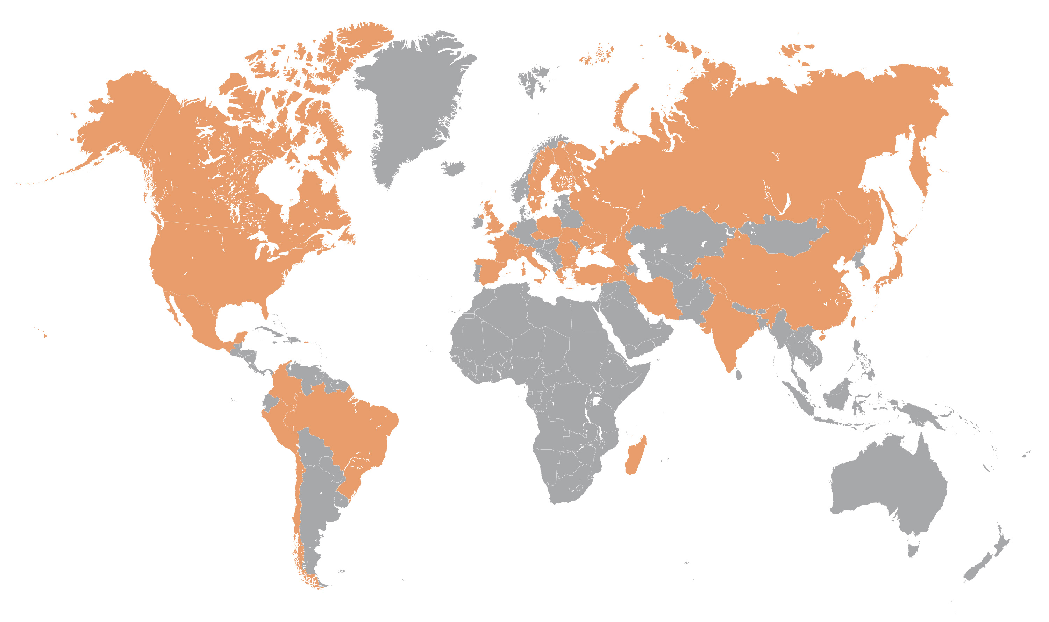
Overview of the DUNE Collaboration
The international DUNE Collaboration is responsible for managing the design, funding, construction, and operation of the neutrino detectors at both the near and far sites.
>60 % non-US
  As of today:
  1041 collaborators from 176 institutions in 31 nations
Armenia, Brazil, Bulgaria, Canada, CERN, Chile, China, Colombia, Czech Republic, Finland, France, Greece, India, Iran, Italy, Japan, Madagascar, Mexico, Netherlands, Paraguay, Peru, Poland, Romania, Russia, South Korea, Spain, Sweden, Switzerland, Turkey, UK, Ukraine, USA
DUNE has broad international support and is growing

Slide 29
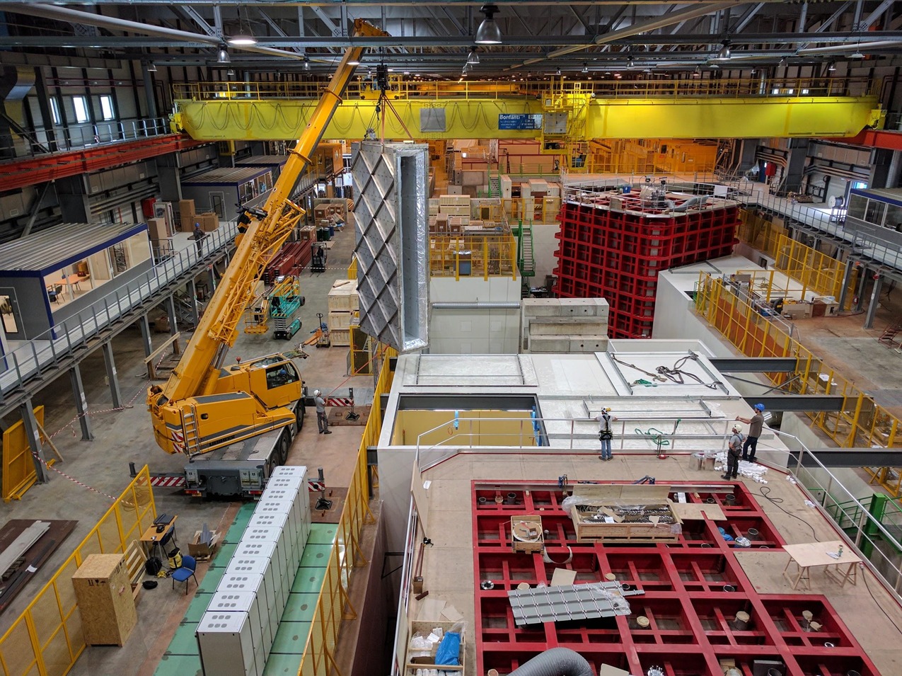
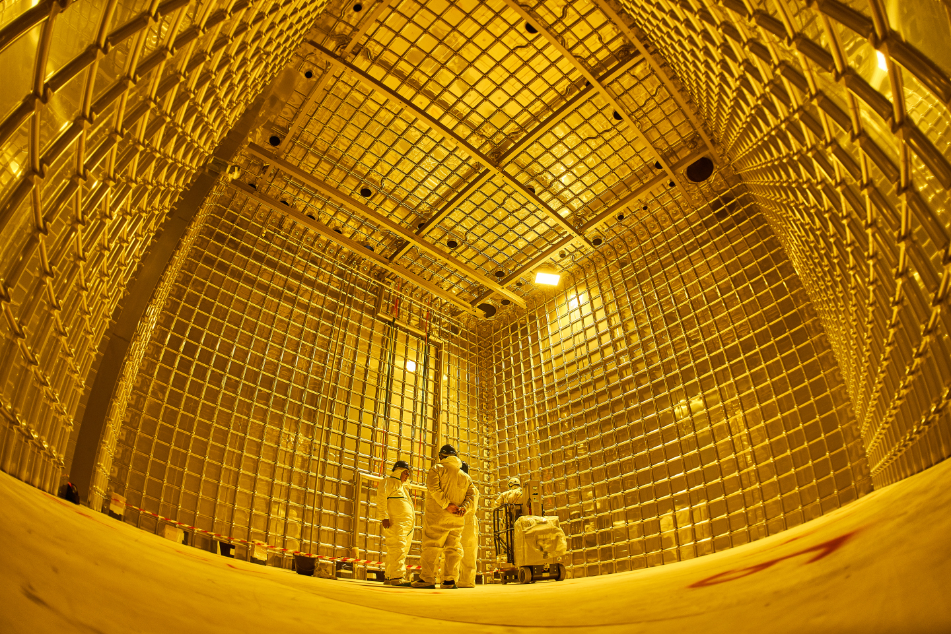
Overview of DUNE Experiment
Approximate
DUNE Funding
Breakdown
The DUNE experiment will consist of:
  four 17,700 ton liquid argon time projection chambers
  at the South Dakota site
  a neutrino detector at Fermilab
View protoDUNE Single Phase detector (near) and Dual Phase detector (far) at CERN. The prototypes are 1/25 scale.
View of stainless steel membrane inside single phase protoDUNE cryostat.
In order to build the massive DUNE detectors, two 700-ton scale prototype liquid-argon detectors are currently under construction at CERN - will take data in fall 2018.
The DUNE Collaboration is organizing and overseeing institutional consortia that will
have responsibility for design and construction of different detector elements.

Slide 30
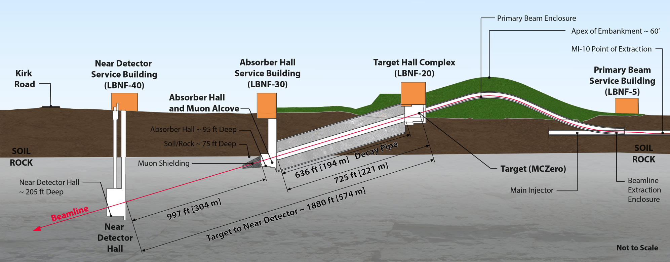
LBNF/DUNE Overview - Near Site at Fermilab, Batavia, IL
Primary proton beam extracted from existing Main Injector
Initial 1.2 MW beam power, upgradable to 2.4 MW
Embankment allows target complex to be at grade
and neutrino beam to be aimed to South Dakota
Decay region followed by absorber
Four surface support buildings, including an
underground hall to support DUNE near detector
Beamline design based on Fermilab’s NuMI beam, currently the most powerful neutrino beam in the world

Slide 31
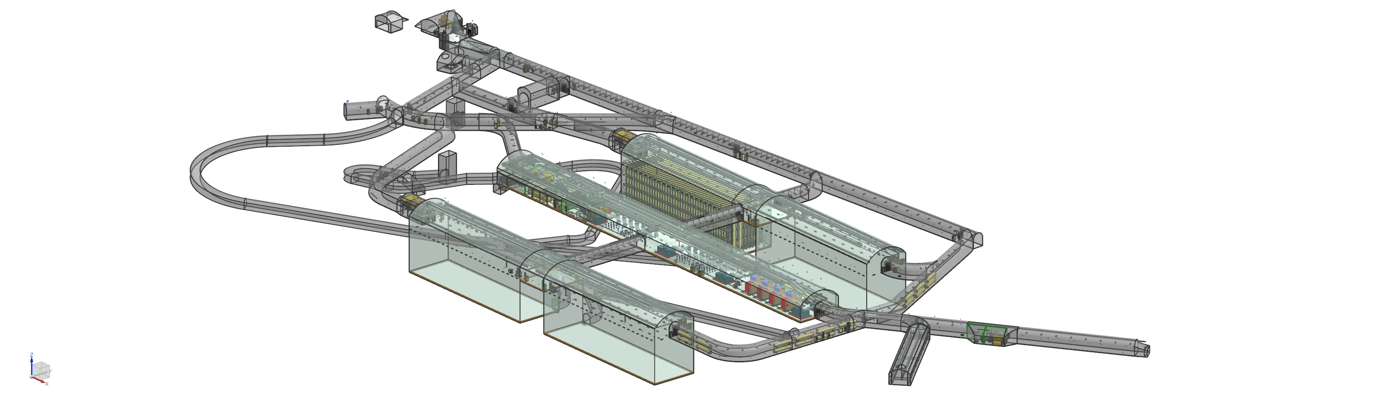
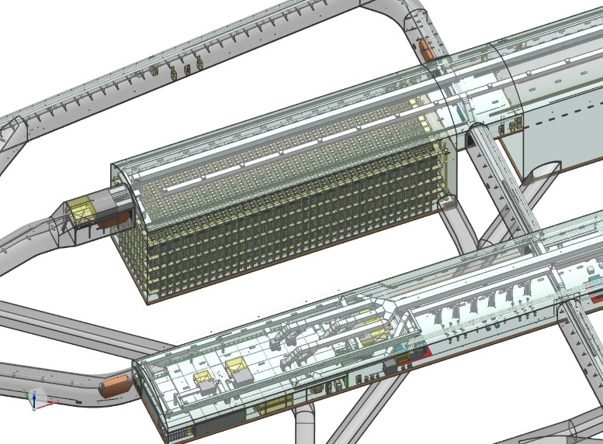
LBNF/DUNE Overview - Far Site at Sanford Lab, Lead, SD
Conventional Facilities:
  Surface and shaft Infrastructure
  including utilities
  Drifts and two caverns for detectors
  Central utility cavern for conventional and
  cryogenic equipment
Cryostats:
  Four membrane cryostats supported by external
  steel frames
Cryogenic Systems:
  Liquid nitrogen refrigeration system for cooling
  and re-condensing gaseous argon
  Systems for purification and recirculation of
  liquid argon
Argon:
  70,000 tons of liquid argon
DUNE neutrino detectors
4850L caverns and drift layout
LBNF facilities will support DUNE experiment
Single cryostat and portion of central utility cavern

Slide 32
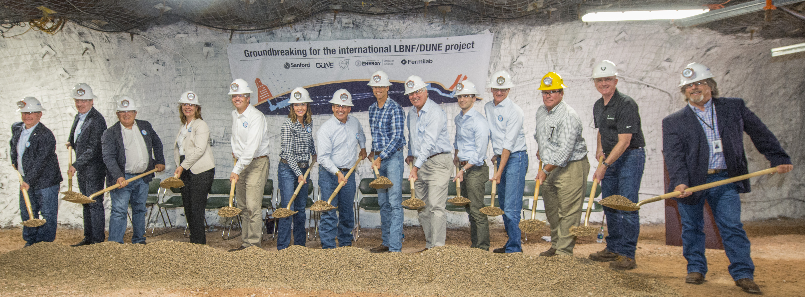
LBNF and DUNE progressing rapidly…
July 2017: LBNF groundbreaking in South Dakota
Participants included CERN, INFN, STFC, congressional delegations, SD governor, and Executive Office of the President
August 2017: Contract awarded to Kiewit/Alberici Joint Venture (KAJV) to begin laying the groundwork for the excavation for LBNF
August 2017: DUNE collaboration welcomes 1,000th member- Vitor Prestes Luzio from Brazil
August 2017: Construction of protoDUNE cryostats at CERN nearly complete; first Anode Plane Assembly (major detector component) delivered to CERN by DUNE-US for installation

Slide 33
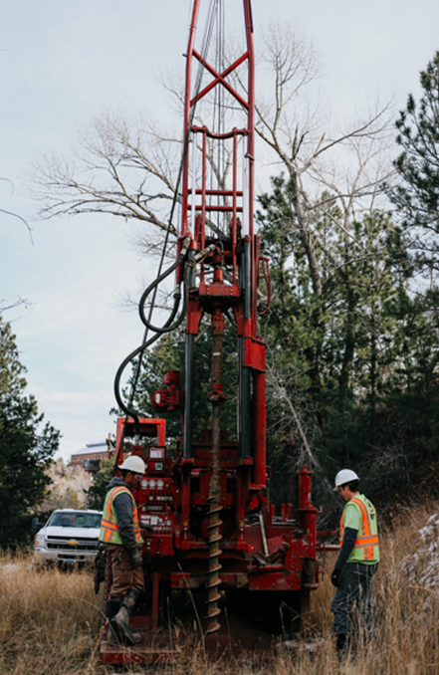
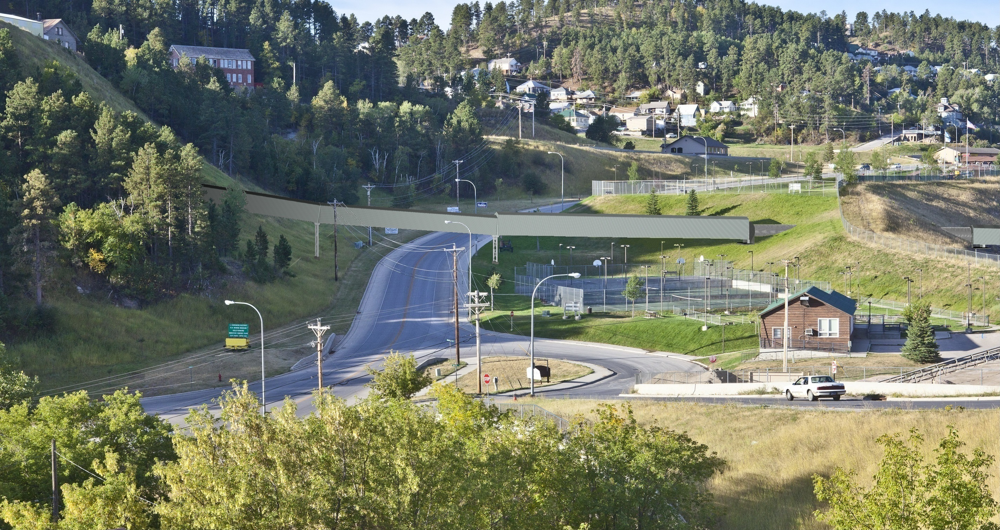
Rock Disposal System
Future conveyor across US 85 in Lead (below) with Open Cut at right
Geotech site investigation finished last week (right)

Slide 34
International Project Milestones
The LBNF Project, working with the international DUNE collaboration and CERN, has established “international project milestones” that provide focus, establish confidence among the various partners, and serve to coordinate international deliverables.
  For example, these dates help coordinate delivery of major in-kind deliverables from partners, such as the LBNF cryostat being supplied by CERN (first investment by CERN outside Europe in 60 years).
  Detailed logistics planning and coordination is critical to LBNF/DUNE project success.
International Project Milestones | Date
Start Main Cavern Excavation | 2019
Start Detector #1 Installation | 2022
Neutrino beam on with two detectors | 2026
Fermilab/DOE/U.S. must demonstrate to the world that we are reliable partners to ensure success

Slide 35
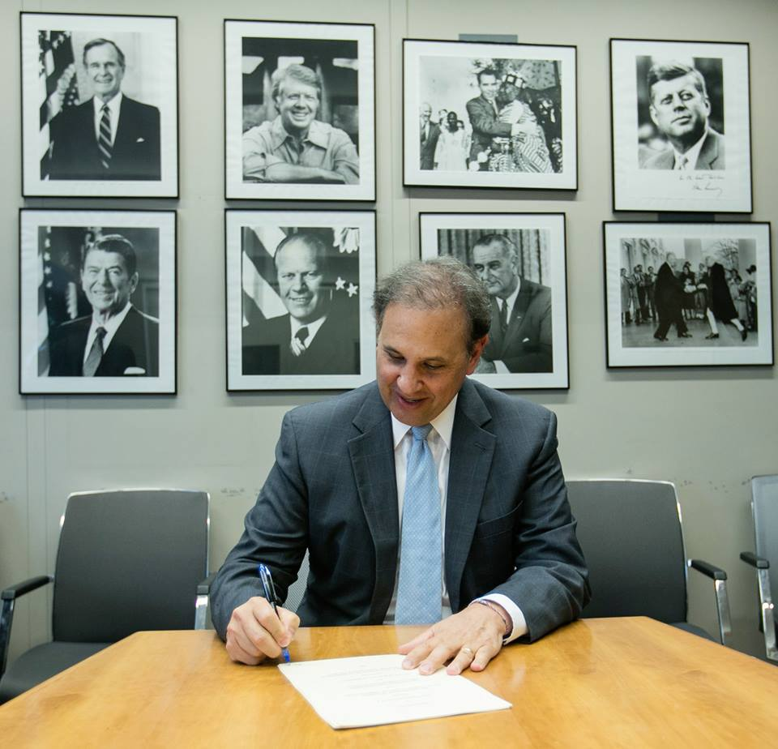
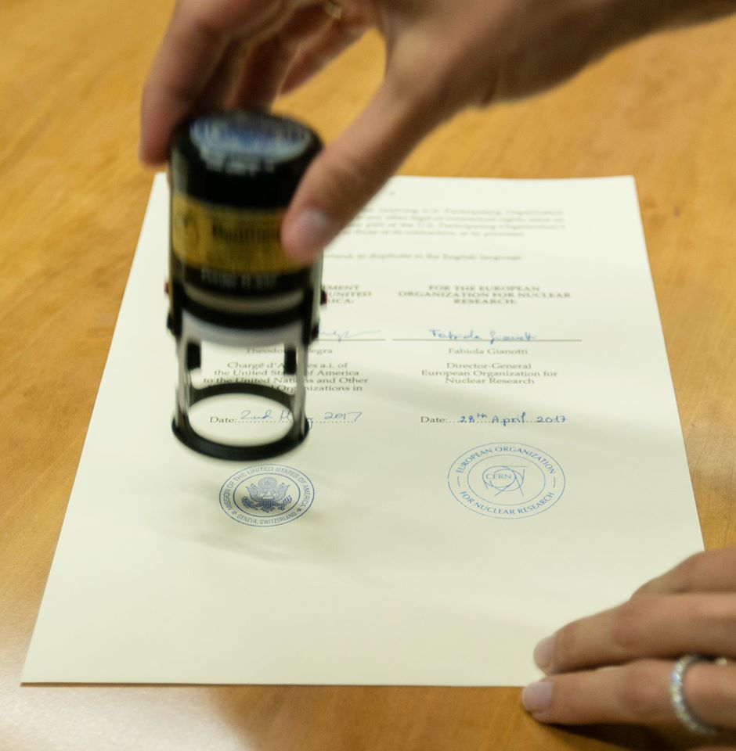
Agreement with CERN
First time in history CERN investing outside of Europe
Addenda signed May 2017:
Official Seal: On behalf of the U.S. Department of Energy, Chargé Theodore Allegra signed three amended protocols to the United States CERN 2015 cooperation agreement on May 2. The agreements will enable the U.S. and CERN to contribute technical equipment and scientific expertise to support the U.S. hosted Long Baseline Neutrino Facility in Illinois and South Dakota

Slide 36

UK Science and Technology Agreement
First ever S&T agreement between U.S. and U.K. signed on September 20, 2017 by U.K. Science Minister Jo Johnson
Commits £65M (about $88M) to DUNE, LBNF, and PIP-II

Slide 37

UK Minister Johnson Visits Fermilab

Slide 38


Italy: Funding Agency INFN
Engaged in short baseline neutrino program, ICARUS Neutrino Detector, upgraded by CERN & INFN
PIP-II R&D secure, production quantities good promise

Slide 39


Deep Underground Neutrino Experiment (DUNE)
DUNE is building a regional collaborative effort in Latin America that focuses on leadership roles in high speed electronics, advanced computing, and a novel light detection technology: ARAPUCA
ARAPUCA in the language of native Brazilian means a trap for birds; the new detector technology concept was invented at a Brazilian university with Brazilian funding

Slide 40

LBNF/Fermilab at the OAS ministerial and High authorities Science and Technology meeting. (Medellin, Nov.2, 2017)
Presentation to the Ministers and High Authorities jump-started/consolidated high interest in Fermilab’s science and technology program
Colombia: Intend of commitment from Colciencias President to support a consortium of Colombian university groups in DUNE in the next 4 years
Mexico: following on letter of CONACYT’s President to DOE, expressing strong interest in participation in the DUNE program, CONACYT’s President offered to explore new venues within their institutes to support DUNE groups in Mexico
Brazil: Leading group in DUNE ARAPUCA detectors, received support from Sao Paulo State funding agency
Peru CONCYTEC and Paraguay CONACYT: Commitment from both Presidents, to financially support DUNE groups as part of ARAPUCA

Slide 41
Outlook
Fermilab and US HEP program has unique strengths, a powerful network of partners around the world, and a good relationship with DOE, administration, and Congress
All will need to be fully leveraged to realize the ambitions of the field…and then some
The international dimensions have attracted significant positive attention and must be managed carefully to succeed
US program healthy with many good projects and programs but we must stretch to succeed

Slide 42





