Slide 1
PMCDP Application Process
And
Frequently Asked Questions
Alex Bachowski
Office of Project Assessment (OPA)
Rev 3/2023

Slide 2
Requirements for PMCDP certification
The detailed requirements for PMCDP are included in the Certification Equivalency Guide (CEG) available in ESS/PMCDP menu or on PM Max at https://community.max.gov/download/attachments/1131743009/Certification%20and%20Equivalency%20Guidelines%20%28CEG%29.pdf?api=v2.
Be sure to have the latest CEG when completing your application! The CEG gets updated often so do not rely on old PDFs.
A candidate must meet all the competencies. No exceptions.

Slide 3
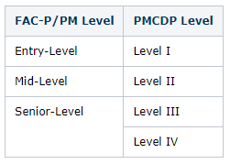
FPD Levels
Level I: TPC greater than $5M and equal to or less than $50 million (M).
Level II: TPC greater than $50M and equal to or less than $100M.
Level III: TPC greater than $100M and equal to or less than $400M.
Level IV: TPC exceeding $400M.
PMCDP certification provides equivalency for FAC-P/PM levels:

Slide 4
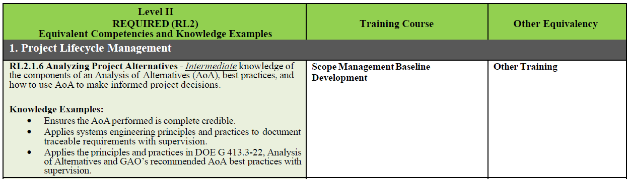
Requirements for PMCDP certification
The CEG provides the PMCDP’s “Training Course” along with “Other Equivalency” for all the required competencies:

Slide 5
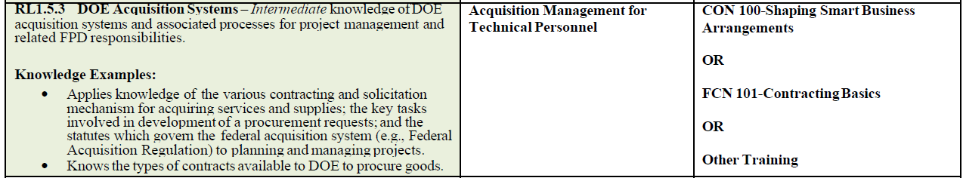
Requirements for PMCDP certification
One PMCDP training course can cover multiple competencies and sometimes there is an explicit equivalent course that can be taken:
For the above example, if you take DAU’s CON 100 course, you will satisfy RL 1.5.3 as CON 100 is equivalent to the PMCDP course “Acquisition Management for Technical Personnel.”
This is a straightforward example. There are a few like this in the CEG.

Slide 6
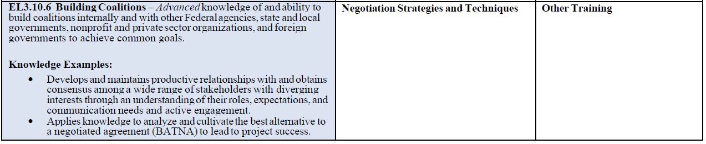
Requirements for PMCDP certification
Most of the “Other Equivalency” boxes are only filled with ‘other training’ as the equivalent to the PMCDP course. Obviously, this isn’t as helpful.
For the above example, you can still seek an equivalency in your application if you have taken other negotiation courses which satisfy the description detailed for EL 3.10.6 and provide an equal or greater number of contact hours (compared to the PMCDP course).
A one-hour negotiation class is not equivalent to the 9-hour PMCDP course.
You must provide the Course Syllabus along with your completion certificate so that we can verify the course satisfies the requirements.

Slide 7
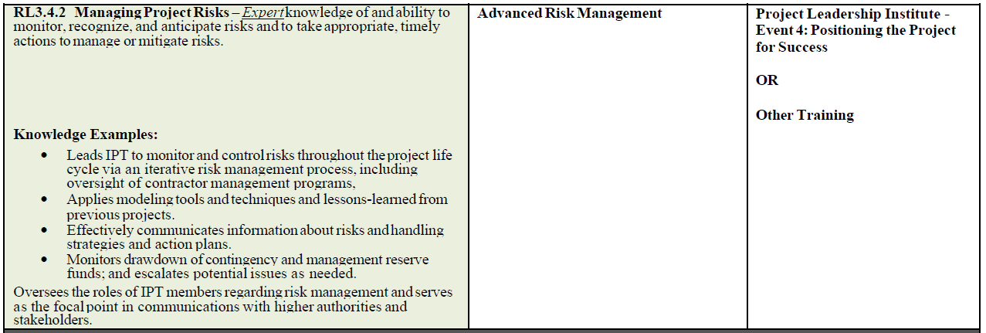
Requirements for PMCDP certification
Project Leadership Institute (PLI) events are equivalents to multiple PMCDP courses. So, if you completed PLI, you do not need to take certain training courses.
Provide your PLI completion certificate in your application package.

Slide 8
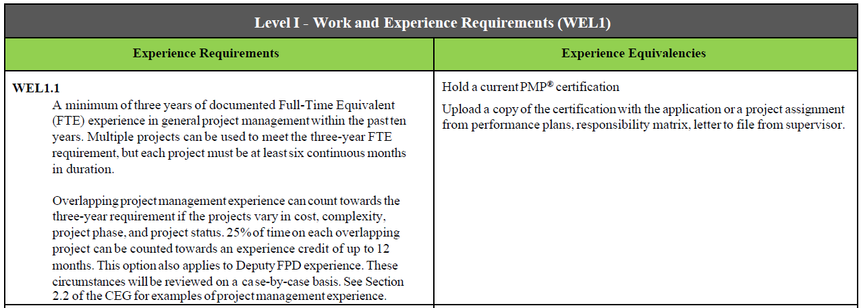
Requirements for PMCDP certification
For work experience, there are also equivalencies. For Level 1, having a current PMP certification satisfies both work experience requirements (WEL 1.1 and 1.2)
Provide your PMP certificate with your application.
Make sure to download the latest one (it must be current or it will get rejected).

Slide 9
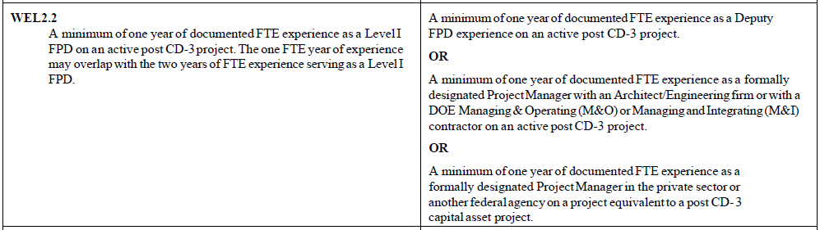
Requirements for PMCDP certification
Level 1 is straightforward. Level 2 and beyond, the work experience equivalencies become more complicated. For example, WEL 2.2:
Any of the three scenarios listed in the right column will satisfy WEL 2.2.
For most new FPDs with limited/no prior experience, the first equivalency is usually appropriate.
For new FPDs coming from another agency or private industry, the third equivalency is usually used.

Slide 10
Complete Profile in ESS
After understanding the requirements, the candidate should start filing out the PMCDP profile in ESS
For new candidates, you may need to have PMCDP module activated in ESS to allow you to complete the profile
To request to be added to the PMCDP module, send a message to CBSHelpDesk@hq.doe.gov,
and
cc: Mike Armogida at mike.armogida@hq.doe.gov, and have the request assigned to Mike Armogida.
After completing the profile, request certification approval and review in ESS, PMCDP menu, Certification Request (see next page)

Slide 11
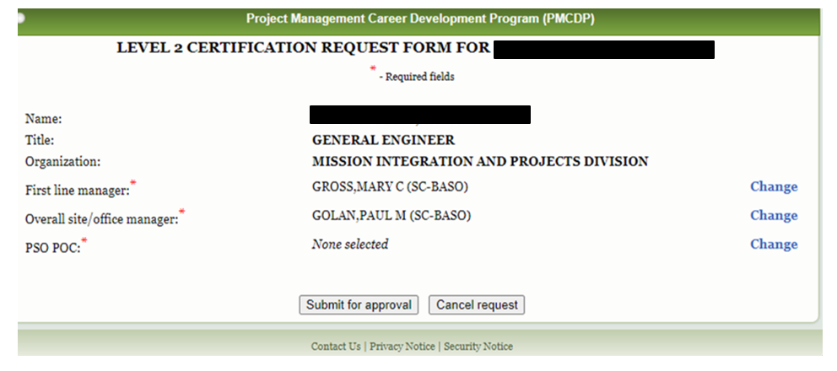
Very Important
Note: FPD candidates and incumbents should enter my name—Alex Bachowski in the certification request form in ESS under the PSO POC entry by clicking on “Change” before submitting the request. This informs me that your package is ready via an automated email from ESS.
*After it is approved, send me (alex.bachowski@science.doe.gov) the signed PDF of your package.

Slide 12
Steps of the Certification Review Process
Once the application is complete in PMCDP, the first page of the application must be signed by first line manager and site office manager in ESS.
After the package is approved, the candidate needs to e-mail Alex Bachowski the ESS application (Signed)(PDF), proof of FPD experience (i.e., PEP or Memorandum) and other documents (training, certifications, letters, etc.).
OPA will complete the FPD checklist.
OPA will upload the package and other documents in PM MAX and forward review request to CRB Secretariat. FPDs: Do NOT upload documents to PM MAX.
CRB Secretariat will then forward the package for review by independent reviewer(s).
Any comments or questions from independent reviewer(s) will be forwarded to Alex Bachowski.
After questions and comments have been resolved, the package is forwarded to Certification Review Board (CRB) representatives (EM, NNSA, PM, and SC) for review.
Any comments from CRB members/representatives will be forwarded to Alex Bachowski for resolution.

Slide 13
Details of Certification Review Process
For Level 3, the CRB Secretariat will also perform an in-depth reference check of the candidate. Three (3) references are needed:
Another FPD (preferably Level 3 or 4) from within the past five years.
Current Supervisor
Federal Project Management Executive (PME) for the candidate’s most recent project
CRB voting on applicants is done virtually through PM MAX. If a majority of the CRB votes to approve and no interview is requested (for Level 3 and 4), the certification is issued.
The CRB will convene to discuss FPD certification if:
An interview with the candidate is requested
Any issues with the application cannot be resolved
A CRB voting member requests further discussion before casting a vote

Slide 14
Do’s and Don’ts
Don’t upload anything into PM MAX. I will do that for you.
Don’t include description/discussion of information not relevant to the competency. For example, do not discuss your experience in safety for a Cost Management requirement.
Don’t have one overall answer for competencies and just cut and paste the same response for different competencies. This will get rejected.
Don’t just list the competencies—you need to demonstrate your knowledge. For example: “working on xxx as an FPD for 5 years, I was responsible for approving contingency use, presented at ESAABS for CD approvals, …”

Slide 15
Do’s and Don’ts (cont’d)
Don’t try and seek equivalencies to all the PMCDP courses.
First, proving equivalencies is difficult and makes your application more difficult to approve (by the CRB).
Second, the PMCDP courses are tailored to the DOE’s approach to project management. Even if you have 10+ years experience in other agencies, DOE does things differently and you should learn about those differences to become an effective FPD.
Don’t let your CLPs lapse and lose your certification.
Do only send evidence/proof of experience that is relevant to the application. Extraneous documentation only slows down the process.
Do ensure experience evidence shows start date and end date/current date.

Slide 16
Do’s and Don’ts (cont’d)
Do include all Critical Decision (CD) or equivalent CD dates in your work experience narratives.
Do write out your experience as simply and succinctly as possible… the CRB voting members have full time jobs and don’t want to read pages upon pages of text.
Do ensure the information is consistent and correct throughout the package (i.e., information in History of Project Management experience section reflects what’s in the package including project titles, dates, cost, etc.)
Do ask questions and seek clarifications along the way. I am here to help you get certified!

Slide 17
Do’s and Don’ts (cont’d)
Do review the PMCDP training schedule at the beginning of the fiscal year and by the end of the first quarter to make sure you sign up for the courses you need.
Do get signed up and be active on the PM MAX PMCDP page: PM PMCDP Home - Dept of Energy-External - MAX Federal Community
Do search in Learning Nucleus for courses you need, and if not yet available (because they aren’t on the schedule), express interest so you get an email when the course is scheduled. This will also tell PM-30 that there are candidates looking to take the course, so they are more apt to offer it sooner.

Slide 18
Frequently Asked Questions
Q: I need help with my profile in ESS. I can’t find my name on the list to complete the form?
A: You need your “ESS account associated with the PMCDP module”. Please email the Corporate Business Systems help desk at
CBSHelpDesk@hq.doe.gov AND
ask to assign the request to and cc: Mike Armogida at mike.armogida@hq.doe.gov.

Slide 19
Frequently Asked Questions
Q: How do I find out what courses to take and how do I sign up for them?
A: The PMCDP training schedule is at this link: PM FY PMCDP Training Schedule - Dept of Energy-External - MAX Federal Community
You sign up for training via Learning Nucleus (can be accessed via ESS).
Search for the courses you need in Learning Nucleus and if they are not yet available (i.e., not scheduled), express interest so that you are e-mailed when they are put on the schedule.

Slide 20
Frequently Asked Questions
Q: I understand that courses are now virtual. Is it expected this will continue?
A: All PMCDP courses went virtual due to the COVID-19 pandemic. There has been no discussion within the CRB to go back to in-person learning.
However, it is not guaranteed that courses will remain virtual.
Therefore, it is highly recommended that all FPDs take advantage of virtual courses and complete their training ASAP. Not having to travel and be away from home for several weeks is a huge advantage! Plus, it saves your Site Office a lot of money (travel costs are high).

Slide 21
Frequently Asked Questions
Q: I need a xx training class for my PMCDP certification. However, I can’t attend the training due to a calendar conflict. What are my options?
A: There are other ways to qualify for a competency besides PMCDP training courses. A candidate can qualify through
Work experience,
Training class or classes outside of PMCDP (e.g., xxx), or
Combination of both.
NOTE: Seeking equivalency for training courses is difficult (requires a compelling write-up) and opens your application to more scrutiny. It is ALWAYS preferred to sit for the course, especially now that they are all virtual and offered at least once a year, sometimes twice a year (for core courses).

Slide 22
Frequently Asked Questions
Q: I am a Deputy FPD for a project, can I use that duty to qualify for the work/developmental experience requirements?
A: Yes, the deputy may take credit for experience with the following conditions. The candidate must
Serve as a Deputy FPD on an active, post CD-3 project having a TPC:
Level II and III candidates - greater than the GPP threshold (currently $30M).
Level IV - greater than $100M.
Demonstrate they have been accountable and responsible (i.e., “owned”) for a complete, discrete and usable subset of the overall project (i.e., a complete subset of the work breakdown structure [WBS]).
Describe and show in documentation how he or she has functioned as the FPD on a specific piece of the project scope, and be able to identify the cost, schedule, and scope of the project sub-part; this may be a separate building or a major, discrete sub-system of a very large project, like the piping and pressure vessels in a nuclear power plant
Work directly for the FPD on a capital asset project.
Formally designated in project documents (e.g., Project Execution Plan) by the PME or an SES who is a program representative, site manager, or FPD.

Slide 23
Frequently Asked Questions
Q: I was an FPD for a $25M Capital Asset Project, but the project was delegated or program that funded the project was lax in following the DOE O 413.3B—not in PARS II, no ESAABs, no reviews, etc. ? Can I take credit as the FPD for the project for PMCDP?
A: If the DOE project is not in PARS II, the FPD will not get credit for that project.
The reason is that if the project is not in PARS II, DOE-PM would not know that there is a project and there is no visibility on what the project is doing—reviews, ESAABS, AE/owner, changes to Performance Baseline, etc.

Slide 24
Frequently Asked Questions
Q: What backup documentation do I need for non-DOE project work experience?
A: After you finish writing up your experience statement, send it to Alex Bachowski (DOE/OPA) for review.
Once the statement is reviewed, send the statement (verbatim) to your past supervisor/team leader/program manager (i.e., somebody one level above you) to attest to the accuracy of the statement.
Include the email chain (both your email and their email) with your application documentation.
Non-DOE experience without backup documentation will not be considered.

Slide 25
Frequently Asked Questions
Q: I am an FPD for multiple projects with a total aggregated TPC of $108M. Can I aggregate the cost and schedule of projects for getting a Level 4?
A: The aggregation of smaller TPCs or schedule are not allowed. This is because individual projects with higher TPCs has more scrutiny and oversights (i.e., ICE/ICRs, EVMS, AE levels, etc.).

Slide 26
Frequently Asked Questions
Q: I have a computing project in PARS II and manage it in accordance with DOE O 413.3B, can I take credit for experience for this project?
A: You can get credit for “general project management” experience, which applies for Level 1 certification.
However, computing projects are not recognized as Capital Asset in DOE O 413.3B and these projects cannot be used for experience for Levels 2-4.

Slide 27
Frequently Asked Questions
Q: I have a PMP, do I need to provide any past experience for Level 1 certification?
A: No. Do not input any past experience into your PMCDP application since your PMP is sufficient to satisfy WEL 1.1 and WEL 1.2.
Include your current PMP certificate in your application package and make sure your PMP number is entered into your ESS profile (so it appears on Page 1 of your application).

Slide 28
Frequently Asked Questions
Q: The CEG says I need one (1) year of documented FTE experience as the formally designated COR for Level 2 FPD (WEL 2.4). However, my Site Office does not designate COR’s and I do not have any past experience at other agencies/offices — What can I do?
A: Have your local Contracting Officer draft a memo for the Certification Review Board (CRB) that he/she does not appoint COR’s and provide a detailed explanation. Typically, in DOE-SC due to the M&O contracting method, COR’s are not assigned. This is Site Office/Contracting Officer dependent. The memo can be generic for the entire Site Office so other FPDs can use it in the future.
Please send Alex Bachowski the draft memo prior to the CO signing so he can make sure it includes the necessary verbiage.

Slide 29
Frequently Asked Questions
Q: I need to obtain my Level 2 certification, but I’ve only been with DOE for four months. Do I have to wait a few years before I can qualify for my Level 2 because I don’t have DOE experience?
A: No, you don’t have to wait. You can use previous experiences from other agencies or company if you worked in a position similar to an FPD. Like all experiences, you still need documentation/proof of your duties and experience.
Proof of experience is typically a letter/memo/e-mail from your previous supervisor attesting to the accuracy of the experience write-up that is being uploaded into ESS.

Slide 30
Frequently Asked Questions
Q: For Level 3, the CEG says I need two (2) years of documented FTE experience as the formally designated COR (WEL 3.3). However, my Site Office does not designate CORs, and I do not have any past experience at other agencies/offices — What can I do?
A: Have your local Contracting Officer draft a memo for the Certification Review Board (CRB) that he/she does not appoint CORs and provide a detailed explanation. Typically, in DOE-SC due to the M&O contracting method, CORs are not assigned. This is Site Office/Contracting Officer dependent. The memo can be generic for the entire Site Office so other FPDs can use it in the future.
Please send Alex Bachowski the draft memo prior to the CO signing so he can make sure it includes the necessary verbiage.

Slide 31
Frequently Asked Questions
Q: For Level 3 certification, WEL 3.4 requires a minimum of six months of documented experience being formally mentored by a Level III or IV FPD who has a minimum of two years’ experience on a Level III or higher project. The fine print says that a formal mentoring agreement must be signed and to provide documentation that the mentoring was successfully completed. Do you have sample documents?
A: I have a Mentoring Agreement template which can be used for both the Agreement/Plan (prior to starting mentoring) and for documenting success of the mentorship (after the six month mentorship ends). After you achieve Level 2 certification, please e-mail me and I can send you the template.

Slide 32
Frequently Asked Questions
Q: For Level 4 certification, WEL 4.3 and 4.4 requires participation on three (3) peer reviews and to chair a review. Please advise how I can achieve this?
A: Since I work for OPA, I can get you on upcoming peer reviews (IPRs). We would strongly suggest attending all three (3) reviews in person so you can get a good feel for how the reviews are run and observe the review Chairperson since you will need to chair a review for Level 4 certification (WEL 4.4). There is flexibility to have you participate in one (1) peer review remotely, but the other two (2) must be in person.
After serving on three (3) IPRs, we will then discuss having you serve as the review Chairperson for an IPR. This will require coordination with the Director of OPA.

Slide 33
Frequently Asked Questions
Q: For Level 4 certification, WEL 4.5 requires a minimum of one FTE year of experience serving as Program Manager. How can I achieve this?
A: As stated in the equivalency for this WEL, the CRB in consultation with the Office of Science, may waive this requirement for FPDs with more than 10 years of federal experience in project management roles.

Slide 34
Frequently Asked Questions
Q: What are Continuous Learning Point (CLP) requirements for maintaining my certification?
A: An FPD needs 80 CLPs every two years.
Besides training, examples of activities an FPD can get credit for includes participating in project reviews, presenting or attending conferences, being part of an IPT, mentoring FPDs, and other responsibilities.
List of approved activities is maintained on PM-MAX: PM PMCDP Certification Renewal - Dept of Energy-External - MAX Federal Community
The PMCDP training schedule is at this link: PM FY PMCDP Training Schedule - Dept of Energy-External - MAX Federal Community

Slide 35
Frequently Asked Questions
Q: What happens if I don’t have sufficient points for maintaining certification?
A: If an FPD doesn’t have the necessary 80 CLPs within two years, the PMCDP certification can be revoked.
FPDs are provided plenty of notice that their CLPs are due and are told of the requirement upon being certified. Therefore, we reject any excuses related to being unaware of the due date or requirement for CLPs. Also, all PMCDP courses are held virtually now so taking courses is not a major disruption.
If an FPD needs to maintain certification and has a valid excuse (e.g., medical illness, extended emergency leave, etc.) an extension can be requested if reasonable (e.g., shouldn’t ask for 15 months extension for 70 CLPs) but this is a LAST RESORT option!
To obtain an extension, an FPD needs to e-mail to Alex Bachowski, explaining why the CLP requirement has not been met, how they will meet the requirement, and by when. This request for extension is then forwarded to CRB Secretariat for the CRB’s decision.

Slide 36
Frequently Asked Questions
Q: Can you explain more on the Certification Review Board (CRB) and the voting?
A: The CRB is comprised of senior project management personnel from DOE PM and the three major DOE Programs (SC, NNSA, and EM).
The CRB meets quarterly to discuss Level 1 or 2 candidates that the Programs has concerns about or for all Level 3 and 4 candidates.
Certification is approved based on a majority vote (not unanimous).

Slide 37
Four Steps for Certification Nominations in the Office of Science
1 | Prior to completing any form or signing any approval, the FPD/candidate needs to contact Alex Bachowski to ensure latest requirements are considered and other information.
2 | Prior to site managers and supervisor singing any forms, the FPD/candidate needs to send Alex Bachowski a copy of the PMCDP profile for review and comment.
3 | After the Site Manager and the Supervisor have approved the PMCDP package in ESS, the FPD/candidate needs to request HQ approvals by sending a .pdf copy of the signed profile and all backup documentation to Alex Bachowski at alex.bachowski@science.doe.gov.
4 | The package will be then forwarded to the CRB Secretariat after Office Project Assessment (OPA) review.

Slide 38
Questions?

