Slide 1
The DOE Webinar will begin shortly . . .
Why is there no sound?
Once you logged into the webinar, you were provided two options to listen to this broadcast. The first option is through your computer speakers, the second option is via dialing the phone number provided to you upon login to the webinar. If you chose to listen through your computer speakers, you may need to turn your speaker volume on or up.
Will DOE provide access to the recorded webinar after the meeting?
Yes, all those who registered will receive a link to the slides and to the recorded webinar soon after the meeting. It will also be available on the DOE SBIR/STTR web site.
Where can I find the Topics being discussed today?
This link will take you to the Funding Opportunity Announcement (FOA) page that lists the FY 2022 Phase I Release 2 Topics: https://science.osti.gov/sbir/Funding-Opportunities
What if my question was not answered at today’s webinar?
Please contact the point of contact that follows each subtopic in the document listed above for further clarification.
If you have a question about the grant application process, please send us an email at: sbir-sttr@science.doe.gov.

Slide 2

DOE SBIR/STTR Phase I Release 2 Topics Webinar Topics associated with the FY 2022 Phase I Release 2 Funding Opportunity Announcement Topics 7-20
DOE SBIR/STTR Programs Office
November 17, 2021

Slide 3
TODAY’S AGENDA
Topics Introduction | DOE SBIR/STTR Programs Office
Topic 7-20 | Office of Energy Efficiency and Renewable Energy (EERE)

Slide 4
FY 2022 Phase I Schedule
 | Release 1 | Release 2
Topics Issued | Monday, July 12, 2021 | Monday, November 8, 2021
Webinar(s) | Week of July 19, 2021 | Week of November 15, 2021
FOA Issued | Monday, August 9, 2021 | Monday, December 13, 2021
Webinar(s) | Friday, August 13, 2021 | Friday, December 17, 2021
Letters of Intent (LOI) Due | Monday, August 30, 2021 | Monday, 3 January, 2022
Non-responsive LOI Feedback Provided | Monday, September 20, 2021 | Monday, January 24, 2022
Applications Due | Tuesday, October 12, 2021 | Tuesday, February 22, 2022
Award Notification | Monday, January 3, 2022 | Monday, May 16, 2022

Slide 5

Phase I Funding Opportunity Announcements Participating DOE Programs (FY 2022)
Office of Advanced Scientific Computing Research
Office of Basic Energy Sciences
Office of Biological and Environmental Research
Office of Nuclear Physics
Phase I
Release 1
Office of Cybersecurity, Energy Security, and Emergency Response
Office of Defense Nuclear Nonproliferation
Office of Electricity
Office of Energy Efficiency and Renewable Energy
Office of Fossil Energy and Carbon Management
Office of Fusion Energy Sciences
Office of High Energy Physics
Office of Nuclear Energy
Phase I
Release 2

Slide 6
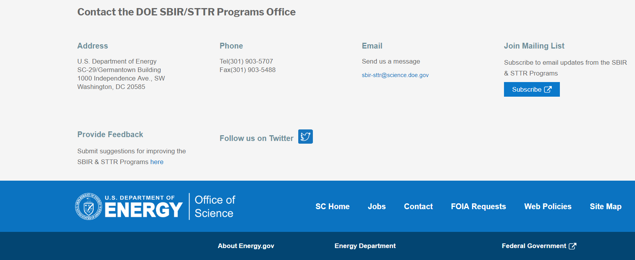
Funding Opportunity Announcement (FOA) Webinar
FY22 Phase I Release 2 FOA will be issued on December 13th
Join our Mailing List – this field is on every DOE SBIR/STTR web page
Following the issuance of the FOA, look for an email with a link to the FOA
Webinar with Q&A for this FOA on December 17th
Overview of the FY 2022 DOE SBIR/STTR Programs
Following the issuance of the FOA, look for an email announcing this webinar

Slide 7
Topic Basics
Topics are created by DOE program managers and define important technology breakthroughs needed in R&D areas that support the DOE mission
Topics are organized by DOE Program Office, e.g., ASCR, BES, etc.
DOE program managers are listed with each subtopic
Questions to DOE program managers are limited to clarification of the topic and subtopic (including references)
Clarification is provided to help you determine whether your technology fits within the topic and subtopic
You may communicate with these topic managers from the release of topics until the grant application due date
The decision to apply is yours

Slide 8
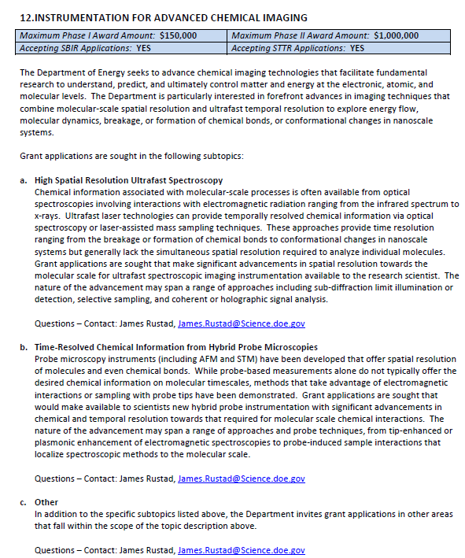
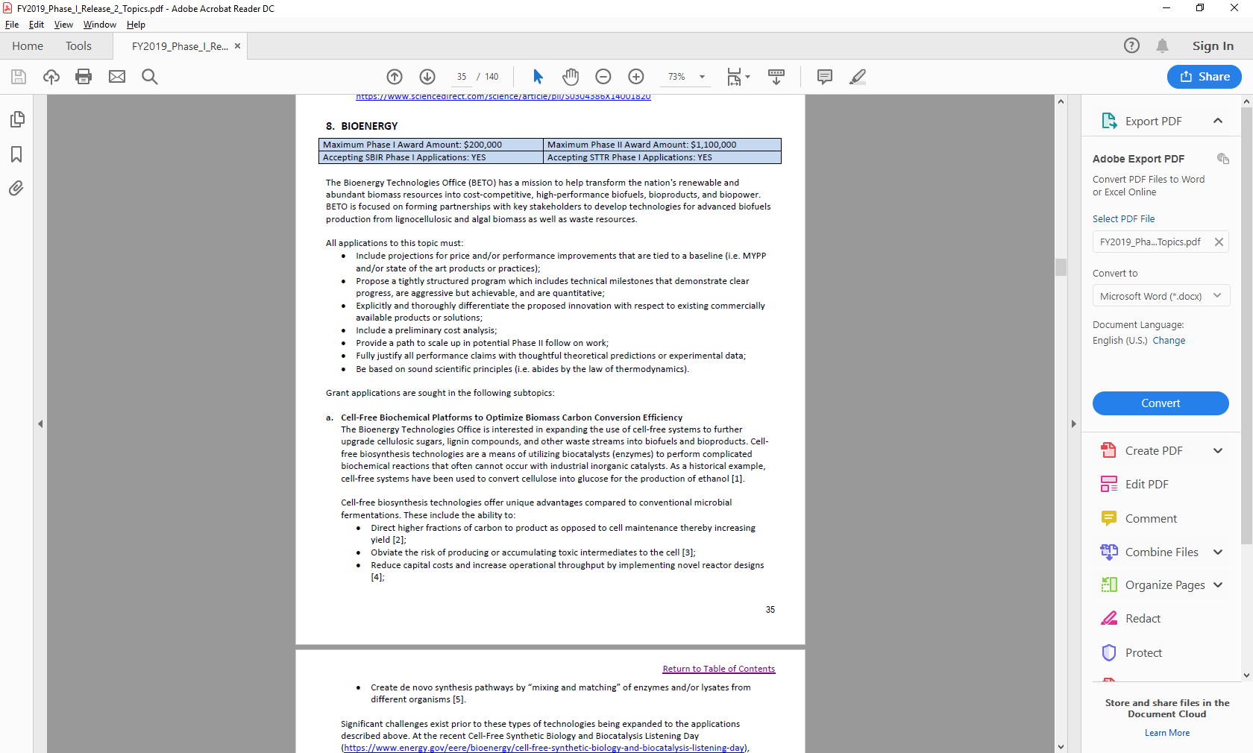
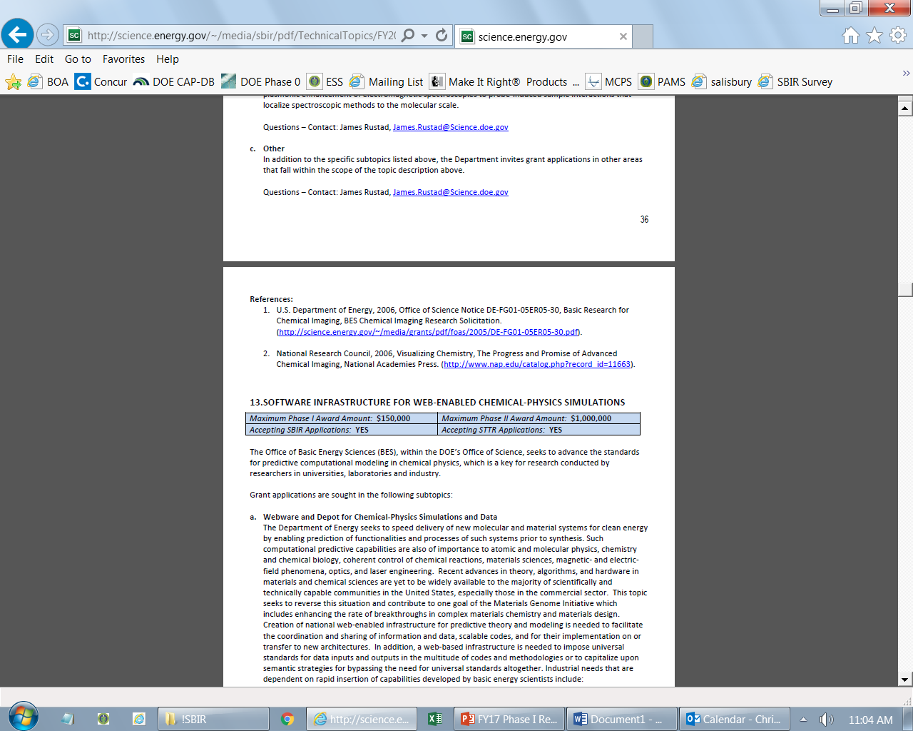
Example Topic
Topic & Subtopic
You must specify the same topic and subtopic in your Letter of Intent and grant application
Topic Header
Lists the maximum award amounts for Phase I & Phase II and the types of application accepted (SBIR and/or STTR)
Program Manager
Each subtopic lists the responsible DOE program manager
“Other” Subtopic
References
Notes:
Here is an example topic from our current announcement. Note that every SBIR or STTR application must include the topic and subtopic to which you are applying. The general topic description describes the general field of technology that is of interest. The subtopics describe specific opportunities in which proposals are requested. Each topic at DOE will also have an “other” subtopic. Under this subtopic you can submit proposals that fall within the general topic description, but do not fit with any of the other subtopics. We have found that when we write the subtopics too narrow sometimes we miss good opportunities, and this “other” subtopic is a means collecting disruptive solutions.

Slide 9
Topic 7: JOINT TOPIC: COMMUNITY-DRIVEN SOLUTIONS FOR A JUST AND EQUITABLE ENERGY TRANSITION
Maximum Phase I Award Amount: $200,000 | Maximum Phase II Award Amount: $1,100,000
Accepting SBIR Phase I Applications: YES | Accepting STTR Phase I Applications: YES
Bioenergy Technologies Office
Water Power Technologies Office
Geothermal Technologies Office
Solar Energy Technologies Office
Questions: Subtopic a – Brianna Farber, brianna.farber@ee.doe.gov
and Elizabeth Burrows, elizabeth.burrows@ee.doe.gov
Questions: Subtopic b – Rukmani Vijayaraghavan, rukmani.vijayaraghavan@ee.doe.gov
Questions: Subtopic c – Lauren Boyd, lauren.boyd@ee.doe.gov
Questions: Subtopic d – Rukmani Vijayaraghavan, rukmani.vijayaraghavan@ee.doe.gov and Maggie Yancey, maggie.yancey@ee.doe.gov

Slide 10
Topic 7: JOINT TOPIC: COMMUNITY-DRIVEN SOLUTIONS FOR A JUST AND EQUITABLE ENERGY TRANSITION (CONTINUED)
Maximum Phase I Award Amount: $200,000 | Maximum Phase II Award Amount: $1,100,000
Accepting SBIR Phase I Applications: YES | Accepting STTR Phase I Applications: YES
Advanced Manufacturing Office
Hydrogen & Fuel Cell Technologies Office
Wind Energy Technologies Office and Water Power Technologies Office – Technology Solutions for Advancing Ocean Co-Existence and Co-Use with Marine Energy and Communities
Vehicle Technologies – Energy Efficiency in Emerging Mobility Systems (EEMS): Developing and Applying Novel Mobility Solutions for Underserved and Disadvantaged Communities
Questions: Subtopic e – Brianna Farber, brianna.farber@ee.doe.gov
and Elizabeth Burrows, elizabeth.burrows@ee.doe.gov
Questions: Subtopic f – Donna Ho, donna.ho@ee.doe.gov
Questions: Subtopic g – Rukmani Vijayaraghavan, rukmani.vijayaraghavan@ee.doe.gov and Maggie Yancey, maggie.yancey@ee.doe.gov
Questions: Subtopic h – Contact: eems@ee.doe.gov

Slide 11
Topic 8: JOINT AMO/FECM TOPIC: DIVERSIFYING SUSTAINABLE SOURCES OF CRITICAL MINERALS AND MATERIALS
Maximum Phase I Award Amount: $200,000 | Maximum Phase II Award Amount: $1,100,000
Accepting SBIR Phase I Applications: YES | Accepting STTR Phase I Applications: YES
Production of CMM By-Products and Other Value-Add Minerals from Domestic Operations
Advanced Mining Techniques that Increase Environmental and Material Stewardship
Questions: Helena Khazdozian, Advanced Manufacturing Office, Helena.Khazdozian@ee.doe.gov
or Grant Bromhal, Fossil Energy and Carbon Management Office, Grant.Bromhal@hq.doe.gov

Slide 12
Topic 9: JOINT TOPIC: CABLE CHARACTERIZATION & MODELING FOR FABRICATION
Maximum Phase I Award Amount: $200,000 | Maximum Phase II Award Amount: $1,100,000
Accepting SBIR Phase I Applications: YES | Accepting STTR Phase I Applications: YES
Enhanced Electrical Conductivity of Metals
Enhanced Thermal Conductivity of Non-Metals
Questions: Subtopic a – Tina Kaarsberg, Advanced Manufacturing Office, Tina.Kaarsberg@ee.doe.gov
Questions: Subtopic b – Tony Bouza, Advanced Manufacturing Office, Antonio.Bouza@ee.doe.gov

Slide 13
Topic 10:JOINT BTO/AMO TOPIC: THERMAL ENERGY STORAGE (TES)
Maximum Phase I Award Amount: $200,000 | Maximum Phase II Award Amount: $1,100,000
Accepting SBIR Phase I Applications: YES | Accepting STTR Phase I Applications: YES
Simplified Sizing and Selection Tool for TES
Advanced Building Controls for Managing and Controlling TES
Integrated TES in HVAC&R Systems
Questions: Sven Mumme, Sven.Mumme@ee.doe.gov

Slide 14
Topic 11: JOINT TOPIC: WATER AND WIND TECHNOLOGIES AND ADVANCED MANUFACTURING OFFICES: DEVELOPMENT OF COST EFFECTIVE SUBSEA WET-MATEABLE CONNECTOR TECHNOLOGIES
Maximum Phase I Award Amount: $250,000 | Maximum Phase II Award Amount: $1,600,000
Accepting SBIR Phase I Applications: YES | Accepting STTR Phase I Applications: YES
Development of Manufacturable, Cost Effective Wet-Mateable Connector Technologies
Questions: Rajesh Dham, rajesh.dham@ee.doe.gov

Slide 15
Topic 12: BIOENERGY TECHNOLOGIES
Maximum Phase I Award Amount: $200,000 | Maximum Phase II Award Amount: $1,100,000
Accepting SBIR Phase I Applications: YES | Accepting STTR Phase I Applications: YES
Increasing the Algal Portion of Fuels and Products
Questions: Daniel Fishman, daniel.fishman@ee.doe.gov

Slide 16
Topic 13: HYDROGEN AND FUEL CELL TECHNOLOGIES
Maximum Phase I Award Amount: $200,000 | Maximum Phase II Award Amount: $1,100,000
Accepting SBIR Phase I Applications: YES | Accepting STTR Phase I Applications: YES
TECHNOLOGY TRANSFER OPPORTUNITY: In-line Hydrogen Contaminant Detector
Innovative, Durable PEM Fuel Cell Cathode Catalysts for Medium- and Heavy-Duty Truck Applications
Flow Control and Metering Technologies for Heavy-Duty Hydrogen Fueling
Questions: Subtopic a – Laura Hill, Laura.Hill@ee.doe.gov
Questions: Subtopic b – Gregory Kleen, Gregory.Kleen@ee.doe.gov
Questions: Subtopic c – Neha Rustagi, Neha.Rustagi@ee.doe.gov

Slide 17
Topic 14: VEHICLE TECHNOLOGIES
Maximum Phase I Award Amount: $200,000 | Maximum Phase II Award Amount: $1,100,000
Accepting SBIR Phase I Applications: YES | Accepting STTR Phase I Applications: YES
Electric Drive Vehicle Batteries
Planar Magnetic Solutions for High Frequency Power Conversion in Medium Voltage (MV) Grid-Tied EV Charging Systems
Innovative Green Composites for Future Vehicles
Questions: Subtopic a – Simon Thompson, Simon.Thompson@ee.doe.gov
Questions: Subtopic b – Steven Boyd, steven.boyd@ee.doe.gov
Questions: Subtopic c – Felix Wu, felix.wu@ee.doe.gov

Slide 18
Topic 15: SOLAR ENERGY TECHNOLOGIES
Maximum Phase I Award Amount: $200,000 | Maximum Phase II Award Amount: $1,100,000
Accepting SBIR Phase I Applications: YES | Accepting STTR Phase I Applications: YES
Multiuse Integrated Photovoltaic Systems
Photovoltaic Recycling
Next-Generation Power Electronics based on Silicon Carbide and/or Planar Magnetics
Technologies to Integrate Solar Generation with Energy Storage Systems and/or Electric Vehicle Charging
Concentrating Solar-Thermal Power System Construction, Manufacturing, and Reliability
Solar Hardware and Software Technologies: Affordability, Reliability, Performance, and Manufacturing
TECHNOLOGY TRANSFER OPPORTUNITY: Hierarchical Distributed Voltage Regulation in Networked Autonomous Grids
TECHNOLOGY TRANSFER OPPORTUNITY: Novel Solar Collector Tracking Error Direction; “NIO-Heliostat”
Questions: Contact: solar.sbir@ee.doe.gov

Slide 19
Topic 16: SOLAR ENERGY TECHNOLOGIES (STTR ONLY)
Maximum Phase I Award Amount: $200,000 | Maximum Phase II Award Amount: $1,100,000
Accepting SBIR Phase I Applications: NO | Accepting STTR Phase I Applications: YES
Transferring Novel Solar Technologies from Research Laboratories to the Market
Concentrating Solar Power Technologies for Industrial Decarbonization
Next Generation Solar Forecasting
Questions: Contact: solar.sbir@ee.doe.gov

Slide 20
Topic 17: WIND ENERGY TECHNOLOGIES
Maximum Phase I Award Amount: $200,000 | Maximum Phase II Award Amount: $1,100,000
Accepting SBIR Phase I Applications: YES | Accepting STTR Phase I Applications: YES
Offshore Wind Operations & Maintenance Topic
Innovative Solutions to Wind Transmission Interconnection and Wind Cybersecurity Challenges
Questions: Subtopic a – Ben Hallissy, benjamin.hallissy@ee.doe.gov
Nate McKenzie, nathan.mckenzie@ee.doe.gov
Questions: Subtopic b – Jian Fu, jian.fu@ee.doe.gov

Slide 21
Topic 18: WATER POWER TECHNOLOGIES
Maximum Phase I Award Amount: $200,000 | Maximum Phase II Award Amount: $1,100,000
Accepting SBIR Phase I Applications: YES | Accepting STTR Phase I Applications: YES
Cost Saving Innovations for Water Conveyance Systems for Powering Non-Powered Dams
Innovative Hydropower Technologies for Low Head (Less Than 30-ft.)
Innovations Accelerating Pumped Storage Hydropower Deployment
Co-Development of Marine Energy Technologies with End User Partners (CMET)
Questions:Rajesh Dham, rajesh.dham@ee.doe.gov

Slide 22
Topic 19: ADVANCED MANUFACTURING
Maximum Phase I Award Amount: $200,000 | Maximum Phase II Award Amount: $1,100,000
Accepting SBIR Phase I Applications: YES | Accepting STTR Phase I Applications: YES
Decarbonizing Industrial Heat with Heat Pumps: Industrial Heat Pumps Research
High Operating Temperature Storage (HOTS) for Manufacturing
High Voltage (≥3.3 kV, ≥ 100 A) Half-Bridge SiC Powers Module for High Voltage EV Charging Stations, and DC-AC Inverters for Grid-Tied Renewables
Analog Semiconductor Devices for Sensing and Communications in Manufacturing
Affordable Technologies for Controlled Environment Agriculture
Other for Industrial Decarbonization
Questions: Subtopic a – Antonio Bouza, antonio.bouza@ee.doe.gov
Questions: Subtopic b – Chris Oshman, Christopher.Oshman@ee.doe.gov
Questions: Subtopic c – Nick Lalena, Nick.Lalena@ee.doe.gov
Questions: Subtopic d – Paul Syers, Paul.Syers@ee.doe.gov
Questions: Subtopic e – Felicia Lucci, Felicia.Lucci@ee.doe.gov or John Winkel, John.Winkel@ee.doe.gov or Antonio Bouza, Antonio.bouza@ee.doe.gov
Questions: Subtopic f – Tina Kaarsberg, tina.kaarsberg@ee.doe.gov

Slide 23
Topic 20: BUILDING TECHNOLOGIES
Maximum Phase I Award Amount: $200,000 | Maximum Phase II Award Amount: $1,100,000
Accepting SBIR Phase I Applications: YES | Accepting STTR Phase I Applications: YES
High Performance Insulated Cladding for Residential Field Applied Applications
Low-Cost Exterior Window Attachments for Disadvantaged Communities
Home Energy Score
Questions: Subtopic a – Sven Mumme, Sven.Mumme@ee.doe.gov
Questions: Subtopic b – Marc LaFrance, Marc.Lafrance@ee.doe.gov
Questions: Subtopic c – Maddy Salzman, Madeline.Salzman@ee.doe.gov

Slide 24
DOE SBIR/STTR Programs Office Contact Information
Join our mailing list: https://science.osti.gov/sbir
Follow us on twitter: @DOESBIR
Follow us on LinkedIn: U.S. Department of Energy (DOE) SBIR/STTR Programs | LinkedIn
Phase 0 Application Assistance: https://doephase0.dawnbreaker.com/
Email: sbir-sttr@science.doe.gov
Phone: (301) 903-5707

