Slide 1
The DOE Webinar will begin shortly . . .
Why is there no sound?
  Once you logged into the webinar, you were provided two options to listen to this broadcast. The first option is through your computer speakers, the second option is via dialing the phone number provided to you upon login to the webinar. If you chose to listen through your computer speakers, you may need to turn your speaker volume on or up.
Will DOE provide access to the recorded webinar after the meeting?
  Yes, all those who registered will receive a link to the slides and to the recorded webinar soon after the meeting. It will also be available on the DOE SBIR/STTR web site.
Where can I find the Topics being discussed today?
  This link will take you to the Funding Opportunity Announcement (FOA) page that lists the FY 2022 Phase I Release 2 Topics: https://science.osti.gov/sbir/Funding-Opportunities
What if my question was not answered at today’s webinar?
  Please contact the point of contact that follows each subtopic in the document listed above for further clarification.
  If you have a question about the grant application process, please send us an email at: sbir-sttr@science.doe.gov.

Slide 2
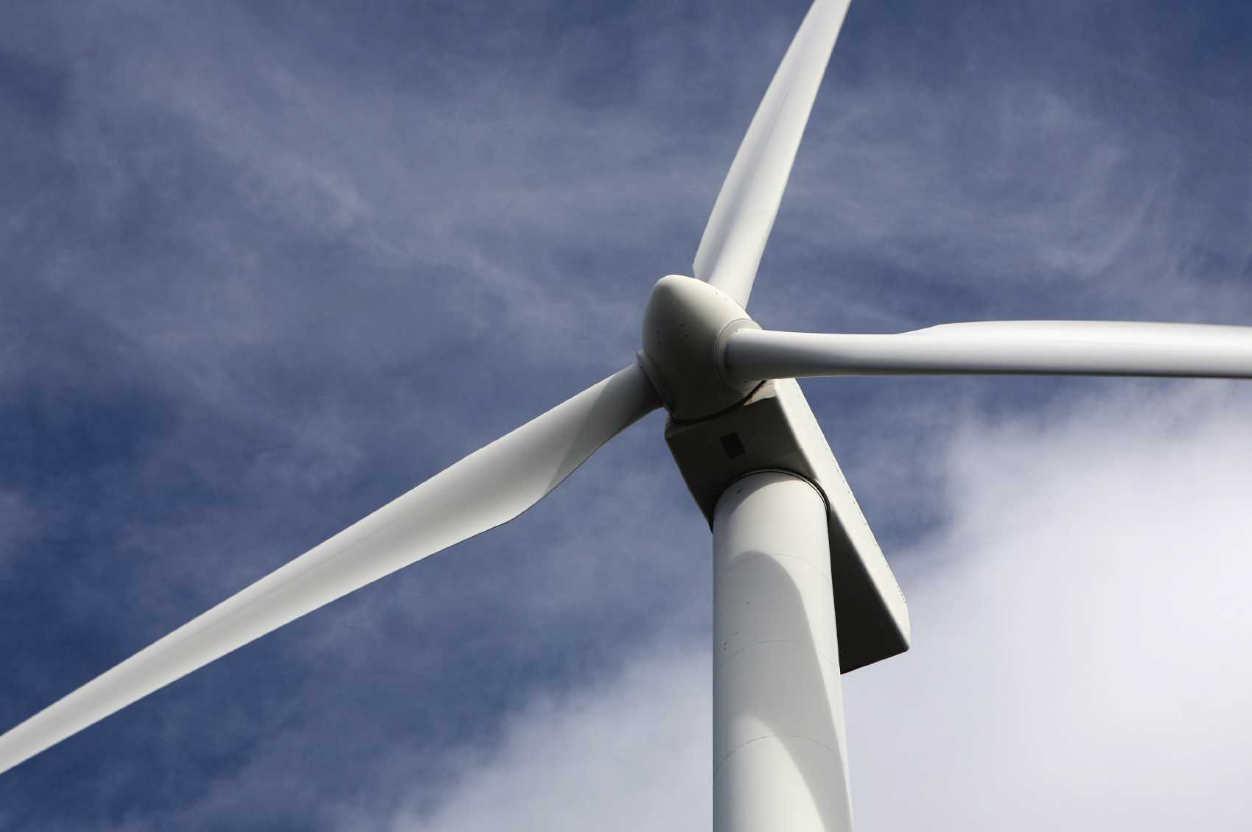
DOE SBIR/STTR
Phase I Release 2 Topics Webinar
Topics associated with the
FY 2022 Phase I Release 2
Funding Opportunity Announcement
Topics 24-38
DOE SBIR/STTR Programs Office
November 18, 2021

Slide 3
TODAY’S AGENDA
Topics Introduction | DOE SBIR/STTR Programs Office
Topics 24 – 28 | Office of Fusion Energy Sciences (FES)
Topics 29 – 35 | Office of High Energy Physics (HEP)
Topics 36–38 | Office of Nuclear Energy (NE)

Slide 4
FY 2022 Phase I Schedule
 | Release 1 | Release 2
Topics Issued | Monday, July 12, 2021 | Monday, November 8, 2021
Webinar(s) | Week of July 19, 2021 | Week of November 15, 2021
FOA Issued | Monday, August 9, 2021 | Monday, December 13, 2021
Webinar(s) | Friday, August 13, 2021 | Friday, December 17, 2021
Letters of Intent (LOI) Due | Monday, August 30, 2021 | Monday, January 3, 2022
Non-responsive LOI Feedback Provided | Monday, September 20, 2021 | Monday, January 24, 2022
Applications Due | Tuesday, October 12, 2021 | Tuesday, February 22, 2022
Award Notification | Monday, January 3, 2022 | Monday, May 16, 2022

Slide 5

Phase I Funding Opportunity Announcements
Participating DOE Programs (FY 2022)
Office of Advanced Scientific Computing Research
Office of Basic Energy Sciences
Office of Biological and Environmental Research
Office of Nuclear Physics
Phase I
Release 1
Office of Cybersecurity, Energy Security, and Emergency Response
Office of Defense Nuclear Nonproliferation
Office of Electricity
Office of Energy Efficiency and Renewable Energy
Office of Fossil Energy and Carbon Management
Office of Fusion Energy Sciences
Office of High Energy Physics
Office of Nuclear Energy
Phase I
Release 2

Slide 6
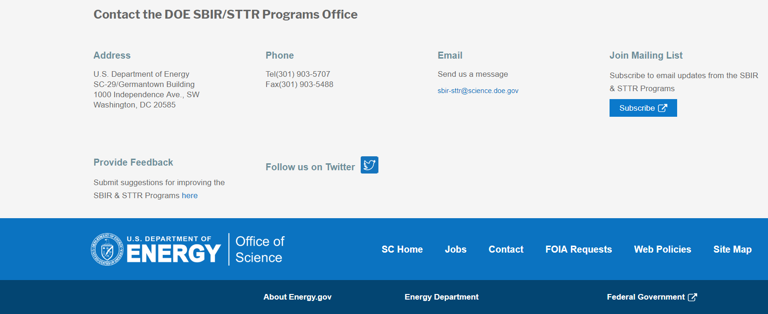
Funding Opportunity Announcement (FOA) Webinar
FY22 Phase I Release 2 FOA will be issued on December 13th
Join our Mailing List – this field is on every DOE SBIR/STTR web page
  Following the issuance of the FOA, look for an email with a link to the FOA
Webinar with Q&A for this FOA on December 17th
  Overview of the FY 2022 DOE SBIR/STTR Programs
    Following the issuance of the FOA, look for an email announcing this webinar

Slide 7
Topic Basics
Topics are created by DOE program managers and define important technology breakthroughs needed in R&D areas that support the DOE mission
Topics are organized by DOE Program Office, e.g., ASCR, BES, etc.
DOE program managers are listed with each subtopic
  Questions to DOE program managers are limited to clarification of the topic and subtopic (including references)
  Clarification is provided to help you determine whether your technology fits within the topic and subtopic
  You may communicate with these topic managers from the release of topics until the grant application due date
  The decision to apply is yours

Slide 8
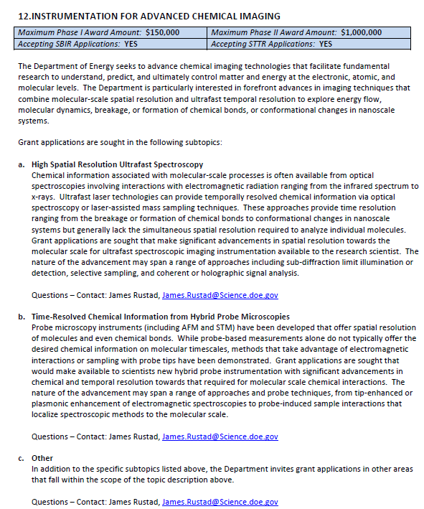
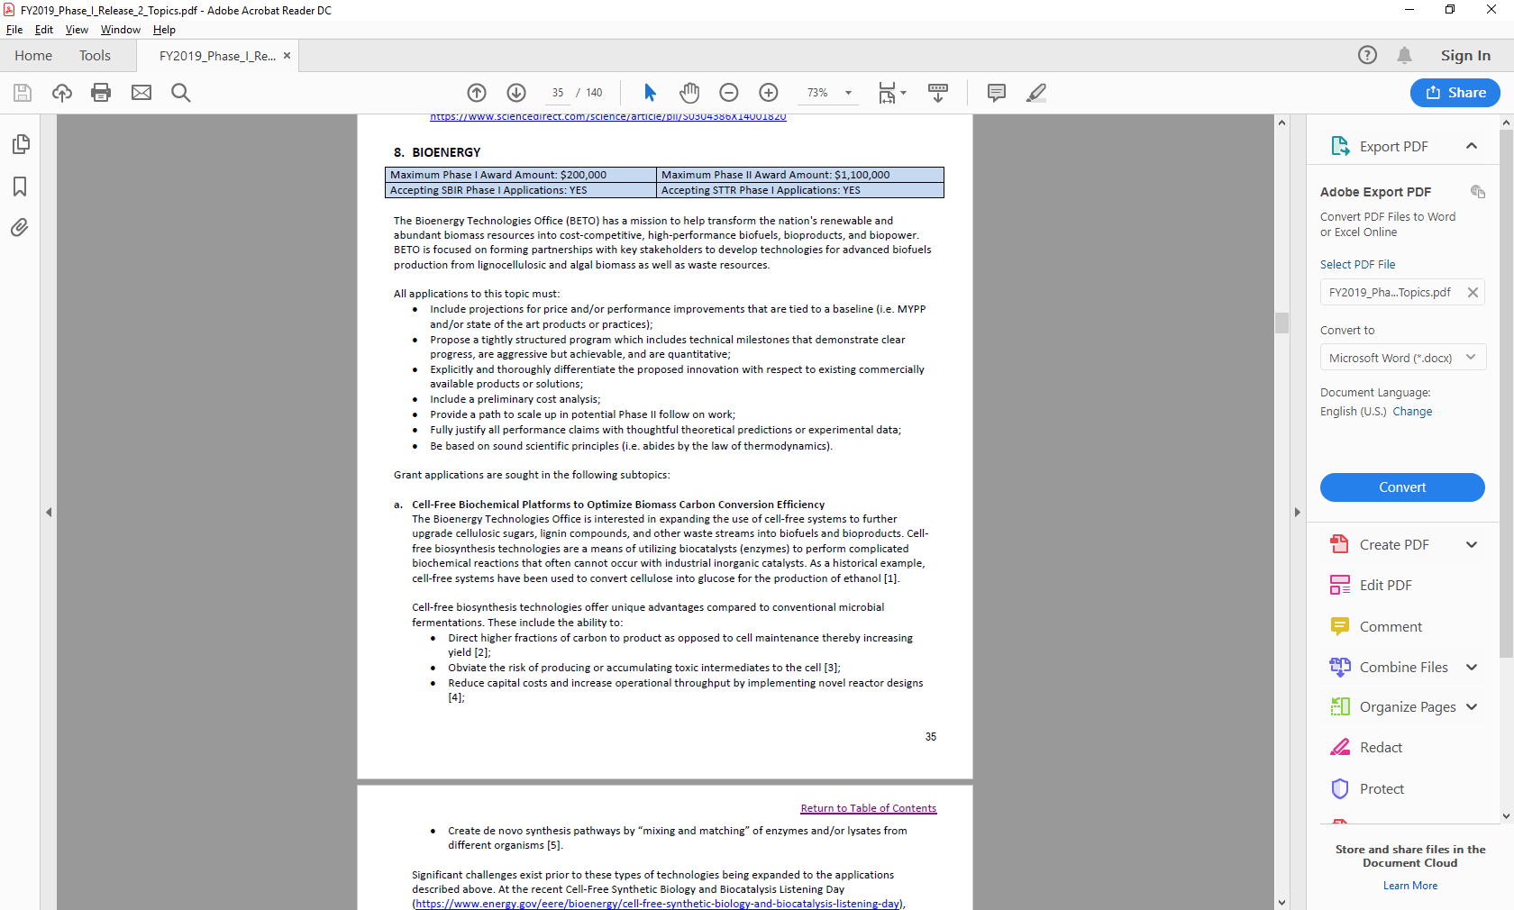
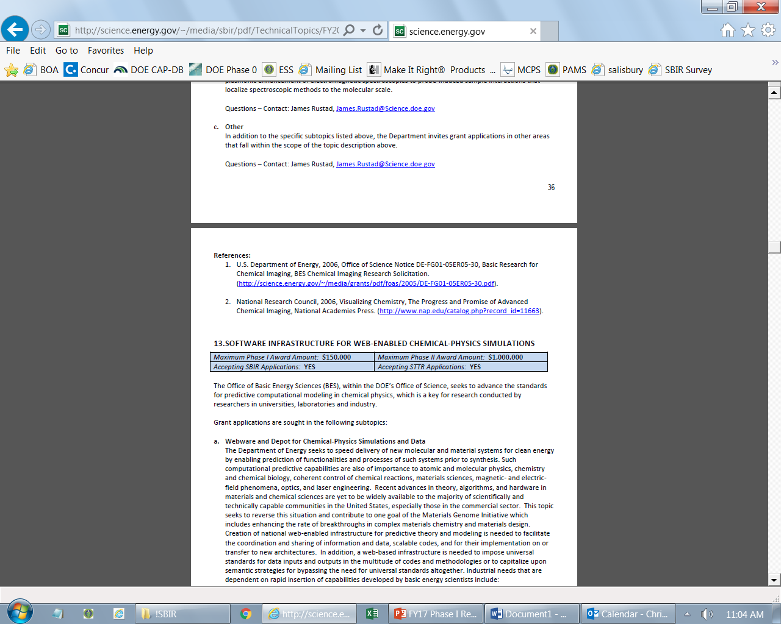
Example Topic
Topic & Subtopic
  You must specify the same topic and subtopic in your Letter of Intent and grant application
Topic Header
  Lists the maximum award amounts for Phase I & Phase II and the types of application accepted (SBIR and/or STTR)
Program Manager
  Each subtopic lists the responsible DOE program manager
“Other” Subtopic
References
Notes:
Here is an example topic from our current announcement. Note that every SBIR or STTR application must include the topic and subtopic to which you are applying. The general topic description describes the general field of technology that is of interest. The subtopics describe specific opportunities in which proposals are requested. Each topic at DOE will also have an “other” subtopic. Under this subtopic you can submit proposals that fall within the general topic description, but do not fit with any of the other subtopics. We have found that when we write the subtopics too narrow sometimes we miss good opportunities, and this “other” subtopic is a means collecting disruptive solutions.

Slide 9
Topic 24: FUSION BLANKET AND TRITIUM FUEL CYCLE
Maximum Phase I Award Amount: $200,000 | Maximum Phase II Award Amount: $1,100,000
Accepting SBIR Phase I Applications: YES | Accepting STTR Phase I Applications: YES
Dual Cooled Lead Lithium Blanket
Helium Cooled Ceramic Breeders
Tritium Fuel Cycle System Components
Other
Questions: Guinevere Shaw, guinevere.shaw@science.doe.gov

Slide 10
Topic 25: SUPERCONDUCTING MAGNETS
Maximum Phase I Award Amount: $200,000 | Maximum Phase II Award Amount: $1,100,000
Accepting SBIR Phase I Applications: YES | Accepting STTR Phase I Applications: YES
Superconducting Magnetic Technology
Other
Questions: Guinevere Shaw, guinevere.shaw@science.doe.gov

Slide 11
Topic 26: HIGH ENERGY DENSITY LABORATORY PLASMAS
Maximum Phase I Award Amount: $200,000 | Maximum Phase II Award Amount: $1,100,000
Accepting SBIR Phase I Applications: YES | Accepting STTR Phase I Applications: YES
High Repetition Rates HED Diagnostics
Other
Questions: Kramer Akli, Kramer.akli@science.doe.gov

Slide 12
Topic 27: LOW TEMPERATURE PLASMAS AND MICROELECTRONICS
Maximum Phase I Award Amount: $200,000 | Maximum Phase II Award Amount: $1,100,000
Accepting SBIR Phase I Applications: YES | Accepting STTR Phase I Applications: YES
LTP Science and Engineering for Microelectronics and Nanotechnology
Other
Questions: Nirmol Podder, Nirmol.Podder@science.doe.gov

Slide 13
Topic 28: TECHNOLOGY FOR FUSION PLASMA SCIENCES
Maximum Phase I Award Amount: $200,000 | Maximum Phase II Award Amount: $1,100,000
Accepting SBIR Phase I Applications: YES | Accepting STTR Phase I Applications: YES
Actuators for Plasma Profile and Stability Control
Fiber Optic Bolometer Diagnostic
Other
Questions: Subtopic a – Matthew Lanctot, matthew.lanctot@science.doe.gov
Questions: Subtopic b & c – Curt Bolton, curt.bolton@science.doe.gov

Slide 14
Topic 29: ADVANCED CONCEPTS AND TECHNOLOGY FOR PARTICLE ACCELERATORS
Maximum Phase I Award Amount: $200,000 | Maximum Phase II Award Amount: $1,100,000
Accepting SBIR Phase I Applications: YES | Accepting STTR Phase I Applications: YES
Non-Destructive Electron Beam Position Monitors
Structure Wakefield Acceleration (SWFA)
High Fidelity Modeling of Advanced Accelerator Structures
Data Infrastructure for the Next Generation of Adaptive Real-Time Controls for Large-Scale Facilities
Other
Questions: Ken Marken, ken.marken@science.doe.gov

Slide 15
Topic 30: RADIO FREQUENCY ACCELERATOR TECHNOLOGY
Maximum Phase I Award Amount: $200,000 | Maximum Phase II Award Amount: $1,100,000
Accepting SBIR Phase I Applications: YES | Accepting STTR Phase I Applications: YES
Low-Cost Radio Frequency Power Sources for Accelerator Application
Automation of SRF Cavity String Assembly
Auxiliary Components and Instrumentation for SRF Cavities
Other
Questions: Subtopic a – Eric Colby, Eric.Colby@science.doe.gov
Questions: Subtopics b, c & d – Ken Marken, ken.marken@science.doe.gov

Slide 16
Topic 31: LASER TECHNOLOGY R&D FOR ACCELERATORS
Maximum Phase I Award Amount: $200,000 | Maximum Phase II Award Amount: $1,100,000
Accepting SBIR Phase I Applications: YES | Accepting STTR Phase I Applications: YES
High Energy and Broadband Components for Fiber Lasers and Arrays
Additive Manufacturing of Laser Materials for High-Average-Power Ultrashort Pulse lasers
Aperture-Scalable High Performance Diffraction Gratings
Large Format Faraday Isolators for High Power Ultrafast Laser Systems
Other
Questions: Eric Colby, eric.colby@science.doe.gov

Slide 17
Topic 32: HIGH FIELD SUPERCONDUCTING MAGNET TECHNOLOGY
Maximum Phase I Award Amount: $200,000 | Maximum Phase II Award Amount: $1,100,000
Accepting SBIR Phase I Applications: YES | Accepting STTR Phase I Applications: YES
High-Field Superconducting Wire and Cable Technologies for Magnets
Magnet Quench Detection Systems
Cryogenic Power Electronics for Distributed Powering and Quench Protection of HTS and Hybrid Magnets
Non-Invasive Imaging of Interfacial Bonding and Mechanical Failure Modes in High-Field Magnets
Other
Questions: Ken Marken, ken.marken@science.doe.gov

Slide 18
Topic 33: HIGH ENERGY PHYSICS ELECTRONICS
Maximum Phase I Award Amount: $200,000 | Maximum Phase II Award Amount: $1,100,000
Accepting SBIR Phase I Applications: YES | Accepting STTR Phase I Applications: YES
Radiation-Hard CMOS Sensors and Engineered Substrates for Detectors at High Energy Colliders
High-Density Chip Interconnect Technology
Radiation-Hard High-Bandwidth Data Transmission for Detectors at High Energy Colliders
Electronics Systems for Ultra-Low-Temperature Experiments
High-Channel Count Electronic Tools for Picosecond Timing
Other
Questions: Helmut Marsiske, helmut.marsiske@science.doe.gov

Slide 19
Topic 34: HIGH ENERGY PHYSICS DETECTORS AND INSTRUMENTATION
Maximum Phase I Award Amount: $200,000 | Maximum Phase II Award Amount: $1,100,000
Accepting SBIR Phase I Applications: YES | Accepting STTR Phase I Applications: YES
Low-Cost, High-Performance (V)UV/Visible/Near-IR Photon Detection
Scintillating Detector Materials and Wavelength Shifters
High-Strength, High-Radiopurity Materials
Advanced Composite Materials
New Cryogenic Cooling Solutions for Low-Temperature Experiments
Other
Questions: Helmut Marsiske, helmut.marsiske@science.doe.gov

Slide 20
Topic 35: QUANTUM INFORMATION SCIENCE (QIS) SUPPORTING TECHNOLOGIES
Maximum Phase I Award Amount: $200,000 | Maximum Phase II Award Amount: $1,100,000
Accepting SBIR Phase I Applications: YES | Accepting STTR Phase I Applications: YES
a. Design and Fabrication of Microdisk Optical Resonators Supporting Very High-Q Optical Modes
b. High Efficiency Photodetectors and Homodyne Detectors
c. Other
Questions: Ken Marken, ken.marken@science.doe.gov

Slide 21
Topic 36: ADVANCED TECHNOLOGIES FOR NUCLEAR ENERGY
Maximum Phase I Award Amount: $200,000 | Maximum Phase II Award Amount: $1,100,000
Accepting SBIR Phase I Applications: YES | Accepting STTR Phase I Applications: YES
Materials Protection Accounting and Control for Domestic Fuel Cycles
Advanced Modeling and Simulation
Plant Modernization
Component Development to Support Liquid Metal Reactors – Electromagnetic Pumps
Roller Bearings for High Temperature Sodium Applications
Rapid, Inexpensive Molten Salt Property Measurement
National Reactor Innovation Center (NRIC)
Advanced Methods and Manufacturing Technologies (AMMT) Program
Questions: Subtopic a – Michael Reim, michael.reim@nuclear.energy.gov
Questions: Subtopic b – David Henderson, David.Henderson@nuclear.energy.gov
Questions: Subtopic c – William Walsh, william.walsh@nuclear.energy.gov
Questions: Subtopics d, e & f – Brian K. Robinson, Brian.Robinson@nuclear.energy.gov
Questions: Subtopic g – Janelle Eddins, Janelle.Eddins@nuclear.energy.gov
Questions: Subtopic h – Dirk Cairns-Gallimore, dirk.cairns-gallimore@nuclear.energy.gov

Slide 22
Topic 36: ADVANCED TECHNOLOGIES FOR NUCLEAR ENERGY (CONTINUED)
Maximum Phase I Award Amount: $200,000 | Maximum Phase II Award Amount: $1,100,000
Accepting SBIR Phase I Applications: YES | Accepting STTR Phase I Applications: YES
Nuclear Science User Facilities (NSUF) Program
Cybersecurity Technologies for Protection of Nuclear Critical Systems
Cost Analysis for Thermal Distribution and Storage Components
Envisioning Distributed Nuclear Generation and Reactor Siting Considerations for Integrated Energy Systems
Small Modular Reactor Capabilities, Components, and Systems
Microreactor Applications, Unattended Operations, and Cost-Reduction Technologies
Advanced and Small Reactor Physical Security Cost Reduction
Questions: Subtopic i –Tansel Selekler, Tansel.Selekler@nuclear.energy.gov
Questions: Subtopics j & m – Rebecca Onuschak, rebecca.onuschak@nuclear.energy.gov
Questions: Subtopics k & l – Jason Marcinkoski, Jason.Marcinkoski@nuclear.energy.gov
Questions: Subtopic n – Diana Li, Diana.Li@nuclear.energy.gov
Questions: Subtopic o – Alison Hahn, alison.hahn@nuclear.energy.gov

Slide 23
Topic 36: ADVANCED TECHNOLOGIES FOR NUCLEAR ENERGY (CONTINUED)
Maximum Phase I Award Amount: $200,000 | Maximum Phase II Award Amount: $1,100,000
Accepting SBIR Phase I Applications: YES | Accepting STTR Phase I Applications: YES
Advanced Technologies for the Fabrication, Characterization of Nuclear Reactor Fuel
Advanced Sensors and Instrumentation (Crosscutting Research)
Other
Develop or Improve Small Scale Mechanical Testing Techniques to Provide Size-independent Material Properties of Alloys in a Nuclear Power Plant Environment
Thermally Driven Mechanical Heat Pumps for Thermal Storage and Industrial Applications
Questions: Subtopic p – Frank Goldner, Frank.Goldner@nuclear.energy.gov
Questions: Subtopics q & r – Daniel Nichols, daniel.nichols@nuclear.energy.gov
Questions: Subtopic s – Sue Lesica, Sue.Lesica@nuclear.energy.gov
Questions: Subtopic t – Jason Marcinkoski, Jason.Marcinkoski@nuclear.energy.gov

Slide 24
Topic 37: ADVANCED TECHNOLOGIES FOR NUCLEAR WASTE
Maximum Phase I Award Amount: $200,000 | Maximum Phase II Award Amount: $1,100,000
Accepting SBIR Phase I Applications: YES | Accepting STTR Phase I Applications: YES
Spent Fuel and Waste Science and Technology, Disposal Research
Spent Fuel and Waste Science and Technology, Storage & Transportation R&D
Questions: Subtopic a – Prasad Nair, Prasad.Nair@nuclear.energy.gov
Questions: Subtopic b – John Orchard, John.Orchard@doe.gov

Slide 25
Topic 38: MATERIAL RECOVERY AND WASTE FORM DEVELOPMENT
Maximum Phase I Award Amount: $200,000 | Maximum Phase II Award Amount: $1,100,000
Accepting SBIR Phase I Applications: YES | Accepting STTR Phase I Applications: YES
Metal Organic Framework Manufacturing Technology
Phosphate-based Salt Waste Dechlorination and Immobilization Process Technology
Krypton Separations Technology
Questions: Kimberly Gray, Kimberly.Gray@nuclear.energy.gov

Slide 26
DOE SBIR/STTR Programs Office
Contact Information
Join our mailing list: https://science.osti.gov/sbir
Follow us on twitter: @DOESBIR
Follow us on LinkedIn: U.S. Department of Energy (DOE) SBIR/STTR Programs | LinkedIn
Phase 0 Application Assistance: https://doephase0.dawnbreaker.com/
Email: sbir-sttr@science.doe.gov
Phone: (301) 903-5707

