Slide 1
The DOE Webinar will begin shortly . . .
Why is there no sound?
Once you logged into the webinar, you were provided two options to listen to this broadcast. The first option is through your computer speakers, the second option is via dialing the phone number provided to you upon login to the webinar. If you chose to listen through your computer speakers, you may need to turn your speaker volume on or up.
Will DOE provide access to the recorded webinar after the meeting?
Yes, all those who registered will receive a link to the slides and to the recorded webinar soon after the meeting. It will also be available on the DOE SBIR/STTR web site.
Where can I find the Topics being discussed today?
This link will take you to the Funding Opportunity Announcement (FOA) page that lists the FY 2021 Phase I Release 2 Topics: https://science.osti.gov/sbir/Funding-Opportunities
What if my question was not answered at today’s webinar?
Please contact the point of contact that follows each subtopic in the document listed above for further clarification.
If you have a question about the grant application process, please send us an email at: sbir-sttr@science.doe.gov.

Slide 2

DOE SBIR/STTR Phase I Release 2 Topics Webinar Topics associated with the FY 2021 Phase I Release 2 Funding Opportunity Announcement Topics 1-8 & 21-27
DOE SBIR/STTR Programs Office
November 16, 2020

Slide 3
TODAY’S AGENDA
Topics Introduction | DOE SBIR/STTR Programs Office
Topic 01 | Office of Cybersecurity, Energy Security, and Emergency Response
Topics 02 – 06 | Office of Defense Nuclear Nonproliferation
Topics 7-8 | Office of Electricity
Topic 21 | Office of Environmental Management
Topics 22-27 | Office of Fossil Energy

Slide 4
FY 2021 Phase I Schedule
 | Release 1 | Release 2
Topics Issued | Monday, July 13, 2020 | Monday, November 9, 2020
Webinar(s) | Week of July 20, 2020 | Week of November 16, 2020
FOA Issued | Monday, August 10, 2020 | Monday, December 14, 2020
Webinar(s) | Monday, August 17, 2020 | Friday, December 18, 2020
Letters of Intent (LOI) Due | Monday, August 31, 2020 | Monday, 4 January, 2021
Non-responsive LOI Feedback Provided | Monday, September 21, 2020 | Monday, January 25, 2021
Applications Due | Tuesday, October 13, 2020 | Monday, February 22, 2021
Award Notification | Monday, January 4, 2021 | Monday, May 17, 2021

Slide 5

Phase I Funding Opportunity Announcements Participating DOE Programs (FY 2021)
Office of Advanced Scientific Computing Research
Office of Basic Energy Sciences
Office of Biological and Environmental Research
Office of Nuclear Physics
Office of Science
Phase I
Release 1
Office of Cybersecurity, Energy Security, and Emergency Response
Office of Defense Nuclear Nonproliferation
Office of Electricity
Office of Energy Efficiency and Renewable Energy
Office of Environmental Management
Office of Fossil Energy
Office of Fusion Energy Sciences
Office of High Energy Physics
Office of Nuclear Energy
Phase I
Release 2

Slide 6
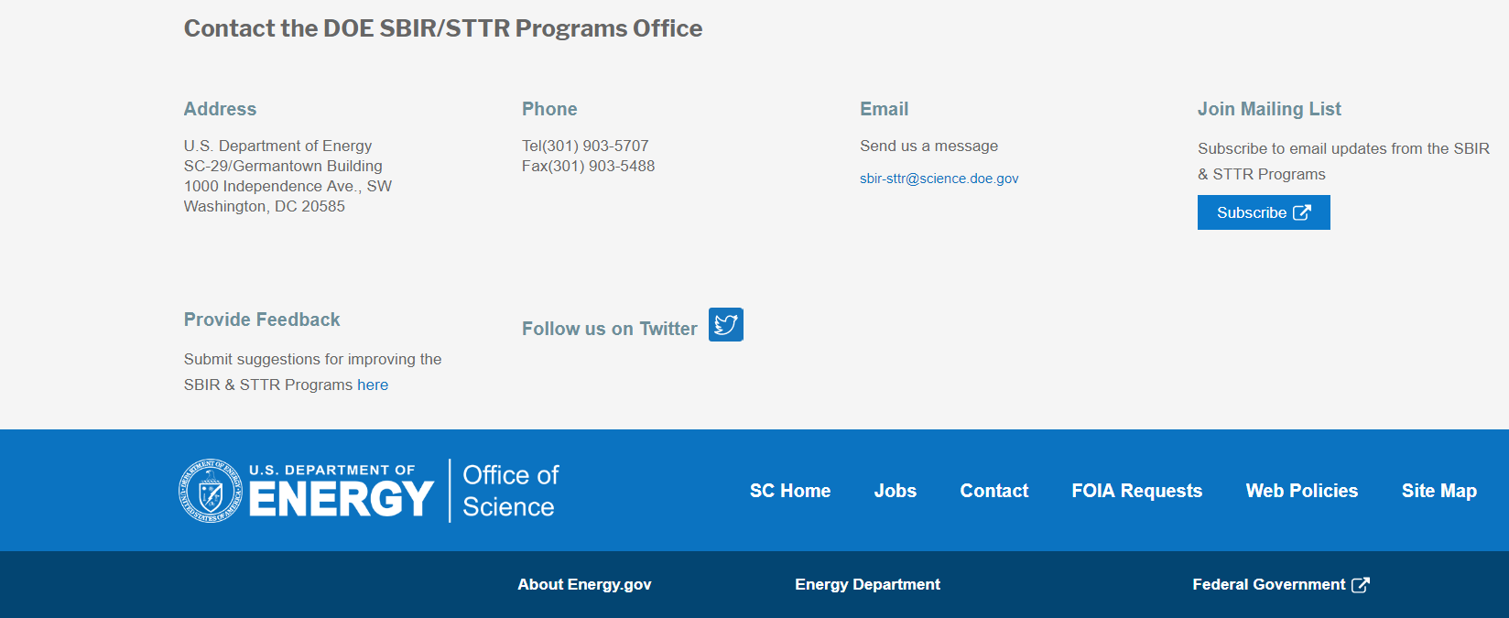
Funding Opportunity Announcement (FOA) Webinar
FY21 Phase I Release 2 FOA will be issued on December 14th
Join our Mailing List – this field is on every DOE SBIR/STTR web page
Following the issuance of the FOA, look for an email with a link to the FOA
Webinar with Q&A for this FOA on December 18th
Overview of the FY 2021 DOE SBIR/STTR Programs
Following the issuance of the FOA, look for an email announcing this webinar

Slide 7
Topic Basics
Topics are created by DOE program managers and define important technology breakthroughs needed in R&D areas that support the DOE mission
Topics are organized by DOE Program Office, e.g., EERE, BES, etc.
DOE program managers are listed with each subtopic
Questions to DOE program managers are limited to clarification of the topic and subtopic (including references)
Clarification is provided to help you determine whether your technology fits within the topic and subtopic
You may communicate with these topic managers from the release of topics until the grant application due date
The decision to apply is yours

Slide 8
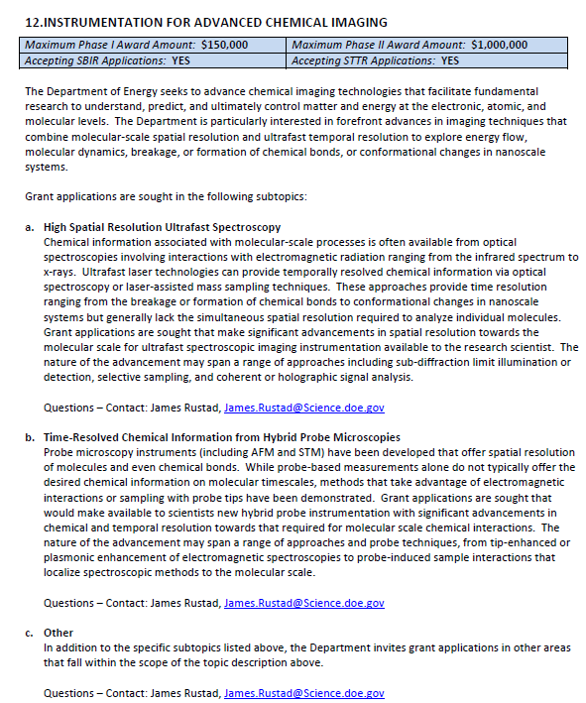
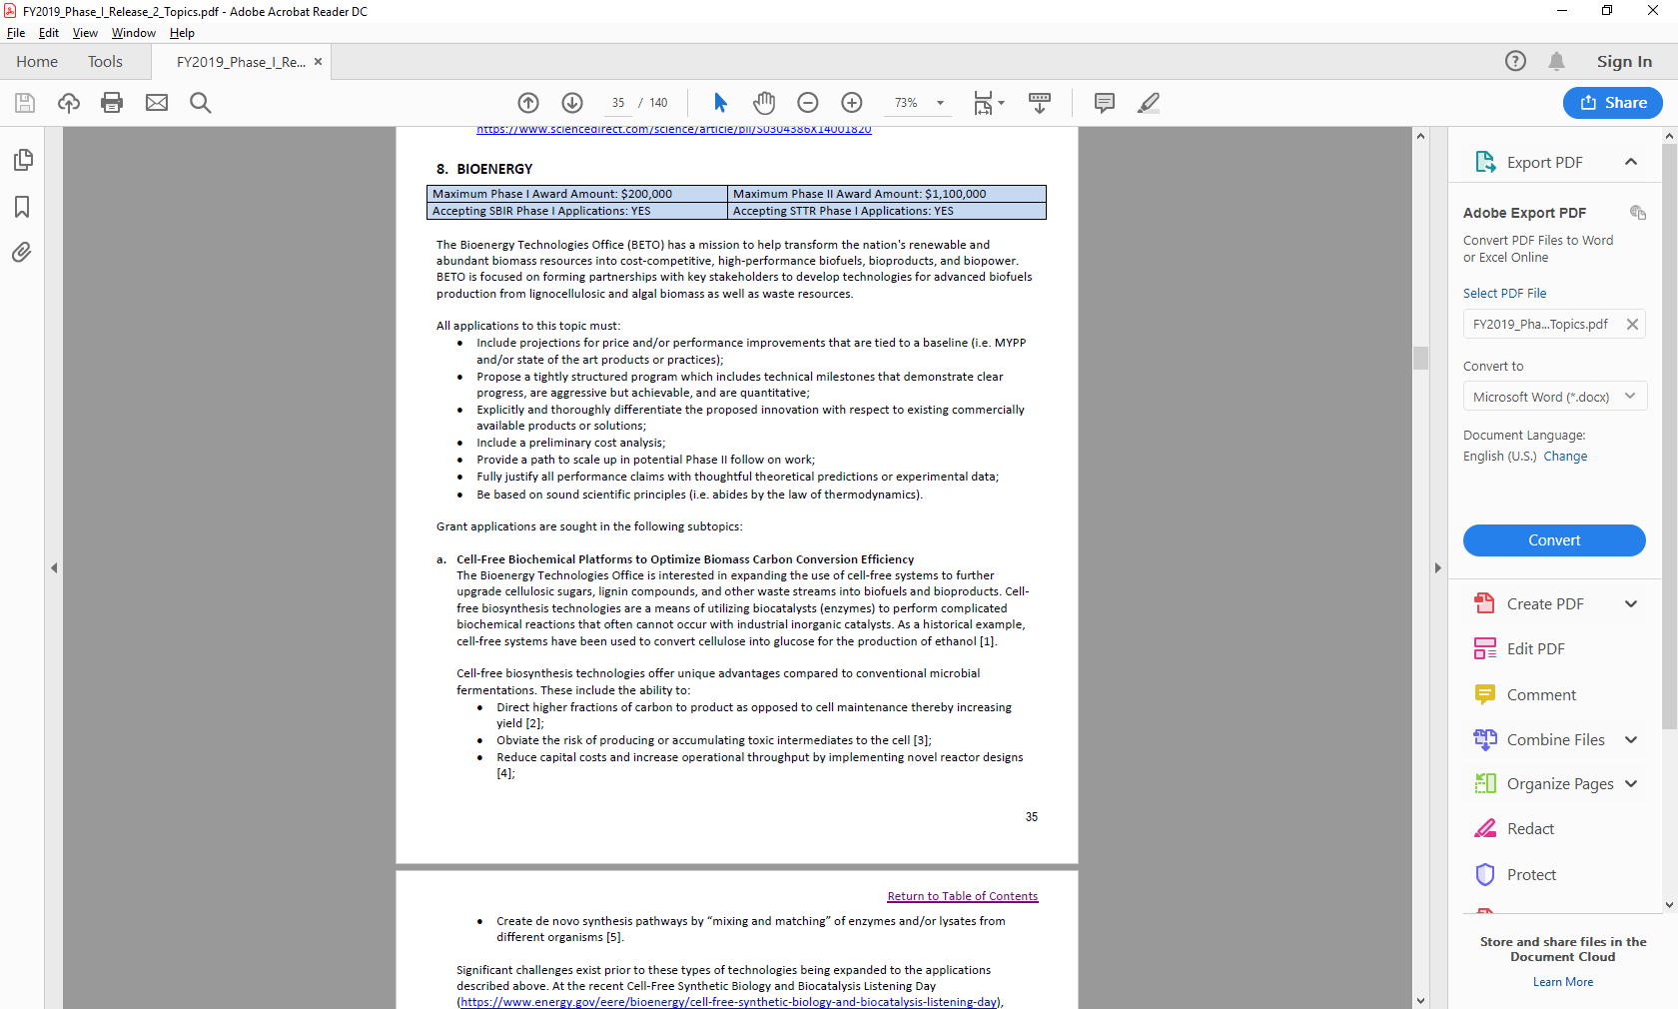
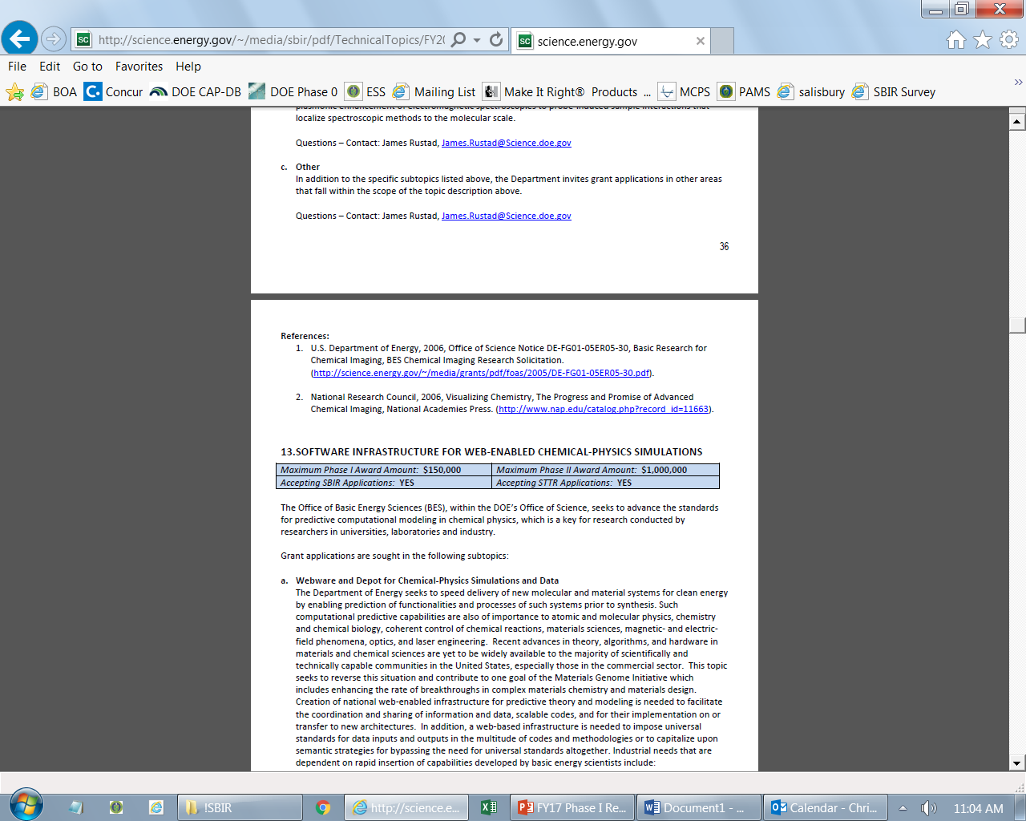
Example Topic
Topic & Subtopic
You must specify the same topic and subtopic in your Letter of Intent and grant application
Topic Header
Lists the maximum award amounts for Phase I & Phase II and the types of application accepted (SBIR and/or STTR)
Program Manager
Each subtopic lists the responsible DOE program manager
“Other” Subtopic
References
Notes:
Here is an example topic from our current announcement. Note that every SBIR or STTR application must include the topic and subtopic to which you are applying. The general topic description describes the general field of technology that is of interest. The subtopics describe specific opportunities in which proposals are requested. Each topic at DOE will also have an “other” subtopic. Under this subtopic you can submit proposals that fall within the general topic description, but do not fit with any of the other subtopics. We have found that when we write the subtopics too narrow sometimes we miss good opportunities, and this “other” subtopic is a means collecting disruptive solutions.

Slide 9
Topic 01:ENERGY SYSTEMS CYBERSECURITY
Maximum Phase I Award Amount: $200,000 | Maximum Phase II Award Amount: $1,100,000
Accepting SBIR Phase I Applications: YES | Accepting STTR Phase I Applications: No
a. Cybersecurity during Contingency Operations
b. Cybersecurity in Supply Chain and Acquisition
c. Enhancing Organizational Cybersecurity Awareness
Questions: Walter Yamben, Walter.Yamben@netl.doe.gov

Slide 10
Topic 02: ALTERNATIVE RADIOLOGICAL SOURCE TECHNOLOGIES
Maximum Phase I Award Amount: $200,000 | Maximum Phase II Award Amount: $1,100,000
Accepting SBIR Phase I Applications: YES | Accepting STTR Phase I Applications: No
Portable Modular Accelerator Technology to Replace Gamma in Irradiation Applications
Glass-metal Fritted Assemblies for Alpha-detection
Other
Questions: Donald Hornback, Donald.Hornback@nnsa.doe.gov

Slide 11
Topic 03: REMOTE DETECTION TECHNOLOGIES
Maximum Phase I Award Amount: $200,000 | Maximum Phase II Award Amount: $1,100,000
Accepting SBIR Phase I Applications: YES | Accepting STTR Phase I Applications: NO
Extending Remote Gas Sensing Range
Networked Edge Sensing
Other
Questions: Chris Ramos, Christopher.ramos@nnsa.doe.gov

Slide 12
Topic 04: ARTIFICIAL INTELLIGENCE
Maximum Phase I Award Amount: $200,000 | Maximum Phase II Award Amount: $1,100,000
Accepting SBIR Phase I Applications: YES | Accepting STTR Phase I Applications: NO
Cloud/High-Performance Computing (HPC) Architectures by Design
Other
Questions: Angie Sheffield, angela.sheffield@nnsa.doe.gov

Slide 13
Topic 05: DIGITIZING AND ANALYZING LEGACY SEISMO-ACOUSTIC DATA
Maximum Phase I Award Amount: $200,000 | Maximum Phase II Award Amount: $1,100,000
Accepting SBIR Phase I Applications: YES | Accepting STTR Phase I Applications: NO
Digitization of Legacy Seismo-acoustic Waveform Data
Methods to Readily Read, Recover, and Organize Legacy Digital Storage Media
Analysis Methods to Identify the Instrument Response Function (IRF) for De-convolution
Other
Questions: Thomas Kiess, thomas.kiess@nnsa.doe.gov

Slide 14
Topic 06: SURFACE MAPPING MICROANALYSIS
Maximum Phase I Award Amount: $200,000 | Maximum Phase II Award Amount: $1,100,000
Accepting SBIR Phase I Applications: YES | Accepting STTR Phase I Applications: NO
Rapid Scanning and Feature Discrimination
2-D and 3-D Surface Mapping Across Multiple Microscopy Platforms
Spatial Alignment and Target Extraction
Other
Questions: Timothy Ashenfelter, Timothy.Ashenfelter@nnsa.doe.gov

Slide 15
Topic 07: ADVANCED GRID TECHNOLOGIES
Maximum Phase I Award Amount: $200,000 | Maximum Phase II Award Amount: $1,100,000
Accepting SBIR Phase I Applications: YES | Accepting STTR Phase I Applications: NO
Advanced Protective Relaying Technologies and Tools
New Methods for Training Operators Leveraging Advances in Cognitive Science
Questions: Subtopic a – David Howard, david.howard@hq.doe.gov
Questions: Subtopic b – Sandra Jenkins, sandra.jenkins@hq.doe.gov

Slide 16
Topic 08: ADVANCED POWER CONVERSION SYSTEM MAGNETICS FOR GRID-TIED ENERGY STORAGE
Maximum Phase I Award Amount: $200,000 | Maximum Phase II Award Amount: $1,100,000
Accepting SBIR Phase I Applications: YES | Accepting STTR Phase I Applications: NO
Advanced Manufactured High Frequency Link Transformers for Next Generation Grid-tied Energy Storage Power Conversion Systems
Questions: Imre Gyuk, imre.gyuk@hq.doe.gov

Slide 17
Topic 21: NOVEL MONITORING CONCEPTS IN THE SUBSURFACE
Maximum Phase I Award Amount: $200,000 | Maximum Phase II Award Amount: $1,100,000
Accepting SBIR Phase I Applications: YES | Accepting STTR Phase I Applications: NO
Real-time Sampling & Analysis of Tank Waste with Remote or On-pipe Monitoring
Non-Intrusive Mercury Detection and Measurement
Other
Questions: Latrincy Bates, Latrincy.Bates@em.doe.gov or Grover Chamberlain, grover.chamberlain@em.doe.gov

Slide 18
Topic 22: CARBON STORAGE R&D
Maximum Phase I Award Amount: $250,000 | Maximum Phase II Award Amount: $1,600,000
Accepting SBIR Phase I Applications: YES | Accepting STTR Phase I Applications: YES
Technologies for Detection and Characterization of Legacy Wellbores: Carbon Storage
Other
Questions: Kyle Smith, kyle.smith@netl.doe.gov

Slide 19
Topic 23: SUPERCRITICAL CARBON DIOXIDE (SCO2)
Maximum Phase I Award Amount: $250,000 | Maximum Phase II Award Amount: $1,600,000
Accepting SBIR Phase I Applications: YES | Accepting STTR Phase I Applications: YES
Supercritical Carbon Dioxide Resistant Coatings for Turbomachinery
Advanced Coolers for Supercritical Carbon Dioxide Base Power Cycles
Other
Questions: Subtopic a – Richard Dalton, Richard.Dalton@netl.doe.gov
Subtopic b – Drew O’Connell, Andrew.Oconnell@netl.doe.gov
Subtopic c – Mark Freeman, Mark.Freeman@netl.doe.gov

Slide 20
Topic 24: RARE EARTH ELEMENTS AND CRITICAL MINERALS FROM COAL-BASED RESOURCES
Maximum Phase I Award Amount: $250,000 | Maximum Phase II Award Amount: $1,600,000
Accepting SBIR Phase I Applications: YES | Accepting STTR Phase I Applications: YES
Advanced Technology Development for Production of Individually Separated, High Purity, (ISHP) Rare Earth Oxides/Rare Earth Salts (REO/RES)
Advanced Technology Development for Production of Rare Earth Metals
Production of Critical Minerals from Coal-Based Resources
Other
Questions: Mark Render, mark.render@netl.doe.gov

Slide 21
Topic 25: CARBON CAPTURE
Maximum Phase I Award Amount: $250,000 | Maximum Phase II Award Amount: $1,600,000
Accepting SBIR Phase I Applications: YES | Accepting STTR Phase I Applications: YES
Novel Cryogenic Processes to Support Transformational Carbon Capture Technologies
Other
Questions: Krista Hill, krista.hill@netl.doe.gov

Slide 22
Topic 26: UNCONVENTIONAL OIL & NATURAL GAS TECHNOLOGIES
Maximum Phase I Award Amount: $250,000 | Maximum Phase II Award Amount: $1,600,000
Accepting SBIR Phase I Applications: YES | Accepting STTR Phase I Applications: YES
Advanced Shale Gas Recovery Technologies for Horizontal Well Completion Optimization
Advanced Hydraulic Fracture Diagnostics for Unconventional Oil and Natural Gas Wells
Other
Questions: William Fincham, william.fincham@netl.doe.gov

Slide 23
Topic 27 : NATURAL GAS TECHNOLOGIES: NATURAL GAS INFRASTRUCTURE
Maximum Phase I Award Amount: $250,000 | Maximum Phase II Award Amount: $1,600,000
Accepting SBIR Phase I Applications: YES | Accepting STTR Phase I Applications: YES
Hydrogen Transport
Sensors for Hydrogen Monitoring
Hydrogen Leakage Detection and Mitigation
Other
Questions: William Fincham, william.fincham@netl.doe.gov

Slide 24

DOE SBIR/STTR Programs Office Contact Information
SBIR/STTR Web: https://science.osti.gov/sbir
Email: sbir-sttr@science.doe.gov
Phone Assistance Hotline: 301-903-5707
DOE Phase 0 Assistance Program: http://www.dawnbreaker.com/doephase0/
DOE Application Assistance: https://science.osti.gov/SBIRLearning

