Slide 1
The DOE Webinar will begin shortly . . .
Why is there no sound?
Once you logged into the webinar, you were provided two options to listen to this broadcast. The first option is through your computer speakers, the second option is via dialing the phone number provided to you upon login to the webinar. If you chose to listen through your computer speakers, you may need to turn your speaker volume on or up.
Will DOE provide access to the recorded webinar after the meeting?
Yes, the recorded webinar and the slides will be available on the DOE SBIR/STTR web site.
Where can I find the Topics being discussed today?
This link will take you to the Funding Opportunity Announcement (FOA) page that lists the FY 2021 Phase I Release 2 Topics: https://science.osti.gov/sbir/Funding-Opportunities
Technology Transfer Opportunity subtopics 16a, 16b, 19c and 20a will not be discussed in this webinars. Please contact the TTO point of contact directly as listed in the Topics document on the DOE SBIR/STTR web site.
What if my question was not answered at today’s webinar?
Please contact the point of contact that follows each subtopic in the document listed above for further clarification.
If you have a question about the grant application process, please send us an email at: sbir-sttr@science.doe.gov.

Slide 2

DOE SBIR/STTR Phase I Release 2 Topics Webinar Topics associated with the FY 2021 Phase I Release 2 Funding Opportunity Announcement Topics 9-20
DOE SBIR/STTR Programs Office
November 17, 2020

Slide 3
TODAY’S AGENDA
Topics Introduction | DOE SBIR/STTR Programs Office
Topics 9-20 | Office of Energy Efficiency and Renewable Energy

Slide 4
FY 2021 Phase I Schedule
 | Release 1 | Release 2
Topics Issued | Monday, July 13, 2020 | Monday, November 9, 2020
Webinar(s) | Week of July 20, 2020 | Week of November 16, 2020
FOA Issued | Monday, August 10, 2020 | Monday, December 14, 2020
Webinar(s) | Monday, August 17, 2020 | Friday, December 18, 2020
Letters of Intent (LOI) Due | Monday, August 31, 2020 | Monday, 4 January, 2021
Non-responsive LOI Feedback Provided | Monday, September 21, 2020 | Monday, January 25, 2021
Applications Due | Tuesday, October 13, 2020 | Monday, February 22, 2021
Award Notification | Monday, January 4, 2021 | Monday, May 17, 2021

Slide 5

Phase I Funding Opportunity Announcements Participating DOE Programs (FY 2021)
Office of Advanced Scientific Computing Research
Office of Basic Energy Sciences
Office of Biological and Environmental Research
Office of Nuclear Physics
Office of Science
Phase I
Release 1
Office of Cybersecurity, Energy Security, and Emergency Response
Office of Defense Nuclear Nonproliferation
Office of Electricity
Office of Energy Efficiency and Renewable Energy
Office of Environmental Management
Office of Fossil Energy
Office of Fusion Energy Sciences
Office of High Energy Physics
Office of Nuclear Energy
Phase I
Release 2

Slide 6
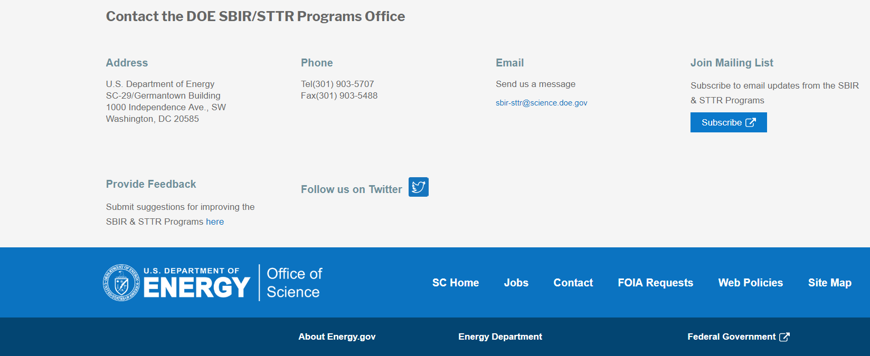
Funding Opportunity Announcement (FOA) Webinar
FY21 Phase I Release 2 FOA will be issued on December 14th
Join our Mailing List – this field is on every DOE SBIR/STTR web page
Following the issuance of the FOA, look for an email with a link to the FOA
Webinar with Q&A for this FOA on December 18th
Overview of the FY 2021 DOE SBIR/STTR Programs
Following the issuance of the FOA, look for an email announcing this webinar

Slide 7
Topic Basics
Topics are created by DOE program managers and define important technology breakthroughs needed in R&D areas that support the DOE mission
Topics are organized by DOE Program Office, e.g., EERE, BES, etc.
DOE program managers are listed with each subtopic
Questions to DOE program managers are limited to clarification of the topic and subtopic (including references)
Clarification is provided to help you determine whether your technology fits within the topic and subtopic
You may communicate with these topic managers from the release of topics until the grant application due date
The decision to apply is yours

Slide 8
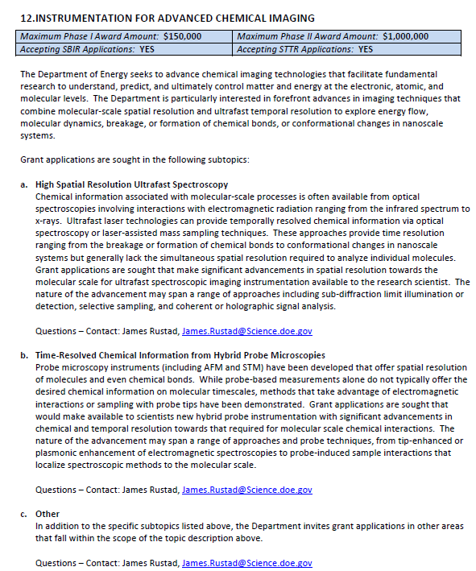
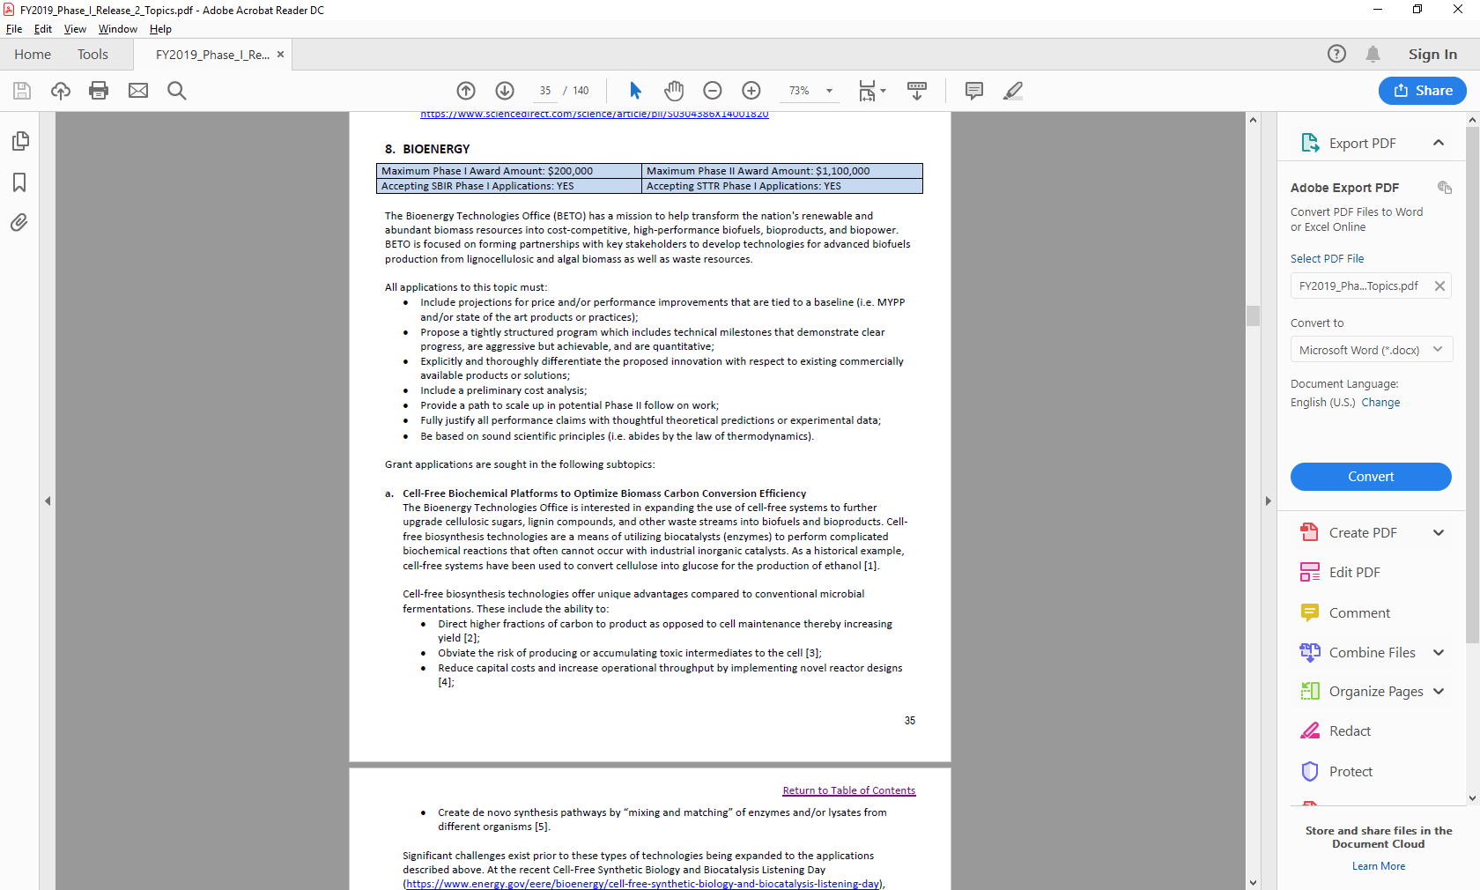
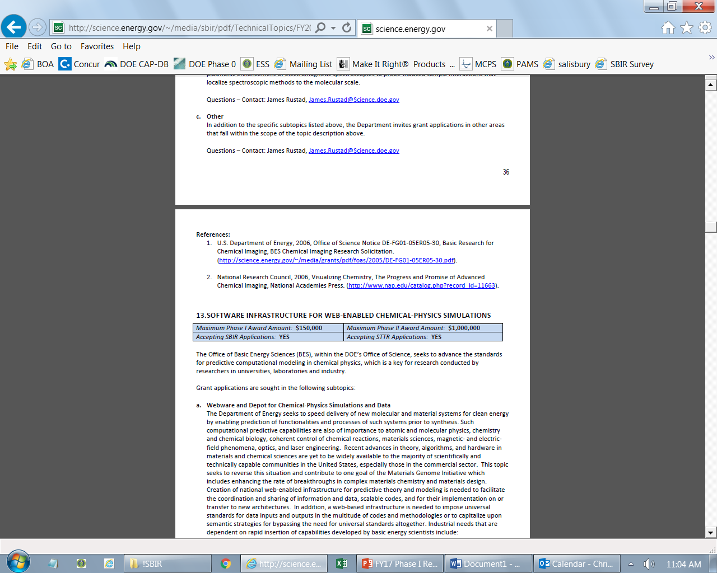
Example Topic
Topic & Subtopic
You must specify the same topic and subtopic in your Letter of Intent and grant application
Topic Header
Lists the maximum award amounts for Phase I & Phase II and the types of application accepted (SBIR and/or STTR)
Program Manager
Each subtopic lists the responsible DOE program manager
“Other” Subtopic
References
Notes:
Here is an example topic from our current announcement. Note that every SBIR or STTR application must include the topic and subtopic to which you are applying. The general topic description describes the general field of technology that is of interest. The subtopics describe specific opportunities in which proposals are requested. Each topic at DOE will also have an “other” subtopic. Under this subtopic you can submit proposals that fall within the general topic description, but do not fit with any of the other subtopics. We have found that when we write the subtopics too narrow sometimes we miss good opportunities, and this “other” subtopic is a means collecting disruptive solutions.

Slide 9
Topic 09: ADVANCED MANUFACTURING
Maximum Phase I Award Amount: $200,000 | Maximum Phase II Award Amount: $1,100,000
Accepting SBIR Phase I Applications: YES | Accepting STTR Phase I Applications: YES
Innovation Research in Application Specific Integrated Circuit ASIC Semiconductor Chip Design for Edge Computing in Manufacturing
Novel Manufacturing Methods for Membranes and Desalination System Components
Questions: Subtopic a – Brian Valentine, Brian.Valentine@ee.doe.gov
Subtopic b – Melissa Klembara, Melissa.Klembara@ee.doe.gov

Slide 10
Topic 10: BIOENERGY
Maximum Phase I Award Amount: $200,000 | Maximum Phase II Award Amount: $1,100,000
Accepting SBIR Phase I Applications: YES | Accepting STTR Phase I Applications: YES
Small Business Bioenergy Technologies Increasing Community Partnerships
Cultivating a More Competitive Bioeconomy Through Strengthening Small Business Workforces
Questions: Devinn Lambert, Devinn.Lambert@ee.doe.gov

Slide 11
Topic 11:JOINT TOPIC: POLYMERS UPCYCLING AND RECYCLING
Maximum Phase I Award Amount: $200,000 | Maximum Phase II Award Amount: $1,100,000
Accepting SBIR Phase I Applications: YES | Accepting STTR Phase I Applications: YES
Improving Plastics Compatibilization for More Efficient Recycling
Questions: Melissa Klembara, Melissa.Klembara@ee.doe.gov or Gayle Bentley, Gayle.Bentley@ee.doe.gov

Slide 12
Topic 12: BUILDINGS
Maximum Phase I Award Amount: $200,000 | Maximum Phase II Award Amount: $1,100,000
Accepting SBIR Phase I Applications: YES | Accepting STTR Phase I Applications: YES
Remote Building Data Collection Technologies for Virtual Audits and Inspections
Building Energy Modeling
Solid-State Lighting Technologies
Advanced Building Control Systems for Controlled Environment Agriculture (CEA)
Healthy Efficient Buildings
Questions: Subtopic a – Harry Bergmann, harry.bergmann@ee.doe.gov
Subtopic b – Amir Roth, Amir.Roth@ee.doe.gov
Subtopic c – Brian Walker, Brian.Walker@ee.doe.gov
Subtopic d – Cedar Blazek, cedar.blazek@ee.doe.gov
Subtopic e – Eric Werling, eric.werling@ee.doe.gov

Slide 13
Topic 13: JOINT TOPIC: ADVANCED BUILDING CONSTRUCTION TECHNOLOGIES
Maximum Phase I Award Amount: $200,000 | Maximum Phase II Award Amount: $1,100,000
Accepting SBIR Phase I Applications: YES | Accepting STTR Phase I Applications: YES
Diagnostic Technologies and Tools
Low-cost, high-R Insulation
Advanced Building Equipment Technologies
Advanced Building Construction Digitization Solutions
Questions: Subtopics a & b – Sven Mumme, sven.mumme@ee.doe.gov
Subtopic c – Karma Sawyer, karma.sawyer@ee.doe.gov
Subtopics d – Eric Werling, eric.werling@ee.doe.gov

Slide 14
Topic 14: GEOTHERMAL TECHNOLOGIES
Maximum Phase I Award Amount: $200,000 | Maximum Phase II Award Amount: $1,100,000
Accepting SBIR Phase I Applications: YES | Accepting STTR Phase I Applications: YES
Usage of Critical Materials, Minerals, Isotopes, and other Naturally Occurring Tracers to Characterize Geothermal Reservoirs
Questions: William Vandermeer, William.Vandermeer@ee.doe.gov

Slide 15
Topic 15: HYDROGEN AND FUEL CELL TECHNOLOGIES
Maximum Phase I Award Amount: $200,000 | Maximum Phase II Award Amount: $1,100,000
Accepting SBIR Phase I Applications: YES | Accepting STTR Phase I Applications: YES
Novel PEM Fuel Cell Membrane Electrode Assemblies for High Efficiency and Durability in Heavy Duty Applications
Innovative Approaches to Minimize Boil-off Losses from Liquid Hydrogen Storage Systems
In-line Filter for Particulate Matter at Heavy-Duty Hydrogen Fueling Stations
Efficient Chillers for Hydrogen Pre-cooling at Heavy-Duty Hydrogen Fueling Stations
Other
Questions: Subtopic a &e – Donna Ho, Donna.Ho@ee.doe.gov
Subtopic b – Zeric Hulvey, Zeric.Hulvey@ee.doe.gov
Subtopic c & d – Neha Rustagi, Neha.Rustagi@ee.doe.gov

Slide 16
Topic 16: SOLAR TECHNOLOGIES
Maximum Phase I Award Amount: $200,000 | Maximum Phase II Award Amount: $1,100,000
Accepting SBIR Phase I Applications: YES | Accepting STTR Phase I Applications: YES
Technology Transfer Opportunity: Method for Mechanical Load Testing of Photovoltaic Modules with Concurrently Applied Stressors and Diagnostic Methods
Technology Transfer Opportunity: Nanocomposite Barrier Films for Photovoltaic Applications
Floating Solar-Powered Aeration Systems
Solar Systems Resilient to Weather-related or Cyber Threats
Innovation in Solar Aesthetics for Residential Photovoltaic Systems
Commercial and Industrial Solar Systems
Agricultural Solar Systems
Components for Gen3 CSP Thermal Transport Systems
Affordability, Reliability, and Performance of Solar Technologies
Questions: solar.sbir@ee.doe.gov

Slide 17
Topic 17: VEHICLES
Maximum Phase I Award Amount: $200,000 | Maximum Phase II Award Amount: $1,100,000
Accepting SBIR Phase I Applications: YES | Accepting STTR Phase I Applications: YES
Electric Drive Vehicle Batteries
Motor Designs without Critical Materials for Electric Drive Vehicles
Game Changing Technologies for Polymer Composites
Reliable, Durable, Low-Cost Sensors for Advanced Combustion and Emission Control Strategies
Questions: Subtopic a – Simon Thompson, Simon.Thompson@ee.doe.gov
Subtopic b – Steven Boyd, steven.boyd@ee.doe.gov
Subtopic c – Felix Wu, felix.wu@ee.doe.gov
Subtopic d – Michael Weismiller, michael.weismiller@ee.doe.gov

Slide 18
Topic 18: WATER TECHNOLOGIES
Maximum Phase I Award Amount: $200,000 | Maximum Phase II Award Amount: $1,100,000
Accepting SBIR Phase I Applications: YES | Accepting STTR Phase I Applications: YES
Co-Development of Marine Energy Technology at Smaller Scales (CMETTS)
Low-Cost, User-Friendly Monitoring Tools for MHK Sites
Questions: Rajesh Dham, Rajesh.Dham@EE.Doe.Gov

Slide 19
Topic 19: WIND TECHNOLOGIES
Maximum Phase I Award Amount: $200,000 | Maximum Phase II Award Amount: $1,100,000
Accepting SBIR Phase I Applications: YES | Accepting STTR Phase I Applications: YES
Technical Solutions to Offshore and Land-Based Wind Siting and Environmental Challenges
Distributed Wind Technology-Compatible Power Converters for Grid-Connected and Isolated Distributed Energy Systems
Technology Transfer Opportunity: Wind Turbine Blade Design for Small Wakes
Questions: Subtopic a – Jocelyn Brown-Saracino, Jocelyn.Brown-Saracino@ee.doe.gov
Subtopic b – Patrick Gilman, Patrick.Gilman@ee.doe.gov
Subtopic c – Ben Hallissy, Ben.Hallissy@ee.doe.gov

Slide 20
Topic 20: JOINT TOPIC: CABLE MATERIALS AND APPLICATIONS
Maximum Phase I Award Amount: $200,000 | Maximum Phase II Award Amount: $1,100,000
Accepting SBIR Phase I Applications: YES | Accepting STTR Phase I Applications: YES
TECHNOLOGY TRANSFER OPPORTUNITY: Metal-carbon composition and composites manufacturing (CABLE)
Electricity Delivery System Applications (CABLE)
Non-metallic Heat Exchangers (CABLE)
Ice-storage and Other Thermal Storage-related Systems (CABLE)
Electric Systems—Generators and Motors (CABLE)
Questions: Subtopic a – John Ahn, jahn@anl.gov , Argonne National Laboratory and Tina Kaarsberg, Tina.Kaarsberg@ee.doe.gov
Subtopic b – Benjamin Shrager, Benjamin.shrager@hq.doe.gov
Subtopic c & d – Karma Sawyer, Karma.Sawyer@ee.doe.gov
Subtopic e – Karma Sawyer, Karma.Sawyer@ee.doe.gov and Erik Mauer, erik.mauer@ee.doe.gov

Slide 21
Topic 20: JOINT TOPIC: CABLE MATERIALS AND APPLICATIONS CONTINUED
Maximum Phase I Award Amount: $200,000 | Maximum Phase II Award Amount: $1,100,000
Accepting SBIR Phase I Applications: YES | Accepting STTR Phase I Applications: YES
Photovoltaics module and system electrical connections (CABLE)
Geothermal: Direct Use and Electricity Generation Applications (CABLE)
Enhanced Conductivity EV Charging Cables and Couplers (CABLE)
Questions: Subtopic f – solar.sbir@ee.doe.gov
Subtopic g – William Vandermeer, William.Vandermeer@ee.doe.gov
Subtopic h – Lee Slezak, Lee.Slezak@ee.doe.gov

Slide 22
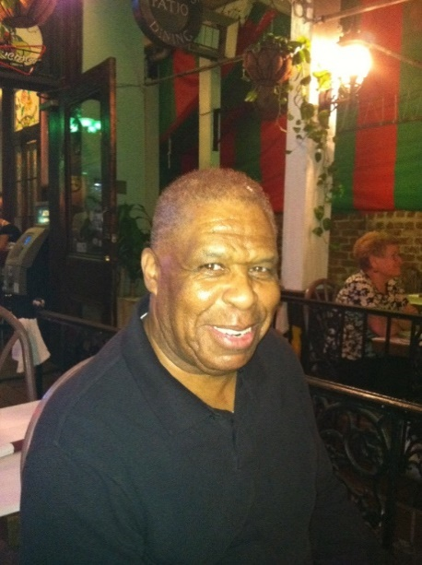
DOE SBIR/STTR Programs Office Contact Information
SBIR/STTR Web: https://science.osti.gov/sbir
Email: sbir-sttr@science.doe.gov
Phone Assistance Hotline: 301-903-5707
DOE Phase 0 Assistance Program: http://www.dawnbreaker.com/doephase0/
DOE Application Assistance: https://science.osti.gov/SBIRLearning

