Slide 1
The DOE Webinar will begin shortly . . .
Why is there no sound?
  Once you logged into the webinar, you were provided two options to listen to this broadcast. The first option is through your computer speakers, the second option is via dialing the phone number provided to you upon login to the webinar. If you chose to listen through your computer speakers, you may need to turn your speaker volume on or up.
Will DOE provide access to the recorded webinar after the meeting?
  Yes, all those who registered will receive a link to the slides and to the recorded webinar soon after the meeting. It will also be available on the DOE SBIR/STTR web site.
Where can I find the Topics being discussed today?
  This link will take you to the Funding Opportunity Announcement (FOA) page that lists the FY 2023 Phase I Release 1 Topics: https://science.osti.gov/sbir/Funding-Opportunities
What if my question was not answered at today’s webinar?
  Please contact the point of contact that follows each subtopic in the document listed above for further clarification.
  If you have a question about the grant application process, please send us an email at: sbir-sttr@science.doe.gov.

Slide 2

DOE SBIR/STTR
Phase I Release 1 Topics Webinar
Topics associated with the
FY 2023 Phase I Release 1
Funding Opportunity Announcement
Topics 16-24
DOE SBIR/STTR Programs Office
July 21, 2022

Slide 3
TODAY’S AGENDA
Topics Introduction | DOE SBIR/STTR Programs Office
Topics 16 – 20 | Office of Biological and Environmental Research
Topics 21 – 24 | Office of Nuclear Physics

Slide 4
FY 2023 Phase I Schedule
 | Release 1 | Release 2
Topics Issued | Monday, July 11, 2022 | Monday, November 7, 2022
Webinar(s) | Week of July 18, 2022 | Week of November 14, 2022
FOA Issued | Monday, August 8, 2022 | Monday, December 12, 2022
Webinar(s) | Friday, August 12, 2022 | Friday, December 16, 2022
Letters of Intent (LOI) Due | Monday, August 29, 2022 | Tuesday, January 3, 2023
Non-responsive LOI Feedback Provided | Monday, September 19, 2022 | Tuesday, January 24, 2023
Applications Due | Tuesday, October 11, 2022 | Tuesday, February 21, 2023
Award Notification | Tuesday, January 3, 2023 | Monday, May 15, 2023

Slide 5

Phase I Funding Opportunity Announcements
Participating DOE Programs (FY 2023)
Office of Advanced Scientific Computing Research
Office of Basic Energy Sciences
Office of Biological and Environmental Research
Office of Nuclear Physics
Phase I
Release 1
Office of Cyber Security, Energy Security, and Emergency Response
Office of Defense Nuclear Nonproliferation
Office of Electricity
Office of Energy Efficiency and Renewable Energy
Office of Fossil Energy and Carbon Management
Office of Fusion Energy Sciences
Office of High Energy Physics
Office of Nuclear Energy
Phase I
Release 2

Slide 6
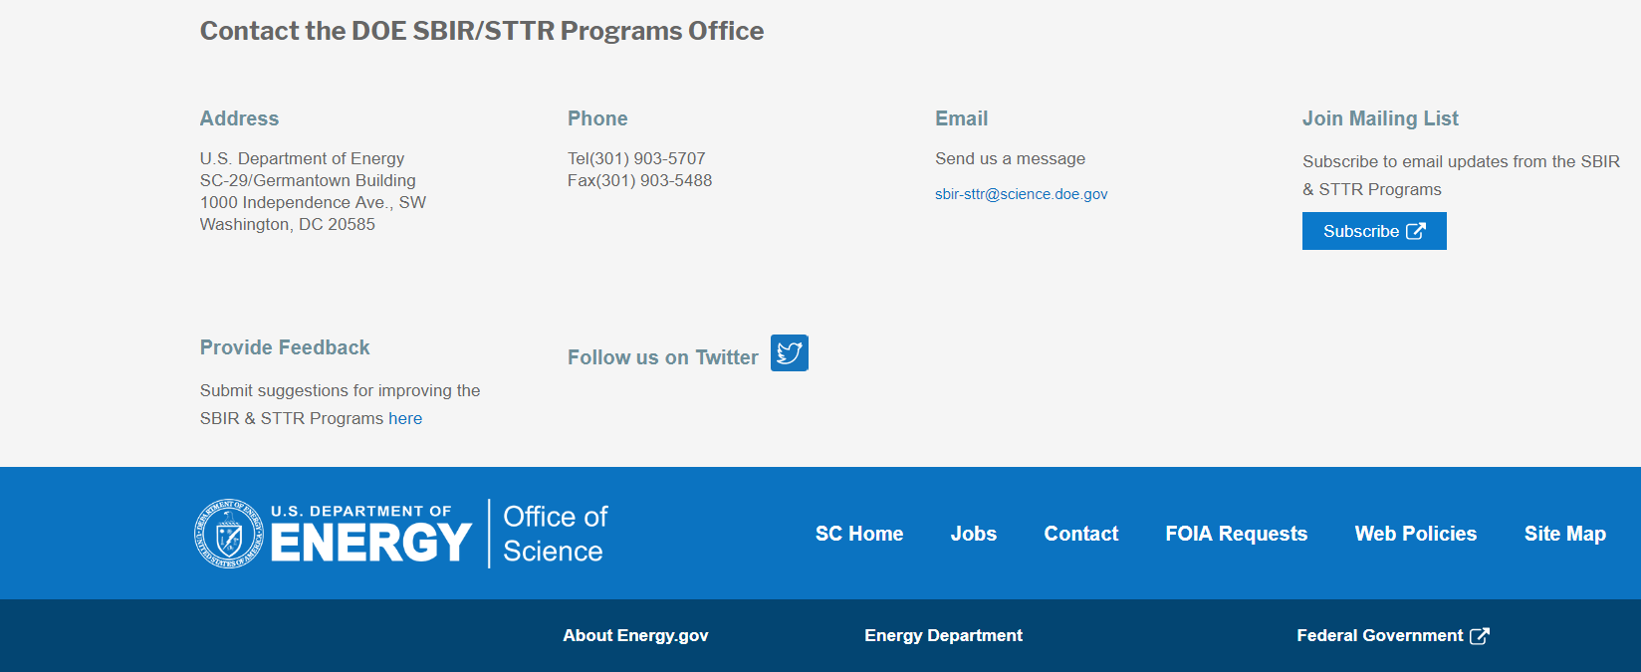
Funding Opportunity Announcement (FOA) Webinar
FY23 Phase I Release 1 FOA will be issued on August 8th
Join our Mailing List – this field is on every DOE SBIR/STTR web page
  Following the issuance of the FOA, look for an email with a link to the FOA
Webinar with Q&A for this FOA on August 12th
  Overview of the FY 2023 DOE SBIR/STTR Programs
    Following the issuance of the FOA, look for an email announcing this webinar

Slide 7
Reminder - Phase 0 Application Assistance Program
Free
to you!
Phase 0 application assistance program is available for first-time DOE SBIR/STTR applicants
Participants receive an individual coach who is an expert in our application process.
Program opens when Topics are released (Open now!)
Visit http://www.dawnbreaker.com/doephase0/ to determine your eligibility and apply to Phase 0

Slide 8
Reauthorization
The SBIR program is 40 years old this month!
The SBIR and STTR Programs are not permanent programs and require Congressional reauthorization
The current Programs are set to expire on September 30, 2022
We are actively assessing the impacts and how to move forward in the case there is a lapse in reauthorization
Existing awards will move forward regardless of whether there is lapse or not

Slide 9
Topic Basics
Topics are created by DOE program managers and define important technology breakthroughs needed in R&D areas that support the DOE mission
Topics are organized by DOE Program Office, e.g., ASCR, BES, etc.
DOE program managers are listed with each subtopic
  Questions to DOE program managers are limited to clarification of the topic and subtopic (including references)
  Clarification is provided to help you determine whether your technology fits within the topic and subtopic
  You may communicate with these topic managers from the release of topics until the grant application due date
  The decision to apply is yours

Slide 10
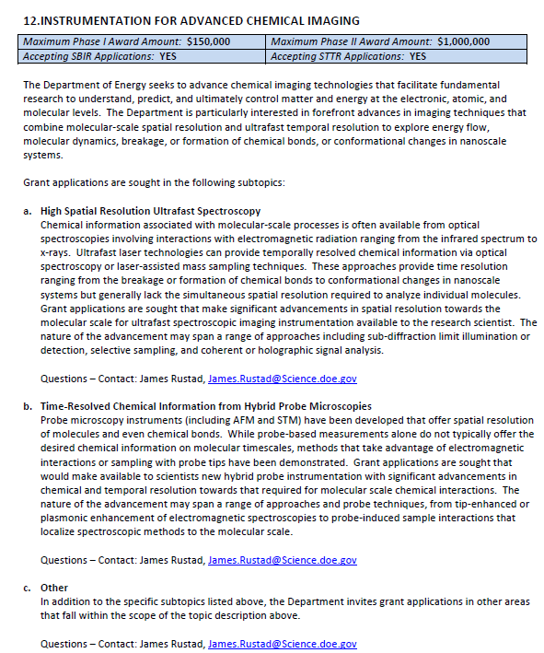
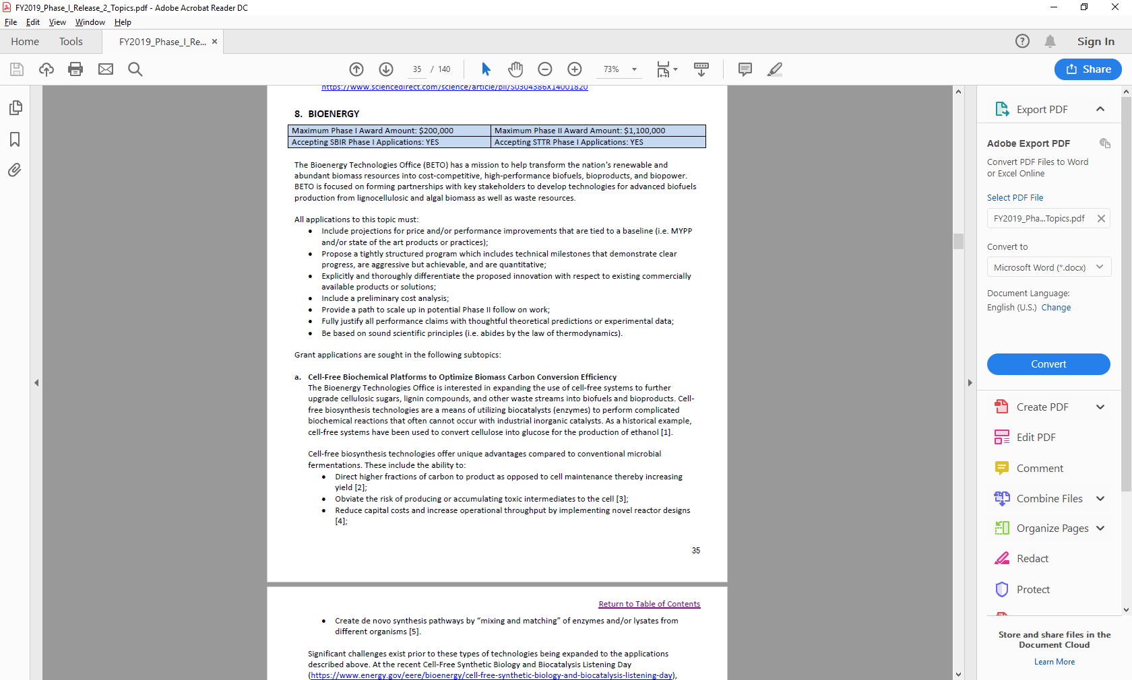
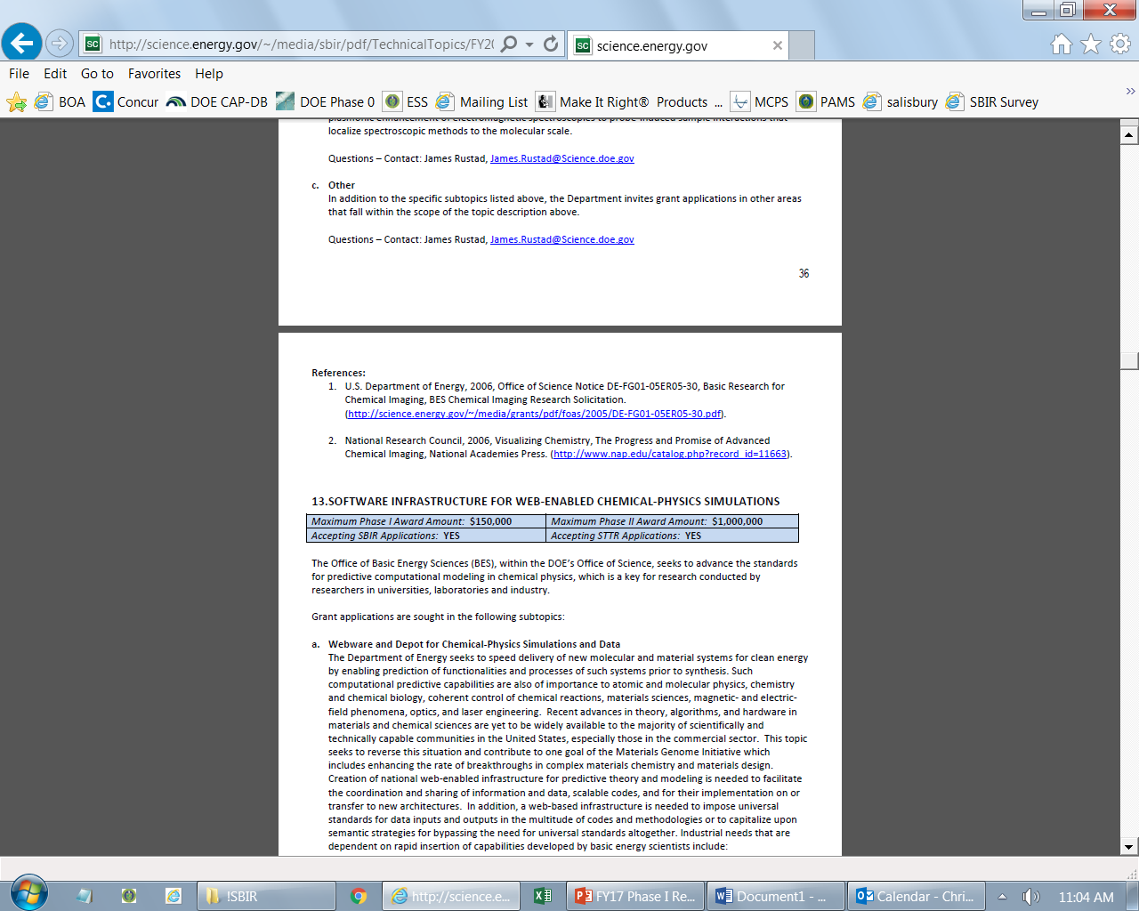
Example Topic
Topic & Subtopic
  You must specify the same topic and subtopic in your Letter of Intent and grant application
Topic Header
  Lists the maximum award amounts for Phase I & Phase II and the types of application accepted (SBIR and/or STTR)
Program Manager
  Each subtopic lists the responsible DOE program manager
“Other” Subtopic
References
Notes:
Here is an example topic from our current announcement. Note that every SBIR or STTR application must include the topic and subtopic to which you are applying. The general topic description describes the general field of technology that is of interest. The subtopics describe specific opportunities in which proposals are requested. Each topic at DOE will also have an “other” subtopic. Under this subtopic you can submit proposals that fall within the general topic description, but do not fit with any of the other subtopics. We have found that when we write the subtopics too narrow sometimes we miss good opportunities, and this “other” subtopic is a means collecting disruptive solutions.

Slide 11
Topic 16: URBAN MEASUREMENT TECHNOLOGY
Maximum Phase I Award Amount: $250,000 | Maximum Phase II Award Amount: $1,600,000
Accepting SBIR Phase I Applications: YES | Accepting STTR Phase I Applications: YES
a. Urban Atmospheric Characterization
a. Urban Hydrologic Measurements
b. Urban Visualization and Data Analysis Tools
c. Other
Questions: Subtopic a – Sally McFarlane, Sally.McFarlane@science.doe.gov or Jeff Stehr, Jeff.Stehr@science.doe.gov
Questions: Subtopic b – Jennifer Arrigo, Jennifer.Arrigo@science.doe.gov
Questions: Subtopic c – Justin Hnilo, Justin.Hnilo@science.doe.gov , Jeff Stehr Jeff.Stehr@science.doe.gov or Sally McFarlane, Sally.McFarlane@science.doe.gov
Questions: Subtopic d – Sally McFarlane, Sally.McFarlane@science.doe.gov

Slide 12
Topic 17: COMPLEX DATA: ADVANCED DATA ANALYTIC TECHNOLOGIES FOR SYSTEMS BIOLOGY AND BIOENERGY
Maximum Phase I Award Amount: $250,000 | Maximum Phase II Award Amount: $1,600,000
Accepting SBIR Phase I Applications: YES | Accepting STTR Phase I Applications: YES
Complex Data: Advanced Data Analytic Technologies for Systems Biology and Bioenergy
Other
Questions: Ramana Madupu, Ramana.Madupu@Science.doe.gov or Resham Kulkarni, Resham.Kulkarni@science.doe.gov

Slide 13
Topic 18: ENABLING TOOLS FOR STRUCTURAL BIOLOGY OF MICROBIAL AND PLANT SYSTEMS RELEVANT TO BIOENERGY
Maximum Phase I Award Amount: $250,000 | Maximum Phase II Award Amount: $1,600,000
Accepting SBIR Phase I Applications: YES | Accepting STTR Phase I Applications: YES
Tools or Instruments for Structural Characterization of Biological Systems Ranging from Atomic to Multi-Cellular Scales
Other
Questions: Amy Swain, Amy.Swain@science.doe.gov

Slide 14
Topic 19: BIOIMAGING TECHNOLOGIES FOR BIOLOGICAL SYSTEMS
Maximum Phase I Award Amount: $250,000 | Maximum Phase II Award Amount: $1,600,000
Accepting SBIR Phase I Applications: YES | Accepting STTR Phase I Applications: YES
Automated Bioimaging Devices for Structural and Functional Characterization of Plant and Microbial Communities
Quantum Enabled Bioimaging and Sensing Approaches for Bioenergy
Other
Questions: Paul Sammak, Paul.Sammak@science.doe.gov

Slide 15
Topic 20: BIOLOGICAL APPROACHES AND TECHNOLOGIES FOR SYNTHETIC POLYMER UPCYCLING
Maximum Phase I Award Amount: $250,000 | Maximum Phase II Award Amount: $1,600,000
Accepting SBIR Phase I Applications: YES | Accepting STTR Phase I Applications: YES
Biological Approaches and Technologies for Synthetic Polymer Upcycling
Other
Questions: Dawn M. Adin, dawn.adin@science.doe.gov

Slide 16
Topic 21: NUCLEAR PHYSICS SOFTWARE AND DATA MANAGEMENT
Maximum Phase I Award Amount: $200,000 | Maximum Phase II Award Amount: $1,100,000
Accepting SBIR Phase I Applications: YES | Accepting STTR Phase I Applications: YES
Tools for Large Scale, Widely Distributed Nuclear Physics Data Processing
Applications of AI/ML to Nuclear Physics
Heterogeneous Concurrent Computing
Other
Questions: Michelle Shinn, Michelle.Shinn@science.doe.gov or
Gulshan Rai, Gulshan.Rai@science.doe.gov

Slide 17
Topic 22: NUCLEAR PHYSICS ELECTRONICS DESIGN AND FABRICATION
Maximum Phase I Award Amount: $200,000 | Maximum Phase II Award Amount: $1,100,000
Accepting SBIR Phase I Applications: YES | Accepting STTR Phase I Applications: YES
Advances in Digital Processing Electronics
Front-End Application-Specific Integrated Circuits
Next Generation Pixel Sensors
Other
Questions: Michelle Shinn, Michelle.Shinn@science.doe.gov or Farkhondeh, Manouchehr.Farkhondeh@science.doe.gov

Slide 18
Topic 23: NUCLEAR PHYSICS ACCELERATOR TECHNOLOGY
Maximum Phase I Award Amount: $200,000 | Maximum Phase II Award Amount: $1,100,000
Accepting SBIR Phase I Applications: YES | Accepting STTR Phase I Applications: YES
Materials and Components for Radio Frequency Devices
Design and Operation of Radio Frequency Beam Acceleration Systems
Particle Beam Sources and Techniques
Polarized Beam Sources and Polarimeters
Rare Isotope Beam Production Technology
Accelerator Control and Diagnostics
Magnet Development for NP facilities
Other
Questions: Michelle Shinn, Michelle.Shinn@science.doe.gov

Slide 19
Topic 24: NUCLEAR PHYSICS INSTRUMENTATION, DETECTION SYSTEMS AND TECHNIQUES
Maximum Phase I Award Amount: $200,000 | Maximum Phase II Award Amount: $1,100,000
Accepting SBIR Phase I Applications: YES | Accepting STTR Phase I Applications: YES
Advances in Detector and Spectrometer Technology
Development of Novel Gas and Solid-State Detectors
Technology for Rare Decay and Rare Particle Detection
Other
Questions: Michelle Shinn, Michelle.Shinn@science.doe.gov or Elizabeth Bartosz, Elizabeth.Bartosz@science.doe.gov

Slide 20

DOE SBIR/STTR Programs Office
Contact Information
SBIR/STTR Web: https://science.osti.gov/sbir
Email: sbir-sttr@science.doe.gov
Phone Assistance Hotline: 301-903-5707
DOE Phase 0 Assistance Program: https://doephase0.dawnbreaker.com/
DOE Application Assistance: https://science.osti.gov/SBIRLearning

