Slide 1
DOE SBIR/STTR Phase II Application Requirement:
Cybersecurity Self-Assessment
Webinar
October 24, 2023

Slide 2
SBIR and STTR Extension Act of FY 2022
Foreign Risk Management
The SBIR and STTR Extension Act of 2022 requires agencies to assess the foreign risks associated with SBIR/STTR applicants and awardees
To facilitate this assessment, SBIR/STTR applicants are required to disclose their foreign relationships and update them during the award period. (Please use the new revised version of this form for FY 2024.)
Agencies can deny an award based on risks posed by an applicant’s foreign relationships and recover awards funds if an awardee failed to disclose foreign relationships
Focus is on the following countries of concern: the People's Republic of China, the Democratic People's Republic of Korea, the Russian Federation, the Islamic Republic of Iran

Slide 3
SBIR and STTR Extension Act of FY 2022
Cybersecurity
The Act does not require specific disclosures related to cybersecurity, but required agencies to assess the cybersecurity practices of SBIR/STTR applicants & awardees
Phase I
  DOE does not plan to implement new cybersecurity requirements for Phase I applications or reporting requirements for Phase I awardees at this time
  Phase I awardees are expected to leverage available resources to improve their cybersecurity practices in advance of applying for a Phase II award
Phase II
  Beginning in FY 2024, DOE will require Phase II applicants to submit a cybersecurity self-assessment. DOE evaluation of an applicant’s risk will include an evaluation of cybersecurity practices

Slide 4
Phase II Cybersecurity Self-Assessment
DOE will leverage the Cybersecurity and Infrastructure Security Agency’s (CISA) Cybersecurity Performance Goals for the self-assessment.
  “Applicants will use the CISA CPG Checklist (https://www.cisa.gov/resources-tools/resources/cisa-cpg-checklist ) to submit their Cybersecurity Self-Assessment.”
  “There are 39 CPGs included in the checklist. For the purpose of the DOE Cybersecurity Self-Assessment, Phase II applicants are required to complete the checklist for the following CPGs: 1A, 1B, 2A, 2B, 2D, 2E, 2G, 2H, 2I, 2K, 2L, 2M, 2R, 2S, 2W, and 4A. Applicants may complete the checklist for other CPGs that are not specifically required above.”
  “DOE will use this information as part of its assessment of risk when determining which applicants will be selected for award. Based on the evaluation of the Cybersecurity Self-assessment, those selected for award may be required to take actions to improve their cybersecurity posture during the first period of performance of their Phase II award.”

Slide 5
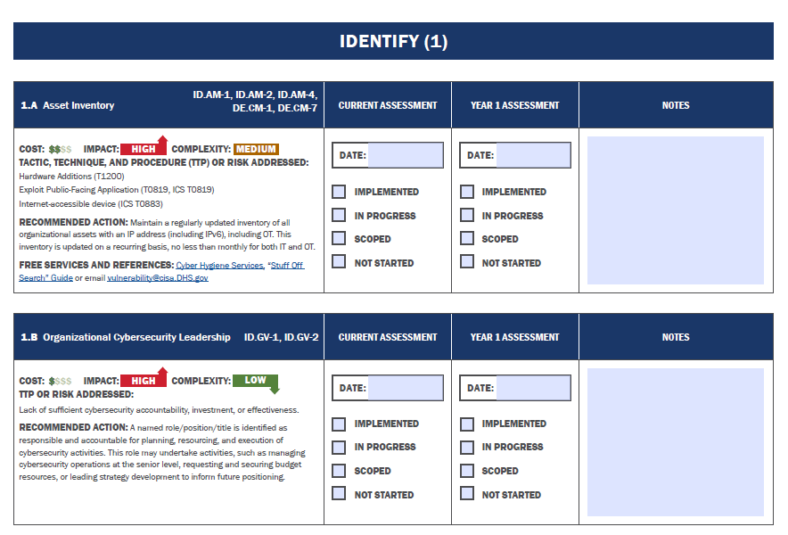
CISA CPGs
Fill out the “Current Assessment” and include notes where appropriate
Please utilize the free services and references where available

Slide 6
Evaluation of Cybersecurity Self-Assessment
Your cybersecurity self-assessment will be evaluated as part of DOE’s assessment of risk
DOE may elect not to fund applications that present unacceptably high levels of risk.

Slide 7
Cybersecurity Resources
Examples of services and training include, but are not limited to:
  CISA has an excellent Cyber essentials guide aimed at small businesses: https://www.cisa.gov/resources-tools/resources/cyber-essentials
  NIST has a useful publication that discusses the Fundamentals of Small Business Information Security: https://www.nist.gov/publications/fundamentals-small-business-information-security
  The NM FBI Office of Counter Intelligence offers a free, daily newsletter on cyber security breaches and trends.
  The main Federal SBIR website, https://www.sbir.gov, offers a lot of information and training.
  The Federal Trade Commission has a good reference page dedicated to small businesses and cybersecurity https://www.ftc.gov/business-guidance/small-businesses/cybersecurity
  USAF SBIR cybersecurity page: (https://www.safcn.af.mil/CISO/Small-Business-Cybersecurity-Information/)

Slide 8
Building our Cybersecurity Due Diligence Program
An IT Cybersecurity Specialist with be joining the SBIR/STTR programs office soon
She will be responsible for overseeing DOE’s cybersecurity due diligence program and will be supported by a contractor to assist with training, reviewing self-assessments, and conducting audits.
As we learn more about our applicant and awardee cybersecurity practices, we expect our due diligence program to evolve.

Slide 9
CISA CPGs
Subset Required for DOE Applications
1A, 1B, 2A, 2B, 2D, 2E, 2G, 2H, 2I, 2K, 2L, 2M, 2R, 2S, 2W, and 4A

Slide 10
Utilizing IT Providers
It is important to note that many small business rely on 3rd party IT providers for most, if not all, of their internal IT.
  Examples include Google Workspace, Microsoft O365, Zoho, Dropbox/Box, etc.
Most professional commercial IT services will satisfy many of the requirements in this SBIR/STTR assessment.
  But your IT staff must enable the security settings appropriately.
Examples include but are not limited to:
  2B Password Management (2H utilize Multifactor Authentication as much as possible)
  2E Account Management (dashboards to assign roles and responsibilities to users and enforce separation of general users from administrators)
  2K Encryption of data in transit and in storage
  2M Email Security
  2R Data Backups
  Etc.

Slide 11
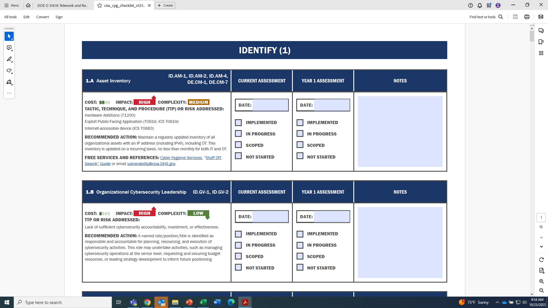
1A: Asset Inventory

Slide 12
1B: Organizational Cybersecurity Leadership

Slide 13
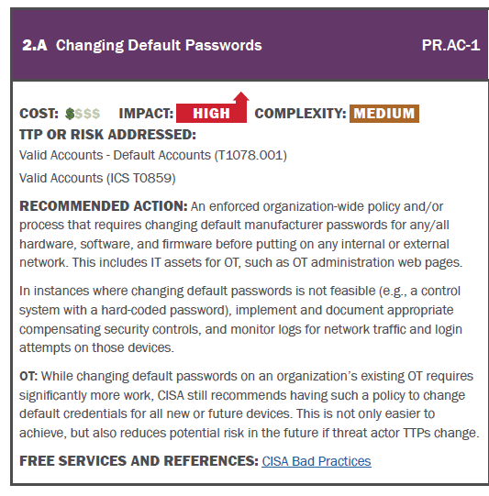
2A: Changing Default Passwords

Slide 14
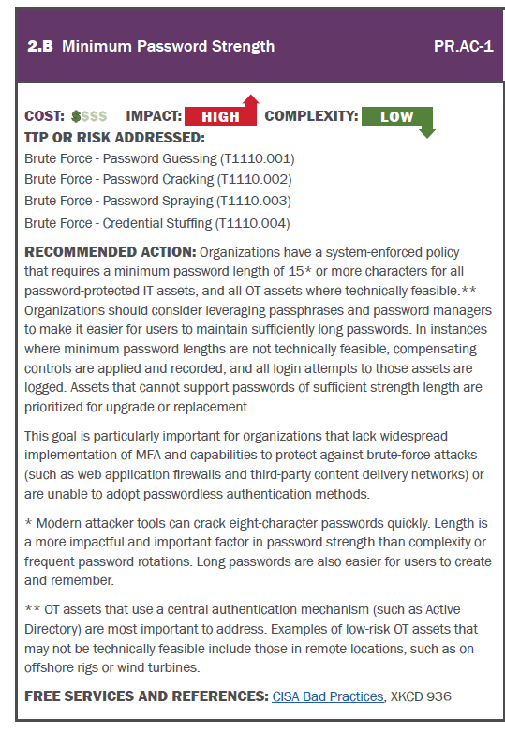
2B: Minimum Password Strength

Slide 15
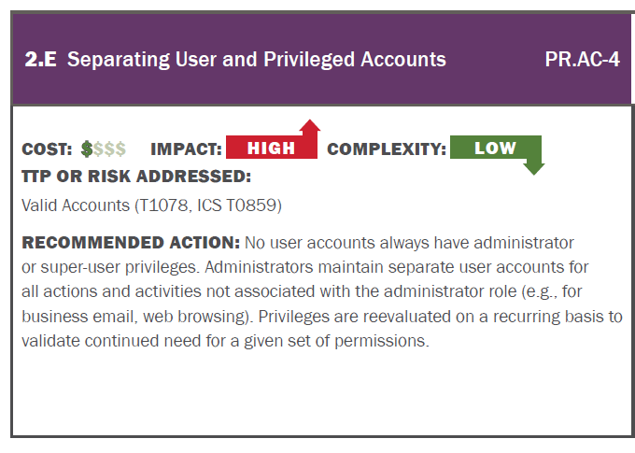
2E: Separating User and Privileged Accounts

Slide 16
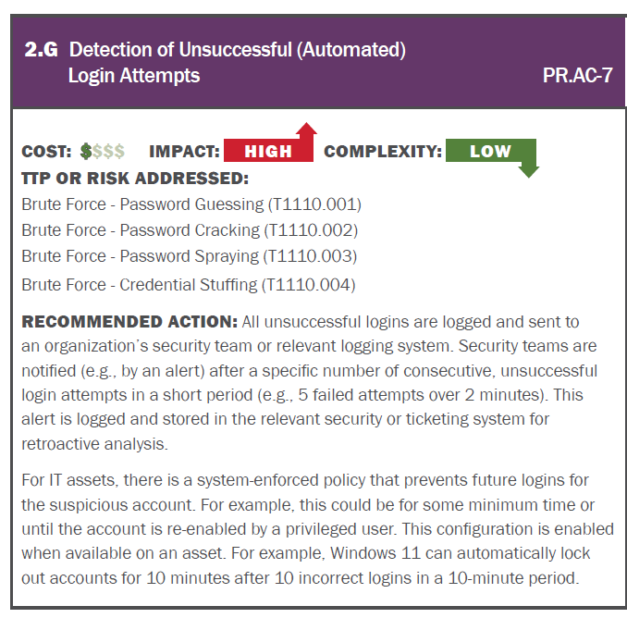
2G: Detection of Unsuccessful (Automated) Login Attempts

Slide 17
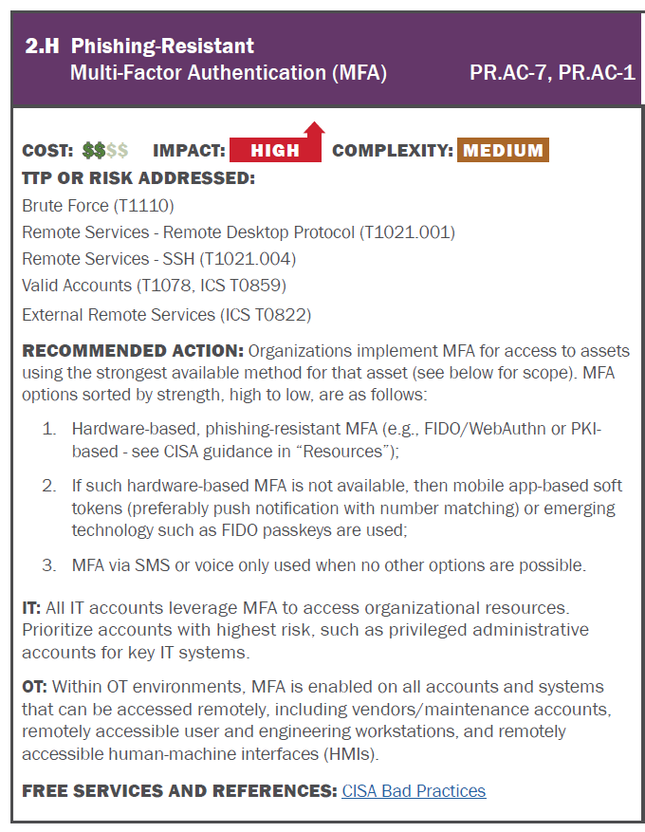
2H: Phishing-Resistant
Multi-Factor
Authentication

Slide 18
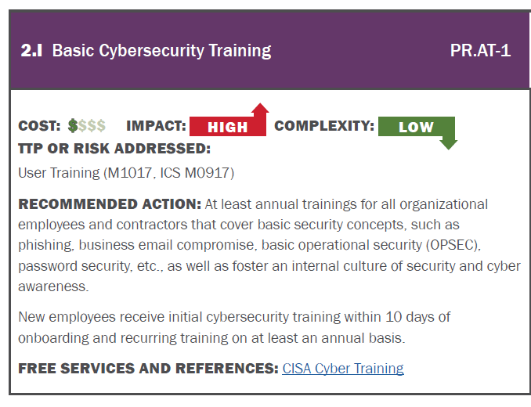
2I: Basic Cybersecurity Training

Slide 19
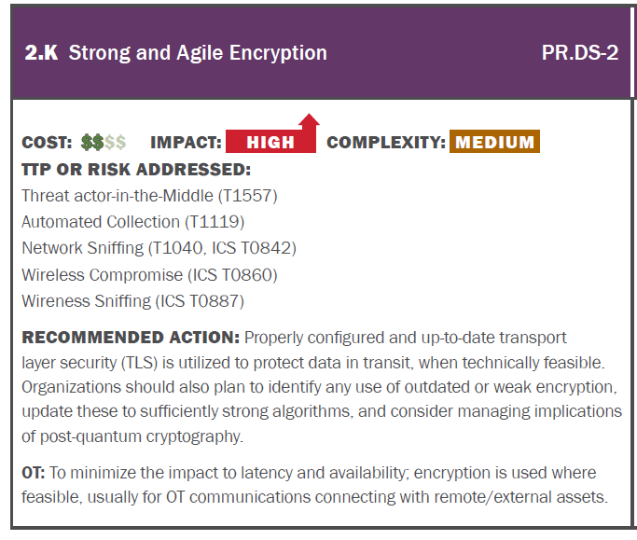
2K: Strong and Agile Encryption

Slide 20
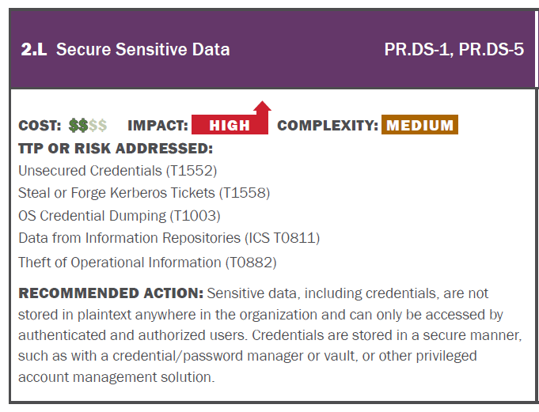
2L: Secure Sensitive Data

Slide 21
2L: Secure Sensitive Data

Slide 22
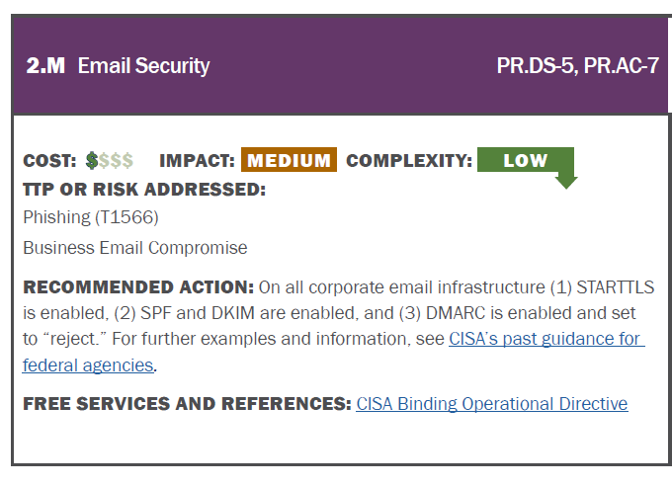
2M: Email Security

Slide 23
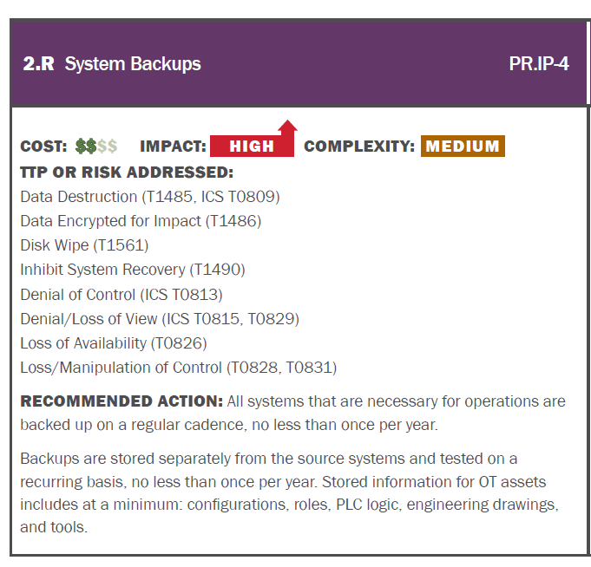
2R: System Backups

Slide 24
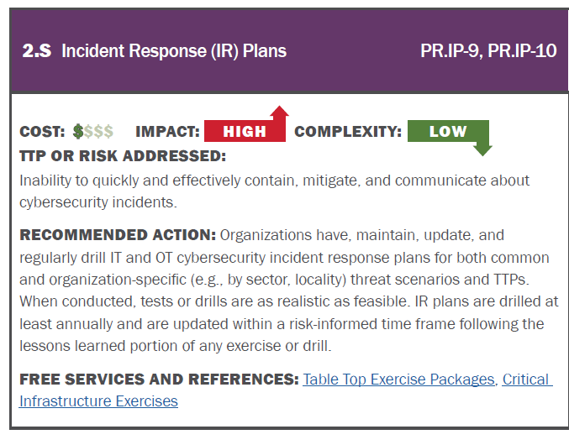
2S: Incident Response Plans

Slide 25
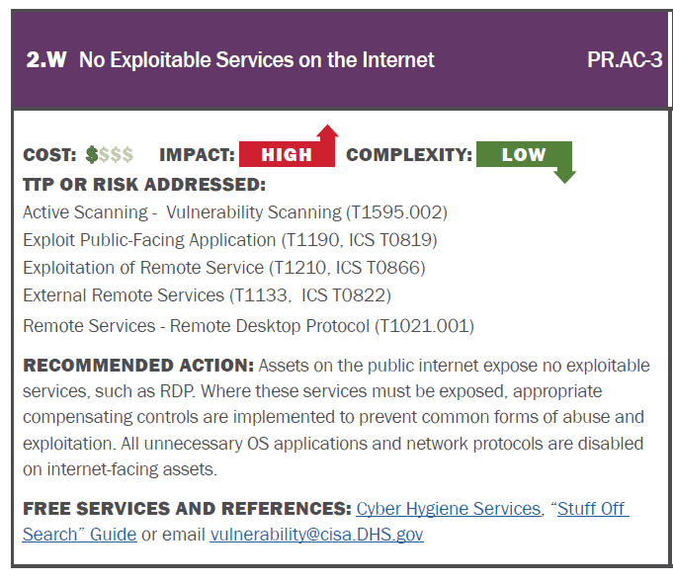
2W: No Exploitable Services on the Internet

Slide 26
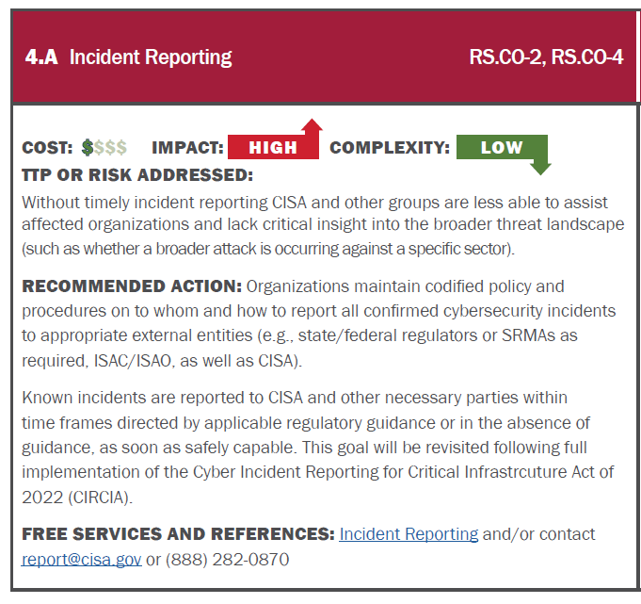
4A: Incident Reporting

