Slide 1
SBIR/STTR Cybersecurity Due Diligence Program
Q&A Webinar
September 19th, 2024

Slide 2


Why is there a Cybersecurity (CS) Requirement for SBIR/STTR Awards?
  SBIR and STTR Extension Act of 2022
  Applicable to Phase II Applicants/Awardees
  Foreign Risk Management
    Patent
    Employee
    Foreign Ownership
    *** Security Risk associated with SBIR/STTR small business practices
  SBIR/STTR CS Due Diligence Program
  Objectives: Protect against the unauthorized disclosure of sensitive information and intellectual property to cyber criminals, specifically foreign countries of concern (China, Russia, North Korea and Iran)

Slide 3
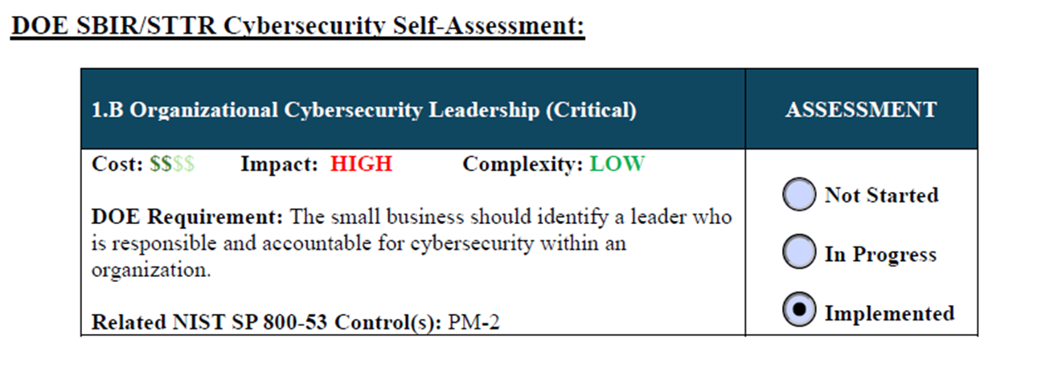
SBIR/STTR Cybersecurity Self-Assessment
Cybersecurity Infrastructure Security Agency (CISA)
National Institute of Standards and Technology (NIST)
  Consists of 16 CISA Cybersecurity Performance Goals (CPGs) applicable to small businesses’ practices
  Prioritized and modified to meet SBIR/STTR Small Businesses
  Small Businesses should indicate if the implementation of the CPG, is currently (fully) implemented, in-progress, or not started.
Notes:
Self Assessment Requirement Explained
What are Cybersecurity Performance Goals?
The SBIR/STTR Performance Goals (CPGs) which are a subset of the Cybersecurity (CS) Infrastructure Security Agency (CISA) CPG Checklist, they are intend to be:
CS best practices that have been prioritized to focus on small business applicants and awardees applying for SBIR/STTR awards
A baseline set of cybersecurity best practices that have been prioritized for small business information technology owners
A benchmark to measure and improve cybersecurity maturity
A unique security control framework intended to address risk to small businesses
The CS Self-Assessment contains 16 required CS Performance Goals (CPGs) that were leveraged from the CISA CPG Checklist. The SBIR/STTR applicant/awardee should complete the CS Self-Assessment by indicating whether the CPG is fully Implemented, In-Progress, or Not Started.
The SBIR/STTR CPGs are CS best practices that supports the “prevention of damage to, protection of, and restoration of computers, electronic communications systems, electronic communications services, wire communication, and electronic communication, including information contained therein, to ensure its availability, integrity, authentication, confidentiality, and nonrepudiation,” as defined by the Committee on National Security Systems (CNSSI 4009) Homeland Security Presidential Directive [HSPD23]. It is highly recommended that the applicant/awardees have the 16 CPGs fully implemented prior to their application submission for SBIR/STTR awards. Small businesses are responsible for fully implementing each CPG and will have to certify the CPGs are implemented on the CS Self-Assessment.

Slide 4
SBIR/STTR CPGs
2.L Secure Sensitive Data (Critical)
2.E Separate User and Privileged Accounts (Critical)
2.D Revoke Credentials (Critical)
1.B Organizational CS Leadership (Critical)
2.I Basic CS Training
1.A Asset Inventory (Critical)
2.A Change Default Passwords (Critical)
2.R System Backups (Critical)
2.B Minimum Password Strength
2.H Phishing Multi-Factor Authentication (MFA)
2.W No Exploitable Services
2.K Strong and Agile Encryption
2.M Email Security
2.G Detection of Login Attempts
2.S Incident Response Plan
4.A Incident ResponseReporting

Slide 5
SBIR/STTR Cybersecurity Self-Assessment (cont’d.)
Can be found here: SBIR Applicant Resources | U.S. DOE Office of Science (SC) (osti.gov)
Should be completed and submitted with application prior to application submission date listed on Funding Opportunity Page: SBIR Funding Opportunity Announc... | U.S. DOE Office of Science (SC) (osti.gov)
More information regarding the CS Due Diligence Program and CS Self-Assessment can be found on our web page: SBIR Introduction to Cybersecuri... | U.S. DOE Office of Science(SC) (osti.gov)
Note:
*Responses provided are subject to audit per award terms and conditions
*Highly recommend all CPGs are fully implemented prior to application submission
Notes:
Funding Opportunity Phases and CS – Program relevant to these phases/releases…..
Continuity, Integrity, Availability (CIA) - The CIA triad, which stands for confidentiality, integrity, and availability, is a widely used information security model for guiding an organization’s efforts and policies aimed at keeping its data secure. Confidentiality: Only authorized users and processes should be able to access or modify data, Integrity: Data should be maintained in a correct state and nobody should be able to improperly modify it, either accidentally or maliciously, Availability: Authorized users should be able to access data whenever they need to do so

Slide 6



CS Self-Assessment Review
  Small Business Practices
  Risk Rating Assignment
    Low *
    Medium *
    High
*Applicants with Low or Medium Risk Rating that have been selected for a SBIR/STTR award may have to provide mitigation
Notes:
The Cybersecurity (CS) Due Diligence Program is responsible for the CS review of the CS business practices of SBIR/STTR applicants/awardees determine if security risk associated with the CS business practices are within an acceptable level. Based on this review, a CS risk rating will be assigned to the applicant/awardee and will be one many factors used to determine recommendation/non-recommendation of a SBIR/STTR award. The CS risk rating will be provided to the program managers and as part of the review selection process of SBIR/STTR awards. The SBIR/STTR applicants/awardees will also receive the CS risk rating after there responses on the CS self-assessment are recorded in the Portfolio and Analysis Management System (PAMS).

Slide 7
SBIR/STTR Cybersecurity Performance Goals
Critical CPGs (Why are these critical?)
  2.L Secure Sensitive Data (Critical)
    2.E Separate User and Privileged Accounts (Critical)
    2.D Revoke Credentials (Critical)
  1.B Organizational CS Leadership (Critical)
  2.I Basic CS Training
  1.A Asset Inventory (Critical)
  2.A Change Default Passwords (Critical)
  2.R System Backups (Critical)
Remaining CPG requirements and implementation guidance
Notes:
1.B Organizational CS Leadership (Critical)
2.I Basic CS Training
1.A Asset Inventory (Critical)
2.A Change Default Passwords (Critical)
2.L Secure Sensitive Data (Critical)
2.R System Backups (Critical)
2.B Minimum Password Strength
2.H Phishing Multi-Factor Authentication (MFA)
2.W No Exploitable Services
2.K Strong and Agile Encryption
2.E Separate User and Privileged Accounts
2.D Revoke Credentials
2.M Email Security
2.G Detection of Login Attempts
2.S Incident Response Plan
4.A IR Reporting
6 Critical CPGs (Present 6 Critical CPGs First? In this Order?)
1.A Asset Inventory
1.B Organizational CS Leadership
2.A Change Default Passwords
2.L Secure Sensitive Data
2.E Separating User and Privileged Accounts
2.D Revoking Credentials
2.R System Backups

Slide 8


Does Business Size Matter?
Yes, it matters.
Small businesses will have to determine the appropriate level of protection to ensure their intellectual property is secure.
CS Resources
  Global Cybersecurity Alliance (GCA) Learning Portal and Toolkit (recommended by NIST CSF 2.0 for Small Business Quick Start Guide): Global Cyber Alliance
  NIST Cybersecurity Corner: Small Business Cybersecurity Corner | NIST
  Cybersecurity and Infrastructure Security Agency (CISA): Home Page | CISA
  SBIR/STTR CPG Implementation Guidance: SBIR Implementation Guidance for... | U.S. DOE Office of Science(SC) (osti.gov)
This Photo by Unknown Author is licensed under CC BY
Notes:
Does small business size matter? (note to presenter - understand audience is small business with an average size of 5-10 people)
Needs of small business varies – SBs will vary in their level of CS infrastructure maturity, and may need more, or additional supports/resources to raise their maturity level.
The SBIR/STTR CS Due Diligence Program will utilize the Global Cyber Alliance (GCA) Toolkit which is sponsored by Public Internet Registry (PIR). The toolkit was recommended by NIST CS Framework (CSF) v2.0 Small Business Quick Start Guide. We’ll go into more detail of the GCA a bit later in the presentation.
The SBIR/STTR applicants/awardees are highly encouraged to sign up for a free account to review the documents, videos and training presentations found on the GCA Toolkit/Learning Portal to understand how to implement the required CPGs.

Slide 9
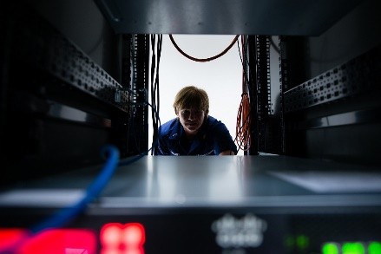



CS Options for Implementing the Required CPGs
Option 1 – Small businesses implement CPGs on their own
Option 2 – Small businesses use an Information Technology (IT) service provider
Option 3 – Small businesses use A Managed Security Service Provider (MSSP) and/or Managed Service Provider (MSP)
Option 4 – Small businesses employ a CS consultant
This Photo by Unknown Author is licensed under CC BY-NC-ND
This Photo by Unknown Author is licensed under CC BY-SA
Notes:
Option 1 - The SBIR/STTR applicants and awardees may fully implement the 16 required CPGs by reviewing the Implementation Guidance for the Required CPGs section of the CS Due Diligence Program section of the DOE Office of Science SBIR/STTR Web site and following the recommended implementation guidance provided. It is also recommended that applicants and awardees review the GCA Toolkit before choosing the appropriate option for implementing the 16 required CPGs. Small businesses are responsible for understanding the requirements for each CPG and ensuring that each CPG is implemented.
Option 2 - Another way for SBIR/STTR applicants/awardees to address the full implementation of the required CPGs is to contact your Information Technology (IT) service providers and do some research on the services that are offered. Before contacting the IT service representative, the applicants and awardees should understand the SBIR/STTR CPG requirements in the Implementation Guidance for the Required CPGs section of the CS Due Diligence Program section of the DOE Office of Science SBIR/STTR Web site and following the recommended implementation guidance provided. It is also recommended that applicants and awardees review the GCA Toolkit before choosing the appropriate option for implementing the 16 required CPGs.
Option 3 - A Managed Security Service Provider (MSSP) and/or Managed Service Provider (MSP) could also assist small businesses with full implementation of the required CPGs. The SBIR/STTR applicants and awardees should understand the SBIR/STTR CPG requirements in the Implementation Guidance for the Required CPGs section of the CS Due Diligence Program section of the DOE Office of Science SBIR/STTR Web site before contacting a MSSP or MSP. It is also recommended that applicants and awardees review the GCA Toolkit before choosing the appropriate option for implementing the 16 required CPGs. A MSSP is third party provider (outsourced) that manages and monitors a small business’ security systems and devices (i.e. firewalls, virus protection, and intrusion detection) and ensures access is only for authorized personnel).
Option 4 – Another way to address the full implementation of the SBIR/STTR CPGs is to employ a CS consultant, however, before contacting a CS consultant, applicants and awardees should understand the SBIR/STTR CPG requirements by reviewing the Implementation Guidance for the Required CPGs section of the CS Due Diligence Program section of the DOE Office of Science SBIR/STTR Web site. It is also recommended that applicants and awardees review the GCA Toolkit before choosing the appropriate option for implementing the 16 required CPGs. CS consultants are subject matter experts on CS and should be able to assist the small business with identifying the threat environment and vulnerabilities associated with their current business operations.

Slide 10
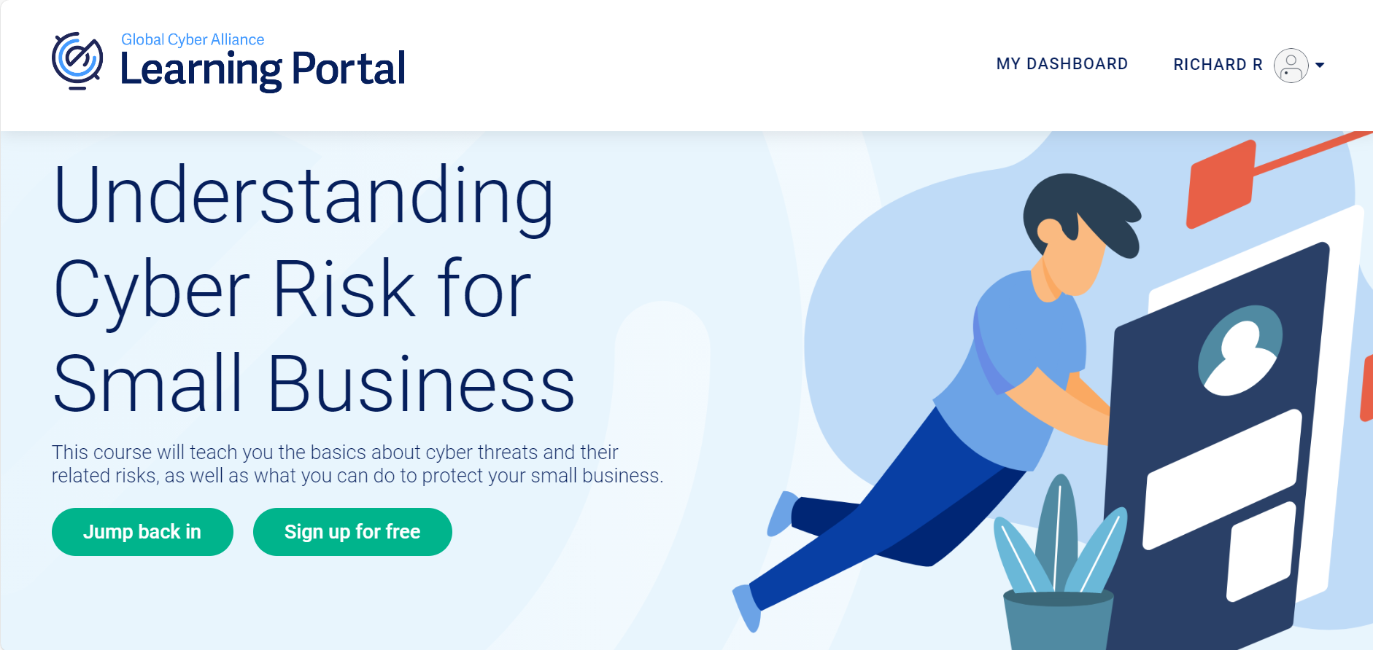
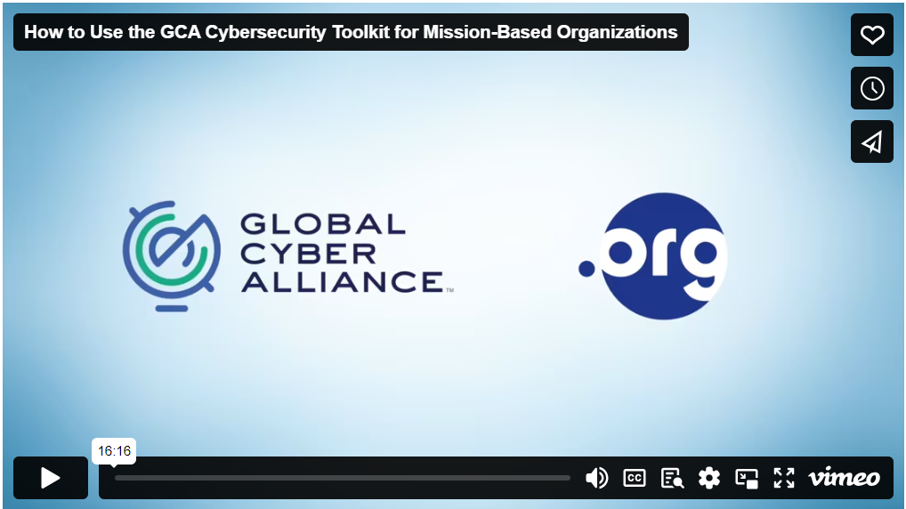
Introduction to the CPG Implementation Guidance
GCA Signup:
Overview
Factors to consider
GCA Toolkit (Free!)
  Overview
  Account signup
  Navigation
  Training
  Resources
GCA Training:
Notes:
Overview: The implementation guidance for the required 16 CPGs is based on the documents and guidance from GCA, FTC, DHS, CISA, and the NIST CSF 2.0 Quick Start Guide for Small Businesses, however, the guidance has been modified to address SBIR/STTR Small Businesses. In addition, there are sections that make up the implementation guidance. They are as follows:
What DOE SBIR/STTR CS Self-Assessment requirement(s) is/are being met?
This section identifies the applicable CPG(s) and displays the actual language found on the DOE SBIR/STTR CS Self-Assessment. Note: The language in this section has been modified from the CISA CPG Checklist to reflect additional clarification and guidance for DOE SBIR/STTR specific CPG requirements.
What is required to implement the CPG(s)?
This section of the guidance will provide the resources required to implement the CPG.
As mentioned earlier, the SBIR/STTR Program will be utilizing the Global Cyber Alliance (GCA) Toolkit to assist small businesses with the implementation of the required CPGs.
Factors to Consider: The SBIR/STTR applicants/awardees should consider the following factors before choosing how to implement the CPGs, (but, not limited to):
Reviewing and identifying current business practices (i.e., researching, collaborating with other stakeholders, etc.)
Identifying type of data used (i.e. Microsoft Documents, Excel Spreadsheets etc.)
Identifying the classification of the data (i.e. intellectual property/sensitive information, such as, business financial and personnel information)
Understanding accessibility to this information (users who have access to this information)
Identifying assets that processes, stores, and/or transmits the information (including interconnections to other assets)
The SBIR/STTR CS Due Diligence Program will utilize the Global Cyber Alliance (GCA) Toolkit to assist small businesses with the implementation of the required CPGs. The GCA toolkit is sponsored by Public Internet Registry (PIR). The toolkit was recommended by NIST CSF v2.0 Small Business Quick Start Guide. The link to the toolkit is: GCA Cybersecurity Toolkit for Small Business | Sponsored by Mastercard (gcatoolkit.org). The SBIR/STTR Program will be utilizing the Global Cyber Alliance (GCA) Toolkit to assist small businesses with the implementation of the required CPGs.
The free toolkit can assist SBIR/STTR Small Businesses with developing their asset inventory and configuring, strengthening, protecting and backing up its devices and accounts. The GCA Learning Portal has useful tools, training videos and checklists/guides that give a brief introduction of the threats, risks, and explain methods to implement CS best practices/CPGs to ensure your small business is protected.
Applicants/awardees are highly encouraged to sign up for a free account to review the documents, videos and training presentations found on the GCA Toolkit/Learning Portal to understand how to implement the required CPGs. The GCA Learning Portal link: Understanding Cyber Risk for Small Business (globalcyberalliance.org)
All SBIR/STTR applicants/awardees should scroll down on the left side of the main screen, click on ‘Resources’ and view the video, ‘How to Use the Toolkit’ to learn how this resource should be used (about a 16 minute video).
The tools, training videos and checklists/guides mentioned are suggested and part of the SBIR/STTR implementation guidance. Each CPG has a short training presentation from the GCA Learning Portal and downloadable tools and/or checklists/guides to implement the cybersecurity best practice which also addresses the required CPG(s). In addition, other applicable resources from FTC, DHS, CISA and NIST are listed to provide assistance with CPG implementation.

Slide 11

1B: Organizational Cybersecurity Leadership
Requirement
The small business should identify a leader who is responsible and accountable for cybersecurity within an organization.
How does the CPG relate to small businesses and why is it important?
Centralized responsibility
Risk management
Resource allocation
Security culture
How do small businesses implement the CPG?
Develop CS strategy
Develop a risk management strategy
Notes:
How does the CPG relate to small businesses and why is it important?
CS Leadership provides for Centralized Responsibility – A cybersecurity leader centralizes the responsibility of security, ensuring that there someone focused on protecting the business from cyber threats.
Provides for Risk Management – They can prioritize and help with the implementation of CPGs to mitigate risk, balancing the need for security with the business’s operational goals.
Provides for Resource Allocation – By understanding the specific needs of the business, a cybersecurity leader can ensure that resources are allocated efficiently, avoiding unnecessary expenditures while still maintaining robust security.
Fosters a Security Culture – The CS Leader can lead efforts to create a security-ware culture within the small business, providing training and resources to employees. A CS leader promotes best practices in cybersecurity, ensuring that all employees understand their role in protecting the business.
Having a dedicated senior cybersecurity professional is crucial for ensuring the effectiveness of the information security management and establishing cybersecurity training and culture at the organizational level. Ultimately this leadership role helps protect sensitive information, mitigates risk, and maintains regulatory compliance.
How do small businesses Implement the CPG?
To fully implement the Organizational CS Leadership CPG, the applicants/awardees should assign a leader who is responsible for CS within the organization and has developed a plan to fully implement the required CPGs. To fully implement the Basic CS Training CPG, the CS leader should also document, develop, maintain and implement a training plan on how the workforce will be trained to support the protection of the small business computer systems, data and personnel from cyberattacks (as discussed in the webinar).

Slide 12
1B: Organizational Cybersecurity Leadership
  Training and Resources
    Please reference the NIST CSF v.2 Small Business Quick Start Guide for more details on how to establish CS governance. Also, for a free basic CS training video that can be used at your small business, log into the Global Cyber Alliance Learning Portal: https://edu.globalcyberalliance.org and review the training called “Understand Cyber Risk for Small Business” to learn more about managing cyber risks for small business.
  Additional Training:
  Foundations of Cybersecurity for Managers (usalearning.gov)
  CS Essentials: fedvte.usalearning.gov/publiccourses/cyberessentials/index.htm?track=trackingon
  Cloud Security – What Leaders Need to Know (usalearning.gov)

Slide 13

2I: Basic Cybersecurity Training
Requirement
The small business’ workforce should be trained in cybersecurity and be able to support CS best practices.
How does the CPG relate to small businesses and why is it important?
Empowered Workforce
Collective Responsibility
Safe Practices
How do small businesses implement the CPG?
Cybersecurity awareness
This Photo by Unknown Author is licensed under CC BY
Notes:
How does the CPG relate to small business and why its important?
Provides for an Empowered Workforce – CS training fosters a culture of security within the organization, where every employee understands their role in protecting the business
Fosters Collective Responsibility – It creates a sense of collective responsibility, where security is viewed as everyone’s responsibility, not just IT.
Promotes Safe Practices- Employees learn best practices such as creating strong passwords, securely handling sensitive data, and email awareness which can prevent breaches
Researchers from Stanford University and a top cybersecurity organization found that approximately 88 percent of all data breaches are caused by an employee mistake. Human error is still very much the driving force behind an overwhelming majority of cybersecurity problems.
Example: Ubiquiti Networks, a major provider of networking equipment suffered a breach that led to attackers gaining access to their cloud storage servers hosted by a third-party provider. An insider later blew the whistle, revealing that Ubiquiti had failed to implement basic cybersecurity practices and that employees lacked essential training to recognize threats and follow security protocols.
How does the small business implement the CPG
To implement a basic CS training program:
Develop, document, and disseminate within the organization a CS training program which includes basic security concepts associated with the required CPGs, such as phishing, business email compromise, basic operational security (OPSEC), and password security to foster an internal culture of security and cyber awareness.
New employees should receive initial cybersecurity training within 10 days of onboarding and recurring training on at least an annual basis.

Slide 14
2I: Basic Cybersecurity Training
  Training and Resources
  Free Basic CS Training Video that can be used at your Small Business: Log into the Global Cyber Alliance Learning Portal: https://edu.globalcyberalliance.org and review the training called, ‘Protect Against Email Spoofs & Phishing’ to learn more about Phishing and Spoofing.
  Additional Training:
  NIST Free Training: Free and Low Cost Online Cybersecurity Learning Content | NIST
  Cybersecurity Essentials fedvte.usalearning.gov
  Free Security Awareness Chapter 1 - Here is How I will Hack You! - YouTube
  GCA Toolkit
  GCA Toolkit References

Slide 15

1A: Asset Inventory
Requirement
The small business should create an asset inventory to identify authorized/unauthorized use of any digital service or device and unmanaged/managed assets that are not formally approved and supported by the IT department, and rapidly detect and respond to new vulnerabilities.
How does the CPG relate to small businesses and why is it important?
Visibility and Control
Risk management
Recovery planning
Audit Readiness
How do small businesses implement the CPG?
Develop, document and maintain an asset inventory
Actively manage and vulnerability scan
Notes:
How does the CPG relate to small businesses and why is it important?
Provides for Visibility and control – An asset inventory provides a clear picture of all the hardware, software, and data assets the business owns, allowing for better management.
For Risk Management purposes – Knowing what assets you have helps in identifying which ones are critical and may be vulnerable to cyber threats.
For Recovering Planning – Having an asset inventory aids in developing and executing recovery plans by knowing exactly what needs to be restored or replaced.
For Audit Readiness – An accurate asset inventory ensures the business is prepared for audits, reducing the risk of compliance issues.
Developing and maintaining a comprehensive asset inventory is crucial for effective system management and security. It helps organizations identify and keep track of their high value assets, understand system vulnerabilities, system users/owners, system connections, and helps the organization understand the various data types that the company is employing and ensuring accountability.
Example: Equifax, a credit reporting agency, suffered a massive data breach that exposed personal information such as social security numbers, birth dates, and addresses. The breach occurred due to a vulnerability in Apache-struts, a web application framework. The vulnerability had been publicly disclosed, and a patch was available for months before the attack. However, Equifax failed to apply the patch in time, leaving its systems vulnerable to attack. Had Equifax kept an accurate inventory and checked it weekly, they would have noticed that patches hadn’t been applied.
How does the small business implement the CPG?
To fully implement this CPG, the SBIR/STTR Applicant and Awardee should develop, document, maintain and share with stakeholders an asset inventory that will be used to identify authorized/unauthorized use of any digital service or device this not approved/supported, managed/unmanaged by the IT department.
This CPG will take the most time to implement because of the amount of research and detail required, however, if implemented properly the small business will have a centralized repository of all assets which promotes a more efficient and effective way to protect against cyber-attacks, such as the unauthorized disclosure of sensitive information/intellectual property. To fully implement this CPG, the SBIR/STTR Applicant and Awardee should create an asset inventory that will be:
Used to identify authorized/unauthorized use of any digital service or device this not approved/supported, managed/unmanaged by the IT department.
Assist with rapid detection and response to vulnerabilities.
We recommend registering and/or logging into the GCA Learning Portal: https://edu.globalcyberalliance.org/ and viewing the free training presentation, “How to Inventory Your Devises, Apps, and Accounts.”
Also, download and complete the ‘Know What You Have Checklist’ to learn what assets need to be identified, documented and maintained within your business
Understand the data that you are processing, storing and transferring. To help your workforce identify, classify and label sensitive data and intellectual property, download and complete the ‘Data Classification’ policy template.
After free training and internal research is completed (steps above), then you should create your asset inventory by downloading and completing the ‘CIS Hardware and Software Asset Training Spreadsheet’ for all assets found on the GCA Learning Portal.
Document and track any devices that are managed or not managed by your small business. (i.e. third-party service providers)
Download the GCA Asset Inventory & Device Management Policy template for assistance with developing and documenting an Asset Management Policy. If needed, download the DHS, CRR Supplemental Resource Guide, Volume 1 Asset Management (DHS, CRR AM) guide for more information on developing an Asset Management process/policy that will align with the Asset Inventory & Device Management Policy.

Slide 16
1A : Asset Inventory
  Training and Resources
  Cover Your Assets! – Securing Critical and High-Value Assets (HVAs) (youtube.com)
  Critical Assets and Operations (usalearning.gov)
  Network Mapper | CISA
  GCA Toolkit
  GCA Toolkit References : https://edu.globalcyberalliance.org/
  GCA Asset Inventory & Device Management Policy
  ‘How Devices, Application and Accounts Impact Security’ on the GCA Learning Portal

Slide 17
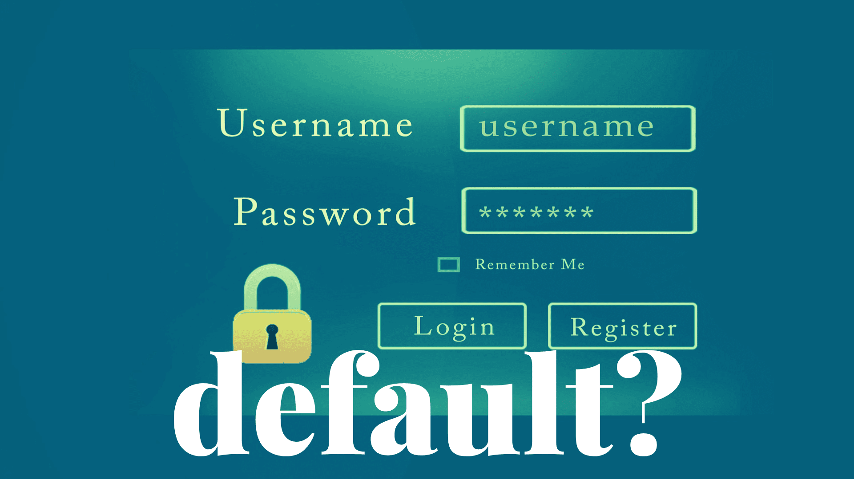
2A: Changing Default Passwords
Requirement
The small business should prevent threat actors from using default passwords to achieve initial access or to move laterally in a network.
How does the CPG relate to small businesses and why is it important?
Reducing vulnerability
Limiting attacking surface
Immediate protections
How do small businesses implement the CPG?
Process to change default passwords
Establish a default password policy
Conduct vulnerability scanning
Notes:
How does the CPG relate to small businesses and why is it important?
Reduces Vulnerabilities – Default passwords are widely known and easily accessible, making devices or accounts with unchanged passwords vulnerable to attacks. So, changing them reduces the risk significantly.
Limits the Attacking Surface – Changing default passwords minimizes the chances of attackers exploiting weak entry points.
Provides for Immediate Protections – Changing default passwords provides immediate protection against one of the most common security weaknesses, making this a quick win for small businesses.
Example: Printers, a device which may seem harmless, but when connected to a network, there can be dire consequences of not changing default passwords. In most cases, the device ships with a default username and password which is publicly available. Changing the default password is an incredibly easy task, but if not changed, this opens the company or individual up to an immediate attack. Once authenticated, attackers can access the configuration page as administrator, allowing them to perform malicious tasks throughout a company’s network.
How do small businesses implement the CPG?
To fully implement this CPG, applicant/awardees should create, document and implement processes to change default passwords on all systems, software and services identified in your asset inventory. The process should be disseminated to all stakeholders.

Slide 18
2A: Changing Default Passwords
Training and Resources
  Cyber Hygiene Services | CISA
More than a Password | CISA
Cyb3R_Sm@rT!: Use a Password Manager to Create and “Remember” Strong Passwords | CISA
  CISA Alert Code: TA13-175A Risks of Default Passwords on the Internet at this link: https://www.cisa.gov/news-events/alerts/2013/06/24/risks-default-passwords-internet and implement unique, strong passwords
  GCA Toolkit
the GCA Learning Portal: https://edu.globalcyberalliance.org/ to review the training video called, ‘Software Updates & Business Security’
  Download and complete the ‘Update Your Defenses Checklist’ document and use the tools on the GCA CS Toolkit

Slide 19

2L: Secure Sensitive Data
Requirement
The small business should protect sensitive information from unauthorized access.
How does the CPG relate to small businesses and why is it important?
Protects business integrity
Reputation management
Preventing financial loss
How do small businesses implement the CPG?
Access management
Protect sensitive data
Encryption methods
Notes:
How does the CPG relate to small businesses and why is it important?
Protects Business Integrity – Securing Sensitive data, such as financial records, intellectual property, and other important information is essential to maintaining the confidentially and integrity of the business
Reputation Management – A breach of sensitive data can severely damage a business’s reputation. Securing data helps avoid the negative publicity and loss of customer confidence that can result from such incidents.
Preventing Financial Loss – Data breaches can lead to significant financial losses through theft, fraud, or ransom demands.
Example: In 2015, Anthem Inc. was breached, exposing the personal data of 78.8 million people. Hackers accessed unencrypted sensitive data after a phishing attack. The lack of full disk encryption made it easier for attackers to steal information. Anthem faced a 16 million dollar HIPAA fine and significant reputational damage. The incident underscored the need for encryption, better access controls and phishing prevention.
How do small businesses implement the CPG?
Ultimately, the overall goal of implementing all CPGs is to Secure Sensitive Data (information/intellectual property) of small businesses from unauthorized disclosure. However, as part of implementing this ‘critical’ requirement (Secure Sensitive Data), small businesses should implement 2.E Separating User and Privileged Accounts and 2.D Revoke Credentials, which will be discussed shortly.
Develop an Access Management Policy documenting the process of restricting access to sensitive information and intellectual property to authorized users. Separate User and Privileged Accounts and Revoke Credentials (which will be discussed next).
The policy should include, but is not limited to:
Identifying who are assigned users and who has privileged accounts along with their roles/responsibilities.
A process for how to establish and enforce separation of duties.
A process of how privileged/user accounts are created and managed.
A process of creating and disabling accounts for new, temporary, departing, and terminated employees. (2.D Revoke Credentials)
Identifying who is responsible for disabling accounts and revoking credentials for departing/terminated employees. (2.D Revoke Credentials)
A process to delete/disable accounts.
A process if privilege accounts are compromised.
A process on how remote access is established and managed.

Slide 20
2L: Secure Sensitive Data
  Training and Resources
  Don’t Wake Up to a Ransomware Attack (usalearning.gov)
  Protect the Physical Security of Your Digital Devices | CISA
  How to Protect the Data that is Stored on Your Devices | CISA
  GCA Toolkit
  GCA Toolkit References
  All Tools - Small Business - GCA Cybersecurity Toolkit | Tools and Resources to Improve Your Cyber Defenses (gcatoolkit.org)

Slide 21
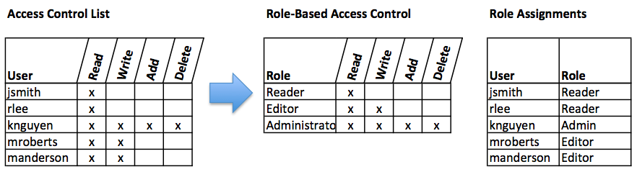
2E: Separating User and Privileged Accounts
Requirement
The small business should make it harder for threat actors to gain access to administrator or privileged accounts, even if common user accounts are compromised.
How does the CPG relate to small businesses and why is it important?
Limits access
Mitigates insider threats
Prevents mistakes
Better forensics
How do small businesses implement the CPG?
Access control model
Access control management
Notes:
How does the CPG relate to small businesses and why is it important?
Limits Access – By separating user accounts (for regular task) and privileged accounts (for administrative tasks), the business limits access to critical systems and sensitive data, reducing the risk of unauthorized changes or data breaches.
Mitigates Insider Threats – This separation ensures that even if a regular user account is compromised, the attacker cannot gain access to privileged functions, thereby mitigating the risk of insider threats.
Prevents Mistakes – Privileged accounts have higher access levels and can make significant changes to systems and data. By limiting the use of these accounts to specific administrative tasks, the risk of accidental errors (e.g., deleting important files or misconfiguring settings) is reduced.
Provides for Better Forensics – Separating accounts enables better tracking and forensics, as it is easier to identify which actions were performed by regular users versus administrators during an investigation.
Example: Sony pictures suffered a cyber attack in which hackers stole and leaked sensitive data. They managed to do this by gaining access to Sony’s internal network, eventually escalating their privileges to access highly sensitive systems. Sony's network lacked proper segregation between regular user accounts and privileged accounts, allowing the attackers to move laterally across the network and compromise critical systems.
How do small businesses implement the CPG?
The SBIR/STTR Small Business should decide on what type of access control model best meets their mission. Some factors to consider when deciding on an access control model:
Think about the level of access for employees. Are there different levels of access required or is everyone on the same level? Is there sensitive information or intellectual property that should not be available for all to view?
Determine who needs access and what level of access is required.
……and identify critical assets that need to be protected (systems/devices that store sensitive data like financial and personnel data, intellectual property, etc.).
We recommend using the GCA Access Management Policy Template to document how access to sensitive data and intellectual property is managed on assets/resources/services/facilities.
Lastly, define and maintain role-based access control, through determining and documenting the access rights necessary for each role within the business to successfully carry out its assigned duties. The business should perform access control reviews of business assets to validate that all privileges are authorized, on a recurring schedule at a minimum of annually, or more frequently.

Slide 22
2E: Separating User and Privileged Accounts
  Training and Resources
Securing Network Infrastructure Devices | CISA
Identity and Access Management Recommended Best Practices for Administrators (cisa.gov)
Securing Network Infrastructure Devices | CISA
Identity and Access Management Recommended Best Practices for Administrators (cisa.gov)
  GCA Toolkit
  GCA Toolkit References
All Tools - Small Business - GCA Cybersecurity Toolkit | Tools and Resources to Improve Your Cyber Defenses (gcatoolkit.org)
GCA Access Management Policy Template

Slide 23

2D: Revoke Credentials
Requirement
The small business should prevent unauthorized access to organizational accounts or resources by former employees.
How does the CPG relate to small businesses and why is it important?
Reduces risk of malicious actions
Ensures smooth transitions
Facilitates investigations
How do small businesses implement the CPG?
Revoke account access for departing employees
Notes:
How does the CPG relate to small businesses and why is it important?
Reduces Risk of Malicious Actions – A disgruntled former employee could attempt to harm the business by using their old credentials. Revoking access immediately upon departure mitigates this insider threat.
Ensures Smooth Transitions – By revoking access, the business can more easily transition responsibilities to other employees, ensuring that critical tasks and data remain secure during staff changes.
Facilitates investigations – In the event of a security incident, knowing that credentials of former employees have been revoked can help narrow down potential sources of unauthorized access, aiding in quicker resolutions.
Example: A fired employee at a Singapore based company called NCS accessed the company’s computer 'test system' and deleted servers, causing the company to lose $678,000. The fired employee deleted 180 virtual servers. He accessed NCS' QA system 13 times before being caught. The fired employee was sentenced to two years and eight months' jail time for one charge of unauthorized access to computer material. Had the fired employee’s access credentials been revoked at the time of his employment termination, this situation would never have occurred.
Revoking credentials for departing employees is critical for maintaining security and preventing unauthorized access. It helps protect sensitive information, systems, and resources from potential misuse or data breaches. By promptly revoking credentials, organizations can ensure that former employees no longer have access to company assets, reducing the risk of insider threats and maintain regulatory compliance.
How do small businesses implement the CPG
Identify who is responsible for disabling accounts and revoking credentials for departing/terminated employees.
Establish a process for creating and disabling accounts for new, temporary, departing, and terminated employees
…..and then delete/disable accounts for departing employees
Implement a timely revocation of a user’s access to data and organizationally owned or managed (physical and virtual) applications, infrastructure systems, and network components at the time of termination of employment.

Slide 24

2R. System Backups
Requirement
The small business should secure data and reduce the likelihood/duration of data loss during loss of service, delivery, or operations
How does the CPG relate to small businesses and why is it important?
Prevents data loss
Restores corrupted data
Disaster recovery
Reduces ransomware impact
How do small businesses implement the CPG?
Redundant system
Service (cloud)
Notes:
How does the CPG relate to small businesses and why is it important?
Prevents Data Loss – Regular backups protect against data loss due to hardware failures, Cyberattacks, human errors, or natural disasters. Backups ensures that critical business information is not permanently lost.
Restores Corrupted Data - If data becomes corrupted or compromised, backups allow the business to restore the data to a previous, uncorrupted state.
Disaster Recovery – Backups are a key component of a disaster recovery plan, allowing the business to recover and continue operations even after a major incident.
Reduces Ransomware Impact – In the event if a ransomware attack, having up-to-date backups can allow the business to restore it’s systems without paying the ransom, saving money and reducing risk.
How do small businesses implement the CPG?
To fully implement this CPG, applicants/awardees should develop, test, document and implement a process which ensures the replication of information to a redundant system, service, device or medium and has the ability to restore when needed.
Download and review Data Backup Options (cisa.gov) available from CISA and choose a backup method that suits your small business, to include, but not limited to full backups, incremental backups (copying only changed data since that last backup), or differential backups (copying changed data since the last full backup).
Use an alternate offsite backup storage solution, such as external hard drives, network-attached storage (NAS), cloud storage, or dedicated backup servers. Ensure that the alternate storage site provides controls equivalent to that of the primary site.
Automate backup processes to ensure regular and consistent backups without manual intervention.
Test backups periodically to verify their integrity and ensure they can be restored successfully in case of a data loss event.
Develop, document and maintain a Backup and Recovery Process which should include:
How to perform backup and recovery on critical assets.
Who is responsible for backup and recovery.
How often is the backup and recovery performed.
Identify critical data, applications and system configurations (from your asset inventory) that should be backed up regularly.
Before backing up systems, we suggest that applicants/awardees conduct vulnerability scans on systems/devices and address all known vulnerabilities.
Small Businesses should be able to copy information or process status to a redundant system, service, device or medium (Cloud) that can provide the needed processing capability when needed.

Slide 25
2R. System Backups
  Training and resources
  Data Backup Options (cisa.gov)
  How to Protect the Data that is Stored on Your Devices | CISA
  Get the Most out of Cloud Storage and Services while Minimizing the Risk | CISA
  GCA Toolkit
  GCA Toolkit References
  Global Cyber Alliance https://edu.globalcyberalliance.org/ review the training video called, ‘Protecting Your Data with Backups’ to learn how to set up backups and restore capability to protect systems from data loss.

Slide 26
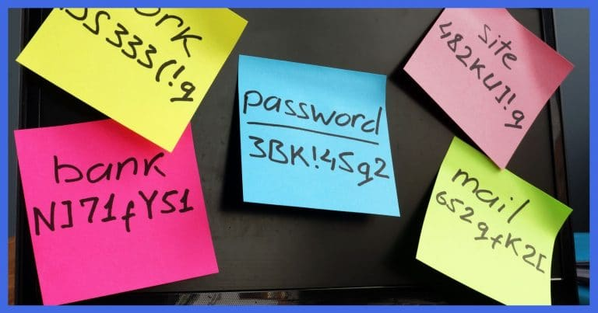
2B: Minimum Password Strength
Requirement
The small business should create and use complex passwords that are harder for threat actors to guess or crack.
How does the CPG relate to small businesses and why is it important?
Protecting accounts
Disregarded vulnerability
How do small businesses implement the CPG?
Minimum password length
Password Strength for MFA and without
Notes:
How does the CPG relate to small businesses and why is it important?
Protecting accounts – strong passwords make It harder for attackers to brute force, reducing the risk of unauthorized access to sensitive business accounts and systems.
Disregarded vulnerability - Its important to have a minimum password strength policy because without it. employees are likely to use simple passwords such as bobby123 which can be easily brute forces by threat actors.
Example: In June 2021, New York City’s Law Department fell victim to a cyberattack that granted attackers access to sensitive information including the personal data of thousands of city employees, evidence of police misconduct, medical records for plaintiffs, and the identities of children charged with serious crimes. And all that data was compromised using a single employee’s stolen email account password.
How does a small businesses implement the CPG?
Develop and document a process for establishing complex passwords that are harder for threat actors to guess or crack.
To fully implement Minimum Password Strength
Create unique passwords for all accounts.
Document, maintain and enforce password requirements for all employees. (Systems may be configured to ensure passwords meet certain criteria)
Use a password manager to help you remember your passwords. Do not write passwords down.
At a minimum, use an 8-character password for accounts using MFA. And for accounts not using MFA, use a 14-character password for accounts not using MFA Without MFA, longer passwords are preferred because they are harder to crack than shorter passwords, as they contain more characters and therefore more possible combinations. This makes them less vulnerable to brute force attacks.

Slide 27
2B: Minimum Password Strength
  Training and Resources
Stop Online Crime with Strong Passwords (youtube.com)
More than a Password | CISA
  For training on MFA we suggest applicants and awardees review, the NIST Small Business CS Corner: Multi-Factor Authentication | NIST
  GCA Toolkit
  GCA Toolkit References
  log into the Global Cyber Alliance Learning Portal and review training called, ‘Creating Strong Passwords & Two-Factor Authentication’ to learn how to create strong passwords and two factor authentication (2FA).
  To implement strong passwords, download and complete Beyond Simple Passwords - GCA Cybersecurity Toolkit | Tools and Resources to Improve Your Cyber Defenses (gcatoolkit.org)

Slide 28
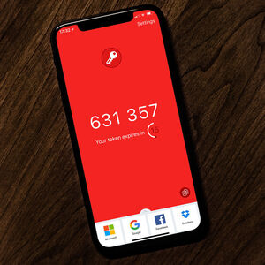
2H: Phishing-Resistant Multi-Factor Authentication
Requirement
The small business should include additional layer(s) of security to protect assets accounts whose credentials have been compromised.
How does the CPG relate to small businesses and why is it important?
Enhanced security against phishing
Preventing disruptions
Supporting remote work
How do small businesses implement the CPG?
Administrative accounts
Services
Notes:
How does the CPG relate to small businesses and why is it important?
Enhanced Security Against Phishing - Phishing resistant MFA, such as hardware tokens or biometric authentication, prevents attackers from easily gaining access to accounts, even if they obtain the user’s password through phishing.
Preventing disruptions – By securing access to critical systems and accounts Phishing-resistant MFA helps prevent operational disruptions caused by unauthorized access or system compromise due to phishing attacks.
Supporting Remote Work – Phishing-Resistant MFA is especially important in environments where employees work remotely, as it ensures secure access to business systems from any location, reducing the risk of breaches in a dispersed workforce.
How do small businesses implement the CPG?
To fully implement MFA, develop, document and implement the processes for enabling/installing MFA. Here are the suggestions for implementing MFA:
applicants/awardees must decide the extent of security required to ensure (critical) assets are protected from unauthorized users if credentials are compromised.
MFA should be implemented on administrative access accounts, on all business assets, whether managed on-site or through a third-party provider.
Also, Phishing resistant MFA options to consider. Google Authentication or Microsoft authenticator
Side note
SMS 2FA is not safe because of how vulnerable it is to spoofing, man in the middle attacks and phishing attacks we recommend not using this if possible.

Slide 29
2H: Phishing-Resistant Multi-Factor Authentication
  Training and Resources
  Make Your Accounts Safer with Multifactor Authentication (MFA) (youtube.com)
  Recognize and Report Phishing (youtube.com)
  GCA Toolkit
  GCA Toolkit References
  Visit the GCA Cybersecurity Toolkit: Beyond Simple Passwords - GCA Cybersecurity Toolkit | Tools and Resources to Improve Your Cyber Defenses (gcatoolkit.org)

Slide 30

2W: No Exploitable Services on the Internet
Requirement
The small business should identify and monitor all assets, especially public-facing assets, and ensure unauthorized users cannot gain an initial system foothold by exploiting known weaknesses.
How does the CPG relate to small businesses and why is it important?
Minimizing Attack Surface
Preventing Common Exploits
How do small businesses implement the CPG?
Public internet
Systems and software are patched
Notes:
How does the CPG relate to small businesses and why is it important?
Minimizing Attack Surface – By not exposing services to the internet, the business reduces the number of entry points that attackers can use to breach systems. This makes it harder for cybercriminals to find and exploit vulnerabilities
Preventing Common Exploits – Services that are unnecessarily exposed to the internet can be targeted by automated attacks such as those exploiting known vulnerabilities in outdated software. Securing these services or removing public access helps prevent such exploits
Example: In 2014, hackers executed a successful cyber attack against Target. The attackers secretly gained access to Target’s computer network through their HVAC system and stole the financial and personal information of 110 million Target customers, and then moved this sensitive information from Target’s network to a server in Eastern Europe.
How do small businesses implement the CPG?
Develop and document a process to:
Conduct vulnerability scanning
Operate services exposed on internet-accessible systems with secured configurations
Keep software updated by installing and turning on automatic updates
Check all ports and verify all connections are authorized. If there are unused or open ports secure them with port blockers.

Slide 31
2W: No Exploitable Services on the Internet
  Training and Resources
  Don’t Let Cyber Criminals Steal Your Connections: Securing Internet-Accessible Systems (youtube.com)
  Securing Internet-Accessible Systems (usalearning.gov)
  GCA Toolkit
  GCA Toolkit References
    Protect against Malware by using MS Defender which can be found in the GCA CS Toolkit: Prevent Phishing and Malware - GCA Cybersecurity Toolkit | Tools and Resources to Improve Your Cyber Defenses (gcatoolkit.org)
    Detect for phishing websites and forged accounts on social networks. Link: All Tools - Small Business - GCA Cybersecurity Toolkit | Tools and Resources to Improve Your Cyber Defenses (gcatoolkit.org) Download the ImmuniWeb Phishing Detection Test tool. Also on the same site, download quad9 to prevent computers and devices from connecting to known malicious sites.

Slide 32
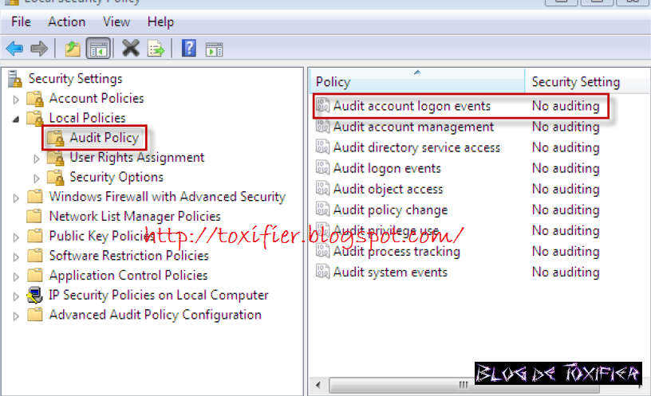
2G: Detection of Unsuccessful (Automated) Login Attempts
Requirement
The small business should protect its assets from automated, credential-based attacks.
How does the CPG relate to small businesses and why is it important?
Identifying brute force attacks
Recognizing suspicious activity
Enforcing account lockout policies
How do small businesses implement the CPG?
Login attempts
Account lock outs
Notes:
How does the CPG relate to small businesses and why is it important?
Identifying Brute Force Attacks – Automated login attempts are often part of brute force attacks, where attackers try multiple username and password combinations to gain access. Detecting these attempts early allows the business to respond quickly before an account is compromised.
Recognizing suspicious activity – A high number of failed login attempts can indicate that someone is trying to breach the system. By monitoring and detecting these attempts, the business can identify suspicious activity and take action to secure accounts.
Enforcing account lockout polices – Detecting failed login attempts allows the business to implement account lockout polices after a certain number of failures, further protecting accounts from being compromised.
Example: In 2016, Uber suffered a major breach that exposed the personal information of 57 million users and drivers. The breach occurred when attackers accessed Uber’s Amazon Web Services (AWS) by using login credentials found in a private GitHub repository. Uber failed to detect the suspicious login attempts and did not have Multi-Factor Authentication (MFA) enabled allowing attackers to exfiltrate sensitive data undetected.
How do small businesses implement the CPG?
Develop and document a process which prescribes a limit of (organization-defined number) consecutive invalid logon attempts by a user. Automatically lock the account for a period or lock the account until released by an administrator; the notify Cyber security leader and take other actions when the maximum number of unsuccessful attempts is exceeded.
For example, Microsoft Enterprise OS allows you to enforce a limit on consecutive invalid login attempts by utilizing Microsoft’s local security policy functionality to automatically lock an account after a preset limit of invalid login attempts. Also, the local security policy manager allows you to detect login attempts with its Account Logon Events feature.

Slide 33
2G: Detection of Unsuccessful (Automated) Login Attempts
  Training and resources
  What Is SIEM? (youtube.com)
  GCA Toolkit
  GCA Toolkit References
    Protect against Malware by using MS Defender which can be found in the GCA CS Toolkit: Prevent Phishing and Malware - GCA Cybersecurity Toolkit | Tools and Resources to Improve Your Cyber Defenses (gcatoolkit.org)
  Detect for phishing websites and forged accounts on social networks. Link: All Tools - Small Business - GCA Cybersecurity Toolkit | Tools and Resources to Improve Your Cyber Defenses (gcatoolkit.org) Download the ImmuniWeb Phishing Detection Test tool and implement. Also on the same site, download quad9 to prevent computers

Slide 34

2K: Strong and Agile Encryption
Requirement
The small business should deploy effective encryption to maintain confidentiality and integrity of sensitive data being processed, in transit or at rest.
How does the CPG relate to small businesses and why is it important?
Evolving security needs
Limiting damage
How do small businesses implement the CPG?
Encryption
Data at Rest
Data in Transit
Notes:
How does the CPG relate to small businesses and why is it important?
Evolving security needs – Agile encryption allows the business to adapt quickly to new security threats and technological changes by updating encryption protocols and practices as needed.
Limiting Damage – In the event of a data breach, encrypted data is less valuable to attackers because it is unreadable without proper passwords or keys. This limits the potential damage and exposure for the business.
Strong and agile encryption is vital for protecting sensitive information and maintaining data confidentiality. It ensures that even if unauthorized parties gain access to encryption keys the data is safe.
How do small businesses implement the CPG?
Develop and document a process to:
Encrypt devices, removable media, documents and files.
Use Full Disk Encryption (FDE): by encrypting all the data on a disk, including temporary files, programs, and systems files. (We suggest using BitLocker which comes with windows.)
Properly configure Email Security by updating transport layer security (TLS) to protect data in transit and utilize AES (Advanced Encryption Standard) to Secure Sensitive Data at rest.
Implement additional layers of security, such as Phishing resistant multi-factor authentication (MFA) to enhance overall protection.

Slide 35
2K: Strong and Agile Encryption
  Training and Resources
  Encryption | CISA
  Known Exploited Vulnerabilities Catalog | CISA
  Securing Network Infrastructure Devices | CISA
  Identity and Access Management Recommended Best Practices for Administrators (cisa.gov)
  Securing Network Infrastructure Devices | CISA ,
  Identity and Access Management Recommended Best Practices for Administrators (cisa.gov)
  GCA Toolkit
    GCA Toolkit References
    Download and review the GCA document: Update Your Defenses - GCA Cybersecurity Toolkit | Tools and Resources to Improve Your Cyber Defenses (gcatoolkit.org) and learn how to do Full Disk Encryption (FDE): Protecting information by encrypting all the data on a disk, including temporary files, programs, and systems files.
    How to Protect the Data that is Stored on Your Devices | CISA

Slide 36
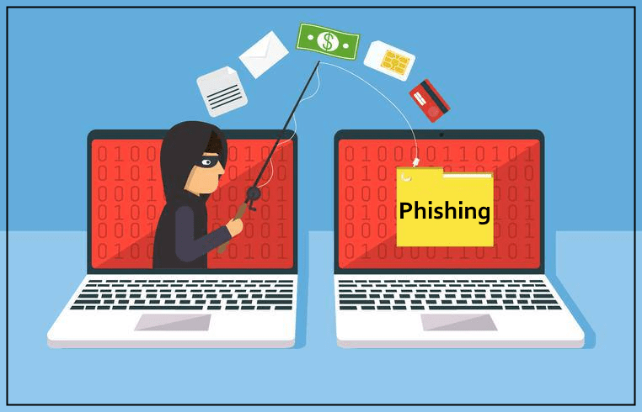
2M: Email Security
Requirement
The small business should reduce risk from common email-based threats, such as spoofing, phishing, and interception.
How does the CPG relate to small businesses and why is it important?
Securing communication channels
Enhancing verification
How do small businesses implement the CPG?
Email Configuration
Notes:
How does the CPG relate to small businesses and why is it important?
Securing Communication Channel - Email Security helps ensure that sensitive information sent via email, such as contracts, financial details, or personal data, is protected from interception or unauthorized access.
Enhancing Verification – Advanced email security solutions often include features like domain authentication (DKIM, SPF, DMARC) to ensure that emails are coming from legitimate sources, reducing the risk of impersonation.
Email is a common target for cyber-attacks due to its widespread use and potential for containing sensitive information. Email security is crucial for protecting against threats like data breaches, Malware infections, financial fraud, and unauthorized access to confidential information. By implementing robust email security measures, organizations can safeguard their communication channels, maintain trust with customers and partners, comply with regulations, and mitigate the risk associated with cyber threats targeting emails.
Example: In 2018, the Federal Elections Commission (FEC) fell victim to an email spoofing attack due to the lack of proper email securities including DMARC and TLS. Attackers sent spoofed emails that appeared to be from FEC officials to various entities.
How do small businesses implement the CPG?
Set up Domain-based Message Authentication Reporting and Conformance (DMARC) to protect your small businesses’ domain name.
If stronger protection is required, then have all internet-facing email services be configured to enable Start Transport Layer Security (STARTTLS)/(TLS) to encrypt emails in transit.
Enable Sender Policy Framework (SPF) to prevent email spoofing and DomainKeys Identified Mail (DKIM) to authenticate email integrity, and all second-level organization domains have Domain-based Message Authentication, Reporting and Conformance (DMARC) to reject unauthorized emails.
You can also Check your current email services as many of these feature may be available.
Yahoo offers 2 Step Security Keys for email accounts.
Google also offers 2 Step Verification for email accounts and a slew of other features Check out the Gmail Help Center and check out the Security and Privacy Features.
MS 365 offers all of the features mentioned early : Within Outlook

Slide 37
2M: Email Security
  Training and resources
Don’t Let Cyber Criminals Cash In – Preventing Business Email Compromise (youtube.com)
Understanding Web and Email Server Security (usalearning.gov)
  GCA Toolkit
  GCA Toolkit References
https://edu.globalcyberalliance.org review the training called, ‘Protect Against Email Spoofs & Phishing’ to learn more about securing your emails.
Download and complete the ‘Protect Your Email & Reputation: Email Security Checklist’
Valimail Monitor - GCA Cybersecurity Toolkit | Tools and Resources to Improve Your Cyber Defenses (gcatoolkit.org)
GCA DMARC Setup Guide - GCA Cybersecurity Toolkit | Tools and Resources to Improve Your Cyber Defenses (gcatoolkit.org)
(visit All Tools - Small Business - GCA Cybersecurity Toolkit | Tools and Resources to Improve Your Cyber Defenses (gcatoolkit.org) and use tools: ‘Let’s Encrypt and/or PGP),

Slide 38
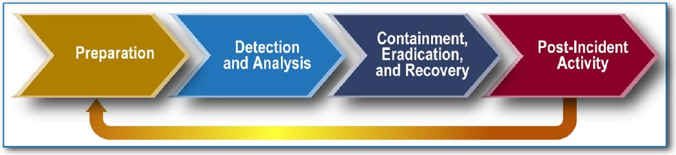
2S: Incident Response Plans
Requirement
The small business should develop, document, maintain, practice, and update cybersecurity incident response plans for relevant threat scenarios.
How does the CPG relate to small businesses and why is it important?
Quick Response
Reducing Downtime
Coordinated Response
Promoting a Security Culture
How do small businesses implement the CPG?
Predefined plans
Notes:
How does the CPG relate to small businesses and why is it important?
Quick Response – An incident response plan provides a structured approach to responding to incidents, allowing the business to act quickly and contain the situation before it escalates. This minimizes the impact on operations and reduces the potential for data loss or system damage.
Reducing Downtime – with a well-prepared IRP, the business can restore normal operations more quickly after an incident, minimizing downtime and its associated costs.
Coordinated Response – The plan ensures that all employees know their roles and responsibilities during an incident, leading to a more coordinated and effective response.
Promoting a Security Culture – Regular training and drills based on the IRP help foster a culture of security awareness, ensuring that all employees understand the importance of their role in maintaining cybersecurity
How do small businesses implement the CPG?
Develop and document an IR Plan which should:
Identify the small business’ high value assets which should be listed in the asset inventory and are the most vulnerable assets.
Identify threat scenarios that could have a severe negative impact to the SBIR/STTR Small Business’ should one or more assets be compromised in the event of a security incident.
Define the security incidents (type, criteria for what is reportable and acceptable timeline for reporting).
Establish key stakeholder roles and responsibilities and communication/escalation channels to share pertinent information of security incidents, to include any mitigation measures taken, new vulnerabilities identified, risks accepted. In addition, this information should be tracked and documented.
Establish IR objectives and that includes predefined steps for detecting, analyzing, containing, eradicating, recovering from, and reporting security incidents.
Include process for reporting incidents for employees teleworking or working remote.
Test the IR Plan to verify that it meets security requirements to protect the small businesses assets.
Conduct regular training and drills to ensure that employees are familiar with the IR plan, know their roles, and can respond effectively to incidents
The IR Plan should include a form to identify the security incident (date, time, location, individuals involved, contact information, description of incident and actions taken, etc.) and made available for everyone within the small business. This form should also be used in the IR Reporting process.
Side Note: Check current IT service provider as coverage may be available to satisfy this CPG requirement.
Google and Microsoft

Slide 39
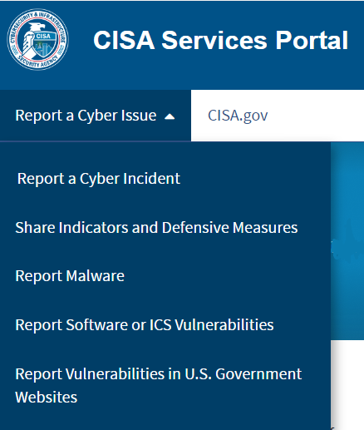
4A: Incident Reporting
Requirement
The small business should have security incident reporting procedures to contact incident response team and/or senior management. In addition, the small business should have the CISA, FBI, or local police contact information available to assist or understand the broader scope of a cyberattack.
How does the CPG relate to small businesses and why is it important?
Coordinating with External Parties
Engaging Industry Networks
Access to Government Resources
Preventing Wider Harm
How do small businesses implement the CPG?
Reporting external and internal
Notes:
How does the CPG relate to small businesses and why is it important?
Coordinating with External Parties - Reporting to authorities often requires the business to document and communicate the details of the incident, which can help clarify the situation and improve the overall incident response.
Engaging Industry Networks – Reporting incidents can also connect the business with industry-specific networks or information-sharing organizations, providing valuable insights and support.
Access to Government Resources – Many government agencies like CISA offer support to businesses that report cybersecurity incidents, including technical assistance and legal advice. This can be crucial for small businesses that may lack internal resources.
Preventing Wider Harm – by reporting incidents, the business can help prevent further attacks on other entities. For example, if a small business is a part of a supply chain, reporting an incident can alert other companies to the threat potentially protecting them from similar attacks.
It’s important to report actual or suspected security incidents immediately so that work can begin to investigate and resolve the incident. Reported incidents that uncover system vulnerabilities should be analyzed by organizational personnel. The analysis can serve to prioritize and initiate mitigation actions to address the discovered system vulnerability.
How do small businesses implement the CPG?
Develop and document an incident reporting process. At a minimum, the small business should utilize their Incident Response Plan and develop incident reporting process objectives. The incident reporting process should identify personnel responsible for developing and updating on a yearly basis or when needed, a process that:
Specifies when coordination is required for personnel to manage security incidents.
Addresses personnel teleworking and working remote.
Is disseminated or provided to all stakeholders.
Is tested and proven that the process meets the small business’ Incident Reporting objectives.
IR Reporting should be part of the IR Plan and be made available for all personnel
Identifies and assigns roles to key stakeholders (external and internal) responsible for reporting incidents to essential Incident Response personnel (external/internal), to include.
Organizational Cybersecurity Lead, the Small Business Owner, CISA, FBI and local Police.
For example, you can report a cyber incident to CISA via their portal located on their website. CISA Services Portal.
Fill out a cyber incident report form: IRF Incident Reporting Start - IRF (cisa.gov)
The Portal is a secure platform with enhanced functionality for cyber incident reporting, including integration with login.gov credentials. The portal’s enhanced functionality includes the ability to save and update reports, share submitted reports with colleagues or clients for third-party reporting, and search and filter reports. A new collaboration feature allows users to engage in informal discussions with CISA.
For further guidance, please reference CISA’s voluntary cyber incident reporting resource
Google, Microsoft, CISA FBI

Slide 40
4A: Incident Reporting
  Training and Resources
CISA Cyber security Incident Response Playbooks - Episode 1 - Overview - YouTube
4 Wix Features You Gotta Know (youtube.com)
CISA Cyber security Incident Response Playbooks - Episode 2 - Preparation Phase (youtube.com)
CISA Cyber security Incident Response Playbooks - Episode 3 - Detection Phase (youtube.com)
CISA Cyber security Incident Response Playbooks - Episode 4 - Containment (youtube.com)
CISA Cyber security Incident Response Playbooks - Episode 5 - Eradication and Recovery (youtube.com)
CISA Cybersecurity Incident Response Playbooks - Episode 6 - Post-Incident Activity (youtube.com)
CISA Cyber security Incident Response Playbooks - Episode 7 - Coordination (youtube.com)
CISA Cyber security Incident Response Playbooks - Episode 8 - FTK and CISA (youtube.com)
  Incident reporting services
CISA Services Portal.
CISA’s voluntary cyber incident reporting resource.
  FBI Internet Crime Link: Internet Crime Complaint Center(IC3) | Home Page
  GCA Toolkit
  GCA Toolkit References
  Download the DHS, CRR Supplemental Resource Guide, Incident Management . You will use these documents in conjunction with the SBIR/STTR supplemental guidance Hyperlink. User should be able to download this document from the Artifacts Folder
Notes:
Google and Microsoft also have incident reporting centers.

Slide 41
SBIR/STTR CS Due Diligence Team Contact Information
Florence Carr – Cybersecurity Specialist Lead
Phone: 240.263.0322
Email: florence.carr@science.doe.gov
Richard Rosenblatt – Cybersecurity Specialist
Phone: 571.414.5063
Email: richard.rosenblatt@science.doe.gov
Jonathan Jack – Cybersecurity Specialist
Phone: 703.294.1963
Email: jonathan.jack@science.doe.gov
For more information, please visit the SBIR/STTR Cybersecurity Due Diligence Program Website:
SBIR Introduction to Cybersecuri... | U.S. DOE Office of Science(SC) (osti.gov)
Notes:
Google, Microsoft, CISA FBI

