Slide 1
The DOE Webinar will begin shortly . . .
Why is there no sound?
  Once you logged into the webinar, you were provided two options to listen to this broadcast. The first option is through your computer speakers, the second option is via dialing the phone number provided to you upon login to the webinar. If you chose to listen through your computer speakers, you may need to turn your speaker volume on or up.
Will DOE provide access to the recorded webinar after the meeting?
  Yes, all those who registered will receive a link to the slides and to the recorded webinar soon after the meeting. It will also be available on the DOE SBIR/STTR web site.
Where can I find the Topics being discussed today?
  This link will take you to the Funding Opportunity Announcement (FOA) page that lists the FY 2020 Phase I Release 2 Topics: https://science.osti.gov/sbir/Funding-Opportunities
What if my question was not answered at today’s webinar?
  Please contact the point of contact that follows each subtopic in the document listed above for further clarification.
  If you have a question about the grant application process, please send us an email at: sbir-sttr@science.doe.gov or call us at (301) 903-5707.

Slide 2

DOE SBIR/STTR
Phase I Release 2 Topics Webinar
Topics associated with the
FY 2020 Phase I Release 2
Funding Opportunity Announcement
Topics 06-17
DOE SBIR/STTR Programs Office
November 19, 2019

Slide 3
TODAY’S AGENDA
Topics Introduction | DOE SBIR/STTR Programs Office – Chris O’Gwin
Topic 06 - 17 | Office of Energy Efficiency and Renewable Energy

Slide 4
FY 2020 Phase I Schedule
 | Release 1 | Release 2
Topics Issued | Monday, July 15, 2019 | Tuesday, November 12, 2019
Webinar(s) | Week of July 22, 2019 | Week of November 18, 2019
FOA Issued | Monday, August 12, 2019 | Monday, December 16, 2019
Webinar(s) | Friday, August 19, 2019 | Thursday, December 19, 2019
Letters of Intent (LOI) Due | Tuesday, September 3, 2019 | Monday, 6 January, 2020
Non-responsive LOI Feedback Provided | Tuesday, September 24, 2019 | Tuesday, January 27, 2020
Applications Due | Tuesday, October 15, 2019 | Monday, February 24, 2020
Award Notification | Monday, January 6, 2020 | Monday, May 18, 2020

Slide 5

Phase I Funding Opportunity Announcements
Participating DOE Programs (FY 2020)
Office of Advanced Scientific Computing Research
Office of Basic Energy Sciences
Office of Biological and Environmental Research
Office of Nuclear Physics
Office of Science
Phase I
Release 1
Office of Cybersecurity, Energy Security, and Emergency Response
Office of Defense Nuclear Nonproliferation
Office of Electricity
Office of Energy Efficiency and Renewable Energy
Office of Environmental Management
Office of Fossil Energy
Office of Fusion Energy Sciences
Office of High Energy Physics
Office of Nuclear Energy
Phase I
Release 2

Slide 6
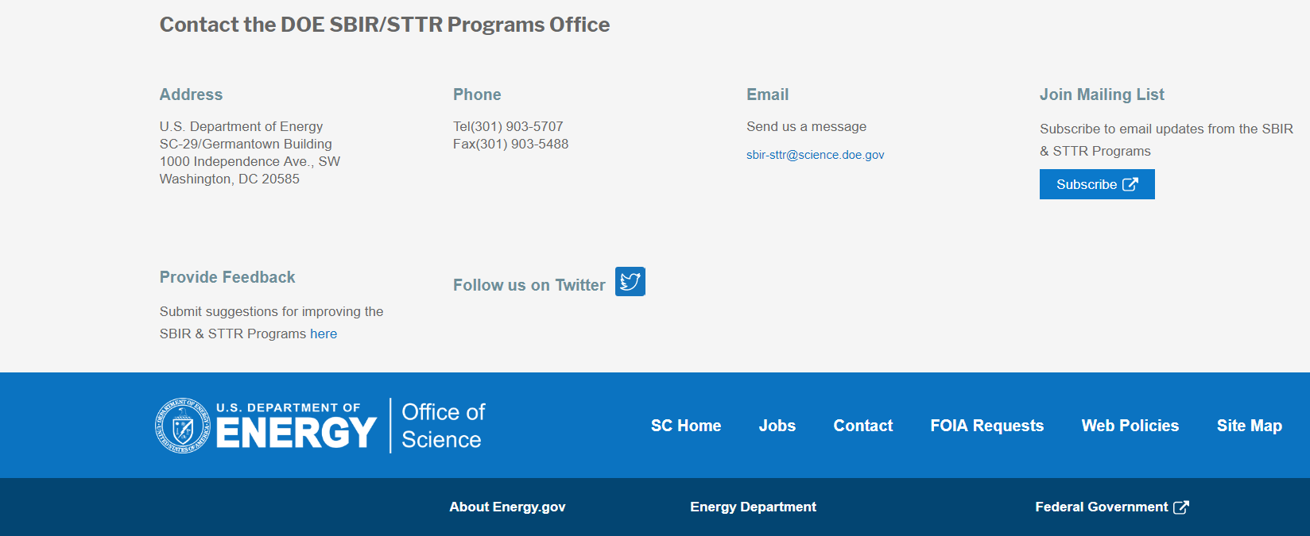
Funding Opportunity Announcement (FOA) Webinar
FY20 Phase I Release 2 FOA will be issued on December 16th
Join our Mailing List – this field is on every DOE SBIR/STTR web page
  Following the issuance of the FOA, look for an email with a link to the FOA
Webinar with Q&A for this FOA on December 19th
  Overview of the FY 2020 DOE SBIR/STTR Programs
    Following the issuance of the FOA, look for an email announcing this webinar

Slide 7
Topic Basics
Topics are created by DOE program managers and define important technology breakthroughs needed in R&D areas that support the DOE mission
Topics are organized by DOE Program Office, e.g., EERE, BES, etc.
DOE program managers are listed with each subtopic
  Questions to DOE program managers are limited to clarification of the topic and subtopic (including references)
  Clarification is provided to help you determine whether your technology fits within the topic and subtopic
  You may communicate with these topic managers from the release of topics until the grant application due date
  The decision to apply is yours

Slide 8
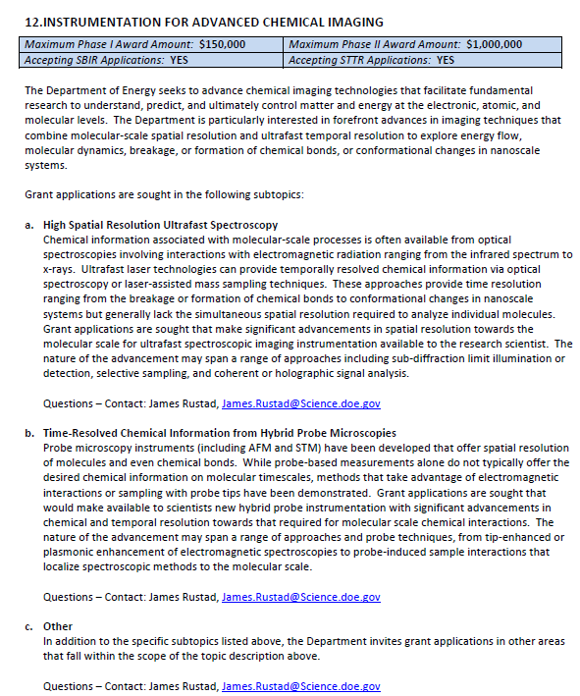
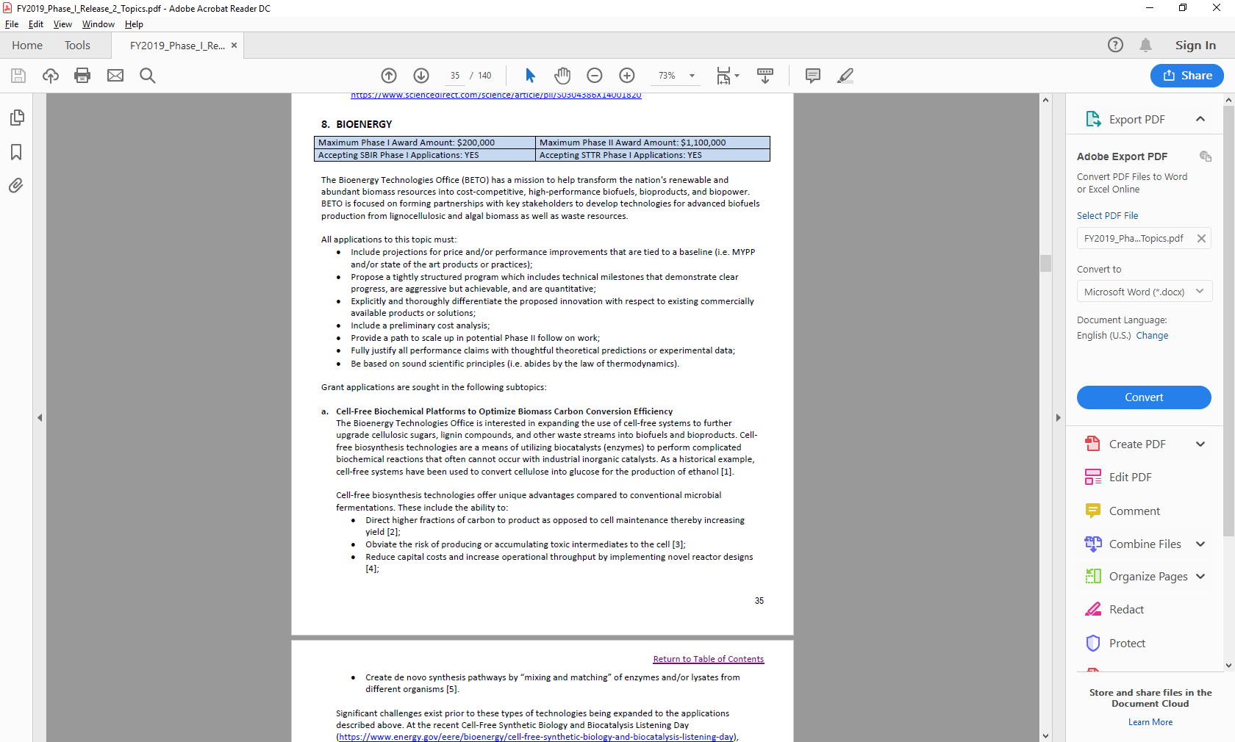
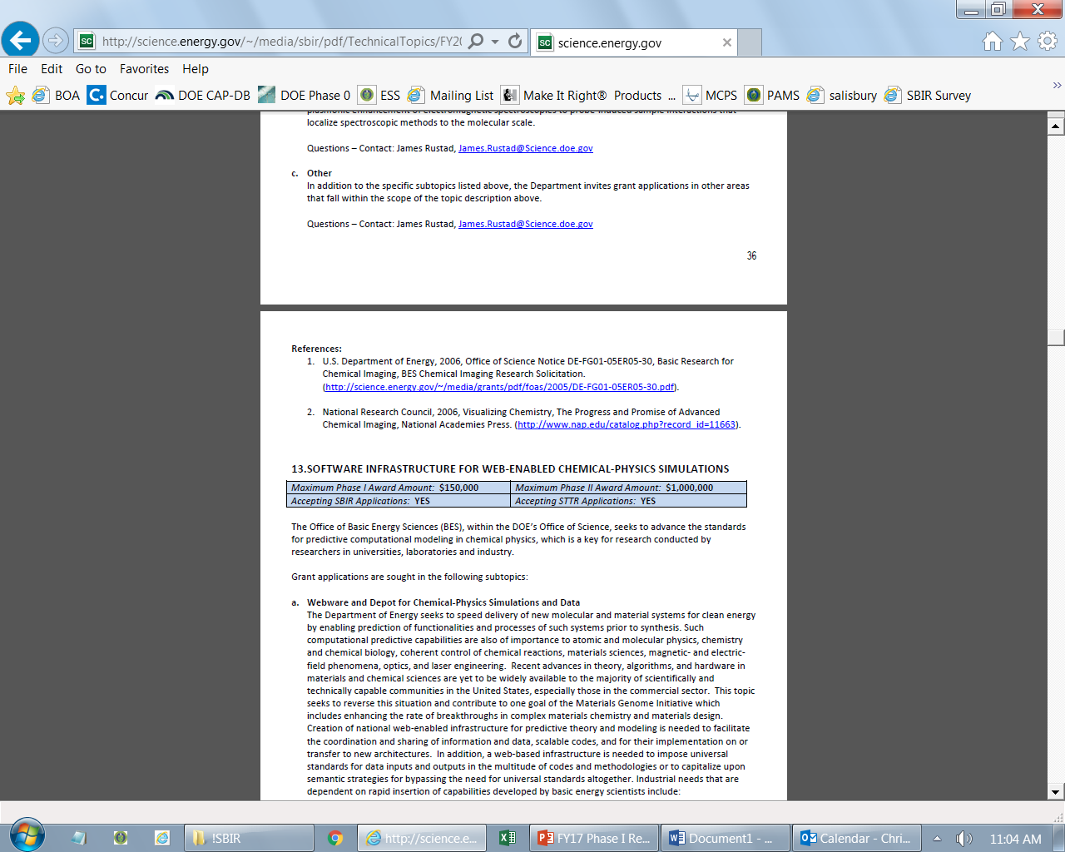
Example Topic
Topic & Subtopic
  You must specify the same topic and subtopic in your Letter of Intent and grant application
Topic Header
  Lists the maximum award amounts for Phase I & Phase II and the types of application accepted (SBIR and/or STTR)
Program Manager
  Each subtopic lists the responsible DOE program manager
“Other” Subtopic
References
Notes:
Here is an example topic from our current announcement. Note that every SBIR or STTR application must include the topic and subtopic to which you are applying. The general topic description describes the general field of technology that is of interest. The subtopics describe specific opportunities in which proposals are requested. Each topic at DOE will also have an “other” subtopic. Under this subtopic you can submit proposals that fall within the general topic description, but do not fit with any of the other subtopics. We have found that when we write the subtopics too narrow sometimes we miss good opportunities, and this “other” subtopic is a means collecting disruptive solutions.

Slide 9
Topic 14: WIND
Maximum Phase I Award Amount: $200,000 | Maximum Phase II Award Amount: $1,100,000
Accepting SBIR Phase I Applications: YES | Accepting STTR Phase I Applications: YES
Integrated Low-Cost Instrumentation for Wind Turbine, Plant Control, and Distributed Wind Site Assessment
Sensor and Sensing Technologies for Offshore Subsea Cable Monitoring and Fault Detection System
Other
Questions: Mike Derby, Michael.Derby@ee.doe.gov

Slide 10
Topic 17: JOINT TOPIC: WATER, WIND, AND ADVANCED MANUFACTURING TECHNOLOGIES OFFICES: AFFORDABLE, GRID-FRIENDLY, HIGH-TORQUE DIRECT-DRIVE GENERATORS
Maximum Phase I Award Amount: $250,000 | Maximum Phase II Award Amount: $1,600,000
Accepting SBIR Phase I Applications: YES | Accepting STTR Phase I Applications: YES
Compact Power Conditioning Systems for High-Torque, Low-Speed Machines
Questions: Rajesh Dham, rajesh.dham@ee.doe.gov
Michael Derby, michael.derby@ee.doe.gov
Allen Hefner allen.hefner@ee.doe.gov

Slide 11
Topic 06: ADVANCED MANUFACTURING
Maximum Phase I Award Amount: $200,000 | Maximum Phase II Award Amount: $1,100,000
Accepting SBIR Phase I Applications: YES | Accepting STTR Phase I Applications: YES
Atomic Precision for Energy Efficient and Clean Energy-Related Microelectronics
Sensors for Harsh and Corrosive Environments
Critical Materials Supply Chain Enabling Research
Water Desalination: Cost-effective Energy-Recovery for Modular Desalination Systems
Questions: Subtopics a – Tina Kaarsberg, tina.kaarsberg@ee.doe.gov
Subtopics b – Brian Valentine, brian.valentine@ee.doe.gov or Al Hefner, allen.hefner@ee.doe.gov
Subtopics c – Helena Khazdozian, Helena.khazdozian@ee.doe.gov
Subtopics d – Melissa Klembara, melissa.klembara@ee.doe.gov

Slide 12
Topic 07: BIOENERGY
Maximum Phase I Award Amount: $200,000 | Maximum Phase II Award Amount: $1,100,000
Accepting SBIR Phase I Applications: YES | Accepting STTR Phase I Applications: YES
Novel Approaches for Monitoring and Valorizing Bioenergy-Derived Ecosystem Services
Bioenergy Feedstock Engineering Incubator
Questions: Subtopics a – Kristen Johnson, kristen.johnson@ee.doe.gov
Subtopics b – Mark Elless, mark.elless@ee.doe.gov

Slide 13
Topic 08: BUILDINGS
Maximum Phase I Award Amount: $200,000 | Maximum Phase II Award Amount: $1,100,000
Accepting SBIR Phase I Applications: YES | Accepting STTR Phase I Applications: YES
Advanced Robotics, Tools, and Approaches for Retrofitting of Existing Buildings
Innovative Building Energy Rating Delivery Models
Efficient, Resilient Building Technologies
Novel Materials and Processes for Solid-State Lighting
Questions: Subtopics a – Sven Mumme, sven.mumme@ee.doe.gov
Subtopics b – Madeline Salzman, madeline.salzman@ee.doe.gov
Subtopics c – Nelson James, nelson.james@ee.doe.gov
Subtopics d – Brian Walker, brian.walker@ee.doe.gov

Slide 14
Topic 09: FUEL CELLS
Maximum Phase I Award Amount: $200,000 | Maximum Phase II Award Amount: $1,100,000
Accepting SBIR Phase I Applications: YES | Accepting STTR Phase I Applications: YES
Production of Low-cost Hydrogen from Off-shore Wind Power
Questions: Subtopics a – Michael Hahn, michael.hahn@ee.doe.gov

Slide 15
Topic 10: GEOTHERMAL
Maximum Phase I Award Amount: $200,000 | Maximum Phase II Award Amount: $1,100,000
Accepting SBIR Phase I Applications: YES | Accepting STTR Phase I Applications: YES
Advanced Geothermal Energy Storage
Questions: William Vandermeer, william.vandermeer@ee.doe.gov

Slide 16
Topic 11: SOLAR
Maximum Phase I Award Amount: $200,000 | Maximum Phase II Award Amount: $1,100,000
Accepting SBIR Phase I Applications: YES | Accepting STTR Phase I Applications: YES
TECHNOLOGY TRANSFER OPPORTUNITY: Microwave Photoconductance Spectrometer for Roll-to-Roll Deposited Semiconductor Materials
Solar Seed Fund: Affordability, Reliability, and Performance of Solar Technologies
Questions: solar.sbir@ee.doe.gov

Slide 17
Topic 12: VEHICLES
Maximum Phase I Award Amount: $200,000 | Maximum Phase II Award Amount: $1,100,000
Accepting SBIR Phase I Applications: YES | Accepting STTR Phase I Applications: YES
Electric Drive Vehicle Batteries
Gallium Nitride Device Qualification for Electric Drive Vehicle Power Electronics
Research on Energy Efficiency in Emerging Mobility Systems
Multifunctional Composite Materials and Structures for Vehicle Applications
Questions: Subtopics a – Samm Gillard, Samuel.Gillard@ee.doe.gov
Subtopics b – Steven Boyd, steven.boyd@ee.doe.gov
Subtopics c – Prasad Gupte, Prasad.Gupte@ee.doe.gov
Subtopics d – Felix Wu, felix.wu@ee.doe.gov

Slide 18
Topic 13: WATER
Maximum Phase I Award Amount: $200,000 | Maximum Phase II Award Amount: $1,100,000
Accepting SBIR Phase I Applications: YES | Accepting STTR Phase I Applications: YES
Research & Development for Testing of Oil-Free Bearings/Bushings for Hydropower Components
Innovative Sensing and Data Platforms for Water and Hydropower
Co-Development of Marine Energy Technology at Smaller Scales
Waterway Debris Remediation Powered by Marine Energy
Questions: Rajesh Dham, rajesh.dham@ee.doe.gov

Slide 19
Topic 15: JOINT TOPIC: BIOENERGY AND ADVANCED MANUFACTURING TECHNOLOGY OFFICES: NOVEL UTILIZATION STRATEGIES FOR OCEAN PLASTIC WASTE
Maximum Phase I Award Amount: $200,000 | Maximum Phase II Award Amount: $1,100,000
Accepting SBIR Phase I Applications: YES | Accepting STTR Phase I Applications: YES
Novel Utilization Strategies for Ocean Plastic Waste
Questions: Melissa Klembara, Melissa.Klembara@ee.doe.gov or Jay Fitzgerald, Jay.Fitzgerald@ee.doe.gov

Slide 20
Topic 16: JOINT TOPIC: BUILDING AND ADVANCED MANUFACTURING TECHNOLOGIES OFFICES: ADVANCED, AFFORDABLE THERMAL ENERGY STORAGE
Maximum Phase I Award Amount: $200,000 | Maximum Phase II Award Amount: $1,100,000
Accepting SBIR Phase I Applications: YES | Accepting STTR Phase I Applications: YES
Thermal Energy Storage in Buildings
Thermal Energy Storage in Industry and Relevant Materials Manufacturing
Questions: Subtopics a – Sven Mumme, sven.mumme@ee.doe.gov
Subtopics b – Tina Kaarsberg, tina.kaarsberg@ee.doe.gov
or Robert Gemmer, bob.gemmer@ee.doe.gov

Slide 21


DOE SBIR/STTR Programs Office
Contact Information
SBIR/STTR Web: https://science.osti.gov/sbir
Email: sbir-sttr@science.doe.gov
Phone Assistance Hotline: 301-903-5707
DOE Phase 0 Assistance Program: http://www.dawnbreaker.com/doephase0/
DOE Application Assistance: https://science.osti.gov/SBIRLearning

