Slide 1
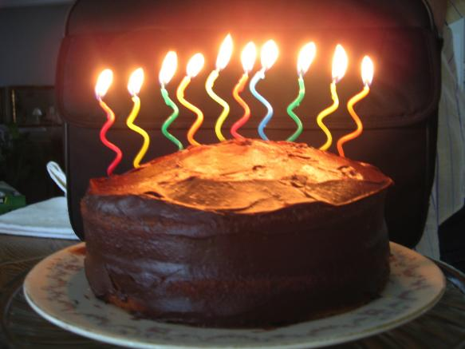

SciDAC at 10
SciDAC 2011
11 July 2011
Dr. Patricia M. Dehmer
Deputy Director for Science Programs
Office of Science, U.S. Department of Energy
http://science.energy.gov/sc-2/presentations-and-testimony/

Slide 2

Secretary
Steven Chu
Deputy Secretary
Daniel B. Poneman
Advanced Research Projects Agency – Energy
Arun Majumdar
Under Secretary for Nuclear Security/Administrator for National Nuclear Security Administration
Thomas P. D’Agostino
Under Secretary
for Science
Steven E. Koonin
Under Secretary
Arun Majumdar (A)
Defense Nuclear Nonproliferation
Office of Science
William Brinkman
Patricia Dehmer
Energy Efficiency & Renewable Energy
Defense Programs
Fossil Energy
Basic Energy Sciences
Harriet Kung
High Energy Physics
Mike Procario(A)
Naval Reactors
Nuclear Energy
Counter-terrorism
Advanced Scientific Computing Research
Daniel Hitchcock (A)
Nuclear Physics
Tim Hallman
Electricity Delivery
& Energy Reliability
Defense Nuclear Security
Biological & Environmental Research
Sharlene Weatherwax
Fusion Energy Sciences
Ed Synakowski
Emergency Operations
SBIR/STTR
Manny Oliver
Workforce Develop. for Teachers & Scientists
Patricia Dehmer (A)
SciDAC @ 10
2
Notes:
2

Slide 3
The World Before SciDAC
The Scientific Simulation Initiative (SSI) (submitted to Congress February 1999)
SSI – “It is now possible to obtain computational capabilities 100 times faster than currently in common use through the application of technologies developed for the Accelerated Strategic Computing Initiative (ASCI)*. … The mission of the SSI is to further develop and employ the emerging generation of very high performance computers as major tools for scientific inquiry.”
SSI included:
  Advanced computing (terascale computers)
  High performance networks
  Computer science and enabling technology research
  Investments in scientific applications
SSI applications:
Two mission critical, time critical applications: global systems and combustion systems. These apps were to help define hardware and software.
A small number of basic science applications to be selected by peer review.
*Established in 1995, ASCI supports the development of computer simulation capabilities to analyze and predict the performance, safety, and reliability of nuclear weapons and to certify their functionality.

Slide 4
SSI: The FY 2000 Senate Report
May 27, 1999
The Committee recommendation does not include the $70,000,000 requested for the Department’s participation in the Scientific Simulation Initiative.

Slide 5
SSI: The FY 2000 House Report
July 23, 1999
The Committee recommendation …does not include funds for the Scientific Simulation Initiative (SSI) …
The budget justification for SSI failed to justify the need to establish a second supercomputing program in the Department of Energy. … The ASCI program, for which Congress is providing more than $300,000,000 per year, seeks to build and operate massively parallel computers with a performance goal of 100 TeraOps by 2004. The proposed SSI program has a goal of building and operating a separate, yet similar, program dedicated exclusively to domestic purposes. …The Committee appreciates the advantages of modeling and having computing capability to analyze complex problems. The Committee would like to work with the Department to get better answers to questions it has about this new proposal. The Committee looks forward to further discussions to identify a program that has mutually supportable budget and program plans.

Slide 6
SSI: The FY 2000 Conference Report
September 27, 1999
The conference agreement includes $132,000,000, instead of $143,000,000 as provided by the House or $129,000,000 as provided by the Senate. The conferees strongly support the Department’s current supercomputer programs including ASCI, NERSC, and modeling programs. The conferees urge the Department to submit a comprehensive plan for a non-Defense supercomputing program that reflects a unique role for the Department in this multi-agency effort and a budget plan that indicates spending requirements over a five-year budget cycle.

Slide 7
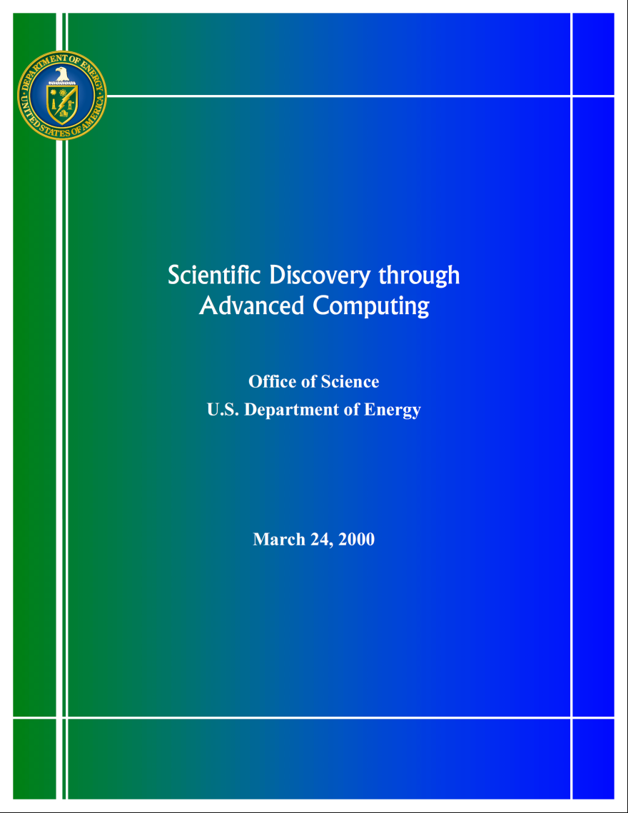
And then there was SciDAC
On March 30, 2000, SC submitted a plan for scientific computing to the EWD Subcommittees of the Appropriations Committees of the U.S. Congress.
The plan, “Scientific Discovery through Advanced Computing,” outlined a five-year program to develop the Scientific Computing Software and Hardware Infrastructure needed to use terascale computers to advance research programs in basic energy sciences, biological and environmental research, fusion energy sciences, and high energy and nuclear physics.

Slide 8
SciDAC Goals (2001)
Create scientific codes that take advantage of terascale computers.
Create mathematical and computing systems software to efficiently use terascale computers.
Create a collaboratory environment to enable geographically separated researchers to work together and to facilitate remote access to facilities and data.

Slide 9
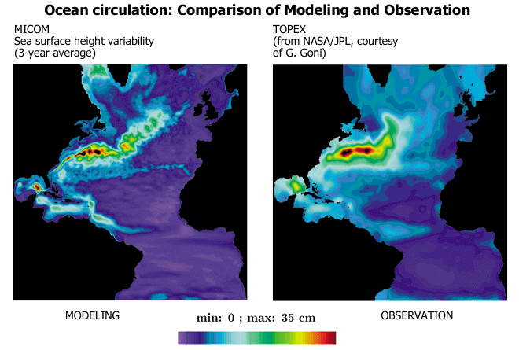
Advancing Climate Simulation
Climate simulation on terascale computers will improve our understanding of global climate and enable the study of regional scale impacts of global change.
DOE’s program is an element of the U.S. Global Change Research Program.
DOE’s program is designed to make full use of the computing capabilities provided by computers capable of 10 to 100 teraflops.
The new program will provide greater certainty in predictions of future climates at both global and regional scales. It will also provide detailed information on the effects of climate change, including many not now possible, e.g., changes in topical storm frequency.

Slide 10
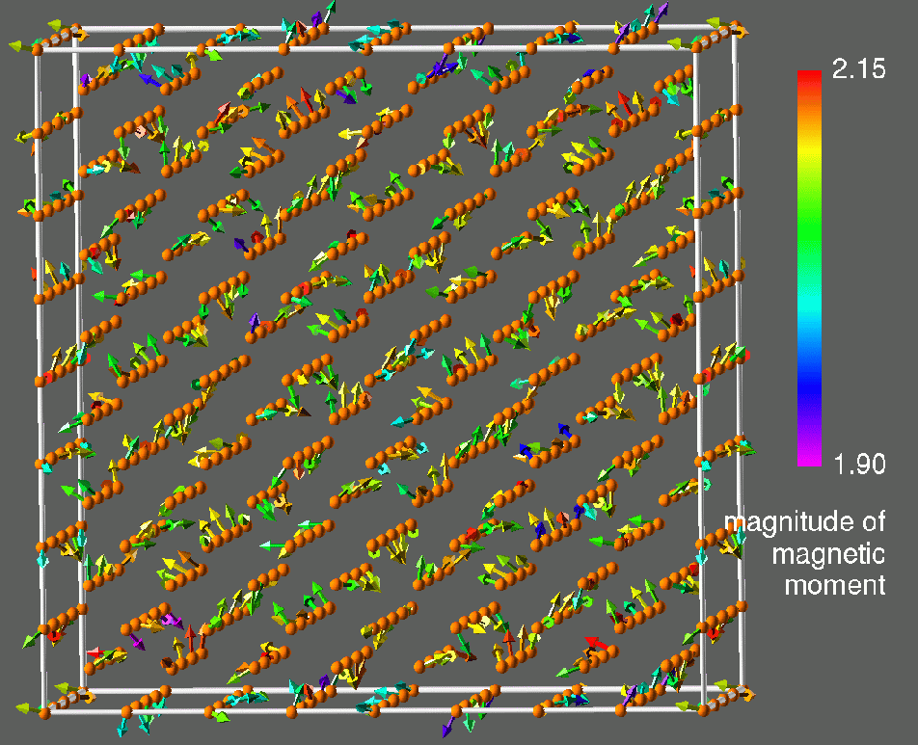
Advancing Materials Sciences
Prediction of the magnetic properties of materials will enable the design of stronger, lighter magnets and new materials for magnetic data storage and recording.
Scientists recently reported a break-through in calculating the magnetic properties of materials.
Combining modeling advances with the most powerful DOE-SC computer, DOE scientists were able to predict the effect of temperature on the magnetic moment of a crystal of iron. This is the first step to predicting the performance of magnets at typical operating temperatures.
These simulations won the 1998 Gordon Bell prize in supercomputing for the fastest scientific application.

Slide 11
Advancing Structural Genomics
DOE is involved in both the Human Genome Project and the Microbial Genome Project. These projects are laying the foundation for a revolution in human health and biotechnology.
To develop more effective drugs or redesign microbes for bioremediation, scientists must determine the structures and elucidate the functions of the proteins encoded in DNA.
Determining the structure of a single protein is a time-consuming process and not always successful. There are approximately 140,000 proteins in the human body alone.
Advances in scientific computing, coupled with DOE’s national light sources, will be critical for predicting protein structures.

Slide 12
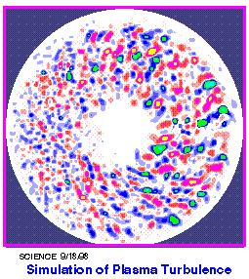
Advancing Plasma Physics
Predicting and controlling turbulence is of fundamental scientific interest as well as critically important for developing viable magnetic fusion devices
Using DOE-SC’s existing computing capabilities and new mathematical techniques, scientists recently performed three-dimensional simulations of microturbulence with parameters appropriate for present-day fusion plasmas. These simulations, for the first time, reproduced the major features of turbulent transport observed in the core of tokamaks.
With increased computing power, it will be possible to simulate turbulent transport under realistic reactor-relevant plasma conditions

Slide 13
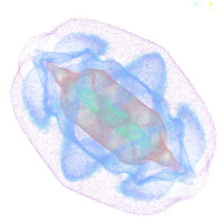
Advancing Accelerator Physics
Increased capabilities in accelerator physics simulation will enable improved designs and reduce cost and risk of next-generation accelerators.
In past five years our ability to model particle beam dynamics in accelerators has increased dramatically —leading, for the first time, to reliable prediction of “beam halos” that limit the performance of accelerators.
Greatly increased computer capability will enable:
Coupling of accelerator subsystems, e.g., the particle beam and electromagnetic field
Exploration of advanced concepts to push the frontiers of accelerator science
HPC simulation of intense beam exhibits ultra-low density beam halo

Slide 14
Progress in Computational Science
Molecular Calculations
Hexadecane
C₁₆H₃₄
Catalysts
(complex)
Octane
C₈H₁₈
Molecular Complexity
Computation:
275. million equations (non-linear)
30. quadrillion arithmetic operations
16. days for complete calculation
. (0.25 teraflops computer)
Ethane
C₂H₆
Methane
CH₄
CH
1970
1980
1990
2000
2010
2020
2030
Computing
Power (Peak)
????
0.0001
0.002
0.5
1,000
???
???
Hexadecane, aka cetane, ignites easily under compression. All other hydrocarbons in diesel fuel are indexed to cetane as to how well they ignite under compression.

Slide 15
Dramatic Advances in Computing
Terascale Today, Petascale Tomorrow ( 2001)
IBM “Blue Gene”
Innovative Designs
1,000
MICROPROCESSORS
2x increase in microprocessor speeds every 18-24 months
(“Moore’s Law”)
PARALLELISM
More and more processors being used on single problem
INNOVATIVE DESIGNS
Processors-in-Memory
HTMT
100
Increased Use of Parallelism
Peak Teraflops
10
Microprocessor Advances
1
0.1
1996
1998
2000
2002
2004
2006

Slide 16
Peak Performance and Real Performance Diverging
1,000
Peak Performance is skyrocketing
In past 10 years, peak performance has increased 100x; in next 5 years, it will increase 1000x
Real Performance is increasing
But efficiency has declined from 40-50% on vector supercomputers of 1990s to as little as 5-10% on parallel supercomputers of today
Efficiency on tomorrow’s supercomputers?
Research challenge is software
Scientific codes to model and simulate physical processes and systems
Computing and math software to enable use of advanced computers for scientific applications
Peak Performance
100
Software
Challenge
Teraflops
10
1
Real Performance
0.1
1996
2000
2004

Slide 17
The Software Challenge
“vector”
“parallel”
100
ideal Performance
On “parallel” machines, existing scientific codes realize as little as 5-10% of peak performance
10
Real Teraflops
1
On “vector” machines, scientific codes realized 40-50% of peak performance
0.1
Real Performance
0.01
0.01
0.1
1
10
100
Peak Teraflops

Slide 18
Changing Memory Hierarchies Create Technical Challenges
The Old Days - c.1990
Few Processors
Today
1000 Processors
Tomorrow
5000 Processors
Access Times for 1 Word from memory:
CPU
CPU
CPU
CPU
~ 1 CPU cycle
CPU
Cache
1
Cache
1
Cache
1
Cache
1
CPU
~ 100 CPU cycles
Cache
2
Cache
2
Cache
2
Cache
2
Vector
Register
Cache
Node Memory
~ 1000 CPU cycles
Node Memory
Shared
Memory
Inter-connect Fabric
CPU
Vector
Register
Vector
Register
CPU
Inter-connect Fabric
Vector
Register
Node Memory
CPU
CPU
CPU
CPU
CPU
CPU
Cache
Cache
1
Cache
1
Cache
1
Cache
1
One Level of Memory
Access Time: ~ 1 Word* / CPU cycle
Node Memory
Cache
2
Cache
2
Cache
2
Cache
2
Three Levels of Memory
Access times: 1 Word/ CPU cycle to
1 Word/1000 CPU cycles
Four Levels of Memory
Access times: 1 Word/ CPU cycle to
1 Word/10,000 CPU cycles
* 1 Word = 1 piece of data
18

Slide 19
SciDAC Investment Strategy, Year #1
Scientific Challenge
Teams (+$20.0M)
BES
Challenges
BER
Challenges
FES
Challenges
HENP
Challenges
Enabling Technology
(+$25.0M)
Numerical
Algorithms
Scientific Data
Management
Performance
Tuning Tools
Operating System
Enhancements
Computing
Hardware (+$12.3M)
ESnet
Flagship, Topical, and Experimental Computing Facilities
Collaboratory Software Infrastructure (+$10.1M)
Computational Science Graduate Fellowship Program (+$2.0M)

Slide 20
Topology of SC and ASCI Programs
Secure Network
Classified Computers
Classified Applications
Open Networks
Open Computers
Broad Scientific Applications
Community Codes
Fully Integrated Teams
ASCI Program:
SC Program:
Non DP Laboratories
Universities
“The Team”
LANL
LLNL
SNL
NNSA Laboratories

Slide 21
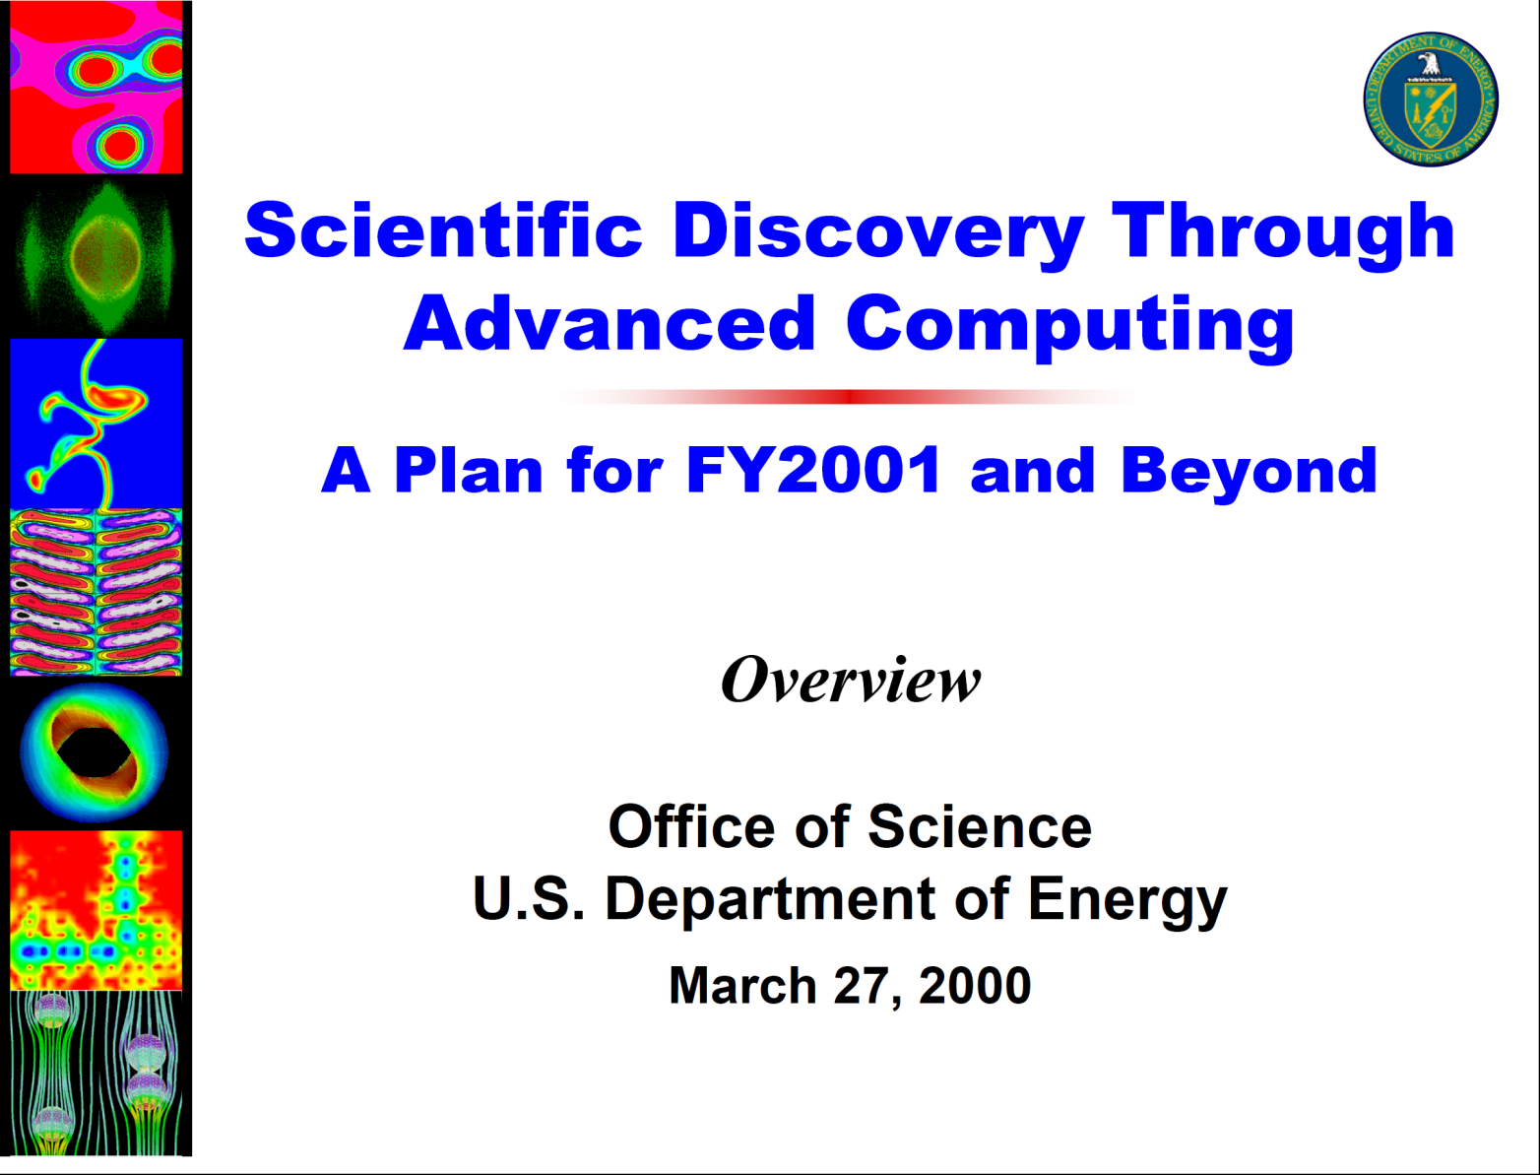
The Campaign for SciDAC
(~20 Hill contacts, mostly personal visits in 2 months)

Slide 22
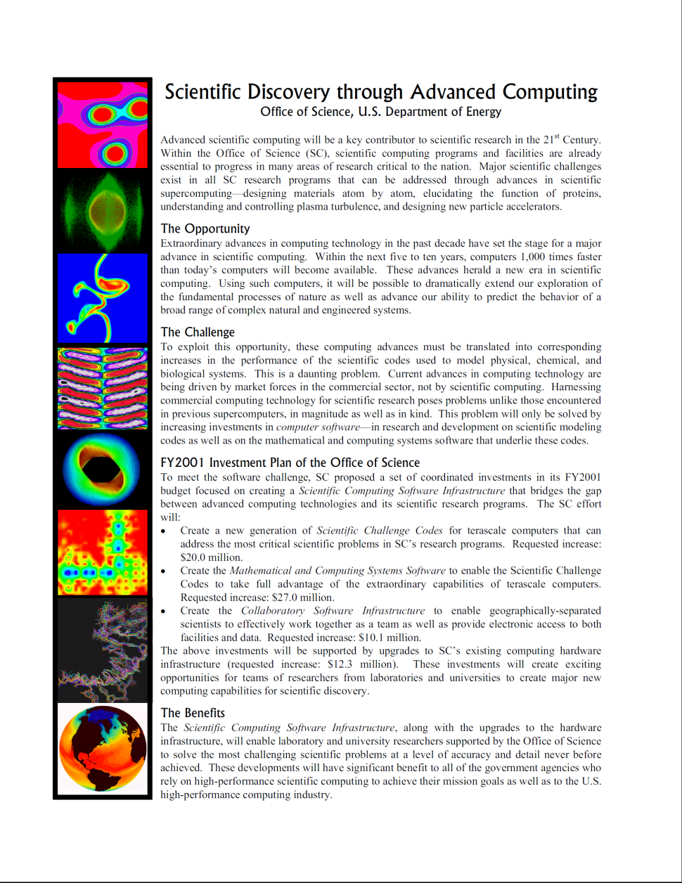
SciDAC in One Page

Slide 23
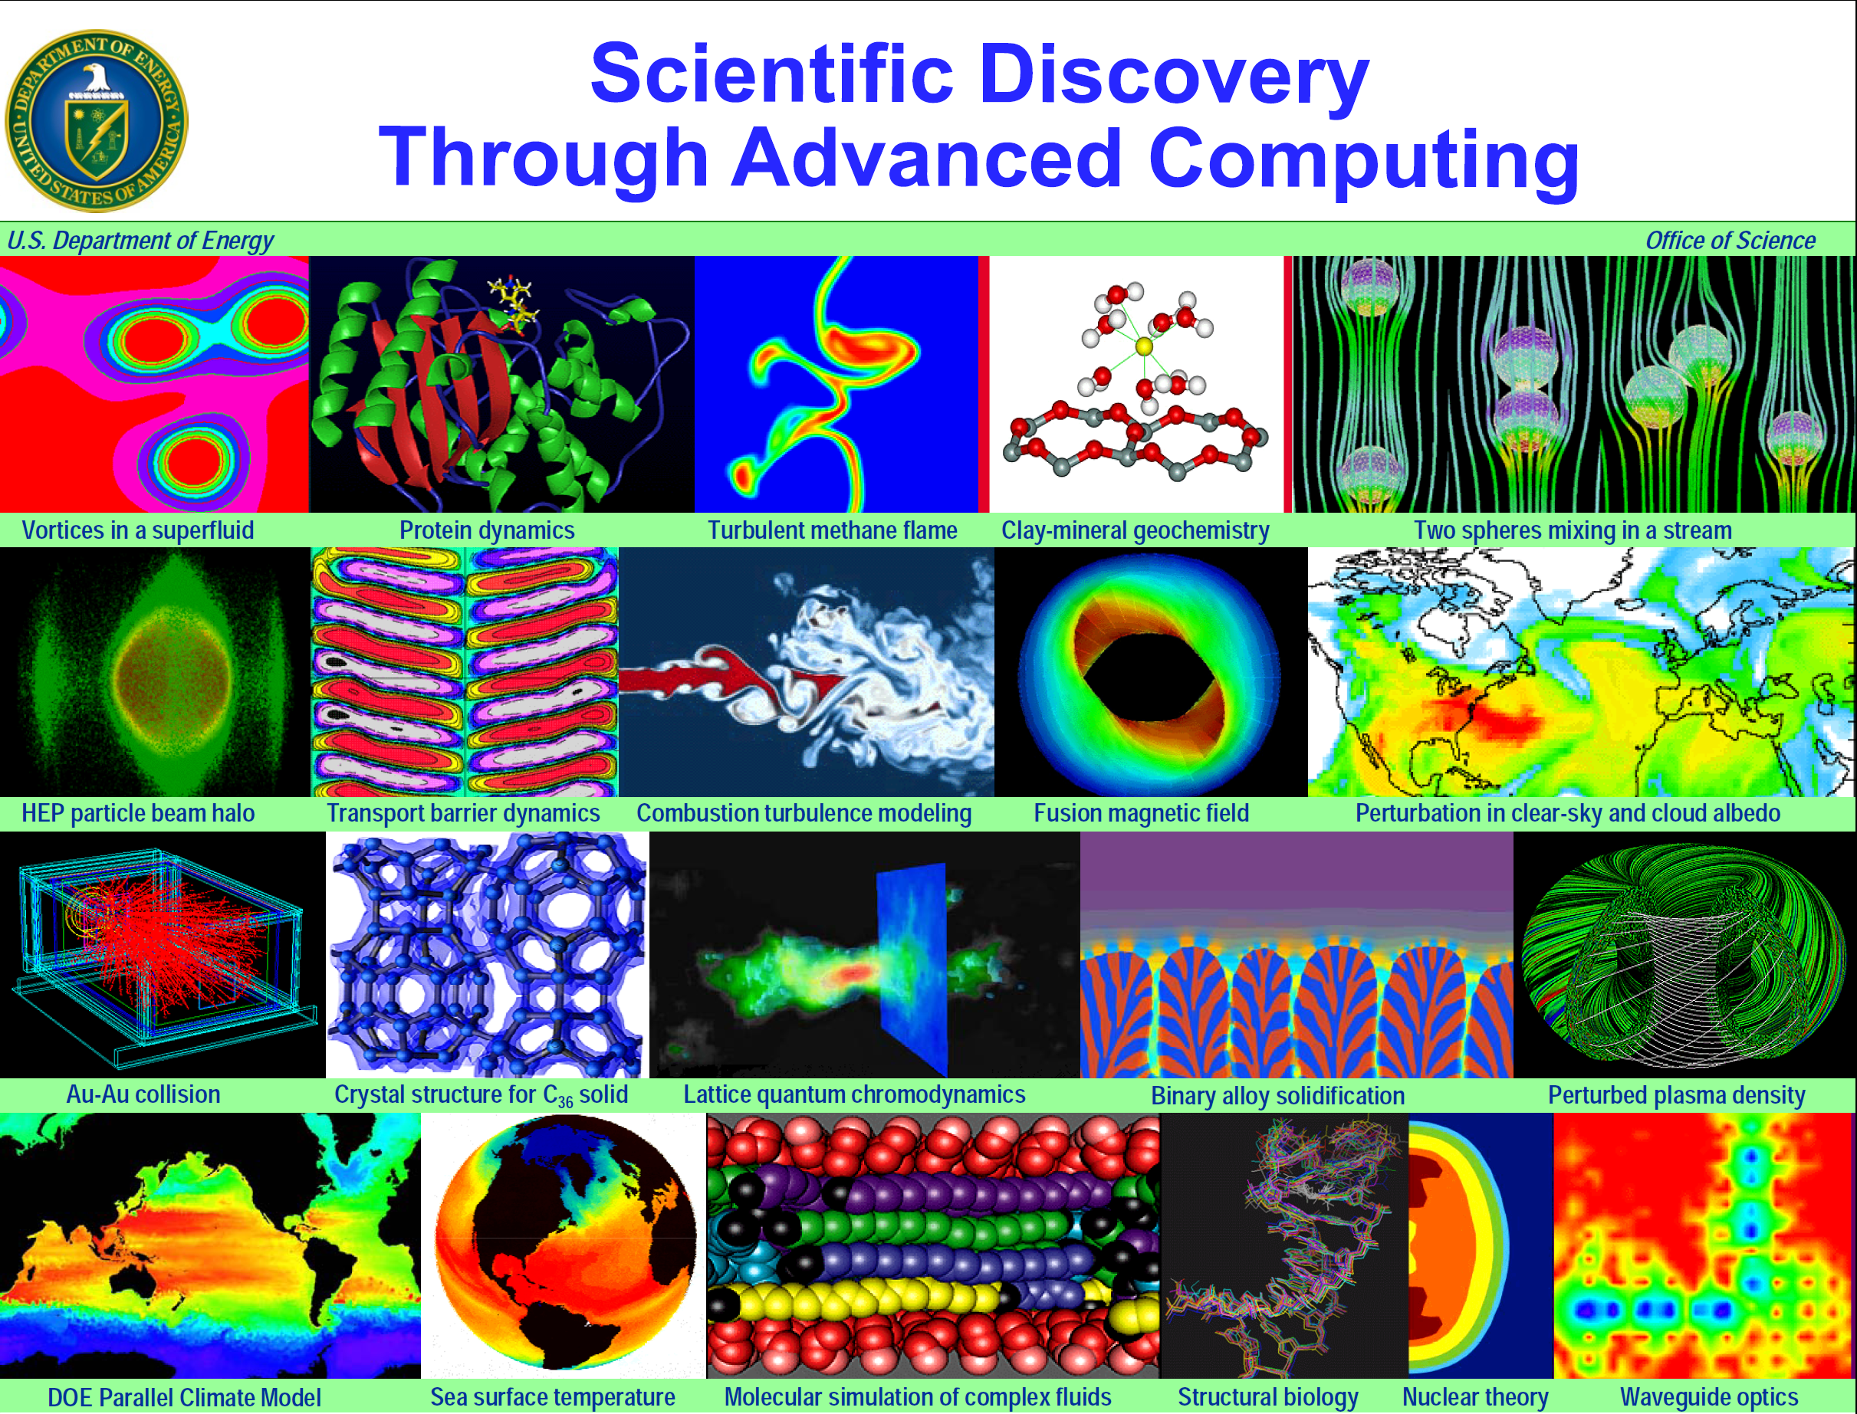

Slide 24
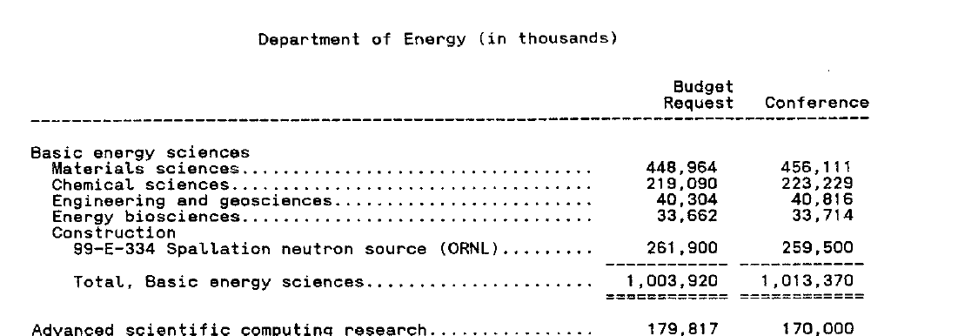
The FY 2001 Outcome
Conference Report: October 18, 2000

Slide 25
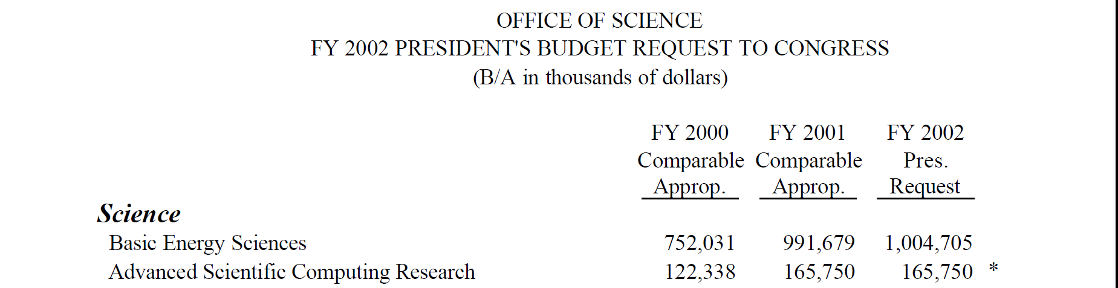
The FY 2001 Outcome

Slide 26
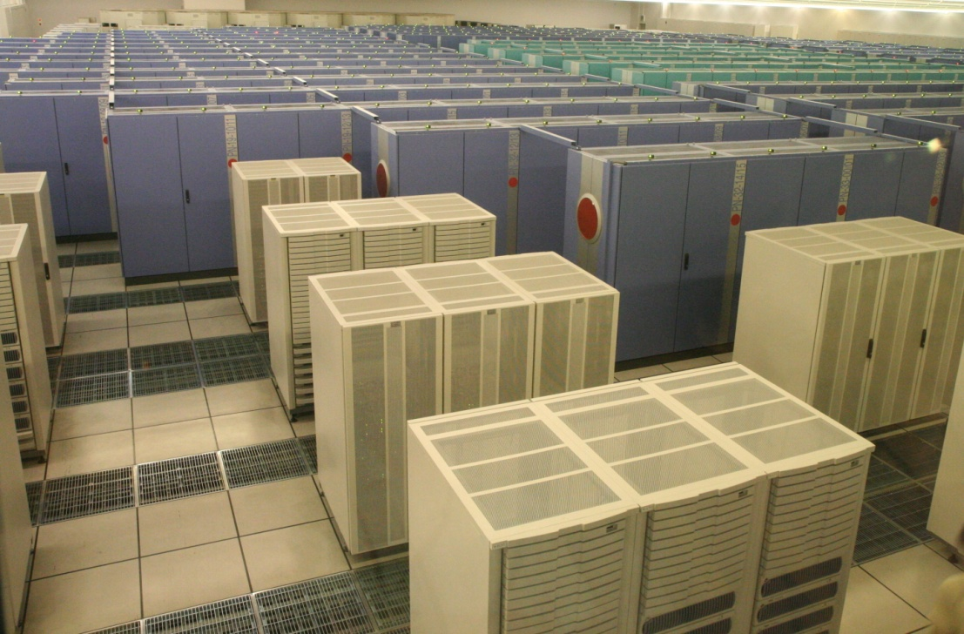
But the joy was short lived, because …
… on March 11, 2002, the Earth Simulator, developed by the Japanese government, officially opened. The ES was a was a highly parallel vector supercomputer system for running global climate models to study global warming and solid earth geophysics. The ES ran simulations of global climate in both the atmosphere and the oceans to a resolution of 10 km. Its performance on the LINPACK benchmark was 35.86 TFLOPS, which was almost five times faster than ASCI White.

Slide 27
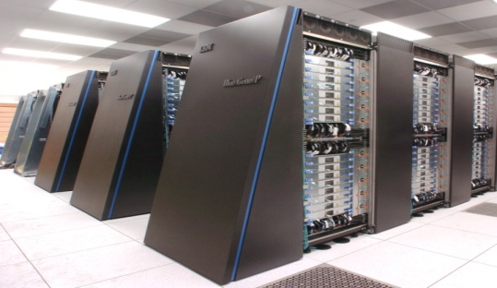
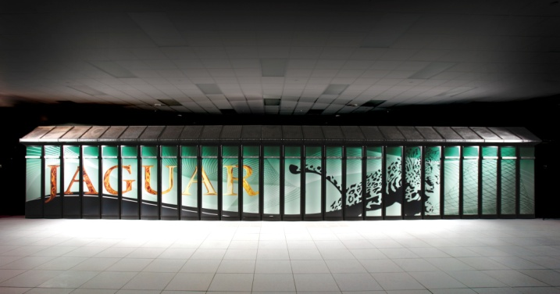
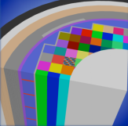
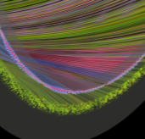
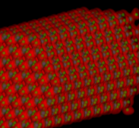
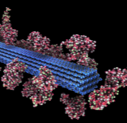
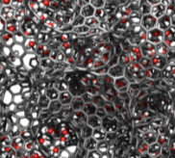
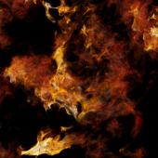

And DOE responded with the Leadership Computing Facilities
The Cray XT5 ("Jaguar") at ORNL and the IBM Blue Gene/P ("Intrepid") at ANL will provide ~2.3 billion processor hours in FY12 to address science and engineering problems that defy traditional methods of theory and experiment and that require the most advanced computational power.
Peer reviewed projects are chosen to advance science, speed innovation, and strengthen industrial competitiveness.
Demand for these machines has grown each year, requiring upgrades of both.
Among the topics in FY2011:
Advancing materials for lithium air batteries, solar cells, and superconductors
Exploring carbon sequestration
Improving combustion in fuel-efficient, near-zero-emissions systems
Understanding how turbulence affects the efficiency of aircraft and other transportation systems
Designing next-generation nuclear reactors and fuels and extending the life of aging reactors
Developing fusion energy systems
Understanding the roles of ocean, atmosphere, land, and ice in climate change
Argonne Leadership Computing Facility
Oak Ridge Leadership Computing Facility
In FY 2012, the Argonne LCF will be upgraded with a
10 petaflop IBM Blue Gene/Q. The Oak Ridge LCF will continue site preparations for a system expected in FY 2013 that will be 5-10 times more capable than the Cray XT-5.
Nuclear Reactor Simulation
Fusion Plasmas
Nanoscale Science
Biofuels
Energy Storage Materials
Turbulence

Slide 28
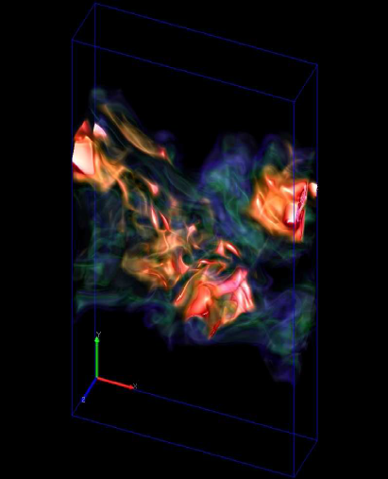
SciDAC1 Successes
SciDAC teams created first laboratory-scale flame simulation in three dimensions to better understand combustion which provides 80% of the energy used in the U.S.
Magnetic fusion scientists and applied mathematicians simulated techniques for re-fueling fusion reactors
Teams developed new methods for simulating improvements in future particle accelerators
Partnerships improved effectiveness of scientific applications codes between 275% to over 10,000%
The SciDAC data mining tool Sapphire awarded a 2006 R&D100 award
Hydroxyl radical in a turbulent jet flame

Slide 29
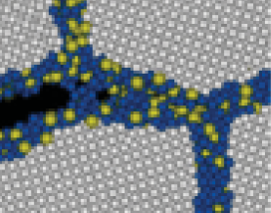
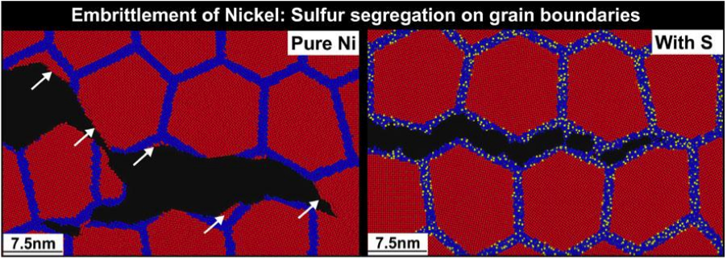


Stress Corrosion Cracking
Molecular Dynamics Simulation Reveals Mechanisms of Nickel Fracture
Fracture simulations for nanocrystalline nickel without and with amorphous sulfide grain- boundary phases, showing ductile, transgranular tearing and brittle, intergranular cleavage.
The performance and lifetime of materials used in nuclear technology and in advanced power generation are severely limited by corrosive environments and extreme conditions.
Premature failure of materials can result from undetected stress corrosion cracking.
Annually, corrosion costs about 3% of the U.S. gross domestic product.
48-million-atom simulation on Argonne Leadership Computing Facility showed a link between sulfur impurities segregated at grain boundaries of nickel and embrittlement. An order-of-magnitude reduction in grain-boundary shear strength, combined with tensile-strength reduction, allows the crack tip to always find an easy propagation path in this configuration. This mechanism explains an experimentally observed crossover from microscopic fracture to macroscopic cracks due to sulfur impurities.
P. Vashishta (USC)

Slide 30
SciDAC 1 SciDAC 2
The SciDAC program was re-competed in FY2006
Goals:
Create comprehensive, scientific computing software infrastructure to enable scientific discovery in the physical, biological, and environmental sciences at the petascale
Develop a new generation of data management and knowledge discovery tools for large data sets (obtained from scientific user facilities and simulations)
>230 proposals received requesting approximately $1 B

Slide 31
What’s next?

Slide 32
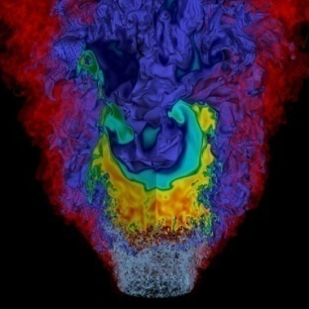
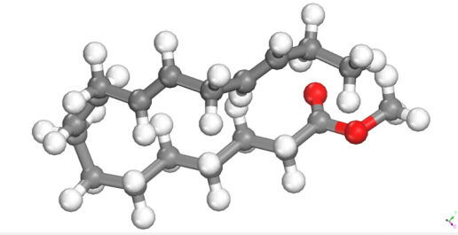
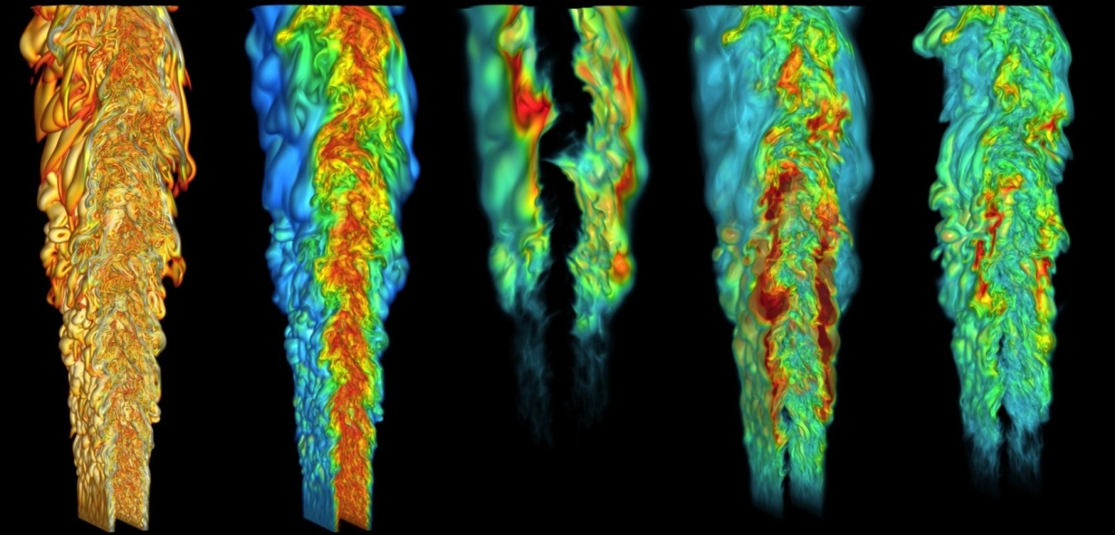
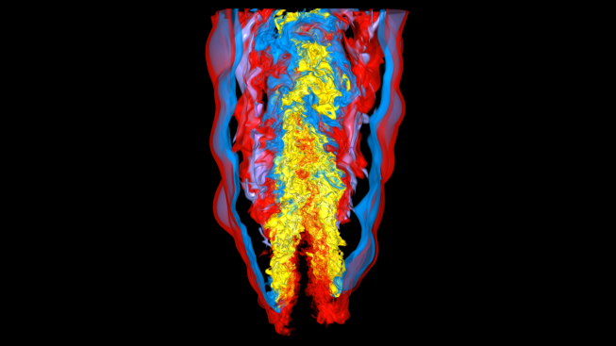
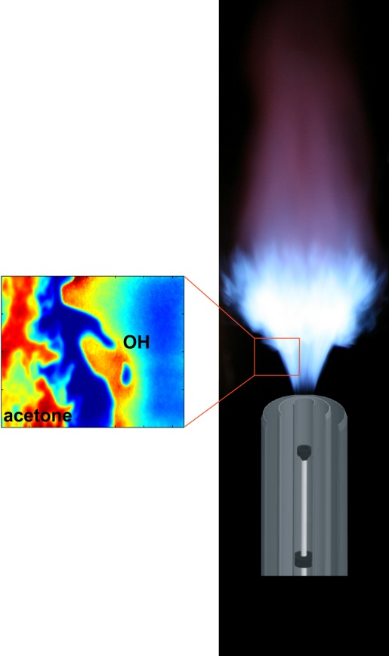
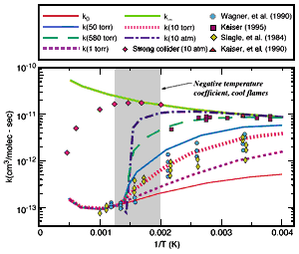
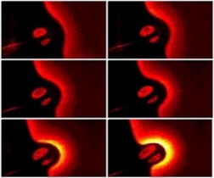
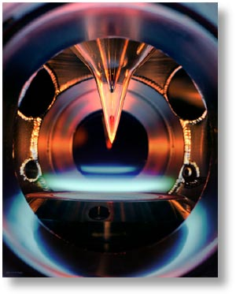
Why Exascale?
Combustion Models Coupling Biofuels with Turbulence
Exaflops
Large-Eddy
Simulation (LES)
Petaflops
Sub-Model
Development
Bio-Diesels
Methyl
Decanoate
Direct Numerical
Simulation (DNS)
Teraflops
Methyl
Butanoate
Unsteady Laminar
Flame Simulations
Alcohols
Gigaflops
Butanol
Turbulent Flame Experiments
Di-methyl Ether
Quantum chemical
Kinetics Simulations
Mechanism Validation
Experiments
Foundational fuels (C1-C4)
Ethanol
Ethylene
Methane
Laminar Flame/Ignition
Experiments
Syngas
Hydrogen
Chemical Kinetics Experiments
Notes:
High performance computing is enabling fundamental research in renewable fuels – especially carbon neutral biofuels – and their coupling with turbulent flame and ignition processes relevant to the design of fuel efficient, clean burning automobiles, trucks, and gas turbines for power generation. At a research level increasing computing power is enabling research in fuels of increasing chemical complexity broadly categorized as: foundation fuels (C1-C4), alcohols in general, and biodiesels. Characterization of these three categories of fuels not only will provide the combustion and fuels community with a solid base for fuels combustion research in general, but they will also facilitate the development of the broad range of biofuels that hold potential for commercialization. Moreover, understanding their the coupling of fuel chemistry with turbulent flame simulations will enable their utilization in transportation and power generation. As we move towards exascale computing it will be possible to directly simulate increased complexity in fuel chemistry coupled with a wider range of turbulence scales, and hence provide fundamental insight and numerical validation data for submodel development in coarse-grained engineering design CFD approaches.
Notes on chemical complexity:
Specifically, for the foundation fuels a comprehensive mechanism will be developed that can describe the oxidation mechanisms of C0-C4 fuels, which include hydrogen, carbon monoxide, and the light hydrocarbon fuels containing one to four carbon atoms. Examples are methane, ethylene, propane, and butane. These molecules not only are important fuels in their own right, but they are also key building blocks for accurately describing the kinetic behavior of larger hydrocarbons - hence foundation fuels.
Mechanisms for alcohols, particularly ethanol and butanol are important. It also includes the ethers such as dimethyl ether (DME). The interest in ethanol is obvious because it is the alcohol that is currently in commercial use. Butanol is preferred over ethanol because it has higher energy density, is miscible with gasoline in all proportions, does not absorb water and hence is non-corrosive, and has a lower volatility contribution than ethanol when blended with gasoline.
Finally, as exascale computing comes on line reaction mechanisms of biodiesels will be developed and will be coupled with turbulent flame simulations. Biodiesels can be produced from fats and oils formed by a wide range of organisms, and holds the potential of reducing lifecycle greenhouse gas emissions. Furthermore, since they do not contain aromatics and also have oxygenated functional groups within their molecular structure, they are considerably less sooting than petroleum derived fuels. Important classes of molecules here include the oxidation of methyl esters, with the focus on methyl butanoate (MB) and methyl decanoate (MD), which are currently being investigated as surrogates for biodiesel fuels.

Slide 33
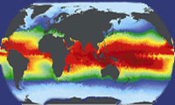
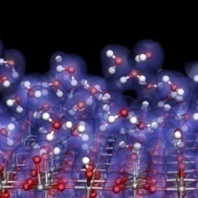
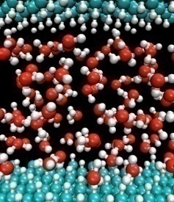
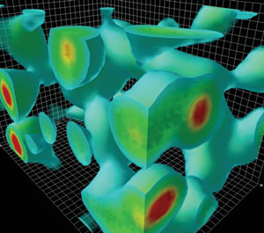
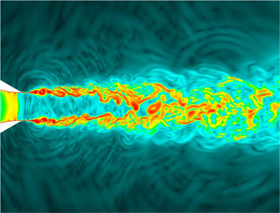
Investments for Exascale Computing
Opportunities to Accelerate the Frontiers of Science through HPC
Why Exascale?
SCIENCE: Computation and simulation advance knowledge in science, energy, and national security; numerous S&T communities and Federal Advisory groups have demon-strated the need for computing power 1,000 times greater than we have today.
U.S. LEADERSHIP: The U.S. has been a leader in high performance computing for decades. U.S. researchers benefit from open access to advanced computing facilities, software, and programming tools.
BROAD IMPACT: Achieving the power efficiency, reliability, and programmability goals for exascale will have dramatic impacts on computing at all scales–from PCs to mid-range computing and beyond.
DOE Activities will:
Leverage new chip technologies from the private sector to bring exascale capabilities within reach in terms of cost, feasibility, and energy utilization by the end of the decade;
Support research efforts in applied mathematics and computer science to develop libraries, tools, and software for these new technologies;
Create close partnerships with computational and computer scientists, applied mathematicians, and vendors to develop exascale platforms and codes cooperatively.

Slide 34
Final thought … Expect the unexpected from new tools

Slide 35
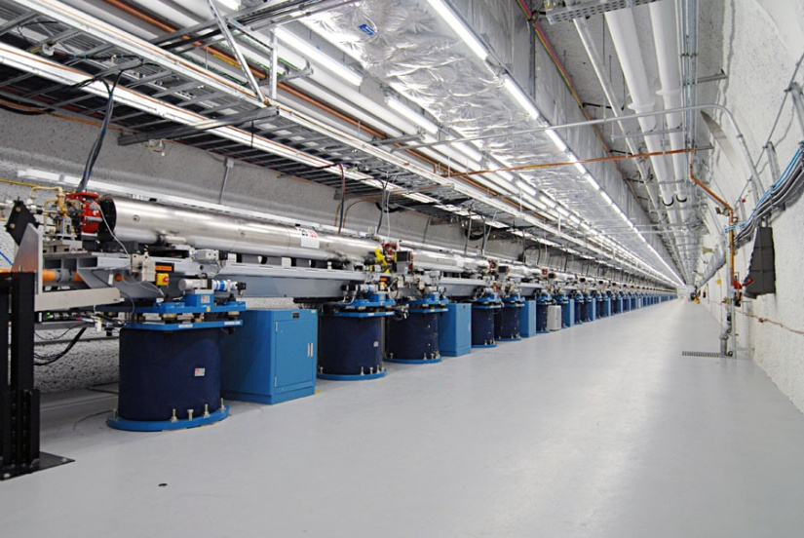
Nature Publishes First Bioimaging Results from the LCLS
The World’s First Hard X-ray Laser
Within 6 months of completion, LCLS is being used to study a wide array of science topics, including:
Hollow atoms
Magnetic materials
Structure of biomolecules in nano-crystals
Single shot images of viruses and whole cells

Slide 36
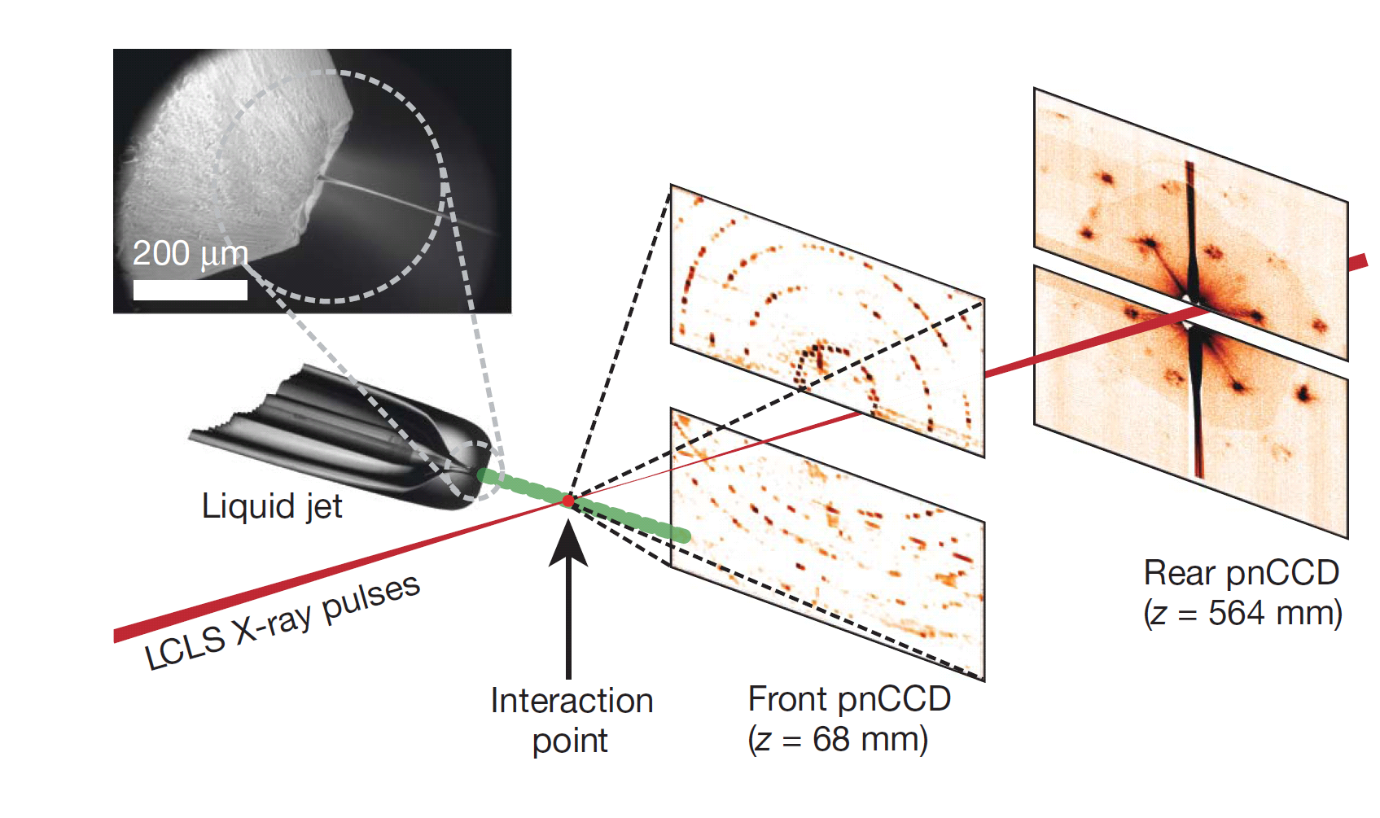
Femtosecond X-ray Protein Nanocrystallography
Nanocrystals flow in their buffer solution in a gas-focused, 4-μm-diameter jet at a velocity of 10m/sec perpendicular to the pulsed X-ray FEL beam that is focused on the jet.
Chapman, H. N., et al. Nature, Feb 3rd, 2011.

Slide 37
Femtosecond X-ray Protein Nanocrystallography
Photosystem I plays key role in photosynthesis.
Difficult to crystallize and use standard x-ray crystallography to obtain structure.
Single shot images from LCLS of nanocrystals used to build up full 3-D diffraction pattern.
Low resolution (~9 Å) shows structural details (e.g., helix density).
High resolution image subsequently taken
Single shot diffraction pattern
Combined 3D diffraction pattern
Reconstructed 3-D Structure
Chapman, H. N., et al. Nature, Feb 3rd, 2011.

