Slide 1
Program/Project Management in DOE’s Office of Science
2012 DOE Project Management Workshop
April 4, 2012
Dr. Patricia M. Dehmer Deputy Director for Science Programs
Office of Science, U.S. Department of Energy
http://www.science.energy.gov/sc-2/presentations-and-testimony/

Slide 2
P.M. TechieTalk

Slide 3
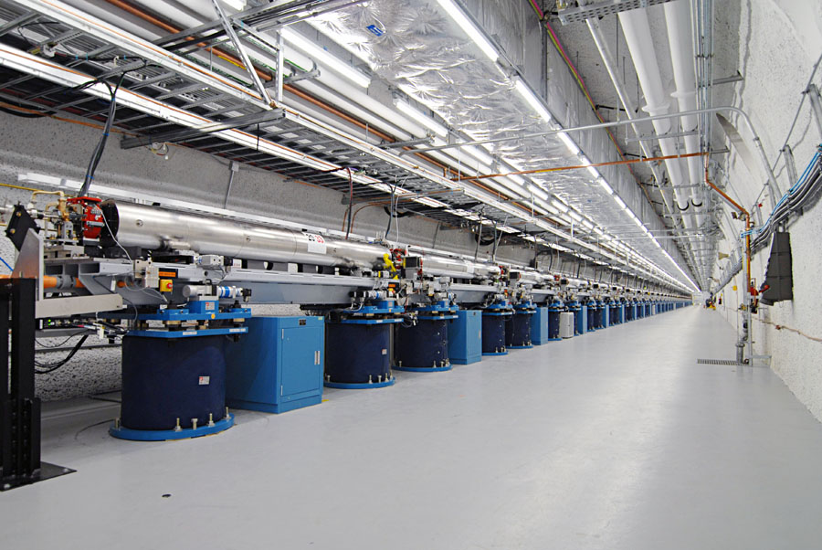
Office of Science Science to Meet the Nation’s Challenges Today and into the 21st Century
The Frontiers of Science
Supporting research that led to over 100 Nobel Prizes during the past 6 decades—more than 20 in the past 10 years
Providing 45% of Federal support of basic research in the physical and energy related sciences and key components of the Nation’s basic research in biology and computing
Supporting over 25,000 Ph.D. scientists, graduate students, undergraduates, engineers, and support staff at more than 300 institutions
21st Century Tools of Science
Providing the world’s largest collection of scientific user facilities to over 26,000 users each year
Lead chart of the Office of Science FY 2013 budget rollout. Note prominence of major projects.
The undulator hall at the Linac Coherent Light Source, SLAC, 2011.

Slide 4
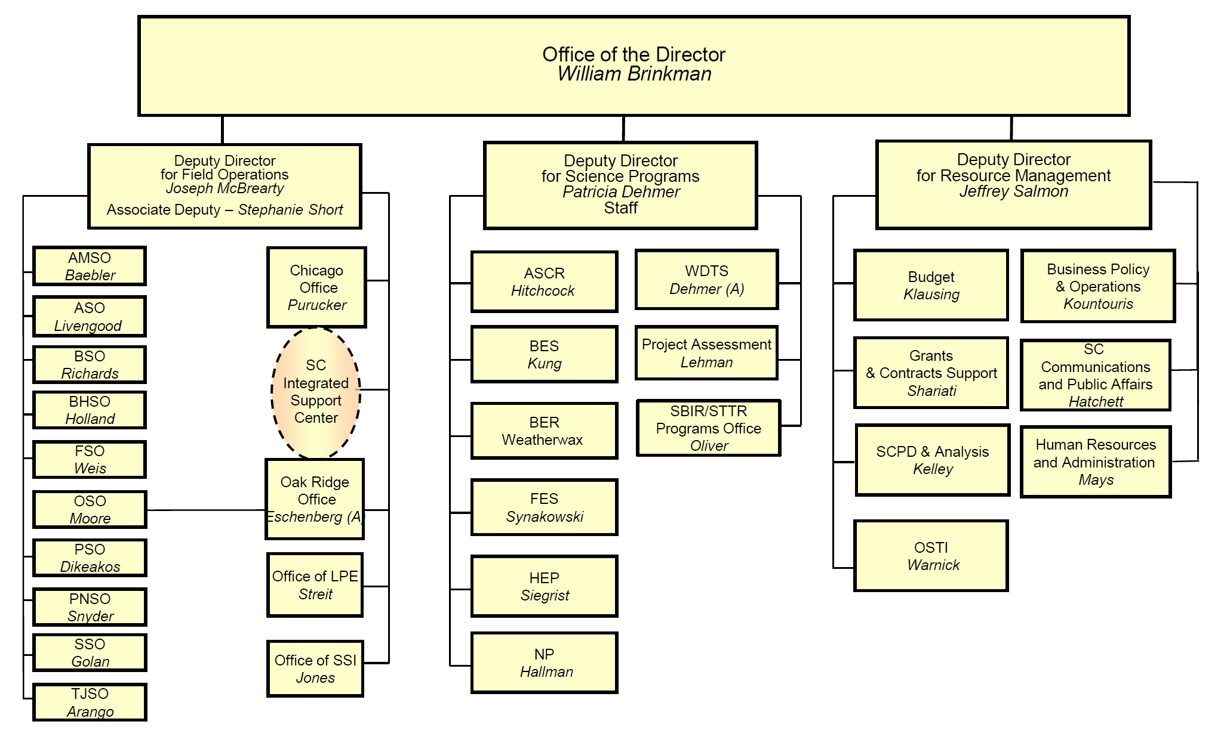
Office of Science Organization … and the flow of funding to the field
FY2013 Req. $5,001M
$456M
$15M
Kountouris
$1,799M
$625M
$202M
$398M
$776M
$84M S&S
$118M SLI
$527M
10 SC Labs

Slide 5
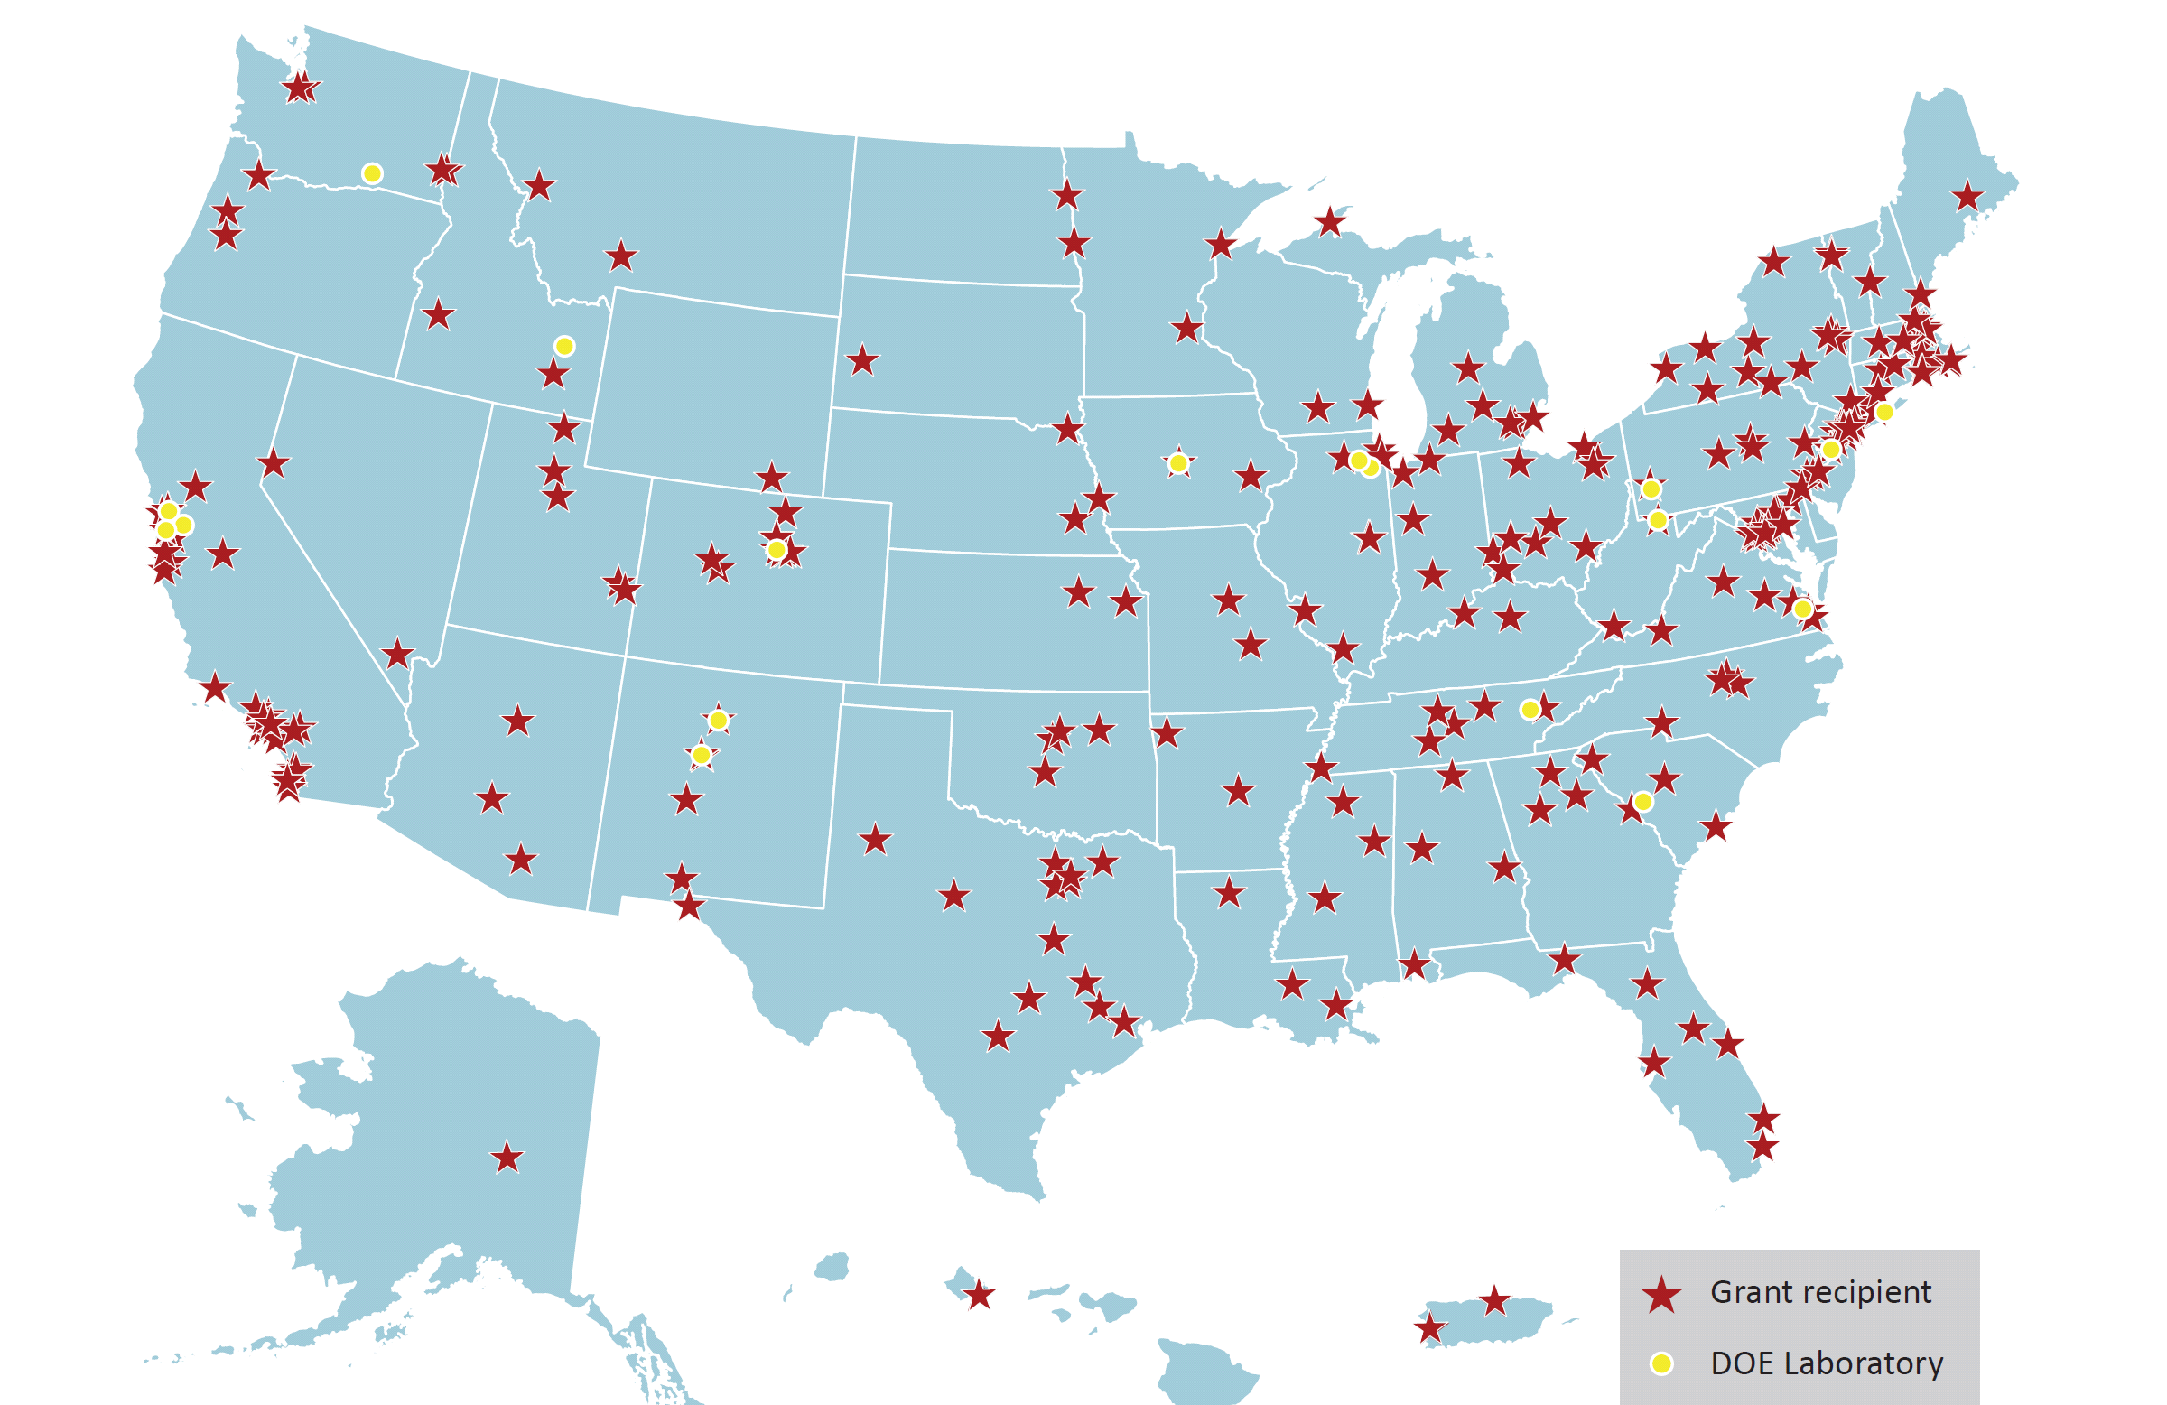










SC Funding Recipients—Labs and Universities, FY 2011
10 SC Labs

Slide 6
An Historical Detour – Big Science and the Office of Science
Big science was born at the labs after WWII.
Over time, big science begat the large suite of Office of Science user facilities.
These facilities transformed the nature of the labs, and they define the Office of Science today.

Slide 7
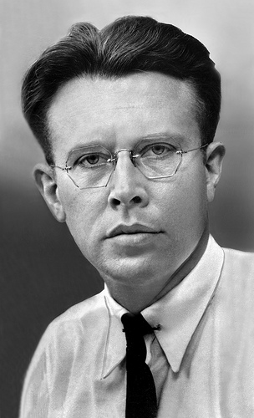
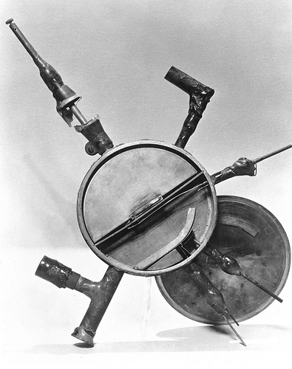
Origins of Big Science in the Office of Science
Ernest O. Lawrence
Lawrence’s original 5-inch cyclotron, 80 keV, 1931

Slide 8
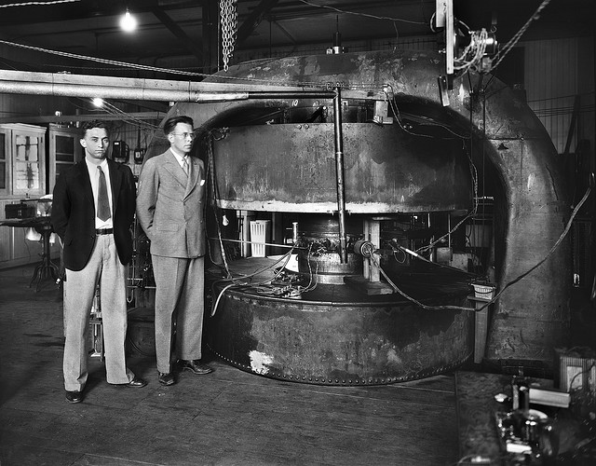
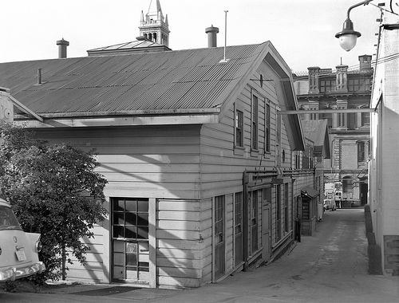
Lawrence’s Pursuit of Bigger and Bigger and Bigger Machines
Later that year the Berkeley Radiation Laboratory is born . . .
Surplus 80 ton magnet from the Federal Telegraph Company
27-inch cyclotron, 3.6 MeV, 1932

Slide 9
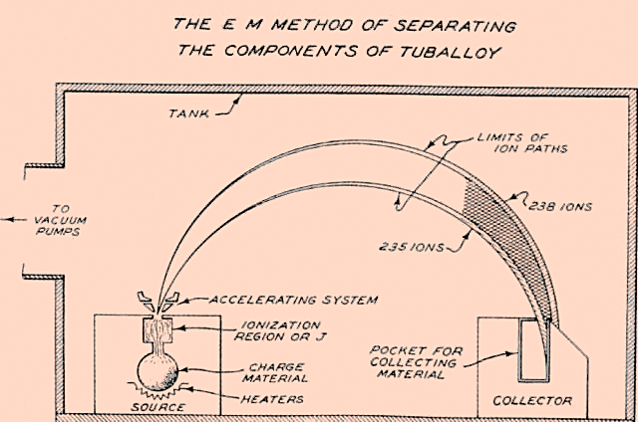
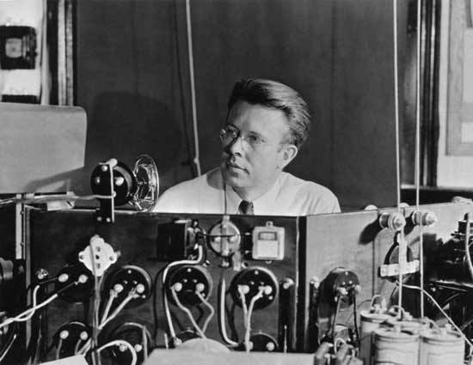
Accelerators and the Manhattan Project
Challenge: uranium isotope separation
Lawrence advanced accelerators as mass separators through modification of the 37-inch cyclotron; he named the new configuration . . . the “calutron.”

Slide 10
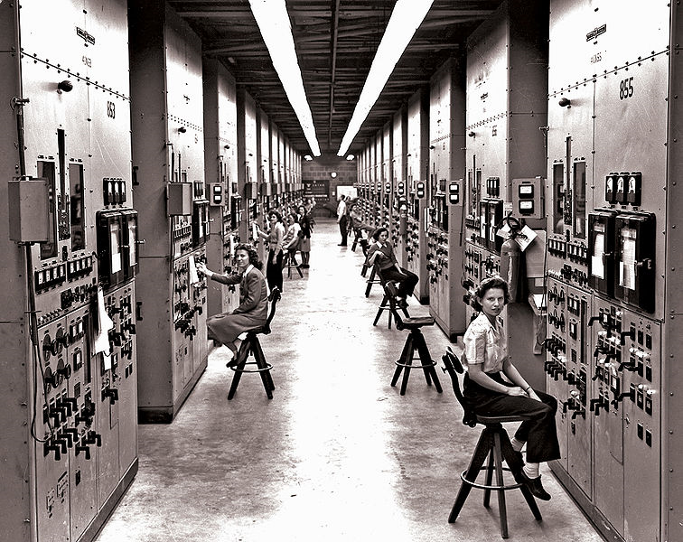
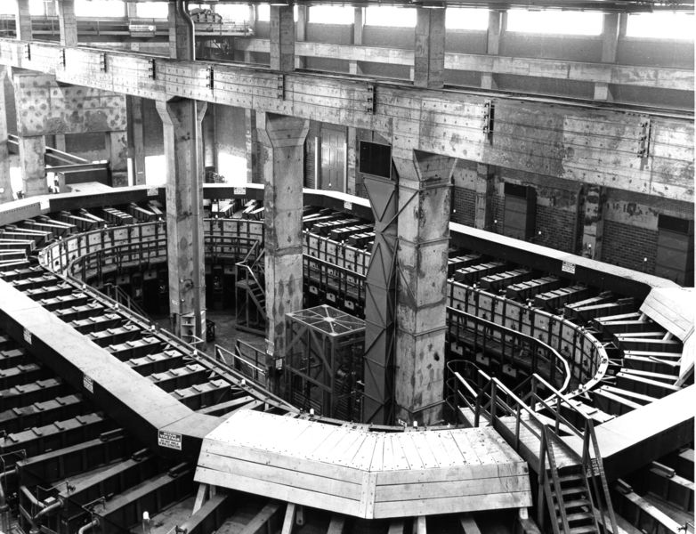
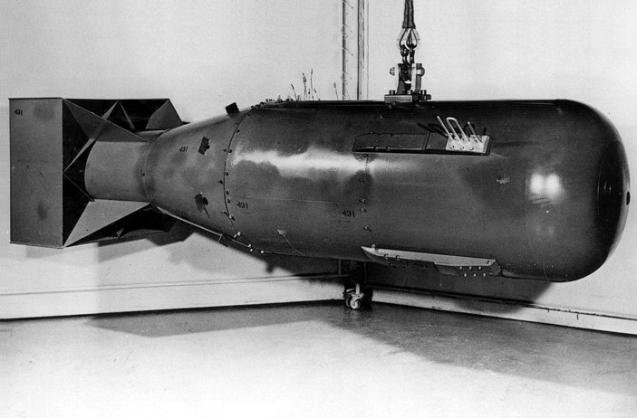
From Prototype to (Big Time) Reality
Lawrence’s calutrons were built at industrial scale at the Oak Ridge Y-12 complex to yield usable quantities of uranium 235.
“Little Boy”

Slide 11
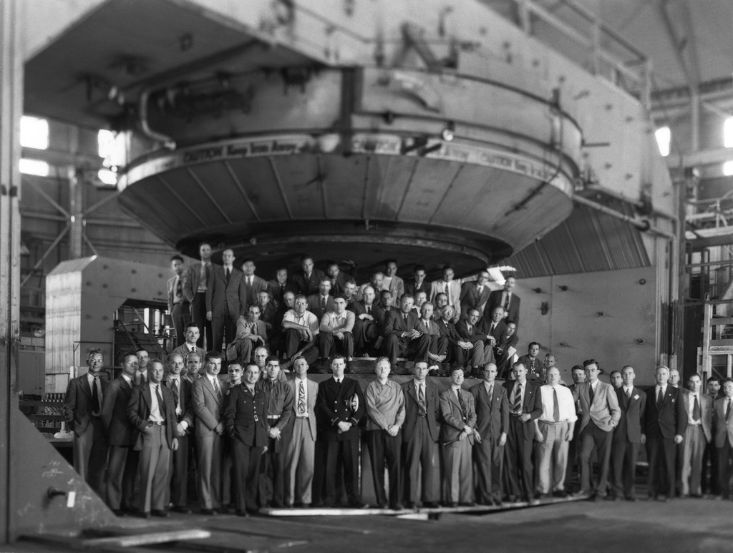
Transition from Wartime to Peacetime Research
4,000 ton magnet
184-inch cyclotron, > 100 MeV, 1946

Slide 12
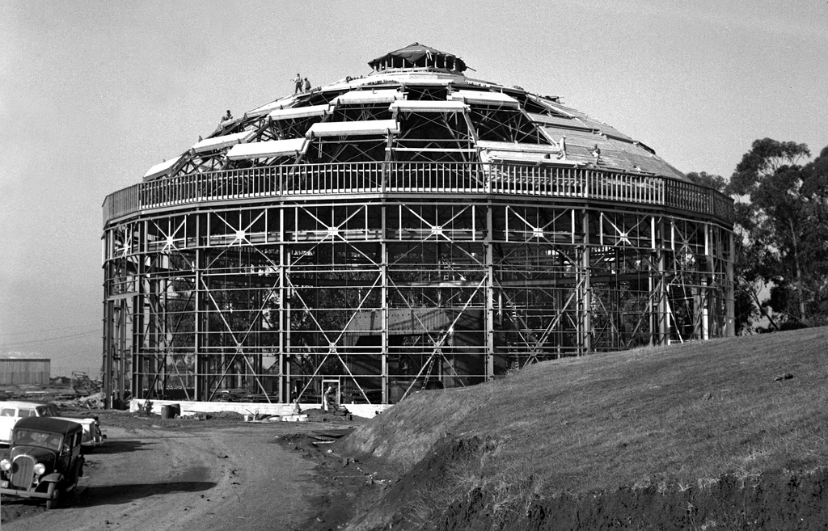
A National Laboratory is Born

Slide 13
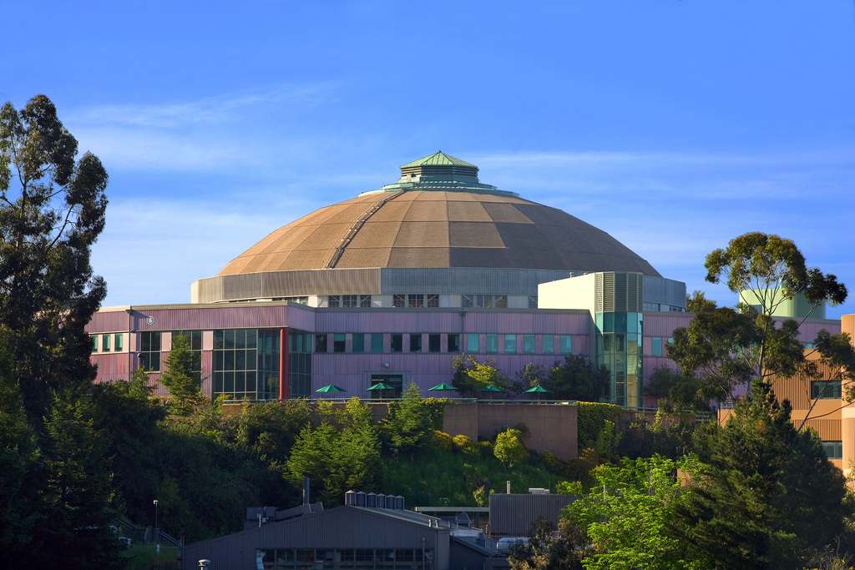
This building was later expanded to house the Advanced Light Source, an SC User Facility, …

Slide 14
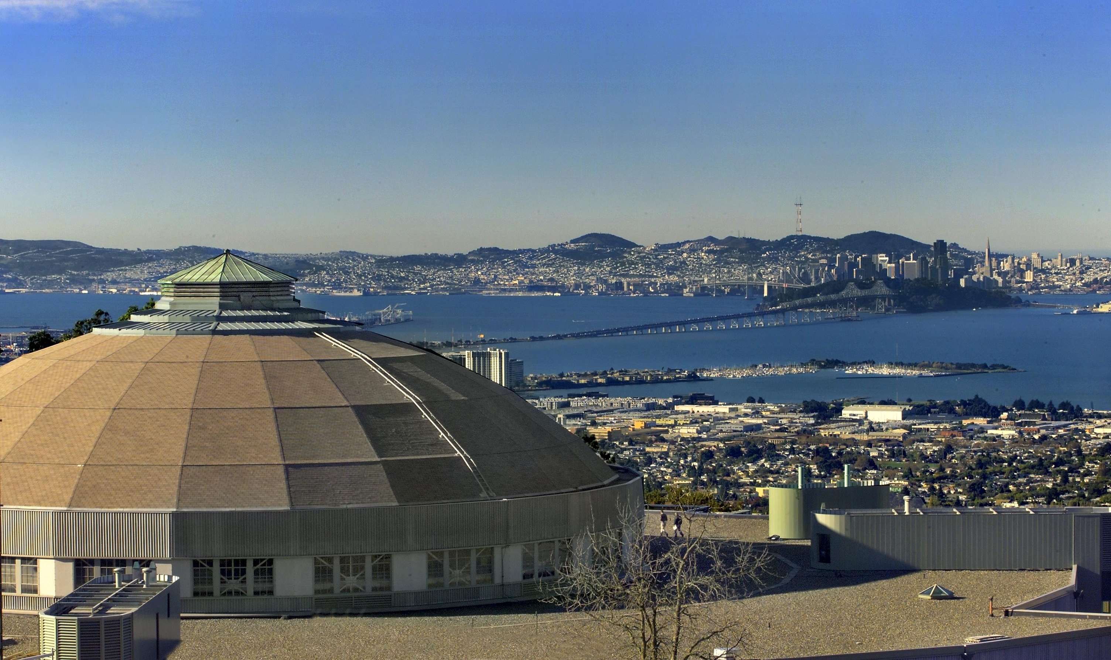
… which now takes1st Prize for best view.

Slide 15
Research and Facilities in the Office of Science
All Other
Funding = $5B
Major Items of Equipment
Support for 25,000 Ph.D.s, grad students, undergrads, engineers, and support staff
Facility Construction
Research
(About 1/3 of the research is sited at universities)
The world’s largest collection of scientific user facilities with over 26,000 users /yr
Facility Operations
Energy Frontier Research Centers, Energy Innovation Hubs, Bioenergy Research Centers

Slide 16
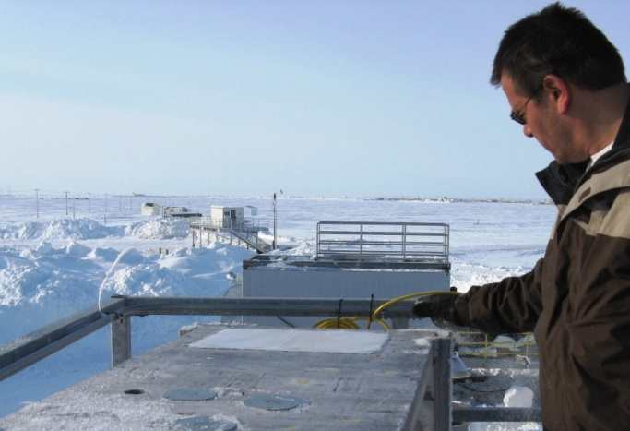
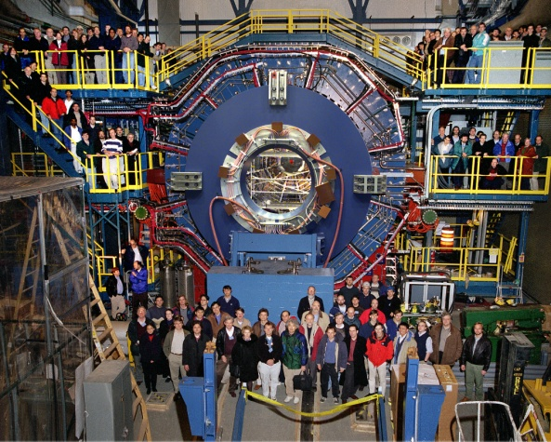
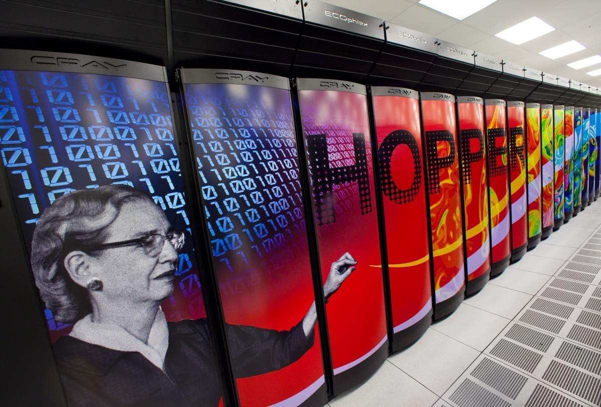
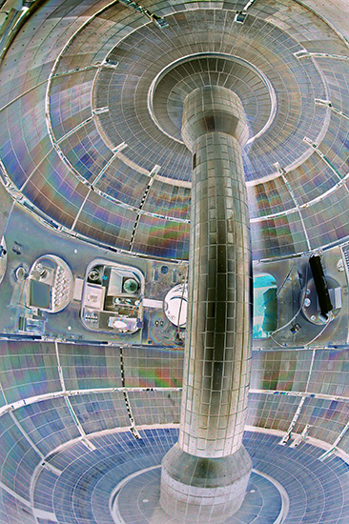
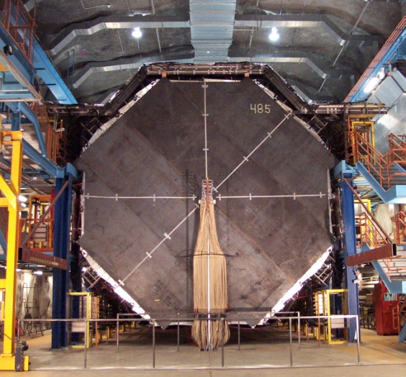
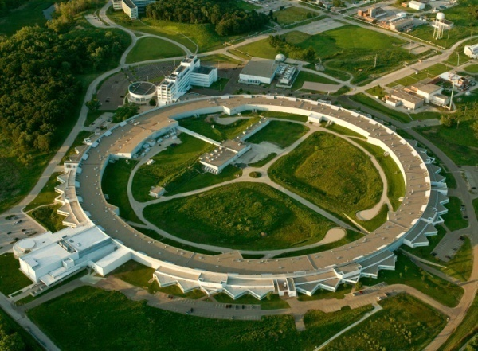
Some of the 32 Office of Science User Facilities
Open access
Allocation determined through peer review of research proposals
Free for non-proprietary work published in the open literature
Full cost recovery for proprietary work
Does not compete with private capability
Formal user organization
ARM, North Slope of Alaska; STAR Detector at RHIC, BNL; NSTX, PPPL; APS, ANL; MINOS far detector, U.Minn/FNAL; NERSC Computing Center, LBNL

Slide 17
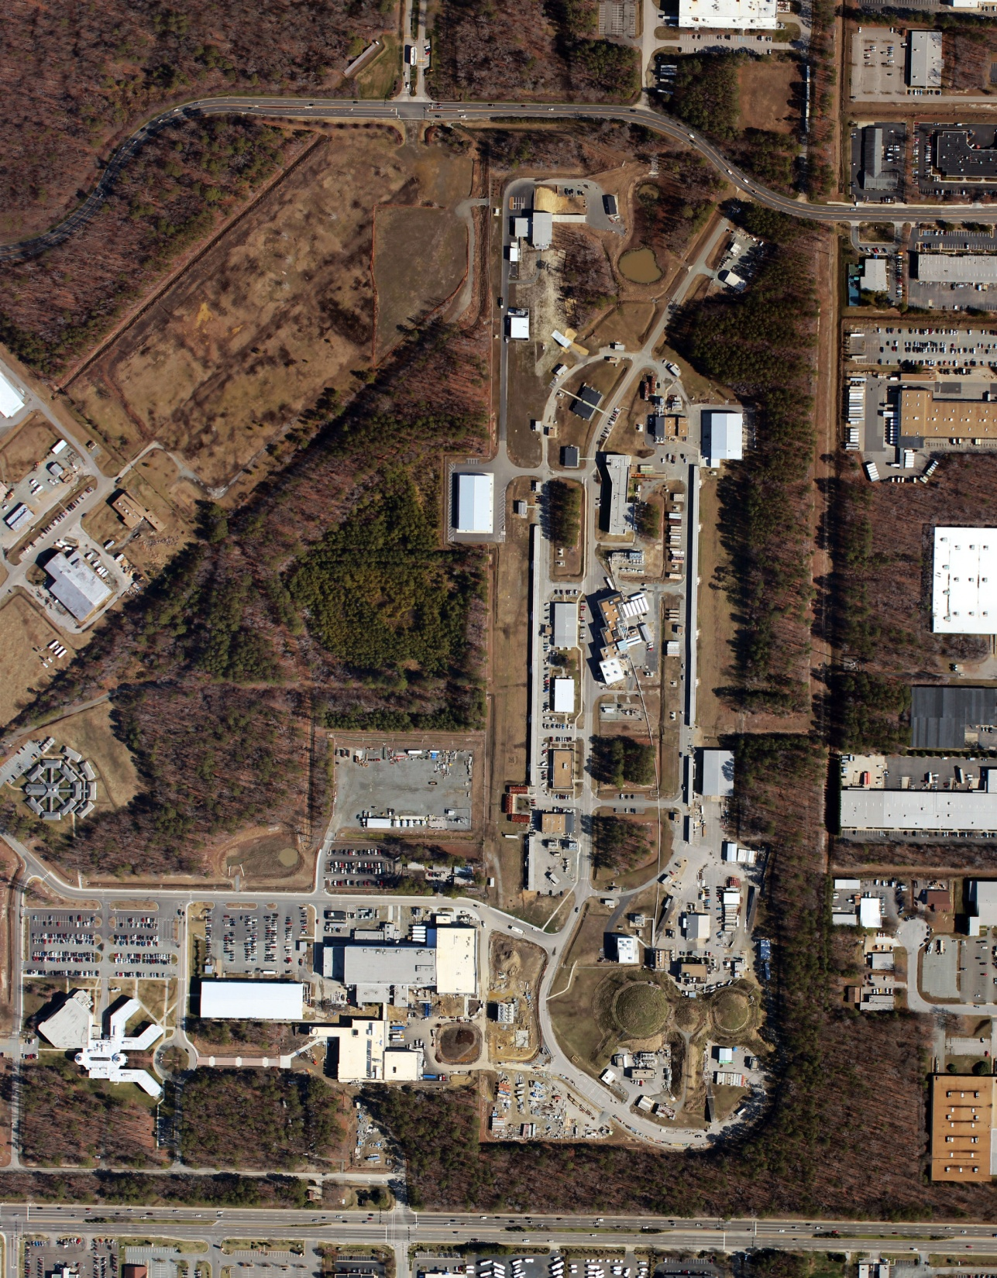
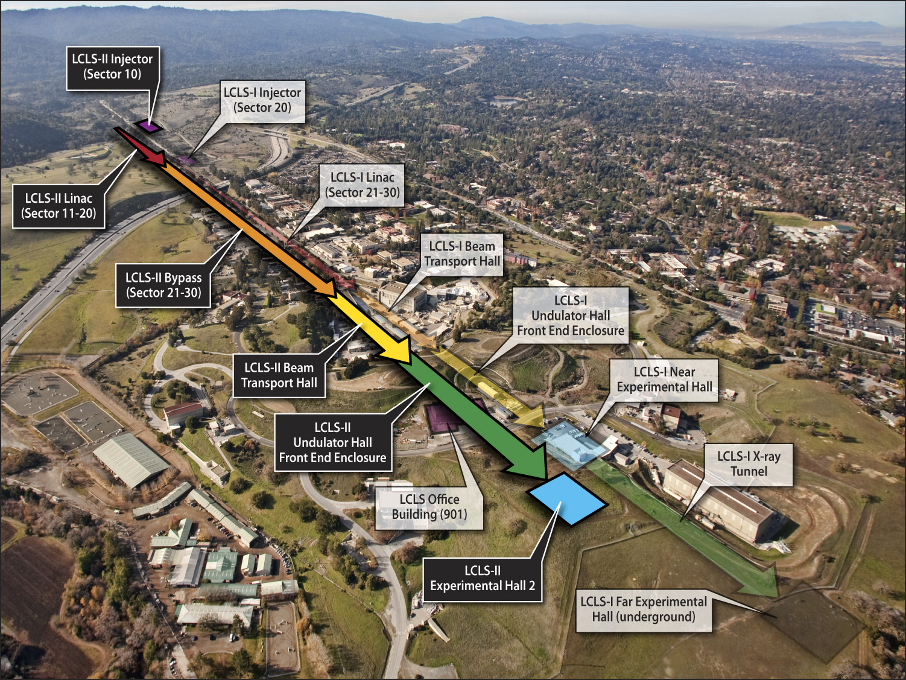
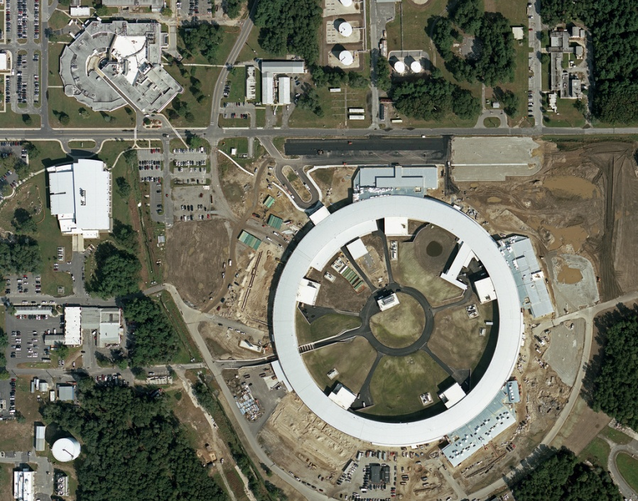
Some User Facilities Now in Construction or Upgrade
LCLS-II at SLAC (TPC=$405M)
NSLS
NSLS-II at BNL (TPC=$912M)
NSLS-II
12 GeV Upgrade at TJNAF (TPC=$310M)

Slide 18
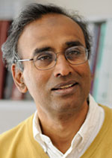
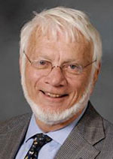
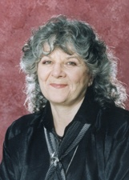
SC User Facilities – From Nobel Prize winning work … 3 Nobel Prizes in 6 Years in macromolecular crystallography with the synchrotrons
2009 Prize in Chemistry: Venkatraman Ramakrishnan, Thomas Steitz, and Ada Yonath) "for studies of the structure and function of the ribosome.” Used all 4 light sources.
2006 Prize in Chemistry: Roger Kornberg "for his studies of the molecular basis of eukaryotic transcription.” Used SSRL macromolecular crystallography beamlines.
2003 Prize in Chemistry: Roderick MacKinnon for “structural and mechanistic studies of ion channels.” Used NSLS beamlines X25 and X29.
Venkatraman Ramakrishnan
Thomas Steitz
Ada Yonath

Slide 19
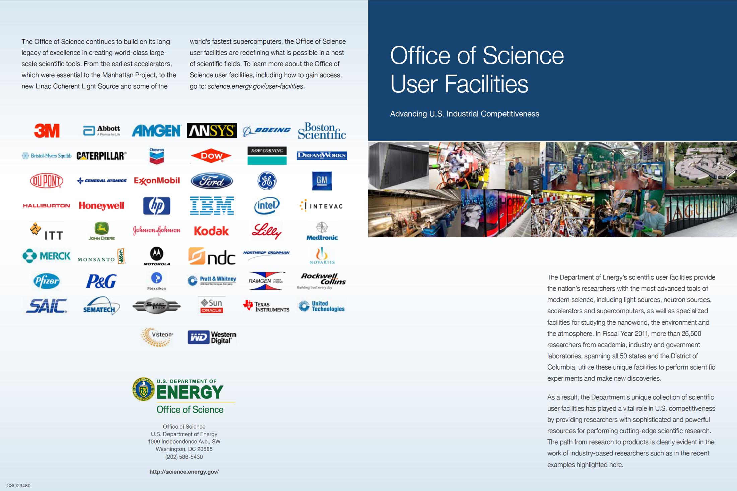
… to a key role in U.S. industrial competitiveness.

Slide 20
R2A2s: Owners, FPDs, PMs, SC’s Off. of Project Assessment
FY2013 Req. $5,001M
$456M
$15M
Kountouris
Dan Lehman is here
$1,799M
$625M
$202M
$398M
$776M
$84M S&S
$118M SLI
$526M
Owners are here
FPDs are here
10 SC Labs
Contractor Project Managers are here

Slide 21
Typical owner at work

Slide 22
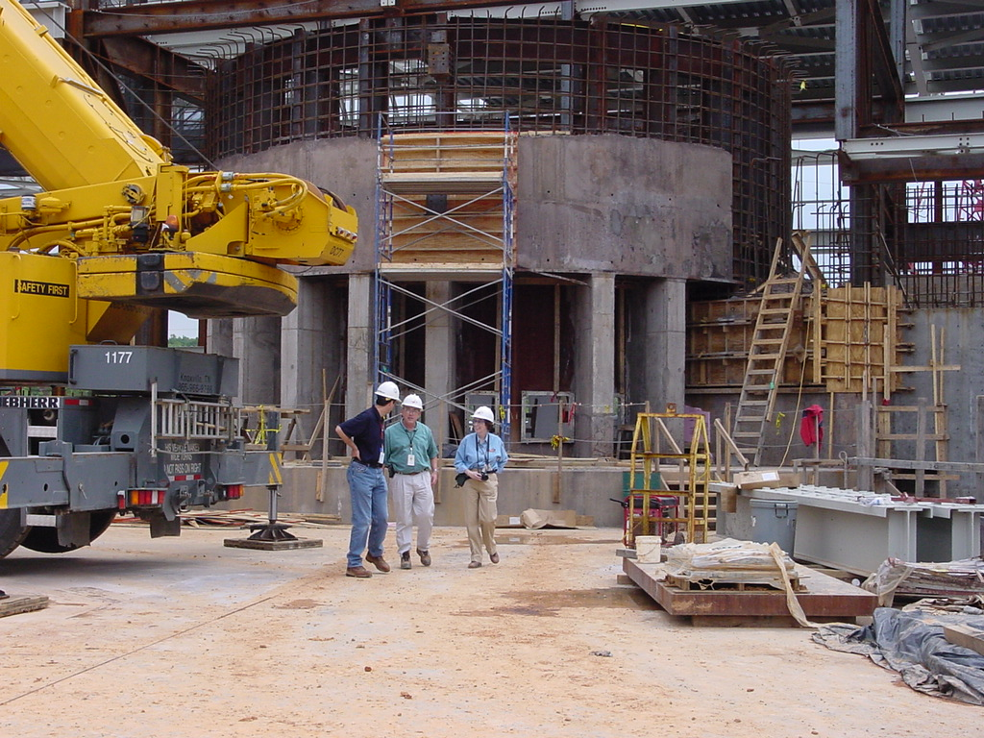
xxxxxxxxxxxxxx
22

Slide 23
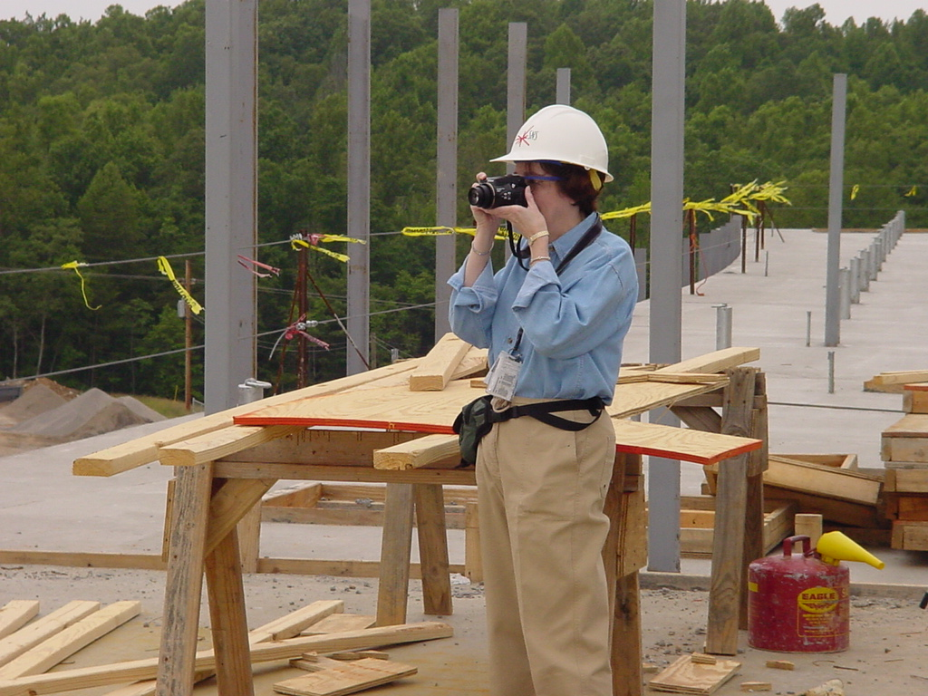
xxxxxxxxxxxxxx
23

Slide 24
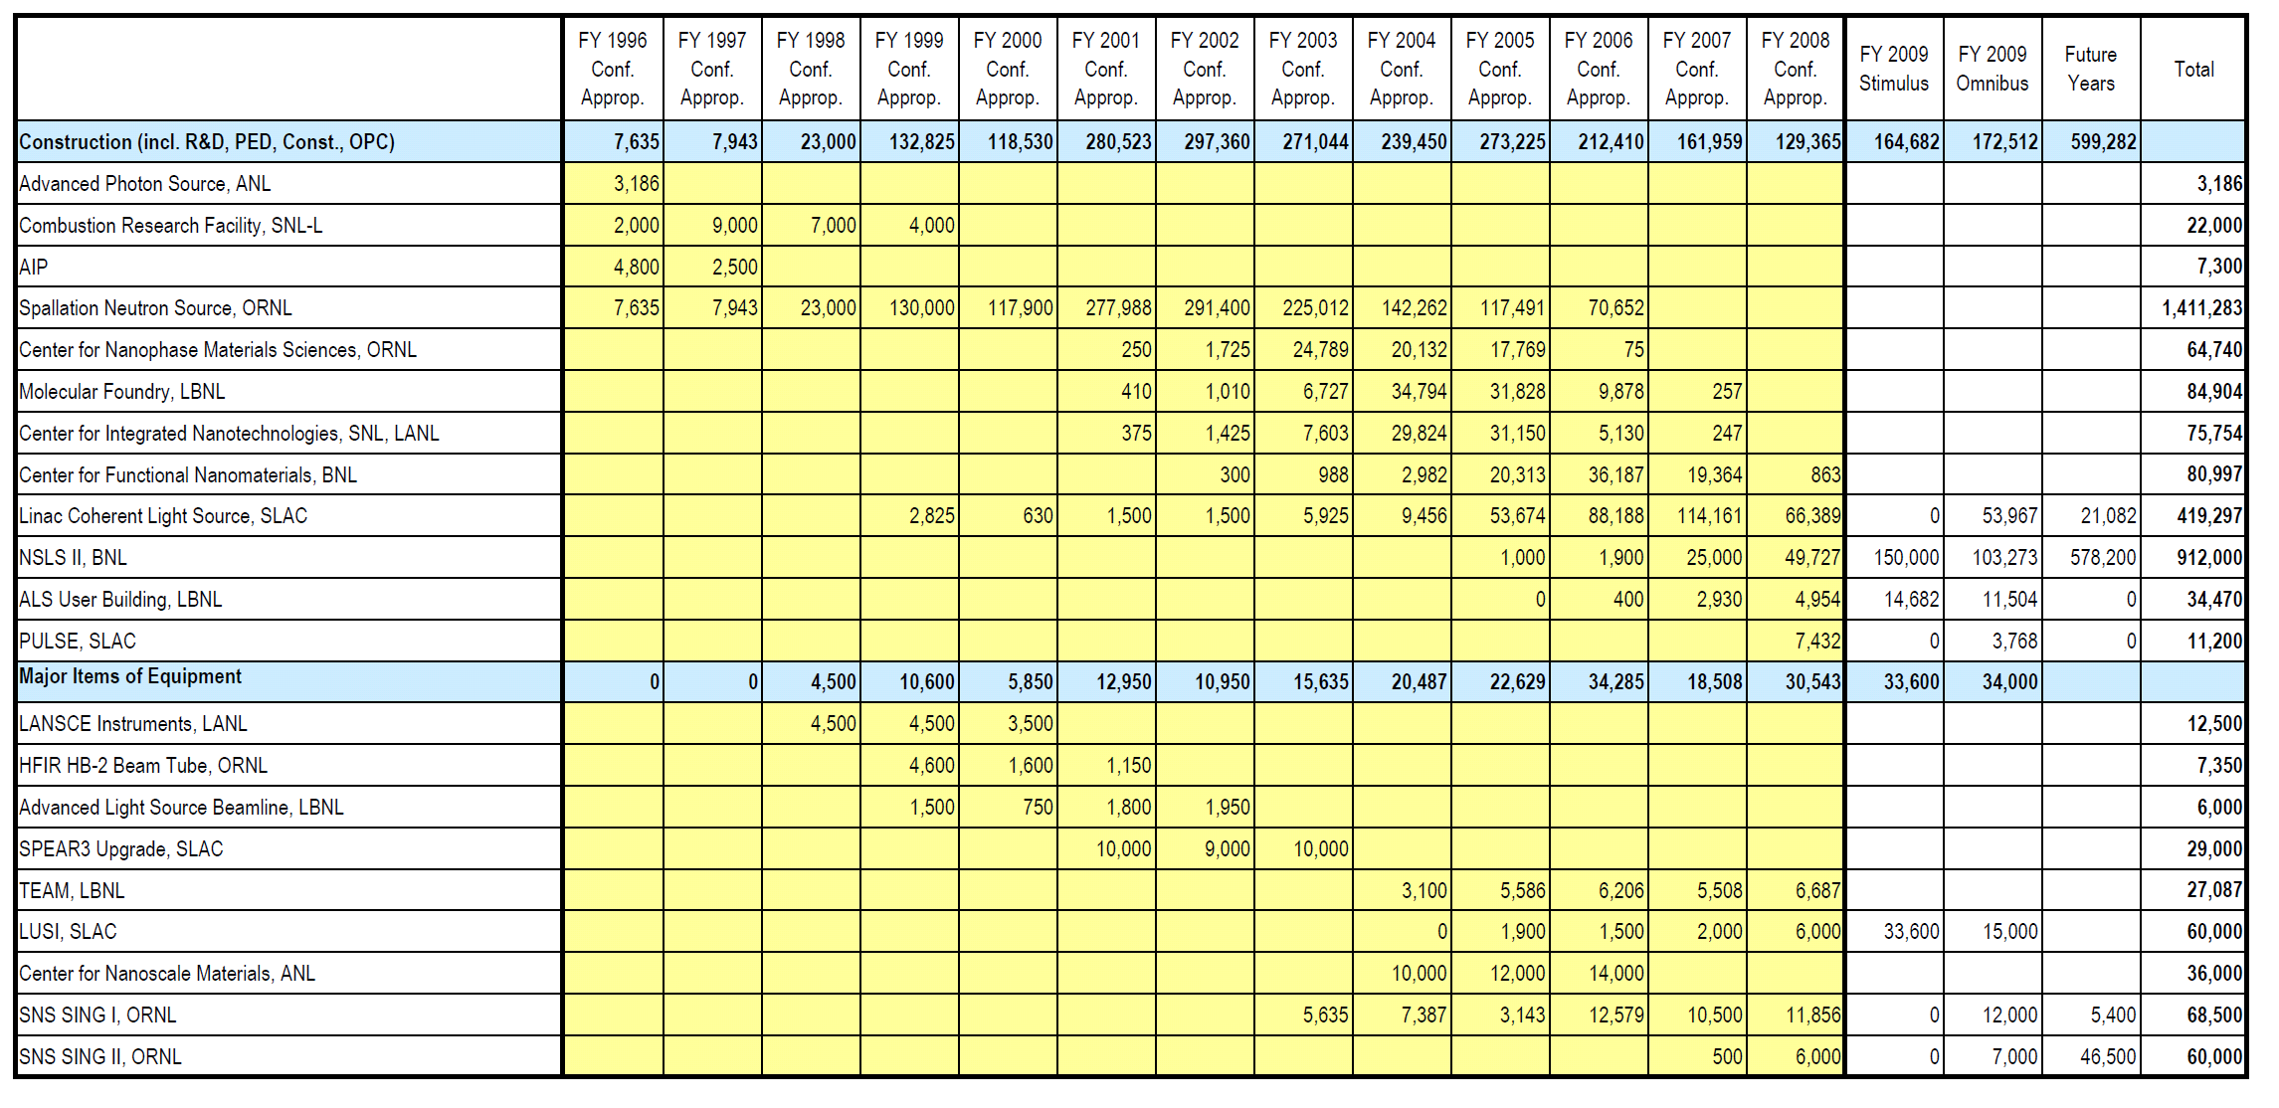
Owner Experience: BES Projects During Pat’s Years

Slide 25
Those BES Projects Did Pretty Well
Secretary of Energy’s Project Management Awards
2010 Award of Excellence: Linac Coherent Light Source (LCLS), SLAC NAL
2009 Award of Achievement: Transmission Electron Aberration-corrected Microscope (TEAM), LBNL
2008 Award of Achievement: Center for Functional Nanomaterials (CFN), BNL
2007 Award of Excellence: Molecular Foundry, LBNL
2007 Award of Achievement: Center for Integrated Nanotechnologies, SNL & LANL
2006 Award of Excellence: Spallation Neutron Source, ORNL
2006 Award of Achievement: Center for Nanophase Materials Sciences (CNMS), ORNL
2004 Award of Excellence: Stanford Positron Electron Asymmetric Ring 3 (SPEAR3) Upgrade, SLAC NAL

Slide 26
Hard Lessons Learned as an Owner Not just platitudes, though they may sound like it
Owners are accountable and responsible for project success.
Ownership is neither delegated nor usurped.
The owner is focused on the successful completion of the project throughout the life of the project.
All projects will have trouble, particularly in their early stages; owners must manage this.
The owner knows what is needed and the approximate cost, schedule, and technical specifications that must be met. Owners manage creep.
Open communications, mutual trust, and close coordination are maintained between owner and project management during planning, design, construction, commissioning, and operation.
Regularly scheduled management review meetings are conducted to act on problems and issues as they arise.
See also: Characteristics of Megaprojects
Conditions Essential to Success
Improving Project Management in the Department of Energy
National Research Council ISBN: 0-309-52033-9 (1999)

Slide 27
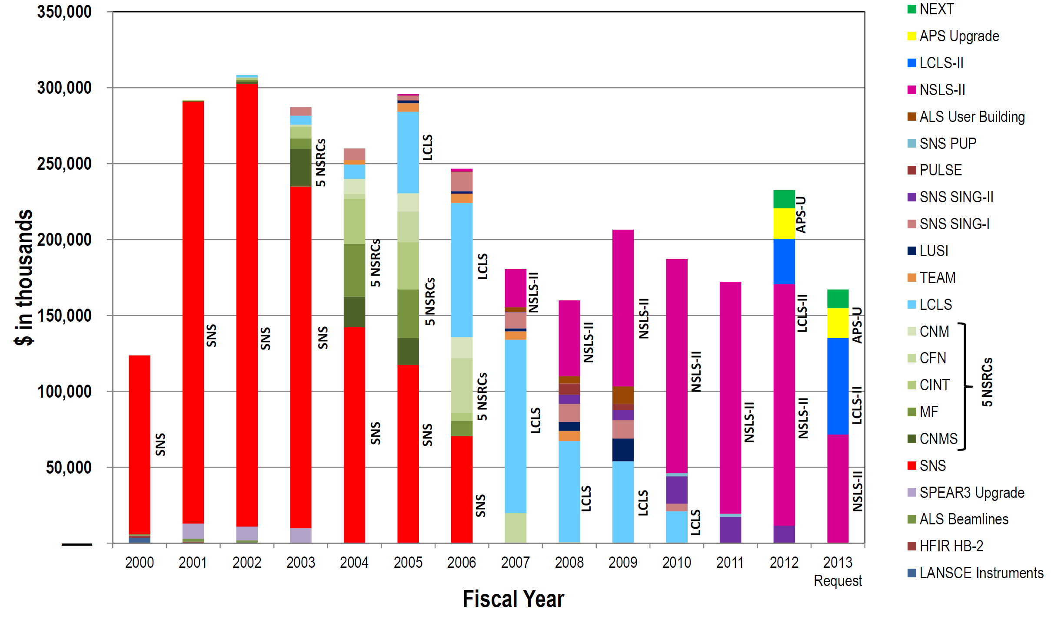
Managing ProjectS is Another Part of the Challenge

Slide 28
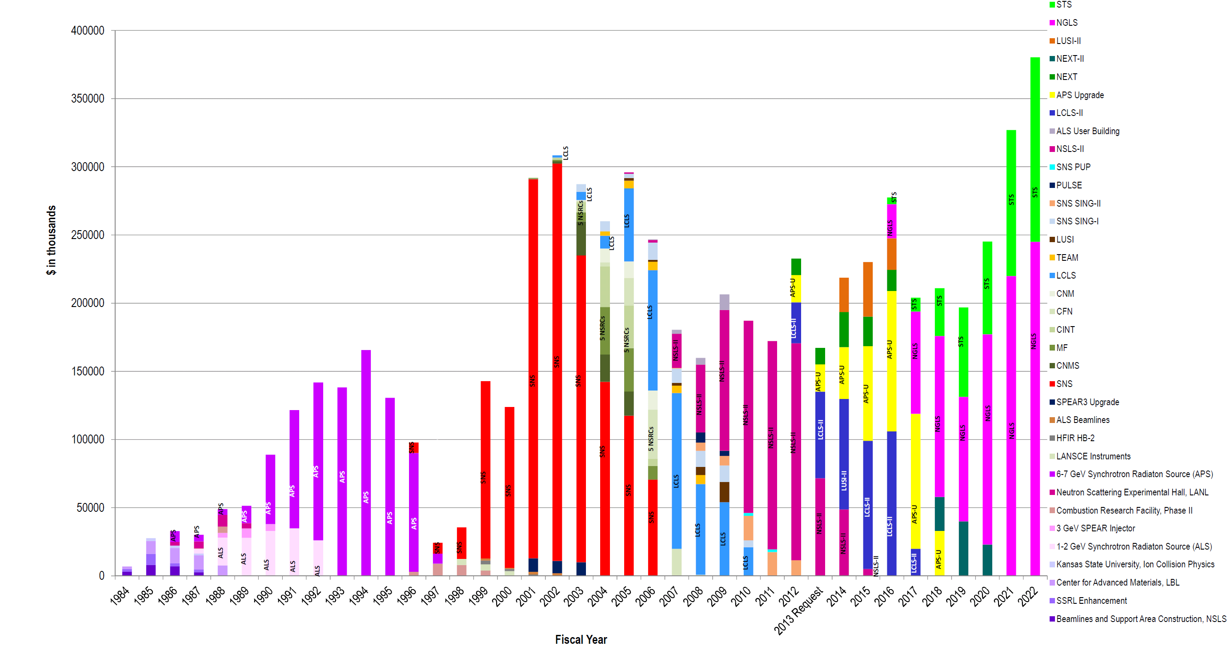
Things to avoid: Too many overlapping projects and long interludes between projects

Slide 29
END

Slide 31
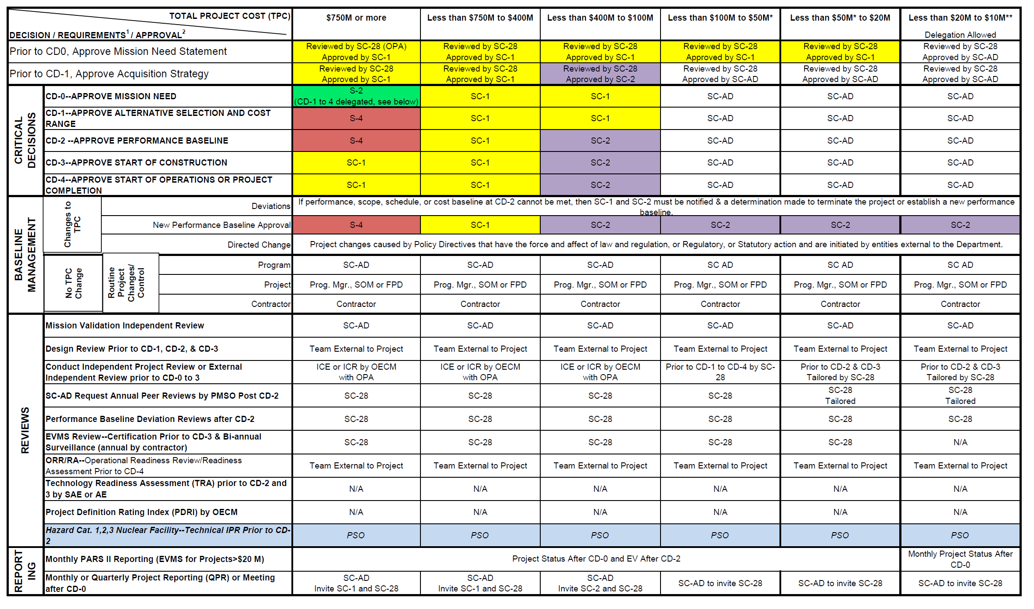
Project Decision Matrix

