Slide 1

Some Basic Energy Facts:
A mini tutorial from DOE’s Office of Science
Science and Technology Policy Issues
Facing the United States
The Brookings Institution
21 June 2012
Dr. Patricia M. Dehmer
Deputy Director for Science Programs
Office of Science, U.S. Department of Energy
http://science.energy.gov/sc-2/presentations-and-testimony/

Slide 2
The Department of Energy

Slide 3
DOE Evolution - I
1942-1946 Manhattan Project led by War Department Army Corps of Engineers
  Classified R&D
  Sprawling logistical and technical demands
  Foundations of first multi-purpose national labs
1946 Atomic Energy Act (P.L. 79-585)
1946-1974 Atomic Energy Commission (AEC)
  Charter emphasized research into
    Basic nuclear processes
    Nuclear energy
    Utilization of nuclear materials for variety of purposes
  Continual expansion of R&D activities and facilities

Slide 4

DOE Evolution - II
1971 AEC charter expands to non-nuclear energy
1974 Arab oil embargo motivates creation of new energy R&D agency (P.L. 93-438)
1974-1977 Energy Research and Development Administration
  Nuclear, solar, fossil, geothermal, synthetic fuels, transmission, conservation, etc.
1977 Consolidation of Federal energy activity into a new Department of Energy (P.L. 95-91)
  Formal separation of management oversight of weapons and non-weapons labs
  Formal separation of basic and applied research programs

Slide 5
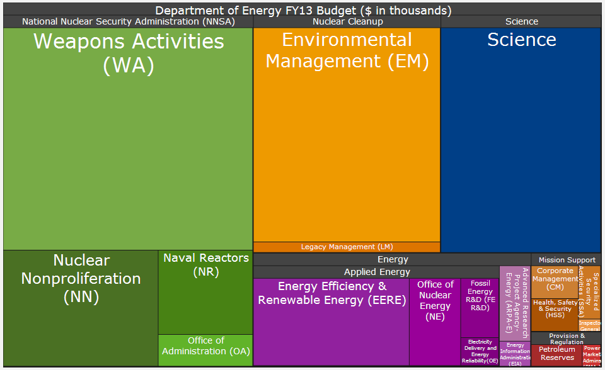
The DOE Portfolio Today
Area map of the FY 2013 budget request to Congress ($27.2B)
Notes:
Begin with a short intro to DOE

Slide 6
DOE’s Office of Science

Slide 7
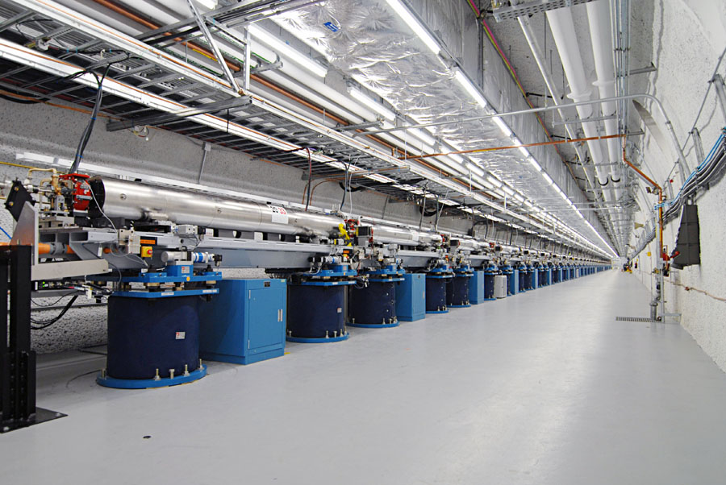
DOE’s Office of Science, by the numbers
  $5B annual budget
  25,000 Ph.D. scientists, graduate students, under-graduates, engineers, and technical staff at more than 300 institutions in all 50 States and DC through competitive awards
  32 national user facilities serving more than 26,000 users each year
  100 Nobel Prizes during the past 6 decades—more than 20 in the past 10 years
The undulator hall at the Linac Coherent Light Source, SLAC, 2011.

Slide 8
The Energy Challenge

Slide 9
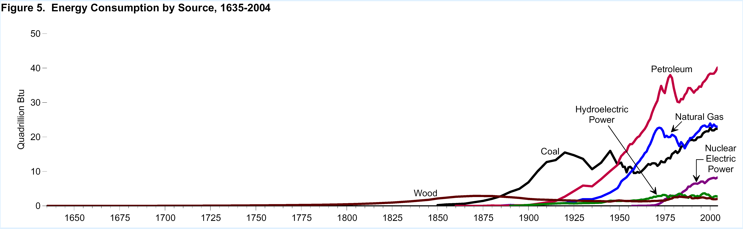
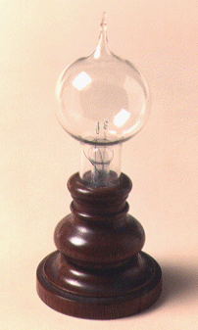
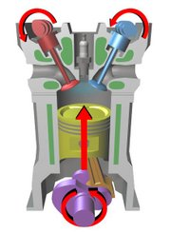
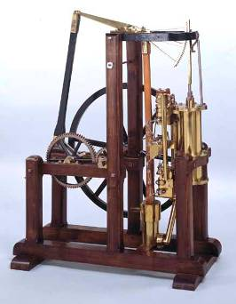
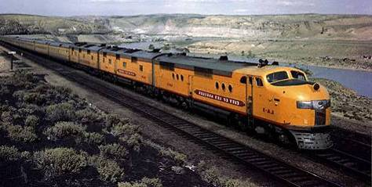
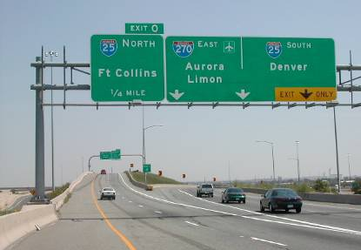
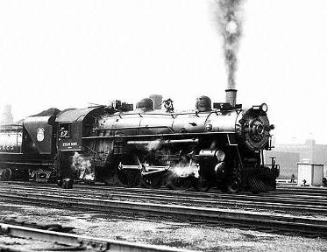

400 Years of Energy Use in the U.S.
19th C discoveries and 20th C technologies are very much part of today’s infrastructure
Still ~85% reliant on fossil fuels
40
Petroleum
40
U.S. Energy Consumption by Source
30
30
Hydroelectric
Power
Natural Gas
Quadrillion Btu
Quadrillion Btu
20
20
Coal
Nuclear Electric Power
Incandescent lamp,
1870s
Four-stroke combustion engine, 1870s
10
10
Wood
Watt Steam Engine, 1782
0
0
1650
1700
1750
1800
1850
1900
1950
2000
Rural Electrification Act,
1935
Intercontinental Rail System, mid 1800s
Eisenhower Highway System, 1956

Slide 10
Sustainable Energy = High Tech Materials
Materials, Chemical Transformations, & Biology by (Computer-Aided) Design
Today
Gas CH₄
Oil CH₂
Coal CH_{0.8}
useful work
combustion
heat
Disposable fuels
Commodity materials
Future
direct conversion
Sunlight
Wind
Water
Geothermal
Biomass
+
Storage
Transmission
CCS
Efficiency
Electricity
and
fuels
useful work
High-tech materials, chemistry, biology, e.g., for photovoltaics, electrodes and electrolytes, smart membranes, separators, superconductors, catalysts, fuels, sensors, and novel piezoelectrics
10

Slide 11
Banishing fear of
energy discussions

Slide 12

Fear of Too Many Energy Units
BTU .. quad .. boe .. bboe .. toe .. tce .. Joule .. therm .. thermie .. calorie ..
“quads”
“toe”

Slide 13
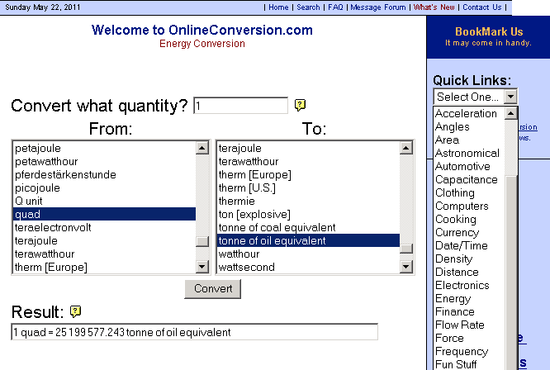
On-Line Energy Conversion Calculators Banish Fear of Units

Slide 14

Fear of Too Many Facts

Slide 15
World energy consumption

Slide 16
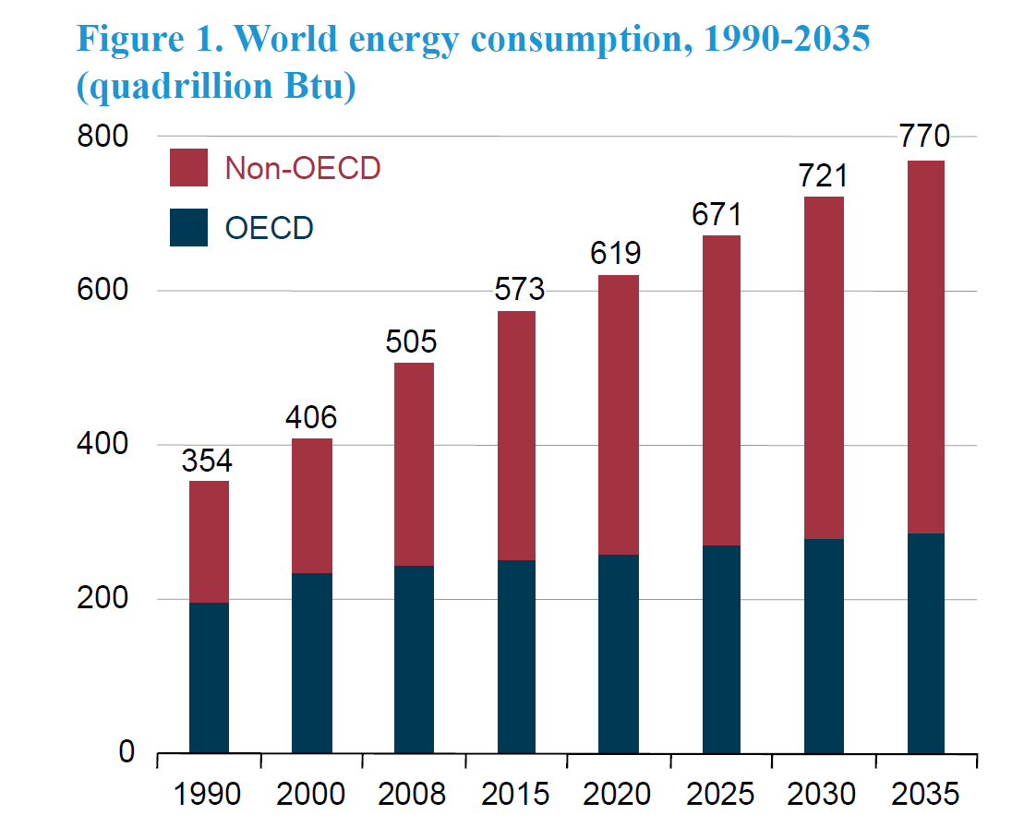

World Energy Consumption (Quads)
Some equivalent ways of referring to the energy used by the U.S. in 1 year (approx. 100 Quads)
100.0 quadrillion British Thermal Units (Quads) U.S. & British unit of energy
105.5 exa Joules (EJ) Metric unit of energy
3.346 terawatt-years (TW-yr) Metric unit of power (energy/sec)x(#seconds in a year)

Slide 17
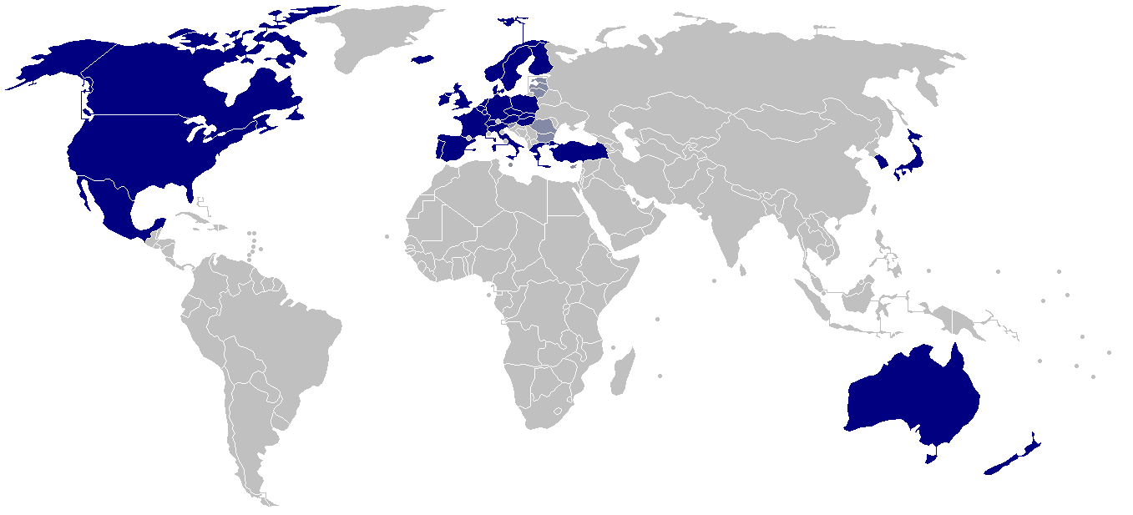

OECD Member Countries (32)
The OECD is a forum of countries committed to democracy and the market economy, providing a setting to compare policy experiences, seek answers to common problems, identify good practices, and co-ordinate domestic and international policies. Twenty countries signed the Convention on the OECD on 14 December 1960; twelve additional countries have joined since.

Slide 18
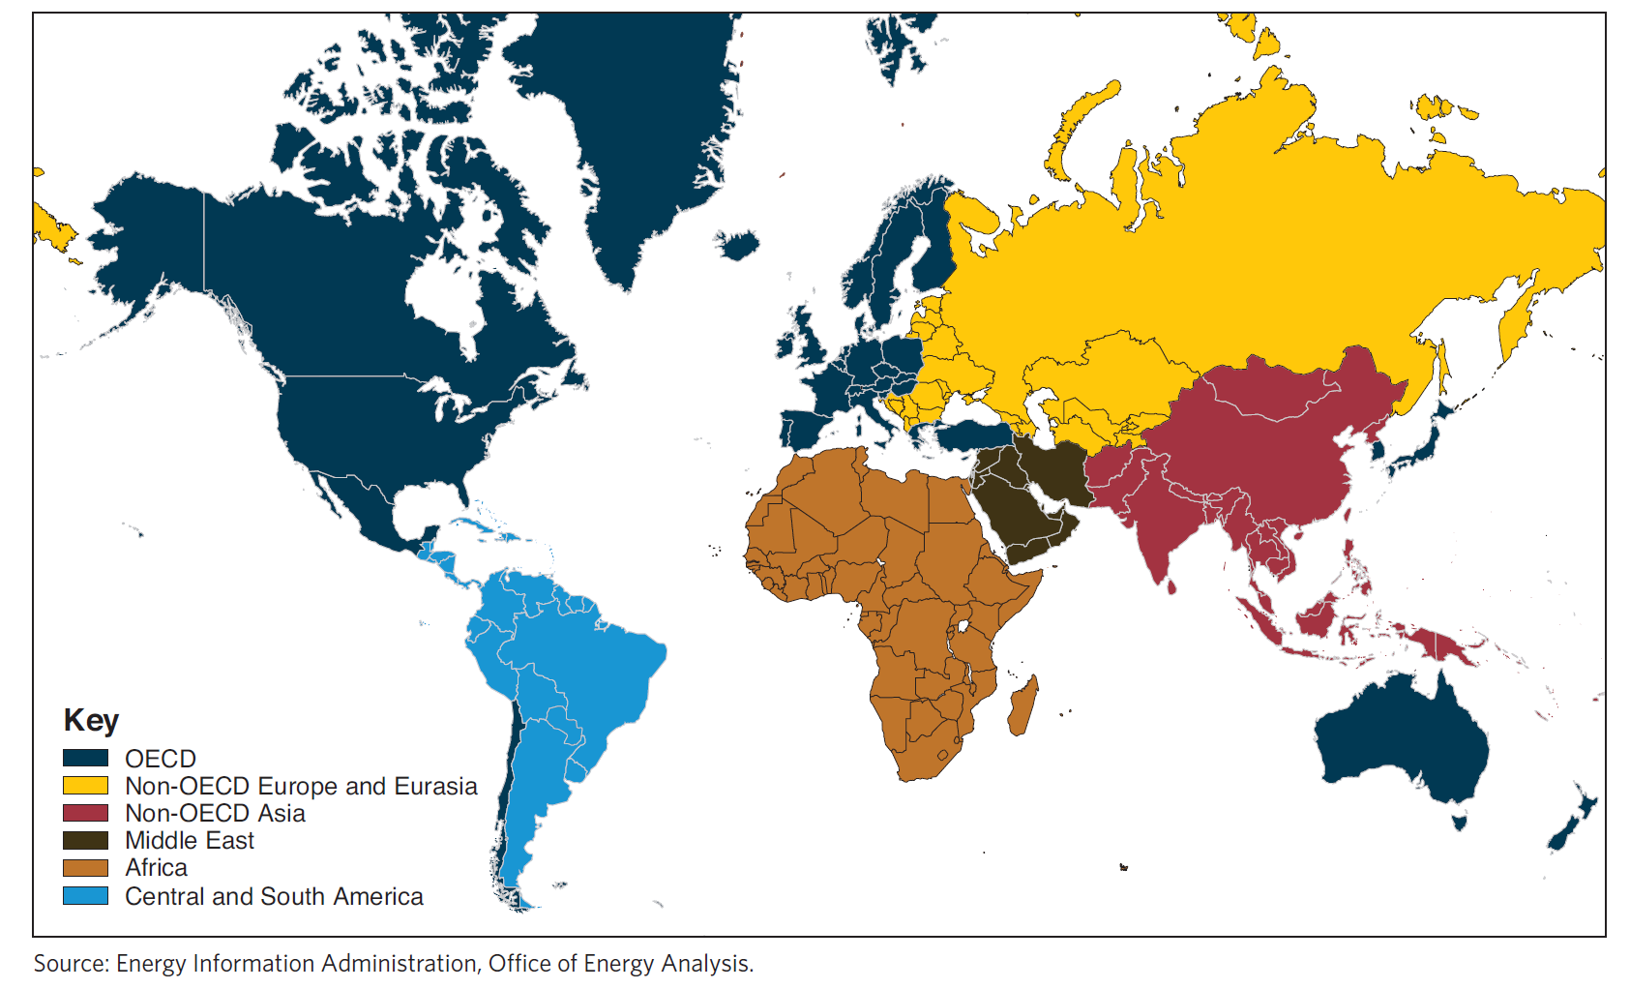
World Regions and OECD Member Countries
The OECD is a forum of countries committed to democracy and the market economy, providing a setting to compare policy experiences, seek answers to common problems, identify good practices, and co-ordinate domestic and international policies. Twenty countries signed the Convention on the OECD on 14 December 1960; twelve additional countries have joined since.

Slide 19
OECD Member Countries
AUSTRALIA: 7 June 1971
AUSTRIA: 29 September 1961
BELGIUM: 13 September 1961
CANADA: 10 April 1961
CHILE: 7 May 2010
CZECH REPUBLIC: 21 December 1995
DENMARK: 30 May 1961
FINLAND: 28 January 1969
FRANCE: 7 August 1961
GERMANY: 27 September 1961
GREECE: 27 September 1961
HUNGARY: 7 May 1996
ICELAND: 5 June 1961
IRELAND: 17 August 1961
ITALY: 29 March 1962
JAPAN: 28 April 1964
KOREA: 12 December 1996
LUXEMBOURG: 7 December 1961
MEXICO: 18 May 1994
NETHERLANDS: 13 November 1961
NEW ZEALAND: 29 May 1973
NORWAY: 4 July 1961
POLAND: 22 November 1996
PORTUGAL: 4 August 1961
SLOVAK REPUBLIC: 14 December 2000
SLOVENIA: 21 July 2010
SPAIN: 3 August 1961
SWEDEN: 28 September 1961
SWITZERLAND: 28 September 1961
TURKEY: 2 August 1961
UNITED KINGDOM: 2 May 1961
UNITED STATES: 12 April 1961
OECD MEMBER COUNTRIES
Twenty countries originally signed the Convention on the Organisation for Economic Co-operation and Development on 14 December 1960. Since then twelve countries have become members of the Organisation. The Member countries of the Organisation and the dates on which they deposited their instruments of ratification are:

Slide 20
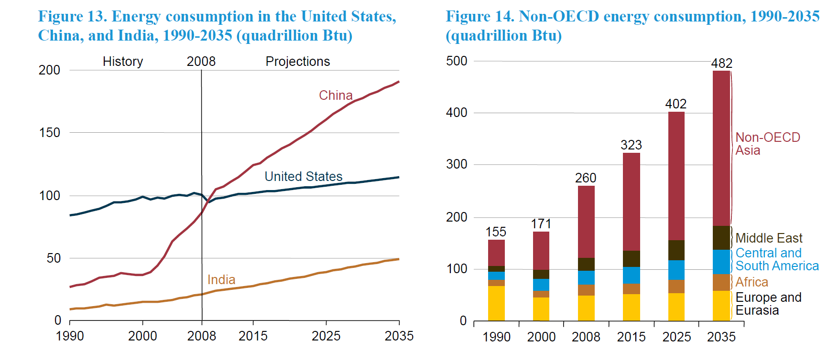
Growth in Global Energy Consumption Occurs
Almost Exclusively in non-OECD Countries
Energy consumption in the U.S., China, and India, 1990-2035 (Quads)
Non-OECD energy consumption,
1990-2035 (Quads)
Some equivalent ways of referring to the energy used by the U.S. in 1 year (approx. 100 Quads)
100.0 quadrillion British Thermal Units (Quads) U.S. & British unit of energy
105.5 exa Joules (EJ) Metric unit of energy
3.346 terawatt-years (TW-yr) Metric unit of power (energy/sec)x(#seconds in a year)

Slide 21
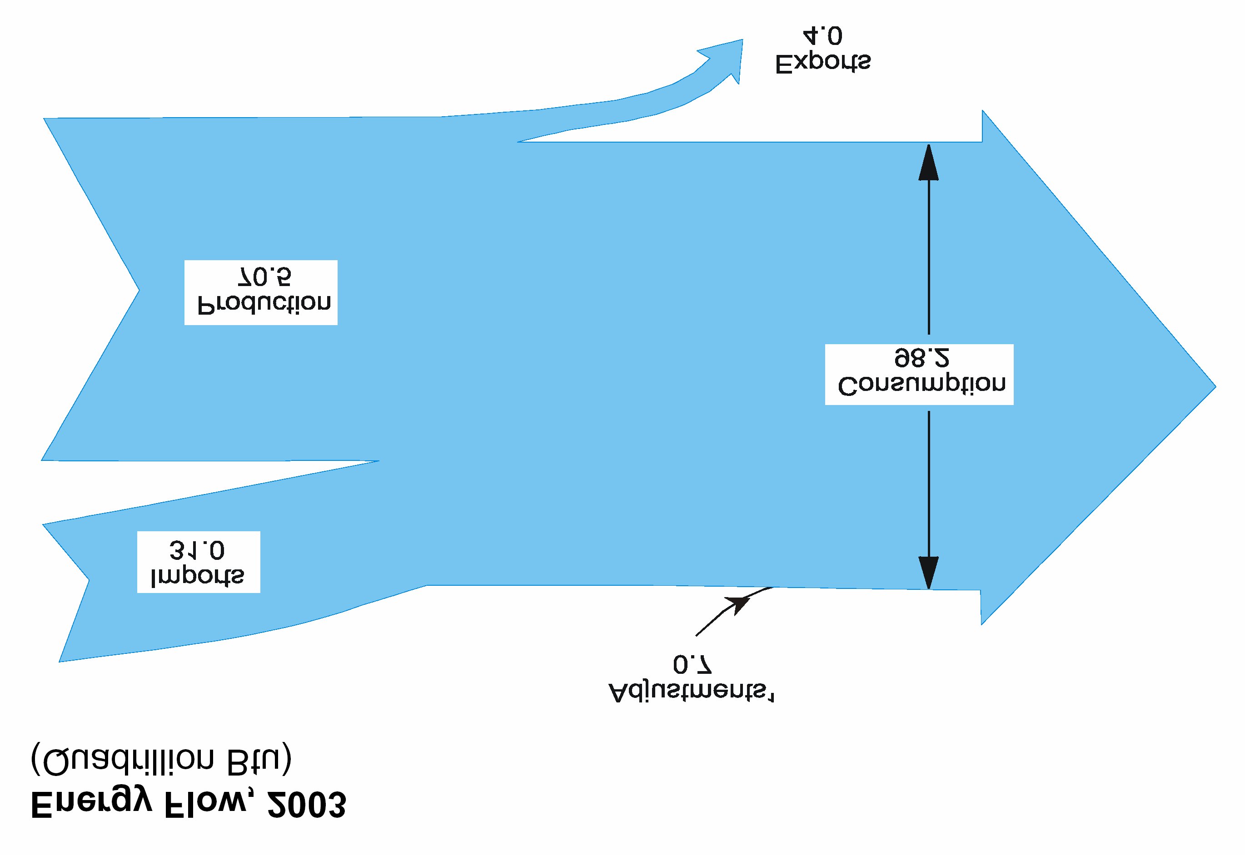

Energy sources and consumption sectors in the U.S.

Slide 22
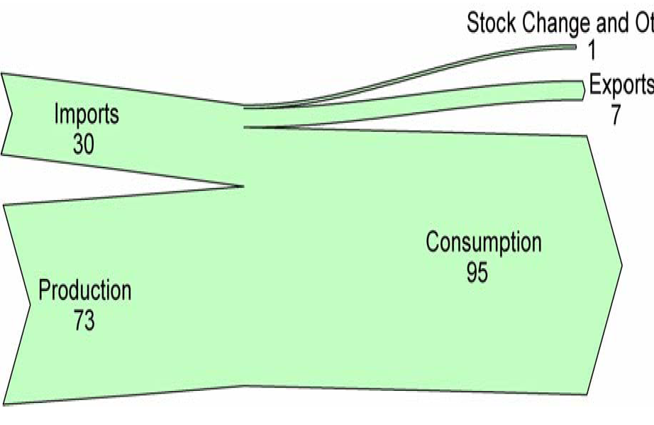
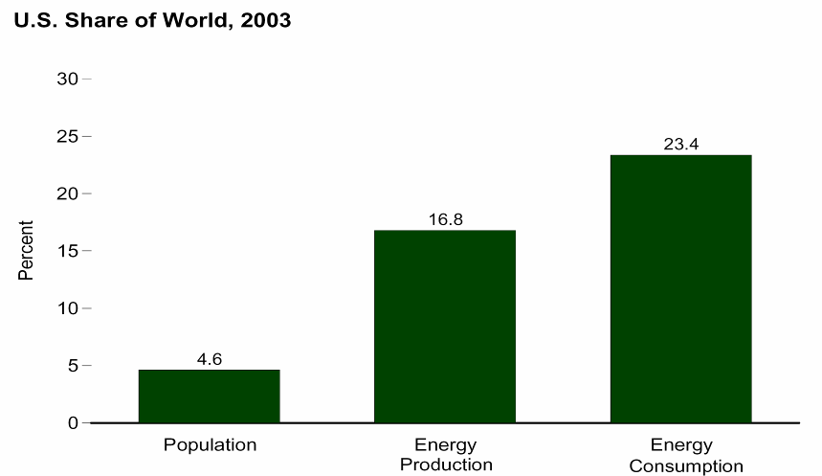

U.S. Energy Flow, 2010
About 1/3 of U.S. primary energy is imported
Adjustments: -1
Exports:
8 Quads
Imports:
30 Quads
Consumption:
98 Quads
Energy Supply (Quads)
Energy Consumption
Domestic
Production:
75 Quads
U.S. Share of World, 2007
21.0%
15.0%
4.6%
Population
Energy
Production
Energy
Consumption

Slide 23
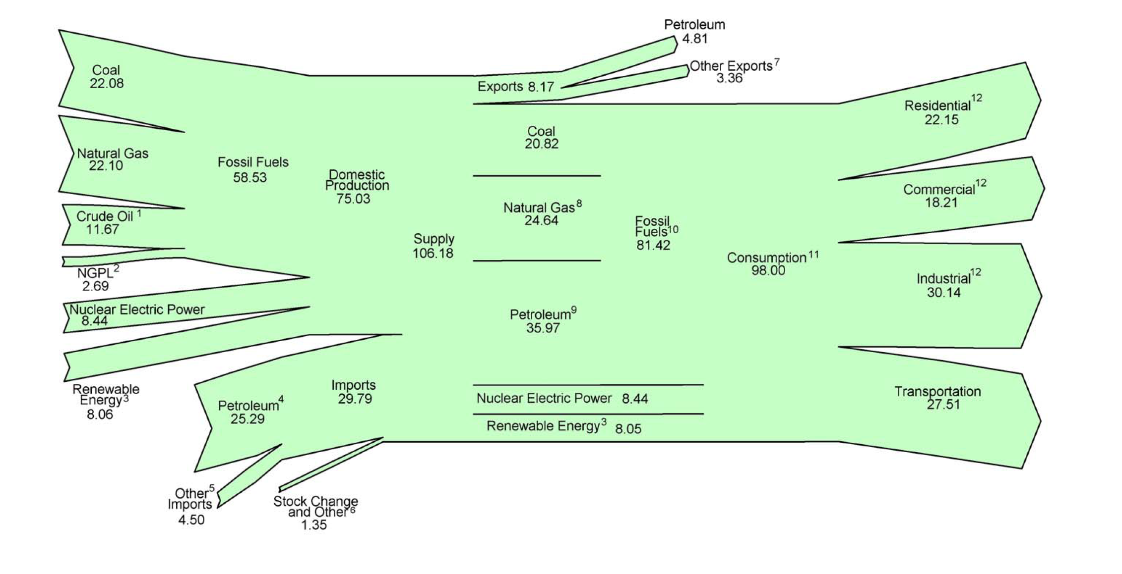
U.S. Energy Flow, 2010 (Quads)
>80% of primary energy is from fossil fuels
Residential
Domestic
72%
Commercial
Supply
106
Quads
Fossil
83%
Consume
98
Quads
Industrial
Imports
28%
Nuclear 9%
Transportation
Renewable 8%

Slide 24
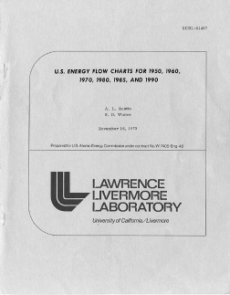
U.S. Energy Flow, 1950 (Quads)
At midcentury, the U.S. used 1/3 of the primary energy used today and with greater overall efficiency

Slide 25
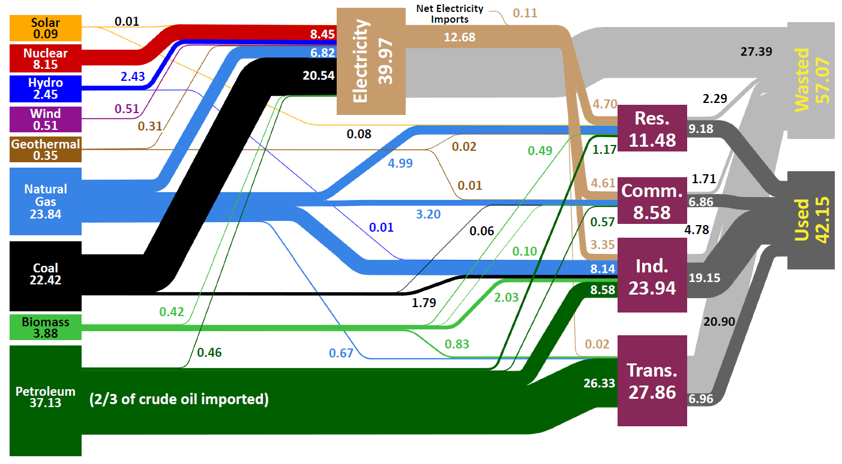
U.S. Energy Production and Usage in 2008
Units in Quadrillion BTUs (Quads)
Today compared to 1950:
U.S. population ~2x that in 1950
Total primary energy ~3x that in 1950
Primary energy (petroleum) for transportation ~4x that in 1950
Primary energy for electricity generation ~10x that in 1950
Little or no imported petroleum in 1950
“Used” and “Wasted” energy were about equal in 1950
Source: Lawrence Livermore National Laboratory and the Department of Energy, Energy Information Administration, 2009 (based on data from DOE/EIA-0384(2008), June 2009).
Notes:
Delete yellow things

Slide 26
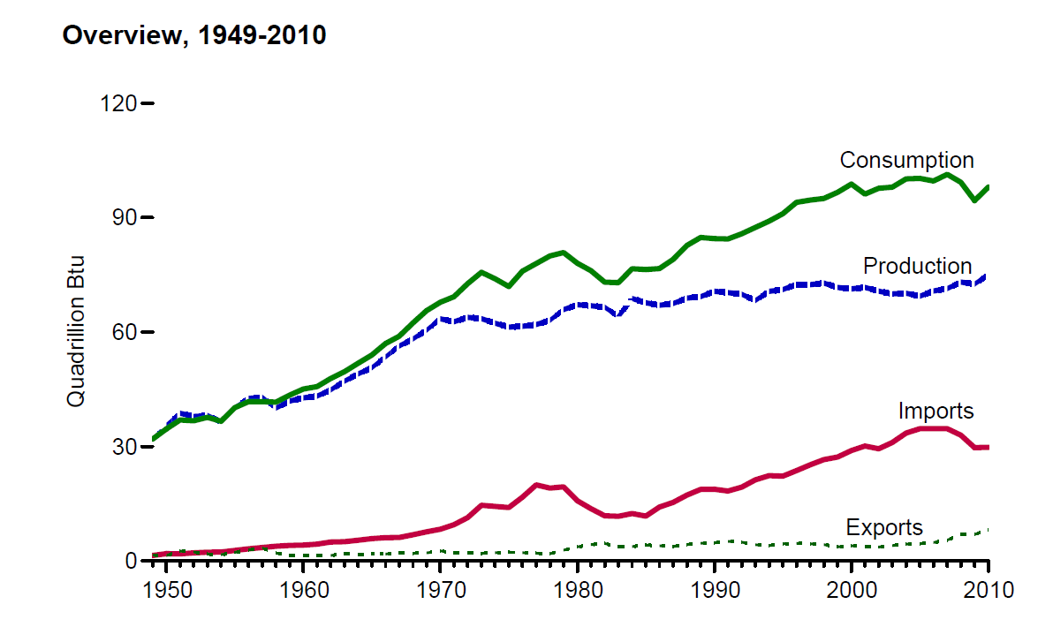
U.S. Energy Production & Consumption Since 1950
The U.S. was self sufficient in energy until the 1950s

Slide 27
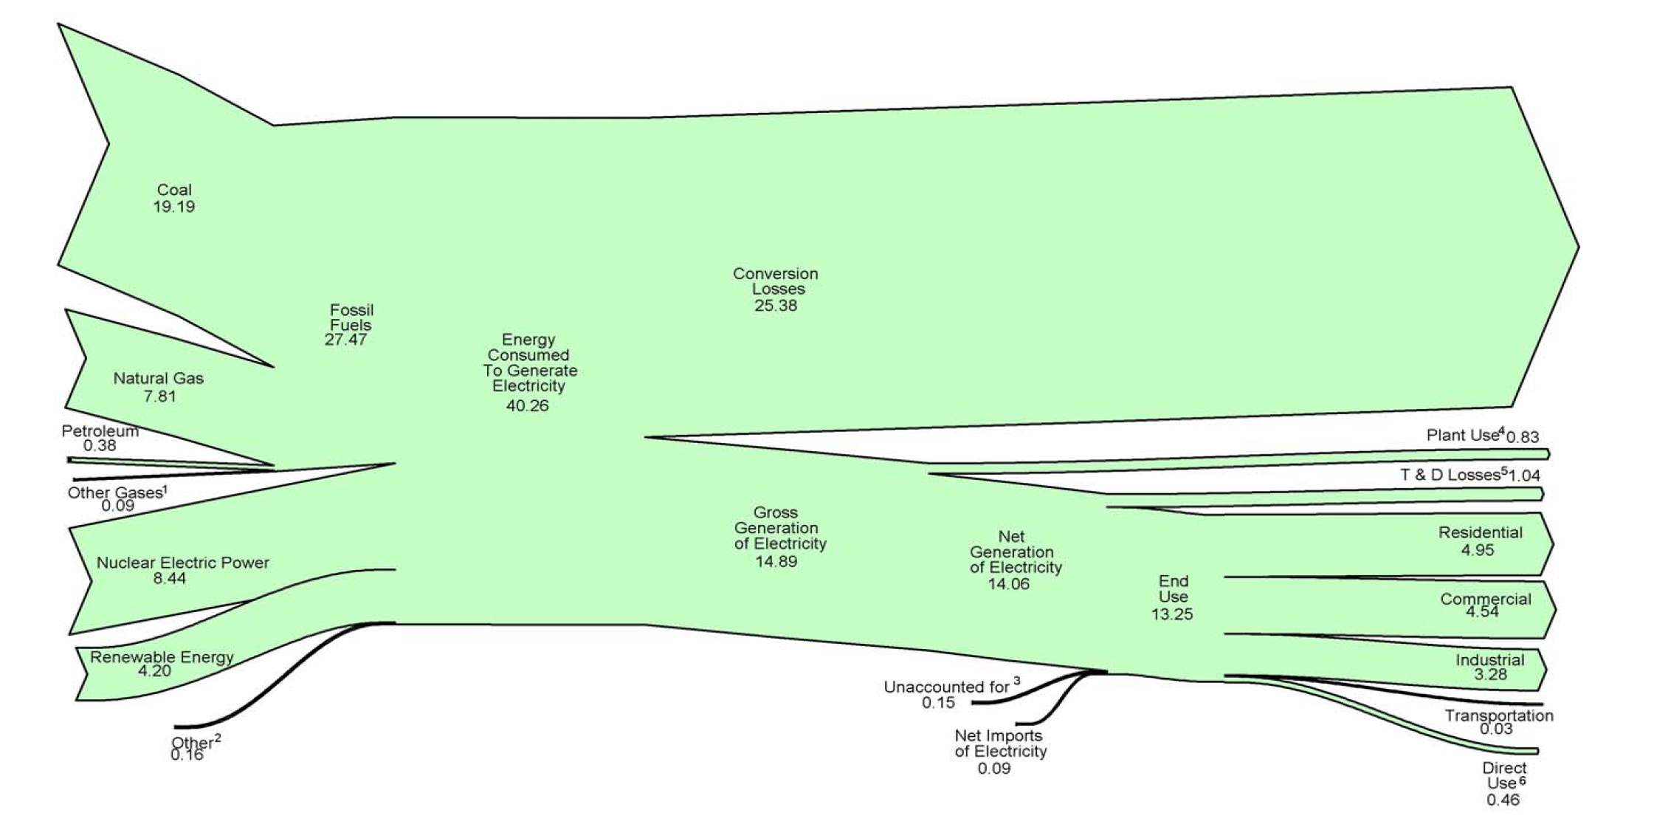
Electricity Sources and End Uses (Trillion Btu)
Conversion Losses
25 Quads
Energy Consumed to
Generate Electricity
40 Quads
Gross Generation
15 Quads
Residential
Commercial
Industrial

Slide 28
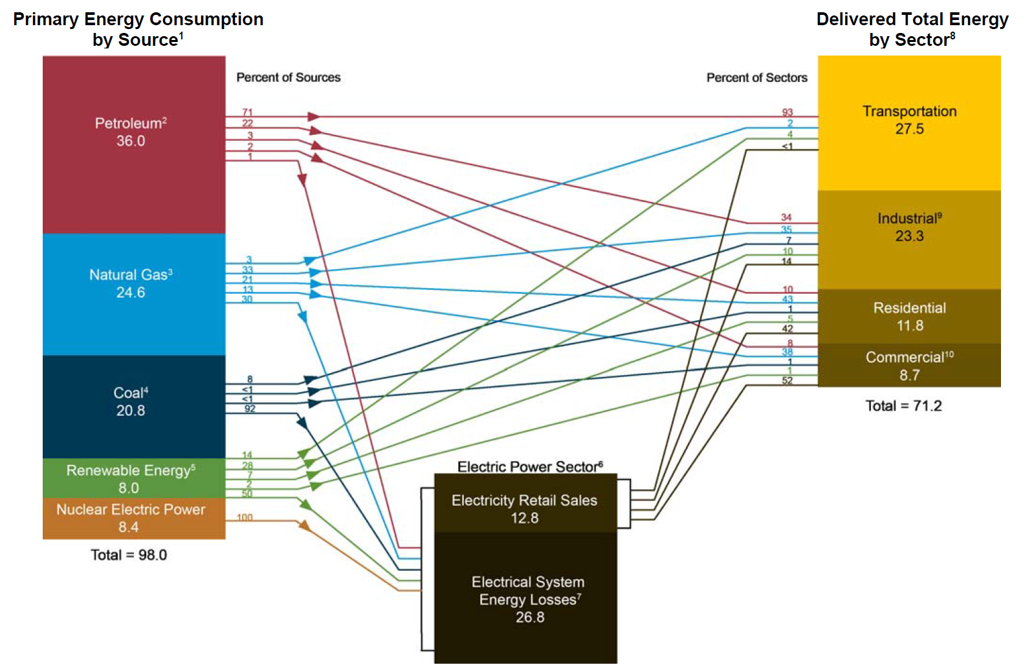
Summary of Sources and Consumption Sectors (Quads)

Slide 29
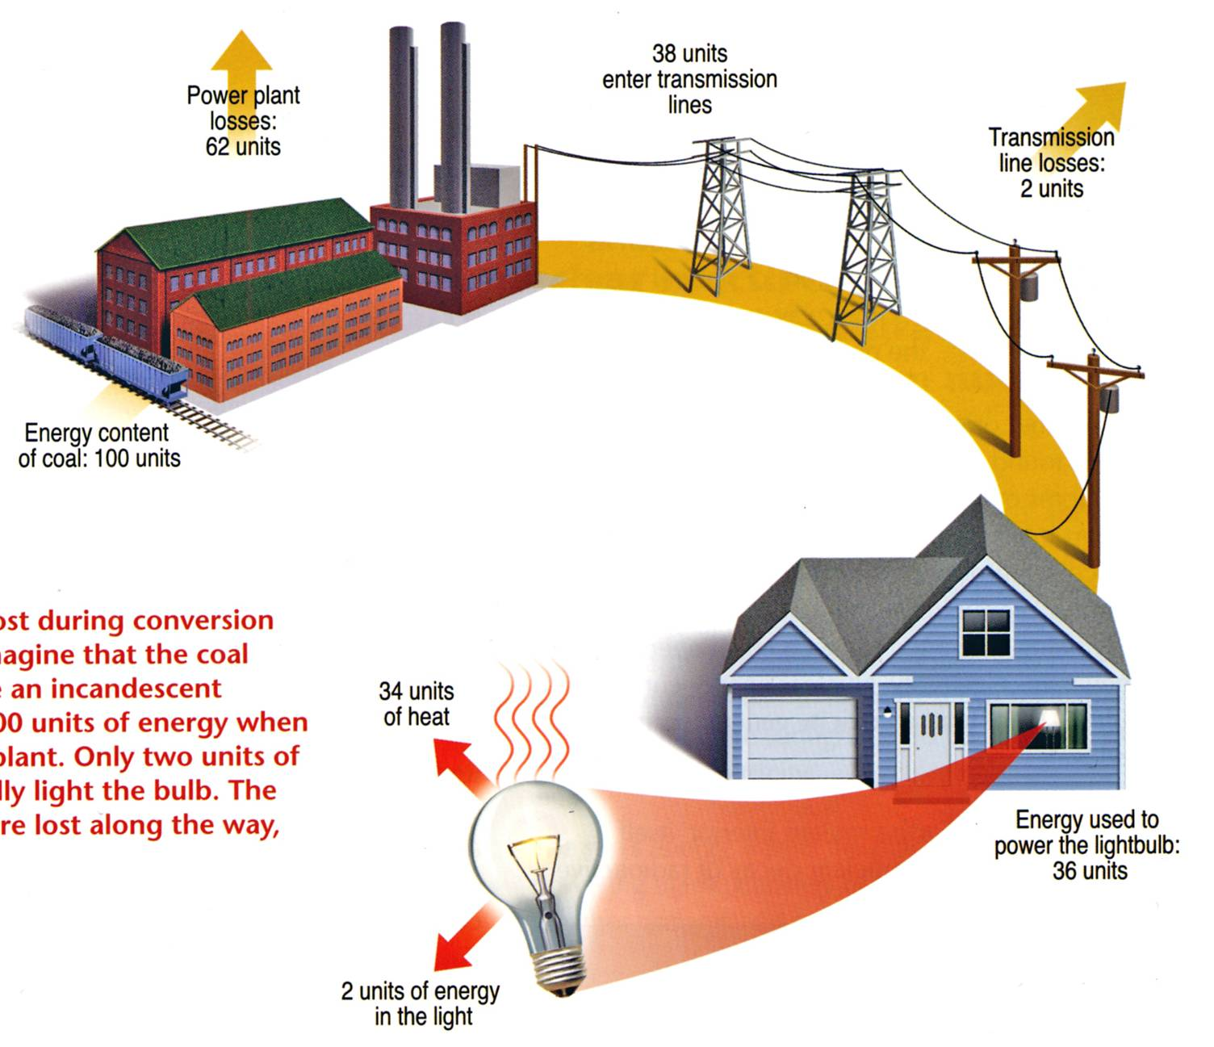

Overall Efficiency of an Incandescent Bulb ≅ 2%
Lighting accounts for 22% of all electricity usage in the U.S.
Energy content of coal: 100 units
The Energy Independence and Security Act of 2007 requires light bulbs be 30% more energy efficient (similar to current halogen lamps) than current incandescent bulbs by 2012 to 2014. The efficiency standards start with 100-watt bulbs in January 2012 and end with 40-watt bulbs in January 2014. By 2020, all general-purpose bulbs must produce at least 45 lumens per watt (similar to current CFLs).
Example of energy lost during conversion and transmission. Imagine that the coal needed to illuminate an incandescent light bulb contains 100 units of energy when it enters the power plant. Only two units of energy eventually light the bulb. The remaining 98 units are lost along the way, primarily as heat.
2 units of energy
in light output

Slide 30
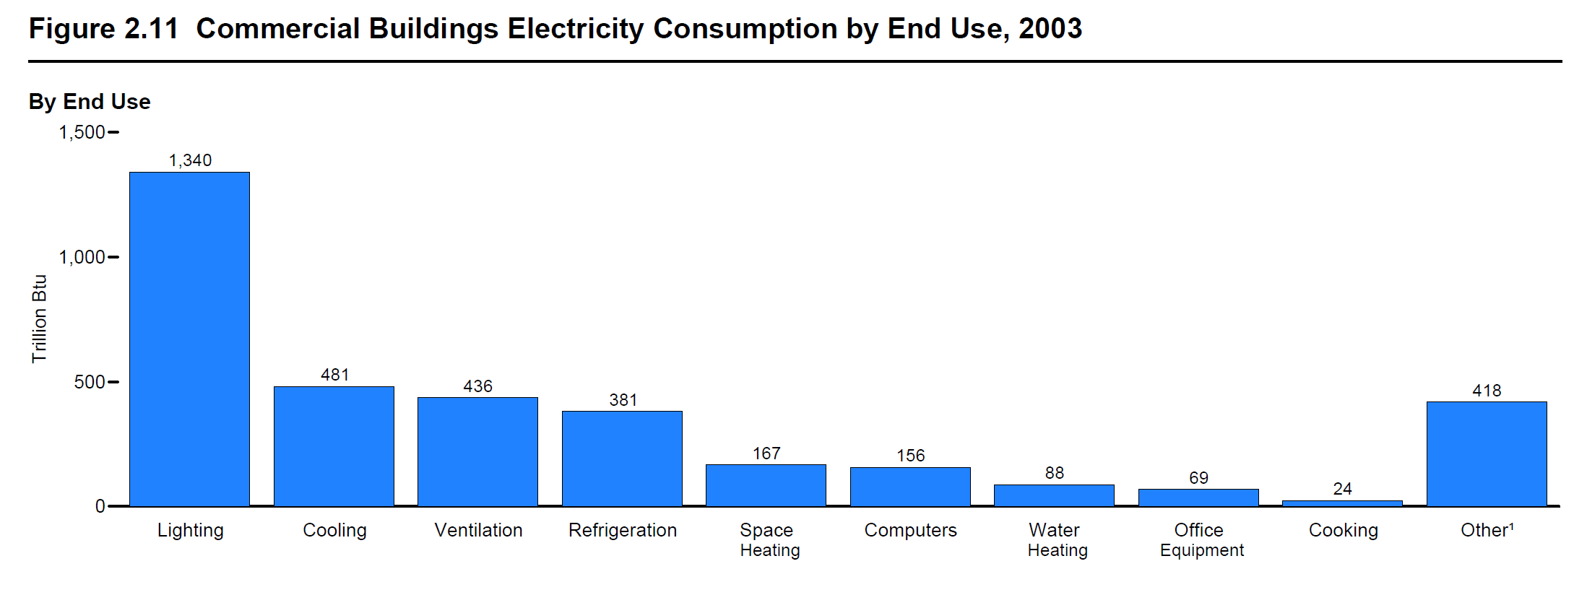
Commercial Buildings Electricity Consumption by End Use, 2003
(Trillion Btu)
Lighting
Cooling
Ventilation
Cooking
All Other
Refrigeration
Computers
Space Heating
Water Heating
Office Equipment

Slide 31
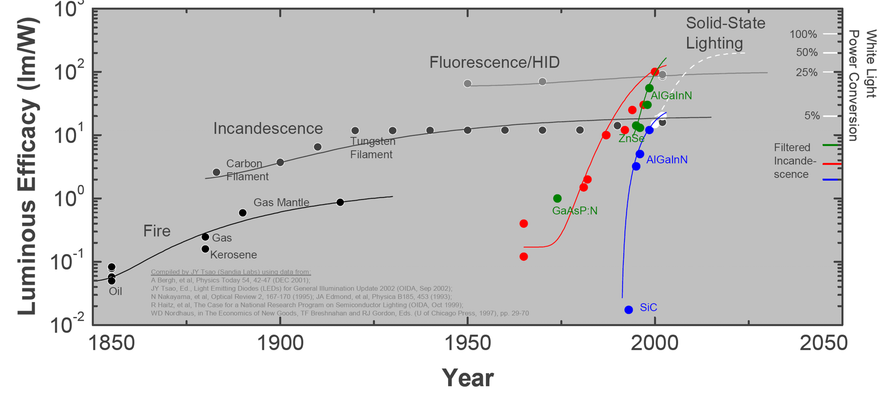
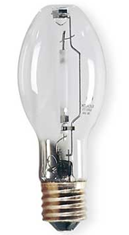
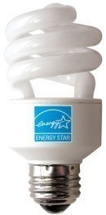
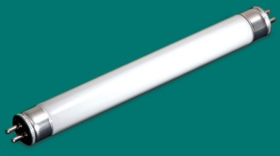
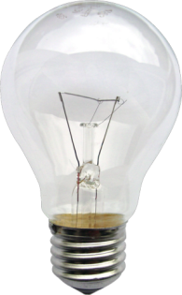



Luminous Efficacy for Lighting Technologies
3
Jeff Y. Tsao, “Solid-State Lighting: Lamps, Chips and Materials for Tomorrow,” IEEE Circuits & Devices 20(3), 28-37 (2004).
Notes:
Lighting technologies are substitutes for sunlight in the 425-675 nm spectral region where sunlight is most concentrated and to which the human eye has evolved to be most sensitive. The history of lighting can be viewed as the development of increasingly efficient technologies for creating visible light inside, but not wasted light outside, of that spectral region.
A 200-year perspective on that history is shown in the figure. The left axis indicates luminous efficacy, in units of lumens (a measure of light which factors in the human visual response to various wavelengths) per watt. The right axis indicates the corresponding power-conversion efficiency for a tri-LED tri-color white light source with moderate color rendering (CRI=80) and relatively warm color temperature (CCT=3900K). For such a source, 400lm/W would correspond to 100% power-conversion efficiency.
The three traditional technologies are fire; incandescence; and fluorescence and high-intensity discharges (HID). These three traditional technologies have all made significant progress over the past 200 years, but appear to be saturating at efficiencies in the 1-25% range.
A new, fourth technology is solid-state lighting. In principle, the technology is simple: electrons and holes are injected into a forward-biased semiconductor p-n junction; they recombine creating photons; the resulting photons are extracted from the chip; then the photons are either mixed with different-color photons from other LEDs, or are energy down-converted into a distribution of colors using phosphors or other down-conversion materials, with the colors chosen so as to create the appearance of white.
In practice, there are losses at every step of the way, and efficiently creating white light from semiconductor materials with band-gaps that span the visible spectrum is extremely challenging. Nevertheless, great strides are being made, and SSL-LED technology is currently on a very rapid improvement curve, particularly the red, green and blue monochrome lamps necessary for white light.

Slide 32
Energy needs in the 21st century
?
U.S.
~100 Quads
?
World
~500 Quads

Slide 33
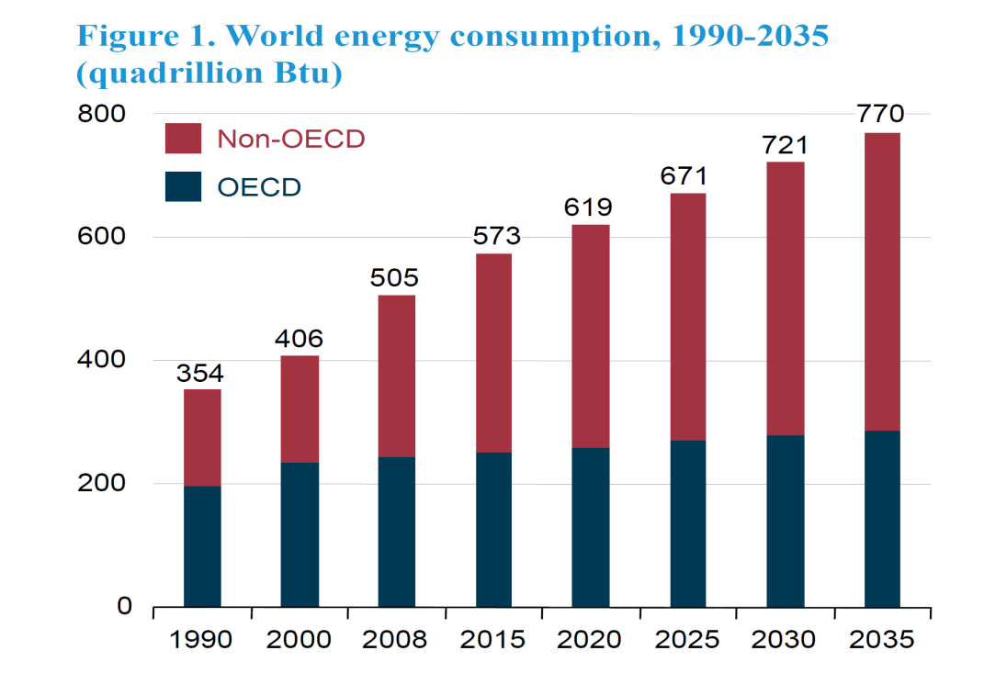
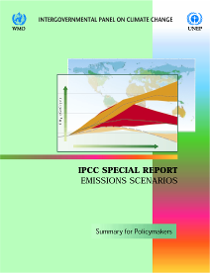
World Energy Needs will Grow in the 21st Century
1,286
Projections to 2035 are from the Energy Information Administration, International Energy Outlook, 2010.
World energy consumption (Quads)
Projections for 2050 and 2100 are based on a scenario from the Intergovern-mental Panel on Climate Change (IPCC), an organization jointly established in 1988 by the World Meteorological Organization and the United Nations Environment Programme. The IPCC provides comprehensive assessments of information relevant to human-induced climate change. The scenario chosen is based on “moderate” assumptions (Scenario B2) for population and economic growth and hence is neither overly conservative nor overly aggressive.
826
2050
2100

Slide 34
Fossil fuels
Coal 21%
Nuclear 9%
Petroleum 37%
Renewables 8%
Natural Gas 25%

Slide 35
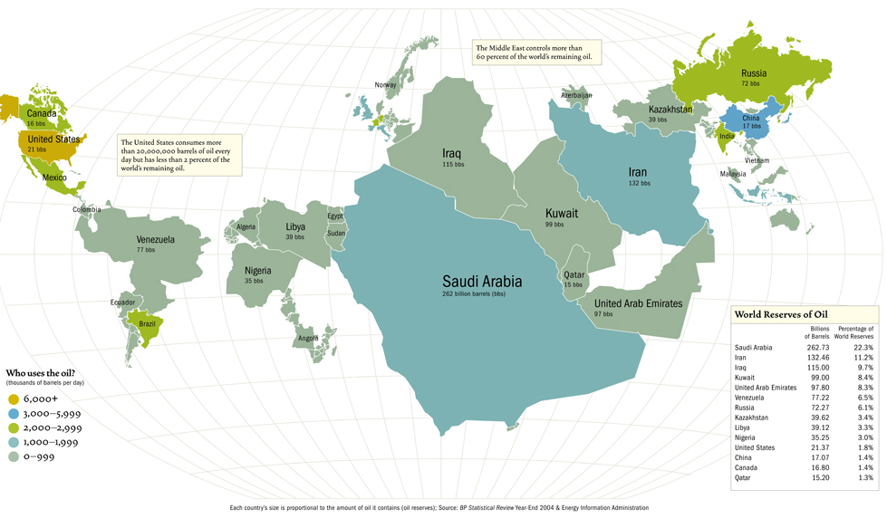
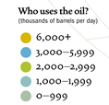
World Reserves of Oil
There is a significant dislocation between fossil fuel supply and demand
Who uses the oil?
(thousands of barrels per day)
(http://www.energybulletin.net/37329.html)
Notes:
“BP Statistical Review of World Energy 2005,” http://www.bp.com/liveassets/bp_internet/globalbp/globalbp_uk_english/publications/energy_reviews_2005/STAGING/local_assets/downloads/pdf/statistical_review_of_world_energy_full_report_2005.pdf
Slide Courtesy: Steven E. Koonin, Chief Scientist, BP, plc

Slide 36
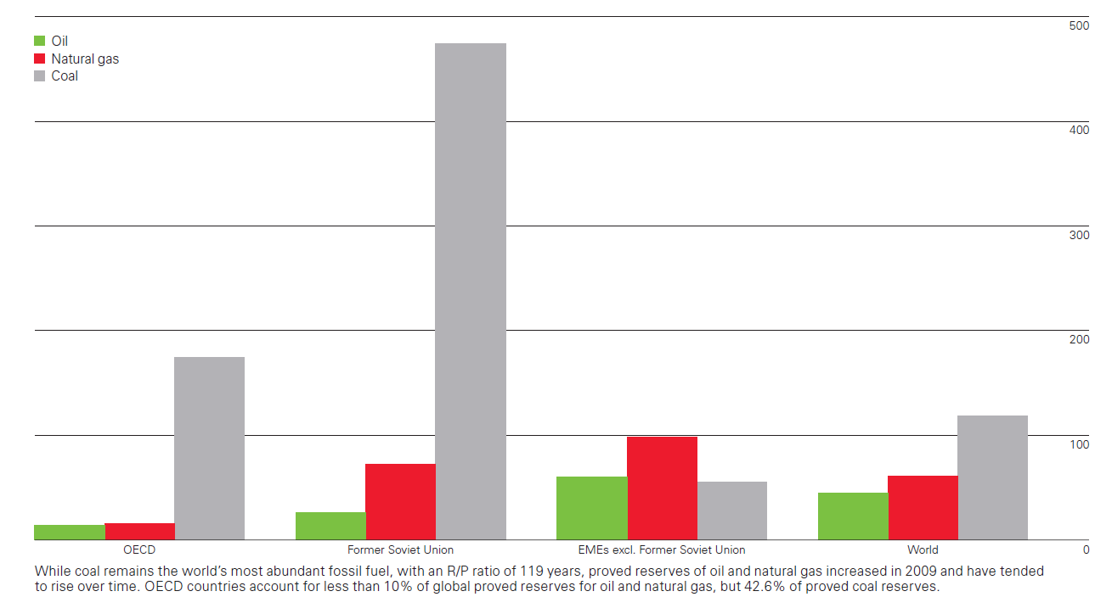
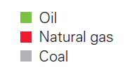

Fossil Fuel Supplies are Estimated using
Reserves-to-Production (R/P) Ratios
500
The R/P ratio is the number of years that proved reserves would last at current production rates.
400
300
Proven World Reserves-to-Production Ratio at End 2009 (Years)
200
100
OECD
Former
Soviet Union
Emerging
Market
Economies
World
Notes:
“BP Statistical Review of World Energy 2005,” http://www.bp.com/liveassets/bp_internet/globalbp/globalbp_uk_english/publications/energy_reviews_2005/STAGING/local_assets/downloads/pdf/statistical_review_of_world_energy_full_report_2005.pdf
Slide Courtesy: Steven E. Koonin, Chief Scientist, BP, plc

Slide 37
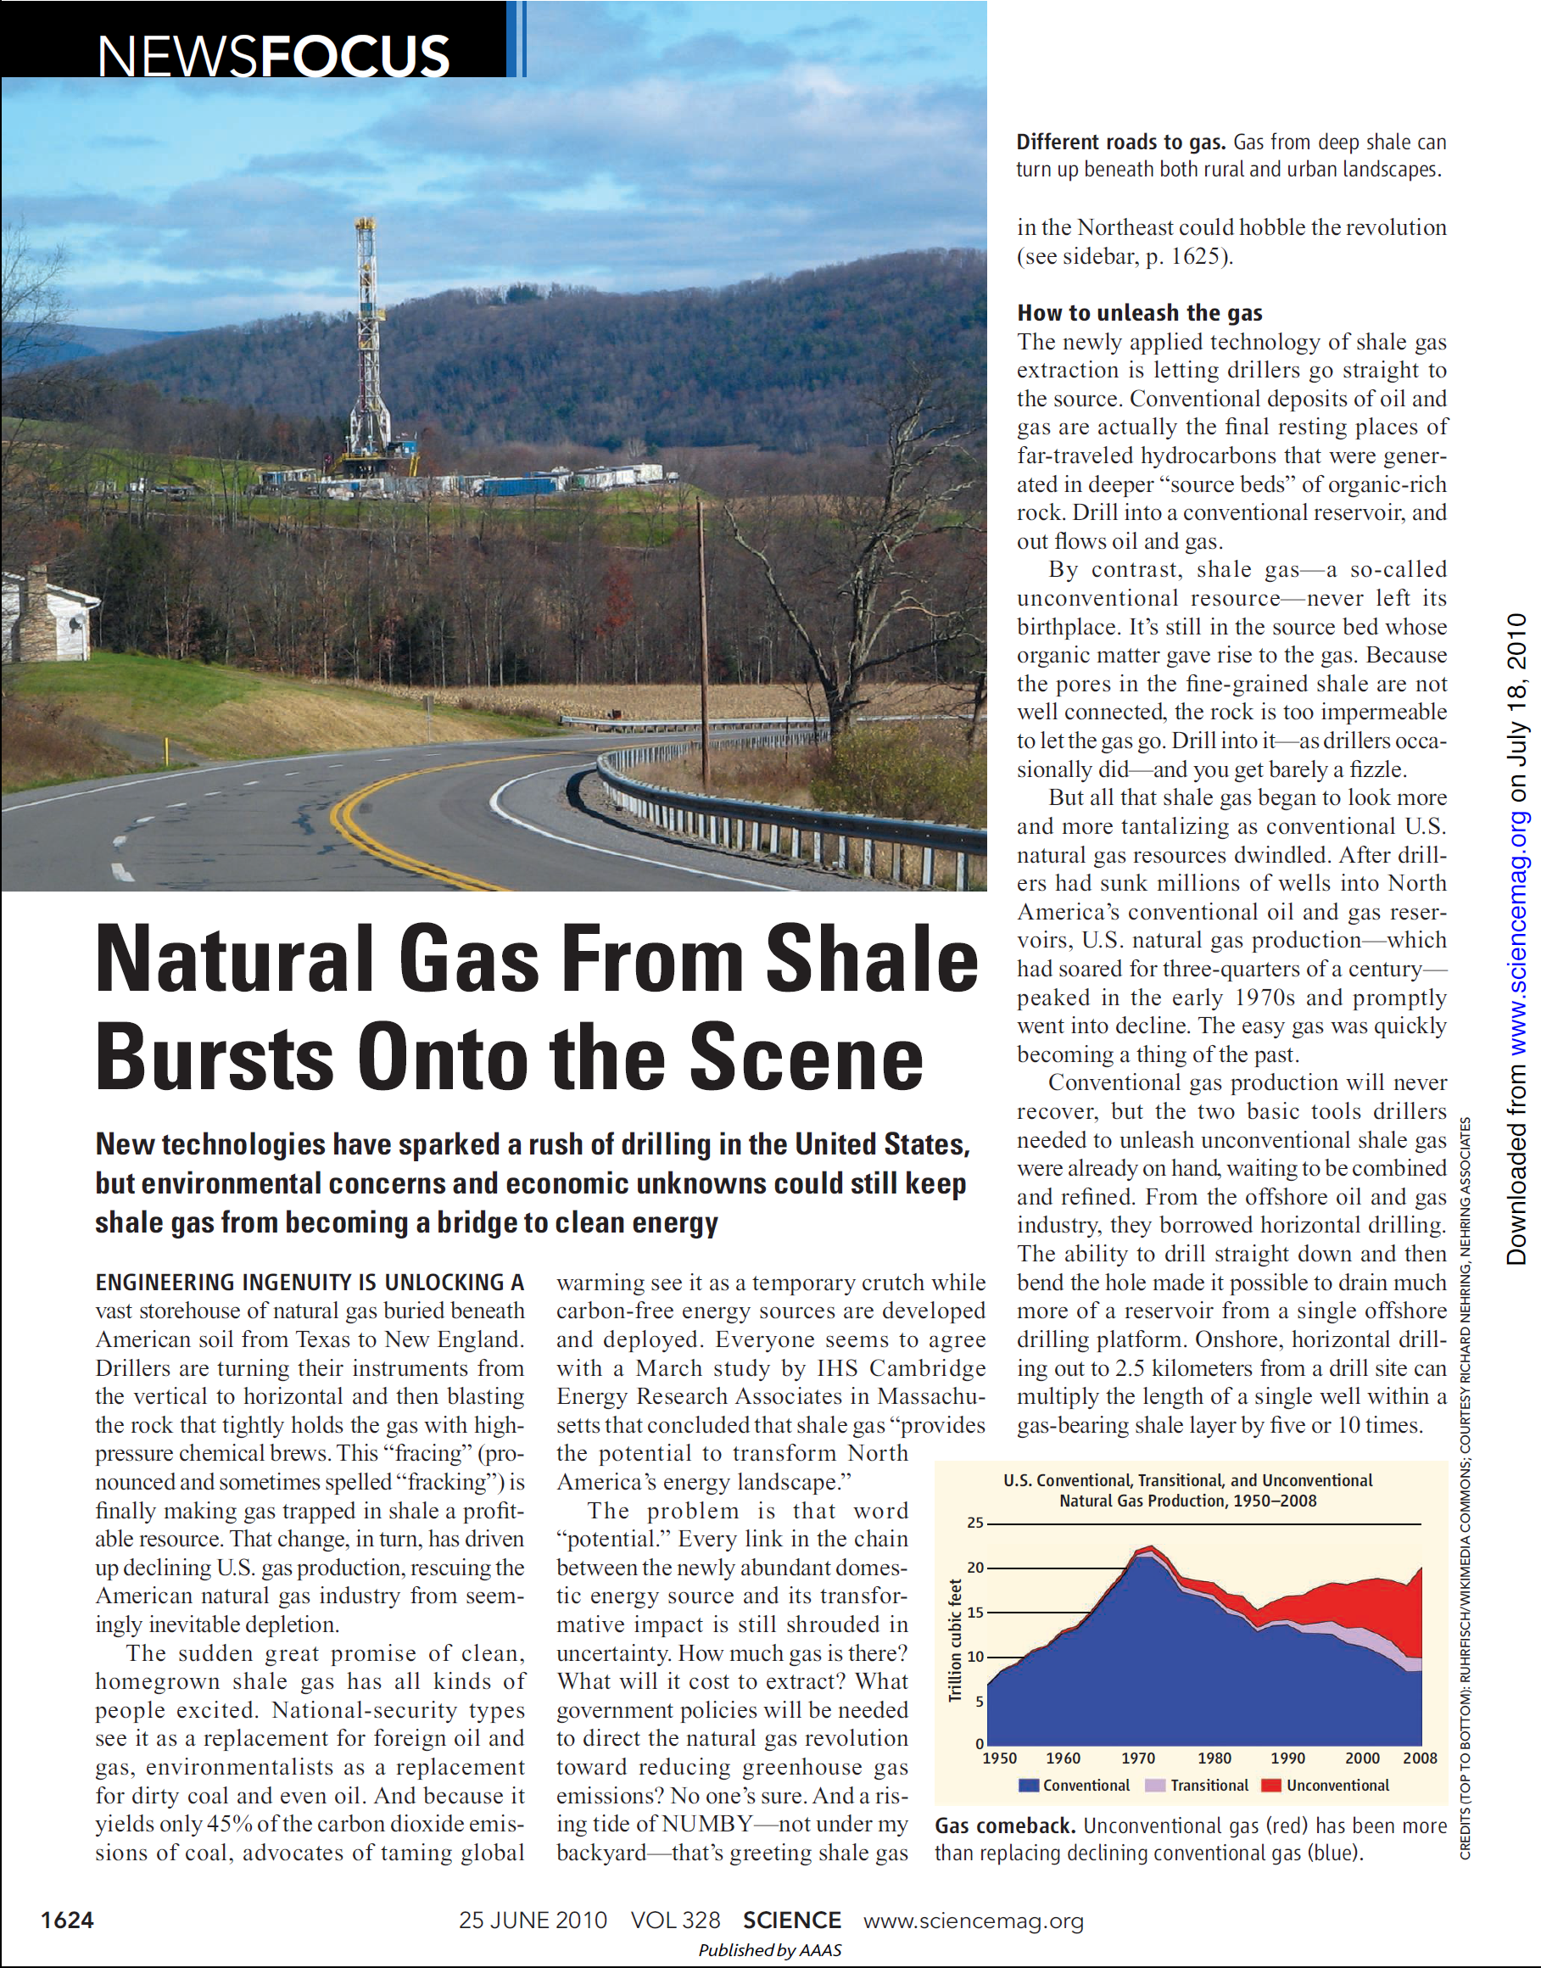
Unconventional Gas: Shale Gas

Slide 38
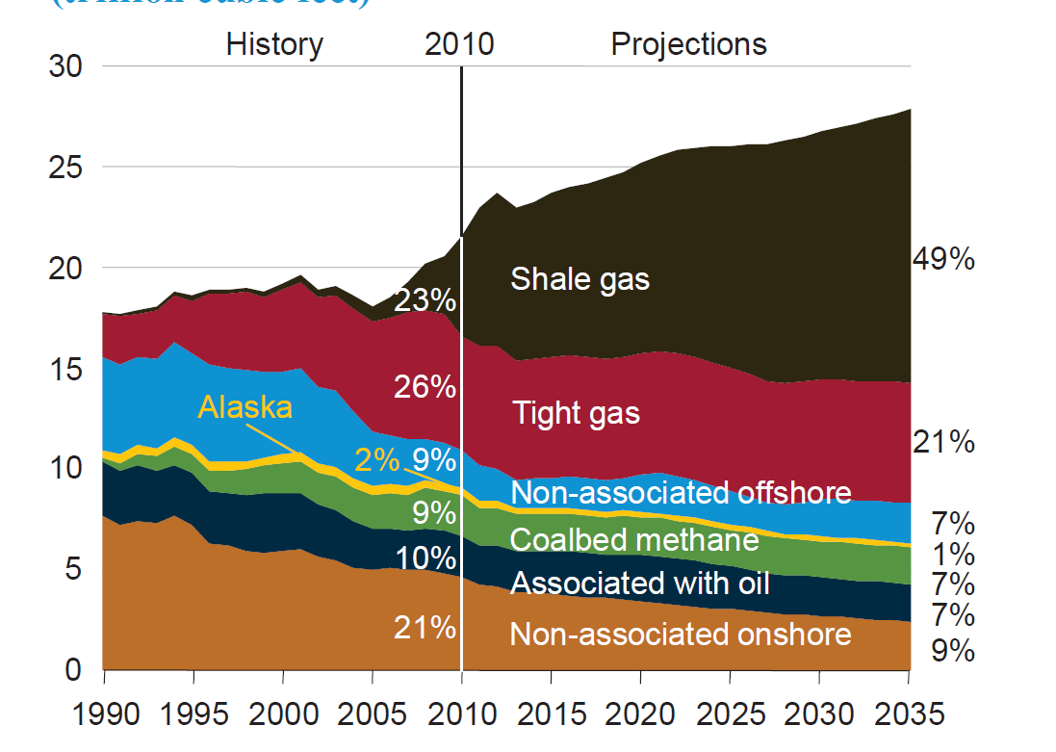
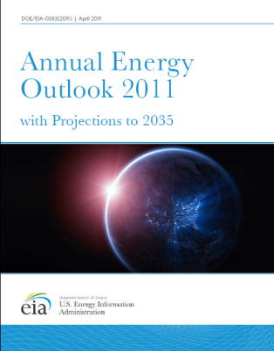
U.S. Natural Gas Production Showing Increase in Shale Gas
Trillion cubic feet per year

Slide 39
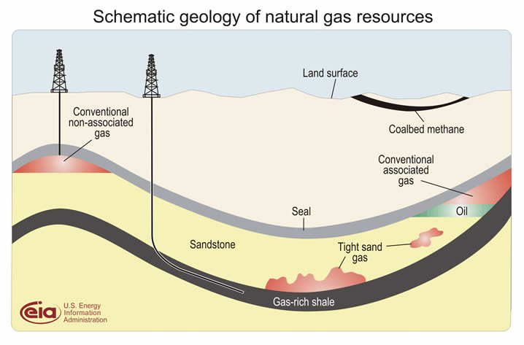
Tight Gas vs. Shale Gas

Slide 40
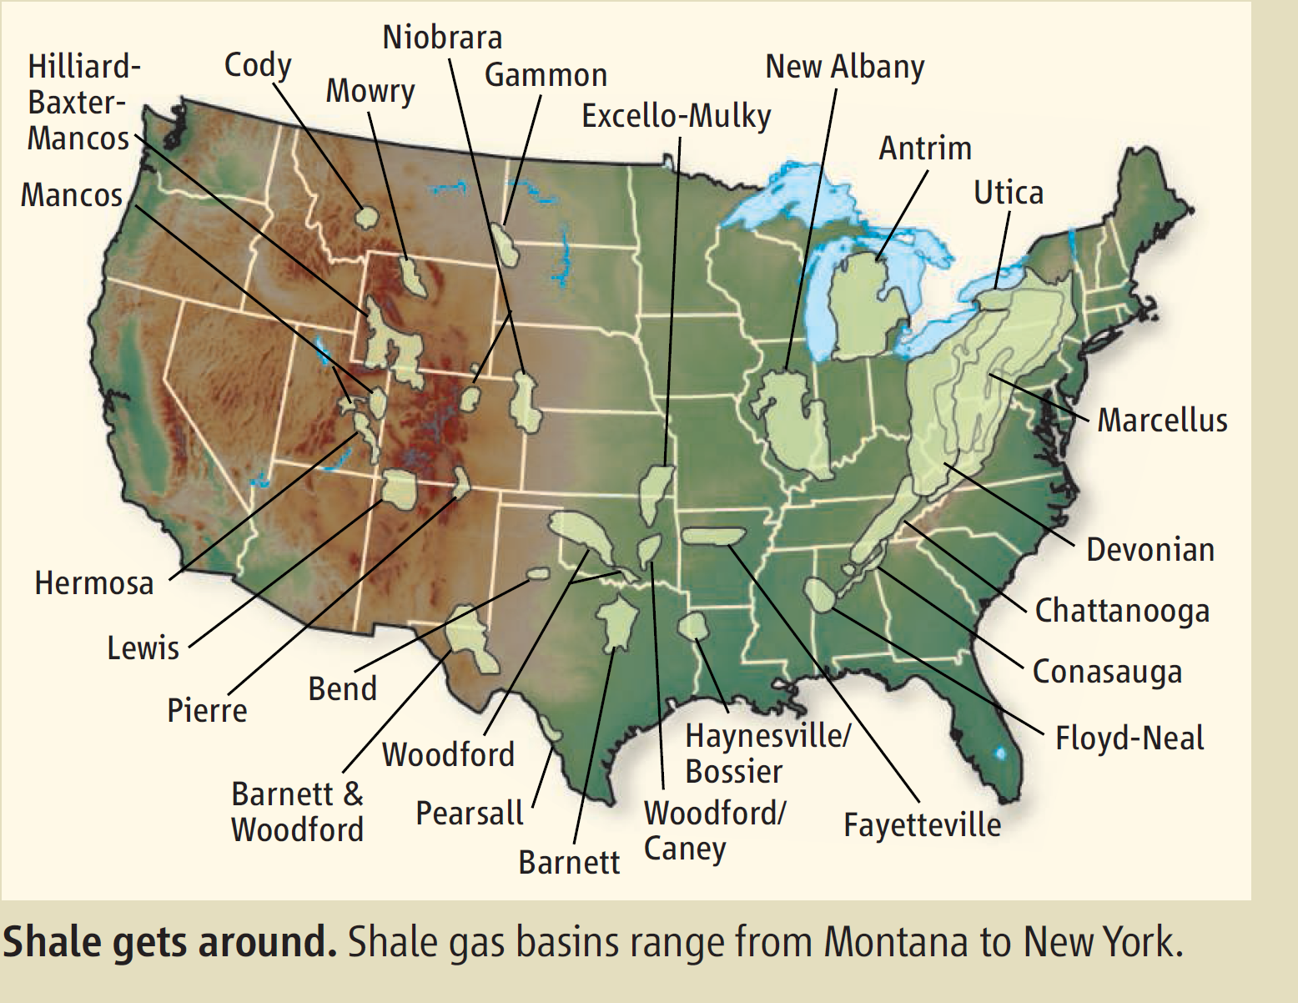
Unconventional Gas: Shale Gas
Energy Facts 2012
40

Slide 41
Fuels: Nuclear energy
Coal 21%
Nuclear 9%
Petroleum 37%
Renewables 8%
Natural Gas 25%

Slide 42
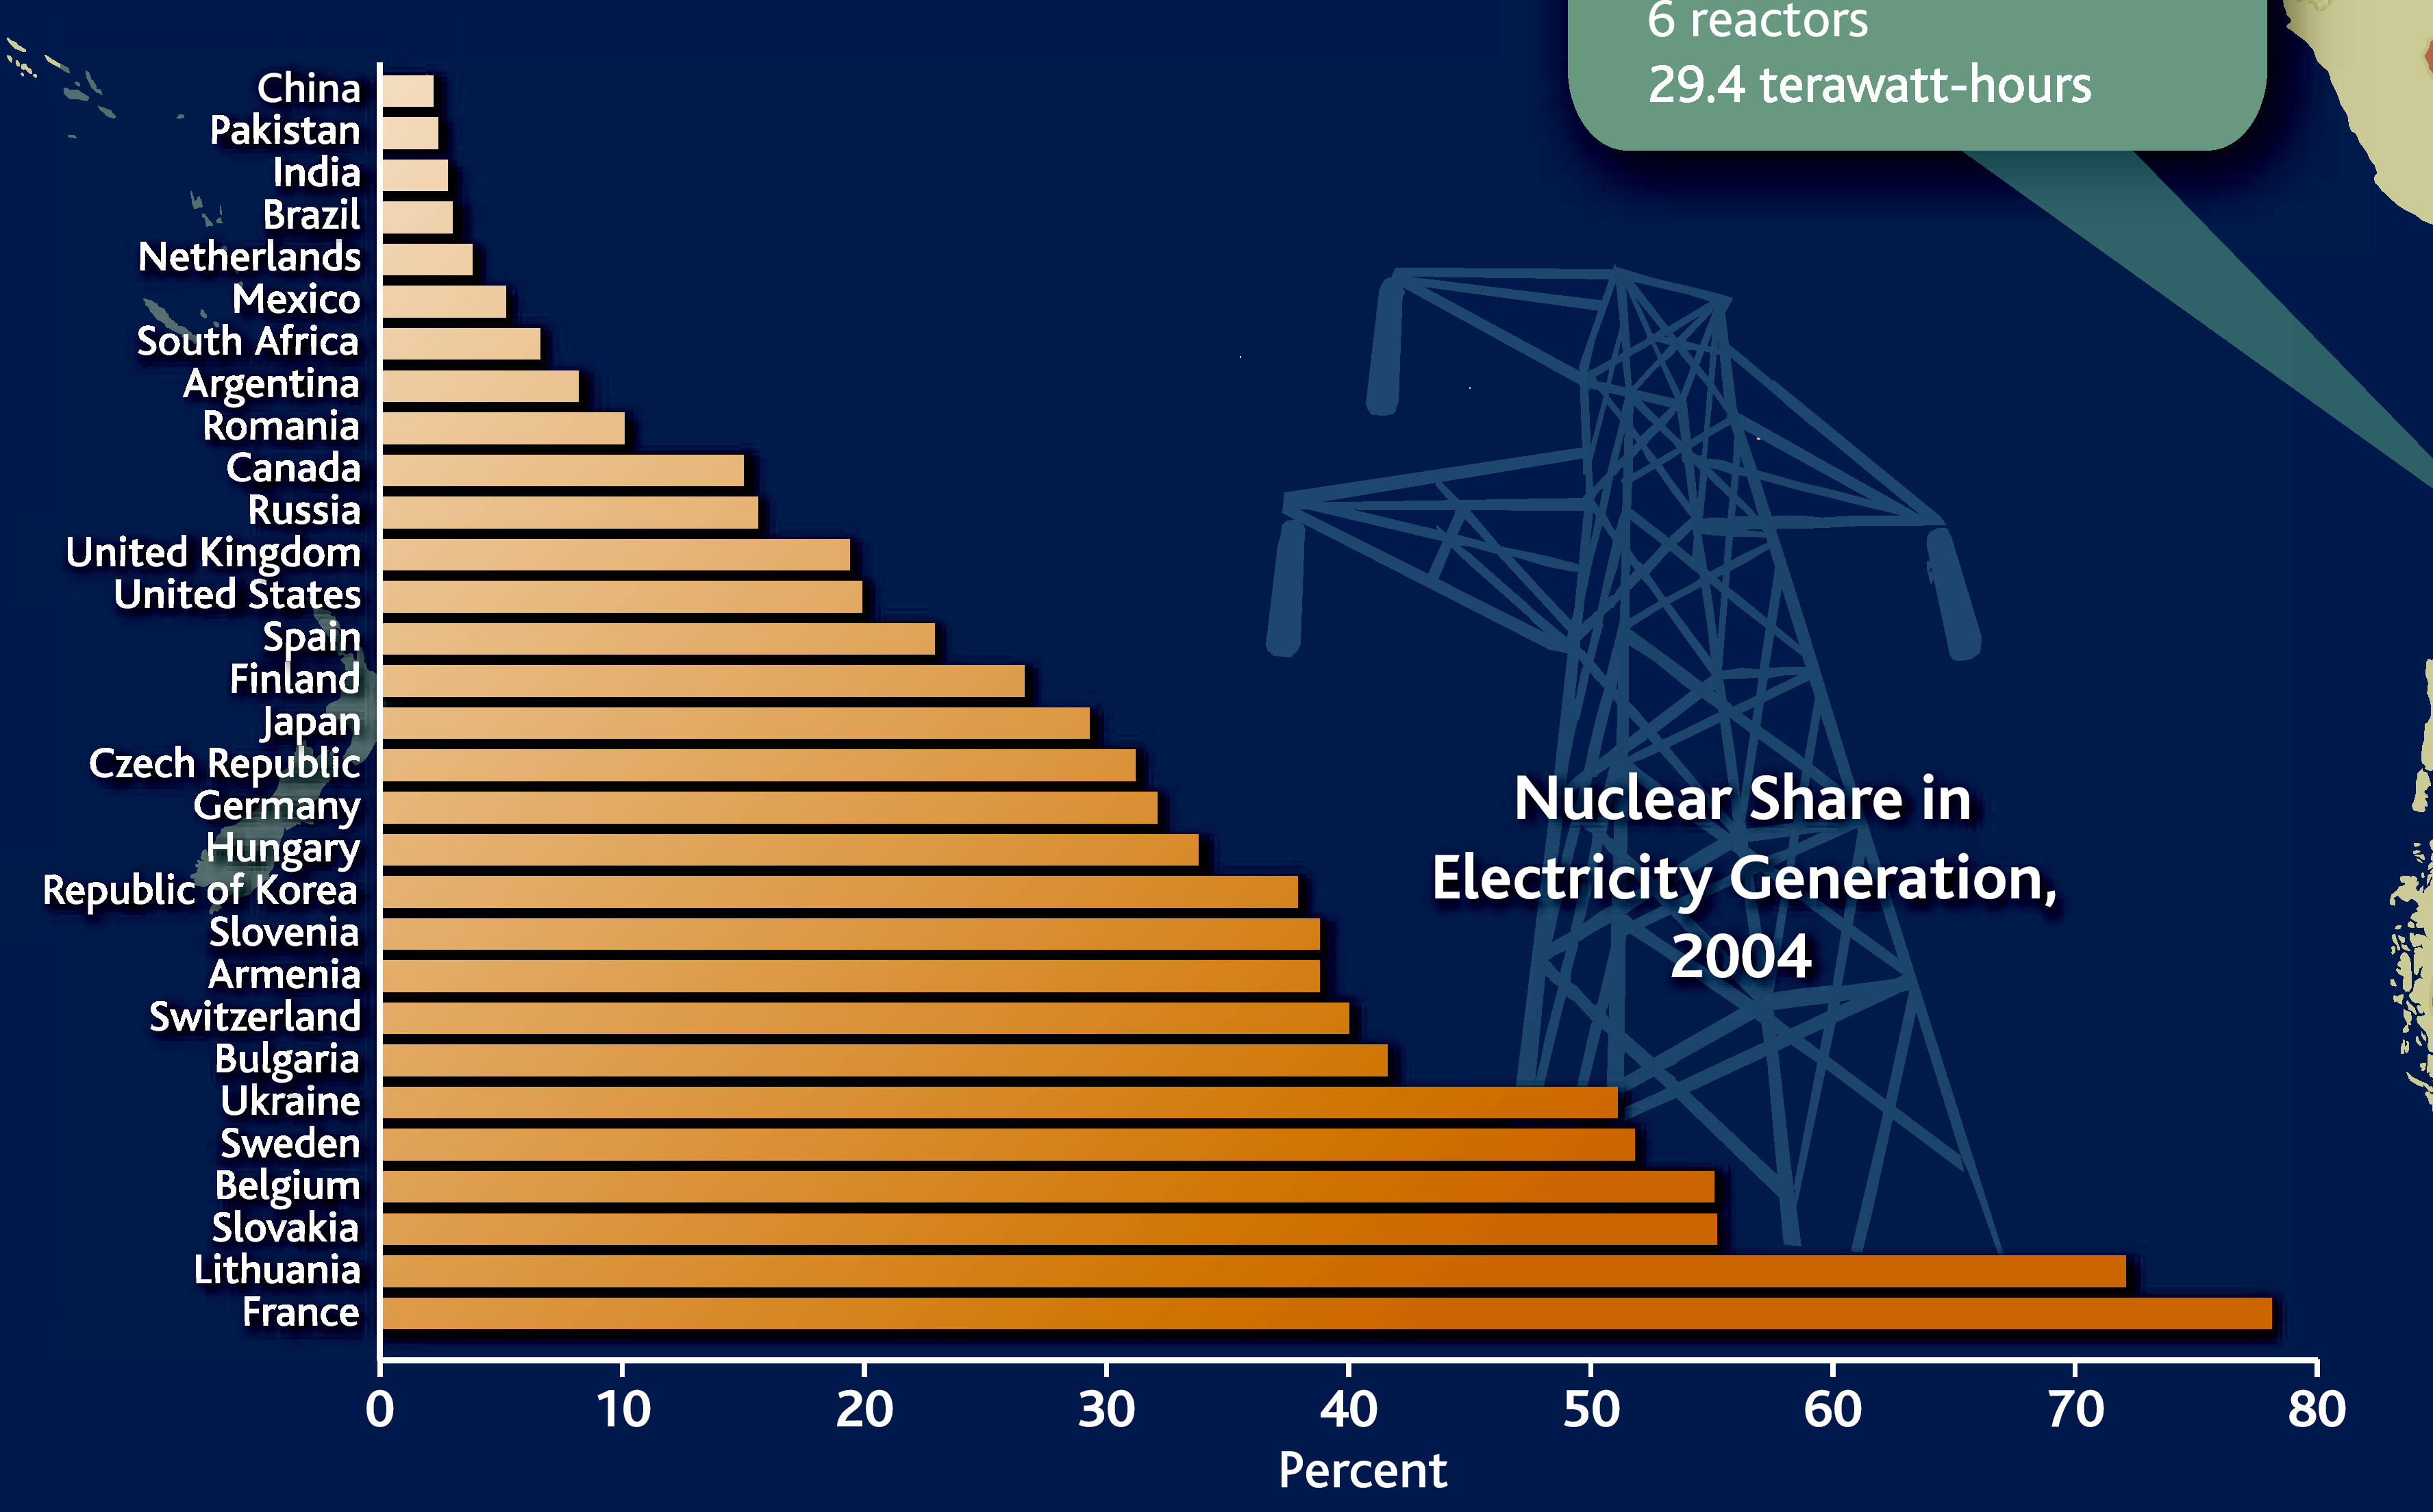



Nuclear Energy Provides 20% of U.S. Electricity
Europe and Japan rely much more heavily on nuclear energy for electricity generation
42

Slide 43
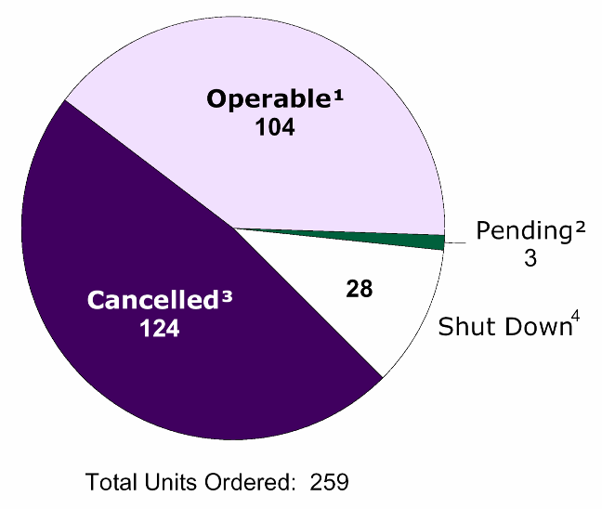

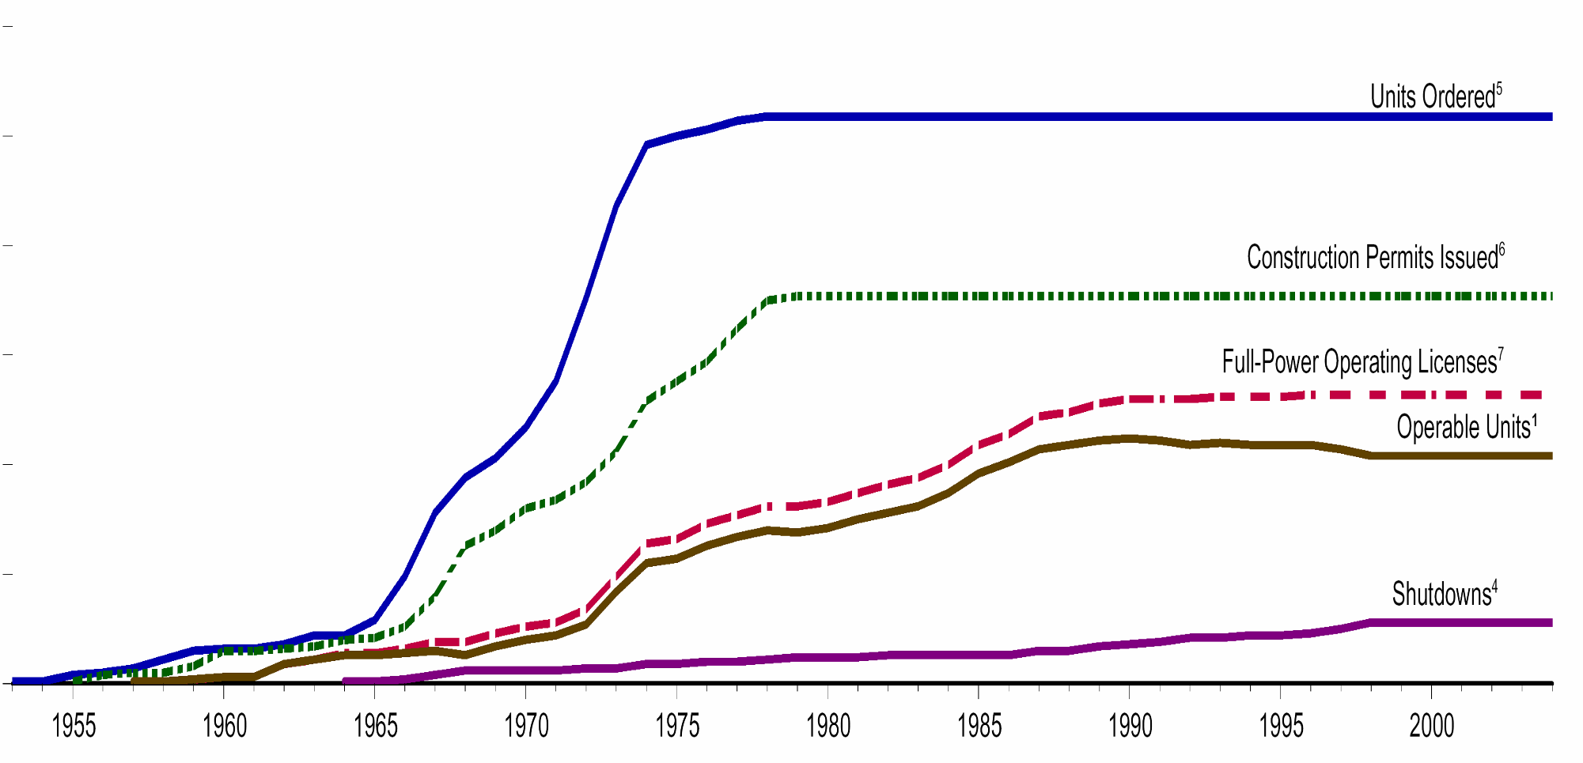

Permits for U.S. Reactors Issued Only Until 1979
8.4 quads of nuclear energy produced by 104 operable nuclear power plants
300
Units Ordered
250
200
Construction Permits Issued
Number of Units
150
Full-power Operating Licenses
100
Operable Units
50
Shutdowns
0
1955
1960
1965
1970
1975
1980
1985
1990
1995
2000
Year

Slide 44
Fuels: Renewables
Coal 21%
Nuclear 9%
Petroleum 37%
Renewables 8%
Natural Gas 25%

Slide 45
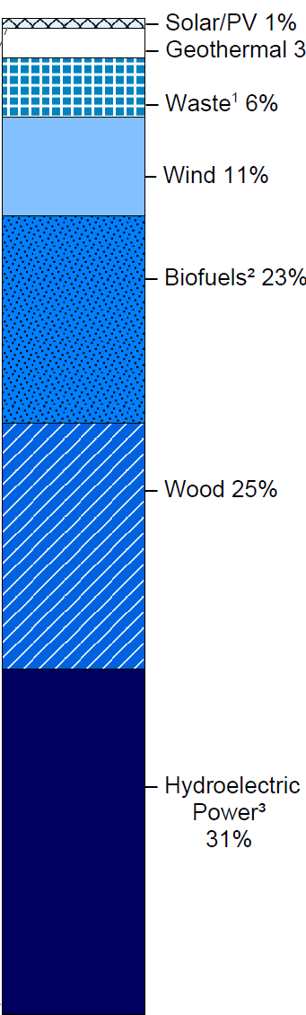
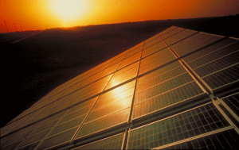
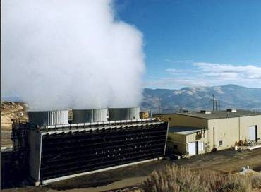
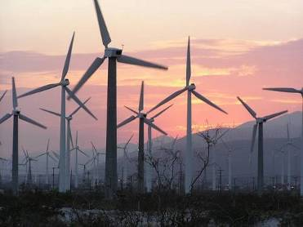
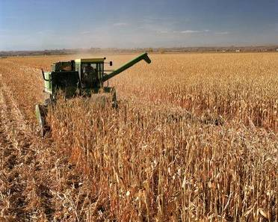
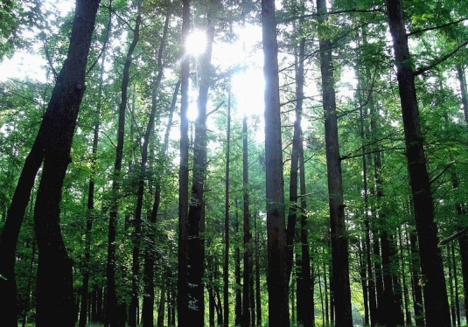

Nuclear and Renewable are ~17% of Energy Supply
Hydroelectric and wood still dominate the renewable energies
Coal
21%
Nuclear 9%
Petroleum 37%
Renewables 8%
Natural Gas 25%
Energy Facts 2012
45

Slide 46

Renewable Energy Consumption and Major Sources
Total renewable energy tracked hydroelectric power for the last half century

Slide 47

Generation and Use of Wind and Solar Energy
The separation between renewable sources and demand centers requires new long distance transmission lines.
Wind
Demand
Demand
Sun
Wind
http://visibleearth.nasa.gov/view_rec.php?id=1438l
Chart adapted from the American Physical Society report, Integrating Renewable Energy on the Grid

Slide 48

Renewables – Fastest Growing Energy Source
(But from a Small Base)

Slide 49





Energy and the environment

Slide 50

Planets, Atmospheres, and Climate
A planet's climate is determined by its mass, its distance from the sun, and the composition of its atmosphere. Earth's atmosphere is 78% nitrogen, 21% oxygen, and 1% other gases. Carbon dioxide accounts for 0.03 - 0.04%. Water vapor, carbon dioxide, and other minor gases absorb thermal radiation leaving the surface. These greenhouse gases act as a partial blanket for the thermal radiation from the surface and enable it to be substantially warmer than it would otherwise be. Without the greenhouse gases, Earth's average temperature would be roughly -20°C = -4 °F.
= -58ºF
= 59ºF
= 788 ºF
Sun
Notes:
A planet's climate is decided by its mass, its distance from the sun and the composition of its atmosphere. Mars is too small to keep a thick atmosphere. Its atmosphere consists mainly of carbon dioxide, but the atmosphere is very thin. The atmosphere of the Earth is a hundred times thicker. Most of Mars' carbon dioxide is frozen in the ground. Mars' average surface temperature is about -50°C. Venus has almost the same mass as Earth but a thicker atmosphere, composed of 96% carbon dioxide. The surface temperature on Venus is +460°C. Earth's atmosphere is 78% nitrogen, 21% oxygen, and 1% other gases. Carbon dioxide accounts for just 0.03 - 0.04%. Water vapour, varying in amount from 0 to 2%, carbon dioxide and some other minor gases present in the atmosphere absorb some of the thermal radiation leaving the surface and emit radiation from much higher and colder levels out to space. These radiatively active gases are known as greenhouse gases because they act as a partial blanket for the thermal radiation from the surface and enable it to be substantially warmer than it would otherwise be, analogous to the effect of a greenhouse. This blanketing is known as the natural greenhous effect. Without the greenhouse gases, Earth's average temperature would be roughly -20°C. The climates on Mars and Venus are very different, but very stable and highly predictable. The Earth's climate is unstable and rather unpredictable as compared with that of the other two planets.
Planets and atmospheres. (2000). In UNEP/GRID-Arendal Maps and Graphics Library. Retrieved from http://maps.grida.no/go/graphic/planets_and_atmospheres.

Slide 51

Modern CO₂ Concentrations are Increasing
The current concentration is the highest in 800,000 years, as determined by ice core data
Concentration now ~395 ppm. Under a “business-as-usual” scenario, concentration could rise to 1,000 ppm
Concentration prior to 1800 was ~280 ppm

Slide 52

Carbon Cycle
Atmosphere = 800 GtC
52

Slide 53


Solar Energy Cycle
And the Greenhouse Effect
Notes:
THE FLOW OF ENERGY THROUGH THE CLIMATE SYSTEM
A suite of papers has provided updated estimates of trends, variability, mean and annual cycle of energy flowing through the climate system, and energy storage, release, and transport in the atmosphere, ocean, and land surface. The estimates are obtained from recent observations using the latest datasets ([1]-[5]). The results indicate that the global energy budget can now be estimated reasonably well, with the largest continuing sources of uncertainty being the ocean heat budget south of about 35°S. The current imbalance in radiation at the top-of-atmosphere owing to human-induced increases in greenhouse gases means that the atmosphere, land and ocean are warming up, and ice is melting, leading to a rise in sea level. A holistic integrated approach that brings all information to bear provides constraints on what is happening and where the main weaknesses are in the current observing system. These analyses also provide insights into both top-of-atmosphere and surface balances and model problems. For instance, the results indicate that climate models typically have too much downward longwave radiation, which is compensated by too much evaporation and precipitation.
Figure: From Trenberth et al (2008) shows the estimated global mean energy flows for the 2000 to 2004 time frame.
Fasullo, J. T., and K. E. Trenberth, 2008: The annual cycle of the energy budget. Part I: Global mean and land-ocean exchanges. J. Climate, 21, 2297-2312.
Fasullo, J. T., and K. E. Trenberth, 2008: The annual cycle of the energy budget. Part II: Meridional structures and poleward transports. J. Climate, 21, 2313-2325.
Trenberth, K. E., and L. Smith, 2008: The three dimensional structure of the atmospheric energy budget: methodology and evaluation. Climate Dynamics, in press. doi:10.1007/s00382-008-0389-3.
Trenberth, K. E., and L. Smith, 2008: Atmospheric energy budgets in the Japanese Reanalysis: Evaluation and variability. J. Meteor. Soc. Japan, in press.
Trenberth, K. E., J. T. Fasullo, and J. Kiehl, 2008: Earth's global energy budget. Bull. Amer. Meteor. Soc., in press.
Several recent presentations by Trenberth may be found at http://www.cgd.ucar.edu/cas/Trenberth/trenberth_presentations.html

Slide 54

Radiation Transmitted by the Atmosphere
Atmospheric Window

Slide 55




Proxies for Climate Change
Preserved physical characteristics of the past that enable reconstruction of past climatic conditions. The deposition or growth rates of the proxies' material is influenced by the climatic conditions of the time in which they were laid down or grew. Examples of proxies include ice cores, tree rings, boreholes, corals, land & sea ice, and lake and ocean sediments.

Slide 56

Bubbles – 800,000 Years of CO₂ Concentrations
Nature, 15 May 2008, Cover Image: The air bubbles trapped in the Antarctic Vostok and EPICA Dome C ice cores provide composite records of levels of atmospheric carbon dioxide and methane covering the past 650,000 years. Now the record of atmospheric carbon dioxide and methane concentrations has been extended by two more complete glacial cycles to 800,000 years ago. The new data are from the lowest 200 metres of the Dome C core. This ice core went down to just a few metres above bedrock at a depth of 3,270 metres.
The cover shows a strip of ice core from another ice core in Antarctica (Berkner Island) from a depth of 120 metres. Photo credit: Chris Gilbert, British Antarctic Survey.

Slide 57
Bubbles – 800,000 Years of CO₂ Concentrations
Nature, 15 May 2008 The air bubbles trapped in the Antarctic Vostok and EPICA Dome C ice cores provide composite records of levels of atmospheric carbon dioxide and methane for the past 800,000 years.
The fundamental conclusion is that today's concentrations of these greenhouse gases have no past analogue in the ice-core record. Concentrations do not rise above pre-industrial revolution values.
The general long-term behavior of methane and carbon dioxide, following patterns driven by slow changes in Earth's orbit, continues throughout the older sections of the records.

Slide 58
CO₂ Concentrations and Temperature
The correlation extends throughout the 800,000-year time span of the ice core data
a The 800,000-year records of atmospheric carbon dioxide (red; parts per million, p.p.m.) and methane (green; parts per billion, p.p.b.) from the EPICA Dome C ice core together with a temperature reconstruction (relative to the average of the past millennium) based on the deuterium–hydrogen ratio of the ice, reinforce the tight coupling between greenhouse-gas concentrations and climate observed in previous, shorter records. Concentrations of greenhouse gases in the modern atmosphere are highly anomalous with respect to natural greenhouse-gas variations (present-day concentrations are around 380 p.p.m. for carbon dioxide and 1,800 p.p.b. for methane).
b The carbon dioxide and methane trends from the past 2,000 years.
E.J. Brook, Nature 453, 291 (2008).

Slide 59

Greenland Ice Mass Loss – 2002 to 2009
Increasing rates of ice mass loss from the Greenland and Antarctic ice sheets revealed by GRACE (Gravity Recovery and Climate Experiment) satellite
In Greenland, the mass loss increased from 137 Gt/yr in 2002–2003 to 286 Gt/yr in 2007–2009
In Antarctica, the mass loss increased from 104 Gt/yr in 2002–2006 to 246 Gt/yr in 2006–2009
Time series of ice mass changes for the Greenland ice sheet estimated from GRACE monthly mass solutions for the period from April 2002 to February 2009. Unfiltered data are blue crosses. Data filtered for the seasonal dependence using a 13-month window are shown as red crosses. The best-fitting quadratic trend is shown (green line). The GRACE data have been corrected for leakage and GIA.
I. Velicogna, GEOPHYSICAL RESEARCH LETTERS, VOL. 36, L19503, doi:10.1029/2009GL040222, 2009

Slide 60

Gravity Recovery and Climate Experiment (GRACE)
GRACE uses a microwave ranging system to measure changes in the speed and distance between two identical spacecraft flying about 220 kilometers apart, 500 kilometers above Earth. Separation changes as small as 10 microns—about one-tenth the width of a human hair—can be detected.
GRACE satellites can sense minute variations in Earth's gravitational pull. When the first satellite passes over a region of slightly stronger gravity, it is pulled ahead of the trailing satellite, causing the distance between the satellites to increase.
By measuring the changing distance between the two satellites and combining that data with positioning measurements from GPS instruments, a gravity map can be constructed.

Slide 61
How GRACE Works
GRACE uses a microwave ranging system to measure changes in the speed and distance between two identical spacecraft flying in a polar orbit about 220 kilometers apart, 500 kilometers above Earth. The ranging system can detect separation changes as small as 10 microns over a distance of 220 kilometers.
As the GRACE satellites circle the globe 16 times a day, they sense minute variations in Earth's gravitational pull. When the first satellite passes over a region of slightly stronger gravity, a gravity anomaly, it is pulled slightly ahead of the trailing satellite. This causes the distance between the satellites to increase. The first spacecraft then passes the anomaly, and slows down again; meanwhile the following spacecraft accelerates, then decelerates over the same point.
By measuring the constantly changing distance between the two satellites and combining that data with precise positioning measurements from Global Positioning System (GPS) instruments, scientists can construct a detailed map of Earth's gravity.
The two satellites (nicknamed "Tom" and "Jerry") constantly maintain a two-way microwave-ranging link between them. Fine distance measurements are made by comparing frequency shifts of the link. As a cross-check, the vehicles measure their own movements using accelerometers. All of this information is then downloaded to ground stations. To establish baseline positions and fulfill housekeeping functions, the satellites also use star cameras, magnetometers, and GPS receivers. The GRACE vehicles also have optical corner reflectors to enable laser ranging from ground stations, bridging the range between spacecraft positions and Doppler ranges.
Notes:
Sec. Chu has pic of two satellites; missing estimate of sea level rise; consider 14C/12C story

Slide 62

Radiative Forcing of Climate, 1750-2005
Summary of the components of the radiative forcing of climate change in 2005 relative to the start of the industrial era (about 1750). Human activities cause significant changes in long-lived gases, ozone, water vapor, surface albedo, aerosols and contrails. The only increase in natural forcing is in solar irradiance. Positive forcings lead to warming of climate and negative forcings lead to a cooling.
IPCC Fourth Assessment Report (AR4), Climate Change 2007: The Physical Science Basis

Slide 63



Natural Variations in the Earth’s Orbit Affect Climate
and Greenhouse Gas Concentrations
W. F. Ruddiman, Scientific American, March 2005, p. 46
There are three orbital perturbations with five periods: eccentricity (at 400 and 100 ky); obliquity (41 ky); and precession (23 and 19 ky). (A) Eccentricity refers to the shape of Earth’s orbit around the sun, varying from near circular to elliptical. (B) Obliquity refers to the tilt of Earth’s axis relative to the plane of the ecliptic, varying between 22.1º and 24.5º. A high angle of tilt increases the seasonal contrast, most effectively at high latitudes. (C) Precession refers to the wobble of the axis of rotation describing a circle in space with a period of 26 ky. Modulated by orbital eccentricity, precession determines where on the orbit around the sun seasons occur, thereby increasing the seasonal contrast in one hemisphere and decreasing it in the other. The periods of the precessional signal modulated by eccentricity are 23 and 19 ky.
James Zachos, Mark Pagani, Lisa Sloan, Ellen Thomas, and Katharina Billups, Science 292, 4 (2001).

Slide 64
Modeling and Computation

Slide 65


Types of Climate Models
Global models: Based on general circulation models (GCMS) driven by physical forcing in the atmosphere and oceans Earth system models: Couple individual process models (e.g., atmosphere, land, ocean, sea ice, carbon, and sulfur cycles) | Integrated assessment models: Understand and model the complex interactions of human and natural systems Regional models: Models at scales that are useful for regional and local planners
10km
IPCC AR5
2010

Slide 66






Climate Models Over the Decades
Mid 1970s
Mid 1980s
1988
1994
2001
2010

Slide 67

Evolution of Climate Models
✔
✔
Global Climate Models
✔
✔
✔
✔
Earth System Models
✔
✔
DOE contributions

Slide 68

Sources of Uncertainty in Climate Modeling
Limits to theory and understanding
Limits to the ability
to mathematically describe the earth system
Computational system errors and limitations

Slide 69


CO₂ Concentration, Temperature, and Sea Level
Rise Long after Emissions are Reduced
Sea-level rise due to ice melting
Assume anthropogenic CO₂ emissions peak in 0-100 years, then drop off to near zero
Sea-level rise due to thermal expansion
Temp stabilization
CO₂ stabilization
CO₂ emissions
Now
100 yrs
1,000 yrs

Slide 70

Past and Future CO₂ Concentrations
CO₂ concentrations are predicted to increase by a factor of two to three
X 388
X 388
Preindustrial concentration = 280 ppm
70

Slide 71


Recent Predictions of Climate Models

Slide 72

IPCC Socioeconomic Scenarios for Climate Modeling
72

Slide 73
Global Climate Models
First type of climate model, pioneered by DOE supported scientists in the 1980s
Based on general circulation models (GCMs) that describe physics of atmospheric and ocean circulation
More recently, land surface and sea ice have been included in GCMs
Spatial resolution is currently 10–100 km

Slide 74
Earth System Models
Highly coupled models that incorporate information from GCMs as well as
  Biogeochemical cycles (carbon and sulfur)
  Atmospheric chemistry (a variety of active species)
  Land models include dynamic vegetation
  Spatial resolution is currently similar to GCMs

Slide 75
Regional Climate Models
Typically at scale 1–50 km
May be derived in 2 different ways:
  “Bottom up” approach incorporating regional and local scale data—adapted from regional forecast models
  “Top down” approach, downscaling from Global or Earth System model
In demand by regional and local planners

Slide 76
Integrated Assessment Models
Assessing human interactions with nature and the role of human decision-making
Scenarios involve changes in energy sources, energy policy, and economics
Current conditions
  Continental or country scales
  Strongly assumption driven
Beginning to address emerging interest in impacts, adaptation, and vulnerabilities

Slide 77


Scenarios from the U.S. Climate Change Science Program Report
“Scenarios of Greenhouse Gas Emissions and Atmospheric Concentrations”
Integrated Assessment Models – include both physical and social science models that consider demographic, political, and economic variables that affect greenhouse gas emission scenarios in addition to the physical climate system (atmosphere, oceans, and terrestrial biosphere).
The Integrated Global Systems Model (IGSM) [MIT]
Model for Evaluating the Regional and Global Effects (MERGE) of GHG Reduction Policies [Stanford University and EPRI]
The MiniCAM Model of the Joint Global Change Research Institute [PNNL and the University of Maryland]

Slide 78

U.S Primary Energy Consumption by Fuels Across Scenarios
IGSM
MERGE
MiniCAM
Reference Scenarios
450 ppmv CO₂
Energy Facts 2012
78

Slide 79
Continuous improvement –
the role of current technologies

Slide 80

One Strategy: Use Current Technologies
Stabilization Wedges: Pacala and Socolow Challenge for CO₂ Stabilization for Kids and Lawmakers

Slide 81
Stabilization Wedges:
Two Emission Scenarios Define the Stabilization Triangle
Emissions-doubling path
7 wedges are needed to build the stabilization triangle. Each avoids 1 billion tons of carbon emissions per year by 2055

Slide 82

The Wedge Stabilization Game Pieces

Slide 83

Energy Facts
and the components of energy strategies

Slide 84

A National Strategy for a New Energy Economy
Climate Science
Notes:
“Zero Carbon Energy”

Slide 85










A National Research Strategy for a New Energy Economy
Nanostructured thin-film organic photovoltaic devices
High-Tc and high current superconductors for grid and other electrical applications
Nanoscale science of materials, interfaces, charge transport & cycling, mechanical stability
Artificial
Photosynthesis
Capture or separation of CO₂ from gas mixtures
Lightweight structural materials
for transportation
Sequestration of CO₂ underland
Radiation-resistant Materials
Climate Science
Structure of lignocellulose at the nanoscale and the rules by which plants create this material
Conversion of electricity to light using new designs, such as luminescent nanowires, quantum dots, and hybrid architectures;
Notes:
“Zero Carbon Energy”

Slide 86

END

