Slide 1
Experiments in Federal R&D Support DOE’s Bioenergy Research Centers, Energy Frontier Research Centers, and Energy Innovation Hubs
38th Annual AAAS Forum on Science and Technology Policy
May 2, 2013
Dr. Patricia M. Dehmer Deputy Director for Science Programs
Office of Science, U.S. Department of Energy
http://www.science.energy.gov/sc-2/presentations-and-testimony/

Slide 2




DOE and its predecessors
1942-1946 Manhattan Project, War Department Army Corps of Engineers
Wartime weapons development
Foundations of first DOE multi-purpose national labs
1946-1974 Atomic Energy Commission created by the 1946 Atomic Energy Act (P.L. 79-585)
Research in basic nuclear processes, nuclear reactor technologies, use of nuclear materials for variety of purposes
Establishment of 9 of the 10 DOE/SC national labs
1974-1977 Energy Research and Development Administration, a new energy R&D agency motivated by Arab oil embargo and created by (P.L. 93-438)
Research expands to include solar, fossil, geothermal, synthetic fuels, transmission, conservation, etc.
1977-present Department of Energy (P.L. 95-91)
Separation of management oversight of weapons and non-weapons labs and separation of basic and applied research
DOE/SC labs undergo transition to “open” labs with 1000s of visitors/users annually

Slide 3
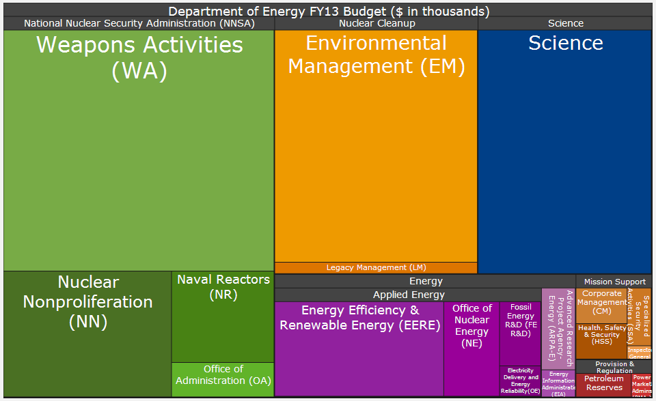
The DOE Portfolio Today Area map of the FY 2013 budget request to Congress ($27.2B)
3 Bioenergy Research Centers (2007)
46 Energy Frontier Research Centers (2009)
Fuels from Sunlight Hub (2010)
Batteries and Energy Storage Hub (2012)
Energy Efficient Buildings Hub (2010)
Critical Materials Hub (2012)
Modeling and Simulation of Nuclear Reactors Hub (2010)
Notes:
Begin with a short intro to DOE

Slide 4
First came the Bioenergy Research Centers (BRCs)

Slide 5


Bioenergy Research Centers—Precursors to the Hubs
The National Academies played an important role in defining the BRCs:
Rising Above the Gathering Storm (2005)
Recommended major increases in federal spending for basic physical sciences and also prompted discussions on new modes for organizing, funding, and managing DOE-supported research.
Review of the Department of Energy’s Genomics: GTL Program (2006)
Did not support the SC Biological and Environmental Research (BER) facilities plan to construct (sequentially) and operate four separate centers for biosciences. Instead recommended the establishment of “vertically integrated” centers, each focused on a specific mission area, beginning with bioenergy.
Steven Chu, then Director of LBNL, was part of the “Gathering Storm” panel; he specifically emphasized the need for more active research management, advocating “Bell Labs” model.

Slide 6
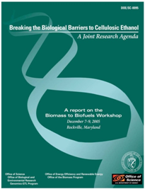
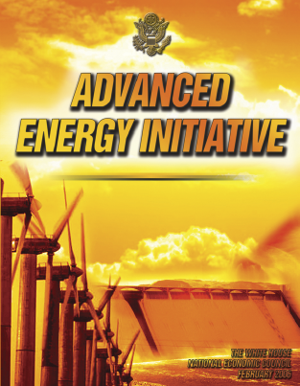
Other Influences Suggesting a New Approach, c. 2006
BER, through workshops, developed a roadmap for bioenergy research:
Science breakthroughs were needed to overcome barriers to cost-effective cellulosic biofuels –incremental improvements in existing technologies were insufficient.
Broader context:
Energy: Near-doubling of gasoline prices between 2000 and 2006 and dependence on foreign petroleum stimulated renewed interest in alternative energy.
Climate: Concern about climate change was growing.
Policy: Administration at the time favored “scientific/ technological” approaches rather than “policy” approaches to curbing carbon emissions.

Slide 7
Initiation of the BRCs
Based on the NRC reports and the BER workshops, SC proposed two BRCs at $25M/year each for an initial 5 years.
Multidisciplinary and multi-institutional; partnering encouraged
Basic research is goal-oriented—new knowledge to support cost-effective production of cellulosic biofuels
Researchers work in an integrated, coordinated team under strong management
Management has flexibility to shift research directions
Why $25M? Large enough to do the job; small enough to resist fragmentation. About the size of a biotech startup.
Three* BRCs competitively selected and launched Sept. 2007.
*Administration increased the number from 2 to 3

Slide 8
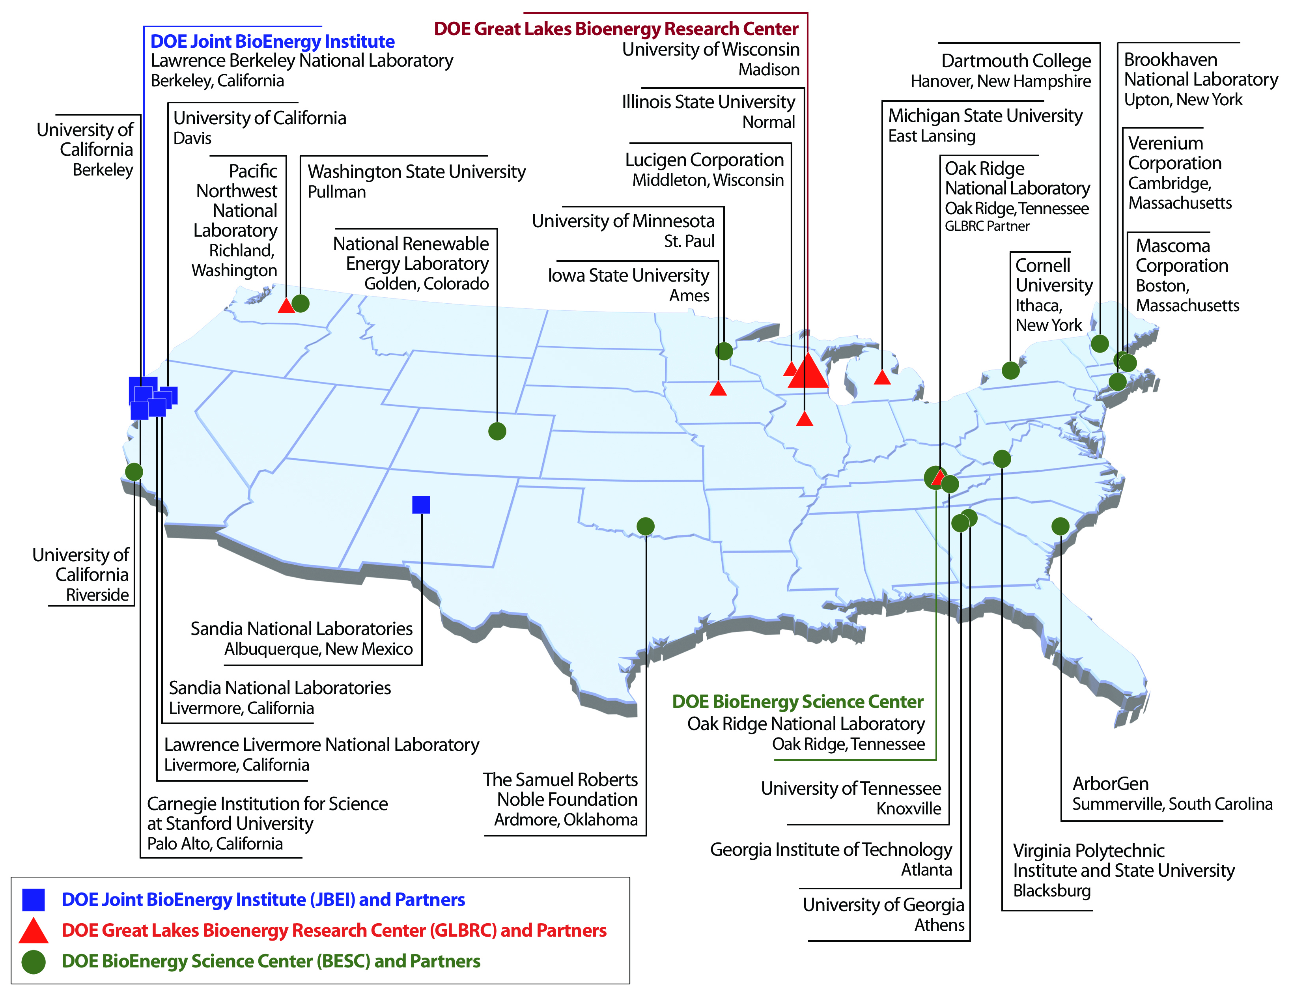
Bioenergy Research Centers Investment Map

Slide 9



Advancing Development of Next-Generation Biofuels
Discovered a new type of lignin in plants extending the understanding of lignin biosynthesis and identifying new targets to alter lignin biosynthetic pathways for improved biomass digestibility.
Developed new techniques to track, image and analyze the molecular-scale sites of cellulase attack on cellulose polymers in corn stover and other natural biomass samples.
Developed new methods to track gene expression in biofuel-producing microbes on exposure to pretreatment chemicals and identify genetic targets to increase chemical tolerance in these organisms.
New biosensor techniques to identify modified microorganisms capable of producing biofuel components at high concentrations.
New NMR technique to analyze the lignin content in biomass samples as an important tool for bioenergy crop development
Analyzed 20 years of data from 10 Midwest states to conclude that properly managed marginal lands could provide sufficient biomass to support a viable yet environmentally beneficial cellulosic biofuel production industry.

Slide 10
Then came the Energy Frontier Research Centers (EFRCs)

Slide 11
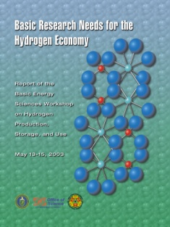



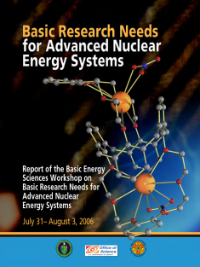
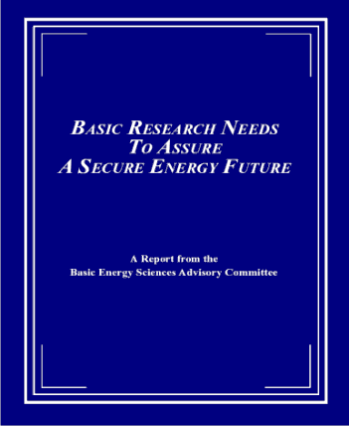
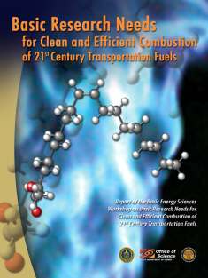

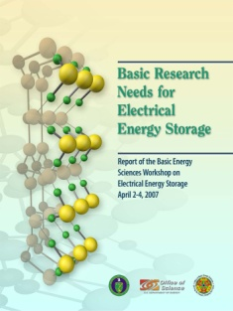

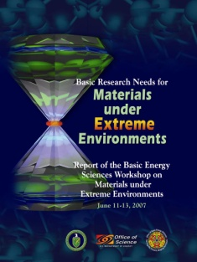
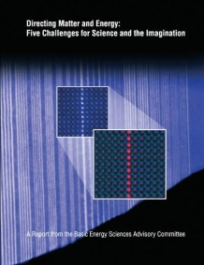
“Basic Research Needs” + “Grand Challenges for Science and the Imagination”
Basic Research Needs to Assure a Secure Energy Future, 2002
Synthesize, atom by atom, new forms of matter with tailored properties
Synthesize man-made nanoscale objects with capabilities rivaling those of living things
Control the quantum behavior of electrons in materials
Control emergent properties that arise from the complex correlations of atomic and electronic constituents
Control matter very far away from equilibrium
Directing Matter and Energy: Five Challenges for Science and the Imagination, 2007
10 workshops; 5 years; more than 1,500 participants from academia, industry, and DOE labs
Notes:
CHARACTERISTICS OF A BASIC RESEARCH NEEDS WORKSHOP
Each workshop has three goals: (1) to summarize, prior to the workshop, the current state of technology and the associated R&D challenges in a Technology Perspectives Factual Document, which is used as a resource document for the basic research community at the workshop and well into the future; (2) to define a set of Proposed Research Directions that address the technology R&D challenges, the so-called technology show stoppers; and (3) to define a set of Science Grand Challenges that, if solved, might result in transformational changes in energy technologies.
The Basic Research Needs workshops must accomplish a great deal in a short time and their output must be authoritative, influential, and enduring. To accomplish the goals, the workshop planning, execution, and output stages are defined and structured. Ideally, each workshop report should serve as a reference document with a long shelf life. Additionally, the reports should be readily accessible. All reports are available on the BES website (http://www.sc.doe.gov/bes), usually within 60-75 days of the workshop.
The workshops are structured so that the participants learn about the status and challenges of a particular energy technology, generate proposed basic research directions to address short-term technology showstoppers, and articulate basic research grand challenges that might lead to transformational changes in energy technologies for the 21st century and beyond. The workshop reports that result from this process can help define the basic research agenda for a “decades-to-century” national energy agenda.
Workshop planning begins many months in advance and is performed by the workshop executive group, which is led by strong scientist chairs and co-chairs from academia and/or national laboratories. The executive group is made up of the workshop chair, co-chair(s), and panel leads. Participants come primarily from the scientific community and include the workshop chair(s), plenary speakers, panel leads, panelists, and writers. Each role is assigned tasks to complete before, during, and after the workshop. Technology experts serve as plenary speakers to provide applied perspectives to the scientific community.
A hallmark of the Basic Research Needs workshops is the production of the Technology Perspectives Factual Document. This feature describes the current status of technology development and is prepared prior to the workshop. It provides a common context and language for workshop discussions, it is used to educate workshop participants, and it becomes part of the workshop report. The Technology Perspectives Factual Document is written by technology experts from inside and outside DOE. If existing material is available (for example, technology roadmaps), it is included either explicitly or by reference. The Technology Perspectives Factual Document is not meant to provide the perspectives of the science community. Instead, science perspectives are garnered as an outcome of the workshop.
The outputs of the workshop are organized as (1) Panel Surveys describing the current state of science for each panel theme, (2) Priority Research Directions and Cross-Cutting Research Directions listed by each panel, (3) Science Grand Challenges outlined by all participants, and (4) Science and Technology Relationships Charts completed by the participants.
The result is a prioritization of the discovery-class and use-inspired basic research pertinent to energy technologies, obtained through a documented process. Often after the workshop, the chair and co-chair(s) and BES federal staff members participate in outreach activities to communicate the results of the workshop to the scientific community. Additionally, BES federal staff members brief other interested parties in the federal system, both inside and outside of DOE.

Slide 12
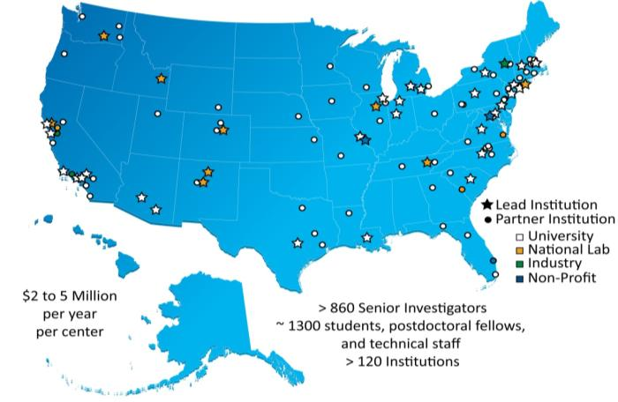
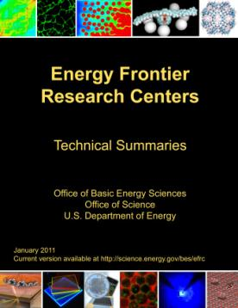
Energy Frontier Research Centers Blending use-inspired research and grand challenge research
46 EFRCs in 35 States + DC launched in fall 2009
$155M/yr ($100M/yr from BES; $55M/yr from Recovery Act)
$2M-$5M/year each
~850 senior investigators and ~2,000 students, postdoctoral fellows, and technical staff at ~115 institutions
>250 scientific advisory board members from 13 countries and >40 companies
Impact to date (~3.5 years of funding)
>3,400 peer-reviewed papers including >110 publications in Science and Nature
18 PECASE and 11 DOE Early Career Awards
>200 patents applications and plus >60 additional patent/invention disclosures and at least 30 licenses
at least 60 companies have benefited from EFRC research
http://science.energy.gov/bes/efrc/
12
Notes:
Harriet’s slide from July 2012 BESAC presentation

Slide 13























































Companies that Benefit from EFRC Research
Notes:
Note: not all of the 60 companies have logos ☺

Slide 14
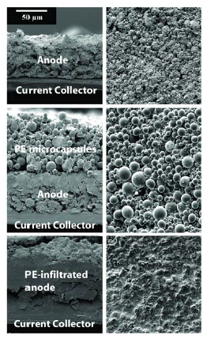
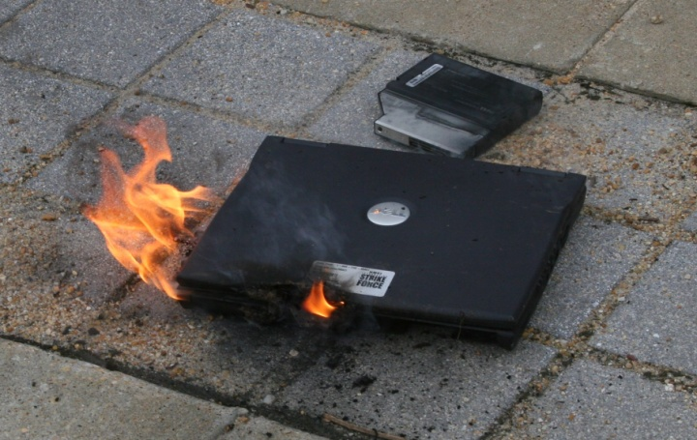




Autonomic Shutdown of Overheated Li-ion Batteries
Scientific Achievement
Thermally-triggered shutdown of lithium-ion batteries was achieved using thermo-responsive microcapsules.
Significance and Impact
Engineered microcapsules do not harm performance and do prevent fires through shutdown of overheated lithium ion batteries.
Research Details
~4 μm thermo-responsive polyethylene microspheres were deposited on battery components with no impact on normal operation.
Batteries were cycled at 110°C to activate micro- spheres, which safely terminated battery operation.
Cross section (left) and top-down (right) views of:
Top: a graphite (MCMB) anode.
Middle: an MCMB anode coated with thermoresponsive PE microspheres.
Bottom: a coated MCMB anode that has undergone autonomic shutdown (110°C).
Real example of a laptop with a lithium ion battery experiencing a thermal runaway. The owner dropped it on the ground as it started to flame. Moments later there was a small explosion that ejected the CD drive.
.
M. Baginska, B.J. Blaiszik, R.J. Merriman, N.R. Sottos, J.S. Moore, and S.R. White, Advanced Energy Materials 2(5), 583–590 (2012). Work was performed at the University of Illinois, Urbana-Champaign
Notes:
MCMB = mesocarbon microbeads
Lithium-ion (Li-ion) batteries are widely used for powering mobile electronic devices, ranging from consumer electronics to electric vehicles. Improvements in safety are necessary, especially with the increased energy densities in advanced battery systems. Currently, multi-layer separators between the anode and cathode are used to terminate cell operation if the internal battery temperature exceeds a design threshold corresponding to the softening temperature of the separator. When the separator softens, its pores close up, and lithium ion transport is shutdown. However, due to the related shrinkage of the separator as it is heated, the separator can also fail if the cell temperature continues to increase post-shutdown as a result of thermal inertia, exposing the electrodes to internal shorting and increasing the possibility of fire and/or rupture of the battery.
To enhance the safety of Li-ion batteries, researchers at the Center for Electrical Energy Storage, a U.S. Department of Energy Frontier Research Center, have developed a novel technique to terminate cell operation during an overheating event, while minimizing the risk for electrode shorting. Autonomic, thermally induced shutdown of Li-ion batteries is demonstrated by incorporating thermoresponsive polyethylene (PE) microspheres (ca. 4 µm) onto battery anodes. When the internal battery environment reaches a critical temperature, the microspheres melt and coat the anode with a non-conductive barrier, halting Li-ion transport and shutting down the cell permanently (see figure at bottom of graphic in slide). Scanning electron microscopy (SEM) images of electrode surfaces from cells that have undergone autonomic shutdown provides evidence of melting, wetting, and resolidification of PE into the anode and polymer film formation at the anode/separator interface. Additionally, the research showed that the microcapsules can be engineered to respond at a temperature lower than the softening of the separator meaning that shutdown of the battery can be triggered reliably with the separator fully intact.
This work was published as a cover article in the journal Advanced Energy Materials.
(Text taken and adapted from ANL website at: web.anl.gov/energy-storage-science/news/thermoresponsive_microcapsules.html)

Slide 15
Finally came the Energy Innovation Hubs (Hubs)

Slide 16

Energy Innovation Hubs
A signature initiative of former Secretary Chu, Energy Innovation Hubs address research challenges that have proved the most resistant to solution by conventional R&D management structures.
Selection of topics:
Problems represent a significant grand challenge; advances are likely to have an impact on energy production or use and on reducing greenhouse gas emissions.
Although individual investigators or small groups may have studied the problems for decades, solutions have not been forthcoming. A large-scale coordinated, multidisciplinary, systems-level approach is needed to accelerate the pace of discovery and innovation and to realize efficiency, manufacturability, deployment, and utilization of new technologies.

Slide 17
Hubs Management Philosophy
a lead institution with strong scientific leadership;
a central location;
if geographically distributed, state-of-the-art telepresence technology to enable long distance collaboration;
a strong organization and management plan to effect goals;
$25M/year each, same as the Bioenergy Research Centers.
Failure mode: over constrained via budget atomization
Failure mode: mini-funding agency
The Hub Funding Opportunity Announcements, available on FedConnect, contain detailed descriptions of the Hub management philosophy and selection criteria.

Slide 18



The Hubs
Fuels from Sunlight Hub
Awarded to the Joint Center for Artificial Photosynthesis
Location: Pasadena and Berkeley, California
Caltech lead, LBNL co-lead
5 core partners: SLAC, UC Berkeley, UC Santa Barbara, UC Irvine, and UC San Diego
Nuclear Modeling and Simulation Hub
Awarded to the Consortium for Advanced Simulation of LWRs
Location: Oak Ridge, Tennessee
ORNL lead
8 core partners: INL, LANL, Sandia, EPRI, Westinghouse, TVA, MIT, NC State, Michigan
Energy Efficient Buildings Hub/Regional Innovation Cluster
Location: Philadelphia, Pennsylvania
Penn State lead, sited at the Philadelphia Navy Yard
21 core partners
$5.2 million in additional funds from EDA, SBA, and NIST
Notes:
http://gpichub.org/about/background/funding:
The GPIC was awarded more than $129 million from a federal multi-agency funding opportunity to support an Energy Regional Innovation Cluster (E-RIC).
The Energy Regional Innovation Cluster (E-RIC) was announced in February 2010 in an effort to spur regional economic growth while developing innovative energy efficient building technologies, designs, and systems.
The GPIC Consortium, consisting of five co-applicants, applied for and received the award from the following agencies:
Department of Energy (DOE)
Award Amount: $122 million for an Energy Innovation Hub.
GPIC Co-Applicant: The Pennsylvania State University
The Commonwealth of Pennsylvania has committed an additional $30 million of new capital funding to support the GPIC/HUB facilities at The Navy Yard in Philadelphia.
Economic Development Administration (EDA)
Award Amount: Up to $3 million in Public Works and Economic Development funds and up to $2 million in Economic Adjustment Assistance funds.
GPIC Co-Applicants: Philadelphia Industrial Development Corporation (PIDC) and Ben Franklin Technology Partners of Southeastern PA
National Institute of Standards and Technology (NIST)
Award Amount: $1 million to provide services dedicated to the GPIC's effort to transfer technology to industry.
GPIC Co-Applicant: Delaware Valley Industrial Resource Center
Small Business Administration (SBA)
Award Amount: $1.2 million to provide services dedicated to the Consortium’s effort to grow the GPIC.
GPIC Co-Applicant: Wharton Small Business Development Center
The GPIC is the culmination of more than a decade of dedicated team building efforts. All told, more than 90 organizations representing government, industry, education, workforce development, finance, labor, and philanthropic foundations have made commitments to help achieve the GPIC goals of national energy independence and regional economic development.

Slide 19


The Hubs - II
Battery and Energy Storage Hub
Awarded to the Joint Center for Energy Storage Research
Location: Argonne, Illinois
ANL lead
13 core partners: Northwestern, University of Chicago, University of Illinois at Chicago, University of Illinois at Urbana-Champaign, University of Michigan, LBNL, PNNL, Sandia, SLAC, Dow Chemical, Applied Materials, Johnson Controls
Critical Materials Hub
Awarded to the Critical Materials Institute
Location: Ames, Iowa
Ames Laboratory lead
17 core partners: INL, LLNL, ORNL, Brown University, Colorado School of Mines, Purdue, Rutgers, University of California-Davis, Iowa State, Florida Industrial and Phosphate Research Institute, General Electric, OLI Systems, Inc., SpinTek Filtration, Inc., Advanced Recovery, Cytec, Inc., Molycorp, Inc. and Simbol Materials.
Notes:
http://gpichub.org/about/background/funding:
The GPIC was awarded more than $129 million from a federal multi-agency funding opportunity to support an Energy Regional Innovation Cluster (E-RIC).
The Energy Regional Innovation Cluster (E-RIC) was announced in February 2010 in an effort to spur regional economic growth while developing innovative energy efficient building technologies, designs, and systems.
The GPIC Consortium, consisting of five co-applicants, applied for and received the award from the following agencies:
Department of Energy (DOE)
Award Amount: $122 million for an Energy Innovation Hub.
GPIC Co-Applicant: The Pennsylvania State University
The Commonwealth of Pennsylvania has committed an additional $30 million of new capital funding to support the GPIC/HUB facilities at The Navy Yard in Philadelphia.
Economic Development Administration (EDA)
Award Amount: Up to $3 million in Public Works and Economic Development funds and up to $2 million in Economic Adjustment Assistance funds.
GPIC Co-Applicants: Philadelphia Industrial Development Corporation (PIDC) and Ben Franklin Technology Partners of Southeastern PA
National Institute of Standards and Technology (NIST)
Award Amount: $1 million to provide services dedicated to the GPIC's effort to transfer technology to industry.
GPIC Co-Applicant: Delaware Valley Industrial Resource Center
Small Business Administration (SBA)
Award Amount: $1.2 million to provide services dedicated to the Consortium’s effort to grow the GPIC.
GPIC Co-Applicant: Wharton Small Business Development Center
The GPIC is the culmination of more than a decade of dedicated team building efforts. All told, more than 90 organizations representing government, industry, education, workforce development, finance, labor, and philanthropic foundations have made commitments to help achieve the GPIC goals of national energy independence and regional economic development.

Slide 20
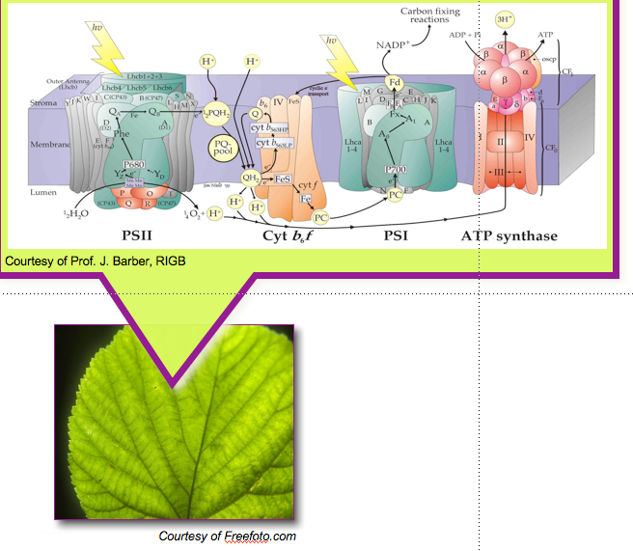
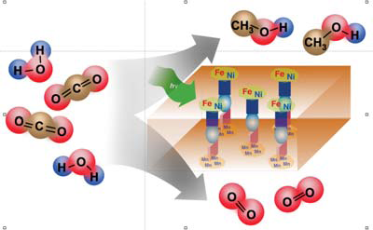
Fuels from Sunlight Hub
JCAP Mission: JCAP's mission is to develop a manufacturable solar-fuels generator, made of earth abundant elements, that will use only sunlight, water, and carbon as inputs and robustly produce fuel from the sun ten times more efficiently that current crops.

Slide 21
The Nuclear Energy Modeling and Simulation Hub is Building a Virtual Reactor
Advanced modeling and simulation capabilities to create a usable environment for predictive simulation of light water reactors.
The Hub will incorporate science-based models, state-of-the-art numerical methods, modern computational science and engineering practices, and validation against data from operating pressurized water reactors (PWRs).
It will couple state-of-the-art fuel performance, neutronics, thermal-hydraulics, and structural models with existing tools for systems and safety analysis and will be designed for implementation on both today’s leadership-class computers and the advanced architecture platforms now under development by DOE.

Slide 22
The Virtual Reactor

Slide 23
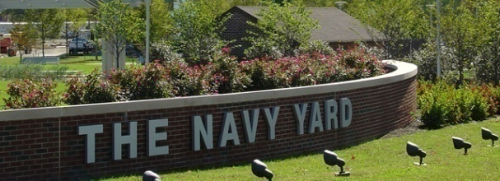
Energy Efficient Building Hub Objectives
Develop and deploy to the building industry a state-of-the-art modeling platform to integrate design, construction, commissioning, and operation
Demonstrate the market viability of integrating energy saving technologies for whole building solutions at the Navy Yard and elsewhere in the region
270 Buildings
Early 19th Century to the present
Most occupied and some awaiting redevelopment,
Mix of industrial, commercial and government uses
Notes:
PC/ET = Photon capture and energy transfer (fs timeframe); CS/et = Charge separation and electron transport (ps to ns timeframe) and Cat (catalysis has trouble keeping up (μιχροsec to ms timeframe)).

Slide 24
Battery and Energy Storage Hub
JCESR challenge: 5-5-5
5x energy density, 1/5 cost, in 5 years
Legacies:
Library of fundamental knowledge
Atomic and molecular understanding of battery phenomena
New paradigm of battery development
Build the battery from the bottom up
Systems-centric
End-to-end integration
Pre-commercial prototypes for grid and transportation
Notes:
5x energy density: driving range Volt=38 mi/full charge, Leaf=73 mi/full charge, gas car=300 mi/full tank
(Tesla is 265 mi/full charge, simply by using bigger, more expensive battery. Tesla S retail $80K/265 mi, volt $39K/38 mi, Leaf $35.2K/73 mi.)
For grid, main drive is cost: compete against hydroelectric where geologically suitable, and gas turbines as back up for variability of wind and solar.
Community recognizes these as aggressive goals. In response:
On the back of an envelope, the most improvement you can get with the “best case scenario” (assuming all phenomena operate at high efficiency) is 10x. On this scale, 5x is well within reach
5-5-5 are the goals needed to transform transportation and the grid; lesser outcomes will not succeed in pushing transportation and the grid beyond the tipping point. JCESR wants to face the challenge of transforming the grid and transportation; lesser goals will not be transformative.

Slide 25
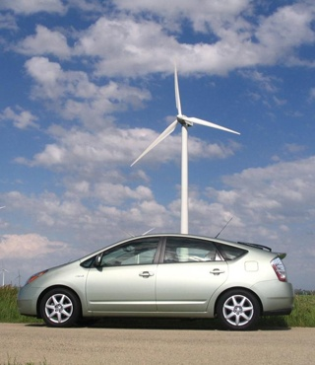
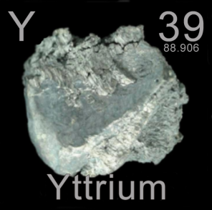
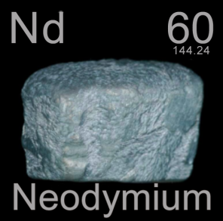
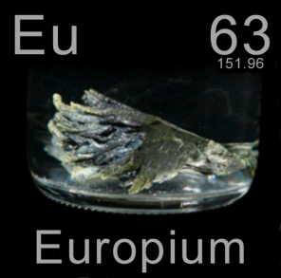
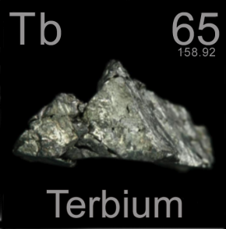
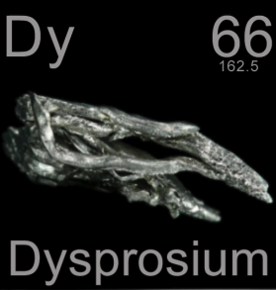
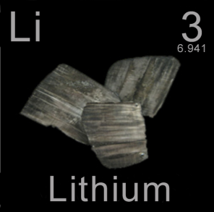
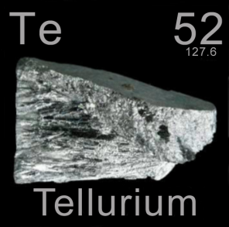
Critical Materials Hub
Eliminate materials criticality as an impediment to commercialization of clean energy technologies.
Diversify global supply chains,
Develop substitute materials,
Enhance recycling, reuse and efficient use of materials, …but not all of these in every case!

Slide 26
Backup

Slide 27
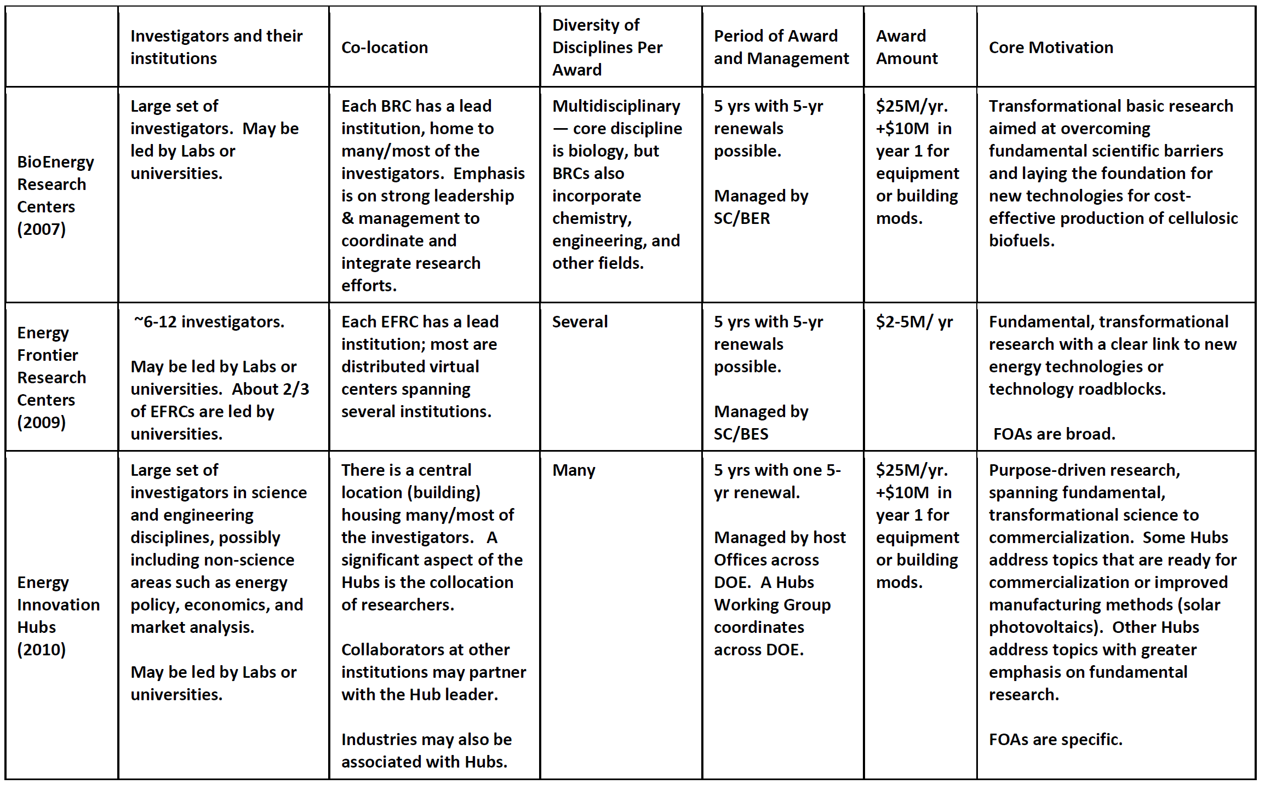
Bioenergy Research Centers (2007) Energy Frontier Research Centers (2009) Energy innovation Hubs (2010)
Notes:
slide c. Nov. 2009

